Slide 1


WEEK 5 · DAY 2
The metric trap
“The model is about 90 percent accurate. How many repeat buyers did it actually find?”
Kavya Nair, senior analyst, Kalpa Retail
01
Where did each land?
02
Which denominator?
03
What does it reward?
04
When does a nudge pay?
05
Which line is cheapest?
06
Where is Rohan's line?
07
Who did it find?
08
What does 1 in 31 call?
09
Which 1,000 to call?
Week 5, Day 2. The metric trap
1 / 64
Notes:
LIVE, 1 minute. Read Kavya's question aloud and leave it on screen. Do not answer it: the whole
morning is the answer. Ask the room for a guess: of 928 real buyers, how many did Monday's model
find at its default setting? Write three guesses on the board; chapter 7 reveals 174.

Slide 2

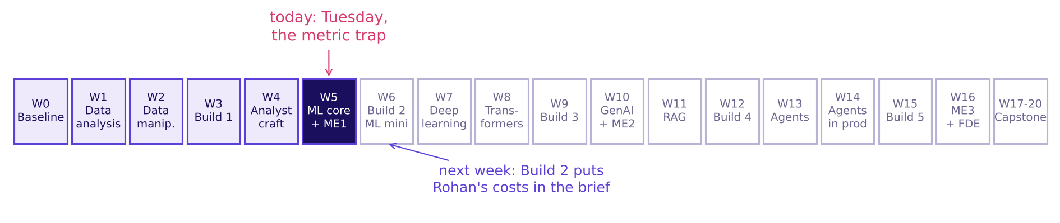
WEEK 5 · TUESDAY · THE METRIC TRAP
Week 5 of 20: the machine learning core
Today turns Monday's score into a decision someone pays for.
The programme's twenty weeks, Week 5 lit
Where did each land?
Which denominator?
What does it reward?
When does a nudge pay?
Which line is cheapest?
Where is Rohan's line?
Who did it find?
S1 · 2 / 64
…
Notes:
LIVE, 1 minute. Monday framed the problem and scored a baseline. Today asks what the score is
worth in rupees. Next week, Build 2 hands the room Rohan Desai's lending brief with exactly
today's constraint written in. Point at W6 and say: what you learn today is graded there.

Slide 3
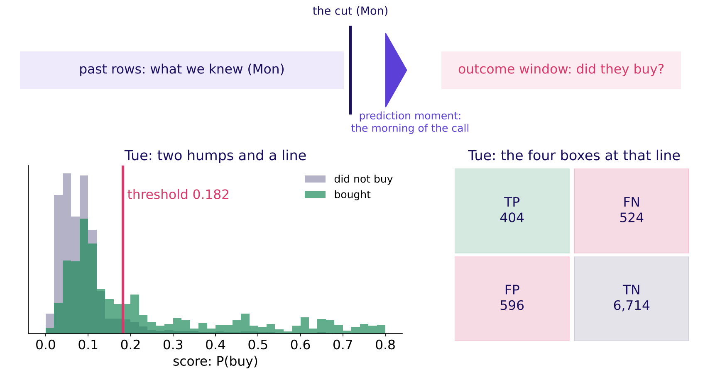
WEEK 5 · TUESDAY · THE METRIC TRAP
The week's picture gains two humps and a line
Draw this from memory tonight: past rows, the cut, the call, the outcome, then the humps.
The Week 5 timeline in its Tuesday state
Where did each land?
Which denominator?
What does it reward?
When does a nudge pay?
Which line is cheapest?
Where is Rohan's line?
Who did it find?
S2 · 3 / 64
…
Notes:
LIVE, 2 minutes. Monday drew the top strip: past rows, the cut, the prediction moment, the outcome
window. Tuesday adds the bottom: every client gets a score, buyers and non-buyers form two humps,
and the threshold is a vertical line. Everything right of the line is called. The four boxes are
what the line produces. Ask: if I slide the red line left, which boxes grow?

Slide 4
WEEK 5 · TUESDAY · THE METRIC TRAP
Today's ticket: 89.7 percent, and the buyers found
One question for the day, priced in rupees.
On the ticket | What it says
The data | A Portuguese bank's phone campaign: 41,188 calls, May 2008 to November 2010
The claim | Monday's model is 89.7 percent accurate
The prices | A wasted nudge Rs 40; a missed buyer about Rs 1,200 (Anand, Finance)
The ask | Pick the metric, set the threshold, explain Rohan's
Where did each land?
Which denominator?
What does it reward?
When does a nudge pay?
Which line is cheapest?
Where is Rohan's line?
Who did it find?
S3 · 4 / 64
…
Notes:
LIVE, 2 minutes. The bank's call is Kalpa's nudge: same decision, whom to contact. Kalpa's prices
come from Anand Iyer in Finance and are applied to the bank's calls. Rohan Desai, head of risk at
Kalpa Financial Services, will ask in the afternoon whether the same model can score loans.
Ask: what single number would you ask for before believing 89.7 percent?

Slide 5
WEEK 5 · TUESDAY · THE METRIC TRAP
Six topics, six chapters, then three case chapters
The curriculum's words, in its order, each with the chapter and notebook that teach it.
# | The topic, in the curriculum's words | Chapter | Min | Notebook
1 | The confusion matrix, cell by cell | Four boxes that tell the truth | 18 | ch01
2 | Precision, recall and F1 derived | Of those we flagged, of those we missed | 20 | ch02
3 | Class imbalance against accuracy | Why 89 percent can mean zero | 15 | ch03
4 | Choosing the metric from business cost; the 1-in-N test (course construction) | What does each mistake cost? | 22 | ch04
5 | Threshold selection as a business decision | Where to draw the line | 20 | ch05
6 | The transfer: the same model, a lending business, the opposite threshold | Same model, opposite threshold | 15 | ch06
Where did each land?
Which denominator?
What does it reward?
When does a nudge pay?
Which line is cheapest?
Where is Rohan's line?
Who did it find?
S4 · 5 / 64
…
Notes:
LIVE, 1 minute. Read the second column once: these are the words to search for later. The six
concept chapters use tiny invented tables you can count by hand. Then three case chapters run the
same ideas on the bank's 8,238 validation clients: case01, case02, case03. Chapter 6 opens the
afternoon, after the financial services story.

Slide 6
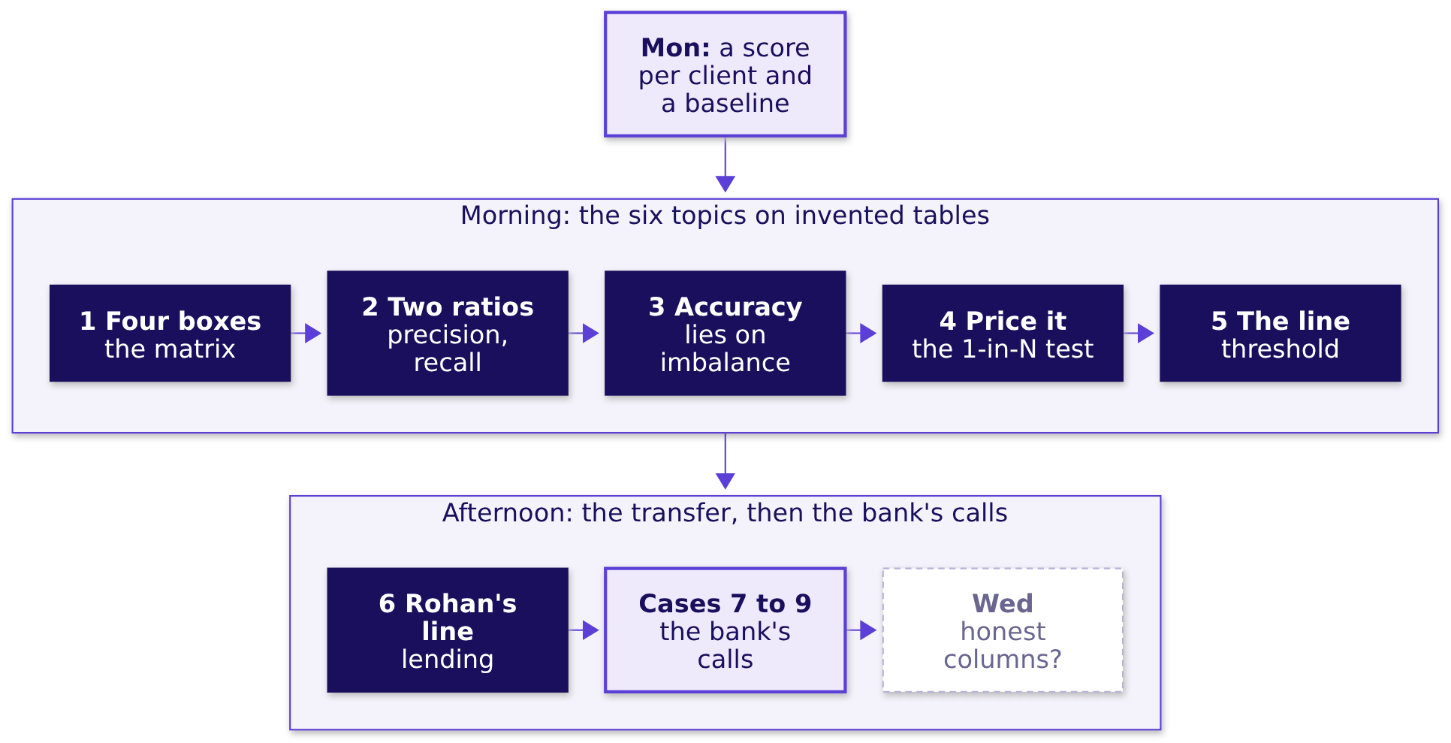
WEEK 5 · TUESDAY · THE METRIC TRAP
How the six topics join, and where they are used
Each box rests on the one before it.
Where did each land?
Which denominator?
What does it reward?
When does a nudge pay?
Which line is cheapest?
Where is Rohan's line?
Who did it find?
S5 · 6 / 64
…
Notes:
LIVE, 2 minutes. Walk it left to right. Monday gave a probability per client. The matrix counts
outcomes at one line; the two ratios read the matrix; accuracy is the ratio that lies here; the
prices pick the ratio and the line; Rohan's prices flip the line. The cases apply all six to the
bank's real file. Wednesday asks whether the columns behind the score were known in time.

Slide 7
01
Four boxes that tell the truth
Where did each land?
The confusion matrix, cell by cell · also searched as: confusion matrix explained, true positive false positive
Where did each land?
Which denominator?
What does it reward?
When does a nudge pay?
Which line is cheapest?
Where is Rohan's line?
Who did it find?
What does 1 in 31 call?
Which 1,000 to call?
Week 5 Day 2: the metric trap
7 / 64
Notes:
LIVE, 18 minutes for the chapter. Open notebook ch01 and run the first cell: twenty invented Kalpa
customers. Prediction before anything: how many sit in "nudged and came back"? Take three answers.

Slide 8
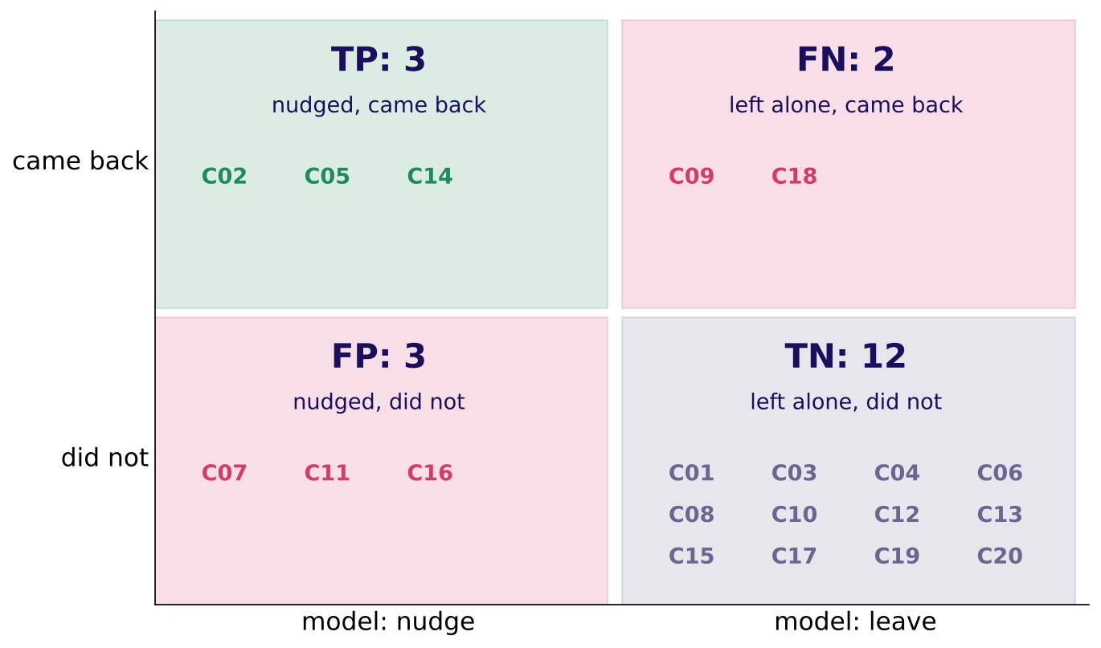
WEEK 5 · TUESDAY · THE METRIC TRAP
Two labels per customer make four boxes
What the model said, against what happened: twenty invented customers.
Twenty invented customers sorted into four boxes
Where did each land?
Which denominator?
What does it reward?
When does a nudge pay?
Which line is cheapest?
Where is Rohan's line?
Who did it find?
S6 · 8 / 64
…
Notes:
LIVE, 6 minutes. Count three boxes aloud with the room before showing the picture: C02, C05 and C14
were nudged and came back. The misconception to stage: "the model was right 15 times, so it is
good". Ask which 5 it got wrong and what each wrong one cost. Click: notebook ch01, the loop cell.

Slide 9
WEEK 5 · TUESDAY · THE METRIC TRAP
Each box is a sentence about a customer
Two boxes are free; two carry Anand's prices.
Box | In Kalpa's words | Count | Cost each
TP | nudged and came back | 3 | none
FP | nudged, did not come back | 3 | Rs 40
FN | left alone, a repeater missed | 2 | Rs 1,200
TN | left alone, did not come back | 12 | none
The bill of mistakes: 3 x Rs 40 + 2 x Rs 1,200 = Rs 2,520.
Where did each land?
Which denominator?
What does it reward?
When does a nudge pay?
Which line is cheapest?
Where is Rohan's line?
Who did it find?
S7 · 9 / 64
…
Notes:
LIVE, 5 minutes. Have two learners read one row each aloud as a sentence about a person. The line
to land: every metric today is a ratio of these four cells, and the bill is two of them priced.
Interview line: "Read this matrix aloud in the business's words."

Slide 10

WEEK 5 · TUESDAY · THE METRIC TRAP
scikit-learn prints the true negatives top-left
Rows are the truth, columns the prediction, sorted 0 then 1.
confusion_matrix(came_back, model_says_nudge)
# [[12 3] top-left 12 is TN, not TP
# [ 2 3]] bottom-right 3 is TP
WHAT BREAKS
Reading 12 as the true positives tells Marketing the model found twelve repeaters. The check: the bottom row must sum to the five real repeaters.
Where did each land?
Which denominator?
What does it reward?
When does a nudge pay?
Which line is cheapest?
Where is Rohan's line?
Who did it find?
S8 · 10 / 64
…
Notes:
LIVE, 5 minutes. Show the printout first and ask which number is the true positives. Most of the
room says 12. Then run the notebook's labelled DataFrame cell. Fix: always print the matrix with
row and column labels. This is a two-minute trap; do not let it become a syntax lecture.

Slide 11
02
Of those we flagged, of those we missed
Which denominator?
Precision, recall and F1 derived · also searched as: precision vs recall, F1 score, harmonic mean
Where did each land?
Which denominator?
What does it reward?
When does a nudge pay?
Which line is cheapest?
Where is Rohan's line?
Who did it find?
What does 1 in 31 call?
Which 1,000 to call?
Week 5 Day 2: the metric trap
11 / 64
Notes:
LIVE, 20 minutes for the chapter. Notebook ch02. Prediction: which is bigger here, the share of
flags that landed or the share of repeaters found?

Slide 12
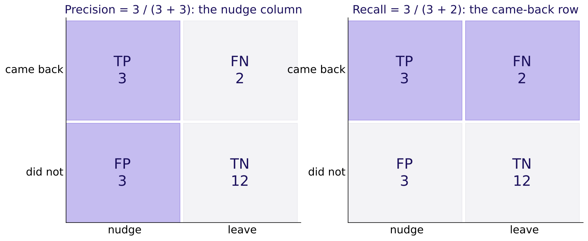
WEEK 5 · TUESDAY · THE METRIC TRAP
Same numerator, two denominators
Precision divides by the column of flags; recall by the row of real repeaters.
Precision lights the nudge column, recall lights the came-back row
Where did each land?
Which denominator?
What does it reward?
When does a nudge pay?
Which line is cheapest?
Where is Rohan's line?
Who did it find?
S9 · 12 / 64
…
Notes:
LIVE, 7 minutes. Draw the 2 by 2 on the board, shade the column, then the row. Say each as a
sentence first: "of those we flagged, 3 of 6 came back" and "of those who came back, 3 of 5 were
flagged". The formula comes after the sentence. Interview anchor [S], asked aloud here: precision,
recall and F1 from a confusion matrix.

Slide 13
WEEK 5 · TUESDAY · THE METRIC TRAP
The wrong denominator divides by everyone
The most common slip, shown exactly.
Reported as precision | Arithmetic | What it really measures
0.15 (wrong) | 3 of 20 customers | share of everyone who was flagged and came back
0.50 (right) | 3 of 6 flagged | share of nudges that landed
Where did each land?
Which denominator?
What does it reward?
When does a nudge pay?
Which line is cheapest?
Where is Rohan's line?
Who did it find?
S10 · 13 / 64
…
Notes:
LIVE, 4 minutes. Marketing reading 0.15 would cut a campaign whose nudges land half the time. The
check: precision's denominator equals the number flagged. Fix: say "of those we flagged" before
writing any fraction.

Slide 14
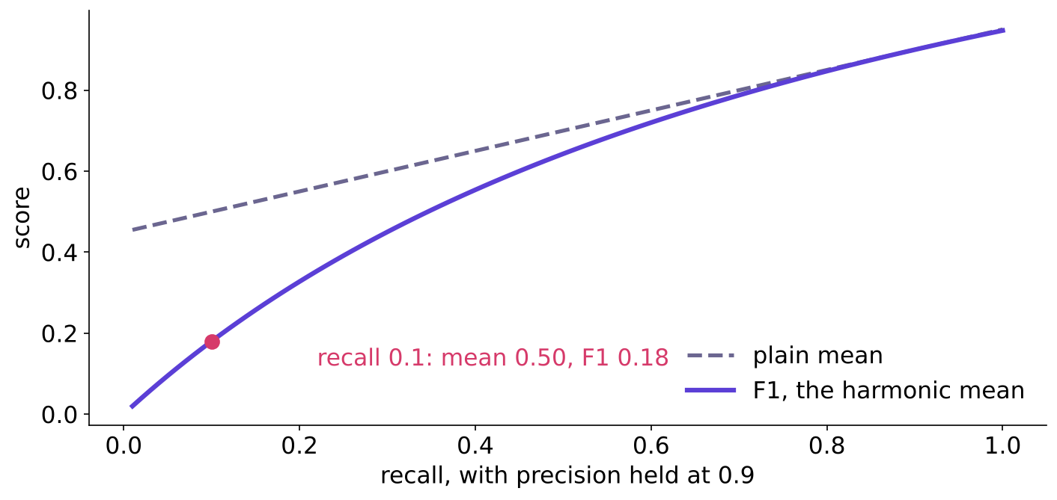
WEEK 5 · TUESDAY · THE METRIC TRAP
F1 punishes the weaker of the two
A model that flags one customer and is right: plain mean 0.60, F1 0.33.
F1 against the plain mean as recall falls
Where did each land?
Which denominator?
What does it reward?
When does a nudge pay?
Which line is cheapest?
Where is Rohan's line?
Who did it find?
S11 · 14 / 64
…
Notes:
LIVE, 6 minutes; CUT FIRST if the room is late (keep one sentence: F1 stays low when either ratio
is low). The harmonic mean is pulled to the smaller number. Ask: when would one number be the wrong
thing to report? Answer: when the two errors cost different amounts, which chapter 4 prices.

Slide 15
WEEK 5 · TUESDAY · THE METRIC TRAP
Three ratios, named last
Each answers one business question.
Ratio | The question | Formula | Here
Precision | Of those we flagged, how many were right? | TP / (TP + FP) | 0.50
Recall | Of those who were real, how many did we flag? | TP / (TP + FN) | 0.60
F1 | One grade, low if either is low | 2PR / (P + R) | 0.55
Where did each land?
Which denominator?
What does it reward?
When does a nudge pay?
Which line is cheapest?
Where is Rohan's line?
Who did it find?
S12 · 15 / 64
…
Notes:
LIVE, 3 minutes. Rule with its flip: F1 is a fair single number only while the two errors cost
about the same. Kalpa's do not.

Slide 16
03
Why 89 percent can mean zero
What does it reward?
Class imbalance against accuracy · also searched as: accuracy paradox, imbalanced classification, base rate
Where did each land?
Which denominator?
What does it reward?
When does a nudge pay?
Which line is cheapest?
Where is Rohan's line?
Who did it find?
What does 1 in 31 call?
Which 1,000 to call?
Week 5 Day 2: the metric trap
16 / 64
Notes:
LIVE, 15 minutes for the chapter. Notebook ch03. Prediction: the rule "say no to everyone" is right
on how many of these hundred customers?

Slide 17
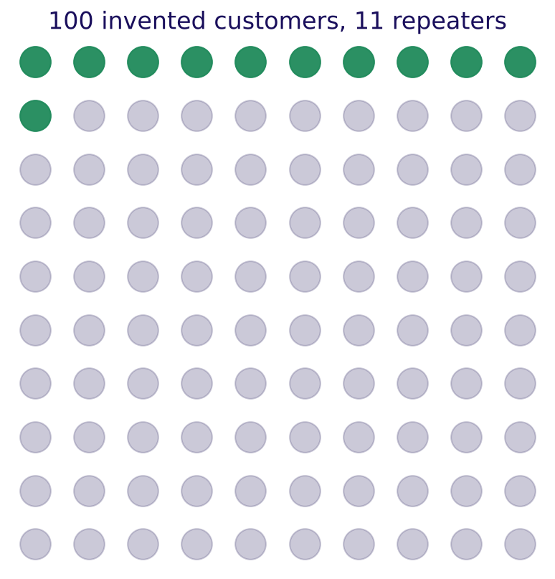
WEEK 5 · TUESDAY · THE METRIC TRAP
Saying no to everyone is right 89 times in 100
Eleven green repeaters, all missed; 89 grey customers, all "correct".
One hundred invented customers, eleven repeaters
Where did each land?
Which denominator?
What does it reward?
When does a nudge pay?
Which line is cheapest?
Where is Rohan's line?
Who did it find?
S13 · 17 / 64
…
Notes:
LIVE, 5 minutes. Point at the grey dots: accuracy counts every one of them as a win. The model
learned the base rate and nothing else. Interview anchor [S], asked aloud here: accuracy is 96
percent on a 96 to 4 split; good model? The shape of a good answer: ask for the base rate and the
true-positive cell first.

Slide 18
WEEK 5 · TUESDAY · THE METRIC TRAP
The more accurate rule has the bigger bill
Ranked by accuracy, the useless rule wins.
Rule | Accuracy | Repeaters found | Bill
Say no to everyone | 89% | 0 of 11 | Rs 13,200
A model that flags 20 | 85% | 8 of 11 | Rs 4,080
Where did each land?
Which denominator?
What does it reward?
When does a nudge pay?
Which line is cheapest?
Where is Rohan's line?
Who did it find?
S14 · 18 / 64
…
Notes:
LIVE, 5 minutes. The trap: "ship the say-no rule, it is more accurate". Check: recall and the bill
beside accuracy. Ask the business owner's question: which rule would you pay for?

Slide 19
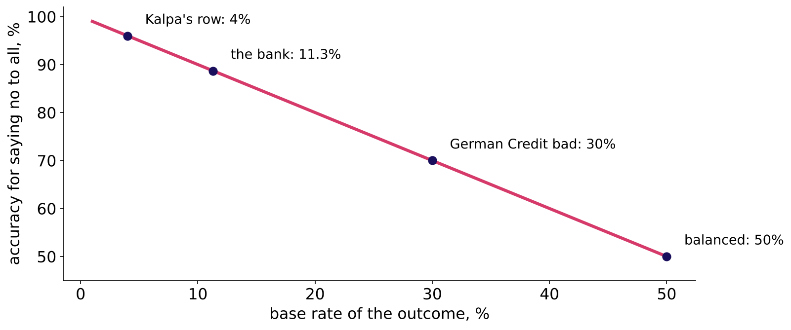
WEEK 5 · TUESDAY · THE METRIC TRAP
The accuracy you get for doing nothing
Accuracy stops lying as the outcome nears 50:50.
Free accuracy against the base rate
Where did each land?
Which denominator?
What does it reward?
When does a nudge pay?
Which line is cheapest?
Where is Rohan's line?
Who did it find?
S15 · 19 / 64
…
Notes:
LIVE, 5 minutes. The rule with its flip: accuracy misleads when one class dominates; near 50:50,
and when both errors cost the same, it becomes a fair summary again. German Credit's 30 percent bad
rate, tonight's lab, sits in the middle.

Slide 20
WEEK 5 · TUESDAY · THE METRIC TRAP
Drill: four matrices, precision and recall, fast
Twelve minutes in pairs: precision, recall, and one sentence each.
Matrix | TP | FP | FN | TN
A, a fraud screen | 40 | 160 | 10 | 9,790
B, a churn list | 300 | 100 | 300 | 4,300
C, a loan book | 630 | 90 | 70 | 210
D, Monday's model at 0.5 | 174 | 94 | 754 | 7,216
Where did each land?
Which denominator?
What does it reward?
When does a nudge pay?
Which line is cheapest?
Where is Rohan's line?
Who did it find?
S16 · 20 / 64
…
Notes:
LIVE, 12 minutes (the row's first mid-session drill, trimmed from 15). Answers: A precision 0.20,
recall 0.80; B 0.75 and 0.50; C 0.875 and 0.90; D 0.649 and 0.188. Ask one pair per matrix to say
it as a sentence about people. D is the bank's real matrix; chapter 7 returns to it.

Slide 21
04
What does each mistake cost?
When does a nudge pay?
Choosing the metric from business cost; the 1-in-N test (course construction) · also searched as: cost-sensitive evaluation, choosing a metric
Where did each land?
Which denominator?
What does it reward?
When does a nudge pay?
Which line is cheapest?
Where is Rohan's line?
Who did it find?
What does 1 in 31 call?
Which 1,000 to call?
Week 5 Day 2: the metric trap
21 / 64
Notes:
LIVE, 22 minutes for the chapter. Spotlight seat today: the business owner. Every slide in this
chapter asks the owner's question: what does each mistake cost, in rupees? Notebook ch04.

Slide 22
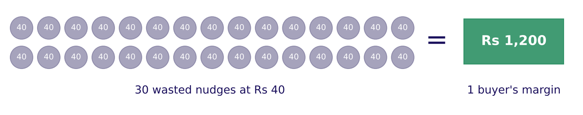
WEEK 5 · TUESDAY · THE METRIC TRAP
Thirty Rs 40 nudges equal one Rs 1,200 buyer
Nudge 31 lookalikes; if one comes back, Kalpa breaks even.
Thirty Rs 40 coins balance one Rs 1,200 margin
Where did each land?
Which denominator?
What does it reward?
When does a nudge pay?
Which line is cheapest?
Where is Rohan's line?
Who did it find?
S17 · 22 / 64
…
Notes:
LIVE, 6 minutes. Prediction before the picture: above what chance of coming back does a nudge pay,
1 in 2, 1 in 10, 1 in 31 or 1 in 100? Then count the coins. The line to land: one buyer pays for
thirty wasted nudges, so act above about 1 in 31.

Slide 23
WEEK 5 · TUESDAY · THE METRIC TRAP
The 1-in-N test, named last
Rights per wrong equals damage over saving.
threshold = cost of acting wrongly / (cost of acting wrongly + cost of failing to act)
nudge: 40 / (40 + 1,200) = 0.032, act when P(buy) is above 1 in 31
loan: 60,000 / (60,000 + 3,000) = 0.952, lend when P(repay) is above 20 in 21
Where did each land?
Which denominator?
What does it reward?
When does a nudge pay?
Which line is cheapest?
Where is Rohan's line?
Who did it find?
S18 · 23 / 64
…
Notes:
LIVE, 5 minutes. Write both lines on the board, on the same quantity: the chance of the good
outcome. The 1-in-N name is this course's own; outside, search "expected cost threshold" or
"cost-sensitive threshold". The formula assumes honest probabilities; case 2 checks that.

Slide 24
WEEK 5 · TUESDAY · THE METRIC TRAP
Three businesses, three lines
The metric follows the dearer mistake.
Business | Acting wrongly | Failing to act | Act above | Leads
Kalpa nudge | Rs 40 | Rs 1,200 | P(buy) 0.032 | recall
Stripe fraud block | 2.08 dollars | 38.92 dollars | P(fraud) 0.051 | fraud recall
Kalpa Financial loan | Rs 60,000 | Rs 3,000 | P(repay) 0.952 | precision
Where did each land?
Which denominator?
What does it reward?
When does a nudge pay?
Which line is cheapest?
Where is Rohan's line?
Who did it find?
S19 · 24 / 64
…
Notes:
LIVE, 6 minutes (the row's second drill, folded in). Stripe's own guide: one missed fraud wipes
out 18.71 good sales and its break-even precision is 5.07 percent (Stripe, verified 28 October
2026). Interview anchor [S], asked aloud here: precision or recall for fraud, and why?

Slide 25
WEEK 5 · TUESDAY · THE METRIC TRAP
Same accuracy, bills Rs 5,800 apart
Three invented models on chapter 1's twenty customers.
Model | Accuracy | Bill
Flags nobody | 75% | Rs 6,000
Chapter 1's model | 75% | Rs 2,520
Flags ten | 75% | Rs 200
Where did each land?
Which denominator?
What does it reward?
When does a nudge pay?
Which line is cheapest?
Where is Rohan's line?
Who did it find?
S20 · 25 / 64
…
Notes:
LIVE, 5 minutes. The trap: choosing the metric by habit. Accuracy calls these three equal; Anand's
prices separate them. Ask the owner's question: which one do you fund?

Slide 26
05
Where to draw the line
Which line is cheapest?
Threshold selection as a business decision · also searched as: classification threshold tuning, decision threshold
Where did each land?
Which denominator?
What does it reward?
When does a nudge pay?
Which line is cheapest?
Where is Rohan's line?
Who did it find?
What does 1 in 31 call?
Which 1,000 to call?
Week 5 Day 2: the metric trap
26 / 64
Notes:
LIVE, 20 minutes for the chapter. Notebook ch05, then the explorable.

Slide 27
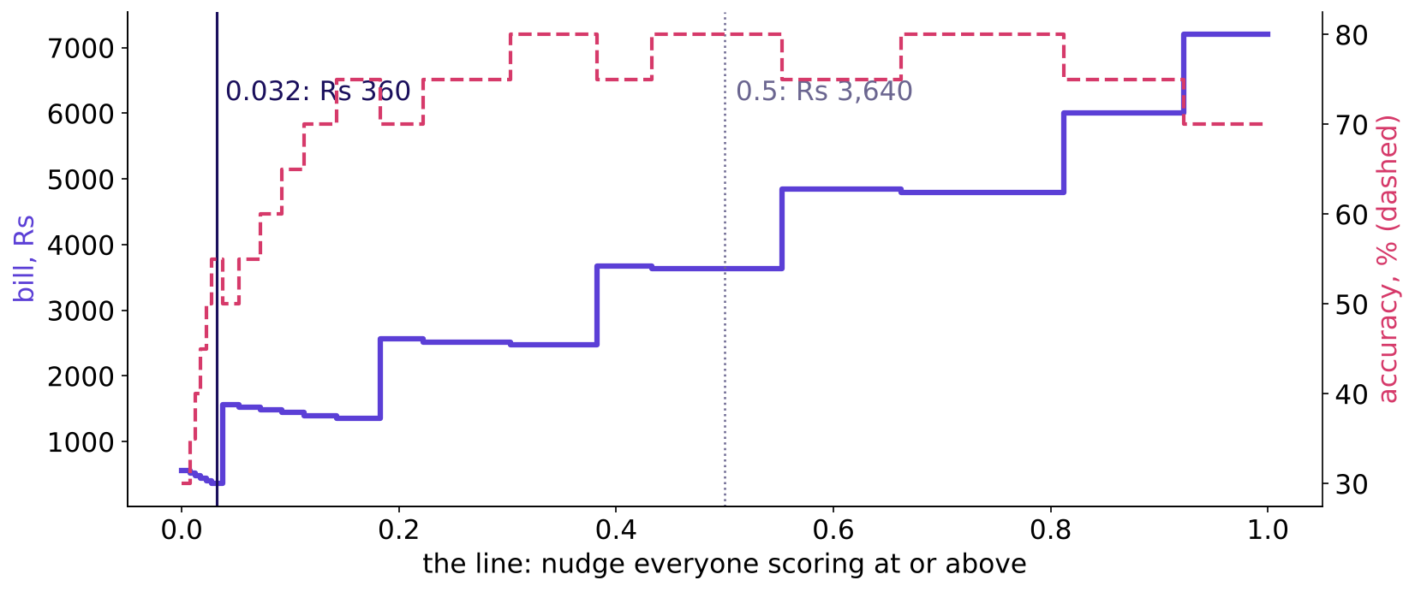
WEEK 5 · TUESDAY · THE METRIC TRAP
Slide the line, watch the bill
Twenty invented scores: the bill is lowest at 0.032, Rs 360.
Bill and accuracy as the line slides
…
Which denominator?
What does it reward?
When does a nudge pay?
Which line is cheapest?
Where is Rohan's line?
Who did it find?
What does 1 in 31 call?
S21 · 27 / 64
…
Notes:
LIVE, 6 minutes. Prediction first: 0.5, 0.2, 0.032 or nudge everyone? The default 0.5 costs Rs
3,640, ten times the bill at 0.032. Point at the dashed accuracy line: it peaks at 0.31 to 0.55,
far from the cheapest line.

Slide 28
WEEK 5 · TUESDAY · THE METRIC TRAP
Accuracy peaks where the bill does not
The plausible wrong threshold, shown exactly.
Line | List | Repeaters caught | Accuracy | Bill
0.5, best accuracy | 4 | 3 of 6 | 80% | Rs 3,640
0.032, from the prices | 15 | 6 of 6 | 55% | Rs 360
…
Which denominator?
What does it reward?
When does a nudge pay?
Which line is cheapest?
Where is Rohan's line?
Who did it find?
What does 1 in 31 call?
S22 · 28 / 64
…
Notes:
LIVE, 4 minutes. The trap: "0.5 is the best threshold, 80 percent accurate". Check: the bill at the
chosen line. Fix: choose from the prices; report accuracy only as a by-product.

Slide 29
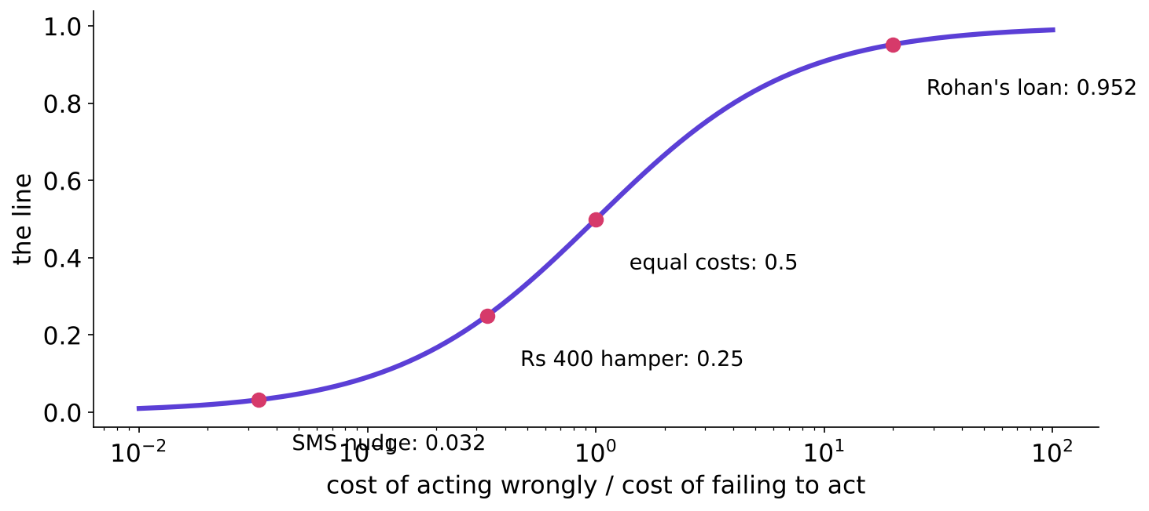
WEEK 5 · TUESDAY · THE METRIC TRAP
The line climbs as acting gets dearer
One curve turns a price ratio into a threshold.
Threshold against the price ratio
…
Which denominator?
What does it reward?
When does a nudge pay?
Which line is cheapest?
Where is Rohan's line?
Who did it find?
What does 1 in 31 call?
S23 · 29 / 64
…
Notes:
LIVE, 4 minutes. Rs 40 SMS gives 0.032; a Rs 400 hamper 0.25; equal costs 0.5; Rohan's loan 0.952.
Rule with its flip: the line falls when missing is dearer, rises when acting is dearer.
Interview anchor [F], asked aloud here: how do you set a threshold when the two errors cost
differently?

Slide 30
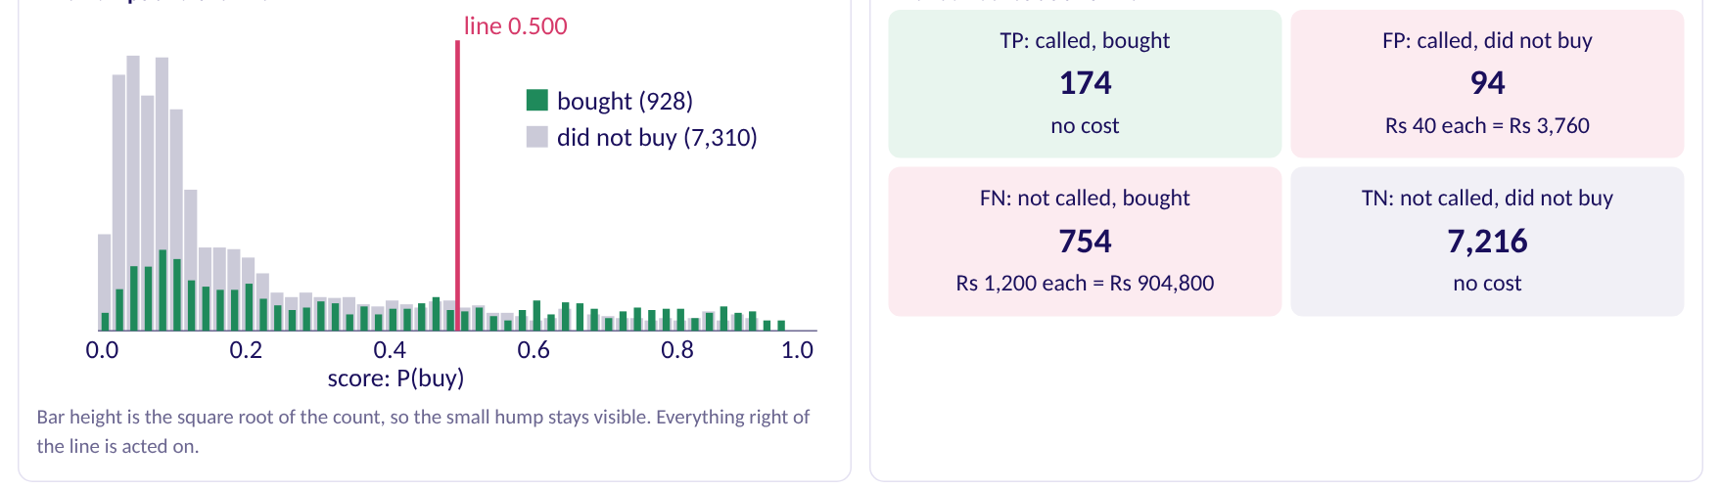
WEEK 5 · TUESDAY · THE METRIC TRAP
The explorable: drag the line on the bank's scores
It opens on the wrong default: 0.5, and 754 buyers left alone.
The threshold explorer in its opening state
…
Which denominator?
What does it reward?
When does a nudge pay?
Which line is cheapest?
Where is Rohan's line?
Who did it find?
What does 1 in 31 call?
S24 · 30 / 64
…
Notes:
LIVE, 6 minutes. Open demos/C2_W05_D02_threshold_explorer_STUDENT.html. Before any click, each
learner types a guess of the cheapest line and locks it. Click 1: read the default aloud, 174 found
and Rs 904,800 of missed margin. Click 2: drag the line left and watch the bill fall until about
0.03. Click 3 waits for case 2: tighten the ratio from 30:1 to 8:1. Keep the loan switch for
chapter 6. If the projector fails, show the case02 notebook's bill chart instead.

Slide 31



WEEK 5 · TUESDAY · THE METRIC TRAP
Financial services enters: Rohan's business
Fifteen minutes on how a lender makes and loses money, before chapter 6.
THE BUSINESS
THE DECIDER
READ AFTER CLASS
Lending and payments
Rohan Desai, head of risk
The dossier and its card
Interest earned, defaults lost, regulation on every decision.
Kalpa Financial Services; returns as Build 2's stakeholder.
In 3_study_material_for_students.
…
Which denominator?
What does it reward?
When does a nudge pay?
Which line is cheapest?
Where is Rohan's line?
Who did it find?
What does 1 in 31 call?
S25 · 31 / 64
…
Notes:
LIVE, 15 minutes. Run the domain story from 4_trainer_only/C2_W05_D02_domain_story_TRAINER.md
(built by a separate session); the learner files are C2_W05_D02_domain_financial_services_STUDENT
and C2_W05_D02_financial_services_card_STUDENT. End on Rohan's two prices: Rs 60,000 for a false
approval, Rs 3,000 for a wrongful rejection.

Slide 32
06
Same model, opposite threshold
Where is Rohan's line?
The transfer: the same model, a lending business, the opposite threshold · also searched as: credit risk threshold, cost matrix
Where did each land?
Which denominator?
What does it reward?
When does a nudge pay?
Which line is cheapest?
Where is Rohan's line?
Who did it find?
What does 1 in 31 call?
Which 1,000 to call?
Week 5 Day 2: the metric trap
32 / 64
Notes:
LIVE, 15 minutes for the chapter, ten of them a hand count. Notebook ch06. Prediction: lend when
P(repay) is above 0.05, 0.50, 0.83 or 0.95?

Slide 33
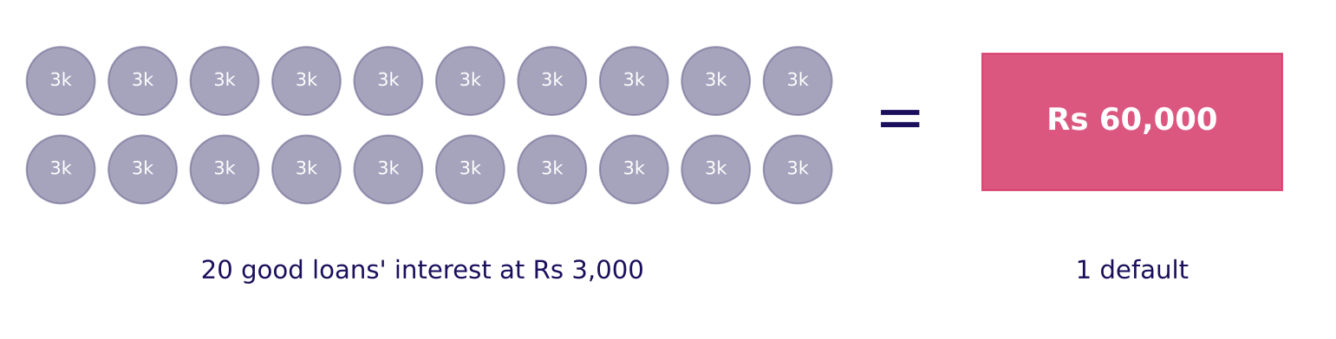
WEEK 5 · TUESDAY · THE METRIC TRAP
One default wipes out twenty good loans
Rs 60,000 lost on one default; Rs 3,000 of interest earned on each good loan.
Twenty Rs 3,000 coins balance one Rs 60,000 default
…
What does it reward?
When does a nudge pay?
Which line is cheapest?
Where is Rohan's line?
Who did it find?
What does 1 in 31 call?
Which 1,000 to call?
S26 · 33 / 64
Notes:
LIVE, 4 minutes. Hand count on the board: 20 x 3,000 = 60,000. So Rohan needs at least 20 repayers
in every 21 approvals. The dearer mistake changed sides: in Retail it was the miss, here it is the
approval.

Slide 34
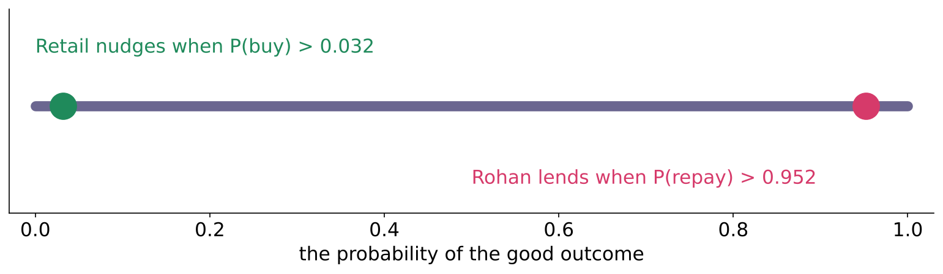
WEEK 5 · TUESDAY · THE METRIC TRAP
Two lines at opposite ends of one axis
Said on the same quantity: the chance of the good outcome.
Retail's line near 0 and Rohan's line near 1
…
What does it reward?
When does a nudge pay?
Which line is cheapest?
Where is Rohan's line?
Who did it find?
What does 1 in 31 call?
Which 1,000 to call?
S27 · 34 / 64
Notes:
LIVE, 4 minutes. Say it exactly: nudge when P(buy) is above 0.03; lend when P(repay) is above
0.95. Never compare 0.03 on P(buy) with 0.05 on P(default): that is two quantities. Explorable:
flip the switch to the loan and drag the line to the right end.

Slide 35
WEEK 5 · TUESDAY · THE METRIC TRAP
Copying Retail's line approves every defaulter
Twenty invented applicants, five lines.
Line | Lends | Defaults approved | Good turned away | Bill
Retail's 0.032, copied | 20 | 6 | 0 | Rs 360,000
0.5, the default | 18 | 4 | 0 | Rs 240,000
0.952, Rohan's | 8 | 0 | 6 | Rs 18,000
Reject everyone | 0 | 0 | 14 | Rs 42,000
…
What does it reward?
When does a nudge pay?
Which line is cheapest?
Where is Rohan's line?
Who did it find?
What does 1 in 31 call?
Which 1,000 to call?
S28 · 35 / 64
Notes:
LIVE, 4 minutes. The trap: reusing Marketing's code and threshold. The model is fine; the line was
set for the wrong business. Interview anchor [D], asked aloud here: the same model in retail and in
lending, why are the thresholds opposite, and how do you explain that to each business?

Slide 36
WEEK 5 · TUESDAY · THE METRIC TRAP
Say it to Rohan in one sentence
The transfer note's core.
"We lend only when at least 20 in 21 applicants like this one repay, because one default costs the interest on twenty good loans."
The model is the same; your prices move the line.
…
What does it reward?
When does a nudge pay?
Which line is cheapest?
Where is Rohan's line?
Who did it find?
What does 1 in 31 call?
Which 1,000 to call?
S29 · 36 / 64
Notes:
LIVE, 3 minutes. Ask two learners to say it to a neighbour playing Rohan. The flip: if Rohan's loss
on a default halves to Rs 30,000, his line falls to 10 in 11, about 0.91.

Slide 37
07
The do-nothing matrix
Who did it find?
Case step 1 · applies chapters 1, 2 and 3 · also searched as: confusion matrix sklearn, accuracy paradox
Where did each land?
Which denominator?
What does it reward?
When does a nudge pay?
Which line is cheapest?
Where is Rohan's line?
Who did it find?
What does 1 in 31 call?
Which 1,000 to call?
Week 5 Day 2: the metric trap
37 / 64
Notes:
LIVE, 15 minutes for the chapter. Notebook case01: run the first cell (the bank's file downloads
once, then reads from the cache) and read the row count, 41,188.

Slide 38
WEEK 5 · TUESDAY · THE METRIC TRAP
A bank's 41,188 calls stand in for Kalpa's nudge
Same decision: whom to contact, from what is known that morning.
Fact | Value
Source | UCI Bank Marketing, CC BY 4.0, Moro, Rita and Cortez (2014)
Calls | 41,188, May 2008 to November 2010
Bought (subscribed) | 11.27 percent
Scored today | 8,238 validation clients, 928 buyers
…
What does it reward?
When does a nudge pay?
Which line is cheapest?
Where is Rohan's line?
Who did it find?
What does 1 in 31 call?
Which 1,000 to call?
S30 · 38 / 64
Notes:
LIVE, 3 minutes. The test slice stays sealed in Monday's envelope until Friday. Everything today is
on validation. Kalpa's prices are applied to the bank's calls; the bank's own prices are unknown.

Slide 39
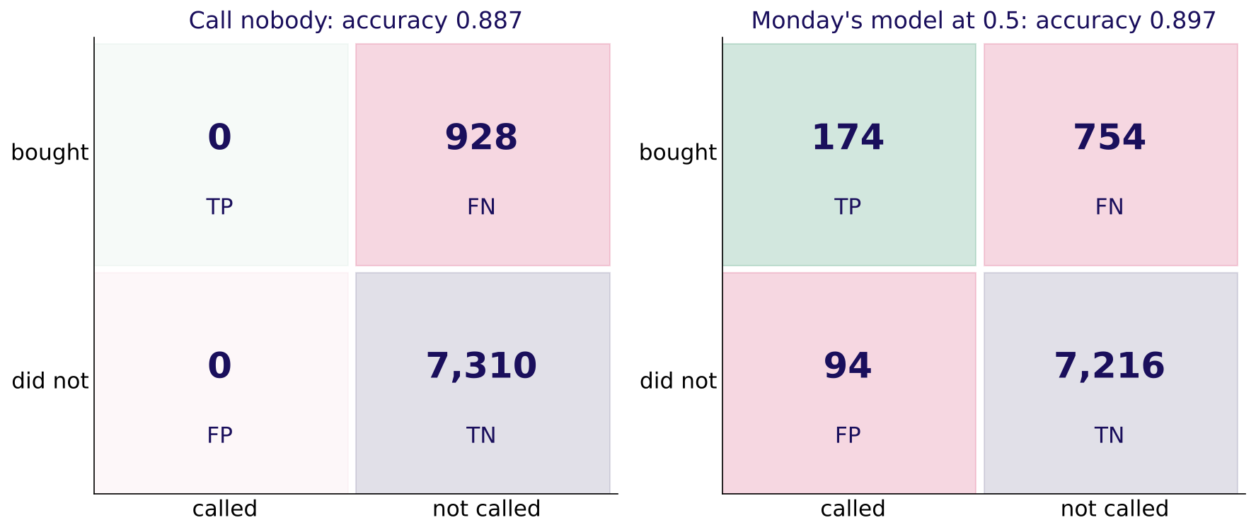
WEEK 5 · TUESDAY · THE METRIC TRAP
Call nobody: 88.74 percent right, 0 buyers found
Monday's model at 0.5: 89.71 percent right, 174 of 928 found.
Two confusion matrices on the bank's validation clients
…
What does it reward?
When does a nudge pay?
Which line is cheapest?
Where is Rohan's line?
Who did it find?
What does 1 in 31 call?
Which 1,000 to call?
S31 · 39 / 64
Notes:
LIVE, 5 minutes. Prediction first: how accurate is calling nobody? Then the reveal: 88.74. The
empty column is the day's picture. Monday's model: precision 0.649 (its calls are good), recall
0.188 (it misses four buyers in five). Accuracy moved by one point and told you none of this.

Slide 40
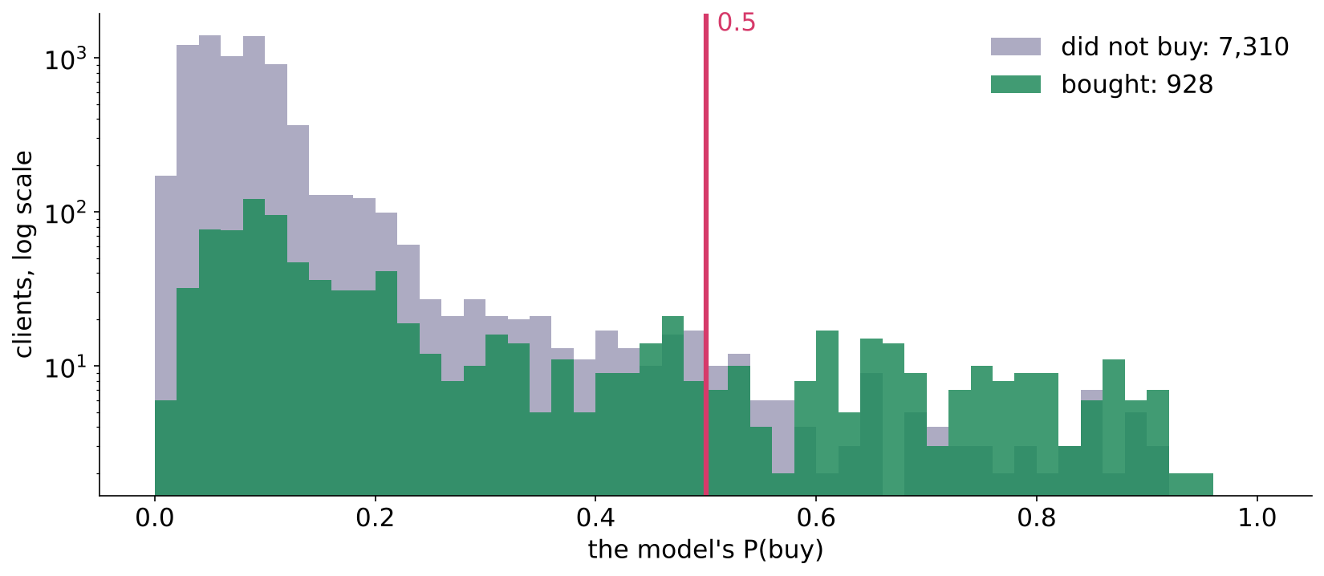
WEEK 5 · TUESDAY · THE METRIC TRAP
Most buyers score below 0.5
754 of 928 buyers sit left of the default line.
Score humps for buyers and non-buyers with the 0.5 line
…
What does it reward?
When does a nudge pay?
Which line is cheapest?
Where is Rohan's line?
Who did it find?
What does 1 in 31 call?
Which 1,000 to call?
S32 · 40 / 64
Notes:
LIVE, 3 minutes. The two humps overlap heavily; the 0.5 line cuts off almost all of the green.
Ask: where would you move the line, and what would it cost? That is case 2.

Slide 41
WEEK 5 · TUESDAY · THE METRIC TRAP
The trap: "89.7 percent accurate, ready to ship"
True and misleading, on the bank's real numbers.
Step | On this file
The claim | 89.7 percent accurate
What it hides | 754 of 928 buyers left alone, about Rs 9.05 lakh of margin
The check | recall, 0.188, beside the do-nothing 88.74 percent
The fix | report the matrix and recall with every accuracy
…
What does it reward?
When does a nudge pay?
Which line is cheapest?
Where is Rohan's line?
Who did it find?
What does 1 in 31 call?
Which 1,000 to call?
S33 · 41 / 64
Notes:
LIVE, 4 minutes. Have the room write the corrected sentence to Marketing in one line. Kavya's
review: a matrix, a recall, and the do-nothing number beside the claim.

Slide 42
08
The cost threshold
What does 1 in 31 call?
Case step 2 · applies chapters 4 and 5 · also searched as: cost-sensitive evaluation, expected cost threshold
Where did each land?
Which denominator?
What does it reward?
When does a nudge pay?
Which line is cheapest?
Where is Rohan's line?
Who did it find?
What does 1 in 31 call?
Which 1,000 to call?
Week 5 Day 2: the metric trap
42 / 64
Notes:
LIVE, 20 minutes for the chapter. Notebook case02. Prediction: which of four lines has the lowest
bill on the bank's clients?

Slide 43
WEEK 5 · TUESDAY · THE METRIC TRAP
Four ways to set the line, sized in rupees
On 8,238 clients at Rs 40 and Rs 1,200.
Option | Called | Buyers found | Bill
Keep 0.5 | 268 | 174 | Rs 908,560
F1 threshold, 0.154 | 1,226 | 454 | Rs 599,680
Cost threshold, 0.032 | 7,438 | 913 | Rs 279,000
Call everyone | 8,238 | 928 | Rs 292,400
…
What does it reward?
When does a nudge pay?
Which line is cheapest?
Where is Rohan's line?
Who did it find?
What does 1 in 31 call?
Which 1,000 to call?
S34 · 43 / 64
Notes:
LIVE, 5 minutes. The cost line calls nine clients in ten. F1's line sits far higher because F1
treats a Rs 40 waste and a Rs 1,200 miss as equal. The call: ship the cost line; the price ratio
is the fact that would change it.

Slide 44
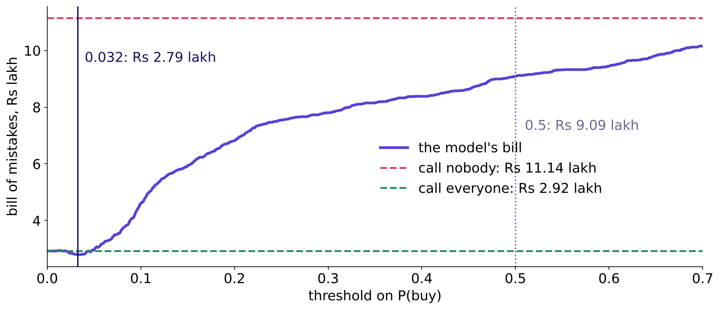
WEEK 5 · TUESDAY · THE METRIC TRAP
The bill bottoms out at 0.032
Rs 279,000 at the cost line; Rs 292,400 for calling everyone.
The bill of mistakes against the threshold
…
What does it reward?
When does a nudge pay?
Which line is cheapest?
Where is Rohan's line?
Who did it find?
What does 1 in 31 call?
Which 1,000 to call?
S35 · 44 / 64
Notes:
LIVE, 4 minutes. Point at how close the violet minimum sits to the green call-everyone line. Ask:
how much is the model saving us here, really?

Slide 45
WEEK 5 · TUESDAY · THE METRIC TRAP
The trap: Rs 6.3 lakh saved against the wrong rival
Price the free rules before crediting the model.
Compared with | Saving | Share
The default 0.5 | Rs 629,560 | misleading: nobody ships 0.5 now
Calling everyone | Rs 13,400 | 4.6% of its bill
Margin at stake | Rs 13,400 | 1.2% of Rs 11.1 lakh
…
What does it reward?
When does a nudge pay?
Which line is cheapest?
Where is Rohan's line?
Who did it find?
What does 1 in 31 call?
Which 1,000 to call?
S36 · 45 / 64
Notes:
LIVE, 4 minutes. The trap: the arithmetic is right, the comparison is wrong. If Kalpa funded a
model on the Rs 6.3 lakh, it would pay for a saving a spreadsheet rule already gets. Fix: report
the saving against the cheaper of call-nobody and call-everyone.

Slide 46
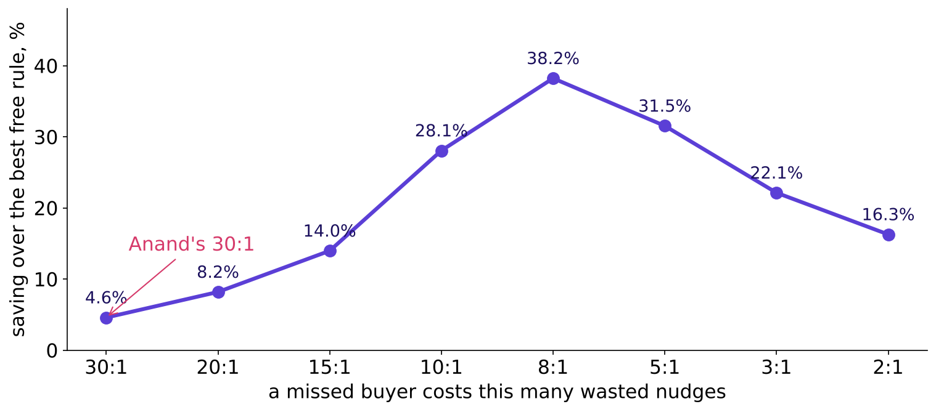
WEEK 5 · TUESDAY · THE METRIC TRAP
At 30 to 1 the model barely matters
Tighten the ratio and the model's saving climbs to 38 percent.
Saving over the best free rule as the cost ratio tightens
…
What does it reward?
When does a nudge pay?
Which line is cheapest?
Where is Rohan's line?
Who did it find?
What does 1 in 31 call?
Which 1,000 to call?
S37 · 46 / 64
Notes:
LIVE, 4 minutes. Explorable: drag the ratio slider from 30:1 to 8:1 and watch the gap open. The
rule with its flip: at an extreme ratio the cheap action wins almost everywhere; the model earns
its keep when the ratio tightens or a budget binds.

Slide 47
WEEK 5 · TUESDAY · THE METRIC TRAP
Stripe sets its line the same way
The model shapes the curve; the policy picks the point.
Stripe's worked example | Value
Sale, margin | 26 dollars at 8 percent: 2.08 dollars profit
A missed fraud costs | 38.92 dollars, which is 18.71 good sales
Break-even precision | 1 / (1 + 18.71) = 5.07 percent
Source: Stripe, primer on machine learning for fraud protection (verified 28 October 2026).
…
What does it reward?
When does a nudge pay?
Which line is cheapest?
Where is Rohan's line?
Who did it find?
What does 1 in 31 call?
Which 1,000 to call?
S38 · 47 / 64
Notes:
LIVE, 3 minutes. Same arithmetic as Anand's, in dollars. Stripe's own words: "The model controls
the shape of the precision-recall curve. The policy controls where on the curve we're operating."

Slide 48
09
The budget
Which 1,000 to call?
Case step 3 · applies chapters 2, 4 and 5 · also searched as: precision at k, lift chart, cumulative gains
Where did each land?
Which denominator?
What does it reward?
When does a nudge pay?
Which line is cheapest?
Where is Rohan's line?
Who did it find?
What does 1 in 31 call?
Which 1,000 to call?
Week 5 Day 2: the metric trap
48 / 64
Notes:
LIVE, 18 minutes for the chapter. Notebook case03. Marketing can afford 1,000 calls in this slice.
Prediction: how many buyers sit in the top 1,000 by score?

Slide 49
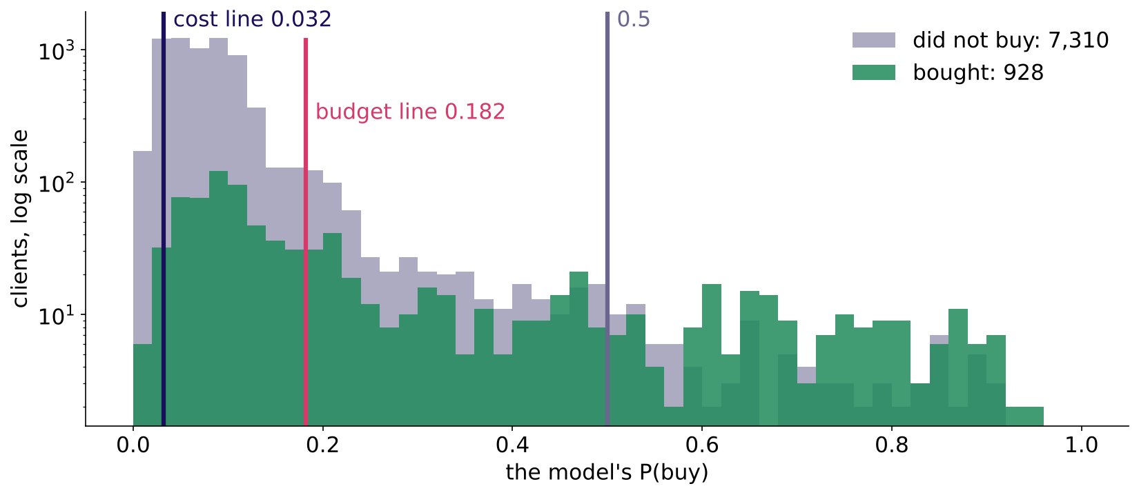
WEEK 5 · TUESDAY · THE METRIC TRAP
A budget is a line in disguise
1,000 calls means calling everyone above the 1,000th score, 0.182.
Three lines on the score humps: cost, budget and 0.5
…
What does it reward?
When does a nudge pay?
Which line is cheapest?
Where is Rohan's line?
Who did it find?
What does 1 in 31 call?
Which 1,000 to call?
S39 · 49 / 64
Notes:
LIVE, 3 minutes. The cost rule says act above 0.032 and asks for 7,438 calls; the budget allows
1,000, which is the line at 0.182. When both hold, the stricter binds: here, the budget.

Slide 50
WEEK 5 · TUESDAY · THE METRIC TRAP
The top 1,000 hold 404 buyers; a random 1,000, 113
Precision at 1,000 is 0.404 against a 0.113 base rate.
List | Buyers found | Precision at 1,000 | Bill
Random 1,000 | 112 | 0.112 | Rs 1,014,264
Top 1,000 by score | 404 | 0.404 | Rs 652,640
…
What does it reward?
When does a nudge pay?
Which line is cheapest?
Where is Rohan's line?
Who did it find?
What does 1 in 31 call?
Which 1,000 to call?
S40 · 50 / 64
Notes:
LIVE, 4 minutes. About 3.6 times a random list, and about Rs 3.6 lakh off the bill in this slice.
The line to land: under a budget the ranking carries the decision, and this is where the model
earns its keep.

Slide 51
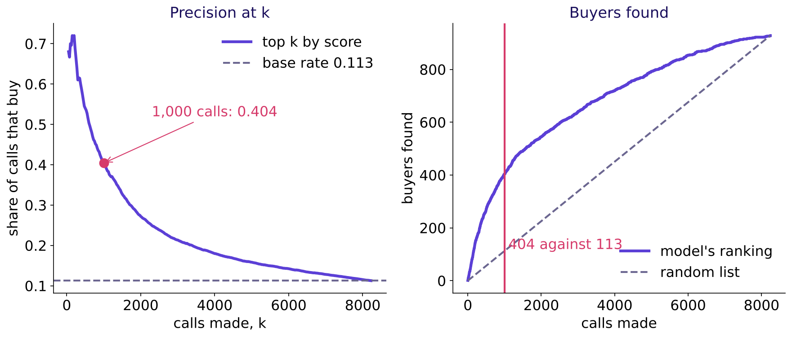
WEEK 5 · TUESDAY · THE METRIC TRAP
Precision at k is where the model earns its keep
The curve falls as the list grows; the gap to random is the model's value.
Precision at k and buyers found against calls made
…
What does it reward?
When does a nudge pay?
Which line is cheapest?
Where is Rohan's line?
Who did it find?
What does 1 in 31 call?
Which 1,000 to call?
S41 · 51 / 64
Notes:
LIVE, 4 minutes. Read the left chart at 500 calls (0.540) and 1,000 (0.404). On the right, the
violet curve above the dashed diagonal is everything the model adds over a random list.

Slide 52
WEEK 5 · TUESDAY · THE METRIC TRAP
The trap: 544 buyers from twice the calls
Compare two lists only at the same number of calls.
List | Buyers | Precision | Nudge spend per buyer
Top 1,000 | 404 | 0.404 | Rs 99
Top 2,000 | 544 | 0.272 | Rs 147
Razorpay: catching more by reviewing more "is a threshold change, not proof that the model improved" (verified 28 October 2026).
…
What does it reward?
When does a nudge pay?
Which line is cheapest?
Where is Rohan's line?
Who did it find?
What does 1 in 31 call?
Which 1,000 to call?
S42 · 52 / 64
Notes:
LIVE, 4 minutes. A colleague claims "35 percent more buyers". It is the same model with a lower
line. Razorpay's fraud team compares models at the same alert volume for exactly this reason.

Slide 53
WEEK 5 · TUESDAY · THE METRIC TRAP
Flipkart's trust team read the top 250 by hand
A review budget is a precision at k.
Flipkart and CMU, ratings fraud (BIRDNEST) | Value
Ratings scanned | 3.3 million, from 1.1 million users
Accounts sent for review | the top 250 by suspicion score
Found to be fraud | 211 of 250, over 84 percent; all of the first 50
Source: Hooi and others, arXiv 1511.06030 (verified 28 October 2026).
…
What does it reward?
When does a nudge pay?
Which line is cheapest?
Where is Rohan's line?
Who did it find?
What does 1 in 31 call?
Which 1,000 to call?
S43 · 53 / 64
Notes:
LIVE, 3 minutes. The team could investigate 250 accounts, so the paper reports precision at 250.
Same shape as Marketing's 1,000 calls.

Slide 54


WEEK 5 · TUESDAY · THE METRIC TRAP
The guided memo: claim, evidence, caveat, action
Notebook guided: steps 1 to 3 together, steps 4 and 5 on your own.
TO KAVYA
TO ROHAN
THE CHECK
The metric memo
The transfer note
PASS lines
The metric, the line, the matrix, what it hides.
His line on P(repay), and why it sits high.
Each step prints PASS when your number is right.
…
What does it reward?
When does a nudge pay?
Which line is cheapest?
Where is Rohan's line?
Who did it find?
What does 1 in 31 call?
Which 1,000 to call?
S44 · 54 / 64
Notes:
LIVE, 20 minutes: 12 guided (steps 1 to 3 on the projector), 8 unguided (step 4 and the two
paragraphs). Collect two memos and read their caveat lines aloud: the best ones say that at 30:1
calling almost everyone is nearly as cheap, so the model's value shows under the budget.

Slide 55
WEEK 5 · TUESDAY · THE METRIC TRAP
Five interview anchors from today's row
Each with the shape of a good answer.
Tag | Question | A good answer opens with
[S] | Precision, recall and F1 from a matrix | the two sentences, then the fractions
[S] | 96 percent on a 96 to 4 split: good? | the base rate and the TP cell
[S] | Precision or recall for fraud? | what each mistake costs
[F] | Threshold when errors cost differently? | cost ratio, then the line, then the check
[D] | Retail and lending: why opposite? | the dearer mistake changed sides
…
What does it reward?
When does a nudge pay?
Which line is cheapest?
Where is Rohan's line?
Who did it find?
What does 1 in 31 call?
Which 1,000 to call?
S45 · 55 / 64
Notes:
LIVE, 3 minutes. Tags: [S] staple, [F] frequent in product and GCC screens, [D] differentiator.
The bank carries full model answers with the interviewer's two follow-ups.

Slide 56
WEEK 5 · TUESDAY · THE METRIC TRAP
Six seats ask six questions of one threshold
Today's spotlight: the business owner.
Seat | Their question about the line
Business owner | What does each mistake cost, in rupees?
Product manager | What does the customer see when we are wrong?
Solution architect | Where does the threshold live, and who changes it?
Senior ML engineer | Are the probabilities honest enough for the formula?
Implementation engineer | How is it configured and logged?
QA | Which test proves the right line is in force?
…
What does it reward?
When does a nudge pay?
Which line is cheapest?
Where is Rohan's line?
Who did it find?
What does 1 in 31 call?
Which 1,000 to call?
S46 · 56 / 64
Notes:
LIVE, 2 minutes. A good interview answer names the one or two seats that decide and says why the
others do not bind. Today the business owner decides the line; the senior ML engineer decides
whether the formula can be trusted.

Slide 57
WEEK 5 · TUESDAY · THE METRIC TRAP
Quiz 1 of 5: buyers found at 0.5
TP 174, FP 94, FN 754, TN 7,216.
Option | Buyers found
A | 7,216
B | 268
C | 928
D | 174
…
What does it reward?
When does a nudge pay?
Which line is cheapest?
Where is Rohan's line?
Who did it find?
What does 1 in 31 call?
Which 1,000 to call?
S47 · 57 / 64
Notes:
KEY D. B is everyone called; C is every buyer; A is the true negatives.

Slide 58
WEEK 5 · TUESDAY · THE METRIC TRAP
Quiz 2 of 5: recall from four cells
TP 30, FP 20, FN 70, TN 880.
Option | Recall
A | 0.60
B | 0.30
C | 0.03
D | 0.91
…
What does it reward?
When does a nudge pay?
Which line is cheapest?
Where is Rohan's line?
Who did it find?
What does 1 in 31 call?
Which 1,000 to call?
S48 · 58 / 64
Notes:
KEY B: 30 of 100 real positives. A is precision (30 of 50); C divides by everyone; D is accuracy.

Slide 59
WEEK 5 · TUESDAY · THE METRIC TRAP
Quiz 3 of 5: 96 percent on a 96 to 4 outcome
What did the model learn?
Option | It learned
A | the base rate and nothing else
B | a strong signal for repeat buyers
C | how to rank the top 4 percent
D | the cost of a missed buyer
…
What does it reward?
When does a nudge pay?
Which line is cheapest?
Where is Rohan's line?
Who did it find?
What does 1 in 31 call?
Which 1,000 to call?
S49 · 59 / 64
Notes:
KEY A. Saying no to everyone scores 96 on a 96 to 4 outcome, so the accuracy alone shows nothing
learned beyond the base rate.

Slide 60
WEEK 5 · TUESDAY · THE METRIC TRAP
Quiz 4 of 5: a miss Rs 1,200, a false nudge Rs 40
Which metric leads, and roughly where is the line?
Option | Metric and line
A | precision; near 0.97
B | recall; near 0.03
C | accuracy; at 0.50
D | F1; near 0.50
…
What does it reward?
When does a nudge pay?
Which line is cheapest?
Where is Rohan's line?
Who did it find?
What does 1 in 31 call?
Which 1,000 to call?
S50 · 60 / 64
Notes:
KEY B: 40 / 1,240 = 0.032. A has the ratio upside down; D treats the errors as equal.

Slide 61
WEEK 5 · TUESDAY · THE METRIC TRAP
Quiz 5 of 5: Rs 60,000 against Rs 3,000
A false approval against a wrongful rejection: which way does the line move?
Option | The line on P(repay)
A | it falls to about 0.05 on P(repay)
B | it stays at 0.50
C | it rises toward 0.95 on P(repay)
D | it depends only on the model
…
What does it reward?
When does a nudge pay?
Which line is cheapest?
Where is Rohan's line?
Who did it find?
What does 1 in 31 call?
Which 1,000 to call?
S51 · 61 / 64
Notes:
KEY C: 60,000 / 63,000 = 0.952. A states the default-risk line (0.048) on the wrong quantity.

Slide 62
WEEK 5 · TUESDAY · THE METRIC TRAP
Monday's return question: the model tied the baseline
What do you tell Marketing?
Option | What you say
A | ship it, since it is no worse than the rule
B | it has not earned its keep; ship the rule
C | it scores 89 percent, so it is ready to use
D | retrain it until accuracy passes 95 percent
…
What does it reward?
When does a nudge pay?
Which line is cheapest?
Where is Rohan's line?
Who did it find?
What does 1 in 31 call?
Which 1,000 to call?
S52 · 62 / 64
Notes:
KEY B. A tie costs maintenance and trust for no gain; offer the rule with its cost and name the
date of the next check.

Slide 63
WEEK 5 · TUESDAY · THE METRIC TRAP
What you can now do
Five moves, each with a number from today.
You can | Today's number
Read a matrix in business words | 174 of 928 buyers found
Expose accuracy on imbalance | 88.74% for calling nobody
Set the line from two prices | 1 in 31, 0.032
Say when the model matters | under a budget: 0.404 against 0.113
Move the line to lending | 20 in 21, 0.952 on P(repay)
…
What does it reward?
When does a nudge pay?
Which line is cheapest?
Where is Rohan's line?
Who did it find?
What does 1 in 31 call?
Which 1,000 to call?
S53 · 63 / 64
Notes:
LIVE, 1 minute. Ask each learner to redraw the week's picture with today's two humps and line.

Slide 64
WEEK 5 · TUESDAY · THE METRIC TRAP
Tonight, and tomorrow
The practice set is two to three hours; the lab runs with the TAs.
What | Where | Minutes
Practice set | 2_take_home_mandatory | 150
Practice lab, German Credit's 5:1 matrix | with the TAs | extra
Financial services dossier and card | 3_study_material_for_students | 25
Wednesday: are the columns honest? | pre-read at the end of the practice set | 10
…
What does it reward?
When does a nudge pay?
Which line is cheapest?
Where is Rohan's line?
Who did it find?
What does 1 in 31 call?
Which 1,000 to call?
S54 · 64 / 64
Notes:
LIVE, 1 minute. The IITGN faculty session W5-2 (tentative) on ROC curves, precision-recall curves
and expected cost follows; today named ROC and AUC and stopped before them on purpose.

