Slide 1


Indian Institute of Technology Gandhinagar
ADMINISTERED THROUGH THE COMPETENCY ADVANCEMENT ACADEMY
WEEK 2 · MONDAY · AFTERNOON
Will next Monday's run give the analyst the same answer?
“Every Monday I rerun your suite and trace five delivered app orders against the ERP. If my rerun differs from yours, I need to know whether the book changed or your query did.”
Anand's analyst, finance, Kalpa Retail, to the data and AI team at Kalpa's Global Capability Centre
06
Same answer next week?
07
Can you do it alone?
08
What do we tell Anand?
Week 2, Day 1. Will next Monday's run give the analyst the same answer?
1 / 28
Notes:
LIVE, one minute. Read the analyst's words aloud. The morning built every number on Anand's
Monday sheet; the afternoon asks whether the suite repeats, then hands the room a case to run
alone. The trainer's part of the afternoon is 60 minutes: chapter 6 (30), the escalated case's
first two parts (20) and the Kahoot (10). Then what the morning established.

Slide 2

Indian Institute of Technology Gandhinagar
WEEK 2 · DAY 1 · KALPA GLOBAL CAPABILITY CENTRE
ADMINISTERED THROUGH THE COMPETENCY ADVANCEMENT ACADEMY
The morning built the suite in five chapters
What did the morning's five chapters establish, with their numbers?
Chapter | What it answered
1. What does the book say? | Rs 10,00,00,000 on 538 orders in Q1 and Rs 9,84,00,000 on 462 in Q2; 244 then 227 customers who bought
2. Same story as Week 1? | Revenue agrees; customers fell 7.0% on the book where last week's extract showed them flat
3. Which segment moved? | Retail-Plus, down 29.4%, with orders per customer 2.36 then 1.84
4. Which branch moved? | Frequency, 0.780 of Q1; each Retail-Plus member spent 29.4% less
5. Does the suite add up? | Segments add to the book; 107 Retail-Plus customers in the half-year, not 167
Same answer next week?
Can you do it alone?
What do we tell Anand?
S1 · 2 / 28
Notes:
LIVE, 2 minutes. Read the five answers as one story: the book fell 1.6 percent, Retail-Plus
carries the fall in orders, and every count, ratio and average on the sheet says what it counts.
Q1 is April to June 2026 and Q2 is July to September 2026; revenue is booked revenue, every order
at its amount. Then chapter 6.

Slide 3
Indian Institute of Technology Gandhinagar
PG DIPLOMA IN AI-ML AND AGENTIC AI ENGINEERING · COHORT 2
ADMINISTERED THROUGH THE COMPETENCY ADVANCEMENT ACADEMY
06
Same answer next week?
Will next Monday's run give Anand's analyst the same answer from the same book?
Same answer next week?
Can you do it alone?
What do we tell Anand?
Week 2, Day 1. Will next Monday's run give the analyst the same answer?
3 / 28
Notes:
LIVE. Thirty minutes: the need and the company (3), the options and the call (5), the fingerprint
and the reload (5), the trap, its check and its fix (9, never cut), the second route (3), the
sentence to Anand (3) and the close (2). Notebook 6 and sql/C2_W02_D01_06_same_answer_STUDENT.sql
run beside it.

Slide 4
Indian Institute of Technology Gandhinagar
WEEK 2 · DAY 1 · KALPA GLOBAL CAPABILITY CENTRE
ADMINISTERED THROUGH THE COMPETENCY ADVANCEMENT ACADEMY
Answered in five questions, before the first rerun
Who needs this answer, and which questions lead to it?
Who needs the answer. Anand's analyst reruns the suite every Monday and checks five orders against the ERP, the system Finance books orders in. A rerun that disagrees with the team's run on a sample that should be identical, even by a few hundred rupees, makes every number in the suite suspect, because nobody can say whether the book moved or the query did.
1
2
3
4
5
How does a run prove itself?
What does it leave behind?
Which five orders?
Does Python agree?
What does Anand hear?
The audit sample the analyst traces
The same five, sorted another way
Four ways to tell two runs apart
This Monday's fingerprint
The day's answer in one message
Same answer next week?
Can you do it alone?
What do we tell Anand?
S2 · 4 / 28
Notes:
LIVE, 1 minute. Read the five questions. Then the need.

Slide 5



Indian Institute of Technology Gandhinagar
WEEK 2 · DAY 1 · KALPA GLOBAL CAPABILITY CENTRE
ADMINISTERED THROUGH THE COMPETENCY ADVANCEMENT ACADEMY
The need: a rerun that matches to the rupee
Who asks, what is measured, and what does a rerun that differs cost?
WHO ASKS
THE METRIC
A RERUN THAT DIFFERS COSTS
Anand's analyst
The run itself
Every number doubted
Reruns the suite every Monday and traces five delivered Q2 app orders against the ERP.
What the book held when the suite ran, and which orders the sample drew.
Nobody can say whether the book moved or the query did, so nothing on the sheet is signed.
Same answer next week?
Can you do it alone?
What do we tell Anand?
S3 · 5 / 28
Notes:
LIVE, 2 minutes. The ERP is the enterprise system where Finance books every order; the analyst
traces a sample of warehouse orders back to it to prove the warehouse matches the books. Q2 is July
to September 2026. Then a company that checks every run before anyone reads it.

Slide 6
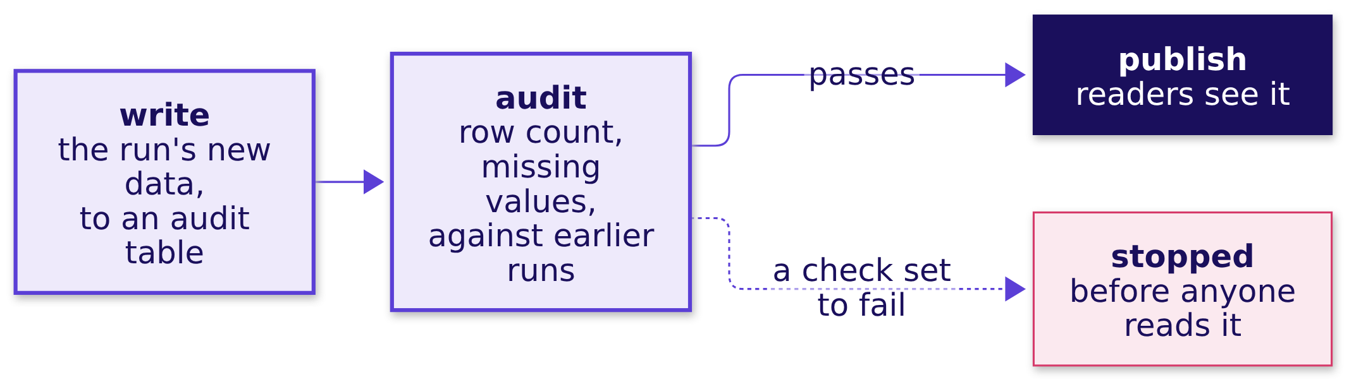
Indian Institute of Technology Gandhinagar
WEEK 2 · DAY 1 · KALPA GLOBAL CAPABILITY CENTRE
ADMINISTERED THROUGH THE COMPETENCY ADVANCEMENT ACADEMY
Netflix audits each run before anyone reads it
Has a real data team built its runs to prove themselves before they are published?
Netflix's data engineering team called the pattern write, audit, publish: a number published every week checks itself against last week before anyone reads it.
Same answer next week?
Can you do it alone?
What do we tell Anand?
S4 · 6 / 28
Notes:
LIVE, 1 minute. Michelle Ufford's talk "Whoops, The Numbers Are Wrong! Scaling Data Quality @
Netflix" at DataWorks Summit, San Jose, 13 June 2017. One of its slides sets a new batch of 17,240
rows with 17,240 missing values beside the previous day's 16,135 rows with 21: every value of the
column was missing. In the talk's rules the row-count checks fail the job and the missing-value
check only warns, so that batch raised a warning; say it that way. Source and check date are in
the day's provenance. Then four ways a Kalpa run could prove itself.

Slide 7
Indian Institute of Technology Gandhinagar
WEEK 2 · DAY 1 · KALPA GLOBAL CAPABILITY CENTRE
ADMINISTERED THROUGH THE COMPETENCY ADVANCEMENT ACADEMY
A fingerprint: 7 numbers, and read access is enough
How can a run show that it computed the same thing as last week's?
Option | Stored with each run | Access it needs | What it can tell apart
A. Rerun and compare by eye | Nothing | Read | Whatever someone happens to notice
B. A fingerprint block that runs with the suite | 7 numbers about the book | Read | A changed book from a changed query
C. Snapshot each Monday's outputs into a table | About 18 rows a Monday | Write, to a schema the team owns | What changed in any output, row by row
D. Write, audit, publish | A staging table per run | Write, and a scheduler | A bad run, stopped before anyone reads it
The call. B, with an ORDER BY on a unique column in every list: the team has read access, which rules out C and D, and B answers the analyst's first question.
Same answer next week?
Can you do it alone?
What do we tell Anand?
S5 · 7 / 28
Notes:
LIVE, 3 minutes. The fingerprint reads each table once: orders gives its rows, its rupees, its
distinct customers and its latest date, and customers gives its rows, its distinct customers and
its latest joining date, seven numbers in all, since customers carries no rupees. If next
Monday's fingerprint matches this one, the book has not changed, so any difference in the numbers
is the query's. Then what would switch the call.

Slide 8
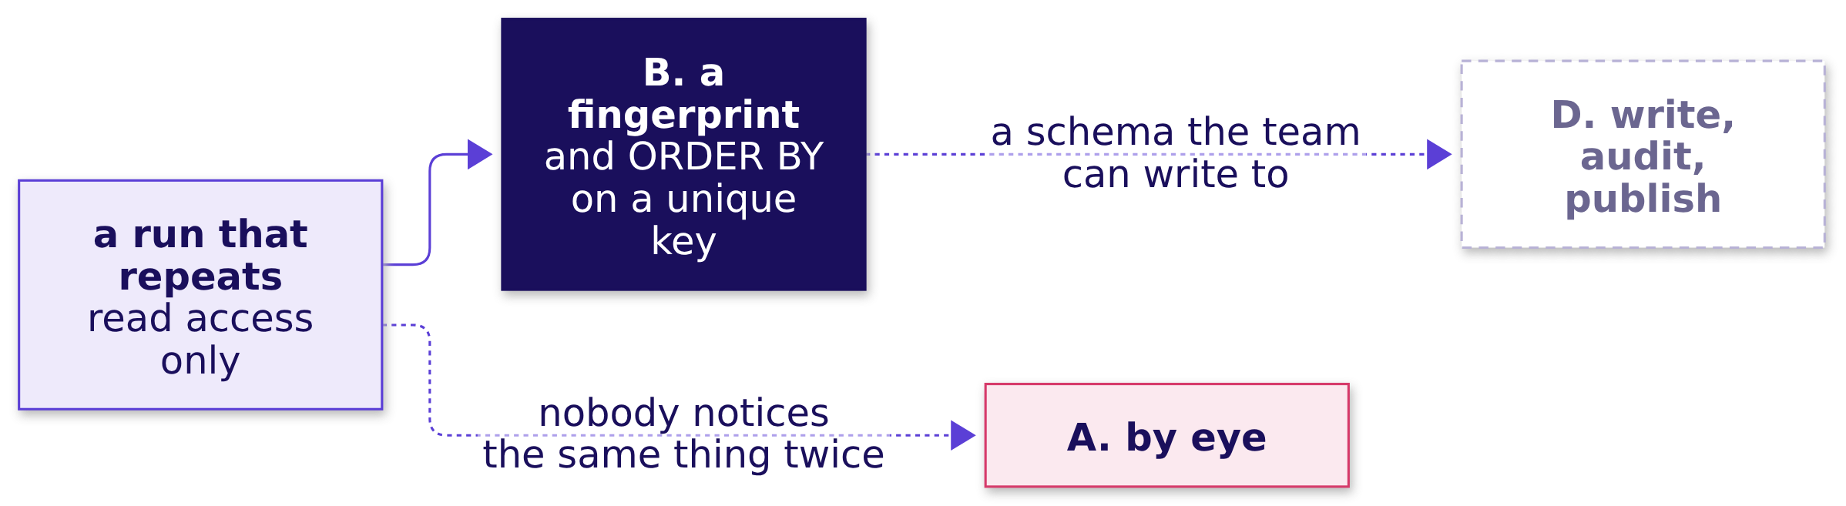
Indian Institute of Technology Gandhinagar
WEEK 2 · DAY 1 · KALPA GLOBAL CAPABILITY CENTRE
ADMINISTERED THROUGH THE COMPETENCY ADVANCEMENT ACADEMY
A schema of the team's own would switch it to D
What fact would move the call away from a fingerprint?
The fact that would change the call. Once the platform lead grants a schema the team can write to, D runs the audit before the numbers are released, which beats finding the problem after Anand has read them.
Same answer next week?
Can you do it alone?
What do we tell Anand?
S6 · 8 / 28
Notes:
LIVE, 2 minutes. C costs little here, about 18 output rows a Monday, and it needs the same write
access D does, so the switch is to D, the pattern that stops a bad run. Then this Monday's
fingerprint.

Slide 9
Indian Institute of Technology Gandhinagar
WEEK 2 · DAY 1 · KALPA GLOBAL CAPABILITY CENTRE
ADMINISTERED THROUGH THE COMPETENCY ADVANCEMENT ACADEMY
Question: does a reload move the fingerprint?
Overnight the warehouse reloads two order rows with the values they already hold: does the fingerprint change?
SELECT 'orders' AS table_name, count(*) AS rows, sum(amount) AS rupees,
count(DISTINCT customer_id) AS distinct_customers,
max(order_date) AS latest_date
FROM orders
UNION ALL
SELECT 'customers', count(*), NULL, count(DISTINCT customer_id), max(joined_date)
FROM customers;
Question. Does the fingerprint change? a) yes, two rows were written, so the row count moves; b) yes, the rupees move, since the rows were rewritten; c) no, the rows, the rupees and the customers are all the same; d) it cannot be read during a reload.
Same answer next week?
Can you do it alone?
What do we tell Anand?
S7 · 9 / 28
Notes:
LIVE, 1 minute. UNION ALL stacks the two tables' rows into one result, one row per table. The
notebook runs the reload inside a transaction and rolls it back, so the warehouse is left as it
was. Letters, then the answer.

Slide 10
Indian Institute of Technology Gandhinagar
WEEK 2 · DAY 1 · KALPA GLOBAL CAPABILITY CENTRE
ADMINISTERED THROUGH THE COMPETENCY ADVANCEMENT ACADEMY
Answer: no: 1,000 rows, Rs 19.84 crore, 301 buyers
What fingerprint does this Monday's run leave?
1,000
Rs 19.84 cr
301
340
ORDER ROWS
RUPEES ON THE BOOK
DISTINCT CUSTOMERS
CUSTOMER ROWS
before and after the reload
Rs 19,84,00,000, Q1 and Q2 together
who bought in either quarter
members on the book
The answer is c. The reload rewrote two rows with their own values, so whatever differs between two runs after it cannot be the book.
Same answer next week?
Can you do it alone?
What do we tell Anand?
S8 · 10 / 28
Notes:
LIVE, 2 minutes. The latest order date is 28 September 2026 and the latest joining date on the
customer table is 25 December 2025; both sit in the fingerprint and both held. Print the
fingerprint at the top of every Monday's run: it is the first thing the analyst compares. Then
the audit sample.

Slide 11
Indian Institute of Technology Gandhinagar
WEEK 2 · DAY 1 · KALPA GLOBAL CAPABILITY CENTRE
ADMINISTERED THROUGH THE COMPETENCY ADVANCEMENT ACADEMY
Question: which five orders does LIMIT 5 return?
The analyst traces five delivered Q2 app orders: which five does the quickest query return?
SELECT order_id, amount FROM orders
WHERE quarter = 'Q2' AND channel = 'app' AND status = 'delivered'
LIMIT 5;
Question. With no ORDER BY, which five rows come back? a) the five with the smallest order ids; b) the five most recent orders; c) whichever five the database reaches first, which can change between runs; d) five chosen at random on every run.
Same answer next week?
Can you do it alone?
What do we tell Anand?
S9 · 11 / 28
Notes:
LIVE, 1 minute. Letters. Expect a, because on a small, freshly loaded table the first rows often
are the smallest ids, and the first run seems to confirm it. Then both runs side by side.

Slide 12

Indian Institute of Technology Gandhinagar
WEEK 2 · DAY 1 · KALPA GLOBAL CAPABILITY CENTRE
ADMINISTERED THROUGH THE COMPETENCY ADVANCEMENT ACADEMY
Answer: whichever five come first, Rs 690 apart
What happens when the analyst reruns the same query after the reload?
Your run on Monday | Amount | The analyst's rerun | Amount
KR-00542 | Rs 790 | KR-00545 | Rs 680
KR-00544 | Rs 960 | KR-00546 | Rs 500
KR-00545 | Rs 680 | KR-00547 | Rs 970
KR-00546 | Rs 500 | KR-00549 | Rs 970
KR-00547 | Rs 970 | KR-00553 | Rs 1,470
Total | Rs 3,900 | Total | Rs 4,590
WHAT BREAKS
The audit reports a Rs 690 disagreement on a sample that should be identical, and every other number in the suite comes under question. The answer is c.
Same answer next week?
Can you do it alone?
What do we tell Anand?
S10 · 12 / 28
Notes:
LIVE, 2 minutes. This is the plausible wrong answer: the query ran, returned five delivered Q2 app
orders, and looked right both times. Two of the five differ between the runs, and nothing in the
book changed. Then why.

Slide 13
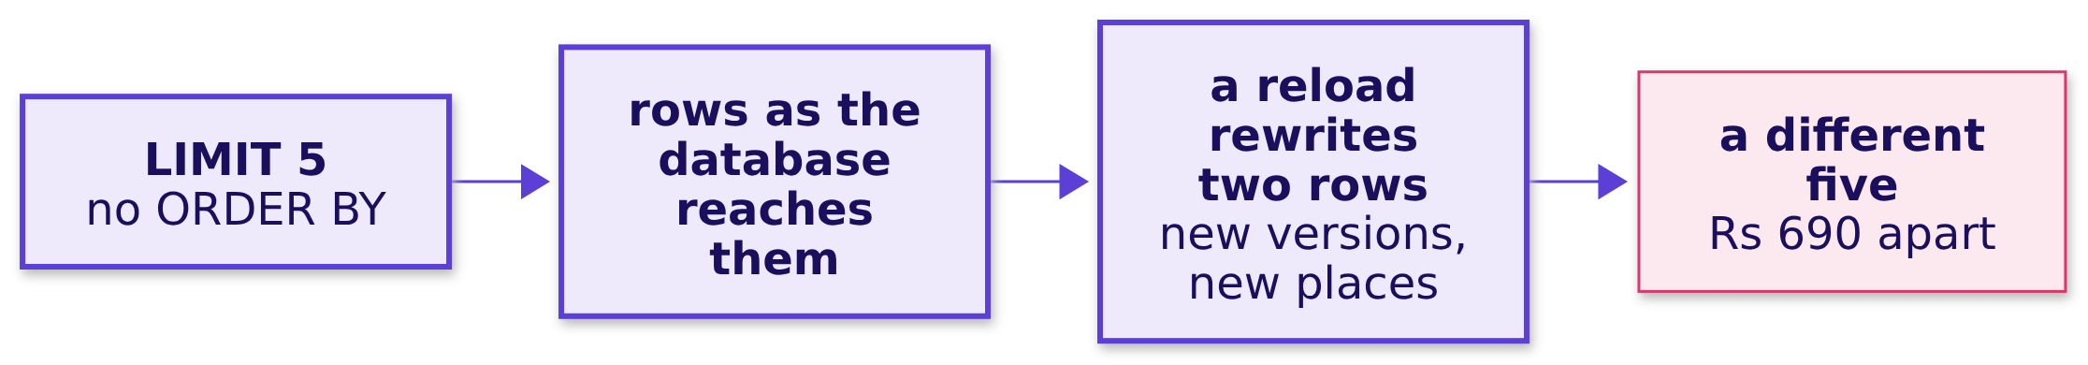
Indian Institute of Technology Gandhinagar
WEEK 2 · DAY 1 · KALPA GLOBAL CAPABILITY CENTRE
ADMINISTERED THROUGH THE COMPETENCY ADVANCEMENT ACADEMY
Why it is wrong: a table has no order to keep
Why did the same query on the same book draw a different five?
The check. The fingerprint said the book did not change; the samples say the five did. Without ORDER BY, Postgres returns rows "in an unspecified order", and LIMIT returns "an unpredictable subset of the query's rows".
Same answer next week?
Can you do it alone?
What do we tell Anand?
S11 · 13 / 28
Notes:
LIVE, 3 minutes. The PostgreSQL documentation on sorting: the order "will depend on the scan and
join plan types and the order on disk, but it must not be relied on". Postgres writes a rewritten
row as a new version in a new place, so after the reload the first five rows the database reaches
are a different five. The room's sixty Codespaces hold identical data and will often draw the same
five, which is exactly why the habit survives until the first reload. Then the fix.

Slide 14
Indian Institute of Technology Gandhinagar
WEEK 2 · DAY 1 · KALPA GLOBAL CAPABILITY CENTRE
ADMINISTERED THROUGH THE COMPETENCY ADVANCEMENT ACADEMY
The fix: ORDER BY order_id draws the same five
Which five orders will the analyst trace against the ERP?
SELECT order_id, amount FROM orders
WHERE quarter = 'Q2' AND channel = 'app' AND status = 'delivered'
ORDER BY order_id
LIMIT 5;
KR-00542 to KR-00547
Rs 3,900
Rs 3,900
THE FIVE
BEFORE THE RELOAD
AFTER THE RELOAD
542, 544, 545, 546 and 547
the same five
the same five
Same answer next week?
Can you do it alone?
What do we tell Anand?
S12 · 14 / 28
Notes:
LIVE, 2 minutes. order_id is the table's key, a column no two rows share, so the order is unique
and every run draws the same five. Ordering on a column rows can share, such as the customer or
the date, still leaves ties the database may break differently. Then the same five, reached a
second way.

Slide 15
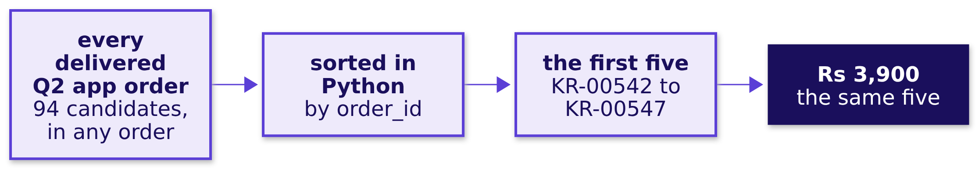
Indian Institute of Technology Gandhinagar
WEEK 2 · DAY 1 · KALPA GLOBAL CAPABILITY CENTRE
ADMINISTERED THROUGH THE COMPETENCY ADVANCEMENT ACADEMY
A second route: Python's sort picks the same five
Does a sort in Python, after the database returns every candidate, pick the same five?
The first route asked the database to sort and cut; this one asks for all 94 candidates in whatever order they arrive and sorts them in Python, and it names the same five orders.
Same answer next week?
Can you do it alone?
What do we tell Anand?
S13 · 15 / 28
Notes:
LIVE, 2 minutes. 80 of the 94 candidates are under Rs 5,000, and the sampled five average Rs 780;
the other 14 are Business orders worth lakhs. When to switch: sorting in Python is fine for a
one-off check; the Monday suite sorts in the query, so the file the analyst reruns carries its
own order. Then what the suite now tells Anand.

Slide 16
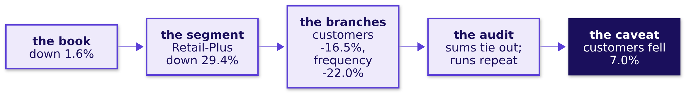
Indian Institute of Technology Gandhinagar
WEEK 2 · DAY 1 · KALPA GLOBAL CAPABILITY CENTRE
ADMINISTERED THROUGH THE COMPETENCY ADVANCEMENT ACADEMY
The message to Anand: down 1.6%, and Retail-Plus
What does the Monday suite tell Anand?
"Anand, the Monday suite now runs on the warehouse itself. Booked revenue fell 1.6 percent, from Rs 10.00 crore to Rs 9.84 crore, and Retail-Plus carries the fall in orders: its revenue is down 29.4 percent because 16.5 percent fewer members bought and each ordered 22.0 percent less often. Every count says what it counts, every ratio multiplies back, and each run prints the book's fingerprint, so a rerun on the same book gives the same answer. One caveat: last week's extract showed customers flat, and the full book shows 7.0 percent fewer customers in Q2."
Same answer next week?
Can you do it alone?
What do we tell Anand?
S14 · 16 / 28
Notes:
LIVE, 3 minutes. Read the message aloud once, then ask the room which sentence Anand's analyst
checks first. The caveat is the sentence that earns the rest their trust: it says, before anyone
else does, where the book and last week's note part company. Then the chapter's answer.

Slide 17


Indian Institute of Technology Gandhinagar
WEEK 2 · DAY 1 · KALPA GLOBAL CAPABILITY CENTRE
ADMINISTERED THROUGH THE COMPETENCY ADVANCEMENT ACADEMY
Yes, once every list is ordered and fingerprinted
So will next Monday's run give Anand's analyst the same answer from the same book?
The question on the way | The answer
1. How does a run prove itself? | A fingerprint block, 7 numbers, and ORDER BY on a unique key
2. What does it leave behind? | 1,000 orders, Rs 19,84,00,000, 301 customers; unchanged by the reload
3. Which five orders? | KR-00542 to KR-00547, Rs 3,900; unordered, a rerun drew Rs 4,590
4. Does Python agree? | Yes: sorting all 94 candidates picks the same five
5. What does Anand hear? | Down 1.6%, Retail-Plus carries it, and every rerun repeats
KAVYA'S REVIEW
A run that cannot be repeated cannot be audited. Every list carries an ORDER BY on a column no two rows share, and the book's fingerprint prints beside the numbers, so a difference next Monday says whether the book moved or the query did.
IN THE INTERVIEW
[F] What does LIMIT without ORDER BY return? [F] Your KPI moved 30 percent overnight and the data did not change; what do you suspect?
Same answer next week?
Can you do it alone?
What do we tell Anand?
S15 · 17 / 28
Notes:
LIVE, 2 minutes. The overnight answer in one breath: check the book's fingerprint first; if rows
and rupees are the same, suspect the query: an unordered LIMIT, a definition that changed, a
denominator that shifted, or integer division. Every one of those is a chapter from today. Then
the case the room runs alone.

Slide 18
Indian Institute of Technology Gandhinagar
PG DIPLOMA IN AI-ML AND AGENTIC AI ENGINEERING · COHORT 2
ADMINISTERED THROUGH THE COMPETENCY ADVANCEMENT ACADEMY
07
Can you do it alone?
Does the Monday suite hold on Anand's definition, the orders that were delivered?
Same answer next week?
Can you do it alone?
What do we tell Anand?
Week 2, Day 1. Will next Monday's run give the analyst the same answer?
18 / 28
Notes:
LIVE. Twenty minutes in the afternoon for parts 1 and 2, alone, in
notebooks/C2_W02_D01_ex1_escalated_case_STUDENT.ipynb with the brief
exercises/unguided/C2_W02_D01_escalated_case_STUDENT.md. Parts 3 to 5 run in the practice lab
after the day.

Slide 19

Indian Institute of Technology Gandhinagar
WEEK 2 · DAY 1 · KALPA GLOBAL CAPABILITY CENTRE
ADMINISTERED THROUGH THE COMPETENCY ADVANCEMENT ACADEMY
Answer it in five parts: two now, three in the lab
Which parts does the case ask for, and which runs where?
THE CLIENT ASKS
"Finance counts the orders that reached the customer and stayed there. Run me the same suite on delivered orders, and tell me whether the story changes."
PART 1
PART 2
PART 3
PART 4
PART 5
The delivered book
Each segment's frequency
Branches and spend
The tie-outs
The run that repeats
Orders, customers and rupees per quarter, on Anand's definition. This afternoon.
Retail-Plus's branches and spend per member. In the lab.
Segments against the book, the half-year counted once. In the lab.
An ordered sample and the delivered book's fingerprint. In the lab.
Orders per customer per segment, and the groups too thin to quote. This afternoon.
Same answer next week?
Can you do it alone?
What do we tell Anand?
S16 · 19 / 28
Notes:
LIVE, 3 minutes. Read Anand's words aloud. Delivered means the order reached the customer and was
not returned or cancelled; on the book 653 of the 1,000 orders are delivered. Nothing from the
morning can be copied: every number changes on the new definition, and each part climbs one
chapter's method. Post ten letters and three numbers when the case is done. Then the rules the
brief holds the room to.

Slide 20




Indian Institute of Technology Gandhinagar
WEEK 2 · DAY 1 · KALPA GLOBAL CAPABILITY CENTRE
ADMINISTERED THROUGH THE COMPETENCY ADVANCEMENT ACADEMY
Every choice is yours, and the analyst reads it first
Which rules does the delivered suite have to keep, whatever the numbers turn out to be?
THE DEFINITION
THE COUNTS
THE RATIOS
THE RUN
Delivered only
Named for what they count
Divided in numeric
Ordered and fingerprinted
A filter on the order's status keeps orders that reached the customer and stayed.
Every ratio keeps its decimals and multiplies back to its orders.
Orders are rows; customers are counted once each.
The sample orders on a unique key, and the delivered book's fingerprint prints beside it.
Same answer next week?
Can you do it alone?
What do we tell Anand?
S17 · 20 / 28
Notes:
LIVE, 17 minutes of work after this slide: parts 1 and 2 alone, in the notebook. Walk the room.
Where a learner stalls on part 1, ask which clause runs first and what it keeps; on part 2, ask
what 2 times 26 gives back. Do not give letters. At the end of the 20 minutes, collect part 1's
revenue change and part 2's thinnest segment-quarter on the board, and say parts 3 to 5 run in the
lab tonight. Then the close.

Slide 21
Indian Institute of Technology Gandhinagar
PG DIPLOMA IN AI-ML AND AGENTIC AI ENGINEERING · COHORT 2
ADMINISTERED THROUGH THE COMPETENCY ADVANCEMENT ACADEMY
08
What do we tell Anand?
What did the day answer, and what does Anand ask next?
Same answer next week?
Can you do it alone?
What do we tell Anand?
Week 2, Day 1. Will next Monday's run give the analyst the same answer?
21 / 28
Notes:
LIVE. Ten minutes: the day's answer (1), the crux lines (1), the Kahoot (7) and tomorrow's
question (1). The self-study
slides after the Kahoot carry the interview drill, the second case and the day's wrong numbers for
the lab and the take-home.

Slide 22
Indian Institute of Technology Gandhinagar
WEEK 2 · DAY 1 · KALPA GLOBAL CAPABILITY CENTRE
ADMINISTERED THROUGH THE COMPETENCY ADVANCEMENT ACADEMY
Answer: yes: down 1.6%, Retail-Plus, and it reruns
Can the warehouse itself give Anand the Monday numbers, every segment, every week?
1.6%
29.4%
7.0%
7
THE BOOK'S FALL
RETAIL-PLUS'S FALL
FEWER CUSTOMERS
FINGERPRINT NUMBERS
Rs 10.00 crore to Rs 9.84 crore
16.5% fewer members, each 22.0% less often
the caveat against last week's extract
so a rerun says whether the book moved
Yes. Every number on Anand's sheet is a named query on the book, every count says what it counts, every ratio multiplies back, and every run repeats.
Same answer next week?
Can you do it alone?
What do we tell Anand?
S18 · 22 / 28
Notes:
LIVE, 1 minute. Ask two learners to read their own sentence to Anand before this slide: the
full message is S14's. Then the six lines worth keeping.

Slide 23
Indian Institute of Technology Gandhinagar
WEEK 2 · DAY 1 · KALPA GLOBAL CAPABILITY CENTRE
ADMINISTERED THROUGH THE COMPETENCY ADVANCEMENT ACADEMY
Six lines worth keeping, one per chapter
Which line does each chapter leave the Monday suite with?
CHAPTER 1
CHAPTER 2
CHAPTER 3
CHAPTER 4
CHAPTER 5
CHAPTER 6
Counts
Sources
Ratios
Averages
Sums
Runs
A count says what it counts: order rows are count(*), customers are count(DISTINCT customer_id).
A matching total is one leaf matching, so compare every leaf as a change.
Divide in numeric, round on purpose, and keep the counts beside the ratio.
An average names who is inside it, so write the zero on purpose.
Orders and rupees add across quarters; customers are counted again from the orders.
Order every list on a column no two rows share, and print the book's fingerprint beside the numbers.
Same answer next week?
Can you do it alone?
What do we tell Anand?
S19 · 23 / 28
Notes:
LIVE, 1 minute. Read the six lines; the cheat sheet prints them word for word. Each is the check
that caught one of the day's plausible wrong numbers. Then the Kahoot.

Slide 24
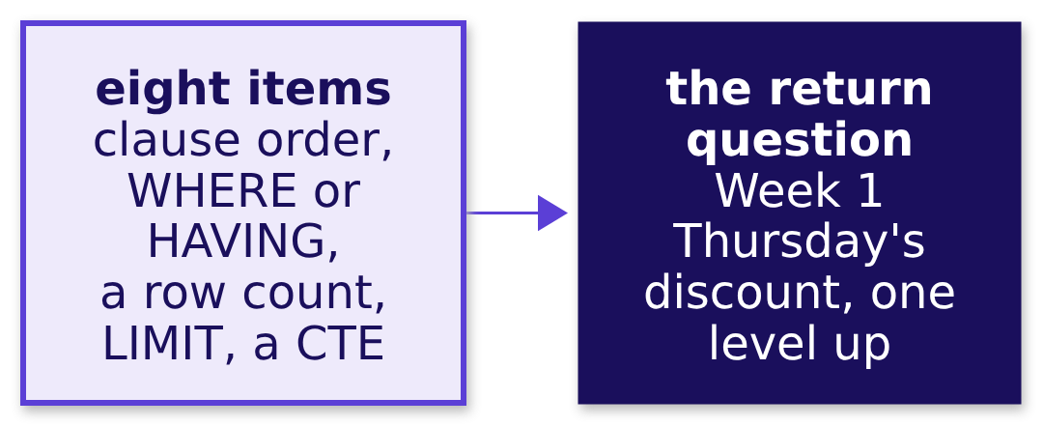
Indian Institute of Technology Gandhinagar
WEEK 2 · DAY 1 · KALPA GLOBAL CAPABILITY CENTRE
ADMINISTERED THROUGH THE COMPETENCY ADVANCEMENT ACADEMY
The Kahoot: eight items, none of them graded
Which of the day's decisions can the room make in twenty seconds each?
8
0
20 s
ITEMS
GRADES
PER ITEM
seven on today, one returning from Week 1 Thursday
the Kahoot is daily and ungraded
then the reason, aloud
Same answer next week?
Can you do it alone?
What do we tell Anand?
S20 · 24 / 28
Notes:
LIVE, 7 minutes. The pack is kahoot/C2_W02_D01_quiz_STUDENT.md. After each item, one learner says
why the key holds. The last item returns to Week 1 Thursday: the discount's 6 percent lift was a
mix effect, and the room says in one line what a fair comparison would need. Then tomorrow's
question.

Slide 25
Indian Institute of Technology Gandhinagar
WEEK 2 · DAY 1 · KALPA GLOBAL CAPABILITY CENTRE
ADMINISTERED THROUGH THE COMPETENCY ADVANCEMENT ACADEMY
The interview drill, for the lab: ten questions
DEPTH
Which interview questions does today equip you to answer, and how are they tagged?
Tag | The question
[S] | WHERE against HAVING, one sentence each.
[S] | Explain the logical order in which a SQL query runs.
[F] | Why would you compute a KPI in the warehouse rather than in a notebook?
[F] | What does LIMIT without ORDER BY return?
[D] | An analyst must audit your query: what changes in how you write it, and what would you refuse to compute in a notebook?
[F] | Orders per customer reads 1 for a segment; what do you check first?
[F] | An average moved but the total did not; how?
[F] | Why can you not add two quarters' customer counts to get the half-year's?
[D] | Two analysts report different customer counts for one quarter; how do you settle it?
[F] | Your KPI moved 30 percent overnight and the data did not change; what do you suspect?
Tags: [S] asked everywhere, [F] frequent in GCC and product screens, [D] a differentiator.
Same answer next week?
Can you do it alone?
What do we tell Anand?
D21 · 25 / 28
Notes:
SELF-STUDY, 2 minutes to read. The drill runs aloud in the practice lab, sixty seconds per answer,
in pairs. Each chapter's closing slide and the study notes carry the full answers. The design
question among them: four ways to produce a number, which would you choose, sized how, and what
would make you switch.

Slide 26
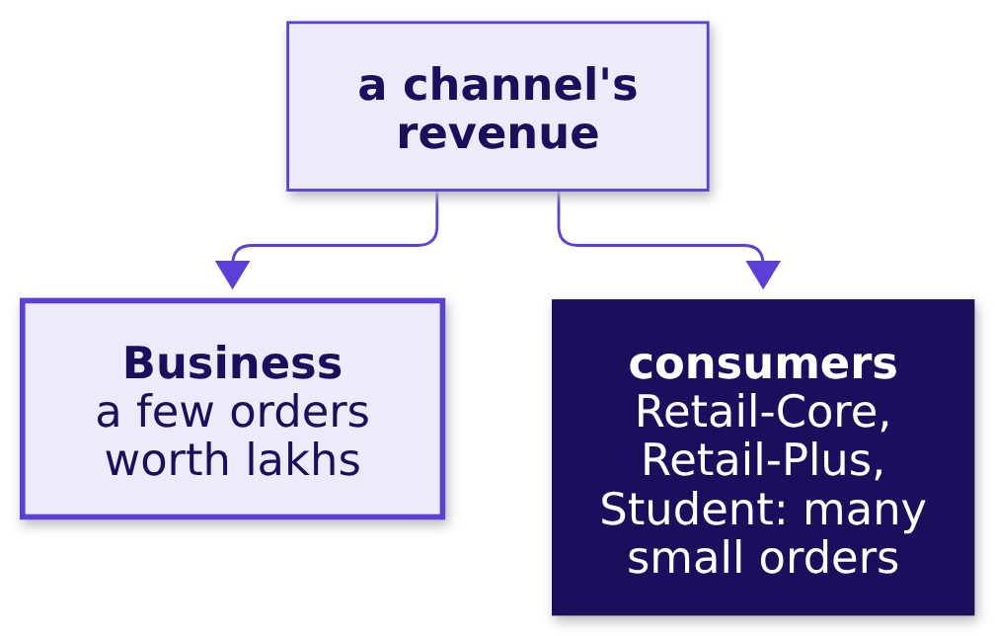
Indian Institute of Technology Gandhinagar
WEEK 2 · DAY 1 · KALPA GLOBAL CAPABILITY CENTRE
ADMINISTERED THROUGH THE COMPETENCY ADVANCEMENT ACADEMY
The second case, for the take-home: the channels
DEPTH
Which channel is losing Kalpa's consumers, once the Business orders are read apart?
THE CLIENT ASKS
"The same numbers for every channel: app, web and store. Marketing says the store is booming and the web is collapsing, and wants the budget moved. Is that what the book says?"
Kalpa sells through its app, its website and its stores. Business books about 99 percent of the rupees, so each channel's total is two businesses in one line.
Same answer next week?
Can you do it alone?
What do we tell Anand?
D22 · 26 / 28
Notes:
SELF-STUDY. The case runs in the take-home, in pairs or alone:
notebooks/C2_W02_D01_ex2_second_case_STUDENT.ipynb with the brief
exercises/unguided/C2_W02_D01_second_case_STUDENT.md. Seven lettered choices and one line for
Anand naming the channel losing its consumers fastest, with its number.

Slide 27
Indian Institute of Technology Gandhinagar
WEEK 2 · DAY 1 · KALPA GLOBAL CAPABILITY CENTRE
ADMINISTERED THROUGH THE COMPETENCY ADVANCEMENT ACADEMY
The day's wrong numbers, each with its check
DEPTH
Which plausible wrong numbers did the day stage, and what caught each?
Chapter | The plausible wrong number | The check that caught it
1 | 538 and 462 customers, 1.00 order each | Three counts of one table: 1,000 rows, 340 members, 301 buyers
2 | Customers held flat, as last week said | Who bought in both quarters: 69 of 69 against 170 of 301
3 | Retail-Plus frequency 2 then 1, "halved" | Multiply back: 1 times 76 is 76, where the orders are 140
4 | Each member spent 15.5% less | Who is inside each average: 107, 91 and 76
5 | 167 Retail-Plus customers in the half-year | Buyers against members: 167 of a tier of 120
6 | Rs 3,900 against a rerun's Rs 4,590 | The fingerprint held while the sample moved
Same answer next week?
Can you do it alone?
What do we tell Anand?
D23 · 27 / 28
Notes:
SELF-STUDY. The debrief of wrong answers runs in the lab on a faculty day. A learner who missed
the class can take each row back to its chapter's slides and notebook.

Slide 28
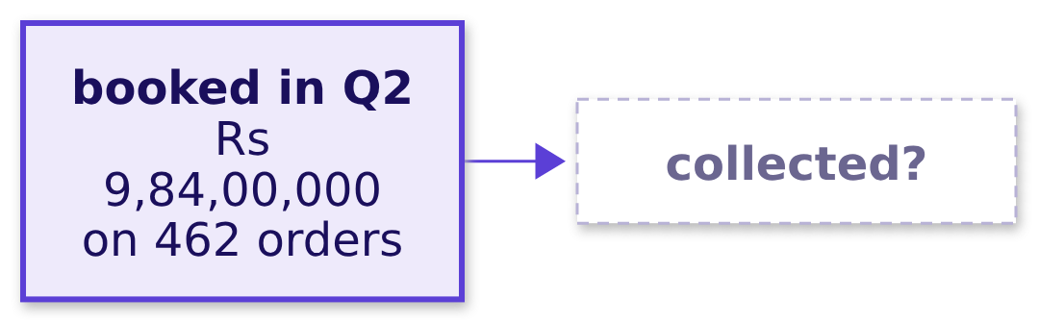
Indian Institute of Technology Gandhinagar
WEEK 2 · DAY 1 · KALPA GLOBAL CAPABILITY CENTRE
ADMINISTERED THROUGH THE COMPETENCY ADVANCEMENT ACADEMY
Tomorrow: booked against collected, left open
Anand asks the next question: what does the book say about the money itself?
"Booked revenue is not collected revenue. Show me, order by order, what we actually collected against what we booked in Q2."
Anand Iyer, finance controller, Kalpa Retail, the question he sends back
Same answer next week?
Can you do it alone?
What do we tell Anand?
S24 · 28 / 28
Notes:
LIVE, 1 minute. Leave the question open. Tonight's pre-read opens on Anand's message. Then the
practice lab after the day, and before it the IITGN faculty session, which is tentative and runs
120 minutes on a topic of its own.

