Slide 1


Indian Institute of Technology Gandhinagar
ADMINISTERED THROUGH THE COMPETENCY ADVANCEMENT ACADEMY
WEEK 2 · WEDNESDAY · HALF TWO
Marketing's Monday file, and the sentence on it
“We act on this list on Monday. Tell us the tie rule and the number of members it ships.”
Marketing, Kalpa Retail, to the data and AI team at Kalpa's Global Capability Centre
01
The escalated case
02
The debrief
03
The close
Week 2, Day 3. Marketing's Monday file, and the sentence on it
1 / 20
Notes:
LIVE, one minute. Read Marketing's line aloud and leave it on screen. The morning ran the three
rounds one at a time; the afternoon puts them into one file Marketing acts on. The trainer's part
of the afternoon is 60 minutes: the case with its debrief folded in (45), then the Kahoot and
Thursday's ask (15).

Slide 2
Indian Institute of Technology Gandhinagar
PG DIPLOMA IN AI-ML AND AGENTIC AI ENGINEERING · COHORT 2
ADMINISTERED THROUGH THE COMPETENCY ADVANCEMENT ACADEMY
01
The escalated case
One file with five named steps: the list, the flag, the plan, the check and the sentence.
The escalated case
The debrief
The close
Week 2, Day 3. Marketing's Monday file, and the sentence on it
2 / 20
Notes:
LIVE. The case runs 45 minutes, unguided, with the debrief folded into its last ten. The brief is
exercises/unguided/C2_W02_D03_marketing_case_STUDENT.md and the file the room fills is
sql/C2_W02_D03_04_marketing_case_STUDENT.sql, which runs as it ships because every placeholder is
a comment.

Slide 3


Indian Institute of Technology Gandhinagar
WEEK 2 · DAY 3 · KALPA GLOBAL CAPABILITY CENTRE
ADMINISTERED THROUGH THE COMPETENCY ADVANCEMENT ACADEMY
Marketing's Monday file
Everything the morning built, in one file, read by the people who act on it.
THE CLIENT ASKS
"We act on this list on Monday. One file: the top fifty members by Q2 revenue in every segment, ranked the way the head of Retail-Plus asked, a column that says whether each one's spend fell in August and again in September, and the running total against the plan so Meera can see where the quarter stood at mid-quarter and where it closed. Tell us the tie rule and the number of members it ships."
4
3
13
SEGMENTS
MONTHS
PLAN WEEKS
each ranked on its own
July, August, September
6 July to 28 September
The escalated case
The debrief
The close
S1 · 3 / 20
Notes:
LIVE, 1 minute. Read the message aloud. Point out that it asks for two things the morning never
produced on one screen: the flag joined to the list, and the check on the running total. The
learner's role is unchanged: state the tie rule and why, and defend the flag against the member
who was on holiday. Transition: the five parts.

Slide 4




Indian Institute of Technology Gandhinagar
WEEK 2 · DAY 3 · KALPA GLOBAL CAPABILITY CENTRE
ADMINISTERED THROUGH THE COMPETENCY ADVANCEMENT ACADEMY
Five parts, each a named step
Each part is a CTE with one comment line above it: the question it answers and its denominator.
1
2
3
4
5
PART 1
PART 2
PART 3
PART 4
PART 5
The protect list
The flag
Against plan
The check
The sentence
The top fifty by Q2 booked revenue in each segment, ties ranked the same.
Listed members who spent less in August than July, and less again in September.
Booked to date against plan to date, at the end of each plan week.
The last booked-to-date against Monday's Q2 total of Rs 9,84,00,000.
Three sentences for Marketing and Meera: the rule, the flag, the plan.
The escalated case
The debrief
The close
S2 · 4 / 20
Notes:
LIVE, 1 minute. Read the five parts once. The comment line above each step is the line Anand's
analyst reads first, so it is part of the answer. Part 4 is the one hurried rooms skip.
Transition: what done looks like.

Slide 5
Indian Institute of Technology Gandhinagar
WEEK 2 · DAY 3 · KALPA GLOBAL CAPABILITY CENTRE
ADMINISTERED THROUGH THE COMPETENCY ADVANCEMENT ACADEMY
What done looks like
Each part is done when its result carries the check that proves it.
Part | What it returns | The check it carries
1 | Members per segment and the last position | The count per segment, stated with its reason
2 | The flagged members with segment and position | A member with a skipped month is off the flag
3 | Thirteen rows of plan to date and booked to date | Both columns accumulate
4 | The close against Monday's total | The two numbers are equal to the rupee
5 | Three sentences in a comment | Each carries a number and what it means
The escalated case
The debrief
The close
S3 · 5 / 20
Notes:
LIVE, 1 minute. Leave this on screen while the room starts. The right-hand column is what Kavya
reads first. Transition: the clock.

Slide 6
Indian Institute of Technology Gandhinagar
WEEK 2 · DAY 3 · KALPA GLOBAL CAPABILITY CENTRE
ADMINISTERED THROUGH THE COMPETENCY ADVANCEMENT ACADEMY
Forty-five minutes, parts first
A four-minute brief, thirty-one minutes on the five parts, then ten minutes of debrief on what the room found.
Brief
Parts 1 and 2
Part 3
Parts 4 and 5
Debrief
4
13 minutes
9 minutes
9 minutes
10 minutes
Work alone. The morning's three SQL files and notebooks are open to you, and the solution is released at the close.
The escalated case
The debrief
The close
S4 · 6 / 20
Notes:
LIVE, 31 minutes of unguided work, then the debrief on the next slides. Walk the room from the
fifteenth minute and watch for four things, which are the debrief's four slides: a plan-first
join, a count of 49, 50 or 52 in Retail-Plus, a flag that includes a member with no August order,
and LAG with no PARTITION BY. Note which pairs hit which, without naming them in the debrief.

Slide 7
Indian Institute of Technology Gandhinagar
PG DIPLOMA IN AI-ML AND AGENTIC AI ENGINEERING · COHORT 2
ADMINISTERED THROUGH THE COMPETENCY ADVANCEMENT ACADEMY
02
The debrief
Four wrong answers the room is likely to ship, each with the number it produces and the check.
The escalated case
The debrief
The close
Week 2, Day 3. Marketing's Monday file, and the sentence on it
7 / 20
Notes:
LIVE. The debrief runs about 10 minutes inside the case's 45. Take each wrong answer as a number
first, then the check. Nobody is named; the numbers are what the room saw.

Slide 8
Indian Institute of Technology Gandhinagar
WEEK 2 · DAY 3 · KALPA GLOBAL CAPABILITY CENTRE
ADMINISTERED THROUGH THE COMPETENCY ADVANCEMENT ACADEMY
Question: the plan-first running total
Start from plan_line, LEFT JOIN weekly revenue on date_trunc('week'), and accumulate both sides.
hurried AS (
SELECT p.week_start,
sum(w.booked) OVER (ORDER BY p.week_start) AS booked_to_date,
sum(p.plan_revenue) OVER (ORDER BY p.week_start) AS plan_to_date
FROM plan_line p
LEFT JOIN weekly w ON w.week_start = p.week_start
)
Question. Thirteen rows, thirteen numbers. Where does booked to date close? a) Rs 9,84,00,000, Monday's total; b) Rs 9,68,60,180; c) Rs 9,83,99,990, the plan; d) it cannot close, a LEFT JOIN drops no rows.
The escalated case
The debrief
The close
S5 · 8 / 20
Notes:
LIVE, 1 minute. Take letters. Expect a and d: the join keeps all thirteen plan weeks, so it feels
complete. The query is the hurried Part 3 several pairs wrote.

Slide 9
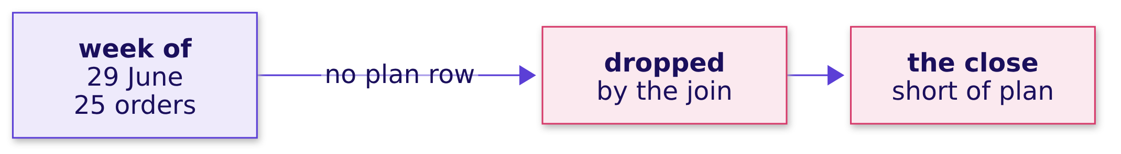

Indian Institute of Technology Gandhinagar
WEEK 2 · DAY 3 · KALPA GLOBAL CAPABILITY CENTRE
ADMINISTERED THROUGH THE COMPETENCY ADVANCEMENT ACADEMY
Answer: Rs 15,39,820 fell out before week one
Q2 orders start on 1 July and the plan starts on 6 July, so the week of 29 June has no plan row.
WHAT BREAKS
Meera would be told Q2 missed plan by Rs 15,39,810 when it landed on it. The check is Part 4: the last booked-to-date must equal Monday's Rs 9,84,00,000, and this one is Rs 15,39,820 short.
The escalated case
The debrief
The close
S6 · 9 / 20
Notes:
LIVE, 2 minutes. The answer is b. The fix: accumulate the actual by day from the first Q2 order
and read it at each plan week's last day, week_start + 6. Then Q2 closes at Rs 9,84,00,000 against
Rs 9,83,99,990, Rs 10 ahead. The Rs 15,39,810 and Rs 15,39,820 differ by the plan's own Rs 10
rounding; say so if anyone asks. Transition: what Meera reads once the total is right.

Slide 10
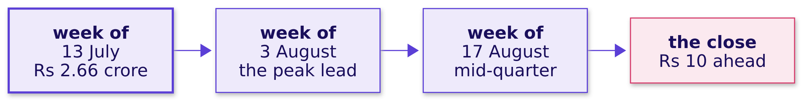
Indian Institute of Technology Gandhinagar
WEEK 2 · DAY 3 · KALPA GLOBAL CAPABILITY CENTRE
ADMINISTERED THROUGH THE COMPETENCY ADVANCEMENT ACADEMY
On plan by the total, below plan by the run rate
The quarter closed Rs 10 ahead, and its lead came from one week in July.
Rs 2,16,69,660
Rs 1,57,51,980
6 of 7
PEAK LEAD
MID-QUARTER LEAD
WEEKS BELOW PLAN
end of the week of 3 August
end of the seventh plan week
from 10 August, against Rs 75,69,230 a week
The escalated case
The debrief
The close
S7 · 10 / 20
Notes:
LIVE, 1 minute. This is the reading for Meera, and it is two sentences: on track by the total,
off track by the run rate. Mid-quarter is the end of the seventh plan week, the week of 17 August,
where Q2 had booked Rs 6,87,36,590 against a plan to date of Rs 5,29,84,610.
Transition: the protect list's count.

Slide 11
Indian Institute of Technology Gandhinagar
WEEK 2 · DAY 3 · KALPA GLOBAL CAPABILITY CENTRE
ADMINISTERED THROUGH THE COMPETENCY ADVANCEMENT ACADEMY
Question: how many Retail-Plus members ship
Four counts came back from the room for the same segment and the same fifty.
49
50
51
52
COUNT ONE
COUNT TWO
COUNT THREE
COUNT FOUR
from one pair's file
from another
from another
from another
Question. Which count answers the head of Retail-Plus, and which rule produced each of the others?
The escalated case
The debrief
The close
S8 · 11 / 20
Notes:
LIVE, 1 minute. Take one answer per count. Push each pair for the rule behind its number before
revealing anything.

Slide 12

Indian Institute of Technology Gandhinagar
WEEK 2 · DAY 3 · KALPA GLOBAL CAPABILITY CENTRE
ADMINISTERED THROUGH THE COMPETENCY ADVANCEMENT ACADEMY
Answer: RANK's count, and the line says why
The room's four counts came from four rules, and the one to ship is the count RANK returned.
Rule | The room's count | What the rule did at the line, in the room's files
RANK at most 50 | 51 | Every member sharing the last position kept, which is what the head asked
Whole ties only | 49 | The members sharing the last position all dropped, the forty-nine he forbade
ROW_NUMBER at most 50 | 50 | One member at the last position dropped by the database's choice
DENSE_RANK at most 50 | 52 | A shared position higher up saved a number, so a member past the line ships
KAVYA'S REVIEW
The RANK count is correct, and it is only defensible with its reason beside it, read from your own file: count the members at the last position and say it in the same line as the count.
The escalated case
The debrief
The close
S9 · 12 / 20
Notes:
LIVE, 2 minutes. RANK is the rule the head of Retail-Plus asked for. ROW_NUMBER's fifty looks
right and is the dangerous one: which member at the line ships depends on the tiebreaker, so a
member can be on Monday's list and off Tuesday's with the same spend. Interview [F] follow-up: your
top ten came back with eleven rows; it is no bug, and the stakeholder is told the tie and the count.

Slide 13
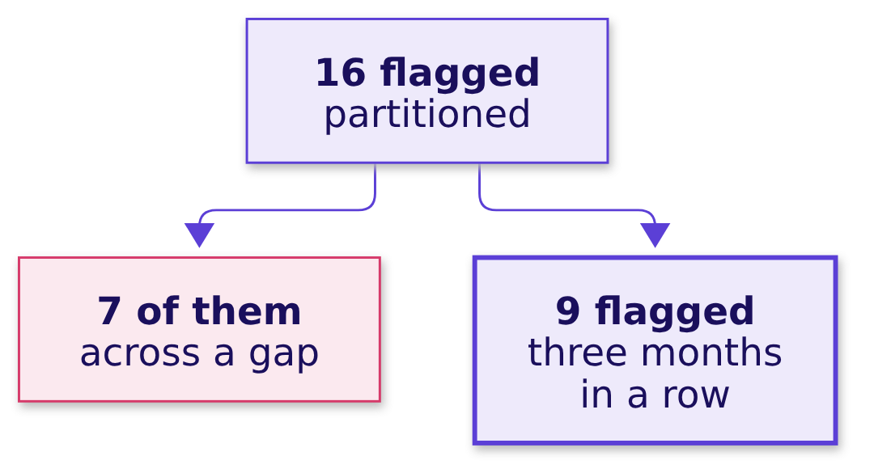

Indian Institute of Technology Gandhinagar
WEEK 2 · DAY 3 · KALPA GLOBAL CAPABILITY CENTRE
ADMINISTERED THROUGH THE COMPETENCY ADVANCEMENT ACADEMY
The holiday member, flagged by LAG
Sixteen flagged is seven too many, because a skipped month was read as last month.
THE RULE
A month with no order is no reading, so it breaks the run. Nine listed members spent less in August than July and less again in September.
The escalated case
The debrief
The close
S10 · 13 / 20
Notes:
LIVE, 1 minute. C-0216 is the example: May, July and September, and LAG called July last month.
Interview [D] for the notes: why not fill August with zero? Because every holiday month would then
read as a fall to zero, accusing every member who skipped a month. Transition: the other LAG slip.

Slide 14
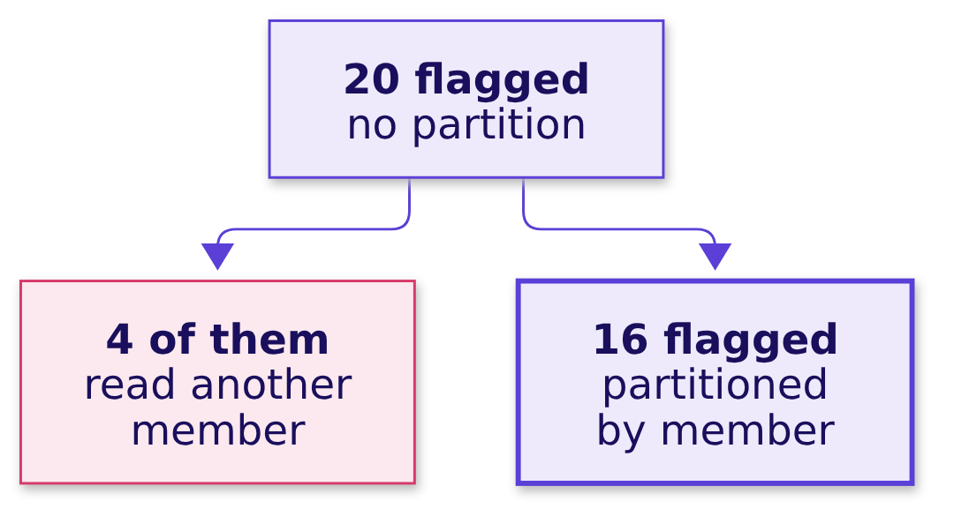
Indian Institute of Technology Gandhinagar
WEEK 2 · DAY 3 · KALPA GLOBAL CAPABILITY CENTRE
ADMINISTERED THROUGH THE COMPETENCY ADVANCEMENT ACADEMY
LAG across members: 20 flagged
Without PARTITION BY, a member's first month reads the last month of the member sorted before.
THE RULE
Count the first months that carry a previous value. The count must be zero, and any other number means the partition is missing.
The escalated case
The debrief
The close
S11 · 14 / 20
Notes:
LIVE, 1 minute. Quick, since the morning covered it. The check works on ten thousand rows as well
as on ten: count rows where the lagged customer_id differs from the row's own.
Transition: the sentence that goes to Marketing and Meera.

Slide 15
Indian Institute of Technology Gandhinagar
WEEK 2 · DAY 3 · KALPA GLOBAL CAPABILITY CENTRE
ADMINISTERED THROUGH THE COMPETENCY ADVANCEMENT ACADEMY
The sentence to Marketing and Meera
Three sentences, each carrying its number and what it means for the decision.
"We ranked with RANK inside each segment, so tied members share a place and nobody at the line is dropped by a coin toss: the list carries 35 Business and 20 Student members, which is every Q2 buyer there, 50 Retail-Core and 51 Retail-Plus, where our RANK file shows two members sharing the fiftieth place. Nine listed members spent less in August than July and less again in September; a member with no August order is not flagged, because a month without an order is no reading. Q2 closed on plan, Rs 9,84,00,000 against Rs 9,83,99,990, and the Rs 1.58 crore lead at mid-quarter came from one week in July, so the weekly run rate has been below plan since 10 August."
The escalated case
The debrief
The close
S12 · 15 / 20
Notes:
LIVE, 1 minute. Read it aloud once, slowly, and ask each learner to compare it with their own Part 5:
which of the three numbers did theirs carry, and which meaning did it leave out? The solution file
is released now. Transition: the four lines the day comes down to.

Slide 16
Indian Institute of Technology Gandhinagar
PG DIPLOMA IN AI-ML AND AGENTIC AI ENGINEERING · COHORT 2
ADMINISTERED THROUGH THE COMPETENCY ADVANCEMENT ACADEMY
03
The close
Four lines to keep, eight Kahoot questions, and Thursday's question left open.
The escalated case
The debrief
The close
Week 2, Day 3. Marketing's Monday file, and the sentence on it
16 / 20
Notes:
LIVE. The close runs 15 minutes: the crux lines (3), the Kahoot (8), Thursday's ask (3) and the
hand-over to the IITGN session, which is tentative (1).

Slide 17




Indian Institute of Technology Gandhinagar
WEEK 2 · DAY 3 · KALPA GLOBAL CAPABILITY CENTRE
ADMINISTERED THROUGH THE COMPETENCY ADVANCEMENT ACADEMY
Four lines the day comes down to
The cheat sheet and the study notes carry these four lines word for word.
1
2
3
4
WINDOW
TIES
LAG
RUNNING TOTAL
Every row stays
A business decision
Last month, same member
Order and start
GROUP BY answers how much per group; a window keeps every row and says where each row stands.
The tie rule is a business decision written as a function name: RANK keeps everyone at the line, and the report says how many.
LAG reads the previous row, so partition by the member and check the previous row is last month.
A running total is only as true as its order and its start; check it closes on the quarter's total.
The escalated case
The debrief
The close
S13 · 17 / 20
Notes:
LIVE, 3 minutes. Read the four lines aloud. Ask two learners to say one each without the slide.
These are the lines Saturday's paper leans on.

Slide 18
Indian Institute of Technology Gandhinagar
WEEK 2 · DAY 3 · KALPA GLOBAL CAPABILITY CENTRE
ADMINISTERED THROUGH THE COMPETENCY ADVANCEMENT ACADEMY
The Kahoot: eight questions on the day
Eight questions, played for practice, with Tuesday's join question returning one level up.
2
2
2
2
ON TIES
ON WINDOWS
ON LAG
RUNNING TOTAL AND TUESDAY
the three rules, and the business choice
PARTITION BY, and ROW_NUMBER's cut at a tie
the first month, and the missing month
a full order, a join that grew
The escalated case
The debrief
The close
S14 · 18 / 20
Notes:
LIVE, 8 minutes. Run the eight items from the kahoot file. After each item, one sentence on why
the popular wrong option was wrong. The Tuesday item: a LEFT join grew rows because the right side
had more than one match per key; the check is the row count before and after.
Transition: Thursday's ask.

Slide 19



Indian Institute of Technology Gandhinagar
WEEK 2 · DAY 3 · KALPA GLOBAL CAPABILITY CENTRE
ADMINISTERED THROUGH THE COMPETENCY ADVANCEMENT ACADEMY
Thursday: one table per customer, every Monday
The question left open: when SQL, plain Python and pandas can each answer it, which tool do you pick, and why?
THE CLIENT ASKS
"The warehouse queries are fine for Finance, but Marketing's analysts live in Python. Build them the table in pandas, from the warehouse, and make it refreshable in one run."
ONE ROW EACH
FROM CAMPAIGNS
FROM TODAY
Per customer
The monsoon sale
Last week's flags
How recently, how often and how much, with the segment.
Whether the campaign reached the customer.
The falling-spend flag, carried into the table.
The escalated case
The debrief
The close
S15 · 19 / 20
Notes:
LIVE, 3 minutes. The speaker is Kalpa's platform lead. Leave the question open; do not answer it.
Thursday's pre-read is preread/C2_W02_D03_preread_STUDENT.md. Point out that today's ranks and LAG
return tomorrow as groupby transforms, and that today's flag becomes one of the table's columns.

Slide 20
Indian Institute of Technology Gandhinagar
WEEK 2 · DAY 3 · KALPA GLOBAL CAPABILITY CENTRE
ADMINISTERED THROUGH THE COMPETENCY ADVANCEMENT ACADEMY
Next: the IITGN session W2-3, tentative
The afternoon continues with the tentative IITGN faculty session on errors, power and sample size.
W2-3
120
IITGN SESSION
MINUTES
tentative
tentative
The IITGN faculty session W2-3 (tentative) runs for 120 minutes on Type I and Type II errors, power and the sample size a comparison needs. The tentative session picks up the rule of thumb of thirty observations from Week 1 Thursday.
The escalated case
The debrief
The close
S16 · 20 / 20
Notes:
LIVE, 1 minute. The trainer's row stops here, where the tentative IITGN block starts. Everything about the
block is tentative, so say only what the slide says: the tentative session W2-3, 120 minutes, on
errors, power and sample size. The TA-led practice lab runs after it from the practice set.

