Slide 1


Indian Institute of Technology Gandhinagar
ADMINISTERED THROUGH THE COMPETENCY ADVANCEMENT ACADEMY
WEEK 1 · FRIDAY · THE GROWTH-REVIEW REHEARSAL
Does your note hold when Marketing pushes?
“Then say it to me the way you will say it to her, because I will push the way Marketing will.”
Kavya Nair, senior analyst, Kalpa Retail data team, to the trainees at Kalpa's Global Capability Centre
01
Does the note hold?
02
Which approach fits?
03
What is yours now?
Week 1, Day 5. Does your note hold when Marketing pushes?
1 / 27
Notes:
LIVE, one minute. The afternoon, after the debrief's second half: the rehearsal in two rounds (100
minutes), three timed design cases (40), and the Kahoot with Saturday's preview (20). Nothing new
is taught; the afternoon is practice with a hostile listener.

Slide 2

Indian Institute of Technology Gandhinagar
WEEK 1 · DAY 5 · KALPA GLOBAL CAPABILITY CENTRE
ADMINISTERED THROUGH THE COMPETENCY ADVANCEMENT ACADEMY
Three questions for the afternoon
Does your note hold when Marketing pushes, and what do you do when the clock runs?
SECTION 1
SECTION 2
SECTION 3
Does the note hold?
Which approach fits?
What is yours now?
Thursday's note, defended in pairs and then to the room.
Three timed design cases, answered aloud.
The Kahoot, Saturday's paper and tonight's rerun.
Does the note hold?
Which approach fits?
What is yours now?
S1 · 2 / 27
Notes:
LIVE, half a minute. Read the three questions and start round one's brief.

Slide 3
Indian Institute of Technology Gandhinagar
PG DIPLOMA IN AI-ML AND AGENTIC AI ENGINEERING · COHORT 2
ADMINISTERED THROUGH THE COMPETENCY ADVANCEMENT ACADEMY
01
Does the note hold?
Does your note hold when a partner playing Marketing pushes, and can you keep its caveat without folding or overclaiming?
Does the note hold?
Which approach fits?
What is yours now?
Week 1, Day 5. Does your note hold when Marketing pushes?
3 / 27
Notes:
LIVE. Round one is fifty minutes in pairs, round two is fifty minutes of call-outs to the room. If
time is short, cut round two first and keep round one whole.

Slide 4
Indian Institute of Technology Gandhinagar
WEEK 1 · DAY 5 · KALPA GLOBAL CAPABILITY CENTRE
ADMINISTERED THROUGH THE COMPETENCY ADVANCEMENT ACADEMY
Answered in six questions, over two rounds
Who needs this answer, and which smaller questions lead to it?
Who needs the answer. Meera, at Monday's growth review with Marketing in the room: a caveat that folds under a push sends her budget after a number that has not earned it, and one that overclaims loses the room.
QUESTION 1
QUESTION 2
QUESTION 3
QUESTION 4
QUESTION 5
QUESTION 6
Who hears the note?
How do two minutes fit?
What will Marketing push?
How do you hold a caveat?
How do the rounds run?
What does a partner write?
Four people, four weaknesses.
Four parts, one order.
Fair questions with motives.
Restate, bound, offer the test.
Pairs, then the room.
Four answers, no score.
Does the note hold?
Which approach fits?
What is yours now?
S2 · 4 / 27
Notes:
LIVE, half a minute. Read who needs the answer and the six questions.

Slide 5





Indian Institute of Technology Gandhinagar
WEEK 1 · DAY 5 · KALPA GLOBAL CAPABILITY CENTRE
ADMINISTERED THROUGH THE COMPETENCY ADVANCEMENT ACADEMY
Four people hear the note, each for a weakness
Who hears the note on Monday, and what does each listen for?
CEO
OWNS CAMPAIGNS
FINANCE
PAID TIER
Meera Raghavan
The marketing lead
Anand Iyer
The head of Retail-Plus
One page, two minutes, and what to do. She acts on the first line.
Defends the monsoon sale and the acquisition budget against your reading.
Checks that every number matches the books and can be audited.
Wants to know whether the paid tier is slipping and whom to protect first.
THE CLIENT ASKS
How do you know, what did you leave out, and what would change your mind? These are the questions every interviewer asks about a project too.
Does the note hold?
Which approach fits?
What is yours now?
S3 · 5 / 27
Notes:
LIVE, 2 minutes. Name the four and the one thing each listens for. The note being rehearsed is the
final version of Thursday's one-page note: Meera's three questions, the Retail-Plus gap, the Student
rise and the monsoon sale, each as claim, evidence, caveat and action, which is what goes to
Monday's review.

Slide 6

Indian Institute of Technology Gandhinagar
WEEK 1 · DAY 5 · KALPA GLOBAL CAPABILITY CENTRE
ADMINISTERED THROUGH THE COMPETENCY ADVANCEMENT ACADEMY
Four parts in two minutes, always in one order
How do two minutes carry the note's four parts?
30 SECONDS
40 SECONDS
30 SECONDS
20 SECONDS
Claim
Evidence
Caveat
Action
One sentence, with the number and what it is out of.
What you computed, on how many, and how you checked it.
The thing that would change the claim, said before anyone finds it.
What to do, what it costs, and what would tell us more.
KAVYA'S REVIEW
Say the caveat before Marketing finds it, so the room hears it as part of the claim.
Does the note hold?
Which approach fits?
What is yours now?
S4 · 6 / 27
Notes:
LIVE, 1 minute. The timings add to two minutes. A learner who runs long almost always ran long in
the evidence; the fix is one number fewer at the same pace.

Slide 7
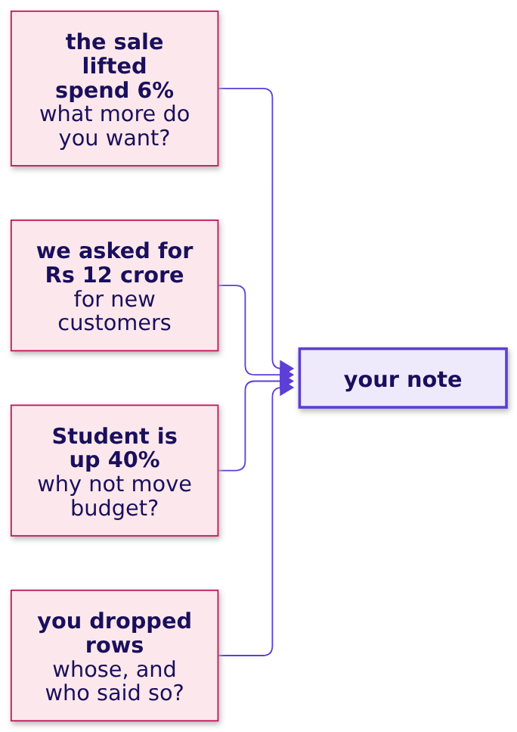
Indian Institute of Technology Gandhinagar
WEEK 1 · DAY 5 · KALPA GLOBAL CAPABILITY CENTRE
ADMINISTERED THROUGH THE COMPETENCY ADVANCEMENT ACADEMY
Marketing pushes with numbers that are true
What will a partner playing Marketing push on?
Every push is a fair question with a motive behind it, so the answer is to the question it asks. The pair lists, with a harder set for the second pairing, are in the rehearsal brief.
Does the note hold?
Which approach fits?
What is yours now?
S5 · 7 / 27
Notes:
LIVE, 2 minutes. Read the four pushes in a fair Marketing voice. The partner playing Marketing is
doing the defender a favour, and the room should hear that before round one starts. The first push
is the sharpest: the brief answers it in full, and after S7 a TA reads Marketing's lines while you
model the answer once, in four minutes. It is on neither pair list.

Slide 8
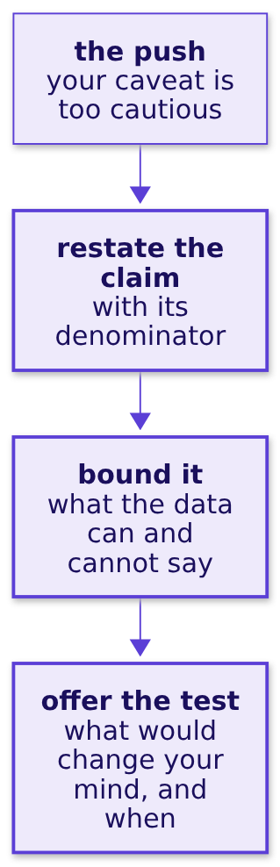

Indian Institute of Technology Gandhinagar
WEEK 1 · DAY 5 · KALPA GLOBAL CAPABILITY CENTRE
ADMINISTERED THROUGH THE COMPETENCY ADVANCEMENT ACADEMY
Restate, bound, offer the test
How do you hold a caveat without folding or overclaiming?
IN THE INTERVIEW
[D] A stakeholder attacks your caveat in front of the room; how do you hold it without overclaiming?
Does the note hold?
Which approach fits?
What is yours now?
S6 · 8 / 27
Notes:
LIVE, 2 minutes. Demonstrate the three moves once with a volunteer playing Marketing on the Student
question. Then say what it would sound like to fold (dropping the caveat) and to overclaim (calling
the rise noise when you only know it is uncertain); the three moves sit between the two.

Slide 9
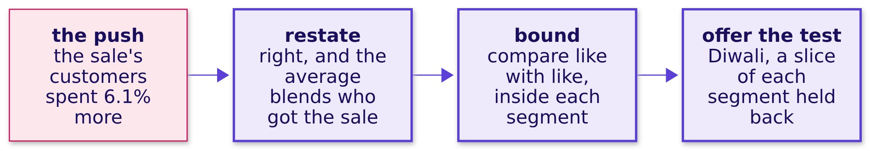
Indian Institute of Technology Gandhinagar
WEEK 1 · DAY 5 · KALPA GLOBAL CAPABILITY CENTRE
ADMINISTERED THROUGH THE COMPETENCY ADVANCEMENT ACADEMY
The sharpest push agrees with the numbers first
How do you answer a push whose every number is true?
Folding loses the finding and overclaiming loses the room; the answer that holds agrees with Marketing's arithmetic and then shows who the blend was made of.
Does the note hold?
Which approach fits?
What is yours now?
S7 · 9 / 27
Notes:
LIVE, 4 minutes: the modelled push. A TA reads Marketing's lines from the rehearsal brief, the
monsoon sale's two averages, and you answer once in the three moves, using the segment table the
brief prints. The brief carries the answer in full; this slide is its shape.

Slide 10
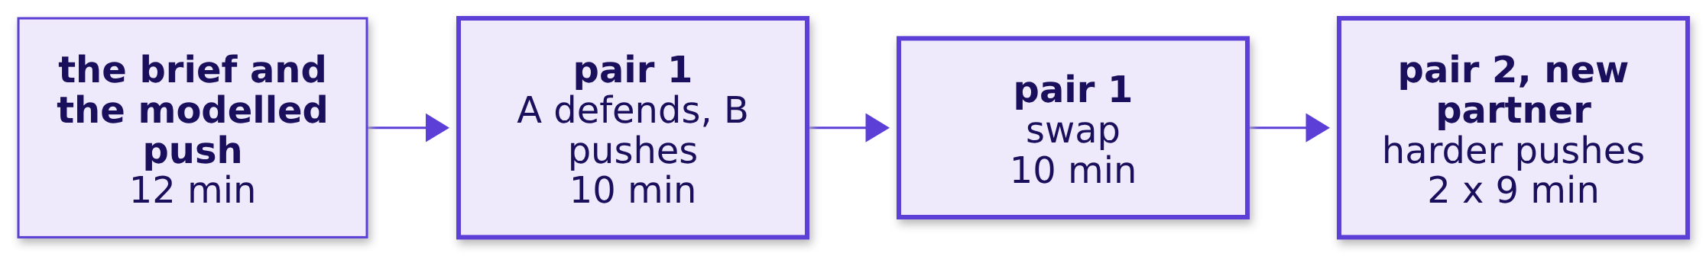
Indian Institute of Technology Gandhinagar
WEEK 1 · DAY 5 · KALPA GLOBAL CAPABILITY CENTRE
ADMINISTERED THROUGH THE COMPETENCY ADVANCEMENT ACADEMY
Each person defends twice, to two partners
How does round one run?
In pair one each ten minutes runs: two minutes of the note read aloud, five of pushes and answers, three for the partner to fill the feedback card. Pair two takes nine: two, four and three.
Does the note hold?
Which approach fits?
What is yours now?
S8 · 10 / 27
Notes:
LIVE, 50 minutes: S1 to S6 and S9 take eight, Marketing's sharpest push, modelled once with a TA,
takes four, and the pairs take the other 38. The TAs walk the room. Each TA also uses this round to
tell each of their learners, quietly and one at a time, the step the lab's observation sheet marked
for them, never aloud and never to a group.

Slide 11




Indian Institute of Technology Gandhinagar
WEEK 1 · DAY 5 · KALPA GLOBAL CAPABILITY CENTRE
ADMINISTERED THROUGH THE COMPETENCY ADVANCEMENT ACADEMY
The partner writes four answers and no score
What does the partner write on the card?
1
2
3
4
The claim
The caveat
The hardest push
Keep and cut
Quote the number and what it was out of, as you heard it.
Said before the push, after it, or not at all?
Which one landed, and what answer would have held it?
One sentence to keep, one to cut.
The card is exercises/guided/C2_W01_D05_feedback_card_STUDENT.md, one per defence; the defender keeps it.
Does the note hold?
Which approach fits?
What is yours now?
S9 · 11 / 27
Notes:
LIVE, 1 minute before the round starts. Say it once: the card has no score because a score turns
the partner into a judge, and the job is to be the harder audience, then the useful one.

Slide 12
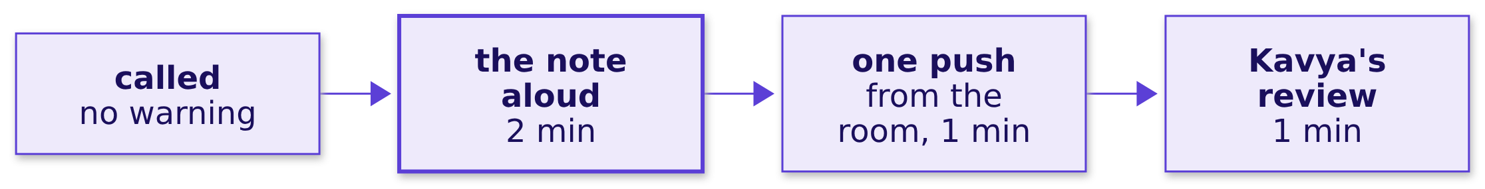
Indian Institute of Technology Gandhinagar
WEEK 1 · DAY 5 · KALPA GLOBAL CAPABILITY CENTRE
ADMINISTERED THROUGH THE COMPETENCY ADVANCEMENT ACADEMY
A dozen notes, two minutes each, to the room
How does round two run?
About a dozen people are called in fifty minutes, so everybody prepares as if they are next.
Does the note hold?
Which approach fits?
What is yours now?
S10 · 12 / 27
Notes:
LIVE, 50 minutes. Call names from a shuffled list, never by volunteering. The room's push comes
from a learner who has not yet been called. Kavya's review is the trainer's one minute: what held,
and the one change. This is the first round to cut if the day runs long.

Slide 13
Indian Institute of Technology Gandhinagar
PG DIPLOMA IN AI-ML AND AGENTIC AI ENGINEERING · COHORT 2
ADMINISTERED THROUGH THE COMPETENCY ADVANCEMENT ACADEMY
02
Which approach fits?
Which approach fits each case, sized how, and what would make you switch?
Does the note hold?
Which approach fits?
What is yours now?
Week 1, Day 5. Does your note hold when Marketing pushes?
13 / 27
Notes:
LIVE. Forty minutes, thirteen per case plus one to set up. Show each answer slide only after the
two call-outs.

Slide 14
Indian Institute of Technology Gandhinagar
WEEK 1 · DAY 5 · KALPA GLOBAL CAPABILITY CENTRE
ADMINISTERED THROUGH THE COMPETENCY ADVANCEMENT ACADEMY
Answered in three cases, thirteen minutes each
Who needs this answer, and which cases lead to it?
Who needs the answer. An interviewer asking the design question, and behind each case a Kalpa stakeholder who acts on the call: Meera, Anand and the product head.
CASE 1
CASE 2
CASE 3
What do you leave out?
Which check runs first?
Can 12 visits beat 1,200?
Meera's first read in two hours.
Zero rejects and a Rs 20 lakh gap.
42 percent on twelve visits.
Does the note hold?
Which approach fits?
What is yours now?
S11 · 14 / 27
Notes:
LIVE, 1 minute. Read who needs the answer and the three cases.

Slide 15
Indian Institute of Technology Gandhinagar
WEEK 1 · DAY 5 · KALPA GLOBAL CAPABILITY CENTRE
ADMINISTERED THROUGH THE COMPETENCY ADVANCEMENT ACADEMY
Read, think, answer aloud, then two call-outs
How does a timed design case run?
1 MINUTE
3 MINUTES
4 MINUTES
5 MINUTES
Read
Think
Answer aloud
Two call-outs
The case, its options and the real company it is like.
On paper: which option fits, sized how, and what would switch it.
Two minutes each, to your partner.
Two answers to the room, then the model answer.
IN THE INTERVIEW
A design question is scored on three things said in order: the option you choose, its size in minutes, rupees or visits, and the fact that would move you to another.
Does the note hold?
Which approach fits?
What is yours now?
S12 · 15 / 27
Notes:
LIVE, 1 minute. The prompts are in exercises/unguided/C2_W01_D05_timed_cases_STUDENT.md. The model
answers, their sizing and the real-company sources are in trainer/C2_W01_D05_timed_cases_key_TRAINER.md;
read the model after the call-outs.

Slide 16
Indian Institute of Technology Gandhinagar
WEEK 1 · DAY 5 · KALPA GLOBAL CAPABILITY CENTRE
ADMINISTERED THROUGH THE COMPETENCY ADVANCEMENT ACADEMY
Question: which step do you leave out?
Meera wants a first read on Q3 in two hours, from a raw export of about 2,000 orders: which plan?
Question. Each plan fits the clock at the lab's pace. Choose one: a) no reconciliation; b) no test, the note marked provisional; c) the tree and a test for one segment only; d) no profile, straight to cleaning.
IN THE INTERVIEW
[F] You have two hours and a raw export; what do you do first, and what do you skip? DMart is the likeness: its July to September 2025 revenue went out as a provisional update eight days before it filed the results.
Does the note hold?
Which approach fits?
What is yours now?
S13 · 16 / 27
Notes:
LIVE, 13 minutes: read 1, think 3, pairs 4, two call-outs 3, the next slide 2. Listen for every plan
sized from the lab's pace, for the reconciliation named as the step never dropped, and for the fact
that would switch the plan. The 2,000 orders are illustrative.

Slide 17

Indian Institute of Technology Gandhinagar
WEEK 1 · DAY 5 · KALPA GLOBAL CAPABILITY CENTRE
ADMINISTERED THROUGH THE COMPETENCY ADVANCEMENT ACADEMY
Answer: leave out the test, never the reconciliation
Which plan fits, what does each cost, and what would switch it?
Plan | Minutes at the lab's pace | What it leaves out
A | 105 | The reconciliation, the step that can flip the first line's sign
B | 105 | The test; the note says provisional
C | 95 | Every segment but one
D | 100 | The profile, so it cleans only the defects someone expected
THE RULE
B, because every plan fits the clock and the call is which step to leave out. When Meera will act on one segment's gap, add the test on that gap and trim the tree to find the minutes, or take C if she named the segment herself. With no control total, B still holds, and the first line says the read is unreconciled.
Does the note hold?
Which approach fits?
What is yours now?
S14 · 17 / 27
Notes:
LIVE, 2 minutes, after the call-outs. The model answer in full is in the trainer's key.

Slide 18
Indian Institute of Technology Gandhinagar
WEEK 1 · DAY 5 · KALPA GLOBAL CAPABILITY CENTRE
ADMINISTERED THROUGH THE COMPETENCY ADVANCEMENT ACADEMY
Question: which check runs first on the gap?
The migrated ERP's first quarter shows zero rejects and a dashboard Rs 20 lakh above Anand's books: which check runs first?
Question. About 50,000 rows. Choose the order: a) the ledger match first, since it names every order; b) ids against rows and the value accounting, then a monthly bridge; c) the monthly bridge first, then ids against rows; d) the dashboard's own query, since it ran for years.
IN THE INTERVIEW
[S] Walk me through how you clean and check a dataset you have never seen. TSB is a loose likeness: a new platform whose output was trusted before it was checked.
Does the note hold?
Which approach fits?
What is yours now?
S15 · 18 / 27
Notes:
LIVE, 13 minutes. Listen for the checks ordered by cost against what each catches, for a stopping
point, and for Finance's number treated as the reference until the bridge closes. The 50,000 rows
and the Rs 20 lakh are illustrative.

Slide 19
Indian Institute of Technology Gandhinagar
WEEK 1 · DAY 5 · KALPA GLOBAL CAPABILITY CENTRE
ADMINISTERED THROUGH THE COMPETENCY ADVANCEMENT ACADEMY
Answer: two cells, then the bridge, then stop
Which check runs first, and where do you stop?
Check | What it catches | Cost on 50,000 rows
Ids against rows | A batch posted twice | One cell, seconds
Every value summed or logged | Values set to zero without a log line | One cell, minutes to read
A rupee bridge by month | How big the gap is, and in which month | About 30 minutes
The ledger, order by order | Which orders differ | Most of a day
THE RULE
b. The two cheap checks catch the commonest causes, the bridge says whether they explain the whole Rs 20 lakh, and only a month it cannot close is matched order by order. Tonight Anand hears that his number is the reference.
Does the note hold?
Which approach fits?
What is yours now?
S16 · 19 / 27
Notes:
LIVE, 2 minutes, after the call-outs.

Slide 20
Indian Institute of Technology Gandhinagar
WEEK 1 · DAY 5 · KALPA GLOBAL CAPABILITY CENTRE
ADMINISTERED THROUGH THE COMPETENCY ADVANCEMENT ACADEMY
Question: can 5 of 12 visits beat 31 percent?
A redesigned checkout converted 5 of 12 visits; the current one converted 31 percent of 1,200. Ship it tomorrow?
Question. Choose one: a) ship to everyone now; b) keep the pilot small and wait, at about 12 visits a week; c) split the traffic in half until each checkout has about 300 visits; d) one visit in ten to the new checkout for a fortnight.
IN THE INTERVIEW
[D] A stakeholder attacks your caveat in front of the room; how do you hold it without overclaiming? Bing is the likeness: a 12 percent revenue lift checked before anyone believed it.
Does the note hold?
Which approach fits?
What is yours now?
S17 · 20 / 27
Notes:
LIVE, 13 minutes. Listen for the three moves from S6 and a test sized in visits and days. Folding
and overclaiming are both answers you will hear. The traffic figures are illustrative.

Slide 21
Indian Institute of Technology Gandhinagar
WEEK 1 · DAY 5 · KALPA GLOBAL CAPABILITY CENTRE
ADMINISTERED THROUGH THE COMPETENCY ADVANCEMENT ACADEMY
Answer: split the traffic for about half a week
Which option fits, sized in visits and days, and what would switch it?
300
half a week
3 in 10
VISITS PER CHECKOUT
AT 1,200 VISITS A WEEK
CHANCE ALONE
the case's given size to tell 42% from 31%
a half-and-half split
5 or more of 12 at a true 31%
THE RULE
c. Waiting at 12 visits a week takes about 14 weeks, and shipping now bets on five conversions. Switch to d, one visit in ten for a fortnight, when a worse checkout would lose money.
Does the note hold?
Which approach fits?
What is yours now?
S18 · 21 / 27
Notes:
LIVE, 2 minutes, after the call-outs. D gathers more evidence than C in four times the time; the
arithmetic is in the trainer's key, for a TA asked, never for the room.

Slide 22
Indian Institute of Technology Gandhinagar
PG DIPLOMA IN AI-ML AND AGENTIC AI ENGINEERING · COHORT 2
ADMINISTERED THROUGH THE COMPETENCY ADVANCEMENT ACADEMY
03
What is yours now?
What did the week make yours, what does Saturday ask, and what do you rerun tonight?
Does the note hold?
Which approach fits?
What is yours now?
Week 1, Day 5. Does your note hold when Marketing pushes?
22 / 27
Notes:
LIVE. Twenty minutes: the Kahoot, Saturday previewed, the crux lines, tonight's tasks.

Slide 23
Indian Institute of Technology Gandhinagar
WEEK 1 · DAY 5 · KALPA GLOBAL CAPABILITY CENTRE
ADMINISTERED THROUGH THE COMPETENCY ADVANCEMENT ACADEMY
Answered in four questions, in twenty minutes
Who needs this answer, and which smaller questions lead to it?
Who needs the answer. You, before Saturday's paper and Monday's review: the lines you carry out of the week are the ones Marketing and an interviewer will test.
QUESTION 1
QUESTION 2
QUESTION 3
QUESTION 4
Did the method stick?
What does Saturday ask?
Which lines carry over?
What do you rerun?
The Kahoot, eight items.
The paper's format.
Five, one per step.
Tonight's three tasks.
Does the note hold?
Which approach fits?
What is yours now?
S19 · 23 / 27
Notes:
LIVE, half a minute.

Slide 24
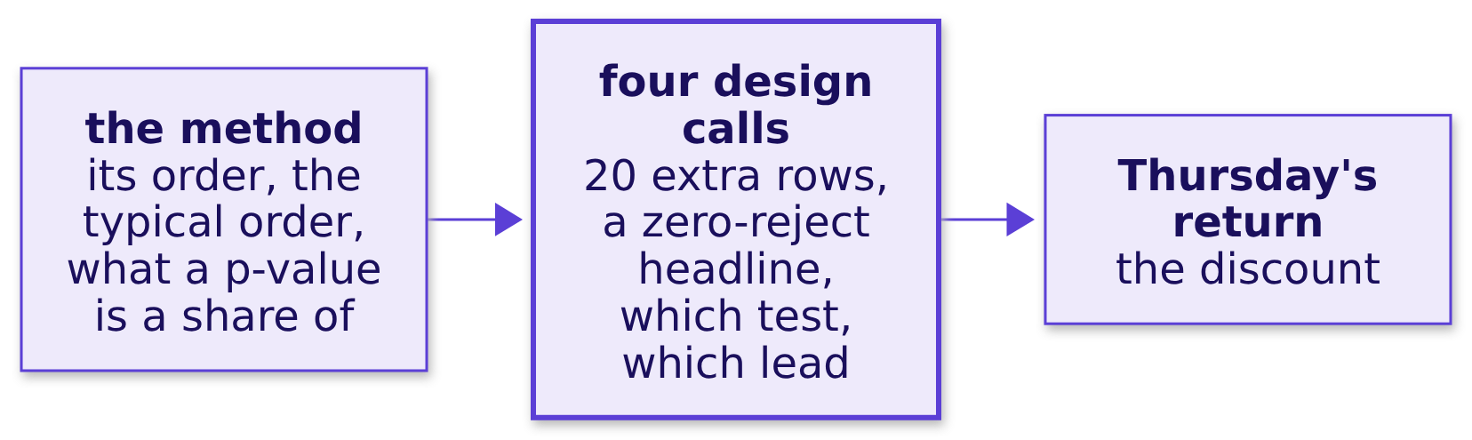
Indian Institute of Technology Gandhinagar
WEEK 1 · DAY 5 · KALPA GLOBAL CAPABILITY CENTRE
ADMINISTERED THROUGH THE COMPETENCY ADVANCEMENT ACADEMY
Eight questions test the week's method
Did the week's method stick, and which calls still wobble?
Three items on the method, four design calls and Thursday's return question, ungraded.
Does the note hold?
Which approach fits?
What is yours now?
S20 · 24 / 27
Notes:
LIVE, 8 minutes. Run kahoot/C2_W01_D05_quiz_STUDENT.md. After each item, one sentence on the wrong
answer most people picked, and move on.

Slide 25




Indian Institute of Technology Gandhinagar
WEEK 1 · DAY 5 · KALPA GLOBAL CAPABILITY CENTRE
ADMINISTERED THROUGH THE COMPETENCY ADVANCEMENT ACADEMY
Saturday puts the week on paper
What does Saturday's paper ask, and how is it marked?
THE PAPER
MARKING
DISCUSSION
STATUS
120 minutes
Swapped
Aloud
Ungraded
Blanks from a word bank, pairs from a match table, statements judged with their reason, scenario sets, applied maths and ordering.
Papers change hands and are marked against the key, read out by the Academic TA.
The most-missed items first, then the week's interview questions as interview answers.
A performance indicator for you and the team, with no ranking.
Does the note hold?
Which approach fits?
What is yours now?
S21 · 25 / 27
Notes:
LIVE, 4 minutes. Describe the format only; never preview an item. The pre-read for Saturday is in
preread/ and ships tonight.

Slide 26
Indian Institute of Technology Gandhinagar
WEEK 1 · DAY 5 · KALPA GLOBAL CAPABILITY CENTRE
ADMINISTERED THROUGH THE COMPETENCY ADVANCEMENT ACADEMY
Five lines, one per step the week made yours
Which lines carry out of the week?
01
Reconcile counts and rupees to a control total before you quote a total.
02
A zero-reject pass on a file you know is dirty is the first thing to investigate.
03
Count before rate: put the order count beside every rate before it leads a note.
04
Keep each customer's own two quarters together in every shuffle.
05
Say the claim with its denominator, the caveat before they find it, and what would change your mind.
Does the note hold?
Which approach fits?
What is yours now?
S22 · 26 / 27
Notes:
LIVE, 4 minutes. Read all five, then ask two learners which line they broke this morning. Keep it
light; everybody broke one.

Slide 27
Indian Institute of Technology Gandhinagar
WEEK 1 · DAY 5 · KALPA GLOBAL CAPABILITY CENTRE
ADMINISTERED THROUGH THE COMPETENCY ADVANCEMENT ACADEMY
One rerun, one recap, and nothing to install
What do you do tonight, and what does Saturday ask you to bring?
FIX
RECAP
SETUP
Rerun your step
From memory
Sunday evening
The step the TA marked, on the practice export, with one line on what you will do differently.
The note's four parts and the p-value sentence; both are on Saturday's paper.
Week 2 works in a live Postgres connection from VS Code; the setup steps arrive on Sunday.
KAVYA'S REVIEW
On Monday, Meera hears a note from someone who rebuilt every number in it alone this morning and reconciled it to Anand's books.
Does the note hold?
Which approach fits?
What is yours now?
S23 · 27 / 27
Notes:
LIVE, 4 minutes. Close on the three tasks. The practice set is in exercises/practice/ and the TAs
run the practice lab from it after this block.

