Slide 1


Indian Institute of Technology Gandhinagar
ADMINISTERED THROUGH THE COMPETENCY ADVANCEMENT ACADEMY
WEEK 1 · TUESDAY · HALF ONE
Which branch moved
“Are we losing customers, or are the ones we have buying less? Marketing says more customers. Prove it or disprove it.”
Meera Raghavan, CEO, Kalpa Retail, replying to Monday's numbers
01
The ask and the thinking
02
Round 1, is the drop real
03
Round 2, which branch moved
04
Round 3, every kind of customer
Week 1, Day 2. Which branch moved
1 / 52
Notes:
LIVE, one minute. Read Meera's reply aloud and leave it on screen while the room settles. Monday
drew the tree; today the tree meets two quarters of orders, and the question is which branch moved.
The morning runs three rounds on one case, each harder than the last. The afternoon escalates it.

Slide 2
Indian Institute of Technology Gandhinagar
PG DIPLOMA IN AI-ML AND AGENTIC AI ENGINEERING · COHORT 2
ADMINISTERED THROUGH THE COMPETENCY ADVANCEMENT ACADEMY
01
The ask and the thinking
Three voices reach the team with one drop between them, and the thinking is drawn before any code.
The ask and the thinking
Round 1, is the drop real
Round 2, which branch moved
Round 3, every kind of customer
Week 1 Day 2: which branch moved
2 / 52
Notes:
LIVE. This chapter runs 20 minutes and opens no notebook. Its job is to put the question, the
voices and the ladder on the board, so every round after it has a rung to stand on.

Slide 3


Indian Institute of Technology Gandhinagar
WEEK 1 · DAY 2 · KALPA GLOBAL CAPABILITY CENTRE
ADMINISTERED THROUGH THE COMPETENCY ADVANCEMENT ACADEMY
Meera wants to know which branch moved
Q2 came in below Q1, and she names the two branches she suspects.
THE CLIENT ASKS
"So revenue is customers, times how often they buy, times basket, times price. Now: which of those moved? Q2 was Rs 1.9 crore, Q1 was 2.1. Are we losing customers, or are the ones we have buying less? Marketing says more customers. Prove it or disprove it."
Rs 2.1 cr
Rs 1.9 cr
2
Rs 12 cr
Q1 REVENUE
Q2 REVENUE
SUSPECTS
STILL ON THE TABLE
as Meera remembers it
as Meera remembers it
fewer customers, or less buying each
Marketing's acquisition budget
The ask and the thinking
Round 1, is the drop real
Round 2, which branch moved
Round 3, every kind of customer
S1 · 3 / 52
Notes:
LIVE, 3 minutes. Read the message aloud. Point out that Meera has already done Monday's work in
her head: she says the tree back to us. Her figures are rounded and from memory; the file will
give exact ones. Ask which of the four stats worries her most. The budget, again: it is still
waiting on this answer.
Transition: two more voices land on the same thread.

Slide 4



Indian Institute of Technology Gandhinagar
WEEK 1 · DAY 2 · KALPA GLOBAL CAPABILITY CENTRE
ADMINISTERED THROUGH THE COMPETENCY ADVANCEMENT ACADEMY
Two more voices land on the same thread
A tier head forwards a complaint, and Marketing already has its answer.
THE CEO
THE PAID TIER
MARKETING
Meera Raghavan
The head of Retail-Plus
The marketing lead
Wants to know which branch of the tree moved, and whether acquisition is the one to fund.
Forwards a member's complaint that the app's reorder feature has been broken for six weeks, and asks whether his tier is the one slipping.
Says the answer is more customers, and has a slide that shows revenue falling by a quarter.
Your role. Present the decomposition to all three, name a cause as a hypothesis, and say what evidence would prove it. Marketing will push back.
The ask and the thinking
Round 1, is the drop real
Round 2, which branch moved
Round 3, every kind of customer
S2 · 4 / 52
Notes:
LIVE, 3 minutes. Three stakeholders, one set of numbers, three different wishes. The head of
Retail-Plus wants a verdict on his tier; Marketing wants a budget; Meera wants the truth before
she signs. Say plainly that the team works for the truth, and that each voice gets the same
numbers. Do not answer the head of Retail-Plus today in the morning; his question comes back
after lunch.

Slide 5
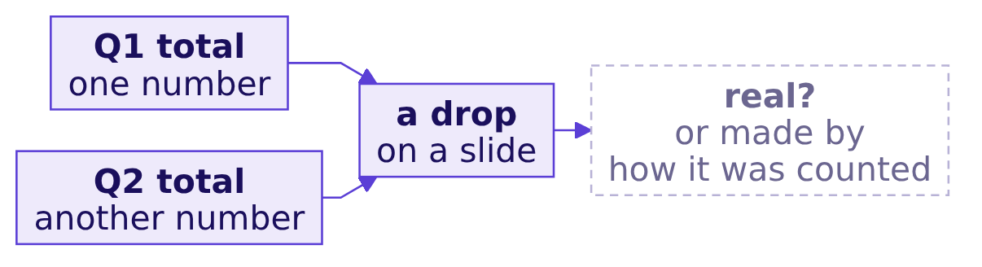
Indian Institute of Technology Gandhinagar
WEEK 1 · DAY 2 · KALPA GLOBAL CAPABILITY CENTRE
ADMINISTERED THROUGH THE COMPETENCY ADVANCEMENT ACADEMY
Question: what makes a drop look real when it is not
Before anyone explains a fall, the room lists what could manufacture one.
Question. In pairs, two minutes: write down three ways a comparison of two totals could show a fall that the business never had.
The ask and the thinking
Round 1, is the drop real
Round 2, which branch moved
Round 3, every kind of customer
S3 · 5 / 52
Notes:
LIVE, 4 minutes. Two minutes in pairs, then collect answers on the board in two columns: things
about the window and things about the counting. Expect "different lengths of time", "a different
definition of sales", "missing values", "one huge order". Keep every answer; the next slide sorts
them. Do not lead the room towards any one.

Slide 6
Indian Institute of Technology Gandhinagar
WEEK 1 · DAY 2 · KALPA GLOBAL CAPABILITY CENTRE
ADMINISTERED THROUGH THE COMPETENCY ADVANCEMENT ACADEMY
Answer: five ways a drop can be made by the counting
Each one is a check that runs before any explanation is offered.
What differs | How it fakes a drop | The check
The window | One side covers fewer weeks than the other | First and last date, and weeks covered
The definition | Booked on one side, delivered on the other | The status filter written beside each total
A missing field | Read as zero, it drags a total or an average down | Count the records that carry the field
The weights | Averages of groups averaged as if the groups were equal | The roll-up reproduces the company total
A few large orders | Three orders move a total more than a hundred small ones | The typical value and the spread, per group
The ask and the thinking
Round 1, is the drop real
Round 2, which branch moved
Round 3, every kind of customer
S4 · 6 / 52
Notes:
LIVE, 4 minutes. Map the room's board answers onto these five rows. Every row returns today as a
trap: the window in round 1, the missing field in round 2, the weights in round 3, the large
orders in rounds 1 and 3. Tell the room the list is the day's checklist. A row the room did not
think of gets one sentence now and its full treatment when it arrives.

Slide 7
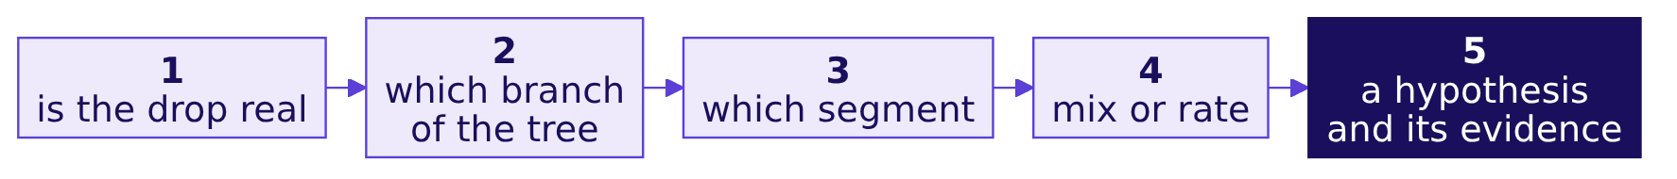

Indian Institute of Technology Gandhinagar
WEEK 1 · DAY 2 · KALPA GLOBAL CAPABILITY CENTRE
ADMINISTERED THROUGH THE COMPETENCY ADVANCEMENT ACADEMY
A drop is investigated in a fixed order
Five rungs, climbed in order, so no explanation is offered for a fall that is not there.
THE RULE
Confirm, compare like with like, decompose, isolate, then hypothesise. A rung skipped is a question someone in the meeting will ask you.
The ask and the thinking
Round 1, is the drop real
Round 2, which branch moved
Round 3, every kind of customer
S5 · 7 / 52
Notes:
LIVE, 3 minutes. Draw the ladder on the board, left to right, and leave it there all day. The
morning climbs rungs 1 to 3, one per round. Rung 4 is the escalated case after lunch, and rung 5
is the second case, where Marketing attacks your hypothesis. This is also the answer shape for
interview question 1: sales dropped 15 percent, how would you investigate. Say that once.

Slide 8
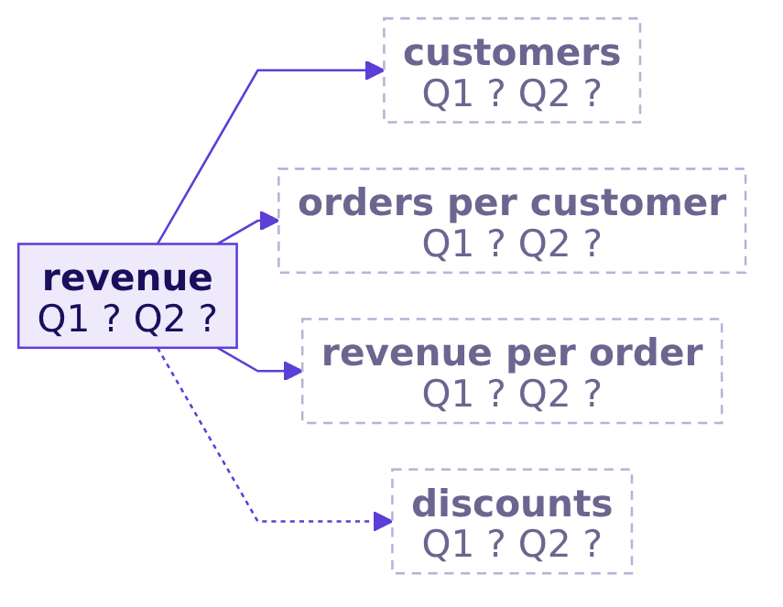
Indian Institute of Technology Gandhinagar
WEEK 1 · DAY 2 · KALPA GLOBAL CAPABILITY CENTRE
ADMINISTERED THROUGH THE COMPETENCY ADVANCEMENT ACADEMY
Monday's tree, with two empty columns
The same tree, a Q1 column and a Q2 column, and nothing filled in yet.
The formula. Revenue equals customers, times orders per customer, times revenue per order, and the discounts sit beside it as the branch Marketing does not mention.
The ask and the thinking
Round 1, is the drop real
Round 2, which branch moved
Round 3, every kind of customer
S6 · 8 / 52
Notes:
LIVE, 3 minutes. Redraw Monday's tree with two empty columns under every branch. Items per order
and price per item are folded into revenue per order today, because the file has no line items.
Every round fills some of these blanks. Ask: if customers is flat and revenue fell, which
branch must have moved? One of the other two, which is round 2.
Transition to round 1: before filling any box, check that the two totals deserve comparing.

Slide 9
Indian Institute of Technology Gandhinagar
PG DIPLOMA IN AI-ML AND AGENTIC AI ENGINEERING · COHORT 2
ADMINISTERED THROUGH THE COMPETENCY ADVANCEMENT ACADEMY
02
Round 1, is the drop real
Marketing's slide says revenue fell by a quarter, and the first rung checks the windows before the story.
The ask and the thinking
Round 1, is the drop real
Round 2, which branch moved
Round 3, every kind of customer
Week 1 Day 2: which branch moved
9 / 52
Notes:
LIVE. Round 1 runs 50 minutes. Open notebooks/C2_W01_D02_01_is_the_drop_real_STUDENT.ipynb on the
projector now; the trainer drives and the room follows in its own Codespace.

Slide 10
Indian Institute of Technology Gandhinagar
WEEK 1 · DAY 2 · KALPA GLOBAL CAPABILITY CENTRE
ADMINISTERED THROUGH THE COMPETENCY ADVANCEMENT ACADEMY
Marketing's slide says revenue fell 25.9 percent
Its Q2 figure comes from the dashboard tile, cut on 15 September.
Rs 2,10,00,000
Rs 1,55,59,950
-25.9%
Q1 ON MARKETING'S SLIDE
Q2 ON MARKETING'S SLIDE
THE HEADLINE
1 April to 30 June
the dashboard tile, cut 15 September
"revenue fell by a quarter"
THE CLIENT ASKS
If revenue fell by a quarter in one quarter, Marketing says, the acquisition budget cannot wait.
The ask and the thinking
Round 1, is the drop real
Round 2, which branch moved
Round 3, every kind of customer
S7 · 10 / 52
Notes:
LIVE, 3 minutes. Put Marketing's claim up exactly as they would show it. The arithmetic on the slide
is correct: 1,55,59,950 over 2,10,00,000 is 0.741, a fall of 25.9 percent. Ask: is there anything
wrong here? Most of the room will not see it yet. That is the point of the round.

Slide 11
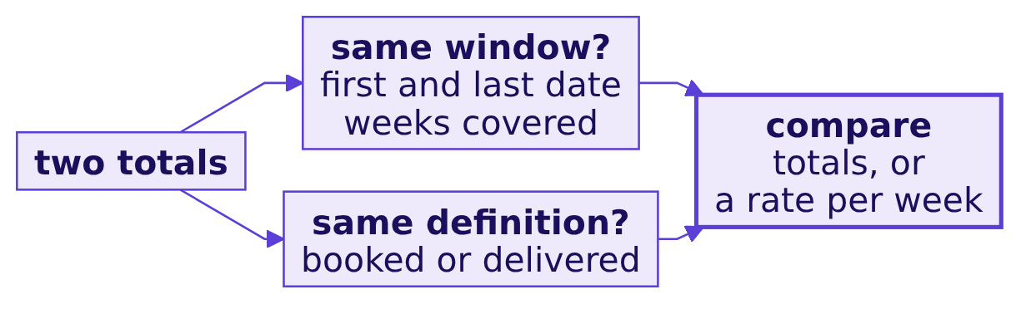
Indian Institute of Technology Gandhinagar
WEEK 1 · DAY 2 · KALPA GLOBAL CAPABILITY CENTRE
ADMINISTERED THROUGH THE COMPETENCY ADVANCEMENT ACADEMY
Like with like means the same window and definition
Two totals compare only when their windows, their definitions and their records match.
THE RULE
When the windows differ, compare the same weeks of each, or a rate per week or per day, and write the window beside the number.
The ask and the thinking
Round 1, is the drop real
Round 2, which branch moved
Round 3, every kind of customer
S8 · 11 / 52
Notes:
LIVE, 3 minutes. Draw this before any code. The window question is always first because it is the
cheapest: two dates per side. The definition is Monday's lesson, and today both sides are booked
orders as exported. Say that a rate per week is the same idea as orders per customer: a numerator,
a denominator and the window it covers.

Slide 12
Indian Institute of Technology Gandhinagar
WEEK 1 · DAY 2 · KALPA GLOBAL CAPABILITY CENTRE
ADMINISTERED THROUGH THE COMPETENCY ADVANCEMENT ACADEMY
Step 1: read each window's first and last date
A loop keeps the earliest and the latest date it has seen, one quarter at a time.
first, last = "9999-12-31", "0000-01-01"
for order in ORDERS:
if order["quarter"] == "Q1":
first = min(first, order["order_date"])
last = max(last, order["order_date"])
print(first, last)
Dates written as year, month, day sort as text in date order, so min and max work on them directly.
The ask and the thinking
Round 1, is the drop real
Round 2, which branch moved
Round 3, every kind of customer
S9 · 12 / 52
Notes:
LIVE, 5 minutes. Type it in notebook 01 with the room. The starting values are chosen so any real
date beats them. Run it for Q1, then change the filter to the dashboard's Q2 window: quarter Q2 and
order_date on or before 2026-09-15. Do not read out the results yet; the next slide asks for a
prediction first.

Slide 13
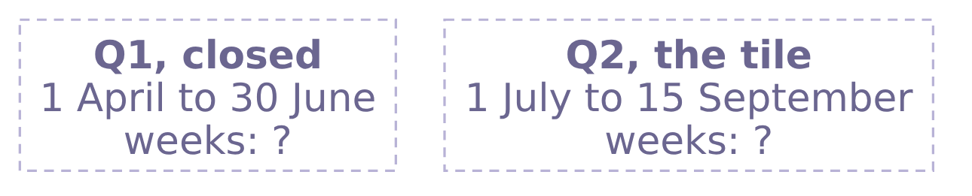
Indian Institute of Technology Gandhinagar
WEEK 1 · DAY 2 · KALPA GLOBAL CAPABILITY CENTRE
ADMINISTERED THROUGH THE COMPETENCY ADVANCEMENT ACADEMY
Question: how many weeks does each side cover
Q1 is the closed quarter; Q2 is the tile as cut on 15 September.
Question. Predict before the loop prints: a) 13 weeks against 13; b) 13 weeks against 11; c) 12 weeks against 12; d) 13 weeks against 9.
The ask and the thinking
Round 1, is the drop real
Round 2, which branch moved
Round 3, every kind of customer
S10 · 13 / 52
Notes:
LIVE, 2 minutes. Take letters. Some will count months and say three against two and a half. The
count in weeks is the one a rate per week needs.

Slide 14
Indian Institute of Technology Gandhinagar
WEEK 1 · DAY 2 · KALPA GLOBAL CAPABILITY CENTRE
ADMINISTERED THROUGH THE COMPETENCY ADVANCEMENT ACADEMY
Answer: 13 weeks against 11
The two totals were never measuring the same stretch of time.
Window | First order | Last order | Weeks covered | Orders | Revenue
Q1, closed | 1 Apr | 27 Jun | 13 | 114 | Rs 2,10,00,000
Q2 tile, cut 15 Sep | 2 Jul | 15 Sep | 11 | 70 | Rs 1,55,59,950
Q2, closed | 2 Jul | 28 Sep | 13 | 86 | Rs 1,87,00,000
The check. First and last order date of each window, and the weeks each one covers, before any total is compared.
The ask and the thinking
Round 1, is the drop real
Round 2, which branch moved
Round 3, every kind of customer
S11 · 14 / 52
Notes:
LIVE, 3 minutes. The answer is b. Q1 runs 1 April to 30 June, 13 weeks and 91 days. The tile runs
1 July to 15 September, 11 weeks. The last row is the closed quarter, which ended on 30 September
and is now in the export. Show the three rows and let the room say what went wrong before the
next slide names it.

Slide 15
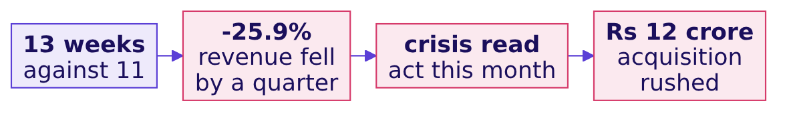

Indian Institute of Technology Gandhinagar
WEEK 1 · DAY 2 · KALPA GLOBAL CAPABILITY CENTRE
ADMINISTERED THROUGH THE COMPETENCY ADVANCEMENT ACADEMY
The wrong answer: revenue fell 25.9 percent
A two-week gap reads as a crisis, and a crisis rushes a budget.
WHAT BREAKS
Two missing weeks look exactly like lost customers, and the decision they would mislead is the largest one on Meera's desk.
The ask and the thinking
Round 1, is the drop real
Round 2, which branch moved
Round 3, every kind of customer
S12 · 15 / 52
Notes:
LIVE, 3 minutes. This is the round's trap, shown exactly. The number is correct arithmetic on the
wrong windows. Name the decision it would have misled: a crisis read that rushes the Rs 12 crore
budget. Ask how many people in the room would have checked the dates before the total.

Slide 16
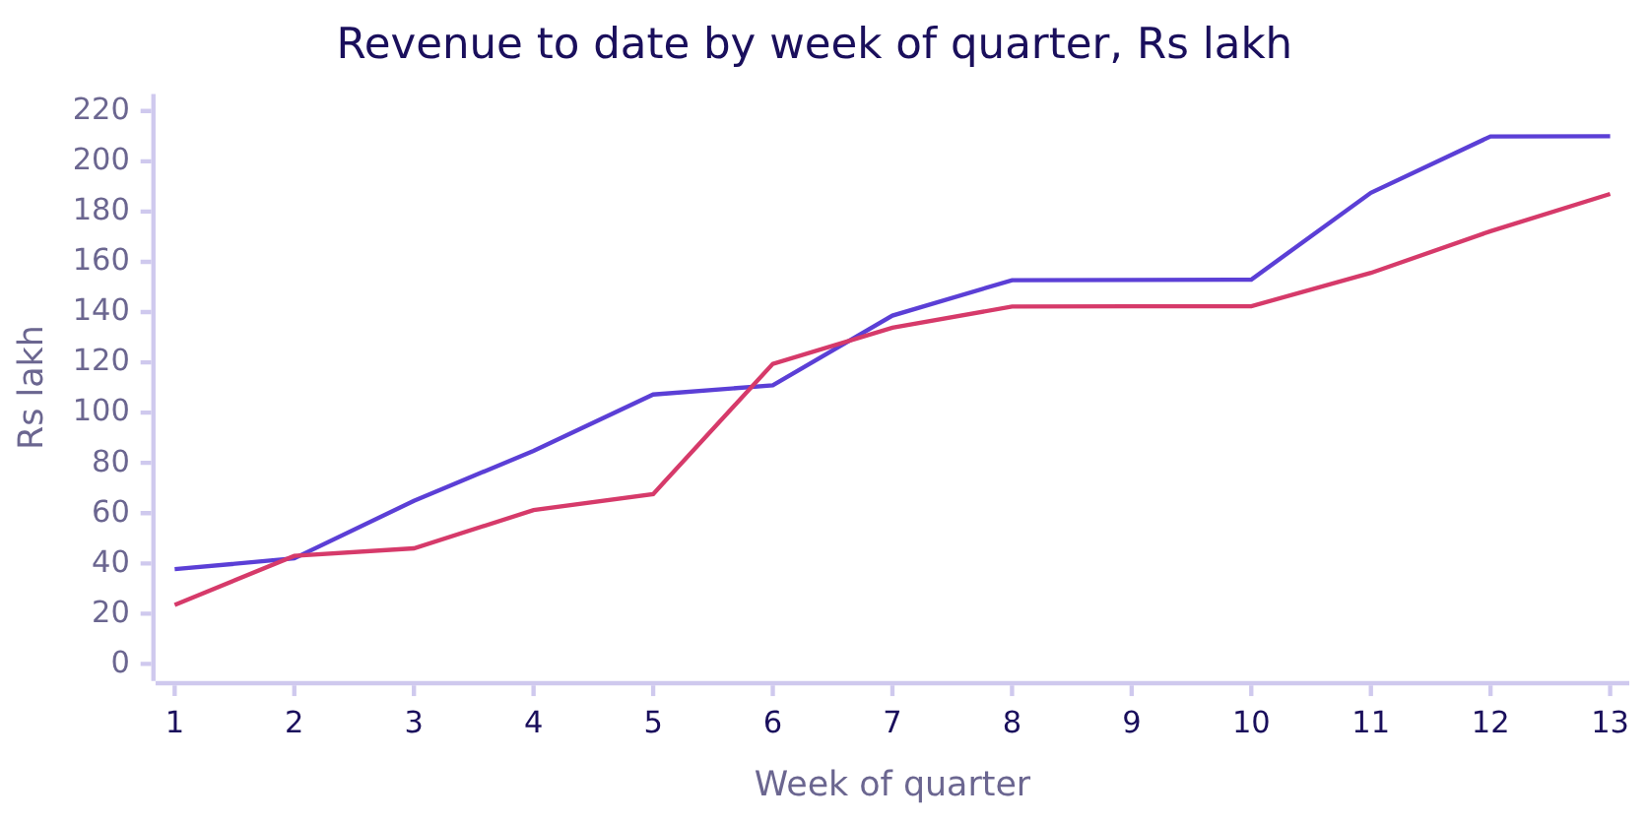
Indian Institute of Technology Gandhinagar
WEEK 1 · DAY 2 · KALPA GLOBAL CAPABILITY CENTRE
ADMINISTERED THROUGH THE COMPETENCY ADVANCEMENT ACADEMY
Cumulative revenue shows where the tile stopped
Q1 reaches Rs 210.0 lakh at week 13; the tile stopped Q2 at week 11, at Rs 155.6 lakh.
Q1 ends at Rs 210.0 lakh and Q2 at Rs 187.0 lakh. At week 11, Q2 stood at Rs 155.6 lakh, which is the tile.
The ask and the thinking
Round 1, is the drop real
Round 2, which branch moved
Round 3, every kind of customer
S13 · 16 / 52
Notes:
LIVE, 4 minutes. The notebook draws the same picture with kit.line and shows the cut. The first
line is Q1 and the second is Q2. The steps show that revenue arrives in lumps: weeks where a large
order lands jump, and weeks without one are flat. That lumpiness is why the harder variant later
gives a different number from the per-week rate.

Slide 17
Indian Institute of Technology Gandhinagar
WEEK 1 · DAY 2 · KALPA GLOBAL CAPABILITY CENTRE
ADMINISTERED THROUGH THE COMPETENCY ADVANCEMENT ACADEMY
Question: the fair change between the quarters
Both quarters have now closed, so both can be compared whole.
Rs 2,10,00,000
Rs 1,87,00,000
Q1, CLOSED
Q2, CLOSED
13 weeks, 114 orders
13 weeks, 86 orders
Question. Predict the change: a) down 25.9 percent; b) down 11.0 percent; c) down 24.6 percent; d) flat, once the weeks match.
The ask and the thinking
Round 1, is the drop real
Round 2, which branch moved
Round 3, every kind of customer
S14 · 17 / 52
Notes:
LIVE, 2 minutes. Option c is the fall in orders, 114 to 86, which a hurried learner reads as the
fall in revenue. Take letters and run the cell.

Slide 18
Indian Institute of Technology Gandhinagar
WEEK 1 · DAY 2 · KALPA GLOBAL CAPABILITY CENTRE
ADMINISTERED THROUGH THE COMPETENCY ADVANCEMENT ACADEMY
Answer: down 11.0 percent, Rs 23,00,000 less
The drop is real, and it is less than half of what the tile said.
Comparison | Q1 | Q2 | Change
Closed quarters, totals | Rs 2,10,00,000 | Rs 1,87,00,000 | -11.0%
Per day, 91 against 92 days | Rs 2,30,769 | Rs 2,03,261 | -11.9%
Per week, Q1 against the tile | Rs 16,15,385 | Rs 14,14,541 | -12.4%
The fix. Once a quarter has closed, compare closed quarters. A rate per week rescues a cut window, and it carries its numerator, its denominator and its window.
The ask and the thinking
Round 1, is the drop real
Round 2, which branch moved
Round 3, every kind of customer
S15 · 18 / 52
Notes:
LIVE, 4 minutes. The answer is b. Say the fix in rupees: the real fall is Rs 23,00,000, and the tile
said Rs 54,40,050. Walk the per-week row as a rate: Rs 2,10,00,000 over 13 weeks, Rs 1,55,59,950
over 11 weeks. A rate without its denominator is a rumour; write "per week, 13 weeks" beside it.
Say once: every number today is on the export as it stands, and tomorrow's work checks that export.

Slide 19
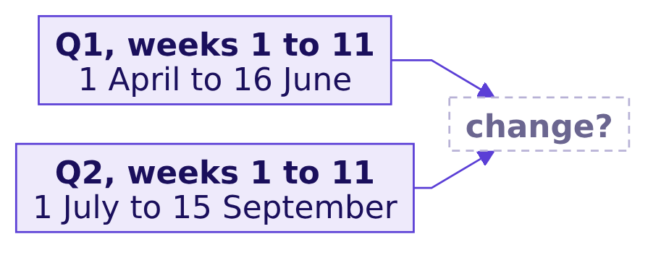
Indian Institute of Technology Gandhinagar
WEEK 1 · DAY 2 · KALPA GLOBAL CAPABILITY CENTRE
ADMINISTERED THROUGH THE COMPETENCY ADVANCEMENT ACADEMY
Question: the same 11 weeks of each quarter
Q1 up to 16 June against Q2 up to 15 September, both 11 weeks long.
Question. The room runs it in notebook 01. Before you run it, predict: a) down 12.4 percent, the same as per week; b) down 17.0 percent; c) down 11.0 percent; d) down 25.9 percent.
The ask and the thinking
Round 1, is the drop real
Round 2, which branch moved
Round 3, every kind of customer
S16 · 19 / 52
Notes:
LIVE, 10 minutes: 8 for the room to run it, 2 to collect letters. This is the harder variant, the
room's own run. Pairs filter Q1 to order_date on or before 2026-06-16 and total it. Circulate and
listen for pairs who reuse the per-week figure without running anything.

Slide 20
Indian Institute of Technology Gandhinagar
WEEK 1 · DAY 2 · KALPA GLOBAL CAPABILITY CENTRE
ADMINISTERED THROUGH THE COMPETENCY ADVANCEMENT ACADEMY
Answer: down 17.0 percent over the same 11 weeks
Matched weeks and the per-week rate disagree, because large orders land unevenly.
Window | Revenue | Orders
Q1, weeks 1 to 11 | Rs 1,87,51,440 | 97
Q2, weeks 1 to 11 | Rs 1,55,59,950 | 70
Change | -17.0% | -27.8%
THE RULE
A quarter-to-date comparison uses the same weeks of both quarters. Once the quarter closes, the closed quarters replace it, because a few large Business orders can land in week 12 as easily as in week 3.
The ask and the thinking
Round 1, is the drop real
Round 2, which branch moved
Round 3, every kind of customer
S17 · 20 / 52
Notes:
LIVE, 4 minutes. The answer is b. The per-week rate assumes revenue arrives evenly, and the
cumulative chart showed it does not: Q1 jumps from Rs 152.9 lakh to Rs 187.5 lakh in week 11
alone. Three numbers now describe one drop: -11.0, -12.4 and -17.0 percent. The honest one for
Meera is the closed quarters, because both are complete.

Slide 21
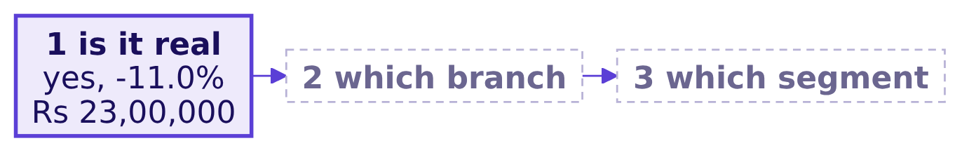


Indian Institute of Technology Gandhinagar
WEEK 1 · DAY 2 · KALPA GLOBAL CAPABILITY CENTRE
ADMINISTERED THROUGH THE COMPETENCY ADVANCEMENT ACADEMY
Kavya's review of round 1
Rung 1 holds: the drop is real, and it is 11.0 percent.
KAVYA'S REVIEW
"Before you explain a fall, prove it with matching windows. Put the dates next to the number, every time."
IN THE INTERVIEW
[F] What has to match before a quarter-on-quarter comparison is fair?
The ask and the thinking
Round 1, is the drop real
Round 2, which branch moved
Round 3, every kind of customer
S18 · 21 / 52
Notes:
LIVE, 3 minutes. One breath for the interview answer: the window's length and its dates, the
definition of the metric, and the population counted; then say you would compare closed quarters
or a rate over the same weeks. Transition: the drop is real, so which branch of the tree moved?

Slide 22
Indian Institute of Technology Gandhinagar
PG DIPLOMA IN AI-ML AND AGENTIC AI ENGINEERING · COHORT 2
ADMINISTERED THROUGH THE COMPETENCY ADVANCEMENT ACADEMY
03
Round 2, which branch moved
The tree meets both quarters, and one branch carries the fall while the one Marketing wants to fund stays flat.
The ask and the thinking
Round 1, is the drop real
Round 2, which branch moved
Round 3, every kind of customer
Week 1 Day 2: which branch moved
22 / 52
Notes:
LIVE. Round 2 runs 50 minutes. Switch to notebooks/C2_W01_D02_02_which_branch_STUDENT.ipynb.

Slide 23
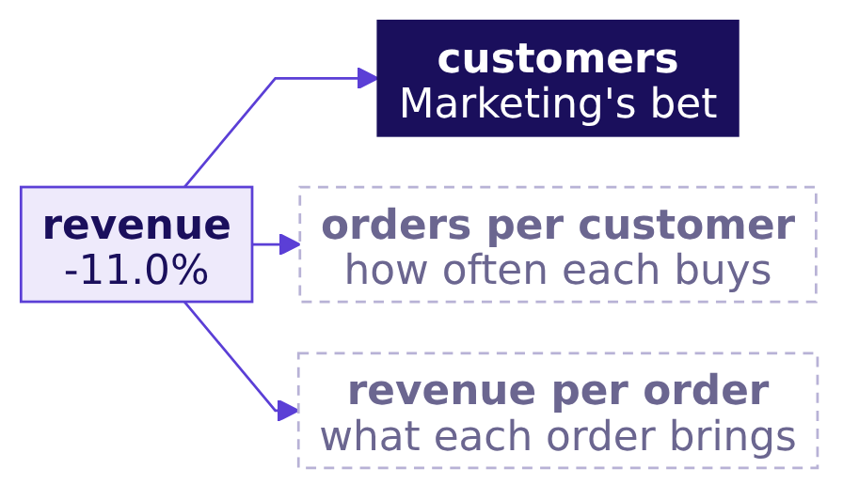
Indian Institute of Technology Gandhinagar
WEEK 1 · DAY 2 · KALPA GLOBAL CAPABILITY CENTRE
ADMINISTERED THROUGH THE COMPETENCY ADVANCEMENT ACADEMY
Marketing bets on customers; Meera wants proof
Three branches, one of them already funded in Marketing's head.
THE CLIENT ASKS
"Are we losing customers, or are the ones we have buying less?"
The ask and the thinking
Round 1, is the drop real
Round 2, which branch moved
Round 3, every kind of customer
S19 · 23 / 52
Notes:
LIVE, 3 minutes. The round's question is Meera's, word for word. Ask the room to predict which
branch moved before any code runs, and write the guesses on the board. They come back at the end
of the round.

Slide 24
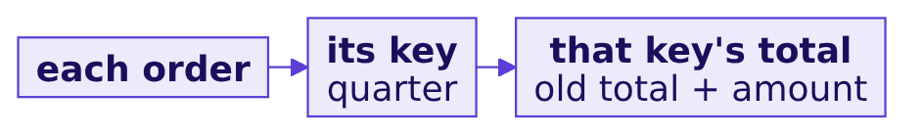
Indian Institute of Technology Gandhinagar
WEEK 1 · DAY 2 · KALPA GLOBAL CAPABILITY CENTRE
ADMINISTERED THROUGH THE COMPETENCY ADVANCEMENT ACADEMY
Group by key with a dictionary accumulator
One pass over the orders fills a total for every quarter at once.
revenue_by_q = {}
for order in ORDERS:
q = order["quarter"]
revenue_by_q[q] = revenue_by_q.get(q, 0) + order["amount"]
print(revenue_by_q) # {'Q1': 21000000, 'Q2': 18700000}
The ask and the thinking
Round 1, is the drop real
Round 2, which branch moved
Round 3, every kind of customer
S20 · 24 / 52
Notes:
LIVE, 5 minutes. Monday's accumulator, with one change: a dictionary holds one total per key.
get(q, 0) is a decision, and here it is the right one: a quarter with no orders yet has summed to
zero. Keep that sentence; the discount branch will test whether zero is always the right default.
Have the room type it, then change the key to segment and back.

Slide 25
Indian Institute of Technology Gandhinagar
WEEK 1 · DAY 2 · KALPA GLOBAL CAPABILITY CENTRE
ADMINISTERED THROUGH THE COMPETENCY ADVANCEMENT ACADEMY
Step 2: count orders and customers per quarter
Orders are rows; customers are distinct ids, counted with Monday's seen list.
customers = {"Q1": [], "Q2": []}
for order in ORDERS:
q, cid = order["quarter"], order["customer_id"]
if cid not in customers[q]:
customers[q].append(cid)
print(len(customers["Q1"]), len(customers["Q2"]))
Quarter | Orders | Customers
Q1 | 114 | 69
Q2 | 86 | ?
The ask and the thinking
Round 1, is the drop real
Round 2, which branch moved
Round 3, every kind of customer
S21 · 25 / 52
Notes:
LIVE, 4 minutes. Type it and run it only for Q1. Q2's customer count is the next slide's
prediction, so cover the output or run the Q1 half alone.

Slide 26
Indian Institute of Technology Gandhinagar
WEEK 1 · DAY 2 · KALPA GLOBAL CAPABILITY CENTRE
ADMINISTERED THROUGH THE COMPETENCY ADVANCEMENT ACADEMY
Question: how many customers bought in Q2
Orders fell from 114 to 86, and Marketing says customers are the problem.
69
86
Q1 CUSTOMERS
Q2 ORDERS
distinct ids, 1 April to 30 June
down from 114
Question. Predict Q2's customer count: a) 52, since orders fell by a quarter; b) 69; c) 81; d) 86.
The ask and the thinking
Round 1, is the drop real
Round 2, which branch moved
Round 3, every kind of customer
S22 · 26 / 52
Notes:
LIVE, 2 minutes. Option d is the rows-as-customers trap from Monday. Option a is Marketing's story
carried through. Take letters, then run the cell.

Slide 27
Indian Institute of Technology Gandhinagar
WEEK 1 · DAY 2 · KALPA GLOBAL CAPABILITY CENTRE
ADMINISTERED THROUGH THE COMPETENCY ADVANCEMENT ACADEMY
Answer: 69 customers in both quarters
The branch Marketing wants to fund did not move.
69
69
0.0%
Q1 CUSTOMERS
Q2 CUSTOMERS
CHANGE IN CUSTOMERS
114 orders
86 orders
the acquisition branch
The claim. Customers held at 69, so the fall sits in how often they buy or in what each order brings.
The ask and the thinking
Round 1, is the drop real
Round 2, which branch moved
Round 3, every kind of customer
S23 · 27 / 52
Notes:
LIVE, 3 minutes. The answer is b. Let the silence land: Marketing's branch is flat. Do not go
further than the count today. Whether these are the same 69 people is a sharper question that
the afternoon answers; a flat count alone does not prove nobody left.

Slide 28
Indian Institute of Technology Gandhinagar
WEEK 1 · DAY 2 · KALPA GLOBAL CAPABILITY CENTRE
ADMINISTERED THROUGH THE COMPETENCY ADVANCEMENT ACADEMY
The tree says frequency moved and order value rose
Customers flat, orders per customer down a quarter, revenue per order up.
Branch | Q1 | Q2 | Change
Customers | 69 | 69 | 0.0%
Orders per customer | 1.65 (114 over 69) | 1.25 (86 over 69) | -24.6%
Revenue per order | Rs 1,84,211 | Rs 2,17,442 | +18.0%
Revenue | Rs 2,10,00,000 | Rs 1,87,00,000 | -11.0%
The check. The branches multiply back to revenue: 1.000 times 0.754 times 1.180 is 0.890, and Rs 1.87 crore over Rs 2.10 crore is 0.890.
The ask and the thinking
Round 1, is the drop real
Round 2, which branch moved
Round 3, every kind of customer
S24 · 28 / 52
Notes:
LIVE, 5 minutes. Fill the tree on the board with these numbers. The product check is the proof
that the decomposition is complete: if it does not multiply back, a branch is missing. Revenue per
customer went from Rs 3,04,348 to Rs 2,71,014, which is the two lower branches together.
Leave revenue per order rising for the afternoon: whether prices went up is a trap of its own.

Slide 29
Indian Institute of Technology Gandhinagar
WEEK 1 · DAY 2 · KALPA GLOBAL CAPABILITY CENTRE
ADMINISTERED THROUGH THE COMPETENCY ADVANCEMENT ACADEMY
In rupees, frequency cost Rs 51.6 lakh
The revenue bridge moves one branch at a time from Q1 to Q2.
Frequency lost 28 orders at Q1's Rs 1,84,211 each; the remaining 86 orders each brought Rs 33,231 more.
The ask and the thinking
Round 1, is the drop real
Round 2, which branch moved
Round 3, every kind of customer
S25 · 29 / 52
Notes:
LIVE, 4 minutes. The notebook draws this with kit.bridge. Walk the arithmetic: 69 customers times
the change in orders per customer is 28 fewer orders, times Q1's revenue per order is Rs 51,57,895.
Then 86 orders times Rs 33,231 is Rs 28,57,895. The two sum to the Rs 23,00,000 fall.

Slide 30
Indian Institute of Technology Gandhinagar
WEEK 1 · DAY 2 · KALPA GLOBAL CAPABILITY CENTRE
ADMINISTERED THROUGH THE COMPETENCY ADVANCEMENT ACADEMY
The discount branch stops on a KeyError
Some orders carry no discount field, so asking for it by name stops the loop.
given = 0
for order in ORDERS:
given += order["discount"]
KeyError: 'discount'
The ask and the thinking
Round 1, is the drop real
Round 2, which branch moved
Round 3, every kind of customer
S26 · 30 / 52
Notes:
LIVE, 2 minutes, and no more. This is a runtime error: read the last line, which names the key,
and move on. The notebook shows it with kit.expect_error. try/except is one way through and
appears in the notebook in passing; the decision that matters is on the next slide, and it is what
to do about the orders without the field.

Slide 31
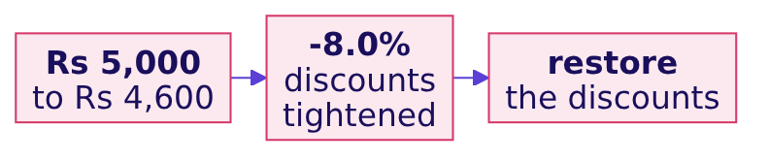
Indian Institute of Technology Gandhinagar
WEEK 1 · DAY 2 · KALPA GLOBAL CAPABILITY CENTRE
ADMINISTERED THROUGH THE COMPETENCY ADVANCEMENT ACADEMY
The wrong answer: discounts fell 8.0 percent
Reading a missing discount as zero gives a total, a story and a decision.
given = 0
for order in quarter_rows:
given += order.get("discount", 0)
The ask and the thinking
Round 1, is the drop real
Round 2, which branch moved
Round 3, every kind of customer
S27 · 31 / 52
Notes:
LIVE, 4 minutes. This is the round's trap. The hurried fix silences the error, and the story
writes itself: discounts fell 8.0 percent, members pulled back, so restore the discounts. Name the
decision it would mislead. Ask what the zero means: did the order get no discount, or did nobody
record one? Nobody in the room can say, and that is the lesson.

Slide 32
Indian Institute of Technology Gandhinagar
WEEK 1 · DAY 2 · KALPA GLOBAL CAPABILITY CENTRE
ADMINISTERED THROUGH THE COMPETENCY ADVANCEMENT ACADEMY
Why it is wrong: an absent field is unknown
Three invented orders show what reading absent as zero does to an average.
Invented order | Discount field | Read as zero | Recorded only
A | Rs 100 | Rs 100 | Rs 100
B | Rs 0 | Rs 0 | Rs 0
C | absent | Rs 0 | left out
Average |  | Rs 33 | Rs 50
WHAT BREAKS
Read as zero, every unrecorded order pulls the average down, and the total becomes a floor that nobody labelled as one.
The ask and the thinking
Round 1, is the drop real
Round 2, which branch moved
Round 3, every kind of customer
S28 · 32 / 52
Notes:
LIVE, 3 minutes. These three orders are invented to show the mechanism. Order B is a real zero:
someone recorded that no discount was given. Order C is unknown. The two are different facts, and
get with a default of zero erases the difference.

Slide 33
Indian Institute of Technology Gandhinagar
WEEK 1 · DAY 2 · KALPA GLOBAL CAPABILITY CENTRE
ADMINISTERED THROUGH THE COMPETENCY ADVANCEMENT ACADEMY
Question: the average where a discount is recorded
Q1 averages Rs 60.98 per order that records one; predict Q2.
Rs 43.86
Rs 53.49
Rs 60.98
Q1, ABSENT READ AS ZERO
Q2, ABSENT READ AS ZERO
Q1, RECORDED ONLY
per order
per order
per order that records it
Question. Predict Q2's average over orders that record a discount: a) Rs 53.49, the same; b) Rs 46.00, down; c) Rs 60.98, flat; d) Rs 76.67, up.
The ask and the thinking
Round 1, is the drop real
Round 2, which branch moved
Round 3, every kind of customer
S29 · 33 / 52
Notes:
LIVE, 3 minutes. Before running, the room counts the orders that record the field in each quarter
in the empty your-turn cell of notebook 02. Nobody reads a count aloud; each learner has their own.
Then take letters.

Slide 34
Indian Institute of Technology Gandhinagar
WEEK 1 · DAY 2 · KALPA GLOBAL CAPABILITY CENTRE
ADMINISTERED THROUGH THE COMPETENCY ADVANCEMENT ACADEMY
Answer: up 25.7 percent, the opposite direction
Counted where it is recorded, the average discount rose.
Reading | Q1 | Q2 | Change
Total, absent read as zero | Rs 5,000 | Rs 4,600 | -8.0%
Average, absent read as zero | Rs 43.86 | Rs 53.49 | up
Average, recorded only | Rs 60.98 | Rs 76.67 | +25.7%
The check. Count the orders that record the field, and average only over those; then say how many orders the average rests on.
The ask and the thinking
Round 1, is the drop real
Round 2, which branch moved
Round 3, every kind of customer
S30 · 34 / 52
Notes:
LIVE, 3 minutes. The answer is d. The total fell because fewer Q2 orders exist and some carry no
field; where discounts were recorded, they got larger. The story and its decision flipped. Ask a
learner to say the count they found and what it means for how far to trust any discount figure.

Slide 35
Indian Institute of Technology Gandhinagar
WEEK 1 · DAY 2 · KALPA GLOBAL CAPABILITY CENTRE
ADMINISTERED THROUGH THE COMPETENCY ADVANCEMENT ACADEMY
The fix: write the default, then bound the branch
The largest recorded discount caps what this branch could possibly explain.
Rs 150
Rs 12,900
Rs 23,00,000
LARGEST RECORDED DISCOUNT
THE MOST Q2 COULD GIVE
THE FALL TO EXPLAIN
on any order in the file
86 orders at Rs 150 each
Q1 to Q2
The fix. "Absent means not recorded; reported separately; never summed as zero." Even at Rs 150 on every Q2 order, discounts could explain Rs 12,900 of a Rs 23,00,000 fall, so the discount branch did not move revenue.
The ask and the thinking
Round 1, is the drop real
Round 2, which branch moved
Round 3, every kind of customer
S31 · 35 / 52
Notes:
LIVE, 4 minutes. Two moves. First, the decision is written down beside the number, with its
reason. Second, a bound: when a branch is uncertain, ask how large it could possibly be. Here the
worst case is under one percent of the fall, so the branch closes without anyone guessing.

Slide 36
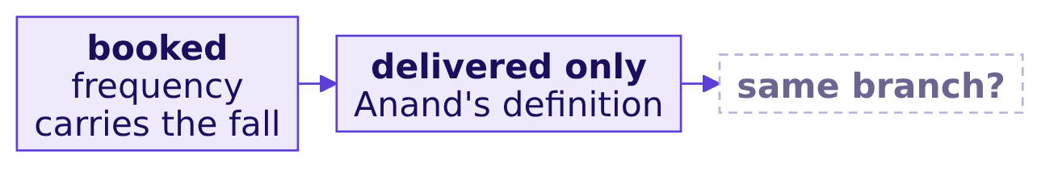
Indian Institute of Technology Gandhinagar
WEEK 1 · DAY 2 · KALPA GLOBAL CAPABILITY CENTRE
ADMINISTERED THROUGH THE COMPETENCY ADVANCEMENT ACADEMY
Question: the tree on delivered orders only
Anand counts only delivered orders; does the story survive his definition?
Question. Run the tree on delivered orders in notebook 02, then say which branch carries the fall: a) customers; b) orders per customer; c) revenue per order; d) no branch, the fall disappears.
The ask and the thinking
Round 1, is the drop real
Round 2, which branch moved
Round 3, every kind of customer
S32 · 36 / 52
Notes:
LIVE, 12 minutes: 10 for the room's run, 2 to collect. This is the harder variant. Pairs add one
filter, status equal to delivered, to both quarters and rebuild all three branches. Watch for pairs
who filter one quarter and forget the other.

Slide 37
Indian Institute of Technology Gandhinagar
WEEK 1 · DAY 2 · KALPA GLOBAL CAPABILITY CENTRE
ADMINISTERED THROUGH THE COMPETENCY ADVANCEMENT ACADEMY
Answer: frequency still carries the fall
On delivered orders, fewer customers appear, and orders per customer still falls hardest.
Branch, delivered only | Q1 | Q2 | Change
Revenue | Rs 1,45,04,970 | Rs 1,28,64,680 | -11.3%
Customers | 54 | 50 | -7.4%
Orders per customer | 1.50 | 1.14 | -24.0%
Revenue per order | Rs 1,79,074 | Rs 2,25,696 | +26.0%
KAVYA'S REVIEW
"The branch that moved is orders per customer, on booked and on delivered. A definition change that leaves the answer standing makes the answer stronger."
The ask and the thinking
Round 1, is the drop real
Round 2, which branch moved
Round 3, every kind of customer
S33 · 37 / 52
Notes:
LIVE, 4 minutes. The answer is b. Customers do dip on this definition, and a sharp learner will
say so; the dip is smaller than the fall in frequency, which survives both definitions.
Interview questions for this round: [S] Why is a rate without a denominator meaningless? [S] A
field is missing on some records; do you fill it with zero? One breath each, in the day sheet.
Break for 10 minutes after this slide.

Slide 38
Indian Institute of Technology Gandhinagar
PG DIPLOMA IN AI-ML AND AGENTIC AI ENGINEERING · COHORT 2
ADMINISTERED THROUGH THE COMPETENCY ADVANCEMENT ACADEMY
04
Round 3, every kind of customer
The same tree for every segment and quarter means writing it once, as a function that returns its answer.
The ask and the thinking
Round 1, is the drop real
Round 2, which branch moved
Round 3, every kind of customer
Week 1 Day 2: which branch moved
38 / 52
Notes:
LIVE. Round 3 runs 50 minutes after the break. Switch to
notebooks/C2_W01_D02_03_which_segment_STUDENT.ipynb.

Slide 39
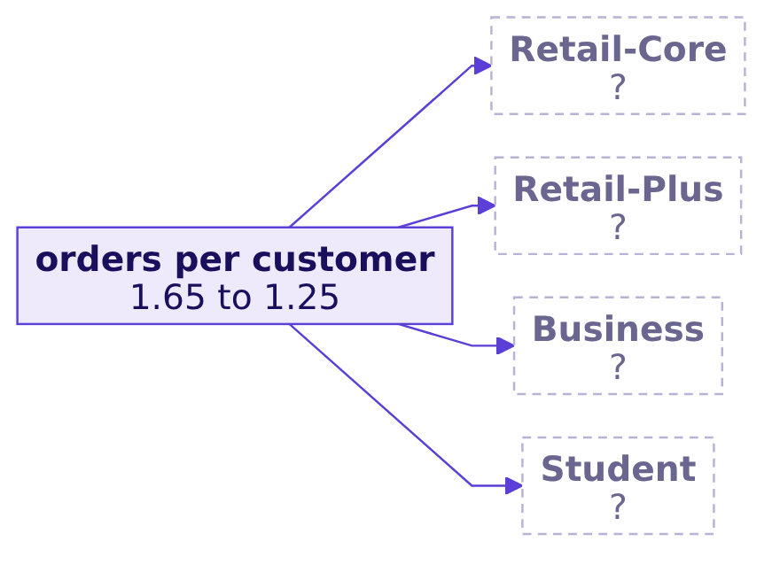
Indian Institute of Technology Gandhinagar
WEEK 1 · DAY 2 · KALPA GLOBAL CAPABILITY CENTRE
ADMINISTERED THROUGH THE COMPETENCY ADVANCEMENT ACADEMY
Is the fall in every kind of customer
Four segments, two quarters, and the head of Retail-Plus asking about his tier.
THE CLIENT ASKS
The head of Retail-Plus wants to know whether his tier is the one slipping, and Meera wants to know whether it is everyone.
The ask and the thinking
Round 1, is the drop real
Round 2, which branch moved
Round 3, every kind of customer
S34 · 39 / 52
Notes:
LIVE, 2 minutes. Eight trees are needed: four segments, two quarters. Ask how many times the room
wants to paste the round 2 code. Nobody does, which is why functions arrive now.

Slide 40
Indian Institute of Technology Gandhinagar
WEEK 1 · DAY 2 · KALPA GLOBAL CAPABILITY CENTRE
ADMINISTERED THROUGH THE COMPETENCY ADVANCEMENT ACADEMY
A function applies one decision everywhere
tree_for takes any group of orders and returns the whole tree for it.
def tree_for(rows):
revenue, ids = 0, []
for order in rows:
revenue += order["amount"]
if order["customer_id"] not in ids:
ids.append(order["customer_id"])
return {"revenue": revenue, "orders": len(rows),
"customers": len(ids),
"orders_per_customer": len(rows) / len(ids),
"revenue_per_order": revenue / len(rows)}
The ask and the thinking
Round 1, is the drop real
Round 2, which branch moved
Round 3, every kind of customer
S35 · 40 / 52
Notes:
LIVE, 6 minutes. Build it line by line with the room. Name the parts: def, the parameter rows, the
body, and return, which hands the dictionary back to whoever called it. One definition of a
customer now lives in one place, so a change to it changes every segment and quarter together.

Slide 41
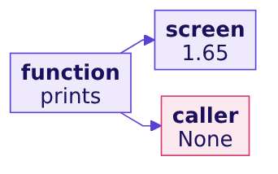
Indian Institute of Technology Gandhinagar
WEEK 1 · DAY 2 · KALPA GLOBAL CAPABILITY CENTRE
ADMINISTERED THROUGH THE COMPETENCY ADVANCEMENT ACADEMY
A function that prints hands back None
Printing shows a number to you; returning hands it to the next line of code.
def orders_per_customer(rows):
print(len(rows) / count_customers(rows))
result = orders_per_customer(q1_rows) # 1.6521739130434783 is printed
print(result) # None
The ask and the thinking
Round 1, is the drop real
Round 2, which branch moved
Round 3, every kind of customer
S36 · 41 / 52
Notes:
LIVE, 3 minutes, in passing. A function with no return hands back None. It looks right on screen
and breaks the next step silently. Keep this in mind for the afternoon: a colleague's helper will
test it. Interview question [F] lives here: why does a function that prints instead of returning
break a pipeline?

Slide 42
Indian Institute of Technology Gandhinagar
WEEK 1 · DAY 2 · KALPA GLOBAL CAPABILITY CENTRE
ADMINISTERED THROUGH THE COMPETENCY ADVANCEMENT ACADEMY
Step 3: tree_for reproduces round 2
Before trusting the function on segments, run it where the answer is known.
tree_for on | Orders | Customers | Orders per customer | Revenue per order
All of Q1 | 114 | 69 | 1.65 | Rs 1,84,211
All of Q2 | 86 | 69 | 1.25 | Rs 2,17,442
The check. A new function earns trust by reproducing a number you already proved another way.
The ask and the thinking
Round 1, is the drop real
Round 2, which branch moved
Round 3, every kind of customer
S37 · 42 / 52
Notes:
LIVE, 3 minutes. The notebook's check cell compares these to round 2's numbers and passes. This is
the habit: test the function where you know the answer, then use it where you do not.

Slide 43
Indian Institute of Technology Gandhinagar
WEEK 1 · DAY 2 · KALPA GLOBAL CAPABILITY CENTRE
ADMINISTERED THROUGH THE COMPETENCY ADVANCEMENT ACADEMY
describe gives each group a typical value and spread
The median, the smallest, the largest and the range, returned as one dictionary.
def describe(amounts):
s = sorted(amounts)
n = len(s)
if n % 2 == 1:
median = s[n // 2]
else:
median = (s[n // 2 - 1] + s[n // 2]) / 2
return {"median": median, "min": s[0], "max": s[-1],
"range": s[-1] - s[0]}
The ask and the thinking
Round 1, is the drop real
Round 2, which branch moved
Round 3, every kind of customer
S38 · 43 / 52
Notes:
LIVE, 4 minutes. Monday's median by hand, now inside a function. Anand's warning returns: one
large Business order can move an average, so each group gets a typical value and its spread,
never a mean alone.

Slide 44
Indian Institute of Technology Gandhinagar
WEEK 1 · DAY 2 · KALPA GLOBAL CAPABILITY CENTRE
ADMINISTERED THROUGH THE COMPETENCY ADVANCEMENT ACADEMY
Step 4: two segments, both quarters
Retail-Core and Business, run through tree_for.
Segment, quarter | Orders | Customers | Orders per customer | Revenue
Retail-Core, Q1 | 38 | 34 | 1.12 | Rs 80,460
Retail-Core, Q2 | 36 | 34 | 1.06 | Rs 72,510
Business, Q1 | 20 | 11 | 1.82 | Rs 2,07,71,180
Business, Q2 | 17 | 11 | 1.55 | Rs 1,85,41,460
Two segments run here, and the other two are yours in the last run of the round.
The ask and the thinking
Round 1, is the drop real
Round 2, which branch moved
Round 3, every kind of customer
S39 · 44 / 52
Notes:
LIVE, 5 minutes. Two calls per segment, one per quarter. Retail-Core barely moves in frequency;
Business falls from 1.82 to 1.55. Business revenue is almost all of the company's revenue, which
is why its three lost orders matter in rupees. Do not run Retail-Plus or Student on the projector.

Slide 45
Indian Institute of Technology Gandhinagar
WEEK 1 · DAY 2 · KALPA GLOBAL CAPABILITY CENTRE
ADMINISTERED THROUGH THE COMPETENCY ADVANCEMENT ACADEMY
Question: what did Business orders look like in Q2
Q1's median Business order was Rs 9,83,780, with a range of Rs 15,80,940.
Rs 9,83,780
Rs 15,80,940
Q1 MEDIAN
Q1 RANGE
Business, 20 orders
Rs 2,03,060 to Rs 17,84,000
Question. Predict describe for Business in Q2: a) the median and the range both fall; b) the median barely moves and the range nearly doubles; c) the median doubles; d) nothing changes.
The ask and the thinking
Round 1, is the drop real
Round 2, which branch moved
Round 3, every kind of customer
S40 · 45 / 52
Notes:
LIVE, 2 minutes. Take letters, then run describe on Business Q2.

Slide 46
Indian Institute of Technology Gandhinagar
WEEK 1 · DAY 2 · KALPA GLOBAL CAPABILITY CENTRE
ADMINISTERED THROUGH THE COMPETENCY ADVANCEMENT ACADEMY
Answer: the median held, one order doubled the range
A typical Business order barely changed; one large order stretched the spread.
describe | Median | Min | Max | Range
Retail-Core, Q1 | Rs 2,325 | Rs 860 | Rs 3,000 | Rs 2,140
Retail-Core, Q2 | Rs 2,080 | Rs 890 | Rs 2,950 | Rs 2,060
Business, Q1 | Rs 9,83,780 | Rs 2,03,060 | Rs 17,84,000 | Rs 15,80,940
Business, Q2 | Rs 9,52,000 | Rs 2,17,000 | Rs 29,45,460 | Rs 27,28,460
The claim. Business orders are the same size as before, and fewer of them; one order of Rs 29,45,460 is the outlier to name.
The ask and the thinking
Round 1, is the drop real
Round 2, which branch moved
Round 3, every kind of customer
S41 · 46 / 52
Notes:
LIVE, 3 minutes. The answer is b. A mean would have hidden this: the one large order lifts it
while the typical order fell slightly. Sorted values in the notebook show the order sitting alone
at the top.

Slide 47
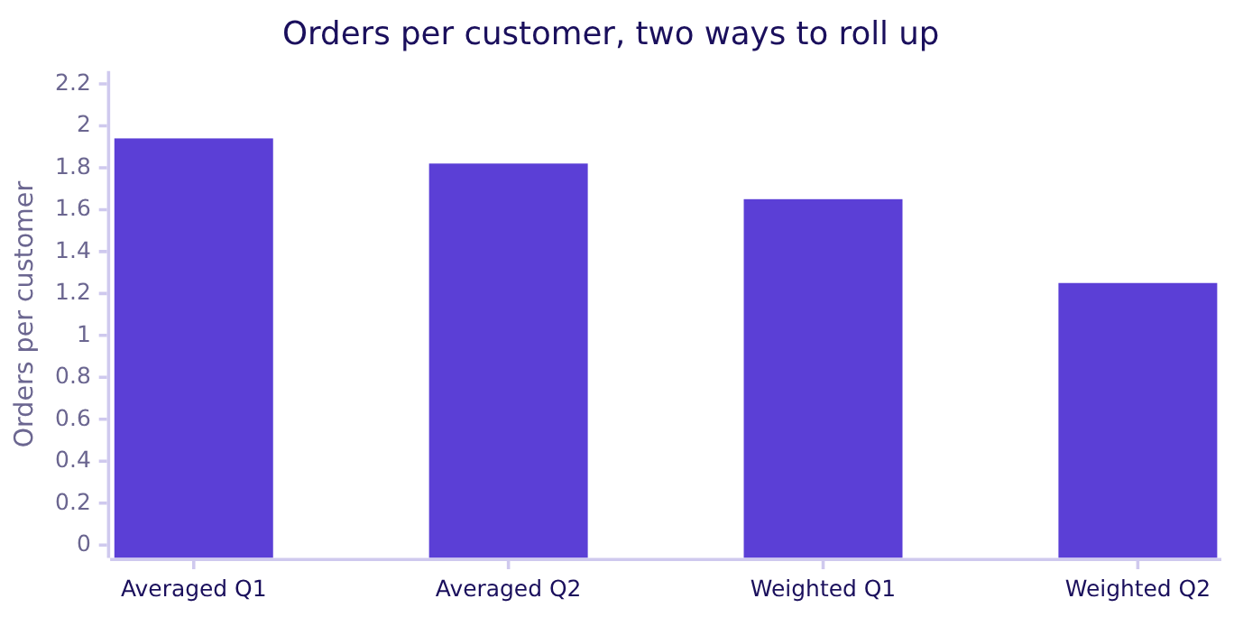
Indian Institute of Technology Gandhinagar
WEEK 1 · DAY 2 · KALPA GLOBAL CAPABILITY CENTRE
ADMINISTERED THROUGH THE COMPETENCY ADVANCEMENT ACADEMY
The wrong answer: frequency fell only 6.0 percent
Averaging the four segments' orders per customer gives a softer story.
WHAT BREAKS
Averaged, the four segments say 1.94 to 1.82, a fall of 6.0 percent: "frequency is not the branch, and Marketing may be right".
The ask and the thinking
Round 1, is the drop real
Round 2, which branch moved
Round 3, every kind of customer
S42 · 47 / 52
Notes:
LIVE, 4 minutes. This is the round's trap. The room computes each segment's orders per customer,
adds the four and divides by four. The average is correct arithmetic and the wrong question. Do
not show the per-segment rows; only the two averages and the weighted figures appear. Name the
decision it would mislead: the acquisition budget goes back on the table.

Slide 48
Indian Institute of Technology Gandhinagar
WEEK 1 · DAY 2 · KALPA GLOBAL CAPABILITY CENTRE
ADMINISTERED THROUGH THE COMPETENCY ADVANCEMENT ACADEMY
Why it is wrong: each group counts once
Thirty invented customers and two invented customers get the same vote.
Invented group | Customers | Orders per customer | Orders
Large | 30 | 1.1 | 33
Small | 2 | 3.5 | 7
Average of the two |  | 2.30
Weighted, 40 over 32 | 32 | 1.25 | 40
The check. The roll-up must reproduce the company figure from round 2, 1.65 and 1.25, and the averaged one does not.
The ask and the thinking
Round 1, is the drop real
Round 2, which branch moved
Round 3, every kind of customer
S43 · 48 / 52
Notes:
LIVE, 3 minutes. The invented example shows the mechanism: two small-group customers pull the
average towards their rate. In the real file Student has 2 customers and Retail-Core has 34, and
each counts once in the average of averages.

Slide 49
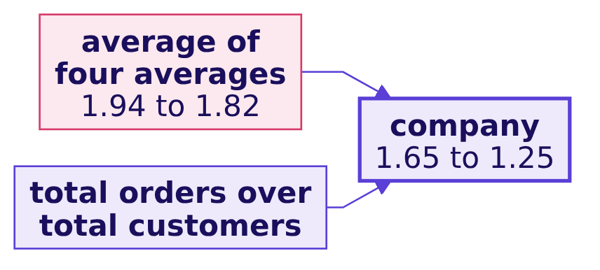
Indian Institute of Technology Gandhinagar
WEEK 1 · DAY 2 · KALPA GLOBAL CAPABILITY CENTRE
ADMINISTERED THROUGH THE COMPETENCY ADVANCEMENT ACADEMY
Question: which roll-up reproduces the company
Two ways to turn four segments into one orders-per-customer figure.
Question. Which roll-up reproduces 1.65 and 1.25: a) the average of the four averages; b) total orders over total customers; c) the median of the four; d) the largest segment's figure.
The ask and the thinking
Round 1, is the drop real
Round 2, which branch moved
Round 3, every kind of customer
S44 · 49 / 52
Notes:
LIVE, 2 minutes. Take letters. Most rooms are ready for b by now; ask one learner why.

Slide 50
Indian Institute of Technology Gandhinagar
WEEK 1 · DAY 2 · KALPA GLOBAL CAPABILITY CENTRE
ADMINISTERED THROUGH THE COMPETENCY ADVANCEMENT ACADEMY
Answer: weighted, frequency fell 24.6 percent
Total orders over total customers gives the company figure back.
1.94 to 1.82
1.65 to 1.25
AVERAGED AVERAGES
WEIGHTED BY CUSTOMERS
-6.0%, the wrong roll-up
-24.6%, the company figure
The fix. Roll a rate up with its weights: 114 orders over 69 customers, then 86 over 69. The fall is 24.6 percent, and frequency is the branch.
The ask and the thinking
Round 1, is the drop real
Round 2, which branch moved
Round 3, every kind of customer
S45 · 50 / 52
Notes:
LIVE, 3 minutes. The answer is b. The weighted figure is round 2's number, which is the proof.
Interview question [F]: you have orders per customer for four segments; why can't you average them
for the company figure? One breath: each segment's rate is weighted by its customers, and an
average gives two customers the same vote as thirty-four.

Slide 51
Indian Institute of Technology Gandhinagar
WEEK 1 · DAY 2 · KALPA GLOBAL CAPABILITY CENTRE
ADMINISTERED THROUGH THE COMPETENCY ADVANCEMENT ACADEMY
Your run: all four segments, both quarters
tree_for and describe on every segment, and one sentence to the head of Retail-Plus.
STEP 1
STEP 2
STEP 3
STEP 4
Four segments in
Four rows out
Weighted roll-up
One sentence
Group the orders by segment and by quarter with a dictionary.
Call tree_for on each group, and count the rows that come back.
Check that the segments reproduce 1.65 and 1.25.
Name the segment whose orders per customer moved most, with its numbers.
The ask and the thinking
Round 1, is the drop real
Round 2, which branch moved
Round 3, every kind of customer
S46 · 51 / 52
Notes:
LIVE, 15 minutes. The room's harder variant, in the empty your-turn cells of notebook 03. The
trainer does not run it on the projector and does not confirm any segment aloud. Walk the room.
Listen for pairs who count four groups in and four rows out; the afternoon's helper tests exactly
that habit. Collect two sentences read aloud without comment; the afternoon opens on them.

Slide 52
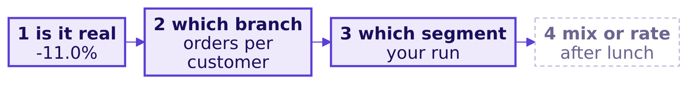
Indian Institute of Technology Gandhinagar
WEEK 1 · DAY 2 · KALPA GLOBAL CAPABILITY CENTRE
ADMINISTERED THROUGH THE COMPETENCY ADVANCEMENT ACADEMY
Kavya's review of round 3
Three rungs climbed, and the morning ends with a segment in your own notebook.
KAVYA'S REVIEW
"A function returns its answer; count the groups in and the groups out. Roll a rate up with its weights."
IN THE INTERVIEW
[F] Why does a function that prints instead of returning break a pipeline?
The ask and the thinking
Round 1, is the drop real
Round 2, which branch moved
Round 3, every kind of customer
S47 · 52 / 52
Notes:
LIVE, 2 minutes, then lunch. One breath: the caller receives None, the next step either crashes
or silently drops that group, and nobody sees it because the screen looked right. Transition to
the afternoon: Meera escalates the case, and a colleague's helper is waiting in it.

