Slide 1
SECTION A. The ask
Week 0, Day 3. Half one: the librarian's log
1 / 21

Slide 2
S1
Every book that goes out is logged
The college librarian, before the term review:
"Every book that goes out is logged. Before the term review I need how many issues we had, which department borrows most, and how many days late books came back. And I need the same numbers every week."
You are the one person in the building who can write Python. The log holds one row per book lent out.
Week 0, Day 3. Half one: the librarian's log
2 / 21

Slide 3
S2
Four questions, one way of answering them
The librarian asks | Python needs
How many issues? | A count
Which department borrows most? | A count per department
How many days late? | A sum of the days past the loan
The same numbers every week | A function that returns each answer
Week 0, Day 3. Half one: the librarian's log
3 / 21

Slide 4
SECTION B. Values and records
Week 0, Day 3. Half one: the librarian's log
4 / 21

Slide 5
S3
Every value has a type, and the type decides
Value | Type | What * does to it
12 | int | Multiplies
3.5 | float | Multiplies, and keeps the decimal
"12" | str | Repeats the text
True | bool | Counts as 1
type(12) names the type of any value. Every surprise in this half starts with a value whose type you guessed.
Week 0, Day 3. Half one: the librarian's log
5 / 21

Slide 6
D4
What does this line print?
DEPTH
Question. Write the four values before anything runs.
print("5" * 2, 5 * 2, 7 / 2, 7 // 2)
Week 0, Day 3. Half one: the librarian's log
6 / 21

Slide 7
D5
Answer: 55 10 3.5 3
DEPTH
55 10 3.5 3
"5" * 2 repeats the text. 5 * 2 multiplies. 7 / 2 always gives a float. 7 // 2 divides and drops the remainder.
The same symbol did four different things, because four values carried their types in with them.
Week 0, Day 3. Half one: the librarian's log
7 / 21

Slide 8
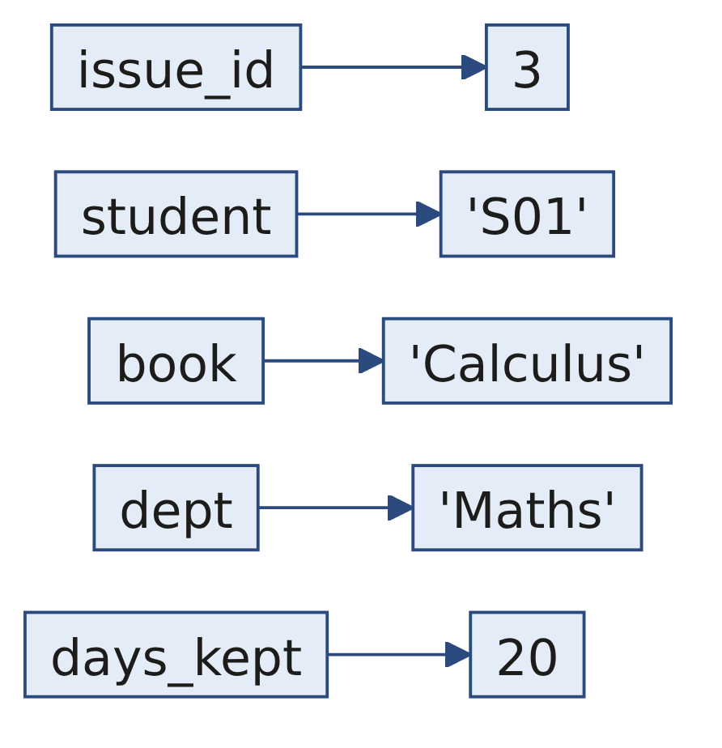
S6
One issue is one dictionary
issue = {"issue_id": 3, "student": "S01", "book": "Calculus", "dept": "Maths", "days_kept": 20}
issue["days_kept"] # 20
A key names a field, and the value sits beside it. One row of the log is one dictionary.
Week 0, Day 3. Half one: the librarian's log
8 / 21

Slide 9
S7
The log is a list of those dictionaries
log = [
{"issue_id": 1, "student": "S01", "book": "Algebra", "dept": "Maths", "days_kept": 12},
{"issue_id": 2, "student": "S02", "book": "Poetry", "dept": "Arts", "days_kept": 5},
{"issue_id": 3, "student": "S01", "book": "Calculus", "dept": "Maths", "days_kept": 20},
{"issue_id": 4, "student": "S03", "book": "Poetry", "dept": "Arts", "days_kept": 9},
{"issue_id": 5, "student": "S04", "book": "Physics", "dept": "Science", "days_kept": 14},
{"issue_id": 6, "student": "S02", "book": "Algebra", "dept": "Maths", "days_kept": 3},
{"issue_id": 7, "student": "S05", "book": "Chemistry", "dept": "Science", "days_kept": 21},
{"issue_id": 8, "student": "S03", "book": "Calculus", "dept": "Maths", "days_kept": 7},
]
len(log) # 8
log[2]["book"] # 'Calculus': the list counts from 0, the dictionary answers by name
Week 0, Day 3. Half one: the librarian's log
9 / 21

Slide 10
SECTION C. One loop, one running total
Week 0, Day 3. Half one: the librarian's log
10 / 21

Slide 11
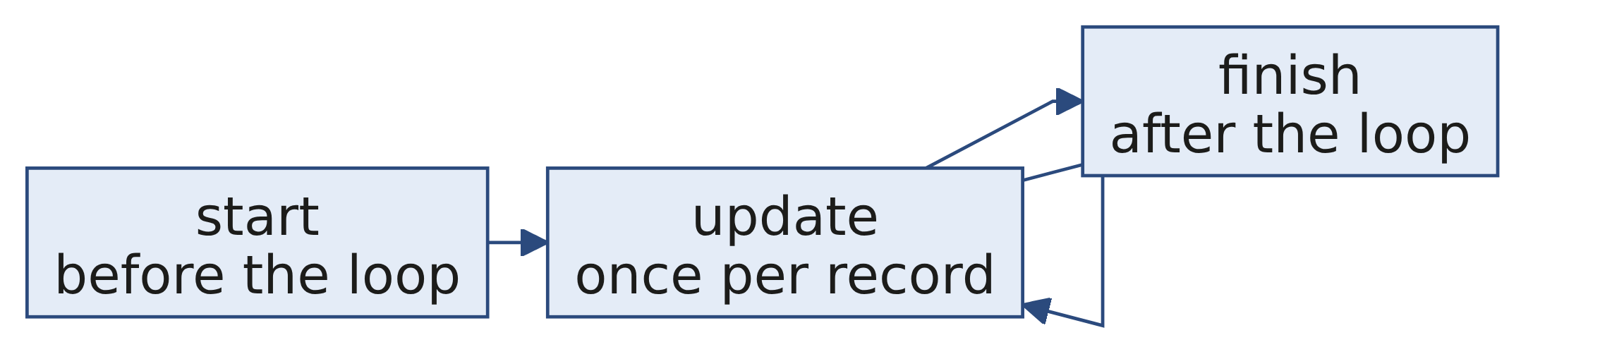
S8
A running total makes three moves
total = 0 # start
for issue in log:
total = total + issue["days_kept"] # update
print(total) # finish: 91
A count is the same three moves with + 1 in the update. The librarian's first answer is 8 issues.
Week 0, Day 3. Half one: the librarian's log
11 / 21

Slide 12
S9
A dictionary can be the running total
counts = {}
for issue in log:
dept = issue["dept"]
if dept not in counts:
counts[dept] = 0 # the first time a department appears
counts[dept] = counts[dept] + 1
print(counts)
{'Maths': 4, 'Arts': 2, 'Science': 2}
Maths borrows most. The start move now happens once per key, inside the loop.
Week 0, Day 3. Half one: the librarian's log
12 / 21

Slide 13
D10
Whose books spend the most days out?
DEPTH
Question. Change one line of the counting loop so it answers this, then predict the three totals.
Week 0, Day 3. Half one: the librarian's log
13 / 21

Slide 14
D11
Answer: Maths 42, Science 35, Arts 14
DEPTH
counts[dept] = counts[dept] + issue["days_kept"] # add the days, not 1
{'Maths': 42, 'Arts': 14, 'Science': 35}
Science reaches 35 days from two issues, while Maths needs four for 42. Borrowing most and keeping longest are different questions, and the loop answers whichever one its update line asks.
Week 0, Day 3. Half one: the librarian's log
14 / 21

Slide 15
SECTION D. A function that returns
Week 0, Day 3. Half one: the librarian's log
15 / 21

Slide 16
S12
Wrap the loop so next week gets the same answer
def busiest_department(log):
counts = {}
for issue in log:
dept = issue["dept"]
if dept not in counts:
counts[dept] = 0
counts[dept] = counts[dept] + 1
best = None
for dept in counts:
if best is None or counts[dept] > counts[best]:
best = dept
return best
busiest_department(log) # 'Maths'
Next week's log goes in, and the same question comes back answered.
Week 0, Day 3. Half one: the librarian's log
16 / 21

Slide 17
D13
The helper printed 6, so why did the total stop?
DEPTH
Question. The loan is 14 days. Read the output, then say what late_days gave back.
def late_days(issue):
print(issue["days_kept"] - 14)
late = 0
for issue in log:
if issue["days_kept"] > 14:
late = late + late_days(issue)
6
TypeError: unsupported operand type(s) for +: 'int' and 'NoneType'
Week 0, Day 3. Half one: the librarian's log
17 / 21

Slide 18
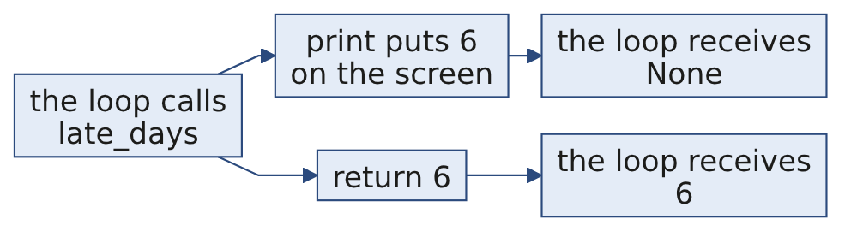
D14
Answer: print shows a value, return hands it back
DEPTH
def late_days(issue):
return issue["days_kept"] - 14 # the loop now adds 6, then 7: 13 days late
A function without return gives back None, and late + None is the line that fails.
Week 0, Day 3. Half one: the librarian's log
18 / 21

Slide 19
SECTION E. Tracebacks
Week 0, Day 3. Half one: the librarian's log
19 / 21

Slide 20
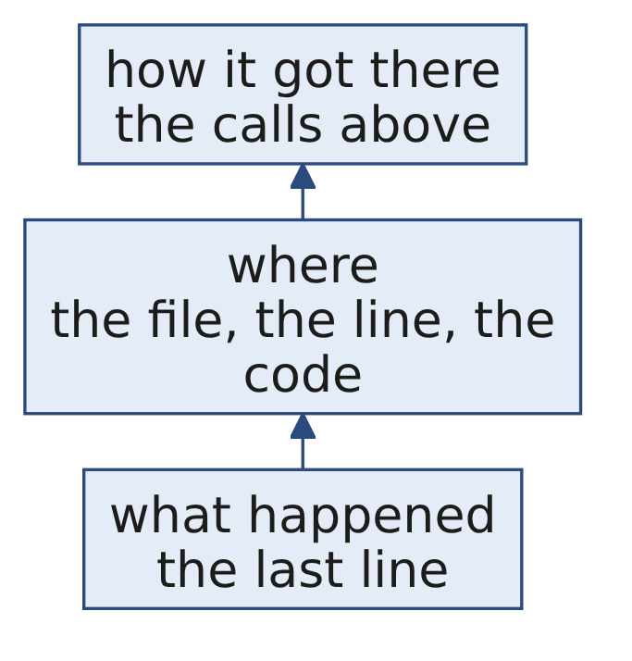
S15
Read a traceback from the bottom up
The Python tutorial says it in one line: "The last line of the error message indicates what happened." Then find the line it names, and ask what value each name on that line held when it ran.
Week 0, Day 3. Half one: the librarian's log
20 / 21

Slide 21
S16
Your turn
What | Where
Twelve items on the log, answered as letters | The unguided exercise
The next week's log, with checks that tell you when you are right | The hands-on notebook
The five ideas on one page | Today's cheat sheet
The next week's log has different numbers, so nothing from the demo can be pasted in.
Week 0, Day 3. Half one: the librarian's log
21 / 21

