Slide 1
SECTION A. Two figures
Week 1, Day 3. Half one: two figures, and the file that decides
1 / 19

Slide 2
S1
Finance will not act on your number
Anand Iyer, replying to the whole leadership group:
"Your dashboard says Q1 was Rs 2.1 crore. Our books say 1.9. Until your numbers match ours,
Finance will not act on a drop measured from an ERP export. Send me a reconciliation."
Tuesday's finding is now blocked behind Rs 20 lakh nobody can explain.
Week 1, Day 3. Half one: two figures, and the file that decides
2 / 19

Slide 3
S2
What arrived with it
The ERP team sends the raw exports: an orders CSV and the app's JSON feed. The note says the CSV was
"stitched from two extracts during the Q1 migration."
Marketing is impatient. If the drop is a data problem, a month is lost arguing.
Week 1, Day 3. Half one: two figures, and the file that decides
3 / 19

Slide 4
S3
Both figures are computable
Dashboard | Rs 2.10 crore
Finance | Rs 1.90 crore
The gap | Rs 20 lakh
Neither is a rounding error and neither person is guessing. Somewhere in the file there is Rs 20 lakh that one of them is counting and the other is not.
Week 1, Day 3. Half one: two figures, and the file that decides
4 / 19

Slide 5
S4
What an export can do that arithmetic cannot
Cause | What it does to the total
A migration that ran twice | Rows appear more than once
Two extracts stitched with an overlap | The overlap is counted twice
A header row pasted in again | One row of text becomes a record
Cancelled orders in one figure and not the other | Two definitions, one word
None of these is "the amounts are wrong". That is the insight of the morning.
Week 1, Day 3. Half one: two figures, and the file that decides
5 / 19

Slide 6
SECTION B. Reading a file
Week 1, Day 3. Half one: two figures, and the file that decides
6 / 19

Slide 7
S5
Everything read from a file is text
import csv
with open("orders.csv", newline="") as f:
rows = list(csv.DictReader(f))
print(rows[0]["amount"], type(rows[0]["amount"]))
2200 <class 'str'>
It looks like a number and it is not one. Monday's TypeError was one row; from a file it is every row.
Week 1, Day 3. Half one: two figures, and the file that decides
7 / 19

Slide 8
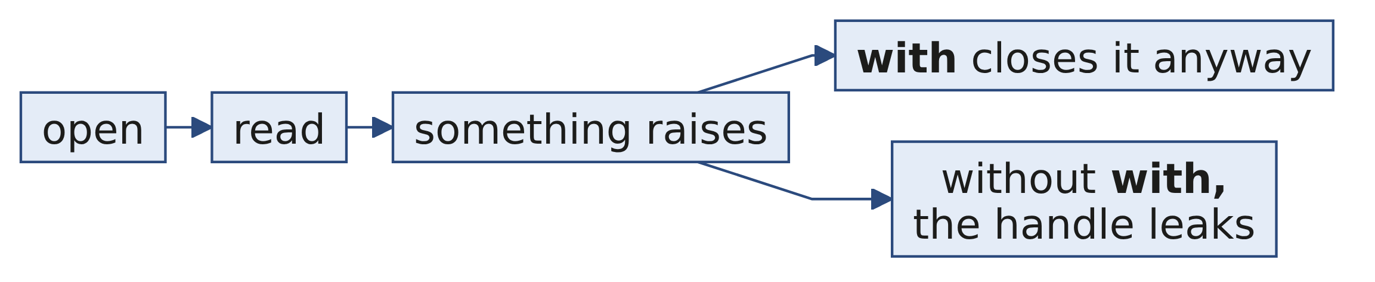
S6
The with block closes the file even when you fail
with is not style. It is the difference between a failed run that leaves the system clean and one that leaves a file locked.
Week 1, Day 3. Half one: two figures, and the file that decides
8 / 19

Slide 9
S7
The JSON feed does not open
import json
with open("orders.json") as f:
data = json.load(f)
json.decoder.JSONDecodeError: Unterminated string starting at: line 1397 column 15 (char 27679)
The message gives you the line, the column and the character offset. Open the file at that line before you form a theory.
Week 1, Day 3. Half one: two figures, and the file that decides
9 / 19

Slide 10
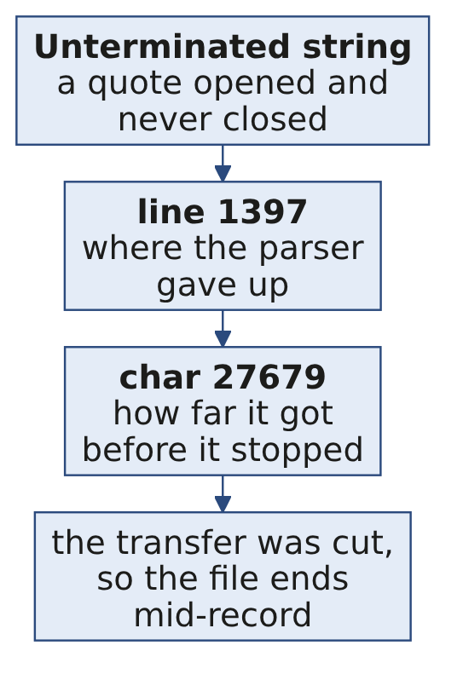
S8
Reading a parse error
A truncated file is not a corrupt file. It is a complete file that stops early, and the fix is to ask for it again rather than to patch it.
Week 1, Day 3. Half one: two figures, and the file that decides
10 / 19

Slide 11
SECTION C. Profiling
Week 1, Day 3. Half one: two figures, and the file that decides
11 / 19

Slide 12
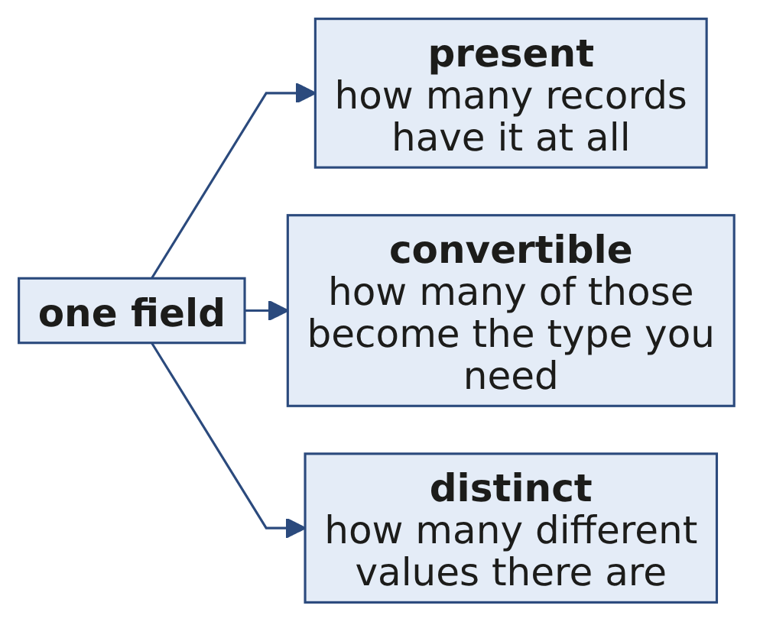
S9
Profile before you analyse
Count | The question it answers
Present | How many records have this field at all
Convertible | How many of those can become the type you need
Distinct | How many different values there are
Any field where these three disagree with what you expected is a finding.
Week 1, Day 3. Half one: two figures, and the file that decides
12 / 19

Slide 13
S10
Distinct is the one that catches migrations
ids = [r["order_id"] for r in rows]
print(len(ids), len(set(ids)))
201 186
Two hundred and one rows carrying one hundred and eighty-six order ids. Fifteen ids appear more than once, and nobody mentioned that in the note.
Week 1, Day 3. Half one: two figures, and the file that decides
13 / 19

Slide 14
D11
Is fifteen repeated ids the whole Rs 20 lakh?
DEPTH
Question. Fifteen rows out of two hundred is seven percent, and the gap is about nine percent of the quarter. Close enough to stop looking?
Week 1, Day 3. Half one: two figures, and the file that decides
14 / 19

Slide 15
D12
Answer: no, and the arithmetic is the check
DEPTH
Seven percent of rows is not nine percent of revenue unless the repeated rows happen to be larger than average.
Total the repeated rows and see. If they come to Rs 20 lakh, you have the answer. If they come to Rs 3 lakh, there is a second cause and you have not found it yet.
Week 1, Day 3. Half one: two figures, and the file that decides
15 / 19

Slide 16
SECTION D. What the profile found
Week 1, Day 3. Half one: two figures, and the file that decides
16 / 19

Slide 17
S13
The profile, field by field
Field | Present | Convertible | Distinct
order_id | 201 | n/a | 186
amount | 201 | 200 | many
status | 200 | n/a | 3
customer_id | 201 | n/a | 69
Three anomalies in one table: repeated ids, one amount that will not convert, one record missing a status.
Week 1, Day 3. Half one: two figures, and the file that decides
17 / 19

Slide 18
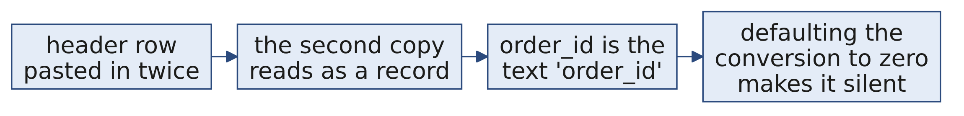
S14
The companion file that is worse
A header read as a record gives you an order whose id is the text order_id and whose amount is the text amount. It will not convert, and if you default the conversion to zero it becomes a silent extra row.
Week 1, Day 3. Half one: two figures, and the file that decides
18 / 19

Slide 19
S15
What half two does with this
You now have three anomalies and a gap of Rs 20 lakh. Half two decides what to do about each one, records the decision, and produces a bridge that lands on Finance's number.
Week 1, Day 3. Half one: two figures, and the file that decides
19 / 19

