Slide 1


Indian Institute of Technology Gandhinagar
ADMINISTERED THROUGH THE COMPETENCY ADVANCEMENT ACADEMY
WEEK 2 · FRIDAY · HALF ONE
What can a director open, change and still trust?
“Monday's growth review deck needs three things I can open on my laptop without a login. If a director changes an assumption in the room, the sheet must recalculate in front of them.”
Meera's chief of staff, Kalpa Retail, to the data and AI team at Kalpa's Global Capability Centre
01
Which segment carries it?
02
Where did Q2 fall?
03
Find any member by id?
04
Read right in two minutes?
05
What must Excel never do?
Week 2, Day 5. What can a director open, change and still trust?
1 / 80
Notes:
LIVE, one minute. Read the chief of staff's message aloud and leave it on screen. The day is one
question climbed in six chapters: what can a director open on Monday without a login, change in the
room, and still trust. Five chapters this morning, the sixth after lunch, then the escalated case
alone and the director's edit in pairs. Excel is the tool the room holds today; the notebooks are the
second route to every number.

Slide 2

Indian Institute of Technology Gandhinagar
WEEK 2 · DAY 5 · KALPA GLOBAL CAPABILITY CENTRE
ADMINISTERED THROUGH THE COMPETENCY ADVANCEMENT ACADEMY
Six questions answer the chief of staff
What can a director open on Monday without a login, change in the room, and still trust?
CHAPTER 1
CHAPTER 2
CHAPTER 3
CHAPTER 4
CHAPTER 5
CHAPTER 6
Which segment carries it?
Where did Q2 fall?
Find any member by id?
Read right in two minutes?
What must Excel never do?
Can a director break it?
The tree by segment, from the customer table.
Both quarters, from the raw export.
The protect list and a lookup.
The front-page number.
The rule behind all three.
The checks that stop them.
Which segment carries it?
Where did Q2 fall?
Find any member by id?
Read right in two minutes?
What must Excel never do?
S1 · 2 / 80
Notes:
LIVE, 3 minutes. Read the day's question, then the six chapter questions in order. Each chapter's
answer raises the next question: the customer table cannot split the quarters, so chapter 2 opens
the raw export; the fall sits partly in a paid tier, so chapter 3 protects its best members; and so
on. Tell the room every chapter ends on a number and a sentence they could send.
Transition: first, what exactly was asked.

Slide 3

Indian Institute of Technology Gandhinagar
WEEK 2 · DAY 5 · KALPA GLOBAL CAPABILITY CENTRE
ADMINISTERED THROUGH THE COMPETENCY ADVANCEMENT ACADEMY
Three deliverables and one hard condition
What exactly did the chief of staff ask for?
THE CLIENT ASKS
"Monday's growth review deck needs three things I can open on my laptop without a login: the revenue tree by segment for both quarters, the top-fifty protect list with a lookup so I can find any member by id, and one number on the front page with its trend. Nothing that needs Python. If a director changes an assumption in the room, the sheet must recalculate in front of them."
What was asked | What it becomes | Chapters
The revenue tree by segment, both quarters | A pivot that ties to the warehouse | 1 and 2
The protect list and a lookup by id | A ranked list and a lookup that says when an id is missing | 3
One number with its trend | A card with its period, comparison and base | 4
Recalculates when a director changes an assumption | Yellow inputs, formulas everywhere else, and checks | 5 and 6
Which segment carries it?
Where did Q2 fall?
Find any member by id?
Read right in two minutes?
What must Excel never do?
S2 · 3 / 80
Notes:
LIVE, 5 minutes. Read the message aloud, then the last row: it is the hardest line in the brief and it
applies to everything. Kavya's challenge sits under it: which parts belong in Excel, which must never
be there, and how do the two stay in step. That is chapter 5.
Transition: before any tool opens, where could a sheet like this go wrong?

Slide 4
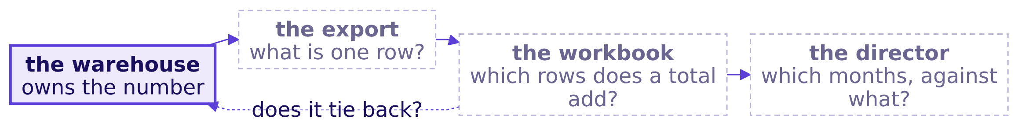
Indian Institute of Technology Gandhinagar
WEEK 2 · DAY 5 · KALPA GLOBAL CAPABILITY CENTRE
ADMINISTERED THROUGH THE COMPETENCY ADVANCEMENT ACADEMY
What could make a sheet lie without an error?
Before Excel opens: where can each number go wrong on its way to a director?
Question. Where would you check first, as a letter? a) the export: what one row stands for; b) the workbook: which rows a total adds; c) the director: what a number is read against; d) the warehouse itself.
Which segment carries it?
Where did Q2 fall?
Find any member by id?
Read right in two minutes?
What must Excel never do?
S3 · 4 / 80
Notes:
LIVE, 7 minutes. Draw this on the board with the room and leave it up all day: it is the day's
picture. Pairs, two minutes: one way each box could produce a wrong number that raises no error.
Expect: rows that are payments, a lookup that answers wrong, a total under a filter, a card with no
period. The point is the list; the letter comes next.

Slide 5
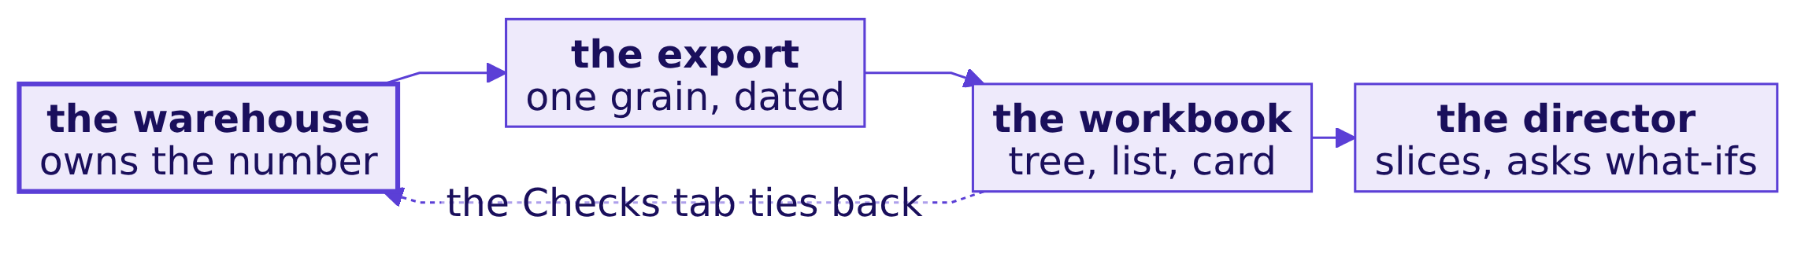
Indian Institute of Technology Gandhinagar
WEEK 2 · DAY 5 · KALPA GLOBAL CAPABILITY CENTRE
ADMINISTERED THROUGH THE COMPETENCY ADVANCEMENT ACADEMY
Answer: the export first; every number sits on it
Where does the day start, and what does the finished picture look like?
The answer is a, for cost more than likelihood: saying what one row stands for takes a minute and rules a whole family of wrong numbers in or out. The dashed arrow is the day's discipline: every number in the workbook ties back to the warehouse before a director reads it.
Which segment carries it?
Where did Q2 fall?
Find any member by id?
Read right in two minutes?
What must Excel never do?
S4 · 5 / 80
Notes:
LIVE, 5 minutes. This is the finished picture; the cheat sheet's first panel and the board carry the
same drawing. The warehouse owns the number, the export carries one grain, the workbook presents it,
the director slices and asks what-ifs, and the Checks tab ties the workbook back.
Transition: chapter 1, the first deliverable, from the table Marketing already has.

Slide 6
Indian Institute of Technology Gandhinagar
PG DIPLOMA IN AI-ML AND AGENTIC AI ENGINEERING · COHORT 2
ADMINISTERED THROUGH THE COMPETENCY ADVANCEMENT ACADEMY
01
Which segment carries it?
Which segment carries Kalpa's revenue, and which leaf of the tree separates the segments? Page two of Monday's deck rides on it.
Which segment carries it?
Where did Q2 fall?
Find any member by id?
Read right in two minutes?
What must Excel never do?
Week 2, Day 5. What can a director open, change and still trust?
6 / 80
Notes:
LIVE. Thirty minutes. Notebook C2_W02_D05_01_segment_tree runs beside it as the second route.
Excel live on data/C2_W02_D05_customer_table_STUDENT.csv.

Slide 7
Indian Institute of Technology Gandhinagar
WEEK 2 · DAY 5 · KALPA GLOBAL CAPABILITY CENTRE
ADMINISTERED THROUGH THE COMPETENCY ADVANCEMENT ACADEMY
Answer it in six steps, from one row to the tree
Who needs the answer, and what must we find out on the way?
Who needs the answer. The chief of staff, whose tree by segment is page two of Monday's deck; a leaf computed the wrong way puts a tree on the page that does not multiply back to its own revenue.
1
2
3
4
5
6
One row?
Which way?
Which segment?
Which leaf?
Averaged leaf?
Quarters?
What one row of the table stands for.
Pivot, formula grid, pasted values or a dashboard.
Who carries the revenue.
What separates Retail-Plus from Retail-Core.
What averaging per customer does.
Whether the table can split Q1 from Q2.
Which segment carries it?
Where did Q2 fall?
Find any member by id?
Read right in two minutes?
What must Excel never do?
S5 · 7 / 80
Notes:
LIVE, 1 minute. Read the six smaller questions; they are the notebook's headings and the chapter's
objectives. Ask the room to hold one number in mind for question 4: how much more a Retail-Plus
member spends than a Retail-Core shopper.

Slide 8
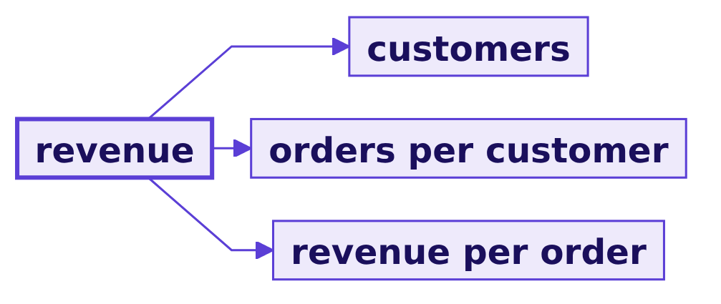
Indian Institute of Technology Gandhinagar
WEEK 2 · DAY 5 · KALPA GLOBAL CAPABILITY CENTRE
ADMINISTERED THROUGH THE COMPETENCY ADVANCEMENT ACADEMY
The tree by segment is page two of Monday's deck
What is at stake, who asks, and what does a wrong leaf cost?
Revenue
Chief of staff
Trust
THE METRIC
WHO ASKS
WHAT A WRONG LEAF COSTS
booked order value, April to September
page two of Monday's deck
a tree that does not multiply back
Which segment carries it?
Where did Q2 fall?
Find any member by id?
Read right in two minutes?
What must Excel never do?
S6 · 8 / 80
Notes:
LIVE, 2 minutes. Revenue here is booked order value: every order at its price, whatever became of it.
The tree is Week 1 Monday's: customers times orders per customer times revenue per order. The
segments: Retail-Core, everyday shoppers; Retail-Plus, the paid membership tier; Business, corporate
buyers invoiced in large amounts; Student. The first director who multiplies a leaf back and gets a
different revenue stops trusting page three.

Slide 9
Indian Institute of Technology Gandhinagar
WEEK 2 · DAY 5 · KALPA GLOBAL CAPABILITY CENTRE
ADMINISTERED THROUGH THE COMPETENCY ADVANCEMENT ACADEMY
Costco reports its sales by member tier
Which real company answers the same question?
81.0 m
38.7 m
~73.6%
PAID MEMBERS
EXECUTIVE MEMBERS
OF NET SALES
Costco, year to 31 August 2025
the paid upgrade tier
from the Executive tier
"The sales penetration of Executive members represented approximately 73.6% of worldwide net sales in 2025."
Costco Form 10-K, fiscal 2025
Which segment carries it?
Where did Q2 fall?
Find any member by id?
Read right in two minutes?
What must Excel never do?
S7 · 9 / 80
Notes:
LIVE, 1 minute. Source: Costco's 10-K for the year to 31 August 2025, on sec.gov, checked 30 September
2026. Say "approximately" as the filing does. The question is the one Kalpa asks of Retail-Plus: how
much revenue does the paid tier carry, and through which leaf.

Slide 10
Indian Institute of Technology Gandhinagar
WEEK 2 · DAY 5 · KALPA GLOBAL CAPABILITY CENTRE
ADMINISTERED THROUGH THE COMPETENCY ADVANCEMENT ACADEMY
A PivotTable, with each leaf beside it
Which way should the director get the tree, and what does each way cost on this table?
Option | What it takes here | What a director can slice | Recalculates
a) PivotTable | 1 pivot and 8 leaf formulas | any of 6 columns, in seconds | on Refresh
b) SUMIFS grid | 12 formulas reading 3,600 cells | only what was built; a city split adds 72 | at once
c) Pasted values | 0 formulas | nothing | never
d) Live dashboard | a query per view | anything | needs a login
The call. a, because a director re-slices in the room and only the pivot answers a question nobody built. What would switch it: a director who changes an assumption, since a pivot waits for Refresh and a formula does not; chapter 6.
Which segment carries it?
Where did Q2 fall?
Find any member by id?
Read right in two minutes?
What must Excel never do?
S8 · 10 / 80
Notes:
LIVE, 4 minutes. The sizing is on this table: 300 rows, 6 columns; 4 segments times 3 measures is 12
formulas, each reading 300 rows. Option d fails the brief on the login. Ask which option a director
would break first; hold the answer for chapter 6.

Slide 11
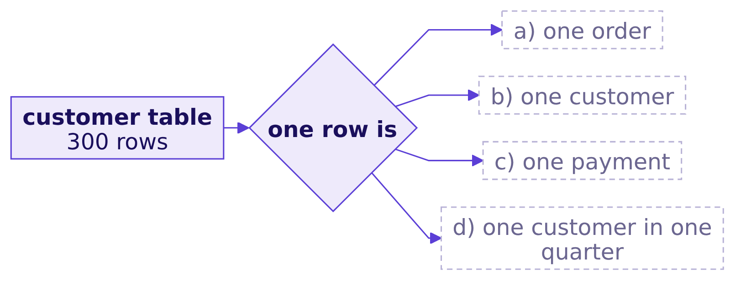
Indian Institute of Technology Gandhinagar
WEEK 2 · DAY 5 · KALPA GLOBAL CAPABILITY CENTRE
ADMINISTERED THROUGH THE COMPETENCY ADVANCEMENT ACADEMY
What does one row of the customer table stand for?
Before any pivot, what is the grain of this table?
Question. One row of this table is which, as a letter?
Which segment carries it?
Where did Q2 fall?
Find any member by id?
Read right in two minutes?
What must Excel never do?
S9 · 11 / 80
Notes:
LIVE, 1 minute. Letters in the chat. Open the CSV in Excel and scroll it while they answer.

Slide 12
Indian Institute of Technology Gandhinagar
WEEK 2 · DAY 5 · KALPA GLOBAL CAPABILITY CENTRE
ADMINISTERED THROUGH THE COMPETENCY ADVANCEMENT ACADEMY
Answer: one customer, so a Sum adds each once
What does the count say?
300
300
6
ROWS
DISTINCT IDS
COLUMNS
in the CSV
one per row
id, segment, city, orders, revenue, last order date
The answer is b. Each row is one customer who ordered between April and September 2026, with that customer's orders and revenue summed. The check: rows equal distinct ids, 300 and 300.
Which segment carries it?
Where did Q2 fall?
Find any member by id?
Read right in two minutes?
What must Excel never do?
S10 · 12 / 80
Notes:
LIVE, 2 minutes. In Excel: =COUNTA(A2:A301) and a distinct count beside it. The habit is what
matters: the grain is said aloud before any pivot, because chapter 2's export will not be so kind.

Slide 13
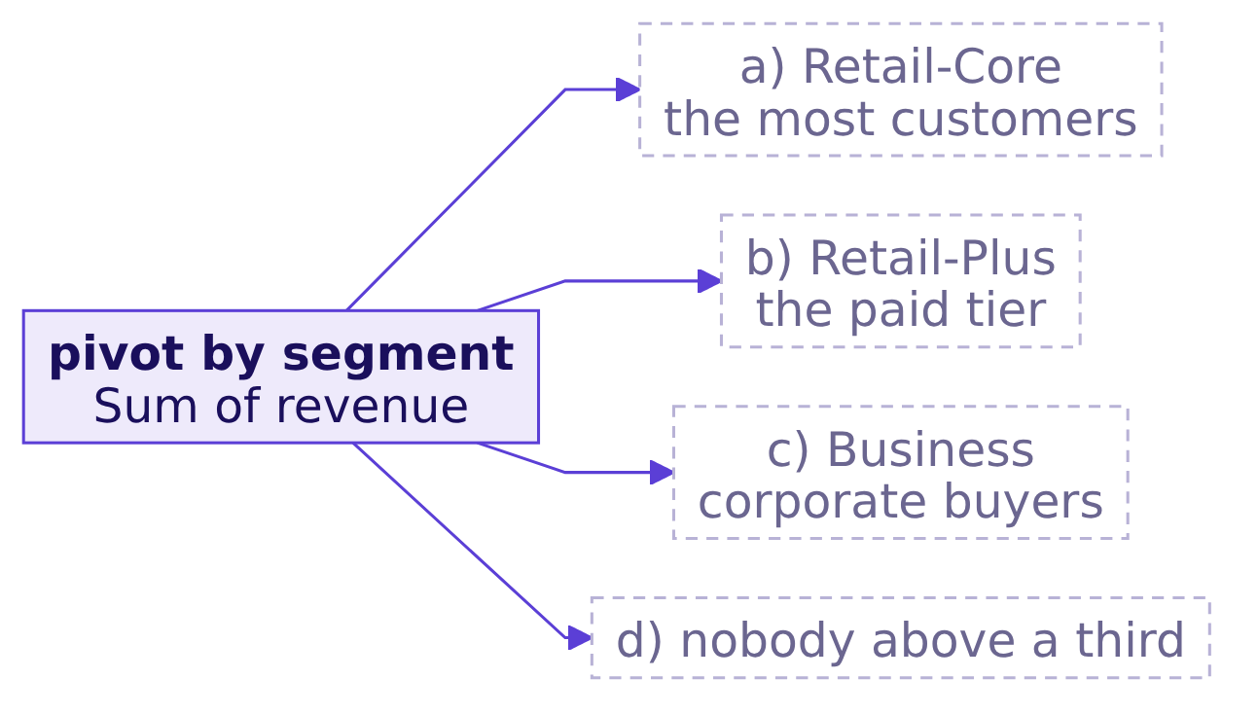
Indian Institute of Technology Gandhinagar
WEEK 2 · DAY 5 · KALPA GLOBAL CAPABILITY CENTRE
ADMINISTERED THROUGH THE COMPETENCY ADVANCEMENT ACADEMY
Which segment carries the revenue?
With segment in Rows and revenue in Values, whose bar is longest?
Question. Which segment carries most of the revenue, as a letter?
Which segment carries it?
Where did Q2 fall?
Find any member by id?
Read right in two minutes?
What must Excel never do?
S11 · 13 / 80
Notes:
LIVE, 1 minute. Build it live: select the table, Insert, PivotTable, segment to Rows, customer_id to
Values (Excel counts text), orders and revenue to Values (Excel sums numbers by default, Microsoft
Support, checked 30 September 2026). Take letters before you drag revenue in.

Slide 14
Indian Institute of Technology Gandhinagar
WEEK 2 · DAY 5 · KALPA GLOBAL CAPABILITY CENTRE
ADMINISTERED THROUGH THE COMPETENCY ADVANCEMENT ACADEMY
Answer: Business carries 99.1 percent
What does the pivot show, segment by segment?
Segment | Customers | Orders | Revenue | Share
Business | 39 | 188 | Rs 19,65,99,040 | 99.1%
Retail-Core | 131 | 392 | Rs 7,39,320 | 0.4%
Retail-Plus | 106 | 349 | Rs 9,77,410 | 0.5%
Student | 24 | 65 | Rs 62,490 | 0.0%
The answer is c. Thirty-nine corporate buyers carry the half-year, so any company-wide number on the page is a Business number, and a consumer segment can fall by a third without moving it.
Which segment carries it?
Where did Q2 fall?
Find any member by id?
Read right in two minutes?
What must Excel never do?
S12 · 14 / 80
Notes:
LIVE, 2 minutes. Point at the share column: Student rounds to 0.0 percent. Ask what a company-wide
revenue number can say about members. Almost nothing, and chapter 4 has to live with that.

Slide 15
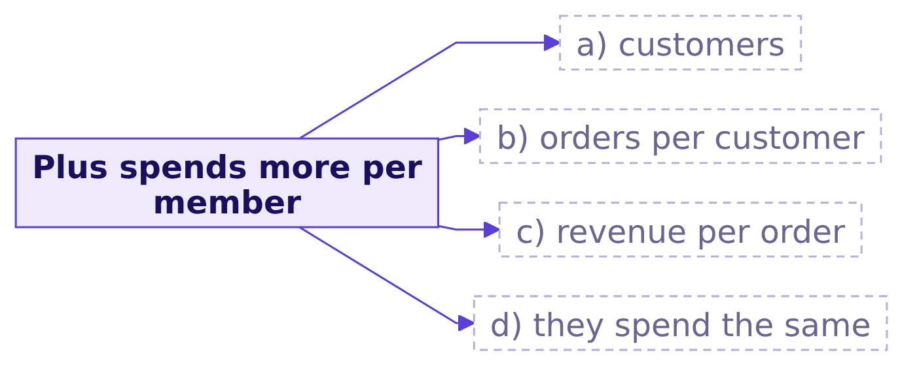
Indian Institute of Technology Gandhinagar
WEEK 2 · DAY 5 · KALPA GLOBAL CAPABILITY CENTRE
ADMINISTERED THROUGH THE COMPETENCY ADVANCEMENT ACADEMY
Which leaf separates Retail-Plus from Retail-Core?
A Retail-Plus member spends more across the half-year; which leaf of the tree says why?
Question. Which leaf explains most of the gap in revenue per member, as a letter?
Which segment carries it?
Where did Q2 fall?
Find any member by id?
Read right in two minutes?
What must Excel never do?
S13 · 15 / 80
Notes:
LIVE, 1 minute. In Excel, two formulas beside the pivot: orders divided by customers, revenue divided
by orders, each reading the pivot's own sums. Letters first.

Slide 16
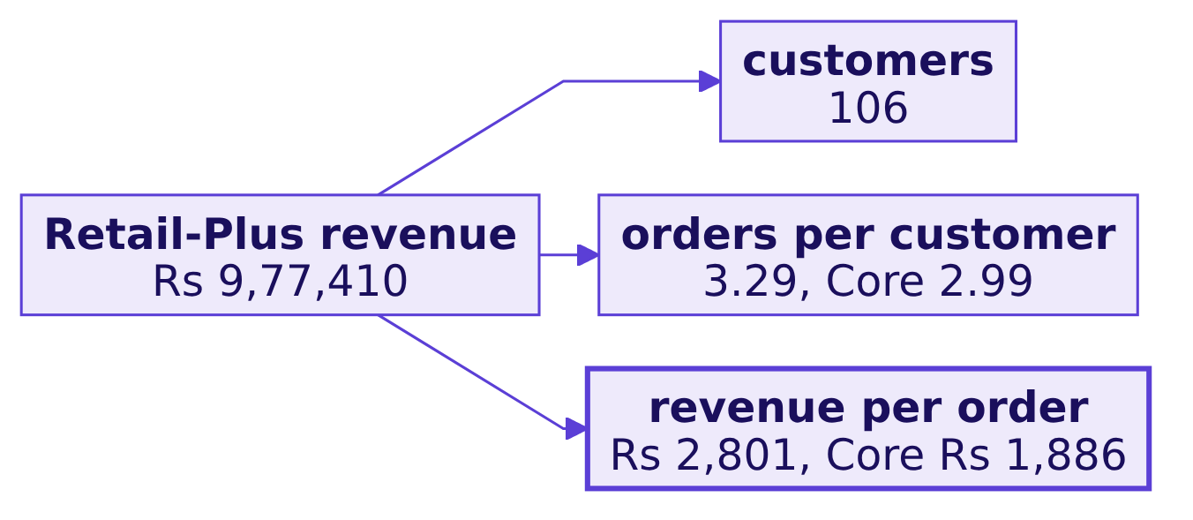
Indian Institute of Technology Gandhinagar
WEEK 2 · DAY 5 · KALPA GLOBAL CAPABILITY CENTRE
ADMINISTERED THROUGH THE COMPETENCY ADVANCEMENT ACADEMY
Answer: the basket, 48.5 percent bigger
What do the leaves say, with Retail-Core at 100?
The answer is c. A Retail-Plus member spends Rs 9,221 across the half-year against Retail-Core's Rs 5,644, 63 percent more: orders per customer are 10 percent higher, revenue per order 48.5 percent higher. The check: each tree multiplies back to its revenue, 106 times 3.29 times Rs 2,801 is Rs 9.77 lakh.
Which segment carries it?
Where did Q2 fall?
Find any member by id?
Read right in two minutes?
What must Excel never do?
S14 · 16 / 80
Notes:
LIVE, 2 minutes. Multiply back aloud. The paid tier's members fill bigger baskets; hold that thought
for chapter 2, where the question is which leaf moved between the quarters.
Transition: now the way a hurried analyst builds the same leaf.

Slide 17
Indian Institute of Technology Gandhinagar
WEEK 2 · DAY 5 · KALPA GLOBAL CAPABILITY CENTRE
ADMINISTERED THROUGH THE COMPETENCY ADVANCEMENT ACADEMY
What does a leaf averaged per customer say?
What happens when a per-customer ratio column is dragged into the pivot?
The move | What the pivot shows for Business
Drag the per-customer column into Values | Sum of it: Rs 4,55,04,669, plainly nonsense
Switch the field to Average | ?
Revenue divided by orders, the tree's leaf | Rs 10,45,740
Question. The Average reads about: a) exactly Rs 10,45,740; b) a little below it; c) about 12 percent above it; d) about twice it.
Which segment carries it?
Where did Q2 fall?
Find any member by id?
Read right in two minutes?
What must Excel never do?
S15 · 17 / 80
Notes:
LIVE, 1 minute. Build it live: add =E2/D2 as a column, drag it in, watch Excel sum it, switch to
Average. Take letters before the value shows.

Slide 18
Indian Institute of Technology Gandhinagar
WEEK 2 · DAY 5 · KALPA GLOBAL CAPABILITY CENTRE
ADMINISTERED THROUGH THE COMPETENCY ADVANCEMENT ACADEMY
Answer: Rs 11,66,786, and the tree fails
Why is the averaged leaf the plausible wrong answer, and what catches it?
Rs 11,66,786
Rs 10,45,740
+Rs 2.28 cr
AVERAGED PER CUSTOMER
REVENUE OVER ORDERS
THE MULTIPLY-BACK ERROR
what the pivot shows
the tree's leaf
188 orders times the averaged leaf
The answer is c, 11.6 percent high. What breaks: 39 times 4.82 times Rs 11.67 lakh rebuilds Business at Rs 21.94 crore against the Rs 19.66 crore it sold, and the director who checks stops trusting the page. Why: the average gives each customer one vote, and Business baskets range twentyfold, Rs 3.34 lakh to Rs 66.98 lakh.
Which segment carries it?
Where did Q2 fall?
Find any member by id?
Read right in two minutes?
What must Excel never do?
S16 · 18 / 80
Notes:
LIVE, 4 minutes. The check that catches it is the multiply-back from S14. The consumer segments barely
move (Core Rs 1,884 against Rs 1,886) because their baskets are alike; the averaged leaf is wrong
everywhere and badly wrong where customers differ most in size.

Slide 19
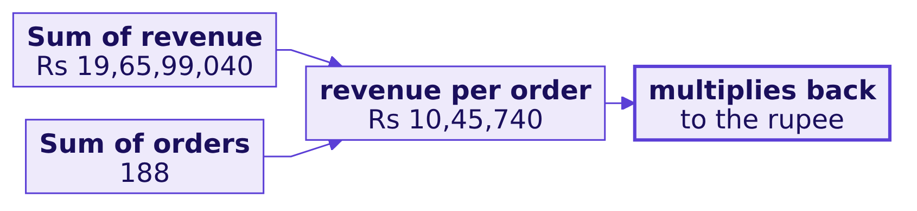
Indian Institute of Technology Gandhinagar
WEEK 2 · DAY 5 · KALPA GLOBAL CAPABILITY CENTRE
ADMINISTERED THROUGH THE COMPETENCY ADVANCEMENT ACADEMY
The fix: a ratio of the pivot's own sums
What changes when the leaf is revenue divided by orders?
A formula beside the pivot, or a calculated field =revenue/orders: "Formulas for calculated fields operate on the sum of the underlying data" (Microsoft Support, checked 30 September 2026). What changed: Business falls from Rs 11,66,786 to Rs 10,45,740 an order and the tree multiplies back exactly.
Which segment carries it?
Where did Q2 fall?
Find any member by id?
Read right in two minutes?
What must Excel never do?
S17 · 19 / 80
Notes:
LIVE, 2 minutes. Show both ways in Excel. A JPMorgan Chase task force found a risk spreadsheet that
"divided by their sum instead of their average, as the modeler had intended" (report of 16 January
2013, page 128, checked 30 September 2026): a ratio on the wrong total at a bank's scale.

Slide 20
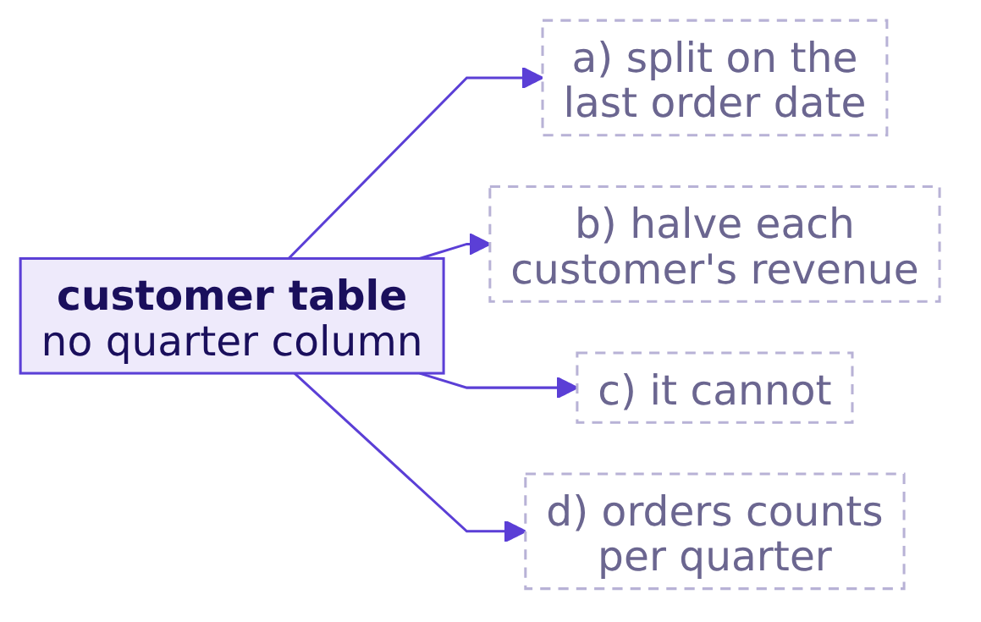
Indian Institute of Technology Gandhinagar
WEEK 2 · DAY 5 · KALPA GLOBAL CAPABILITY CENTRE
ADMINISTERED THROUGH THE COMPETENCY ADVANCEMENT ACADEMY
Can this table split Q1 from Q2?
With only a last order date, can the half-year be split into quarters?
Question. How does this table give Q1 against Q2, as a letter?
Which segment carries it?
Where did Q2 fall?
Find any member by id?
Read right in two minutes?
What must Excel never do?
S18 · 20 / 80
Notes:
LIVE, 1 minute. Option a is the tempting one. Ask what happens to a customer who bought every month
and once more in September.

Slide 21
Indian Institute of Technology Gandhinagar
WEEK 2 · DAY 5 · KALPA GLOBAL CAPABILITY CENTRE
ADMINISTERED THROUGH THE COMPETENCY ADVANCEMENT ACADEMY
Answer: it cannot; the last order date is a recency
What would the split on the last order date put in Q2?
Rs 17.88 cr
Rs 1.96 cr
0
Q2, SPLIT ON LAST ORDER
Q1, SPLIT ON LAST ORDER
QUARTER COLUMNS
against Monday's Rs 9.84 crore
against Monday's Rs 10.00 crore
in the table
The answer is c. A customer who bought in both quarters moves the whole half-year into Q2 by buying once in September. The quarter split needs one row per order, which only the raw export carries: chapter 2.
Which segment carries it?
Where did Q2 fall?
Find any member by id?
Read right in two minutes?
What must Excel never do?
S19 · 21 / 80
Notes:
LIVE, 1 minute. This is the question chapter 1's answer raises: the chief of staff asked for both
quarters, and the only export with order dates is the raw one.

Slide 22
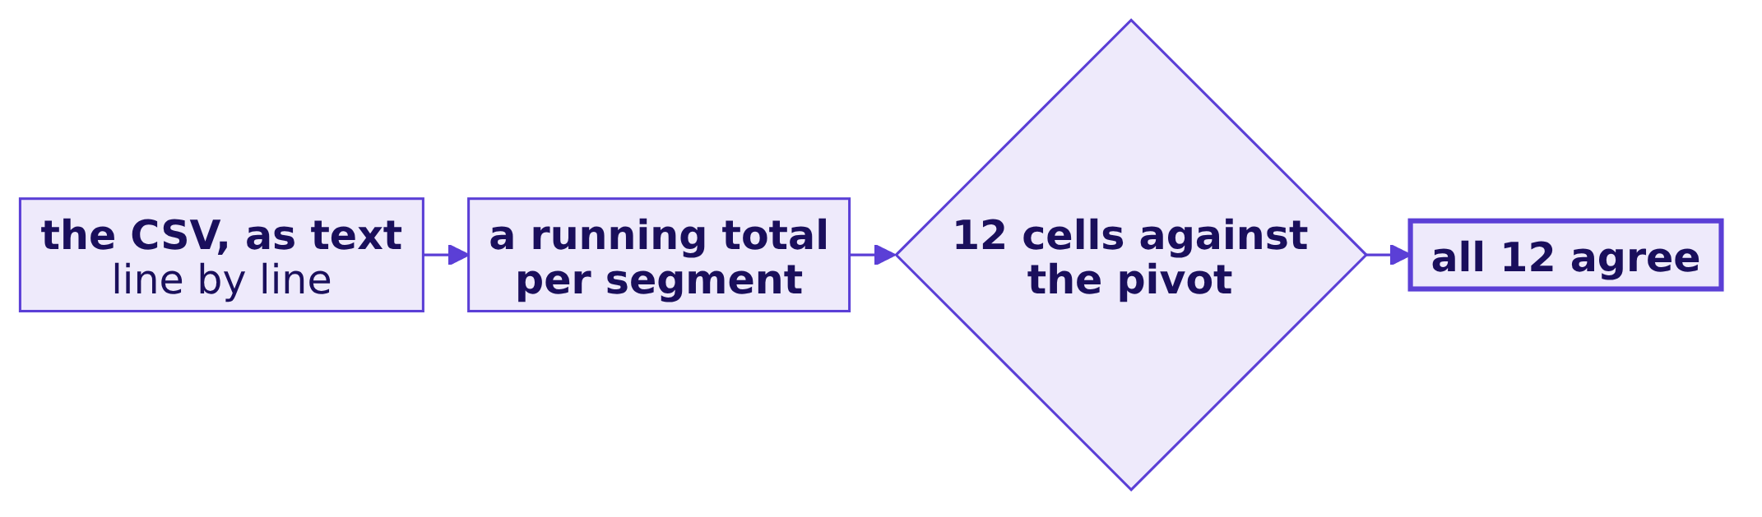
Indian Institute of Technology Gandhinagar
WEEK 2 · DAY 5 · KALPA GLOBAL CAPABILITY CENTRE
ADMINISTERED THROUGH THE COMPETENCY ADVANCEMENT ACADEMY
A second route: a plain count of the CSV
Does a method that never touches the pivot reach the same twelve cells?
In Excel the same second route is a COUNTIF and two SUMIFS per segment beside the pivot; in the notebook, Week 1 Monday's accumulator over the CSV's text. Customers, orders and revenue agree in all four segments.
Which segment carries it?
Where did Q2 fall?
Find any member by id?
Read right in two minutes?
What must Excel never do?
S20 · 22 / 80
Notes:
LIVE, 1 minute. A second route has to be able to fail when the first is wrong, so it cannot reuse the
pivot. This one would have caught the averaged leaf and a filter left on the pivot. It cannot tell you
whether the table itself is complete; that is a different check, in chapter 3.

Slide 23


Indian Institute of Technology Gandhinagar
WEEK 2 · DAY 5 · KALPA GLOBAL CAPABILITY CENTRE
ADMINISTERED THROUGH THE COMPETENCY ADVANCEMENT ACADEMY
Business carries it; the basket separates the tiers
What did chapter 1 answer, question by question?
Question | Answer
One row? | One customer: 300 rows, 300 ids
Which way? | The PivotTable, each leaf beside it from its sums
Which segment? | Business, 99.1 percent of the half-year
Which leaf? | Revenue per order: Rs 2,801 against Rs 1,886
Averaged leaf? | Rs 11,66,786, 11.6 percent high; the tree fails
Quarters? | No; the split needs one row per order
KAVYA'S REVIEW
"Say what one row is before you pivot, make every leaf a ratio of the pivot's sums, and multiply the tree back before it goes on a page."
IN THE INTERVIEW
[D] A leaf of your tree does not multiply back to the revenue; what happened, and what do you fix?
Which segment carries it?
Where did Q2 fall?
Find any member by id?
Read right in two minutes?
What must Excel never do?
S21 · 23 / 80
Notes:
LIVE, 3 minutes. One learner answers the interview question aloud in under a minute: averaged over
rows instead of divided over totals; Rs 11,66,786 against Rs 10,45,740; recompute as a ratio of sums
and keep the multiply-back as the check.
Transition: the chief of staff asked for both quarters, so the raw export.

Slide 24
Indian Institute of Technology Gandhinagar
PG DIPLOMA IN AI-ML AND AGENTIC AI ENGINEERING · COHORT 2
ADMINISTERED THROUGH THE COMPETENCY ADVANCEMENT ACADEMY
02
Where did Q2 fall?
How much did revenue fall from Q1 to Q2, and in which segment and which leaf? The growth plan funds the branch this answer names.
Which segment carries it?
Where did Q2 fall?
Find any member by id?
Read right in two minutes?
What must Excel never do?
Week 2, Day 5. What can a director open, change and still trust?
24 / 80
Notes:
LIVE. Thirty minutes. Notebook C2_W02_D05_02_both_quarters beside it; Excel live on
data/C2_W02_D05_raw_export_STUDENT.csv.

Slide 25
Indian Institute of Technology Gandhinagar
WEEK 2 · DAY 5 · KALPA GLOBAL CAPABILITY CENTRE
ADMINISTERED THROUGH THE COMPETENCY ADVANCEMENT ACADEMY
Answer it in six steps, from the quarter to the tie
Who needs the answer, and what must we find out on the way?
Who needs the answer. The chief of staff, for the tree for both quarters, and Meera, who decides which branch the growth plan funds; a pivot that counts orders twice puts nearly twice Finance's revenue in front of the directors.
1
2
3
4
5
6
Which quarter?
The pivot says?
Why double?
Counted once?
Which leaf fell?
Warehouse agrees?
Kalpa's quarter on every row.
Q1 and Q2 as a pivot adds them.
And whether Remove Duplicates helps.
Each order once.
Segment and leaf.
The second route.
Which segment carries it?
Where did Q2 fall?
Find any member by id?
Read right in two minutes?
What must Excel never do?
S22 · 25 / 80
Notes:
LIVE, 1 minute. Read the six questions. Say the chapter 1 finding in one line: Business carries 99.1
percent, and the basket separates the tiers; the customer table cannot split the quarters.

Slide 26
Indian Institute of Technology Gandhinagar
WEEK 2 · DAY 5 · KALPA GLOBAL CAPABILITY CENTRE
ADMINISTERED THROUGH THE COMPETENCY ADVANCEMENT ACADEMY
The quarters have to tie to Monday's warehouse
What is at stake, who asks, and what does a wrong number cost?
Rs 10.00 cr
Rs 9.84 cr
The plan
Q1, THE WAREHOUSE
Q2, THE WAREHOUSE
WHAT A WRONG NUMBER COSTS
April to June 2026
July to September 2026
a growth plan aimed at the wrong segment
THE CLIENT ASKS
"The revenue tree by segment for both quarters."
Which segment carries it?
Where did Q2 fall?
Find any member by id?
Read right in two minutes?
What must Excel never do?
S23 · 26 / 80
Notes:
LIVE, 1 minute. Monday's warehouse queries gave Rs 10,00,00,000 for Q1 and Rs 9,84,00,000 for Q2.
Kalpa's financial year starts in April, so Q1 is April to June. Every number on the deck ties to
these, or it does not go on the deck.

Slide 27
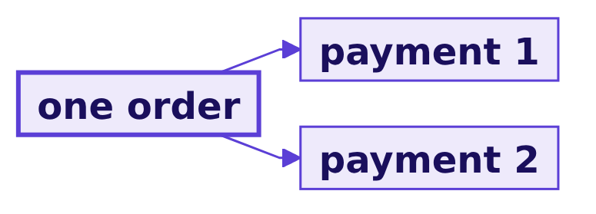
Indian Institute of Technology Gandhinagar
WEEK 2 · DAY 5 · KALPA GLOBAL CAPABILITY CENTRE
ADMINISTERED THROUGH THE COMPETENCY ADVANCEMENT ACADEMY
Razorpay orders carry several payments
Which real company holds orders and payments at different grains?
"Combines multiple payment attempts for a single order."
Razorpay documentation, Orders
"Each partial payment would have a unique payment_id, but will be tied to the same order_id."
Razorpay documentation, Payment Links partial payments
Which segment carries it?
Where did Q2 fall?
Find any member by id?
Read right in two minutes?
What must Excel never do?
S24 · 27 / 80
Notes:
LIVE, 1 minute. Both pages checked 30 September 2026. Every merchant's finance team meets this: an
export of payments repeats its orders. Do not say what Kalpa's export holds yet; the room finds it.

Slide 28
Indian Institute of Technology Gandhinagar
WEEK 2 · DAY 5 · KALPA GLOBAL CAPABILITY CENTRE
ADMINISTERED THROUGH THE COMPETENCY ADVANCEMENT ACADEMY
A quarter column, then the pivot
Which way should the team split revenue by quarter, and what does each way cost?
Option | What it reads | What it risks here
a) Customer table, last order date | 300 rows | 170 customers bought in both quarters; Rs 8.04 crore of Q1 lands in Q2
b) SUMIFS grid on the raw export | 8 formulas, 34,800 tests | recalculates at once; slices only 8 cells
c) Kalpa's quarter as a column, then a pivot | 1,450 rows | slices anything; recalculates on Refresh
d) Ask the data platform lead | the warehouse | exact, and a day's wait per question
The call. c, because it labels quarters the way Finance does and lets a director re-slice. What would switch it: a deadline far enough away for the warehouse team to answer.
Which segment carries it?
Where did Q2 fall?
Find any member by id?
Read right in two minutes?
What must Excel never do?
S25 · 28 / 80
Notes:
LIVE, 3 minutes. Size each option on this export. Option a's cost comes from chapter 1: a last order
date is a recency. Option d is exact and too slow for a meeting; chapter 5 comes back to who owns
which number.

Slide 29
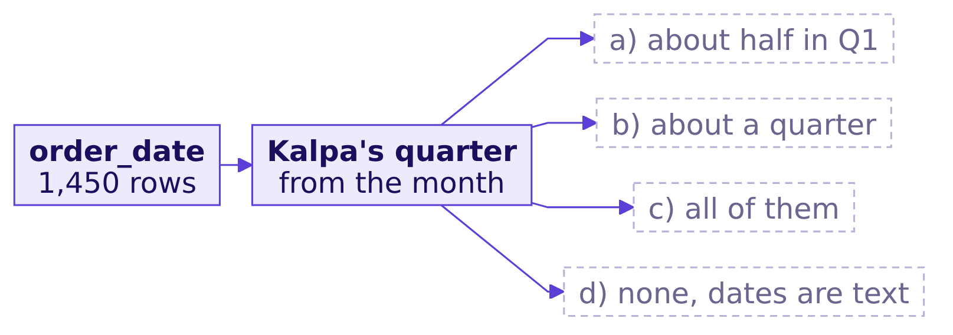
Indian Institute of Technology Gandhinagar
WEEK 2 · DAY 5 · KALPA GLOBAL CAPABILITY CENTRE
ADMINISTERED THROUGH THE COMPETENCY ADVANCEMENT ACADEMY
Which quarter does each row belong to?
Filled down beside order_date, how many rows land in Q1?
=IF(MONTH(E2)<=6,"Q1","Q2")
Question. Of the 1,450 rows, how many fall in Q1, as a letter?
Which segment carries it?
Where did Q2 fall?
Find any member by id?
Read right in two minutes?
What must Excel never do?
S26 · 29 / 80
Notes:
LIVE, 1 minute. Type the formula live in a new column beside order_date and fill it down.

Slide 30
Indian Institute of Technology Gandhinagar
WEEK 2 · DAY 5 · KALPA GLOBAL CAPABILITY CENTRE
ADMINISTERED THROUGH THE COMPETENCY ADVANCEMENT ACADEMY
Answer: 772 rows in Q1, 678 in Q2
What does the new column say?
772
678
1,450
ROWS IN Q1
ROWS IN Q2
ROWS IN ALL
April to June 2026
July to September 2026
every row has a quarter
The answer is a. The dates read cleanly and the labels now match Finance's. The pivot is one drag away.
Which segment carries it?
Where did Q2 fall?
Find any member by id?
Read right in two minutes?
What must Excel never do?
S27 · 30 / 80
Notes:
LIVE, 1 minute. Keep it moving; the next slide is where the chapter's trap waits.

Slide 31
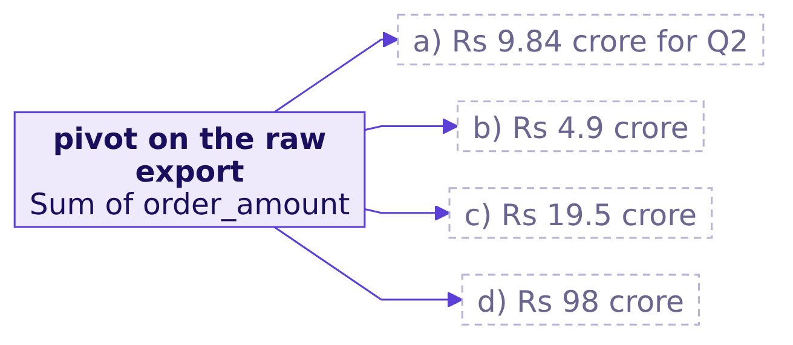
Indian Institute of Technology Gandhinagar
WEEK 2 · DAY 5 · KALPA GLOBAL CAPABILITY CENTRE
ADMINISTERED THROUGH THE COMPETENCY ADVANCEMENT ACADEMY
What does the pivot say for Q1 and Q2?
With segment in Rows, quarter in Columns and order_amount summed, what is Q2?
Question. The pivot's Q2 total reads about which, as a letter?
Which segment carries it?
Where did Q2 fall?
Find any member by id?
Read right in two minutes?
What must Excel never do?
S28 · 31 / 80
Notes:
LIVE, 1 minute. Every learner builds it on their own screen before you show yours. Do not warn them.

Slide 32

Indian Institute of Technology Gandhinagar
WEEK 2 · DAY 5 · KALPA GLOBAL CAPABILITY CENTRE
ADMINISTERED THROUGH THE COMPETENCY ADVANCEMENT ACADEMY
Answer: Rs 19.47 crore, and Core looks healthy
What is the plausible wrong answer, exactly?
Segment | Q1, as the pivot shows | Q2, as the pivot shows | Change
Business | Rs 19,80,28,880 | Rs 19,34,72,200 | -2.3%
Retail-Core | Rs 4,33,760 | Rs 4,38,160 | +1.0%
Retail-Plus | Rs 9,38,160 | Rs 7,00,910 | -25.3%
Student | Rs 35,350 | Rs 48,070 | +36.0%
All segments | Rs 19,94,36,150 | Rs 19,46,59,340 | -2.4%
WHAT BREAKS
The deck carries Rs 19.47 crore for Q2, nearly twice the warehouse's Rs 9.84 crore, and calls Retail-Core the healthy segment the plan can leave alone.
Which segment carries it?
Where did Q2 fall?
Find any member by id?
Read right in two minutes?
What must Excel never do?
S29 · 32 / 80
Notes:
LIVE, 4 minutes. The answer is c. Let it stand. Somebody usually says the totals look big but the
percentages look reasonable: the percentages are wrong too. Ask whether anyone would send it.

Slide 33
Indian Institute of Technology Gandhinagar
WEEK 2 · DAY 5 · KALPA GLOBAL CAPABILITY CENTRE
ADMINISTERED THROUGH THE COMPETENCY ADVANCEMENT ACADEMY
Why it is wrong: 1,450 rows, 1,000 orders
What does one row of the raw export stand for, and which check catches it?
1,450
1,000
450
ROWS
ORDER IDS
ORDERS ON TWO ROWS
one per payment
what the warehouse holds
550 on one
The check. Count rows against distinct order ids, then tie the grand total to the warehouse; either catches it in a minute. The export repeats each order's amount on every payment row, and a Sum adds every repeat.
Which segment carries it?
Where did Q2 fall?
Find any member by id?
Read right in two minutes?
What must Excel never do?
S30 · 33 / 80
Notes:
LIVE, 2 minutes. In Excel: COUNTA on order_id, a distinct count beside it. Then the grand total against
Rs 19,84,00,000. Name the grain now: one row is one payment.

Slide 34
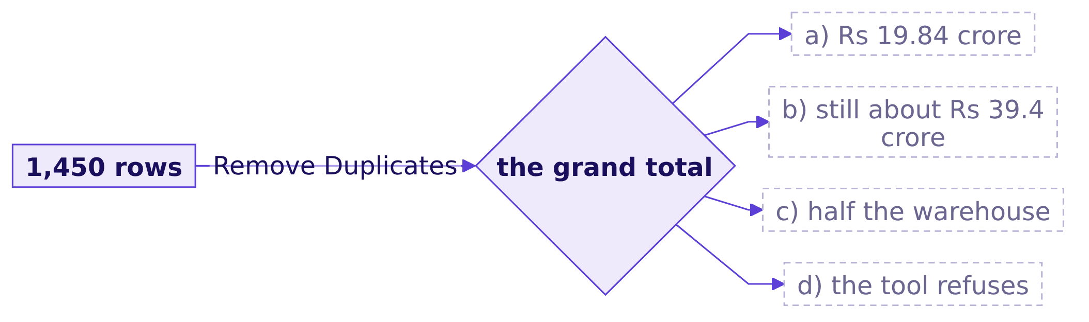
Indian Institute of Technology Gandhinagar
WEEK 2 · DAY 5 · KALPA GLOBAL CAPABILITY CENTRE
ADMINISTERED THROUGH THE COMPETENCY ADVANCEMENT ACADEMY
Does Remove Duplicates fix it?
With every column ticked, what does Remove Duplicates leave?
Question. After Remove Duplicates, the grand total reads which, as a letter?
Which segment carries it?
Where did Q2 fall?
Find any member by id?
Read right in two minutes?
What must Excel never do?
S31 · 34 / 80
Notes:
LIVE, 1 minute. Letters first, then run it live. Most rooms say a.

Slide 35
Indian Institute of Technology Gandhinagar
WEEK 2 · DAY 5 · KALPA GLOBAL CAPABILITY CENTRE
ADMINISTERED THROUGH THE COMPETENCY ADVANCEMENT ACADEMY
Answer: 50 rows go, and the total barely moves
Why does removing identical rows leave the double count?
Version of the export | Rows | Grand total
As exported | 1,450 | Rs 39,40,95,490
After Remove Duplicates | 1,400 | Rs 39,40,57,740
The warehouse | 1,000 orders | Rs 19,84,00,000
The answer is b. Only the 50 orders the gateway posted twice have identical rows; the 400 orders paid in two instalments differ in paid_amount, so both rows stay. Now the analyst believes the file is clean.
Which segment carries it?
Where did Q2 fall?
Find any member by id?
Read right in two minutes?
What must Excel never do?
S32 · 35 / 80
Notes:
LIVE, 2 minutes. Remove Duplicates is a cleaning step with no record, and here it did not even clean.
The fix has to name the grain.

Slide 36
Indian Institute of Technology Gandhinagar
WEEK 2 · DAY 5 · KALPA GLOBAL CAPABILITY CENTRE
ADMINISTERED THROUGH THE COMPETENCY ADVANCEMENT ACADEMY
The fix: flag each order's first row
What does the tree say when each order counts once?
=IF(COUNTIF($A$2:A2,A2)=1,1,0)
Segment | Q1 | Q2 | Change
Business | Rs 9,90,14,440 | Rs 9,75,84,600 | -1.4%
Retail-Core | Rs 3,73,070 | Rs 3,66,250 | -1.8%
Retail-Plus | Rs 5,85,770 | Rs 4,13,380 | -29.4%
All segments | Rs 10,00,00,000 | Rs 9,84,00,000 | -1.6%
What changed: the total falls by Rs 19,56,95,490 to the warehouse's, and Retail-Core turns from a 1.0 percent rise into a 1.8 percent fall.
Which segment carries it?
Where did Q2 fall?
Find any member by id?
Read right in two minutes?
What must Excel never do?
S33 · 36 / 80
Notes:
LIVE, 4 minutes. Type the flag in column A's neighbour and fill it down; pivot with the flag as a
filter, or SUMIFS on flag equals 1. Student moves from Rs 26,720 to Rs 35,770, up 33.9 percent, on few
orders. The running COUNTIF compares each row with every row above it: 1,051,975 comparisons here,
about 10.5 billion at 145,000 rows, which is the interview's design question.

Slide 37
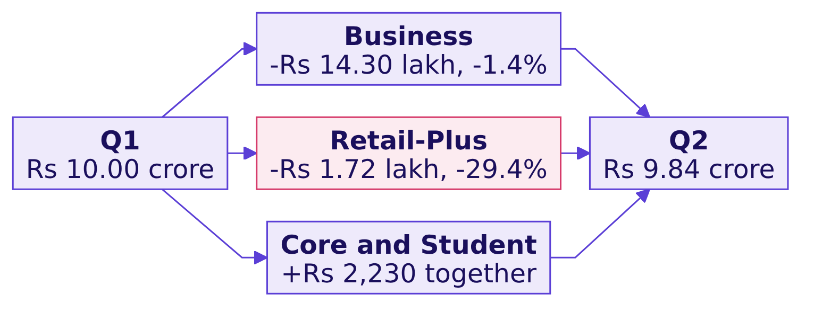
Indian Institute of Technology Gandhinagar
WEEK 2 · DAY 5 · KALPA GLOBAL CAPABILITY CENTRE
ADMINISTERED THROUGH THE COMPETENCY ADVANCEMENT ACADEMY
In rupees Business fell most; Plus fell steepest
Which segment and which leaf fell?
Retail-Plus | Q1 | Q2 | Change
Customers | 91 | 76 | -16.5%
Orders per customer | 2.36 | 1.84 | -22.0%
Revenue per order | Rs 2,725 | Rs 2,953 | +8.4%
Which segment carries it?
Where did Q2 fall?
Find any member by id?
Read right in two minutes?
What must Excel never do?
S34 · 37 / 80
Notes:
LIVE, 3 minutes. Two readings, both true. In rupees Business carries Rs 14,29,840 of the Rs 16,00,000
fall, the size of a few invoices landing in one quarter or the next. The steepest fall is Retail-Plus:
members kept buying big baskets and bought less often, the frequency branch Week 1 found. Multiply Q2
back: 76 times 1.84 times Rs 2,953 is Rs 4.13 lakh. Chapter 4 decides how each goes on the page.

Slide 38
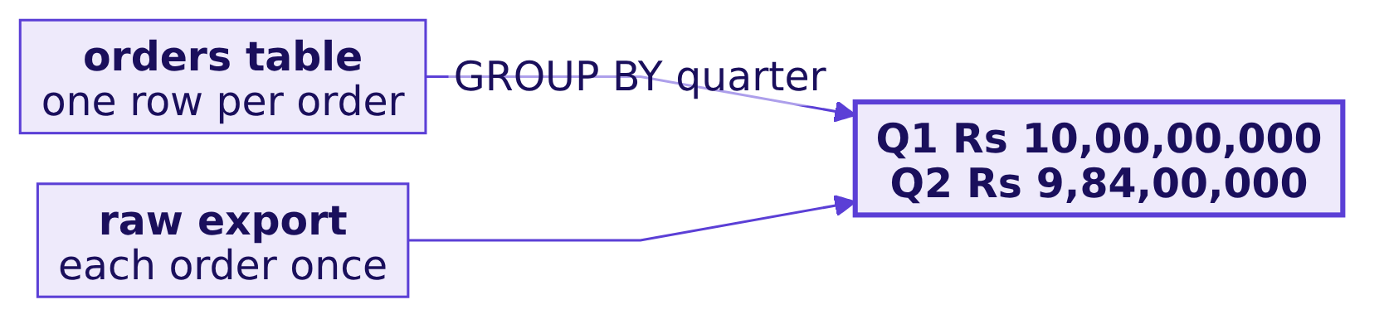
Indian Institute of Technology Gandhinagar
WEEK 2 · DAY 5 · KALPA GLOBAL CAPABILITY CENTRE
ADMINISTERED THROUGH THE COMPETENCY ADVANCEMENT ACADEMY
A second route: the warehouse's own quarters
Does the warehouse reach the same two numbers by a query that never saw the export?
SELECT quarter, count(*), sum(amount) FROM orders GROUP BY quarter returns 538 orders and Rs 10,00,00,000 for Q1, 462 and Rs 9,84,00,000 for Q2: equal to the export counted once, to the rupee and to the order.
Which segment carries it?
Where did Q2 fall?
Find any member by id?
Read right in two minutes?
What must Excel never do?
S35 · 38 / 80
Notes:
LIVE, 3 minutes. The notebook runs Monday's query against the warehouse. The export was written from
the warehouse; the second route asks the warehouse itself, which never saw the export, so it can
disagree. Here it does not.

Slide 39
Indian Institute of Technology Gandhinagar
WEEK 2 · DAY 5 · KALPA GLOBAL CAPABILITY CENTRE
ADMINISTERED THROUGH THE COMPETENCY ADVANCEMENT ACADEMY
Down 1.6 percent; Plus fell on frequency
What did chapter 2 answer, question by question?
Question | Answer
Which quarter? | 772 rows in Q1, 678 in Q2
The pivot says? | Rs 19,94,36,150 and Rs 19,46,59,340; Core up 1.0%
Why double? | One row per payment; Remove Duplicates leaves Rs 39,40,57,740
Counted once? | Rs 10.00 crore to Rs 9.84 crore, down 1.6%
Which leaf fell? | Business most in rupees; Retail-Plus 29.4% on frequency
Warehouse agrees? | To the rupee, both quarters
KAVYA'S REVIEW
"Two exports, two grains. Say the grain, count rows against ids, tie the total to the warehouse; a pivot that has not been tied has not been built."
IN THE INTERVIEW
[F] Your pivot shows a different total from the warehouse; where do you look first?
Which segment carries it?
Where did Q2 fall?
Find any member by id?
Read right in two minutes?
What must Excel never do?
S36 · 39 / 80
Notes:
LIVE, 2 minutes. One learner answers: the grain first, rows against keys; here 1,450 rows held 1,000
orders and Rs 39.41 crore against Rs 19.84 crore; then the period and filters; then keys missing on
either side.
Transition: Retail-Plus members are ordering less often, so which of them does the head of
Retail-Plus protect first?

Slide 40
Indian Institute of Technology Gandhinagar
PG DIPLOMA IN AI-ML AND AGENTIC AI ENGINEERING · COHORT 2
ADMINISTERED THROUGH THE COMPETENCY ADVANCEMENT ACADEMY
03
Find any member by id?
Which fifty Retail-Plus members go on the protect list, and when the chief of staff types an id, does the sheet answer for that member? Retention offers ride on it.
Which segment carries it?
Where did Q2 fall?
Find any member by id?
Read right in two minutes?
What must Excel never do?
Week 2, Day 5. What can a director open, change and still trust?
40 / 80
Notes:
LIVE. Thirty minutes. Notebook C2_W02_D05_03_member_lookup beside it; Excel live on the customer
table.

Slide 41
Indian Institute of Technology Gandhinagar
WEEK 2 · DAY 5 · KALPA GLOBAL CAPABILITY CENTRE
ADMINISTERED THROUGH THE COMPETENCY ADVANCEMENT ACADEMY
Answer it in six steps, from the list to the lookup
Who needs the answer, and what must we find out on the way?
Who needs the answer. The head of Retail-Plus, who sends the fifty a retention offer, and the chief of staff, who reads a member's line aloud when a director names one; a wrong row tells a director that a lapsed member is one of the best.
1
2
3
4
5
6
Who is on it?
Does it tie?
Which lookup?
A missing id?
Found or not?
A count agrees?
The fifty, and where the list stops.
The list's source against the warehouse.
Four ways, sized.
What the fourth argument does.
The exact match, and a re-sorted list.
The second route.
Which segment carries it?
Where did Q2 fall?
Find any member by id?
Read right in two minutes?
What must Excel never do?
S37 · 41 / 80
Notes:
LIVE, 1 minute. Chapter 2's finding in one line: Retail-Plus fell 29.4 percent because members
ordered less often, 2.36 orders each in Q1 and 1.84 in Q2. The head of Retail-Plus wants to protect
the best members before more of them drift.

Slide 42
Indian Institute of Technology Gandhinagar
WEEK 2 · DAY 5 · KALPA GLOBAL CAPABILITY CENTRE
ADMINISTERED THROUGH THE COMPETENCY ADVANCEMENT ACADEMY
The list sizes a retention budget
What is at stake, who asks, and what does a wrong row cost?
50
Head of Retail-Plus
One offer
MEMBERS PROTECTED
WHO ASKS
WHAT A WRONG ROW COSTS
Retail-Plus, by two-quarter revenue
sends the retention offer
spent on someone who stopped buying
THE CLIENT ASKS
"The top-fifty protect list with a lookup so I can find any member by id."
Which segment carries it?
Where did Q2 fall?
Find any member by id?
Read right in two minutes?
What must Excel never do?
S38 · 42 / 80
Notes:
LIVE, 1 minute. The protect list comes from the customer table, one row per customer, because that is
the table the chief of staff refreshes every Monday. Wednesday built a per-segment list in SQL on Q2;
this one ranks the two quarters together from the export.

Slide 43
Indian Institute of Technology Gandhinagar
WEEK 2 · DAY 5 · KALPA GLOBAL CAPABILITY CENTRE
ADMINISTERED THROUGH THE COMPETENCY ADVANCEMENT ACADEMY
TransAlta's ranked sheet returned the wrong rows
Which real company lost money to a sorted list whose rows answered for the wrong item?
US$24 m
10%
THE COST
OF THE YEAR'S PROFIT
TransAlta, 2003
The Globe and Mail
"It was literally a cut-and-paste error in an Excel spreadsheet that we did not detect when we did our final sorting and ranking of bids prior to submission."
Steve Snyder, TransAlta's president
Which segment carries it?
Where did Q2 fall?
Find any member by id?
Read right in two minutes?
What must Excel never do?
S39 · 43 / 80
Notes:
LIVE, 1 minute. The Globe and Mail, 4 June 2003, checked 30 September 2026: bids for New York
transmission congestion contracts, "misaligned the rows of information in the spreadsheet". A row
answering for the wrong item is expensive at any scale.

Slide 44
Indian Institute of Technology Gandhinagar
WEEK 2 · DAY 5 · KALPA GLOBAL CAPABILITY CENTRE
ADMINISTERED THROUGH THE COMPETENCY ADVANCEMENT ACADEMY
An exact match that says when an id is missing
Which lookup should answer "find this member", and what does each one return?
Option | A present id, C-0152 | An absent id, C-0195 | Re-sorted list | Excel 2016
a) VLOOKUP(id, A:F, 5) | Rs 25,840 | another member's row | unreliable | yes
b) VLOOKUP(id, A:F, 5, FALSE) | Rs 25,840 | #N/A | right | yes
c) IFERROR(INDEX(MATCH)), exact | Rs 25,840 | not in the table | right | yes
d) XLOOKUP(id, A:A, E:E, "not in the table") | Rs 25,840 | not in the table | right | no
The call. d on the room's Microsoft 365, c wherever the file must open. What would switch it: the Excel version on the chief of staff's laptop.
Which segment carries it?
Where did Q2 fall?
Find any member by id?
Read right in two minutes?
What must Excel never do?
S40 · 44 / 80
Notes:
LIVE, 4 minutes. Microsoft's page says XLOOKUP "is not available in Excel 2016 and Excel 2019", and
LibreOffice 24.2 shows #NAME? for it (both checked 30 September 2026). Option b is honest and ugly:
a director reads #N/A as a broken sheet. C-0195 is a Retail-Plus member with no orders in the two
quarters, so the table has no row for it.

Slide 45
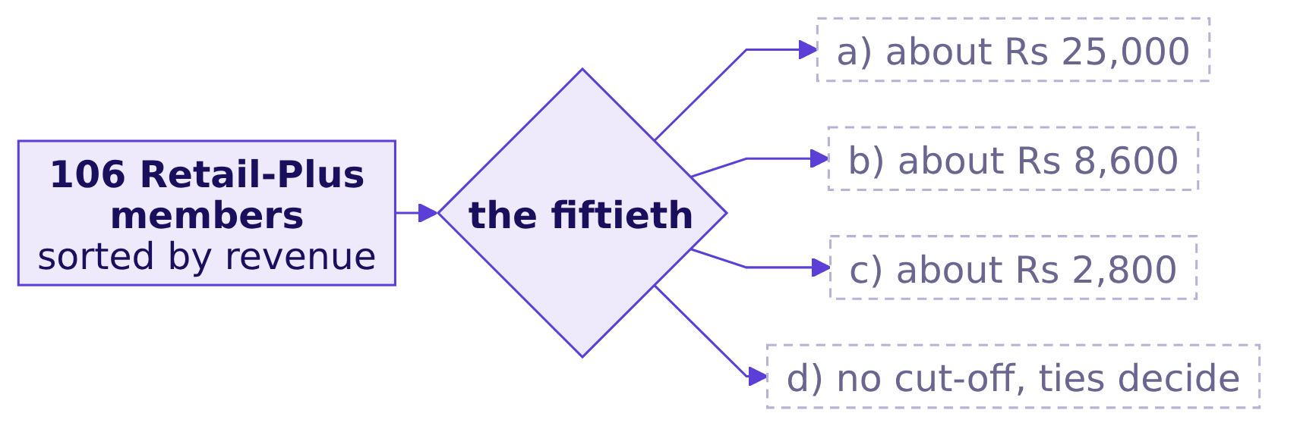
Indian Institute of Technology Gandhinagar
WEEK 2 · DAY 5 · KALPA GLOBAL CAPABILITY CENTRE
ADMINISTERED THROUGH THE COMPETENCY ADVANCEMENT ACADEMY
Who makes the list, and where does it stop?
Filter to Retail-Plus, sort by revenue, keep fifty: what is the cut-off?
Question. The fiftieth member's revenue, the list's cut-off, is about which, as a letter?
Which segment carries it?
Where did Q2 fall?
Find any member by id?
Read right in two minutes?
What must Excel never do?
S41 · 45 / 80
Notes:
LIVE, 1 minute. Build it live: copy the Retail-Plus rows to their own sheet, sort Largest to
Smallest, add =RANK.EQ(E2, E$2:E$107).

Slide 46
Indian Institute of Technology Gandhinagar
WEEK 2 · DAY 5 · KALPA GLOBAL CAPABILITY CENTRE
ADMINISTERED THROUGH THE COMPETENCY ADVANCEMENT ACADEMY
Answer: Rs 8,580, and no tie at the boundary
What does the list hold?
Rs 25,840
Rs 8,580
Rs 7,14,890
RANK 1
RANK 50, THE CUT-OFF
THE FIFTY TOGETHER
C-0152
the 51st spent Rs 8,520
April to September
The answer is b. Fifty of the 106 Retail-Plus members make the list, and since the fifty-first spent less than the fiftieth, the list ships exactly fifty rows; Wednesday's tie rule has nothing to decide.
Which segment carries it?
Where did Q2 fall?
Find any member by id?
Read right in two minutes?
What must Excel never do?
S42 · 46 / 80
Notes:
LIVE, 2 minutes. Mention Wednesday once: with a tie at fifty, the rule decides whether a list ships 49
or 51 rows. Not today.

Slide 47

Indian Institute of Technology Gandhinagar
WEEK 2 · DAY 5 · KALPA GLOBAL CAPABILITY CENTRE
ADMINISTERED THROUGH THE COMPETENCY ADVANCEMENT ACADEMY
Your turn: tie the list's source yourself
The raw export tied to the warehouse in chapter 2; does the customer table tie on its own?
STEP 1
STEP 2
STEP 3
STEP 4
Sum it
Tie it
Find it
Say it
The customer table's orders and revenue.
Against the raw export counted once, 1,000 orders and Rs 19,84,00,000.
Any id in the export and not in the table.
What your answer means for the list and the lookup.
THE RULE
A list built on a table that has not been tied has not been built. In Excel: SUM the table's orders and revenue, set them beside the raw export counted once, and COUNTIF each export id in the table.
Which segment carries it?
Where did Q2 fall?
Find any member by id?
Read right in two minutes?
What must Excel never do?
S43 · 47 / 80
Notes:
LIVE, 5 minutes; the notebook's empty cell holds the same lines for self-study. TRAINER: the day sheet has what they
should find. Let them find it; take two sentences aloud and do not confirm or name anything. Whoever
finds it has just made the lookup trap catchable.

Slide 48
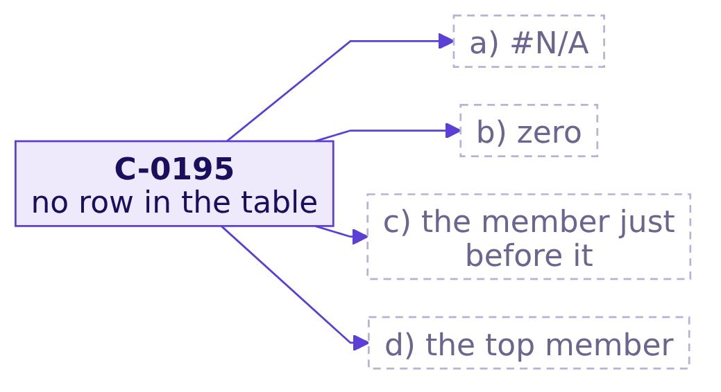
Indian Institute of Technology Gandhinagar
WEEK 2 · DAY 5 · KALPA GLOBAL CAPABILITY CENTRE
ADMINISTERED THROUGH THE COMPETENCY ADVANCEMENT ACADEMY
What does VLOOKUP return for C-0195?
The table has no row for C-0195; what comes back when the fourth argument is left out?
=VLOOKUP("C-0195", A2:F301, 5)
Question. What comes back, as a letter?
Which segment carries it?
Where did Q2 fall?
Find any member by id?
Read right in two minutes?
What must Excel never do?
S44 · 48 / 80
Notes:
LIVE, 1 minute. Letters first. Most rooms say a.

Slide 49
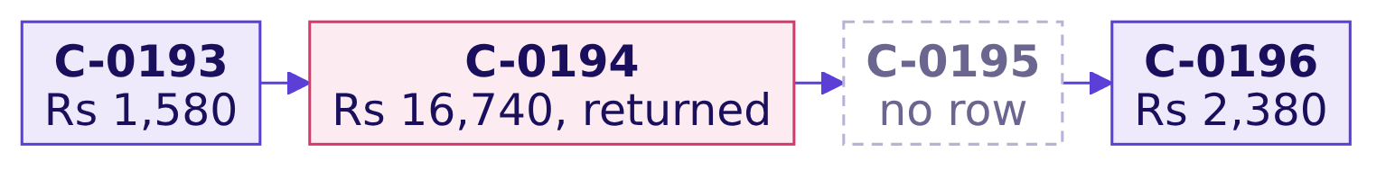
Indian Institute of Technology Gandhinagar
WEEK 2 · DAY 5 · KALPA GLOBAL CAPABILITY CENTRE
ADMINISTERED THROUGH THE COMPETENCY ADVANCEMENT ACADEMY
Answer: C-0194's row, rank 15, and nothing is red
What is the plausible wrong answer, and why does the sheet give it?
The answer is c. Left out, the fourth argument "will always be TRUE or approximate match" (Microsoft Support, VLOOKUP, checked 30 September 2026), which returns the largest id not above the one asked for. What breaks: a director hears that C-0195 spent Rs 16,740 and sits at rank 15, and a retention offer goes to someone who placed no order between April and September.
Which segment carries it?
Where did Q2 fall?
Find any member by id?
Read right in two minutes?
What must Excel never do?
S45 · 49 / 80
Notes:
LIVE, 4 minutes. Run it live. Nothing on screen is red: that is the whole trap. The check that catches
it: test every lookup with an id you know is missing, and print the id returned beside the id asked
for.

Slide 50
Indian Institute of Technology Gandhinagar
WEEK 2 · DAY 5 · KALPA GLOBAL CAPABILITY CENTRE
ADMINISTERED THROUGH THE COMPETENCY ADVANCEMENT ACADEMY
The fix: an exact match with a not-found path
What do C-0195, C-0152 and C-0194 return once the match is exact?
Asked for | Exact, with a not-found path | Approximate
C-0195 | not in the table | C-0194: Rs 16,740
C-0152 | Rs 25,840 | C-0152: Rs 25,840
C-0194 | Rs 16,740 | C-0194: Rs 16,740
What changed: C-0195's line moves from "rank 15, Rs 16,740" to "not in the table", the answer that makes somebody check the export. For members in the table the two agree, which is why a lookup tested only on present ids looks fine.
Which segment carries it?
Where did Q2 fall?
Find any member by id?
Read right in two minutes?
What must Excel never do?
S46 · 50 / 80
Notes:
LIVE, 3 minutes. Type both forms: =XLOOKUP(id, A:A, E:E, "not in the table") and
=IFERROR(INDEX(E:E, MATCH(id, A:A, 0)), "not in the table"). Now the room reads out an id; see the day
sheet for the moment.

Slide 51
Indian Institute of Technology Gandhinagar
WEEK 2 · DAY 5 · KALPA GLOBAL CAPABILITY CENTRE
ADMINISTERED THROUGH THE COMPETENCY ADVANCEMENT ACADEMY
The room sorts the list by revenue
What happens to each lookup once the ids are no longer in order?
24 of 49
50 of 50
STEPS DOWN THE LIST
EXACT LOOKUPS
to a smaller id
still right, shuffled
An approximate match assumes the first column is sorted: "If the first column isn't sorted, the return value might be something you don't expect" (Microsoft Support, VLOOKUP, checked 30 September 2026). An exact match does not care about order, so it survives the view a director actually looks at.
Which segment carries it?
Where did Q2 fall?
Find any member by id?
Read right in two minutes?
What must Excel never do?
S47 · 51 / 80
Notes:
LIVE, 2 minutes. The room sees the list sorted by revenue, never by id. Walking down it, 24 of 49
steps go to a smaller id, so an approximate match has nothing sorted to search.

Slide 52
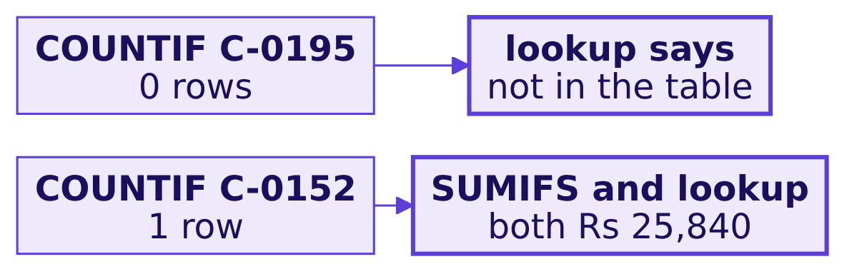
Indian Institute of Technology Gandhinagar
WEEK 2 · DAY 5 · KALPA GLOBAL CAPABILITY CENTRE
ADMINISTERED THROUGH THE COMPETENCY ADVANCEMENT ACADEMY
A second route: a count instead of a match
Does an independent count agree with the lookup?
=COUNTIF(A:A, "C-0195") counts zero rows, which has to meet a not-found answer; =SUMIFS(E:E, A:A, "C-0152") adds Rs 25,840, which has to meet the lookup. Counting and matching are different methods, so each can catch the other.
Which segment carries it?
Where did Q2 fall?
Find any member by id?
Read right in two minutes?
What must Excel never do?
S48 · 52 / 80
Notes:
LIVE, 2 minutes. The count is the check a director can see: put it beside the lookup on the sheet.

Slide 53
Indian Institute of Technology Gandhinagar
WEEK 2 · DAY 5 · KALPA GLOBAL CAPABILITY CENTRE
ADMINISTERED THROUGH THE COMPETENCY ADVANCEMENT ACADEMY
Fifty members, and a lookup that says so
What did chapter 3 answer, question by question?
Question | Answer
Who is on it? | Fifty, Rs 25,840 down to Rs 8,580
Does it tie? | The room's own answer, from the your-turn step
Which lookup? | XLOOKUP on 365; IFERROR with INDEX and MATCH anywhere
A missing id? | Approximate returns C-0194, Rs 16,740, rank 15
Found or not? | "Not in the table"; the same on a re-sorted list
A count agrees? | COUNTIF 0 and 1, both matching the lookup
KAVYA'S REVIEW
"A lookup that answers with somebody else's row is worse than no lookup, because nobody in the room can tell. Test with an id you know is missing."
IN THE INTERVIEW
[F] Your lookup returned a member for an id that does not exist; which argument was wrong?
Which segment carries it?
Where did Q2 fall?
Find any member by id?
Read right in two minutes?
What must Excel never do?
S49 · 53 / 80
Notes:
LIVE, 3 minutes. One learner answers: the match type; VLOOKUP's fourth argument left out is
approximate; exact with a not-found path, tested with a missing id. BREAK, 10 minutes, after this
slide.

Slide 54
Indian Institute of Technology Gandhinagar
PG DIPLOMA IN AI-ML AND AGENTIC AI ENGINEERING · COHORT 2
ADMINISTERED THROUGH THE COMPETENCY ADVANCEMENT ACADEMY
04
Read right in two minutes?
What must sit beside the front-page number so a director reads it right in two minutes? The meeting's first decision is made from it.
Which segment carries it?
Where did Q2 fall?
Find any member by id?
Read right in two minutes?
What must Excel never do?
Week 2, Day 5. What can a director open, change and still trust?
54 / 80
Notes:
LIVE. Thirty minutes. Notebook C2_W02_D05_04_front_page beside it.

Slide 55
Indian Institute of Technology Gandhinagar
WEEK 2 · DAY 5 · KALPA GLOBAL CAPABILITY CENTRE
ADMINISTERED THROUGH THE COMPETENCY ADVANCEMENT ACADEMY
Answer it in six steps, from total to scope
Who needs the answer, and what must we find out on the way?
Who needs the answer. Meera and her directors, who read the front page first and may read nothing else, and the chief of staff, who answers for it; a card without its period reads two quarters as one.
1
2
3
4
5
6
A bare total?
Which form?
The card?
A bare percentage?
Trend and scope?
Warehouse agrees?
What a director reads in it.
Four cards, sized.
Period, comparison, base.
Six months, and a director's input.
What it leaves out.
The second route.
Which segment carries it?
Where did Q2 fall?
Find any member by id?
Read right in two minutes?
What must Excel never do?
S50 · 55 / 80
Notes:
LIVE, 1 minute. The number itself is given: revenue, Q2 against Q1. Which metric belongs on a growth
review's front page at all is a later week's question; today is about reading this one right.

Slide 56
Indian Institute of Technology Gandhinagar
WEEK 2 · DAY 5 · KALPA GLOBAL CAPABILITY CENTRE
ADMINISTERED THROUGH THE COMPETENCY ADVANCEMENT ACADEMY
The front page is read in two minutes
What is at stake, who reads it, and what does a misread cost?
Rs 9.84 cr
-1.6%
2 minutes
Q2 REVENUE
ON Q1
THE READING TIME
July to September 2026
Rs 10.00 crore
a director's, for the front page
THE CLIENT ASKS
"One number on the front page with its trend."
Which segment carries it?
Where did Q2 fall?
Find any member by id?
Read right in two minutes?
What must Excel never do?
S51 · 56 / 80
Notes:
LIVE, 1 minute. Chapter 2's numbers: Q1 Rs 10.00 crore, Q2 Rs 9.84 crore; in rupees Business carries
Rs 14.30 lakh of the Rs 16.00 lakh fall, and the steepest fall is Retail-Plus, 29.4 percent.

Slide 57
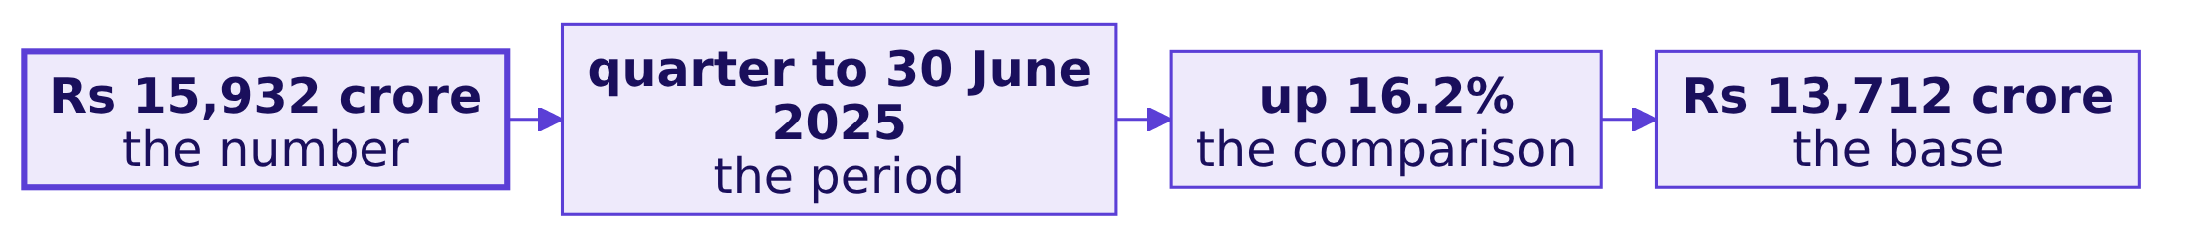
Indian Institute of Technology Gandhinagar
WEEK 2 · DAY 5 · KALPA GLOBAL CAPABILITY CENTRE
ADMINISTERED THROUGH THE COMPETENCY ADVANCEMENT ACADEMY
DMart's headline carries all four parts
Which real company writes this card every quarter?
"Standalone Total Revenue up by 16.2% at Rs.15,932 Crore."
Avenue Supermarts (DMart), press release, quarter ended 30 June 2025
Which segment carries it?
Where did Q2 fall?
Find any member by id?
Read right in two minutes?
What must Excel never do?
S52 · 57 / 80
Notes:
LIVE, 2 minutes. Press release of 11 July 2025, checked 30 September 2026: revenue "stood at
Rs.15,932 crore, as compared to Rs.13,712 crore in the same period last year." The number, the
period, the comparison and the base are all in the first two lines.

Slide 58
Indian Institute of Technology Gandhinagar
WEEK 2 · DAY 5 · KALPA GLOBAL CAPABILITY CENTRE
ADMINISTERED THROUGH THE COMPETENCY ADVANCEMENT ACADEMY
The quarter against the last, with its sentence
Which form should the card take, and what does each ask the director to remember?
Option | The card | Words | The director must bring
a) The total | "Revenue Rs 19.84 crore" | 4 | the period and the last figure
b) The quarter | "Q2 revenue Rs 9.84 crore" | 5 | Q1's figure, from memory
c) Against the last | "Q2 ... Rs 9.84 crore, down 1.6 percent on Q1 (Rs 10.00 crore)" | 29 | nothing
d) c with sentence and trend | c, where the change sits, and six months drawn | 53 | nothing
The call. d. What would switch it: a board that reviews every month against the plan line, where the comparison becomes the plan.
Which segment carries it?
Where did Q2 fall?
Find any member by id?
Read right in two minutes?
What must Excel never do?
S53 · 58 / 80
Notes:
LIVE, 4 minutes. Fifty-odd words and one small line, read in the two minutes a director gives the
front page, with nothing left to memory.

Slide 59
Indian Institute of Technology Gandhinagar
WEEK 2 · DAY 5 · KALPA GLOBAL CAPABILITY CENTRE
ADMINISTERED THROUGH THE COMPETENCY ADVANCEMENT ACADEMY
What does a director read in "Revenue Rs 19.84 crore"?
The fastest card is the export's grand total; what does a director who remembers Q1 read into it?
Rs 19.84 cr
REVENUE
the card as drafted
Question. A director who remembers Q1 at Rs 10.00 crore reads this card as: a) two quarters of revenue; b) revenue nearly doubled this quarter; c) a number to check later; d) nothing wrong, since the number is right.
Which segment carries it?
Where did Q2 fall?
Find any member by id?
Read right in two minutes?
What must Excel never do?
S54 · 59 / 80
Notes:
LIVE, 2 minutes. Letters. Then ask who has seen b happen in a real meeting.

Slide 60
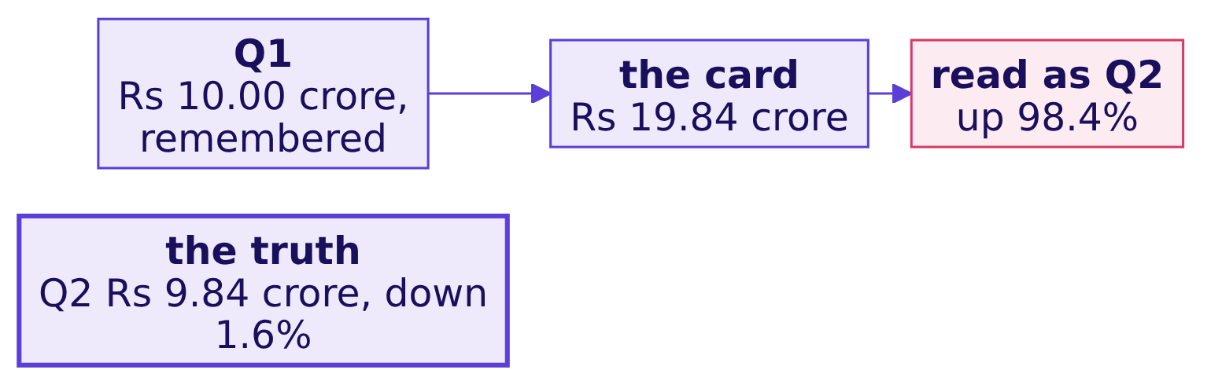
Indian Institute of Technology Gandhinagar
WEEK 2 · DAY 5 · KALPA GLOBAL CAPABILITY CENTRE
ADMINISTERED THROUGH THE COMPETENCY ADVANCEMENT ACADEMY
Answer: up 98.4 percent, a quarter that never happened
Why is the bare total the plausible wrong answer, and what catches it?
The answer is b. The number is right and its period is missing, so the reader supplies one, and the minutes record a boom. The check: read the card aloud and ask which months, against what. The fix: the period and the comparison on the card itself.
Which segment carries it?
Where did Q2 fall?
Find any member by id?
Read right in two minutes?
What must Excel never do?
S55 · 60 / 80
Notes:
LIVE, 3 minutes. The card is April to September added together. Read against one remembered quarter
it reads up 98.4 percent.

Slide 61
Indian Institute of Technology Gandhinagar
WEEK 2 · DAY 5 · KALPA GLOBAL CAPABILITY CENTRE
ADMINISTERED THROUGH THE COMPETENCY ADVANCEMENT ACADEMY
The card: period, comparison, base, sentence
What does the card say, and what sits beside it?
Rs 9.84 cr
-1.6%
Rs 10.00 cr
Q2, JULY TO SEPTEMBER 2026
ON Q1
Q1, APRIL TO JUNE 2026
the number and its period
the comparison, measured on Q1
the base
The sentence beside it. "Business invoices carry Rs 14.30 lakh of the Rs 16.00 lakh fall; Retail-Plus, the paid tier, fell 29.4 percent because members ordered less often."
Which segment carries it?
Where did Q2 fall?
Find any member by id?
Read right in two minutes?
What must Excel never do?
S56 · 61 / 80
Notes:
LIVE, 4 minutes. Read the card aloud: "All segments, Q2, July to September 2026: Rs 9.84 crore, down
1.6 percent on Q1, April to June 2026 (Rs 10.00 crore); 100.0 percent of company revenue in Q2." The
change is Q2 minus Q1, divided by Q1.

Slide 62
Indian Institute of Technology Gandhinagar
WEEK 2 · DAY 5 · KALPA GLOBAL CAPABILITY CENTRE
ADMINISTERED THROUGH THE COMPETENCY ADVANCEMENT ACADEMY
What does "Retail-Plus down 29.4 percent" leave out?
The second slot is drafted as a bare percentage; what must sit beside it?
-29.4%
RETAIL-PLUS, AS DRAFTED
no base, no share
Question. What must sit beside it? a) nothing, since it is correct; b) its rupee base and its share of revenue; c) the Business figure; d) the protect list.
Which segment carries it?
Where did Q2 fall?
Find any member by id?
Read right in two minutes?
What must Excel never do?
S57 · 62 / 80
Notes:
LIVE, 1 minute. The percentage is right. Letters first.

Slide 63
Indian Institute of Technology Gandhinagar
WEEK 2 · DAY 5 · KALPA GLOBAL CAPABILITY CENTRE
ADMINISTERED THROUGH THE COMPETENCY ADVANCEMENT ACADEMY
Answer: Rs 1.72 lakh, 0.4 percent of the quarter
What is the base the draft left out, and what slip makes it worse?
Rs 1.72 lakh
0.4%
-41.7%
THE FALL IN RUPEES
OF Q2 REVENUE
DIVIDED BY Q2
Rs 5.86 lakh to Rs 4.13 lakh
Retail-Plus's share
the slip that makes it worse
The answer is b. Read without its base, "down 29.4 percent" sounds like the business collapsing, and the meeting argues about a panic instead of about members ordering less often. The fix: "Retail-Plus, Q2: Rs 4.13 lakh, down 29.4 percent on Q1 (Rs 5.86 lakh); 0.4 percent of company revenue."
Which segment carries it?
Where did Q2 fall?
Find any member by id?
Read right in two minutes?
What must Excel never do?
S58 · 63 / 80
Notes:
LIVE, 3 minutes. The slip: the same change divided by Q2 instead of Q1 reads 41.7 percent. A change is
measured on the earlier period.

Slide 64
Indian Institute of Technology Gandhinagar
WEEK 2 · DAY 5 · KALPA GLOBAL CAPABILITY CENTRE
ADMINISTERED THROUGH THE COMPETENCY ADVANCEMENT ACADEMY
The trend beside it, and the scope a director picks
What do six months show, and what happens when a director changes the scope?
The director asks for | The card says
All segments | Rs 9.84 crore, down 1.6% on Q1; 100.0% of revenue
All except Business | Rs 8.15 lakh, down 17.3% on Q1; 0.8% of revenue
Retail-Plus | Rs 4.13 lakh, down 29.4% on Q1; 0.4% of revenue
The company line jumps in July to Rs 4.51 crore, 45 percent above June, on corporate invoices; without Business, revenue slides from Rs 3.32 lakh in June to Rs 2.48 lakh in September. The scope is a yellow input, and each card prints its own scope.
Which segment carries it?
Where did Q2 fall?
Find any member by id?
Read right in two minutes?
What must Excel never do?
S59 · 64 / 80
Notes:
LIVE, 5 minutes. The notebook draws both lines; describe them here. Two directors asking for two scopes
get two honest cards, and down 1.6 and down 17.3 percent are never compared as one number.

Slide 65
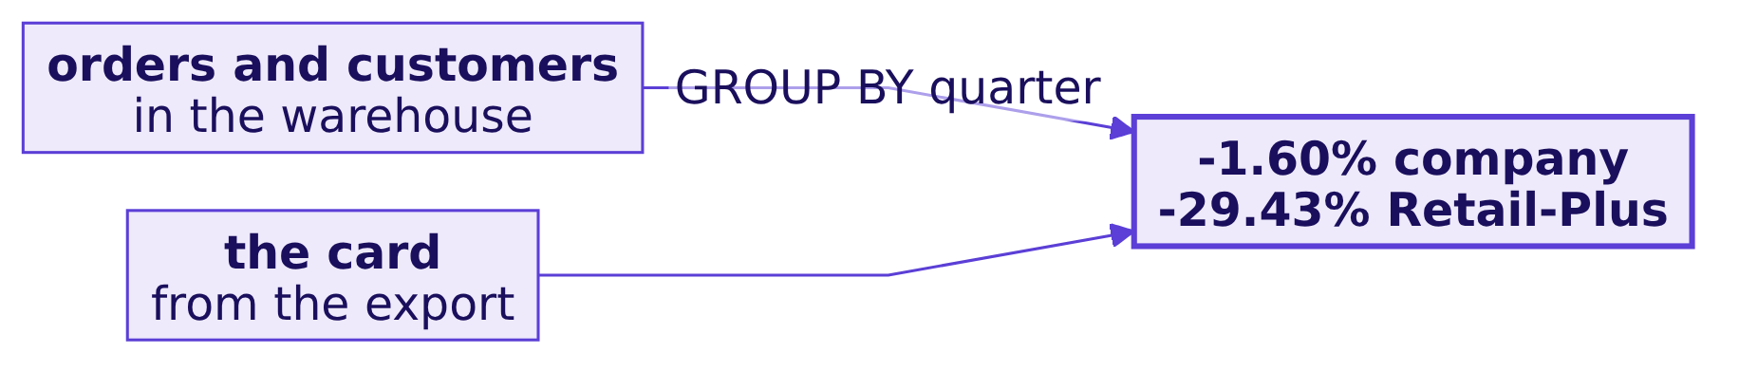
Indian Institute of Technology Gandhinagar
WEEK 2 · DAY 5 · KALPA GLOBAL CAPABILITY CENTRE
ADMINISTERED THROUGH THE COMPETENCY ADVANCEMENT ACADEMY
A second route: the warehouse's own change
Does the warehouse reach the same two changes by its own query?
The warehouse's orders, joined to its customers for the segment, give the same changes to the hundredth of a percent: minus 1.60 for the company and minus 29.43 for Retail-Plus.
Which segment carries it?
Where did Q2 fall?
Find any member by id?
Read right in two minutes?
What must Excel never do?
S60 · 65 / 80
Notes:
LIVE, 1 minute. The query joins orders to customers on customer_id and groups by quarter.

Slide 66
Indian Institute of Technology Gandhinagar
WEEK 2 · DAY 5 · KALPA GLOBAL CAPABILITY CENTRE
ADMINISTERED THROUGH THE COMPETENCY ADVANCEMENT ACADEMY
Q2 against Q1, and every percentage in rupees
What did chapter 4 answer, question by question?
Question | Answer
A bare total? | Rs 19.84 crore, read as up 98.4%
Which form? | d: the quarter against the last, with sentence and trend
The card? | Q2 Rs 9.84 crore, down 1.6% on Q1 (Rs 10.00 crore)
A bare percentage? | Rs 1.72 lakh on Rs 5.86 lakh, 0.4% of revenue
Trend and scope? | July's jump is invoices; without Business, down 17.3%
Warehouse agrees? | -1.60% and -29.43%
KAVYA'S REVIEW
"A number without its period is read against whatever the director remembers; a percentage without its base is read as whatever the director fears."
IN THE INTERVIEW
[F] How do you present one number so it is not misread?
Which segment carries it?
Where did Q2 fall?
Find any member by id?
Read right in two minutes?
What must Excel never do?
S61 · 66 / 80
Notes:
LIVE, 3 minutes. One learner answers aloud with the card as the example.

Slide 67
Indian Institute of Technology Gandhinagar
PG DIPLOMA IN AI-ML AND AGENTIC AI ENGINEERING · COHORT 2
ADMINISTERED THROUGH THE COMPETENCY ADVANCEMENT ACADEMY
05
What must Excel never do?
Which of the week's steps belong in the workbook, which must never be done there, and how do the two stay in step? Every number Finance relies on depends on it.
Which segment carries it?
Where did Q2 fall?
Find any member by id?
Read right in two minutes?
What must Excel never do?
Week 2, Day 5. What can a director open, change and still trust?
67 / 80
Notes:
LIVE. Thirty minutes. Notebook C2_W02_D05_05_operating_rule beside it.

Slide 68
Indian Institute of Technology Gandhinagar
WEEK 2 · DAY 5 · KALPA GLOBAL CAPABILITY CENTRE
ADMINISTERED THROUGH THE COMPETENCY ADVANCEMENT ACADEMY
Answer it in six steps, from the week to the rule
Who needs the answer, and what must we find out on the way?
Who needs the answer. Kavya, who signs the team's rule, and Anand's analyst, who audits every number Finance relies on; a join done in a sheet can report as unpaid money that customers have paid.
1
2
3
4
5
6
What each touches?
Where could it live?
A lookup joins?
Every payment?
Where each belongs?
How in step?
Booked against collected.
What adding them says.
The drift check.
The week's steps.
Four arrangements, sized.
The rule.
Which segment carries it?
Where did Q2 fall?
Find any member by id?
Read right in two minutes?
What must Excel never do?
S62 · 68 / 80
Notes:
LIVE, 1 minute. Read Kavya's challenge aloud: "Which parts belong in Excel, which parts must never be in
Excel, and how do you keep the two from drifting apart?" Chapters 1 to 4 built the three deliverables;
this is the rule behind them.

Slide 69
Indian Institute of Technology Gandhinagar
WEEK 2 · DAY 5 · KALPA GLOBAL CAPABILITY CENTRE
ADMINISTERED THROUGH THE COMPETENCY ADVANCEMENT ACADEMY
Collected against booked is the test case
What is at stake, who asks, and what does a wrong number cost?
Rs 19.84 cr
Anand
A false alarm
BOOKED
WHO ASKS
WHAT IT COSTS
the orders' value, both quarters
finance controller
a collections team chasing paid accounts
Booked is the value of the orders; collected is the money received against them. Tuesday built the report in the warehouse; it needs a join, one order to several payments.
Which segment carries it?
Where did Q2 fall?
Find any member by id?
Read right in two minutes?
What must Excel never do?
S63 · 69 / 80
Notes:
LIVE, 2 minutes. Anand asks whether the deck pack could carry Tuesday's collected figure too, computed
in the workbook so nobody needs a login.

Slide 70
Indian Institute of Technology Gandhinagar
WEEK 2 · DAY 5 · KALPA GLOBAL CAPABILITY CENTRE
ADMINISTERED THROUGH THE COMPETENCY ADVANCEMENT ACADEMY
Public Health England left 15,841 cases unreported
Which real organisation ran a pipeline step in a spreadsheet?
15,841
~65,000
~1,400
CASES NOT REPORTED
ROWS PER XLS TEMPLATE
CASES PER TEMPLATE
25 September to 2 October 2020
BBC News
several rows per test result
"15,841 cases between 25 September and 2 October were not included in the reported daily COVID-19 cases."
Public Health England, 4 October 2020
Which segment carries it?
Where did Q2 fall?
Find any member by id?
Read right in two minutes?
What must Excel never do?
S64 · 70 / 80
Notes:
LIVE, 2 minutes. GOV.UK statement of 4 October 2020 and BBC News of 5 October 2020, both checked 30
September 2026. Rows past the old format's limit were dropped, not rejected: nothing was red.

Slide 71
Indian Institute of Technology Gandhinagar
WEEK 2 · DAY 5 · KALPA GLOBAL CAPABILITY CENTRE
ADMINISTERED THROUGH THE COMPETENCY ADVANCEMENT ACADEMY
The split: warehouse, pandas, workbook
Where could the week's work live, and what does each arrangement cost?
Option | Collected per order costs | Who can rerun it | What an auditor traces
a) All in the workbook | 1,000 SUMIFS x 1,450 rows = 1,450,000 tests a recalculation | its author, by hand | the cells
b) The split | one GROUP BY over 1,428 payments | anyone with the query | the query
c) pandas pastes values | one groupby over 1,450 rows | the analyst | the notebook
d) Dashboard | a query a view | its owner | the queries, behind a login
The call. b. What would switch it: a one-off question nobody audits and nobody reruns can live in a sheet.
Which segment carries it?
Where did Q2 fall?
Find any member by id?
Read right in two minutes?
What must Excel never do?
S65 · 71 / 80
Notes:
LIVE, 3 minutes. The warehouse owns every join, dedupe and rank because a query can be rerun and
audited. Option d fails the brief on the login.

Slide 72
Indian Institute of Technology Gandhinagar
WEEK 2 · DAY 5 · KALPA GLOBAL CAPABILITY CENTRE
ADMINISTERED THROUGH THE COMPETENCY ADVANCEMENT ACADEMY
What did each day build, and what does it read?
Which of the week's steps touches the most rows?
Day | Step | Reads
Monday | The tree by segment and quarter | 1,000 orders
Tuesday | Booked against collected | 1,000 orders and 1,428 payments
Wednesday | Top fifty, falling spend | orders, by window
Thursday | The customer table | orders, customers, exposure
Friday | Pivot, lookup, card | the two exports
Question. Which step touches the most rows? a) the tree; b) booked against collected; c) the top fifty; d) Friday's pivot.
Which segment carries it?
Where did Q2 fall?
Find any member by id?
Read right in two minutes?
What must Excel never do?
S66 · 72 / 80
Notes:
LIVE, 1 minute. Letters, quickly.

Slide 73
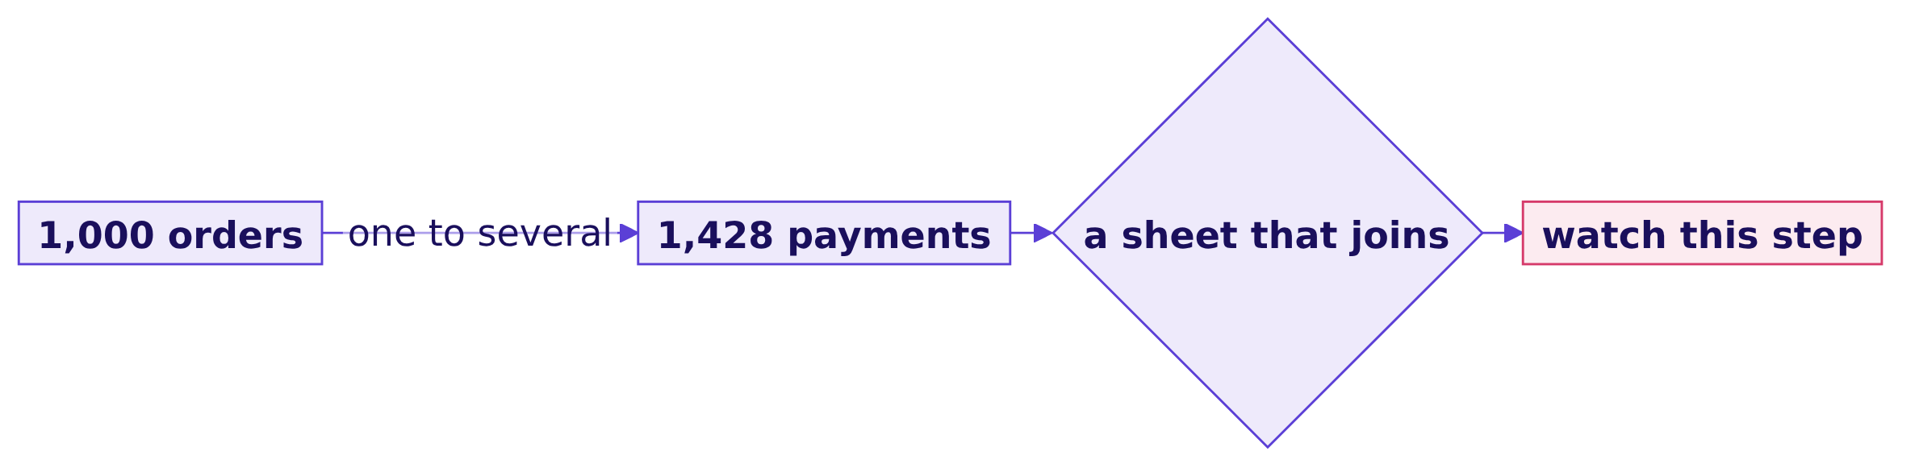
Indian Institute of Technology Gandhinagar
WEEK 2 · DAY 5 · KALPA GLOBAL CAPABILITY CENTRE
ADMINISTERED THROUGH THE COMPETENCY ADVANCEMENT ACADEMY
Answer: Tuesday's join, one order to several payments
Why is that the step to watch?
The answer is b. It is the one step where one row on one side meets several on the other, which is exactly what a lookup in a sheet handles worst.
Which segment carries it?
Where did Q2 fall?
Find any member by id?
Read right in two minutes?
What must Excel never do?
S67 · 73 / 80
Notes:
LIVE, 1 minute. Transition: so try it the hurried way.

Slide 74
Indian Institute of Technology Gandhinagar
WEEK 2 · DAY 5 · KALPA GLOBAL CAPABILITY CENTRE
ADMINISTERED THROUGH THE COMPETENCY ADVANCEMENT ACADEMY
What does collected say when a lookup joins?
=VLOOKUP(A2, RawExport!A:H, 7, FALSE) fetches paid_amount beside each order; what does it add up to?
Rs 19.84 cr
?
BOOKED
COLLECTED, BY LOOKUP
1,000 orders
one exact match per order
Question. Collected reads about: a) Rs 19.7 crore; b) Rs 11.8 crore; c) Rs 39 crore; d) exactly booked.
Which segment carries it?
Where did Q2 fall?
Find any member by id?
Read right in two minutes?
What must Excel never do?
S68 · 74 / 80
Notes:
LIVE, 2 minutes. The match is exact. Letters first; most rooms say a or d.

Slide 75
Indian Institute of Technology Gandhinagar
WEEK 2 · DAY 5 · KALPA GLOBAL CAPABILITY CENTRE
ADMINISTERED THROUGH THE COMPETENCY ADVANCEMENT ACADEMY
Answer: Rs 8.00 crore "outstanding", 40.3 percent
What is the plausible wrong answer, and what decision would it mislead?
Rs 11.84 cr
Rs 8.00 cr
450
COLLECTED, BY LOOKUP
OUTSTANDING, IT SAYS
ORDERS ON TWO ROWS
Rs 11,83,81,974
40.3 percent of booked
the lookup reads one
The answer is b. What breaks: Anand's team chases Rs 8 crore from accounts that paid, most of them corporate buyers, and the board pack reports a cash problem Kalpa does not have. Why: a lookup returns the first matching row and stops.
Which segment carries it?
Where did Q2 fall?
Find any member by id?
Read right in two minutes?
What must Excel never do?
S69 · 75 / 80
Notes:
LIVE, 4 minutes. Every channel reads about 60 percent collected. The check: count the rows each order
has; any order with two rows needs its payments added, never looked up.

Slide 76
Indian Institute of Technology Gandhinagar
WEEK 2 · DAY 5 · KALPA GLOBAL CAPABILITY CENTRE
ADMINISTERED THROUGH THE COMPETENCY ADVANCEMENT ACADEMY
The fix: add every payment, and join upstream
What does adding every payment say?
=SUMIFS(G:G, A:A, A2) adds every payment for the order: collected Rs 19,66,82,820, Rs 17,17,180 short of booked, 0.9 percent. What changed: Rs 7,83,00,846 of "outstanding" money disappears. The join belongs in the warehouse, where Tuesday did it; SUMIFS is only a check.
Which segment carries it?
Where did Q2 fall?
Find any member by id?
Read right in two minutes?
What must Excel never do?
S70 · 76 / 80
Notes:
LIVE, 3 minutes. The real gaps are Tuesday's: orders nobody has paid for and payments posted twice that
are owed back. Point back at Tuesday by name; do not re-teach it.

Slide 77
Indian Institute of Technology Gandhinagar
WEEK 2 · DAY 5 · KALPA GLOBAL CAPABILITY CENTRE
ADMINISTERED THROUGH THE COMPETENCY ADVANCEMENT ACADEMY
Each step in one place: the rule
Where does each of the week's steps belong?
Step | Where it lives | Why
The tree by segment and quarter | warehouse | Finance audits it
Counting each order once | warehouse | a grain fix is cleaning
Booked against collected | warehouse | a join, one to several
Top fifty with a tie rule | warehouse | a rank others rely on
The customer table | pandas | the weekly iteration
Pivot, lookup, card, what-ifs | workbook | the last mile, on an export that ties
THE RULE
The warehouse owns the number and every join, dedupe and rank; pandas owns the iteration; the workbook owns the last mile, and nobody types over the source.
Which segment carries it?
Where did Q2 fall?
Find any member by id?
Read right in two minutes?
What must Excel never do?
S71 · 77 / 80
Notes:
LIVE, 3 minutes. Chapter 2's first-row flag was right for Friday's deadline and is a cleaning step
with no record; next week the export should arrive at the order grain, and the flag becomes a check.

Slide 78
Indian Institute of Technology Gandhinagar
WEEK 2 · DAY 5 · KALPA GLOBAL CAPABILITY CENTRE
ADMINISTERED THROUGH THE COMPETENCY ADVANCEMENT ACADEMY
A second route, and the drift check
Does the warehouse agree on collected, and how do the sheet and the warehouse stay in step?
Check | The workbook | The warehouse | Verdict
Collected, every payment | Rs 19,66,82,820 | Rs 19,66,82,820 | ties
Q2 orders, today's export | 462 | 462 | ship
Q2 orders, an export a week early | 430 | 462 | hold
The warehouse's payments joined to its orders give the same collected figure to the rupee. The drift check ties the workbook's quarters to the warehouse on every refresh; the same export pulled a week early, Rs 9,20,15,460 for Q2, is held.
Which segment carries it?
Where did Q2 fall?
Find any member by id?
Read right in two minutes?
What must Excel never do?
S72 · 78 / 80
Notes:
LIVE, 4 minutes. Every row in the early export is real, and Q2 still falls short, so the check holds
the deck until someone pulls a fresh export. It catches a typed-over number too, which is chapter 6.

Slide 79
Indian Institute of Technology Gandhinagar
WEEK 2 · DAY 5 · KALPA GLOBAL CAPABILITY CENTRE
ADMINISTERED THROUGH THE COMPETENCY ADVANCEMENT ACADEMY
The warehouse owns it; the workbook presents it
What did chapter 5 answer, question by question?
Question | Answer
What each touches? | Tuesday's join: 1,000 orders to 1,428 payments
Where could it live? | b, the split
A lookup joins? | Rs 11.84 crore collected, "Rs 8.00 crore outstanding"
Every payment? | Rs 19.67 crore, 0.9 percent short
Where each belongs? | Joins, dedupes, ranks upstream; the last mile in the workbook
How in step? | A drift check on every refresh
KAVYA'S REVIEW
"Excel presents; it does not clean, join or compute the source of truth, because a sheet with a typed-over cell has no audit trail."
IN THE INTERVIEW
[S] SQL, pandas or Excel: how do you choose?
Which segment carries it?
Where did Q2 fall?
Find any member by id?
Read right in two minutes?
What must Excel never do?
S73 · 79 / 80
Notes:
LIVE, 3 minutes. One learner answers: by who has to trust the number and who has to rerun it.
Transition to lunch: after it, a director gets their hands on the workbook.

Slide 80
Indian Institute of Technology Gandhinagar
WEEK 2 · DAY 5 · KALPA GLOBAL CAPABILITY CENTRE
ADMINISTERED THROUGH THE COMPETENCY ADVANCEMENT ACADEMY
The morning's answers, in one picture
What can a director trust so far, and what is still open?
The tree ties to the warehouse, the list and its lookup say what they hold, the card carries its period, comparison and base, and the rule says who owns each number. After lunch a director takes the laptop.
Which segment carries it?
Where did Q2 fall?
Find any member by id?
Read right in two minutes?
What must Excel never do?
S74 · 80 / 80
Notes:
LIVE, 1 minute. Point back at the morning's first picture, S4. Lunch.

