Slide 1

KALPA FINANCIAL · GROUP __ · CARD __
Call our top __: the error bill falls __ units
Rohan acts on the first sentence he hears, so it carries the list, the bill and the caveat.
Say this first. Rohan, call the __ customers our list ranks highest before the due date: the list's error bill is __ cost units, __ fewer than calling nobody, and __ would change our call.
Part | Seconds | Your words
Situation | 20 | Kalpa launches cards in India with no card history, so we proved the method on __.
Complication | 25 | A missed default costs __ wasted calls, the team can make __ calls, and our card says __.
Question | 15 | So whom do we call first, and what does that list cost when it is wrong?
Whom Kalpa calls before the due date
S1 · 1 / 8
Notes:
SPEAKER: drawn by the panel on the day, so all three of you rehearse this slide. 0:00 to 1:30.
0:00 to 0:20. Read the headline, then the "Say this first" line word for word, with your numbers in it.
0:20 to 1:20. Situation, complication, question: one row each, inside the seconds in the table.
1:20 to 1:30. Hand over: "[name] now shows what each mistake costs."
Your first word is "Rohan". Never open with a greeting, your group's name, an agenda, the dataset or
how you worked; the panel has read the ticket.
Rehearse with a phone timer. Over 90 seconds: cut words from the situation, never the number.

Slide 2
KALPA FINANCIAL · GROUP __ · CARD __
A missed default costs __ wasted calls
So we judge every list by its error bill in cost units, which accuracy cannot see.
 | The customer defaults | The customer pays
We call | Caught: 0 units | Wasted call: 1 unit
We do not call | Missed default: __ units | Left alone: 0 units
The metric that follows. Error bill = 1 x wasted calls + __ x missed defaults, on the same __ customers.
So the line sits at. Call when the chance of default is above __, which is 1 in __.
Whom Kalpa calls before the due date
S2 · 2 / 8
Notes:
SPEAKER: the decision owner. 1:30 to 3:00, ninety seconds.
Read the four cells as a story about one customer: "If we call and they default, we caught it..."
Then say the formula with your card's ratio in it, and where your line sits and why.
Then one sentence on accuracy: "Calling nobody is __ percent accurate and misses every defaulter."
Do not explain the data again. Hand over: "[name] scores one customer live."

Slide 3
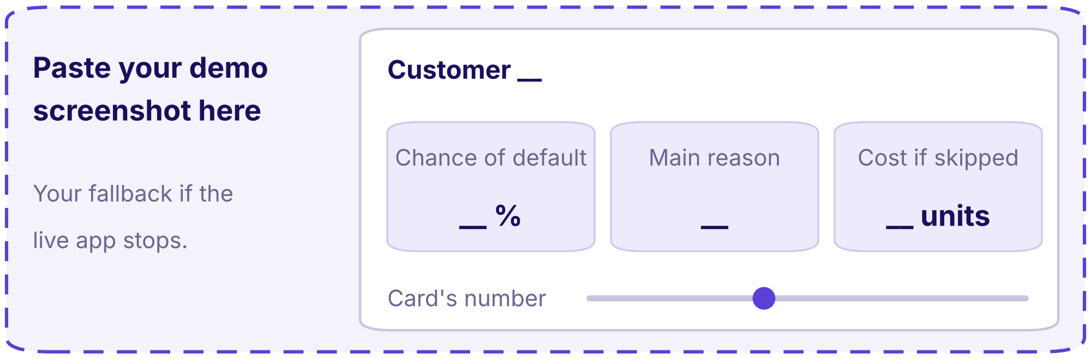
KALPA FINANCIAL · GROUP __ · CARD __
Customer __ is __% likely to default, so we call
One customer, scored live: the chance, the main reason and what skipping them costs.
__%
__
__ units
CHANCE OF DEFAULT
MAIN REASON
COST IF WE SKIP THEM
customer __, from score()
the column that moved the score most
chance x the cost of a miss
Change the card's number. At __ instead of __, the list becomes __ customers and its bill __ units.
The fallback: your screenshot of the same screen
Whom Kalpa calls before the due date
S3 · 3 / 8
Notes:
SPEAKER: the builder. 3:00 to 6:00, three minutes, the longest slide.
0:00 to 0:20. Open the app. It is already running from a fresh start.
0:20 to 1:20. Pick one customer, read the three numbers aloud, and say what Rohan's caller does next.
1:20 to 2:20. Change your card's number live and read the new list size and bill aloud.
2:20 to 3:00. What that means for Rohan in one sentence, then hand over:
"[name] shows why we chose this way over the other."
Show no code. If the app stops, say what stopped it, show the screenshot on this slide, and carry on;
the clock does not stop. Rehearse the demo from a fresh Codespace at least twice.

Slide 4
KALPA FINANCIAL · GROUP __ · CARD __
__ beats __ by __ units, so we chose __
Two ways to make the same call, scored on the same customers and the same costs.
 | A: __ | B: __
What it is, in one line
Error bill on the same __ customers | __ units | __ units
Build time | __ hours | __ hours
Can Rohan say why a customer is called
How it fails, and how we would notice
The fact that would flip our choice
Whom Kalpa calls before the due date
S4 · 4 / 8
Notes:
SPEAKER: the evaluator. 6:00 to 8:00, two minutes.
Read the bill row first, then the explanation row, then the row that would flip your choice.
Say one sentence on why a group with another card might choose the other way.
Hand over: "So how honest is our number? [name] again."

Slide 5
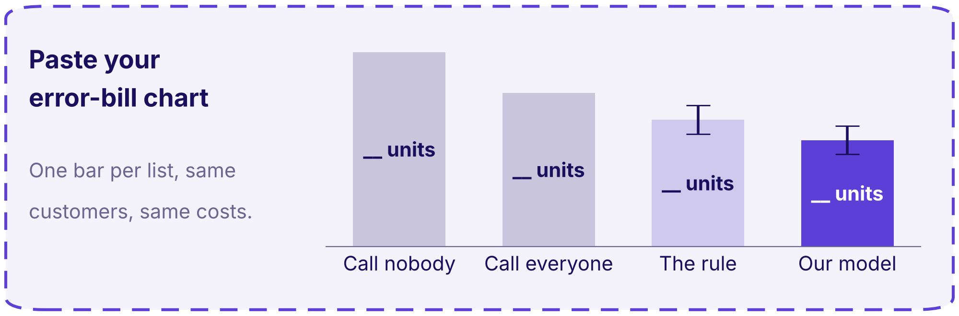
KALPA FINANCIAL · GROUP __ · CARD __
Our bill is __ units, give or take __
Measured against doing nothing, with its spread, and with the trap that would have flattered it.
Your chart: the error bill of four lists
The trap we caught. __, which would have made our bill look __ units better.
Honesty line one. The Taiwan score proves the pipeline and is never Kalpa's score.
Honesty line two. This data allows no out-of-time split, so the MVP must add one.
Whom Kalpa calls before the due date
S5 · 5 / 8
Notes:
SPEAKER: the evaluator. 8:00 to 9:30, ninety seconds.
Point at calling nobody first, then your list, then the spread: "Across five splits it moved by __."
Say the trap you caught in one sentence and what it would have done to the number.
Read both honesty lines as they are written. Hand over: "[name]: what this proved, and what it did not."

Slide 6
KALPA FINANCIAL · GROUP __ · CARD __
The POC proved __; an MVP still needs __
What the public book proved, and what Kalpa needs before one real customer is called.
 | What the POC proved | What the MVP still needs
Functional: what it must do
Non-functional: how well, how fast
Constraints: rules, security, privacy, governance
Not in the MVP. __ and __.
Whom Kalpa calls before the due date
S6 · 6 / 8
Notes:
SPEAKER: the decision owner. 9:30 to 11:00, ninety seconds.
One row at a time, left column then right. Say where each constraint comes from: your card, Rohan's
call, or a rule a lender in India works under.
Name the two things the MVP will not do, so nobody asks for them.
Hand over: "[name] closes on what would change our call."

Slide 7



KALPA FINANCIAL · GROUP __ · CARD __
We would change our call if __
The one fact that would flip the recommendation, the risk we watch and what we ask of Rohan.
WHAT WOULD FLIP IT
OUR TOP RISK
OUR ASK
__
__
__
If __ moved to __, we would __.
From our pre-mortem: __, and we watch it by __.
Rohan, we need __ from your team by __.
Whom Kalpa calls before the due date
S7 · 7 / 8
Notes:
SPEAKER: the builder. 11:00 to 12:00, one minute.
Say each card in one sentence, the ask last. Then stop: no thank you and no summary.
This slide stays on screen while the panel asks its questions.

Slide 8
KALPA FINANCIAL · GROUP __ · CARD __
Backup: the five numbers behind every slide
Any member recomputes any of these live from the repository when the panel asks.
Number | Value | What it means | Where it is computed
Base rate | __ |  | src/__, function __
Do-nothing bill | __ units
List size or threshold | __
Our model's bill | __ units
Our card's number | __
Both honesty lines hold. The Taiwan score is never Kalpa's score, and the MVP adds an out-of-time split.
Whom Kalpa calls before the due date
S8 · 8 / 8
Notes:
Shown only when the panel asks for a number. Whoever the panel names opens the repository, finds the
line in the right-hand column and reruns it. Each of you rehearses all five, since any of you can be
named.

