Slide 1





WEEK 5 · THURSDAY · OVERFITTING AND REGULARISATION
Generalise or memorise, and the honest tuned model
Five topics on tiny invented examples, then one real file, then one decision.
THE TOPICS
THE CASE
THE DECISION
Three students, ten customers
A Portuguese bank's 41,188 calls
Kalpa's one-campaign nudge
Past papers, a twelve-week footfall curve and twenty shoppers carry the five topics by hand.
UCI Bank Marketing, public data, Wednesday's honest columns.
Anand's budget covers one campaign: which model ships, and what gap would change it.
Is 100 percent good?
What does a brake buy?
Is one split enough?
Which tool, and when?
When does simple win?
What did it learn?
Can we trust 0.79?
S1 · 1 / 65
…
Notes:
LIVE, 1 minute. Three layers, same as all week: the idea on numbers small enough to check by hand,
the same idea on the bank's real file, and the decision Kalpa has to make with it. Ask: who
remembers the do-nothing score from Monday? (88.7 percent.) Keep that number in the room all day.

Slide 2
WEEK 5 · THURSDAY · OVERFITTING AND REGULARISATION
Thursday in the twenty weeks
The machine learning core sits between analyst craft and Kalpa Financial's build.
Is 100 percent good?
What does a brake buy?
Is one split enough?
Which tool, and when?
When does simple win?
What did it learn?
Can we trust 0.79?
S2 · 2 / 65
…
Notes:
LIVE, 1 minute. Point at Week 5. Every later week that trains a model, from deep learning to the
capstone, meets today's question: does it work on rows it never saw? Build 2 next week reuses this
exact pipeline on Kalpa Financial's lending book. Transition: the week's one picture.

Slide 3
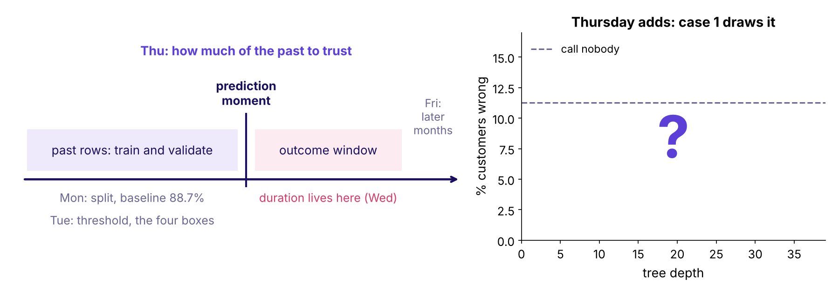
WEEK 5 · THURSDAY · OVERFITTING AND REGULARISATION
The week's picture, Thursday state
Monday split it, Tuesday set the line, Wednesday removed the leak. Today fills the last panel.
The week's timeline with Thursday's panel still empty
Is 100 percent good?
What does a brake buy?
Is one split enough?
Which tool, and when?
When does simple win?
What did it learn?
Can we trust 0.79?
S3 · 3 / 65
…
Notes:
LIVE, 2 minutes. The same timeline every morning. Left: past rows we train and validate on, the
prediction moment, the outcome window where duration lived. The right panel is empty on purpose:
case 1 draws validation error against tree depth on the bank's file. Ask the room to sketch the
shape they expect, with the dashed call-nobody line, and keep the sketches for case 1.

Slide 4
WEEK 5 · THURSDAY · OVERFITTING AND REGULARISATION
The ticket: a tree that scored 99.6 on practice
A teammate's tree, the room's own honest columns, one campaign of budget.
99.6%
?
88.7%
TRAINING ACCURACY
VALIDATION ACCURACY
CALL NOBODY
the number Marketing saw first
8,238 customers the tree never saw
the do-nothing baseline from Monday
Is 100 percent good?
What does a brake buy?
Is one split enough?
Which tool, and when?
When does simple win?
What did it learn?
Can we trust 0.79?
S4 · 4 / 65
…
Notes:
LIVE, 2 minutes. This is the destination; the topics come first. A teammate grew a decision tree
with no depth limit on Wednesday's honest feature set and posted 99.6 percent. Ask: would you book
Anand's one campaign on it? Take two answers, park them. Case 1 reveals the validation number (84.1,
below the 88.7 baseline); do not say it now. The row's story said 100 and 61; our run on public data
says 99.6 and 84.1, and we quote our run.

Slide 5
WEEK 5 · THURSDAY · OVERFITTING AND REGULARISATION
Five topics, five chapters, then the case
The curriculum's words, in its order.
# | The topic, in the curriculum's words | Chapter | Minutes | Notebook
1 | Overfitting; bias and variance through learning curves | 1 Memorising against learning | 25 | ch01
2 | Regularisation | 2 Putting brakes on the model | 20 | ch02
3 | Cross-validation | 3 Five exams instead of one | 20 | ch03
4 | Trees, ensembles, clustering: used, compared, not derived | 4 Trees, forests and groups | 15 | ch04
5 | When the simpler model wins | 5 Why the boring model often ships | 20 | ch05
Cases 1 to 3 then run every topic on the bank's file: notebooks case01, case02, case03.
Is 100 percent good?
What does a brake buy?
Is one split enough?
Which tool, and when?
When does simple win?
What did it learn?
Can we trust 0.79?
S5 · 5 / 65
…
Notes:
LIVE, 1 minute. Read the five topics down the second column once; these are the words to search
by. Each chapter has one short notebook with the same name. The explorable (depth and brake sliders)
opens in chapters 1 to 3. Transition: how the five join.

Slide 6
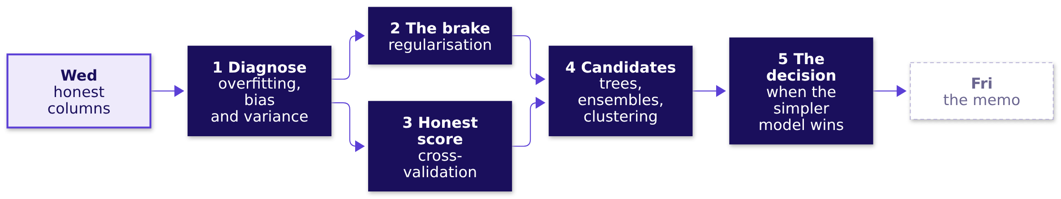
WEEK 5 · THURSDAY · OVERFITTING AND REGULARISATION
How the five topics join
Two ways to be wrong, two tools against them, one decision.
Is 100 percent good?
What does a brake buy?
Is one split enough?
Which tool, and when?
When does simple win?
What did it learn?
Can we trust 0.79?
S6 · 6 / 65
…
Notes:
LIVE, 1 minute. Chapter 1 gives the diagnosis. Chapters 2 and 3 are the two tools: a brake for the
model, an honest average for the score. Chapter 4 brings the candidates; chapter 5 decides between
them. Friday turns the decision into the committee memo.

Slide 7

PG DIPLOMA IN AI-ML AND AGENTIC AI ENGINEERING · COHORT 2
01
Memorising against learning
Is 100 percent good?
Overfitting; bias and variance through learning curves · also searched as: overfitting vs underfitting, bias variance tradeoff, learning curves
Is 100 percent good?
What does a brake buy?
Is one split enough?
Which tool, and when?
When does simple win?
What did it learn?
Can we trust 0.79?
Which model ships?
Week 5 Thursday: generalise or memorise
7 / 65
Notes:
LIVE, 25 minutes for the chapter. Notebook ch01. The misconception to stage: a perfect training
score means a ready model. The prediction to ask for: who tops the new exam.

Slide 8



WEEK 5 · THURSDAY · OVERFITTING AND REGULARISATION
Question: who tops the new exam?
Five past papers. One student memorises, one learns the method, one skims. Invented.
STUDENT 1
STUDENT 2
STUDENT 3
The memoriser
The learner
The skimmer
Every answer by heart. Past papers: perfect.
Works out each method. Past papers: good.
Reads quickly. Past papers: weak.
Is 100 percent good?
What does a brake buy?
Is one split enough?
Which tool, and when?
When does simple win?
What did it learn?
Can we trust 0.79?
S7 · 8 / 65
…
Notes:
LIVE, 3 minutes. Ask for a prediction in the chat or by raised fingers: 1, 2 or 3.
Count them aloud. Most rooms vote for the memoriser, who topped practice. Do not reveal; click.

Slide 9
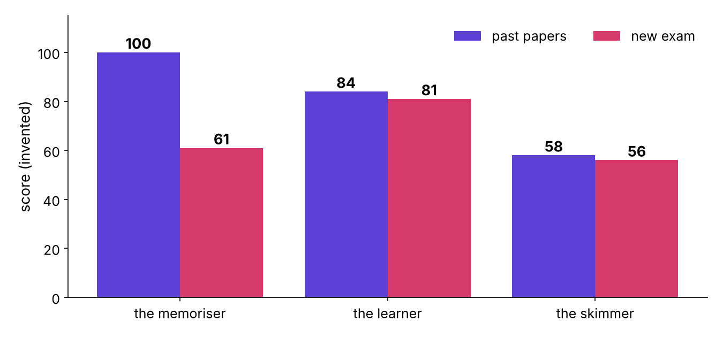
WEEK 5 · THURSDAY · OVERFITTING AND REGULARISATION
Answer: the student who learned the method
The memoriser's 39-point drop is the whole lesson.
Practice against new exam for three invented students
Is 100 percent good?
What does a brake buy?
Is one split enough?
Which tool, and when?
When does simple win?
What did it learn?
Can we trust 0.79?
S8 · 9 / 65
…
Notes:
LIVE, 3 minutes. The memoriser: 100 on practice, 61 on the exam. The learner: 84 and 81. The skimmer: 58 and 56. Land
the line: practice scores reward memory; only the exam measures learning. These are the row's own
100 and 61, kept as an invented story. Ask: which student is a tree with no depth limit? (The memoriser.)

Slide 10
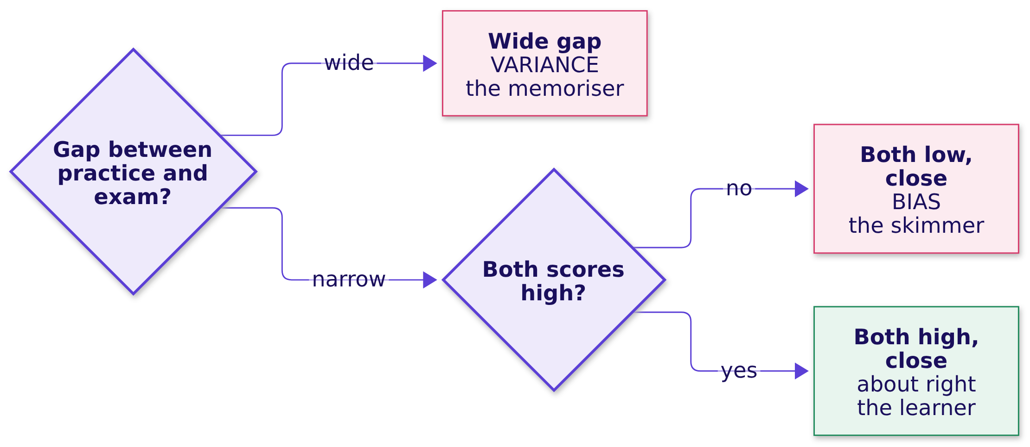
WEEK 5 · THURSDAY · OVERFITTING AND REGULARISATION
Two ways to be wrong
Read the gap first, then the level.
Is 100 percent good?
What does a brake buy?
Is one split enough?
Which tool, and when?
When does simple win?
What did it learn?
Can we trust 0.79?
S9 · 10 / 65
…
Notes:
LIVE, 3 minutes. Variance: the model changes a lot when the data changes, so new data surprises it.
Bias: the model is too simple to be right anywhere. Say the order out loud: gap first, level second.
Interview line: overfitting is a gap you can measure, never a feeling.

Slide 11
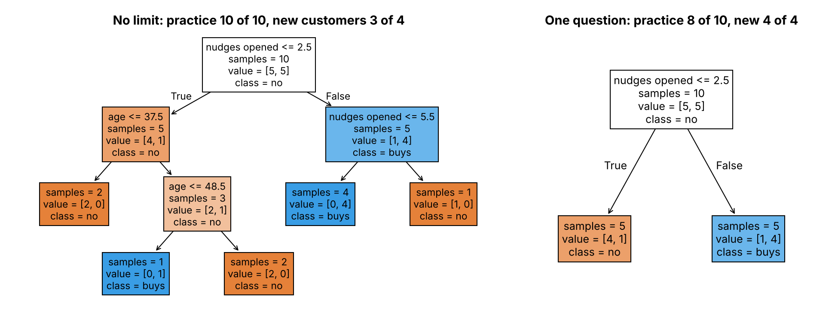
WEEK 5 · THURSDAY · OVERFITTING AND REGULARISATION
A tree that never stops asking
Ten invented customers, three who break the pattern.
An unlimited tree against a one-question tree on ten invented customers
Is 100 percent good?
What does a brake buy?
Is one split enough?
Which tool, and when?
When does simple win?
What did it learn?
Can we trust 0.79?
S10 · 11 / 65
…
Notes:
LIVE, 5 minutes. Notebook ch01, the tree cell. The pattern: opened three or more nudges, then
bought. Three customers break it. The unlimited tree writes a private rule for each awkward one: 10
of 10 on practice, 3 of 4 on new customers. One question: 8 of 10 on practice, 4 of 4 on new. Ask:
which tree learned Kalpa's customers, and which learned these ten people?

Slide 12
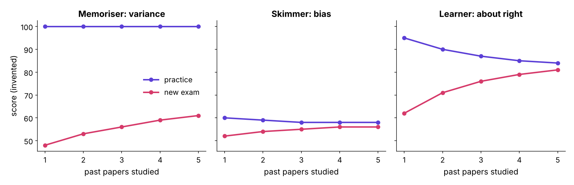
WEEK 5 · THURSDAY · OVERFITTING AND REGULARISATION
Learning curves from tiny numbers
Add one past paper at a time; score practice and a fresh exam.
Three pairs of learning curves for the invented students
Is 100 percent good?
What does a brake buy?
Is one split enough?
Which tool, and when?
When does simple win?
What did it learn?
Can we trust 0.79?
S11 · 12 / 65
…
Notes:
LIVE, 5 minutes. A learning curve is two lines against the amount of training. The memoriser's practice
line stays at 100 while the exam line crawls: a gap that more papers barely close. The skimmer's two lines
meet low; the learner's meet high. Explorable click: open the depth and brake explorer, default degree 12,
read the two errors, and let the room name it: memorising.

Slide 13
WEEK 5 · THURSDAY · OVERFITTING AND REGULARISATION
The rule, with the condition that flips it
What each picture tells you to do next.
You see | It is | Do | Unless
Wide gap | variance | brake it, or add rows | the new rows carry the same noise
Both low, close | bias | more capacity, better columns | the columns hold no signal
Both high, close | about right | compare on folds | one split only: check its luck
Is 100 percent good?
What does a brake buy?
Is one split enough?
Which tool, and when?
When does simple win?
What did it learn?
Can we trust 0.79?
S12 · 13 / 65
…
Notes:
LIVE, 4 minutes. The flip column is the interview differentiator. More rows is the textbook cure for
variance; case 1 shows it failing on the bank's file, where the brake works. Mid-session drill 1
(15 minutes) runs after chapter 3 with four curve pairs.

Slide 14
PG DIPLOMA IN AI-ML AND AGENTIC AI ENGINEERING · COHORT 2
02
Putting brakes on the model
What does a brake buy?
Regularisation · also searched as: L1 L2 regularization, ridge regression, lasso regression
Is 100 percent good?
What does a brake buy?
Is one split enough?
Which tool, and when?
When does simple win?
What did it learn?
Can we trust 0.79?
Which model ships?
Week 5 Thursday: generalise or memorise
14 / 65
Notes:
LIVE, 20 minutes for the chapter. Notebook ch02. Misconception to stage: regularisation improves
accuracy. It trades fit on the teaching rows for stability on new ones.

Slide 15
WEEK 5 · THURSDAY · OVERFITTING AND REGULARISATION
Question: will the seven-bend curve predict well?
Twelve weeks of footfall at one Kalpa store. Nine teach, three are held out. Invented.
9
3
7
TEACHING WEEKS
HELD-OUT WEEKS
BENDS ALLOWED
the curve may pass through all of them
weeks 4, 7 and 10
a degree-7 polynomial
Is 100 percent good?
What does a brake buy?
Is one split enough?
Which tool, and when?
When does simple win?
What did it learn?
Can we trust 0.79?
S13 · 15 / 65
…
Notes:
LIVE, 2 minutes. Ask for a prediction: will the held-out error be smaller or larger than the
teaching error, and by how much? Write two guesses on the board. Click.

Slide 16
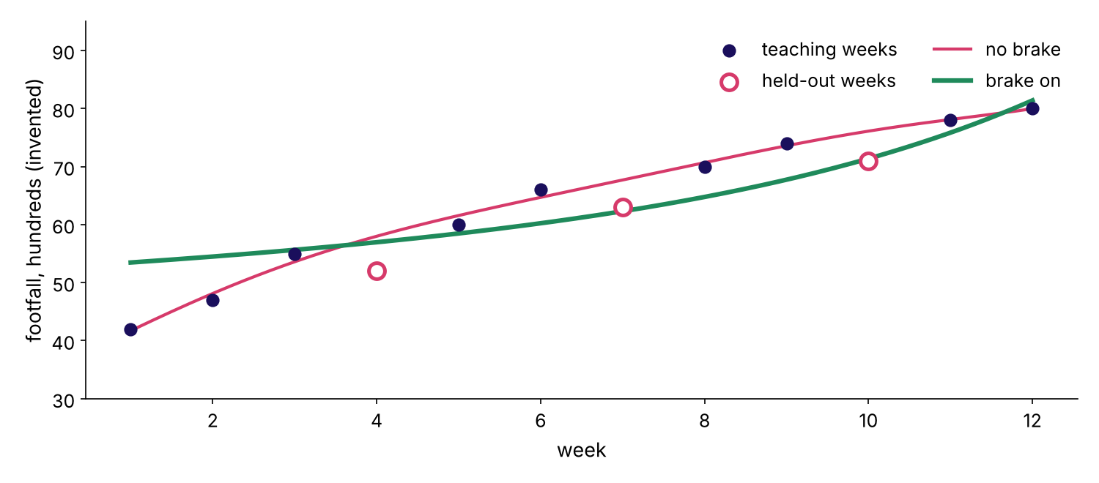
WEEK 5 · THURSDAY · OVERFITTING AND REGULARISATION
Answer: it threads the teaching weeks and misses
Error 0.95 on teaching weeks, 5.28 on held-out weeks, in hundreds of visitors.
The seven-bend curve with and without a brake
Is 100 percent good?
What does a brake buy?
Is one split enough?
Which tool, and when?
When does simple win?
What did it learn?
Can we trust 0.79?
S14 · 16 / 65
…
Notes:
LIVE, 4 minutes. The red curve passes near every black dot and swings past the hollow ones. The
green curve has the same seven bends with a brake: teaching error 5.74, held-out 2.90. Land it: the
brake made the fit worse where we can see and better where we cannot.

Slide 17
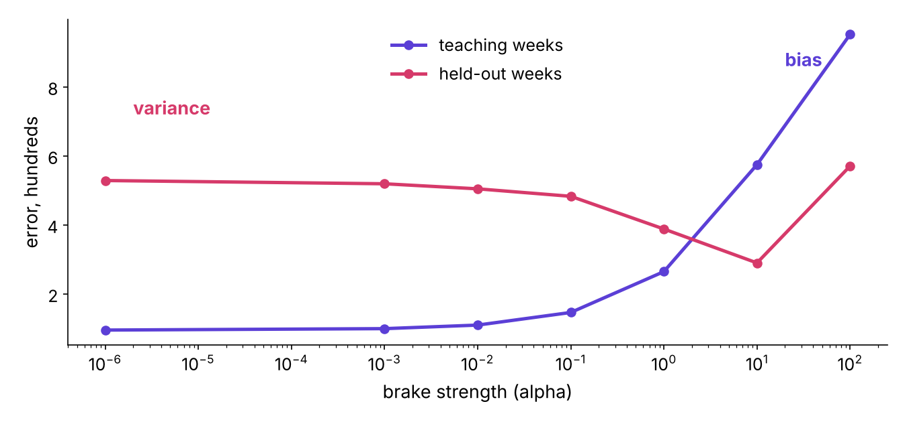
WEEK 5 · THURSDAY · OVERFITTING AND REGULARISATION
Turn the brake slowly
Too soft: variance. Too hard: bias. The best brake sits in the middle.
Teaching and held-out error against brake strength
Is 100 percent good?
What does a brake buy?
Is one split enough?
Which tool, and when?
When does simple win?
What did it learn?
Can we trust 0.79?
S15 · 17 / 65
…
Notes:
LIVE, 4 minutes. Notebook ch02, the sweep cell. Teaching error only rises as alpha grows; held-out
error falls to 2.90 at alpha 10 and climbs to 5.70 at 100. Explorable click: back at degree 12, drag
the brake up and watch validation settle near the degree-3 value. Choose alpha on held-out rows,
never on the teaching rows, because the teaching error always votes for no brake.

Slide 18
WEEK 5 · THURSDAY · OVERFITTING AND REGULARISATION
The formula, named last
The misfit plus a price on big coefficients.
ridge (L2): minimise misfit + alpha * (sum of squared coefficients)
lasso (L1): minimise misfit + alpha * (sum of absolute coefficients)
scikit-learn LogisticRegression: C = 1 / alpha
small C = strong brake
Is 100 percent good?
What does a brake buy?
Is one split enough?
Which tool, and when?
When does simple win?
What did it learn?
Can we trust 0.79?
S16 · 18 / 65
…
Notes:
LIVE, 4 minutes. Name the formula only now, as the shorthand for what the picture showed. Stage the
trap: C looks like a strength and behaves like its opposite; a learner who sets C = 100 to brake
harder has switched the brake off.
The geometry of why L1 lands on zero belongs to the tentative IITGN faculty session.

Slide 19
WEEK 5 · THURSDAY · OVERFITTING AND REGULARISATION
L1 switches columns off; trees brake differently
Same idea, different knobs.
Model | The brake | What it does
Linear, logistic | L2 (ridge) | shrinks every coefficient a little
Linear, logistic | L1 (lasso) | sets weak coefficients to exactly zero
Decision tree | max_depth | caps the questions in a row
Decision tree | min_samples_leaf | each answer must cover enough customers
Is 100 percent good?
What does a brake buy?
Is one split enough?
Which tool, and when?
When does simple win?
What did it learn?
Can we trust 0.79?
S17 · 19 / 65
…
Notes:
LIVE, 3 minutes. On the footfall curve L1 kept 1 to 3 of the 7 bends. A tree has no coefficients,
so its brakes have other names; case 1 turns max_depth on the bank's file. Interview line:
regularisation trades a little bias for a lot less variance.

Slide 20
PG DIPLOMA IN AI-ML AND AGENTIC AI ENGINEERING · COHORT 2
03
Five exams instead of one
Is one split enough?
Cross-validation · also searched as: k-fold cross validation, cross validation explained
Is 100 percent good?
What does a brake buy?
Is one split enough?
Which tool, and when?
When does simple win?
What did it learn?
Can we trust 0.79?
Which model ships?
Week 5 Thursday: generalise or memorise
20 / 65
Notes:
LIVE, 20 minutes for the chapter. Notebook ch03. Misconception to stage: one validation score is the
model's score.

Slide 21
WEEK 5 · THURSDAY · OVERFITTING AND REGULARISATION
Question: does a different deal change the score?
Twenty invented shoppers. Five sit the exam, fifteen teach. Re-deal five times.
20
5
5
SHOPPERS
IN EACH EXAM
DEALS
visits last month, bought in the sale
dealt at random
same model every time
Is 100 percent good?
What does a brake buy?
Is one split enough?
Which tool, and when?
When does simple win?
What did it learn?
Can we trust 0.79?
S18 · 21 / 65
…
Notes:
LIVE, 2 minutes. Prediction: how far apart will five exam scores land? Ask for a number between 0
and 100 points. Click.

Slide 22
WEEK 5 · THURSDAY · OVERFITTING AND REGULARISATION
Answer: from 40 to 80 percent, on luck alone
Scores on five deals: 60, 60, 80, 40, 60.
Is 100 percent good?
What does a brake buy?
Is one split enough?
Which tool, and when?
When does simple win?
What did it learn?
Can we trust 0.79?
S19 · 22 / 65
…
Notes:
LIVE, 3 minutes. Same model, same customers, a 40-point swing. A five-customer exam is mostly luck.
Ask: which of these would you have put on a slide? Whichever you picked, you picked luck.

Slide 23
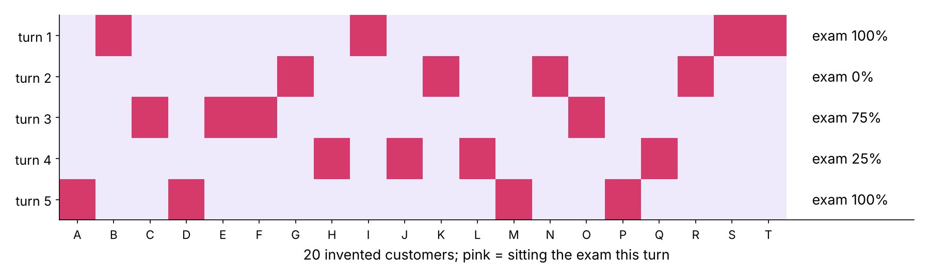
WEEK 5 · THURSDAY · OVERFITTING AND REGULARISATION
Five folds: every customer sits the exam once
Average the five scores; quote the spread beside the mean.
Five folds over twenty invented customers
Is 100 percent good?
What does a brake buy?
Is one split enough?
Which tool, and when?
When does simple win?
What did it learn?
Can we trust 0.79?
S20 · 23 / 65
…
Notes:
LIVE, 5 minutes. Notebook ch03, the fold grid. Each row is one turn; pink cells sit the exam. Every
customer is examined exactly once and teaches four times. The mean is the score; the spread is the
size of the luck. Explorable click: press reshuffle five times and watch the validation number jump
while the mean of five holds.

Slide 24
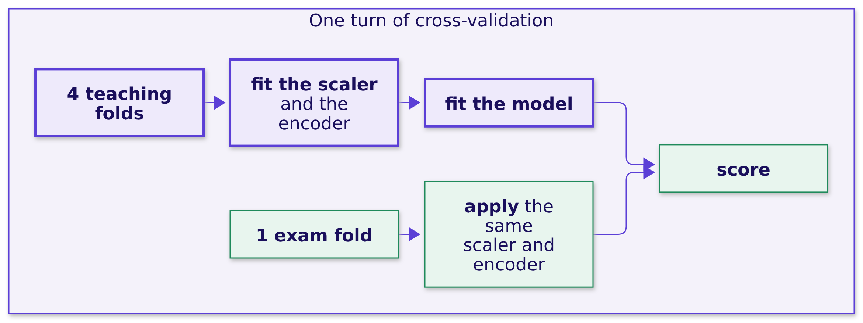
WEEK 5 · THURSDAY · OVERFITTING AND REGULARISATION
Everything that learns stays inside the folds
The scaler, the gap-filler, the encoder: fitted on the teaching folds only.
Is 100 percent good?
What does a brake buy?
Is one split enough?
Which tool, and when?
When does simple win?
What did it learn?
Can we trust 0.79?
S21 · 24 / 65
…
Notes:
LIVE, 4 minutes. In the notebook the mean visits of all 20 shoppers is 4.10; of the 16 teaching
shoppers, 3.81. The first number has seen the exam. A scikit-learn Pipeline keeps the second, which
is why every case notebook wraps the scaler and the encoder in one.

Slide 25
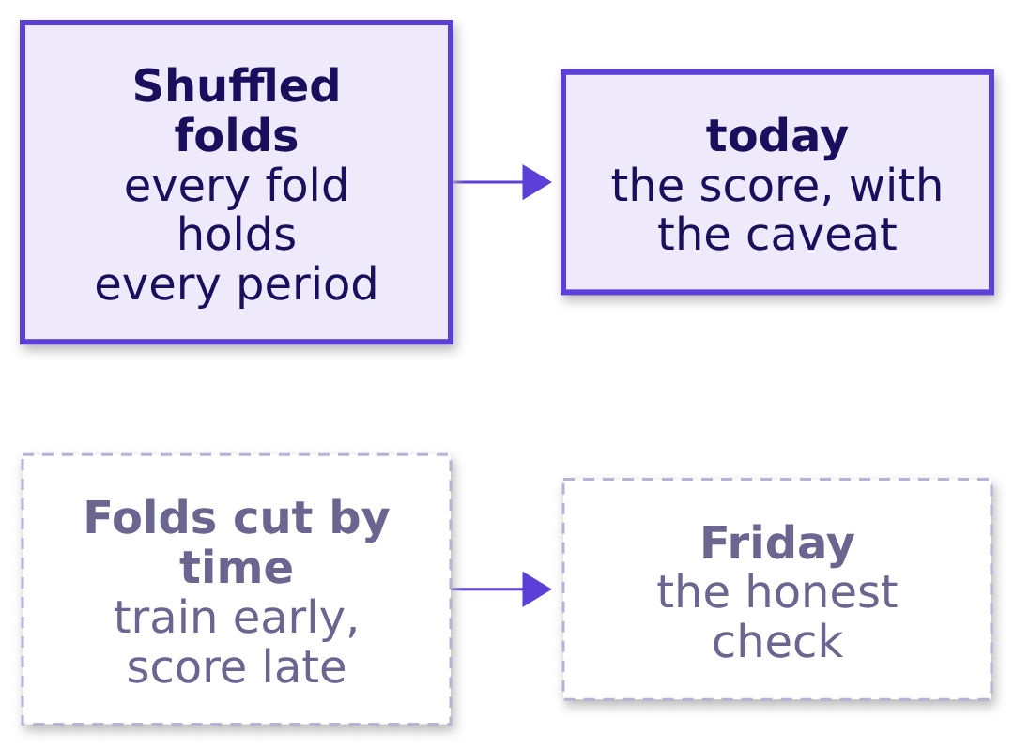
WEEK 5 · THURSDAY · OVERFITTING AND REGULARISATION
Rows in time order: write the caveat
Shuffled folds mix early and late months. Friday tests what that hides.
Is 100 percent good?
What does a brake buy?
Is one split enough?
Which tool, and when?
When does simple win?
What did it learn?
Can we trust 0.79?
S22 · 25 / 65
…
Notes:
LIVE, 3 minutes. The bank's file is sorted from May 2008 to November 2010. Today's folds shuffle, so
every number carries the caveat "random folds, mixed periods". Search term for later: time series
split. Do not run the time split today; Friday owns it. Then mid-session drill 1, 15 minutes: four
curve pairs on the explorable's strip, the room names each in under a minute.

Slide 26
PG DIPLOMA IN AI-ML AND AGENTIC AI ENGINEERING · COHORT 2
04
Trees, forests and groups
Which tool, and when?
Trees, ensembles, clustering: used, compared, not derived · also searched as: decision tree, random forest, gradient boosting, k-means clustering
Is 100 percent good?
What does a brake buy?
Is one split enough?
Which tool, and when?
When does simple win?
What did it learn?
Can we trust 0.79?
Which model ships?
Week 5 Thursday: generalise or memorise
26 / 65
Notes:
LIVE, 15 minutes for the chapter. Notebook ch04. Recognition depth only: what each does to a tree's
weakness and what it costs to explain. Internals and boosting mathematics are out of scope today.

Slide 27
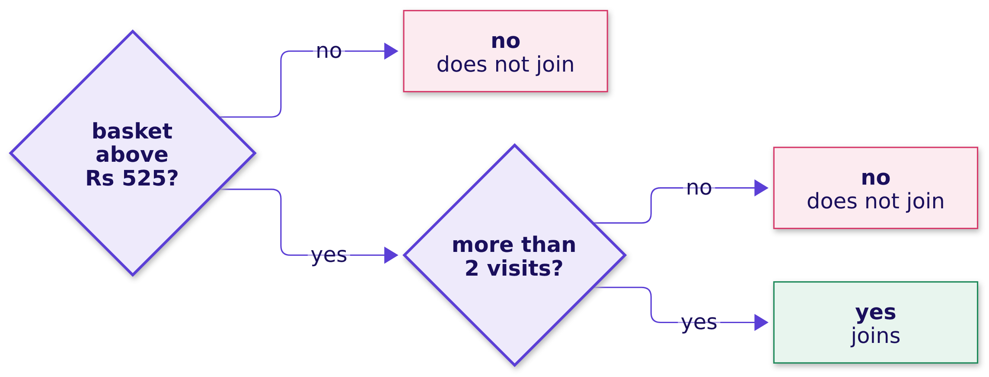
WEEK 5 · THURSDAY · OVERFITTING AND REGULARISATION
A tree is twenty questions
Twelve invented shoppers; two questions decide who joins the loyalty plan.
Is 100 percent good?
What does a brake buy?
Is one split enough?
Which tool, and when?
When does simple win?
What did it learn?
Can we trust 0.79?
S23 · 27 / 65
…
Notes:
LIVE, 3 minutes. Ask the room to predict the first question before showing it. Anyone can read this
tree aloud to Marketing, which is its strength. Its weakness is chapter 1: let it grow and it
memorises.

Slide 28
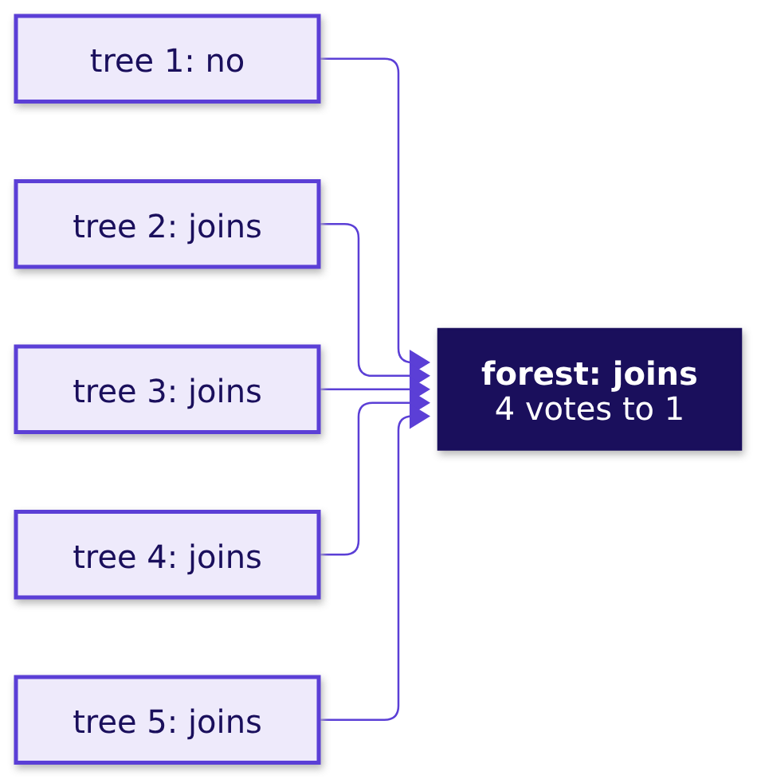
WEEK 5 · THURSDAY · OVERFITTING AND REGULARISATION
A forest votes
Many trees on resampled rows; the majority answers. Five of them, on a newcomer.
Is 100 percent good?
What does a brake buy?
Is one split enough?
Which tool, and when?
When does simple win?
What did it learn?
Can we trust 0.79?
S24 · 28 / 65
…
Notes:
LIVE, 2 minutes. Notebook ch04: five forest trees vote on a newcomer with 7 visits and a Rs 1,000
basket; four say joins. Each tree saw a different resample of the twelve shoppers, so their wobbles
differ and the vote averages them away: a forest lowers variance.

Slide 29
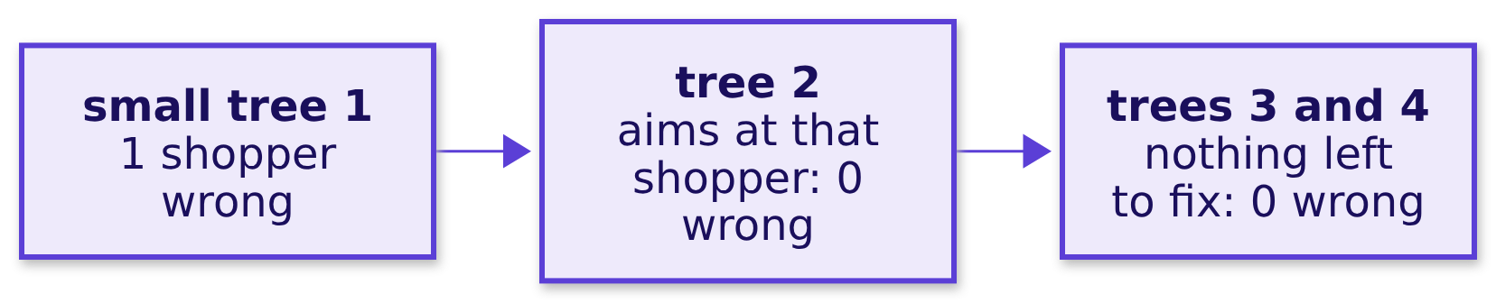
WEEK 5 · THURSDAY · OVERFITTING AND REGULARISATION
A booster corrects
Small trees in a chain, each aimed at what is still wrong.
Is 100 percent good?
What does a brake buy?
Is one split enough?
Which tool, and when?
When does simple win?
What did it learn?
Can we trust 0.79?
S24a · 29 / 65
…
Notes:
LIVE, 2 minutes. The booster's mistakes on the twelve shoppers fall from 1 to 0 after round two. It
chips away at what is still wrong (bias). Neither ensemble is free to explain: 100 small trees mean
200 to 280 leaves to read. Internals and boosting mathematics are for later.

Slide 30
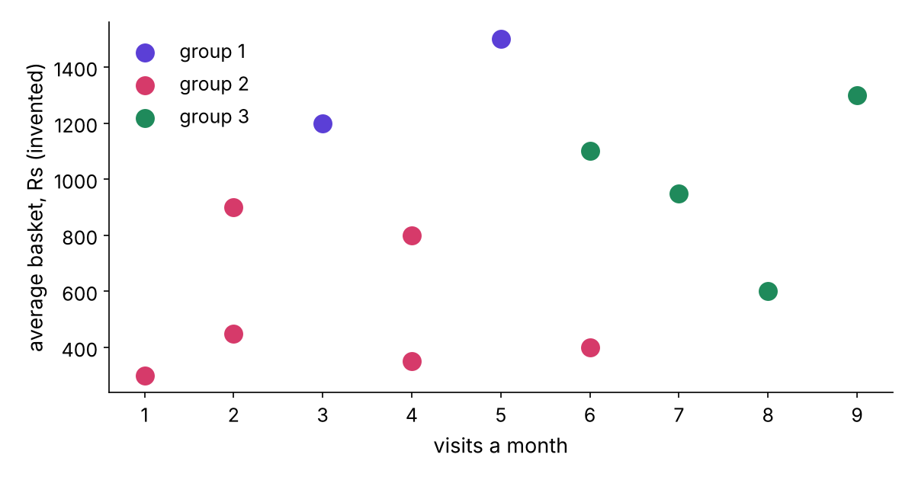
WEEK 5 · THURSDAY · OVERFITTING AND REGULARISATION
Clustering: groups, no answers
k-means groups shoppers by distance. It predicts nothing.
k-means with three groups on twelve invented shoppers
Is 100 percent good?
What does a brake buy?
Is one split enough?
Which tool, and when?
When does simple win?
What did it learn?
Can we trust 0.79?
S25 · 30 / 65
…
Notes:
LIVE, 2 minutes. CUT FIRST if late: this slide and its one notebook cell. Clustering needs no
answer column; Marketing uses it to name segments. It never tells you who will buy.

Slide 31
WEEK 5 · THURSDAY · OVERFITTING AND REGULARISATION
Which tool, and when
Reach for the one whose weakness your decision can afford.
Tool | Reach for it when | Watch out
One tree | a committee must read the rule | deep trees memorise
Random forest | one tree wobbles | still must beat the simple model
Gradient boosting | the last points of ranking pay | more to monitor and explain
Logistic regression | a cost rule needs probabilities | misses interactions you do not build
k-means | you need segments, no answer column | groups, never predicts
Is 100 percent good?
What does a brake buy?
Is one split enough?
Which tool, and when?
When does simple win?
What did it learn?
Can we trust 0.79?
S26 · 31 / 65
…
Notes:
LIVE, 3 minutes. Read one row per tool. Interview line: a forest lowers a tree's variance by
averaging, and it still has to beat the baseline and the simpler model on the same folds.

Slide 32
PG DIPLOMA IN AI-ML AND AGENTIC AI ENGINEERING · COHORT 2
05
Why the boring model often ships
When does simple win?
When the simpler model wins · also searched as: model selection, Occam's razor machine learning, interpretable vs black box
Is 100 percent good?
What does a brake buy?
Is one split enough?
Which tool, and when?
When does simple win?
What did it learn?
Can we trust 0.79?
Which model ships?
Week 5 Thursday: generalise or memorise
32 / 65
Notes:
LIVE, 20 minutes for the chapter. Notebook ch05. Misconception to stage: the highest score ships.
This is the recommendation the room resists and the interviewer rewards.

Slide 33
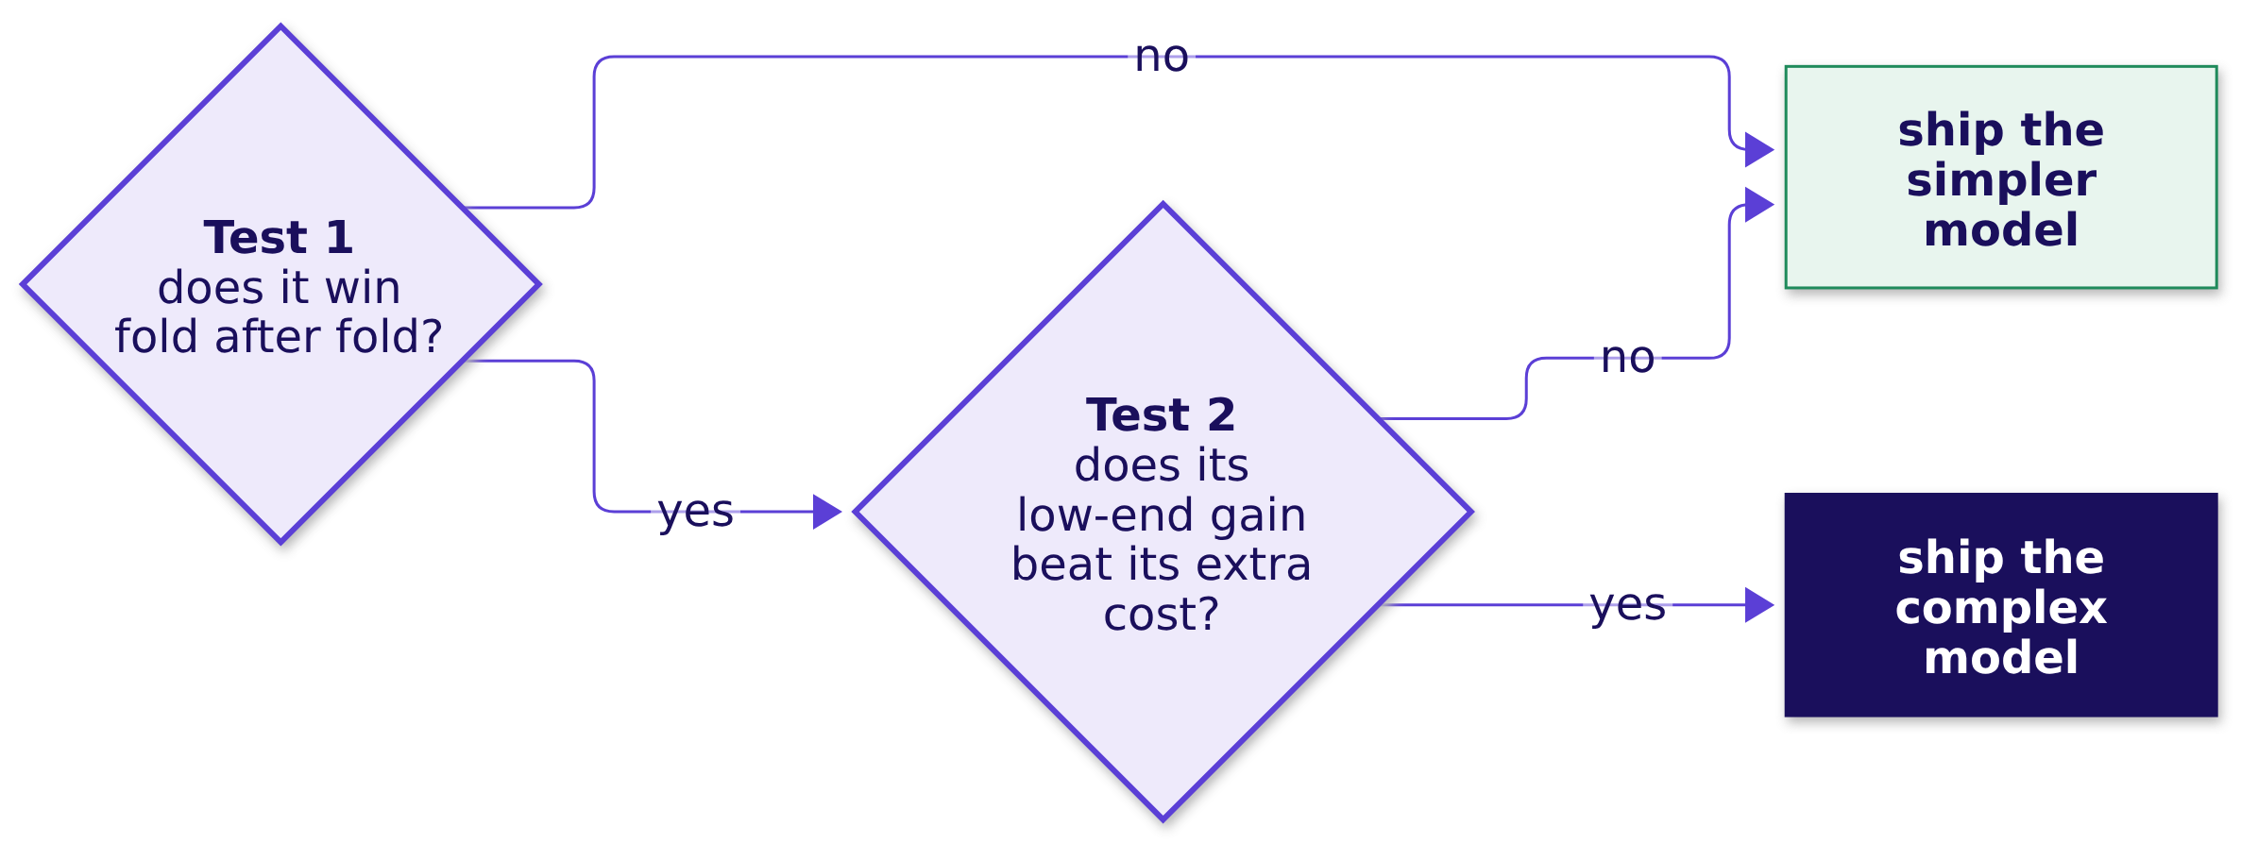
WEEK 5 · THURSDAY · OVERFITTING AND REGULARISATION
Two tests a complex model must pass
Is the gap real? Is it worth what it costs?
…
What does a brake buy?
Is one split enough?
Which tool, and when?
When does simple win?
What did it learn?
Can we trust 0.79?
Which model ships?
S27 · 33 / 65
Notes:
LIVE, 3 minutes. Two different questions. A lead can be real and still not worth having. Write both
tests on the board; they stay up through case 3.

Slide 34
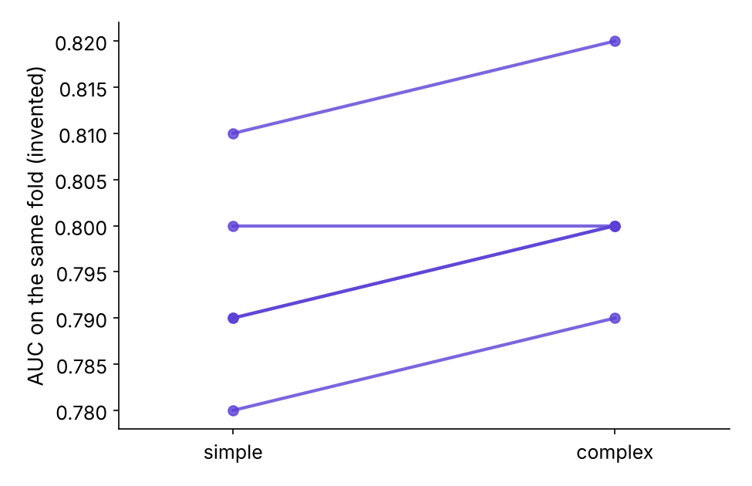
WEEK 5 · THURSDAY · OVERFITTING AND REGULARISATION
Test 1: join each fold's two scores
Invented: the complex model wins four folds and ties one.
Paired fold scores for an invented simple and complex model
…
What does a brake buy?
Is one split enough?
Which tool, and when?
When does simple win?
What did it learn?
Can we trust 0.79?
Which model ships?
S28 · 34 / 65
Notes:
LIVE, 4 minutes. Means 0.794 and 0.802. Comparing the two means alone hides how hard each fold was;
joining each fold's two scores shows the complex model ahead on four folds, level on one. So test 1
passes. Now ask: so it ships? Click.

Slide 35
WEEK 5 · THURSDAY · OVERFITTING AND REGULARISATION
Test 2: the gain at the low end against the cost
Invented: 30 to 70 extra buyers, Rs 1,200 margin each, Rs 60,000 extra cost.
gain at the low end = 30 buyers * Rs 1,200 = Rs 36,000
extra cost = Rs 60,000 a campaign
break-even = 60,000 / 1,200 = 50 extra buyers
ships? 36,000 > 60,000 -> no
…
What does a brake buy?
Is one split enough?
Which tool, and when?
When does simple win?
What did it learn?
Can we trust 0.79?
Which model ships?
S29 · 35 / 65
Notes:
LIVE, 5 minutes. Read the low end, never the best case, so a wide range cannot sneak a model
through. The extra cost is what the complex model adds: a second pipeline to run and monitor,
explanations a committee can check, a longer review when it drifts. Ask: who in Kalpa owns that
number? (The platform team, with Anand.) If it fell to Rs 30,000, the complex model would ship.

Slide 36
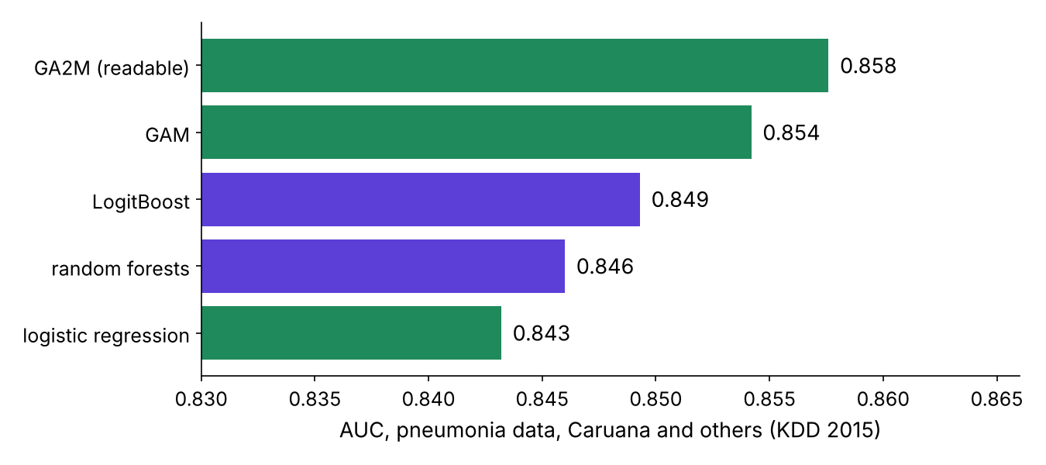
WEEK 5 · THURSDAY · OVERFITTING AND REGULARISATION
Pneumonia: the readable model shipped
Five published models within 0.02 AUC; readability decided.
Published AUCs of five models on pneumonia data, Caruana and others, KDD 2015
…
What does a brake buy?
Is one split enough?
Which tool, and when?
When does simple win?
What did it learn?
Can we trust 0.79?
Which model ships?
S30 · 36 / 65
Notes:
LIVE, 5 minutes. Caruana and others, KDD 2015, verified 28 October 2026. In the 1990s a neural net
scored 0.86 against logistic regression's 0.77, and a rule learner on the same data found "asthma
lowers risk", because asthmatics were sent straight to intensive care. The team went forward only
with models it could read, even at lower AUC. On the 2015 data the readable GA2M sat within 0.02 of
the black boxes, and the asthma term could be fixed by hand. Ask: what would the neural net have
done to asthmatic patients?

Slide 37
WEEK 5 · THURSDAY · OVERFITTING AND REGULARISATION
The flip, said both ways
Every rule today comes with the fact that reverses it.
The simpler model ships when | The complex model ships when
its gap to the complex one is not real across folds | it wins fold after fold
the complex model's low-end gain is below its extra cost | that gain clears the extra cost
someone must read and repair it | the decision needs an interaction only it captures
…
What does a brake buy?
Is one split enough?
Which tool, and when?
When does simple win?
What did it learn?
Can we trust 0.79?
Which model ships?
S31 · 37 / 65
Notes:
LIVE, 3 minutes. Say both columns. Interview line: I recommend the simpler model and I name the gap,
in rupees, at which I would switch. Transition: the bank's file, and the tree from the ticket.

Slide 38
PG DIPLOMA IN AI-ML AND AGENTIC AI ENGINEERING · COHORT 2
06
The tree that aced practice
What did it learn?
Case 1 applies: Overfitting; bias and variance through learning curves · Regularisation · Trees, ensembles, clustering · also searched as: overfitting decision tree, max_depth, learning curve scikit-learn
Is 100 percent good?
What does a brake buy?
Is one split enough?
Which tool, and when?
When does simple win?
What did it learn?
Can we trust 0.79?
Which model ships?
Week 5 Thursday: generalise or memorise
38 / 65
Notes:
LIVE, 30 minutes for the case chapter, including the guided read. Notebook case01. Everyone runs it;
one notebook open at a time.

Slide 39
WEEK 5 · THURSDAY · OVERFITTING AND REGULARISATION
Wednesday's honest columns, the week's split
Customer table, economy, the never-contacted flag. No duration. Test sealed.
24,712
8,238
8,238
TRAINING CUSTOMERS
VALIDATION CUSTOMERS
TEST, SEALED
the model learns here
we choose here
opened once, on Friday
…
What does a brake buy?
Is one split enough?
Which tool, and when?
When does simple win?
What did it learn?
Can we trust 0.79?
Which model ships?
S32 · 39 / 65
Notes:
LIVE, 2 minutes. Run the first four cells: 41,188 calls, 11.27 percent said yes, 10 number columns
and 10 category columns. The envelope stays on the wall. Call nobody: right for 7,310 of 8,238
validation customers, 88.7 percent.

Slide 40
WEEK 5 · THURSDAY · OVERFITTING AND REGULARISATION
Question: what will the unlimited tree score?
On the 24,712 it learned from, and on 8,238 it never saw.
?
?
88.7%
TRAINING ACCURACY
VALIDATION ACCURACY
CALL NOBODY
write it down
write it down
the line to beat
…
What does a brake buy?
Is one split enough?
Which tool, and when?
When does simple win?
What did it learn?
Can we trust 0.79?
Which model ships?
S33 · 40 / 65
Notes:
LIVE, 2 minutes. Everyone writes two numbers before running the cell. Ask three learners to read
theirs aloud.

Slide 41
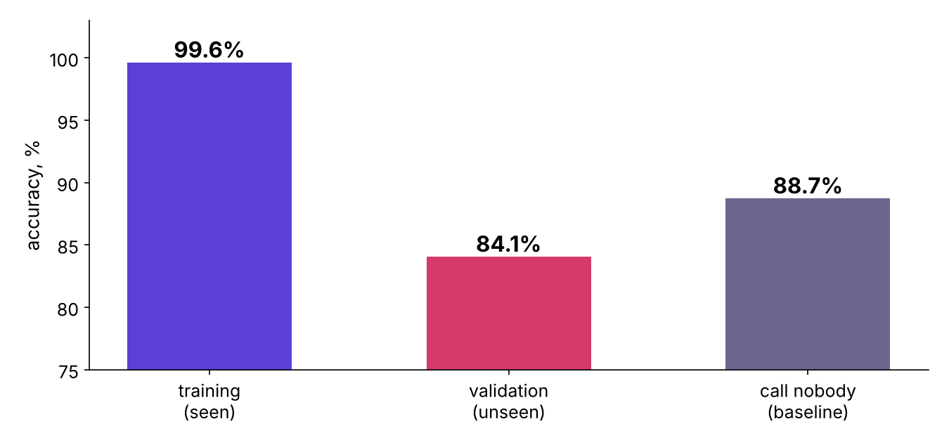
WEEK 5 · THURSDAY · OVERFITTING AND REGULARISATION
Answer: 99.6 on practice, 84.1 on the exam
Below the 88.7 percent of calling nobody.
Unlimited tree accuracy on training and validation against the baseline
…
What does a brake buy?
Is one split enough?
Which tool, and when?
When does simple win?
What did it learn?
Can we trust 0.79?
Which model ships?
S34 · 41 / 65
Notes:
LIVE, 4 minutes. The trap, shown exactly: 99.6 percent is the number a teammate posts, and a
Marketing lead who sees it books the campaign. The check that catches it is the validation number
beside the baseline. The fix is the brake. Land the line: this tree is the memoriser.

Slide 42
WEEK 5 · THURSDAY · OVERFITTING AND REGULARISATION
What the tree memorised
37 questions deep, 3,662 leaves: one leaf per 6.7 customers.
3,662
1,709
63%
LEAVES
HOLD ONE CUSTOMER
HOLD ONE OR TWO
final answers in the tree
a private rule each
2,323 of 3,662 leaves
…
What does a brake buy?
Is one split enough?
Which tool, and when?
When does simple win?
What did it learn?
Can we trust 0.79?
Which model ships?
S35 · 42 / 65
Notes:
LIVE, 3 minutes. Notebook step 4. A leaf holding one customer is that customer's private rule. It
will fire for next quarter's customer only by coincidence.

Slide 43
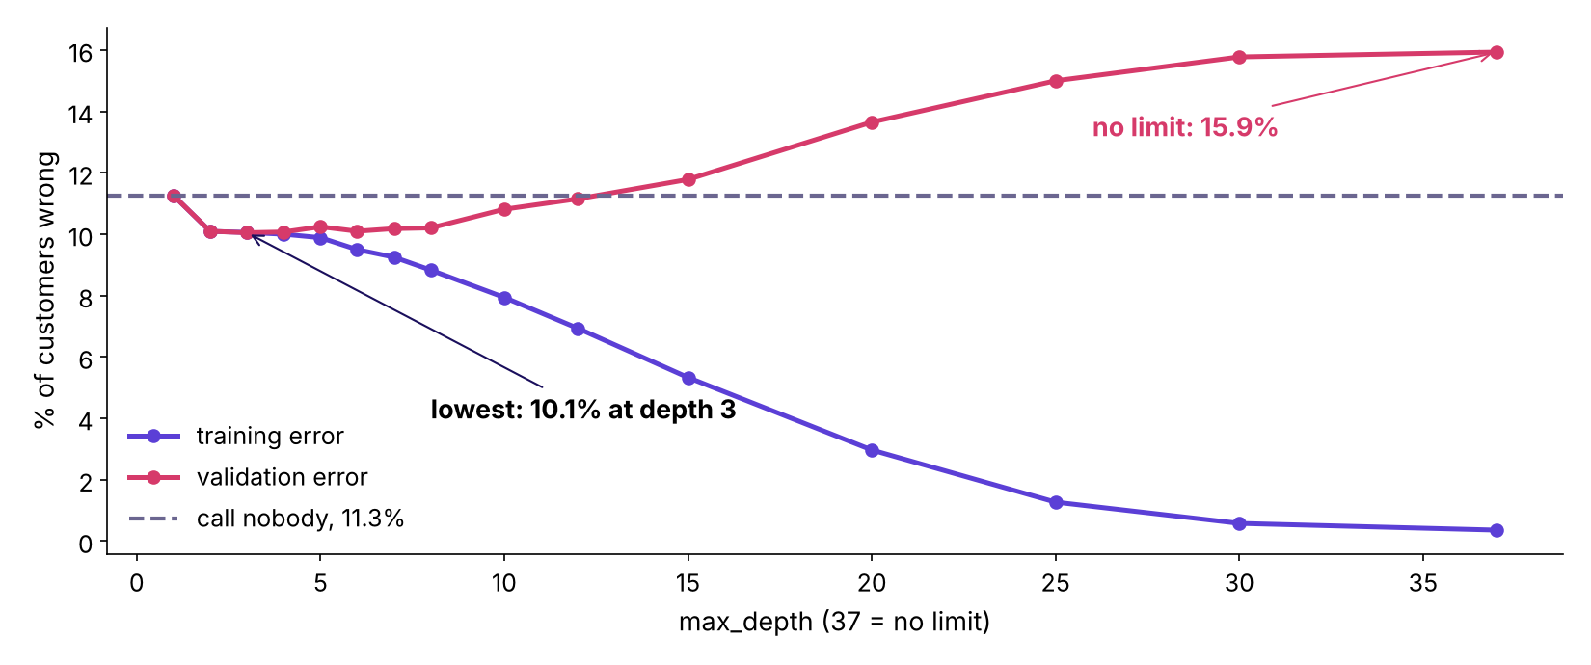
WEEK 5 · THURSDAY · OVERFITTING AND REGULARISATION
The depth curve: the U on real data
Lowest validation error at depth 3; no limit ends at 15.9 percent.
Training and validation error against max_depth on the bank's file
…
What does a brake buy?
Is one split enough?
Which tool, and when?
When does simple win?
What did it learn?
Can we trust 0.79?
Which model ships?
S36 · 43 / 65
Notes:
LIVE, 5 minutes. Notebook step 5. Training error falls all the way to 0.4 percent. Validation error
falls from 11.3 to about 10.1, stays flat to depth 8, then climbs past the dashed line by depth 15.
The left arm is bias, the right arm is variance, the bottom is the brake setting. This is Thursday's
addition to the week's picture.

Slide 44
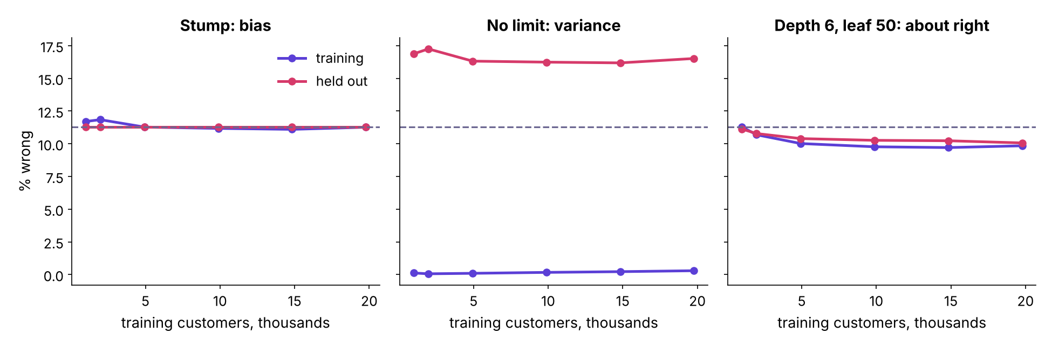
WEEK 5 · THURSDAY · OVERFITTING AND REGULARISATION
Three trees, three learning curves
Stump, no limit, depth 6 with leaf 50: five folds each.
Learning curves for a stump, an unlimited tree and a braked tree
…
What does a brake buy?
Is one split enough?
Which tool, and when?
When does simple win?
What did it learn?
Can we trust 0.79?
Which model ships?
S37 · 44 / 65
Notes:
LIVE, 4 minutes. Stump: both lines at 11.3, the baseline, close together: bias. No limit: training
near 0, held out near 16.5: a 16-point gap. Depth 6, leaf 50: 9.8 and 10.1, close and low.

Slide 45
WEEK 5 · THURSDAY · OVERFITTING AND REGULARISATION
More rows did not close the gap; the brake did
The unlimited tree's gap at 988 rows and at 19,769 rows.
Unlimited tree | 988 rows | 19,769 rows
Training error | 0.1% | 0.3%
Held-out error | 16.9% | 16.5%
Gap | 16.8 points | 16.2 points
Depth 6, leaf 50, at 19,769 rows: gap 0.2 points.
…
What does a brake buy?
Is one split enough?
Which tool, and when?
When does simple win?
What did it learn?
Can we trust 0.79?
Which model ships?
S38 · 45 / 65
Notes:
LIVE, 3 minutes. The flip of chapter 1's rule, on real data. Twenty times more customers moved the
gap by half a point, because the tree memorises noise and more rows bring more noise. The brake
closed it. Interview line: more data is the cure for variance only when the model is learning
signal it lacked.

Slide 46
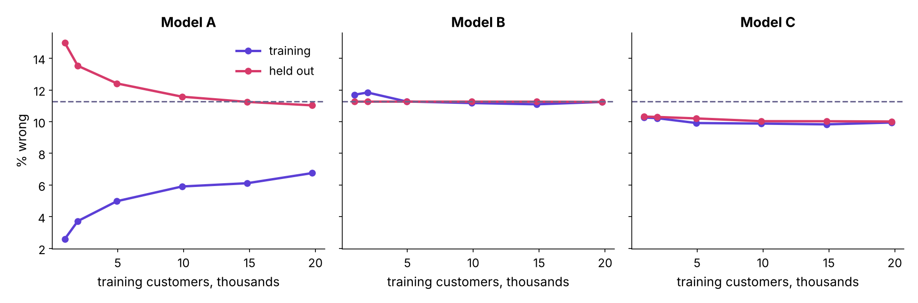
WEEK 5 · THURSDAY · OVERFITTING AND REGULARISATION
Guided: three mystery models
Name each side and prescribe one fix. Then one cross-validation, together.
Learning curves for three unnamed models A, B and C
…
What does a brake buy?
Is one split enough?
Which tool, and when?
When does simple win?
What did it learn?
Can we trust 0.79?
Which model ships?
S39 · 46 / 65
Notes:
LIVE, 15 minutes. Guided notebook. YOUR TURN 1: each learner writes bias, variance or about right
for A, B, C, plus one fix. YOUR TURN 2: run five-fold cross-validation, then k = 3 and k = 10. The
answer cell is last: A variance whose gap is still closing (a tree capped at depth 12, so more rows
help it, unlike the unlimited tree), B bias from a brake set far too hard (logistic at C = 0.0001), C
about right (logistic at C = 0.1). End of block one.

Slide 47
PG DIPLOMA IN AI-ML AND AGENTIC AI ENGINEERING · COHORT 2
07
Five exams on the bank's file
Can we trust 0.79?
Case 2 applies: Regularisation · Cross-validation · also searched as: k-fold cross validation scikit-learn, Pipeline data leakage, logistic regression C regularization
Is 100 percent good?
What does a brake buy?
Is one split enough?
Which tool, and when?
When does simple win?
What did it learn?
Can we trust 0.79?
Which model ships?
Week 5 Thursday: generalise or memorise
47 / 65
Notes:
LIVE, 20 minutes for the case chapter. Notebook case02, building on case 1's honest set, now in the
logistic model.

Slide 48
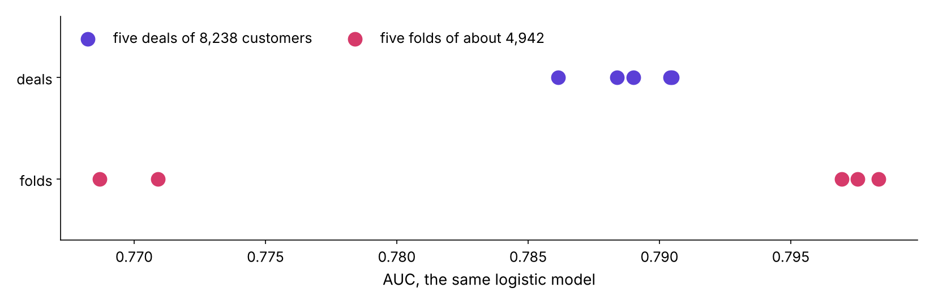
WEEK 5 · THURSDAY · OVERFITTING AND REGULARISATION
Five deals against five folds
Bigger exams, smaller luck: deals swing 0.004 AUC, folds 0.03.
Validation AUC on five deals of 8,238 customers and on five folds of 4,942
…
What does a brake buy?
Is one split enough?
Which tool, and when?
When does simple win?
What did it learn?
Can we trust 0.79?
Which model ships?
S40 · 48 / 65
Notes:
LIVE, 4 minutes. Notebook steps 1 and 2. Five re-deals of 8,238 validation customers move AUC
between 0.786 and 0.790. Five folds of about 4,942 customers each run from 0.769 to 0.798: mean
0.786, spread 0.014. The smaller the exam, the bigger the luck, which is why a score is quoted with
its spread.

Slide 49
WEEK 5 · THURSDAY · OVERFITTING AND REGULARISATION
The scaler goes inside the Pipeline
Each fold learns its means from its own teaching folds.
model = Pipeline([("prep", prep()), # scaler + one-hot, fitted per fold
("model", LogisticRegression(C=0.1, max_iter=3000))])
scores = cross_val_score(model, X_train, y_train, cv=folds, scoring="roc_auc")
…
What does a brake buy?
Is one split enough?
Which tool, and when?
When does simple win?
What did it learn?
Can we trust 0.79?
Which model ships?
S41 · 49 / 65
Notes:
LIVE, 3 minutes. Read the three lines. prep() holds the scaler and the one-hot encoder, so
cross_val_score refits them inside every turn.

Slide 50
WEEK 5 · THURSDAY · OVERFITTING AND REGULARISATION
Question: what did scaling first cost here?
Scale all 24,712 rows, then cross-validate.
0.78648
?
SCALER INSIDE
SCALER BEFORE
the right way
predict it
…
What does a brake buy?
Is one split enough?
Which tool, and when?
When does simple win?
What did it learn?
Can we trust 0.79?
Which model ships?
S42 · 50 / 65
Notes:
LIVE, 2 minutes. Prediction: bigger, smaller, or the same? By how much? Most rooms expect a visible
jump. Click.

Slide 51
WEEK 5 · THURSDAY · OVERFITTING AND REGULARISATION
Answer: 0.00003, and the rule still binds
A scaler learns two numbers per column. Target-aware steps leak far more.
Step before the split | What it learns | Leak here
Scaler | mean, spread | 0.00003 AUC
Filling gaps with a mean | mean | small
Choosing columns by their link to y | the answers | large
Encoding a category by its yes rate | the answers | large
…
What does a brake buy?
Is one split enough?
Which tool, and when?
When does simple win?
What did it learn?
Can we trust 0.79?
Which model ships?
S43 · 51 / 65
Notes:
LIVE, 3 minutes. Honest number: on this file, with 24,712 rows, the scaler leak is invisible. Say
why the habit stays: the next step someone adds before the split may learn from the answers. Rule:
everything that learns goes inside the Pipeline.

Slide 52
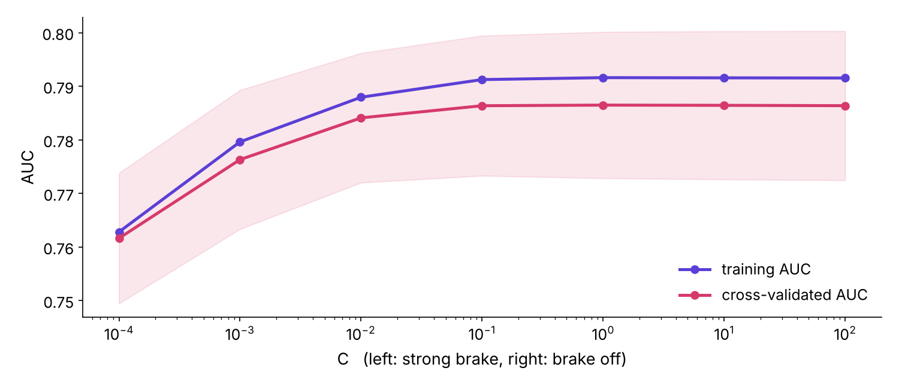
WEEK 5 · THURSDAY · OVERFITTING AND REGULARISATION
Sweep C: the logistic model barely needs a brake
Strong brake underfits; from C = 0.01 up, nothing changes.
Training and cross-validated AUC against C
…
What does a brake buy?
Is one split enough?
Which tool, and when?
When does simple win?
What did it learn?
Can we trust 0.79?
Which model ships?
S44 · 52 / 65
Notes:
LIVE, 4 minutes. C = 0.0001: AUC 0.762, bias. From C = 0.01: about 0.786 cross-validated and 0.79
on training, flat and close. With 24,712 rows and 63 columns the logistic model has little room to
memorise, so little variance to brake. The tree had room for 3,662 leaves. The flip: the practice
lab's 1,000 lending rows, where the brake matters.

Slide 53
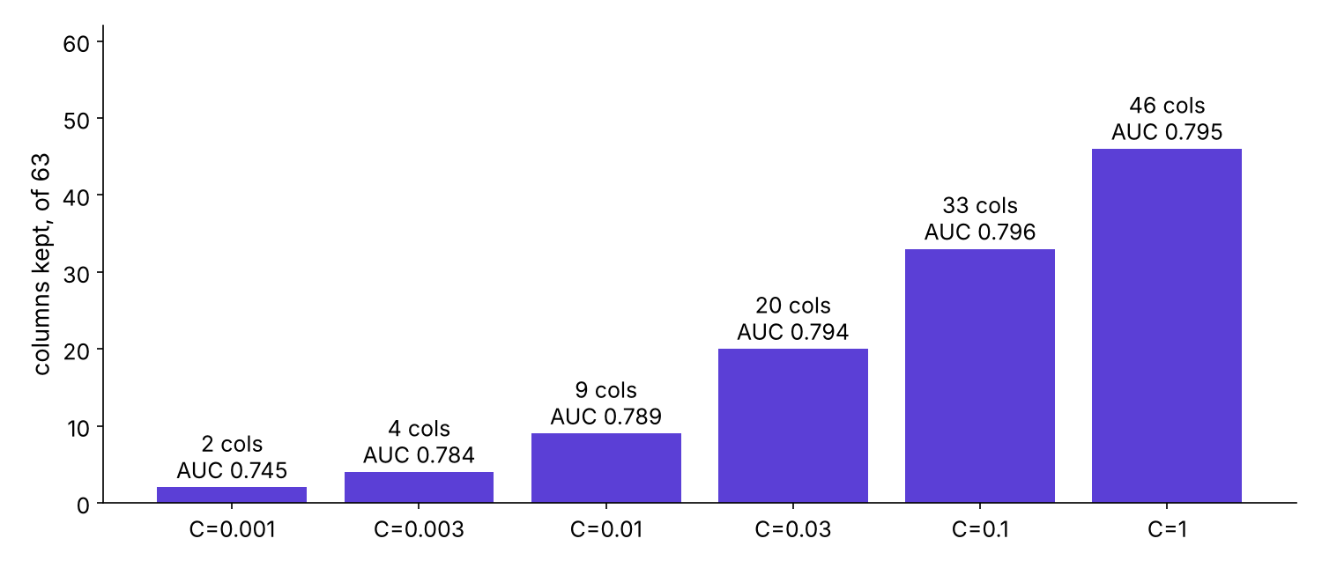
WEEK 5 · THURSDAY · OVERFITTING AND REGULARISATION
L1: 20 of 63 columns, within 0.002 AUC
The brake that also chooses columns.
Columns kept and validation AUC under L1 at six strengths
…
What does a brake buy?
Is one split enough?
Which tool, and when?
When does simple win?
What did it learn?
Can we trust 0.79?
Which model ships?
S45 · 53 / 65
Notes:
LIVE, 4 minutes. At C = 0.03, 20 columns survive with validation AUC 0.794, against 0.795 with 45
columns at C = 1. A shorter model is cheaper to explain and to monitor, which is chapter 5's argument
arriving early. Caveat: when columns move together, L1 keeps one of them almost by chance.

Slide 54
PG DIPLOMA IN AI-ML AND AGENTIC AI ENGINEERING · COHORT 2
08
The three-way race
Which model ships?
Case 3 applies: Cross-validation · Trees, ensembles, clustering · When the simpler model wins · also searched as: random forest vs gradient boosting, model comparison cross validation, precision at k
Is 100 percent good?
What does a brake buy?
Is one split enough?
Which tool, and when?
When does simple win?
What did it learn?
Can we trust 0.79?
Which model ships?
Week 5 Thursday: generalise or memorise
54 / 65
Notes:
LIVE, 25 minutes for the case chapter, with mid-session drill 2 inside it. Notebook case03. This is
also the row's unguided exercise: the room runs it and writes the provisional call.

Slide 55
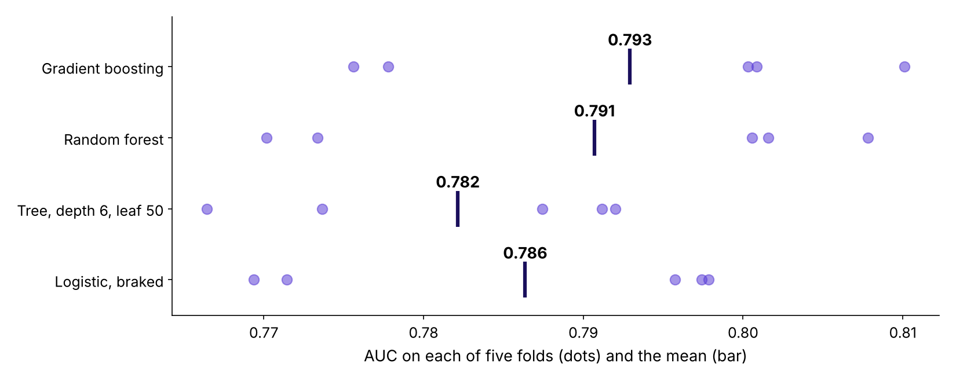
WEEK 5 · THURSDAY · OVERFITTING AND REGULARISATION
Four candidates on the same five folds
Boosting 0.793, forest 0.791, logistic 0.786, tuned tree 0.782.
Fold AUCs and means for four models
…
What does a brake buy?
Is one split enough?
Which tool, and when?
When does simple win?
What did it learn?
Can we trust 0.79?
Which model ships?
S46 · 55 / 65
Notes:
LIVE, 4 minutes. The tree was tuned with a plain loop over depth and leaf size on the same folds:
depth 6, leaf 50. Ask the room to predict the order before showing. Every model's five dots
overlap the others'. Validation AUC: logistic 0.796, tree 0.790, forest 0.803, boosting 0.804.

Slide 56
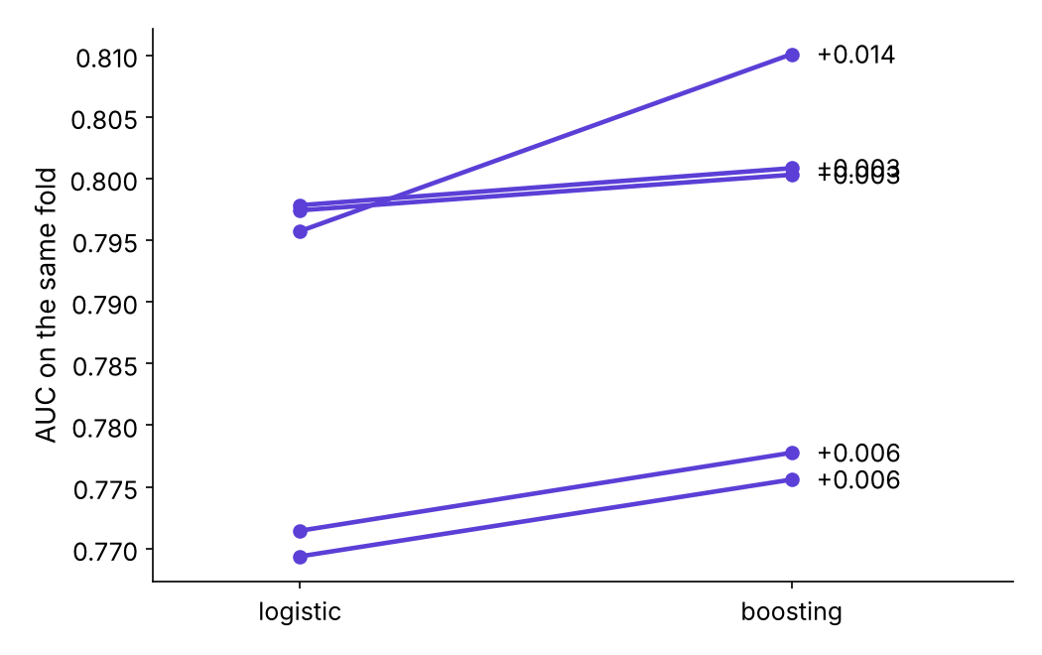
WEEK 5 · THURSDAY · OVERFITTING AND REGULARISATION
Test 1: boosting wins every fold, by a little
Fold by fold: +0.007, +0.007, +0.003, +0.014, +0.003 AUC.
Paired fold AUCs, logistic against boosting
…
What does a brake buy?
Is one split enough?
Which tool, and when?
When does simple win?
What did it learn?
Can we trust 0.79?
Which model ships?
S47 · 56 / 65
Notes:
LIVE, 3 minutes. Test 1 passes: the lead is real, about 0.007 AUC. Now test 2, in rupees.

Slide 57
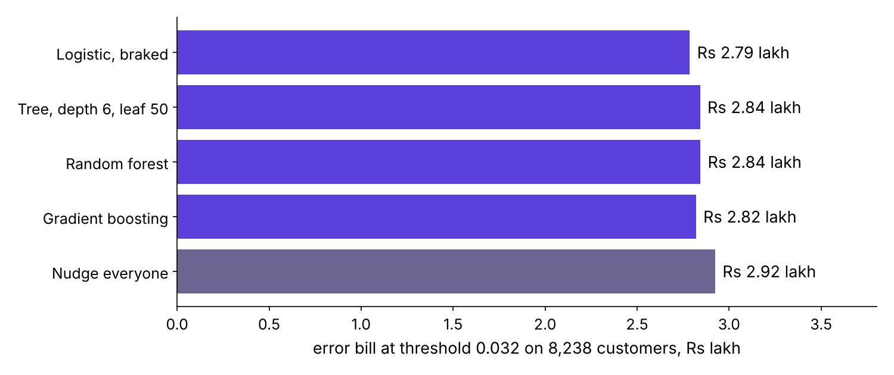
WEEK 5 · THURSDAY · OVERFITTING AND REGULARISATION
At the cost threshold, all four nudge nearly everyone
Bills at 40 / 1,240 = 0.032 sit within about 2 percent.
Error bills at the cost threshold for four models and for nudging everyone
…
What does a brake buy?
Is one split enough?
Which tool, and when?
When does simple win?
What did it learn?
Can we trust 0.79?
Which model ships?
S48 · 57 / 65
Notes:
LIVE, 4 minutes. Tuesday's threshold: act when P(buy) beats 0.032. Logistic Rs 2.79 lakh, boosting
Rs 2.82 lakh, nudge everyone Rs 2.92 lakh on 8,238 customers. At Rs 40 against Rs 1,200 a model
barely matters; the budget is where ranking pays.

Slide 58
WEEK 5 · THURSDAY · OVERFITTING AND REGULARISATION
Under the budget: buyers in the top 1,000
5,000 nudges for 41,188 customers is the top 12 percent: 1,000 of 8,238.
Model | Buyers in top 1,000 | Precision | Campaign value
Logistic, braked | 465 | 46.5% | Rs 5.18 lakh
Tree, depth 6, leaf 50 | 469 | 46.9% | Rs 5.23 lakh
Random forest | 476 | 47.6% | Rs 5.31 lakh
Gradient boosting | 472 | 47.2% | Rs 5.26 lakh
A random 1,000 | about 113 | 11.3%
…
What does a brake buy?
Is one split enough?
Which tool, and when?
When does simple win?
What did it learn?
Can we trust 0.79?
Which model ships?
S49 · 58 / 65
Notes:
LIVE, 3 minutes. Every model is four times better than random. Between models: 7 buyers per 1,000
nudges between logistic and boosting on validation. Value = buyers x Rs 1,200 minus 1,000 x Rs 40.

Slide 59
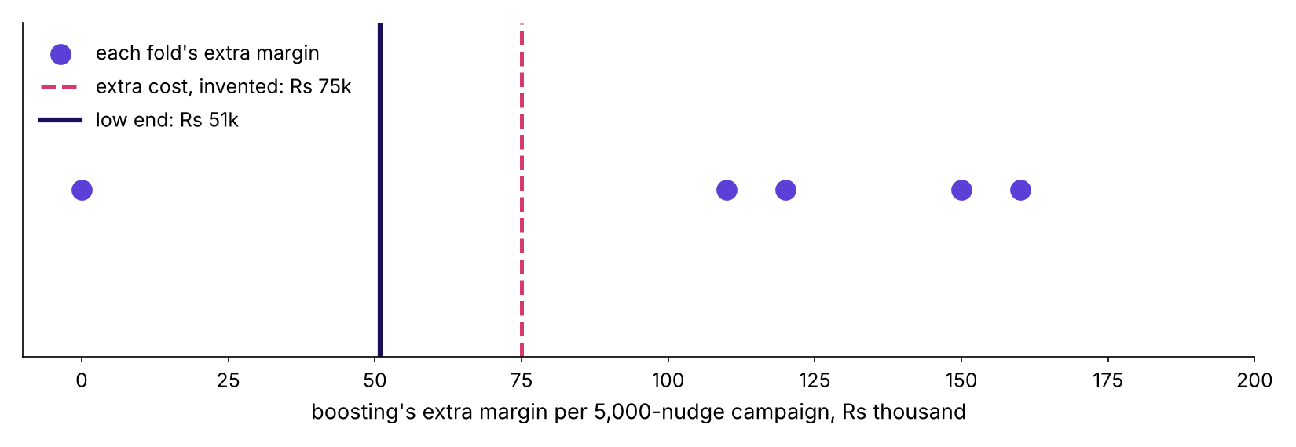
WEEK 5 · THURSDAY · OVERFITTING AND REGULARISATION
Test 2: the low end against the extra cost
Extra buyers per 5,000 nudges, fold by fold: 0, 133, 100, 92, 125.
Boosting's extra margin per campaign, fold by fold, against an invented extra cost
…
What does a brake buy?
Is one split enough?
Which tool, and when?
When does simple win?
What did it learn?
Can we trust 0.79?
Which model ships?
S50 · 59 / 65
Notes:
LIVE, 5 minutes. Mean 90 extra buyers, spread 48, low end 42 buyers, Rs 50,939 a campaign. The extra
cost is invented at Rs 75,000 because Kalpa's platform team has not priced it; that is the
clarifying question to ask. Break-even: Rs 75,000 / Rs 1,200 = 62.5, so 63 extra buyers at the low end. Mid-session drill 2 (15
minutes): three score gaps, simpler or complex, defend one.

Slide 60
WEEK 5 · THURSDAY · OVERFITTING AND REGULARISATION
The provisional call
Friday turns it into the committee memo.
Part | With your numbers
Claim | ship the braked logistic model for the first campaign
Evidence | boosting leads by 0.007 AUC; bills within 2 percent; low-end gain Rs 51k
Caveat | folds mix 2008 to 2010; Friday scores the late months
Action | switch when the low end clears the priced extra cost
…
What does a brake buy?
Is one split enough?
Which tool, and when?
When does simple win?
What did it learn?
Can we trust 0.79?
Which model ships?
S51 · 60 / 65
Notes:
LIVE, 3 minutes. Each learner writes this in their own words in the case notebook's last cell. Say
it to a room that saw 99.6: the 99.6 was the tree memorising last quarter's customers; the 84.1 is
what next quarter would have seen; this model protects Anand's one campaign.

Slide 61
WEEK 5 · THURSDAY · OVERFITTING AND REGULARISATION
The QA seat: what breaks it, which split, segment
Today's spotlight. Three checks before anyone trusts 0.786.
Check | How | A pass looks like
Shuffle the answers | cross-validate with y shuffled | AUC falls to about 0.5
Change the split | folds cut by time (Friday) | the score holds
Break it by segment | score each segment apart | no segment below the baseline
…
What does a brake buy?
Is one split enough?
Which tool, and when?
When does simple win?
What did it learn?
Can we trust 0.79?
Which model ships?
S52 · 61 / 65
Notes:
LIVE, 3 minutes. The tester asks how to break the model, not whether it works. A shuffled-answer run
that stays above 0.5 means something leaks. The time split and the segment table are Friday's
checks; today, name them. The practice lab runs the shuffle test.

Slide 62
WEEK 5 · THURSDAY · OVERFITTING AND REGULARISATION
Interview corner
The row's four anchors, each with the shape of a good answer.
Tag | Question | A good answer's shape
[S] | Overfitting: what, detect, fix? | gap, curves, brake or rows, and when rows fail
[S] | Bias against variance, plain words | too simple anywhere; too sensitive to the draw
[F] | Why cross-validation, not one split? | split luck, mean with spread, same folds
[D] | Tuned model wins by a point, ten times harder to explain | two tests, rupees, the flip, the 99.6 named
…
What does a brake buy?
Is one split enough?
Which tool, and when?
When does simple win?
What did it learn?
Can we trust 0.79?
Which model ships?
S53 · 62 / 65
Notes:
LIVE, 4 minutes. [S] staple asked everywhere, [F] frequent in GCC and product screens, [D] a
differentiator. Pick one learner per question; 30 seconds each. The interview bank carries the model
answers and the two follow-ups.

Slide 63
WEEK 5 · THURSDAY · OVERFITTING AND REGULARISATION
Quiz: five questions and the return question
Kahoot, ungraded.
# | Question
1 | Train 99.6, validation 84.1, baseline 88.7: name it
2 | Which curve pair says high bias?
3 | Cross-validation averages away what?
4 | The tuned tree beats logistic by 0.4 points: recommend which?
5 | Regularisation trades what for what?
R | Wednesday: the leak went, the score fell; why is the model better?
…
What does a brake buy?
Is one split enough?
Which tool, and when?
When does simple win?
What did it learn?
Can we trust 0.79?
Which model ships?
S54 · 63 / 65
Notes:
LIVE, 8 minutes. Keys and options are in the trainer guide. Question 4 is the trap: 0.4 points is
inside the fold spread and is worth no extra cost.

Slide 64
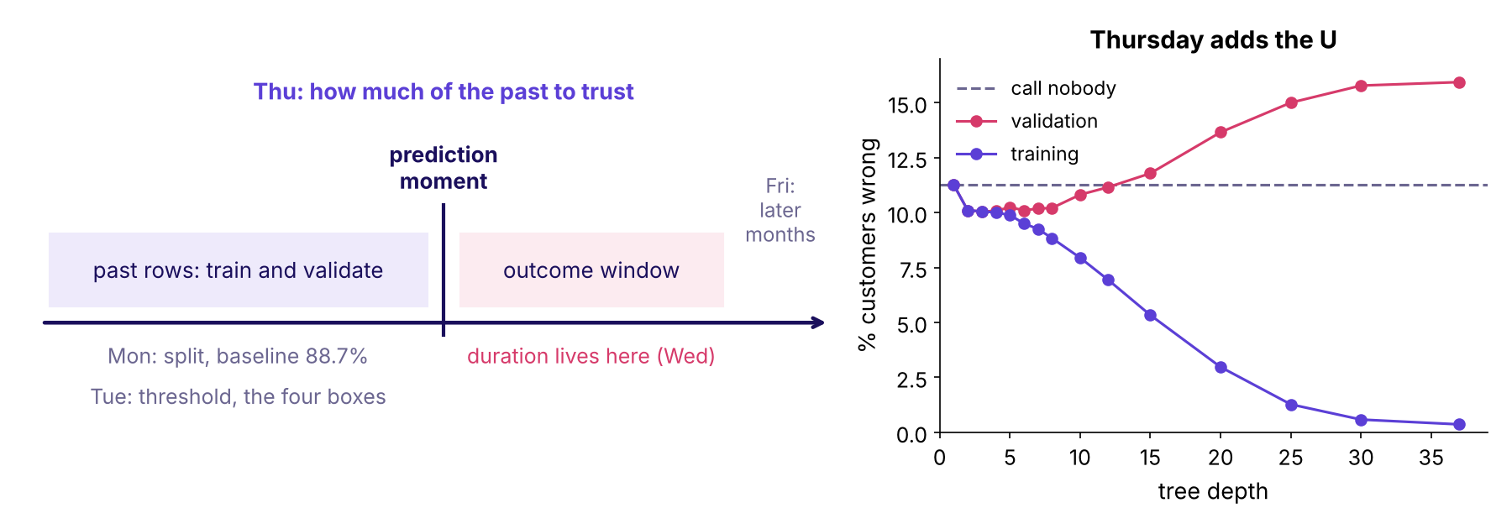
WEEK 5 · THURSDAY · OVERFITTING AND REGULARISATION
The week's picture, Thursday filled in
Redraw it from memory tonight: the U, the baseline line, the depth you chose.
The week's timeline with Thursday's U of validation error against tree depth
…
What does a brake buy?
Is one split enough?
Which tool, and when?
When does simple win?
What did it learn?
Can we trust 0.79?
Which model ships?
S54a · 64 / 65
Notes:
LIVE, 1 minute. Hold the room's sketches from the opening against the real U. Friday adds the last
panel: what happens to the score in the later months.

Slide 65



WEEK 5 · THURSDAY · OVERFITTING AND REGULARISATION
What you can do now, tonight, tomorrow
Two to three hours of practice set; the lab runs with the TAs.
NOW
TONIGHT
FRIDAY
Diagnose, brake, cross-validate
Practice set and lab
The committee memo
Read two curves, choose a brake on held-out rows, quote a score with its spread, run both tests.
Ten problems, eighteen self-checks; rerun the race with one column removed.
Train early, score late; open the envelope once; reread Tuesday's metric memo.
…
What does a brake buy?
Is one split enough?
Which tool, and when?
When does simple win?
What did it learn?
Can we trust 0.79?
Which model ships?
S55 · 65 / 65
Notes:
LIVE, 2 minutes. Close on the week's picture: redraw the U from memory tonight.
The tentative IITGN faculty session follows with the bias-variance decomposition and the penalty shapes.

