Slide 1


Indian Institute of Technology Gandhinagar
PG DIPLOMA IN AI-ML AND AGENTIC AI ENGINEERING · COHORT 2
ADMINISTERED THROUGH THE COMPETENCY ADVANCEMENT ACADEMY
07
Can weaning lift retention?
Zomato Gold, Chennai, continued, beside Swiggy's own published cohorts: Swiggy removed users with low expected value, so how much of a retention rise can that alone produce?
Can weaning lift retention?
Does a weekly table agree?
Did Gold cause the orders?
Is the app team's stage fine?
Week 4 Day 4: the fallback block
1 / 14
Notes:
This block runs only if the IITGN faculty session W4-3 (tentative) slips. It teaches no survival
curves, censoring or tests between curves, which stay with the block whenever it runs. Four
parts: 35, 40, 25 and 20 minutes, 120 in all.
LIVE, 35 minutes. Styles: StatQuest (ten members on the board), the case method (Swiggy's own
decision). The denominator question closes the part.
Transition: Swiggy's numbers.

Slide 2

Indian Institute of Technology Gandhinagar
WEEK 4 · DAY 4 · THE FALLBACK, IF THE TENTATIVE FACULTY BLOCK SLIPS
ADMINISTERED THROUGH THE COMPETENCY ADVANCEMENT ACADEMY
Swiggy weaned 4 million users; retention rose
What did Swiggy decide, and what did its numbers do?
4M+
55 to 61
4.14x
USERS WEANED AWAY
PERCENT
SPEND AT Q6
unprofitable Instamart users, over three quarters to Q1 FY27
one-month retention of the transacting base, Q1 FY26 to Q1 FY27
the Q4 FY24 cohort's spend in its sixth quarter against its first
Swiggy says it used cohort-level levers (minimum order thresholds, free deliveries, new-user coupons) and weaned away users with low expected lifetime value. Sources: Swiggy's Q1 FY27 and Q2 FY26 shareholder letters, each checked 12 October 2026.
Can weaning lift retention?
Does a weekly table agree?
Did Gold cause the orders?
Is the app team's stage fine?
S1 · 2 / 14
Notes:
Sources:
https://nsearchives.nseindia.com/corporate/SWIGGY_30072026154100_Covering_Letter_Letter_to_Shareholders_-_signed.pdf (checked 12 October 2026)
https://www.swiggy.com/corporate/wp-content/uploads/2025/10/Q2-FY2026-Shareholder-letter.pdf (checked 12 October 2026)
LIVE, 8 minutes. Read the three numbers and the decision. Ask: which of these could rise with no
user ordering a single extra time? Expect "the retention rate"; the next slide shows how.
Transition: ten members on the board.

Slide 3
Indian Institute of Technology Gandhinagar
WEEK 4 · DAY 4 · THE FALLBACK, IF THE TENTATIVE FACULTY BLOCK SLIPS
ADMINISTERED THROUGH THE COMPETENCY ADVANCEMENT ACADEMY
Drop five weak members, and every column rises
Ten members, five strong and five weak: what happens to each month's rate when the weak five leave (invented)?
Month | All ten | The strong five only
Month one | 7 of 10 | 5 of 5
Month two | 5 of 10 | 5 of 5
Month three | 4 of 10 | 4 of 5
Month four | 3 of 10 | 3 of 5
No member changed what she did, and every month's rate rose: 70 to 100, 50 to 100, 40 to 80, 30 to 60 percent. A retention rise after a weaning is partly the mix of who remains.
Can weaning lift retention?
Does a weekly table agree?
Did Gold cause the orders?
Is the app team's stage fine?
S2 · 3 / 14
Notes:
LIVE, 12 minutes. Build the table on the board with the room, column by column (invented
numbers). Then ask: from the blended number alone, could you tell a weaning from a better product?
No; the cohort table with its denominator can.
Transition: the denominator question.

Slide 4
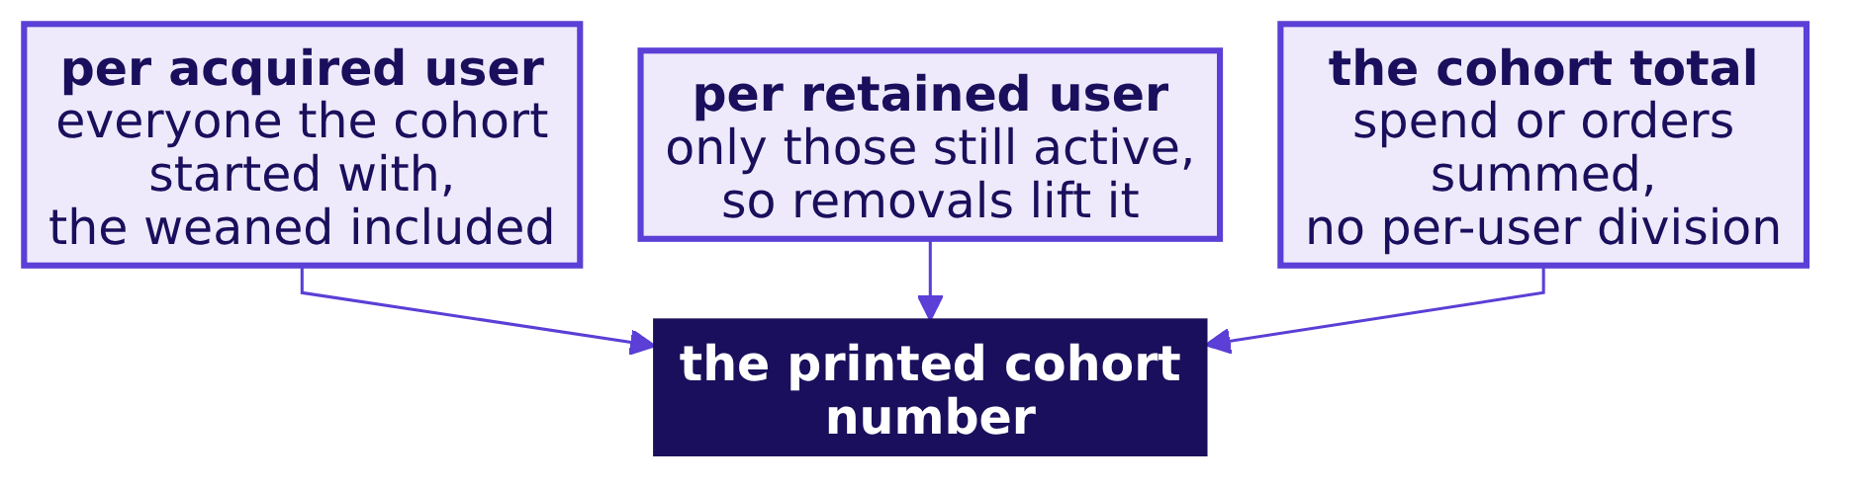
Indian Institute of Technology Gandhinagar
WEEK 4 · DAY 4 · THE FALLBACK, IF THE TENTATIVE FACULTY BLOCK SLIPS
ADMINISTERED THROUGH THE COMPETENCY ADVANCEMENT ACADEMY
Three denominators give three different charts
Which denominator does a published cohort chart use, and what would the others say?
A cohort chart without its denominator is a shape. Swiggy's table is indexed to its Q4 FY24 cohort's first quarter, and calls the groups "retained user cohorts": the first thing to ask is who stays in the count.
Can weaning lift retention?
Does a weekly table agree?
Did Gold cause the orders?
Is the app team's stage fine?
S3 · 4 / 14
Notes:
LIVE, 15 minutes. Groups write what each denominator would show after a weaning. Per retained
user rises most; per acquired user shows the removals as a fall; the total moves least.
Transition: the rerun, by week.

Slide 5
Indian Institute of Technology Gandhinagar
PG DIPLOMA IN AI-ML AND AGENTIC AI ENGINEERING · COHORT 2
ADMINISTERED THROUGH THE COMPETENCY ADVANCEMENT ACADEMY
08
Does a weekly table agree?
Rebuilt by signup week instead of signup month, which part of the morning's story holds and which needs new words?
Can weaning lift retention?
Does a weekly table agree?
Did Gold cause the orders?
Is the app team's stage fine?
Week 4 Day 4: the fallback block
5 / 14
Notes:
LIVE, 40 minutes. The row's after-class task done in class, in pairs, on the event log. Styles:
Krish Naik (a table built line by line), Veritasium (predict the sale week's row first).
Transition: the task.

Slide 6
Indian Institute of Technology Gandhinagar
WEEK 4 · DAY 4 · THE FALLBACK, IF THE TENTATIVE FACULTY BLOCK SLIPS
ADMINISTERED THROUGH THE COMPETENCY ADVANCEMENT ACADEMY
The task: cohorts by signup week, from the log
How is a weekly cohort table built from the event log?
placed = ev[ev["stage"] == "order_placed"]
week = lambda t: t.dt.to_period("W-SUN").dt.start_time # weeks start on Monday
orders_week = set(zip(placed["user_id"], week(placed["event_ts"])))
# members who joined 3 August to 13 September; week k is the k-th full week after the signup week
Members who joined from 3 August to 13 September form six weekly cohorts. A member is active in week k when she placed an order that week. The week of 28 September is three days long, so the table stops at the week of 21 September.
Can weaning lift retention?
Does a weekly table agree?
Did Gold cause the orders?
Is the app team's stage fine?
S4 · 6 / 14
Notes:
LIVE, 20 minutes in pairs. Ask each pair to predict the sale week's row before computing it.
Transition: the table.

Slide 7
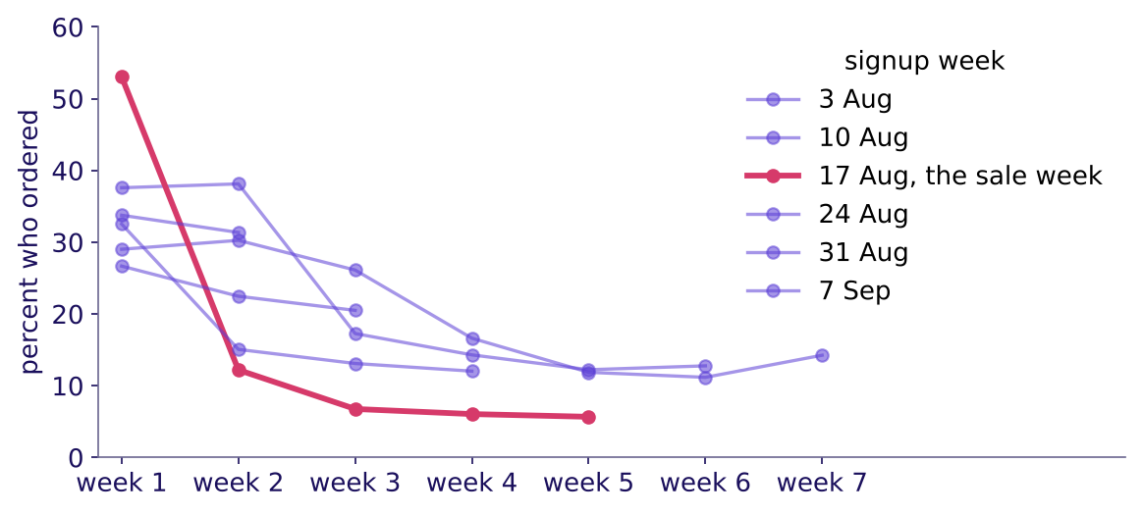
Indian Institute of Technology Gandhinagar
WEEK 4 · DAY 4 · THE FALLBACK, IF THE TENTATIVE FACULTY BLOCK SLIPS
ADMINISTERED THROUGH THE COMPETENCY ADVANCEMENT ACADEMY
The sale week: 53 percent, then 12
What does the weekly table show for the sale week against the weeks either side of it?
Weekly cohorts: the sale week orders once, then falls away
Percent of each weekly cohort that ordered in each full week after joining. The week of 17 August, the sale week, brought 9,108 members, the 8,027 who joined on the sale's discount among them. They ordered at 53 percent in their first full week, the most of any cohort, and then fell off a cliff to 12, the steepest fall of the six. The five other weeks, 1,112 to 1,247 members each, start between 27 and 38 percent.
Can weaning lift retention?
Does a weekly table agree?
Did Gold cause the orders?
Is the app team's stage fine?
S5 · 7 / 14
Notes:
LIVE, 10 minutes. Point at the sale week's two cells. The monthly table hid this inside the
signup month, which is month zero and never counted.
Transition: which story survives.

Slide 8
Indian Institute of Technology Gandhinagar
WEEK 4 · DAY 4 · THE FALLBACK, IF THE TENTATIVE FACULTY BLOCK SLIPS
ADMINISTERED THROUGH THE COMPETENCY ADVANCEMENT ACADEMY
The method survives; the words change
Which sentence of the morning holds on a weekly table, and which has to be rewritten?
The morning said | On the weekly table
Every cohort falls with age | Holds, with noise: weekly cohorts of 1,112 to 1,247 members
The sale-week members are the weakest | Holds for the sale week's cohort after its first week; in that first week it looks strongest
Rates near 38 percent | Weekly rates are lower: ordering in a given week is rarer than in a month
The last month counts | The last week is partial and leaves the table
Can weaning lift retention?
Does a weekly table agree?
Did Gold cause the orders?
Is the app team's stage fine?
S6 · 8 / 14
Notes:
LIVE, 10 minutes. The lesson: a cohort table's grain changes the numbers and keeps the method.
Name the grain on every chart, as the unit is named on every funnel.
Transition: Zomato's own number.

Slide 9
Indian Institute of Technology Gandhinagar
PG DIPLOMA IN AI-ML AND AGENTIC AI ENGINEERING · COHORT 2
ADMINISTERED THROUGH THE COMPETENCY ADVANCEMENT ACADEMY
09
Did Gold cause the orders?
Zomato says Gold members order about 60 percent more after joining; what comparison would let anyone say Gold caused it?
Can weaning lift retention?
Does a weekly table agree?
Did Gold cause the orders?
Is the app team's stage fine?
Week 4 Day 4: the fallback block
9 / 14
Notes:
LIVE, 25 minutes. Kept descriptive: no causal method is taught. Styles: Veritasium (the
misconception first), the case method.
Transition: the number.

Slide 10
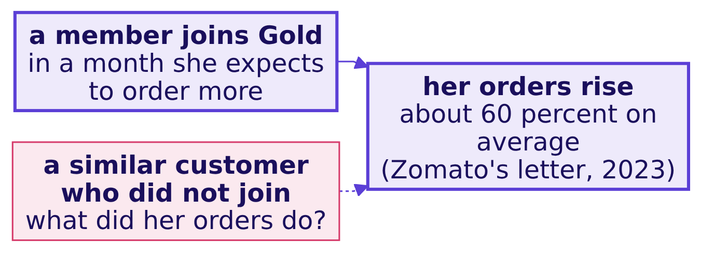
Indian Institute of Technology Gandhinagar
WEEK 4 · DAY 4 · THE FALLBACK, IF THE TENTATIVE FACULTY BLOCK SLIPS
ADMINISTERED THROUGH THE COMPETENCY ADVANCEMENT ACADEMY
Gold members order about 60 percent more after joining
What does Zomato's own number say, and what does it leave out?
Zomato's shareholder letter of 19 May 2023 (checked 12 October 2026) says Gold reached 1.8 million members in Q4 FY23, its members' orders were about 30 percent of food delivery GOV in March 2023, and their order frequency rose about 60 percent after joining. The number describes members; it does not show what Gold caused.
Can weaning lift retention?
Does a weekly table agree?
Did Gold cause the orders?
Is the app team's stage fine?
S7 · 10 / 14
Notes:
Source:
https://www.bseindia.com/xml-data/corpfiling/AttachHis/42b3bf3b-1edb-4da7-849a-87ca9da27ff8.pdf (checked 12 October 2026)
LIVE, 10 minutes. Members choose to join when they expect to order more, so before and after
mixes the choice with the effect. Ask what a fair comparison would be.
Transition: the comparisons.

Slide 11
Indian Institute of Technology Gandhinagar
WEEK 4 · DAY 4 · THE FALLBACK, IF THE TENTATIVE FACULTY BLOCK SLIPS
ADMINISTERED THROUGH THE COMPETENCY ADVANCEMENT ACADEMY
Three comparisons that would say more
Which comparison would separate what Gold did from who chose Gold?
Comparison | What it controls for | What it still misses
Matched customers who did not join | Customers who ordered alike before | Why one joined and the other did not
The trend before joining | A member already ordering more each month | A planned change (a move, a new job)
A holdout: Gold offered to some, withheld from others | Who chose to join | The cost of withholding the offer
Can weaning lift retention?
Does a weekly table agree?
Did Gold cause the orders?
Is the app team's stage fine?
S8 · 11 / 14
Notes:
LIVE, 15 minutes. Groups rank the three for what Zomato could run. Keep it at this depth: how to
estimate the effect belongs to later weeks.
Transition: the second transcript.

Slide 12
Indian Institute of Technology Gandhinagar
PG DIPLOMA IN AI-ML AND AGENTIC AI ENGINEERING · COHORT 2
ADMINISTERED THROUGH THE COMPETENCY ADVANCEMENT ACADEMY
10
Is the app team's stage fine?
The app team says the funnel stage the room blamed is fine: how does a strong candidate answer a dispute that is partly right?
Can weaning lift retention?
Does a weekly table agree?
Did Gold cause the orders?
Is the app team's stage fine?
Week 4 Day 4: the fallback block
12 / 14
Notes:
LIVE, 20 minutes. The row's [D] anchor: the app team says the funnel stage you blamed is fine;
what evidence do you bring to the meeting? Pairs read and score it.
Transition: the transcript.

Slide 13
Indian Institute of Technology Gandhinagar
WEEK 4 · DAY 4 · THE FALLBACK, IF THE TENTATIVE FACULTY BLOCK SLIPS
ADMINISTERED THROUGH THE COMPETENCY ADVANCEMENT ACADEMY
The dispute, answered with the split
What does a weak answer bring to the meeting, and what does a hire-grade one bring?
Beat | A weak answer | A hire-grade answer
Opening | "Your release broke checkout." | "You're right that checkout starts held at 80 percent; I'd like to show the next step."
Evidence | Overall conversion before and after | Checkout start to order, 72.5 to 55, members on Android only, from the release week
The comparators | None | iOS members 57 to 56; non-members on Android 52 to 51
What would change my mind | Nothing | "If the event the release renamed is mapped wrong, I'd rerun it on your mapping."
Can weaning lift retention?
Does a weekly table agree?
Did Gold cause the orders?
Is the app team's stage fine?
S9 · 13 / 14
Notes:
LIVE, 15 minutes. Pairs score the hire-grade side on the scorecard. The move is Tuesday's: restate,
answer from the evidence, concede what is true, say what would change your mind.
Transition: the close.

Slide 14
Indian Institute of Technology Gandhinagar
WEEK 4 · DAY 4 · THE FALLBACK, IF THE TENTATIVE FACULTY BLOCK SLIPS
ADMINISTERED THROUGH THE COMPETENCY ADVANCEMENT ACADEMY
The block in one sentence
What did the fallback block add to the day?
A retention number can rise or hold because of who is counted, with nobody's behaviour changing: the cohort table with its denominator and its grain named is what tells the two apart.
Can weaning lift retention?
Does a weekly table agree?
Did Gold cause the orders?
Is the app team's stage fine?
S10 · 14 / 14
Notes:
LIVE, 2 minutes. Nothing here touched survival curves, censoring or tests between curves; the
faculty block (tentative) takes them whenever it runs. Then return to the Kahoot if it has not run.
Transition: end of the block.

