Slide 1


Indian Institute of Technology Gandhinagar
ADMINISTERED THROUGH THE COMPETENCY ADVANCEMENT ACADEMY
WEEK 1 · MONDAY · MORNING
The question before the budget
“Before I sign anything, I want to understand our own sales. Is acquisition even the branch that is short?”
Meera Raghavan, CEO, Kalpa Retail, to the data and AI team at Kalpa's Global Capability Centre
00
How does retail earn
01
Which total is sales
02
What is each branch
03
Do customers come back
04
What is a typical order
Week 1, Day 1. The question before the budget
1 / 76
Notes:
On screen before the clock starts. Leave Meera's words up while the room settles and do not explain
them yet: the next slide sets out the questions that climb to her answer, and the story ends on her
full message. Say once that Kalpa is fictional and the whole programme is set inside it, and that
the first 45 minutes are about the business, with no laptop open.
Transition: the day's question, and the nine questions that climb to its answer.

Slide 2

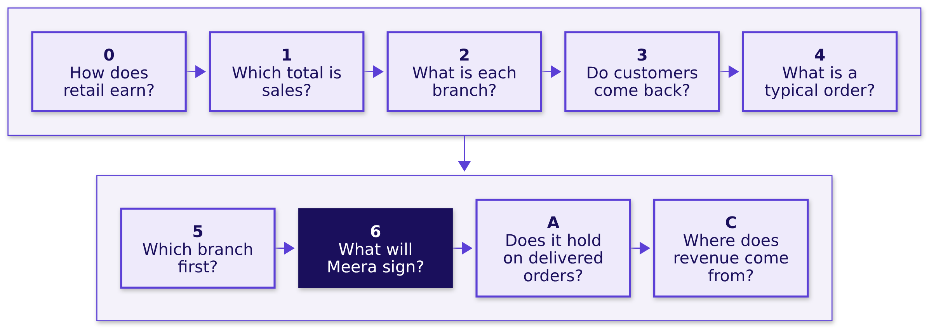
Indian Institute of Technology Gandhinagar
WEEK 1 · DAY 1 · KALPA GLOBAL CAPABILITY CENTRE
ADMINISTERED THROUGH THE COMPETENCY ADVANCEMENT ACADEMY
Nine questions climb to Meera's answer
Before Meera signs Rs 12 crore for new customers, is acquisition even the branch of sales that is short?
How does retail earn
Which total is sales
What is each branch
Do customers come back
What is a typical order
S1 · 2 / 76
Notes:
LIVE, 1 minute. Read the day's question once, then the nine short questions in order: the story
first, chapters 1 to 4 this morning with a break before chapter 4, and chapters 5 and 6 and the two
cases after lunch. Each chapter ends on a number, the next chapter asks the question that number
raises, and the afternoon closes on the sentence Meera signs. Answer nothing yet.
Ask: if you had to answer Meera by tonight, which of the nine would you start with? Take one answer
and leave it open.
Watch for anyone who jumps straight to "buy more customers" or "cut prices"; write it on the board
and say chapter 5 tests it.
Transition: before any data, the business, starting with how a retailer earns.

Slide 3
Indian Institute of Technology Gandhinagar
PG DIPLOMA IN AI-ML AND AGENTIC AI ENGINEERING · COHORT 2
ADMINISTERED THROUGH THE COMPETENCY ADVANCEMENT ACADEMY
04
How does retail earn
How does a retailer like Kalpa make money, who asks the data team for which number, and how is each number worked out?
How does retail earn
Which total is sales
What is each branch
Do customers come back
What is a typical order
Week 1, Monday morning: the story and chapters 1 to 4
3 / 76
Notes:
LIVE, 45 minutes in six parts, told from the talk track, trainer/C2_W01_D01_domain_story_TRAINER.md,
which holds what to say, the question for each part and the facts you may quote with their sources:
the map 1, the Saturday 7, the real companies 7, where Rs 100 goes 10, who asks 6, the tree 9, and
describing to acting 5. No laptop opens. Each part puts one drawing on the board, and the Rs 100
journey and the metric tree stay up all day. The story states every metric as a formula with what it
answers and who asks, and it stages no wrong number, since each of those belongs to a chapter.
Meera's ask follows in 4 minutes. The domain card goes out at the close of the afternoon.
Transition: the six questions the story answers.

Slide 4
Indian Institute of Technology Gandhinagar
WEEK 1 · DAY 1 · KALPA GLOBAL CAPABILITY CENTRE
ADMINISTERED THROUGH THE COMPETENCY ADVANCEMENT ACADEMY
The team needs the business first, in six questions
Who needs to know how a retailer earns, and which questions get us there?
Who needs the answer. Everyone on the data team: each of Kalpa's stakeholders asks us for a number, and an analyst who cannot say how the money moves cannot say which number answers them or what a wrong one costs.
PART 1
PART 2
PART 3
PART 4
PART 5
PART 6
One Saturday
Real companies
Rs 100
Who asks
The tree
People and agents
What happens at a Kalpa store and on its app in one day?
Which real companies is Kalpa like?
Where does Rs 100 at the checkout go?
Who asks the data team for which number?
Which tree does every retail number hang off?
How far may a system act with no person checking?
How does retail earn
Which total is sales
What is each branch
Do customers come back
What is a typical order
S2 · 4 / 76
Notes:
LIVE, 1 minute, the first of part 1's 8. Read the six questions aloud and say that the story
answers them in this order and then hands over to Meera's message. Nobody needs to write anything,
since each part leaves a drawing on the board.
Ask: which of the six have you wondered about as a shopper? Take one hand.
Watch for laptops opening; the story runs without them.
Transition: one Saturday at a Kalpa Retail store and on its app.

Slide 5
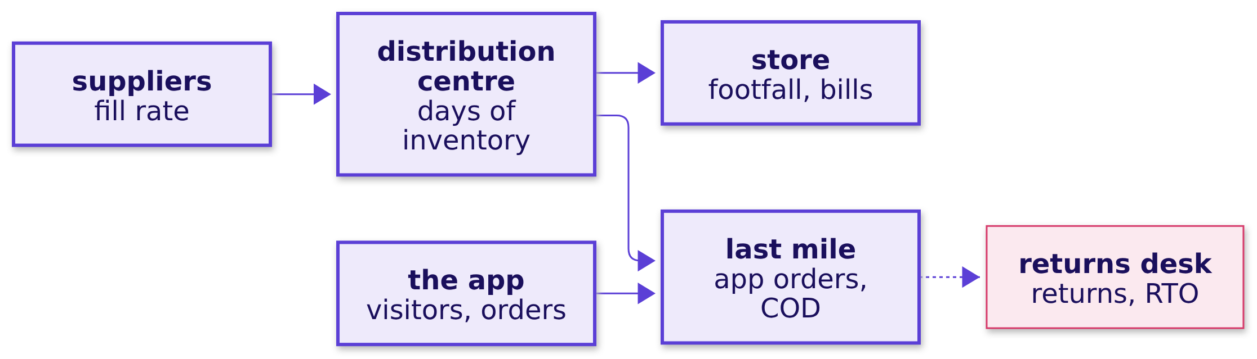
Indian Institute of Technology Gandhinagar
WEEK 1 · DAY 1 · KALPA GLOBAL CAPABILITY CENTRE
ADMINISTERED THROUGH THE COMPETENCY ADVANCEMENT ACADEMY
A Saturday runs from the shelf to Monday's page
What happens on one Saturday at a Kalpa store and on its app?
Suppliers fill the distribution centre, which stocks the store and feeds the last mile; the app's orders ride the last mile, and what comes back goes to the returns desk.
How does retail earn
Which total is sales
What is each branch
Do customers come back
What is a typical order
S3 · 5 / 76
Notes:
LIVE, 7 minutes, the rest of part 1 of the talk track. Tell the Saturday: the store manager checks
every shelf against its planogram, and one check in twenty-five finds a gap; the truck brings 900 of
the 1,000 cases the cookware supplier was asked for; 1,200 people come through the doors and 480 pay
at a till, with an average bill of Rs 1,250. On the app the same day, 50,000 people open it 80,000
times, fill 8,000 carts and place 2,000 orders averaging Rs 1,500. Follow one Retail-Plus member's
basket: Rs 2,000 of goods, Rs 200 off in a promotion, Rs 1,800 paid with a card the app holds only
as a token. Next week the bedsheet comes back, and a cash-on-delivery parcel is refused at the door
and travels back as an RTO. On Monday the CEO reads one page.
Ask: think of the last thing you bought in a shop and the last thing you ordered on an app; which
one knew more about you, and what exactly did it know?
Watch for "the shop, because the staff know me": the staff may, and the till keeps only the bill.
Land it: the data team works where customers leave traces, and a store leaves far fewer than an app.
Draw the value chain on the board, six boxes left to right.
Transition: which real companies Kalpa is like.

Slide 6
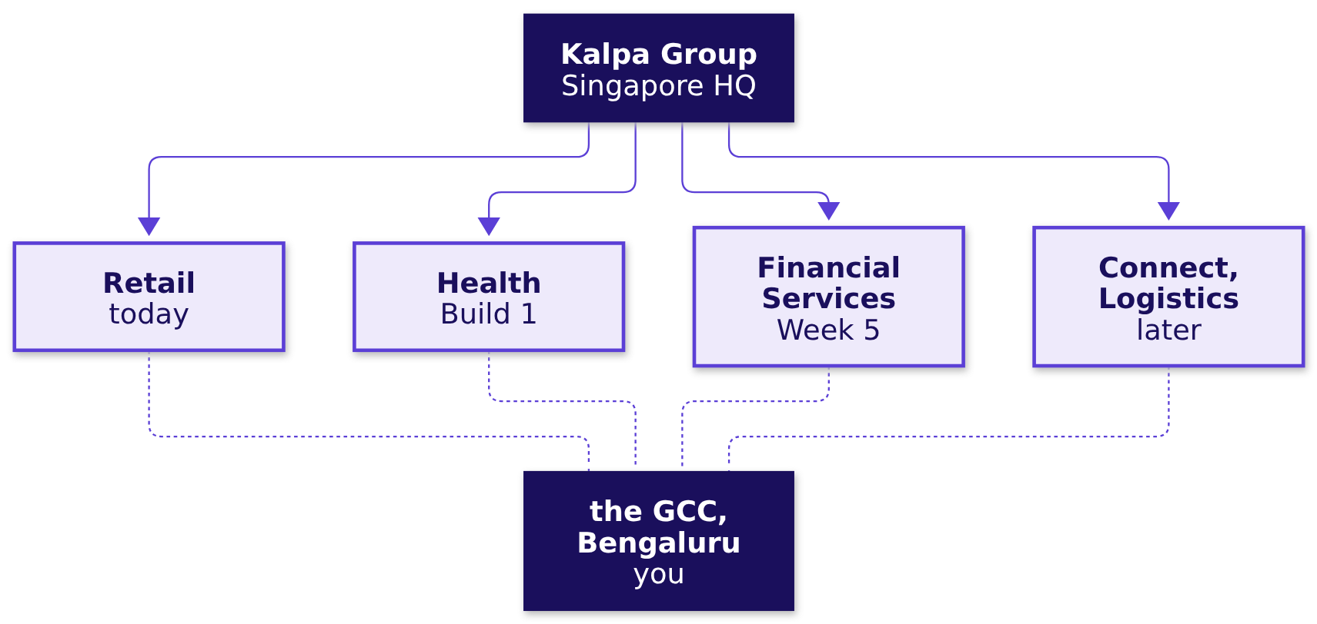
Indian Institute of Technology Gandhinagar
WEEK 1 · DAY 1 · KALPA GLOBAL CAPABILITY CENTRE
ADMINISTERED THROUGH THE COMPETENCY ADVANCEMENT ACADEMY
Kalpa is built like Reliance, its stores like DMart
Which real companies is Kalpa like?
Kalpa is fictional. Its stores work like DMart's and its app sells stock Kalpa owns, like DMart Ready, while Flipkart and Amazon India are marketplaces whose sellers own the goods.
How does retail earn
Which total is sales
What is each branch
Do customers come back
What is a typical order
S4 · 6 / 76
Notes:
LIVE, 7 minutes, part 2 of the talk track. Ask first: what does your phone company know about you
that a grocer would want? Listen for where you are through the day, the apps you open, how you pay
and your number.
Watch for "if both belong to one group, the grocer can simply use it": India's data protection law
ties each use of personal data to a purpose the person agreed to, so even inside one group the
purpose decides what one business may use.
Say that Kalpa Group is headquartered in Singapore and runs five businesses, and that its data and
engineering centre in Bengaluru, the Global Capability Centre, is the team the room has joined.
Reliance and Tata are real groups built like it: in the quarter to June 2026 Reliance reported Jio
with 533 million subscribers and Reliance Retail with 20,169 stores (Reliance Industries media
release, 17 July 2026). The centre works like the Indian centres of Walmart, Target, Tesco and
Lowe's, and Retail-Plus is Kalpa's paid tier, a membership of the kind Amazon Prime is.
Draw the group on the board, six boxes.
Transition: where the money from one basket goes.

Slide 7
Indian Institute of Technology Gandhinagar
WEEK 1 · DAY 1 · KALPA GLOBAL CAPABILITY CENTRE
ADMINISTERED THROUGH THE COMPETENCY ADVANCEMENT ACADEMY
Rs 100 of GMV leaves Rs 2.50 of EBITDA
Where does Rs 100 ordered go before EBITDA, earnings before interest, tax, depreciation and amortisation?
Step | Less | What goes
GMV to net revenue | Rs 20 | GMV is everything ordered at the price charged, net revenue is what Kalpa earns from the goods, and chapter 1 finds what sits between them.
Net revenue to gross margin | Rs 60 | The cost of the goods goes to suppliers.
Gross margin to contribution | Rs 12.5 | Each order pays for picking, packing, delivery, the payment fee and the offers that bring a customer back.
Contribution to EBITDA | Rs 5 | Stores, warehouses, technology, head office and the budget that wins new customers do not grow with one more order.
How does retail earn
Which total is sales
What is each branch
Do customers come back
What is a typical order
S5 · 7 / 76
Notes:
LIVE, 10 minutes, part 3 of the talk track, the part never to cut. The numbers are illustrative.
Say that GMV, gross merchandise value, is everything customers ordered at the price they were
charged, and that finance reports a smaller number, net revenue, which is what Kalpa earns from the
goods. The two differ on purpose: Rs 100 of GMV becomes Rs 80 of net revenue, and what the Rs 20
between them is, the room finds in chapter 1 this morning, so hold the question until then. From net
revenue take the cost of the goods and gross margin is left; take what every order costs and
contribution is left; take the costs that do not grow with one more order and EBITDA is left. Real
retailers keep a thin slice: DMart reported profit after tax of 4.8 percent of revenue for FY26
(Avenue Supermarts results release, 2 May 2026).
Ask first: of the member's Rs 1,800, how much does Kalpa keep as EBITDA: under Rs 20, Rs 20 to 100,
Rs 100 to 400, or more than Rs 400? Hands up for each range, then reveal about Rs 50 on these
illustrative numbers, the basket's Rs 150 of contribution less about Rs 100 towards the costs that
do not change with one more order.
Watch for rooms that guess high; they most need this part.
Add the marketplace sentence: a marketplace such as Flipkart or Amazon India books only its fees as
revenue, and a foreign-owned multi-brand e-commerce business selling to Indian consumers must run
that way under Press Note 2 of 2018.
Draw Rs 100's journey on the board, five boxes top to bottom, with the first arrow left as a
question. It stays up all day.
Transition: who asks the data team for which number.

Slide 8
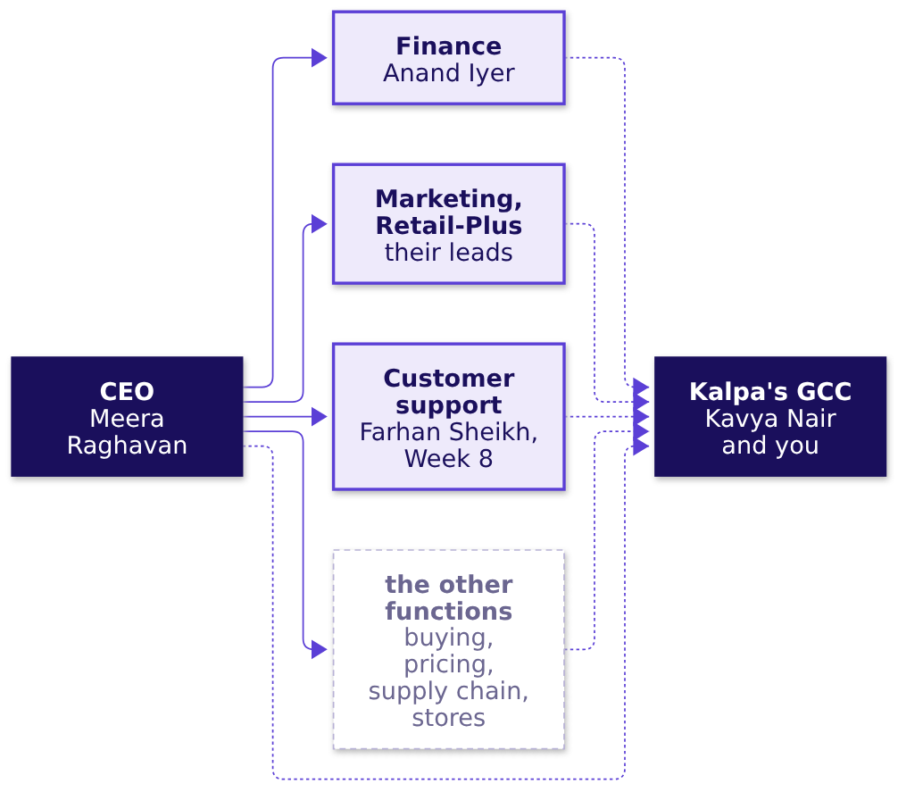
Indian Institute of Technology Gandhinagar
WEEK 1 · DAY 1 · KALPA GLOBAL CAPABILITY CENTRE
ADMINISTERED THROUGH THE COMPETENCY ADVANCEMENT ACADEMY
Six people already want a number from us
Who asks the data team for which number, and what does a wrong one cost them?
Who asks | What they want from us | What a wrong number costs
Meera, CEO | She wants to know where growth comes from and where it leaks. | She signs a budget for the wrong branch.
Anand, finance controller | He wants our numbers to match his books. | He restates a figure in front of the board.
The marketing and Retail-Plus leads | They want to know whether Kalpa needs more customers and whether the paid tier is slipping. | A campaign budget is spent, or the wrong members are protected.
How does retail earn
Which total is sales
What is each branch
Do customers come back
What is a typical order
S6 · 8 / 76
Notes:
LIVE, 6 minutes, part 4 of the talk track. Name the boxes: Meera Raghavan; Anand Iyer, the finance
controller; the marketing lead and the head of Retail-Plus; customer support, where Farhan Sheikh
arrives in Week 8 with two thousand tickets a day; the other functions, whose heads the story has
not named; and Kavya Nair with us in the GCC, who checks everything before it leaves the team. The
data platform lead sits beside the GCC and wants the warehouse queried, never exported.
Ask: if one of our numbers is wrong, whose mistake can we undo next week, and whose can we not?
Watch for "all of them, we send a correction": a correction fixes the dashboard, and the decision
taken on the wrong number stays taken.
Land it: before a number leaves the team, know who asked for it and whether being wrong can be
taken back.
Draw who asks on the board, six boxes. If short of time, draw it, ask once and move on.
Transition: the tree every retail number hangs off.

Slide 9
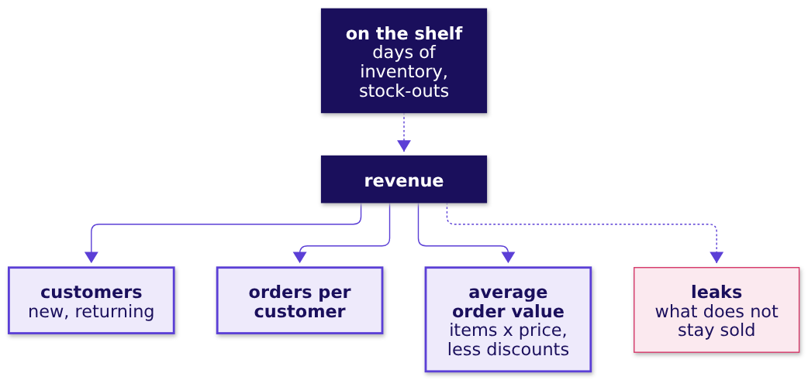
Indian Institute of Technology Gandhinagar
WEEK 1 · DAY 1 · KALPA GLOBAL CAPABILITY CENTRE
ADMINISTERED THROUGH THE COMPETENCY ADVANCEMENT ACADEMY
Revenue is customers x orders each x order value
Which tree does every retail number hang off?
Metric | Formula | Who asks for it
Revenue | Revenue is customers x orders per customer x average order value. | Meera asks, for the plan.
Orders per customer | It is orders in the window over the customers who ordered in it. | The head of Retail-Plus asks.
Average order value | It is revenue in the window over the orders in it. | The marketing lead asks, for the payback.
How does retail earn
Which total is sales
What is each branch
Do customers come back
What is a typical order
S7 · 9 / 76
Notes:
LIVE, 9 minutes, part 5 of the talk track, the other part never to cut. Say that revenue is
customers, times orders per customer, times average order value, and that order value is items per
order times price per item, less discounts. Customers are new or returning: winning new ones costs
acquisition, and bringing them back is retention. Stock on the shelf decides whether any of it can
happen, and some of what is ordered does not stay sold, which is why the leaks sit beside the tree.
Read each formula with who asks for it, and add conversion, orders over visits in the same window,
which the app team asks for. Every metric is a numerator over a denominator in one window.
Ask: which branch does marketing's Rs 12 crore grow, and which would an offer to Retail-Plus
members grow?
Watch for the pair customers and orders per customer; some will add order value for a membership
that lifts the basket.
Land it: each branch has an owner, a formula and a cost to move, and Meera will ask which branch is
short.
Draw the metric tree on the board, six boxes, and leave it up all day; the chapters write their
numbers onto it.
Transition: from describing what happened to letting a system act.

Slide 10
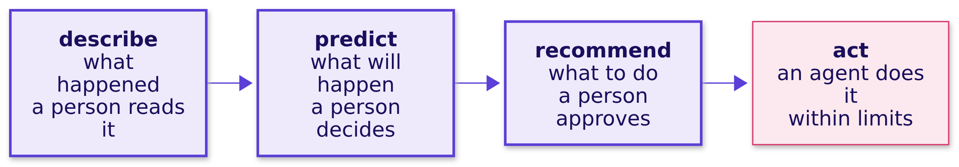
Indian Institute of Technology Gandhinagar
WEEK 1 · DAY 1 · KALPA GLOBAL CAPABILITY CENTRE
ADMINISTERED THROUGH THE COMPETENCY ADVANCEMENT ACADEMY
The further right, the more a wrong answer costs
How far may a system act on its own before a person checks it?
Rule | What it means for the data team
MRP | A price model never sets a price above the maximum retail price printed on the pack.
DPDP Act and Rules | Personal data is used only for a purpose the person agreed to.
RBI tokenisation | A payments table holds tokens and the last four digits, never card numbers.
E-commerce Rules 2020 | Consent is an explicit click, and a ranking comes with its explanation.
How does retail earn
Which total is sales
What is each branch
Do customers come back
What is a typical order
S8 · 10 / 76
Notes:
LIVE, 5 minutes, part 6 of the talk track. Say that analytics describes and a person reads it, a
forecast predicts and a person decides, a model recommends and a person approves, and an agent acts
inside limits with nobody checking before it takes effect. Klarna's AI assistant took two-thirds of
its customer-service chats in its first month in 2024 (Klarna, 27 February 2024), and fifteen months
later its chief executive said the cost focus had lowered quality (Fortune, 9 May 2025); a tribunal
held Air Canada responsible for what its chatbot said about a refund (Moffatt v. Air Canada, 2024
BCCRT 149).
Ask: which would you let a system do with no person checking: send the Monday numbers, reorder
detergent, refund the bedsheet, change a price?
Watch for "the Monday numbers, since they are only a report": they are the riskiest of the four,
because the CEO decides on them before anyone could catch a wrong one, and the detergent reorder
inside limits is the safest.
Land it: an agent is only as safe as its policy and the limits around it. Keep the domain card back
until the close of the afternoon.
Transition: the business in one line, and the question its CEO asked us.

Slide 11

Indian Institute of Technology Gandhinagar
WEEK 1 · DAY 1 · KALPA GLOBAL CAPABILITY CENTRE
ADMINISTERED THROUGH THE COMPETENCY ADVANCEMENT ACADEMY
Meera asks whether acquisition is the short branch
What did Kalpa's CEO ask the data team on Monday?
THE CLIENT ASKS
"Before I sign anything, I want to understand our own sales. What is 'sales' made of? Where does revenue come from, by customer type and channel? Is acquisition even the branch that is short?"
"No averages. One business customer can move an average."
Anand Iyer, finance controller, Kalpa Retail
4%
15%
Rs 12 cr
REVENUE GROWTH
THE PLAN
MARKETING'S ASK
last year
what the board expected
to acquire customers
How does retail earn
Which total is sales
What is each branch
Do customers come back
What is a typical order
S9 · 11 / 76
Notes:
LIVE, 2 minutes. Read the story's last line aloud: "That is the business. On Monday its CEO read
one page: revenue grew 4 percent against a plan of 15, marketing wants Rs 12 crore, and she asked us
one question before she signs anything." Then read her message and Anand's line. Do not explain
Anand's line; chapter 4 tests it on the file.
Ask: which sentence in her message is the real question? Most pick the last one.
Transition: her message, split into the questions the chapters answer.

Slide 12
Indian Institute of Technology Gandhinagar
WEEK 1 · DAY 1 · KALPA GLOBAL CAPABILITY CENTRE
ADMINISTERED THROUGH THE COMPETENCY ADVANCEMENT ACADEMY
Each part of Meera's message becomes a chapter
Which chapter answers each part of Meera's message?
What she asked | The question it becomes | Where it is answered
"What is 'sales' made of?" | Which total is sales, and what is each branch? | Chapters 1 and 2 answer it.
"Is acquisition even the branch that is short?" | Do customers come back, and which branch comes first? | Chapters 3 and 5 answer it.
Anand: "No averages." | What does a typical order look like? | Chapter 4 answers it.
"By customer type and channel" | Where does revenue come from, and does it change the branch? | The second case answers it.
"Before I sign anything" | What one sentence can she sign? | Chapter 6 answers it.
How does retail earn
Which total is sales
What is each branch
Do customers come back
What is a typical order
S10 · 12 / 76
Notes:
LIVE, 2 minutes. Point at each row once. Chapters 1 to 4 run this morning with the break before
chapter 4; chapters 5 and 6 open the afternoon, then the escalated case and the second case. Every
chapter ends on a number written onto the board tree.
Ask: which row would marketing like us to skip? Take one answer; chapter 3 comes back to it.
Transition: chapter 1, which total is sales.

Slide 13
Indian Institute of Technology Gandhinagar
PG DIPLOMA IN AI-ML AND AGENTIC AI ENGINEERING · COHORT 2
ADMINISTERED THROUGH THE COMPETENCY ADVANCEMENT ACADEMY
00
Which total is sales
Which of the file's totals should Meera call sales, and what does each one count?
How does retail earn
Which total is sales
What is each branch
Do customers come back
What is a typical order
Week 1, Monday morning: the story and chapters 1 to 4
13 / 76
Notes:
LIVE, 30 minutes: the map 1, the need 2, Reliance 2, the options 4, the picture 1, the build 7 (the
loop 3, with 2 of them for the TypeError if it happens, the predict 1, the answer 2 and the check
1), the trap 7 (the draft 2, why it is wrong 3 and the fix 2), the second route 3 and the close 3.
Notebook 01 is the demonstration, and every number on these slides is one it prints.
Transition: who needs the answer, and the six questions on the way.

Slide 14
Indian Institute of Technology Gandhinagar
WEEK 1 · DAY 1 · KALPA GLOBAL CAPABILITY CENTRE
ADMINISTERED THROUGH THE COMPETENCY ADVANCEMENT ACADEMY
Meera and Anand need one named total for the plan
Who needs to know which total is sales, and which questions lead there?
Who needs the answer. Meera measures the 15 percent plan from sales and Anand's books must match it, so a total that counts orders nobody kept sets the plan's base too high.
QUESTION 1
QUESTION 2
QUESTION 3
QUESTION 4
QUESTION 5
QUESTION 6
Who needs it
Four ways
Three sums
All 30 as sales
By status
The root
Who needs one number called sales, and what does a wrong one cost?
Which way of answering fits this file?
Which reading of sales comes out largest?
What goes wrong if all 30 orders are sent as sales?
Do sums by status reach the same totals?
Which number goes on the tree's root?
How does retail earn
Which total is sales
What is each branch
Do customers come back
What is a typical order
S11 · 14 / 76
Notes:
LIVE, 1 minute. Read the six questions; the chapter's last slide answers each in one line. The file
is 30 Kalpa Retail orders from 1 July to 26 September 2026, an 88-day window, and each order is
delivered, returned after delivery or cancelled before it left.
Ask the room to hold one question for a slide: what could "sales" mean?
Transition: the need, in Meera's words.

Slide 15
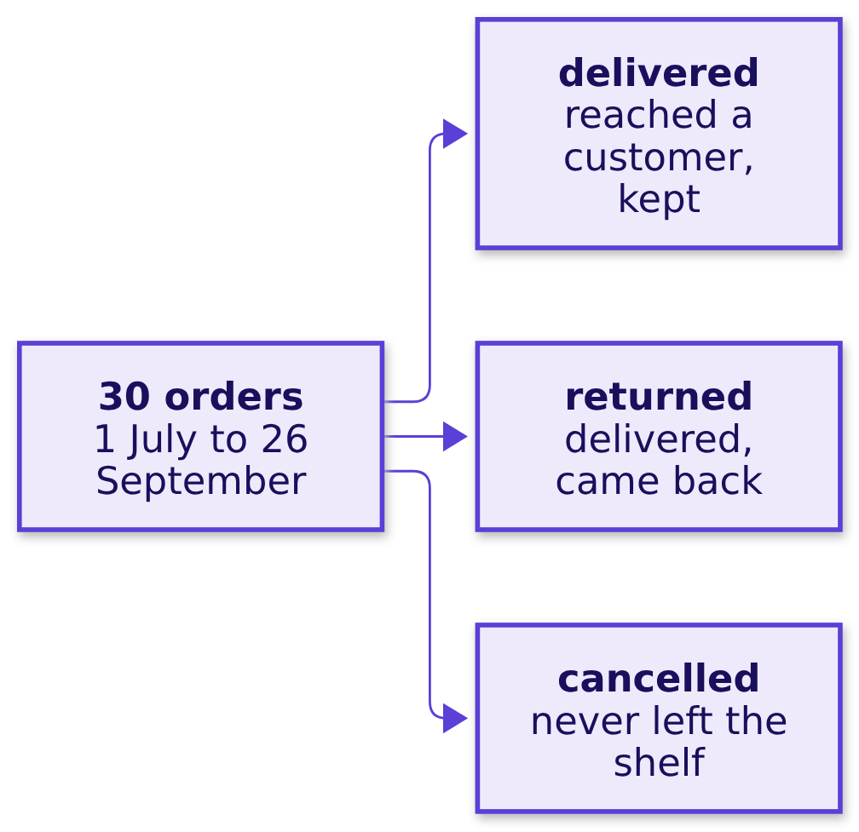
Indian Institute of Technology Gandhinagar
WEEK 1 · DAY 1 · KALPA GLOBAL CAPABILITY CENTRE
ADMINISTERED THROUGH THE COMPETENCY ADVANCEMENT ACADEMY
Meera's 15 percent plan is measured from sales
Who needs one number called sales, and what does a wrong one cost?
THE CLIENT ASKS
"What is 'sales' made of?"
The metric at stake | Sales is the base every growth percentage is measured from.
Who asks | Meera asks, and Anand's books must match the number.
What a wrong number costs | A plan measured from demand that never became a sale sets its target too high.
How does retail earn
Which total is sales
What is each branch
Do customers come back
What is a typical order
S12 · 15 / 76
Notes:
LIVE, 2 minutes. Ask the room to name what "sales" could mean, and write each answer on the board.
Most name everything ordered first; somebody says "what we delivered". Say that the story left
Rs 20 between Rs 100 of GMV and Rs 80 of net revenue as a question, and that this chapter finds the
part of that gap the file can show.
Watch for "sales is the sum of the amount column"; hold it for the options.
Transition: a real retailer that publishes two totals for the same quarter.

Slide 16
Indian Institute of Technology Gandhinagar
WEEK 1 · DAY 1 · KALPA GLOBAL CAPABILITY CENTRE
ADMINISTERED THROUGH THE COMPETENCY ADVANCEMENT ACADEMY
Reliance Retail publishes two totals a quarter
Does a real retailer report more than one total for one quarter?
Rs 90,408 cr
Rs 79,745 cr
GST
GROSS REVENUE
REVENUE FROM OPERATIONS
THE STEP BETWEEN THEM
quarter to June 2026
the same quarter
collected for the state
Source: Reliance Industries media release, 17 July 2026. Both totals are correct, so each goes out with its name. The story's Rs 20 between GMV and net revenue holds two kinds of step, tax like Reliance's GST and orders that never stayed sold, and the second kind is the one Kalpa's file can show.
How does retail earn
Which total is sales
What is each branch
Do customers come back
What is a typical order
S13 · 16 / 76
Notes:
LIVE, 2 minutes. The company is real and the numbers are its own. Make one point: the largest
retailer in India states which revenue it means, and so does every number the team sends. Point at
the first arrow of the Rs 100 drawing on the board and write "tax" and "never stayed sold" beside it.
Ask: which of Reliance's two totals would an investor compare with last year's? Either works, as
long as it is the same one both years.
Transition: four ways the team could answer Meera.

Slide 17

Indian Institute of Technology Gandhinagar
WEEK 1 · DAY 1 · KALPA GLOBAL CAPABILITY CENTRE
ADMINISTERED THROUGH THE COMPETENCY ADVANCEMENT ACADEMY
Summing by status fits: one pass, every reading
Which way of answering fits this file?
Option | Rows | Time | Error on this file
A. Add every amount and send the total | 30 | under a second | It counts every cancelled order as a sale.
B. Sum by status, with a bridge between the totals | 30, once | under a second | It has none once the bridge names each gap.
C. Ask Finance for the figure in the books | none | a day or more | It has none on Finance's definition.
D. Tick the orders off by hand | 30 | about ten minutes | A typo can hide in any of the 30 cells.
THE RULE
B is the best fit, since one pass gives every reading and the bridge names each rupee between them. If Finance has already fixed the definition the plan was set on, C decides which of B's totals goes in the note.
How does retail earn
Which total is sales
What is each branch
Do customers come back
What is a typical order
S14 · 17 / 76
Notes:
LIVE, 4 minutes. Walk the four. D is fine at 30 rows and impossible at 30 lakh; C is the right
answer for the board and too slow for a first look; A is the fastest and hides its definition. What
would change the call: Finance has fixed the definition the 15 percent plan was set on.
Ask: which would you run first if Meera wanted an answer in ten minutes? Most say A; ask what it
would count.
Transition: what each reading keeps.

Slide 18
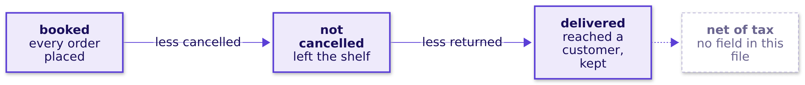
Indian Institute of Technology Gandhinagar
WEEK 1 · DAY 1 · KALPA GLOBAL CAPABILITY CENTRE
ADMINISTERED THROUGH THE COMPETENCY ADVANCEMENT ACADEMY
Each reading of sales drops one more status
What does each reading of sales keep?
The file has no tax field, so the step Reliance reports as GST cannot be taken from it.
How does retail earn
Which total is sales
What is each branch
Do customers come back
What is a typical order
S15 · 18 / 76
Notes:
LIVE, 1 minute. Draw this chain under the board tree. An engineer who can say what the data cannot
answer saves the CEO from a guess.
Transition: the loop that computes all three readings.

Slide 19
Indian Institute of Technology Gandhinagar
WEEK 1 · DAY 1 · KALPA GLOBAL CAPABILITY CENTRE
ADMINISTERED THROUGH THE COMPETENCY ADVANCEMENT ACADEMY
One loop keeps booked, not cancelled and delivered
How does one pass over the 30 orders keep three sums?
readings = {"orders": 0, "booked": 0, "not cancelled": 0, "delivered": 0}
for order in ORDERS:
amount = int(order["amount"])
readings["orders"] += 1
readings["booked"] += amount
if order["status"] != "cancelled":
readings["not cancelled"] += amount
if order["status"] == "delivered":
readings["delivered"] += amount
Each order is added to every reading that keeps its status, and int() makes each amount a whole number before it is added.
How does retail earn
Which total is sales
What is each branch
Do customers come back
What is a typical order
S16 · 19 / 76
Notes:
LIVE, 3 minutes, 2 of them for the TypeError if it happens. Walk the loop: one dictionary holds four
running totals, and each if keeps what its reading keeps. When the room runs the notebook's first
loop, which adds the amounts without int(), it may stop on a TypeError. Give it two minutes and no
more: read the last line bottom up (the kind of error, the operation, the two types), have each
learner print the loop variable on their own screen without reading the record out, apply int() as
this loop does, and move on. Wednesday asks why an amount arrived that way.
Watch for learners who start cleaning the file; today's fix is int() and nothing more.
Transition: predict the result before running it.

Slide 20
Indian Institute of Technology Gandhinagar
WEEK 1 · DAY 1 · KALPA GLOBAL CAPABILITY CENTRE
ADMINISTERED THROUGH THE COMPETENCY ADVANCEMENT ACADEMY
Which reading of sales comes out largest?
Before the loop runs, which of its three sums do you expect on top?
a) Delivered, because only delivered orders are real.
b) Not cancelled, because it keeps returns and deliveries.
c) Booked, because it keeps every order placed.
d) All three come out equal.
How does retail earn
Which total is sales
What is each branch
Do customers come back
What is a typical order
S17 · 20 / 76
Notes:
LIVE, 1 minute. Letters by hand. Most say c; some say a because "only delivered is real", which
confuses the largest reading with the truest one.
Transition: run it and read the three.

Slide 21
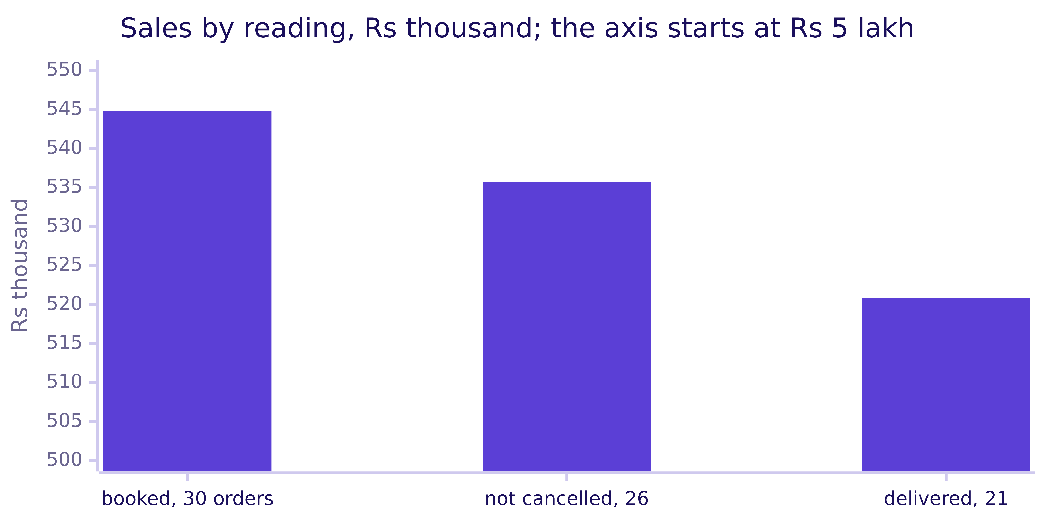
Indian Institute of Technology Gandhinagar
WEEK 1 · DAY 1 · KALPA GLOBAL CAPABILITY CENTRE
ADMINISTERED THROUGH THE COMPETENCY ADVANCEMENT ACADEMY
Answer: c, booked is largest at Rs 5,44,810
How far apart are the three readings of sales?
Booked is Rs 5,44,810 on 30 orders, not cancelled Rs 5,35,760 on 26 and delivered Rs 5,20,790 on 21, so Rs 24,020 on 9 orders separates the widest pair.
How does retail earn
Which total is sales
What is each branch
Do customers come back
What is a typical order
S18 · 21 / 76
Notes:
LIVE, 2 minutes. The answer is c. Delivered (a) is the smallest, since it drops the returns as well
as the cancellations; not cancelled (b) keeps less than booked; the three could only be equal (d) if
no order were cancelled or returned. Read the three with their order counts: the order count, 30,
is a fourth reading, how many times somebody decided to buy. Point at the axis, which starts at
Rs 5 lakh so the gaps show; say so whenever an axis does not start at zero.
Ask: which of the three goes in front of Meera? Take two answers and leave them open.
Transition: the check that the loop did what it claims.

Slide 22
Indian Institute of Technology Gandhinagar
WEEK 1 · DAY 1 · KALPA GLOBAL CAPABILITY CENTRE
ADMINISTERED THROUGH THE COMPETENCY ADVANCEMENT ACADEMY
Check: 30 orders, and each reading keeps less
Did the loop visit every order, and does each narrower reading keep less?
kit.check("the loop visited all 30 orders", readings["orders"] == 30)
kit.check("booked sales is Rs 5,44,810", readings["booked"] == 544810)
kit.check("each narrower reading keeps less",
readings["booked"] >= readings["not cancelled"] >= readings["delivered"])
All three checks pass, so the totals are the file's own and no reading is larger than the one it narrows.
How does retail earn
Which total is sales
What is each branch
Do customers come back
What is a typical order
S19 · 22 / 76
Notes:
LIVE, 1 minute. A check proves the build did what it claims before anyone reads the number aloud.
Point out that these checks test the build and cannot say which reading is sales; that is a
business question.
Transition: the line a colleague sent Meera first.

Slide 23
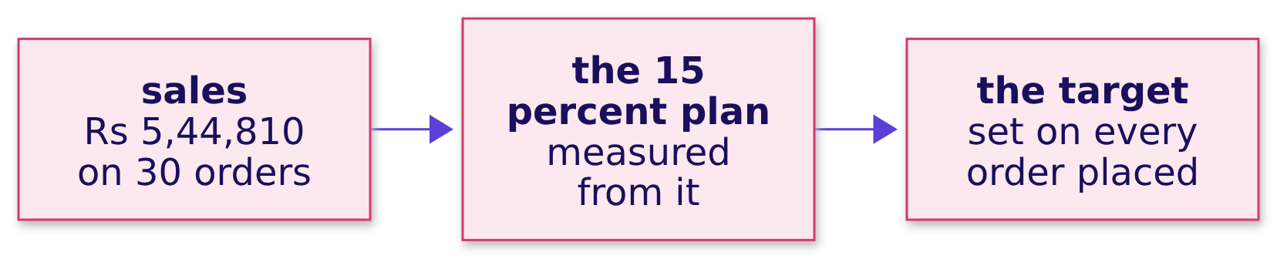
Indian Institute of Technology Gandhinagar
WEEK 1 · DAY 1 · KALPA GLOBAL CAPABILITY CENTRE
ADMINISTERED THROUGH THE COMPETENCY ADVANCEMENT ACADEMY
A draft sends Rs 5,44,810 on 30 orders as sales
What goes wrong if all 30 orders are sent as sales?
The plausible wrong answer. A colleague's first draft to Meera reads: "Sales this quarter: Rs 5,44,810 on 30 orders."
The arithmetic is right, and the draft treats every order placed as a sale Meera's plan has to grow from.
How does retail earn
Which total is sales
What is each branch
Do customers come back
What is a typical order
S20 · 23 / 76
Notes:
LIVE, 2 minutes. Present it confidently, as the colleague's figure, before anyone in the room has
checked it. Ask what is wrong with it, and which decision it would mislead: the plan's base, and the
channel whose orders sit inside it.
Watch for "nothing, the sum is correct": agree that the sum is correct, and ask what it counts.
Transition: the check that catches it.

Slide 24
Indian Institute of Technology Gandhinagar
WEEK 1 · DAY 1 · KALPA GLOBAL CAPABILITY CENTRE
ADMINISTERED THROUGH THE COMPETENCY ADVANCEMENT ACADEMY
A count by status shows 4 cancelled, all in store
Which check catches the orders inside the total that were never sold?
Why it is wrong. A cancelled order never left the shelf and never paid Kalpa a rupee, so it is demand that never arrived, and counting orders by channel and status before adding any amount shows where the 4 sit.
Channel | Delivered | Returned | Cancelled
App | 10 | 0 | 0
Web | 5 | 5 | 0
Store | 6 | 0 | 4
How does retail earn
Which total is sales
What is each branch
Do customers come back
What is a typical order
S21 · 24 / 76
Notes:
LIVE, 3 minutes. The check counts orders before anything is summed. Store's 10 orders overstate its
kept orders by 4 in 10. The five web returns did become sales and came back, which is why they stay
in "not cancelled" and leave "delivered".
Ask: if the head of stores read the draft, what would they believe about store's quarter?
Transition: the fix, drawn as a bridge.

Slide 25
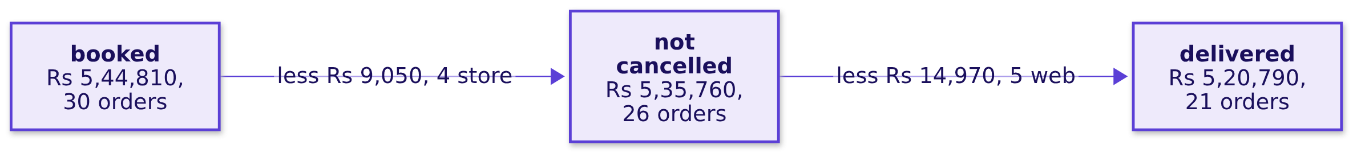
Indian Institute of Technology Gandhinagar
WEEK 1 · DAY 1 · KALPA GLOBAL CAPABILITY CENTRE
ADMINISTERED THROUGH THE COMPETENCY ADVANCEMENT ACADEMY
The fix writes the definition beside each total
What does the fix change in the note to Meera?
The sentence for Meera names the definition first: "Sales this quarter, net of cancellations, were Rs 5,35,760 on 26 orders; Rs 9,050 on 4 store orders was cancelled."
How does retail earn
Which total is sales
What is each branch
Do customers come back
What is a typical order
S22 · 25 / 76
Notes:
LIVE, 2 minutes. What changed: Rs 9,050 and 4 store orders leave sales, and store's kept orders fall
from the 10 the draft implied to 6. Write both totals on the root of the board tree, each with its
definition.
Transition: the same three totals by a second route.

Slide 26
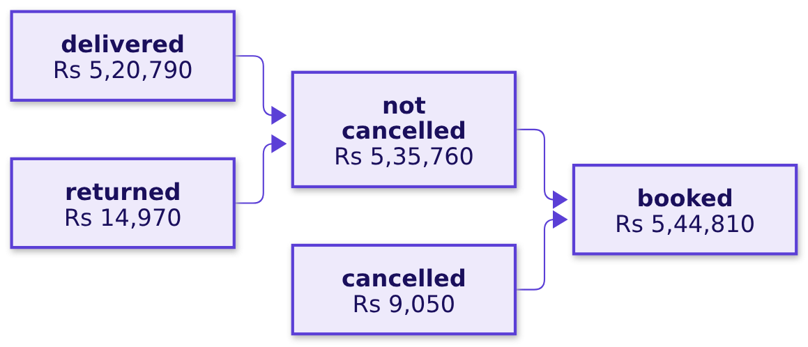
Indian Institute of Technology Gandhinagar
WEEK 1 · DAY 1 · KALPA GLOBAL CAPABILITY CENTRE
ADMINISTERED THROUGH THE COMPETENCY ADVANCEMENT ACADEMY
Sums by status land on the same three totals
Do sums by status reach the same totals as the one loop?
by_status = {}
for order in ORDERS:
status = order["status"]
by_status[status] = by_status.get(status, 0) + int(order["amount"])
not_cancelled = by_status["delivered"] + by_status["returned"]
THE RULE
The two routes must agree to the rupee, and grouping by status is the route to keep when a new status may appear, since it needs no new if.
How does retail earn
Which total is sales
What is each branch
Do customers come back
What is a typical order
S23 · 26 / 76
Notes:
LIVE, 3 minutes. Run the notebook's second-route cell; its checks assert that both routes agree to
the rupee on all three readings. When to switch: a part-refund status tomorrow needs a new if in the
one-loop route and nothing in this one; write each reading out when a reader must see the
definition. At a million rows both become one GROUP BY status, which Week 2 teaches.
Transition: the chapter's answers, one line each.

Slide 27


Indian Institute of Technology Gandhinagar
WEEK 1 · DAY 1 · KALPA GLOBAL CAPABILITY CENTRE
ADMINISTERED THROUGH THE COMPETENCY ADVANCEMENT ACADEMY
Meera gets Rs 5,35,760, named net of cancellations
Which of the file's totals should Meera call sales, and what does each one count?
Question | Answer
Who needs sales? | Meera needs it for the plan's base, and Anand needs it to match his books.
Which way fits? | One pass that sums by status, with a bridge, fits this file.
Which reading is largest? | Booked is Rs 5,44,810, then not cancelled Rs 5,35,760, then delivered Rs 5,20,790.
All 30 as sales? | That total counts 4 cancelled store orders, Rs 9,050 that was never sold.
Sums by status? | They reach the same three totals to the rupee.
The tree's root? | It carries Rs 5,35,760 net of cancellations, with delivered beside it.
KAVYA'S REVIEW
"You found Rs 9,050 that was never a sale by counting before adding. Which definition Meera plans on is her call; your job is to make sure she can see which one she is reading."
IN THE INTERVIEW
[F] What counts as "sales": booked, net of cancellations, or delivered, and which do you give a CEO?
How does retail earn
Which total is sales
What is each branch
Do customers come back
What is a typical order
S24 · 27 / 76
Notes:
LIVE, 3 minutes. Read the six answers down the table. Kavya Nair is the team's senior analyst, and
her review closes every chapter. One learner answers the interview question aloud in under a
minute: name the readings, say what each answers, choose one for the decision and state the others
beside it.
Transition: chapter 2, what each branch of the tree is.

Slide 28
Indian Institute of Technology Gandhinagar
PG DIPLOMA IN AI-ML AND AGENTIC AI ENGINEERING · COHORT 2
ADMINISTERED THROUGH THE COMPETENCY ADVANCEMENT ACADEMY
01
What is each branch
How does sales split into customers, orders per customer and order value, each a fraction on one definition?
How does retail earn
Which total is sales
What is each branch
Do customers come back
What is a typical order
Week 1, Monday morning: the story and chapters 1 to 4
28 / 76
Notes:
LIVE, 30 minutes: the map 1, the need 2, Jio 1, the options 4, the picture 2, the build 6 (the code
2, the predict 1, the answer 2 and the check 1), the trap 9 (the predict 1, the wrong answer 3, why
it is wrong 3 and the fix 2), the second route 3 and the close 2. Notebook 02 is the demonstration.
Transition: who needs the branches, and the six questions on the way.

Slide 29
Indian Institute of Technology Gandhinagar
WEEK 1 · DAY 1 · KALPA GLOBAL CAPABILITY CENTRE
ADMINISTERED THROUGH THE COMPETENCY ADVANCEMENT ACADEMY
Meera and marketing need each branch as a fraction
Who needs each branch of sales as a number, and which questions lead there?
Who needs the answer. Meera, who must see which branch of sales is short, and the marketing lead, whose payback case values every new order: a branch built from two definitions multiplies to revenue nobody booked.
QUESTION 1
QUESTION 2
QUESTION 3
QUESTION 4
QUESTION 5
QUESTION 6
Why fractions
Which tree
Order value
Two reports
The mean
What is missing
Who needs the branches, and why as fractions?
Which tree can this file fill?
What is the average order value?
What goes wrong when booked rupees are divided by delivered orders?
Does the mean of the amounts agree?
Which branches does the file still lack?
How does retail earn
Which total is sales
What is each branch
Do customers come back
What is a typical order
S25 · 29 / 76
Notes:
LIVE, 1 minute. Chapter 1 settled the readings: Rs 5,44,810 booked on 30 orders, Rs 5,35,760 not
cancelled on 26 and Rs 5,20,790 delivered on 21. This chapter builds the tree on them, on the booked
definition. Read the six questions.
Transition: why each branch has to be a fraction.

Slide 30
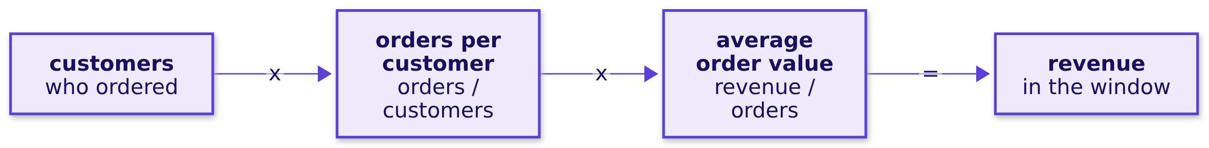
Indian Institute of Technology Gandhinagar
WEEK 1 · DAY 1 · KALPA GLOBAL CAPABILITY CENTRE
ADMINISTERED THROUGH THE COMPETENCY ADVANCEMENT ACADEMY
A branch helps Meera only as a fraction
Who needs the branches, and why must each one be a fraction?
The metric at stake | AOV, revenue over orders, is the first branch this file can measure.
Who asks | Meera asks for the tree, and marketing values each new order with its AOV.
What a wrong number costs | A tree built from two definitions multiplies to revenue nobody booked.
What chapter 1 found | Booked sales is Rs 5,44,810 on 30 orders.
How does retail earn
Which total is sales
What is each branch
Do customers come back
What is a typical order
S26 · 30 / 76
Notes:
LIVE, 2 minutes. Check the multiplication with units on the board: customers times orders per
customer gives orders, and orders times revenue per order gives rupees, because each denominator
cancels the next numerator. That is also why a branch measured on another definition breaks the
chain.
Transition: a real company that reports its revenue this way.

Slide 31
Indian Institute of Technology Gandhinagar
WEEK 1 · DAY 1 · KALPA GLOBAL CAPABILITY CENTRE
ADMINISTERED THROUGH THE COMPETENCY ADVANCEMENT ACADEMY
Jio reports its revenue as a tree of branches
Does a real company report its revenue as branches?
533 million
Rs 215.6
1.6%
JIO SUBSCRIBERS
REVENUE PER USER
MONTHLY CHURN
quarter to June 2026
a month
subscribers who leave
Source: Reliance Industries media release, 17 July 2026. A telecom's revenue is subscribers times revenue per user, with churn as its leak, and investors multiply the branches the way this chapter multiplies Kalpa's.
How does retail earn
Which total is sales
What is each branch
Do customers come back
What is a typical order
S27 · 31 / 76
Notes:
LIVE, 1 minute. Kalpa Connect is the Jio-like unit and arrives in Build 3. The point is the shape: a
company reports its branches, each as a fraction.
Transition: which tree this file can fill.

Slide 32
Indian Institute of Technology Gandhinagar
WEEK 1 · DAY 1 · KALPA GLOBAL CAPABILITY CENTRE
ADMINISTERED THROUGH THE COMPETENCY ADVANCEMENT ACADEMY
This file fills customers x frequency x AOV
Which tree can this file fill?
Option | Fields it needs | In this file? | What it tells Meera
A. Orders x AOV | amount | Yes | It sizes orders and hides who buys.
B. Customers x orders per customer x AOV | amount, customer id | Yes | It shows who buys, how often and for how much.
C. B, with AOV split into items x price, less discounts | items, prices, discounts | No | It would show which part of the basket moved.
D. A funnel from visits to orders | sessions or footfall | No | It would show where shoppers drop out.
THE RULE
B is the best fit: it is the deepest tree this file fills, and it puts marketing's branch beside the two it competes with. Order lines with items and prices would move the call to C.
How does retail earn
Which total is sales
What is each branch
Do customers come back
What is a typical order
S28 · 32 / 76
Notes:
LIVE, 4 minutes. The sizing here counts fields: the file's seven fields fill A and B. Ask what data
would let us draw C; the order-items table arrives later in the programme, and traffic data would
put D in front of the tree.
Transition: the tree the file can fill, drawn beside what it cannot.

Slide 33
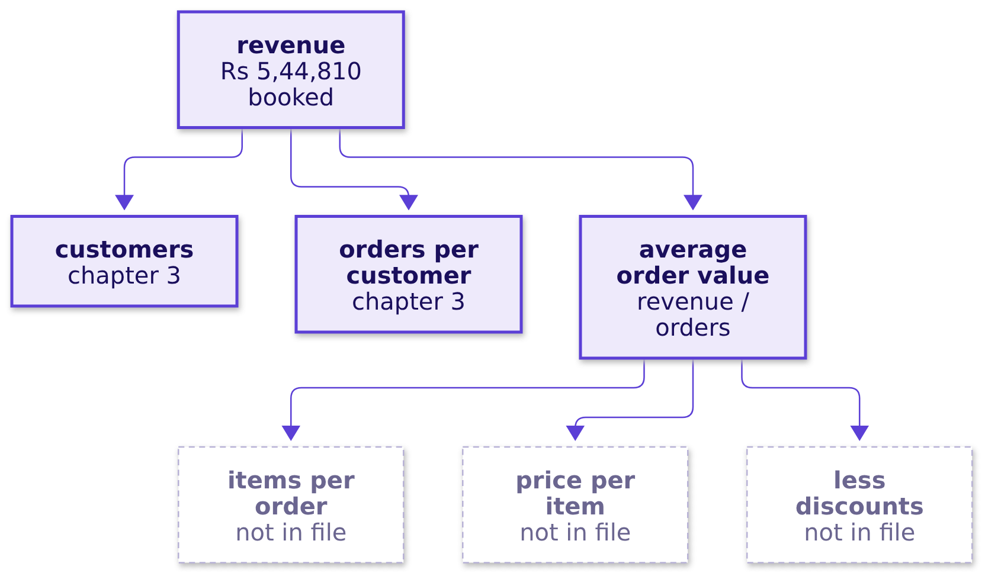
Indian Institute of Technology Gandhinagar
WEEK 1 · DAY 1 · KALPA GLOBAL CAPABILITY CENTRE
ADMINISTERED THROUGH THE COMPETENCY ADVANCEMENT ACADEMY
Three branches can be measured and three cannot
What does each branch divide, and which can this file measure?
How does retail earn
Which total is sales
What is each branch
Do customers come back
What is a typical order
S29 · 33 / 76
Notes:
LIVE, 2 minutes. Draw the three lower branches dashed on the board tree. Saying which branches the
file cannot fill is part of the answer, because those are the ones nobody can plan on yet.
Transition: the code that measures the first branch.

Slide 34
Indian Institute of Technology Gandhinagar
WEEK 1 · DAY 1 · KALPA GLOBAL CAPABILITY CENTRE
ADMINISTERED THROUGH THE COMPETENCY ADVANCEMENT ACADEMY
AOV is booked revenue over the orders it came from
How does the first branch become a number?
orders = len(ORDERS)
revenue = sum(order["amount"] for order in ORDERS)
aov = revenue / orders
Chapter 1's int() fix is applied once as the orders load, so every amount here is a whole number, and both halves of the fraction count the same 30 booked orders.
How does retail earn
Which total is sales
What is each branch
Do customers come back
What is a typical order
S30 · 34 / 76
Notes:
LIVE, 2 minutes. Walk the three lines: a count, a sum on one definition, and the fraction of the
two. Say aloud that both lines read the same list, which is what one definition means in code.
Transition: predict what the two multiply back to.

Slide 35
Indian Institute of Technology Gandhinagar
WEEK 1 · DAY 1 · KALPA GLOBAL CAPABILITY CENTRE
ADMINISTERED THROUGH THE COMPETENCY ADVANCEMENT ACADEMY
What does orders times the AOV give back?
Booked revenue splits into orders x AOV, so what do the two multiply back to?
a) Exactly booked revenue, because the average was made from that total.
b) More than booked revenue, because repeat customers count twice.
c) Less than booked revenue, because the average rounds down.
d) Nothing useful until prices per item are known.
How does retail earn
Which total is sales
What is each branch
Do customers come back
What is a typical order
S31 · 35 / 76
Notes:
LIVE, 1 minute. Letters by hand. Most say a; some say c because of rounding.
Transition: the answer, with the AOV.

Slide 36
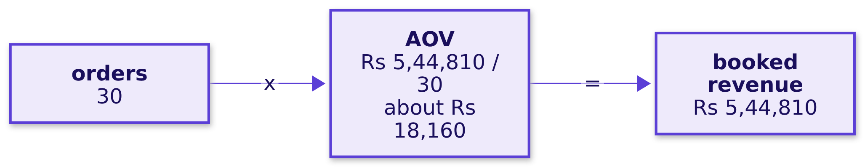
Indian Institute of Technology Gandhinagar
WEEK 1 · DAY 1 · KALPA GLOBAL CAPABILITY CENTRE
ADMINISTERED THROUGH THE COMPETENCY ADVANCEMENT ACADEMY
Answer: a, orders x AOV lands on booked revenue
What is the average order value on the booked definition?
The AOV is Rs 5,44,810 over 30 orders, about Rs 18,160, and 30 times the unrounded AOV is Rs 5,44,810 exactly. The product always lands on revenue, so a wrong branch never shows in the total and shows only in the split.
How does retail earn
Which total is sales
What is each branch
Do customers come back
What is a typical order
S32 · 36 / 76
Notes:
LIVE, 2 minutes. The answer is a. Repeat customers (b) never enter this fraction, which counts
orders; rounding (c) moves the product by a few rupees at most; prices per item (d) split the AOV
further and do not change it. Write Rs 18,160 on the board tree in pencil with a question mark;
Anand's warning is about this number, and chapter 4 comes back to it.
Transition: the checks.

Slide 37
Indian Institute of Technology Gandhinagar
WEEK 1 · DAY 1 · KALPA GLOBAL CAPABILITY CENTRE
ADMINISTERED THROUGH THE COMPETENCY ADVANCEMENT ACADEMY
Check: the tree lands; 3 of 6 branches are absent
Does the identity hold, and how many branches does the file lack?
kit.check("orders x AOV lands on booked revenue", round(orders * aov) == revenue)
kit.check("booked AOV is Rs 18,160", round(aov) == 18160)
missing = [b for b in ("items", "price", "discount") if b not in ORDERS[0]]
kit.check("three branches of six are not in this file", len(missing) == 3)
All three pass: the product lands on Rs 5,44,810, the AOV rounds to Rs 18,160, and items, price and discounts are not fields in the file.
How does retail earn
Which total is sales
What is each branch
Do customers come back
What is a typical order
S33 · 37 / 76
Notes:
LIVE, 1 minute. The checks prove the build. They cannot say whether Rs 18,160 describes an order
anyone at Kalpa would recognise, which is chapter 4's question.
Transition: what happens when two reports feed one fraction.

Slide 38
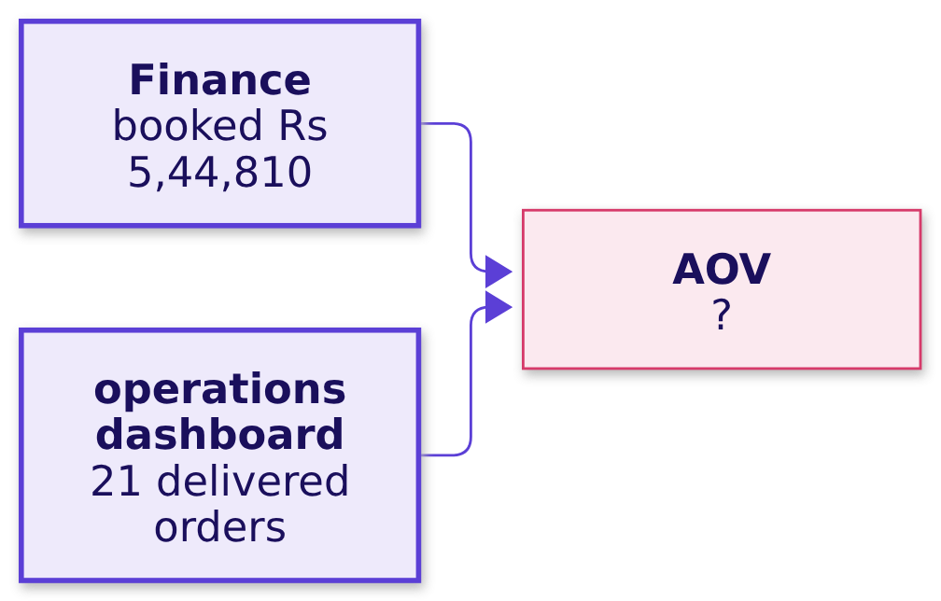
Indian Institute of Technology Gandhinagar
WEEK 1 · DAY 1 · KALPA GLOBAL CAPABILITY CENTRE
ADMINISTERED THROUGH THE COMPETENCY ADVANCEMENT ACADEMY
What AOV do booked rupees over delivered orders give?
Finance reports booked revenue and the operations dashboard counts delivered orders; what if each feeds one half?
a) Rs 18,160
b) Rs 24,800
c) Rs 25,943
d) Rs 23,687
How does retail earn
Which total is sales
What is each branch
Do customers come back
What is a typical order
S34 · 38 / 76
Notes:
LIVE, 1 minute. Letters by hand. Most divide and get c; the real question is whether anyone objects
to the division itself.
Transition: the answer, and the note a colleague sent with it.

Slide 39
Indian Institute of Technology Gandhinagar
WEEK 1 · DAY 1 · KALPA GLOBAL CAPABILITY CENTRE
ADMINISTERED THROUGH THE COMPETENCY ADVANCEMENT ACADEMY
Answer: c, Rs 25,943, which matches no definition
What goes wrong when booked rupees are divided by delivered orders?
The plausible wrong answer. A colleague's note to marketing reads: "Our average order is Rs 25,943."
Rs 25,943
Rs 7,78,300
43%
THE MIXED AOV
MULTIPLIED BACK
ABOVE BOOKED
booked rupees / delivered orders
on the 30 booked orders
revenue nobody booked
How does retail earn
Which total is sales
What is each branch
Do customers come back
What is a typical order
S35 · 39 / 76
Notes:
LIVE, 3 minutes. The answer is c, Rs 5,44,810 over 21. Rs 18,160 (a) is booked over booked, Rs 24,800
(b) is delivered over delivered, and Rs 23,687 (d) divides by the 23 customers. What the mixed
number would mislead: marketing's payback case would value each new customer's order at Rs 25,943.
The error stays invisible until something is multiplied back.
Ask: which half of the fraction would you check first?
Transition: the check that catches it.

Slide 40
Indian Institute of Technology Gandhinagar
WEEK 1 · DAY 1 · KALPA GLOBAL CAPABILITY CENTRE
ADMINISTERED THROUGH THE COMPETENCY ADVANCEMENT ACADEMY
AOV x the orders summed must give revenue back
Which check catches a fraction built from two definitions?
Why it is wrong. The numerator keeps the rupees of the 9 cancelled and returned orders while the denominator has dropped those orders, so every order looks Rs 7,783 larger than a booked order averages.
Fraction | AOV | Times the orders the revenue covers | Does that revenue come back?
Booked / booked | Rs 18,160 | 30 orders give Rs 5,44,810. | Yes, booked revenue comes back.
Delivered / delivered | Rs 24,800 | 21 orders give Rs 5,20,790. | Yes, delivered revenue comes back.
Booked / delivered | Rs 25,943 | 30 orders give Rs 7,78,300. | No, it lands Rs 2,33,490 over.
How does retail earn
Which total is sales
What is each branch
Do customers come back
What is a typical order
S36 · 40 / 76
Notes:
LIVE, 3 minutes. Multiplying the mixed AOV by the 21 delivered orders would only hand back the
numerator, so the check uses the 30 orders the booked rupees came from: 30 x (Rs 5,44,810 / 21) is
Rs 7,78,300.
Transition: the fix.

Slide 41
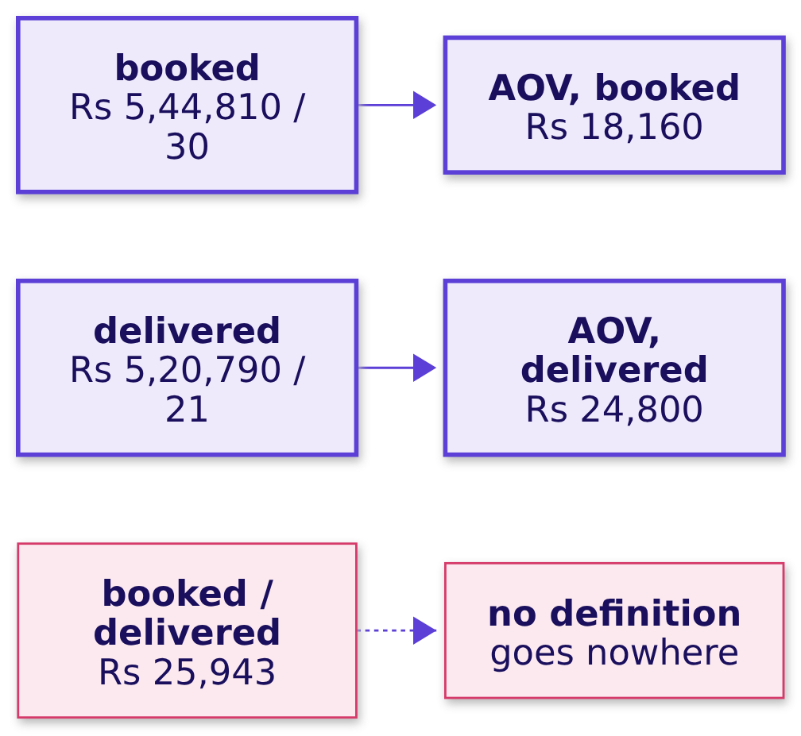
Indian Institute of Technology Gandhinagar
WEEK 1 · DAY 1 · KALPA GLOBAL CAPABILITY CENTRE
ADMINISTERED THROUGH THE COMPETENCY ADVANCEMENT ACADEMY
One definition per fraction: Rs 18,160 or Rs 24,800
What does the fix change in the note to marketing?
THE RULE
Each fraction takes one definition, so ask each report what it counts before you divide.
How does retail earn
Which total is sales
What is each branch
Do customers come back
What is a typical order
S37 · 41 / 76
Notes:
LIVE, 2 minutes. What changed: two honest AOVs, each sent with its definition, and the mixed
Rs 25,943 goes nowhere. Marketing's note names which of the two it uses.
Transition: the same AOV by a second route.

Slide 42
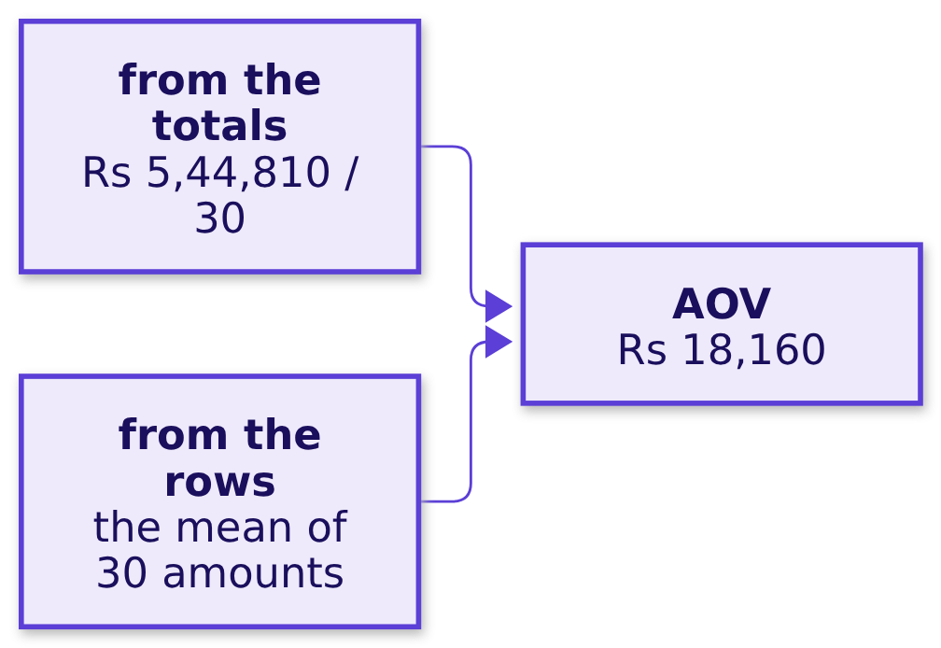
Indian Institute of Technology Gandhinagar
WEEK 1 · DAY 1 · KALPA GLOBAL CAPABILITY CENTRE
ADMINISTERED THROUGH THE COMPETENCY ADVANCEMENT ACADEMY
The mean of the 30 amounts is the same Rs 18,160
Does the mean of the amounts agree with revenue over orders?
amounts = [order["amount"] for order in ORDERS]
mean_route = sum(amounts) / len(amounts) # from the rows
statistics.fmean(amounts) # from the library
THE RULE
Use the totals when a report holds them and the rows when you hold the rows; chapter 4 asks whether the mean is the right middle at all.
How does retail earn
Which total is sales
What is each branch
Do customers come back
What is a typical order
S38 · 42 / 76
Notes:
LIVE, 3 minutes. The notebook asserts that the three routes agree, and they agree because the mean
is what the tree calls AOV. The switch that matters is chapter 4's: when the question is what a
typical order looks like, the mean may be the wrong middle.
Transition: the chapter's answers, one line each.

Slide 43
Indian Institute of Technology Gandhinagar
WEEK 1 · DAY 1 · KALPA GLOBAL CAPABILITY CENTRE
ADMINISTERED THROUGH THE COMPETENCY ADVANCEMENT ACADEMY
Each branch is a fraction; AOV is Rs 18,160 booked
How does sales split into customers, orders per customer and order value, each a fraction on one definition?
Question | Answer
Why fractions? | Each branch is a numerator over a denominator, so the branches multiply back to revenue.
Which tree? | Customers x orders per customer x AOV is the deepest tree this file fills.
The AOV? | It is Rs 18,160, booked revenue over 30 orders.
Booked over delivered? | It gives Rs 25,943, which matches no definition and claims Rs 7,78,300.
Does the mean agree? | The mean of the 30 amounts is the same Rs 18,160.
What is missing? | Items, price and discounts are missing, so order value cannot be split yet.
KAVYA'S REVIEW
"You gave me each branch as a numerator over a denominator and told me which three this file cannot fill, so I know which ones I can plan on. When two reports feed one fraction, ask each what it counts before you divide."
IN THE INTERVIEW
[S] How would you increase sales for an online retailer?
How does retail earn
Which total is sales
What is each branch
Do customers come back
What is a typical order
S39 · 43 / 76
Notes:
LIVE, 2 minutes. One learner answers aloud: draw the tree, measure each branch on one window and one
definition, find the short one, then place initiatives on it.
Transition: chapter 3, the customer branches counted.

Slide 44
Indian Institute of Technology Gandhinagar
PG DIPLOMA IN AI-ML AND AGENTIC AI ENGINEERING · COHORT 2
ADMINISTERED THROUGH THE COMPETENCY ADVANCEMENT ACADEMY
02
Do customers come back
How many customers does Kalpa have, and how many came back for a second order?
How does retail earn
Which total is sales
What is each branch
Do customers come back
What is a typical order
Week 1, Monday morning: the story and chapters 1 to 4
44 / 76
Notes:
LIVE, 30 minutes: the map 1, the need 2, Reliance 1, the options 4, the picture 2, the build 8 (the
code 2, the predict 1, the answer 3 and the check 2), the trap 8 (the draft 3, why it is wrong 3
and the fix 2), the second route 2 and the close 2. D53, the count on delivered orders, is
self-study; in the room it is the first thing to cut. Notebook 03 is the demonstration.
Transition: who needs the count, and the six questions on the way.

Slide 45
Indian Institute of Technology Gandhinagar
WEEK 1 · DAY 1 · KALPA GLOBAL CAPABILITY CENTRE
ADMINISTERED THROUGH THE COMPETENCY ADVANCEMENT ACADEMY
Meera's budget turns on whether customers return
Who needs the customer count, and which questions lead to it?
Who needs the answer. Meera, before she signs Rs 12 crore to buy customers, and the marketing lead and the head of Retail-Plus, who own the two customer branches: if nobody comes back, acquisition is the only branch, and if customers return, frequency can grow without buying anyone new.
QUESTION 1
QUESTION 2
QUESTION 3
QUESTION 4
QUESTION 5
QUESTION 6
What rides on it
Rows and people
Who came back
Every row a customer
The mean of counts
Delivered only
Who needs the customer count, and what rides on it?
How do we count customers when a row is an order?
How many customers came back?
What changes on delivered orders?
What goes wrong if every row is counted as a customer?
Does the mean of the counts agree?
How does retail earn
Which total is sales
What is each branch
Do customers come back
What is a typical order
S40 · 45 / 76
Notes:
LIVE, 1 minute. Chapter 2 measured order value: Rs 5,44,810 over 30 orders is an AOV of Rs 18,160,
and the two customer branches are still empty. Read the six questions.
Transition: what rides on the count.

Slide 46
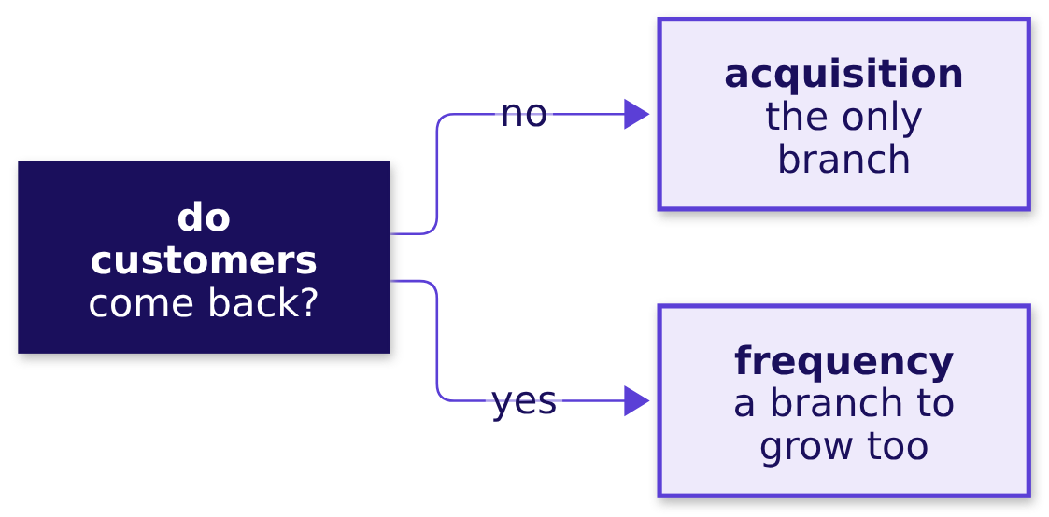
Indian Institute of Technology Gandhinagar
WEEK 1 · DAY 1 · KALPA GLOBAL CAPABILITY CENTRE
ADMINISTERED THROUGH THE COMPETENCY ADVANCEMENT ACADEMY
If nobody comes back, acquisition is the only branch
Who needs the customer count, and what rides on it?
The metric at stake | Customers are counted, and orders per customer is orders over customers in the window.
Who asks | Meera asks, with the marketing lead and the head of Retail-Plus.
What a wrong number costs | "Nobody comes back" makes Rs 12 crore look like the only way to grow.
THE CLIENT ASKS
"Is acquisition even the branch that is short?"
How does retail earn
Which total is sales
What is each branch
Do customers come back
What is a typical order
S41 · 46 / 76
Notes:
LIVE, 2 minutes. Ask: if nobody ever came back, what would orders per customer be? Exactly 1. Keep
that thought for the trap.
Transition: a real retailer's customer count, and its denominator.

Slide 47
Indian Institute of Technology Gandhinagar
WEEK 1 · DAY 1 · KALPA GLOBAL CAPABILITY CENTRE
ADMINISTERED THROUGH THE COMPETENCY ADVANCEMENT ACADEMY
Reliance counts 396 million registered customers
Which customers does a real retailer count?
396 million
20,169
REGISTERED CUSTOMERS
STORES
Reliance Retail, 30 June 2026
the same date
Source: Reliance Industries media release, 17 July 2026. A registered customer is a denominator of its own: divide a quarter's orders by it and you get a smaller metric than orders per customer who ordered.
How does retail earn
Which total is sales
What is each branch
Do customers come back
What is a typical order
S42 · 47 / 76
Notes:
LIVE, 1 minute. The point is the denominator: registered, active and ordering customers are three
different counts, and each gives a different rate.
Transition: four ways to count customers.

Slide 48
Indian Institute of Technology Gandhinagar
WEEK 1 · DAY 1 · KALPA GLOBAL CAPABILITY CENTRE
ADMINISTERED THROUGH THE COMPETENCY ADVANCEMENT ACADEMY
A dictionary counts customers and repeats at once
How do we count customers when a row is an order?
Option | Passes | What it answers | Error on this file
A. len(ORDERS), the rows | none | It says how many orders there are. | It counts a repeat customer once per order.
B. len(set(ids)), distinct ids | one | It says how many customers there are. | It says nothing about who came back.
C. A dictionary of orders per id | one | It says how many customers, how many orders each and who came back. | It has none on this file.
D. Sort the ids and count the changes | a sort and a pass | It says how many customers there are. | It is easy to miscount by hand.
THE RULE
C is the best fit, since one pass fills both customer branches and names the repeat buyers. At millions of rows the count becomes one COUNT(DISTINCT customer_id) in the warehouse, which Week 2 teaches.
How does retail earn
Which total is sales
What is each branch
Do customers come back
What is a typical order
S43 · 48 / 76
Notes:
LIVE, 4 minutes. B is right when only the count is needed, and C when someone will ask who came
back. The switch to SQL is Week 2's.
Ask: which option would you trust if the file had a million rows and you had one minute?
Transition: why one person can leave several rows.

Slide 49
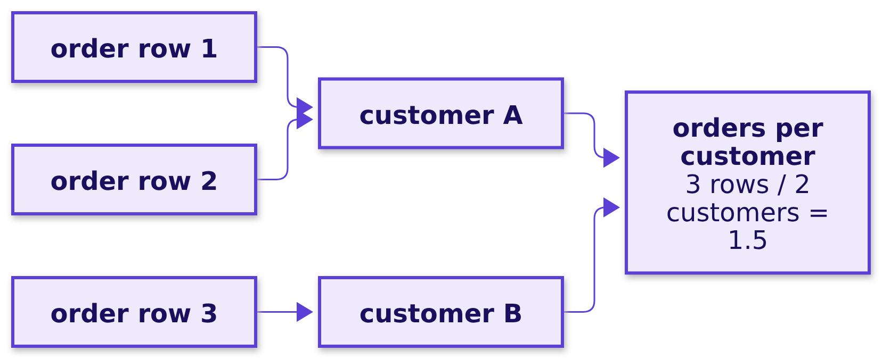
Indian Institute of Technology Gandhinagar
WEEK 1 · DAY 1 · KALPA GLOBAL CAPABILITY CENTRE
ADMINISTERED THROUGH THE COMPETENCY ADVANCEMENT ACADEMY
A row is an order, and one person can place several
Why can one customer leave several rows in the file?
On three invented rows, customer A ordered twice, so three orders come from two people and orders per customer is 1.5.
How does retail earn
Which total is sales
What is each branch
Do customers come back
What is a typical order
S44 · 49 / 76
Notes:
LIVE, 2 minutes. Draw it with the three invented rows. The rows are orders, and the people behind
them are the customers; the rate needs people in its denominator.
Transition: the build on Kalpa's 30 rows.

Slide 50
Indian Institute of Technology Gandhinagar
WEEK 1 · DAY 1 · KALPA GLOBAL CAPABILITY CENTRE
ADMINISTERED THROUGH THE COMPETENCY ADVANCEMENT ACADEMY
A dictionary keyed by customer id counts orders
How does one pass count each customer's orders?
counts = {}
for order in ORDERS:
cid = order["customer_id"]
counts[cid] = counts.get(cid, 0) + 1
customers = len(counts)
once = sum(1 for n in counts.values() if n == 1)
The customer id is the key and the count of that customer's orders is the value, so counts.get(cid, 0) starts each new customer at zero.
How does retail earn
Which total is sales
What is each branch
Do customers come back
What is a typical order
S45 · 50 / 76
Notes:
LIVE, 2 minutes. Walk the loop line by line, then the two lines under it: the number of keys is the
number of customers, and the counts of one are the customers who bought once.
Transition: predict how many came back.

Slide 51
Indian Institute of Technology Gandhinagar
WEEK 1 · DAY 1 · KALPA GLOBAL CAPABILITY CENTRE
ADMINISTERED THROUGH THE COMPETENCY ADVANCEMENT ACADEMY
How many customers bought more than once?
The dictionary holds each customer's order count, so how many counts are above one?
a) None, since orders per customer is close to 1.
b) 7, the gap between 30 orders and 23 customers.
c) 16, the customers who are not new.
d) 23, since the rate is above 1.
How does retail earn
Which total is sales
What is each branch
Do customers come back
What is a typical order
S46 · 51 / 76
Notes:
LIVE, 1 minute. Letters by hand. Some say 16, confusing one-time buyers with repeat buyers.
Transition: the answer.

Slide 52
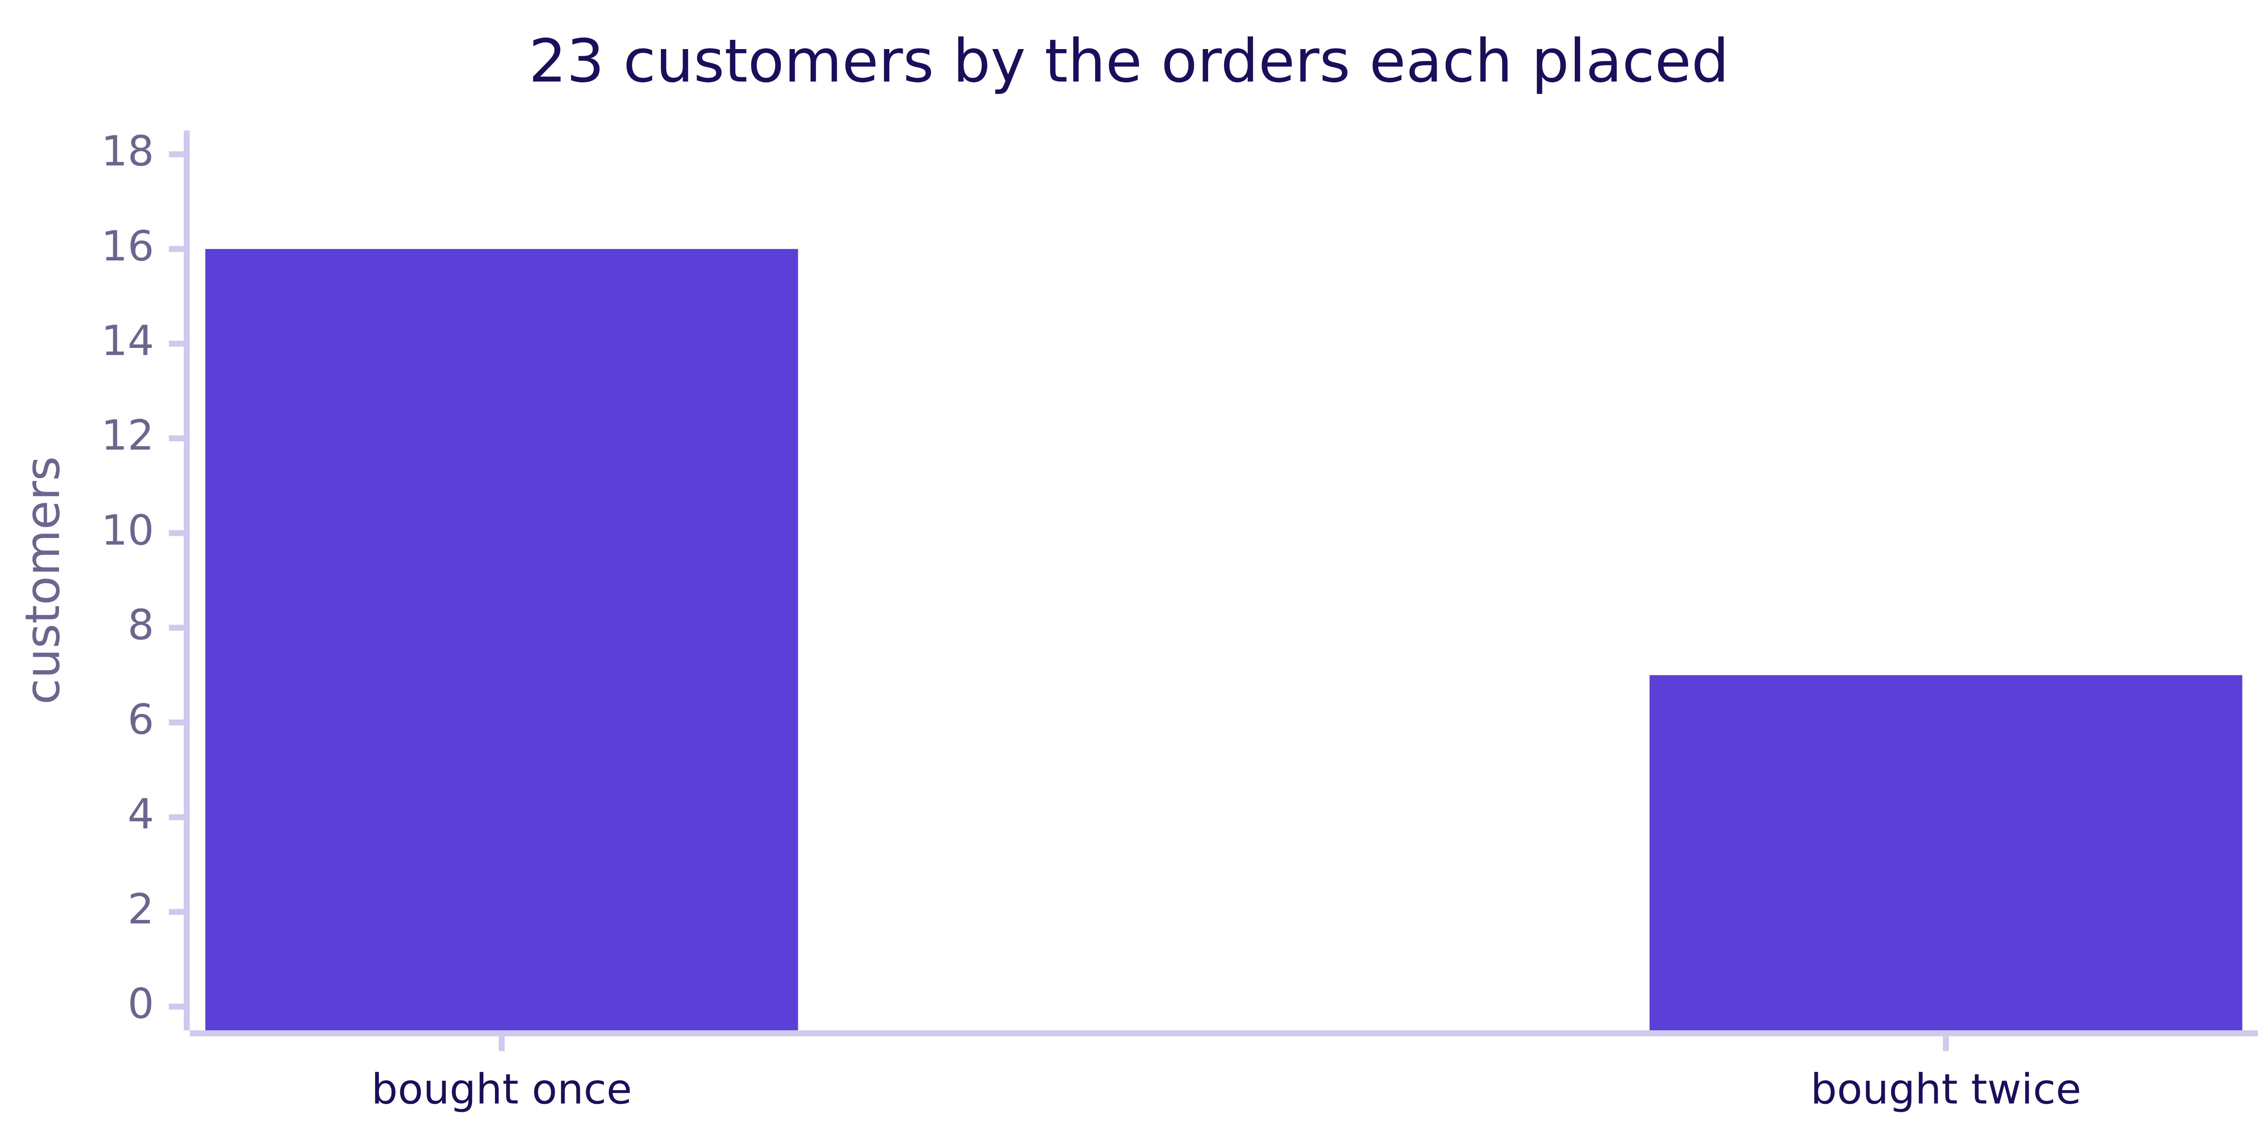
Indian Institute of Technology Gandhinagar
WEEK 1 · DAY 1 · KALPA GLOBAL CAPABILITY CENTRE
ADMINISTERED THROUGH THE COMPETENCY ADVANCEMENT ACADEMY
Answer: b, 7 of Kalpa's 23 customers came back
How many customers does Kalpa have, and how many came back?
23 customers placed 30 orders, 1.30 each; 16 bought once and 7 came back. Orders less customers equals the repeat buyers here only because nobody bought three times.
How does retail earn
Which total is sales
What is each branch
Do customers come back
What is a typical order
S47 · 52 / 76
Notes:
LIVE, 3 minutes. The answer is b. Orders per customer near 1 (a) still leaves room for 7 repeat
buyers; 16 (c) are the customers who bought once; 23 (d) is every customer. Write 23 and 1.30 on the
board tree. One repeat customer carries Retail-Core on one order and Retail-Plus on the other,
because the segment is recorded on each order, so a count of customers per segment has to say which
order's segment it used.
Transition: the checks.

Slide 53
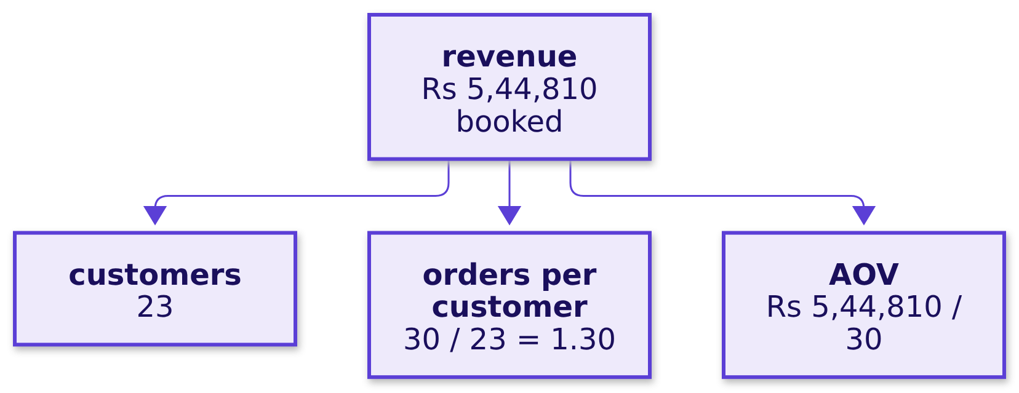
Indian Institute of Technology Gandhinagar
WEEK 1 · DAY 1 · KALPA GLOBAL CAPABILITY CENTRE
ADMINISTERED THROUGH THE COMPETENCY ADVANCEMENT ACADEMY
Check: the counts add to 30 and the tree lands
Do the counts add back to 30, and does the tree multiply back to revenue?
The 23 counts add back to 30 orders, and 23 x (30 / 23) x (Rs 5,44,810 / 30) lands exactly on Rs 5,44,810.
How does retail earn
Which total is sales
What is each branch
Do customers come back
What is a typical order
S48 · 53 / 76
Notes:
LIVE, 2 minutes. Both checks pass in the notebook. With the rounded 1.30 and Rs 18,160 the product
comes to about Rs 5,43,000, so write the fractions unrounded when you check the identity.
Transition: the count a colleague sent first.

Slide 54
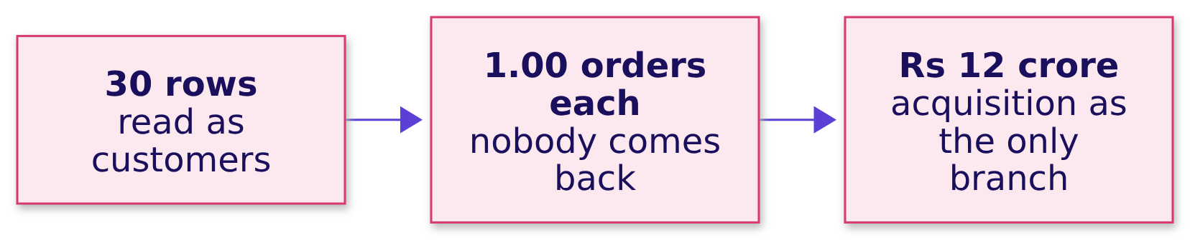
Indian Institute of Technology Gandhinagar
WEEK 1 · DAY 1 · KALPA GLOBAL CAPABILITY CENTRE
ADMINISTERED THROUGH THE COMPETENCY ADVANCEMENT ACADEMY
A draft counts 30 customers at 1.00 order each
What goes wrong if every row is counted as a customer?
The plausible wrong answer. A colleague's first draft to Meera reads: "30 customers placed 30 orders: 1.00 each, so nobody comes back."
How does retail earn
Which total is sales
What is each branch
Do customers come back
What is a typical order
S49 · 54 / 76
Notes:
LIVE, 3 minutes. Present it as the figure a colleague's first draft sent Meera before the room built
the count: the case for the budget, made by a counting slip. Ask what would check it before the
next slide.
Watch for learners who accept it because the division is right.
Transition: the check.

Slide 55
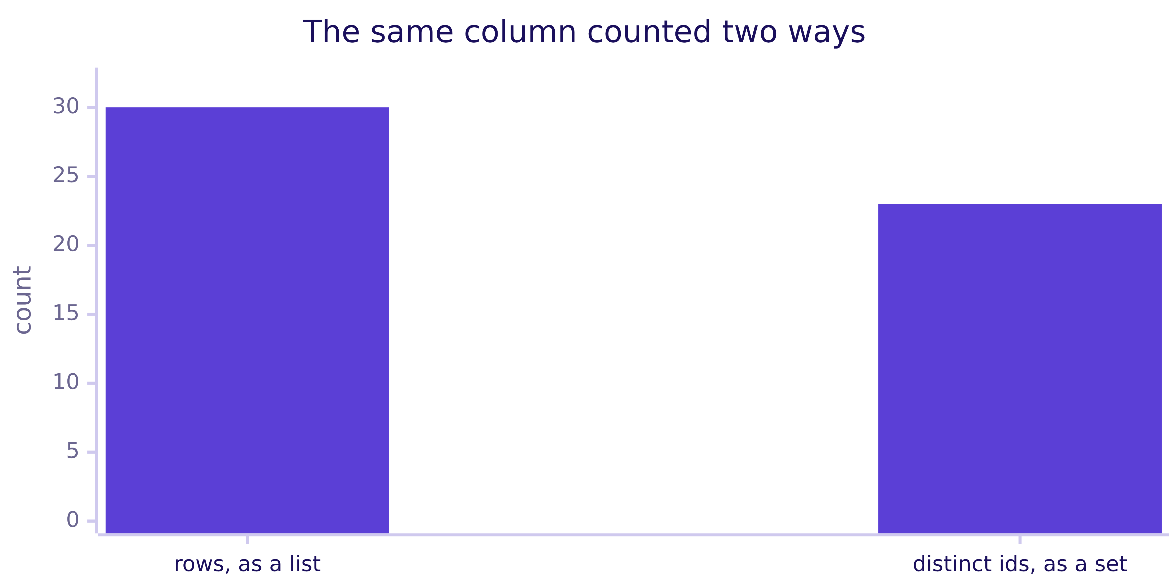
Indian Institute of Technology Gandhinagar
WEEK 1 · DAY 1 · KALPA GLOBAL CAPABILITY CENTRE
ADMINISTERED THROUGH THE COMPETENCY ADVANCEMENT ACADEMY
The id column holds 30 rows and 23 distinct ids
Which check tells rows apart from customers?
Why it is wrong. The division is correct and its denominator is wrong: a row is an order, and one customer can place several.
ids = [order["customer_id"] for order in ORDERS]
len(ids), len(set(ids)) # (30, 23)
How does retail earn
Which total is sales
What is each branch
Do customers come back
What is a typical order
S50 · 55 / 76
Notes:
LIVE, 3 minutes. A set keeps each value once however often it is added, so the list's 30 against the
set's 23 says 7 orders came from people who had already bought.
Transition: the fix.

Slide 56
Indian Institute of Technology Gandhinagar
WEEK 1 · DAY 1 · KALPA GLOBAL CAPABILITY CENTRE
ADMINISTERED THROUGH THE COMPETENCY ADVANCEMENT ACADEMY
Fixed: 30 / 23 = 1.30 orders, and 7 came back
What does dividing by distinct customers change?
23
1.30
7
CUSTOMERS
ORDERS PER CUSTOMER
CAME BACK
distinct ids
30 / 23
16 bought once
The draft's 1.00 goes nowhere, 7 returning customers are visible again, and "nobody comes back" leaves the case for the Rs 12 crore.
How does retail earn
Which total is sales
What is each branch
Do customers come back
What is a typical order
S51 · 56 / 76
Notes:
LIVE, 2 minutes. What changed, in customers: 7 people the draft could not see.
Transition: the same rate by a second route.

Slide 57
Indian Institute of Technology Gandhinagar
WEEK 1 · DAY 1 · KALPA GLOBAL CAPABILITY CENTRE
ADMINISTERED THROUGH THE COMPETENCY ADVANCEMENT ACADEMY
The mean of the 23 counts is the same 1.30
Does the mean of the counts agree with orders over customers?
second_route = sum(counts.values()) / len(counts) # 1.30, the same rate
THE RULE
The ratio needs two counts, which a report holds; the counts need the rows and also show the spread, 16 customers at one order and 7 at two, which the ratio hides. Use the counts whenever someone will ask how many came back.
How does retail earn
Which total is sales
What is each branch
Do customers come back
What is a typical order
S52 · 57 / 76
Notes:
LIVE, 2 minutes. The notebook asserts that the two routes agree and that the dictionary's keys are
the set's members.
Transition: the chapter's answers; D53, on delivered orders, is self-study.

Slide 58
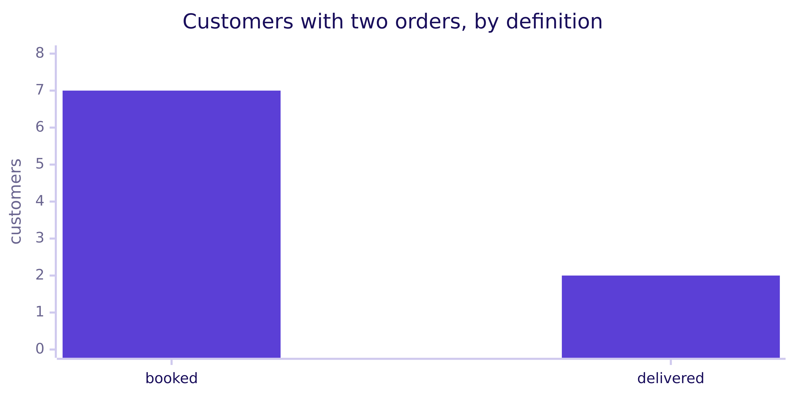
Indian Institute of Technology Gandhinagar
WEEK 1 · DAY 1 · KALPA GLOBAL CAPABILITY CENTRE
ADMINISTERED THROUGH THE COMPETENCY ADVANCEMENT ACADEMY
On delivered orders: 19 customers, 1.11 each
DEPTH
What changes when only delivered orders count?
 | Booked | Delivered
Orders | 30 | 21
Customers | 23 | 19
Orders per customer | 1.30 | 1.11
Customers with two orders | 7 | 2
On the delivered definition 19 customers kept 21 orders and 2 kept two, so every leaf moves with the definition, and each count goes out with the definition it was taken on.
How does retail earn
Which total is sales
What is each branch
Do customers come back
What is a typical order
D53 · 58 / 76
Notes:
SELF-STUDY, 3 minutes. Chapter 1's delivered reading kept 21 of the 30 orders; counted by id they
come from 19 customers, 1.11 orders each, and 2 of them kept two. The escalated case this afternoon
rebuilds Meera's answer on delivered orders, and this is its first leaf. In the room, cut this slide
first.
Transition: the chapter's answers.

Slide 59
Indian Institute of Technology Gandhinagar
WEEK 1 · DAY 1 · KALPA GLOBAL CAPABILITY CENTRE
ADMINISTERED THROUGH THE COMPETENCY ADVANCEMENT ACADEMY
Kalpa has 23 customers, and 7 came back
How many customers does Kalpa have, and how many came back for a second order?
Question | Answer
What rides on the count? | It decides whether acquisition is the only branch before Meera signs Rs 12 crore.
How are customers counted? | A row is an order, so customers are counted by distinct id.
How many came back? | 7 of 23 customers came back and 16 bought once, 1.30 orders each.
Every row a customer? | The draft's 30 at 1.00 each says nobody comes back, and the ids say 7 did.
Does the mean agree? | The mean of the 23 counts is also 1.30.
Delivered only? | 19 customers kept 21 orders, 1.11 each, and 2 kept two.
KAVYA'S REVIEW
"Your first 30 was a count of rows, divided as if it were people. A count of people comes from their ids, and every rate you send upstairs names its denominator."
IN THE INTERVIEW
[F] Your extract shows 30 orders and 30 customers; what do you check before saying nobody comes back?
How does retail earn
Which total is sales
What is each branch
Do customers come back
What is a typical order
S54 · 59 / 76
Notes:
LIVE, 2 minutes. One learner answers aloud: rows against distinct ids, then the window, since a
customer who buys every four months looks like a one-time buyer in one quarter, then whether one
person can carry two ids.
Transition: a 10-minute break, then chapter 4.

Slide 60
Indian Institute of Technology Gandhinagar
PG DIPLOMA IN AI-ML AND AGENTIC AI ENGINEERING · COHORT 2
ADMINISTERED THROUGH THE COMPETENCY ADVANCEMENT ACADEMY
03
What is a typical order
What does a typical Kalpa order look like, stated so that one large order cannot move it?
How does retail earn
Which total is sales
What is each branch
Do customers come back
What is a typical order
Week 1, Monday morning: the story and chapters 1 to 4
60 / 76
Notes:
LIVE, 30 minutes after the break: the map 1, the need 2, Blinkit 1, the options 4, the picture 2,
the build 6 (the code 2, the predict 1, the answer 2 and the check 1), the trap 9 (marketing's slide
3, why it is wrong with the sort 4 and the fix 2), the second route 3 and the close 2. D64 and D65,
the trimmed mean on Kalpa's orders, are self-study. Notebook 04 is the demonstration.
Transition: who needs a typical order, and the six questions on the way.

Slide 61
Indian Institute of Technology Gandhinagar
WEEK 1 · DAY 1 · KALPA GLOBAL CAPABILITY CENTRE
ADMINISTERED THROUGH THE COMPETENCY ADVANCEMENT ACADEMY
Marketing and Anand both need a typical order
Who needs a typical order, and which questions lead to it?
Who needs the answer. The marketing lead, whose payback case values every new customer by the order they will place, Meera, who signs the budget on that payback, and Anand, who has warned against averages: an order valued too high makes Rs 12 crore look cheap.
QUESTION 1
QUESTION 2
QUESTION 3
QUESTION 4
QUESTION 5
QUESTION 6
What it prices
Which middle
The median
Mean as typical
The library
The payback
Who needs a typical order, and what does it price?
Which middle survives one large order?
What is the median order?
What goes wrong when the mean is sold as typical?
Does statistics.median agree?
What goes into the payback case?
How does retail earn
Which total is sales
What is each branch
Do customers come back
What is a typical order
S55 · 61 / 76
Notes:
LIVE, 1 minute. Chapter 3 found 23 customers, 1.30 orders each and 7 who came back, and the tree
multiplies back through an AOV of Rs 18,160. Read the six questions.
Transition: what the typical order prices.

Slide 62
Indian Institute of Technology Gandhinagar
WEEK 1 · DAY 1 · KALPA GLOBAL CAPABILITY CENTRE
ADMINISTERED THROUGH THE COMPETENCY ADVANCEMENT ACADEMY
A first order's value decides the payback
Who needs a typical order, and what does it price?
THE CLIENT ASKS
"What does a typical order look like?"
"No averages. One business customer can move an average."
Anand Iyer, finance controller
The metric at stake | The typical order is what marketing's payback credits to every new customer.
Who asks | Meera and the marketing lead ask, and Anand has already warned against averages.
What a wrong number costs | A first order valued too high makes the payback look short and Rs 12 crore look cheap.
How does retail earn
Which total is sales
What is each branch
Do customers come back
What is a typical order
S56 · 62 / 76
Notes:
LIVE, 2 minutes. Read Anand's line again; now it can be tested on the file.
Transition: a real company's reported order value.

Slide 63
Indian Institute of Technology Gandhinagar
WEEK 1 · DAY 1 · KALPA GLOBAL CAPABILITY CENTRE
ADMINISTERED THROUGH THE COMPETENCY ADVANCEMENT ACADEMY
Blinkit reports a mean order value, right for totals
What does a real company report as its order value?
Rs 518
2,443
BLINKIT NET AOV
DARK STORES
quarter to June 2026
the same quarter
Source: MediaNama on Eternal's results, 24 July 2026. A reported AOV is a mean, the right number for totals across millions of similar baskets and the wrong one for one shopper's basket when a few very large orders share the file.
How does retail earn
Which total is sales
What is each branch
Do customers come back
What is a typical order
S57 · 63 / 76
Notes:
LIVE, 1 minute. A mean over millions of similar small baskets describes them well; the question is
whether Kalpa's 30 orders are that kind of file.
Transition: four middles a team could report.

Slide 64
Indian Institute of Technology Gandhinagar
WEEK 1 · DAY 1 · KALPA GLOBAL CAPABILITY CENTRE
ADMINISTERED THROUGH THE COMPETENCY ADVANCEMENT ACADEMY
The median barely moves when one large order joins
Which middle survives one large order?
Option | Moves when one large order joins | Right call when
A. The mean, total over count | It moves by Rs 14,623. | Totals must multiply back.
B. The median, the middle of the sorted amounts | It moves by Rs 50, one place in the sort. | The question is what a typical order looks like.
C. A trimmed mean, dropping the top and bottom order | It moves by Rs 83, and it needs a rule. | A stated rule says how many to drop.
D. A mean per customer type | It does not move within a type. | Each type gets its own plan.
Sized on six invented orders: five of Rs 1,900 to Rs 2,600, then one of Rs 90,000.
THE RULE
B for the typical order, with A beside it for totals; D answers better if marketing prices the payback per customer type.
How does retail earn
Which total is sales
What is each branch
Do customers come back
What is a typical order
S58 · 64 / 76
Notes:
LIVE, 4 minutes. The invented set is five orders from Rs 1,900 to Rs 2,600 plus one of Rs 90,000;
the notebook's sizing cell draws the three moves. The trimmed mean is the middle a spreadsheet user
reaches for first, and it needs a rule for how many orders to drop.
Ask: which of the four would Anand accept, and why?
Transition: the picture of what one large order does.

Slide 65
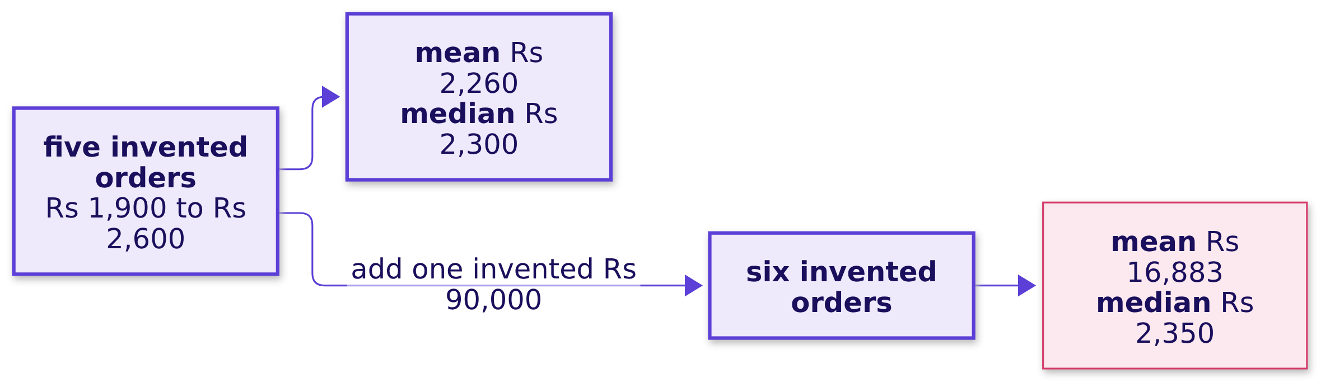
Indian Institute of Technology Gandhinagar
WEEK 1 · DAY 1 · KALPA GLOBAL CAPABILITY CENTRE
ADMINISTERED THROUGH THE COMPETENCY ADVANCEMENT ACADEMY
One large order drags the mean and nudges the median
What does one large order do to each middle?
The mean shares the large order's rupees across every order, so it jumps by Rs 14,623, while the median only asks which order sits in the middle, so it moves Rs 50.
How does retail earn
Which total is sales
What is each branch
Do customers come back
What is a typical order
S59 · 65 / 76
Notes:
LIVE, 2 minutes. The numbers are invented and are no Kalpa orders.
Transition: the median on Kalpa's 30 orders.

Slide 66
Indian Institute of Technology Gandhinagar
WEEK 1 · DAY 1 · KALPA GLOBAL CAPABILITY CENTRE
ADMINISTERED THROUGH THE COMPETENCY ADVANCEMENT ACADEMY
Sort the 30 amounts and average the 15th and 16th
How is the middle of 30 orders found?
ranked = sorted(amounts)
median = (ranked[14] + ranked[15]) / 2 # the 15th and 16th in size order
With an even count there are two middle orders and the median is halfway between them; Python counts from 0, so the 15th order is ranked[14].
How does retail earn
Which total is sales
What is each branch
Do customers come back
What is a typical order
S60 · 66 / 76
Notes:
LIVE, 2 minutes. Walk the two lines. Ask what changes with an odd count, say 31 orders: one middle
order, ranked[15], and no averaging.
Transition: predict the median.

Slide 67
Indian Institute of Technology Gandhinagar
WEEK 1 · DAY 1 · KALPA GLOBAL CAPABILITY CENTRE
ADMINISTERED THROUGH THE COMPETENCY ADVANCEMENT ACADEMY
What is the median of Kalpa's 30 orders?
The mean is Rs 18,160, so where do you expect the middle order to sit?
a) About Rs 2,200.
b) Rs 18,160, the same as the mean.
c) Rs 9,080, half the mean.
d) Rs 2,300, the 16th order in size order.
How does retail earn
Which total is sales
What is each branch
Do customers come back
What is a typical order
S61 · 67 / 76
Notes:
LIVE, 1 minute. Letters by hand. Many expect b, since in a textbook the mean and the median sit close
together.
Transition: the answer.

Slide 68
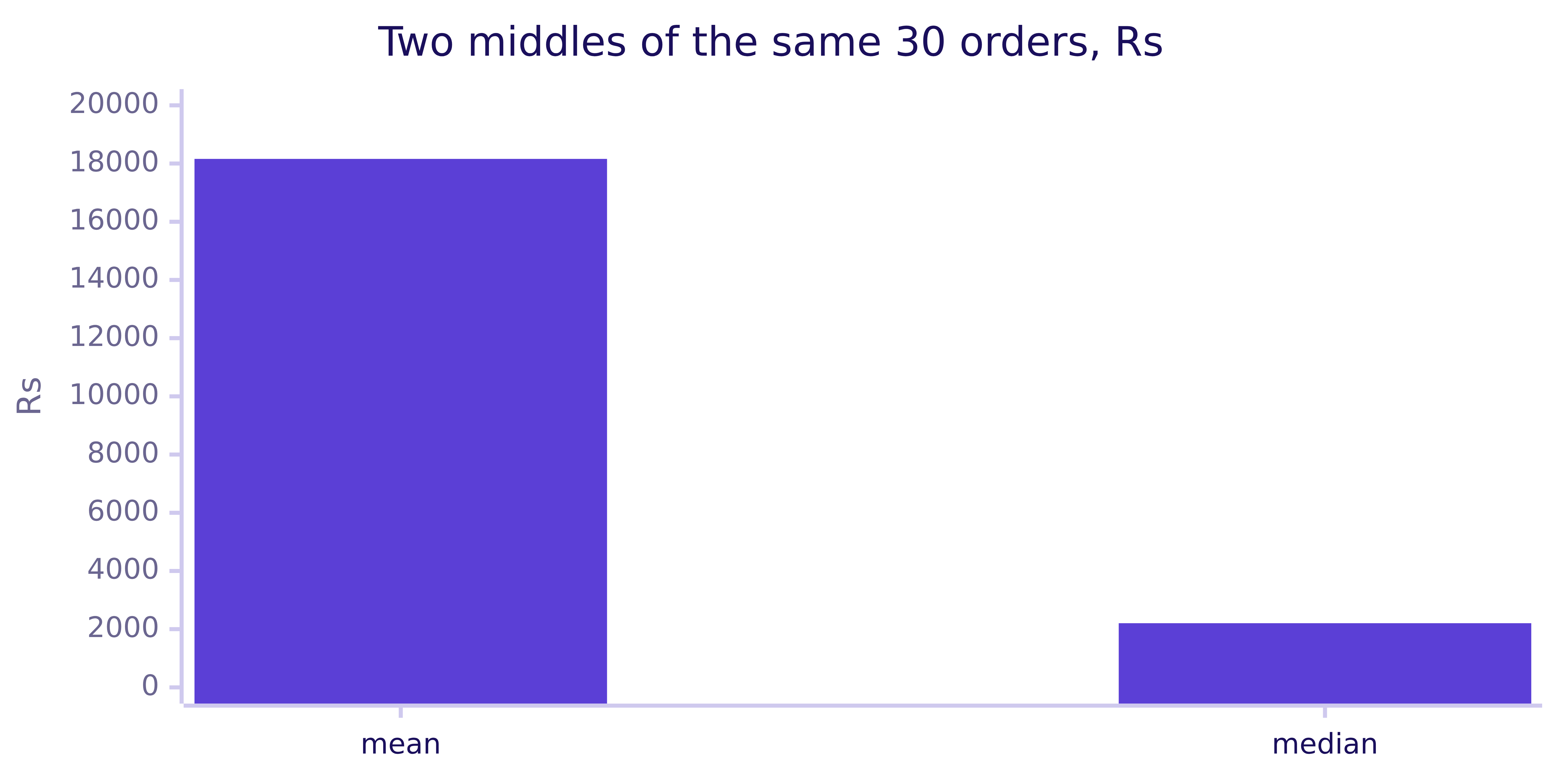
Indian Institute of Technology Gandhinagar
WEEK 1 · DAY 1 · KALPA GLOBAL CAPABILITY CENTRE
ADMINISTERED THROUGH THE COMPETENCY ADVANCEMENT ACADEMY
Answer: a, the median order is Rs 2,205
What is the median order, and how far is it from the mean?
The 15th and 16th orders in size order are Rs 2,110 and Rs 2,300, so the median is Rs 2,205, about one eighth of the Rs 18,160 mean.
How does retail earn
Which total is sales
What is each branch
Do customers come back
What is a typical order
S62 · 68 / 76
Notes:
LIVE, 2 minutes. The answer is a. The mean (b) and the median would match only if the orders spread
evenly around it; half the mean (c) has no rule behind it; Rs 2,300 (d) is one of the two middle
orders, and an even count takes the halfway point. Write Rs 2,205 on the board tree beside the
pencilled Rs 18,160.
Transition: the check.

Slide 69
Indian Institute of Technology Gandhinagar
WEEK 1 · DAY 1 · KALPA GLOBAL CAPABILITY CENTRE
ADMINISTERED THROUGH THE COMPETENCY ADVANCEMENT ACADEMY
Check: the mean is 8.2 times the median
Does the median check out, and how far apart are the two middles?
Rs 2,205
Rs 18,160
8.2
MEDIAN
MEAN
MEAN OVER MEDIAN
halfway between Rs 2,110 and Rs 2,300
chapter 2's AOV
two middles far apart
THE RULE
When the mean is several times the median, sort the file before quoting either.
How does retail earn
Which total is sales
What is each branch
Do customers come back
What is a typical order
S63 · 69 / 76
Notes:
LIVE, 1 minute. The notebook's checks confirm that the median is Rs 2,205 and the mean about eight
times it. Two middles that far apart are a finding in themselves.
Transition: marketing's slide; D64 and D65, on the trimmed mean, are self-study.

Slide 70
Indian Institute of Technology Gandhinagar
WEEK 1 · DAY 1 · KALPA GLOBAL CAPABILITY CENTRE
ADMINISTERED THROUGH THE COMPETENCY ADVANCEMENT ACADEMY
Where does a trimmed mean of the 30 land?
DEPTH
Drop the smallest and the largest order and average the other 28: where do you expect it?
a) Near the mean of Rs 18,160.
b) Halfway between the mean and the median.
c) Within about Rs 100 of the median.
d) Below every order in the file.
How does retail earn
Which total is sales
What is each branch
Do customers come back
What is a typical order
D64 · 70 / 76
Notes:
SELF-STUDY, 2 minutes. This is option C from the options slide, run on Kalpa's own orders, as
notebook 04's second level runs it.
Transition: the answer.

Slide 71
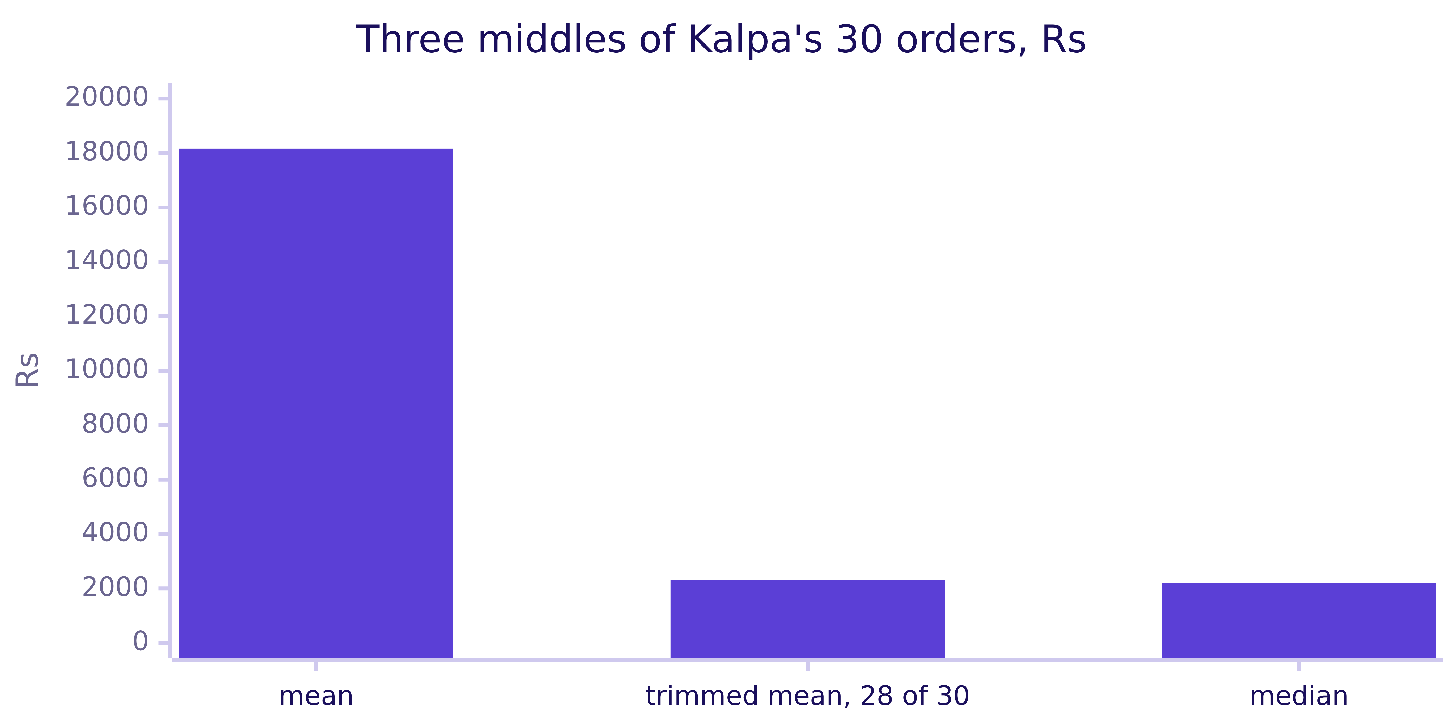
Indian Institute of Technology Gandhinagar
WEEK 1 · DAY 1 · KALPA GLOBAL CAPABILITY CENTRE
ADMINISTERED THROUGH THE COMPETENCY ADVANCEMENT ACADEMY
Answer: c, the trimmed mean is Rs 2,300
DEPTH
What does trimming one order from each end give on this file?
Trimming one order from each end lands at Rs 2,300, beside the median of Rs 2,205. A trim needs a rule for how many orders to drop and the median needs none, so the median stays the call.
How does retail earn
Which total is sales
What is each branch
Do customers come back
What is a typical order
D65 · 71 / 76
Notes:
SELF-STUDY, 2 minutes. The answer is c. The trimmed mean falls far from the mean (a) and from the
halfway point (b), and it cannot fall below every order (d), since it averages 28 of them.
Transition: marketing's slide.

Slide 72
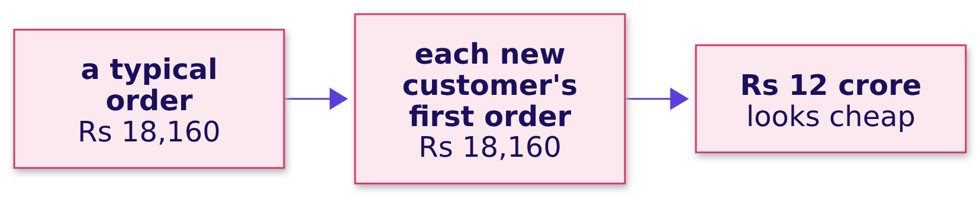
Indian Institute of Technology Gandhinagar
WEEK 1 · DAY 1 · KALPA GLOBAL CAPABILITY CENTRE
ADMINISTERED THROUGH THE COMPETENCY ADVANCEMENT ACADEMY
Marketing's slide says a typical order is Rs 18,160
What goes wrong when the mean is sold as the typical order?
The plausible wrong answer. Marketing's slide reads: "A typical Kalpa order is Rs 18,160, and so is each new customer's first order."
How does retail earn
Which total is sales
What is each branch
Do customers come back
What is a typical order
S66 · 72 / 76
Notes:
LIVE, 3 minutes. Present it as marketing's slide, which reached Meera before the room built the
median; the room's job is to name the check. Ask first how many of the 30 orders sit above the
mean; most say about half.
Transition: the check.

Slide 73
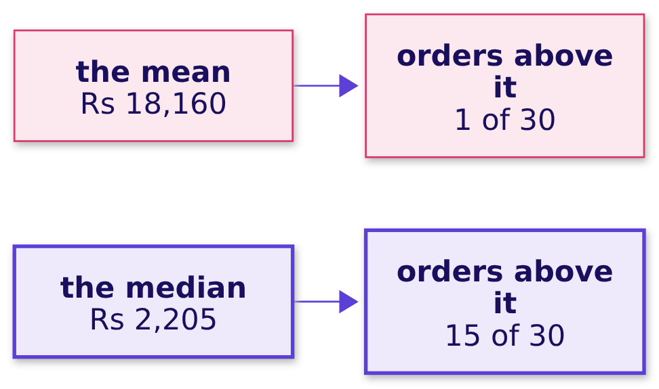
Indian Institute of Technology Gandhinagar
WEEK 1 · DAY 1 · KALPA GLOBAL CAPABILITY CENTRE
ADMINISTERED THROUGH THE COMPETENCY ADVANCEMENT ACADEMY
Only 1 of the 30 orders sits above the mean
Which check shows whether Kalpa's orders look like the mean?
Why it is wrong. A typical order is one most orders look like, and only 1 of the 30 orders is larger than Rs 18,160, so a payback priced on the mean values each new customer's order about eight times too high.
above = sum(1 for a in amounts if a > mean) # 1
How does retail earn
Which total is sales
What is each branch
Do customers come back
What is a typical order
S67 · 73 / 76
Notes:
LIVE, 4 minutes. A middle that describes the orders has about half of them on each side, and the
median has 15 above it by construction. Show the strip chart in notebook 04, where the amounts sit
on a scale in which each step is ten times the one before: they pile up in the low thousands, and
the mean stands far to the right of them. Then every learner runs the sort in the notebook's empty
cell and reads their own result; nobody reads a record aloud.
Transition: the fix.

Slide 74
Indian Institute of Technology Gandhinagar
WEEK 1 · DAY 1 · KALPA GLOBAL CAPABILITY CENTRE
ADMINISTERED THROUGH THE COMPETENCY ADVANCEMENT ACADEMY
Send the median as typical and the mean for totals
What does the fix change in the numbers Meera sees?
Rs 2,205
Rs 18,160
8x
THE TYPICAL ORDER
THE MEAN
OVERSTATED
the median, booked
kept for totals
a first order priced at the mean
THE RULE
Report the median for the typical order and the mean for the total, and say how far apart the two are.
How does retail earn
Which total is sales
What is each branch
Do customers come back
What is a typical order
S68 · 74 / 76
Notes:
LIVE, 2 minutes. What changed: the typical order is Rs 2,205, and the slide's Rs 18,160 overstates it
about eightfold. Rub out the pencilled Rs 18,160 on the board tree and write Rs 2,205. The payback
still needs a mean, taken from the customers the spend targets, which chapter 5 builds.
Transition: the median by a second route.

Slide 75
Indian Institute of Technology Gandhinagar
WEEK 1 · DAY 1 · KALPA GLOBAL CAPABILITY CENTRE
ADMINISTERED THROUGH THE COMPETENCY ADVANCEMENT ACADEMY
The library's median agrees on both definitions
Does statistics.median agree with the hand-written middle?
statistics.median(amounts) # 2205.0, the same as the sorted middle
Definition | Orders | Sorted middle | statistics.median
Booked | 30 | Rs 2,205 | Rs 2,205
Not cancelled | 26 | Rs 2,100 | Rs 2,100
THE RULE
Write the middle once by hand so the even-count rule is yours, then use the library, and in Week 2 PERCENTILE_CONT(0.5) in SQL and median in pandas.
How does retail earn
Which total is sales
What is each branch
Do customers come back
What is a typical order
S69 · 75 / 76
Notes:
LIVE, 3 minutes. The notebook asserts that both routes agree on both definitions. After this the
library is the route; the switch that still matters is between middles, since the mean comes back
whenever a total has to reconcile.
Transition: the chapter's answers.

Slide 76
Indian Institute of Technology Gandhinagar
WEEK 1 · DAY 1 · KALPA GLOBAL CAPABILITY CENTRE
ADMINISTERED THROUGH THE COMPETENCY ADVANCEMENT ACADEMY
A typical Kalpa order is Rs 2,205, the median
What does a typical Kalpa order look like, stated so that one large order cannot move it?
Question | Answer
What does it price? | It prices each new customer's first order in marketing's payback.
Which middle survives? | The median survives, since it moves one place when a large order joins.
What is the median? | It is Rs 2,205, halfway between Rs 2,110 and Rs 2,300.
The mean as typical? | Only 1 of the 30 orders sits above the Rs 18,160 mean.
Does the library agree? | statistics.median gives Rs 2,205, and Rs 2,100 on the not-cancelled orders.
What goes into the payback? | It takes a mean from the customers the spend targets, with the median quoted as the typical order.
KAVYA'S REVIEW
"Anand said no averages, and now you know why. Put the median in the sentence and say the mean is about eight times higher."
IN THE INTERVIEW
[S] Mean or median for order value, and why?
How does retail earn
Which total is sales
What is each branch
Do customers come back
What is a typical order
S70 · 76 / 76
Notes:
LIVE, 2 minutes. One learner answers aloud: the median when a few large orders can pull the mean,
reported with the count of orders above the mean, and the mean kept for totals, since mean times
count gives revenue. Chapter 5 takes the payback's mean from the three consumer segments Meera's
plan concerns, Retail-Core, Retail-Plus and Student. Leave the tree on the board over lunch; chapter
5 opens on it and asks which branch Meera opens first.
Transition: lunch, then chapter 5 in the afternoon deck.

