Slide 1





WEEK 5 · MONDAY · REGRESSION AND CLASSIFICATION
Regression and classification, framed first
Six topics on tiny invented tables, then one real bank's 41,188 calls.
THE TOPICS
THE CASE
THE DECISION
Six chapters
A Portuguese bank
Kalpa's Rs 40 nudge
Each taught on a table small enough to count by hand, invented for teaching.
Whom should the campaign call? UCI Bank Marketing, real public data.
Marketing wants a 90-day repeat score; Kavya wants the baseline first.
Does it need a model?
What may the model read?
Which slice, and when?
Which line is best?
What does 0.73 mean?
What did the fit miss?
Who is worth a call?
S1 · 1 / 62
…
Notes:
LIVE, 1 minute. Three layers, always in this order: the idea on numbers you can count, the idea on
real data, the idea as a Kalpa decision. Line to land: the business question decides whether a
model exists at all. Transition: where the week sits.

Slide 2
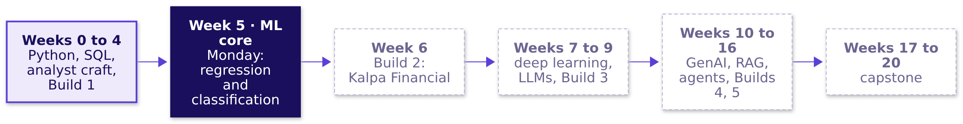
WEEK 5 · MONDAY · REGRESSION AND CLASSIFICATION
Week 5 is where the models start
The programme's twenty weeks, this week lit.
Does it need a model?
What may the model read?
Which slice, and when?
Which line is best?
What does 0.73 mean?
What did the fit miss?
Who is worth a call?
S2 · 2 / 62
…
Notes:
LIVE, 1 minute. Weeks 0 to 4 built the analyst: Python, SQL, statistics, metrics, forecasting with
a naive baseline (Week 4 Friday). Week 5 turns that analyst into someone who can frame, build and
defend a model. Week 6 is Build 2: the same machinery in Rohan's lending book at Kalpa Financial.
ME1 runs this week as a continuous activity; say its scope aloud and nothing more. Transition: the
one picture the week grows.

Slide 3
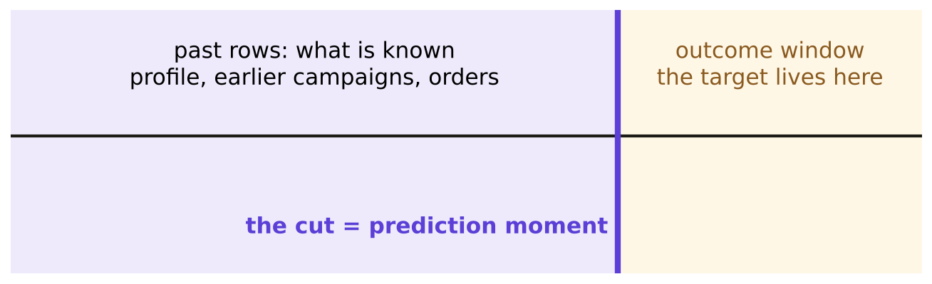
WEEK 5 · MONDAY · REGRESSION AND CLASSIFICATION
One picture grows all week
Monday's state: what is known, the cut, the outcome.
The week's timeline: past rows, the prediction moment, the outcome window
Does it need a model?
What may the model read?
Which slice, and when?
Which line is best?
What does 0.73 mean?
What did the fit miss?
Who is worth a call?
S3 · 3 / 62
…
Notes:
LIVE, 2 minutes. Draw this on the board and leave it up all week. Left of the purple line: what is
known. The line itself: the moment the prediction is made. Right of it: where the answer lives.
Tuesday adds the threshold, Wednesday drops a column to the wrong side, Thursday adds the error
curve, Friday the drift. Nightly self-check: redraw it from memory. Question to ask: where does a
customer's next order sit on this picture? Transition: today's ticket.

Slide 4
WEEK 5 · MONDAY · REGRESSION AND CLASSIFICATION
The ticket: whom the bank should call first
One slide, the destination the six topics lead to.
On the ticket | What it says
Company | a Portuguese retail bank, phone campaigns for a term deposit
Data | UCI Bank Marketing: 41,188 calls, May 2008 to November 2010
The ask | rank clients by chance of a yes, so agents call the best first
Kalpa's twin | Marketing's Rs 40 nudge: who buys again within 90 days?
The condition | Kavya: "show me the dumbest possible baseline first"
Does it need a model?
What may the model read?
Which slice, and when?
Which line is best?
What does 0.73 mean?
What did the fit miss?
Who is worth a call?
S4 · 4 / 62
…
Notes:
LIVE, 2 minutes. Real bank, real public data, CC BY 4.0. Kalpa is the decision layer: same shape,
our costs. Read Kavya's line twice. Question to ask: what would the dumbest possible model do here?
Take two answers, write them on the board, do not settle it; case 2 does. Transition: the six
topics that get us there.

Slide 5
WEEK 5 · MONDAY · REGRESSION AND CLASSIFICATION
Six topics, six chapters, then the case
The curriculum's words, in its order.
# | The topic, in the curriculum's words | Chapter | Min | Notebook
1 | Prediction, rule or query: when a business question is a modelling problem | Is this an ML problem at all | 15 | ch01
2 | Input, target, prediction time; the repeat-purchase target | What do we know, and when | 22 | ch02
3 | Train, validation, test; the seed; the baseline | Don't peek at the exam paper | 20 | ch03
4 | Linear regression: fit, coefficients in units, residuals | Drawing the best line | 22 | ch04
5 | Logistic regression: probability, direction, strength | From a line to a probability | 22 | ch05
6 | Where each model fails; the residual tells | What the leftovers confess | 18 | ch06
Does it need a model?
What may the model read?
Which slice, and when?
Which line is best?
What does 0.73 mean?
What did the fit miss?
Who is worth a call?
S5 · 5 / 62
…
Notes:
LIVE, 1 minute. Read column two once: these are the words to search later. The chapter names are
the ones learners remember. Case chapters 7, 8 and 9 apply them to the bank. Break after chapter 4.
Transition: how they join.

Slide 6
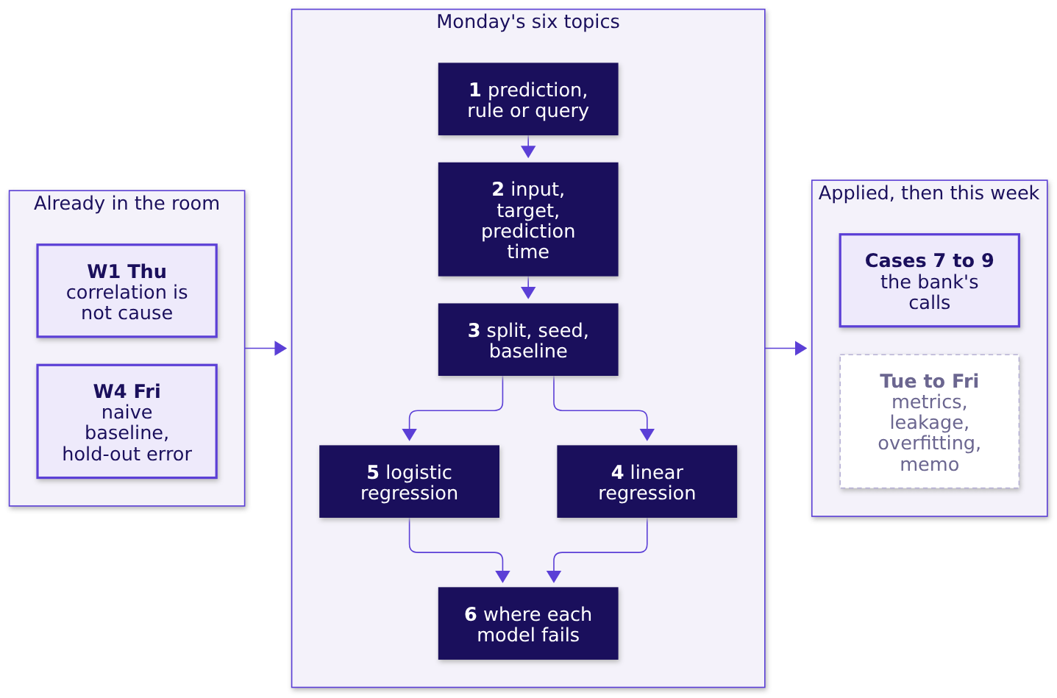
WEEK 5 · MONDAY · REGRESSION AND CLASSIFICATION
How the six topics join
What each rests on, what it feeds.
Does it need a model?
What may the model read?
Which slice, and when?
Which line is best?
What does 0.73 mean?
What did the fit miss?
Who is worth a call?
S6 · 6 / 62
…
Notes:
LIVE, 1 minute. Framing (1, 2, 3) comes before any fitting. Both model families rest on the split
and the baseline. Chapter 6 is where both fail. Week 4 Friday's naive forecast was already a
baseline; today it gets its name. Transition: chapter 1.

Slide 7

PG DIPLOMA IN AI-ML AND AGENTIC AI ENGINEERING · COHORT 2
01
Is this an ML problem at all
Does it need a model?
Prediction, rule or query: when a business question is a modelling problem · also searched as: machine learning problem framing, when to use ML
Does it need a model?
What may the model read?
Which slice, and when?
Which line is best?
What does 0.73 mean?
What did the fit miss?
Who is worth a call?
Does it beat nothing?
What did the peek buy?
Week 5 Monday: regression and classification
7 / 62
Notes:
LIVE, 15 minutes for the chapter, including the six-question sort. Notebook ch01. The
misconception to stage: "we have data, so it is an ML problem". Transition: six questions.

Slide 8
WEEK 5 · MONDAY · REGRESSION AND CLASSIFICATION
Six questions Marketing brought, invented
Each one arrived with the word "AI" attached.
# | Kalpa's question (invented)
1 | How many members bought in September?
2 | Which members will buy again in the next 90 days?
3 | Remind every member whose cart was abandoned yesterday
4 | What was the average basket in Pune last quarter?
5 | How much will each member spend next quarter?
6 | Hold any order above Rs 50,000 from a member who joined this week
Does it need a model?
What may the model read?
Which slice, and when?
Which line is best?
What does 0.73 mean?
What did the fit miss?
Who is worth a call?
S7 · 8 / 62
…
Notes:
LIVE, 3 minutes. Pairs sort the six into query, rule or prediction in two minutes, on paper.
Prediction to ask for first: how many of the six need a trained model? Collect the count from five
pairs. Click: notebook ch01, cell 4 prints the table. Transition: the count.

Slide 9
WEEK 5 · MONDAY · REGRESSION AND CLASSIFICATION
How many of the six need a model?
Commit to a number before the next slide.
6
4
2
0
ALL OF THEM
MOST
TWO
NONE
"it is all data"
anything about members
only the future ones
rules do everything
Does it need a model?
What may the model read?
Which slice, and when?
Which line is best?
What does 0.73 mean?
What did the fit miss?
Who is worth a call?
S8 · 9 / 62
…
Notes:
LIVE, 1 minute. Hands up per option. Most rooms pick 4 or 6. Transition: the three tests.

Slide 10
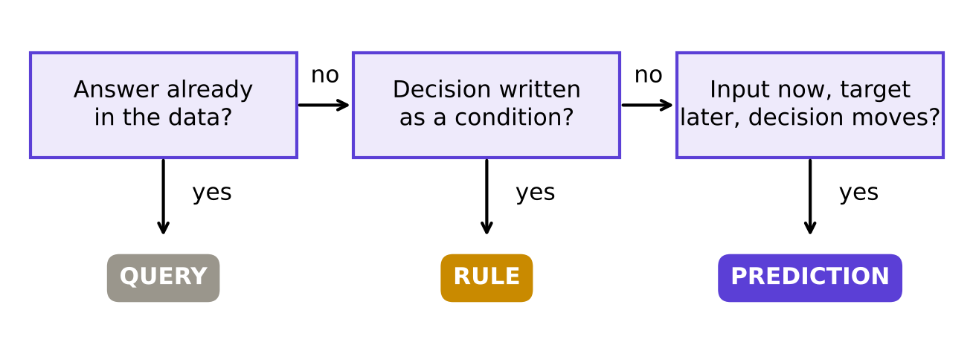

WEEK 5 · MONDAY · REGRESSION AND CLASSIFICATION
Answer: two of six, after three tests
Ask them in order; only the last needs learning.
Three tests in order: query, rule, prediction
THE RULE
Input known now, target known later, a decision that moves with the score: then a model.
Does it need a model?
What may the model read?
Which slice, and when?
Which line is best?
What does 0.73 mean?
What did the fit miss?
Who is worth a call?
S9 · 10 / 62
…
Notes:
LIVE, 4 minutes. Walk the six through the tests aloud. 1 and 4: query. 3 and 6: rule. 2 and 5:
prediction; 2 asks "will they" (classification), 5 asks "how much" (regression). Line to land: the
decision makes the problem, the data only makes a dataset. Interview line [S]: when is a business
problem an ML problem? Transition: when a rule stops being enough.

Slide 11



WEEK 5 · MONDAY · REGRESSION AND CLASSIFICATION
A rule wins until its misses cost money
Google's first rule, and Uber's ETA.
GOOGLE, RULES OF ML
UBER, DEEPETA
THE FLIP
Launch without ML first
Keep the rule, predict its error
Kalpa's numbers
A heuristic gets you about half the gain, Zinkevich estimates.
The routing engine's ETA stays; the model predicts how wrong it will be.
A Rs 1,200 missed buyer against a Rs 40 nudge makes ranking pay.
Does it need a model?
What may the model read?
Which slice, and when?
Which line is best?
What does 0.73 mean?
What did the fit miss?
Who is worth a call?
S10 · 11 / 62
…
Notes:
LIVE, 3 minutes. Google Rules of ML, rule 1: "Don't be afraid to launch a product without machine
learning" (developers.google.com/machine-learning/guides/rules-of-ml, verified 28 October 2026).
Uber DeepETA (uber.com/blog/deepeta-how-uber-predicts-arrival-times, verified 28 October 2026):
the model predicts the residual of the routing engine, which had to be beaten first. Kalpa's Rs
40 and Rs 1,200 are the row's invented numbers. Question to ask: which of Kalpa's two rules would
you replace with a model first, and what would have to be true? Transition: chapter 2.

Slide 12
PG DIPLOMA IN AI-ML AND AGENTIC AI ENGINEERING · COHORT 2
02
What do we know, and when
What may the model read?
Input, target, prediction time; the repeat-purchase target · also searched as: features and labels, supervised learning setup
Does it need a model?
What may the model read?
Which slice, and when?
Which line is best?
What does 0.73 mean?
What did the fit miss?
Who is worth a call?
Does it beat nothing?
What did the peek buy?
Week 5 Monday: regression and classification
12 / 62
Notes:
LIVE, 22 minutes. Notebook ch02. The misconception to stage: "use the latest table, it is the
freshest". Transition: four members.

Slide 13
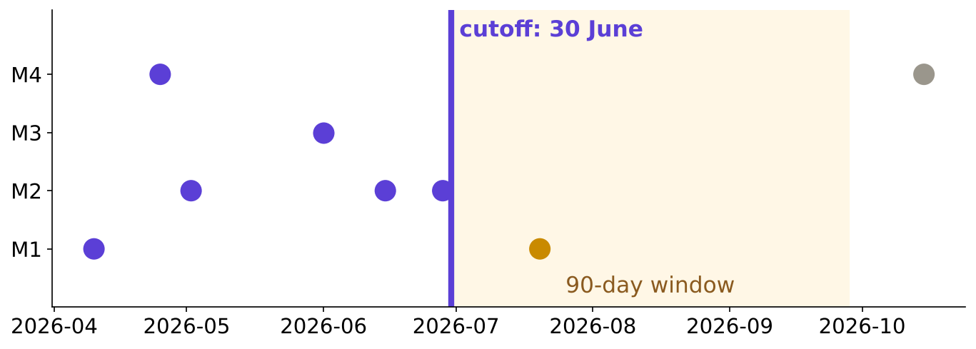
WEEK 5 · MONDAY · REGRESSION AND CLASSIFICATION
Eight orders, four members, one cutoff
Invented. Purple is history; amber decides the target; grey is too late.
Four members' orders against a 30 June cutoff and a 90-day window
Does it need a model?
What may the model read?
Which slice, and when?
Which line is best?
What does 0.73 mean?
What did the fit miss?
Who is worth a call?
S11 · 13 / 62
…
Notes:
LIVE, 4 minutes. Draw the line at 30 June on the board first, then place the eight dots. The
prediction time is the morning Marketing sends the nudge. The window is 90 days because that is
what Marketing's budget covers. Click: notebook ch02, the timeline cell. Transition: who counts.

Slide 14
WEEK 5 · MONDAY · REGRESSION AND CLASSIFICATION
Which members buy again inside the window?
Count before the next slide: none, one, two or four?
Member | Orders before 30 June | Next order
M1 | 10 April | 20 July
M2 | 2 May, 15 June, 28 June | none
M3 | 1 June | none
M4 | 25 April | 15 October
Does it need a model?
What may the model read?
Which slice, and when?
Which line is best?
What does 0.73 mean?
What did the fit miss?
Who is worth a call?
S12 · 14 / 62
…
Notes:
LIVE, 2 minutes. Pairs answer. Trap to watch: M4 bought again, so many say two. Transition: answer.

Slide 15
WEEK 5 · MONDAY · REGRESSION AND CLASSIFICATION
Answer: one member, M1
M4 bought again, after the window closed.
Member | Orders before | Days since last | Spend before, Rs | Repeat in 90 days
M1 | 1 | 81 | 800 | 1
M2 | 3 | 2 | 1,900 | 0
M3 | 1 | 29 | 950 | 0
M4 | 1 | 66 | 500 | 0
Does it need a model?
What may the model read?
Which slice, and when?
Which line is best?
What does 0.73 mean?
What did the fit miss?
Who is worth a call?
S13 · 15 / 62
…
Notes:
LIVE, 4 minutes. The target is a definition: "buys again" means inside these ninety days. Every
input column is computed only from orders on or before the cutoff. Line to land: freeze the
reference date, then build both sides from it. Transition: the trap.

Slide 16
WEEK 5 · MONDAY · REGRESSION AND CLASSIFICATION
The trap: count orders on the whole log
M1 shows two orders. One of them is the answer.
Member | Orders before cutoff | Orders all time | Repeat in 90 days
M1 | 1 | 2 | 1
M4 | 1 | 2 | 0
The check. Ask of every column: would I know this value on 30 June?
Does it need a model?
What may the model read?
Which slice, and when?
Which line is best?
What does 0.73 mean?
What did the fit miss?
Who is worth a call?
S14 · 16 / 62
…
Notes:
LIVE, 4 minutes. The all-time count includes 20 July, the very purchase we predict. Offline the
model looks brilliant; the first real morning it collapses. Fix: inputs from history only, target
from the window only. This is the same question Wednesday asks of every column. Interview line [F]:
where is the 90-day flag computed, and as of which date? Transition: chapter 3.

Slide 17
PG DIPLOMA IN AI-ML AND AGENTIC AI ENGINEERING · COHORT 2
03
Don't peek at the exam paper
Which slice, and when?
Train, validation, test; the seed; the baseline · also searched as: train validation test split, baseline model
Does it need a model?
What may the model read?
Which slice, and when?
Which line is best?
What does 0.73 mean?
What did the fit miss?
Who is worth a call?
Does it beat nothing?
What did the peek buy?
Week 5 Monday: regression and classification
17 / 62
Notes:
LIVE, 20 minutes. Notebook ch03. The misconception to stage: "the test set is just more validation
data". Transition: three slices.

Slide 18
WEEK 5 · MONDAY · REGRESSION AND CLASSIFICATION
Three slices, three jobs
Practice papers, mock exams, the board exam.
Slice | At school | For a model
train | practice papers you study | rows the model learns from
validation | mock exams, as often as you like | rows you compare models on
test | the board exam, sat once | rows you score the chosen model on, once
Does it need a model?
What may the model read?
Which slice, and when?
Which line is best?
What does 0.73 mean?
What did the fit miss?
Who is worth a call?
S15 · 18 / 62
…
Notes:
LIVE, 3 minutes. The school story lands with this room. Stress "sat once": a board paper seen in
advance proves nothing about the student. Interview line [S]: which slice is spent once, and why?
Transition: what the seed does.

Slide 19
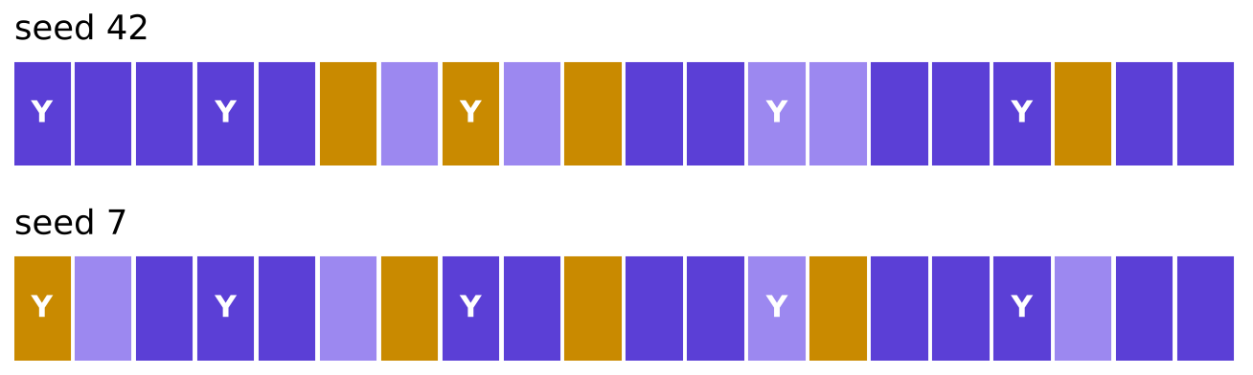
WEEK 5 · MONDAY · REGRESSION AND CLASSIFICATION
The seed is the shuffle
Twenty invented members, two seeds, two different exam papers.
Twenty members split by seed 42 and by seed 7
Does it need a model?
What may the model read?
Which slice, and when?
Which line is best?
What does 0.73 mean?
What did the fit miss?
Who is worth a call?
S16 · 19 / 62
…
Notes:
LIVE, 4 minutes. Purple train, lilac validation, amber test; Y is a member who came back. Same
rule, different seed, different members in each slice. Writing random_state=42 is what lets a
teammate get your slices and your baseline. Stratify keeps one Y in every test of four. Click:
notebook ch03, the two-seed cell. Transition: the dumbest model.

Slide 20
WEEK 5 · MONDAY · REGRESSION AND CLASSIFICATION
Saying "no" to all twenty scores how much?
5 of 20 came back. Commit: 25, 50, 75 or 95 percent?
came back
did not
5 members
15 members
Does it need a model?
What may the model read?
Which slice, and when?
Which line is best?
What does 0.73 mean?
What did the fit miss?
Who is worth a call?
S17 · 20 / 62
…
Notes:
LIVE, 1 minute. Pairs commit. Transition: the answer.

Slide 21
WEEK 5 · MONDAY · REGRESSION AND CLASSIFICATION
Answer: 75 percent, knowing nothing
15 of 20 right by saying "no" to everyone.
75%
mean
1
MAJORITY CLASS
THE AVERAGE
RULE TO BEAT
the bar for "will they"
the bar for "how much"
a cheap rule, where one exists
The flip. Where a cheap rule exists, it replaces the majority class as the bar.
Does it need a model?
What may the model read?
Which slice, and when?
Which line is best?
What does 0.73 mean?
What did the fit miss?
Who is worth a call?
S18 · 21 / 62
…
Notes:
LIVE, 4 minutes. A model that scores 75 here learned the share who came back and nothing else.
Baselines: majority class for classification, the mean for regression, and a simple rule when one
is available. Interview line [F]: why start with a baseline, and what does beating it prove?
Transition: chapter 4. Break after chapter 4.

Slide 22
PG DIPLOMA IN AI-ML AND AGENTIC AI ENGINEERING · COHORT 2
04
Drawing the best line
Which line is best?
Linear regression: fit, coefficients in units, residuals · also searched as: linear regression explained, least squares
Does it need a model?
What may the model read?
Which slice, and when?
Which line is best?
What does 0.73 mean?
What did the fit miss?
Who is worth a call?
Does it beat nothing?
What did the peek buy?
Week 5 Monday: regression and classification
22 / 62
Notes:
LIVE, 22 minutes. Notebook ch04. The misconception to stage: "the best line joins the first and
last points". Transition: six members.

Slide 23
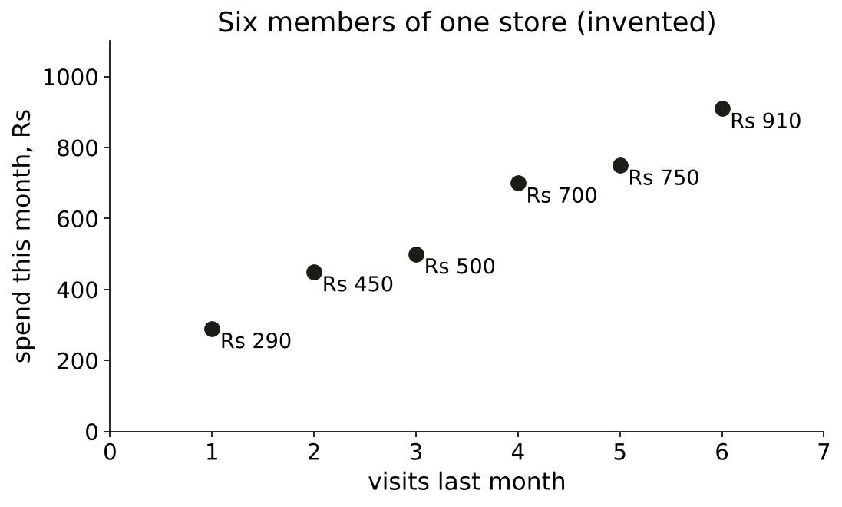
WEEK 5 · MONDAY · REGRESSION AND CLASSIFICATION
Six members of one Kalpa store
Invented. Visits last month against spend this month.
Six invented members: visits and spend
Does it need a model?
What may the model read?
Which slice, and when?
Which line is best?
What does 0.73 mean?
What did the fit miss?
Who is worth a call?
S19 · 23 / 62
…
Notes:
LIVE, 3 minutes. Everyone draws a line by eye on paper. Most join the first and last points:
slope (910 minus 290) / 5 = Rs 124 per visit. Write 124 on the board. Transition: which line wins.

Slide 24
WEEK 5 · MONDAY · REGRESSION AND CLASSIFICATION
Which line leaves the smallest squares?
Mean line, first-to-last by eye, or a third line?
Line | Equation
the mean | spend = Rs 600
by eye, first to last | spend = Rs 166 + Rs 124 x visits
a third line | to be found
Does it need a model?
What may the model read?
Which slice, and when?
Which line is best?
What does 0.73 mean?
What did the fit miss?
Who is worth a call?
S20 · 24 / 62
…
Notes:
LIVE, 2 minutes. Prediction first. Then explain "squared": each miss drawn as a square, so big
misses count far more than small ones. Transition: the answer.

Slide 25
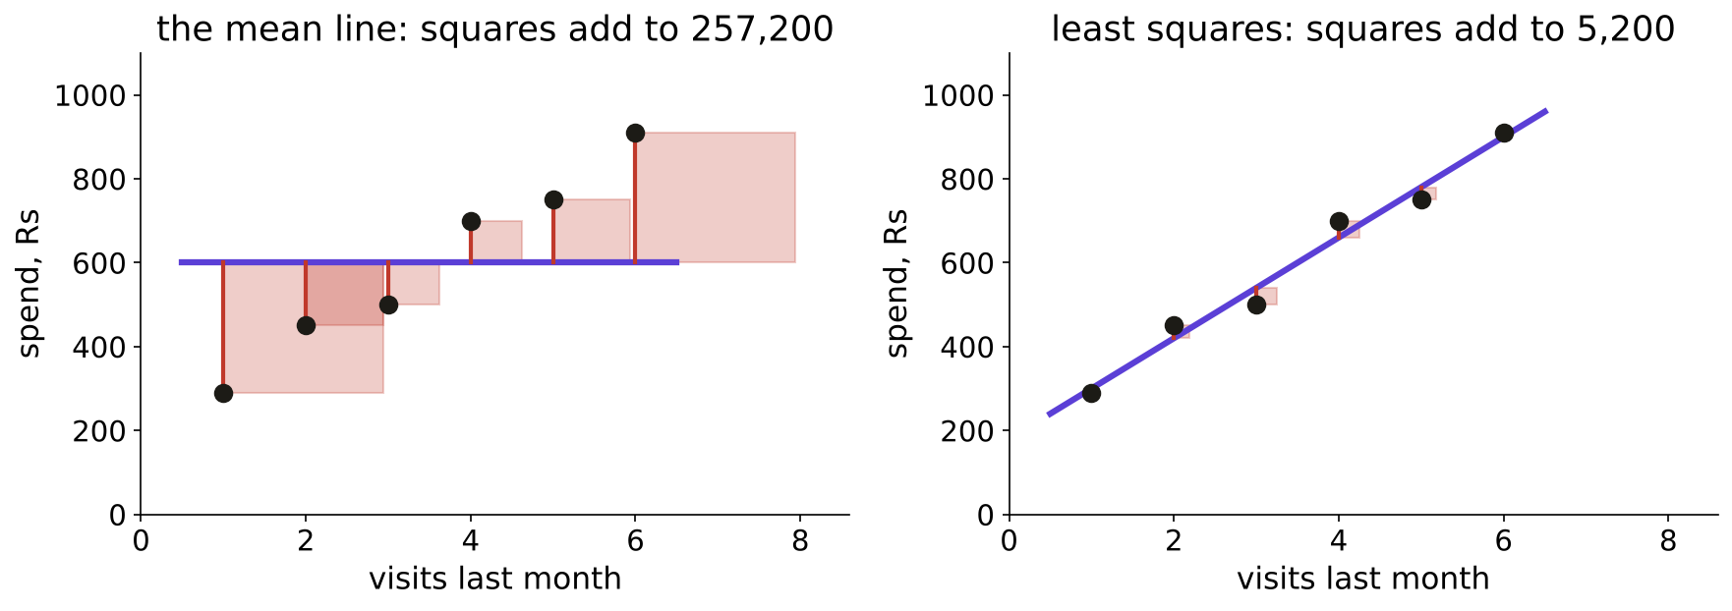
WEEK 5 · MONDAY · REGRESSION AND CLASSIFICATION
Answer: least squares, 5,200 against 5,480
The red squares are the misses, drawn as area.
Residual squares under the mean line and the least-squares line
Does it need a model?
What may the model read?
Which slice, and when?
Which line is best?
What does 0.73 mean?
What did the fit miss?
Who is worth a call?
S21 · 25 / 62
…
Notes:
LIVE, 5 minutes. Least squares: spend = Rs 180 + Rs 120 x visits. Squares: 257,200 for the mean,
5,480 by eye, 5,200 for least squares. The formula, named last: slope = sum of dx times dy / sum
of dx squared = 2,100 / 17.5 = 120. Click: notebook ch04, the hand calculation, then scikit-learn
agreeing. Transition: reading it.

Slide 26
WEEK 5 · MONDAY · REGRESSION AND CLASSIFICATION
Rs 120 per visit, read with care
The coefficient in the target's own units.
Rs 120
Rs 180
-10 to +40
PER EXTRA VISIT
AT ZERO VISITS
RESIDUALS, RS
an association, across members
beyond the data; quote carefully
small, mixed signs, no pattern
Does it need a model?
What may the model read?
Which slice, and when?
Which line is best?
What does 0.73 mean?
What did the fit miss?
Who is worth a call?
S22 · 26 / 62
…
Notes:
LIVE, 4 minutes. Say it for Marketing: "members who visit once more spend about Rs 120 more, in
this data". Whether a nudge that causes a visit adds Rs 120 needs an experiment (Week 1 Thursday).
Kahoot Q5 previews this sentence. Transition: the code, three lines.

Slide 27
WEEK 5 · MONDAY · REGRESSION AND CLASSIFICATION
The same line in three lines of code
scikit-learn agrees with the hand count to the rupee.
from sklearn.linear_model import LinearRegression
lin = LinearRegression().fit(store[["visits"]], store["spend_rs"])
lin.coef_[0], lin.intercept_ # (120.0, 180.0)
Does it need a model?
What may the model read?
Which slice, and when?
Which line is best?
What does 0.73 mean?
What did the fit miss?
Who is worth a call?
S23 · 27 / 62
…
Notes:
LIVE, 2 minutes. Run it in ch04 on the projector. The check cell asserts hand and code agree. The
bridge course met fitting; spend no more time on mechanics. Break now, 10 minutes. Transition:
chapter 5.

Slide 28
PG DIPLOMA IN AI-ML AND AGENTIC AI ENGINEERING · COHORT 2
05
From a line to a probability
What does 0.73 mean?
Logistic regression: probability, direction, strength · also searched as: logistic regression, sigmoid, odds
Does it need a model?
What may the model read?
Which slice, and when?
Which line is best?
What does 0.73 mean?
What did the fit miss?
Who is worth a call?
Does it beat nothing?
What did the peek buy?
Week 5 Monday: regression and classification
28 / 62
Notes:
LIVE, 22 minutes. Notebook ch05. The misconception to stage: "a line on 0s and 1s gives a
probability". Transition: twelve members.

Slide 29
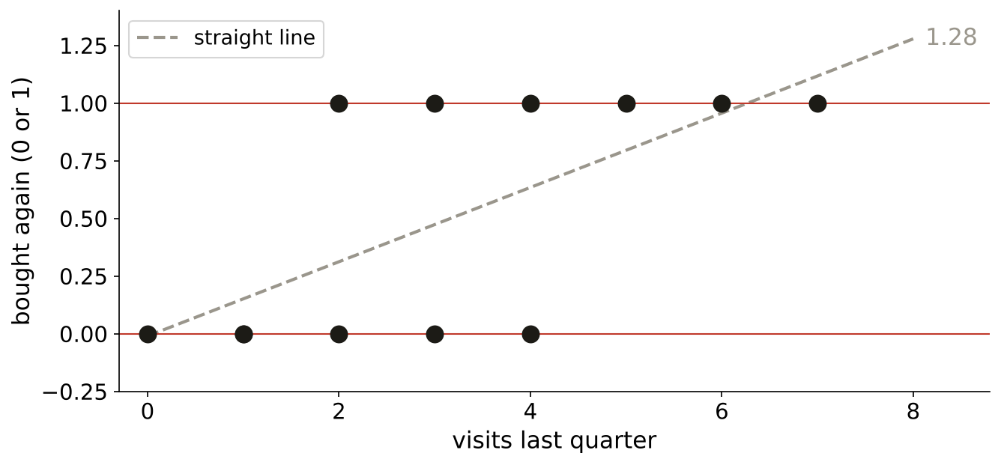
WEEK 5 · MONDAY · REGRESSION AND CLASSIFICATION
A straight line through yes and no
Twelve invented members: visits, and whether they came back.
A straight line fitted to 0 and 1 outcomes
…
Which slice, and when?
Which line is best?
What does 0.73 mean?
What did the fit miss?
Who is worth a call?
Does it beat nothing?
What did the peek buy?
S24 · 29 / 62
Notes:
LIVE, 3 minutes. Dots sit at 0 or 1 only. The dashed line is ordinary least squares on them.
Question to ask: what will this line predict for a member with 8 visits? Transition: commit.

Slide 30
WEEK 5 · MONDAY · REGRESSION AND CLASSIFICATION
What does the line say at 8 visits?
About 0.9, exactly 1, or more than 1?
0.9
1.0
> 1
OPTION A
OPTION B
OPTION C
"nearly certain"
"certain"
"more than certain"
…
Which slice, and when?
Which line is best?
What does 0.73 mean?
What did the fit miss?
Who is worth a call?
Does it beat nothing?
What did the peek buy?
S25 · 30 / 62
Notes:
LIVE, 1 minute. Hands per option. Transition: the S.

Slide 31
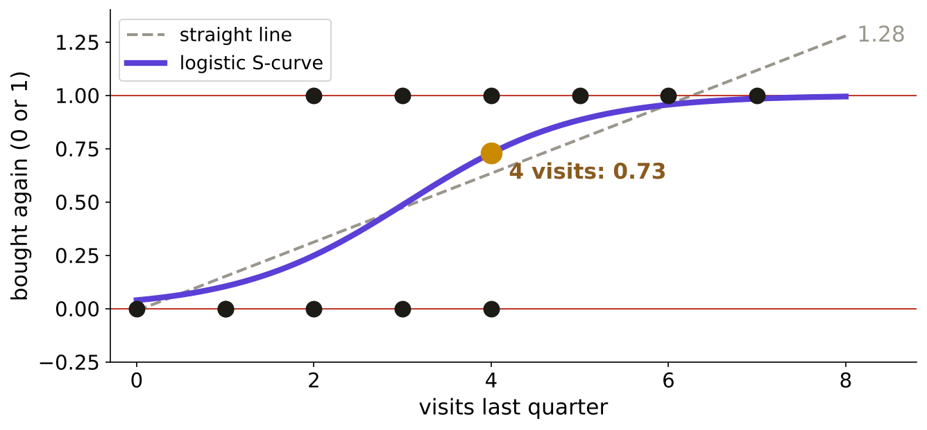
WEEK 5 · MONDAY · REGRESSION AND CLASSIFICATION
Answer: 1.28, so bend the line into an S
The S stays between 0 and 1 wherever you ask it.
The straight line runs past 1; the logistic S stays inside
…
Which slice, and when?
Which line is best?
What does 0.73 mean?
What did the fit miss?
Who is worth a call?
Does it beat nothing?
What did the peek buy?
S26 · 31 / 62
Notes:
LIVE, 5 minutes. The line says 1.28 at 8 visits and -0.01 at 0: impossible probabilities. Logistic
regression keeps a line underneath, z = a + b x visits, and squeezes it: p = 1 / (1 + exp(-z)).
Here z = -3.20 + 1.05 x visits. Click: ch05, the fit cell, model and formula agree at 0.73.
Transition: what 0.73 means.

Slide 32
WEEK 5 · MONDAY · REGRESSION AND CLASSIFICATION
0.73 means 73 of 100 members like this one
A statement about a group, never a promise about one member.
0.73
0.49
0.04
4 VISITS
3 VISITS
0 VISITS
about 73 in 100 come back
about a coin flip
about 4 in 100
…
Which slice, and when?
Which line is best?
What does 0.73 mean?
What did the fit miss?
Who is worth a call?
Does it beat nothing?
What did the peek buy?
S27 · 32 / 62
Notes:
LIVE, 3 minutes. Interview line [F]: what does a logistic output of 0.71 mean? Model answer: among
customers who look like this one, about 71 in 100 do the thing, if the model is calibrated; it is
never "this customer is 71 percent likely" as a promise. Transition: direction and strength.

Slide 33
WEEK 5 · MONDAY · REGRESSION AND CLASSIFICATION
Direction is the sign; strength is exp(b)
Each extra visit multiplies the odds by 2.85.
Visits | p | Odds p / (1 - p) | Ratio to the row above
2 | 0.25 | 0.33
3 | 0.49 | 0.94 | 2.85
4 | 0.73 | 2.69 | 2.85
5 | 0.88 | 7.67 | 2.85
The trap. "Each visit adds 1.05 to the probability" reads a log-odds coefficient as a slope.
…
Which slice, and when?
Which line is best?
What does 0.73 mean?
What did the fit miss?
Who is worth a call?
Does it beat nothing?
What did the peek buy?
S28 · 33 / 62
Notes:
LIVE, 5 minutes. b = 1.05 is positive: more visits, more likely. exp(1.05) = 2.85: the odds
multiply by 2.85 per visit, at every step. The probability step is not constant: 0.25 to 0.49,
then 0.88 to 0.96. Click: ch05, the odds-ratio check. Transition: chapter 6.

Slide 34
PG DIPLOMA IN AI-ML AND AGENTIC AI ENGINEERING · COHORT 2
06
What the leftovers confess
What did the fit miss?
Where each model fails; the residual tells · also searched as: residual plot, regression diagnostics
Does it need a model?
What may the model read?
Which slice, and when?
Which line is best?
What does 0.73 mean?
What did the fit miss?
Who is worth a call?
Does it beat nothing?
What did the peek buy?
Week 5 Monday: regression and classification
34 / 62
Notes:
LIVE, 18 minutes, including the four-plot match drill if time allows. Notebook ch06, the one
concept chapter on real data: UCI Auto MPG. The misconception: "a line that looks close is right".
Transition: 392 cars.

Slide 35
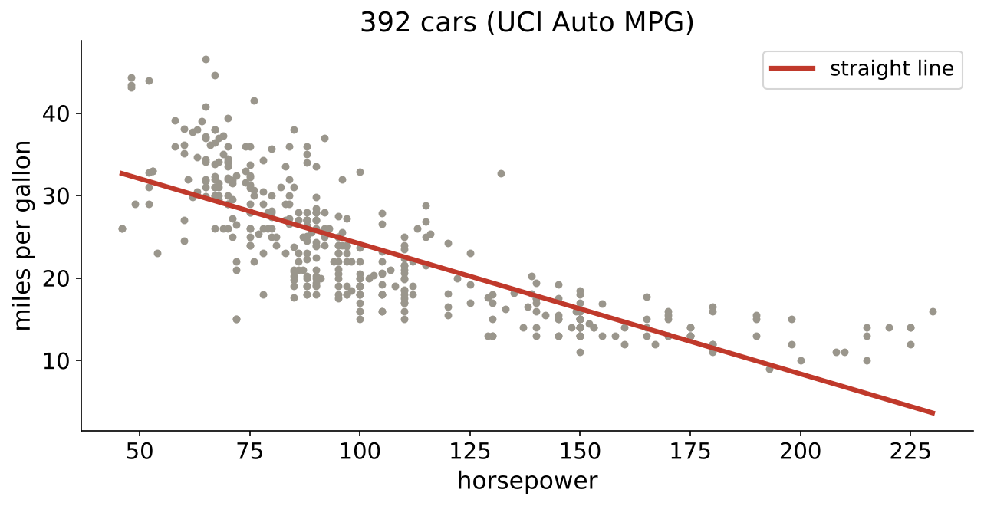
WEEK 5 · MONDAY · REGRESSION AND CLASSIFICATION
392 cars, one straight line
Real data: UCI Auto MPG, 1970s and early 1980s cars.
Miles per gallon against horsepower with a straight line
…
Which slice, and when?
Which line is best?
What does 0.73 mean?
What did the fit miss?
Who is worth a call?
Does it beat nothing?
What did the peek buy?
S29 · 35 / 62
Notes:
LIVE, 3 minutes. 398 cars; six have "?" for horsepower and are dropped, a decision recorded in the
notebook. The line: mpg = 39.94 minus 0.158 x horsepower. From a distance it looks fine. Question:
if the truth bends, what will the misses look like? Transition: commit.

Slide 36



WEEK 5 · MONDAY · REGRESSION AND CLASSIFICATION
What shape will the residuals take?
Even scatter, a bow, or below zero everywhere?
OPTION A
OPTION B
OPTION C
Even scatter
A bow
Below everywhere
Misses spread evenly above and below zero.
Above at both ends, below in the middle.
The line overshoots every car.
…
Which slice, and when?
Which line is best?
What does 0.73 mean?
What did the fit miss?
Who is worth a call?
Does it beat nothing?
What did the peek buy?
S30 · 36 / 62
Notes:
LIVE, 1 minute. Hands per option. Transition: the answer.

Slide 37
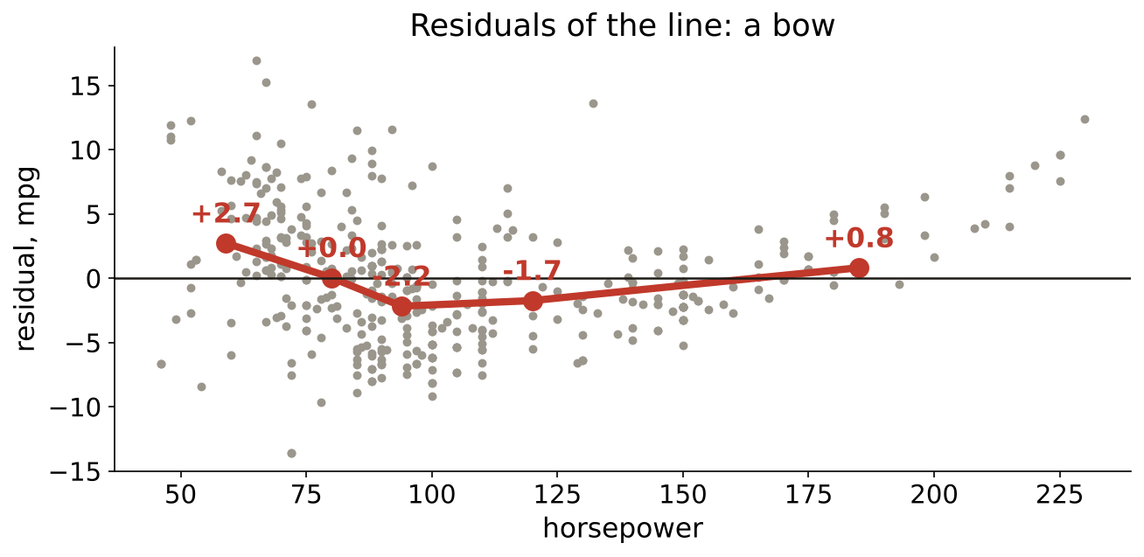
WEEK 5 · MONDAY · REGRESSION AND CLASSIFICATION
Answer: a bow, +2.7 at one end, -2.2 in the middle
Mean residual in five horsepower bands.
Residuals of the straight line bow across horsepower
…
Which slice, and when?
Which line is best?
What does 0.73 mean?
What did the fit miss?
Who is worth a call?
Does it beat nothing?
What did the peek buy?
S31 · 37 / 62
Notes:
LIVE, 4 minutes. Low-power cars beat the line by 2.7 mpg on average, the middle band sits 2.2 below
it, the top band climbs back to +0.8. A pattern in residuals is a shape the model missed; random
scatter is what a good fit leaves. Click: ch06, the bow cell. Transition: the fix.

Slide 38
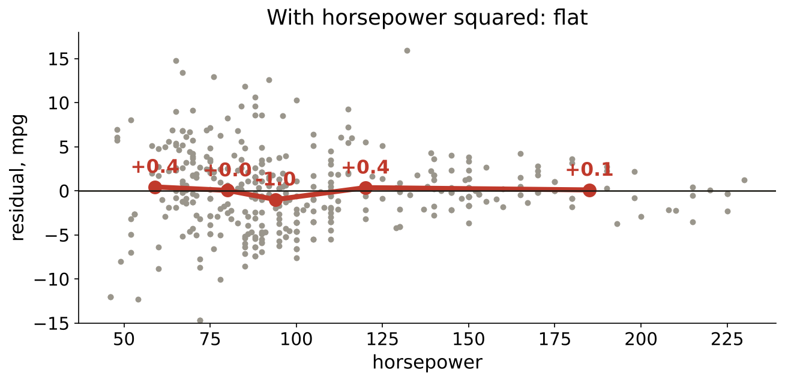
WEEK 5 · MONDAY · REGRESSION AND CLASSIFICATION
Add horsepower squared, and the bow flattens
Every band within 1 mpg; typical miss 4.89 to 4.36.
Residuals after adding horsepower squared
…
Which slice, and when?
Which line is best?
What does 0.73 mean?
What did the fit miss?
Who is worth a call?
Does it beat nothing?
What did the peek buy?
S32 · 38 / 62
Notes:
LIVE, 3 minutes. One extra column, horsepower squared, lets the line bend. Band means now 0.44,
0.05, -0.99, 0.36, 0.10. Wednesday turns this move into feature engineering; today it is only the
cure the residuals asked for. Transition: where the cure fails.

Slide 39
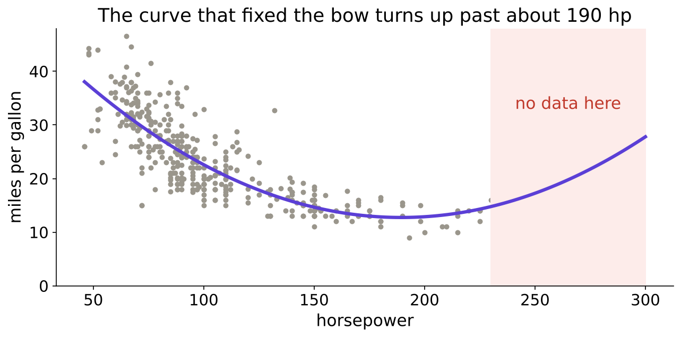
WEEK 5 · MONDAY · REGRESSION AND CLASSIFICATION
The cure fails outside the data
Past about 190 horsepower the curve predicts mileage rising.
The squared-term curve turns upward beyond the data
…
Which slice, and when?
Which line is best?
What does 0.73 mean?
What did the fit miss?
Who is worth a call?
Does it beat nothing?
What did the peek buy?
S33 · 39 / 62
Notes:
LIVE, 3 minutes. At 300 hp the curve says 27.8 mpg, the line says minus 7.4. Both are nonsense,
because no car in the data has 300 hp. Rule: never quote a fit outside the range it was fitted on.
Transition: the failure table.

Slide 40
WEEK 5 · MONDAY · REGRESSION AND CLASSIFICATION
Where each model fails
Read the residuals, and know the range.
Model | Fails when | You see it as
straight line | the truth bends | a bow in the residuals
line plus a squared term | you leave the data's range | predictions turn the wrong way
logistic regression | the chance rises at both ends of an input | one S cannot hold both ends
any model | inputs are missing or wrong | six cars with "?" horsepower
…
Which slice, and when?
Which line is best?
What does 0.73 mean?
What did the fit miss?
Who is worth a call?
Does it beat nothing?
What did the peek buy?
S34 · 40 / 62
Notes:
LIVE, 3 minutes. Mid-session drill if minutes allow: match four residual plots (bow, fan, bands,
flat) to their diagnoses; the practice set carries the plots. Interview line: what does a pattern
in the residuals tell you? Transition: the case.

Slide 41
PG DIPLOMA IN AI-ML AND AGENTIC AI ENGINEERING · COHORT 2
07
Whom should the bank call
Who is worth a call?
Case chapter. Applies: Prediction, rule or query; Input, target, prediction time; Train, validation, test; the seed; the baseline
Does it need a model?
What may the model read?
Which slice, and when?
Which line is best?
What does 0.73 mean?
What did the fit miss?
Who is worth a call?
Does it beat nothing?
What did the peek buy?
Week 5 Monday: regression and classification
41 / 62
Notes:
LIVE, 43 minutes, including the guided notebook, 20 of them. Notebook case01, then guided.
Transition: the bank.

Slide 42
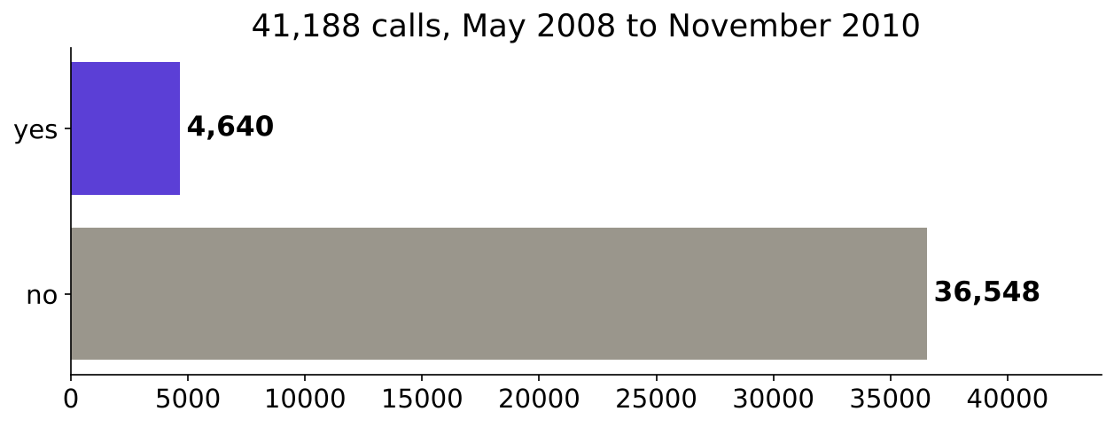
WEEK 5 · MONDAY · REGRESSION AND CLASSIFICATION
41,188 calls; one in nine said yes
A Portuguese bank's term-deposit campaigns, 2008 to 2010.
41,188 calls: 36,548 no and 4,640 yes
…
Which slice, and when?
Which line is best?
What does 0.73 mean?
What did the fit miss?
Who is worth a call?
Does it beat nothing?
What did the peek buy?
S35 · 42 / 62
Notes:
LIVE, 4 minutes. Prediction first: what share said yes? Options half, a quarter, one in nine, one
in thirty. Answer 4,640 of 41,188, 0.1127. Source: UCI Bank Marketing, Moro, Rita and Cortez,
CC BY 4.0, archive.ics.uci.edu/dataset/222/bank+marketing (verified 28 October 2026). Click:
case01, the count cell. Transition: the same question at Kalpa.

Slide 43
WEEK 5 · MONDAY · REGRESSION AND CLASSIFICATION
The bank and Kalpa ask the same question
Different action, same shape.
 | The bank | Kalpa Retail
Action | an agent's call | a Rs 40 nudge
Target | y, known when the call ends | repeat within 90 days
Input | client table, morning of the call | customer table, day of the nudge
Decision | whom to call first | whom to nudge
…
Which slice, and when?
Which line is best?
What does 0.73 mean?
What did the fit miss?
Who is worth a call?
Does it beat nothing?
What did the peek buy?
S36 · 43 / 62
Notes:
LIVE, 3 minutes. The three tests of chapter 1 pass for both: input now, target later, a list
that changes with the score. Transition: which columns are allowed.

Slide 44
WEEK 5 · MONDAY · REGRESSION AND CLASSIFICATION
13 columns known on the morning of the call
Seven about the client, six about campaigns so far.
Group | Columns | Today
profile | age, job, marital, education, default, housing, loan | used
history | contact, month, day_of_week, campaign, previous, poutcome | used
other feeds | seven more columns | Wednesday audits them
target | y | predicted
…
Which slice, and when?
Which line is best?
What does 0.73 mean?
What did the fit miss?
Who is worth a call?
Does it beat nothing?
What did the peek buy?
S37 · 44 / 62
Notes:
LIVE, 4 minutes. Do not explain the seven other columns today; if asked, point at the timeline and
say Wednesday asks the prediction-time question of each one. Click: case01, the groups cell, two
PASS lines. Transition: the split.

Slide 45
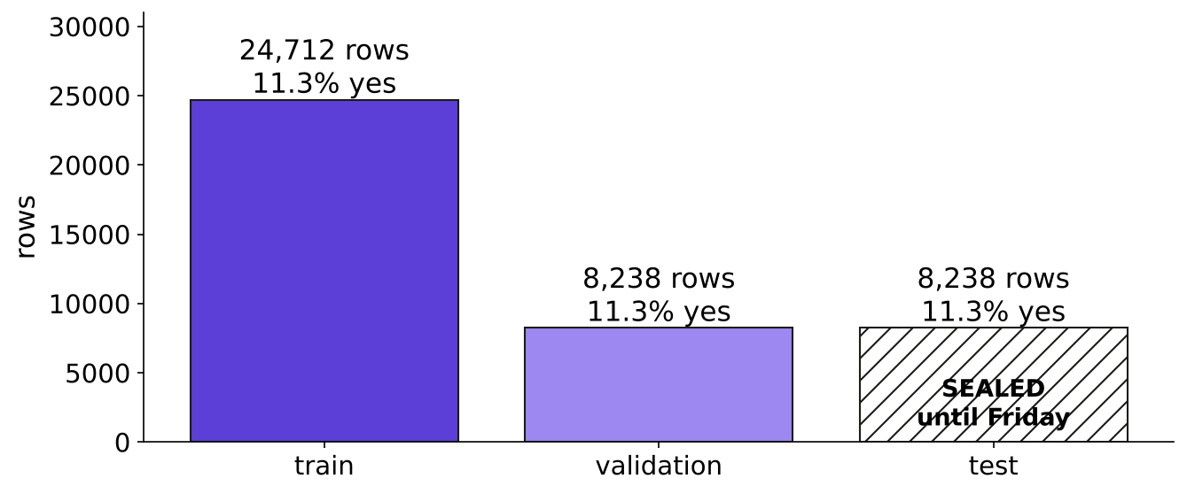
WEEK 5 · MONDAY · REGRESSION AND CLASSIFICATION
The week's split, test sealed first
Seed 42, stratified: 11.3 percent yes in every slice.
Train 24,712, validation 8,238, test 8,238 sealed
…
Which slice, and when?
Which line is best?
What does 0.73 mean?
What did the fit miss?
Who is worth a call?
Does it beat nothing?
What did the peek buy?
S38 · 45 / 62
Notes:
LIVE, 4 minutes. Test is cut first, 20 percent, and sealed. The rest splits 75 to 25. Show the
trap from case01: five unseeded splits give held-out yes shares between about 0.114 and 0.119, so
two teammates quote baselines on different rows. Transition: the envelope.

Slide 46



WEEK 5 · MONDAY · REGRESSION AND CLASSIFICATION
The envelope stays sealed until Friday
TEST SET. DO NOT OPEN UNTIL FRIDAY.
MONDAY
TUESDAY TO THURSDAY
FRIDAY
Sealed
Every peek points here
Opened once
8,238 rows nobody scores a model on this week.
Choices are made on validation, as often as needed.
The chosen model is scored once; that number goes in the memo.
…
Which slice, and when?
Which line is best?
What does 0.73 mean?
What did the fit miss?
Who is worth a call?
Does it beat nothing?
What did the peek buy?
S39 · 46 / 62
Notes:
LIVE, 2 minutes. Point at the card taped to the wall since the start of the day. Line to land: the
test set is spent once. Every time someone asks "can we just check it on test?" this week, point at
the envelope. Transition: the guided notebook.

Slide 47
WEEK 5 · MONDAY · REGRESSION AND CLASSIFICATION
Guided: frame it, split it, score the baseline
Five TODO cells, built together; the answer sits last.
STEP 1
STEP 2
STEP 3
STEP 4
STEP 5
Frame
Columns
Target
Split
Baseline
input, target, prediction time
the 13 known that morning
y as 0 and 1
seed 42, test sealed
accuracy on validation
…
Which slice, and when?
Which line is best?
What does 0.73 mean?
What did the fit miss?
Who is worth a call?
Does it beat nothing?
What did the peek buy?
S40 · 47 / 62
Notes:
LIVE, 20 minutes. Notebook guided_frame_and_split. Trainer types, room mirrors. The progress cell
prints TODO until each step is filled, then PASS. Expected: 4,640 ones; 24,712 / 8,238 / 8,238;
baseline 0.8874. Do not open the answer cell until every pair has tried step 5. Transition: case 2.

Slide 48
PG DIPLOMA IN AI-ML AND AGENTIC AI ENGINEERING · COHORT 2
08
Beat the dumbest model
Does it beat nothing?
Case chapter. Applies: Train, validation, test; the seed; the baseline; Logistic regression: probability, direction, strength
Does it need a model?
What may the model read?
Which slice, and when?
Which line is best?
What does 0.73 mean?
What did the fit miss?
Who is worth a call?
Does it beat nothing?
What did the peek buy?
Week 5 Monday: regression and classification
48 / 62
Notes:
LIVE, 25 minutes. Notebook case02. Transition: the baseline.

Slide 49
WEEK 5 · MONDAY · REGRESSION AND CLASSIFICATION
What does calling nobody score?
Commit: 0.50, 0.75, 0.887 or 1.00?
0.50
0.75
0.887
1.00
OPTION A
OPTION B
OPTION C
OPTION D
a coin flip
the toy table's number
one minus the share of yes
never wrong
…
Which slice, and when?
Which line is best?
What does 0.73 mean?
What did the fit miss?
Who is worth a call?
Does it beat nothing?
What did the peek buy?
S41 · 49 / 62
Notes:
LIVE, 1 minute. Pairs commit. Transition: the answer.

Slide 50
WEEK 5 · MONDAY · REGRESSION AND CLASSIFICATION
Answer: 0.8874, right 7,310 times in 8,238
The bar every model this week has to clear.
0.8874
0.8971
+80
CALL NOBODY
LOGISTIC MODEL
THE EDGE
7,310 right of 8,238
7,390 right of 8,238
under one point of accuracy
…
Which slice, and when?
Which line is best?
What does 0.73 mean?
What did the fit miss?
Who is worth a call?
Does it beat nothing?
What did the peek buy?
S42 · 50 / 62
Notes:
LIVE, 4 minutes. By hand (share of no) and by DummyClassifier: the same 0.8874, a PASS line. The
logistic model on the 13 columns: 0.8971. Line to land: one point above doing nothing. Click:
case02, cells 5 and 7. Transition: the picture.

Slide 51
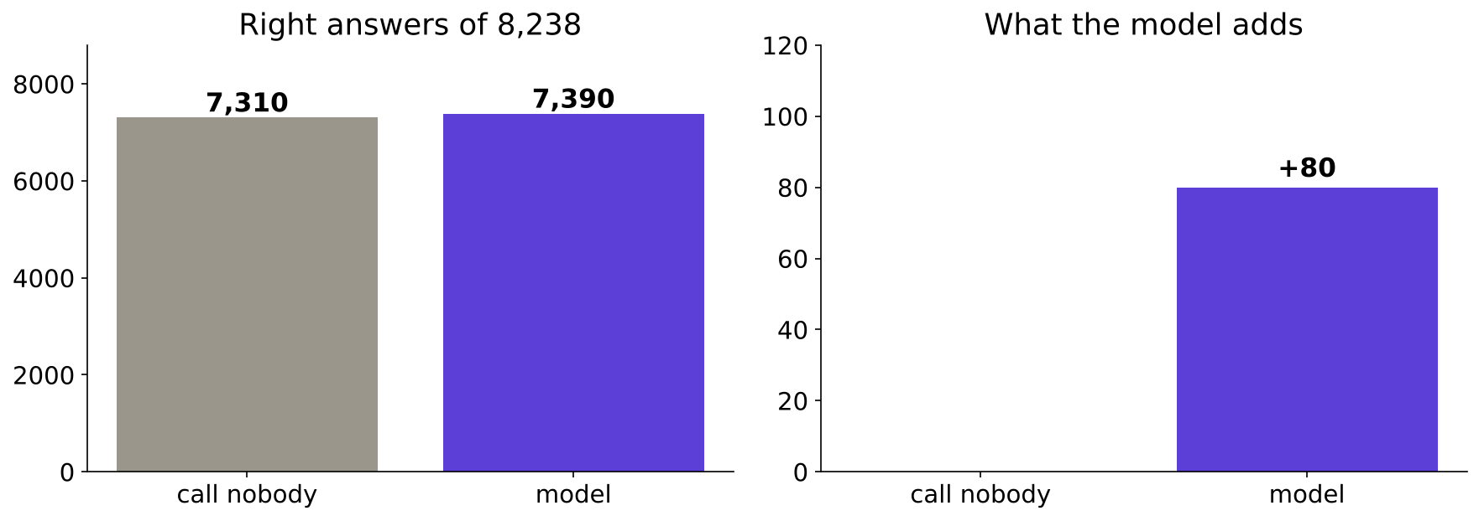
WEEK 5 · MONDAY · REGRESSION AND CLASSIFICATION
80 more right answers, drawn honestly
Side by side they look the same; the gap is what the model adds.
Baseline and model right answers, and the 80-answer gap
…
Which slice, and when?
Which line is best?
What does 0.73 mean?
What did the fit miss?
Who is worth a call?
Does it beat nothing?
What did the peek buy?
S43 · 51 / 62
Notes:
LIVE, 3 minutes. Left: full height, identical-looking bars. Right: only the gap. Tuesday asks how
many of the 928 clients who said yes this model put on the call list; do not answer it today.
Kahoot Q4 and the return question set it up. Transition: what the model outputs.

Slide 52
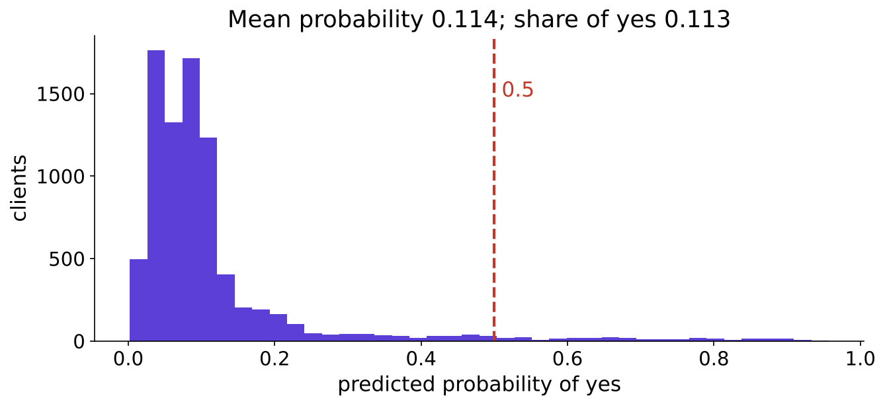
WEEK 5 · MONDAY · REGRESSION AND CLASSIFICATION
Probabilities centred on the base rate
Mean 0.114 against a share of yes of 0.113.
Histogram of predicted probabilities of yes
…
Which slice, and when?
Which line is best?
What does 0.73 mean?
What did the fit miss?
Who is worth a call?
Does it beat nothing?
What did the peek buy?
S44 · 52 / 62
Notes:
LIVE, 3 minutes. Most clients score low, a few high. The 0.5 line is where today's accuracy reads
the probability as yes; Tuesday moves that line. Transition: one coefficient.

Slide 53
WEEK 5 · MONDAY · REGRESSION AND CLASSIFICATION
One coefficient for the campaign manager
campaign: calls already made to this client this campaign.
x 0.93
negative
0.9334
ODDS PER EXTRA CALL
DIRECTION
MEASURED
about 7 percent lower
more calls, fewer yeses
on all 8,238 clients, a second route
For Marketing. Calling the same client again and again goes with a falling chance of a yes.
…
Which slice, and when?
Which line is best?
What does 0.73 mean?
What did the fit miss?
Who is worth a call?
Does it beat nothing?
What did the peek buy?
S45 · 53 / 62
Notes:
LIVE, 5 minutes. Coefficient -0.069 per call after undoing the scaling; exp gives 0.933. Second
route: add one call to every validation client and measure the odds ratio: 0.9334 for every row,
a PASS. Say "association, other columns held"; causation needs an experiment. Interview [F]:
explain one coefficient in the business's words. Transition: the caveat.

Slide 54
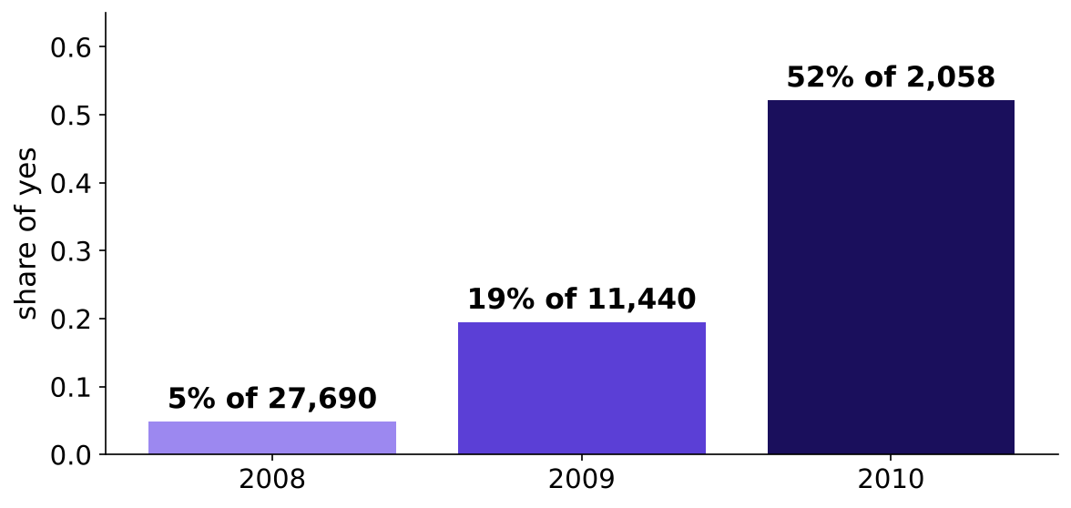
WEEK 5 · MONDAY · REGRESSION AND CLASSIFICATION
The caveat: three very different years
A random split mixes them, so part of the score is the calendar.
Share of yes by year: 5, 19 and 52 percent
…
Which slice, and when?
Which line is best?
What does 0.73 mean?
What did the fit miss?
Who is worth a call?
Does it beat nothing?
What did the peek buy?
S46 · 54 / 62
Notes:
LIVE, 4 minutes. 2008: 4.8 percent yes of 27,690 calls; 2009: 19.5 percent of 11,440; 2010: 52.1
percent of 2,058. The month column is in our 13, so the model partly learns "when". Friday splits
by time and shows what that costs. The trap sentence: "our model is 89.7 percent accurate", true
and misleading. The fix: "under one point above calling nobody, on a random split". Transition:
the peek.

Slide 55
PG DIPLOMA IN AI-ML AND AGENTIC AI ENGINEERING · COHORT 2
09
The peek
What did the peek buy?
Case chapter. Applies: Train, validation, test; the seed; the baseline
Does it need a model?
What may the model read?
Which slice, and when?
Which line is best?
What does 0.73 mean?
What did the fit miss?
Who is worth a call?
Does it beat nothing?
What did the peek buy?
Week 5 Monday: regression and classification
55 / 62
Notes:
LIVE, 15 minutes. Notebook case03. Never cut this chapter (the row says so). Transition: the loop.

Slide 56
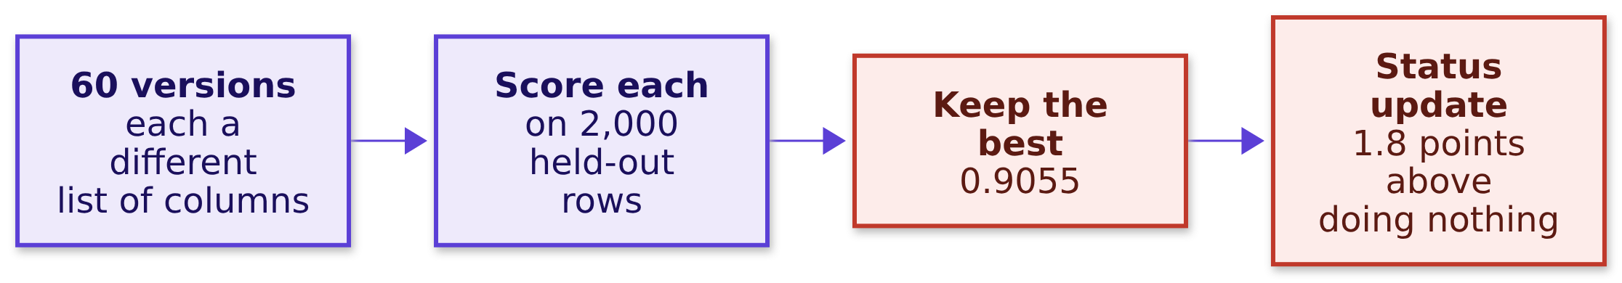
WEEK 5 · MONDAY · REGRESSION AND CLASSIFICATION
The junior's loop: 60 versions, one slice
Keep whichever scores best on the held-out rows.
…
Which slice, and when?
Which line is best?
What does 0.73 mean?
What did the fit miss?
Who is worth a call?
Does it beat nothing?
What did the peek buy?
S47 · 56 / 62
Notes:
LIVE, 3 minutes. The real envelope stays sealed: 2,000 validation rows play the test's part and
the other 6,238 are a fresh slice. Prediction: on fresh rows, the chosen version scores 0.906
again, about 0.897, about 0.887, or 0.80? Transition: the answer.

Slide 57
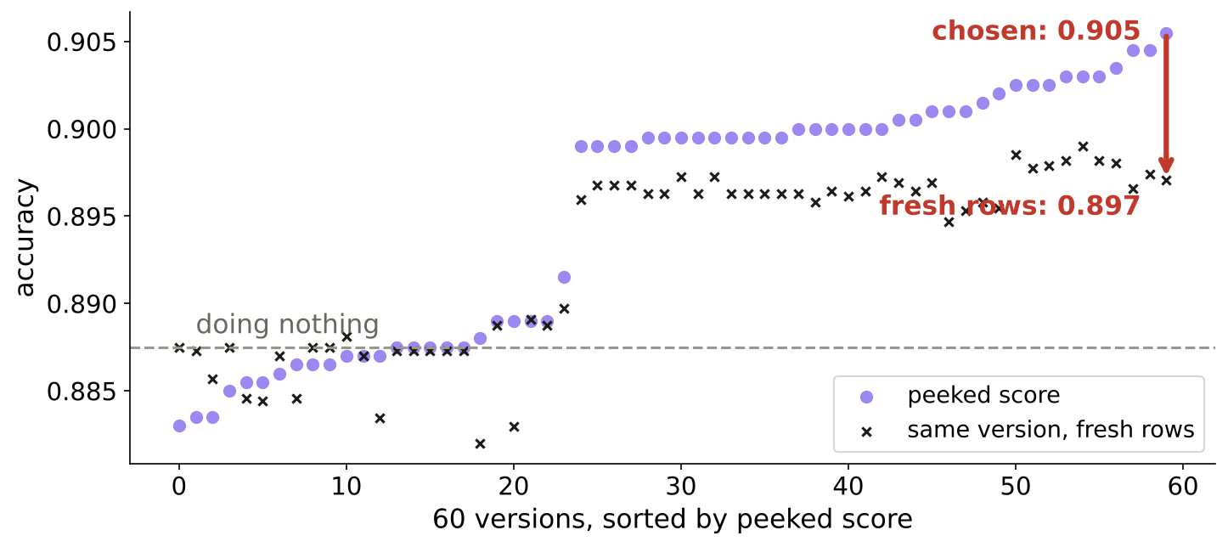
WEEK 5 · MONDAY · REGRESSION AND CLASSIFICATION
Answer: 0.897 on fresh rows, the honest edge
The extra 0.8 points were luck the loop picked.
60 versions: peeked scores against fresh-row scores
…
Which slice, and when?
Which line is best?
What does 0.73 mean?
What did the fit miss?
Who is worth a call?
Does it beat nothing?
What did the peek buy?
S48 · 57 / 62
Notes:
LIVE, 5 minutes. The chosen version: 0.9055 on the peeked slice (doing nothing there 0.8875), 0.8971
on fresh rows (doing nothing 0.8873). Reported edge 1.80 points, real edge 0.98. Line to land: a
test score used to choose anything becomes a validation score. Kahoot Q3 is this slide. Click:
case03, the scatter. Transition: the rule.

Slide 58



WEEK 5 · MONDAY · REGRESSION AND CLASSIFICATION
The test slice is spent once
Choose on validation as often as you like; score the test at the end.
VALIDATION
TEST
PEEKED
Choose here
Score once
Cut a fresh slice
Columns, settings, models: compare as often as needed.
The chosen model, once, with its seed, then report.
A peeked test is validation now; hold out new rows.
…
Which slice, and when?
Which line is best?
What does 0.73 mean?
What did the fit miss?
Who is worth a call?
Does it beat nothing?
What did the peek buy?
S49 · 58 / 62
Notes:
LIVE, 3 minutes. Interview [S]: train, validation, test, what is each for and which is spent once?
The full answer opens on the job of each slice and ends on what to do after a peek. Transition: the
interview corner.

Slide 59
WEEK 5 · MONDAY · REGRESSION AND CLASSIFICATION
Five interview questions from today
The shape of a good answer, never a script.
Tag | Question | A good answer opens on
[S] | When is a business problem an ML problem? | input now, target later, decision moves
[S] | Train, validation, test: which is spent once? | each slice's job, then test
[F] | What does a logistic output of 0.71 mean? | 71 in 100 similar customers
[F] | Why start with a baseline? | a score means nothing without its bar
[D] | Your model ties the baseline by Friday | the clarifying question, then the offer
…
Which slice, and when?
Which line is best?
What does 0.73 mean?
What did the fit miss?
Who is worth a call?
Does it beat nothing?
What did the peek buy?
S50 · 59 / 62
Notes:
LIVE, 5 minutes. Cold-call three people for the 30-second version of one each. The [D] answer
opens with a question: tie on what metric, on which slice? Then: show both numbers, ship the
baseline rule with its cost, ask for time for features, name the next check date. Tags: [S] staple,
[F] frequent in GCC and product screens, [D] differentiator. Transition: the seat.

Slide 60
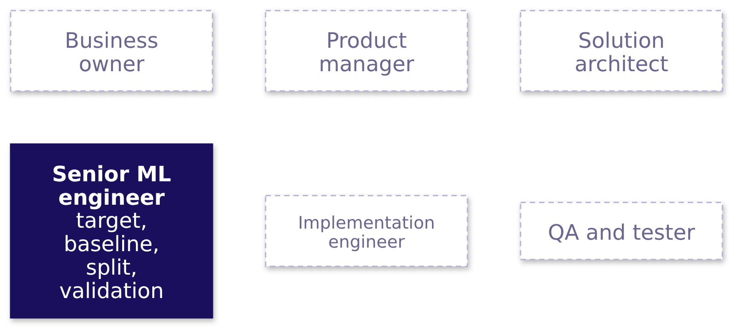
WEEK 5 · MONDAY · REGRESSION AND CLASSIFICATION
Six seats; today the senior ML engineer decides
The target, the baseline, the split, the validation.
…
Which slice, and when?
Which line is best?
What does 0.73 mean?
What did the fit miss?
Who is worth a call?
Does it beat nothing?
What did the peek buy?
S51 · 60 / 62
Notes:
LIVE, 2 minutes. Each day this week lights one seat. Today's questions are the senior ML
engineer's: what exactly is predicted, from what, known when; what is the bar; which rows score
it. Ask: which of today's mistakes would this seat have caught? (the all-time count, the unseeded
split, the peek). Transition: the quiz.

Slide 61
WEEK 5 · MONDAY · REGRESSION AND CLASSIFICATION
Quiz: five questions and one return question
Kahoot, ungraded.
# | What it asks
1 | Prediction, rule or query: five Kalpa questions, fast
2 | Which split tunes, which is spent once
3 | Validation rose after peeking at test: what is now broken
4 | The baseline on a 96 to 4 flag scores what
5 | Rs 240 per unit of recency: finish the sentence for Marketing
R | Week 4 Friday: the vendor curve fit two years perfectly; good forecast?
…
Which slice, and when?
Which line is best?
What does 0.73 mean?
What did the fit miss?
Who is worth a call?
Does it beat nothing?
What did the peek buy?
S52 · 61 / 62
Notes:
LIVE, 8 minutes. Keys in the trainer guide. The return question first, as a warm-up. Q4's 96 to
4 is the row's invented Kalpa flag: the answer is 96 percent. Transition: the close.

Slide 62



WEEK 5 · MONDAY · REGRESSION AND CLASSIFICATION
What you can do now, and what comes next
Tonight: the practice set. Tomorrow: what accuracy hides.
NOW
TONIGHT
TOMORROW
Frame, split, baseline
Practice set
The metric trap
Sort a question, fix a cutoff, seal a test, beat a bar.
Ten problems and eighteen checks, about two and a half hours.
How many of the 928 yeses did the model find?
…
Which slice, and when?
Which line is best?
What does 0.73 mean?
What did the fit miss?
Who is worth a call?
Does it beat nothing?
What did the peek buy?
S53 · 62 / 62
Notes:
LIVE, 5 minutes. The take-home is mandatory; the practice lab with the TAs follows the faculty
block (tentative). Return question for tomorrow: your model only tied the baseline; what do you tell
Marketing? Point at the envelope once more on the way out.

