Slide 1

WEEK 5 · DAY 3
Feature engineering and leakage
“settlement_status is written after delivery, when the payment clears.”
Kalpa's data platform lead, reading the schema the night the score hit 0.99
01
What does a row know?
02
Is Surat twice Pune?
03
Known that morning?
04
Keep, drop or fix?
05
Is it rank or cause?
06
Why did it jump?
07
Known before the call?
08
What does it prove?
Week 5, Day 3. Feature engineering and leakage
1 / 65
Notes:
LIVE, 1 minute. Read the quote and stop. Do not explain it yet; chapter 3 does. Today's whole day
hangs on the gap between a score measured on a table built after the outcome and a model that has
to run before it. Transition: the five topics and the case.

Slide 2

WEEK 5 · WEDNESDAY · WHAT THE MODEL IS ALLOWED TO KNOW
Week 5 sits between the analyst's craft and Build 2
Twenty weeks; today is the middle of the machine learning core
What does a row know?
Is Surat twice Pune?
Known that morning?
Keep, drop or fix?
Is it rank or cause?
Why did it jump?
Known before the call?
S1 · 2 / 65
What does it prove?
Notes:
LIVE, 1 minute. Monday framed the call list and set the baseline of 0.887; Tuesday read the same
model through recall and the Rs 40 against Rs 1,200 bill. Today decides what goes into the model.
Thursday tunes on today's feature set; Build 2 moves the method to Rohan's lending book.

Slide 3
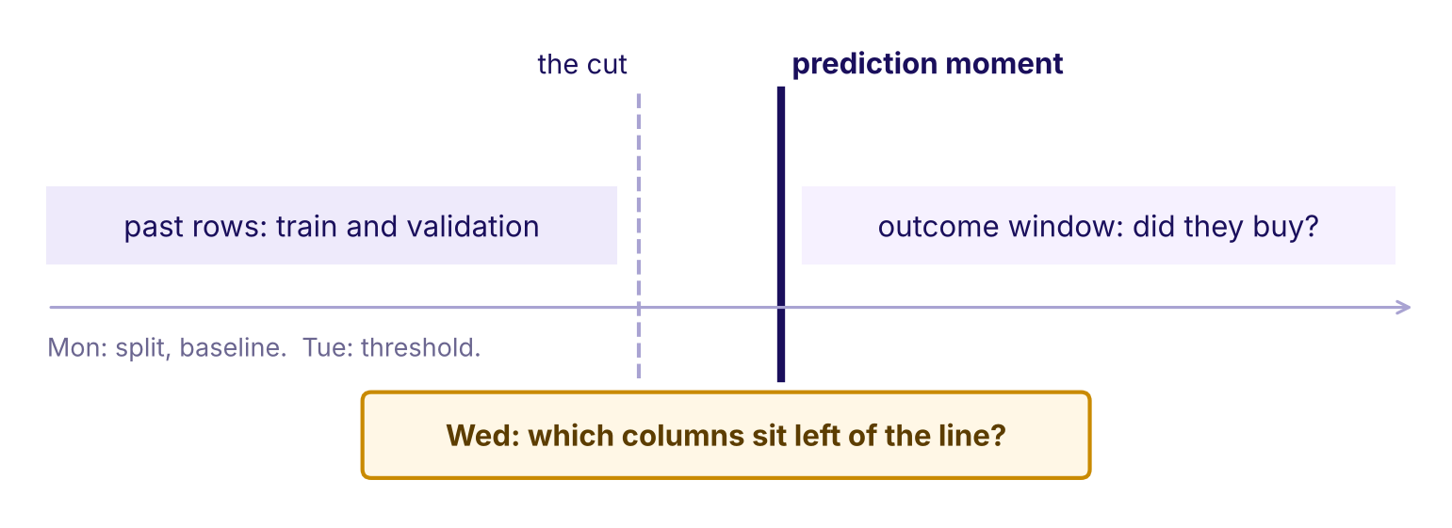
WEEK 5 · WEDNESDAY · WHAT THE MODEL IS ALLOWED TO KNOW
The week's picture, as Tuesday left it
Past rows, the cut, the prediction moment, the outcome window
The week's timeline in Tuesday's state
What does a row know?
Is Surat twice Pune?
Known that morning?
Keep, drop or fix?
Is it rank or cause?
Why did it jump?
Known before the call?
S2 · 3 / 65
What does it prove?
Notes:
LIVE, 1 minute. This is the picture the room redraws every night. Point at the thick line: the
moment the call list is made. Today's question sits in the orange card. Ask the room to keep one
hand on that line all day: every column is either left of it or right of it.

Slide 4
WEEK 5 · WEDNESDAY · WHAT THE MODEL IS ALLOWED TO KNOW
Today's ticket: Kalpa's 0.99 and the bank's jump
The ask, the data and the caveat, on one page
On the ticket | What it says
Kalpa | A junior joins settlement_status from the payments feed; validation hits 0.99; Marketing wants it shipped tonight
The bank | A junior joins the economy feed and the call log to the customer table; AUC jumps from 0.76
The data | UCI Bank Marketing, 41,188 calls, 20 inputs, 11.3 percent yes
The ask | Ship the feature set with a reason per column and the honest score
Who asks | The campaign head and Kavya Nair, Kalpa's senior analyst
The caveat | The rows run May 2008 to November 2010 in date order
What does a row know?
Is Surat twice Pune?
Known that morning?
Keep, drop or fix?
Is it rank or cause?
Why did it jump?
Known before the call?
S3 · 4 / 65
What does it prove?
Notes:
LIVE, 3 minutes. Read the Kalpa row aloud and take a prediction before anything else: what happens
to the 0.99 once the platform lead's remark is taken seriously? Write the room's guesses on the
board; chapter 3 settles them. The bank row is the same file as Monday; the jump is measured in
case 1. Transition: the five topics that get us there.

Slide 5
WEEK 5 · WEDNESDAY · WHAT THE MODEL IS ALLOWED TO KNOW
Five topics in five chapters, then three case chapters
The curriculum's words, the chapter, the minutes and the notebook
# | The topic, in the curriculum's words | Chapter | Minutes | Notebook
1 | Feature engineering from the customer table: ratios, recency, counts, cohort age, basket signals | 1 Turning raw columns into signals | 22 | ch01
2 | Encoding categoricals; scaling numerics; which models care | 2 Teaching a model to read categories | 18 | ch02
3 | Leakage and the prediction-time question | 3 Answers from the future | 20 | ch03
4 | The column audit | 4 Interrogating every column | 15 | ch04
5 | Feature importance and its limits | 5 What the importance chart can't tell you | 15 | ch05
Cases 6, 7 and 8 apply the topics to the bank's calls in notebooks case01 to case03.
What does a row know?
Is Surat twice Pune?
Known that morning?
Keep, drop or fix?
Is it rank or cause?
Why did it jump?
Known before the call?
S4 · 5 / 65
What does it prove?
Notes:
LIVE, 1 minute. Read the second column once; these are the words to search later. Each concept
chapter teaches on an invented Kalpa table, and each case chapter names the topics it applies.
A 10-minute break follows chapter 3.

Slide 6
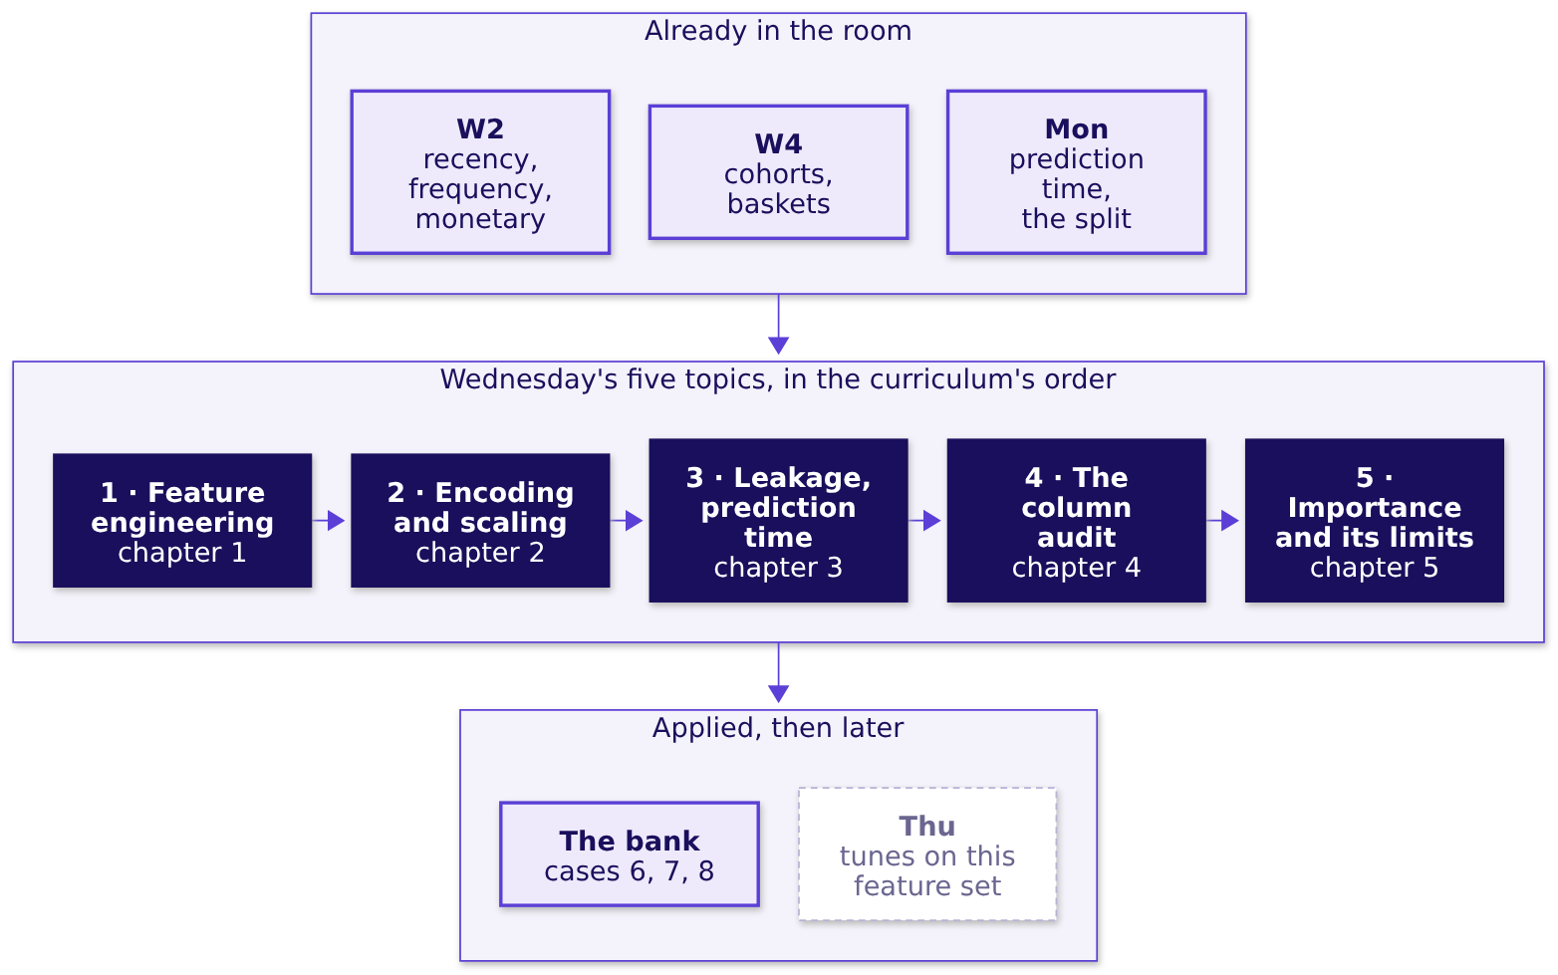
WEEK 5 · WEDNESDAY · WHAT THE MODEL IS ALLOWED TO KNOW
Five topics, joined to what came before and after
What each one rests on and where it is applied
What does a row know?
Is Surat twice Pune?
Known that morning?
Keep, drop or fix?
Is it rank or cause?
Why did it jump?
Known before the call?
S5 · 6 / 65
What does it prove?
Notes:
LIVE, 1 minute. Week 2 gave recency, frequency and monetary; Week 4 gave cohorts and baskets;
Monday gave prediction time. Today turns them into features, checks each against the clock, and
reads what the model does with them.

Slide 7
01
Turning raw columns into signals
What does a row know?
Feature engineering from the customer table: ratios, recency, counts, cohort age, basket signals · also searched as: feature engineering for machine learning, RFM features
What does a row know?
Is Surat twice Pune?
Known that morning?
Keep, drop or fix?
Is it rank or cause?
Why did it jump?
Known before the call?
What does it prove?
Week 5 Wednesday: what the model is allowed to know
7 / 65
Notes:
LIVE, 30 seconds. Chapter 1, 22 minutes, notebook ch01. Eight invented Kalpa members. Laptops
stay shut until slide S8.

Slide 8
WEEK 5 · WEDNESDAY · WHAT THE MODEL IS ALLOWED TO KNOW
Which member would total spend nudge first?
Eight invented Kalpa members on the nudge morning, 1 November 2026
Member | First order | Last order | Orders | Spend, Rs
Asha | Nov 2024 | 29 Oct 2026 | 24 | 16,800
Bilal | Aug 2026 | 25 Oct 2026 | 6 | 4,200
Chitra | May 2023 | 14 Mar 2026 | 30 | 19,500
Dev | Oct 2026 | 30 Oct 2026 | 3 | 2,400
Hari | Feb 2022 | 24 Dec 2025 | 40 | 26,000
(a) Asha (b) Hari (c) Dev
What does a row know?
Is Surat twice Pune?
Known that morning?
Keep, drop or fix?
Is it rank or cause?
Why did it jump?
Known before the call?
S6 · 8 / 65
What does it prove?
Notes:
LIVE, 2 minutes. The table is invented. Ask for a letter, then ask the follow-up: is the top
spender the member most likely to buy in the next ninety days? Three other members (Esha, Farid,
Gauri) are in the notebook.

Slide 9
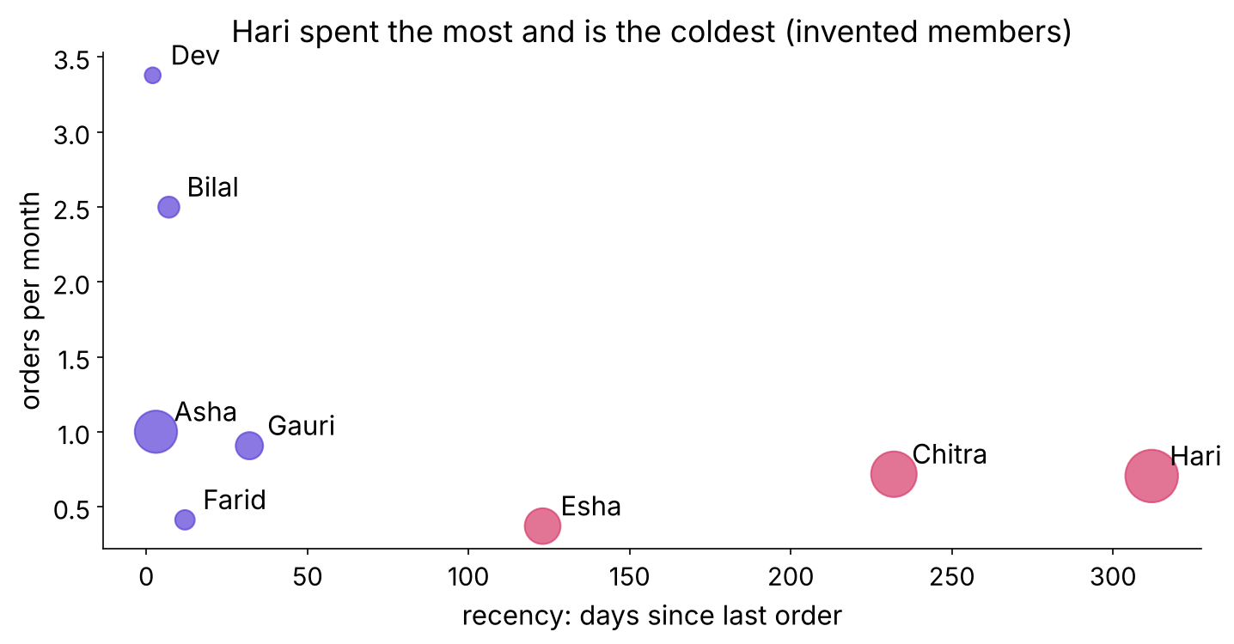
WEEK 5 · WEDNESDAY · WHAT THE MODEL IS ALLOWED TO KNOW
Answer: b, Hari, the coldest member on the table
Total spend grows with time, so it ranks the oldest first
Recency against orders per month, bubble size is spend
What does a row know?
Is Surat twice Pune?
Known that morning?
Keep, drop or fix?
Is it rank or cause?
Why did it jump?
Known before the call?
S7 · 9 / 65
What does it prove?
Notes:
LIVE, 3 minutes. Hari's bubble is the biggest and sits far right: ten months since the last
order. A Rs 40 nudge to Hari reaches the member least likely to answer. Land: a raw total answers
"who spent most", and Marketing asked "who buys next".

Slide 10
WEEK 5 · WEDNESDAY · WHAT THE MODEL IS ALLOWED TO KNOW
Five signals, each with a reason Marketing can repeat
Measured from the nudge morning, never from today
Signal | Formula | The reason
Recency | nudge morning - last order, in days | warm buys again
Count | orders in the last 90 days | habit
Cohort age | nudge morning - first order | new members are still deciding
Ratio | orders / months as a member; spend / orders | puts old and new on one scale
Basket signal | items / orders | weekly shop against top-up
What does a row know?
Is Surat twice Pune?
Known that morning?
Keep, drop or fix?
Is it rank or cause?
Why did it jump?
Known before the call?
S8 · 10 / 65
What does it prove?
Notes:
LIVE, 5 minutes. Count one by hand: Asha's average basket is Rs 16,800 over 24 orders, Rs 700.
Dev's recency is 2 days. Ask: which of these would you have to recompute every morning? (Recency
and cohort age.) Land: every feature is a sentence the business would say. Run notebook ch01 to
cell 4: one line of pandas per signal, measured from NUDGE, never from today.

Slide 11
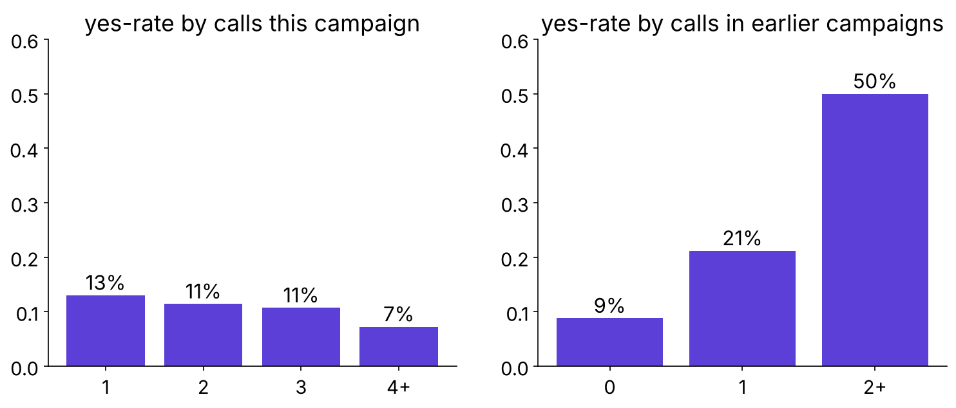
WEEK 5 · WEDNESDAY · WHAT THE MODEL IS ALLOWED TO KNOW
The bank's file already holds counts and a recency
campaign, previous, pdays and poutcome are the same five ideas
Yes-rate by calls this campaign and by earlier calls
What does a row know?
Is Surat twice Pune?
Known that morning?
Keep, drop or fix?
Is it rank or cause?
Why did it jump?
Known before the call?
S9 · 11 / 65
What does it prove?
Notes:
LIVE, 4 minutes. Predict first: does ringing a client more often this campaign raise the yes-rate?
It falls from 13 percent at one call to 7 percent at four or more. Earlier contact helps sharply.
pdays holds 999 for 96.3 percent of rows; case 2 splits it.

Slide 12
WEEK 5 · WEDNESDAY · WHAT THE MODEL IS ALLOWED TO KNOW
Four rules for features, each with its flip
A rule without the condition that flips it is a slogan
Rule | Flips when
Measure from the prediction moment | never; computed from today it leaks
A ratio beats a total | everyone joined in the same window
Count over a fixed window | the decision is a loyalty tier, which wants lifetime
Every feature carries a reason | a fair test shows signal the reasons missed
What does a row know?
Is Surat twice Pune?
Known that morning?
Keep, drop or fix?
Is it rank or cause?
Why did it jump?
Known before the call?
S10 · 12 / 65
What does it prove?
Notes:
LIVE, 3 minutes. Read each rule with its flip. Interview line: "Engineer features from a customer
table and justify each." The answer names the prediction moment first. Transition: chapter 2.

Slide 13
02
Teaching a model to read categories
Is Surat twice Pune?
Encoding categoricals; scaling numerics; which models care · also searched as: one-hot encoding, standard scaling, label encoding
What does a row know?
Is Surat twice Pune?
Known that morning?
Keep, drop or fix?
Is it rank or cause?
Why did it jump?
Known before the call?
What does it prove?
Week 5 Wednesday: what the model is allowed to know
13 / 65
Notes:
LIVE, 30 seconds. Chapter 2, 18 minutes, notebook ch02. Six invented members.

Slide 14
WEEK 5 · WEDNESDAY · WHAT THE MODEL IS ALLOWED TO KNOW
Pune is 1, Surat 2, Indore 3: what does a line read?
A logistic model multiplies the code by one weight
Member | City | city_code | city_Pune | city_Surat | city_Indore
A | Pune | 1 | 1 | 0 | 0
B | Surat | 2 | 0 | 1 | 0
C | Indore | 3 | 0 | 0 | 1
(a) nothing about the cities (b) Indore is as far from Surat as Surat from Pune
What does a row know?
Is Surat twice Pune?
Known that morning?
Keep, drop or fix?
Is it rank or cause?
Why did it jump?
Known before the call?
S11 · 14 / 65
What does it prove?
Notes:
LIVE, 2 minutes. Take letters. Then ask who chose that order: nobody did, the alphabet or the
order of signups did.

Slide 15
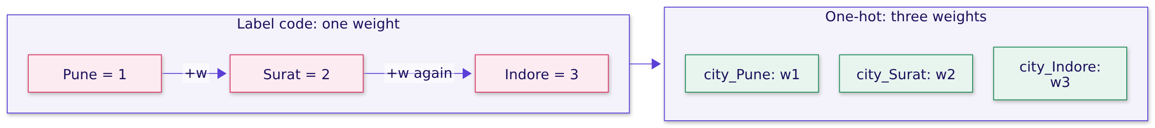
WEEK 5 · WEDNESDAY · WHAT THE MODEL IS ALLOWED TO KNOW
Answer: b, an order and a distance nobody chose
One-hot gives each city its own switch and its own weight
What does a row know?
Is Surat twice Pune?
Known that morning?
Keep, drop or fix?
Is it rank or cause?
Why did it jump?
Known before the call?
S12 · 15 / 65
What does it prove?
Notes:
LIVE, 2 minutes. A tree splits on city_code <= 1.5 and <= 2.5, so the made-up order costs it
little. A linear model reads it as a straight line through the cities. Land: encoding is a model
decision, never a ritual.

Slide 16
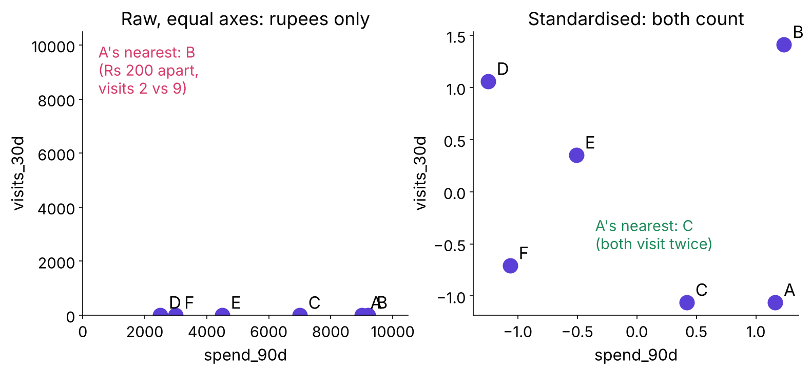
WEEK 5 · WEDNESDAY · WHAT THE MODEL IS ALLOWED TO KNOW
Rupees drown visits in a distance
A to B by hand: square root of 200 squared plus 7 squared, about 200
Raw against standardised, A's nearest neighbour changes
Airbnb's first search network stalled until its features were standardised.
What does a row know?
Is Surat twice Pune?
Known that morning?
Keep, drop or fix?
Is it rank or cause?
Why did it jump?
Known before the call?
S13 · 16 / 65
What does it prove?
Notes:
LIVE, 5 minutes. Airbnb's search team fed their first neural network the tree model's raw features
and the loss stopped improving midway; normalising fixed it (Haldar and others, arXiv 1810.09591,
facts in the sources file). Predict first: after standardising, is A's nearest neighbour still B? It becomes
C, who also visits twice. The formula is named last: z = (value - mean) / standard deviation, with
the mean and spread learned on training rows only.

Slide 17
WEEK 5 · WEDNESDAY · WHAT THE MODEL IS ALLOWED TO KNOW
Which models care, and which shrug
The cut-first table if the room runs late
Model family | Category | Number | Why
Logistic, linear | one-hot | standardise | one weight per column; the penalty reads scale
Nearest neighbours, clustering | one-hot | standardise, decisive | distance adds raw gaps
Tree, forest, boosting | one-hot or an ordinal code | no need | thresholds ignore units
What does a row know?
Is Surat twice Pune?
Known that morning?
Keep, drop or fix?
Is it rank or cause?
Why did it jump?
Known before the call?
S14 · 17 / 65
What does it prove?
Notes:
LIVE, 3 minutes. Kahoot Q4 comes from this table: which family shrugs at unscaled features? A
forty-value city is still one-hot for a logistic model; replacing a city with its average outcome
comes later, because it can carry the target in.

Slide 18
WEEK 5 · WEDNESDAY · WHAT THE MODEL IS ALLOWED TO KNOW
Drill: match the encoder to the column
Three column types, fifteen seconds each
Column | Options
city, 40 values, logistic model | (a) one-hot (b) code 1 to 40 (c) drop it
education, ordered levels, tree | (a) an ordinal code (b) a random code (c) text
default, yes, no or unknown | (a) one-hot with unknown kept (b) unknown as no (c) drop rows
What does a row know?
Is Surat twice Pune?
Known that morning?
Keep, drop or fix?
Is it rank or cause?
Why did it jump?
Known before the call?
S15 · 18 / 65
What does it prove?
Notes:
LIVE, 3 minutes, the mid-session drill. Letters in the chat, then the answer slide.

Slide 19
WEEK 5 · WEDNESDAY · WHAT THE MODEL IS ALLOWED TO KNOW
Answer: a, a, a, and each one has a flip
The flip is what an interviewer asks next
Column | Answer | Flips when
city, 40 values | one-hot | a tree model, or rare cities grouped into "other"
education, ordered | ordinal code for a tree | a logistic model, which wants one-hot
default with unknown | keep unknown as a category | the business confirms unknown is noise
What does a row know?
Is Surat twice Pune?
Known that morning?
Keep, drop or fix?
Is it rank or cause?
Why did it jump?
Known before the call?
S16 · 19 / 65
What does it prove?
Notes:
LIVE, 2 minutes. In the bank's file default has 3 yes rows and 8,597 unknown: the unknown level
carries the signal. Transition: chapter 3, the question that catches the 0.99.

Slide 20
03
Answers from the future
Known that morning?
Leakage and the prediction-time question · also searched as: data leakage in machine learning, target leakage, train test contamination
What does a row know?
Is Surat twice Pune?
Known that morning?
Keep, drop or fix?
Is it rank or cause?
Why did it jump?
Known before the call?
What does it prove?
Week 5 Wednesday: what the model is allowed to know
20 / 65
Notes:
LIVE, 30 seconds. Chapter 3, 20 minutes, notebook ch03, then the explorable. Twelve invented
members.

Slide 21
WEEK 5 · WEDNESDAY · WHAT THE MODEL IS ALLOWED TO KNOW
Settled scores 12 of 12: what on the nudge morning?
Twelve invented members; the rule says bought if settled
Rule | Right, of 12, on the training table
bought if settlement_status is settled | 12
bought if orders_90d >= 2 | 10
predict nobody buys | 6
On the nudge morning the settlement rule scores (a) 12 (b) 10 (c) 6
What does a row know?
Is Surat twice Pune?
Known that morning?
Keep, drop or fix?
Is it rank or cause?
Why did it jump?
Known before the call?
S17 · 21 / 65
What does it prove?
Notes:
LIVE, 3 minutes. This answers the S3 prediction. Take letters. Hint only if stuck: on the nudge
morning, has anyone paid yet for an order in the next ninety days?

Slide 22
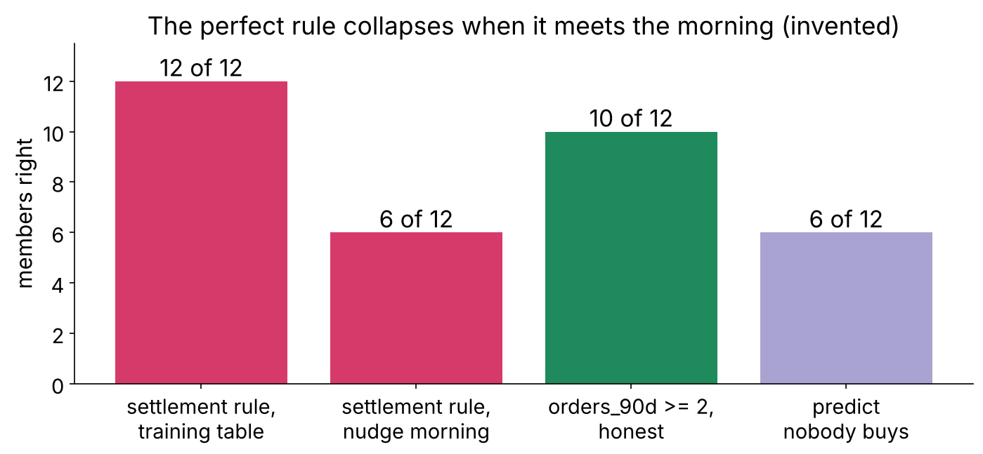
WEEK 5 · WEDNESDAY · WHAT THE MODEL IS ALLOWED TO KNOW
Answer: c, 6 of 12, the score of predicting nobody
No payment from the coming 90 days exists that morning
The perfect rule collapses when it meets the morning
What does a row know?
Is Surat twice Pune?
Known that morning?
Keep, drop or fix?
Is it rank or cause?
Why did it jump?
Known before the call?
S18 · 22 / 65
What does it prove?
Notes:
LIVE, 3 minutes. The column reads none for everyone on the nudge morning, so the rule says nobody
buys. Land: the 0.99 was measured on a table built after the outcome; the model meets a table
built before it.

Slide 23
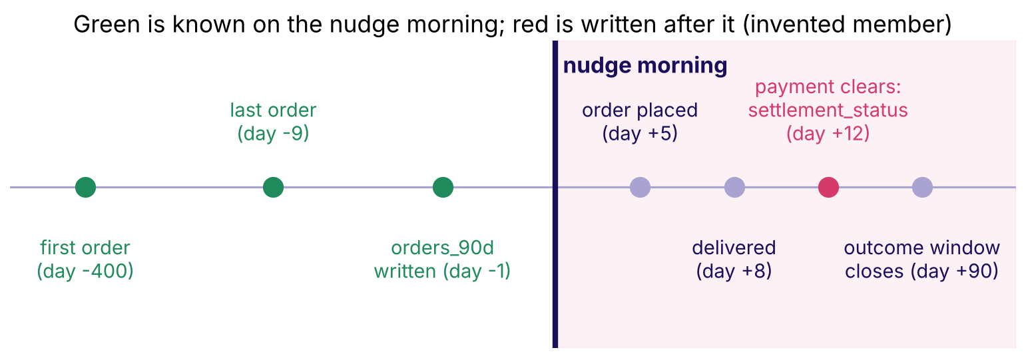
WEEK 5 · WEDNESDAY · WHAT THE MODEL IS ALLOWED TO KNOW
One member's timeline: green known, red written after
The nudge morning is the prediction moment
One invented member's timeline with settlement in red
What does a row know?
Is Surat twice Pune?
Known that morning?
Keep, drop or fix?
Is it rank or cause?
Why did it jump?
Known before the call?
S19 · 23 / 65
What does it prove?
Notes:
LIVE, 3 minutes. Draw this on the board first, then show it. Each column is pinned at the moment
it is written. Settlement sits right of the line: the payments team writes the answer in its own
words.

Slide 24
WEEK 5 · WEDNESDAY · WHAT THE MODEL IS ALLOWED TO KNOW
The prediction-time question
Asked of every column, with the system that writes it
"On the morning the model is used, do we know this value for this customer?"
The prediction-time question, asked of every column
Two more routes for the future | The fix
an encoder or scaler fitted on all rows | fit inside the pipeline, on training rows
rows from after the moment inside training | split by the moment; Friday does it by time
What does a row know?
Is Surat twice Pune?
Known that morning?
Keep, drop or fix?
Is it rank or cause?
Why did it jump?
Known before the call?
S20 · 24 / 65
What does it prove?
Notes:
LIVE, 2 minutes. Read the question aloud twice; Kahoot Q1 asks for it from memory, and tonight's
recap asks for it verbatim. Leakage is any input unavailable at prediction time, however innocent
it looks.

Slide 25
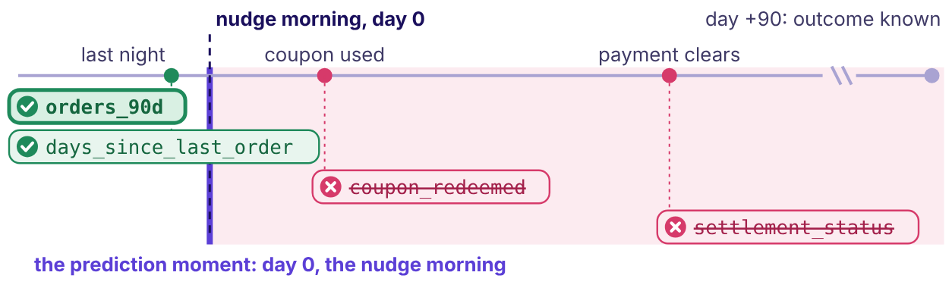
WEEK 5 · WEDNESDAY · WHAT THE MODEL IS ALLOWED TO KNOW
The explorable: slide the prediction moment
Open the explorer at #p3: every column pinned at the day it is written
The explorer's page 3 at the nudge morning: the two columns written after it turn red and leave
What does a row know?
Is Surat twice Pune?
Known that morning?
Keep, drop or fix?
Is it rank or cause?
Why did it jump?
Known before the call?
S21 · 25 / 65
What does it prove?
Notes:
LIVE, 4 minutes. Open demos/C2_W05_D03_leakage_timeline_explorer_STUDENT.html at #p3 and press P
for presenter mode. The room has S18's answer, so commit it on the prediction card first. Press
play: the training table gives the settlement rule 12 of 12, the nudge morning blanks the column,
and the rule falls to 6 of 12. Then drag the prediction moment from day +13 to day 0:
coupon_redeemed and settlement_status turn red and leave, and the rule becomes orders_90d of 2 or
more, 10 of 12 on both tables. Land the day's line: the score fell and the model got better. Drag
on to day -2 for the flip: before last night's columns are written, the model knows nothing.

Slide 26
WEEK 5 · WEDNESDAY · WHAT THE MODEL IS ALLOWED TO KNOW
Four rules for leakage, each with its flip
"Too good" starts the question; it is never the verdict
Rule | Flips when
Drop a column written after the prediction moment | never, whatever it scores
Suspect a jump from one new column | a known, legitimate new source explains it
A strong column known in time stays | never; strength alone is no evidence of a leak
Ship the honest score, which is lower | never ship a model that cannot run that morning
Kaggle, 2011: the winners rebuilt the test answers from a public crawl and scored AUC 0.981.
What does a row know?
Is Surat twice Pune?
Known that morning?
Keep, drop or fix?
Is it rank or cause?
Why did it jump?
Known before the call?
S22 · 26 / 65
What does it prove?
Notes:
LIVE, 3 minutes. Narayanan, Shi and Rubinstein de-anonymised the challenge's test set with their own
Flickr crawl (arXiv 1102.4374): the question that would have caught it is where each input comes
from at prediction time. Interview anchor [S]: what is data leakage, and how do you catch it before it
ships? 10-minute break after this slide.

Slide 27
04
Interrogating every column
Keep, drop or fix?
The column audit · also searched as: feature audit, leakage checklist, point-in-time correct features
What does a row know?
Is Surat twice Pune?
Known that morning?
Keep, drop or fix?
Is it rank or cause?
Why did it jump?
Known before the call?
What does it prove?
Week 5 Wednesday: what the model is allowed to know
27 / 65
Notes:
LIVE, 30 seconds. Chapter 4, 15 minutes, notebook ch04. Nine invented candidate columns.

Slide 28
WEEK 5 · WEDNESDAY · WHAT THE MODEL IS ALLOWED TO KNOW
Five asks of every column, written on one line
A reviewer argues with a line, never with a feeling
Ask | Why
Which system writes it? | the owner knows when it changes
When, in days from the prediction moment? | negative means known in time
Is it overwritten later? | then read it as it stood that morning
What is its business reason? | no reason, no column
Verdict | keep, drop, or fix
What does a row know?
Is Surat twice Pune?
Known that morning?
Keep, drop or fix?
Is it rank or cause?
Why did it jump?
Known before the call?
S23 · 28 / 65
What does it prove?
Notes:
LIVE, 2 minutes. The solution architect's seat: is it there at prediction time? The
implementation engineer's seat: can the scoring service read it the same way every night?

Slide 29
WEEK 5 · WEDNESDAY · WHAT THE MODEL IS ALLOWED TO KNOW
How many of nine candidate columns are dropped?
Invented candidates for Kalpa's nudge model
Column | Written by | Written
days_since_last_order, orders_90d, avg_basket_rs | orders table | last night
city, member_id | signup form | at signup
app_visits_7d | app events | last night
loyalty_tier | loyalty service | nightly, overwritten
coupon_redeemed | checkout | 3 days after the nudge
settlement_status | payments feed | 12 days after
(a) 1 (b) 3 (c) 5
What does a row know?
Is Surat twice Pune?
Known that morning?
Keep, drop or fix?
Is it rank or cause?
Why did it jump?
Known before the call?
S24 · 29 / 65
What does it prove?
Notes:
LIVE, 2 minutes. Take letters with one reason each.

Slide 30
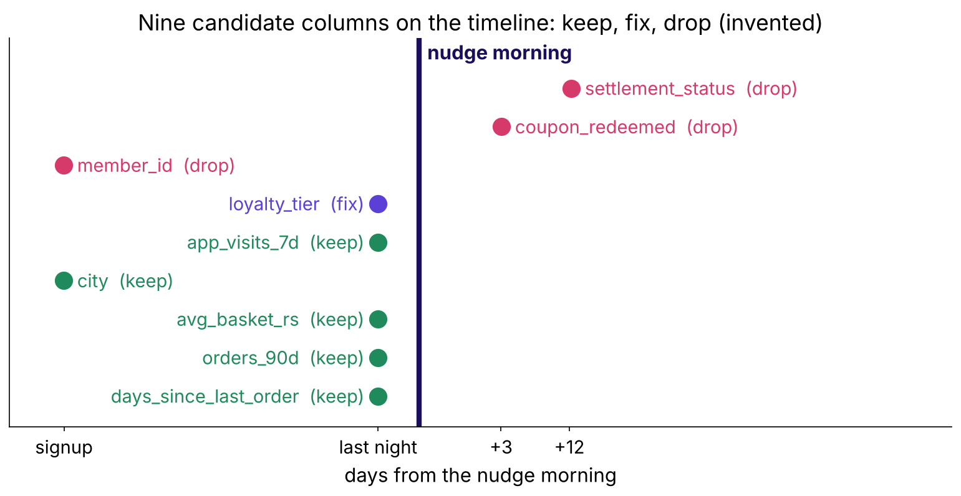
WEEK 5 · WEDNESDAY · WHAT THE MODEL IS ALLOWED TO KNOW
Answer: b, three dropped and one fixed
Two written after the nudge, one with no reason
Nine candidate columns on the timeline
What does a row know?
Is Surat twice Pune?
Known that morning?
Keep, drop or fix?
Is it rank or cause?
Why did it jump?
Known before the call?
S25 · 30 / 65
What does it prove?
Notes:
LIVE, 3 minutes. coupon_redeemed is the outcome itself. member_id is a key; if ids are issued in
signup order it smuggles cohort age, which should be engineered openly. loyalty_tier is kept with
a fix: next slide.

Slide 31
WEEK 5 · WEDNESDAY · WHAT THE MODEL IS ALLOWED TO KNOW
The as-of trap: the purchase wrote today's tier
The warehouse keeps only the latest value
Member | Bought in 90 days | Tier today | Tier on the nudge morning
M04 | no | Silver | Silver
M07 | yes | Gold | Silver
What does a row know?
Is Surat twice Pune?
Known that morning?
Keep, drop or fix?
Is it rank or cause?
Why did it jump?
Known before the call?
S26 · 31 / 65
What does it prove?
Notes:
LIVE, 3 minutes. M07 bought, was upgraded, and today's table says Gold. A model trained on today's
tier learns "Gold buys", which the purchase wrote. Fix: a snapshot, read as of the prediction
morning. The question to the owner: is this field ever overwritten?

Slide 32
WEEK 5 · WEDNESDAY · WHAT THE MODEL IS ALLOWED TO KNOW
Drill: leak or clean, six candidates fast
Kalpa's nudge, predicted on the nudge morning
# | Candidate | Your call
1 | refund_requested in the 90 days after the nudge | leak or clean
2 | orders in the 30 days before the nudge | leak or clean
3 | delivery_rating of the order placed after the nudge | leak or clean
4 | city at signup | leak or clean
5 | loyalty tier read from today's table | leak or clean
6 | app visits in the 7 days before the nudge | leak or clean
What does a row know?
Is Surat twice Pune?
Known that morning?
Keep, drop or fix?
Is it rank or cause?
Why did it jump?
Known before the call?
S27 · 32 / 65
What does it prove?
Notes:
LIVE, 4 minutes, the mid-session drill. Ten seconds each, letters in the chat as L or C.

Slide 33
WEEK 5 · WEDNESDAY · WHAT THE MODEL IS ALLOWED TO KNOW
Answer: leak 1, 3, 5; clean 2, 4, 6
Each leak is written after the morning, or read from a table that was
# | Call | The reason, in one line
1 | leak | written after the outcome window opens
3 | leak | exists only once an order was placed
5 | leak | today's value was overwritten after the purchase
2, 4, 6 | clean | written before the nudge morning
What does a row know?
Is Surat twice Pune?
Known that morning?
Keep, drop or fix?
Is it rank or cause?
Why did it jump?
Known before the call?
S28 · 33 / 65
What does it prove?
Notes:
LIVE, 1 minute. Number 5 is the one most of the room calls clean. Transition: chapter 5.

Slide 34
05
What the importance chart can't tell you
Is it rank or cause?
Feature importance and its limits · also searched as: feature importance, permutation importance, correlation is not causation
What does a row know?
Is Surat twice Pune?
Known that morning?
Keep, drop or fix?
Is it rank or cause?
Why did it jump?
Known before the call?
What does it prove?
Week 5 Wednesday: what the model is allowed to know
34 / 65
Notes:
LIVE, 30 seconds. Chapter 5, 15 minutes, notebook ch05. Twelve invented members, a rule, and a
shuffle done by hand.

Slide 35
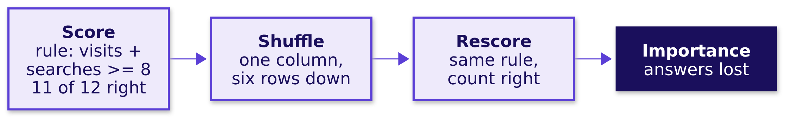
WEEK 5 · WEDNESDAY · WHAT THE MODEL IS ALLOWED TO KNOW
With searches shuffled, how many of 12 stay right?
Visits and searches correlate at 0.94 in this table
(a) about 11 (b) about 7 (c) 0
What does a row know?
Is Surat twice Pune?
Known that morning?
Keep, drop or fix?
Is it rank or cause?
Why did it jump?
Known before the call?
S29 · 35 / 65
What does it prove?
Notes:
LIVE, 4 minutes. The shuffle keeps the column's values and breaks their link to each member; a big
fall means the model leans on that column, nothing more. Take letters, then run the notebook cell.

Slide 36
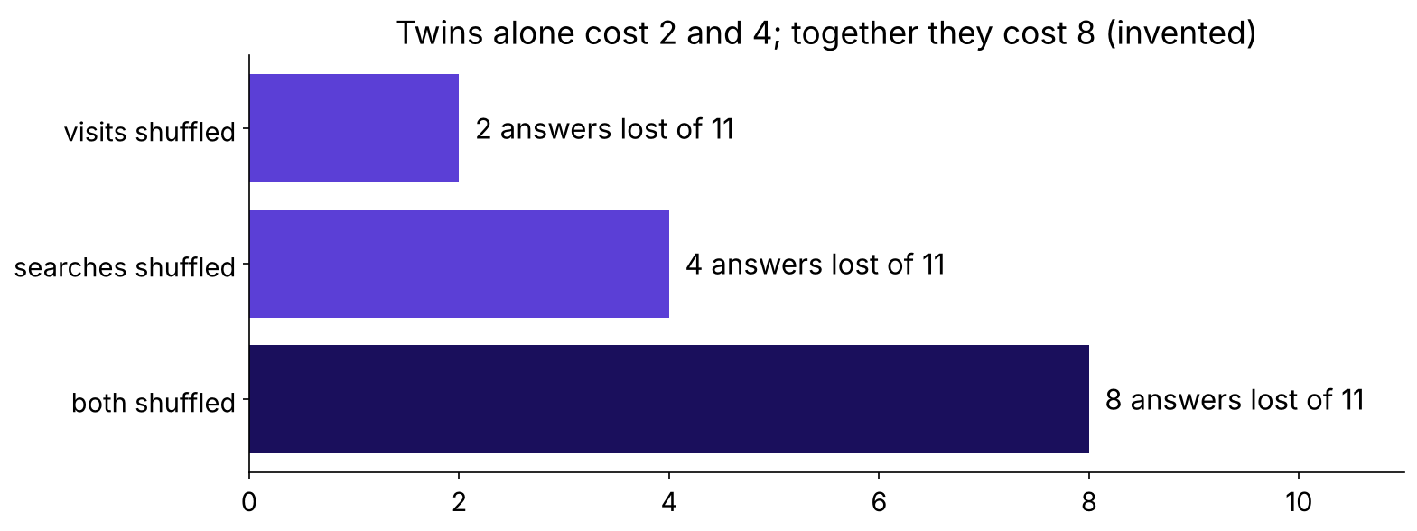
WEEK 5 · WEDNESDAY · WHAT THE MODEL IS ALLOWED TO KNOW
Answer: b, 7; the twins together cost 8
Each twin alone costs little, because the other carries the signal
Answers lost when each twin is shuffled
What does a row know?
Is Surat twice Pune?
Known that morning?
Keep, drop or fix?
Is it rank or cause?
Why did it jump?
Known before the call?
S30 · 36 / 65
What does it prove?
Notes:
LIVE, 3 minutes. Visits alone costs 2, searches alone 4, both together 8, more than 2 + 4. Land:
twins share credit, so shuffle them as a group and read the group.

Slide 37
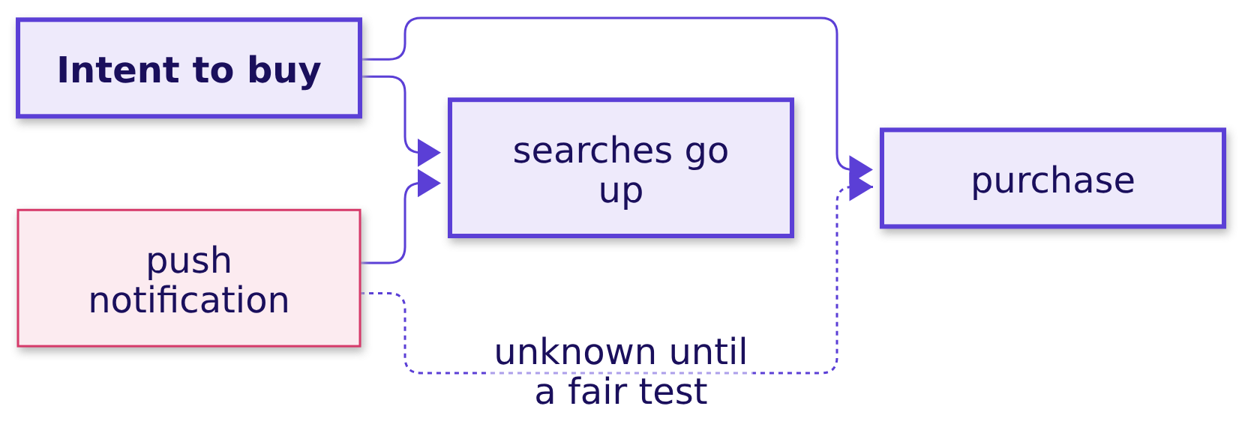
WEEK 5 · WEDNESDAY · WHAT THE MODEL IS ALLOWED TO KNOW
A top bar is a reliance, never a lever
Searches are a symptom of intent
What does a row know?
Is Surat twice Pune?
Known that morning?
Keep, drop or fix?
Is it rank or cause?
Why did it jump?
Known before the call?
S31 · 37 / 65
What does it prove?
Notes:
LIVE, 3 minutes. Marketing proposes pushing searches up. The chart cannot say whether that moves
purchases. Week 1's fair comparison can: push a random half, compare. Interview anchor [F]: what
does a feature importance chart prove, and what does it not?

Slide 38
WEEK 5 · WEDNESDAY · WHAT THE MODEL IS ALLOWED TO KNOW
Four rules for importance, each with its flip
Run the audit before the chart
Rule | Flips when
Importance ranks reliance | the column was changed in a fair test
Shuffle close partners as a group | the column has no twin
Score importance on validation rows | never on training rows
Audit before the chart | never; a leak tops every chart
What does a row know?
Is Surat twice Pune?
Known that morning?
Keep, drop or fix?
Is it rank or cause?
Why did it jump?
Known before the call?
S32 · 38 / 65
What does it prove?
Notes:
LIVE, 2 minutes. Transition: the bank. Everything so far was invented; the case is real.

Slide 39
06
The junior's join
Why did it jump?
Case 1 applies: Feature engineering from the customer table: ratios, recency, counts, cohort age, basket signals · Encoding categoricals; scaling numerics; which models care · notebook case01
What does a row know?
Is Surat twice Pune?
Known that morning?
Keep, drop or fix?
Is it rank or cause?
Why did it jump?
Known before the call?
What does it prove?
Week 5 Wednesday: what the model is allowed to know
39 / 65
Notes:
LIVE, 30 seconds. Case 1, 20 minutes. Every learner runs case01 from the top; the first cell
downloads the bank's file once.

Slide 40
WEEK 5 · WEDNESDAY · WHAT THE MODEL IS ALLOWED TO KNOW
What will the economy and the call log add to 0.76?
Validation AUC of the customer table: 0.761, measured Monday
Option | Economy adds | Call log adds
a | about 0.01 | about 0.01
b | about 0.03 | about 0.14
c | about 0.14 | about 0.03
What does a row know?
Is Surat twice Pune?
Known that morning?
Keep, drop or fix?
Is it rank or cause?
Why did it jump?
Known before the call?
S33 · 40 / 65
What does it prove?
Notes:
LIVE, 3 minutes. Every learner writes a letter before running. This is the prediction the brief
promises the room: the jump is shown only after it.

Slide 41
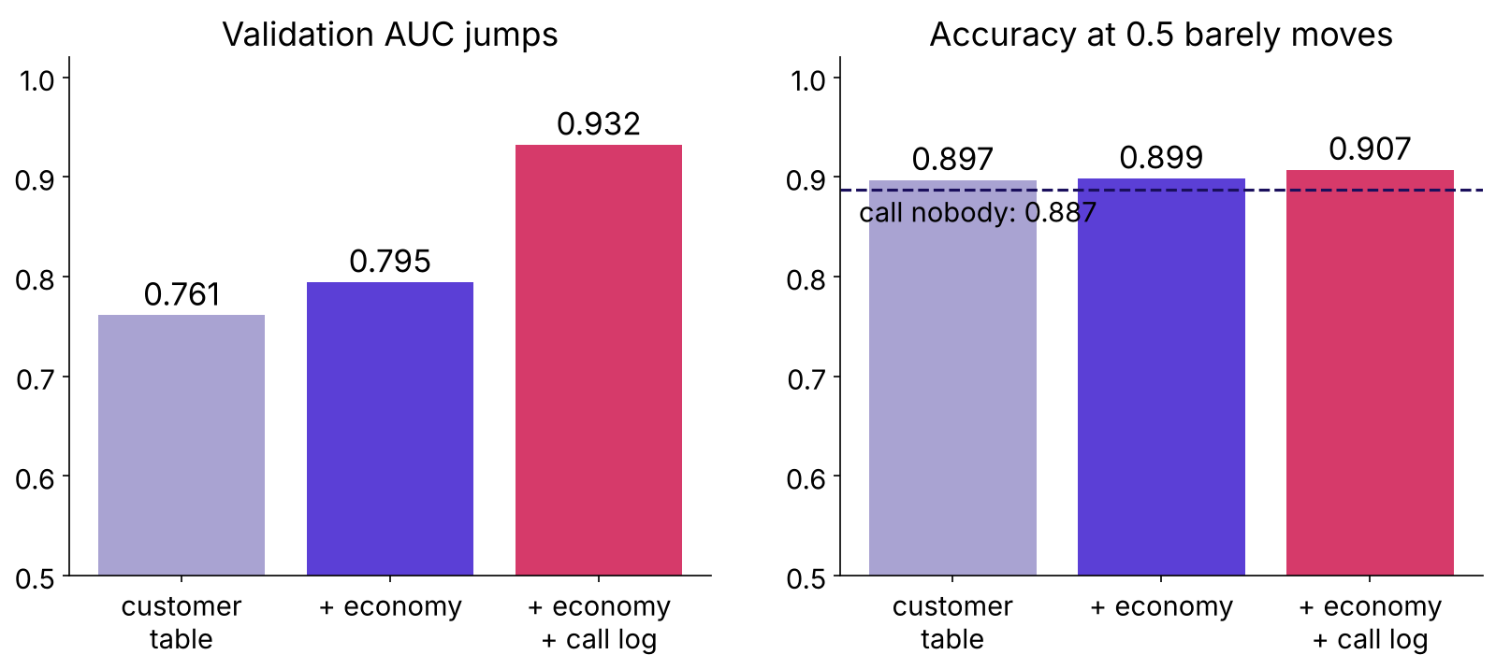
WEEK 5 · WEDNESDAY · WHAT THE MODEL IS ALLOWED TO KNOW
Answer: b, AUC 0.761, 0.795, then 0.932
Accuracy moves one point: 0.897 to 0.907
Validation AUC jumps while accuracy barely moves
What does a row know?
Is Surat twice Pune?
Known that morning?
Keep, drop or fix?
Is it rank or cause?
Why did it jump?
Known before the call?
S34 · 41 / 65
What does it prove?
Notes:
LIVE, 5 minutes. Calling nobody scores 0.887, so accuracy has no room to show the jump. Ask: a
jump of 0.14 from one column; what is your first suspicion? Hold the answer for case 2.

Slide 42
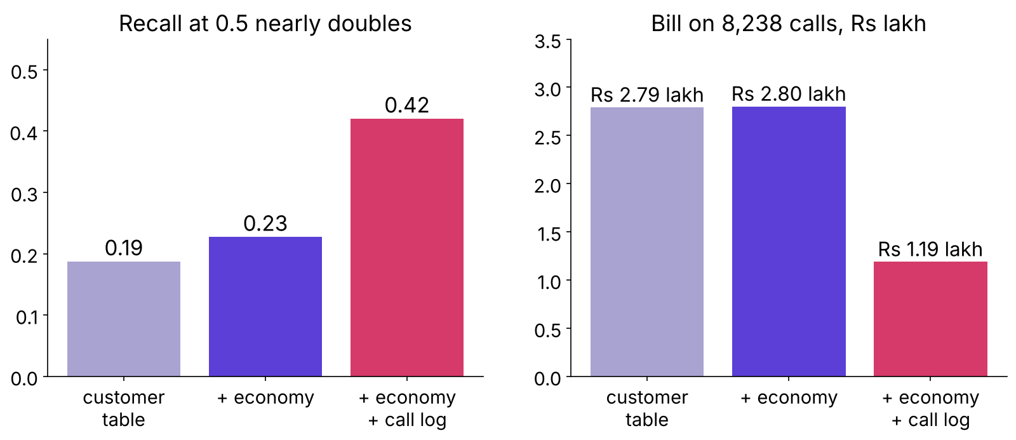
WEEK 5 · WEDNESDAY · WHAT THE MODEL IS ALLOWED TO KNOW
Read the jump in recall and rupees
Rs 40 a call, Rs 1,200 a missed buyer, threshold 0.032
Recall at 0.5 and the bill on 8,238 calls
What does a row know?
Is Surat twice Pune?
Known that morning?
Keep, drop or fix?
Is it rank or cause?
Why did it jump?
Known before the call?
S35 · 42 / 65
What does it prove?
Notes:
LIVE, 5 minutes. Recall at 0.5 goes 0.23 to 0.42 and the bill falls from Rs 2.80 lakh to Rs 1.19
lakh: a promise of Rs 1.61 lakh saved on 8,238 calls. That promise is what the junior would take
to the campaign head.

Slide 43
WEEK 5 · WEDNESDAY · WHAT THE MODEL IS ALLOWED TO KNOW
The scaler saw 24,712 rows and nothing else
Encoders and scalers live inside the pipeline
scaler.n_samples_seen_ # 24712, the training rows
len(encoder.categories_[0]) # 12 job levels, unknown included
StandardScaler().fit(bank[num]) # the trap: all 41,188 rows, test included
Uber's Michelangelo applies the same feature expressions at training and at prediction time.
What does a row know?
Is Surat twice Pune?
Known that morning?
Keep, drop or fix?
Is it rank or cause?
Why did it jump?
Known before the call?
S36 · 43 / 65
What does it prove?
Notes:
LIVE, 4 minutes. The implementation engineer's seat. Uber's feature store exists so a feature such as
"average preparation time over the last hour" means one thing in training and in serving. On this file the means differ only in the
third decimal, which is why the habit looks harmless; on a file where the future differs, it
carries the future in. Then the guided notebook, 20 minutes.

Slide 44
WEEK 5 · WEDNESDAY · WHAT THE MODEL IS ALLOWED TO KNOW
Guided: two features and three columns, together
Notebook guided: three TODO cells, reasons said aloud
TODO | The room decides
1 | the line that turns pdays = 999 into a never-contacted flag
2 | the line that flags a previous success
3 | known or not known that morning: duration, euribor3m, poutcome
What does a row know?
Is Surat twice Pune?
Known that morning?
Keep, drop or fix?
Is it rank or cause?
Why did it jump?
Known before the call?
S37 · 44 / 65
What does it prove?
Notes:
LIVE, 20 minutes. Pairs. Each pair says its reason aloud before typing. The worked answer sits
below the line in the same notebook; the room opens it only after the check cell runs.

Slide 45
07
Every column on the timeline
Known before the call?
Case 2 applies: Leakage and the prediction-time question · The column audit · Feature engineering from the customer table (the 999 sentinel) · notebook case02
What does a row know?
Is Surat twice Pune?
Known that morning?
Keep, drop or fix?
Is it rank or cause?
Why did it jump?
Known before the call?
What does it prove?
Week 5 Wednesday: what the model is allowed to know
45 / 65
Notes:
LIVE, 30 seconds. Case 2, 30 minutes. Never cut the audit.

Slide 46
WEEK 5 · WEDNESDAY · WHAT THE MODEL IS ALLOWED TO KNOW
How often does the shortest fifth of calls say yes?
Calls split into five equal groups by length
Option | Yes-rate of the shortest fifth
a | about 11 percent, like everyone
b | about 0.5 percent
c | about 33 percent
What does a row know?
Is Surat twice Pune?
Known that morning?
Keep, drop or fix?
Is it rank or cause?
Why did it jump?
Known before the call?
S38 · 46 / 65
What does it prove?
Notes:
LIVE, 2 minutes. Letters first.

Slide 47
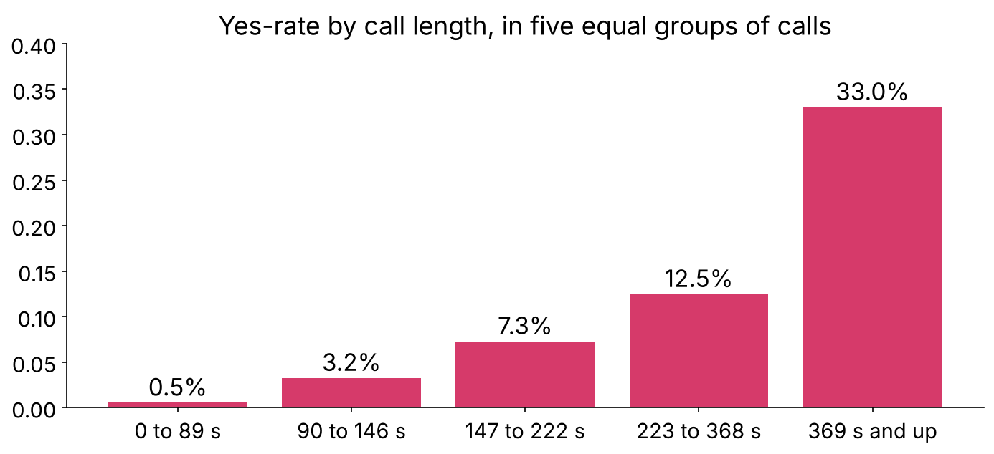
WEEK 5 · WEDNESDAY · WHAT THE MODEL IS ALLOWED TO KNOW
Answer: b, 0.5 percent; the longest fifth, 33
The dataset's own note: the length is unknown before the call
Yes-rate by call length
What does a row know?
Is Surat twice Pune?
Known that morning?
Keep, drop or fix?
Is it rank or cause?
Why did it jump?
Known before the call?
S39 · 47 / 65
What does it prove?
Notes:
LIVE, 4 minutes. All four calls of 0 seconds ended in no. Open the UCI page and read the duration
row aloud (the trainer guide holds the exact text): the authors say the length is unknown before
dialling and the column belongs in benchmarks only. A long call is often the sale being made. Ask the prediction-time question of
duration aloud: on the morning the list is made, do we know how long tomorrow's call will last?

Slide 48
WEEK 5 · WEDNESDAY · WHAT THE MODEL IS ALLOWED TO KNOW
Twenty columns audited: one drop, three flags
Notebook case02, the audit table
Columns | Written | Verdict
profile, credit products | before the campaign | keep
contact, campaign, previous, poutcome | before the call | keep
month, day_of_week | the day of the call | keep, flag
pdays | when the last campaign closed | engineer
economy, five columns | published by the research desk | keep, flag
duration | when the call ends | drop
What does a row know?
Is Surat twice Pune?
Known that morning?
Keep, drop or fix?
Is it rank or cause?
Why did it jump?
Known before the call?
S40 · 48 / 65
What does it prove?
Notes:
LIVE, 4 minutes. The quarterly and monthly indicators pass only if each figure was published
before the call; that is a question for the data owner and is not verified here. The calendar flag
is the next two slides.

Slide 49
WEEK 5 · WEDNESDAY · WHAT THE MODEL IS ALLOWED TO KNOW
What does year and month alone score?
No client information at all
Option | AUC from year and month alone
a | about 0.50, a coin
b | about 0.65
c | about 0.79
What does a row know?
Is Surat twice Pune?
Known that morning?
Keep, drop or fix?
Is it rank or cause?
Why did it jump?
Known before the call?
S41 · 49 / 65
What does it prove?
Notes:
LIVE, 2 minutes. Letters first. Most of the room says a.

Slide 50
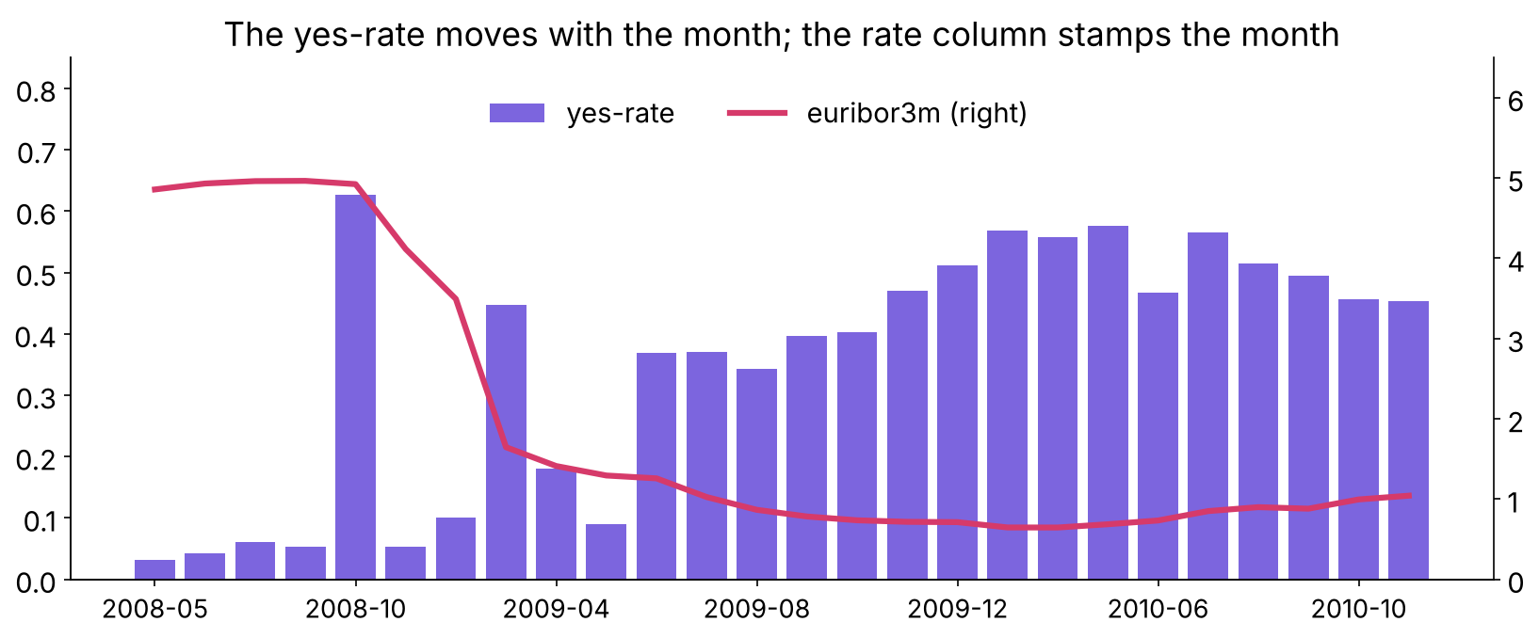
WEEK 5 · WEDNESDAY · WHAT THE MODEL IS ALLOWED TO KNOW
Answer: c, 0.79: the yes-rate moves with the month
From 5 percent of calls in 2008 to 52 percent in 2010
Yes-rate by month with euribor3m
What does a row know?
Is Surat twice Pune?
Known that morning?
Keep, drop or fix?
Is it rank or cause?
Why did it jump?
Known before the call?
S42 · 50 / 65
What does it prove?
Notes:
LIVE, 4 minutes. emp.var.rate and nr.employed take 10 and 11 distinct values: a stamp for the
quarter. On a random split every month sits in training and validation, so the model is scored
partly on months it has seen. Next month's list is a month it has never seen.

Slide 51
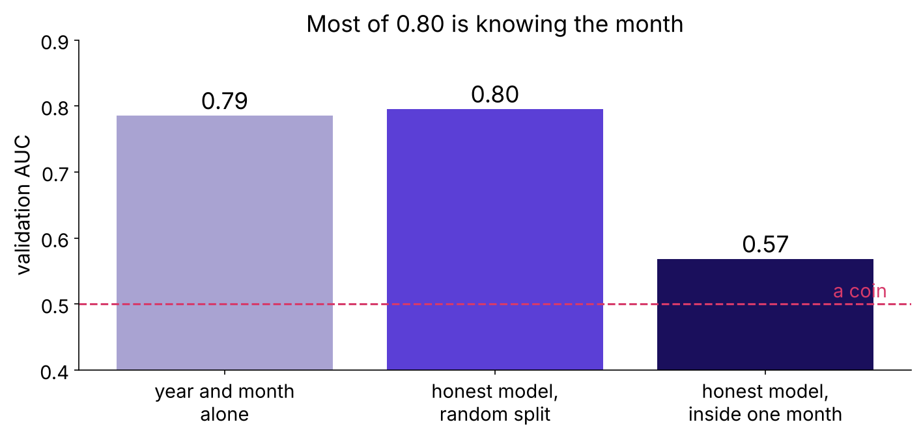
WEEK 5 · WEDNESDAY · WHAT THE MODEL IS ALLOWED TO KNOW
Inside one month the honest model ranks at 0.57
The calendar is a second leak that looks legal
AUC from the calendar, the honest model, and inside one month
A pneumonia model learned the hospital the same way: AUC 0.931 at home, 0.815 at a new site.
What does a row know?
Is Surat twice Pune?
Known that morning?
Keep, drop or fix?
Is it rank or cause?
Why did it jump?
Known before the call?
S43 · 51 / 65
What does it prove?
Notes:
LIVE, 4 minutes. Zech and others (PLOS Medicine 2018): the network identified the hospital system of
99.95 percent of NIH images, partly from a metal token, and hospital prevalence alone ranked at 0.861.
The hospital, like the month, is known when the prediction is made. Known that morning, and still borrowing each month's yes-rate through the split.
Verdict: keep, flag, and write the caveat beside the score. Friday's split by time prices it.

Slide 52
WEEK 5 · WEDNESDAY · WHAT THE MODEL IS ALLOWED TO KNOW
poutcome = success stays; pdays splits in two
"Too good" starts the question and never ends it
Column | What it shows | Verdict
poutcome = success | 65 percent yes, closed months before the call | keep
pdays | 999 in 96.3 percent of rows, a sentinel | never_contacted flag + days_since_contact
What does a row know?
Is Surat twice Pune?
Known that morning?
Keep, drop or fix?
Is it rank or cause?
Why did it jump?
Known before the call?
S44 · 52 / 65
What does it prove?
Notes:
LIVE, 3 minutes. Raw pdays has a mean of 962 days, which describes nobody. AUC barely moves after
the split; the model now reads a sentence a person can say.

Slide 53
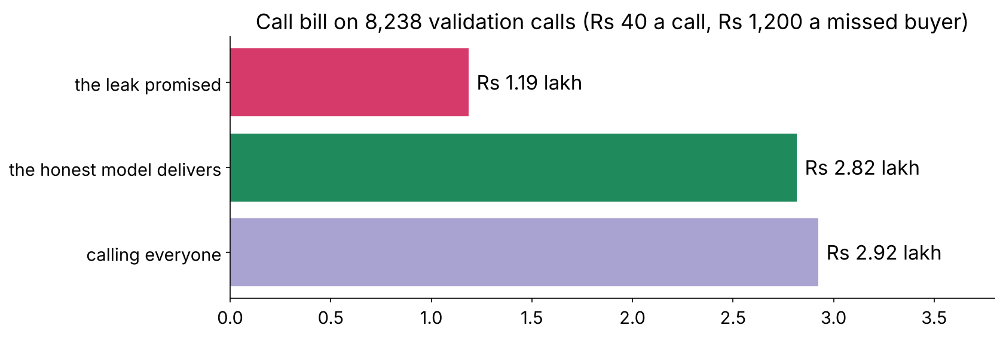
WEEK 5 · WEDNESDAY · WHAT THE MODEL IS ALLOWED TO KNOW
The leak promised Rs 1.19 lakh; honest is Rs 2.82 lakh
AUC 0.932 against 0.796 on the same 8,238 calls
The bill promised, delivered, and calling everyone
What does a row know?
Is Surat twice Pune?
Known that morning?
Keep, drop or fix?
Is it rank or cause?
Why did it jump?
Known before the call?
S45 · 53 / 65
What does it prove?
Notes:
LIVE, 4 minutes. The leaked model can never deliver its promise: on the morning of the call its
best column does not exist. The honest bill sits near calling everyone at these costs (Tuesday's
lesson); under a budget its top 1,000 hold 462 buyers against 113 at random.

Slide 54
WEEK 5 · WEDNESDAY · WHAT THE MODEL IS ALLOWED TO KNOW
Kalpa's settlement_status is the same leak
Written by the payments feed, after delivery
Column | Written by | Written | Verdict
orders_90d | orders table | nightly, before the nudge | keep
days_since_last_order | orders table | nightly, before the nudge | keep
settlement_status | payments feed | when the payment clears | drop
What does a row know?
Is Surat twice Pune?
Known that morning?
Keep, drop or fix?
Is it rank or cause?
Why did it jump?
Known before the call?
S46 · 54 / 65
What does it prove?
Notes:
LIVE, 2 minutes. Close the loop on S3: the 0.99 collapses because a payment can only settle for a
member who already bought. The column is the target in another team's words.

Slide 55
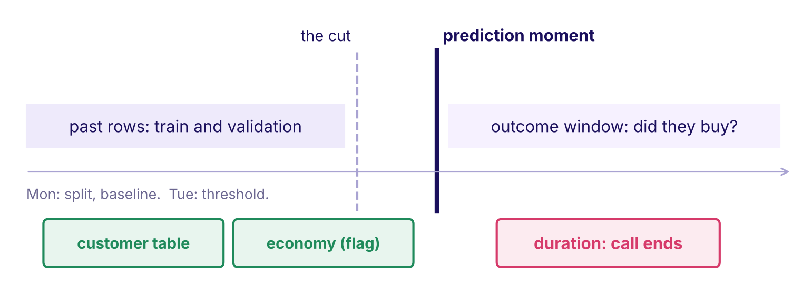
WEEK 5 · WEDNESDAY · WHAT THE MODEL IS ALLOWED TO KNOW
The week's picture, Wednesday state
duration sits right of the prediction moment, in red
The week's timeline with duration in red
What does a row know?
Is Surat twice Pune?
Known that morning?
Keep, drop or fix?
Is it rank or cause?
Why did it jump?
Known before the call?
S47 · 55 / 65
What does it prove?
Notes:
LIVE, 1 minute. Tonight's self-check is to redraw this from memory. Lunch after this slide.

Slide 56
08
The sign that flipped
What does it prove?
Case 3 applies: Feature importance and its limits · Encoding categoricals; scaling numerics; which models care · notebook case03
What does a row know?
Is Surat twice Pune?
Known that morning?
Keep, drop or fix?
Is it rank or cause?
Why did it jump?
Known before the call?
What does it prove?
Week 5 Wednesday: what the model is allowed to know
56 / 65
Notes:
LIVE, 30 seconds. Case 3, 20 minutes. Afternoon block.

Slide 57
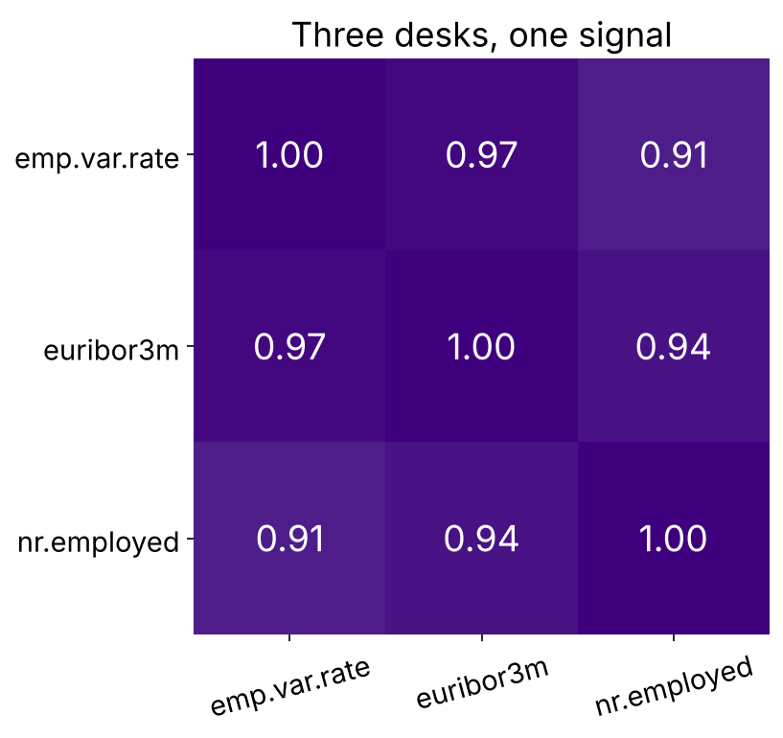
WEEK 5 · WEDNESDAY · WHAT THE MODEL IS ALLOWED TO KNOW
Alone, euribor3m is negative; with its partners?
The three rate columns correlate above 0.9 on training rows
(a) stays negative and shrinks (b) turns positive (c) goes to exactly zero
Correlation of the three rate columns
…
Is Surat twice Pune?
Known that morning?
Keep, drop or fix?
Is it rank or cause?
Why did it jump?
Known before the call?
What does it prove?
S48 · 57 / 65
Notes:
LIVE, 4 minutes. Three desks, one signal: when columns move together this closely the data has
almost no row where one is high and another low. Letters first. This is the row's second discovery; let the room find it.

Slide 58
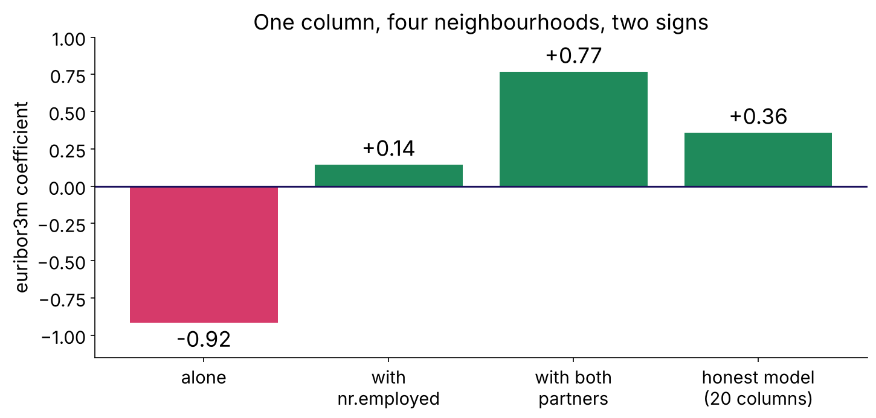
WEEK 5 · WEDNESDAY · WHAT THE MODEL IS ALLOWED TO KNOW
Answer: b, from -0.92 to +0.77 beside both partners
Nothing about interest rates changed between the fits
euribor3m's coefficient in four neighbourhoods
…
Is Surat twice Pune?
Known that morning?
Keep, drop or fix?
Is it rank or cause?
Why did it jump?
Known before the call?
What does it prove?
S49 · 58 / 65
Notes:
LIVE, 4 minutes. A coefficient answers "holding the others fixed", and these partners are never
held fixed in the data. Read a sign alone only when the column has no close partner. Kahoot Q5.
The faculty block, tentative, takes multicollinearity further.

Slide 59
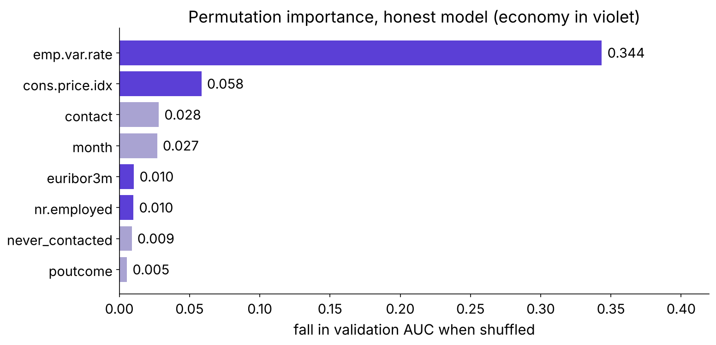
WEEK 5 · WEDNESDAY · WHAT THE MODEL IS ALLOWED TO KNOW
emp.var.rate tops the importance chart at 0.34
Shuffle a column on validation rows; measure the AUC lost
Permutation importance of the honest model
…
Is Surat twice Pune?
Known that morning?
Keep, drop or fix?
Is it rank or cause?
Why did it jump?
Known before the call?
What does it prove?
S50 · 59 / 65
Notes:
LIVE, 3 minutes. The model's whole lift above a coin is 0.30. One column costing 0.34 is costing
more than the model ever earned. Ask why before the next slide.

Slide 60
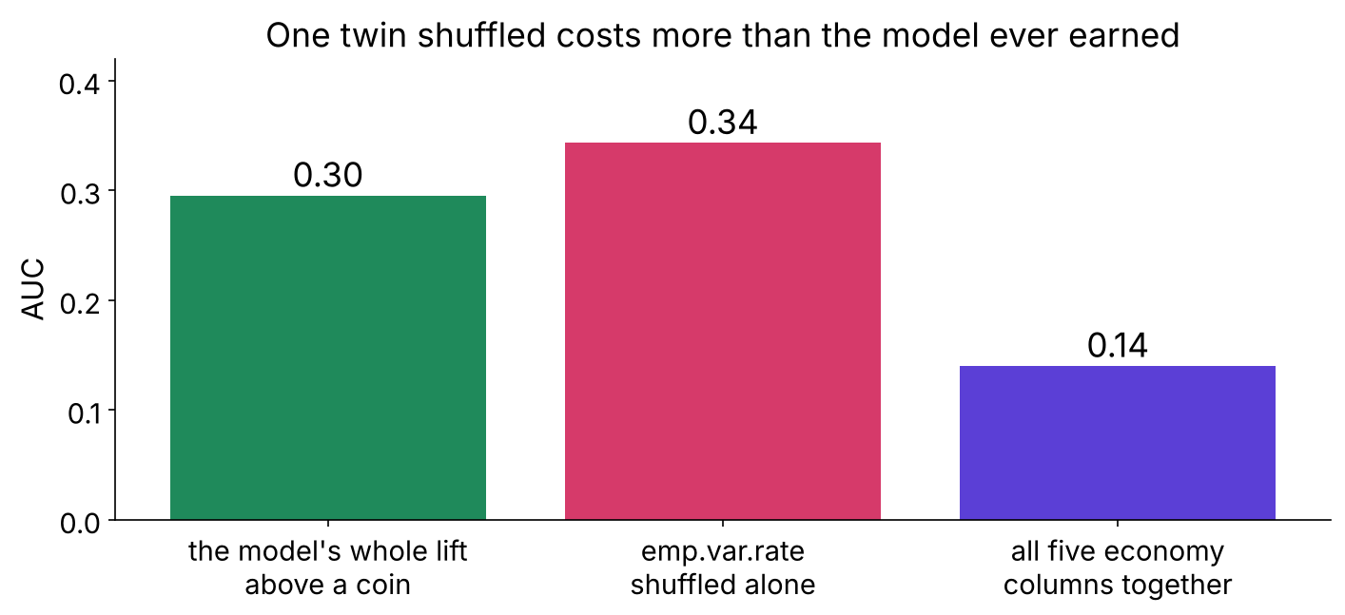
WEEK 5 · WEDNESDAY · WHAT THE MODEL IS ALLOWED TO KNOW
One twin shuffled costs more than the model earned
Shuffled alone, it builds clients who never existed
Single shuffle against group shuffle against the model's lift
…
Is Surat twice Pune?
Known that morning?
Keep, drop or fix?
Is it rank or cause?
Why did it jump?
Known before the call?
What does it prove?
S51 · 60 / 65
Notes:
LIVE, 3 minutes. A 2010 employment rate beside a 2008 interbank rate: an impossible client. Shuffle
the five economy columns together and the cost falls to 0.14. Land: permute partners as a group.

Slide 61
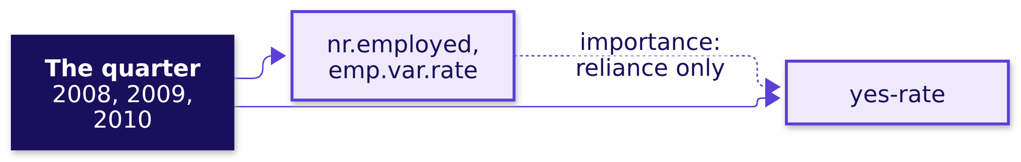
WEEK 5 · WEDNESDAY · WHAT THE MODEL IS ALLOWED TO KNOW
nr.employed ranks high and only stamps the quarter
The chart ranks reliance and never proves cause
…
Is Surat twice Pune?
Known that morning?
Keep, drop or fix?
Is it rank or cause?
Why did it jump?
Known before the call?
What does it prove?
S52 · 61 / 65
Notes:
LIVE, 3 minutes. Ask first: would hiring more people in Portugal raise deposits? The same holds for contact: mobile against landline ranks third, and moving every
client to mobile would not move the yes-rate by that gap. A lever needs a fair test.

Slide 62
WEEK 5 · WEDNESDAY · WHAT THE MODEL IS ALLOWED TO KNOW
The audited feature set goes to Thursday
20 columns, validation AUC 0.796, about 0.57 inside one month
Group | Verdict | Reason
profile, history | keep | known before the call
never_contacted, days_since_contact | keep, engineered | 999 is a sentinel
economy, five columns | keep, flag | a calendar on a random split; read as a group
duration | drop | written when the call ends
…
Is Surat twice Pune?
Known that morning?
Keep, drop or fix?
Is it rank or cause?
Why did it jump?
Known before the call?
What does it prove?
S53 · 62 / 65
Notes:
LIVE, 2 minutes. Then the unguided task, 20 minutes: in a blank notebook, rebuild this set from
the raw file, write the audit table with a reason per column, and report the honest score. Target:
0.796 to the third decimal.

Slide 63
WEEK 5 · WEDNESDAY · WHAT THE MODEL IS ALLOWED TO KNOW
Four interview anchors, and the shape of a good answer
Answers as reasoning, never as paragraphs
Tag | Question | The shape of a good answer
[S] | What is data leakage, and how do you catch it before it ships? | definition by time; the question; the owner
[F] | Which encoder for a forty-value categorical, and why? | ask the model family; one-hot; the flip
[F] | What does an importance chart prove, and what not? | reliance; twins; a fair test for cause
[D] | A colleague's feature lifts the score to 0.99 tonight; what do you say? | ask when it is written; retrain; both scores in rupees
…
Is Surat twice Pune?
Known that morning?
Keep, drop or fix?
Is it rank or cause?
Why did it jump?
Known before the call?
What does it prove?
S54 · 63 / 65
Notes:
LIVE, 6 minutes. Pairs: one asks, one answers in 60 seconds, swap. The [D] answer opens with a
clarifying question: which system writes the column, and when? The model answers with follow-ups
are in the interview bank.

Slide 64
WEEK 5 · WEDNESDAY · WHAT THE MODEL IS ALLOWED TO KNOW
Quiz: five questions and Tuesday's return question
Kahoot, ungraded, keys in the trainer guide
# | The question
1 | The prediction-time question, completed from memory
2 | Validation hit 0.99 after one new column; your first suspicion
3 | Which encoder for a forty-value categorical
4 | Which model family shrugs at unscaled features
5 | A coefficient's sign flipped when a feature was added; the likeliest cause
R | The same model in retail and lending: why the thresholds sit at opposite ends
…
Is Surat twice Pune?
Known that morning?
Keep, drop or fix?
Is it rank or cause?
Why did it jump?
Known before the call?
What does it prove?
S55 · 64 / 65
Notes:
LIVE, 8 minutes. Type the six into Kahoot from the trainer guide. Discuss Q2 and Q5 for a minute
each; they carry the day.

Slide 65
WEEK 5 · WEDNESDAY · WHAT THE MODEL IS ALLOWED TO KNOW
What you can now do, and what tonight holds
Practice set two to three hours; lab with the TAs
Now you can | Tonight
engineer five kinds of feature, each with a reason | practice set: ten problems, eighteen self-check questions
encode and scale for the model family in use | practice lab: Rohan's lending file, the same audit
audit every column with the prediction-time question | redraw the week's picture from memory
say what an importance chart proves | Thursday's pre-read: overfitting, bias, variance, cross-validation
…
Is Surat twice Pune?
Known that morning?
Keep, drop or fix?
Is it rank or cause?
Why did it jump?
Known before the call?
What does it prove?
S56 · 65 / 65
Notes:
LIVE, 4 minutes. Say the ME1 scope aloud and no more. Tomorrow tunes on today's audited feature
set, so every learner commits case03 with its outputs tonight.

