Slide 1


Indian Institute of Technology Gandhinagar
ADMINISTERED THROUGH THE COMPETENCY ADVANCEMENT ACADEMY
WEEK 1 · FRIDAY · THE AI-FREE LAB
The week, rebuilt alone
“Before anything goes to Meera, rebuild the week from a raw export with no assistant and no notes.”
Kavya Nair, senior analyst, Kalpa Retail data team, to the trainees at Kalpa's Global Capability Centre
01
Kavya's terms
02
The clock
Week 1, Day 5. The week, rebuilt alone
1 / 12
Notes:
LIVE, one minute. Read Kavya's line aloud and leave it up. Today teaches nothing new: the morning
finds out which of the week's ideas each person owns, and the afternoon finds out whether they can
say it under pressure. Kavya's terms and the rules take ten minutes, then the clock starts.

Slide 2
Indian Institute of Technology Gandhinagar
PG DIPLOMA IN AI-ML AND AGENTIC AI ENGINEERING · COHORT 2
ADMINISTERED THROUGH THE COMPETENCY ADVANCEMENT ACADEMY
01
Kavya's terms
The growth review is on Monday, Marketing will be in the room, and the method has to be yours.
Kavya's terms
The clock
Week 1 Day 5: the week rebuilt alone
2 / 12
Notes:
LIVE. Chapter one is ten minutes in all: the stakes, the method as one picture, the rules and the
hand-in. Nothing here is new, and the pace matters more than the words.

Slide 3

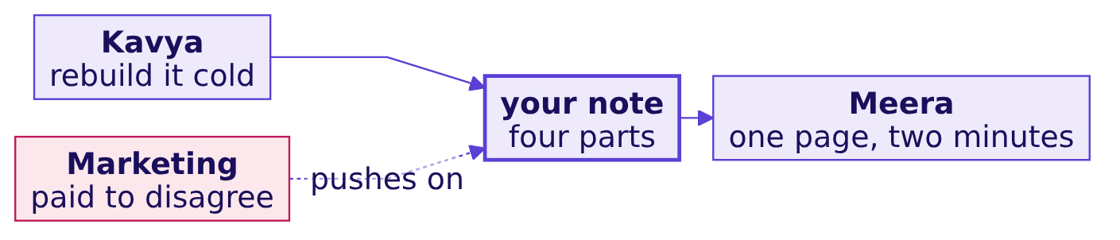

Indian Institute of Technology Gandhinagar
WEEK 1 · DAY 5 · KALPA GLOBAL CAPABILITY CENTRE
ADMINISTERED THROUGH THE COMPETENCY ADVANCEMENT ACADEMY
Monday's room decides on what you can run alone
Meera acts on a note only when the person who wrote it can rebuild every number in it.
THE CLIENT ASKS
Whether the week's pipeline is yours or the notebook's; which step you reach for first on a fresh export; whether your note survives a hostile question; what you still cannot do without help.
Kavya's terms
The clock
S1 · 3 / 12
Notes:
LIVE, 2 minutes. Say the four questions on the table from the row. The first one is the morning's
question and the third is the afternoon's. Do not add anything about which step matters most: the
lab measures what each person does unprompted.

Slide 4
Indian Institute of Technology Gandhinagar
WEEK 1 · DAY 5 · KALPA GLOBAL CAPABILITY CENTRE
ADMINISTERED THROUGH THE COMPETENCY ADVANCEMENT ACADEMY
The method, in the order you run it
Six steps, each one built on a day of this week, and the order never changes.
Each step answers a question the next one depends on: whether the file is what it claims, which rows count, whether the clean data is still the same data, which branch moved, whether chance could do it, and what Meera should do.
Kavya's terms
The clock
S2 · 4 / 12
Notes:
LIVE, 2 minutes. Walk the six boxes left to right once, naming the day each came from. Then stop
talking about the method. This picture stays on the second screen, if there is one, for the whole
lab.

Slide 5
Indian Institute of Technology Gandhinagar
WEEK 1 · DAY 5 · KALPA GLOBAL CAPABILITY CENTRE
ADMINISTERED THROUGH THE COMPETENCY ADVANCEMENT ACADEMY
Question: what do you open first on a fresh export?
Two hours, a raw file and a stakeholder waiting: the first ten minutes decide the rest.
Question. Choose one: a) the quarter totals, so Meera has a number early; b) a profile of every field, before any number; c) the segment split, because that is where last week's finding sat; d) the notebook from Wednesday, to reuse its cleaning code.
Kavya's terms
The clock
S3 · 5 / 12
Notes:
LIVE, 2 minutes. Take letters from three people. Expect some a: it is the instinct under time
pressure and the reason a total gets quoted before anybody knows what the file holds.

Slide 6

Indian Institute of Technology Gandhinagar
WEEK 1 · DAY 5 · KALPA GLOBAL CAPABILITY CENTRE
ADMINISTERED THROUGH THE COMPETENCY ADVANCEMENT ACADEMY
Answer: a profile, before any number
A total computed before the profile is a number about a file nobody has looked at.
3
1
0
COUNTS PER FIELD
FINDING PER MISMATCH
NUMBERS QUOTED
present, convertible, distinct
each count that disagrees with the field
until the profile is read
KAVYA'S REVIEW
A profile costs ten minutes and tells you which of the next ninety you will spend on repairs. Skipping it moves the repairs to Monday, in front of Marketing.
Kavya's terms
The clock
S4 · 6 / 12
Notes:
LIVE, 1 minute. The answer is b. Option d is closed by the rules anyway: no other day's notebook is
open today, and the reason is that code written for Wednesday's file assumes Wednesday's defects.

Slide 7





Indian Institute of Technology Gandhinagar
WEEK 1 · DAY 5 · KALPA GLOBAL CAPABILITY CENTRE
ADMINISTERED THROUGH THE COMPETENCY ADVANCEMENT ACADEMY
The rules of the lab
The lab finds out what you own; it does not rank anybody.
RULE 1
RULE 2
RULE 3
RULE 4
No assistant
Notes closed
120 minutes
Observed, not scored
No chat model, no autocomplete that writes code, no search for code.
No earlier notebook, deck or cheat sheet open on any screen.
The clock runs once; save as you go and hand in what you have.
A TA notes where each person is at each mark; nothing goes on a wall.
THE RULE
Python's own documentation, reached from the notebook with help(), is allowed, because an analyst on the job has it too.
Kavya's terms
The clock
S5 · 7 / 12
Notes:
LIVE, 2 minutes. Read the four cards. Say plainly that the observation sets each person's first
stretch or remedial task and is never shown to the room. The support TA handles Codespace problems
only; a question about the method gets "what would you check?" and nothing more.

Slide 8
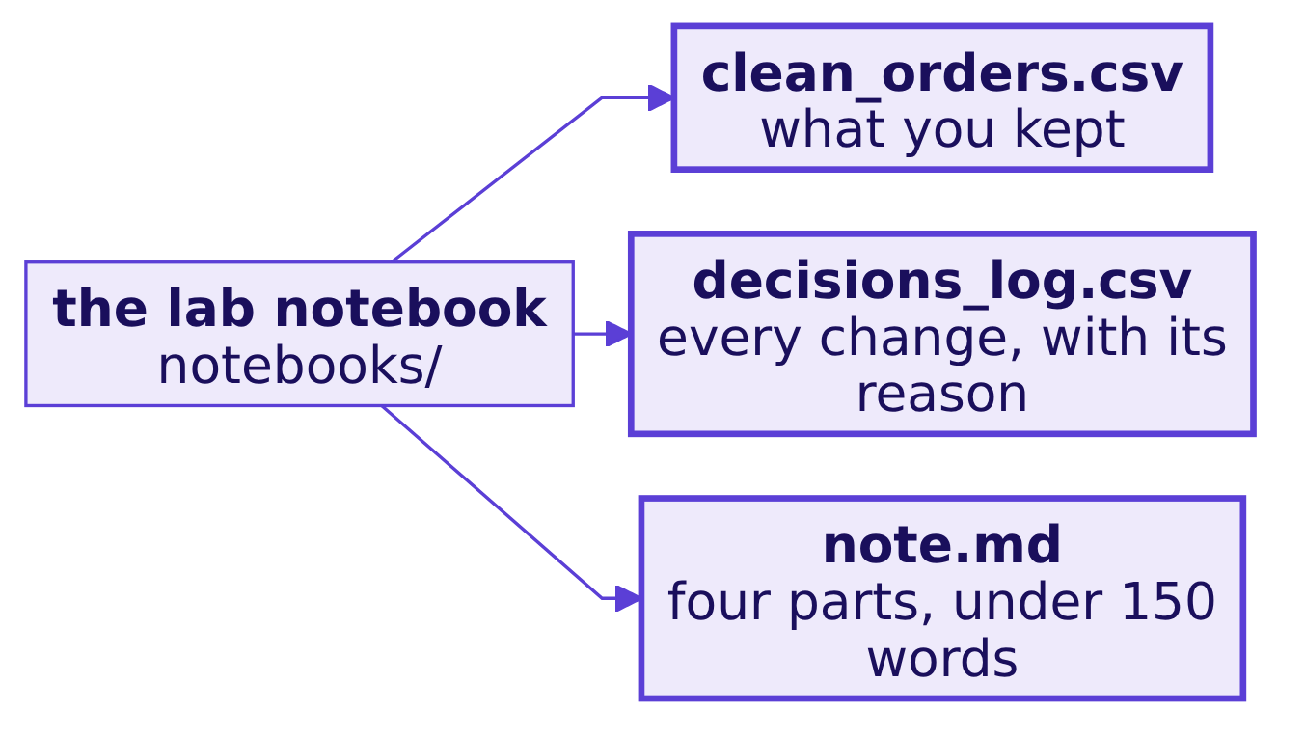
Indian Institute of Technology Gandhinagar
WEEK 1 · DAY 5 · KALPA GLOBAL CAPABILITY CENTRE
ADMINISTERED THROUGH THE COMPETENCY ADVANCEMENT ACADEMY
What you hand in, and where
Three files, written by the notebook's last cell into its output folder.
Open notebooks/C2_W01_D05_lab_STUDENT.ipynb and exercises/unguided/C2_W01_D05_lab_brief_STUDENT.md. The export and Finance's control totals load in the first cell.
Kavya's terms
The clock
S6 · 8 / 12
Notes:
LIVE, 1 minute. Everyone opens both files now and runs the first cell before the clock starts, so
a Codespace problem is found in the ten minutes of terms rather than inside the lab.

Slide 9
Indian Institute of Technology Gandhinagar
PG DIPLOMA IN AI-ML AND AGENTIC AI ENGINEERING · COHORT 2
ADMINISTERED THROUGH THE COMPETENCY ADVANCEMENT ACADEMY
02
The clock
120 minutes, one pass, the week's method from a raw file to a note.
Kavya's terms
The clock
Week 1 Day 5: the week rebuilt alone
9 / 12
Notes:
LIVE. The clock starts when this slide goes up. Leave S7 on screen for the whole lab, and change
nothing on the projector until the 120-minute mark.

Slide 10
Indian Institute of Technology Gandhinagar
WEEK 1 · DAY 5 · KALPA GLOBAL CAPABILITY CENTRE
ADMINISTERED THROUGH THE COMPETENCY ADVANCEMENT ACADEMY
The pace, if you want one
Minutes are a pace, not a limit; the order is not optional.
0 TO 20
20 TO 50
50 TO 65
65 TO 90
90 TO 105
105 TO 120
Profile
Clean
Reconcile
Decompose
Test
Note
Three counts per field, and every mismatch written down.
Drop, default, or keep and flag, each with a reason in the log.
Counts and rupees, against Finance's control totals.
The tree, Q1 against Q2, segment by segment.
One shuffle, 2,000 times, on the gap that matters.
Claim, evidence, caveat, action.
Kavya's terms
The clock
S7 · 10 / 12
Notes:
LIVE, the whole lab. At each mark the TAs walk their rows with the observation sheet and record the
step each learner is on, without a word. Say nothing to the room except the time remaining at 60,
90 and 110 minutes. Answer a method question with "what would you check?"

Slide 11
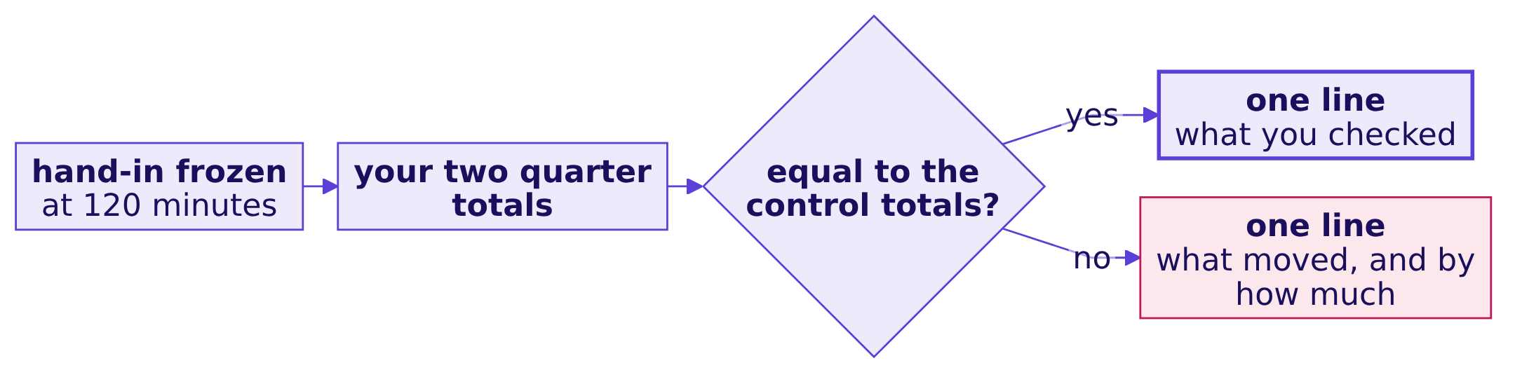
Indian Institute of Technology Gandhinagar
WEEK 1 · DAY 5 · KALPA GLOBAL CAPABILITY CENTRE
ADMINISTERED THROUGH THE COMPETENCY ADVANCEMENT ACADEMY
The second look, after the clock stops
Hand-in is frozen at 120 minutes; the next twenty are yours to check what you sent.
Write the line under your note in a new markdown cell. It does not change what you handed in; it is what you will say at the debrief.
Kavya's terms
The clock
S8 · 11 / 12
Notes:
LIVE, 20 minutes. The TAs copy each learner's output folder at the 120-minute mark before anyone
edits it; that snapshot is what the observation sheet records. Then read this slide aloud. Most of
the room will find its first real number here. Do not comment on anybody's result until the
debrief.

Slide 12
Indian Institute of Technology Gandhinagar
WEEK 1 · DAY 5 · KALPA GLOBAL CAPABILITY CENTRE
ADMINISTERED THROUGH THE COMPETENCY ADVANCEMENT ACADEMY
Kavya's review of the morning
The method is yours when the order holds under a clock, not when each step is remembered.
6
120
0
STEPS
MINUTES
ASSISTANTS
in one order, every time
one pass, observed
the file is new to every model too
KAVYA'S REVIEW
The step you skipped when the clock ran is the step you do not own yet. Knowing which one it is, this week, costs nothing.
Kavya's terms
The clock
S9 · 12 / 12
Notes:
LIVE, 1 minute, then the ten-minute break. The debrief's first break, the reconciliation, runs for
twenty minutes after the break and closes the morning. Over lunch the TAs total the observation
sheets by step, and that tally decides which two breaks open the afternoon.

