Slide 1


Indian Institute of Technology Gandhinagar
ADMINISTERED THROUGH THE COMPETENCY ADVANCEMENT ACADEMY
WEEK 1 · TUESDAY · HALF TWO
The cause on trial
“It is the broken reorder button. One of my members says it has been broken for six weeks.”
The head of Retail-Plus, Kalpa's paid membership tier
01
The memo and its evidence
02
The escalated case
03
The debrief of wrong answers
04
The second case
05
The interview drill
Week 1, Day 2. The cause on trial
1 / 30
Notes:
LIVE, inside chapter 6's first minutes. The morning climbed five chapters: the drop is real at 11.0 percent, the branch is
orders per customer, the segment is Retail-Plus, the rise in order value is mostly mix, and
Marketing's churn claim fails the overlap. The afternoon opens on chapter 6, the cause the head of
Retail-Plus hands us, then the escalated case, the debrief, the second case, the drill and the close.

Slide 2
Indian Institute of Technology Gandhinagar
PG DIPLOMA IN AI-ML AND AGENTIC AI ENGINEERING · COHORT 2
ADMINISTERED THROUGH THE COMPETENCY ADVANCEMENT ACADEMY
06
The memo and its evidence
Chapter 6. The tier hands us a cause and Meera wants one page: what we know, what we guess, and what would settle it.
The memo and its evidence
The escalated case
The debrief of wrong answers
The second case
The interview drill
The close
Week 1, Day 2. The cause on trial
2 / 30
Notes:
LIVE. Chapter 6 runs 30 minutes: 5 on the need and Sonos, 4 on the options, 4 on the monthly line, 8
on the trap and its ceiling, 5 on the season, the channel and the second route, 4 on the memo and
Kavya's review. Open notebooks/C2_W01_D02_06_the_memo_STUDENT.ipynb. The chapter opener is numbered 6 on
purpose; it continues the morning's five.

Slide 3


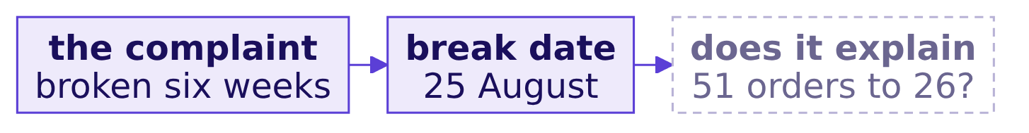
Indian Institute of Technology Gandhinagar
WEEK 1 · DAY 2 · KALPA GLOBAL CAPABILITY CENTRE
ADMINISTERED THROUGH THE COMPETENCY ADVANCEMENT ACADEMY
The tier blames the button; Meera wants a page
Engineering's priority and the story Meera tells the board both ride on whether the button explains the fall.
THE CLIENT ASKS
"Which branch, which segment, and what you would bet on. Tell me what you know and what you are guessing." (Meera Raghavan)
The memo and its evidence
The escalated case
The debrief of wrong answers
The second case
The interview drill
The close
S1 · 3 / 30
Notes:
LIVE, 3 minutes. The metric at stake is Retail-Plus orders per week before and after the break. Six
weeks back from the week of 6 October is 25 August; say it is the complaint taken at its word. A
wrong answer costs a quarter: blame the button for everything, fix it, and the tier keeps falling.

Slide 4
Indian Institute of Technology Gandhinagar
WEEK 1 · DAY 2 · KALPA GLOBAL CAPABILITY CENTRE
ADMINISTERED THROUGH THE COMPETENCY ADVANCEMENT ACADEMY
Sonos tied an app rollout to its guidance
A loyal customer base, an app rollout gone wrong, and a cut in guidance, the revenue promised to investors.
2024
FY2024
up to $30 m
REDESIGNED APP ROLLED OUT
GUIDANCE REDUCED
SHORT-TERM COST TO FIX
the problems it caused
the CEO tied it to the app's rollout
set out in the annual report
The claim. A company can put a broken app into its numbers, and the head of Retail-Plus is asking whether his tier is the same story.
The memo and its evidence
The escalated case
The debrief of wrong answers
The second case
The interview drill
The close
S2 · 4 / 30
Notes:
LIVE, 2 minutes. Sources checked 30 Sep 2026: Sonos third quarter fiscal 2024 results (the chief
executive's statement that the app's rollout required a reduced fiscal 2024 guidance) and the fiscal
2024 annual report on Form 10-K (short-term costs of up to $30 million). No revenue figure for the
app's effect was verified on a primary page, so none is quoted.

Slide 5
Indian Institute of Technology Gandhinagar
WEEK 1 · DAY 2 · KALPA GLOBAL CAPABILITY CENTRE
ADMINISTERED THROUGH THE COMPETENCY ADVANCEMENT ACADEMY
Four tests of a cause, and the call
Run the cheap tests in order, timing first, and request the one that settles it.
Option | Reads | Can rule out
A. Before and after the break | Retail-Plus orders, by date | The button as the whole story
B. A comparison segment | Retail-Core, same months | A season that hit everyone
C. The channel it predicts | Retail-Plus orders by channel | An app-only cause
D. The app's reorder logs | A data request | Nothing today; it settles it later
The call. A, B and C now, D requested today. What would change it: if the break turned out to be in June, A's verdict flips, and D's release date is how we would learn it.
The memo and its evidence
The escalated case
The debrief of wrong answers
The second case
The interview drill
The close
S3 · 5 / 30
Notes:
LIVE, 4 minutes. A cause cannot come after its effect, so timing leads. Each of A to C reads the
export already open in milliseconds; D is days away.

Slide 6
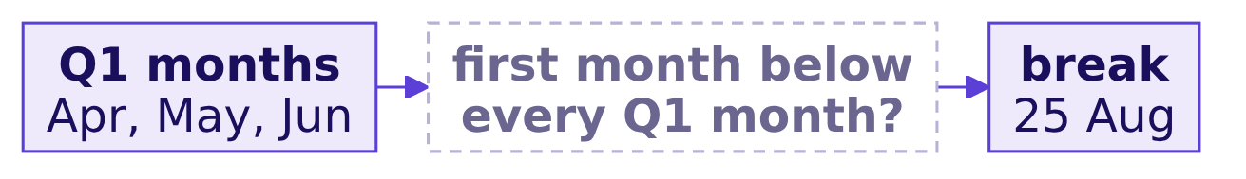
Indian Institute of Technology Gandhinagar
WEEK 1 · DAY 2 · KALPA GLOBAL CAPABILITY CENTRE
ADMINISTERED THROUGH THE COMPETENCY ADVANCEMENT ACADEMY
Question: when did the tier drop below Q1?
Retail-Plus orders by month, with Retail-Core beside it for comparison.
Question. a) September, after the break; b) August, when it broke; c) July, before it broke; d) never.
The memo and its evidence
The escalated case
The debrief of wrong answers
The second case
The interview drill
The close
S4 · 6 / 30
Notes:
LIVE, 2 minutes. Take letters, then run the monthly cell with count_by, chapter 1's accumulator grown
into a function that takes any key.

Slide 7
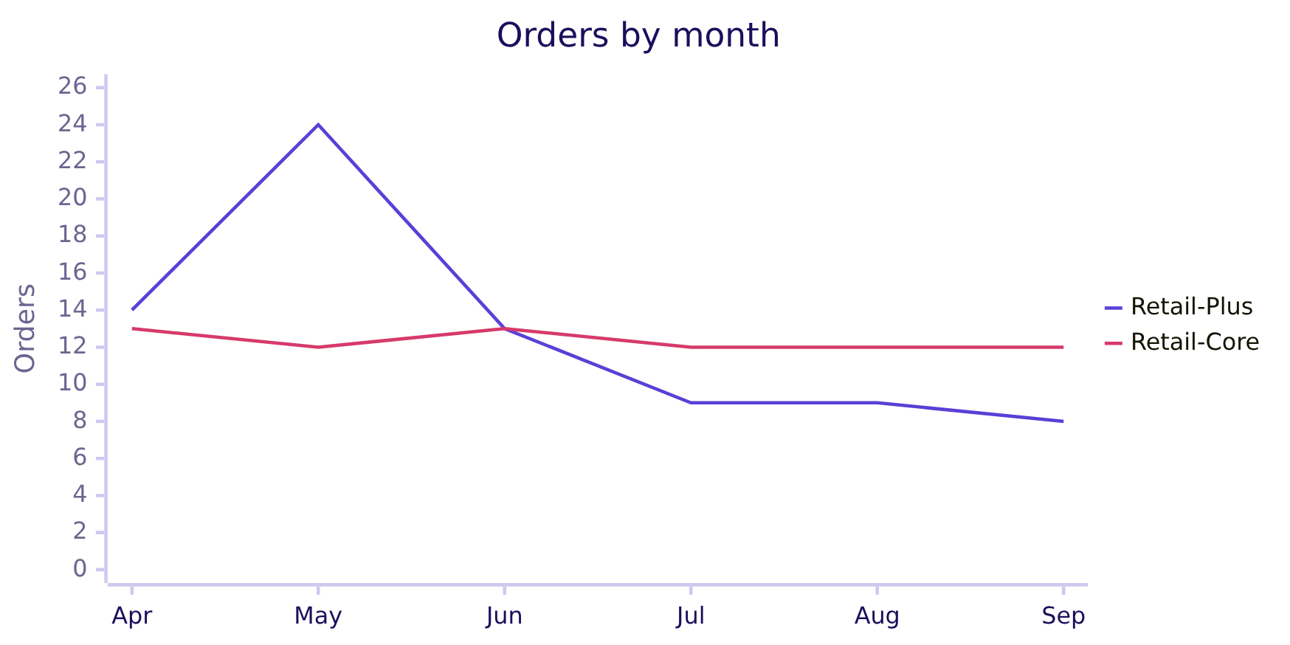
Indian Institute of Technology Gandhinagar
WEEK 1 · DAY 2 · KALPA GLOBAL CAPABILITY CENTRE
ADMINISTERED THROUGH THE COMPETENCY ADVANCEMENT ACADEMY
Answer: July, weeks before the button broke
Retail-Plus stepped down in July while Retail-Core held level through the same months.
The line that falls from 13 to 9 in July is Retail-Plus; the level line is Retail-Core.
The memo and its evidence
The escalated case
The debrief of wrong answers
The second case
The interview drill
The close
S5 · 7 / 30
Notes:
LIVE, 2 minutes. The answer is c. The button may still matter; it cannot be the whole story. Keep to the Q2 months.

Slide 8

Indian Institute of Technology Gandhinagar
WEEK 1 · DAY 2 · KALPA GLOBAL CAPABILITY CENTRE
ADMINISTERED THROUGH THE COMPETENCY ADVANCEMENT ACADEMY
The plausible wrong answer: the button cost 25
The hurried memo charges the button with the tier's whole quarter.
25
Rs 65,250
0
ORDERS THE BUTTON "COST"
RUPEES THE BUTTON "COST"
DAYS CHECKED BEFORE THE BREAK
51 in Q1 less 26 in Q2
the whole tier's fall
the missing check
WHAT BREAKS
Engineering is told the fix recovers 25 orders a quarter; it ships, recovers a handful, and the tier's real problem has had another quarter to run.
The memo and its evidence
The escalated case
The debrief of wrong answers
The second case
The interview drill
The close
S6 · 8 / 30
Notes:
LIVE, 3 minutes. The chapter's trap. The comparison spans the whole quarter, so it charges the button
with about eight weeks of orders lost before it broke.

Slide 9
Indian Institute of Technology Gandhinagar
WEEK 1 · DAY 2 · KALPA GLOBAL CAPABILITY CENTRE
ADMINISTERED THROUGH THE COMPETENCY ADVANCEMENT ACADEMY
Why it is wrong, and the ceiling: about 4
Split Q2 at the break and give each side its window; the rate had fallen by more than a third already.
Window | Days | Orders | Per week
Q1, 1 Apr to 30 Jun | 91 | 51 | 3.92
Q2, 1 Jul to 24 Aug | 55 | 18 | 2.29
Q2, 25 Aug to 30 Sep | 37 | 8 | 1.51
The fix. At the pre-break pace, 37 days would have carried about 12.1 orders; the tier placed 8. The button explains at most about 4 orders, about Rs 12,400, and that is a ceiling.
The memo and its evidence
The escalated case
The debrief of wrong answers
The second case
The interview drill
The close
S7 · 9 / 30
Notes:
LIVE, 5 minutes. The check is chapter 1's lesson: a rate with its window. What changed: "the button
cost 25 orders" became "at most about 4; the rest needs another cause". Engineering still fixes it;
the memo stops promising it fixes the tier.

Slide 10
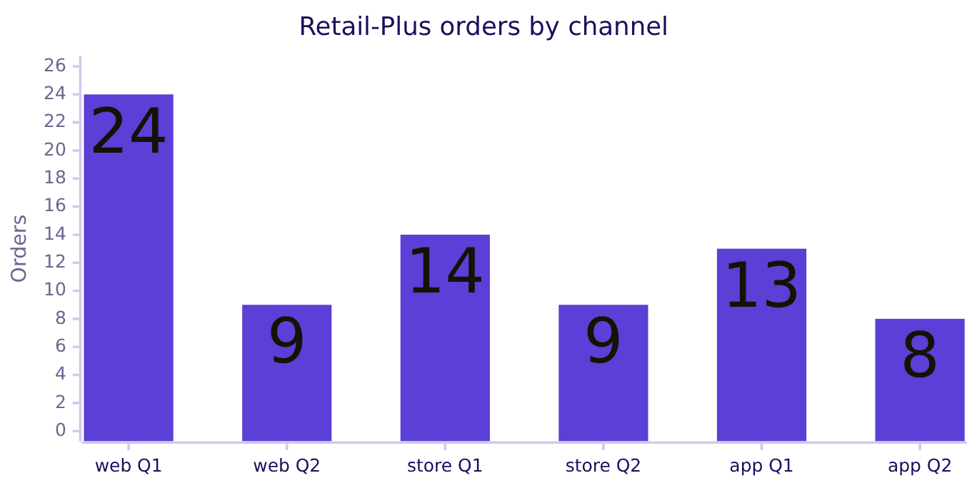
Indian Institute of Technology Gandhinagar
WEEK 1 · DAY 2 · KALPA GLOBAL CAPABILITY CENTRE
ADMINISTERED THROUGH THE COMPETENCY ADVANCEMENT ACADEMY
The season and the channel, both tested
A season that hit everyone would move Retail-Core; an app-only cause would leave the web and store alone.
What it says. Retail-Core kept 95 percent of its Q1 orders and Retail-Plus 51, so an across-the-board season does not fit; every channel fell, so an app-only cause does not fit. A season that hit members harder still fits, and last year's Q2 by segment settles it.
The memo and its evidence
The escalated case
The debrief of wrong answers
The second case
The interview drill
The close
S8 · 10 / 30
Notes:
LIVE, 3 minutes. Two predictions tested, two rivals capped. Something touched members in every
channel.

Slide 11
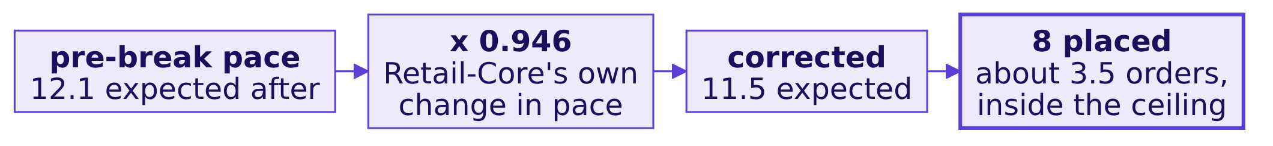
Indian Institute of Technology Gandhinagar
WEEK 1 · DAY 2 · KALPA GLOBAL CAPABILITY CENTRE
ADMINISTERED THROUGH THE COMPETENCY ADVANCEMENT ACADEMY
A second route: the pace, corrected
Take out what slowed Retail-Core across the same date, and the button's share shrinks to about 3.5.
When to switch. Write the ceiling in the memo; bring the corrected route when someone argues for the season.
The memo and its evidence
The escalated case
The debrief of wrong answers
The second case
The interview drill
The close
S9 · 11 / 30
Notes:
LIVE, 2 minutes. Retail-Core placed 22 orders in the 55 days before 25 August and 14 in the 37 after,
a pace 0.946 of what it had been. Scale the tier's expected 12.1 by it: 11.5, against 8 placed, about
3.5 orders. The route could have come out above the ceiling of 4.1 and lands below it, which is what
a ceiling predicts. The notebook also draws section 2's cumulative line against the pre-break pace.

Slide 12
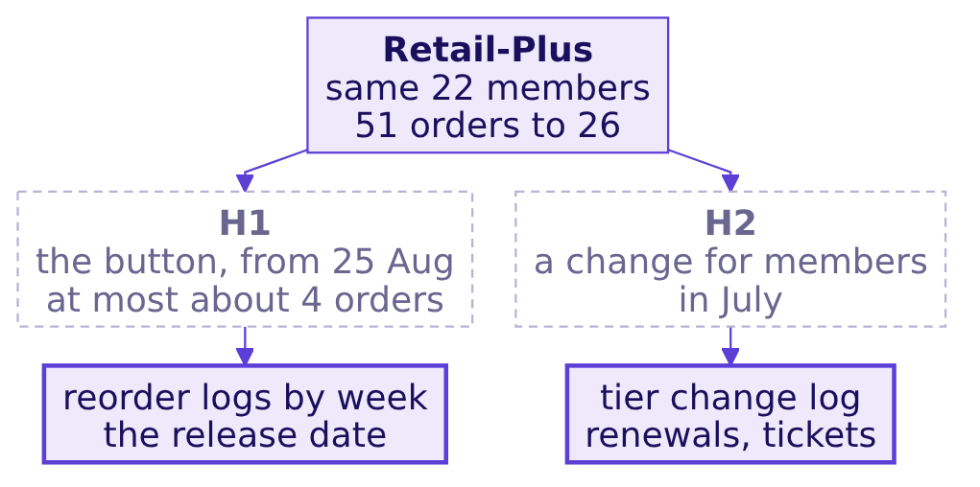


Indian Institute of Technology Gandhinagar
WEEK 1 · DAY 2 · KALPA GLOBAL CAPABILITY CENTRE
ADMINISTERED THROUGH THE COMPETENCY ADVANCEMENT ACADEMY
The memo: what we know, what we are guessing
The claim, two hypotheses with the evidence that settles each, and a rival.
KAVYA'S REVIEW
"You gave the tier a number for his cause, a ceiling of about 4 orders, instead of a yes or a no. Say what you know, then what you are guessing, and stop."
IN THE INTERVIEW
[D] A stakeholder hands you a cause; how do you test it with the data you have and name the data you need?
The memo and its evidence
The escalated case
The debrief of wrong answers
The second case
The interview drill
The close
S10 · 12 / 30
Notes:
LIVE, 4 minutes. The rival, a monsoon dip that hit members harder, goes on the same data request as
last year's Q2 by segment. One breath: restate as a hypothesis, test timing, then the comparison and
the channel, cap it, and name the data that settles it.

Slide 13
Indian Institute of Technology Gandhinagar
PG DIPLOMA IN AI-ML AND AGENTIC AI ENGINEERING · COHORT 2
ADMINISTERED THROUGH THE COMPETENCY ADVANCEMENT ACADEMY
07
The escalated case
The whole ladder again, alone, on the orders that reached customers.
The memo and its evidence
The escalated case
The debrief of wrong answers
The second case
The interview drill
The close
Week 1, Day 2. The cause on trial
13 / 30
Notes:
LIVE. The escalated case runs 50 minutes, unguided. Hand out
exercises/unguided/C2_W01_D02_escalated_case_STUDENT.md; learners work in
notebooks/C2_W01_D02_ex1_escalated_case_STUDENT.ipynb. The solution opens after the debrief.

Slide 14
Indian Institute of Technology Gandhinagar
WEEK 1 · DAY 2 · KALPA GLOBAL CAPABILITY CENTRE
ADMINISTERED THROUGH THE COMPETENCY ADVANCEMENT ACADEMY
Meera asks if the story survives delivery
The board pack, the numbers the board reads, counts only what reached customers and stayed.
THE CLIENT ASKS
"The board pack reports revenue on orders that reached the customer and stayed there. Does your story survive on delivered orders? Which branch, which segment, and what would you bet on?"
PART 1
PART 2
PART 3
PART 4
PART 5
Is the delivered drop real?
The tree on delivered
Are those lost customers?
Four segments on delivered
Mix or rate on delivered
Filter to delivered orders; compare closed quarters.
A bridge in the tree's order, one leaf at a time.
Find out what the customers who left the count did in Q2.
tree_for per segment, the rate rolled up, every group counted.
The split, and the sentence to Meera.
The memo and its evidence
The escalated case
The debrief of wrong answers
The second case
The interview drill
The close
S11 · 14 / 30
Notes:
LIVE, 3 minutes to brief, then 47 of silent work. Walk the room from minute 10. The trap in part 3 is
the escalated one: customers with a delivered order fell from 54 to 50, and Marketing would read that
as churn. Do not hint at it.

Slide 15

Indian Institute of Technology Gandhinagar
WEEK 1 · DAY 2 · KALPA GLOBAL CAPABILITY CENTRE
ADMINISTERED THROUGH THE COMPETENCY ADVANCEMENT ACADEMY
What goes in, and what comes back
Five parts, seven lettered choices in the notebook, and one line of letters posted at the end.
5
7
1
PARTS
LETTERED TODOS
SENTENCE TO MEERA
one item each in the brief
each with a check that says if it holds
branch, segment, hypotheses
THE RULE
Every number carries its definition: say "delivered" beside each one, and "booked" beside anything from this morning.
The memo and its evidence
The escalated case
The debrief of wrong answers
The second case
The interview drill
The close
S12 · 15 / 30
Notes:
LIVE, inside the 3-minute brief, before work starts. Remind the room that the notebook stops at the first placeholder
until it is filled, which is intended.

Slide 16
Indian Institute of Technology Gandhinagar
PG DIPLOMA IN AI-ML AND AGENTIC AI ENGINEERING · COHORT 2
ADMINISTERED THROUGH THE COMPETENCY ADVANCEMENT ACADEMY
08
The debrief of wrong answers
The four wrong answers the room is most likely to have reached, with their exact numbers.
The memo and its evidence
The escalated case
The debrief of wrong answers
The second case
The interview drill
The close
Week 1, Day 2. The cause on trial
16 / 30
Notes:
LIVE. The debrief runs 15 minutes, before the break. Put each wrong answer up, ask who reached it,
and let a learner who avoided it say the check. Release the solution notebook in
exercises/solutions/ at the end.

Slide 17
Indian Institute of Technology Gandhinagar
WEEK 1 · DAY 2 · KALPA GLOBAL CAPABILITY CENTRE
ADMINISTERED THROUGH THE COMPETENCY ADVANCEMENT ACADEMY
Wrong answer 1: customers fell, Marketing wins
On delivered orders customers fell from 54 to 50 and the bridge charges them Rs 10,74,442.
The check. The booked overlap is 69, 0 and 0. The branch that moved is cancellations and returns, to be split by reason, and acquisition still has nothing to replace.
The memo and its evidence
The escalated case
The debrief of wrong answers
The second case
The interview drill
The close
S13 · 17 / 30
Notes:
LIVE, 4 minutes. Ask who wrote "customers fell 7.4 percent" in part 2 and stopped there. The part 3
set, (delivered Q1 minus delivered Q2) and booked Q2, finds all 19 still ordering.

Slide 18
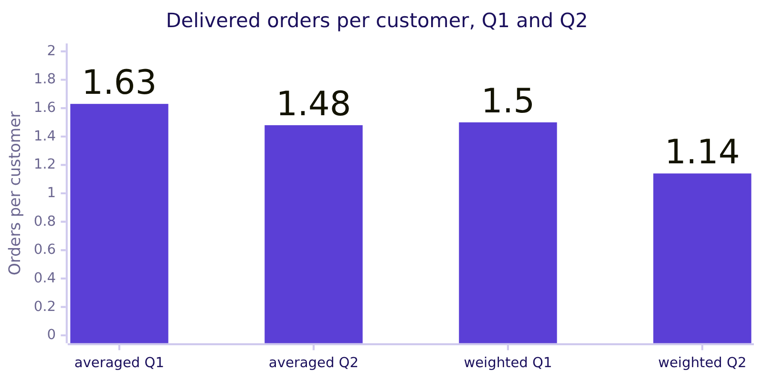
Indian Institute of Technology Gandhinagar
WEEK 1 · DAY 2 · KALPA GLOBAL CAPABILITY CENTRE
ADMINISTERED THROUGH THE COMPETENCY ADVANCEMENT ACADEMY
Wrong answer 2: delivered frequency fell 9.2%
The average of four delivered segment rates says minus 9.2 percent; the weighted figure says minus 24.0.
The check. The roll-up must reproduce 81 orders over 54 customers and 57 over 50: 1.50 and 1.14.
The memo and its evidence
The escalated case
The debrief of wrong answers
The second case
The interview drill
The close
S14 · 18 / 30
Notes:
LIVE, 3 minutes. The morning's trap in a new place. Anyone who averaged has the reason on the board
from chapter 3.

Slide 19
Indian Institute of Technology Gandhinagar
WEEK 1 · DAY 2 · KALPA GLOBAL CAPABILITY CENTRE
ADMINISTERED THROUGH THE COMPETENCY ADVANCEMENT ACADEMY
Wrong answer 3: mix is 44%, so prices rose
On delivered orders the mix explains 44 percent of the rise, and some read the rest as a price rise.
Definition | Revenue per order rise | Mix share | Rate carried by
Booked | +18.0% | 69% | Business, one large order
Delivered | +26.0% | 44% | Business, delivered orders Rs 10,24,651 to Rs 11,60,405
The check. The rate part is Business's lakh-sized orders; the consumer segments' own delivered order values moved by about a hundred rupees at most, so there is still no consumer price signal.
The memo and its evidence
The escalated case
The debrief of wrong answers
The second case
The interview drill
The close
S15 · 19 / 30
Notes:
LIVE, 4 minutes. The definition moved the split without creating a price rise anyone paid. Ask a
learner to read Retail-Plus delivered revenue per order: Rs 2,748 to Rs 2,806.

Slide 20
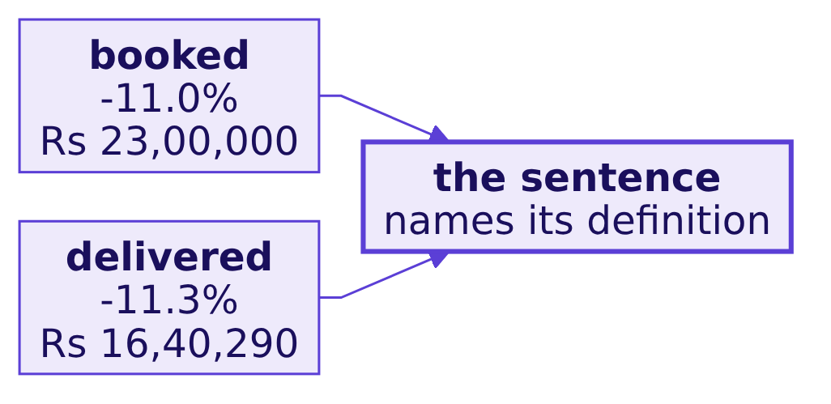
Indian Institute of Technology Gandhinagar
WEEK 1 · DAY 2 · KALPA GLOBAL CAPABILITY CENTRE
ADMINISTERED THROUGH THE COMPETENCY ADVANCEMENT ACADEMY
Wrong answer 4: a sentence with no definition
"Revenue fell 11 percent" is true on both definitions, at 11.0 and 11.3, and says neither.
KAVYA'S REVIEW
"On delivered orders the story held: frequency, Retail-Plus at minus 42.6 percent per member, and the same two hypotheses. The branch that moved was fulfilment, getting orders to customers intact. Put the definition beside every number, and the solution is open now."
The memo and its evidence
The escalated case
The debrief of wrong answers
The second case
The interview drill
The close
S16 · 20 / 30
Notes:
LIVE, 4 minutes, then the 10-minute break. Release the solution notebook.

Slide 21
Indian Institute of Technology Gandhinagar
PG DIPLOMA IN AI-ML AND AGENTIC AI ENGINEERING · COHORT 2
ADMINISTERED THROUGH THE COMPETENCY ADVANCEMENT ACADEMY
09
The second case
In pairs: Marketing's new deck, and the tier asks who to call first.
The memo and its evidence
The escalated case
The debrief of wrong answers
The second case
The interview drill
The close
Week 1, Day 2. The cause on trial
21 / 30
Notes:
LIVE. The second case runs 40 minutes in pairs: 3 to brief, 30 to work, 7 to hear two replies. Hand
out exercises/unguided/C2_W01_D02_second_case_STUDENT.md; the notebook is
notebooks/C2_W01_D02_ex2_second_case_STUDENT.ipynb.

Slide 22



Indian Institute of Technology Gandhinagar
WEEK 1 · DAY 2 · KALPA GLOBAL CAPABILITY CENTRE
ADMINISTERED THROUGH THE COMPETENCY ADVANCEMENT ACADEMY
Marketing's new deck, and the tier's call list
One of each pair answers Marketing, the other the head of Retail-Plus, from the same file.
CLAIM 1
CLAIM 2
THE TIER
7 percent more per order
Web fell hardest
Who do I call first?
"Members spend more each time, so the tier is healthy."
"Retail-Plus web orders fell 24 to 9, so it is the website team's problem."
"Which of my members do I call first?"
THE RULE
Find what each number is made of before you agree or disagree.
The memo and its evidence
The escalated case
The debrief of wrong answers
The second case
The interview drill
The close
S17 · 22 / 30
Notes:
LIVE, 3 minutes to brief. Pairs split the roles, then write one reply together, with the one data
request that settles most.

Slide 23
Indian Institute of Technology Gandhinagar
WEEK 1 · DAY 2 · KALPA GLOBAL CAPABILITY CENTRE
ADMINISTERED THROUGH THE COMPETENCY ADVANCEMENT ACADEMY
What the pairs should reach
Each claim, taken apart, and the call list with its size.
Claim | What it is made of | The reply
7 percent more per order | The same 22 members at about half the orders: 1.000 x 0.510 x 1.070, about 0.55 | Tier revenue fell about 45 percent; one leaf that rose is not the tier
Web fell hardest | Retail-Core web held, 13 to 12, same website | A site-wide fault does not fit; members fell on every channel
Who to call first | 7 members went from 3 orders to 1 | Call the 7, then the 11 who fell by one
The one request. The tier's July change log, renewals and support tickets, since the fall began in July; the reorder logs second.
The memo and its evidence
The escalated case
The debrief of wrong answers
The second case
The interview drill
The close
S18 · 23 / 30
Notes:
LIVE, 7 minutes after the work. Hear two pairs' replies. Say that every member still ordered, which
fits a broken habit more than a tier people left.

Slide 24
Indian Institute of Technology Gandhinagar
PG DIPLOMA IN AI-ML AND AGENTIC AI ENGINEERING · COHORT 2
ADMINISTERED THROUGH THE COMPETENCY ADVANCEMENT ACADEMY
10
The interview drill
Twelve questions asked aloud, one breath each, the design question among them.
The memo and its evidence
The escalated case
The debrief of wrong answers
The second case
The interview drill
The close
Week 1, Day 2. The cause on trial
24 / 30
Notes:
LIVE. The drill runs 20 minutes. Ask each question aloud to a named learner, give one breath, then
read the model answer from the notes. Tags: [S] staple asked everywhere, [F] frequent in GCC and
product screens, [SV] service-major screen opener, [D] differentiator.

Slide 25
Indian Institute of Technology Gandhinagar
WEEK 1 · DAY 2 · KALPA GLOBAL CAPABILITY CENTRE
ADMINISTERED THROUGH THE COMPETENCY ADVANCEMENT ACADEMY
Questions 1 to 6: the ladder and the tree
The row's anchors and the decomposition questions, where a plausible number is waiting.
Tag | Question
[S] | 1. Sales dropped 15 percent last month; how would you investigate?
[S] | 2. Why is a rate without a denominator meaningless?
[F] | 3. Why does a function that prints instead of returning break a pipeline?
[F] | 4. What has to match before a quarter-on-quarter comparison is fair?
[D] | 5. Marketing insists the answer is acquisition and your data says frequency; how do you make the case in the room?
[F] | 6. Revenue fell 11 percent; how do you split the change between customers, frequency and order value?
The memo and its evidence
The escalated case
The debrief of wrong answers
The second case
The interview drill
The close
S19 · 25 / 30
Notes:
LIVE, 10 minutes.
1. Confirm on matched windows, decompose into customers, orders per customer and revenue per order,
isolate the segment, split mix from rate, then name a hypothesis with its evidence, timing first.
2. Nobody can check it or compare it: orders per customer is 1.25 over 69 booked customers and 1.14
over 50 delivered ones, so the denominator decides the number.
3. The caller gets None, and the next step crashes or silently drops that group.
4. Window length and dates, the definition, the population and the denominator; closed quarters, or
the same weeks of each; the season needs last year.
5. Test their claim in its own terms: the overlap shows none lost and none new; show where the fall
is; end on what would change my mind.
6. A bridge one leaf at a time in a fixed order; say the order, or use the symmetric split.

Slide 26
Indian Institute of Technology Gandhinagar
WEEK 1 · DAY 2 · KALPA GLOBAL CAPABILITY CENTRE
ADMINISTERED THROUGH THE COMPETENCY ADVANCEMENT ACADEMY
Questions 7 to 12: weights, churn and design
The case-style follow-ups and the design questions that separate candidates.
Tag | Question
[F] | 7. Revenue per order rose 18 percent while revenue fell; did prices go up?
[S] | 8. A field is missing on some records; do you fill it with zero?
[F] | 9. You have orders per customer for four segments; why can't you average them?
[SV] | 10. The customer count is flat; does that prove no customers were lost?
[D] | 11. The same metrics are needed for every segment and quarter: copy, function or group by key?
[D] | 12. A stakeholder hands you a cause; how do you test it and name the data you need?
The memo and its evidence
The escalated case
The debrief of wrong answers
The second case
The interview drill
The close
S20 · 26 / 30
Notes:
LIVE, 10 minutes.
7. Mostly mix: small orders fell away; 69 percent of the rise on booked orders.
8. No: absent is unknown; count it, report it, write the rule, bound it.
9. Each rate has its own denominator; total over total reproduces the company figure.
10. No: compare ids, lost and new; here 69, 0 and 0.
11. A function when groups are asked one at a time and definitions change; one pass by key when the
file is large and every group is needed at once.
12. Timing first, then a comparison group, then the channel it predicts; cap it; request the data
that settles it.

Slide 27
Indian Institute of Technology Gandhinagar
PG DIPLOMA IN AI-ML AND AGENTIC AI ENGINEERING · COHORT 2
ADMINISTERED THROUGH THE COMPETENCY ADVANCEMENT ACADEMY
11
The close
The Kahoot, the sentence to Meera, the eight lines to keep, and tomorrow's question.
The memo and its evidence
The escalated case
The debrief of wrong answers
The second case
The interview drill
The close
Week 1, Day 2. The cause on trial
27 / 30
Notes:
LIVE. The close runs 15 minutes: Kahoot 8, the sentence and the lines 5, tomorrow's question 2.

Slide 28
Indian Institute of Technology Gandhinagar
WEEK 1 · DAY 2 · KALPA GLOBAL CAPABILITY CENTRE
ADMINISTERED THROUGH THE COMPETENCY ADVANCEMENT ACADEMY
The sentence that goes to Meera
A claim, its evidence, its caveat and the next step, in the order she needs them.
"Revenue fell 11.0 percent between two closed quarters, Rs 2.10 crore to Rs 1.87 crore on the export as it stands. Customers held at 69, every one of them buying in both quarters, so acquisition is not the branch that moved; orders per customer fell from 1.65 to 1.25. In behaviour the fall sits in Retail-Plus, where the same 22 members placed 26 orders against 51, and revenue per order rose mainly because those small orders disappeared. In rupees most of it is three fewer Business orders, each worth lakhs, so one account's timing moves it by lakhs. The fall began in July, before the reorder button broke, so the button explains at most about 4 orders; we are asking for the tier's July change log and the app's reorder logs."
The data and AI team, to Meera Raghavan
The memo and its evidence
The escalated case
The debrief of wrong answers
The second case
The interview drill
The close
S21 · 28 / 30
Notes:
LIVE, 2 minutes after the Kahoot. Read it aloud once, slowly. Ask one learner which part their own
sentence missed; most miss the ceiling or the data to ask for. The Kahoot pack is
kahoot/C2_W01_D02_quiz_STUDENT.md, eight items, ungraded.

Slide 29
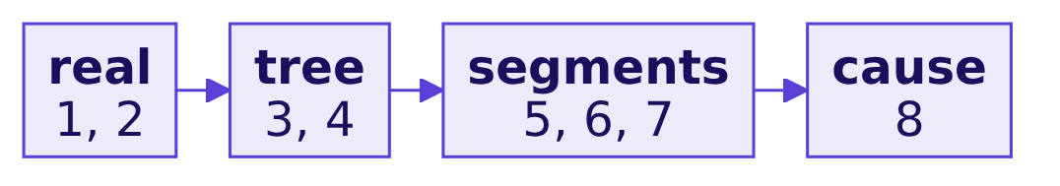
Indian Institute of Technology Gandhinagar
WEEK 1 · DAY 2 · KALPA GLOBAL CAPABILITY CENTRE
ADMINISTERED THROUGH THE COMPETENCY ADVANCEMENT ACADEMY
Eight lines to keep
The day's rules, word for word as the cheat sheet prints them.
01
Confirm the drop on matched windows before you explain it.
02
A rate without its denominator is a rumour.
03
Decompose along the tree: customers, orders per customer, revenue per order.
04
Missing means unknown until someone chooses a default and writes down why.
05
Roll a rate up with its weights; never average the averages.
06
A blended rate can move while no segment moves; split mix from rate.
07
A function returns its answer; count the groups in and the groups out.
08
Name the cause as a hypothesis, with its ceiling and the evidence that would settle it.
The memo and its evidence
The escalated case
The debrief of wrong answers
The second case
The interview drill
The close
S22 · 29 / 30
Notes:
LIVE, 3 minutes. Read the eight lines aloud with the room. The chain maps them onto the chapters.

Slide 30
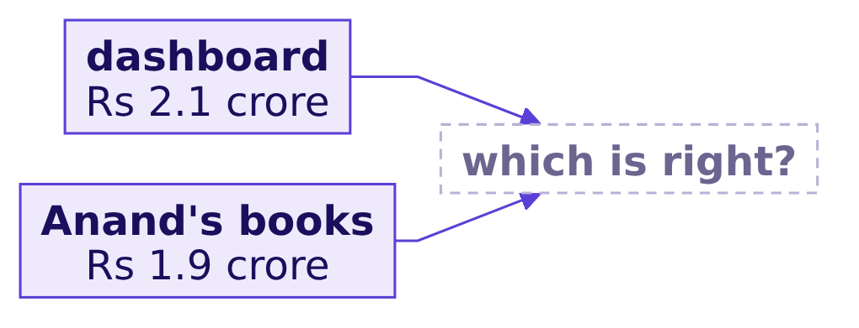
Indian Institute of Technology Gandhinagar
WEEK 1 · DAY 2 · KALPA GLOBAL CAPABILITY CENTRE
ADMINISTERED THROUGH THE COMPETENCY ADVANCEMENT ACADEMY
Tomorrow, Anand questions tonight's numbers
Finance's books and the dashboard disagree about Q1, and the answer waits for Wednesday.
"Your dashboard says Q1 was Rs 2.1 crore. Our books say 1.9. Until your numbers match ours, Finance will not act on a drop measured from an ERP export. Send me a reconciliation."
Anand Iyer, finance controller, Kalpa Retail
The memo and its evidence
The escalated case
The debrief of wrong answers
The second case
The interview drill
The close
S23 · 30 / 30
Notes:
LIVE, 2 minutes. Read Anand's line and stop. Do not predict the answer. Every number today was on the
export as it stands; point to the take-home brief. The TA-led practice lab follows.

