Slide 1


Indian Institute of Technology Gandhinagar
ADMINISTERED THROUGH THE COMPETENCY ADVANCEMENT ACADEMY
WEEK 2 · TUESDAY · AFTERNOON
Can the collected number leave the team?
“If there is a gap, I want to know which orders and which channel.”
Anand Iyer, finance controller, Kalpa Retail, in the message that opened the day
06
Can the number leave?
07
Which orders make the gap?
08
What do the lab and tonight carry?
09
What leaves the room today?
Week 2, Day 2. Can the collected number leave the team?
1 / 34
Notes:
LIVE, one minute. The trainer keeps the afternoon's first 60 minutes: chapter 6 (30), the escalated
case's first two parts (20), and the Kahoot with tomorrow's question (10).
The tentative IITGN faculty block W2-2 takes the last 120 minutes.
The rest of the escalated case, the second case and
the interview drill move to the TA-led practice lab and the take-home; their slides are marked D so
a learner can work them alone.
Transition: one slide of what the morning settled, then chapter 6.

Slide 2

Indian Institute of Technology Gandhinagar
WEEK 2 · DAY 2 · KALPA GLOBAL CAPABILITY CENTRE
ADMINISTERED THROUGH THE COMPETENCY ADVANCEMENT ACADEMY
Five answers the morning reached, with numbers
What did chapters 1 to 5 settle before the number can leave?
Chapter | What it settled
1. What does a join keep? | LEFT JOIN with orders first keeps every booked order; on five invented orders INNER returns 6 rows, LEFT 7, RIGHT 7, FULL 8
2. Why twice the bookings? | A fan-out: the first draft reported Rs 19,29,04,410 against Rs 9,84,00,000 booked; payments go to one row per order before the join
3. Is every order there? | Rows in 462, rows out 462; a plain JOIN drops the unpaid order, and the bridge names every rupee from booked to posted
4. Which orders, exactly? | The unpaid list is an anti-join; a date filter in WHERE empties it; a retry is one order and instalment posted twice
5. What does Anand sign? | The page by channel, reconciled, with both lists; coalesce keeps an unpaid order in the gap
Can the number leave?
Which orders make the gap?
What do the lab and tonight carry?
What leaves the room today?
S1 · 2 / 34
Notes:
LIVE, 1 minute. Read the five lines as the room's own findings; each learner's collected figure,
gap and lists are on their own page from chapter 5. Five wrong pages appeared on the way, each
plausible: chapter 2's fan-out draft, chapter 3's plain JOIN draft and its LEFT JOIN that still read
posted as collected, chapter 4's quarter in WHERE, and chapter 5's gap added up order by order.
Chapter 6 builds the checks that stop all five, every Monday.

Slide 3
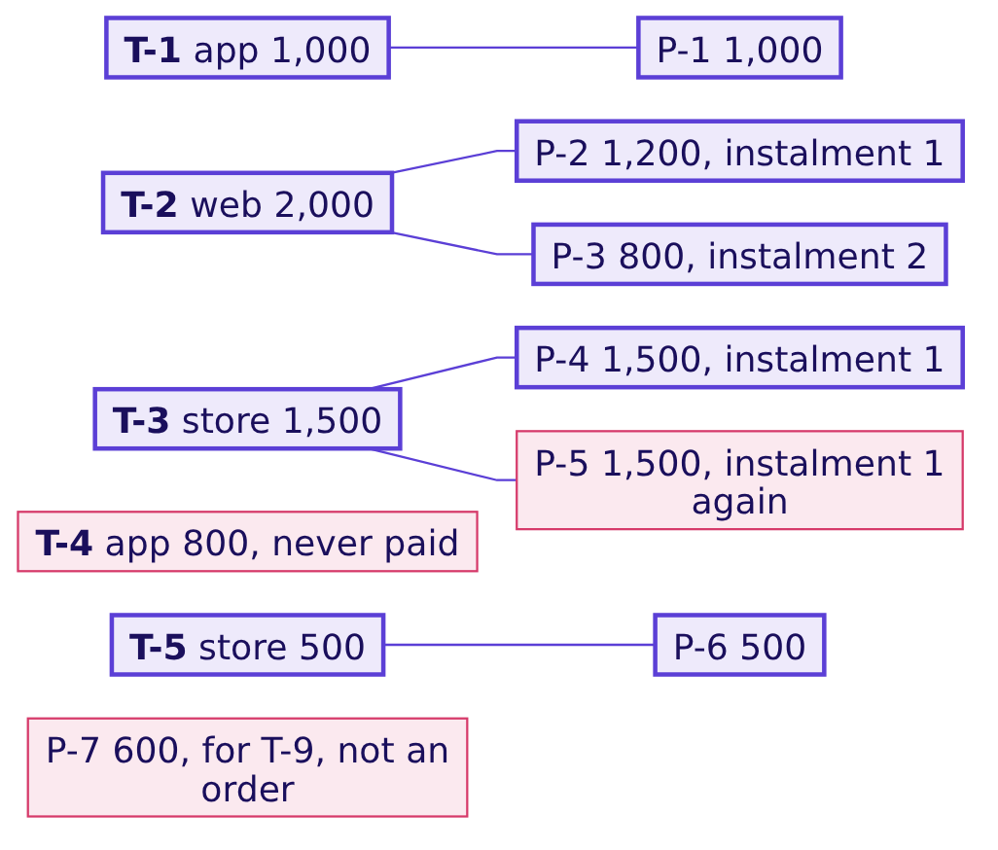
Indian Institute of Technology Gandhinagar
WEEK 2 · DAY 2 · KALPA GLOBAL CAPABILITY CENTRE
ADMINISTERED THROUGH THE COMPETENCY ADVANCEMENT ACADEMY
Five orders, seven payments, every row checkable
Which invented tables does chapter 6 test its checks on?
T-2 paid in two instalments, the gateway posted T-3's one payment twice, T-4 was never paid, and P-7 names an order the orders table does not hold. Booked is 5,800; collected, each payment counted once, is 5,000; the feed posted 6,500 against these five orders; the gap is 800, which is T-4.
Can the number leave?
Which orders make the gap?
What do the lab and tonight carry?
What leaves the room today?
S1b · 3 / 34
Notes:
LIVE, folded into the minute of S1. These are chapter 1's tables, the ones every chapter traced by
hand; the afternoon's wrong pages are all written on them.

Slide 4
Indian Institute of Technology Gandhinagar
PG DIPLOMA IN AI-ML AND AGENTIC AI ENGINEERING · COHORT 2
ADMINISTERED THROUGH THE COMPETENCY ADVANCEMENT ACADEMY
06
Can the number leave?
Which checks must pass before the collected number leaves the team, and what does Anand get when one fails at the end of reporting day?
Can the number leave?
Which orders make the gap?
What do the lab and tonight carry?
What leaves the room today?
Week 2, Day 2. Can the collected number leave the team?
4 / 34
Notes:
LIVE. Chapter 6 runs 30 minutes with the cover and the morning's five answers (2): the map, the need
and Wirecard (4), the four ways and the call (4), the hurried checks and why they pass (6), the
tie-back suite on one report and on all five (7), Kalpa's report (1), the second route (2), the
reporting-day rule (3), the close (1). Notebook 6,
C2_W02_D02_06_can_it_leave_STUDENT.ipynb.

Slide 5
Indian Institute of Technology Gandhinagar
WEEK 2 · DAY 2 · KALPA GLOBAL CAPABILITY CENTRE
ADMINISTERED THROUGH THE COMPETENCY ADVANCEMENT ACADEMY
Answer in six steps, from a PASS to a rule
Who needs chapter 6's answer, and which smaller questions lead to it?
Who needs the answer. Kavya Nair, the team's senior analyst, who reviews every number before it leaves the team; Anand, who forwards it to the CEO's Monday page; and you, who sign it. A validation that cannot fail puts a PASS stamp on a wrong number, and a stamped wrong number is harder to withdraw than an unstamped one.
1
2
3
4
5
6
Can hurried checks miss an order?
Which checks tie to the tables?
Do the two suites stop all five?
Does Kalpa's Q2 page pass?
Does Python reach the same?
What leaves when a check fails?
Five checks, each read outside the report.
The day's five wrong reports, one by one.
The suite on the real page.
The same numbers from the raw rows.
What Anand gets late on reporting day.
Three plausibility checks on a page that hides one.
Can the number leave?
Which orders make the gap?
What do the lab and tonight carry?
What leaves the room today?
S2 · 5 / 34
Notes:
LIVE, 1 minute. The metric is the collected figure and its gap, every Monday, and the checks that
stand between them and Anand: which of the day's wrong reports each check would stop.

Slide 6



Indian Institute of Technology Gandhinagar
WEEK 2 · DAY 2 · KALPA GLOBAL CAPABILITY CENTRE
ADMINISTERED THROUGH THE COMPETENCY ADVANCEMENT ACADEMY
A PASS on a wrong number is forwarded with more trust
What does a PASS stamp cost when the check behind it could not fail?
EVERY MONDAY
WHAT CHECKS BUY
A CHECK THAT CANNOT FAIL
Whoever is on the rota
No line-by-line read
Worse than none
The number is refreshed weekly, sometimes late on reporting day, by whoever runs it that week.
Checks let a number leave without Kavya reading every query.
The PASS line travels with the number, and Anand forwards it with more confidence than an unchecked one.
Can the number leave?
Which orders make the gap?
What do the lab and tonight carry?
What leaves the room today?
S3 · 6 / 34
Notes:
LIVE, 1 minute. Say it plainly: a check is worth only its power to fail. Ask the room for a check in
their own work that has never failed, and what that proves.

Slide 7
Indian Institute of Technology Gandhinagar
WEEK 2 · DAY 2 · KALPA GLOBAL CAPABILITY CENTRE
ADMINISTERED THROUGH THE COMPETENCY ADVANCEMENT ACADEMY
Wirecard reported cash it did not have
Which real company's checks read its own records back to it?
2016 TO 2018
18 JUNE 2020
22 JUNE 2020
25 JUNE 2020
The check that could not fail
No sign-off
1.9 billion euros
Insolvency
EY refused to sign off on the accounts, saying it was unable to confirm the money existed.
Wirecard said there was "a prevailing likelihood" that its trust account balances did not exist.
Wirecard filed for insolvency.
EY had not checked directly with Singapore's OCBC Bank and relied on documents and screenshots from a trustee and from Wirecard itself, the FT reported.
Can the number leave?
Which orders make the gap?
What do the lab and tonight carry?
What leaves the room today?
S4 · 7 / 34
Notes:
LIVE, 2 minutes. Sources: BBC News, 18, 22 and 25 June 2020; the FT's report republished by the
Irish Times on 26 June 2020, attributed to people with first-hand knowledge; all checked 1 Oct 2026,
URLs in the provenance. Wirecard claimed up to 1 billion euros in cash at OCBC; the 1.9 billion was
later said to sit in banks in the Philippines. The point for the day: every check this chapter
builds reads Kalpa's own tables, so name what they cannot see.

Slide 8
Indian Institute of Technology Gandhinagar
WEEK 2 · DAY 2 · KALPA GLOBAL CAPABILITY CENTRE
ADMINISTERED THROUGH THE COMPETENCY ADVANCEMENT ACADEMY
Four ways to validate, sized on five wrong reports
Which of four ways to validate stops the day's wrong reports, and what does each cost?
Option | What it does | Wrong reports it stops, of 5 | Time on Kalpa's Q2
A. Read the report | A person looks at the page | depends on the reader | minutes of a person
B. Plausibility checks | Collected at most booked, no negative gap, every channel present | 3 | milliseconds, the report alone
C. Tie-back checks | Every figure recomputed from the source tables and compared | 5 | milliseconds, report and sources
D. An independent recomputation | The same figures from the raw rows by another tool | 5 | milliseconds, the raw rows
The five wrong pages. Chapter 2's fan-out draft, chapter 3's plain JOIN draft and its LEFT JOIN that still read posted as collected, chapter 4's quarter in WHERE, and chapter 5's gap summed order by order, each written on the invented tables.
Can the number leave?
Which orders make the gap?
What do the lab and tonight carry?
What leaves the room today?
S5 · 8 / 34
Notes:
LIVE, 2 minutes. A is not sized, since what it catches depends on who reads. B costs the same as C
and stops three pages in five; which two it misses is S12's question, so do not say. Hold the call
for the next slide.

Slide 9
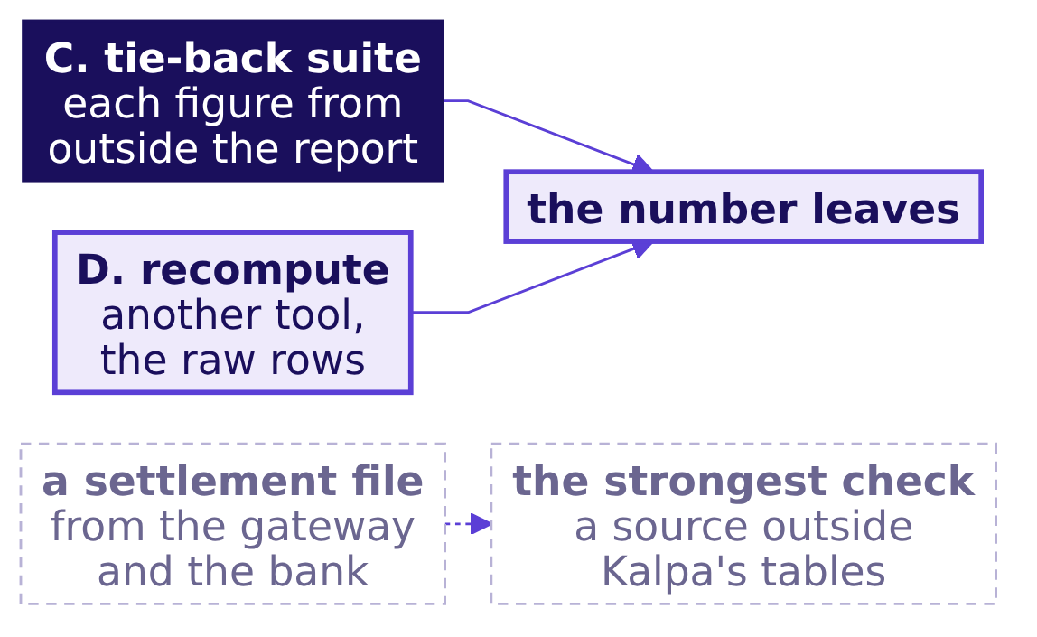
Indian Institute of Technology Gandhinagar
WEEK 2 · DAY 2 · KALPA GLOBAL CAPABILITY CENTRE
ADMINISTERED THROUGH THE COMPETENCY ADVANCEMENT ACADEMY
The call: tie-back, with a recompute beside it
Which way fits, and what fact would change the call?
The fact that would change the call. A settlement file from the gateway, the list of what reached Kalpa's bank, would be a source outside Kalpa's own tables, and reconciling to it would become the strongest check of all.
Can the number leave?
Which orders make the gap?
What do the lab and tonight carry?
What leaves the room today?
S6 · 9 / 34
Notes:
LIVE, 2 minutes. Each tie-back check compares a figure on the report with the same figure computed
outside it: booked from orders alone, posted from payments alone, and the gap from lists no join can
multiply. The Python recomputation reaches
the numbers by a different tool and a different rule for counting a payment once, so an error in
the SQL and the same error in the checks would still be caught.

Slide 10
Indian Institute of Technology Gandhinagar
WEEK 2 · DAY 2 · KALPA GLOBAL CAPABILITY CENTRE
ADMINISTERED THROUGH THE COMPETENCY ADVANCEMENT ACADEMY
Question: do the hurried checks pass the report?
Do the checks a hurried analyst writes pass a report that hides an unpaid order?
The plausible wrong answer. A hurried validation checks what a finance reader expects of any collections report: collected is at most booked, the gap is not negative, and all three channels are on the page. It runs on the page written with chapter 4's mistake, the quarter's dates on payments placed in WHERE, which dropped T-4.
The quarter-in-WHERE page, invented | Figure
Orders | 4
Booked | 5,000
Collected | 5,000
Gap | 0
Question. How many of the three checks pass? a) none; b) one; c) two; d) all three.
Can the number leave?
Which orders make the gap?
What do the lab and tonight carry?
What leaves the room today?
S7 · 10 / 34
Notes:
LIVE, 2 minutes. Take letters. Most rooms expect at least one check to catch it.

Slide 11
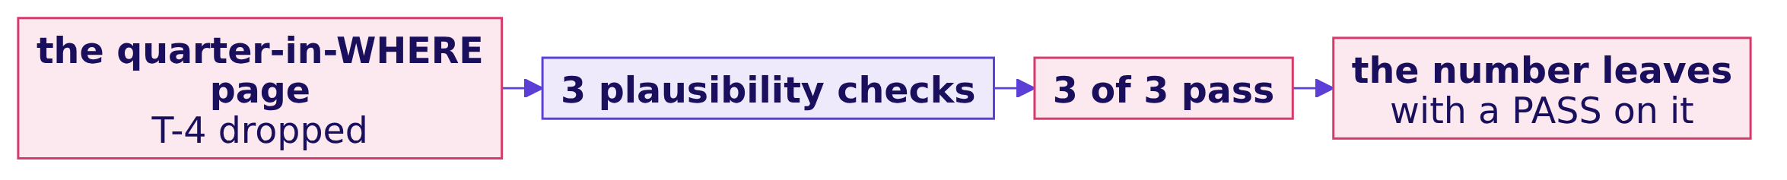
Indian Institute of Technology Gandhinagar
WEEK 2 · DAY 2 · KALPA GLOBAL CAPABILITY CENTRE
ADMINISTERED THROUGH THE COMPETENCY ADVANCEMENT ACADEMY
Answer: all three pass, and the number leaves
What exactly does the hurried suite report on a page that hides T-4?
The answer is d. Collected 5,000 is at most booked 5,000, the gap of 0 is not negative, and app is still on the page through T-1. The suite stamps "3 of 3 passed" on a page that hides the one order nobody paid.
Can the number leave?
Which orders make the gap?
What do the lab and tonight carry?
What leaves the room today?
S8 · 11 / 34
Notes:
LIVE, 2 minutes. Say the wrong output exactly: 3 of 3 passed. This is the chapter's trap.

Slide 12
Indian Institute of Technology Gandhinagar
WEEK 2 · DAY 2 · KALPA GLOBAL CAPABILITY CENTRE
ADMINISTERED THROUGH THE COMPETENCY ADVANCEMENT ACADEMY
Why it is wrong: each check reads the report
Why can a suite that never looks outside the report not see what it left out?
Plausibility check | What it compares | Why the missing order cannot fail it
Collected at most booked | the report with itself | T-4 took its booked amount with it
The gap is not negative | the report with itself | 0 is not negative
All three channels present | the report with itself | app is there through T-1
The check that catches it. One that looks outside the report: orders on the report against orders in the table, 4 against 5.
Can the number leave?
Which orders make the gap?
What do the lab and tonight carry?
What leaves the room today?
S9 · 12 / 34
Notes:
LIVE, 2 minutes. The report agrees with itself and disagrees with the tables. Every plausibility
check tests the report against itself, which is the Wirecard pattern in miniature.

Slide 13
Indian Institute of Technology Gandhinagar
WEEK 2 · DAY 2 · KALPA GLOBAL CAPABILITY CENTRE
ADMINISTERED THROUGH THE COMPETENCY ADVANCEMENT ACADEMY
Question: which tie-back checks fail it?
Which checks tie the report back to the two tables, and which of them fail the quarter-in-WHERE page?
Tie-back check | Computed from
Orders on the report equal orders in the table | orders alone
Booked equals booked from orders alone | orders alone
The gap equals booked less collected | the report's own columns
The gap equals the never-paid and paid-short lists | the anti-join, and each order's instalments against its booked
Collected plus posted twice equals posted from payments alone | payments alone
Question. On the same page, which checks fail? a) none; b) orders, booked and the two lists; c) only the gap; d) all five.
Can the number leave?
Which orders make the gap?
What do the lab and tonight carry?
What leaves the room today?
S10 · 13 / 34
Notes:
LIVE, 2 minutes. Each tie-back check recomputes one figure outside the report and compares it with
the report. Take letters.

Slide 14
Indian Institute of Technology Gandhinagar
WEEK 2 · DAY 2 · KALPA GLOBAL CAPABILITY CENTRE
ADMINISTERED THROUGH THE COMPETENCY ADVANCEMENT ACADEMY
Answer: orders, booked and the two lists fail
What does the tie-back suite say about the report the hurried suite passed?
Tie-back check | On the quarter-in-WHERE page
Orders on the report equal orders in the table | FAIL, 4 against 5
Booked equals booked from orders alone | FAIL, 5,000 against 5,800
The gap equals booked less collected | PASS
The gap equals the never-paid and paid-short lists | FAIL, 0 against 800 never paid and 0 paid short
Collected plus posted twice equals posted from payments alone | PASS
The answer is b. The page's own arithmetic passes; only checks that look outside it can say it is wrong.
Can the number leave?
Which orders make the gap?
What do the lab and tonight carry?
What leaves the room today?
S11 · 14 / 34
Notes:
LIVE, 2 minutes. This is the fix for the hurried suite: the same page, checked against the two
tables, fails three ways. The gap is tied to both lists, the orders never paid and the orders paid
in part, since a part-paid order is a gap too; on these tables nothing is paid short.

Slide 15
Indian Institute of Technology Gandhinagar
WEEK 2 · DAY 2 · KALPA GLOBAL CAPABILITY CENTRE
ADMINISTERED THROUGH THE COMPETENCY ADVANCEMENT ACADEMY
Question: which two wrong pages get through?
Do the two suites stop every wrong report the day has met?
Wrong page, invented | Where the day met it | Orders | Booked | Collected | Gap
The fan-out draft | Chapter 2 | 7 | 5,800 | 8,500 | minus 2,700
The plain JOIN draft | Chapter 3 | 4 | 5,000 | 6,500 | minus 1,500
Posted as collected | Chapter 3, after the LEFT JOIN | 5 | 5,800 | 6,500 | minus 700
The quarter in WHERE | Chapter 4 | 4 | 5,000 | 5,000 | 0
The gap summed per order | Chapter 5 | 5 | 5,800 | 5,000 | 0
Question. The plausibility suite stops three of the five. Which two does it let through? a) the fan-out and plain JOIN drafts; b) the quarter in WHERE and the summed gap; c) posted as collected and the quarter in WHERE; d) the fan-out draft and the summed gap.
Can the number leave?
Which orders make the gap?
What do the lab and tonight carry?
What leaves the room today?
S12 · 15 / 34
Notes:
LIVE, 1 minute. Each page is one of the day's mistakes written with its chapter's figures, and
every page carries all three channels. Take letters.

Slide 16
Indian Institute of Technology Gandhinagar
WEEK 2 · DAY 2 · KALPA GLOBAL CAPABILITY CENTRE
ADMINISTERED THROUGH THE COMPETENCY ADVANCEMENT ACADEMY
Answer: the two pages that hide T-4 get through
Which wrong pages does each suite stop?
Wrong page | Plausibility suite | Tie-back suite
The fan-out draft | fails: 8,500 exceeds 5,800 | fails on orders, the two lists and posted
The plain JOIN draft | fails: 6,500 exceeds 5,000 | fails 4 of 5, all but the page's own arithmetic
Posted as collected | fails: 6,500 exceeds 5,800 | fails on the two lists and posted
The quarter in WHERE | passes | fails on orders, booked and the two lists
The gap summed per order | passes | fails on both gap checks
The answer is b. Every page with more cash on it than was booked fails the hurried suite at once; a page that hides T-4 loses its booked and its cash together, or loses the gap to a NULL, so nothing on it looks wrong. The check. The tie-back suite fails every wrong page on at least one check and passes the true page on all five.
Can the number leave?
Which orders make the gap?
What do the lab and tonight carry?
What leaves the room today?
S13 · 16 / 34
Notes:
LIVE, 2 minutes. Dwell on the last two rows: the mistakes that hide an unpaid order are the quiet
ones, and they are the ones Anand's question is about. Kavya's rule follows from this slide: do not
send a PASS you have never seen fail.

Slide 17
Indian Institute of Technology Gandhinagar
WEEK 2 · DAY 2 · KALPA GLOBAL CAPABILITY CENTRE
ADMINISTERED THROUGH THE COMPETENCY ADVANCEMENT ACADEMY
Kalpa's Q2 page passes all five checks
Does the suite pass Kalpa's Q2 report?
Tie-back check, Kalpa's Q2 | Verdict | Detail
Orders on the report equal orders in the table | PASS | 462 against 462
Booked equals booked from orders alone | PASS | Rs 9,84,00,000 against Rs 9,84,00,000
The gap equals booked less collected | PASS | equal, figures on your own page
The gap equals the never-paid and paid-short lists | PASS | equal, figures on your own page
Collected plus posted twice equals posted | PASS | equal, figures on your own page
The page may leave the team, and every one of the 1,428 payment rows sits on a Q1 order, a Q2 order or no order at all.
Can the number leave?
Which orders make the gap?
What do the lab and tonight carry?
What leaves the room today?
S14 · 17 / 34
Notes:
LIVE, 1 minute. The verdicts print; the figures that would name what the room is finding stay on
each learner's own page. Say the sentence: this report may leave the team.

Slide 18
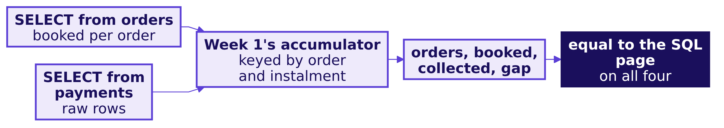
Indian Institute of Technology Gandhinagar
WEEK 2 · DAY 2 · KALPA GLOBAL CAPABILITY CENTRE
ADMINISTERED THROUGH THE COMPETENCY ADVANCEMENT ACADEMY
A second route: Python counts the raw rows
Does a second tool, working from the raw rows, reach the same numbers?
A repeat of the same instalment overwrites itself in the dictionary and counts once. The check. On the invented tables both tools give 5 orders, booked 5,800, collected 5,000 and a gap of 800, and they agree on Kalpa's Q2.
Can the number leave?
Which orders make the gap?
What do the lab and tonight carry?
What leaves the room today?
S15 · 18 / 34
Notes:
LIVE, 2 minutes. The route shares no join, no GROUP BY and no NULL rule with the SQL report, so a
mistake in one is unlikely to repeat in the other. Its own blind spot: it assumes a retry repeats the
same amount, which chapter 3's cap method checked.

Slide 19
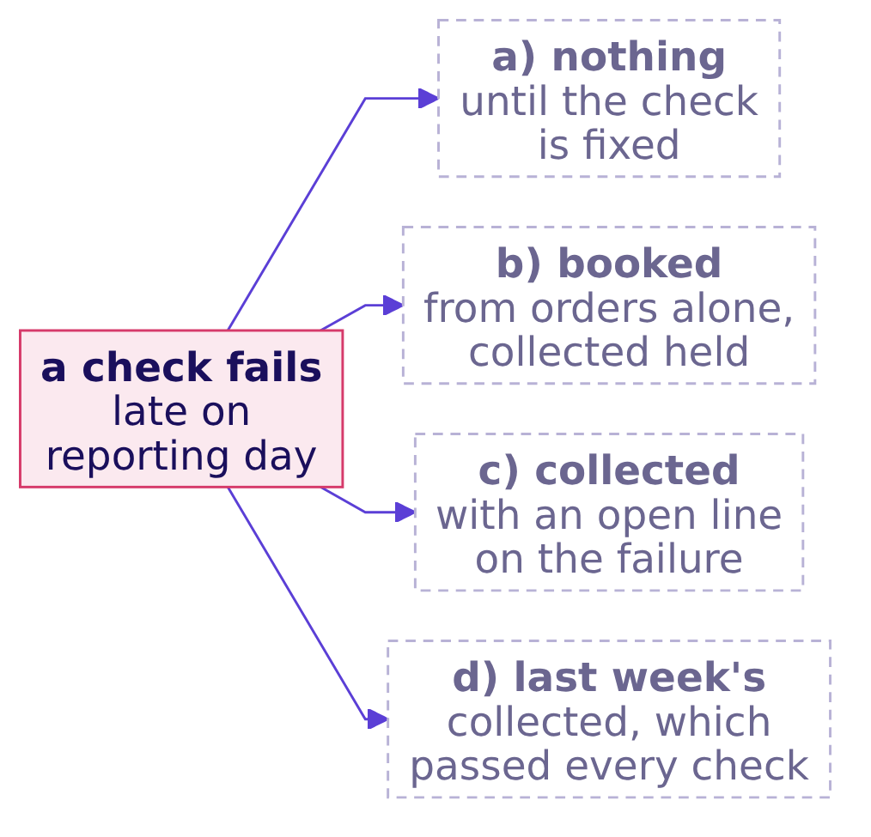
Indian Institute of Technology Gandhinagar
WEEK 2 · DAY 2 · KALPA GLOBAL CAPABILITY CENTRE
ADMINISTERED THROUGH THE COMPETENCY ADVANCEMENT ACADEMY
Question: what does Anand get when a check fails?
What does Anand get when a check fails at the end of reporting day?
An open line names a failed check, what it means and when it will close.
Question. Which does the team send? a) nothing, until the check is fixed and the open line is closed; b) booked from orders alone, with the open line; collected held; c) collected, with an open line saying that one check failed; d) last week's collected, which passed every check.
Can the number leave?
Which orders make the gap?
What do the lab and tonight carry?
What leaves the room today?
S16 · 19 / 34
Notes:
LIVE, 1 minute. A failed check is information, and the day it fails matters: late on reporting day
there may be no time to fix it. Take letters.

Slide 20
Indian Institute of Technology Gandhinagar
WEEK 2 · DAY 2 · KALPA GLOBAL CAPABILITY CENTRE
ADMINISTERED THROUGH THE COMPETENCY ADVANCEMENT ACADEMY
Answer: booked leaves, collected is held
Which check failing means what, and who fixes it the same day?
The check that fails | What it means | What Anand gets that day | Who fixes it
Orders against the table | The join dropped or repeated an order | Booked; collected held | You
Booked against orders alone | A fan-out that reached booked, or a dropped order | Booked from orders alone; collected held | You
The gap against booked less collected | A NULL fell out of a sum | The page with the gap recomputed | You
The gap against the two lists | A list or a bar is wrong | Booked and collected, the gap provisional | You, with Kavya
Collected plus posted twice against posted | The feed changed | Booked; collected held; the lead told | The platform lead
The answer is b. The rule. Booked always leaves, because it ties to the orders table alone; an unreconciled collected figure never leaves; the open line, which check failed, what it means and when it will close, goes with it.
Can the number leave?
Which orders make the gap?
What do the lab and tonight carry?
What leaves the room today?
S17 · 20 / 34
Notes:
LIVE, 2 minutes. Option c is the one people send, and it is the one that puts an unreconciled figure
on the CEO's page. Every check has a named owner. Interview [D]: design the validation you run
before a joined number reaches Finance, and say what you do when it fails at the end of reporting day.

Slide 21


Indian Institute of Technology Gandhinagar
WEEK 2 · DAY 2 · KALPA GLOBAL CAPABILITY CENTRE
ADMINISTERED THROUGH THE COMPETENCY ADVANCEMENT ACADEMY
Chapter 6, answered in six lines
What did chapter 6 answer, and what does the day's page now carry?
Question | The answer, with its number
Can hurried checks miss an order? | Yes: 3 of 3 pass the quarter-in-WHERE page, which hides T-4
Which checks tie to the tables? | Five checks recompute orders, booked, the gap and posted outside the page
Do the two suites stop all five? | Plausibility lets 2 of 5 through; the tie-back suite stops all 5
Does Kalpa's Q2 page pass? | Yes, 5 of 5: 462 against 462, Rs 9,84,00,000 against Rs 9,84,00,000
Does Python reach the same? | Yes: orders, booked, collected and the gap all match
What leaves when a check fails? | Booked leaves with the open line; collected is held; the owner hears that day
KAVYA'S REVIEW
"A check that cannot fail is decoration. For every check, tell me which wrong report it would have stopped, and do not send me a PASS you have never seen fail."
IN THE INTERVIEW
[D] Design the validation a joined number passes before Finance, and what you do when it fails late. And [S] which one check would you keep?
Can the number leave?
Which orders make the gap?
What do the lab and tonight carry?
What leaves the room today?
S18 · 21 / 34
Notes:
LIVE, 1 minute. The day's answer, for Anand: Q2 booked Rs 9,84,00,000; collected, each payment
counted once, is the figure on each learner's own page; the gap is the orders nobody paid, named by
channel; the retries and the payments with no order go to the platform lead; and every figure ties
back to the two tables through checks that have each been seen to fail.

Slide 22
Indian Institute of Technology Gandhinagar
PG DIPLOMA IN AI-ML AND AGENTIC AI ENGINEERING · COHORT 2
ADMINISTERED THROUGH THE COMPETENCY ADVANCEMENT ACADEMY
07
Which orders make the gap?
Which Q2 orders and channels make the gap, and how do you prove the collected figure counts no payment twice, working alone from the warehouse?
Can the number leave?
Which orders make the gap?
What do the lab and tonight carry?
What leaves the room today?
Week 2, Day 2. Can the collected number leave the team?
22 / 34
Notes:
LIVE. The escalated case runs 20 minutes here, parts 1 and 2 alone, with
notebooks/C2_W02_D02_ex1_escalated_case_STUDENT.ipynb and exercises/unguided/C2_W02_D02_escalated_STUDENT.md.
Parts 3 to 5 move to the TA-led practice lab.

Slide 23
Indian Institute of Technology Gandhinagar
WEEK 2 · DAY 2 · KALPA GLOBAL CAPABILITY CENTRE
ADMINISTERED THROUGH THE COMPETENCY ADVANCEMENT ACADEMY
Answer in five parts, two of them now
What does the escalated case ask, and which parts run before the tentative faculty block?
PART 1
PART 2
PART 3
PART 4
PART 5
Booked by channel
Collected, counted
The unpaid list
The double-paid list
The page and its proof
From the orders table alone, the baseline every later figure reconciles to.
At order grain, with the reconciliation written before the query runs.
Every Q2 order with no payment, its total against the gap.
Retries only, its surplus against posted less collected.
One line per channel, the check that proves it, and the sentence to Anand.
Now, alone, 20 minutes. Parts 1 and 2 in the case notebook: pick each lettered option, run the check under it, and write the reconciliation lines. Parts 3 to 5 run in the practice lab.
Can the number leave?
Which orders make the gap?
What do the lab and tonight carry?
What leaves the room today?
S19 · 23 / 34
Notes:
LIVE, 3 minutes. Read the five parts aloud, show the next slide, then start the clock: 15 minutes
alone on parts 1 and 2, which with these two slides makes the block's 20. Each part's check tells a
learner whether their pick holds without showing the answer. Walk the room; the common stall in Part
2 is the grain of the payments CTE.

Slide 24



Indian Institute of Technology Gandhinagar
WEEK 2 · DAY 2 · KALPA GLOBAL CAPABILITY CENTRE
ADMINISTERED THROUGH THE COMPETENCY ADVANCEMENT ACADEMY
Harder: Kalpa's data, your own picks and page
How is the escalated case harder than the six chapters?
NO INVENTED TABLE
YOUR OWN PICKS
YOUR OWN PAGE
Kalpa's warehouse only
Eight lettered choices
The sentence to Anand
Every list is built on the real Q2 orders and payments, with nothing traced first on five rows.
The grain, the join, the anti-join condition, the retry grain, its surplus, the gap expression and the proving check.
Written from the figures you found, with the check that lets it leave.
Can the number leave?
Which orders make the gap?
What do the lab and tonight carry?
What leaves the room today?
S20 · 24 / 34
Notes:
LIVE, 2 minutes, before the clock starts. The case is the day's chapters without the scaffolding.
The debrief of wrong picks runs in the practice lab, where the TA reads the most common wrong letters
for each part. When the 15 minutes end, name the lab slides in one sentence and go to the close.

Slide 25
Indian Institute of Technology Gandhinagar
PG DIPLOMA IN AI-ML AND AGENTIC AI ENGINEERING · COHORT 2
ADMINISTERED THROUGH THE COMPETENCY ADVANCEMENT ACADEMY
08
What do the lab and tonight carry?
Which parts of the day move to the TA-led practice lab and the take-home, since the tentative faculty block takes the last 120 minutes?
Can the number leave?
Which orders make the gap?
What do the lab and tonight carry?
What leaves the room today?
Week 2, Day 2. Can the collected number leave the team?
25 / 34
Notes:
SELF-STUDY. These slides are for the TA-led practice lab and for a learner working alone. The
trainer names them in one minute and moves to the Kahoot.

Slide 26
Indian Institute of Technology Gandhinagar
WEEK 2 · DAY 2 · KALPA GLOBAL CAPABILITY CENTRE
ADMINISTERED THROUGH THE COMPETENCY ADVANCEMENT ACADEMY
Answer: parts 3 to 5, the second case, the drill
DEPTH
What moves from the afternoon to the lab and the take-home, and in what order?
THE LAB, FIRST
THE LAB, THEN
THE LAB, LAST
TONIGHT
The escalated case, parts 3 to 5
The second case, in pairs
The interview drill
The take-home
The platform lead's audit of the payments feed, in four parts.
The day's questions aloud in pairs, sixty seconds each, the design question among them.
A second book in its own schema, collected net of refunds by channel, and a join question of your own.
The unpaid list, the double-paid list and the page with its proof, alone, then the debrief of wrong picks.
Can the number leave?
Which orders make the gap?
What do the lab and tonight carry?
What leaves the room today?
D1 · 26 / 34
Notes:
SELF-STUDY. The TA runs the lab from the practice set and these slides, in this order: the escalated
case's parts 3 to 5 (30 minutes) and the debrief of wrong letters (10), the practice set's problems 1
to 3 (35), the second case in pairs (40), the drill (20), and problem 4 on the warehouse (25, or
tonight). Name the order once and move on to the Kahoot.

Slide 27
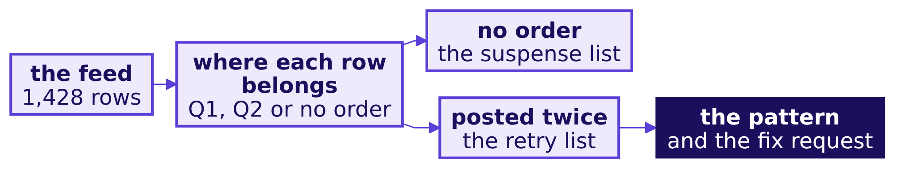

Indian Institute of Technology Gandhinagar
WEEK 2 · DAY 2 · KALPA GLOBAL CAPABILITY CENTRE
ADMINISTERED THROUGH THE COMPETENCY ADVANCEMENT ACADEMY
The second case: the platform lead's audit
DEPTH
Which payment rows in the feed should not be there, and what should the platform lead fix first?
THE CLIENT ASKS
"Before I repair the payments feed, tell me which rows in it should not be there: payments with no order behind them, and payments the gateway posted twice, with the dates, the methods and the rupees at stake, and tell me what to fix first." The data platform lead, Kalpa Retail
In pairs in the lab, four parts: is every payment row in the feed accounted for; which payments match no order; which instalments did the feed post more than once; and is there a pattern the gateway team can act on. The notebook is notebooks/C2_W02_D02_ex2_second_case_STUDENT.ipynb.
Can the number leave?
Which orders make the gap?
What do the lab and tonight carry?
What leaves the room today?
D2 · 27 / 34
Notes:
SELF-STUDY, 40 minutes in the lab. The pairs post their four letters and the request; the TA reads
the most common wrong letter for each part, and the reasons are in the case's solution page.

Slide 28
Indian Institute of Technology Gandhinagar
WEEK 2 · DAY 2 · KALPA GLOBAL CAPABILITY CENTRE
ADMINISTERED THROUGH THE COMPETENCY ADVANCEMENT ACADEMY
The interview drill: six questions, aloud in pairs
DEPTH
Which interview questions does this day equip, and how is each tagged?
Tag | The question
[S] | INNER against LEFT join: what does each drop or keep?
[S] | Your join grew the row count; name the cause and the check.
[F] | How do you find orders with no payment?
[F] | Revenue doubled after a join and every row looks fine; where do you look?
[D] | Design the validation you run before a joined number reaches Finance, and say what you do when it fails at the end of reporting day.
[S] | When is an INNER join the honest choice?
Tags: [S] a staple asked everywhere; [F] frequent in GCC and product screens; [D] a differentiator.
Can the number leave?
Which orders make the gap?
What do the lab and tonight carry?
What leaves the room today?
D3 · 28 / 34
Notes:
SELF-STUDY, 20 minutes in the lab, aloud in pairs: sixty seconds per answer, the partner times it.
Each answer in one breath, in the table's order. INNER keeps only matched rows; LEFT keeps every
left row with NULLs where nothing matched; both repeat a left row once per matching right row. A
row count grows when the join key repeats on the other table: count rows before and after, count that
table's rows per key, and bring it to the key's grain before the join. Orders with no payment come
from a LEFT JOIN that keeps the rows whose payment key IS NULL, or from NOT EXISTS, with the list's
booked total checked against total booked less total collected, less anything paid short, each
computed without the list; never NOT IN, which returns nothing once the subquery holds a NULL. When revenue doubles and every row looks fine, look at the grain: every row is real and the
sum runs per payment, so bring the many side to one row per order and recompute each table alone.
The validation design is counts, including a unique key on the one side and the unmatched keys on
the other; tie-backs to each table alone; one independent recomputation on a feed shown complete to
the cut-off; and a test of the suite on known wrong reports. When a check fails late on reporting
day, booked leaves with the open line named and collected is held. An INNER join is honest when the unmatched rows are
outside the question by definition, such as days to the first payment for paid orders, and the
report says so.

Slide 29
Indian Institute of Technology Gandhinagar
WEEK 2 · DAY 2 · KALPA GLOBAL CAPABILITY CENTRE
ADMINISTERED THROUGH THE COMPETENCY ADVANCEMENT ACADEMY
Follow-ups and the design question
DEPTH
Which follow-ups does an interviewer ask once the first answer lands?
Tag | The follow-up
[F] | A filter on the right-hand table of a LEFT JOIN: WHERE or ON, and what changes?
[F] | HAVING COUNT(*) > 1 on payments by order: what does it find, and what does it wrongly include?
[F] | How do you reconcile a total after a join back to its source table?
[D] | Two errors cancel and the total looks right: how would you find them?
[D] | Anand says the gap is too small to matter: how do you decide whether to chase it?
[S] | If you could keep only one check before a joined number leaves, which would you keep?
Can the number leave?
Which orders make the gap?
What do the lab and tonight carry?
What leaves the room today?
D4 · 29 / 34
Notes:
SELF-STUDY, inside the drill's 20 minutes, sixty seconds an answer. The design question is the [D]
rows: which approach, sized how, and what would make you switch. A strong answer names the check, the number it compares and the wrong report it stops.
Each answer in one breath, in the table's order. A condition on the right-hand table goes in ON; in
WHERE it runs after the join, drops the NULL rows and turns the LEFT JOIN into an INNER one.
HAVING COUNT(*) > 1 by order finds every order with more than one payment row, legitimate
instalments included; a retry is one order and instalment posted twice. A joined total is reconciled
by recomputing it from the source table alone and naming every rupee of difference as a move with
its list. Two errors that cancel are found by counting first and then splitting the difference into
moves with definitions, so each error gets its own bar. A gap that looks too small is sized as a
share of booked, then by channel and by order, since a small total can be one large invoice, and by
age, since an old unpaid order is overdue; the cost of chasing is set against the cash, the large,
old orders go first, and booked and collected stay beside the gap. The one check to keep is orders
on the report against orders in the table: it reads no rupee and catches both ways a join goes
wrong, a fan-out and a dropped order. It misses what goes wrong after the join, posted read as
collected and the gap summed past a NULL, which is why the gap's tie-back to the two lists is added
second. That tie-back stops all five wrong pages and still comes second, because the lists are
queries of their own that can carry the page's mistake, while the count reads nothing but orders.

Slide 30
Indian Institute of Technology Gandhinagar
PG DIPLOMA IN AI-ML AND AGENTIC AI ENGINEERING · COHORT 2
ADMINISTERED THROUGH THE COMPETENCY ADVANCEMENT ACADEMY
09
What leaves the room today?
What sentence goes to Anand, which lines are worth keeping, and what does tomorrow ask?
Can the number leave?
Which orders make the gap?
What do the lab and tonight carry?
What leaves the room today?
Week 2, Day 2. Can the collected number leave the team?
30 / 34
Notes:
LIVE. The close runs about 10 minutes inside the trainer's hour: the sentence, the six lines, the
Kahoot, and tomorrow's question.

Slide 31
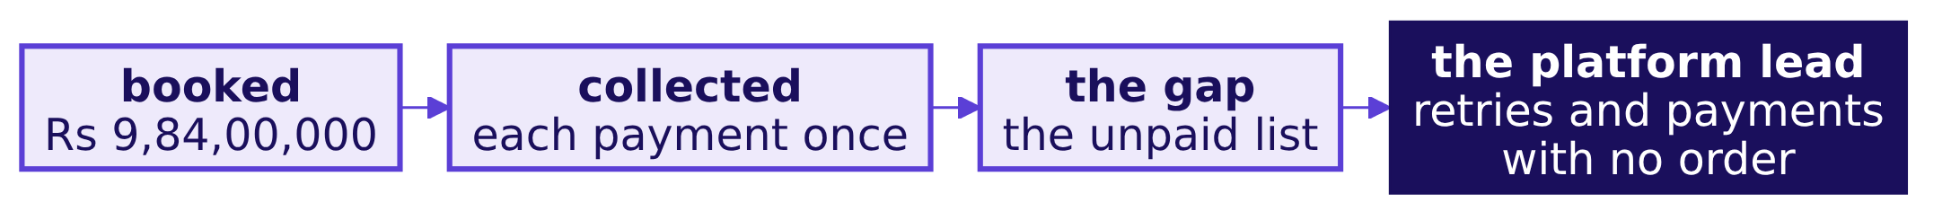
Indian Institute of Technology Gandhinagar
WEEK 2 · DAY 2 · KALPA GLOBAL CAPABILITY CENTRE
ADMINISTERED THROUGH THE COMPETENCY ADVANCEMENT ACADEMY
Answer: the sentence Anand can repeat
What does Anand read, in one sentence he can repeat?
"Q2 booked Rs 9,84,00,000 and collected Rs ___, each payment counted once. The gap of Rs ___ is ___ orders nobody has paid, listed by channel, largest first. Separately, Rs ___ was posted twice by gateway retries and ___ payments match no order; both lists go to the platform lead. Every figure ties back to the orders and payments tables through checks that have each been seen to fail."
Can the number leave?
Which orders make the gap?
What do the lab and tonight carry?
What leaves the room today?
S21 · 31 / 34
Notes:
LIVE, 1 minute. Each learner fills the blanks from their own page; nobody reads another's figures
aloud. The sentence carries the definition, the gap with its orders, the second list's owner and
the proof.

Slide 32
Indian Institute of Technology Gandhinagar
WEEK 2 · DAY 2 · KALPA GLOBAL CAPABILITY CENTRE
ADMINISTERED THROUGH THE COMPETENCY ADVANCEMENT ACADEMY
Six lines worth keeping
Which rules from today hold on every join, in any tool?
The line
A join is done when its row count is explained: rows in, rows out, the difference named.
Start from the table whose every row must survive, and name its grain.
Bring the many side to the grain of the question before you join.
In a LEFT JOIN, a condition on the right-hand table goes in ON.
Two payment rows are not a double payment: a retry is one order and instalment, twice.
A check is worth its power to fail: tie every figure back to one table alone.
Can the number leave?
Which orders make the gap?
What do the lab and tonight carry?
What leaves the room today?
S22 · 32 / 34
Notes:
LIVE, 1 minute. These are the crux lines the cheat sheet prints word for word. Ask each learner to
star the one they would have broken this morning.

Slide 33
Indian Institute of Technology Gandhinagar
WEEK 2 · DAY 2 · KALPA GLOBAL CAPABILITY CENTRE
ADMINISTERED THROUGH THE COMPETENCY ADVANCEMENT ACADEMY
The Kahoot: eight items, ungraded
Which of the day's ideas held, one question each?
8
1
6 min
ITEMS
FROM MONDAY
THE KAHOOT
ungraded, scored on correctness and speed
WHERE against HAVING, one level up
then tomorrow's question and the tentative faculty block
The items: which side a LEFT JOIN keeps; a row count to predict; what an INNER join does to unpaid orders; the anti-join in words; the first check after a doubled total; what HAVING COUNT(*) > 1 finds; where WHERE and HAVING go; a WHERE on the payments side.
Can the number leave?
Which orders make the gap?
What do the lab and tonight carry?
What leaves the room today?
S23 · 33 / 34
Notes:
LIVE, 6 minutes. Run it from kahoot/C2_W02_D02_quiz_STUDENT.md. After each item, one sentence on
the wrong answer most of the room picked.

Slide 34
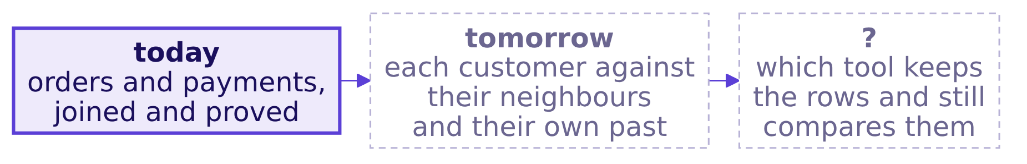
Indian Institute of Technology Gandhinagar
WEEK 2 · DAY 2 · KALPA GLOBAL CAPABILITY CENTRE
ADMINISTERED THROUGH THE COMPETENCY ADVANCEMENT ACADEMY
Tomorrow's question, left open
What does Marketing ask next, and what would you need to answer it?
THE CLIENT ASKS
"Give us the top fifty customers by Q2 revenue in each segment, and flag anyone whose monthly spend has fallen for two months running." Marketing, Kalpa Retail
The pre-read for tomorrow ships tonight with the take-home.
Can the number leave?
Which orders make the gap?
What do the lab and tonight carry?
What leaves the room today?
S24 · 34 / 34
Notes:
LIVE, 2 minutes. Leave the question open: do not name tomorrow's tools. The room's first move
tomorrow is to say why GROUP BY alone cannot answer it.
Then hand over to the tentative IITGN faculty block W2-2.

