Slide 1


Indian Institute of Technology Gandhinagar
ADMINISTERED THROUGH THE COMPETENCY ADVANCEMENT ACADEMY
WEEK 4 · WEDNESDAY · FALLBACK, FACULTY SESSION TENTATIVE
Instamart Pune: the watch list, one zone, and a storm
“Before ice cream and chocolate sauce take a slot, what must a trial show, and what changes when the strip is ranked for one zone at one time of day?”
The growth lead's next questions on the Instamart Pune strip. Illustrative case: the company is real, the situation and the data are synthetic, built for this class.
01
When may a thin pair take a slot?
02
What changes in one zone at one time?
03
Why is a storm's sale no pair rule?
04
The category manager wants a redesign
Week 4, Day 3. Instamart Pune: the watch list, one zone, and a storm
1 / 18
Notes:
On screen when the IITGN faculty session (tentative) cannot run in its slot. These 120 minutes
extend the morning: a trial for a thin pair, a rerun for one zone and one time band, a storm that
is no pair rule, and the second transcript. Nothing here treats association rules as probability
or the algorithms that find them; that stays with the faculty session (tentative) whenever it runs.
Transition: the four parts.

Slide 2

Indian Institute of Technology Gandhinagar
WEEK 4 · DAY 3 · KALPA GLOBAL CAPABILITY CENTRE
ADMINISTERED THROUGH THE COMPETENCY ADVANCEMENT ACADEMY
Four parts fill the 120 minutes
What runs, for how long, and what does each part answer?
Part | Minutes | The question it answers
The watch-list trial | 35 | What must ice cream and chocolate sauce show before they take a slot?
One zone, one time band | 40 | Which pairs change rank when the strip is ranked for one slice of Pune?
The storm and the Pop-Tarts | 20 | Why is a sale that jumps before a storm no pair rule?
The second transcript | 25 | How do you answer a category manager who is sure the strip needs a redesign?
When may a thin pair take a slot?
What changes in one zone at one time?
Why is a storm's sale no pair rule?
The category manager wants a redesign
S1 · 2 / 18
Notes:
LIVE, 2 minutes. How long a trial must run before its answer can be trusted is a sample-size
question, parked by name for the faculty session (tentative). Transition: the trial.

Slide 3
Indian Institute of Technology Gandhinagar
PG DIPLOMA IN AI-ML AND AGENTIC AI ENGINEERING · COHORT 2
ADMINISTERED THROUGH THE COMPETENCY ADVANCEMENT ACADEMY
01
When may a thin pair take a slot?
What must ice cream and chocolate sauce, lift 4.60 on 100 carts, show before they take a slot?
When may a thin pair take a slot?
What changes in one zone at one time?
Why is a storm's sale no pair rule?
The category manager wants a redesign
Week 4 Day 3: what goes with what, beyond chance
3 / 18
Notes:
LIVE, 35 minutes for the section. Groups design the trial; the TA plays the growth lead.
Transition: the four decisions.

Slide 4




Indian Institute of Technology Gandhinagar
WEEK 4 · DAY 3 · KALPA GLOBAL CAPABILITY CENTRE
ADMINISTERED THROUGH THE COMPETENCY ADVANCEMENT ACADEMY
A trial in two zones answers four decisions
Where, for how long, against what, and what stops it?
WHERE
HOW LONG
AGAINST WHAT
WHAT STOPS IT
Two zones alike
Fixed before it starts
The slot's own record
A shock in either zone
Two zones with similar carts and similar ice cream sales, one shown the pair and one left as it is.
The length is chosen before the first day and never stretched to chase a result.
The pair must beat the click-through that slot drew in the same zones before the trial.
A stock-out or a campaign in either zone voids the window and the trial restarts.
When may a thin pair take a slot?
What changes in one zone at one time?
Why is a storm's sale no pair rule?
The category manager wants a redesign
S2 · 4 / 18
Notes:
LIVE, 12 minutes. Each group fills the four cards for its own trial. Press on "fixed before it
starts": a trial watched daily and stopped when it looks good finds a winner by luck. The rule for
how long is the parked sample-size question. Transition: the first data request.

Slide 5
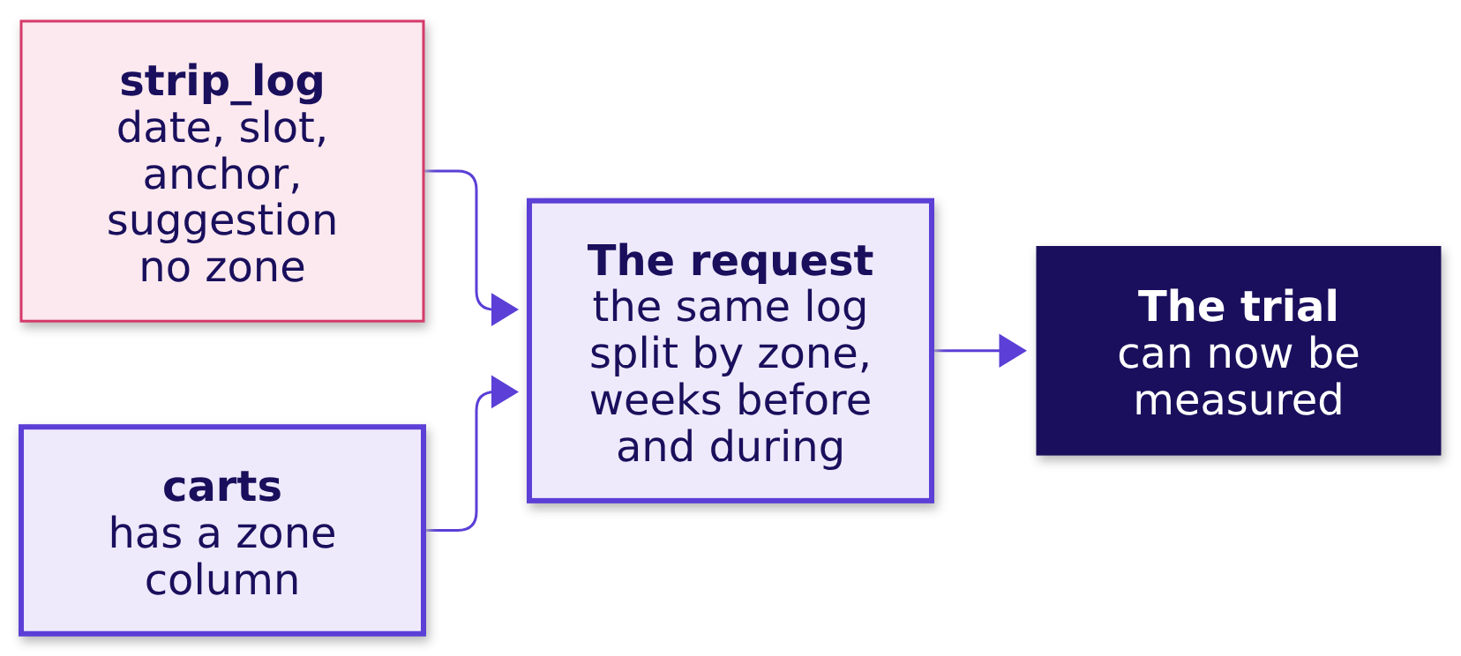
Indian Institute of Technology Gandhinagar
WEEK 4 · DAY 3 · KALPA GLOBAL CAPABILITY CENTRE
ADMINISTERED THROUGH THE COMPETENCY ADVANCEMENT ACADEMY
The trial's first need is a log split by zone
Can today's strip_log measure a two-zone trial?
strip_log counts impressions, clicks and adds for the whole city; it has no zone column. A two-zone trial starts with a data request: the same log, split by zone, for the weeks before and during the trial.
When may a thin pair take a slot?
What changes in one zone at one time?
Why is a storm's sale no pair rule?
The category manager wants a redesign
S3 · 5 / 18
Notes:
LIVE, 8 minutes. This is a real analyst's moment: the method is ready and the data are not. Ask
the room to write the request in one sentence: which table, which new column, which dates.
Transition: the pass rule.

Slide 6
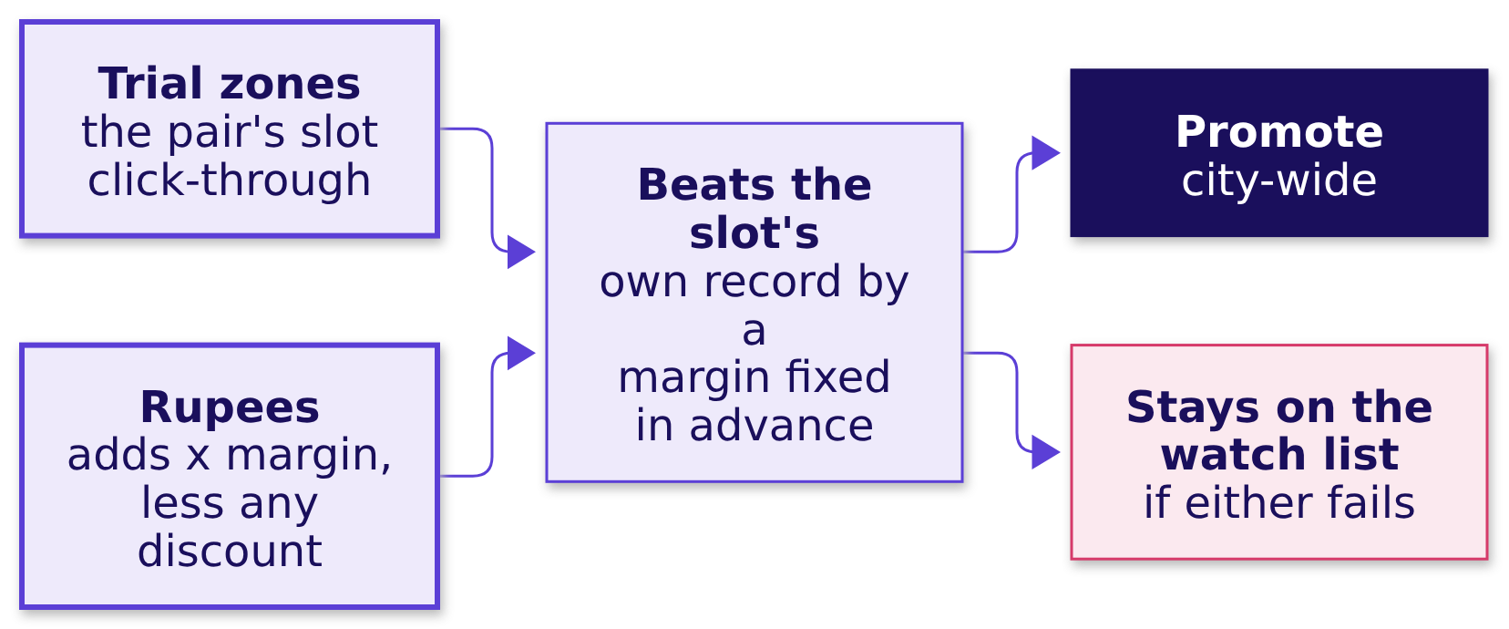
Indian Institute of Technology Gandhinagar
WEEK 4 · DAY 3 · KALPA GLOBAL CAPABILITY CENTRE
ADMINISTERED THROUGH THE COMPETENCY ADVANCEMENT ACADEMY
Pass only if the clicks and the rupees both hold
What rule promotes the pair, and what keeps it on the watch list?
The pair is promoted when its slot beats the slot's own record by a margin set before the trial and its adds repay the slot in margin, after any bundle discount. If either fails, it stays on the watch list, which is what a watch list is for.
When may a thin pair take a slot?
What changes in one zone at one time?
Why is a storm's sale no pair rule?
The category manager wants a redesign
S4 · 6 / 18
Notes:
LIVE, 15 minutes. Groups present their pass rule in two sentences. The weak rule names only the
click-through; the strong rule names the rupees too. Transition: one zone, one time band.

Slide 7
Indian Institute of Technology Gandhinagar
PG DIPLOMA IN AI-ML AND AGENTIC AI ENGINEERING · COHORT 2
ADMINISTERED THROUGH THE COMPETENCY ADVANCEMENT ACADEMY
02
What changes in one zone at one time?
Which pairs change rank when the strip is ranked for one zone and one time band?
When may a thin pair take a slot?
What changes in one zone at one time?
Why is a storm's sale no pair rule?
The category manager wants a redesign
Week 4 Day 3: what goes with what, beyond chance
7 / 18
Notes:
LIVE, 40 minutes for the section, the row's after-class task done in class on notebook 03.
Transition: the code change.

Slide 8
Indian Institute of Technology Gandhinagar
WEEK 4 · DAY 3 · KALPA GLOBAL CAPABILITY CENTRE
ADMINISTERED THROUGH THE COMPETENCY ADVANCEMENT ACADEMY
The rerun is the same pairs table on fewer carts
What changes in the code, and what changes in the reading?
slice_ids = carts.loc[(carts.zone == "Kothrud") & (carts.time_band == "morning"), "cart_id"]
part = baskets[slice_ids] # the same sets, fewer carts
pair_count = Counter(p for b in part for p in combinations(sorted(b), 2))
floor = 0.01 * len(part) # the floor is a share of the slice
The code changes in one line: which carts enter. The reading changes more: a slice holds fewer carts, so every pair rests on fewer of them, and a floor written as a share of the slice admits pairs on thinner ground.
When may a thin pair take a slot?
What changes in one zone at one time?
Why is a storm's sale no pair rule?
The category manager wants a redesign
S5 · 8 / 18
Notes:
LIVE, 8 minutes. Code along. Morning carts hold milk 80 percent of the time against 66 to 69 in the
other bands, so milk's pairs read slightly differently in the morning. Transition: the slices.

Slide 9
Indian Institute of Technology Gandhinagar
WEEK 4 · DAY 3 · KALPA GLOBAL CAPABILITY CENTRE
ADMINISTERED THROUGH THE COMPETENCY ADVANCEMENT ACADEMY
Nine groups, nine slices, one report each
Which slice does each group take, and what does it report?
Groups | Slice | What the group reports
1 and 2 | Kothrud, morning; Kothrud, evening | The top five pairs above the slice's floor, with support and lift
3 and 4 | Baner, morning; Hinjewadi, night | The same, and one pair that moved against the city ranking
5 and 6 | Hadapsar, week three; Hadapsar, week four | What happened to curd's pairs in the stock-out week
7 to 9 | A zone and band of the group's choice | The top five, and whether the city's three slots still lead
When may a thin pair take a slot?
What changes in one zone at one time?
Why is a storm's sale no pair rule?
The category manager wants a redesign
S6 · 9 / 18
Notes:
LIVE, 25 minutes of group work. Groups 5 and 6 find the stock-out in their own slice: curd's pairs
vanish in week three and return in week four. The common stall is a pair below the slice's floor
that looks exciting; the hint is "how many carts is that lift resting on?". Transition: what the
slices say together.

Slide 10
Indian Institute of Technology Gandhinagar
WEEK 4 · DAY 3 · KALPA GLOBAL CAPABILITY CENTRE
ADMINISTERED THROUGH THE COMPETENCY ADVANCEMENT ACADEMY
What the slices agree on, and what they do not
Which findings survive slicing, and which belong to one slice?
SURVIVES
SURVIVES
ONE SLICE ONLY
THIN GROUND
Milk's lift near one
The top two pairs
Curd in Hadapsar, week three
Hinjewadi at night, 649 carts
In every band, bread with milk reads about 1.04.
Chips with cold drink and coriander with green chillies lead every one of the six slices.
Curd falls to 0.2 percent of carts, then 28 percent in week four: a stock-out, never a change in taste.
Three pairs resting on 7 to 10 carts each slip in above bread with butter.
When may a thin pair take a slot?
What changes in one zone at one time?
Why is a storm's sale no pair rule?
The category manager wants a redesign
S7 · 10 / 18
Notes:
LIVE, 7 minutes. Each group reads one line of its report against this list. Transition: a storm.

Slide 11
Indian Institute of Technology Gandhinagar
PG DIPLOMA IN AI-ML AND AGENTIC AI ENGINEERING · COHORT 2
ADMINISTERED THROUGH THE COMPETENCY ADVANCEMENT ACADEMY
03
Why is a storm's sale no pair rule?
Why is a sale that jumps before a storm a forecasting question rather than a pair rule?
When may a thin pair take a slot?
What changes in one zone at one time?
Why is a storm's sale no pair rule?
The category manager wants a redesign
Week 4 Day 3: what goes with what, beyond chance
11 / 18
Notes:
LIVE, 20 minutes for the section. Transition: Walmart's account.

Slide 12
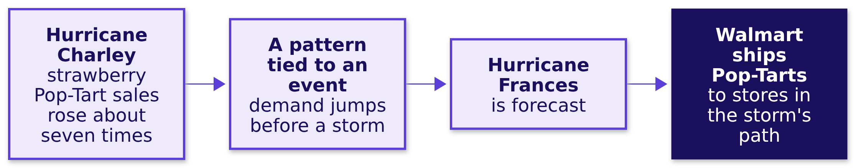
Indian Institute of Technology Gandhinagar
WEEK 4 · DAY 3 · KALPA GLOBAL CAPABILITY CENTRE
ADMINISTERED THROUGH THE COMPETENCY ADVANCEMENT ACADEMY
Walmart stocked Pop-Tarts before Hurricane Frances
What did Walmart see, and what did it do with it?
Walmart's analysts had seen strawberry Pop-Tart sales rise about seven times before Hurricane Charley, so when Hurricane Frances was forecast the chain shipped extra Pop-Tarts to the stores in its path (OpenStax and Newsweek, checked 12 October 2026). The decision moved stock ahead of the storm; a wrong forecast would have left it on the wrong shelves.
When may a thin pair take a slot?
What changes in one zone at one time?
Why is a storm's sale no pair rule?
The category manager wants a redesign
S8 · 12 / 18
Notes:
LIVE, 10 minutes. Read the account. Ask: "is strawberry Pop-Tarts with a storm a pair, like chips
with cold drink?" Transition: the answer.

Slide 13
Indian Institute of Technology Gandhinagar
WEEK 4 · DAY 3 · KALPA GLOBAL CAPABILITY CENTRE
ADMINISTERED THROUGH THE COMPETENCY ADVANCEMENT ACADEMY
A pair holds weekly; a storm's sale needs a forecast
Where does each kind of pattern belong this week?
A PAIR RULE, TODAY
AN EVENT, FRIDAY
FRIDAY'S METHOD
WHAT STAYS
Chips with cold drink
Pop-Tarts before a storm
Line up the event
Two events are two points
Found together in about 5 percent of carts, week after week.
Sales jump around a known future event, which a forecast with the event in it captures.
Compare each week with the same distance from the event, never the same calendar week.
A pattern seen twice is thin ground, as a pair on 100 carts is.
When may a thin pair take a slot?
What changes in one zone at one time?
Why is a storm's sale no pair rule?
The category manager wants a redesign
S9 · 13 / 18
Notes:
LIVE, 10 minutes. Friday's ticket at Flipkart's Lucknow fulfilment centre takes this up with
Diwali as the event. Transition: the second transcript.

Slide 14
Indian Institute of Technology Gandhinagar
PG DIPLOMA IN AI-ML AND AGENTIC AI ENGINEERING · COHORT 2
ADMINISTERED THROUGH THE COMPETENCY ADVANCEMENT ACADEMY
04
The category manager wants a redesign
How do you answer a category manager who is sure the strip needs a new layout?
When may a thin pair take a slot?
What changes in one zone at one time?
Why is a storm's sale no pair rule?
The category manager wants a redesign
Week 4 Day 3: what goes with what, beyond chance
14 / 18
Notes:
LIVE, 25 minutes for the section: the dispute transcript read in pairs, then scored.
Transition: the three sentences.

Slide 15
Indian Institute of Technology Gandhinagar
WEEK 4 · DAY 3 · KALPA GLOBAL CAPABILITY CENTRE
ADMINISTERED THROUGH THE COMPETENCY ADVANCEMENT ACADEMY
Three sentences that sound right
What does the category manager say, and which parts hold?
The click-through fell because shoppers buy differently after the monsoon. The strip needs a redesign; our team has mocked up a two-row layout that sits higher on the page. We can run it next week.
The first sentence names a cause the log can test. The second proposes a fix for a problem nobody has shown. The third is a test, which is the part worth keeping.
When may a thin pair take a slot?
What changes in one zone at one time?
Why is a storm's sale no pair rule?
The category manager wants a redesign
S10 · 15 / 18
Notes:
LIVE, 5 minutes. Pairs list what is partly right and what is unproven before the next slide.
Transition: the four moves.

Slide 16




Indian Institute of Technology Gandhinagar
WEEK 4 · DAY 3 · KALPA GLOBAL CAPABILITY CENTRE
ADMINISTERED THROUGH THE COMPETENCY ADVANCEMENT ACADEMY
The four moves, answered from the log
How does the growth lead answer without dismissing the manager?
RESTATE
ANSWER
CONCEDE
WHAT WOULD CHANGE IT
Habits may have shifted
The fall sits in milk's slots
Position matters
If other slots fell too
The monsoon ended inside the window, so a change in habits is possible.
Slot 1 draws 8.2 percent against 5.4 for slot 3, so a layout is worth testing on its own.
Had the non-milk slots fallen with milk's, the habits story would lead.
Milk slots clicked 1.2 percent; every other slot 6.4, up from 6.2 before the change.
When may a thin pair take a slot?
What changes in one zone at one time?
Why is a storm's sale no pair rule?
The category manager wants a redesign
S11 · 16 / 18
Notes:
LIVE, 10 minutes. Score each pair's answer on the four moves, 0 to 2 each. Transition: the one
chart to hand the manager.

Slide 17
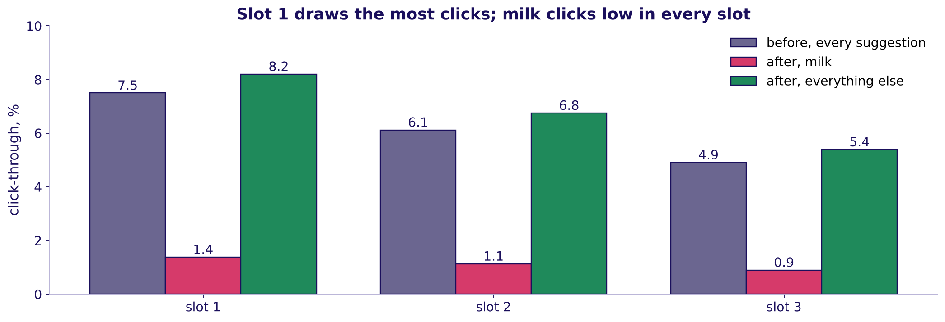
Indian Institute of Technology Gandhinagar
WEEK 4 · DAY 3 · KALPA GLOBAL CAPABILITY CENTRE
ADMINISTERED THROUGH THE COMPETENCY ADVANCEMENT ACADEMY
The chart that settles the dispute
Which picture answers "shoppers changed"?
Click-through by slot position: before the change, milk after, everything else after
In every slot, suggestions other than milk clicked as well after the change as before; milk clicked low in all three. Shoppers who had changed their habits would have stopped clicking everything. A new layout is worth a test of its own; it is not what fell.
When may a thin pair take a slot?
What changes in one zone at one time?
Why is a storm's sale no pair rule?
The category manager wants a redesign
S12 · 17 / 18
Notes:
LIVE, 7 minutes. The sentence to carry: "a redesign is worth testing; the ranking is what fell".
Transition: the close.

Slide 18
Indian Institute of Technology Gandhinagar
WEEK 4 · DAY 3 · KALPA GLOBAL CAPABILITY CENTRE
ADMINISTERED THROUGH THE COMPETENCY ADVANCEMENT ACADEMY
What the fallback leaves the room with
What does the room keep from the four parts?
THE TRIAL
THE SLICES
THE STORM
THE DISPUTE
Four decisions before day one
Thin ground moves
An event needs a forecast
Four moves, one chart
The city's three slots survive; curd's dip belongs to one zone and week.
Friday's question, with Diwali as the event.
The log settles what fell; a layout earns its own test.
Where, how long, against what, and what voids it.
When may a thin pair take a slot?
What changes in one zone at one time?
Why is a storm's sale no pair rule?
The category manager wants a redesign
S13 · 18 / 18
Notes:
LIVE, 1 minute. The faculty session (tentative) runs when IITGN next confirms a slot. Tomorrow's
pre-read ships tonight.

