Slide 1
SECTION A. The new ask
Week 0, Day 4. Half one: the librarian's questions, asked in SQL
1 / 18

Slide 2
S1
The log has moved into a database
The college librarian, the morning after your function worked:
"The office has moved the issue log into the library's database, and it grows every week. Can the same three numbers come straight out of the database, for any week I ask about, without anyone copying rows into a notebook?"
The database is Postgres. The language it answers in is SQL.
Week 0, Day 4. Half one: the librarian's questions, asked in SQL
2 / 18

Slide 3
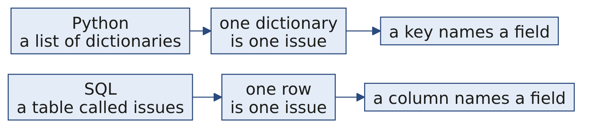
S2
The same log, two shapes
Python on Wednesday | SQL today
log, a list | issues, a table
{"dept": "Maths", ...}, a dictionary | one row
issue["days_kept"] | the column days_kept
The table holds four weeks: week 1 is Wednesday's class log, row for row.
Week 0, Day 4. Half one: the librarian's questions, asked in SQL
3 / 18

Slide 4
SECTION B. A table in your codespace
Week 0, Day 4. Half one: the librarian's questions, asked in SQL
4 / 18

Slide 5
S3
Six ticks, about fifteen minutes
The setup sheet has every command and what you should see after it. The server does not start by itself, so a stopped codespace needs sudo service postgresql start again.
Week 0, Day 4. Half one: the librarian's questions, asked in SQL
5 / 18

Slide 6
SECTION C. One row, one record
Week 0, Day 4. Half one: the librarian's questions, asked in SQL
6 / 18

Slide 7
S4
Ask for columns, and say which rows
SELECT issue_id, student, book, dept, days_kept
FROM issues
WHERE week = 1;
Clause | Says
SELECT | which columns come back
FROM | which table
WHERE | which rows count
Eight rows come back: Wednesday's class log, from the database.
Week 0, Day 4. Half one: the librarian's questions, asked in SQL
7 / 18

Slide 8
D5
How many issues did Maths have in week 1?
DEPTH
Question. This line looks right. Predict what Postgres prints.
SELECT COUNT(*) FROM issues WHERE week = 1 AND dept = "Maths";
Week 0, Day 4. Half one: the librarian's questions, asked in SQL
8 / 18

Slide 9
D6
Answer: an error, because double quotes name a column
DEPTH
ERROR: column "Maths" does not exist
In SQL, double quotes wrap the name of a column or a table. Single quotes wrap text.
SELECT COUNT(*) FROM issues WHERE week = 1 AND dept = 'Maths'; -- 4
Python accepts either kind of quote around text. Postgres gives each kind a different job.
Week 0, Day 4. Half one: the librarian's questions, asked in SQL
9 / 18

Slide 10
SECTION D. Three questions, twice
Week 0, Day 4. Half one: the librarian's questions, asked in SQL
10 / 18

Slide 11
S7
How many issues? A count
count = 0
for issue in log:
count = count + 1 # 8
SELECT COUNT(*) AS issues
FROM issues
WHERE week = 1; -- 8
The loop's start, update and finish all live inside COUNT(*).
Week 0, Day 4. Half one: the librarian's questions, asked in SQL
11 / 18

Slide 12
S8
Which department borrows most? A count per group
SELECT dept, COUNT(*) AS issues
FROM issues
WHERE week = 1
GROUP BY dept
ORDER BY issues DESC, dept;
dept | issues
---------+--------
Maths | 4
Arts | 2
Science | 2
Week 0, Day 4. Half one: the librarian's questions, asked in SQL
12 / 18

Slide 13
D9
How many days late in week 1?
DEPTH
Question. The loan is 14 days. Which two lines turn the Python below into one query?
late = 0
for issue in log:
if issue["days_kept"] > 14:
late = late + (issue["days_kept"] - 14)
Week 0, Day 4. Half one: the librarian's questions, asked in SQL
13 / 18

Slide 14
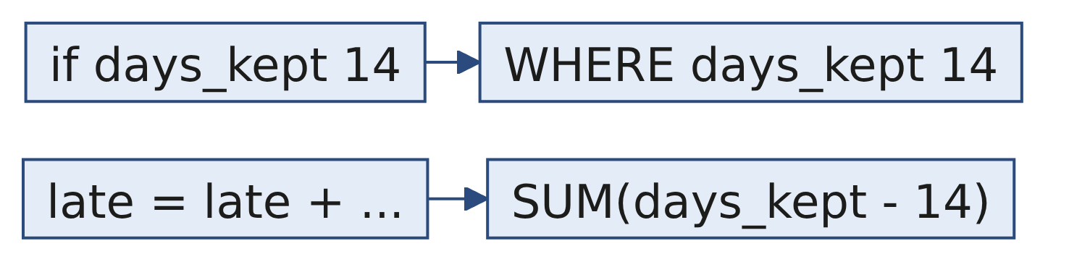
D10
Answer: the if becomes WHERE, the total becomes SUM
DEPTH
SELECT SUM(days_kept - 14) AS late_days
FROM issues
WHERE week = 1
AND days_kept > 14; -- 13
Issue 3 adds 6 and issue 7 adds 7: 13, the same number the function returned.
Week 0, Day 4. Half one: the librarian's questions, asked in SQL
14 / 18

Slide 15
SECTION E. Every week at once
Week 0, Day 4. Half one: the librarian's questions, asked in SQL
15 / 18

Slide 16
S11
The same numbers every week
SELECT week, COUNT(*) AS issues
FROM issues
GROUP BY week
ORDER BY week;
week | issues
------+--------
1 | 8
2 | 10
3 | 10
4 | 10
Wednesday wrapped the loop in a function so next week could reuse it. Grouping by week answers every week in one query.
Week 0, Day 4. Half one: the librarian's questions, asked in SQL
16 / 18

Slide 17
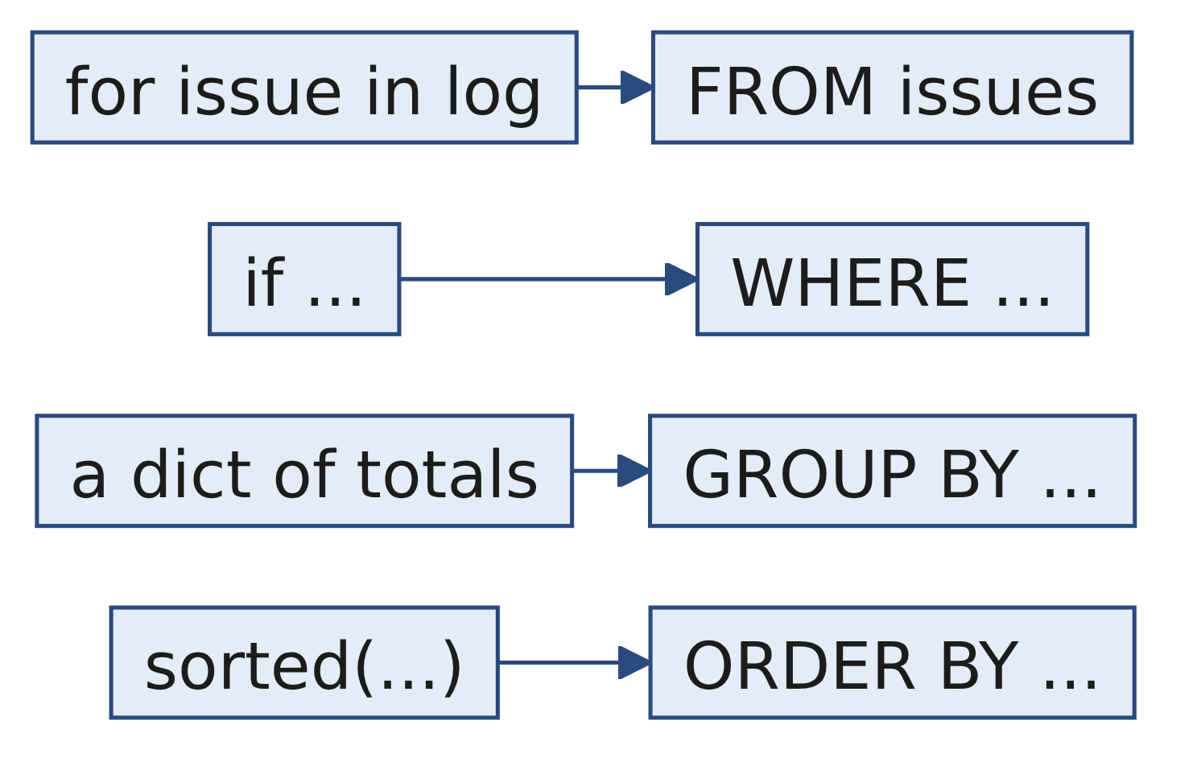
S12
Each Python move has a clause
In Python | In SQL
loop over the records | FROM issues
if inside the loop | WHERE
running count or total | COUNT(*), SUM(...)
a dictionary keyed by department | GROUP BY dept
sorted(..., reverse=True) | ORDER BY ... DESC
Week 0, Day 4. Half one: the librarian's questions, asked in SQL
17 / 18

Slide 18
S13
Your turn
What | Where
The five queries of this half, with the answer each should print | C2_W00_D04_01_librarian_STUDENT.sql
The same questions in Python and SQL, side by side | The demo notebook
Whose books spend the most days out, in SQL | Change one word of S8's query and check for Maths 42, Science 35, Arts 14
Week 0, Day 4. Half one: the librarian's questions, asked in SQL
18 / 18

