Slide 1


WEEK 5 · DAY 5
Model justification: the committee memo
“Which model, why that one, what it will cost us when it is wrong, how we will know it is going stale, and what you would need to run it for Rohan instead.”
Meera Raghavan, CEO, Kalpa Retail
01
What does the room hear?
02
What does wrong cost?
03
How will we know?
04
What carries over?
05
What will they push on?
06
Which model, what cost?
07
What breaks?
08
What transfers?
Week 5, Day 5. Model justification: the committee memo
1 / 60
Notes:
LIVE, 2 minutes. Read Meera's brief aloud, slowly, once. Five questions, five chapters. The
committee meets Monday: Meera, Anand, the marketing lead, and Rohan from Kalpa Financial. Ask the
room to write down, in one word each, what each of the four will push on. Keep the papers; the
pair challenge at the end uses them. Transition: what today builds.

Slide 2




WEEK 5 · FRIDAY · MODEL JUSTIFICATION
Friday turns the week's model into one memo
Topics on a gym's calls, the case on a bank's 41,188 calls, the lab on loans.
THE TOPICS
THE CASE
THE LAB
A gym in Indore, invented
UCI Bank Marketing
Rohan's loan book
Twenty lapsed members, two models, Rs 30 a call, Rs 900 a missed return.
The week's file: three near-tie models, a time split, a sealed test slice.
German Credit's documented 5 : 1 matrix, then Kalpa's 20 : 1.
What does the room hear?
What does wrong cost?
How will we know?
What carries over?
What will they push on?
Which model, what cost?
What breaks?
S1 · 2 / 60
What transfers?
Notes:
LIVE, 1 minute. Three worlds, one method. The gym is small enough to count by hand; the bank is
the week's data; the lending book is where Build 2 starts next week. Transition: where Friday
sits in the programme.

Slide 3
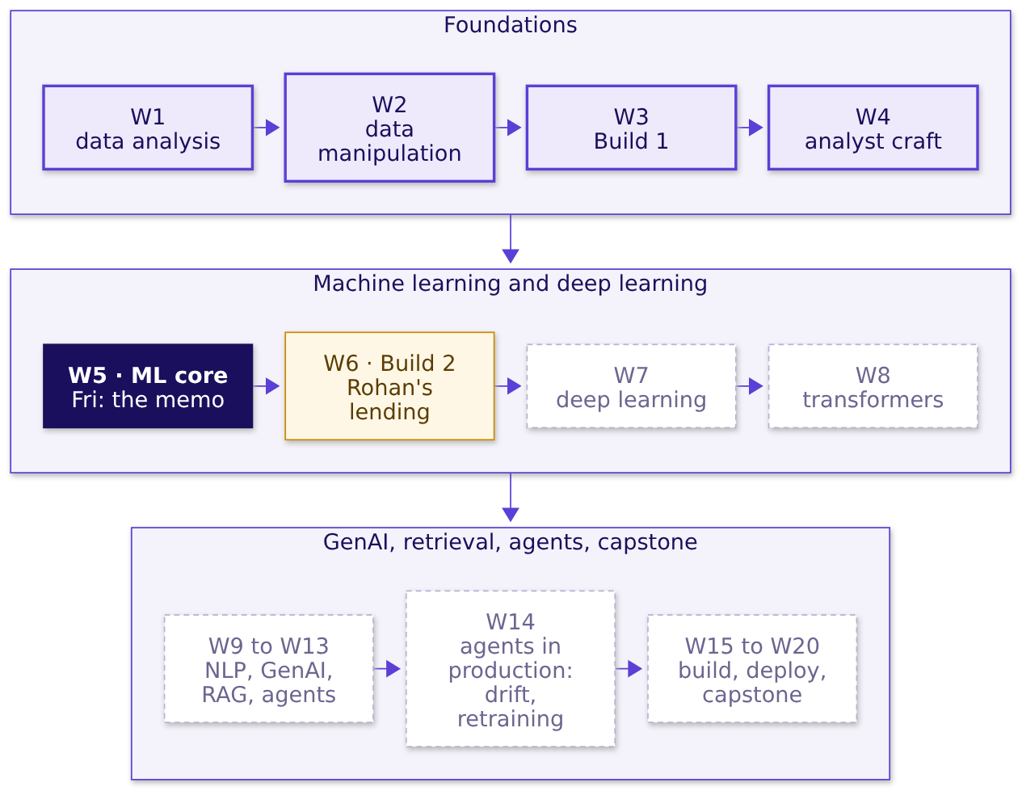
WEEK 5 · FRIDAY · MODEL JUSTIFICATION
Week 5 of 20: the model meets its committee
Monday framed it, Tuesday priced it, Wednesday cleaned it, Thursday chose it.
What does the room hear?
What does wrong cost?
How will we know?
What carries over?
What will they push on?
Which model, what cost?
What breaks?
S2 · 3 / 60
What transfers?
Notes:
LIVE, 1 minute. Week 5 lit. Build 2 next week is Rohan's business, which is why he sits on
Monday's committee. Point at Week 14: drift detection and retraining pipelines are taught there;
today names them and stops. Transition: the one picture the week has grown.

Slide 4
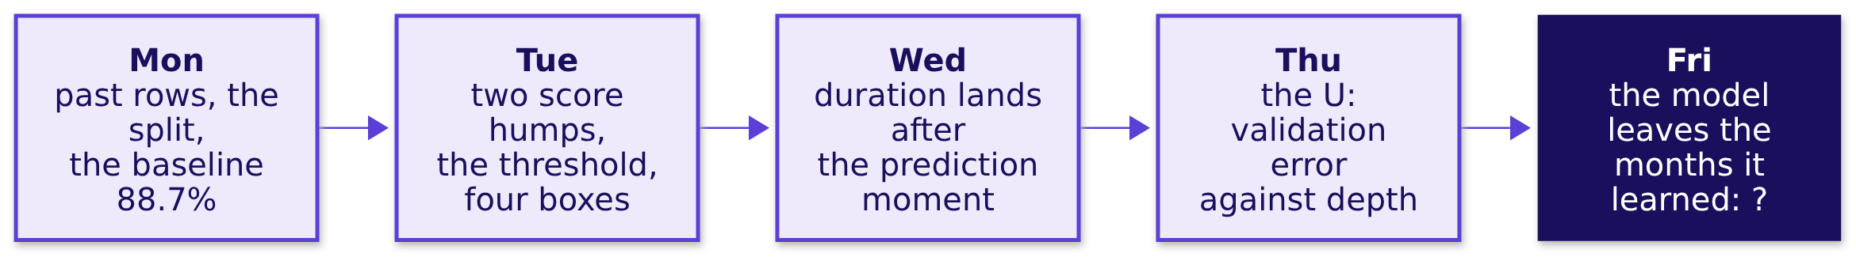
WEEK 5 · FRIDAY · MODEL JUSTIFICATION
The week's picture: Friday adds the last panel
Each day drew one more piece of the same timeline.
What does the room hear?
What does wrong cost?
How will we know?
What carries over?
What will they push on?
Which model, what cost?
What breaks?
S3 · 4 / 60
What transfers?
Notes:
LIVE, 1 minute. Ask the room to redraw Monday to Thursday on paper in one minute, from memory:
that is the nightly self-check. Friday's panel stays a question mark until chapter 7, when the room
trains on the early months and scores the late ones. Transition: the ticket.

Slide 5
WEEK 5 · FRIDAY · MODEL JUSTIFICATION
The ticket: four people, four pushes, one memo
Due Monday: which model, its bill, its staleness rule, what transfers.
Seat at the table | What they push on
Meera, CEO, Kalpa Retail | One page: which model, and why
Marketing lead | "Use the higher-scoring model"
Anand, Finance | "What does wrong cost, in rupees?"
Rohan, head of risk, Kalpa Financial | "What carries over to my loans?"
What does the room hear?
What does wrong cost?
How will we know?
What carries over?
What will they push on?
Which model, what cost?
What breaks?
S4 · 5 / 60
What transfers?
Notes:
LIVE, 4 minutes. Compare with the one-word lists from the cover. The product manager is today's
spotlight seat: the person who reads the memo after the meeting and runs the list every month.
Ask: what does the product manager do with the memo on Tuesday morning? (Runs the 1,000-call list
and owns the monitoring rule.) Transition: the five topics that answer the four pushes.

Slide 6
WEEK 5 · FRIDAY · MODEL JUSTIFICATION
Five topics, five chapters, then three case chapters
The curriculum's words, in the curriculum's order.
# | The topic | Chapter | Min | Notebook
1 | The model justification: claim, evidence, caveat, action | Selling a model to people who don't care about AUC | 15 | ch01
2 | The error bill in rupees under the chosen threshold | What will mistakes cost us | 15 | ch02
3 | Staleness: the monitoring rule and the weakest segment | When the model goes stale | 15 | ch03
4 | The transfer paragraph: what changes, what stays, what would leak | Moving the model to lending | 11 | ch04
5 | Reading the memo aloud under challenge | Defending it in the room | 10 | ch05
What does the room hear?
What does wrong cost?
How will we know?
What carries over?
What will they push on?
Which model, what cost?
What breaks?
S5 · 6 / 60
What transfers?
Notes:
LIVE, 1 minute. Read the second column once: these are the words to search later. Chapters 6, 7
and 8 apply them to the bank's file (case01, case02, case03), then the guided memo and the pair
challenge. Transition: how the five join.

Slide 7
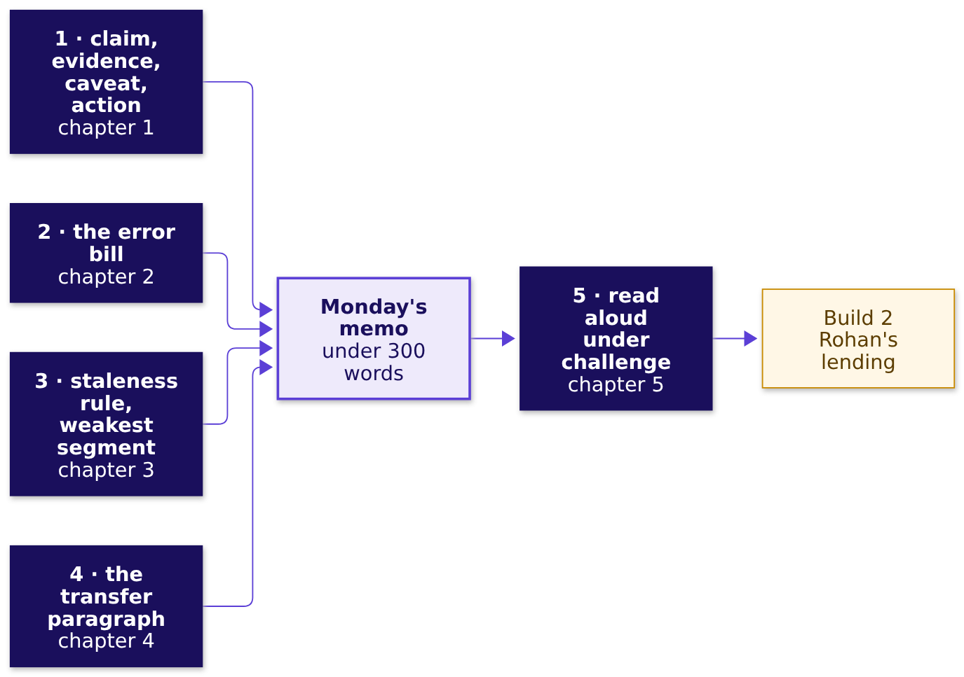
WEEK 5 · FRIDAY · MODEL JUSTIFICATION
Five topics, one memo
Each topic writes one part of Monday's page.
What does the room hear?
What does wrong cost?
How will we know?
What carries over?
What will they push on?
Which model, what cost?
What breaks?
S6 · 7 / 60
What transfers?
Notes:
LIVE, 1 minute. The memo is the module's closing artifact and Build 2's starting point. Every box
feeds one part of it; chapter 5 is how it survives the room. Transition: chapter 1.

Slide 8
PG DIPLOMA IN AI-ML AND AGENTIC AI ENGINEERING · COHORT 2
01
Selling a model to people who don't care about AUC
What does the room hear?
The model justification: claim, evidence, caveat, action · also searched as: presenting ML results to stakeholders, model justification
What does the room hear?
What does wrong cost?
How will we know?
What carries over?
What will they push on?
Which model, what cost?
What breaks?
What transfers?
Week 5 Friday: model justification
8 / 60
Notes:
LIVE, 15 minutes for the chapter. Notebook ch01 at the end. Who needs the answer: the gym's owner,
who pays for the calls and has never heard of AUC.

Slide 9
WEEK 5 · FRIDAY · MODEL JUSTIFICATION
Which opening line gets the calls approved?
A gym owner, 20 lapsed members, two models (invented). Pick one opening.
 | The option
a | "Model B's AUC is 0.85 against A's 0.80."
b | "A's top 6 bring back 4 of 5 returners for Rs 180."
c | "Model A is a logistic regression on two columns."
d | "Here is the confusion matrix at 0.5."
What does the room hear?
What does wrong cost?
How will we know?
What carries over?
What will they push on?
Which model, what cost?
What breaks?
S7 · 9 / 60
What transfers?
Notes:
LIVE, 3 minutes. The misconception first: most of the room picks a, because AUC is the number
they were taught to report. Letter cards up, one minute with a neighbour, vote again. Do not open
the notebook yet. Transition: the reveal.

Slide 10
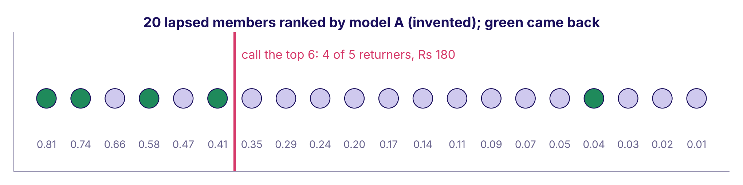
WEEK 5 · FRIDAY · MODEL JUSTIFICATION
Answer: b. The owner hears members and rupees
Model A's ranking of the 20 members; green came back.
Twenty invented gym members ranked by model A, returners in green, the cut after six
Calling nobody loses Rs 4,500. A's top 6 and B's top 6 each find 4 of 5: a bill of Rs 960 either way.
What does the room hear?
What does wrong cost?
How will we know?
What carries over?
What will they push on?
Which model, what cost?
What breaks?
S8 · 10 / 60
What transfers?
Notes:
LIVE, 3 minutes. Read the dots left to right. Both models put the same four returners in their
top six, so the higher AUC buys nothing this week. Land: a model is justified in the reader's
units. Transition: what AUC is, in one sentence.

Slide 11
WEEK 5 · FRIDAY · MODEL JUSTIFICATION
AUC is the share of pairs ranked the right way
5 returners x 15 non-returners = 75 pairs to check.
pairs = [(r, n) for r in returners for n in non_returners]
right = sum(r.score > n.score for r, n in pairs)
print(right, "of", len(pairs)) # A: 60 of 75 = 0.80
# B: 64 of 75 = 0.85
What does the room hear?
What does wrong cost?
How will we know?
What carries over?
What will they push on?
Which model, what cost?
What breaks?
S9 · 11 / 60
What transfers?
Notes:
LIVE, 3 minutes. StatQuest style: pick one returner and one non-returner; did the returner score
higher? Do three pairs aloud from the ranking. AUC is that, over all 75. B ranks four more pairs
right and still finds the same four people in six calls. Notebook ch01 counts it by hand and checks
it against scikit-learn. Transition: the four parts.

Slide 12
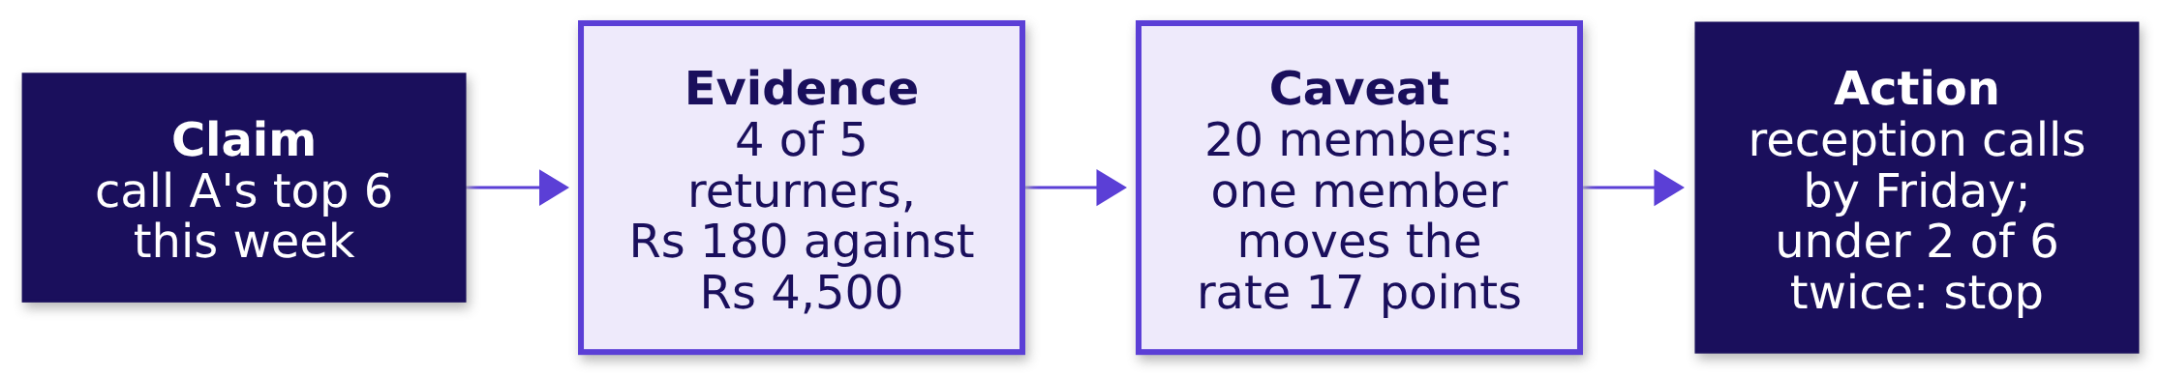

WEEK 5 · FRIDAY · MODEL JUSTIFICATION
Four parts, each carrying a number
Week 1's four-part note, at model scale.
THE RULE
Lead with the decision and its rupees. It flips when the reader is the ML lead reviewing the method.
What does the room hear?
What does wrong cost?
How will we know?
What carries over?
What will they push on?
Which model, what cost?
What breaks?
S10 · 12 / 60
What transfers?
Notes:
LIVE, 4 minutes. Each box answers one of Meera's questions: which model (claim), why (evidence
against a baseline, in rupees), when it is wrong (caveat: when it breaks, where it is weakest),
what happens next (action, with the rule that stops it). Run notebook ch01 now, 3 minutes: the
hand count, the rupee table, the memo with a check that every part carries a number.
Transition: chapter 2 prices every mistake.

Slide 13
PG DIPLOMA IN AI-ML AND AGENTIC AI ENGINEERING · COHORT 2
02
What will mistakes cost us
What does wrong cost?
The error bill in rupees under the chosen threshold · also searched as: cost-benefit analysis of a model, expected cost
What does the room hear?
What does wrong cost?
How will we know?
What carries over?
What will they push on?
Which model, what cost?
What breaks?
What transfers?
Week 5 Friday: model justification
13 / 60
Notes:
LIVE, 15 minutes for the chapter. Notebook ch02 and the explorable's bill panel. Who needs the
answer: Finance, who signs the calling budget.

Slide 14
WEEK 5 · FRIDAY · MODEL JUSTIFICATION
At 0.5, model A calls 4. Cheaper or dearer?
A wasted call costs Rs 30. A missed returner costs Rs 900.
Option | The bill is smaller at
a | 0.5, since it makes 16 fewer calls
b | calling all 20
c | neither: they are equal
d | cannot tell without the AUC
Question. Which bill is smaller?
What does the room hear?
What does wrong cost?
How will we know?
What carries over?
What will they push on?
Which model, what cost?
What breaks?
S11 · 14 / 60
What transfers?
Notes:
LIVE, 2 minutes. Prediction first, written down. Most pick a: fewer calls feels cheaper.
Transition: the sweep.

Slide 15
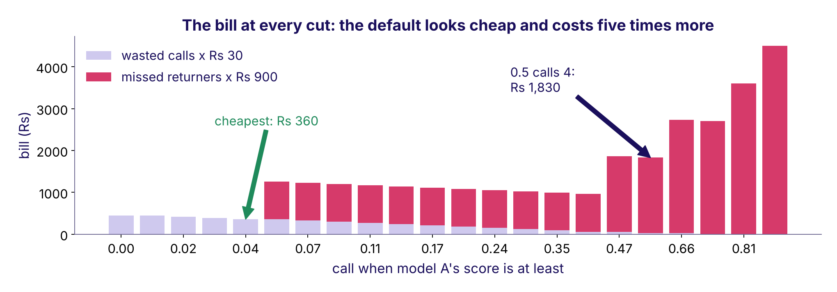
WEEK 5 · FRIDAY · MODEL JUSTIFICATION
Answer: b. The default costs five times more
Rs 1,830 at 0.5, Rs 450 calling everyone, Rs 360 at the cheapest cut.
The invented gym's bill at every threshold, wasted calls in lilac and missed returners in rose
What does the room hear?
What does wrong cost?
How will we know?
What carries over?
What will they push on?
Which model, what cost?
What breaks?
S12 · 15 / 60
What transfers?
Notes:
LIVE, 4 minutes. Read the bars from the right: every cut to the right of the cheapest one adds a
Rs 900 miss. The trap, exactly: "0.5 only makes 4 calls, so it is cheap"; the decision it misleads
is a budget signed for Rs 120 of calls that loses Rs 1,800 of returners. The check: price both
mistakes. Transition: what the bill counts.

Slide 16
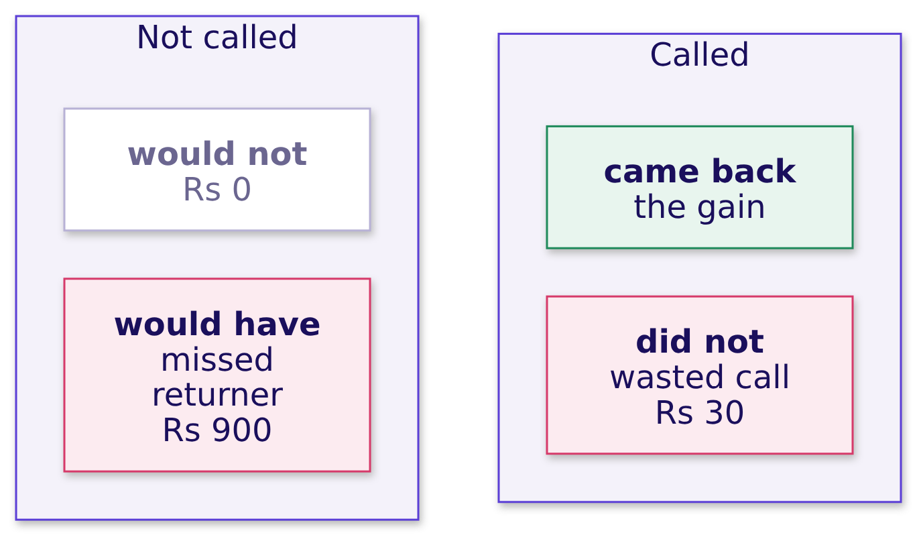
WEEK 5 · FRIDAY · MODEL JUSTIFICATION
The bill counts the two mistakes, never the hits
A returner who is called pays for the call. That is the gain.
bill = wasted calls x Rs 30 + missed returners x Rs 900
What does the room hear?
What does wrong cost?
How will we know?
What carries over?
What will they push on?
Which model, what cost?
What breaks?
S13 · 16 / 60
What transfers?
Notes:
LIVE, 3 minutes. Tuesday's four boxes with a price tag on two of them. The commonest slip in the
take-home: counting the called returners as a cost. They are what the bill is set against.
Transition: where the bill is smallest.

Slide 17
WEEK 5 · FRIDAY · MODEL JUSTIFICATION
The cut, named last: 30 / (30 + 900) = 0.032
Call when the chance of a return beats the cost ratio.
# one member with chance p of returning
cost_if_skipped = p * 900
cost_if_called = (1 - p) * 30
call = p * 900 > (1 - p) * 30 # same as p > 30 / 930 = 0.032
It flips when scores are not honest probabilities, or a budget caps the calls.
What does the room hear?
What does wrong cost?
How will we know?
What carries over?
What will they push on?
Which model, what cost?
What breaks?
S14 · 17 / 60
What transfers?
Notes:
LIVE, 3 minutes. Krish Naik style: three lines, each read aloud. The formula and the sweep call the
same 17 members (notebook ch02 checks it). Open the explorable now: it opens at 0.5 on the bank's
real counts. Ask for a prediction of the bill, then drag to 0.03. Transition: what happens to the
bill when the months change.

Slide 18
PG DIPLOMA IN AI-ML AND AGENTIC AI ENGINEERING · COHORT 2
03
When the model goes stale
How will we know?
Staleness: the monitoring rule and the weakest segment · also searched as: model drift, model monitoring
What does the room hear?
What does wrong cost?
How will we know?
What carries over?
What will they push on?
Which model, what cost?
What breaks?
What transfers?
Week 5 Friday: model justification
18 / 60
Notes:
LIVE, 15 minutes for the chapter. CUT FIRST if late: slide S17's band arithmetic. Who needs the
answer: the gym's owner and the front-desk manager who runs the calls.

Slide 19
WEEK 5 · FRIDAY · MODEL JUSTIFICATION
A rival gym closed in July. When does the rule fire?
Rule: alarm when real sits over 5 points from promised, two months running.
Month | Apr | May | Jun | Jul | Aug | Sep
Promised | 12% | 12% | 13% | 12% | 12% | 13%
Real, of 200 calls | 12% | 11% | 14% | 20% | 22% | 25%
Question. a) April b) July c) August d) never, since the scores did not change
What does the room hear?
What does wrong cost?
How will we know?
What carries over?
What will they push on?
Which model, what cost?
What breaks?
S15 · 19 / 60
What transfers?
Notes:
LIVE, 2 minutes. Invented numbers. Predict on paper. Transition: the reveal.

Slide 20
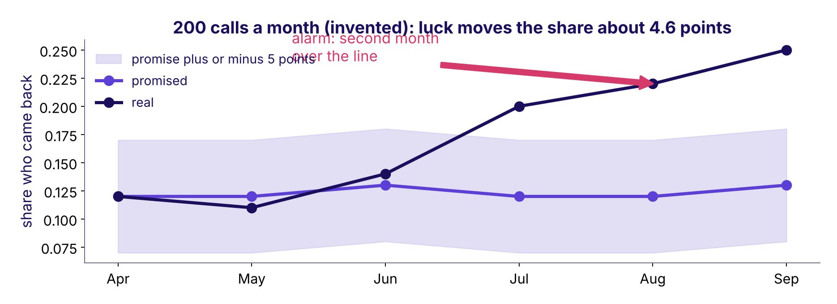
WEEK 5 · FRIDAY · MODEL JUSTIFICATION
Answer: c. August, the second month over the line
One month over is a warning. Two in a row is the rule.
Promised against real share by month for the invented gym, with the 5-point band and the alarm in August
What does the room hear?
What does wrong cost?
How will we know?
What carries over?
What will they push on?
Which model, what cost?
What breaks?
S16 · 20 / 60
What transfers?
Notes:
LIVE, 3 minutes. July alone could be luck. The common wrong answer to "how will you know it is
stale" is "retrain every month": a calendar fires when nothing changed and waits a month when
something has. Transition: what a rule needs.

Slide 21




WEEK 5 · FRIDAY · MODEL JUSTIFICATION
A rule has four parts someone else can check
Number, ceiling, window, owner.
THE NUMBER
THE CEILING
THE WINDOW
THE OWNER
Real against promised
5 points
Two months running
Front-desk manager
The share of called members who return, against the model's promise.
Just above luck: 2 x sqrt(0.12 x 0.88 / 200) = 4.6 points.
One month can be luck.
Pauses the list and sends it back.
What does the room hear?
What does wrong cost?
How will we know?
What carries over?
What will they push on?
Which model, what cost?
What breaks?
S17 · 21 / 60
What transfers?
Notes:
LIVE, 4 minutes. The ceiling is Week 1's sample-size rule: luck moves a share by about two standard
errors. CUT FIRST if late: skip the arithmetic and keep the four cards. Drift detection methods and
retraining pipelines are named here and taught from Week 14. Transition: the weakest segment.

Slide 22
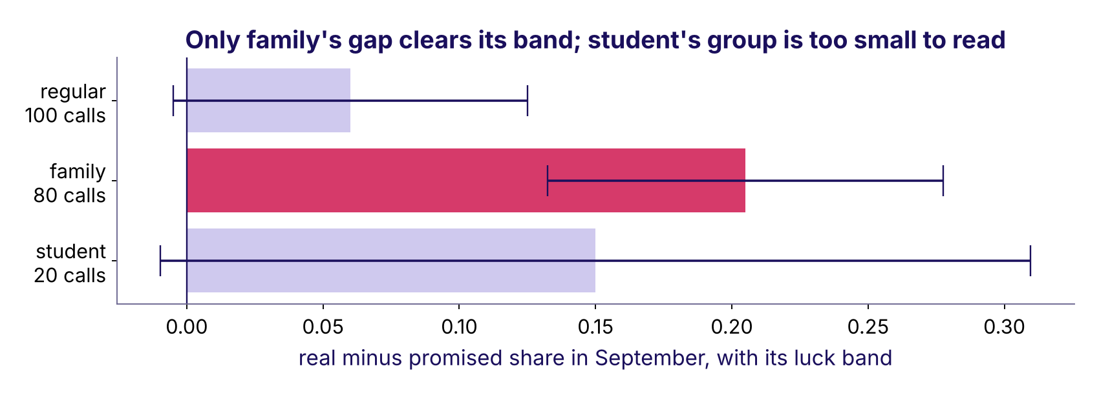
WEEK 5 · FRIDAY · MODEL JUSTIFICATION
The weakest segment needs its band beside it
September by plan type (invented): a gap means nothing without its group size.
Real minus promised share by plan type with luck bands: only family clears its band
What does the room hear?
What does wrong cost?
How will we know?
What carries over?
What will they push on?
Which model, what cost?
What breaks?
S18 · 22 / 60
What transfers?
Notes:
LIVE, 3 minutes. Student shows a wide gap on 20 calls; its band is 16 points, so it cannot be read.
Family's gap clears its band on 80 calls. The Week 1 sample-size reason, again. Run notebook ch03,
3 minutes. Transition: moving the machinery to a lender.

Slide 23
PG DIPLOMA IN AI-ML AND AGENTIC AI ENGINEERING · COHORT 2
04
Moving the model to lending
What carries over?
The transfer paragraph: what changes, what stays, what would leak · also searched as: domain transfer, credit risk model
What does the room hear?
What does wrong cost?
How will we know?
What carries over?
What will they push on?
Which model, what cost?
What breaks?
What transfers?
Week 5 Friday: model justification
23 / 60
Notes:
LIVE, 11 minutes for the chapter. Notebook ch04. Who needs the answer: a head of risk at a lender,
which on Monday is Rohan.

Slide 24
WEEK 5 · FRIDAY · MODEL JUSTIFICATION
A lender's two mistakes: Rs 40,000 or Rs 2,000
A two-wheeler lender in Nagpur, invented: a default costs Rs 40,000, a good applicant turned away Rs 2,000.
 | The option
a | 0.50
b | 0.05
c | 0.95
d | 0.032, the gym's cut
Question. Which cut?
What does the room hear?
What does wrong cost?
How will we know?
What carries over?
What will they push on?
Which model, what cost?
What breaks?
S19 · 24 / 60
What transfers?
Notes:
LIVE, 2 minutes. Prediction on paper. The trap is b or d: copying the formula without asking
which mistake is now the expensive one. Transition: the reveal.

Slide 25
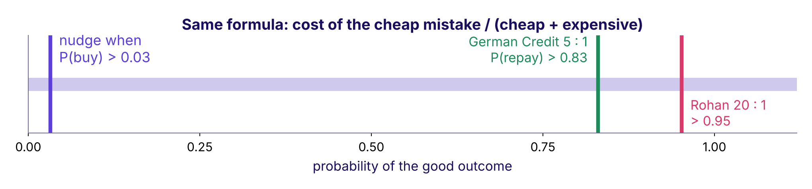
WEEK 5 · FRIDAY · MODEL JUSTIFICATION
Answer: c. The expensive mistake changed sides
40,000 / (40,000 + 2,000) = 0.952, on P(repay).
One probability axis with the nudge cut at 0.03, German Credit's at 0.83 and Rohan's at 0.95
What does the room hear?
What does wrong cost?
How will we know?
What carries over?
What will they push on?
Which model, what cost?
What breaks?
S20 · 25 / 60
What transfers?
Notes:
LIVE, 3 minutes. Say both on the same quantity: nudge when P(buy) is above 0.03; lend when
P(repay) is above 0.95. Same formula: the cost of the cheap mistake over the sum. At 0.5 the
invented lender approves 9 and two defaults cost Rs 80,000; at 0.952 it approves 3 and turns away
4 good applicants for Rs 8,000. Transition: the three columns of the transfer.

Slide 26
WEEK 5 · FRIDAY · MODEL JUSTIFICATION
What changes, what stays, what would leak
The transfer paragraph is these three columns in sentences.
Changes | Stays | Would leak
The target: came back becomes repaid | Split first, seal the test, beat a baseline | Anything written after approval
The costs, so the cut: 0.03 to 0.95 | The four boxes and the bill | An EMI bounce in month two
The moment: the call becomes the approval | The four-part memo | A collections flag
The weakest segment, found again | The rule's four parts | Never judged by its name
What does the room hear?
What does wrong cost?
How will we know?
What carries over?
What will they push on?
Which model, what cost?
What breaks?
S21 · 26 / 60
What transfers?
Notes:
LIVE, 4 minutes. The week's interview move: same pipeline, the other side's costs, the opposite
threshold, and the one feature that would leak. Transition: how to tell a leak.

Slide 27
WEEK 5 · FRIDAY · MODEL JUSTIFICATION
A column's name is never the test; its time stamp is
Each column with the day it is written, counted from the approval.
Column (invented lender) | Written | Known at approval
monthly_income | 30 days before | yes
bureau_score | 2 days before | yes
loan_term_months | at approval | yes
emi_bounce_month2 | 60 days after | no: leaks
collections_flag | 90 days after | no: leaks
What does the room hear?
What does wrong cost?
How will we know?
What carries over?
What will they push on?
Which model, what cost?
What breaks?
S22 · 27 / 60
What transfers?
Notes:
LIVE, 2 minutes. Wednesday's prediction-time question, in a lender's data. Run notebook ch04 in
the remaining minute or set it for the break. Transition: the memo in the room.

Slide 28
PG DIPLOMA IN AI-ML AND AGENTIC AI ENGINEERING · COHORT 2
05
Defending it in the room
What will they push on?
Reading the memo aloud under challenge · also searched as: ML case interview, stakeholder pushback
What does the room hear?
What does wrong cost?
How will we know?
What carries over?
What will they push on?
Which model, what cost?
What breaks?
What transfers?
Week 5 Friday: model justification
28 / 60
Notes:
LIVE, 10 minutes for the chapter. Notebook ch05. Who needs the answer: everyone in Monday's room,
each with a reason to push.

Slide 29
WEEK 5 · FRIDAY · MODEL JUSTIFICATION
"B scores 0.05 higher. Use B." Your one line?
The gym again: same four returners in each model's top six.
 | The option
a | "A is better, trust me."
b | "AUC measures ranking quality across all pairs."
c | "Both find the same 4 in 6 calls: worth Rs 0 this week; B ships if it finds more next month."
d | "We can use both."
Question. Which answer?
What does the room hear?
What does wrong cost?
How will we know?
What carries over?
What will they push on?
Which model, what cost?
What breaks?
S23 · 29 / 60
What transfers?
Notes:
LIVE, 2 minutes. Vote with letter cards. Transition: the reveal.

Slide 30
WEEK 5 · FRIDAY · MODEL JUSTIFICATION
Answer: c. A number, the reason, the flip
B ranks 4 more pairs right of 75, and finds nobody extra.
 | Model A | Model B
AUC | 0.80 | 0.85
Returners in the top 6 | 4 | 4
Rupee gap this week | Rs 0 | Rs 0
Columns to maintain | 2 | 40
What does the room hear?
What does wrong cost?
How will we know?
What carries over?
What will they push on?
Which model, what cost?
What breaks?
S24 · 30 / 60
What transfers?
Notes:
LIVE, 2 minutes. Option b explains the metric to someone who asked for a decision. The good answer
carries three things: the number in the reader's units, the reason, and the condition that would
flip the call. Transition: does it fit in ninety seconds.

Slide 31
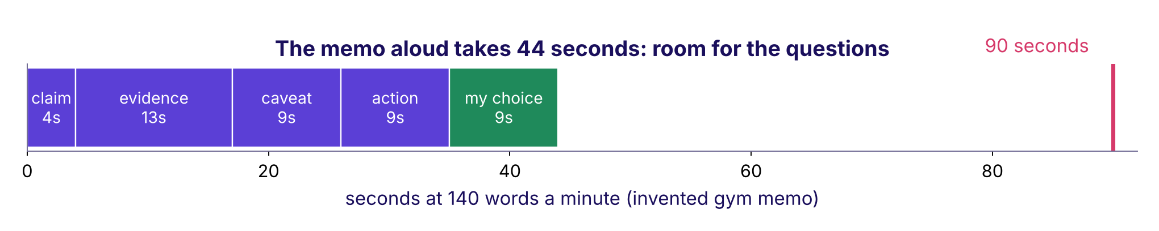
WEEK 5 · FRIDAY · MODEL JUSTIFICATION
Ninety seconds: the memo and one choice of yours
The gym memo aloud at 140 words a minute.
The gym memo's five parts as seconds at 140 words a minute, 44 seconds against a 90-second line
What does the room hear?
What does wrong cost?
How will we know?
What carries over?
What will they push on?
Which model, what cost?
What breaks?
S25 · 31 / 60
What transfers?
Notes:
LIVE, 2 minutes. 140 words a minute is an assumed pace; each learner times themselves once. The
fifth part, "my choice", is the hiring manager's point: one decision you made differently from the
class, with its reason. Transition: who pushes on what.

Slide 32
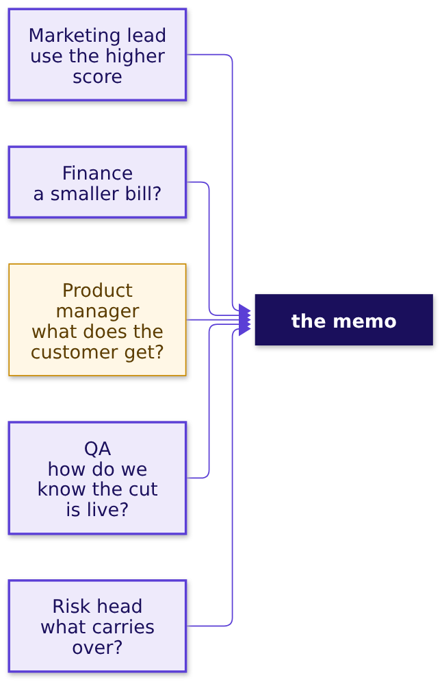
WEEK 5 · FRIDAY · MODEL JUSTIFICATION
Each seat pushes on one thing; answer it with a number
The pushes to rehearse before Monday.
What does the room hear?
What does wrong cost?
How will we know?
What carries over?
What will they push on?
Which model, what cost?
What breaks?
S26 · 32 / 60
What transfers?
Notes:
LIVE, 3 minutes. The product manager is today's spotlight: the one who runs the list after the
meeting and owns the rule's alarm. Ask the room: what does the PM need from the memo that Meera
does not? (The operating point as one number, the monthly check, and who to call when it fires.)
Run notebook ch05, 1 minute. Transition: the case.

Slide 33
PG DIPLOMA IN AI-ML AND AGENTIC AI ENGINEERING · COHORT 2
06
The bill for the near-tie
Which model, what cost?
Applies the model justification and the error bill in rupees under the chosen threshold · notebook case01
What does the room hear?
What does wrong cost?
How will we know?
What carries over?
What will they push on?
Which model, what cost?
What breaks?
What transfers?
Week 5 Friday: model justification
33 / 60
Notes:
LIVE, 25 minutes for the chapter. Notebook case01 on the projector, the room following. The
first cell downloads about 1 MB; if the network is slow, pair learners and project the executed
outputs.

Slide 34
WEEK 5 · FRIDAY · MODEL JUSTIFICATION
Thursday handed over three models within 0.02 of AUC
Fitted on 24,712 rows, compared on 8,238; the test slice still sealed.
Model | Validation AUC | Mean score
Logistic (regularised) | 0.795 | 0.114
Tuned tree (depth 7, leaves of 20) | 0.787 | 0.114
Boosting | 0.803 | 0.113
Question. At the cost cut of 0.032, which has the smallest bill? a) boosting b) the tree c) logistic d) all within 1 percent
What does the room hear?
What does wrong cost?
How will we know?
What carries over?
What will they push on?
Which model, what cost?
What breaks?
S27 · 34 / 60
What transfers?
Notes:
LIVE, 4 minutes. Run the first three cells: the pipeline, the checks, the three fits. Numbers are
from this run on Wednesday's honest columns; Thursday's own run may differ in the third decimal.
Predict on paper. Transition: the reveal.

Slide 35
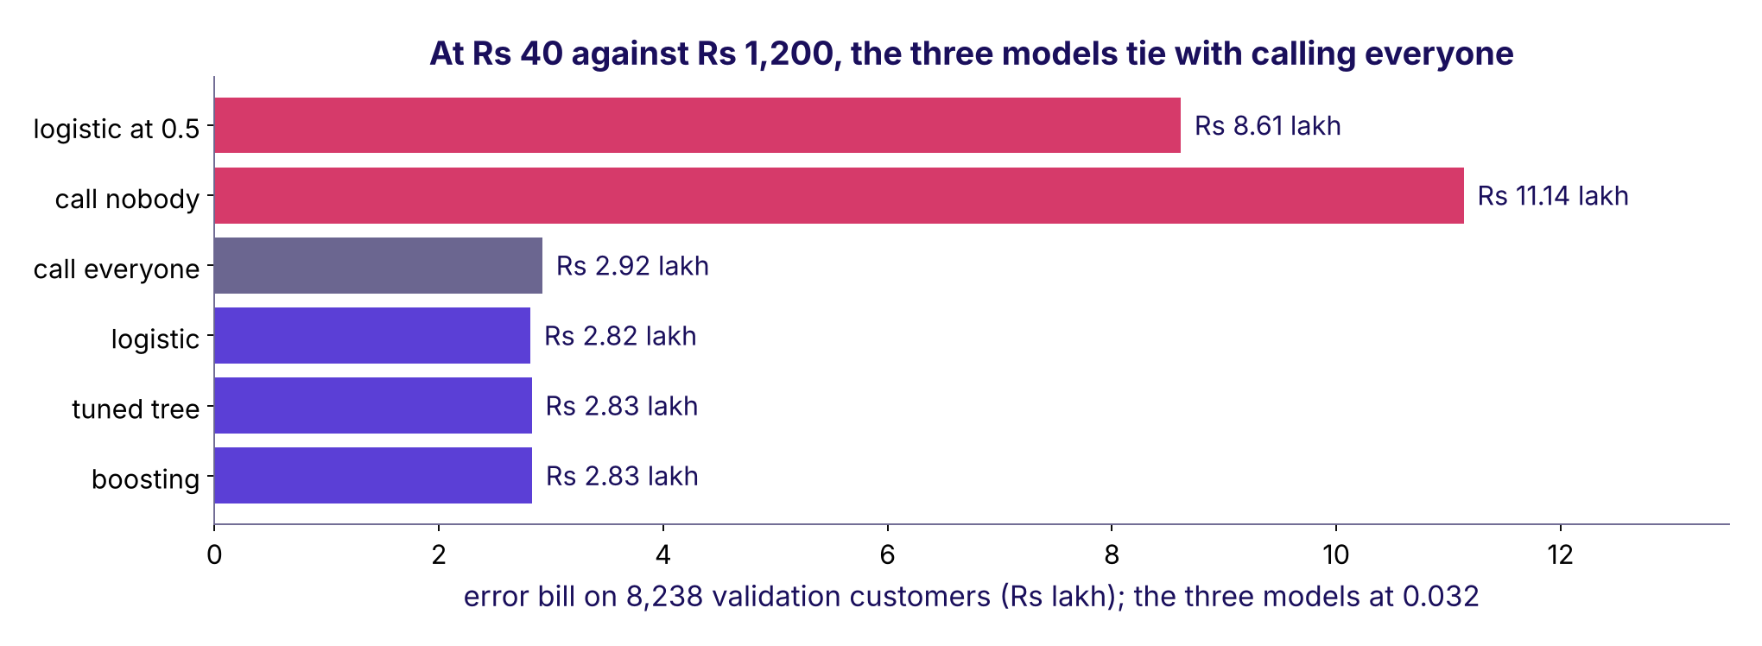
WEEK 5 · FRIDAY · MODEL JUSTIFICATION
Answer: d. All three tie with calling everyone
Rs 40 against Rs 1,200 makes every model call nine in ten.
Error bills on the validation slice: the three models near Rs 2.8 lakh, calling everyone Rs 2.92 lakh, the 0.5 default Rs 8.6 lakh
What does the room hear?
What does wrong cost?
How will we know?
What carries over?
What will they push on?
Which model, what cost?
What breaks?
S28 · 35 / 60
What transfers?
Notes:
LIVE, 5 minutes. The trap, exactly: "boosting has the best AUC, so it saves the most". At 0.032 its
bill is the largest of the three (Rs 2.832 lakh against logistic's Rs 2.817 lakh). The decision it
misleads: paying for a forty-step model for nothing. The check: price both mistakes for each model.
Land: at this cost ratio the model barely matters; the budget is where it earns its keep.
Transition: the budget.

Slide 36
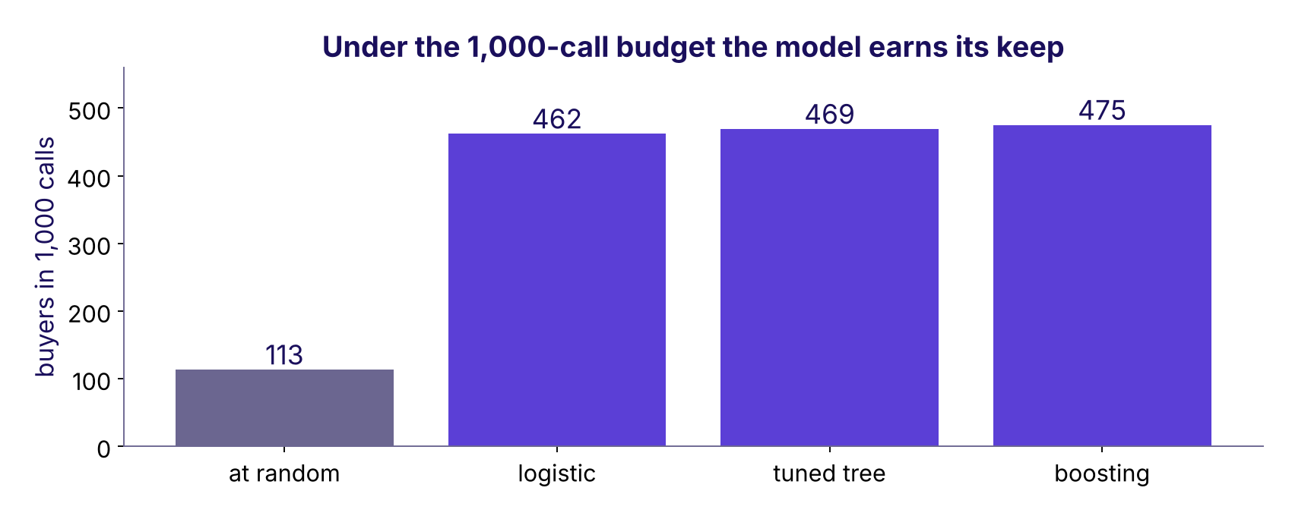
WEEK 5 · FRIDAY · MODEL JUSTIFICATION
Under 1,000 calls the model finds 4x random
Rank the 8,238, call the top 1,000.
Buyers in the top 1,000 calls: 113 at random, 462 logistic, 469 tuned tree, 475 boosting
What does the room hear?
What does wrong cost?
How will we know?
What carries over?
What will they push on?
Which model, what cost?
What breaks?
S29 · 36 / 60
What transfers?
Notes:
LIVE, 4 minutes. The budget binds: the cost cut would call about 7,400. Precision at k, Tuesday's
idea, carries the decision. Boosting finds 13 more than logistic. Each extra buyer is worth
Rs 1,240 on the bill (a call stops being wasted and a buyer stops being missed): Rs 16,120.
Transition: is 13 real?

Slide 37
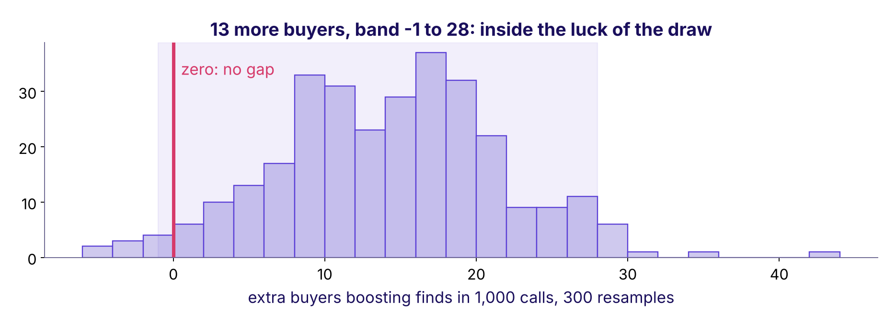
WEEK 5 · FRIDAY · MODEL JUSTIFICATION
Is 13 more buyers real? Resample and count again
300 resamples of the validation customers, the gap recounted each time.
Histogram of the extra buyers boosting finds over 300 resamples, its band reaching zero
What does the room hear?
What does wrong cost?
How will we know?
What carries over?
What will they push on?
Which model, what cost?
What breaks?
S30 · 37 / 60
What transfers?
Notes:
LIVE, 5 minutes. A paired bootstrap: Week 1's permutation idea run on a model comparison. The 95
percent band runs from about -1 to 28, so it reaches zero: a tie on this slice. The flip, said out
loud: boosting ships if a fresh month shows its lead clear of zero. Transition: the memo's first
two parts.

Slide 38
WEEK 5 · FRIDAY · MODEL JUSTIFICATION
The claim and the evidence, from your own run
Every number traces to case01.
Part | The line
Claim | Call the 1,000 customers the logistic model ranks highest (score above 0.245)
Evidence | 462 buyers in 1,000 calls against about 113 at random
Evidence | Boosting finds 13 more; the band reaches zero, so the simpler model is recommended
Evidence | Without the budget, any model's bill sits within 4 percent of calling everyone
What does the room hear?
What does wrong cost?
How will we know?
What carries over?
What will they push on?
Which model, what cost?
What breaks?
S31 · 38 / 60
What transfers?
Notes:
LIVE, 3 minutes. The simpler model is recommended when it ties, and the memo says why out loud.
These two parts are what the guided notebook rebuilds in pairs. Transition: what the bill looks
like next year.

Slide 39
PG DIPLOMA IN AI-ML AND AGENTIC AI ENGINEERING · COHORT 2
07
Train early, score late
What breaks?
Applies the error bill under the chosen threshold, and staleness: the monitoring rule and the weakest segment · notebook case02
What does the room hear?
What does wrong cost?
How will we know?
What carries over?
What will they push on?
Which model, what cost?
What breaks?
What transfers?
Week 5 Friday: model justification
39 / 60
Notes:
LIVE, 30 minutes for the chapter. Notebook case02. Who needs the answer: the product manager who
runs the list after Monday, and Anand, whose budget assumed this month looks like last month.

Slide 40
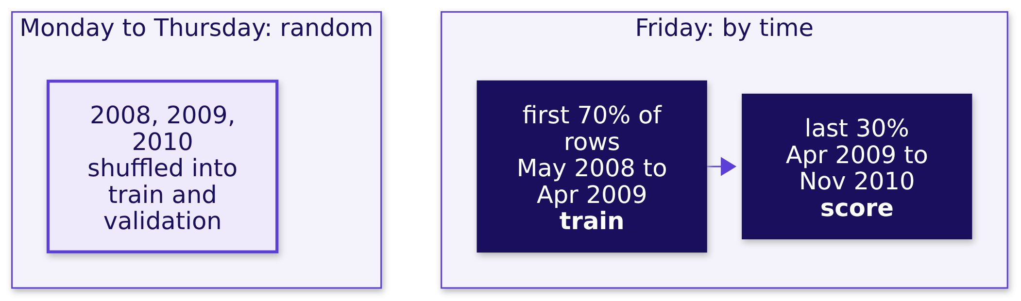
WEEK 5 · FRIDAY · MODEL JUSTIFICATION
Two ways to hold rows out; one asks about next year
The file runs in date order, May 2008 to November 2010.
What does the room hear?
What does wrong cost?
How will we know?
What carries over?
What will they push on?
Which model, what cost?
What breaks?
S32 · 40 / 60
What transfers?
Notes:
LIVE, 3 minutes. The file has a month and no year; the notebook rebuilds the year by counting each
time the month goes backwards, and checks it. Deployment is always the second picture: trained on
the past, used on the future. Transition: predict.

Slide 41
WEEK 5 · FRIDAY · MODEL JUSTIFICATION
Trained early: what happens on the late months?
Predict before the cell runs.
 | The option
a | AUC holds near 0.80 and nothing else moves
b | AUC dips; the promise stays near the old rate while the real rate climbs
c | the model refuses to score new months
d | the promise climbs with the real rate
Question. Which one?
What does the room hear?
What does wrong cost?
How will we know?
What carries over?
What will they push on?
Which model, what cost?
What breaks?
S33 · 41 / 60
What transfers?
Notes:
LIVE, 2 minutes. Letter cards. Run the time-split cell only after the vote. Transition: the reveal.

Slide 42
WEEK 5 · FRIDAY · MODEL JUSTIFICATION
Answer: b. Real 25 in 100; the promise stays 16
The real rate went from 6 to 25 in 100. AUC fell from 0.80 to 0.66, and never mentions the promise.
 | Rows | Real buying rate | Model's promise
Trained on, May 2008 to Apr 2009 | 28,831 | 5.6% | 5.6%
Scored on, Apr 2009 to Nov 2010 | 12,357 | 24.6% | 15.9%
What does the room hear?
What does wrong cost?
How will we know?
What carries over?
What will they push on?
Which model, what cost?
What breaks?
S34 · 42 / 60
What transfers?
Notes:
LIVE, 4 minutes. AUC only asks whether buyers rank above non-buyers. The bill is computed from the
promise, so the promise is what breaks: calibration. Many would still call 0.66 usable; that is the
trap. Transition: the picture.

Slide 43
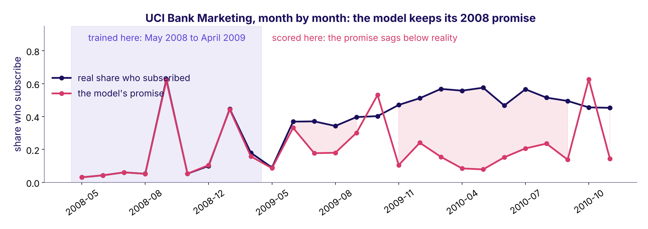
WEEK 5 · FRIDAY · MODEL JUSTIFICATION
The promise sags below reality after training
Friday's panel of the week's picture.
Monthly real subscription share against the model's promise, May 2008 to November 2010, training months shaded
What does the room hear?
What does wrong cost?
How will we know?
What carries over?
What will they push on?
Which model, what cost?
What breaks?
S35 · 43 / 60
What transfers?
Notes:
LIVE, 4 minutes. In the shaded months the lines sit on top of each other because the model learned
them. Right of the shade the rose line stays low while the real line climbs. This is the panel the
week's picture was waiting for. Explorable: the monitor panel replays these months. Transition: what
it cost.

Slide 44
WEEK 5 · FRIDAY · MODEL JUSTIFICATION
The stale model costs more than no model at all
12,357 late customers at the cost cut of 0.032.
Bill on the late customers | Rs lakh
Planned, from validation per customer | 4.23
Ran up by the stale model | 4.62
Calling everyone, no model | 3.73
231 customers scored below 0.032; 79 of them bought.
What does the room hear?
What does wrong cost?
How will we know?
What carries over?
What will they push on?
Which model, what cost?
What breaks?
S36 · 44 / 60
What transfers?
Notes:
LIVE, 4 minutes. The trap, exactly: "AUC 0.66 still beats random, keep it running". It costs about
Rs 89,000 more than calling every customer. The 231 people it promised less than 1 in 31 bought at
about one in three. The check that catches it: the promise against reality, month by month.
Transition: the rule.

Slide 45
WEEK 5 · FRIDAY · MODEL JUSTIFICATION
The rule would have fired in August 2009
Top 12 percent each month; ceiling 10 points, since ~100 calls swing ~9.
Month | Called | Promised | Real | Over 10 points
2009-05 | 703 | 13.6% | 14.2% | no
2009-06 | 87 | 45.1% | 46.0% | no
2009-07 | 22 | 32.4% | 54.5% | yes
2009-08 | 93 | 31.6% | 44.1% | yes: alarm
What does the room hear?
What does wrong cost?
How will we know?
What carries over?
What will they push on?
Which model, what cost?
What breaks?
S37 · 45 / 60
What transfers?
Notes:
LIVE, 4 minutes. The four parts on real data: the number (real against promised among the called),
the ceiling (10 points, because 2 x sqrt(0.3 x 0.7 / 100) is about 9), the window (two months),
the owner (Kavya pauses the list). CUT FIRST if late: the ceiling's arithmetic. Transition: where
today's model is weakest.

Slide 46
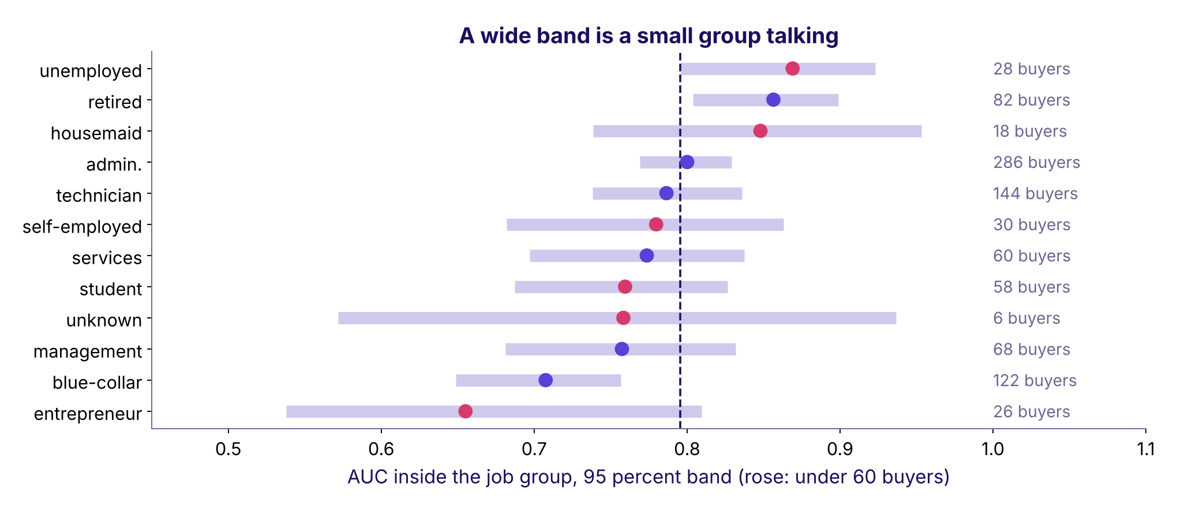
WEEK 5 · FRIDAY · MODEL JUSTIFICATION
Weakest where the band is narrow enough to read
AUC inside each job group, with 200 resamples' band.
AUC by job on the validation slice with bands; entrepreneur lowest on 26 buyers, blue-collar lowest of the large groups
What does the room hear?
What does wrong cost?
How will we know?
What carries over?
What will they push on?
Which model, what cost?
What breaks?
S38 · 46 / 60
What transfers?
Notes:
LIVE, 4 minutes. Entrepreneur reads lowest, 0.655, on 26 buyers with a band from about 0.54 to
0.81: a small group talking. Blue-collar, 0.707 on 122 buyers, is the weakest reading we can trust;
telephone contacts rank worse than mobile ones, 0.721 against 0.779. That sentence goes in the
caveat. Transition: what a stale forecast cost a real company.

Slide 47
WEEK 5 · FRIDAY · MODEL JUSTIFICATION
Zillow Offers: the bill for a stale forecast
Its 8-K and shareholder letter, 2 November 2021.
$304.4M
25%
3 to 6
INVENTORY WRITE-DOWN
OF THE WORKFORCE
MONTHS AHEAD
recorded for Q3 2021
the expected reduction from the wind-down
how far the home price forecast had to reach
What does the room hear?
What does wrong cost?
How will we know?
What carries over?
What will they push on?
Which model, what cost?
What breaks?
S39 · 47 / 60
What transfers?
Notes:
LIVE, 3 minutes. Zillow's letter: "We have been unable to accurately forecast future home prices at
different times in both directions." The forecast had to be right three to six months out, and the
world moved. Sources: the 8-K at https://www.sec.gov/Archives/edgar/data/1617640/000161764021000085/z-20211102.htm
and Exhibit 99.3 at https://www.sec.gov/Archives/edgar/data/1617640/000161764021000085/exhibit993.htm
(verified 28 October 2026). Bridge to Kalpa: the same rule, the promise against reality, catches it.
Transition: Rohan.

Slide 48
PG DIPLOMA IN AI-ML AND AGENTIC AI ENGINEERING · COHORT 2
08
Lending, and the envelope
What transfers?
Applies the transfer paragraph, the model justification, and reading the memo aloud under challenge · notebook case03
What does the room hear?
What does wrong cost?
How will we know?
What carries over?
What will they push on?
Which model, what cost?
What breaks?
What transfers?
Week 5 Friday: model justification
48 / 60
Notes:
LIVE, 22 minutes for the chapter. Notebook case03. Who needs the answer: Rohan, and the whole
committee, which hears one number from data nobody has touched.

Slide 49
WEEK 5 · FRIDAY · MODEL JUSTIFICATION
German Credit documents its own cost matrix
1,000 applicants, Hamburg 1994: 700 good, 300 bad.
Actual, then predicted | Predicted good | Predicted bad
Good | 0 | 1
Bad | 5 | 0
Question. Approve when P(repay) is above: a) 0.50 b) 0.17 c) 0.83 d) 0.03
What does the room hear?
What does wrong cost?
How will we know?
What carries over?
What will they push on?
Which model, what cost?
What breaks?
S40 · 49 / 60
What transfers?
Notes:
LIVE, 3 minutes. Read the matrix as the dataset's documentation states it: a bad customer classed
as good costs 5, a good one classed as bad costs 1. Prediction on paper; b is the slip of putting
the ratio on the wrong side. Transition: the reveal.

Slide 50
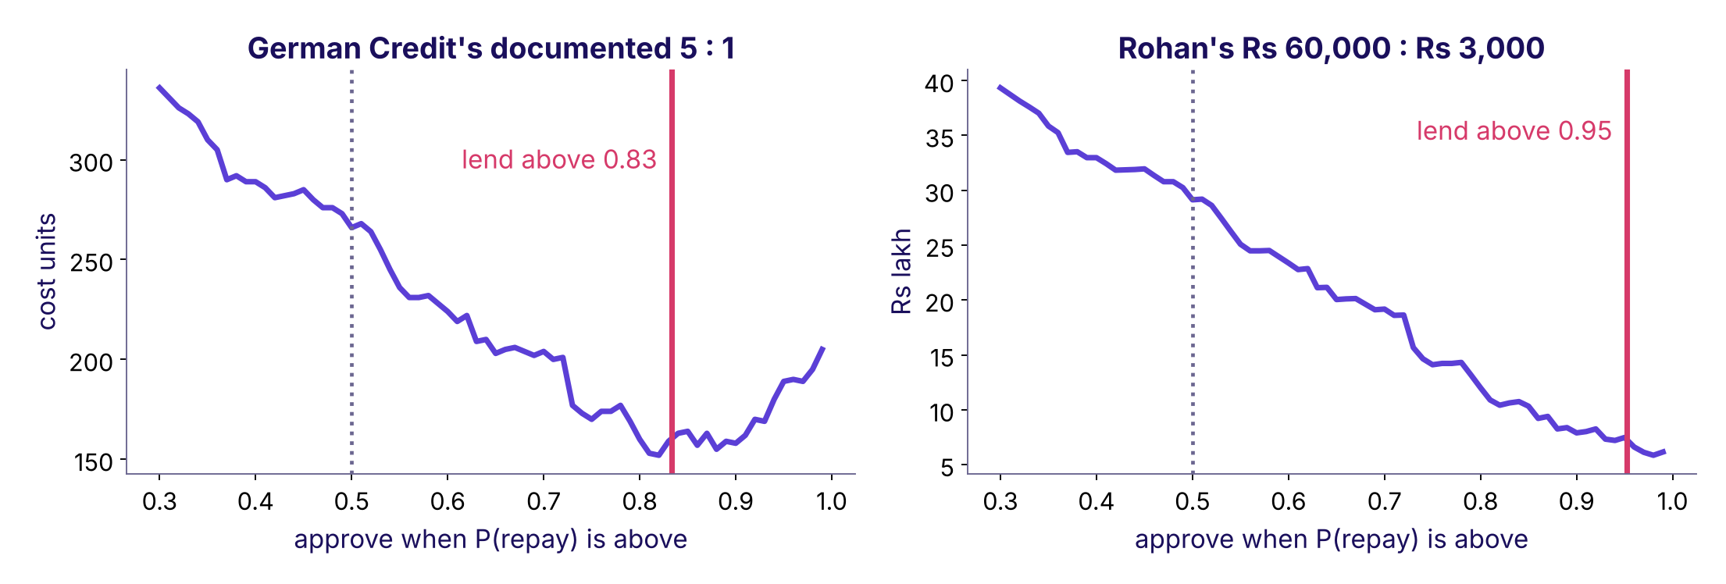
WEEK 5 · FRIDAY · MODEL JUSTIFICATION
Answer: c. Lend above 0.83; Rohan's line is 0.95
300 validation applicants: cost 266 at 0.5, 160 at 0.83. Rohan's 20 : 1 moves the line to 0.95.
Lending cost against threshold for German Credit at 5 to 1 and for Rohan's Rs 60,000 to Rs 3,000
What does the room hear?
What does wrong cost?
How will we know?
What carries over?
What will they push on?
Which model, what cost?
What breaks?
S41 · 50 / 60
What transfers?
Notes:
LIVE, 4 minutes. At 0.5 the model approves 226 and 47 bad loans cost 235 units; at 0.83 it
approves 128, 13 bad loans and 95 good applicants turned away cost 160. About 40 percent cheaper.
Rohan's 20 : 1 moves the line to 0.95. Same quantity on both sides: nudge when P(buy) is above
0.03, lend when P(repay) is above 0.83 or 0.95. Transition: the name trap.

Slide 51
WEEK 5 · FRIDAY · MODEL JUSTIFICATION
German Credit's duration is a loan term: keep it
Wednesday dropped the bank's duration. This one stays.
 | Bank Marketing duration | German Credit duration
What it measures | the call's length, seconds | the loan's term, 4 to 72 months
Written | after the call ends | on the application form
Known at decision | no: leaks | yes: keep
What does the room hear?
What does wrong cost?
How will we know?
What carries over?
What will they push on?
Which model, what cost?
What breaks?
S42 · 51 / 60
What transfers?
Notes:
LIVE, 3 minutes. The prediction-time question decides, never the name. In Rohan's feed, the leak
would be days past due or a collections flag, both written after approval. Transition: the envelope.

Slide 52
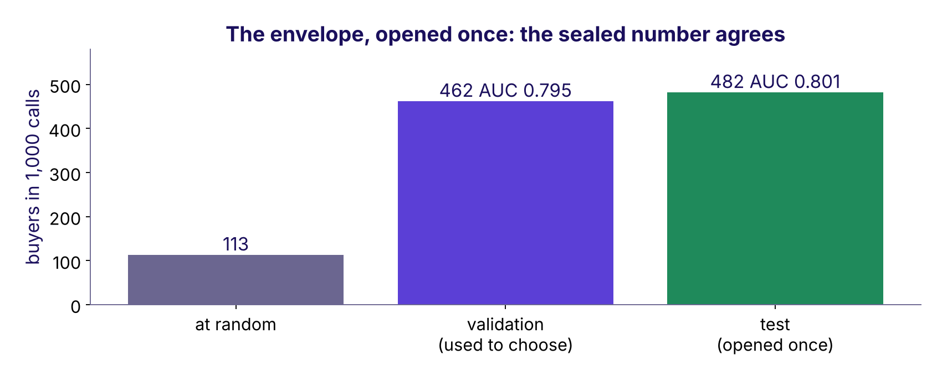
WEEK 5 · FRIDAY · MODEL JUSTIFICATION
The envelope, opened once: the sealed number agrees
Chosen on validation, scored once on 8,238 untouched customers.
Buyers in 1,000 calls: 113 at random, 462 on validation, 482 on the sealed test
What does the room hear?
What does wrong cost?
How will we know?
What carries over?
What will they push on?
Which model, what cost?
What breaks?
S43 · 52 / 60
What transfers?
Notes:
LIVE, 5 minutes. Take the card marked TEST SET down from the wall and open it in front of the room.
Run the cell once. Test AUC 0.801 against 0.795 on validation; 482 buyers in the top 1,000. That
number goes in the memo whatever it says. A second look, or a reselection after it, would make it a
validation number. Transition: the whole memo.

Slide 53
WEEK 5 · FRIDAY · MODEL JUSTIFICATION
The memo, 206 words, every line from a run
Claim, evidence, caveat, action, transfer.
Part | The line, shortened
Claim | Call the top 1,000 by the logistic score in each list of about 8,000
Evidence | 482 buyers in 1,000 on the sealed test, against 113 at random; boosting's lead is a tie
Caveat | Trained to April 2009, it promised 16 in 100 when 25 bought; weakest on blue-collar and telephone
Action | Monthly list; over 10 points from the promise two months running, Kavya pauses it
Transfer | Pipeline, test, baseline, bill stay; target, costs, cut change: lend above 0.95; post-approval columns leak
What does the room hear?
What does wrong cost?
How will we know?
What carries over?
What will they push on?
Which model, what cost?
What breaks?
S44 · 53 / 60
What transfers?
Notes:
LIVE, 4 minutes. Notebook case03's last cell prints the full memo and checks it is under 300 words.
Tonight's WRITE task is the learner's own version, with their own numbers. Transition: your
ninety seconds.

Slide 54
WEEK 5 · FRIDAY · MODEL JUSTIFICATION
Your ninety seconds: walk me through a model you built
Rehearse in pairs; your partner times and pushes once.
10 S
25 S
20 S
15 S
20 S
Claim
Evidence
Caveat
Action
My choice
The model, the operating point.
Against a baseline, in buyers or rupees.
When it goes stale; where it is weakest.
Who runs it, and the rule.
One thing you did differently, and why.
What does the room hear?
What does wrong cost?
How will we know?
What carries over?
What will they push on?
Which model, what cost?
What breaks?
S45 · 54 / 60
What transfers?
Notes:
LIVE, inside the 65-minute practice block. Each learner rehearses with their own numbers and one
choice they made differently from the class (a different budget, a different ceiling, a segment by
contact instead of job). The partner plays one seat from S26 and pushes once. Never cut this.
Transition: the interview corner.

Slide 55
WEEK 5 · FRIDAY · MODEL JUSTIFICATION
Interview corner: four questions, four answer shapes
Tags: [S] staple, [F] frequent in product screens, [D] differentiator.
Tag | The question | The shape of a good answer
[S] | Walk me through a model you built and why you chose it | Claim, evidence against a baseline, caveat, action, one choice of yours
[F] | How would you know your model has gone stale? | Number, ceiling, window, owner; promise against reality
[F] | What would change if this moved to a lending business? | Target, costs, cut change; split and bill stay; post-decision columns leak
[D] | The committee wants the higher score; you recommend the simpler one | The gap in buyers and rupees, its band, the condition that flips it
What does the room hear?
What does wrong cost?
How will we know?
What carries over?
What will they push on?
Which model, what cost?
What breaks?
S46 · 55 / 60
What transfers?
Notes:
LIVE, 5 minutes. Read each question aloud and ask one learner for the first sentence only. The
interview bank carries model answers with the two follow-ups each one draws. Transition: the quiz.

Slide 56
WEEK 5 · FRIDAY · MODEL JUSTIFICATION
Quiz 1 and 2: the parts, and the bill's two numbers
Kahoot, ungraded.
Q | The question
1 | Which list gives the four parts of a model justification, in order?
2 | The error bill under the chosen threshold is computed from which two counts?
What does the room hear?
What does wrong cost?
How will we know?
What carries over?
What will they push on?
Which model, what cost?
What breaks?
S47 · 56 / 60
What transfers?
Notes:
LIVE, Kahoot 10 minutes for all six. Options and keys are in the trainer guide, ready to type.

Slide 57
WEEK 5 · FRIDAY · MODEL JUSTIFICATION
Quiz 3 and 4: the rule, and the leak in lending
Kahoot, ungraded.
Q | The question
3 | Which sentence is a staleness rule someone else could check?
4 | Which column would leak in the lending version, and why?
What does the room hear?
What does wrong cost?
How will we know?
What carries over?
What will they push on?
Which model, what cost?
What breaks?
S48 · 57 / 60
What transfers?
Notes:
LIVE. Keys in the trainer guide.

Slide 58
WEEK 5 · FRIDAY · MODEL JUSTIFICATION
Quiz 5 and the return question from Thursday
Kahoot, ungraded.
Q | The question
5 | The committee wants the 0.4-point winner. Your one-line answer?
Return | Train 100, validation 61: name it and prescribe.
What does the room hear?
What does wrong cost?
How will we know?
What carries over?
What will they push on?
Which model, what cost?
What breaks?
S49 · 58 / 60
What transfers?
Notes:
LIVE. Q5 is the trap: the 0.4-point gap means nothing until it is sized against its band and priced.
Keys in the trainer guide.

Slide 59
WEEK 5 · FRIDAY · MODEL JUSTIFICATION
What you can now do
Five things, each with a number you own.
You can | From
Write a model justification in four parts, every part with a number | Chapter 1, case01
Compute the error bill at any cut and under a budget | Chapter 2, case01
Write a staleness rule with its ceiling, window and owner | Chapter 3, case02
Write the transfer paragraph for a lending business | Chapter 4, case03
Defend the memo in ninety seconds under one push | Chapter 5, the pair challenge
What does the room hear?
What does wrong cost?
How will we know?
What carries over?
What will they push on?
Which model, what cost?
What breaks?
S50 · 59 / 60
What transfers?
Notes:
LIVE, 2 minutes. Read the left column as "I can". Transition: tonight and tomorrow.

Slide 60
WEEK 5 · FRIDAY · MODEL JUSTIFICATION
Tonight, and tomorrow
Saturday is revision, the recap paper and the ME1 window.
When | What | Minutes
Tonight | The practice set, ten problems and the MCQs, self-checked | 150
Tonight | WRITE: your memo, final, under 300 words | inside the set
Lab | The practice lab with the TAs: Rohan's memo on German Credit | lab
Saturday | Revision and the recap paper; reread the week's five artifacts | the day
ME1 covers statistics, data manipulation, analyst technique and the ML core.
What does the room hear?
What does wrong cost?
How will we know?
What carries over?
What will they push on?
Which model, what cost?
What breaks?
S51 · 60 / 60
What transfers?
Notes:
LIVE, 3 minutes. Say ME1's scope aloud and nothing more: no day, no slot, no scoring. ME1 runs this
week as a continuous activity. RECAP task: the three questions Rohan would ask, and your answers.
Close on the week's picture, complete (S35), and ask for it redrawn from memory tonight.

