Slide 1
S1
The machine that remembers
The notebook that opened the day is a machine that holds on to whatever you hand it.
For the next stretch you learn what it is holding, why it sometimes refuses you, and how to get it back when it forgets.
Week 1, Day 1. Half one: the machine that remembers
1 / 35

Slide 2
S2
Where we are
open the workbench
the kernel remembers
type decides
walk the records
the business answer
Every order in this file is a Kalpa Retail order. The same thirty orders come back tomorrow as a file, and they come back again in Week 2 in pandas and in SQL.
Week 1, Day 1. Half one: the machine that remembers
2 / 35

Slide 3
S3
The answer you just watched
The question was "Of these thirty Kalpa Retail orders, how much did we actually collect?"
The answer was 13 delivered orders, totalling Rs 25,720.
Nobody explained those records to you before the notebook ran, and that is the situation you will be hired into.
Week 1, Day 1. Half one: the machine that remembers
3 / 35

Slide 4
S4
Where this is going
total = 0
for r in records:
if r["status"] == "delivered":
total = total + int(r["amount"])
Four lines produced that answer. You will have written this before the day ends.
Week 1, Day 1. Half one: the machine that remembers
4 / 35

Slide 5
SECTION 1: OPEN THE WORKBENCH
open the workbench
the kernel remembers
type decides
walk the records
the business answer
Week 1, Day 1. Half one: the machine that remembers
5 / 35

Slide 6
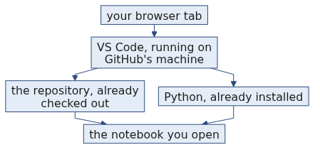
S5
What a Codespace is
A Codespace is a computer that GitHub runs for you and shows you inside a browser tab, with VS Code, Python and this repository already on it.
Nothing is installed on your laptop and nothing needs to be. The Codespace you open today is the environment for the whole programme.
Week 1, Day 1. Half one: the machine that remembers
6 / 35

Slide 7
S6
The layout, part by part
The explorer down the left lists the files in the repository, and today's notebook is one of them.
The editor in the middle is where the notebook opens, one cell under another.
Each cell has a run button on its left, and the output of that cell appears directly under it.
The kernel indicator at the top right names the Python that is running your cells.
The terminal panel at the bottom is a shell on the same machine, and you have no reason to open it today.
Week 1, Day 1. Half one: the machine that remembers
7 / 35

Slide 8
S7
Running a cell
A cell is a box you type Python into, and Shift and Enter runs it.
The output appears under the cell you ran, and it stays on screen until you run that cell again.
Week 1, Day 1. Half one: the machine that remembers
8 / 35

Slide 9
S8
Step card, section 1
1
Open the Codespace from the repository and wait for the editor to finish loading.
2
Open the notebook from the explorer on the left.
3
Run a cell with Shift and Enter.
4
Read the output under the cell before you move on.
Week 1, Day 1. Half one: the machine that remembers
9 / 35

Slide 10
SECTION 2: THE KERNEL REMEMBERS
open the workbench
the kernel remembers
type decides
walk the records
the business answer
Week 1, Day 1. Half one: the machine that remembers
10 / 35

Slide 11
S9
The bench
The kernel is a workbench that keeps whatever you put on it for as long as it is running.
Running a cell is you putting something on the bench. Restarting the kernel sweeps the bench clean, and the file on disk is untouched by that.
This picture is the one we use for the rest of the day.
Week 1, Day 1. Half one: the machine that remembers
11 / 35

Slide 12
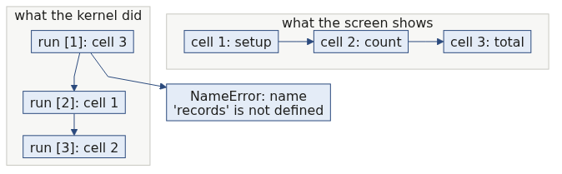
S10
Cells run in the order you run them
The notebook is a stack of cells on a screen, and the kernel has no opinion at all about that stack.
The kernel sees the order you clicked run in. If you ran the third cell first, then the third cell ran first.
Week 1, Day 1. Half one: the machine that remembers
12 / 35

Slide 13
S11
The execution counter is the truth
The number in square brackets to the left of a cell counts the runs the kernel has done.
[2] records = [ ... ]
[3] count = 0
[1] for r in records:
The cell at the bottom of the screen ran first. Read the counters, never the positions.
Week 1, Day 1. Half one: the machine that remembers
13 / 35

Slide 14
S11a
Applied to Kalpa: the counters on today's notebook
The setup cell that loads the thirty Kalpa Retail orders carries counter [1] on a clean kernel, and every later counter climbs from there without a gap.
A gap in that sequence means somebody ran a cell, edited it and ran something else, so the output you are reading came from code that no longer exists on the page.
Read the counters before you read the outputs, every time you open a notebook somebody else ran.
Week 1, Day 1. Half one: the machine that remembers
14 / 35

Slide 15
S12
The break
NameError: name 'records' is not defined
You ran the counting cell before the setup cell, so the name records was never put on the bench and the kernel had nothing to hand your loop.
The error names the exact word it went looking for.
Week 1, Day 1. Half one: the machine that remembers
15 / 35

Slide 16
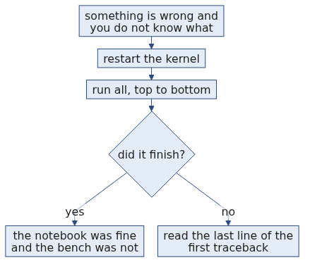
S13
The recovery drill
Restart the kernel, then run all cells from the top. You are back where you were, in a few seconds. The file on disk never changed. What you lost was the state on the bench, and the cells put that state straight back. Do the drill now on purpose, because you will do it many times this week.
Week 1, Day 1. Half one: the machine that remembers
16 / 35

Slide 17
S14
Step card, section 2
1
The kernel holds what you gave it until you restart it.
2
Run order is what the kernel sees, and screen order is what you see.
3
Read the execution counter first when an output surprises you.
4
Restart and run all is the recovery, and it costs you seconds.
Week 1, Day 1. Half one: the machine that remembers
17 / 35

Slide 18
SECTION 3: TYPE DECIDES
open the workbench
the kernel remembers
type decides
walk the records
the business answer
Week 1, Day 1. Half one: the machine that remembers
18 / 35

Slide 19
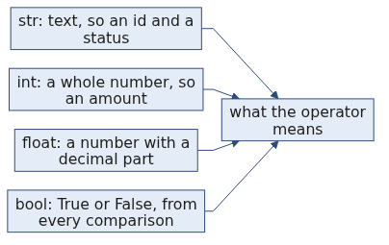
S15
Four types you meet today
str holds text, like the order id "KR4224" and the status "delivered".
int holds a whole number, like the amount 1460.
float holds a number with a decimal part, like 1460.5.
bool holds True or False, which is what every comparison hands back.
Week 1, Day 1. Half one: the machine that remembers
19 / 35

Slide 20
S16
type() is the question you ask
type("4500") <class 'str'>
type(4500) <class 'int'>
type(4500.0) <class 'float'>
type(4500 > 2000) <class 'bool'>
When an operator behaves in a way you did not expect, ask the value what it is before you change any code.
Week 1, Day 1. Half one: the machine that remembers
20 / 35

Slide 21
S17
Look at the record
{"order_id": "KR4200", "segment": "Retail-Core", "amount": "4500", "status": "returned", "order_date": "2026-08-03"}
{"order_id": "KR4201", "segment": "Retail-Plus", "amount": 2395, "status": "delivered", "order_date": "2026-08-03"}
One of those two amounts is wearing quotes. Read the two lines again and find it.
KR4200 stores its amount as the text "4500", and it is the largest amount in the file.
Week 1, Day 1. Half one: the machine that remembers
21 / 35

Slide 22
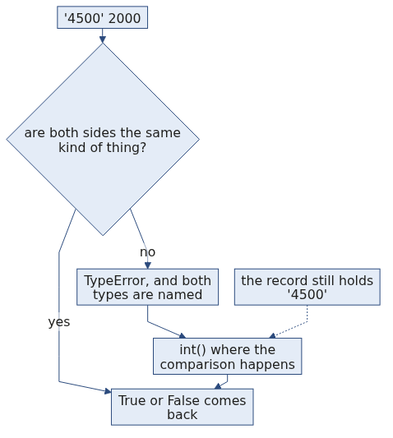
S18
The break
amount = "4500"
amount > 2000
TypeError: '>' not supported between instances of 'str' and 'int'
Python was asked whether a piece of text is greater than a number. It stopped and named both types it was holding.
Week 1, Day 1. Half one: the machine that remembers
22 / 35

Slide 23
S19
From the field
Mars Climate Orbiter, 1999. A value crossed a system boundary in the wrong unit, nothing validated it, and the mission, about USD 327 million, was lost.
Today's type discipline is the small version of that lesson.
Week 1, Day 1. Half one: the machine that remembers
23 / 35

Slide 24
S20
Refusing beats guessing
A spreadsheet would place that text amount somewhere in the sort order and show you a number with no warning attached to it.
Python refuses the comparison and tells you which two types it was holding. You lose ten seconds and you keep the truth.
That is your answer when someone asks why the error was the good outcome.
Week 1, Day 1. Half one: the machine that remembers
24 / 35

Slide 25
S20a
Question: is '10' > 9 True, or an error?
Take thirty seconds and commit to one of these four before the next slide.
a) True, since ten is larger than nine
b) False, since the quotes make it text and text sorts differently
c) A TypeError, because the two sides are different kinds of thing
d) It depends on the version of Python
Week 1, Day 1. Half one: the machine that remembers
25 / 35

Slide 26
S20b
Answer: it raises, and refusing is safer
The claim. '10' > 9 raises TypeError: '>' not supported between instances of 'str' and 'int', and Python names both types while it refuses.
Option | Why it does not hold
a) True | Reads the digits and ignores the quotes. Python has no rule that converts one side to match the other.
b) False | Would be the answer if both sides were text, since '10' > '9' really is False. One side is a number here.
d) It depends on the version | Python 2 compared across types and produced an order nobody could defend. Python 3 removed it on purpose.
The mental model. A spreadsheet guesses and shows you a total. Python refuses and shows you both types. You lose ten seconds and keep the truth.
Week 1, Day 1. Half one: the machine that remembers
26 / 35

Slide 27
S21
Comparison operators
2395 > 2000 True
2395 >= 2395 True
"delivered" == "delivered" True
"delivered" != "returned" True
Each of these hands back a bool, and the if statement reads that bool and nothing else.
Week 1, Day 1. Half one: the machine that remembers
27 / 35

Slide 28
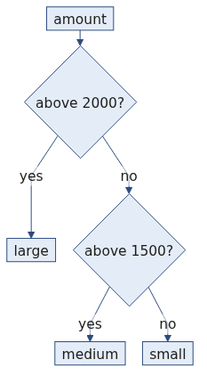
S22
if, elif and else
amount = 1460
if amount > 2000:
band = "large"
elif amount > 1500:
band = "medium"
else:
band = "small"
Python tries the conditions from the top and stops at the first one that is True, so band holds "small" here.
Week 1, Day 1. Half one: the machine that remembers
28 / 35

Slide 29
S23
The loop walks the stack
A dataset is a stack of cards, and the loop deals you one card at a time and calls it r.
for r in records:
print(r["order_id"])
Thirty records means thirty turns through the indented lines. The way a field is fetched by its name gets its proper treatment in half two.
Week 1, Day 1. Half one: the machine that remembers
29 / 35

Slide 30
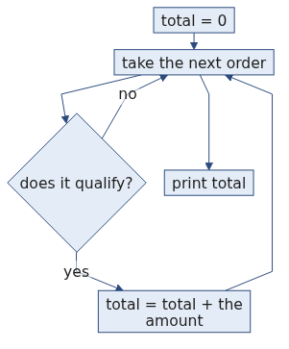
S24
The count accumulator
count = 0
for r in records:
if r["status"] == "delivered":
count = count + 1
print(count)
13
The counter is set to zero once, above the loop, and each card that passes the condition adds one to it.
Week 1, Day 1. Half one: the machine that remembers
30 / 35

Slide 31
S25
The sum accumulator
total = 0
for r in records:
if r["status"] == "delivered":
total = total + int(r["amount"])
print(total)
25720
The shape is the same and the amount goes in where the one was. That is 13 delivered orders totalling Rs 25,720, which is the number the notebook handed you at the start of the day.
Week 1, Day 1. Half one: the machine that remembers
31 / 35

Slide 32
S25a
Applied to Kalpa: the delivered answer, in full
Thirteen of the thirty Kalpa Retail orders were delivered, and those thirteen come to Rs 25,720.
The thirty amounts together come to Rs 58,210, so more than half the money in the file sits in orders that were returned or cancelled.
That gap is the first thing a business person asks about, and your loop is what puts a number on it.
Week 1, Day 1. Half one: the machine that remembers
32 / 35

Slide 33
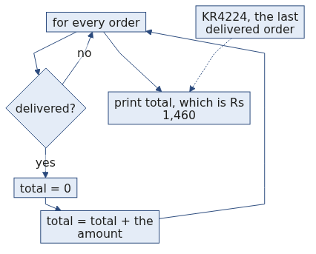
S26
Find the mistake in this loop
for r in records:
if r["status"] == "delivered":
total = 0
total = total + int(r["amount"])
print(total)
1460
This runs and it prints a number. Rs 1,460 is the amount of KR4224, the last delivered order in the file, and it is a total of nothing at all.
Which line is in the wrong place?
Week 1, Day 1. Half one: the machine that remembers
33 / 35

Slide 34
S27
Step card, section 3
1
Ask type() when an operator surprises you.
2
Read both type names in a TypeError before you touch the code.
3
Set the accumulator to zero once, above the loop.
4
When a number looks wrong, go and find the record that explains it.
Week 1, Day 1. Half one: the machine that remembers
34 / 35

Slide 35
S28
Crux, half one
Two errors landed on your screen this half, and each one told you exactly what it was holding.
The kernel remembers exactly what you gave it and nothing else, and the type of a value decides what every operator means.
Week 1, Day 1. Half one: the machine that remembers
35 / 35

