Slide 1
S1
The records answer back
Half one gave you a loop, a condition and an accumulator.
This half points all three at a question somebody actually asked.
Week 1, Day 1. Half two: the records answer back
1 / 35

Slide 2
S2
Where we are
open the workbench
the kernel remembers
type decides
walk the records
the business answer
The kernel holds your records and you can name a value's type. Now the records have to produce a number.
Week 1, Day 1. Half two: the records answer back
2 / 35

Slide 3
S3
The question on the table
Someone on the Kalpa Retail side asks how many of these orders are above Rs 2,000 and what those orders add up to.
Nobody has told you whether the file will cooperate with that question.
Week 1, Day 1. Half two: the records answer back
3 / 35

Slide 4
SECTION 1: THE GUIDED BUILD
open the workbench
the kernel remembers
type decides
walk the records
the business answer
Week 1, Day 1. Half two: the records answer back
4 / 35

Slide 5
S4
Build it with me
The trainer builds this on screen one line at a time, and you build the same lines on your own Codespace at the same pace.
Three pieces, and you already have all three: a loop that walks the records, a condition that asks one question of each record, and two accumulators that remember the answers.
Week 1, Day 1. Half two: the records answer back
5 / 35

Slide 6

S5
The condition
count = 0
total = 0
for r in records:
if r["amount"] > 2000:
count = count + 1
total = total + r["amount"]
Run it.
Week 1, Day 1. Half two: the records answer back
6 / 35

Slide 7
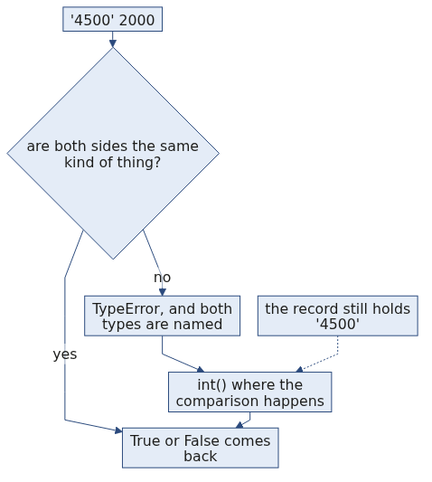
S6
The break
TypeError: '>' not supported between instances of 'str' and 'int'
It stops on the very first record in the file, which is KR4200 storing its amount as the text "4500".
You met this error in half one, and here it is inside the cell you are typing yourself.
Week 1, Day 1. Half two: the records answer back
7 / 35

Slide 8
S7
The fix, at the point of use
for r in records:
if int(r["amount"]) > 2000:
int() takes a value and hands back the whole number it stands for. That is all it is today, a converter you call at the moment you need a number.
You put it where the comparison happens, so the record arrives as text and the comparison still gets a number.
Week 1, Day 1. Half two: the records answer back
8 / 35

Slide 9
S8
The answer
count = 0
total = 0
for r in records:
if int(r["amount"]) > 2000:
count = count + 1
total = total + int(r["amount"])
print(count, total)
13 35020
13 orders are above Rs 2,000 and they total Rs 35,020, and that is a sentence you can say out loud to the person who asked.
Week 1, Day 1. Half two: the records answer back
9 / 35

Slide 10
S9
Two thirteens
The delivered orders came to 13 orders, totalling Rs 25,720.
The orders above Rs 2,000 came to 13 orders, totalling Rs 35,020.
Those are two different groups of orders that happen to hold the same count. Whenever you report either number, name the group it came from.
Week 1, Day 1. Half two: the records answer back
10 / 35

Slide 11
S10
Step card, section 1
1
Set both accumulators to zero above the loop.
2
Ask one condition of each record.
3
Convert at the point where you need the number.
4
Report the answer as a sentence with its group named.
Week 1, Day 1. Half two: the records answer back
11 / 35

Slide 12
SECTION 2: LISTS
open the workbench
the kernel remembers
type decides
walk the records
the business answer
Week 1, Day 1. Half two: the records answer back
12 / 35

Slide 13
S11
A list keeps its order
ids = ["KR4200", "KR4201", "KR4202", "KR4203", "KR4204"]
ids[0] "KR4200"
ids[2] "KR4202"
Counting starts at zero, so the first item is item zero and the third item is item two.
Week 1, Day 1. Half two: the records answer back
13 / 35

Slide 14
S12
A slice and an append
ids[1:3] ["KR4201", "KR4202"]
ids.append("KR4205")
len(ids) 6
A slice takes a run of items, starting at the first number and stopping before the second one.
append puts one more item on the end of the list you already have.
Week 1, Day 1. Half two: the records answer back
14 / 35

Slide 15
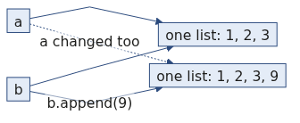
S13
b = a
a = ["KR4200", "KR4201"]
b = a
b.append("KR4202")
len(a) 3
b = a gives the same list a second name. There is one list here and two ways to reach it, so appending through either name changes what both names show.
When you want a second list, say so on purpose:
b = list(a)
Week 1, Day 1. Half two: the records answer back
15 / 35

Slide 16
S13a
Question: after b = a and b.append(9), what is len(a)?
Commit to one before the next slide.
a) 3, since a was never mentioned again
b) 4, since both names point at one list
c) A TypeError, since a list cannot be extended after assignment
d) 1, since a now holds only the appended value
Week 1, Day 1. Half two: the records answer back
16 / 35

Slide 17
S13b
Answer: 4, since one list has two names
The claim. len(a) is 4. b = a copied the name and not the list, so appending through either name changes the one list both names point at.
Option | Why it does not hold
a) 3 | Reads the code as if b = a had made a copy. Assignment never copies a list.
c) TypeError | Appending to a list is always allowed, whatever names point at it.
d) 1 | Confuses appending with replacing. Nothing here replaced anything.
The mental model. A name is a label you stick on a thing. Two labels on one box means opening either one shows you the same contents. Copy on purpose with list(a) or a[:].
Week 1, Day 1. Half two: the records answer back
17 / 35

Slide 18
S14
Step card, section 2
1
Index from zero.
2
A slice stops before its second number.
3
append changes the list in place.
4
Copy with list(a) when you want two lists instead of two names.
Week 1, Day 1. Half two: the records answer back
18 / 35

Slide 19
SECTION 3: A RECORD HAS NAMES
open the workbench
the kernel remembers
type decides
walk the records
the business answer
Week 1, Day 1. Half two: the records answer back
19 / 35

Slide 20
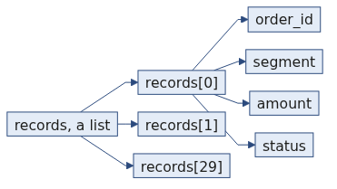
S15
A record is a dictionary
r = {"order_id": "KR4224", "segment": "Retail-Core", "amount": 1460,
"status": "delivered", "order_date": "2026-08-17"}
r["status"] "delivered"
A dictionary stores values under names, and you fetch a field by asking for its name. Your loop has been doing this since half one.
Week 1, Day 1. Half two: the records answer back
20 / 35

Slide 21
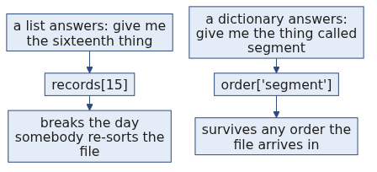
S16
Never by position
Position is a promise the file never made to you.
The day someone adds a column in front of the status field, every position you wrote points one field to the left, and your code keeps running and answers a different question.
A name survives that reordering, and that is the whole argument.
Week 1, Day 1. Half two: the records answer back
21 / 35

Slide 22
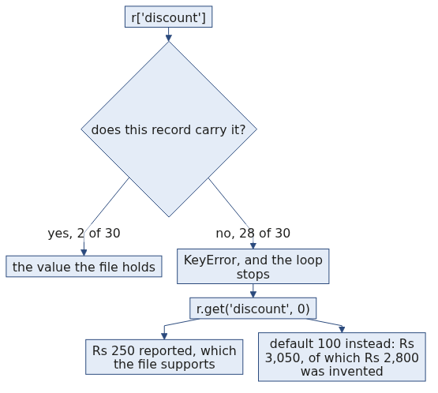
S17
The break
records[0]["discount"]
KeyError: 'discount'
Two of the thirty orders carry a discount field. Asking a dictionary for a name it does not have stops the program, and the error names the field it went looking for.
Week 1, Day 1. Half two: the records answer back
22 / 35

Slide 23
S18
Absent is different from empty
Nobody wrote a discount of nothing on the other twenty-eight orders. Those records have no discount field on them at all.
So your code has to say what happens when the name is missing, and that instruction is yours to write.
Week 1, Day 1. Half two: the records answer back
23 / 35

Slide 24
S19
.get() with a default
r.get("discount", 0)
.get() asks for a name and takes a second value to hand back when that name is absent.
The program keeps running, and the number that arrives is the number you chose.
Week 1, Day 1. Half two: the records answer back
24 / 35

Slide 25
S20
The default is a decision
total = 0
for r in records:
total = total + r.get("discount", 0)
With a default of 0, the thirty records total Rs 250 in discounts, which is the sum of the two discounts the file actually records.
With a default of 100, the same thirty records total Rs 3,050, and Rs 2,800 of that is a number you invented twenty-eight times.
Both cells run to the end. Only one of the two totals is a fact.
Week 1, Day 1. Half two: the records answer back
25 / 35

Slide 26
S20a
Applied to Kalpa: the two defaults, priced
Two of the thirty Kalpa Retail orders carry a discount, KR4215 at Rs 75 and KR4223 at Rs 175.
A default of zero reports Rs 250, which is exactly what the file holds.
A default of a hundred reports Rs 3,050, of which Rs 2,800 was supplied by you rather than by Kalpa. Nothing on the page says which part came from where.
Week 1, Day 1. Half two: the records answer back
26 / 35

Slide 27
S21
Step card, section 3
1
Fetch a field by its name.
2
Never fetch a field by its position.
3
A KeyError means that name is absent from that record.
4
State your default out loud, because it becomes part of your answer.
Week 1, Day 1. Half two: the records answer back
27 / 35

Slide 28
SECTION 4: THE BUSINESS ANSWER
open the workbench
the kernel remembers
type decides
walk the records
the business answer
Week 1, Day 1. Half two: the records answer back
28 / 35

Slide 29
S22
A dataset is a list of dictionaries
records = [
{"order_id": "KR4200", "segment": "Retail-Core", "amount": "4500", "status": "returned", "order_date": "2026-08-03"},
{"order_id": "KR4201", "segment": "Retail-Plus", "amount": 2395, "status": "delivered", "order_date": "2026-08-03"},
]
Thirty records in one list, and each record is a dictionary carrying the same field names. That is the entire shape of the data you have worked on all day.
Week 1, Day 1. Half two: the records answer back
29 / 35

Slide 30
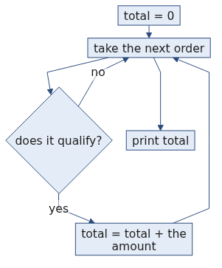
S23
So the loop you already wrote walks it
total = 0
for r in records:
if r["status"] == "delivered":
total = total + int(r["amount"])
This is the cell the day ends on, and it answers the question you were shown at the start: "Of these thirty Kalpa Retail orders, how much did we actually collect?"
The converter sits there because you now know one amount in this file is text, and the cell should not depend on which records happen to be tidy.
Week 1, Day 1. Half two: the records answer back
30 / 35

Slide 31
S24
The recipe for any of these questions
1
Set your accumulators to zero above the loop.
2
Walk the records one card at a time.
3
Ask one condition of each card.
4
Add to the accumulators only when the condition holds, and print at the end.
Week 1, Day 1. Half two: the records answer back
31 / 35

Slide 32
S25
Your three questions
1
How many orders are in the Student segment, and what do they total?
2
How many orders were returned, and what do returned orders total?
3
How many delivered orders are above Rs 2,000, and what do they total?
No hints on these. Work on your own Codespace, and the solution is released at close.
Week 1, Day 1. Half two: the records answer back
32 / 35

Slide 33
S26
Tomorrow
These same thirty records arrive tomorrow as a file rather than as a cell you can read on screen.
A file has forgotten every type it ever knew. Every amount, every status and every date arrives as text, and the cell you just wrote has to survive that.
Week 1, Day 1. Half two: the records answer back
33 / 35

Slide 34
S27
Crux, half two
A dataset is a stack of named cards, and a loop with a condition and an accumulator turns that stack into one number you can defend.
Week 1, Day 1. Half two: the records answer back
34 / 35

Slide 35
S28
Crux, the day
You can take thirty records nobody explained to you and come back with a number, and you can say what would break it.
Week 1, Day 1. Half two: the records answer back
35 / 35

