Slide 1
S1
Package the logic, survive bad data
The three questions this half answers: what do I call again tomorrow, what do I do when a value is wrong, and who finds out.
Week 1, Day 2. Half one: package the logic, survive bad data
1 / 67

Slide 2
S2
Where we are
inline cell
packaged decision
read the failure
log the rejection
cross the boundary
Every order in this file is a Kalpa Retail order, and it will still be Kalpa Retail in Week 15.
Yesterday you answered a question about the orders. Today that answer becomes something you can run again on records you have not seen.
Week 1, Day 2. Half one: package the logic, survive bad data
2 / 67

Slide 3
S2b
Where this is going
clean_record, on three records from today's file:
rejected KR4210 because: invalid literal for int() with base 10: 'twelve'
rejected KR4214 because: invalid literal for int() with base 10: ''
kept KR4200 4500
One function. Three records. Three outcomes, and the rejected ones say why.
You will have written this within the hour.
Week 1, Day 2. Half one: package the logic, survive bad data
3 / 67

Slide 4
S2c
The whole day in one picture
Today has five stops and you will pass through all of them before the close.
Half one is the first four boxes. Half two is the last two.
Week 1, Day 2. Half one: package the logic, survive bad data
4 / 67

Slide 5
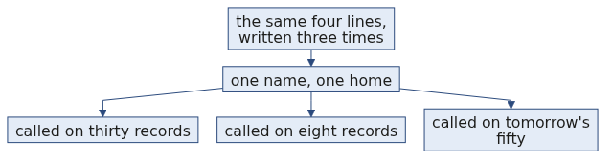
S3
The anchor
You have written this cell three times already.
total = 0
for r in records:
if r["status"] == "delivered":
total = total + int(r["amount"])
Three copies. One of them has a typo. Which one?
Week 1, Day 2. Half one: package the logic, survive bad data
5 / 67

Slide 6
S4
The problem with three copies
A rule that lives in three cells is three rules.
When the rule changes, you have to remember where all three are. The one you forget is the one that ships.
Week 1, Day 2. Half one: package the logic, survive bad data
6 / 67

Slide 7
D2
What three copies costs, counted
DEPTH
Suppose the rule changes four times over a project, and each change has to be applied by hand in three places.
$$\text{edits} = \text{changes} \times \text{copies} = 4 \times 3 = 12$$
$$\text{chances to forget one} = \text{changes} \times (\text{copies} - 1) = 4 \times 2 = 8$$
With the rule in one function, the same four changes are four edits and there is nothing to forget. The arithmetic is small and it is the whole argument for the next twenty slides.
Week 1, Day 2. Half one: package the logic, survive bad data
7 / 67

Slide 8
SECTION 1: THE PACKAGED DECISION
inline cell
packaged decision
read the failure
log the rejection
cross the boundary
Week 1, Day 2. Half one: package the logic, survive bad data
8 / 67

Slide 9
S5
Same rule, one place
def delivered_total(records):
total = 0
for r in records:
if r["status"] == "delivered":
total = total + int(r["amount"])
return total
The rule now has a name and one home.
Week 1, Day 2. Half one: package the logic, survive bad data
9 / 67

Slide 10
S5b
The anatomy of a function
Four parts, and each one has a job you can name.
The parameter is the only door in. The return is the only door out. Everything else is inside and is nobody else's business.
Week 1, Day 2. Half one: package the logic, survive bad data
10 / 67

Slide 11
S6
What the name buys you
You can say the name out loud to a colleague.
You can change the rule in one place.
You can run it on a file that arrives next week.
Week 1, Day 2. Half one: package the logic, survive bad data
11 / 67

Slide 12
S7
The parameter is the promise
def delivered_total(records) says: give me records, I give you a number.
The function cannot see anything you did not hand it. That is the whole of scope for today.
Week 1, Day 2. Half one: package the logic, survive bad data
12 / 67

Slide 13
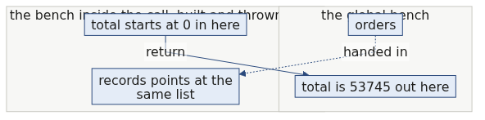
D4
Scope, drawn once
DEPTH
The bench you worked on yesterday is the global bench. A call builds a small second bench, uses it, and throws it away.
Two names spelled total can hold two different numbers at the same time. The one inside the call disappears when the call ends, and the one outside never noticed.
Week 1, Day 2. Half one: package the logic, survive bad data
13 / 67

Slide 14
D5
Prove it to yourself in four lines
DEPTH
total = 99
def delivered_total(records):
total = 0
return total
print(delivered_total([]), total)
0 99
The function set total to zero and the outer total is still 99. If you expected 0 0, that expectation is the single most common source of confusion in this room, and now you have watched it not happen.
Week 1, Day 2. Half one: package the logic, survive bad data
14 / 67

Slide 15
S8
Live demo
Carve delivered_total out of the inline cell together.
Then break it: rename the variable outside the function and watch the function keep working.
Week 1, Day 2. Half one: package the logic, survive bad data
15 / 67

Slide 16
S9
return against print
def fix(record):
print(record["order_id"])
result = fix(rec)
What is inside result now?
Week 1, Day 2. Half one: package the logic, survive bad data
16 / 67

Slide 17
S10
The break
TypeError: 'NoneType' object is not subscriptable
print shows a human. return hands a value back to the code. A function that only prints returns None, and None cannot be indexed.
Week 1, Day 2. Half one: package the logic, survive bad data
17 / 67

Slide 18
D6
The same function, both ways, side by side
DEPTH
def with_print(record):
print(int(record["amount"]))
def with_return(record):
return int(record["amount"])
a = with_print(orders[0])
b = with_return(orders[0])
print("a is", a, "and b is", b)
4500
a is None and b is 4500
Both put 4500 in front of you. Only one of them put it anywhere your next line can reach.
Week 1, Day 2. Half one: package the logic, survive bad data
18 / 67

Slide 19
S11
The rule
Print is for you. Return is for the next line of code.
If the caller needs the answer, the function returns it.
Week 1, Day 2. Half one: package the logic, survive bad data
19 / 67

Slide 20
D7
The compact loop, once, as notation
DEPTH
A list comprehension is the same loop written on one line. It is notation, not a new idea.
amounts = []
for r in orders:
amounts.append(r["amount"])
amounts = [r["amount"] for r in orders]
Both build the same list. Read the second one right to left: for every r in orders, take r["amount"].
You will meet it in other people's code today. You are not required to write one.
Week 1, Day 2. Half one: package the logic, survive bad data
20 / 67

Slide 21
S12
Step card, section 1
1
Name the rule with def.
2
Take what you need as parameters.
3
Hand the answer back with return.
4
Use print only to show a human.
Week 1, Day 2. Half one: package the logic, survive bad data
21 / 67

Slide 22
SECTION 2: READ THE FAILURE
inline cell
packaged decision
read the failure
log the rejection
cross the boundary
Week 1, Day 2. Half one: package the logic, survive bad data
22 / 67

Slide 23
S13
Yesterday you saw three of these
A traceback is not the computer being angry. It is the computer telling you where it stopped and what it was holding.
Week 1, Day 2. Half one: package the logic, survive bad data
23 / 67

Slide 24
S14
Read it bottom-up
Traceback (most recent call last):
File "clean.py", line 12, in <module>
total = total + int(record["amount"])
^^^^^^^^^^^^^^^^^^^^
ValueError: invalid literal for int() with base 10: 'twelve'
Last line: what went wrong. Line above it: where. Everything else: how you got there.
Week 1, Day 2. Half one: package the logic, survive bad data
24 / 67

Slide 25
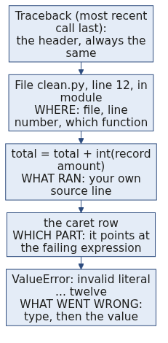
D8
Every part of a traceback, labelled
DEPTH
Read it from the bottom. The value at the end is the part people skip, and it is the part that names the record.
Week 1, Day 2. Half one: package the logic, survive bad data
25 / 67

Slide 26
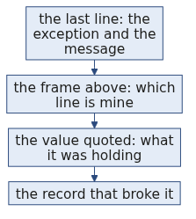
S15
The three questions
1
What is the exception type?
2
Which line is mine?
3
What value was it holding?
The third question is the one people skip.
Week 1, Day 2. Half one: package the logic, survive bad data
26 / 67

Slide 27
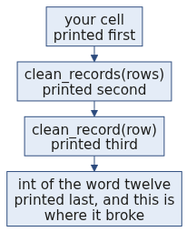
D9
Why the stack reads bottom-up
DEPTH
When one function calls another, each call is pushed onto a stack. The traceback prints the stack from the outside in, so the last frame printed is the innermost call, which is where the failure actually happened. In a long traceback, the deepest frame is almost always library code you did not write. Scan upward until you reach the first line that lives in your own file, and start there.
Week 1, Day 2. Half one: package the logic, survive bad data
27 / 67

Slide 28
S16
Catching it
try:
value = int(record["amount"])
except ValueError:
...
You name the exception you expected. Anything else still stops the program, which is what you want.
Week 1, Day 2. Half one: package the logic, survive bad data
28 / 67

Slide 29
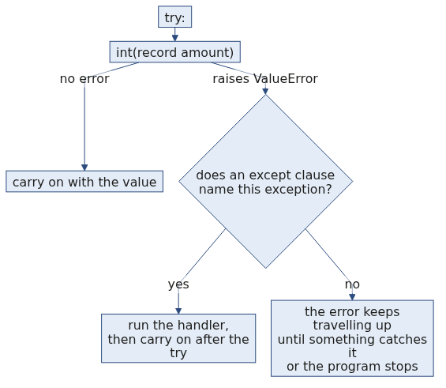
S16b
What try and except actually do to the flow
An exception you did not name is not ignored. It carries on upward, which is exactly the behaviour you want for a failure you did not anticipate.
Week 1, Day 2. Half one: package the logic, survive bad data
29 / 67

Slide 30
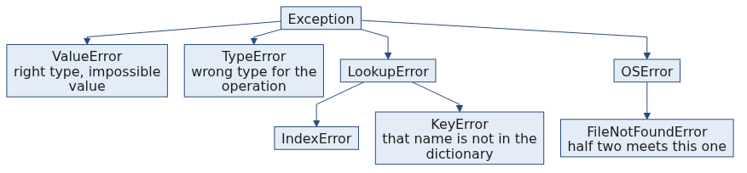
D11
The exception family, and why the name matters
DEPTH
Catching Exception catches every branch of this tree, including the ones you never thought about. Catching ValueError catches the branch you reasoned about and lets the rest travel.
Week 1, Day 2. Half one: package the logic, survive bad data
30 / 67

Slide 31
D12
Two defensive stances, and when each wins
DEPTH
Stance | What it looks like | When it wins
Look before you leap | You test the value first with something like a digit check before converting it. | The check is cheap and total, and there is one clear condition to test.
Ask forgiveness, not permission | You attempt the conversion inside a try and catch the failure it raises. | The check would have to duplicate the conversion's own rules, which is exactly the case for int().
Python leans on the second stance, and int() is the reason why. Writing a test that predicts every string int() accepts means rewriting int(), including the leading sign, the surrounding whitespace and the underscores it allows.
Week 1, Day 2. Half one: package the logic, survive bad data
31 / 67

Slide 32
S17
The trap
try:
value = int(record["amount"])
except:
pass
This runs. It produces a number. The number is wrong and nothing on screen says so.
Week 1, Day 2. Half one: package the logic, survive bad data
32 / 67

Slide 33
S18
Watch it happen
Bare except, on today's 30 records:
Processed 30 records. Total: 53745
Narrow except, same 30 records:
Clean 28, rejected 2, total 53745
Same number. One of these two lines is a lie.
Week 1, Day 2. Half one: package the logic, survive bad data
33 / 67

Slide 34
S19
Which one lied
The first line claims 30 records went into that total. Two of them did not.
A crash costs you an hour. A plausible wrong number costs you the quarter, because nobody goes looking for it.
Week 1, Day 2. Half one: package the logic, survive bad data
34 / 67

Slide 35
D13
The size of the lie, as a formula
DEPTH
Write $n$ for the records that arrived, $r$ for the records that failed to convert, and $\bar{x}$ for the average of the ones that did.
The honest total comes from the ones that converted. The gap between that and the total somebody assumes covers all $n$ records is
$$\text{understatement} \approx r \times \bar{x}$$
Today $r = 2$ and $\bar{x} = 53745 / 28 \approx 1920$, so the silent gap is about Rs 3,840 on a reported Rs 53,745, which is roughly 7 percent.
Nothing on the screen carries that 7 percent. The only way it reaches anybody is if you write $r$ down.
Week 1, Day 2. Half one: package the logic, survive bad data
35 / 67

Slide 36
S20
Step card, section 2
1
Read the traceback from the bottom.
2
Name the exception you expected.
3
Never catch everything.
4
If the count and the claim disagree, the claim is wrong.
Week 1, Day 2. Half one: package the logic, survive bad data
36 / 67

Slide 37
SECTION 3: LOG THE REJECTION
inline cell
packaged decision
read the failure
log the rejection
cross the boundary
Week 1, Day 2. Half one: package the logic, survive bad data
37 / 67

Slide 38
S21
Where does the bad record go
You have three choices when a record will not convert.
Fix it silently. Drop it silently. Set it aside with a reason.
Only the third one survives a question from your manager.
Week 1, Day 2. Half one: package the logic, survive bad data
38 / 67

Slide 39
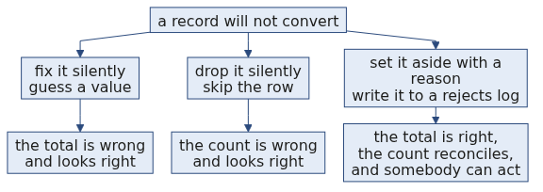
S21b
The three choices, and what each one costs later
The first two are faster today and cost you the conversation you cannot win in three weeks. The third is the job.
Week 1, Day 2. Half one: package the logic, survive bad data
39 / 67

Slide 40
S22
The rejects list
def clean_record(record):
keeper = dict(record)
keeper["amount"] = normalise_amount(record["amount"])
return keeper
clean_record handles one record and decides nothing about failure. clean_records handles the list and owns that decision.
except ValueError as e:
rejects.append({"order_id": record["order_id"], "reason": str(e)})
str(e) carries the exact reason the interpreter gave you. You do not have to invent wording.
Week 1, Day 2. Half one: package the logic, survive bad data
40 / 67

Slide 41

D15
Who decides what, and why the split matters
DEPTH
One function knows how to convert and nothing about policy. The other knows the policy and nothing about conversion. That split is why the same clean_record is called unchanged tomorrow on a dataset four times the size.
Week 1, Day 2. Half one: package the logic, survive bad data
41 / 67

Slide 42
S23
What a good reason looks like
{"id": "KR4210", "reason": "invalid literal for int() with base 10: 'twelve'"}
{"id": "KR4214", "reason": "invalid literal for int() with base 10: ''"}
Someone who was not in the room can act on both of these.
Week 1, Day 2. Half one: package the logic, survive bad data
42 / 67

Slide 43
D16
The fields a reject row needs, and why
DEPTH
Field | Why it is there
The identifier | Without it nobody can find the record in the source system, so the row is a complaint rather than a task.
The reason, verbatim from the interpreter | It distinguishes a word where a number belongs from an empty cell, and those two go to different people.
The field that failed | A record can fail on the amount or on the date, and a fixer needs to know which without opening the file.
The raw value | The person who fixes it upstream needs to see exactly what arrived, including the spaces you cannot see.
Today you ship the first two, which is the minimum that works. Tomorrow's profiler adds the rest.
Week 1, Day 2. Half one: package the logic, survive bad data
43 / 67

Slide 44
S24
The reconciliation
30 records in. 28 clean. 2 rejected.
Input equals clean plus rejected. When that sum does not hold, something disappeared and you do not yet know what.
Week 1, Day 2. Half one: package the logic, survive bad data
44 / 67

Slide 45
D17
The reconciliation, as an identity
DEPTH
$$n_{\text{in}} = n_{\text{clean}} + n_{\text{rejected}}$$
Today that reads $30 = 28 + 2$, and it holds.
The identity is worth writing as an assertion in your own code, because the day it fails is the day you learn something you did not know about the data:
assert len(rows) == len(kept) + len(rejects), "records went missing"
A total with no reconciliation beside it is a number somebody has to take on trust. A total with one is a number they can check in two seconds.
Week 1, Day 2. Half one: package the logic, survive bad data
45 / 67

Slide 46
S25
From the field
Knight Capital, 1 August 2012. About USD 440 million lost in 45 minutes.
A deployment reused an old flag. The system did not fail loudly. It kept trading, at speed, on the wrong rule.
The argument for validating early and failing loudly is not a style preference. It is that number.
Week 1, Day 2. Half one: package the logic, survive bad data
46 / 67

Slide 47
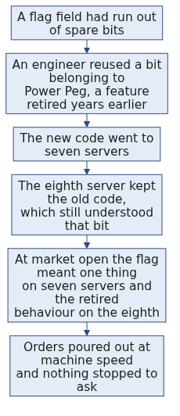
D18
Knight Capital, the mechanism
DEPTH
The dead code was never deleted, only stopped being called. Reusing its flag called it again.
Week 1, Day 2. Half one: package the logic, survive bad data
47 / 67

Slide 48
D19
Knight Capital, what it cost
DEPTH
Fact | Figure
Date | 1 August 2012
Time to the loss | About 45 minutes
Executions | More than 4 million, in 154 stocks
Shares | More than 397 million
Realised pre-tax loss | About USD 440 million
What followed | The firm raised about USD 400 million within days to survive, and was acquired within months
Source: Knight Capital Group, Wikipedia: https://en.wikipedia.org/wiki/Knight_Capital_Group (verified 09 September 2026)
Week 1, Day 2. Half one: package the logic, survive bad data
48 / 67

Slide 49
D20
The line from that to your cell today
DEPTH
Knight had no shortage of engineers. It had a deployment that half succeeded and nothing that said so.
Your clean_records half succeeds every time you run it, because two records will not convert. The difference between you and that morning is one list and one printed count.
The habit is small and it is the same habit at every scale. When part of the work fails, make the failure a value the program carries, rather than a thing that happens and is gone.
Week 1, Day 2. Half one: package the logic, survive bad data
49 / 67

Slide 50
D21
Where a rejects log lives in production
DEPTH
A data pipeline at any size writes the same two outputs you are about to write. The rejects side gets a name and a rule attached to it.
In production it is called | What it holds | The rule attached
A dead letter queue | Messages the consumer could not process | Retry a fixed number of times, then park it for a human
A quarantine table | Rows that failed validation on load | Nothing downstream reads it, and someone owns clearing it
A rejects file beside the clean file | Exactly what you are writing today | The load is not finished until the counts reconcile
The names change with the tool. The identity in D17 does not.
Week 1, Day 2. Half one: package the logic, survive bad data
50 / 67

Slide 51
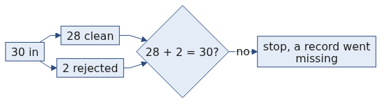
S26
Interview question
"Why is a bare except worse than letting the code crash?"
You can answer this now, with today's two output lines as your evidence.
Week 1, Day 2. Half one: package the logic, survive bad data
51 / 67

Slide 52
S27
Step card, section 3
1
Set the bad record aside, never drop it.
2
Carry the interpreter's own reason.
3
Reconcile: input equals clean plus rejected.
4
Ship the rejects list as part of the job.
Week 1, Day 2. Half one: package the logic, survive bad data
52 / 67

Slide 53
SECTION 4: THE INTERVIEW BLOCK
inline cell
packaged decision
read the failure
log the rejection
cross the boundary
Week 1, Day 2. Half one: package the logic, survive bad data
53 / 67

Slide 54
S28
What this section is
Two of the questions below are on this week's own question set and will be on Saturday's paper. The rest are asked often enough at this level that this programme puts them in front of you now.
Each one gets the same treatment: what the question is really testing, the answer, and the follow-up you should expect.
Week 1, Day 2. Half one: package the logic, survive bad data
54 / 67

Slide 55
S29
Question: what do you read first in a traceback?
A four-line traceback is on the screen and you have ten seconds.
a) The first line, since it says where the run began
b) The frame naming your own file
c) The last line
d) Whichever line names a library you recognise
Week 1, Day 2. Half one: package the logic, survive bad data
55 / 67

Slide 56
S29a
Answer: the last line, and then two more questions
The claim. The last line carries the exception type and the offending value, which is where the diagnosis starts. Then you scan up to the first frame in your own code.
Three questions, every time: what is the exception type, which line is mine, and what value was it holding? The third is the one people skip and it is the one that names the record.
Option | Why it does not hold
a) The first line | It names where the run began, which is almost never where it broke.
b) Your own frame | That is the second thing you look at, and it tells you where rather than what.
d) A library name | The deepest frame is usually library code that did what you asked it to do.
The mental model. A traceback is a receipt printed from the bottom up. The last line is the total.
Week 1, Day 2. Half one: package the logic, survive bad data
56 / 67

Slide 57
D22
The traceback, one level deeper
DEPTH
An interviewer who wants to separate you from the room asks what a re-raised exception means, or why a traceback sometimes shows two failures joined by the line "During handling of the above exception, another exception occurred".
The honest answer at your stage: that second form means an error happened inside an except block, and Python shows both so the original cause is not lost. Say that, and say you have not used chained exceptions in anger yet. Naming the edge of what you know is worth more than guessing at it.
Week 1, Day 2. Half one: package the logic, survive bad data
57 / 67

Slide 58
S30
Question: why is a bare except worse than a crash?
Both cells below ran to the end. Which of these is the strongest reason to prefer the crash?
a) The crash is faster to write
b) The crash stops a wrong number from travelling
c) A bare except is against the style guide
d) A bare except is slower on large files
Week 1, Day 2. Half one: package the logic, survive bad data
58 / 67

Slide 59
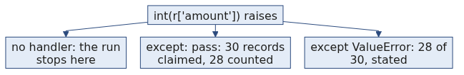
S30a
Answer: the crash stops a wrong number
The claim. A crash is loud and it stops the wrong number from travelling. A bare except catches errors nobody reasoned about and leaves the program producing a plausible number nobody questions.
bare except: Processed 30 records. Total: 53745
named except: Clean 28, rejected 2, total 53745
Option | Why it does not hold
a) Faster to write | True and irrelevant. Both are one line.
c) The style guide | An appeal to authority, which loses the argument in a review.
d) Slower on large files | Invented, and it would not matter if it were true.
The mental model. Same total, and one of them is a lie about its own denominator. Say the two numbers, then say the identity: input equals clean plus rejected.
Week 1, Day 2. Half one: package the logic, survive bad data
59 / 67

Slide 60
D23
The numbers that make the bare except land
DEPTH
Bring the arithmetic, not the adjective. The claim "it hides errors" is a slogan. The claim below is evidence.
bare except: Processed 30 records. Total: 53745
named except: Clean 28, rejected 2, total 53745
Same total, and one of them is a lie about its own denominator. Say the two numbers, then say the identity: input equals clean plus rejected.
Week 1, Day 2. Half one: package the logic, survive bad data
60 / 67

Slide 61
S31
Question: return against print, what differs?
A function calls print and nothing else. What does its caller receive?
a) The value that was printed
b) The record it passed in
c) None
d) Nothing at all, and the next line is skipped
Week 1, Day 2. Half one: package the logic, survive bad data
61 / 67

Slide 62
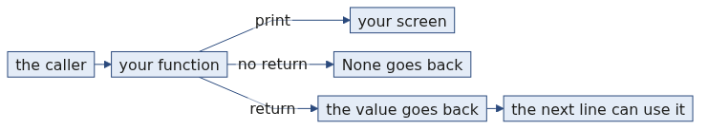
S31a
Answer: None, which is why the next line raises
The claim. print writes to the screen for a person and hands nothing back. return gives a value to the line that called the function. A function that only prints hands back None.
Option | Why it does not hold
a) The printed value | It went to the screen, which the caller cannot read.
b) The record | Confuses the argument with the return.
d) The line is skipped | Python runs the next line, which is why result["order_id"] raises TypeError: 'NoneType' object is not subscriptable.
The mental model. Print shows you. Return hands over.
Week 1, Day 2. Half one: package the logic, survive bad data
62 / 67

Slide 63
S32
Question: what does a parameter list guarantee?
You hand a function one record. What can it see?
a) Every name in the notebook, since it is all one kernel
b) Only what it was handed, plus what it makes itself
c) Whatever the cell above it defined
d) Nothing, until it returns
Week 1, Day 2. Half one: package the logic, survive bad data
63 / 67

Slide 64
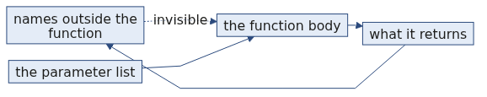
S32a
Answer: only what it was handed
The claim. The parameter list is the only door in. A function cannot see a name you did not hand it, and a name it assigns inside its body does not touch the name outside.
Option | Why it does not hold
a) Every name | That is what the kernel holds, not what the function sees. It is also what makes untested code work by accident.
c) The cell above | The same mistake, dressed as proximity.
d) Nothing until it returns | Confuses what goes in with what comes out.
That is why the same function runs unchanged on today's thirty records and tomorrow's fifty.
The mental model. A function is a room with one door and one window. The parameters are the door and the return is the window.
Week 1, Day 2. Half one: package the logic, survive bad data
64 / 67

Slide 65
S33
Question: zero rejects on a file you know is dirty?
Your run reports zero rejections. What do you check first?
a) Whether the file was the one you meant to open
b) Whether anything was actually caught
c) Whether the output folder exists
d) Whether the input had any rows at all
Week 1, Day 2. Half one: package the logic, survive bad data
65 / 67

Slide 66
S33a
Answer: whether anything was caught, then reconcile
The claim. A bare except with a pass reports zero rejects by construction, so the first check is whether the handler ever appended anything.
Option | Why it does not hold
a) The wrong file | Worth checking, and it produces a low row count rather than zero rejects.
c) The output folder | Missing folders raise on write rather than reporting zero.
d) An empty input | Also produces zero clean rows, which you would have noticed.
Then reconcile: input equals clean plus rejected only tells you something when you compute all three. Then check the condition itself, because a condition nothing matches rejects nothing.
The mental model. Zero is a number somebody has to earn.
Week 1, Day 2. Half one: package the logic, survive bad data
66 / 67

Slide 67
S34
Crux, half one
You have clean_record. That was the promise on the third slide.
A function is a decision you can call again. A named exception is a failure you chose to survive. A rejects log is the difference between a number and a number you can defend.
Week 1, Day 2. Half one: package the logic, survive bad data
67 / 67

