Slide 1
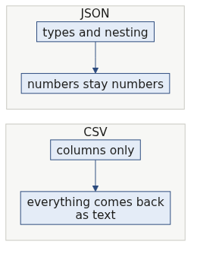
S1
Cross the file boundary
Everything so far lived inside the notebook. Close the notebook and it is gone.
Week 1, Day 2. Half two: cross the file boundary
1 / 71

Slide 2
S2
Where we are
inline cell
packaged decision
read the failure
log the rejection
cross the boundary
Half one made your rule callable. This half makes your data outlive the kernel.
Week 1, Day 2. Half two: cross the file boundary
2 / 71

Slide 3
S3
The anchor
Restart the kernel.
Your 30 records are gone. Yesterday you learned that. Today you do something about it.
Week 1, Day 2. Half two: cross the file boundary
3 / 71

Slide 4
S4
Where the orders actually come from
Nobody hands you a Python list. Kalpa Retail's order system sends you a file.
The file was written by a system you do not control, exported by a person you have not met, at a time you did not choose.
Week 1, Day 2. Half two: cross the file boundary
4 / 71

Slide 5
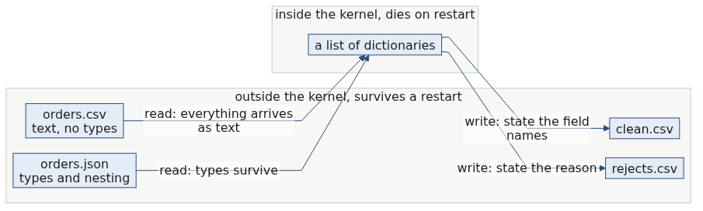
S4b
The boundary, in one picture
Every arrow that crosses the dashed line loses something or has to be told something.
Week 1, Day 2. Half two: cross the file boundary
5 / 71

Slide 6
SECTION 1: A FORMAT IS AN AGREEMENT
inline cell
packaged decision
read the failure
log the rejection
cross the boundary
Week 1, Day 2. Half two: cross the file boundary
6 / 71

Slide 7
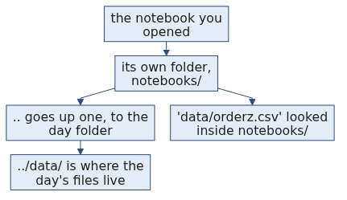
S5
What a file format is
A file format is an agreement about structure.
CSV agrees: one row per record, one comma between fields, the first row names the fields.
That is the entire agreement. Nothing in it mentions types.
Week 1, Day 2. Half two: cross the file boundary
7 / 71

Slide 8
S6
The consequence
Everything you read from a CSV is a string.
4500 becomes "4500"
twelve becomes "twelve"
(empty) becomes ""
The file cannot tell you which one is a number. It never could.
Week 1, Day 2. Half two: cross the file boundary
8 / 71

Slide 9
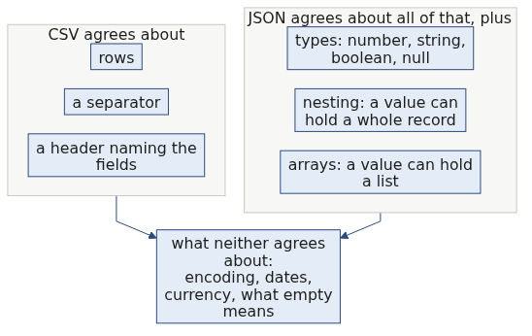
S6b
What each format agrees about
The last box is where most real defects live, and no format will save you from it.
Week 1, Day 2. Half two: cross the file boundary
9 / 71

Slide 10
D1
The round trip that loses types, watched
DEPTH
records = [{"order_id": "KR4201", "amount": 2395}]
with open("round.csv", "w", newline="") as f:
w = csv.DictWriter(f, fieldnames=["order_id", "amount"])
w.writeheader(); w.writerows(records)
with open("round.csv") as f:
back = list(csv.DictReader(f))
print(records[0]["amount"], type(records[0]["amount"]).__name__)
print(back[0]["amount"], type(back[0]["amount"]).__name__)
2395 int
2395 str
The number went out and a string came back. Nothing was corrupted and nothing warned you. The agreement simply never carried the type.
Week 1, Day 2. Half two: cross the file boundary
10 / 71

Slide 11
S7
Yesterday's planted bug, revisited
Monday you had one amount stored as text and it broke a comparison.
Write those same records to CSV and that bug vanishes, because now every amount is text. The defect did not get fixed. It got hidden.
Week 1, Day 2. Half two: cross the file boundary
11 / 71

Slide 12
S8
So conversion is a decision
You convert on purpose, at a place you chose, with a plan for what happens when it fails.
That plan is the try block you wrote in half one. It is already done.
Week 1, Day 2. Half two: cross the file boundary
12 / 71

Slide 13
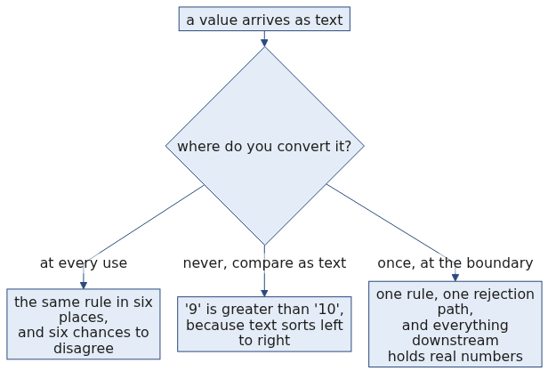
D2
Where to convert, and why the answer is once
DEPTH
Text comparison really does say that. "9" > "10" is True, because it compares the first character and stops.
Week 1, Day 2. Half two: cross the file boundary
13 / 71

Slide 14
S9
Step card, section 1
1
A format is an agreement about structure.
2
CSV agrees about rows and commas, never about types.
3
Everything you read is a string.
4
Convert on purpose, in one place, with a rejection path.
Week 1, Day 2. Half two: cross the file boundary
14 / 71

Slide 15
SECTION 2: OPENING A FILE
inline cell
packaged decision
read the failure
log the rejection
cross the boundary
Week 1, Day 2. Half two: cross the file boundary
15 / 71

Slide 16
S10
The break, first
FileNotFoundError: [Errno 2] No such file or directory: 'data/orderz.csv'
Before we open a file correctly, watch what a wrong path says. It names the exact path it tried. Read it out loud and you find the typo.
Week 1, Day 2. Half two: cross the file boundary
16 / 71

Slide 17
S11
The path is relative to where the kernel is running
Not to where you think you are. Not to where the file browser is pointing.
FileNotFoundError is the cheapest error in this course. It tells you exactly what it looked for.
Week 1, Day 2. Half two: cross the file boundary
17 / 71

Slide 18
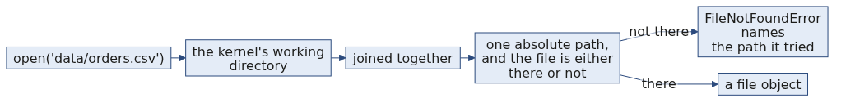
S11b
How a relative path is resolved
When the path in the error is not the path you expected, the working directory is wrong rather than the filename. Print it once and the confusion ends.
Week 1, Day 2. Half two: cross the file boundary
18 / 71

Slide 19
S12
with open
with open("records.csv") as f:
...
The with block guarantees the file closes when the block ends, including when your code raises inside it.
Week 1, Day 2. Half two: cross the file boundary
19 / 71

Slide 20
D3
What the with block is doing for you
DEPTH
These two are equivalent, and the second one is what you would have to write by hand.
with open("records.csv") as f:
rows = list(csv.DictReader(f))
f = open("records.csv")
try:
rows = list(csv.DictReader(f))
finally:
f.close()
The finally runs whether the body finished or raised. That is the guarantee, and it is the reason a crash in the middle of a loop still leaves the file closed.
Week 1, Day 2. Half two: cross the file boundary
20 / 71

Slide 21
S13
Why that guarantee matters
Without it, a crash mid-loop leaves the file open. On your laptop you get away with it. On a server that runs this a thousand times a day, you run out of file handles.
Week 1, Day 2. Half two: cross the file boundary
21 / 71

Slide 22
D4
Running out of handles, as arithmetic
DEPTH
An operating system gives a process a fixed budget of open file handles. A common default is 1024.
$$\text{runs before failure} = \frac{\text{handle limit}}{\text{handles leaked per run}}$$
Leak one handle per run against a limit of 1024 and the job survives 1024 runs. A job that runs every minute reaches that in under a day, and the failure arrives as OSError: [Errno 24] Too many open files, which names nothing about the loop that caused it.
That is why the fix is a habit rather than a debugging skill. You cannot debug your way to the cause quickly.
Week 1, Day 2. Half two: cross the file boundary
22 / 71

Slide 23
D5
The modes you will actually use
DEPTH
Mode | What it means | The trap
"r" | Read text. This is the default. | None, beyond the path.
"w" | Write text, truncating the file to empty first. | It destroys the file's contents the moment it opens, before you have written anything.
"a" | Append text to the end. | Running your cell twice doubles the rows and nothing complains.
newline="" | Passed to open when using the csv module for writing. | Leaving it out gives you a blank line between every row on some platforms.
Week 1, Day 2. Half two: cross the file boundary
23 / 71

Slide 24
S14
Step card, section 2
1
Read the path in the error before you edit anything.
2
Paths are relative to the running kernel.
3
Use with open.
4
The close is guaranteed even when the code fails.
Week 1, Day 2. Half two: cross the file boundary
24 / 71

Slide 25
SECTION 3: CSV WITH NAMES
inline cell
packaged decision
read the failure
log the rejection
cross the boundary
Week 1, Day 2. Half two: cross the file boundary
25 / 71

Slide 26
S15
Reading by position hurts
row[2]
What is field 2? You have to go and look. Then someone adds a column and every number shifts.
Week 1, Day 2. Half two: cross the file boundary
26 / 71

Slide 27
S16
DictReader
import csv
with open("records.csv") as f:
for record in csv.DictReader(f):
print(record["amount"])
Each row arrives as a dictionary. You already know how to read those.
Week 1, Day 2. Half two: cross the file boundary
27 / 71

Slide 28
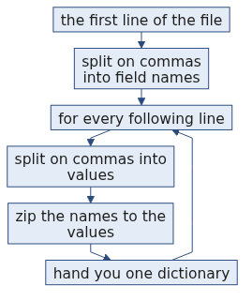
S16b
What DictReader does, step by step
The header is read once and remembered. Every row after it is matched against that same list of names.
Week 1, Day 2. Half two: cross the file boundary
28 / 71

Slide 29
S17
Where the keys come from
DictReader takes its keys from the first row of the file.
Change the header spelling in the file and every record["amount"] in your code raises KeyError. The header row is part of the contract.
Week 1, Day 2. Half two: cross the file boundary
29 / 71

Slide 30
D6
What happens when a row is the wrong length
DEPTH
This is the part people assume raises. It does not.
header: order_id,segment,amount
short: KR4200,Retail-Core
long: KR4201,Retail-Plus,2395,OOPS
{'order_id': 'KR4200', 'segment': 'Retail-Core', 'amount': None}
{'order_id': 'KR4201', 'segment': 'Retail-Plus', 'amount': '2395', None: ['OOPS']}
A short row fills the missing fields with None. A long row puts the surplus under a key that is literally None. Neither one raises, and neither one appears in your output unless you go looking.
Read it yourself in the standard library, Lib/csv.py at the v3.12.0 tag, lines 112 to 132:
https://raw.githubusercontent.com/python/cpython/v3.12.0/Lib/csv.py (verified 09 September 2026)
Week 1, Day 2. Half two: cross the file boundary
30 / 71

Slide 31
D7
So the row count is not enough
DEPTH
If a short row gives you None rather than an error, then counting rows tells you the file was read, never that it was read correctly.
The check that catches it is a presence check per field, which is exactly what you build tomorrow morning. Today it is enough to know the gap exists.
You can name the missing value on the way in:
csv.DictReader(f, restval="MISSING")
Now the absence has a value you can count, rather than a None that looks like every other absent thing in Python.
Week 1, Day 2. Half two: cross the file boundary
31 / 71

Slide 32
S18
Step card, section 3
1
csv.DictReader gives you one dictionary per row.
2
The keys come from the header row.
3
The header row is part of the agreement.
4
Read by name, never by position.
Week 1, Day 2. Half two: cross the file boundary
32 / 71

Slide 33
SECTION 4: JSON AND NESTING
inline cell
packaged decision
read the failure
log the rejection
cross the boundary
Week 1, Day 2. Half two: cross the file boundary
33 / 71

Slide 34
S19
The same agreement, a different shape
import json
with open("records.json") as f:
records = json.load(f)
JSON agrees about types and about nesting. CSV agrees about neither.
Week 1, Day 2. Half two: cross the file boundary
34 / 71

Slide 35
S20
What nesting looks like
{
"order_id": "KR4214",
"amount": null,
"source": {"system": "kalpa_retail_orders", "amount_raw": "2840"}
}
Record KR4214 had an empty amount in the CSV. The JSON still carries the original value, one level down.
Week 1, Day 2. Half two: cross the file boundary
35 / 71

Slide 36
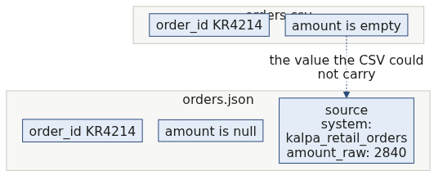
S20b
The same record in both files
The CSV did not corrupt anything. It had nowhere to put a record inside a record, so that part of the truth stayed behind.
Week 1, Day 2. Half two: cross the file boundary
36 / 71

Slide 37
S21
The flattening cost
To put that record in a CSV you have to choose: drop source, or invent a column called source_amount_raw.
Either way the shape changes, and the person downstream has to be told.
Week 1, Day 2. Half two: cross the file boundary
37 / 71

Slide 38
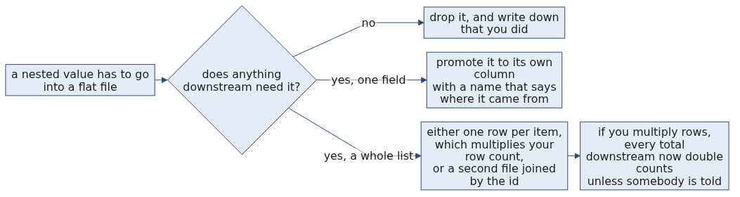
D8
The flattening decision, drawn
DEPTH
The last box is the one that bites. You meet it properly in Week 2, when a join grows one thousand rows into one thousand four hundred and fifty and doubles the revenue.
Week 1, Day 2. Half two: cross the file boundary
38 / 71

Slide 39
S22
When JSON goes wrong
A JSON file is either wholly valid or wholly unreadable. There is no half-parsed JSON.
json.load fails with a line and a column. Your exercise this half is one of these.
Week 1, Day 2. Half two: cross the file boundary
39 / 71

Slide 40
D9
Reading a JSONDecodeError, position by position
DEPTH
The vendor feed in your exercise folder stops mid-record. Loading it gives you exactly this:
json.decoder.JSONDecodeError: Expecting ',' delimiter: line 48 column 1 (char 1027)
Part | What it tells you
Expecting ',' delimiter | The parser was part way through a structure and needed a separator to continue.
line 48 column 1 | Where to put your cursor. Open the file and go there first, before reading any other line.
char 1027 | The same place counted from the start of the file, which is what you use when the file is one long line.
The message points at where the parser gave up, which is usually one line past where the damage is. Look at line 47 as well as 48.
Week 1, Day 2. Half two: cross the file boundary
40 / 71

Slide 41
D10
CSV or JSON, decided rather than defaulted
DEPTH
Choose CSV when | Choose JSON when
Every record has the same flat fields. | Records nest, or fields vary between records.
A spreadsheet or a database load is the destination. | Another program is the destination.
The file is large and you want to read it a line at a time. | You need the types to survive the trip.
The consumer is a person who will open it and look. | The consumer is code that will fail loudly on a shape it did not expect.
The honest answer in an interview names the consumer first. The format follows from who reads it, never from taste.
Week 1, Day 2. Half two: cross the file boundary
41 / 71

Slide 42
S23
Step card, section 4
1
json.load reads types and nesting.
2
Nested values need a stated flattening rule.
3
JSON parses completely or not at all.
4
The error names a line and a column. Go there first.
Week 1, Day 2. Half two: cross the file boundary
42 / 71

Slide 43
SECTION 5: TWO FILES OUT
inline cell
packaged decision
read the failure
log the rejection
cross the boundary
Week 1, Day 2. Half two: cross the file boundary
43 / 71

Slide 44
S24
One pass, two deliverables
clean.csv the records that converted
rejects.csv the records that did not, and why
Shipping only the first one is shipping half the job.
Week 1, Day 2. Half two: cross the file boundary
44 / 71

Slide 45
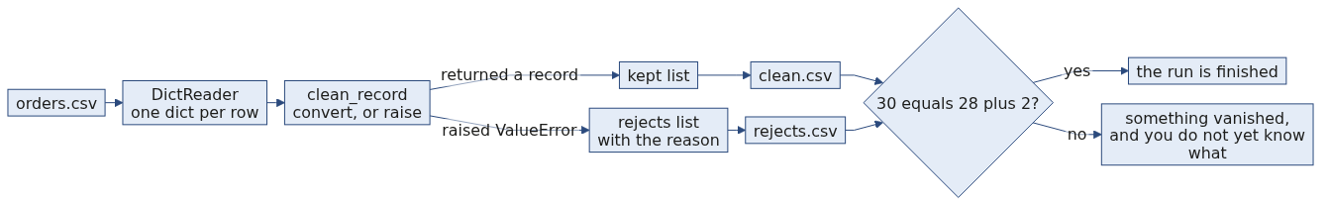
S24b
The one pass, end to end
Week 1, Day 2. Half two: cross the file boundary
45 / 71

Slide 46
S25
Writing with names
writer = csv.DictWriter(f, fieldnames=["order_id","customer_id","segment","amount","status","order_date","discount"])
writer.writeheader()
writer.writerows(clean)
You state the field names on the way out. That is you writing the agreement for the next person.
Week 1, Day 2. Half two: cross the file boundary
46 / 71

Slide 47
D11
What DictWriter does with a field you did not name
DEPTH
By default, handing DictWriter a record containing a key that is not in fieldnames raises ValueError, which is the behaviour you want, because a silently dropped column is a defect nobody finds.
If you genuinely mean to drop the extras, you have to say so out loud:
csv.DictWriter(f, fieldnames=FIELDS, extrasaction="ignore")
Writing that argument is a decision with your name on it. Leaving it out and being surprised is not.
Week 1, Day 2. Half two: cross the file boundary
47 / 71

Slide 48
S26
Prove it parses
Writing a file is not finishing. Reopening it and counting the rows is finishing.
30 in. 28 in clean. 2 in rejects. Reopen both and check.
Week 1, Day 2. Half two: cross the file boundary
48 / 71

Slide 49
D12
The four line ritual that ends every load
DEPTH
with open("clean.csv") as f:
clean_back = list(csv.DictReader(f))
with open("rejects.csv") as f:
rejects_back = list(csv.DictReader(f))
print(len(rows), len(clean_back), len(rejects_back))
assert len(rows) == len(clean_back) + len(rejects_back)
30 28 2
Four lines, and they catch the header you forgot to write, the file you opened in append mode twice, and the rows the writer silently dropped. Every one of those has happened to somebody in this room's future.
Week 1, Day 2. Half two: cross the file boundary
49 / 71

Slide 50
S27
From the field
Public Health England, October 2020. 15,841 COVID cases were dropped from reporting.
A CSV was converted to an old Excel format that has a hard row limit. The rows past the limit were silently discarded. Contact tracing never saw them.
Nobody wrote bad code. Somebody did not know the format's contract.
Week 1, Day 2. Half two: cross the file boundary
50 / 71

Slide 51
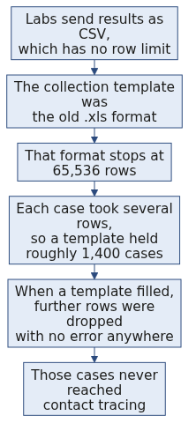
D13
Public Health England, the mechanism
DEPTH
The CSV was fine. The conversion to a format with a smaller agreement is where the truth was lost.
Week 1, Day 2. Half two: cross the file boundary
51 / 71

Slide 52
D14
Public Health England, the arithmetic
DEPTH
The row ceiling of the old format is a fixed number, and the number of cases a file can hold follows directly from it:
$$\text{cases per file} = \frac{\text{row limit}}{\text{rows per case}} = \frac{65{,}536}{\text{about }45} \approx 1{,}400$$
Fact | Figure
Cases left out of the daily figures | 15,841
The window they fell in | 25 September to 2 October 2020
Reported new cases the day before the correction | 12,872
Reported new cases the day after | 22,961
Source: The Register, 5 October 2020: https://www.theregister.com/2020/10/05/excel_england_coronavirus_contact_error/ (verified 09 September 2026)
Week 1, Day 2. Half two: cross the file boundary
52 / 71

Slide 53
D15
The line from that to your cell today
DEPTH
Nobody at Public Health England wrote a line of bad code. A file crossed a boundary into a format whose agreement was smaller than the data, and nothing at that boundary counted the rows on both sides.
Your four line ritual in D12 is the counting nobody did. It costs four lines and it is the difference between a load that worked and a load you can prove worked.
Week 1, Day 2. Half two: cross the file boundary
53 / 71

Slide 54
S28
Interview question
"CSV or JSON for nested records, and what does flattening cost?" You have both files open in front of you. Answer from those.
Week 1, Day 2. Half two: cross the file boundary
54 / 71

Slide 55
S29
Step card, section 5
1
One pass ships clean and rejects.
2
Name the fields on the way out.
3
Reopen both files and count.
4
Input equals clean plus rejected, or something vanished.
Week 1, Day 2. Half two: cross the file boundary
55 / 71

Slide 56
SECTION 6: THE INTERVIEW BLOCK
inline cell
packaged decision
read the failure
log the rejection
cross the boundary
Week 1, Day 2. Half two: cross the file boundary
56 / 71

Slide 57
S30
What this section is
Two of the questions below are on this week's own question set and will be on Saturday's paper. The rest are asked often enough at this level that this programme puts them in front of you now.
Week 1, Day 2. Half two: cross the file boundary
57 / 71

Slide 58
S31
Question: a CSV is all text, so what breaks?
Where does the bug enter?
a) At the read, since the reader should convert
b) At any comparison or sum done before conversion
c) At the write, since the writer flattens types
d) Nowhere, since Python converts as needed
Week 1, Day 2. Half two: cross the file boundary
58 / 71

Slide 59

S31a
Answer: at the first comparison, and it fails quietly
The claim. A CSV agrees about rows, separators and a header, and about nothing else, so every field arrives as text. What breaks is any comparison or arithmetic done before conversion.
Option | Why it does not hold
a) At the read | The reader has nothing to convert from; a CSV carries no type information at all.
c) At the write | Writing is where types are lost, and the bug enters when somebody reads them back and forgets.
d) Python converts | It refuses across types and joins within them, which is worse than either.
"9" > "2000" is True and it does not raise. Text comparison fails quietly rather than loudly, which is why the conversion has to be a decision you took rather than one you assumed.
The mental model. A CSV is a photograph of a table. Everything in a photograph is ink.
Week 1, Day 2. Half two: cross the file boundary
59 / 71

Slide 60
D16
Dates, where the text problem really bites
DEPTH
A stronger interviewer follows with dates, because dates are the field where this really hurts. A CSV carries 2026-08-03 as nine characters, and the string sorts correctly only because that format happens to sort correctly. Hand the same file a date written as 03/08/2026 and both the sort order and the meaning are gone, since nothing in the file says whether that is August or March.
The answer is the same shape: convert at the boundary, state the format you expect, and reject what does not match rather than guessing.
Week 1, Day 2. Half two: cross the file boundary
60 / 71

Slide 61
S32
Question: CSV or JSON for nested records?
The Kalpa feed nests a customer block inside each order. Which format, and what does the other one cost?
a) CSV, since every tool opens it
b) JSON, since it agrees about nesting and types
c) Either, since the data is the same
d) CSV, and nest by repeating rows
Week 1, Day 2. Half two: cross the file boundary
61 / 71

Slide 62
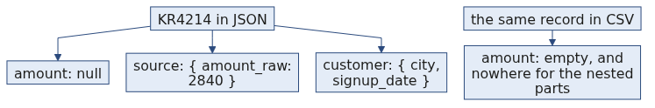
S32a
Answer: JSON, and flattening costs per field
The claim. JSON, when records nest, because it agrees about nesting and about types and CSV agrees about neither.
Option | Why it does not hold
a) Every tool opens it | True of the file and false of the record. Opening it is not the same as reading it correctly.
c) Either | The data is the same and the agreement is not, which is the whole point.
d) Repeat rows | That turns one order into several and every count downstream doubles.
Record KR4214 is the answer in one record. In the CSV its amount is empty. In the JSON the same record still carries source.amount_raw holding 2840, one level down. The CSV did not corrupt the record; it had nowhere to put a record inside a record.
The mental model. Flattening costs one decision per nested field: drop it, promote it to a column whose name says where it came from, or lose it.
Week 1, Day 2. Half two: cross the file boundary
62 / 71

Slide 63
D17
KR4214, the whole answer in one record
DEPTH
Record KR4214 is the whole answer in one record. In the CSV its amount is empty. In the JSON the same record still carries source.amount_raw holding 2840, one level down.
The CSV did not corrupt the record. It had nowhere to put a record inside a record. Say exactly that, then say what flattening it would have cost: either a new column called source_amount_raw, or the value gone.
Week 1, Day 2. Half two: cross the file boundary
63 / 71

Slide 64
S33
Question: what does the with statement guarantee?
You open a file inside a with block and the code inside raises. What happens to the handle?
a) It leaks, since the block never finished
b) It is closed when the block ends, raise or no raise
c) It is closed only if you also call close
d) It depends on the operating system
Week 1, Day 2. Half two: cross the file boundary
64 / 71

Slide 65
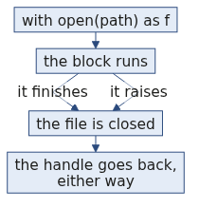
S33a
Answer: closed either way, which is a try and finally
The claim. with guarantees the file is closed when the block ends, including when the code inside raises. It is equivalent to a try and finally where the close sits in the finally.
A leaked handle per run against a limit of about 1024 fails silently for a long time and then fails everywhere at once.
The mental model. with is a promise about the exit, not about the entry.
Option | Why it does not hold
a) It leaks | That is what happens without with, which is why with exists.
c) Only with close | Calling close as well is harmless and unnecessary.
d) The operating system | The guarantee is Python's, and it holds everywhere Python runs.
Week 1, Day 2. Half two: cross the file boundary
65 / 71

Slide 66
S34
Question: how do you know a load finished correctly?
The pass printed no errors. What proves it finished?
a) The absence of a traceback
b) The clean file exists on disk
c) Input equals clean plus rejected, asserted, and both files reopened
d) The row count of the clean file looks about right
Week 1, Day 2. Half two: cross the file boundary
66 / 71

Slide 67
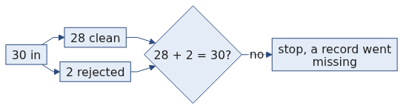
S34a
Answer: reconcile, then reopen both files
The claim. Reconcile as an assertion rather than by eye, then reopen both output files and count the rows, because writing is not finishing.
Option | Why it does not hold
a) No traceback | A bare except guarantees no traceback and proves nothing.
b) The file exists | An empty file exists. So does a half-written one.
d) About right | About right is how every wrong number in this business has travelled.
A row count on its own is not enough either, since a short row in a CSV becomes a dictionary with a missing key rather than an error.
The mental model. Finished means somebody could reconstruct your count from your files without asking you.
Week 1, Day 2. Half two: cross the file boundary
67 / 71

Slide 68
S35
Question: a file arrives with a renamed header?
Your code reads by name. The vendor renames one column. What happens?
a) KeyError, loudly, on the first lookup
b) The column is silently dropped
c) The values shift one column left
d) Nothing, since order is what matters
Week 1, Day 2. Half two: cross the file boundary
68 / 71

Slide 69
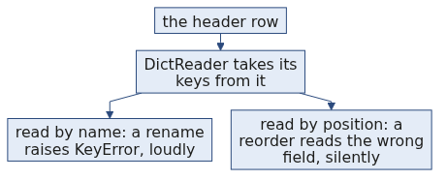
S35a
Answer: KeyError, and that is the good case
The claim. Every lookup by that name raises KeyError, which is the loud failure and the good case.
The bad case is a header renamed to something your code also uses, or a column reordered, because reading by position would then read the wrong field and never complain.
Option | Why it does not hold
b) Silently dropped | That is what a permissive reader would do, and it is the outcome to avoid.
c) Values shift | That is what reading by position does, and it never complains.
d) Order matters | Order is exactly what you refuse to depend on.
The mental model. The header row is part of the contract, so read by name and let a rename break loudly.
Week 1, Day 2. Half two: cross the file boundary
69 / 71

Slide 70
S36
Crux, half two
A file format is an agreement about structure, and everything a CSV agrees to is text. Your job at the boundary is to convert on purpose, reject with a reason, and hand on two files instead of one.
Week 1, Day 2. Half two: cross the file boundary
70 / 71

Slide 71
S37
Tomorrow
Today you cleaned one record at a time. Tomorrow you point these same functions at the whole dataset and find out how many usable records you actually have.
The functions you carved today get called tomorrow without one edit.
Week 1, Day 2. Half two: cross the file boundary
71 / 71

