Slide 1
S1
Per segment, with denominators
Half one gave you one number for the whole file. Nobody runs a business unit on one number.
The question is always the same one level down: which part of Kalpa Retail is working, and how sure can you be.
Week 1, Day 4. Half two: the segment summary, and the count it rests on
1 / 45

Slide 2
S2
Where we are
one column
what is typical
what one order does
what the shape says
per segment, with denominators
You can now pick an honest statistic for a column. Half two splits the file by segment, computes that statistic per group, and attaches the one thing that decides whether the answer means anything.
Week 1, Day 4. Half two: the segment summary, and the count it rests on
2 / 45

Slide 3
S2b
The metric, named before it is computed
Kalpa Retail cares about returns. A returned order costs the delivery, the reverse logistics and usually the margin.
return rate = orders with status "returned" / all orders in the group
This is the first metric in the programme where lower is better. A ranking of return rates puts the best performer at the top with the smallest number beside it. Keep that straight or the next four slides will read backwards.
Week 1, Day 4. Half two: the segment summary, and the count it rests on
3 / 45

Slide 4
S2c
Where this is going
segment orders median amount return rate
Business 9 Rs 2,050 11.1%
Student 10 Rs 1,430 20.0%
Retail-Core 14 Rs 1,910 35.7%
Retail-Plus 11 Rs 1,435 36.4%
You will have built this inside the hour. Then you will spend the rest of the session refusing to send it as it stands.
Week 1, Day 4. Half two: the segment summary, and the count it rests on
4 / 45

Slide 5
S2d
Half two in one picture
Week 1, Day 4. Half two: the segment summary, and the count it rests on
5 / 45

Slide 6
SECTION 1: THE DENOMINATOR
one column
what is typical
what one order does
what the shape says
per segment, with denominators
Week 1, Day 4. Half two: the segment summary, and the count it rests on
6 / 45

Slide 7
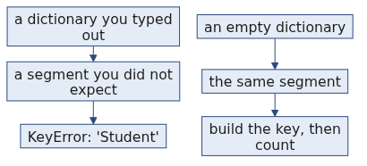
S3
One rate, two files
Two segments in two different companies, same reported number:
segment X: returned 5 of 12 41.7%
segment Y: returned 500 of 1200 41.7%
Identical rates. Which one would you build a quarter's plan on?
Week 1, Day 4. Half two: the segment summary, and the count it rests on
7 / 45

Slide 8
S4
Why the small one moves
In the 12-order segment, one order changing its status moves the rate by 8.3 points.
In the 1,200-order segment, one order moves it by 0.08 points.
The small segment is not wrong. It is loud. Its number swings on evidence too thin to swing on, and next month it will report something different for no reason you can name.
Week 1, Day 4. Half two: the segment summary, and the count it rests on
8 / 45

Slide 9
S5
What a rate actually is
rate = how many did the thing / how many could have
Two numbers, and the reporting convention throws one of them away.
Every argument in this section comes from the thrown-away number.
Week 1, Day 4. Half two: the segment summary, and the count it rests on
9 / 45

Slide 10
D1
A rate written properly, and the number nobody prints
DEPTH
$$\text{rate} = \frac{k}{n} \qquad \text{where } k \text{ did the thing and } n \text{ could have}$$
The reporting convention prints the quotient and discards $n$, and $n$ is the number that decides whether the quotient means anything.
Here is the arithmetic that makes the discard visible. One record changing side moves the rate by
$$\Delta = \frac{1}{n} \qquad \text{or, in percentage points, } \frac{100}{n}$$
Segment | $n$ | One order moves the rate by
Business | 9 | 11.1 points
Student | 10 | 10.0 points
Retail-Plus | 11 | 9.1 points
Retail-Core | 14 | 7.1 points
Business's entire lead over Student is 8.9 points. One order in Business is worth 11.1. The lead is smaller than the resolution of the instrument that measured it.
Week 1, Day 4. Half two: the segment summary, and the count it rests on
10 / 45

Slide 11
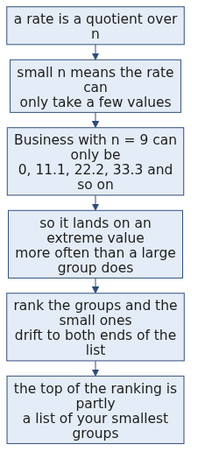
D2
A ranking of small groups reads size
DEPTH
Nothing is causing this and nothing is wrong with the data. It is what quotients over small denominators do, and it is why the fix is the denominator column rather than a better statistic.
Week 1, Day 4. Half two: the segment summary, and the count it rests on
11 / 45

Slide 12
S6
The rule
A rate travels with its denominator or it does not travel.
Write it as 11.1 percent of 9 and nobody can misread it. Write it as 11.1 percent and everybody will.
Week 1, Day 4. Half two: the segment summary, and the count it rests on
12 / 45

Slide 13
SECTION 2: THE ACCUMULATOR
one column
what is typical
what one order does
what the shape says
per segment, with denominators
Week 1, Day 4. Half two: the segment summary, and the count it rests on
13 / 45

Slide 14
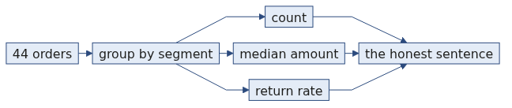
S7
Counting into buckets
Monday you counted orders that passed a test. Today you count them into named piles, one pile per segment.
counts = {"Retail-Core": 0, "Retail-Plus": 0, "Business": 0}
for r in orders:
counts[r["segment"]] = counts[r["segment"]] + 1
Reasonable code. The analyst listed the segments they remembered.
Week 1, Day 4. Half two: the segment summary, and the count it rests on
14 / 45

Slide 15
S8
Run it
KeyError: 'Student'
It failed on the very first order in the file.
Week 1, Day 4. Half two: the segment summary, and the count it rests on
15 / 45

Slide 16
S9
Reading it
KeyError means a dictionary was asked for a key it does not hold. The key it did not hold is printed for you: Student.
The dictionary held three segments because a person typed three segments. Kalpa Retail has four.
Every hard-coded list of categories is a promise about data you have not read yet.
This one is loud, because the first order in the file is a Student order. The dangerous version runs for six months and breaks the week a new segment launches.
Week 1, Day 4. Half two: the segment summary, and the count it rests on
16 / 45

Slide 17
D3
The failure that is worse than the KeyError
DEPTH
The KeyError was the good case, because it stopped.
counts = {"Retail-Core": 0, "Retail-Plus": 0, "Business": 0}
for r in orders:
if r["segment"] in counts:
counts[r["segment"]] = counts[r["segment"]] + 1
Somebody who has met a KeyError once often writes this next. It never raises. It silently ignores every Student order, so the counts come to 34 rather than 44, the totals are all understated, and the file looks fine.
The check that catches it is the one you already write: the segment counts have to add up to the order count. Ten orders are missing and the last line is the only place that shows.
Week 1, Day 4. Half two: the segment summary, and the count it rests on
17 / 45

Slide 18
S10
Build the key when you first see it
counts = {}
for r in orders:
key = r["segment"]
if key not in counts:
counts[key] = 0
counts[key] = counts[key] + 1
Three lines instead of one declaration, and the code now works on a file with segments nobody told you about.
The same shape written shorter, which you will meet again in Week 2:
counts[key] = counts.get(key, 0) + 1
That is Monday's .get() with a default, doing exactly what it did on Monday.
Week 1, Day 4. Half two: the segment summary, and the count it rests on
18 / 45

Slide 19
S11
The fixed count
Business 9
Retail-Core 14
Retail-Plus 11
Student 10
total 44
The total matches your profiled order count. If it did not, you would have a bug and the last line is how you would know.
One number here deserves a second look. Student holds ten. The raw file held twelve, and two Student orders were rejected yesterday for failing conversion. Your cleaning changed the denominator of your smallest segment by seventeen percent, and nothing in today's code would tell you. Yesterday's rejects log is the only place it is written down.
Week 1, Day 4. Half two: the segment summary, and the count it rests on
19 / 45

Slide 20
SECTION 3: THE SEGMENT SUMMARY
one column
what is typical
what one order does
what the shape says
per segment, with denominators
Week 1, Day 4. Half two: the segment summary, and the count it rests on
20 / 45

Slide 21
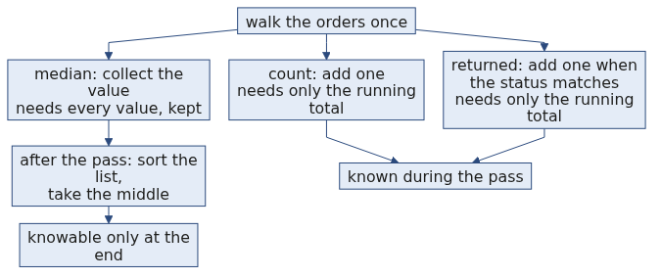
D4
Why the median cannot be accumulated and the count can
DEPTH
A count is a running total, so it is finished the moment the pass is. A median is a position in a sorted list, so it cannot exist until every value has arrived. That distinction is why the code collects amounts into a list rather than trying to be clever, and it is the same reason a median is expensive on data too large to hold.
Week 1, Day 4. Half two: the segment summary, and the count it rests on
21 / 45

Slide 22
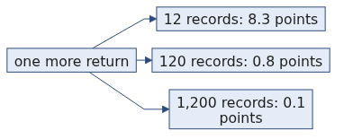
S12
Three accumulators, one pass
Per segment you need three things: how many orders, what a typical amount looks like, and what share came back.
per_segment[key] = {
"count": how many orders landed here,
"amounts": every amount, collected so the median can be taken at the end,
"returned": how many had status "returned",
}
The median cannot be accumulated one order at a time. It needs the whole list sorted, so the list is collected during the pass and the median is taken after it.
Week 1, Day 4. Half two: the segment summary, and the count it rests on
22 / 45

Slide 23
S13
The table
segment orders median amount returned rate
Business 9 Rs 2,050 1 11.1%
Retail-Core 14 Rs 1,910 5 35.7%
Retail-Plus 11 Rs 1,435 4 36.4%
Student 10 Rs 1,430 2 20.0%
Note what is absent from every row: the mean. Half one settled that.
Week 1, Day 4. Half two: the segment summary, and the count it rests on
23 / 45

Slide 24
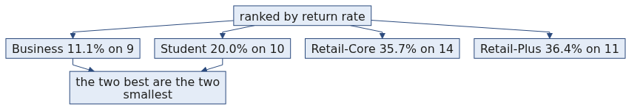
S14
Sort by rate, the way anyone would
Business 11.1%
Student 20.0%
Retail-Core 35.7%
Retail-Plus 36.4%
A clean ranking. Business returns at less than a third of the worst segment.
Somebody in a meeting is about to move budget towards Business.
Week 1, Day 4. Half two: the segment summary, and the count it rests on
24 / 45

Slide 25
S15
Put the count back
Business 11.1% on 9 orders
Student 20.0% on 10 orders
Retail-Core 35.7% on 14 orders
Retail-Plus 36.4% on 11 orders
The top two performers are the two smallest segments in the file.
Business wins on nine orders.
Week 1, Day 4. Half two: the segment summary, and the count it rests on
25 / 45

Slide 26
D5
The same argument, run on every segment
DEPTH
Take each segment in turn and ask what one more return would do.
Segment | Now | With one more return | Does the ranking change
Business | 1 of 9, 11.1 percent | 2 of 9, 22.2 percent | Yes. It falls behind Student and stops being the best segment.
Student | 2 of 10, 20.0 percent | 3 of 10, 30.0 percent | No. It stays second, because it was already ahead of Retail-Core.
Retail-Core | 5 of 14, 35.7 percent | 6 of 14, 42.9 percent | Yes. It becomes the worst segment.
Retail-Plus | 4 of 11, 36.4 percent | 5 of 11, 45.5 percent | It was already last and stays there.
Two of the four positions change on one order, and one of those two is the top of the table. A ranking whose leader can be overturned by a single record is a ranking that should be sent with its counts and a sentence, which is exactly what the next section builds.
Week 1, Day 4. Half two: the segment summary, and the count it rests on
26 / 45

Slide 27
S16
One order
if 0 more Business orders had been returned: 11.1% still best
if 1 more Business order had been returned: 22.2% no longer best
One order out of forty-four, in a segment of nine, and the best segment in the file is no longer the best segment in the file.
Small groups produce extreme rates in both directions, in any dataset, with nothing causing it. Rank groups by a rate and the smallest drift to both ends of the list, so the ranking reads group size as much as performance.
The fix is not a cleverer statistic. It is the column you already have.
Week 1, Day 4. Half two: the segment summary, and the count it rests on
27 / 45

Slide 28
SECTION 4: THE HONEST SENTENCE
one column
what is typical
what one order does
what the shape says
per segment, with denominators
Week 1, Day 4. Half two: the segment summary, and the count it rests on
28 / 45

Slide 29
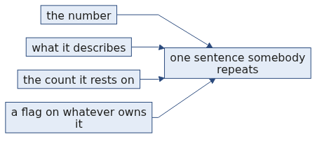
S17
The shape of the sentence
Three parts, in this order, every time:
[the number] [the denominator] [what it does not yet support]
Leaving out the third part is how a caveat gets lost between your notebook and a slide somebody else builds.
Week 1, Day 4. Half two: the segment summary, and the count it rests on
29 / 45

Slide 30
S18
Four sentences, one per segment
Business: returned on 1 of 9 orders, 11.1 percent. Lowest in the file and the
smallest segment in it. One more return takes it to 22.2 percent and
behind Student, so this is not yet a finding.
Student: returned on 2 of 10 orders, 20.0 percent. Ten orders, and the raw file
held twelve before two failed conversion. Treat as unmeasured.
Retail-Core: returned on 5 of 14 orders, 35.7 percent. Largest segment and the
steadiest number here. Median order Rs 1,910; the mean of Rs 36,027.14
is the Rs 480,000 order and should not be quoted.
Retail-Plus: returned on 4 of 11 orders, 36.4 percent. Highest in the file, within
one order of Retail-Core. The two are not separated by this data.
Two decline to make a claim and a third says two segments cannot be told apart. That is the sentence doing its job.
Week 1, Day 4. Half two: the segment summary, and the count it rests on
30 / 45

Slide 31
S19
The convention this follows
Retail-Core's mean order value is Rs 36,027.14. Its median is Rs 1,910. One order separates those.
Reporting the median for money is the standing convention wherever a few very large values sit in a long tail, which is why national statistics report median household income. You applied it in half one to a column. Here it applies to a cell in a table somebody will screenshot.
Week 1, Day 4. Half two: the segment summary, and the count it rests on
31 / 45

Slide 32
S20
The question you are not answering today
Is Business genuinely better than Retail-Plus, or is 11.1 against 36.4 what four groups of these sizes do on their own?
That question has a real answer and a method behind it, and it is Monday's session.
Today you name the question, write it in the notebook, and stop. Saying "we do not know yet, and here is what would tell us" is a complete professional answer.
Week 1, Day 4. Half two: the segment summary, and the count it rests on
32 / 45

Slide 33
D6
Where the number thirty comes from
DEPTH
You will hear that a group under about thirty is too small to trust. It is a useful habit and a bad rule, and knowing why is worth more than obeying it.
The thirty is a rule of thumb from a result about how averages of samples behave as samples get larger. It is a threshold about a particular kind of approximation becoming reasonable, not a line where a number becomes true.
Two things follow. A group of forty can still be far too small when the thing you are counting is rare, because what matters is how many events you saw rather than how many rows. And a group of twenty can be perfectly informative when you are describing it rather than generalising from it.
So the honest habit is not a threshold. It is to say the count out loud and let the reader judge, which is what the sentence on the table above does, and to name what would settle the question, which is Monday.
Week 1, Day 4. Half two: the segment summary, and the count it rests on
33 / 45

Slide 34
D7
Where the median convention comes from
DEPTH
Reporting the median rather than the mean on money is not this programme's preference. It is what statistical agencies do with household income, because a small number of very large incomes drag the mean away from anything a household would recognise.
The same shape appears wherever money is measured: salaries, claim sizes, invoice amounts, basket totals and order values. All of them have a floor at zero and no ceiling, so all of them have a right tail.
Retail-Core in your own table is the case in miniature. Its mean order value is Rs 36,027.14 and its median is Rs 1,910, and one order out of fourteen separates them. If you put the mean in that cell, every reader who screenshots the table carries that one order into their next meeting without knowing it.
Week 1, Day 4. Half two: the segment summary, and the count it rests on
34 / 45

Slide 35
S21
The decision card
Before you send a rate | Check
Is the denominator on the same line as the number | If not, it is not ready
Is any group under about 30 orders | Say so in the sentence, in words
Did you rank groups of very different sizes | Say what the ranking is partly measuring
Is a mean quoted on a money column | Replace it with the median
Is a difference being called real | Park it and name what would settle it
Week 1, Day 4. Half two: the segment summary, and the count it rests on
35 / 45

Slide 36
SECTION 5: THE INTERVIEW BLOCK
one column
what is typical
what one order does
what the shape says
per segment, with denominators
Week 1, Day 4. Half two: the segment summary, and the count it rests on
36 / 45

Slide 37
S21b
Question: why does every rate need its denominator?
What does the count underneath a rate tell you?
a) When the rate was computed
b) How far one event moves the rate
c) Which tool produced it
d) Whether the rate is above average
Week 1, Day 4. Half two: the segment summary, and the count it rests on
37 / 45

Slide 38
S21a
Answer: how far one event can move it
The claim. One event is worth 100 divided by the count, in percentage points. On nine records that is 11 points; on 1,200 it is 0.1.
Option | Why it does not hold
a) When | Provenance, useful and separate.
c) Which tool | The same.
d) Above average | A comparison, which needs every rate's count before it means anything.
The mental model. A rate with no count beside it is a claim nobody can argue with.
Week 1, Day 4. Half two: the segment summary, and the count it rests on
38 / 45

Slide 39
S21c
Question: your smallest segment has the best rate?
Business returns at 11.1 percent, the best of the four. What do you say?
a) Business is our best segment
b) Business returned 1 of 9 orders, a base too small to rank on
c) Business beat Retail-Plus by 25 points
d) Business is best, subject to confirmation
Week 1, Day 4. Half two: the segment summary, and the count it rests on
39 / 45

Slide 40
S21f
Answer: name the count, and decline to rank
The claim. One of nine is 11.1 percent, and one more return would read 22.2 percent, which would put Business behind Student. The ranking is measuring the denominator.
Option | Why it does not hold
a) Best segment | Travels into a slide with nothing attached to it.
c) Beat by 25 points | Precise about a gap that one order erases.
d) Subject to confirmation | A hedge with no number in it, which nobody acts on.
The mental model. The finding is that a 44 order file cannot rank segments. The table is the working.
Week 1, Day 4. Half two: the segment summary, and the count it rests on
40 / 45

Slide 41
S21d
Question: a count and a rate, what is the difference?
Which statement is true of a rate and false of a count?
a) It can be computed from the file
b) It hides how many records it rests on
c) It is always between zero and one
d) It is easier to compare across groups
Week 1, Day 4. Half two: the segment summary, and the count it rests on
41 / 45

Slide 42
S21g
Answer: a rate hides its own base
The claim. A count carries its own size. A rate divides that size away, which is exactly what makes it comparable and exactly what makes it dangerous.
Option | Why it does not hold
a) Computed from the file | True of both.
c) Between zero and one | True of a proportion and beside the point here.
d) Easier to compare | True, and it is the benefit rather than the difference being asked about.
The mental model. Comparability is bought by throwing away the base, so you carry the base back yourself.
Week 1, Day 4. Half two: the segment summary, and the count it rests on
42 / 45

Slide 43
S21e
Question: average order value, one whale?
What do you hand over?
a) The mean, since that is what average means
b) The median, with the mean and its owner named
c) The mean with the large order removed
d) The mean, rounded down
Week 1, Day 4. Half two: the segment summary, and the count it rests on
43 / 45

Slide 44
S21h
Answer: the median, and say what the mean is
The claim. Give the median, then say the mean and name the record that owns it. That is one sentence and it closes every follow-up.
Option | Why it does not hold
a) The mean | Describes one order out of forty-four.
c) Mean without it | Silently deletes a real order to produce a nicer number.
d) Rounded down | Rounding a wrong number does not make it right.
The mental model. Choose the number, then say what you chose and why.
Week 1, Day 4. Half two: the segment summary, and the count it rests on
44 / 45

Slide 45
S22
Crux
Every rate carries its denominator, or it lies for you while you are not in the room.
The best-performing segment in this file is also the smallest, and one order takes the lead away.
Tomorrow is Gandhi Jayanti and the institute is closed. These same orders, cleaned by you, come back as SQL tables and pandas frames in Week 2, and the summary you built by hand today becomes one line of code you will already know the answer to.
Week 1, Day 4. Half two: the segment summary, and the count it rests on
45 / 45

