Slide 1


Indian Institute of Technology Gandhinagar
ADMINISTERED THROUGH THE COMPETENCY ADVANCEMENT ACADEMY
WEEK 2 · THURSDAY · HALF ONE
The customer table Marketing refreshes every Monday
“The warehouse queries are fine for Finance, but Marketing's analysts live in Python. Build them the table in pandas, from the warehouse, and make it refreshable in one run.”
The data platform lead, Kalpa Retail, to the data and AI team at Kalpa's Global Capability Centre
01
The ask
02
One row per customer
03
The exposure merge
04
The months view
Week 2, Day 4. The customer table Marketing refreshes every Monday
1 / 48
Notes:
LIVE, one minute. Read the platform lead's line aloud and leave it up while the room settles.
Say the week's arc once: Monday the tree in SQL, Tuesday the join that doubled money, Wednesday
ranks and falling spend, today the same moves in pandas, Friday the number reaches the deck in
Excel. Every pandas move today is something the room has already done by hand; say that, and
say it again at each round.

Slide 2
Indian Institute of Technology Gandhinagar
PG DIPLOMA IN AI-ML AND AGENTIC AI ENGINEERING · COHORT 2
ADMINISTERED THROUGH THE COMPETENCY ADVANCEMENT ACADEMY
01
The ask
The growth team wants one row per customer every Monday, and the thinking comes before pandas.
The ask
One row per customer
The exposure merge
The months view
Week 2 Day 4: the customer table Marketing refreshes every Monday
2 / 48
Notes:
LIVE. Twenty minutes, no code. The job of this chapter is the picture of the table: its grain,
its columns, where each column comes from, and the three checks it must pass.

Slide 3





Indian Institute of Technology Gandhinagar
WEEK 2 · DAY 4 · KALPA GLOBAL CAPABILITY CENTRE
ADMINISTERED THROUGH THE COMPETENCY ADVANCEMENT ACADEMY
Monday morning, the growth team's ask
One table, one row per customer, refreshed every week without anyone rebuilding it.
THE CLIENT ASKS
"Every Monday, one table: how recently each customer bought, how often, how much, their segment, whether the monsoon sale reached them, and last week's flags. Marketing's analysts will work from it all week."
THE GRAIN
THE SOURCES
THE PROMISE
One row per customer
Warehouse plus a feed
One run, every Monday
340 customers in the warehouse, including those who never ordered.
Orders and customers in Postgres; the sale's exposure arrives as a file.
The same data gives the same table, and a bad feed stops the run.
The ask
One row per customer
The exposure merge
The months view
S1 · 3 / 48
Notes:
LIVE, 3 minutes. Read the ask aloud. Ask what "one row per customer" rules out: a row per order,
a row per month, a row per campaign touch. The grain is the first decision and every trap today
is a table that quietly changed its grain.

Slide 4
Indian Institute of Technology Gandhinagar
WEEK 2 · DAY 4 · KALPA GLOBAL CAPABILITY CENTRE
ADMINISTERED THROUGH THE COMPETENCY ADVANCEMENT ACADEMY
Question: where does each column come from?
Seven columns, and each one is a move you have already made this week.
Column | Where it lives
segment | ?
recency, frequency, spend | ?
reached by the sale | ?
lapsed, falling | ?
Question. Which source and which move produces the recency, frequency and spend columns? a) the customers table, read as it is; b) the orders table, grouped by customer; c) the exposure feed, merged on customer_id; d) Wednesday's window query, pasted in.
The ask
One row per customer
The exposure merge
The months view
S2 · 4 / 48
Notes:
LIVE, 3 minutes. Pairs for one minute, then letters. Most rooms say b quickly; push on why a is
wrong: the customers table knows who exists, not what they did. Hold the full mapping for the
next slide.

Slide 5
Indian Institute of Technology Gandhinagar
WEEK 2 · DAY 4 · KALPA GLOBAL CAPABILITY CENTRE
ADMINISTERED THROUGH THE COMPETENCY ADVANCEMENT ACADEMY
Answer: the orders, grouped, attached to the list
The customer list is the spine; everything else is attached to it by customer_id.
Column | Source | The move | You did it on
segment | customers | the spine itself | Monday's JOIN
recency, frequency, spend | orders | groupby and agg | Week 1's accumulator, Monday's GROUP BY
reached by the sale | exposure feed | merge, validated | Tuesday's LEFT JOIN
lapsed | recency | a condition | Week 1's filter
falling | orders by month | groupby and shift | Wednesday's LAG
The ask
One row per customer
The exposure merge
The months view
S3 · 5 / 48
Notes:
LIVE, 2 minutes. The answer is b. Walk the last column: nothing on this table is new except the
syntax. That is the sentence to repeat all day.

Slide 6
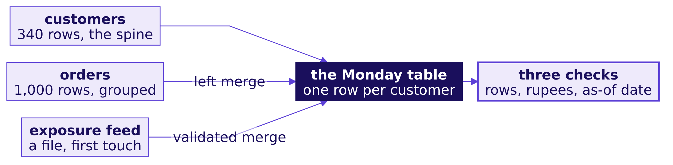
Indian Institute of Technology Gandhinagar
WEEK 2 · DAY 4 · KALPA GLOBAL CAPABILITY CENTRE
ADMINISTERED THROUGH THE COMPETENCY ADVANCEMENT ACADEMY
The table, drawn before any code
A spine of 340 customers, three things attached, and three checks at the end.
The ask
One row per customer
The exposure merge
The months view
S4 · 6 / 48
Notes:
LIVE, 4 minutes. Draw this on the board with the room before any laptop opens, and leave it up
all day; every round adds to it. The three checks on the right are Kavya's, next slide.

Slide 7

Indian Institute of Technology Gandhinagar
WEEK 2 · DAY 4 · KALPA GLOBAL CAPABILITY CENTRE
ADMINISTERED THROUGH THE COMPETENCY ADVANCEMENT ACADEMY
Three moves you have made, in three tools
groupby is the accumulator, merge is the join, shift is LAG.
The move | Plain Python, Week 1 | SQL, this week | pandas, today
total per customer | a dict, start, update, finish | GROUP BY customer_id | groupby("customer_id").agg(...)
attach a second source | a lookup inside the loop | LEFT JOIN ... ON | merge(how="left", validate=...)
the previous month | a variable carried across the loop | LAG() OVER (PARTITION BY ...) | groupby(...).shift(1)
THE RULE
Every pandas move today lands on something you did by hand, and saying which one is half the explanation in an interview.
The ask
One row per customer
The exposure merge
The months view
S5 · 7 / 48
Notes:
LIVE, 3 minutes. Point at each row and ask who wrote that SQL this week. The afternoon's second
case runs one question through all three columns of this table.

Slide 8

Indian Institute of Technology Gandhinagar
WEEK 2 · DAY 4 · KALPA GLOBAL CAPABILITY CENTRE
ADMINISTERED THROUGH THE COMPETENCY ADVANCEMENT ACADEMY
The three checks the table must pass
Kavya's review before the table leaves the team, written down before it is built.
340
Rs 19.84 cr
28 Sep
ROWS
SPEND
AS-OF DATE
one per customer on the list
Monday's two-quarter book
the data's last order
KAVYA'S REVIEW
"Row count against the customer list, spend against Monday's revenue, and the date every recency was measured from. If any of the three moves, the table is wrong until you can say why."
The ask
One row per customer
The exposure merge
The months view
S6 · 8 / 48
Notes:
LIVE, 3 minutes. Write the three numbers on the board beside the drawing. Every trap this
morning moves one of them, and the room should be able to say which one each time.
Transition: round 1 builds the spine.

Slide 9
Indian Institute of Technology Gandhinagar
PG DIPLOMA IN AI-ML AND AGENTIC AI ENGINEERING · COHORT 2
ADMINISTERED THROUGH THE COMPETENCY ADVANCEMENT ACADEMY
02
One row per customer
groupby turns 1,000 order rows into one row per customer, and recency needs a date to stand on.
The ask
One row per customer
The exposure merge
The months view
Week 2 Day 4: the customer table Marketing refreshes every Monday
9 / 48
Notes:
LIVE. Round 1, 50 minutes: the question and its picture (5), the demonstration (15), the trap
(10), the room's harder variant (15), Kavya's review (5). Notebook 1 beside it.

Slide 10
Indian Institute of Technology Gandhinagar
WEEK 2 · DAY 4 · KALPA GLOBAL CAPABILITY CENTRE
ADMINISTERED THROUGH THE COMPETENCY ADVANCEMENT ACADEMY
The question: every customer, one row each
Split the orders by customer, apply three calculations, combine into one row.
THE CLIENT ASKS
"How recently, how often and how much, for every customer, in one table."
The ask
One row per customer
The exposure merge
The months view
S7 · 10 / 48
Notes:
LIVE, 3 minutes. Say split, apply, combine aloud and have the room say it back. This is the
interview's staple sentence, and it is the Week 1 accumulator with a name.

Slide 11
Indian Institute of Technology Gandhinagar
WEEK 2 · DAY 4 · KALPA GLOBAL CAPABILITY CENTRE
ADMINISTERED THROUGH THE COMPETENCY ADVANCEMENT ACADEMY
The warehouse arrives as a DataFrame
read_sql runs the query in Postgres and hands back a frame whose count must match Monday.
ENG = kit.engine()
orders = pd.read_sql("SELECT order_id, customer_id, order_date, quarter, "
"channel, amount, status FROM orders", ENG,
parse_dates=["order_date"])
1,000
float64
str
ROWS
AMOUNT
CUSTOMER_ID
Monday's count(*), matched
numeric(12,2) read as a number
pandas 3's text dtype
The ask
One row per customer
The exposure merge
The months view
S8 · 11 / 48
Notes:
LIVE, 4 minutes. Run notebook 1, section 1. Point out that pandas 3 shows text as str where
older tutorials say object, so a check written as dtype == object misses every text column.
parse_dates is what makes the date subtractable later; without it recency fails in section 4.

Slide 12
Indian Institute of Technology Gandhinagar
WEEK 2 · DAY 4 · KALPA GLOBAL CAPABILITY CENTRE
ADMINISTERED THROUGH THE COMPETENCY ADVANCEMENT ACADEMY
Question: how many rows does groupby return?
orders.groupby("customer_id")["amount"].sum() on the 1,000 orders.
per_customer = orders.groupby("customer_id")["amount"].sum()
len(per_customer)
Question. What does len(per_customer) print? a) 1,000, one per order; b) 340, one per customer in the warehouse; c) 301; d) 4, one per segment.
The ask
One row per customer
The exposure merge
The months view
S9 · 12 / 48
Notes:
LIVE, 2 minutes. Predictions first, in writing. The split will be between a and b; a few will
say c without knowing why.

Slide 13
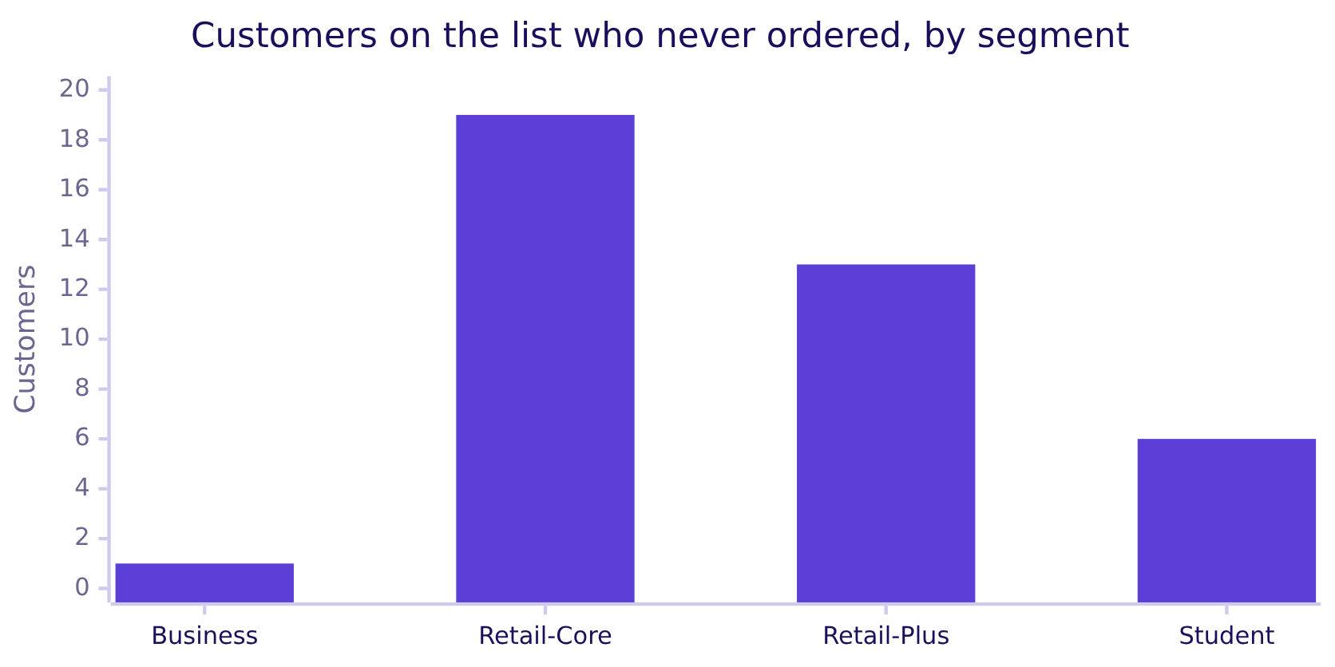
Indian Institute of Technology Gandhinagar
WEEK 2 · DAY 4 · KALPA GLOBAL CAPABILITY CENTRE
ADMINISTERED THROUGH THE COMPETENCY ADVANCEMENT ACADEMY
Answer: 301, because 39 customers never ordered
groupby only makes a group for a key it sees, so the customer list has to be the spine.
340 customers on the list, 301 who ordered, and 39 that groupby never saw. The loop in Week 1 had the same blind spot.
The ask
One row per customer
The exposure merge
The months view
S10 · 13 / 48
Notes:
LIVE, 3 minutes. The answer is c. The fix is the customer list as the spine and the aggregates
attached with a left merge, which is Monday's customers LEFT JOIN orders. The loop and groupby
agree for all 301; the notebook checks that.

Slide 14
Indian Institute of Technology Gandhinagar
WEEK 2 · DAY 4 · KALPA GLOBAL CAPABILITY CENTRE
ADMINISTERED THROUGH THE COMPETENCY ADVANCEMENT ACADEMY
Named aggregations say the SQL in pandas
Three measures per customer in one call, each named as it would be in a SELECT.
rfm = (orders.groupby("customer_id")
.agg(last_order=("order_date", "max"),
frequency=("order_id", "count"),
monetary=("amount", "sum"))
.reset_index())
table = customers.merge(rfm, on="customer_id", how="left",
validate="one_to_one")
SQL | pandas
max(order_date) AS last_order | last_order=("order_date", "max")
count(*) AS frequency | frequency=("order_id", "count")
customers LEFT JOIN | customers.merge(..., how="left")
The ask
One row per customer
The exposure merge
The months view
S11 · 14 / 48
Notes:
LIVE, 4 minutes. Type it live. The tuple is (column, function) and the keyword is the output
name. Say that apply with a custom function exists and is not today's tool; named aggregations
cover what the table needs.

Slide 15
Indian Institute of Technology Gandhinagar
WEEK 2 · DAY 4 · KALPA GLOBAL CAPABILITY CENTRE
ADMINISTERED THROUGH THE COMPETENCY ADVANCEMENT ACADEMY
The merge changed a dtype without a word
Customers with no orders get NaN, and a column holding NaN cannot stay int64.
THE RULE
After every merge, read dtypes; a count that became a float is a merge that met missing keys.
The ask
One row per customer
The exposure merge
The months view
S12 · 15 / 48
Notes:
LIVE, 3 minutes. This is the row's "chained transformation that silently changed a dtype".
Nothing errors. The fix says what missing means in the business: no orders is 0 orders.

Slide 16
Indian Institute of Technology Gandhinagar
WEEK 2 · DAY 4 · KALPA GLOBAL CAPABILITY CENTRE
ADMINISTERED THROUGH THE COMPETENCY ADVANCEMENT ACADEMY
The plausible wrong answer: 166 to win back
Recency from today: on the first Monday refresh, the win-back list reads 166 customers.
RUN_DAY = pd.Timestamp("2026-10-19") # pd.Timestamp.today() on the first refresh
wrong = (RUN_DAY - table["last_order"]).dt.days
(wrong > 60).sum() # 166
166
21
ON THE WIN-BACK LIST
SMALLEST RECENCY, DAYS
no order in 60 days, from the run day
the most recent buyer, as the table says
The ask
One row per customer
The exposure merge
The months view
S13 · 16 / 48
Notes:
LIVE, 4 minutes. The growth team sends a discount code to every lapsed customer, lapsed meaning
no order in 60 days. Ask the room what could be wrong before revealing. The notebook pins the
run day so the number is exact: pd.Timestamp.today() on Monday 19 October returns that date.

Slide 17
Indian Institute of Technology Gandhinagar
WEEK 2 · DAY 4 · KALPA GLOBAL CAPABILITY CENTRE
ADMINISTERED THROUGH THE COMPETENCY ADVANCEMENT ACADEMY
Why it is wrong: the data stopped on 28 September
Measured from the run day, every customer looks 21 days staler than the data says.
The check that catches it. Somebody bought on the data's last day, so the smallest honest recency is 0. This table's smallest is 21.
The ask
One row per customer
The exposure merge
The months view
S14 · 17 / 48
Notes:
LIVE, 3 minutes. The business consequence: customers who bought a fortnight before the extract
closed get a win-back discount, and the table changes every Monday with no new data, which
makes it a function of the calendar. The check is one line: table["recency_days"].min() == 0.

Slide 18
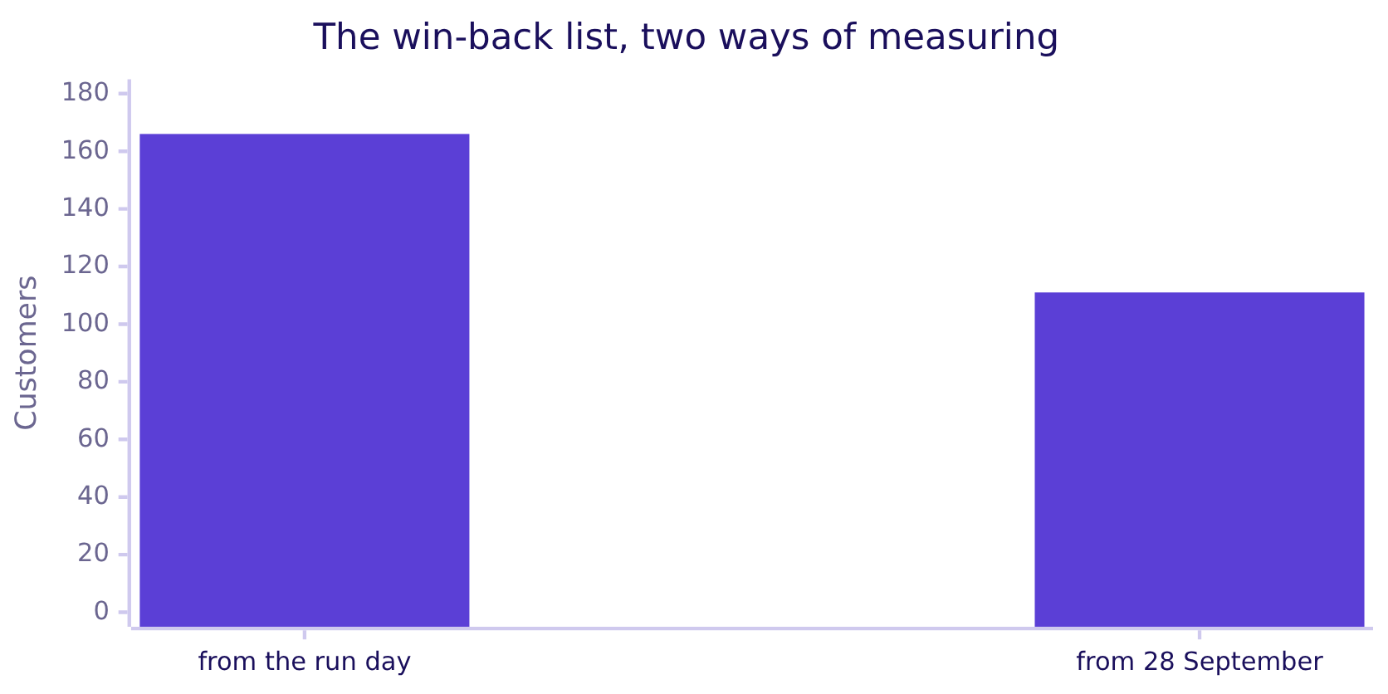
Indian Institute of Technology Gandhinagar
WEEK 2 · DAY 4 · KALPA GLOBAL CAPABILITY CENTRE
ADMINISTERED THROUGH THE COMPETENCY ADVANCEMENT ACADEMY
The fix: 111, measured from the data's last date
AS_OF is the data's own last order, and the table carries it so Marketing can read it.
AS_OF = orders["order_date"].max() is 28 September 2026, and the table carries it as a column so Marketing reads what "as of" means.
The ask
One row per customer
The exposure merge
The months view
S15 · 18 / 48
Notes:
LIVE, 3 minutes. 55 active customers were about to get a discount. Say it as the sentence to
the growth team: "111 customers have not ordered in the 60 days to 28 September, the data's
last date; the table carries that date."

Slide 19
Indian Institute of Technology Gandhinagar
WEEK 2 · DAY 4 · KALPA GLOBAL CAPABILITY CENTRE
ADMINISTERED THROUGH THE COMPETENCY ADVANCEMENT ACADEMY
Question: the 90-day list, both ways?
The growth team asks for a second, stricter list; run it both ways before you answer.
(wrong > 90).sum(), (table["recency_days"] > 90).sum()
Question. How many customers sit on the 90-day list measured from the data's last date, and how many from the run day? a) 101 and 74; b) 74 and 101; c) 74 and 74, since 90 days is long enough not to matter; d) 111 and 166.
The ask
One row per customer
The exposure merge
The months view
S16 · 19 / 48
Notes:
SELF-STUDY for fast pairs, LIVE for the rest, 12 minutes with the per-segment split. The room
runs this in notebook 1's cells, then splits both lists by segment. Watch for pairs who expect a
stricter threshold to make the gap disappear.

Slide 20
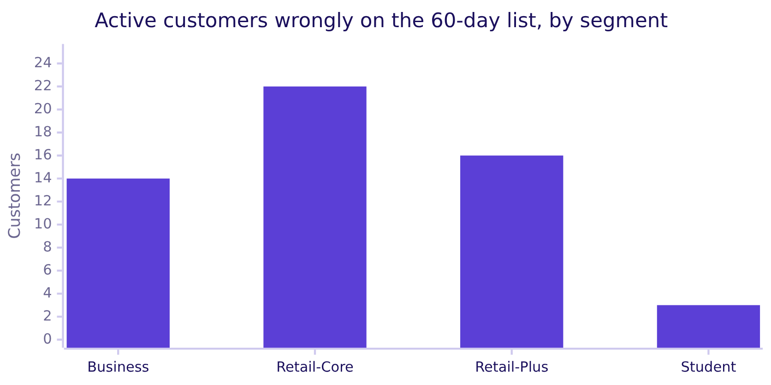
Indian Institute of Technology Gandhinagar
WEEK 2 · DAY 4 · KALPA GLOBAL CAPABILITY CENTRE
ADMINISTERED THROUGH THE COMPETENCY ADVANCEMENT ACADEMY
Answer: 74 honestly, 101 from the run day
A stricter threshold shrinks the list and keeps the error: 27 customers still wrongly listed.
The answer is b. The shift is the same 21 days whatever the threshold, so the error never goes away; it only moves.
The ask
One row per customer
The exposure merge
The months view
S17 · 20 / 48
Notes:
LIVE, 3 minutes. The chart is the 60-day list's error per segment: 55 in all. Business moves
most in proportion, 19 listed against 5 honestly, because corporate buyers order in bursts.

Slide 21

Indian Institute of Technology Gandhinagar
WEEK 2 · DAY 4 · KALPA GLOBAL CAPABILITY CENTRE
ADMINISTERED THROUGH THE COMPETENCY ADVANCEMENT ACADEMY
Kavya's review of round 1
Three checks passed: 340 rows, Rs 19,84,00,000, and a smallest recency of 0.
KAVYA'S REVIEW
"The table carries its as-of date and the smallest recency is 0, which is the check I will run every Monday. Tell Marketing the list is 111 and why it is not 166, in one sentence, before they ask."
IN THE INTERVIEW
[S] groupby in the split-apply-combine sentence.
340
Rs 19.84 cr
0 days
ROWS
SPEND
SMALLEST RECENCY
the customer list, held
Monday's book, held
from 28 September
The ask
One row per customer
The exposure merge
The months view
S18 · 21 / 48
Notes:
LIVE, 5 minutes. Take one learner's split-apply-combine sentence aloud and improve it with the
room: split the orders by customer_id, apply max, count and sum, combine one row per customer;
SQL's GROUP BY and Week 1's accumulator, written once. The full answer is in the notebook and
the study notes.

Slide 22
Indian Institute of Technology Gandhinagar
WEEK 2 · DAY 4 · KALPA GLOBAL CAPABILITY CENTRE
ADMINISTERED THROUGH THE COMPETENCY ADVANCEMENT ACADEMY
transform: the pandas window function
DEPTH
agg shrinks each group to one row; transform returns one value per original row.
share = table["monetary"] / table.groupby("segment")["monetary"].transform("sum")
pandas | SQL | Rows out
groupby().agg("sum") | GROUP BY ... sum() | one per group
groupby().transform("sum") | sum() OVER (PARTITION BY ...) | one per input row
groupby().shift(1) | LAG() OVER (PARTITION BY ... ORDER BY ...) | one per input row
The ask
One row per customer
The exposure merge
The months view
D19 · 22 / 48
Notes:
SELF-STUDY, 5 minutes. For the fast half of the room. Wednesday's window functions mirrored in
pandas; the escalated case uses shift for the falling flag.

Slide 23
Indian Institute of Technology Gandhinagar
PG DIPLOMA IN AI-ML AND AGENTIC AI ENGINEERING · COHORT 2
ADMINISTERED THROUGH THE COMPETENCY ADVANCEMENT ACADEMY
03
The exposure merge
A merge is a join, validate= makes the fan-out loud, and groupby drops what has no key.
The ask
One row per customer
The exposure merge
The months view
Week 2 Day 4: the customer table Marketing refreshes every Monday
23 / 48
Notes:
LIVE. Round 2, 50 minutes: question (5), demonstration (15), the two traps (15), the room on
Kalpa's own feed (10), review (5). Notebook 2 beside it. The fan-out is shown on invented records;
the room meets the real feed in the your-turn cell. The numbers they should reach are in the day
sheet; do not put them on the board before the room says them.

Slide 24
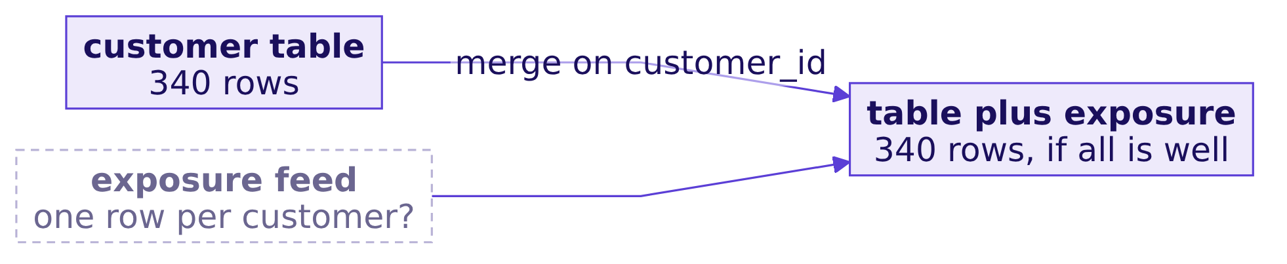
Indian Institute of Technology Gandhinagar
WEEK 2 · DAY 4 · KALPA GLOBAL CAPABILITY CENTRE
ADMINISTERED THROUGH THE COMPETENCY ADVANCEMENT ACADEMY
The question: who did the monsoon sale reach
The marketing lead wants reach and conversion per segment before asking for November's budget.
"Put the monsoon sale on the customer table. I want to see, per segment, who it reached and how many of them bought."
The marketing lead, Kalpa Retail
The ask
One row per customer
The exposure merge
The months view
S20 · 24 / 48
Notes:
LIVE, 3 minutes. The dashed box is the question nobody has asked yet: is the feed one row per
customer? Leave it dashed on the board until the room checks it.

Slide 25
Indian Institute of Technology Gandhinagar
WEEK 2 · DAY 4 · KALPA GLOBAL CAPABILITY CENTRE
ADMINISTERED THROUGH THE COMPETENCY ADVANCEMENT ACADEMY
A merge is a join, with the same four shapes
Tuesday's joins in pandas, and the default is the one that drops the most.
SQL, Tuesday | pandas, today | Keeps
INNER JOIN | merge(), the default | keys on both sides only
LEFT JOIN | merge(how="left") | every row of the left table
RIGHT JOIN | merge(how="right") | every row of the right table
FULL OUTER JOIN | merge(how="outer") | every key from either side
The ask
One row per customer
The exposure merge
The months view
S21 · 25 / 48
Notes:
LIVE, 3 minutes. Read down the table. Ask which row the Monday table needs: left, with the
customer table on the left.

Slide 26




Indian Institute of Technology Gandhinagar
WEEK 2 · DAY 4 · KALPA GLOBAL CAPABILITY CENTRE
ADMINISTERED THROUGH THE COMPETENCY ADVANCEMENT ACADEMY
Question: what does merge keep by default?
table.merge(exposure, on="customer_id") with no how= argument.
A)
B)
C)
D)
Every customer
Feed customers only
Every feed row
None
340 rows, the whole table kept.
The default is inner.
Unknown customers included.
how is a required argument.
Question. Which customers survive a merge with no how? a) every customer on the table; b) only customers the feed names, since the default is inner; c) every feed row, including unknown customers; d) none, because how is required.
The ask
One row per customer
The exposure merge
The months view
S22 · 26 / 48
Notes:
LIVE, 2 minutes. Letters, then the next slide.

Slide 27
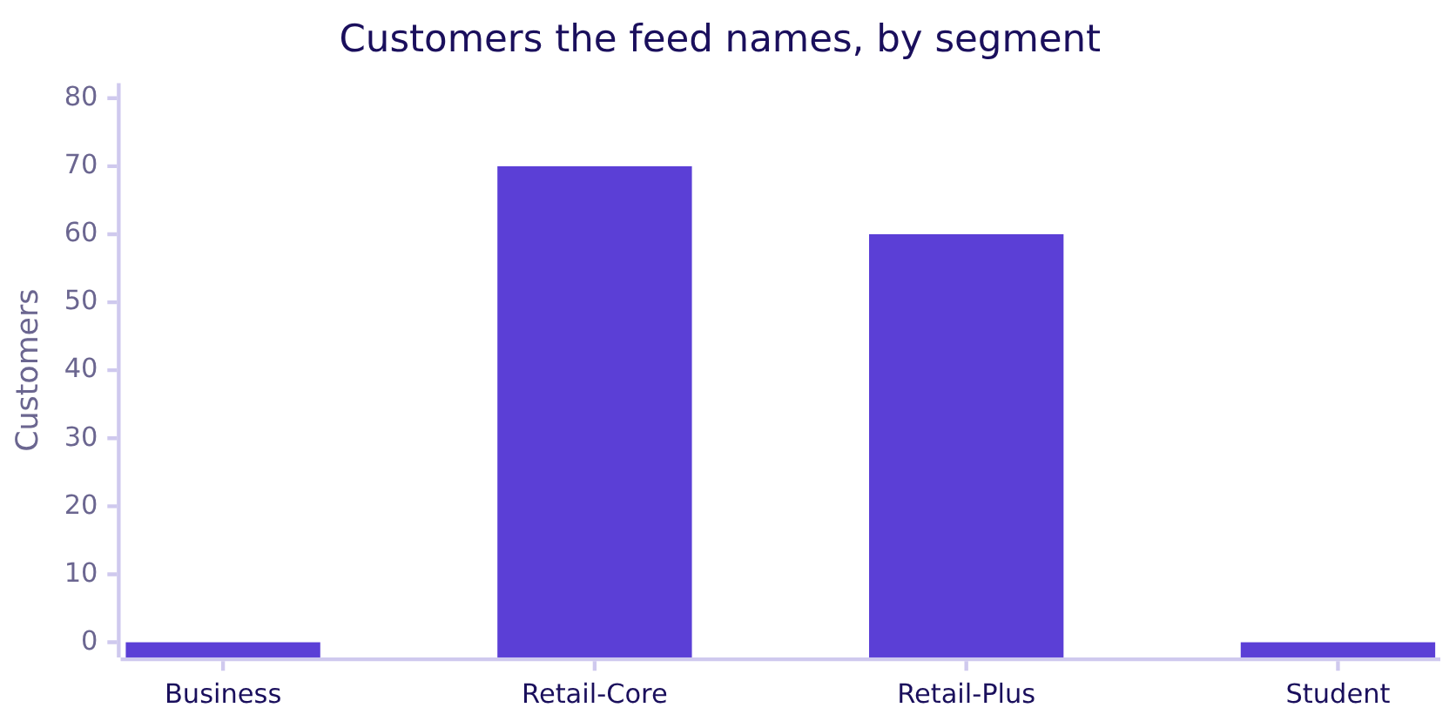
Indian Institute of Technology Gandhinagar
WEEK 2 · DAY 4 · KALPA GLOBAL CAPABILITY CENTRE
ADMINISTERED THROUGH THE COMPETENCY ADVANCEMENT ACADEMY
Answer: inner, which drops the unreached
The default silently removes the comparison group Marketing needs.
The answer is b: 130 of 340 customers survive. Write how= every time, so the reader knows which rows survive.
The ask
One row per customer
The exposure merge
The months view
S23 · 27 / 48
Notes:
LIVE, 2 minutes. The feed only names Retail-Core and Retail-Plus, which is the campaign's
design, not a defect. The unreached 210 are the comparison group.

Slide 28
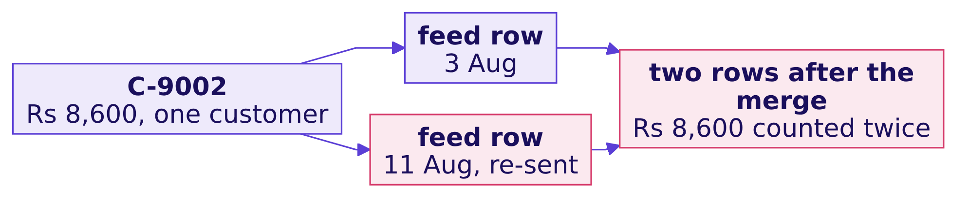
Indian Institute of Technology Gandhinagar
WEEK 2 · DAY 4 · KALPA GLOBAL CAPABILITY CENTRE
ADMINISTERED THROUGH THE COMPETENCY ADVANCEMENT ACADEMY
The plausible wrong answer: Rs 34,700
Invented records: a re-sent feed row makes the reached customers' spend a third too big.
Rs 34,700
Rs 26,100
WHAT THE SLIDE SAID
WHAT THEY SPENT
reached customers' spend
each customer once
The ask
One row per customer
The exposure merge
The months view
S24 · 28 / 48
Notes:
LIVE, 4 minutes. These four customers are invented for the mechanism and labelled so in the
notebook. Walk the diagram: one customer, two feed rows, two merged rows, one spend counted
twice. The business consequence: the case for November's budget is made with money nobody paid.

Slide 29
Indian Institute of Technology Gandhinagar
WEEK 2 · DAY 4 · KALPA GLOBAL CAPABILITY CENTRE
ADMINISTERED THROUGH THE COMPETENCY ADVANCEMENT ACADEMY
Why it is wrong: 4 rows went in, 5 came out
The count check catches it quietly; validate= catches it loudly, before the table exists.
small.merge(small_feed, on="customer_id", how="left",
validate="one_to_one")
MergeError: Merge keys are not unique in right dataset; not a one-to-one merge
THE RULE
validate= is Tuesday's row-count check made loud: it raises pandas.errors.MergeError instead of reporting after the fact.
The ask
One row per customer
The exposure merge
The months view
S25 · 29 / 48
Notes:
LIVE, 4 minutes. This MergeError is not the two-minute kind of error: it is the check that
catches the trap, so it gets the time. Read the last line aloud: which side, which promise.
pandas 3 also lists the duplicated keys under it.

Slide 30
Indian Institute of Technology Gandhinagar
WEEK 2 · DAY 4 · KALPA GLOBAL CAPABILITY CENTRE
ADMINISTERED THROUGH THE COMPETENCY ADVANCEMENT ACADEMY
The fix: one exposure per customer, then validate
A duplicate is a business question first: a customer reached twice was still reached once.
first_touch = (exposure.sort_values("exposed_date")
.drop_duplicates("customer_id", keep="first"))
merged = table.merge(first_touch[["customer_id", "exposed_date"]],
on="customer_id", how="left", validate="one_to_one")
340
Rs 19.84 cr
130
ROWS OUT
SPEND
REACHED
340 in, so the grain held
unchanged by the merge
first exposure per customer
The ask
One row per customer
The exposure merge
The months view
S26 · 30 / 48
Notes:
LIVE, 4 minutes. The rule is stated before the code. Keep validate on after the dedupe: its
job is to stop next Monday's feed if it breaks the rule in a new way.

Slide 31
Indian Institute of Technology Gandhinagar
WEEK 2 · DAY 4 · KALPA GLOBAL CAPABILITY CENTRE
ADMINISTERED THROUGH THE COMPETENCY ADVANCEMENT ACADEMY
Your turn: Kalpa's own feed, three lines
Run them in order and say each answer aloud before the next line.
exposure["customer_id"].duplicated().sum()
len(table), len(table.merge(exposure, on="customer_id", how="left"))
table.merge(exposure, on="customer_id", how="left", validate="one_to_one")
THE CLIENT ASKS
"In one sentence: what would the naive merge have done to the spend of the customers the sale reached?"
The ask
One row per customer
The exposure merge
The months view
S27 · 31 / 48
Notes:
LIVE, 10 minutes. The room runs these in notebook 2's empty cell. Do not say what they will
find. Take three sentences to the marketing lead aloud and pick the one with a number, a cause
and a consequence. The numbers are in the day sheet.

Slide 32
Indian Institute of Technology Gandhinagar
WEEK 2 · DAY 4 · KALPA GLOBAL CAPABILITY CENTRE
ADMINISTERED THROUGH THE COMPETENCY ADVANCEMENT ACADEMY
The second wrong answer: 100 percent bought
Starting from the feed, the table says every customer the sale reached went on to buy.
buyers = orders.merge(customers, on="customer_id").groupby("customer_id").agg(
segment=("segment", "first"), frequency=("order_id", "count")).reset_index()
reach = buyers.merge(first_touch, on="customer_id", how="right")
reach.groupby("segment").agg(reached=("customer_id", "count"),
bought=("frequency", "count"))
100%
107
OF REACHED CUSTOMERS BOUGHT
REACHED
the wrong table's headline
by the wrong table's count
The ask
One row per customer
The exposure merge
The months view
S28 · 32 / 48
Notes:
LIVE, 4 minutes. Ask whether 100 percent conversion is plausible for any campaign. The room
usually smells it; the point is to name the mechanism, next slide.

Slide 33
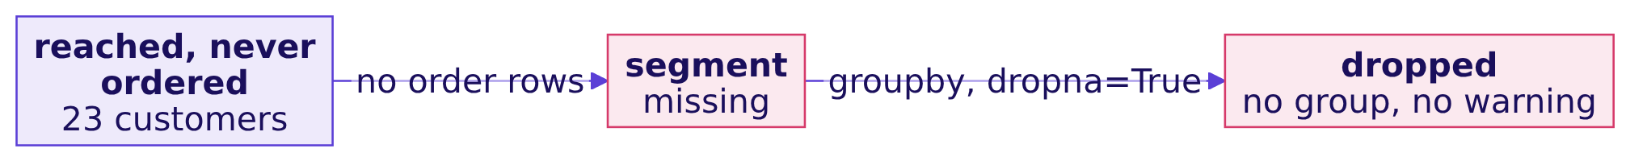
Indian Institute of Technology Gandhinagar
WEEK 2 · DAY 4 · KALPA GLOBAL CAPABILITY CENTRE
ADMINISTERED THROUGH THE COMPETENCY ADVANCEMENT ACADEMY
Why it is wrong: groupby drops a missing key
Reached customers who never ordered have no order rows, so no segment, so no group.
The check that catches it. The groups must add back to the rows: 107 in the groups against 130 rows. groupby(..., dropna=False) shows the missing group.
The ask
One row per customer
The exposure merge
The months view
S29 · 33 / 48
Notes:
LIVE, 3 minutes. The customers that vanished are exactly the ones who were reached and did
not buy. The default was checked on pandas 3; it drops a missing key unless told otherwise.

Slide 34
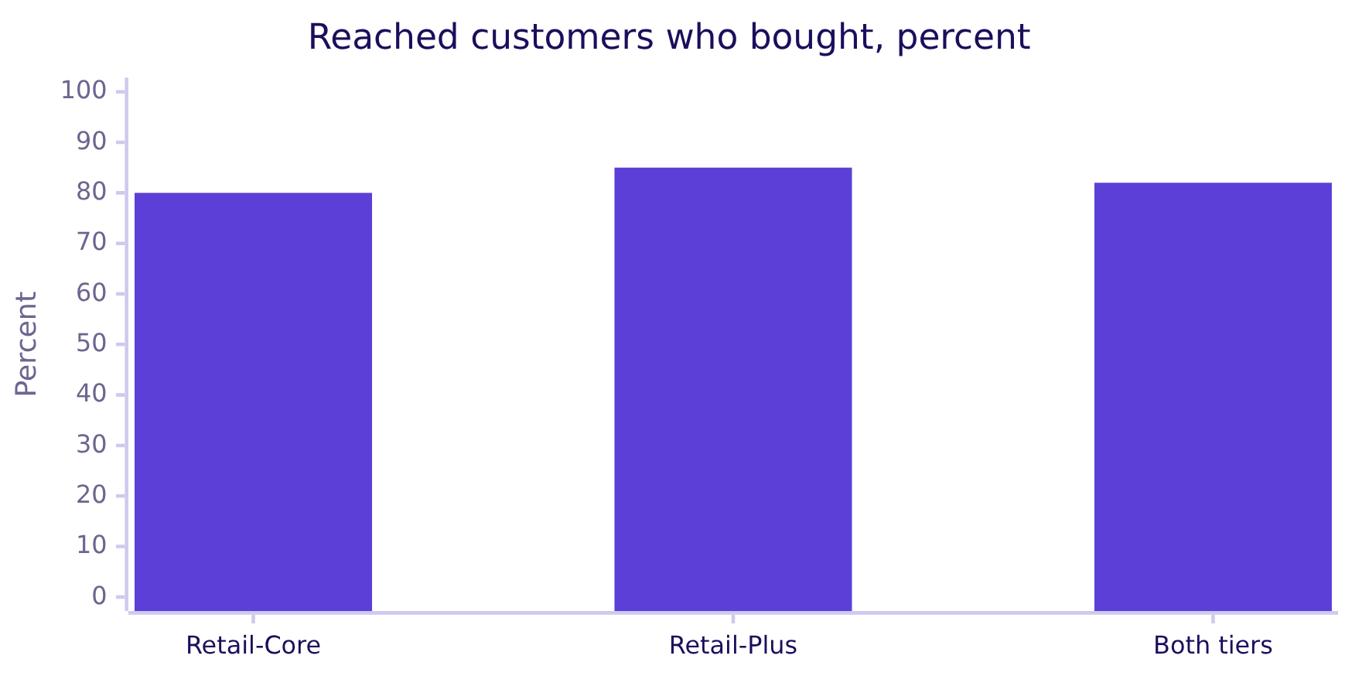
Indian Institute of Technology Gandhinagar
WEEK 2 · DAY 4 · KALPA GLOBAL CAPABILITY CENTRE
ADMINISTERED THROUGH THE COMPETENCY ADVANCEMENT ACADEMY
The fix: 130 reached, 107 bought, 82 percent
Take the segment from the customer list, which has one for every customer.
Retail-Core: 56 of 70 bought. Retail-Plus: 51 of 60. Together 107 of 130, which is 82 percent.
The ask
One row per customer
The exposure merge
The months view
S30 · 34 / 48
Notes:
LIVE, 3 minutes. Remind the room that bought is not caused by: Week 1 Thursday showed the
platform targets customers who were buying anyway. The table records exposure; it proves
nothing about the sale's effect.

Slide 35
Indian Institute of Technology Gandhinagar
WEEK 2 · DAY 4 · KALPA GLOBAL CAPABILITY CENTRE
ADMINISTERED THROUGH THE COMPETENCY ADVANCEMENT ACADEMY
Kavya's review of round 2
Two numbers moved without an error: spend a re-sent row inflated, reach a missing key shrank.
KAVYA'S REVIEW
"The row count before and after, and groups that add back to their rows, caught both. Put both checks in the refresh, and keep validate on after you fix the feed."
IN THE INTERVIEW
[F] Which merge argument raises on duplicate keys, and which error?
340
107 of 130
ROWS IN, ROWS OUT
REACHED AND BOUGHT
the grain held
82 percent
The ask
One row per customer
The exposure merge
The months view
S31 · 35 / 48
Notes:
LIVE, 5 minutes. Answer aloud with the room: validate, with one_to_one, one_to_many or
many_to_one, raising pandas.errors.MergeError naming the side whose keys are not unique. Then
the [S] question: merge against join, same and different. Both in full in the study notes.
Break: 10 minutes after this slide.

Slide 36
Indian Institute of Technology Gandhinagar
PG DIPLOMA IN AI-ML AND AGENTIC AI ENGINEERING · COHORT 2
ADMINISTERED THROUGH THE COMPETENCY ADVANCEMENT ACADEMY
04
The months view
A reshape changes the question a table answers, and pivot_table averages unless told to add.
The ask
One row per customer
The exposure merge
The months view
Week 2 Day 4: the customer table Marketing refreshes every Monday
36 / 48
Notes:
LIVE. Round 3, 50 minutes: question (5), demonstration (15), the trap (10), the room's
Retail-Core variant (15), review (5). Notebook 3 beside it.

Slide 37
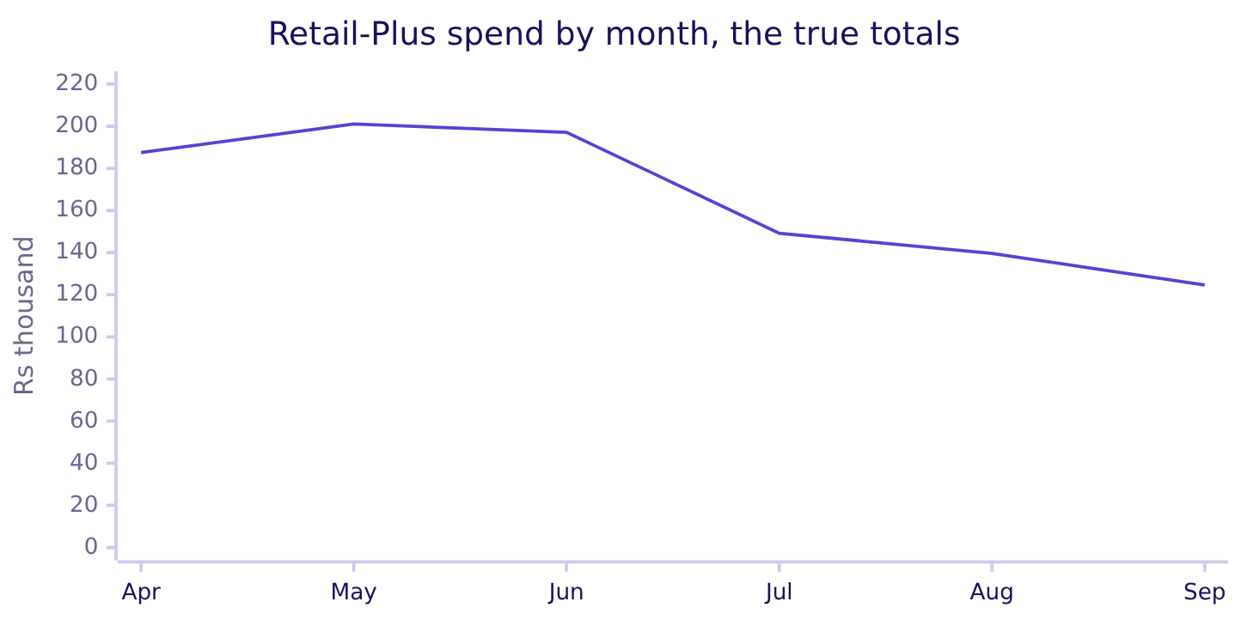
Indian Institute of Technology Gandhinagar
WEEK 2 · DAY 4 · KALPA GLOBAL CAPABILITY CENTRE
ADMINISTERED THROUGH THE COMPETENCY ADVANCEMENT ACADEMY
The question: is Retail-Plus the tier slipping
One row per member, one column per month, and the tier's fall in one number.
"Give me one row per member and one column per month. I want to read along a row and see who is drifting, and the tier's fall from Q1 to Q2 in one number."
The head of Retail-Plus, Kalpa Retail
The ask
One row per customer
The exposure merge
The months view
S32 · 37 / 48
Notes:
LIVE, 4 minutes. This is the long table summed by month: Rs 5,85,770 in Q1 and Rs 4,13,380 in
Q2. Hold these two numbers; the trap is a pivot that reports something else.

Slide 38
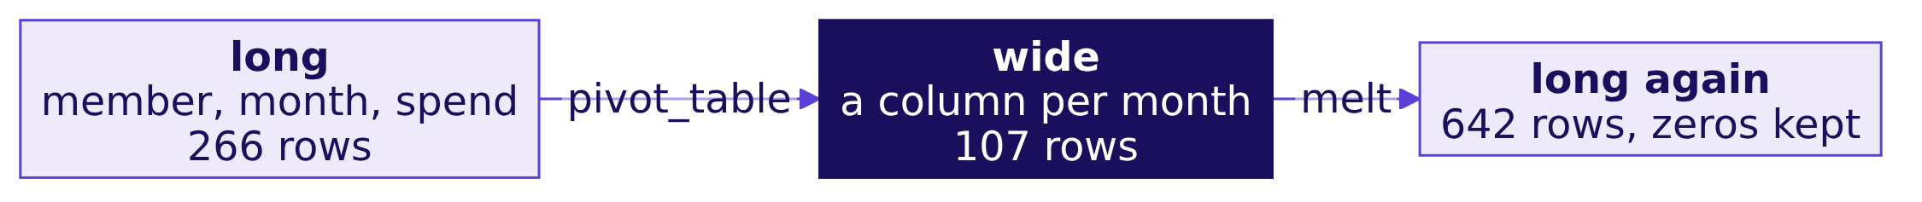
Indian Institute of Technology Gandhinagar
WEEK 2 · DAY 4 · KALPA GLOBAL CAPABILITY CENTRE
ADMINISTERED THROUGH THE COMPETENCY ADVANCEMENT ACADEMY
Long, wide, and long again
pivot widens a table for comparison; melt lengthens it for a trend.
THE RULE
Wide answers "compare across a row"; long answers "follow a line over time" and groups cleanly.
The ask
One row per customer
The exposure merge
The months view
S33 · 38 / 48
Notes:
LIVE, 3 minutes. 266 member-months have orders; 107 members times 6 months is 642 once the
empty months are written as zero. Ask why melt returns more rows than the long table started
with.

Slide 39
Indian Institute of Technology Gandhinagar
WEEK 2 · DAY 4 · KALPA GLOBAL CAPABILITY CENTRE
ADMINISTERED THROUGH THE COMPETENCY ADVANCEMENT ACADEMY
Question: what fall does the pivot report?
One line, months as columns, then each column summed for the tier.
wide = plus.pivot_table(index="customer_id", columns="month", values="amount")
q1, q2 = wide[APR_TO_JUN].sum().sum(), wide[JUL_TO_SEP].sum().sum()
q2 / q1 - 1
Question. What fall from Q1 to Q2 does this pivot report? a) 29 percent; b) 18 percent; c) 0 percent; d) it raises an error.
The ask
One row per customer
The exposure merge
The months view
S34 · 39 / 48
Notes:
LIVE, 2 minutes. Predictions first. Almost nobody predicts b, which is the point.

Slide 40
Indian Institute of Technology Gandhinagar
WEEK 2 · DAY 4 · KALPA GLOBAL CAPABILITY CENTRE
ADMINISTERED THROUGH THE COMPETENCY ADVANCEMENT ACADEMY
Answer: 18 percent, the plausible wrong answer
pivot_table's default aggfunc is the mean, so the columns add up averages.
18%
29%
Rs 2.5 lakh
THE FALL IT REPORTS
THE TRUE FALL
MISSING FROM THE GRAND TOTAL
Rs 4,12,019 to Rs 3,37,266
Rs 5,85,770 to Rs 4,13,380
Rs 7,49,286 against Rs 9,99,150
The answer is b. The head of Retail-Plus would defend a fall about two-thirds of its real size.
The ask
One row per customer
The exposure merge
The months view
S35 · 40 / 48
Notes:
LIVE, 3 minutes. Checked on pandas 3: pivot_table averages by default. The grand total against
the orders is the check, next slide.

Slide 41
Indian Institute of Technology Gandhinagar
WEEK 2 · DAY 4 · KALPA GLOBAL CAPABILITY CENTRE
ADMINISTERED THROUGH THE COMPETENCY ADVANCEMENT ACADEMY
Why it is wrong: the mean hides how often
A member who ordered four times in June shows the average of the four orders.
C-0152 | Orders | The pivot shows | The member spent
June | 4 | Rs 2,557 | Rs 10,230
July | 2 | Rs 2,780 | Rs 5,560
September | 2 | Rs 3,440 | Rs 6,880
The check that catches it. A pivot of spend must add back to the orders it came from. This one is short by a quarter.
The ask
One row per customer
The exposure merge
The months view
S36 · 41 / 48
Notes:
LIVE, 4 minutes. Frequency is the lever Week 1 found moving in Retail-Plus, and the averaged
pivot hides exactly that lever: it reports the typical order, not the month's spend.

Slide 42
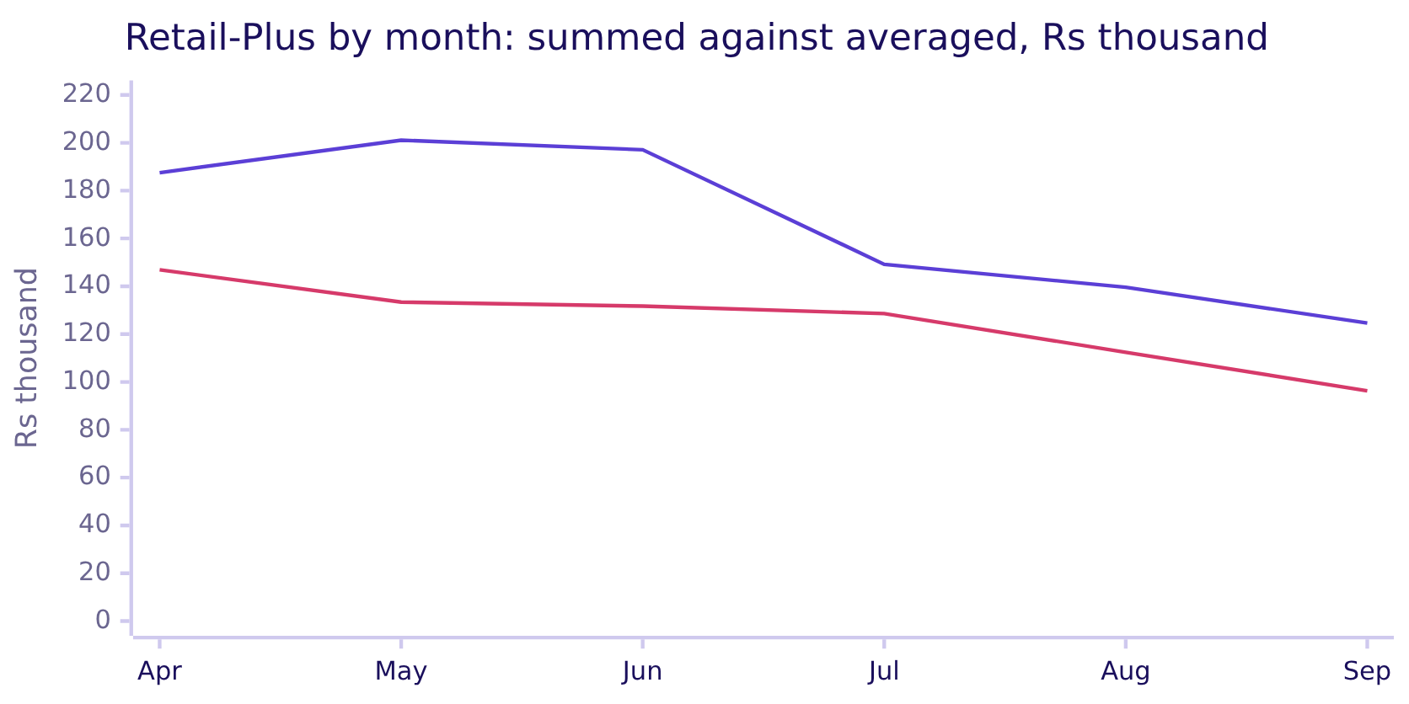
Indian Institute of Technology Gandhinagar
WEEK 2 · DAY 4 · KALPA GLOBAL CAPABILITY CENTRE
ADMINISTERED THROUGH THE COMPETENCY ADVANCEMENT ACADEMY
The fix: say what the cell means
aggfunc="sum" adds a member's orders, and fill_value=0 writes an empty month as zero.
pivot_table(..., aggfunc="sum", fill_value=0) gives the upper line; the lower is the default mean, a quarter of the spend short.
The ask
One row per customer
The exposure merge
The months view
S37 · 42 / 48
Notes:
LIVE, 3 minutes. The upper line is summed, the lower is the default. The gap is widest in the
months where members ordered most often. Write aggfunc every time, the way how= goes on every
merge.

Slide 43
Indian Institute of Technology Gandhinagar
WEEK 2 · DAY 4 · KALPA GLOBAL CAPABILITY CENTRE
ADMINISTERED THROUGH THE COMPETENCY ADVANCEMENT ACADEMY
The wrong index answers a question nobody asked
Index by order_id and every order becomes a row that looks like a months view.
Index | Shape | First row label | One row is
customer_id | 107 by 6 | C-0151 | a member
order_id | 355 by 6 | KR-00125 | an order
The check that catches it. Read the row labels aloud before reading any number.
The ask
One row per customer
The exposure merge
The months view
S38 · 43 / 48
Notes:
LIVE, 3 minutes. The totals of the order-indexed pivot are right, which is why it survives a
glance. Its rows are orders, so "who is drifting" cannot be read from it. The 13 members who
never ordered are absent from both views; say so when the view goes out.

Slide 44
Indian Institute of Technology Gandhinagar
WEEK 2 · DAY 4 · KALPA GLOBAL CAPABILITY CENTRE
ADMINISTERED THROUGH THE COMPETENCY ADVANCEMENT ACADEMY
Question: the Retail-Core view, both ways?
The head of Retail-Core asks for the same view of her members.
core.pivot_table(index="customer_id", columns="month", values="amount")
core.pivot_table(index="customer_id", columns="month", values="amount",
aggfunc="sum", fill_value=0)
Question. Q1 to Q2, what do the two pivots report for Retail-Core? a) both a fall of 1.8 percent; b) the averaged pivot a rise of 1.5 percent, the summed pivot a fall of 1.8 percent; c) the averaged pivot a fall of 18 percent; d) both a rise of 1.5 percent.
The ask
One row per customer
The exposure merge
The months view
S39 · 44 / 48
Notes:
LIVE, 12 minutes. The room builds both in notebook 3's empty cell and checks the grand total
before reading a month. Circulate for pairs who read the averaged total first.

Slide 45
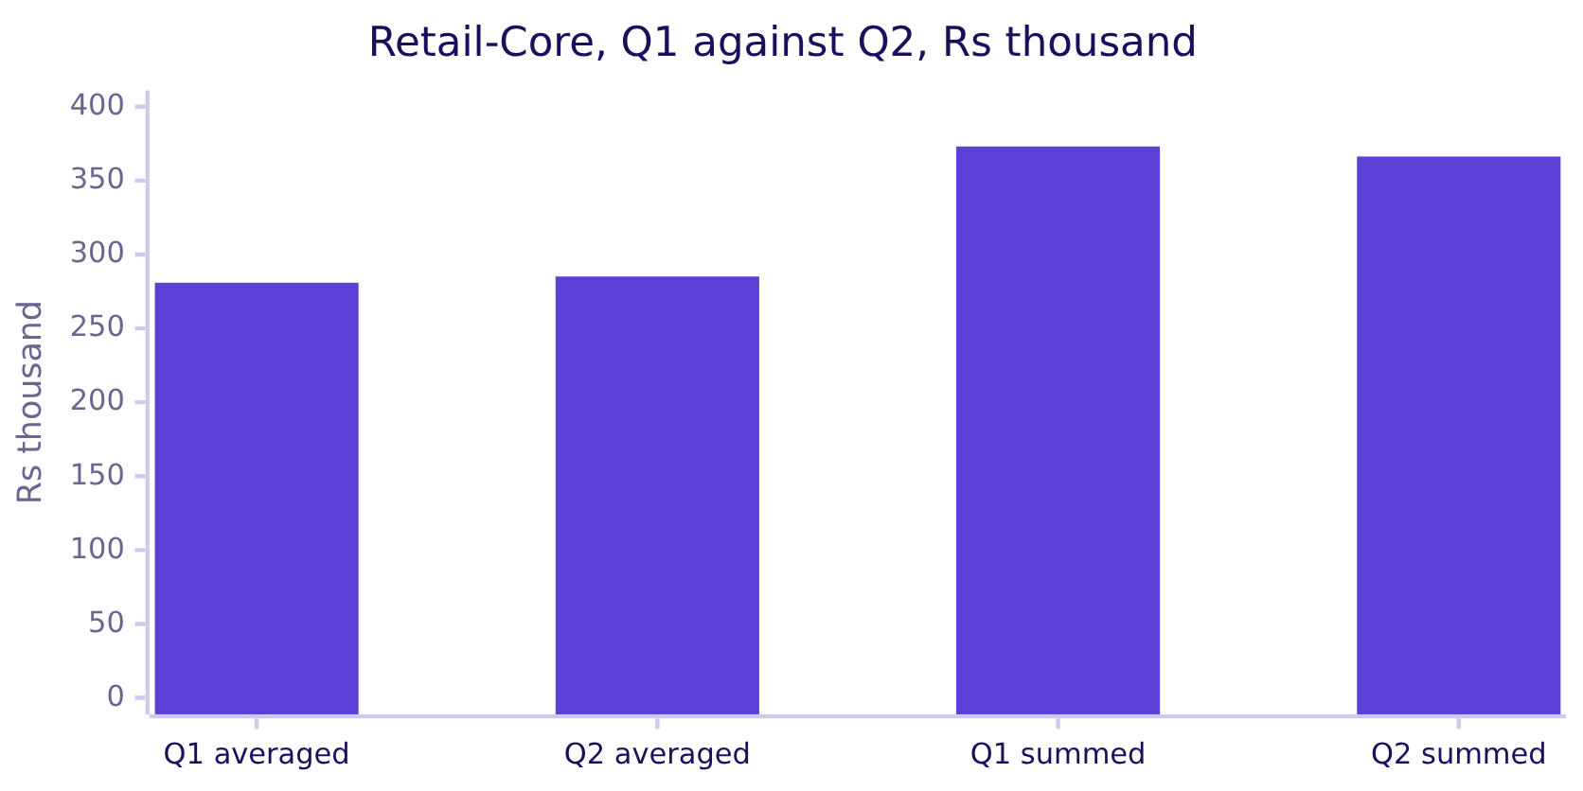
Indian Institute of Technology Gandhinagar
WEEK 2 · DAY 4 · KALPA GLOBAL CAPABILITY CENTRE
ADMINISTERED THROUGH THE COMPETENCY ADVANCEMENT ACADEMY
Answer: the default flips the sign
Averaged, Retail-Core grew 1.5 percent; summed, it fell 1.8 percent.
The answer is b. The averaged view reports a rise because Retail-Core's orders got slightly bigger while members ordered less often.
The ask
One row per customer
The exposure merge
The months view
S40 · 45 / 48
Notes:
LIVE, 3 minutes. The harder form of the trap: the default did not just shrink the number, it
reversed the direction of the story a stakeholder would tell.

Slide 46
Indian Institute of Technology Gandhinagar
WEEK 2 · DAY 4 · KALPA GLOBAL CAPABILITY CENTRE
ADMINISTERED THROUGH THE COMPETENCY ADVANCEMENT ACADEMY
Kavya's review of round 3
A pivot whose grand total equals its source, and a fall of 29 percent said with its months.
KAVYA'S REVIEW
"Q1 Rs 5,85,770, Q2 Rs 4,13,380, a fall of 29 percent, from a pivot that adds back to the orders. The averaged version would have said 18. Write aggfunc every time."
IN THE INTERVIEW
[F] pivot against melt: which widens and which lengthens?
Rs 9,99,150
29%
PIVOT GRAND TOTAL
Q1 TO Q2
equals the orders
the tier's true fall
The ask
One row per customer
The exposure merge
The months view
S41 · 46 / 48
Notes:
LIVE, 5 minutes. pivot and pivot_table widen, melt lengthens. Add the follow-up: pivot against
pivot_table, where pivot raises "Index contains duplicate entries, cannot reshape" on a repeated
pair and pivot_table silently averages it.

Slide 47
Indian Institute of Technology Gandhinagar
WEEK 2 · DAY 4 · KALPA GLOBAL CAPABILITY CENTRE
ADMINISTERED THROUGH THE COMPETENCY ADVANCEMENT ACADEMY
pivot is the loud version of pivot_table
DEPTH
When one value per cell is expected, pivot refuses a repeat instead of averaging it.
plus.pivot(index="customer_id", columns="month", values="amount")
ValueError: Index contains duplicate entries, cannot reshape
Call | A repeated member-month | Use it when
pivot | raises ValueError | one value per cell is a promise
pivot_table | aggregates, the mean by default | cells should aggregate, with aggfunc stated
The ask
One row per customer
The exposure merge
The months view
D42 · 47 / 48
Notes:
SELF-STUDY, 3 minutes. The same pattern as validate on merge: an argument or a function that
makes the wrong shape loud.

Slide 48
Indian Institute of Technology Gandhinagar
WEEK 2 · DAY 4 · KALPA GLOBAL CAPABILITY CENTRE
ADMINISTERED THROUGH THE COMPETENCY ADVANCEMENT ACADEMY
What the morning built
One row per customer, the sale attached, and a months view that adds back to its source.
Round | The number | The trap it replaced
One row per customer | 111 on the win-back list | 166, recency from the run day
The exposure merge | 107 of 130 reached bought, 82 percent | Rs 34,700 on invented records; 100 percent
The months view | Retail-Plus fell 29 percent | 18 percent, the default mean
THE RULE
Write how=, validate=, dropna= and aggfunc= every time; each default decided a number this morning.
The ask
One row per customer
The exposure merge
The months view
S43 · 48 / 48
Notes:
LIVE, 3 minutes. Point at the board drawing from S4, now complete. The afternoon builds the
whole table unguided and then runs one question in three tools.

