Slide 1


Indian Institute of Technology Gandhinagar
PG DIPLOMA IN AI-ML AND AGENTIC AI ENGINEERING · COHORT 2
ADMINISTERED THROUGH THE COMPETENCY ADVANCEMENT ACADEMY
09
Cross-sell and upsell reasoning; expected value in rupees
What is a combo worth?
Cross-sell told apart from upsell, and a corner shop's combo card priced as an expected value in rupees: the margin it adds, less what it hands back on bills that held both anyway.
What is a combo worth?
What is a slot worth?
Week 4, Day 3. Market basket, lift and cross-sell
1 / 21
Notes:
LIVE, 30 seconds, on screen after lunch. Chapter 9, the last chapter of the concept block, on the
topic "Cross-sell and upsell reasoning; expected value in rupees", 18 minutes with the second
concept drill inside them. It opens the afternoon so the morning carried four topics and this one
gets fresh heads. Sharma Kirana's month sheet goes on every table. Transition: who needs the
answer.

Slide 2

Indian Institute of Technology Gandhinagar
WEEK 4 · WEDNESDAY · MARKET BASKET, LIFT AND CROSS-SELL
ADMINISTERED THROUGH THE COMPETENCY ADVANCEMENT ACADEMY
Cross-sell adds a second item; upsell a bigger one
Who needs the answer, and which questions lead to it?
The topic. Cross-sell and upsell reasoning; expected value in rupees.
Who needs the answer. The owner of Sharma Kirana, a corner shop in Pune, invented, who is weighing a counter card that reads "Tea and rusk together, Rs 1 off". Rusk beside tea is cross-sell, a second item that goes with the first; the bigger tea pack in place of the small one would be upsell, a dearer version of the same item.
QUESTION 1
QUESTION 2
QUESTION 3
QUESTION 4
Cross-sell or upsell?
Which bills can the card change?
What is it worth in a month?
What decides the sign?
A second item, or a bigger one of the same.
The response assumed, and the discount.
Only the tea bills without rusk.
The margin added, less every rupee given back.
What is a combo worth?
What is a slot worth?
S56 · 2 / 21
Notes:
LIVE, 1 minute 30 seconds. Define the two words with the shop's own items: cross-sell suggests an additional
product, upsell a more expensive item or an upgrade of the same one (Wikipedia's cross-selling and
upselling pages, checked 13 October 2026). Callback to chapters 3 and 6: tea and rusk sit in 150
of 1,000 bills where chance gives 120, lift 1.25 on plenty of bills, under the 1.5 bar, so chapter
6's sort would give the pair no slot of its own. A card is the shop's cheapest bet on a weak pull,
and this chapter prices what such a bet earns. Instamart's strip suggests a different item beside
the one in the cart, which is cross-sell. Transition: the prediction.

Slide 3
Indian Institute of Technology Gandhinagar
WEEK 4 · WEDNESDAY · MARKET BASKET, LIFT AND CROSS-SELL
ADMINISTERED THROUGH THE COMPETENCY ADVANCEMENT ACADEMY
What is the tea-and-rusk card worth in a month?
Sharma Kirana's month, invented. Which number should the owner weigh against the card?
Line of the month | Value
Bills; with tea; with rusk; with both | 1,000; 600; 200; 150
Rusk's price, and its cost to the shop | Rs 30, and Rs 18
Rusk's margin, what the shop keeps: price less cost | Rs 12
The card's discount, on every bill holding both | Rs 1
Printing the cards | Rs 20
Tea bills without rusk that add a pack, assumed | 4 percent, range 2 to 6
a) Rs 5,040, the rusk sold on every bill that will hold both. b) Rs 2,016, the rusk margin on every bill that will hold both. c) Rs 196, the margin on the new packs less the printing. d) Rs 28, the margin on the new packs less every rupee the card costs.
What is a combo worth?
What is a slot worth?
S57 · 3 / 21
Notes:
LIVE, 2 minutes. The misconception first: a promotion is worth the sales it touches. Groups vote
with a letter card, argue with a neighbour for a minute, then vote again; the split is usually a
against c. Send the room to the sheet: "which bills does the card change, and which does it only
pay?" Transition: the reveal.

Slide 4
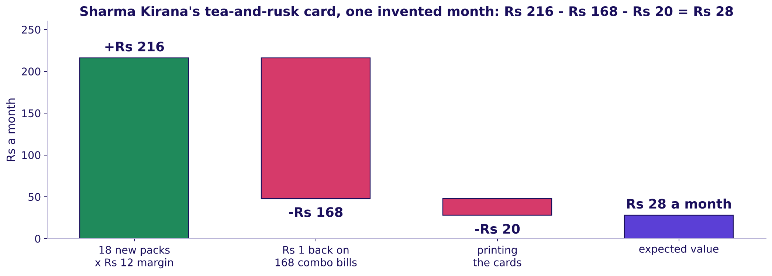
Indian Institute of Technology Gandhinagar
WEEK 4 · WEDNESDAY · MARKET BASKET, LIFT AND CROSS-SELL
ADMINISTERED THROUGH THE COMPETENCY ADVANCEMENT ACADEMY
Answer: d, Rs 28 a month, once the rupee is paid
Where does each rupee of the card go?
Sharma Kirana's card as a bridge: Rs 216 of new margin, less Rs 168 handed back and Rs 20 of printing, leaves Rs 28
The card is assumed to change only the 450 tea bills without rusk: 4 percent of them, 18 bills, add a pack, and 18 x Rs 12 is Rs 216 of margin. The card hands Rs 1 back on all 168 bills that hold both, the 150 that held both anyway and the 18 new ones, and the cards cost Rs 20, so Rs 216 less Rs 168 less Rs 20 leaves Rs 28. Option a books rusk sales on all 168 bills, Rs 5,040, which is 180 times the gain.
What is a combo worth?
What is a slot worth?
S58 · 4 / 21
Notes:
LIVE, 3 minutes. Build the bridge left to right on the board, one bar at a time (StatQuest). The
150 bills that held both before the card are the line most people forget: the card changes nothing
on them except the rupee it hands back. The trap, exactly: Rs 5,040, rusk sales on every combo
bill; the decision it misleads is a card printed as if it earned Rs 5,040; the check is "which
bills does the card change?"; the fix is margin on those bills only, less what the card gives away.
Option b counts every combo as new, Rs 2,016; option c forgets the discount, Rs 196. The second
route, said once: rusk margin with the card is Rs 2,428 against Rs 2,400 without it, the same Rs 28.
Transition: what moves the sign.

Slide 5
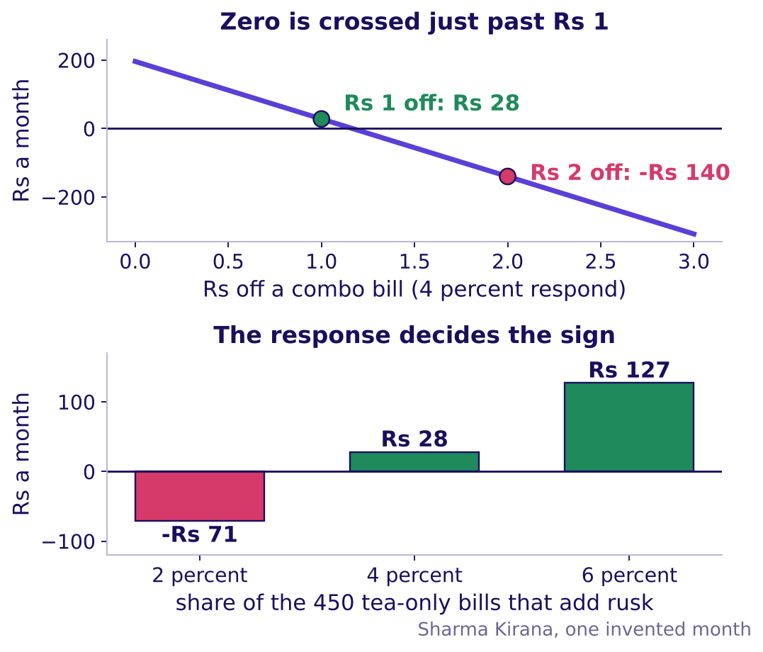
Indian Institute of Technology Gandhinagar
WEEK 4 · WEDNESDAY · MARKET BASKET, LIFT AND CROSS-SELL
ADMINISTERED THROUGH THE COMPETENCY ADVANCEMENT ACADEMY
At the same 4 percent, Rs 2 off loses Rs 140
How does expected value weigh each bill, and what moves it?
The rule, named last: expected value is each outcome times its probability, added up. A tea-only bill earns Rs 11 with probability 0.04, so Rs 0.44, and Rs 198 across 450; less Rs 1 on each of the 150 bills that held both and Rs 20 of printing, Rs 28 again.
def card_value(response, off):
new = round(450 * response)
combos = 150 + new
return new * 12 - combos * off - 20
print(card_value(0.04, 1)) # 28
print(card_value(0.04, 2)) # -140
print(card_value(0.02, 1)) # -71
Expected value against the rupees off a combo bill, and against the response assumed, for Sharma Kirana's invented month
What is a combo worth?
What is a slot worth?
S59 · 5 / 21
Notes:
LIVE, 4 minutes. Read the top panel first: each rupee off costs Rs 168 a month, so at the same 4
percent response the card earns nothing at about Rs 1.17 off and loses Rs 140 at Rs 2; a bigger
discount may draw more buyers, which only a trial of the card would show. Then the bottom panel: at 2 percent the card
loses Rs 71 and at 6 percent it earns Rs 127, so the 4 percent is an assumption said with its
range, and the answer travels with it. The formula comes after the counting, as its shorthand
(Wikipedia's expected value page, checked 13 October 2026: a weighted average, each outcome times
its probability). Then the code-along, one line at a time (Krish Naik); notebook 09 runs the
function and asserts the second route. Upsell is priced the same way: the extra margin of the
bigger pack on the shoppers who switch, less what the switch gives away. Transition: the rules.

Slide 6

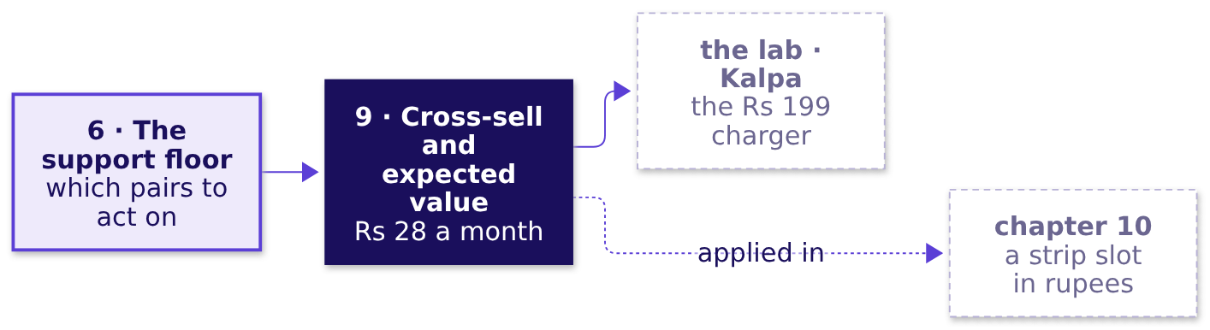
Indian Institute of Technology Gandhinagar
WEEK 4 · WEDNESDAY · MARKET BASKET, LIFT AND CROSS-SELL
ADMINISTERED THROUGH THE COMPETENCY ADVANCEMENT ACADEMY
A card earns only on the bills it changes
What should a learner keep from chapter 9, and where is it used next?
01
Cross-sell suggests a second item that goes with the first; upsell suggests a dearer version of the same item.
02
A card earns only on the bills it changes, so its gain is margin on the new packs, never sales on every combo bill.
03
A discount is paid on every bill that takes it, including the bills that would have held both anyway.
04
Expected value weighs each outcome by its probability, so an assumed response comes with its range, and so does the answer.
IN THE INTERVIEW
[F] "A combo offer lifts the pair's sales; is it worth running?" Margin on the purchases the offer creates, less the discount paid on every purchase that takes it, including those that would have happened anyway, less the fixed cost, said as a range.
What is a combo worth?
What is a slot worth?
S60 · 6 / 21
Notes:
LIVE, 7 minutes. One minute for the rules: fill the concept map's last box, so all five topics are
now on the board. Check question before moving on: "A card reaches 2,000 bills, 5 percent add one
pack at Rs 10 of margin, and the cards cost Rs 600: what is it worth?" 100 packs, Rs 1,000 of
margin, less Rs 600, so Rs 400. Then the second concept drill, items 5 to 7 of
`exercises/unguided/C2_W04_D03_canteen_concepts_STUDENT.md`, on paper, 6 minutes: pairs from one
order, the floor on the canteen's month, and the kirana's forgotten cost line. Checkpoint: the room
says the expected-value line in the topic's words, margin on the purchases a card changes less
every rupee it hands back. Transition: chapter 10, the strip ranked and priced.

Slide 7
Indian Institute of Technology Gandhinagar
PG DIPLOMA IN AI-ML AND AGENTIC AI ENGINEERING · COHORT 2
ADMINISTERED THROUGH THE COMPETENCY ADVANCEMENT ACADEMY
10
The strip ranked by the support floor and priced by expected value in rupees
What is a slot worth?
Chapter 6's floor and watch list re-rank Instamart's strip, chapter 9's expected value prices a slot in rupees, and each group defends one strip to the category manager.
What is a combo worth?
What is a slot worth?
Week 4, Day 3. Market basket, lift and cross-sell
7 / 21
Notes:
LIVE, 30 seconds. The third case chapter, levels L4 and L5. Notebook 10 opens now. Transition:
what the chapter answers, and for whom.

Slide 8
Indian Institute of Technology Gandhinagar
WEEK 4 · WEDNESDAY · MARKET BASKET, LIFT AND CROSS-SELL
ADMINISTERED THROUGH THE COMPETENCY ADVANCEMENT ACADEMY
Four questions from a ranking to rupees
Who needs the answer, and which questions lead to it?
Applies: The support floor and the watch list (chapter 6); Cross-sell and upsell reasoning; expected value in rupees (chapter 9).
Who needs the answer. The growth lead, who takes a ranked list and a rupee figure to Friday's review, where the category manager will argue that milk, the top seller, belongs in every slot.
QUESTION 1
QUESTION 2
QUESTION 3
QUESTION 4
Which pairs beat chance on enough carts?
What happens to a strong thin pair?
What is a slot worth in rupees?
What can the counts not tell us?
Lift above a support floor.
Ice cream and chocolate sauce, watched.
Views, click-through, adds, margin.
The doubts, each with its check.
What is a combo worth?
What is a slot worth?
S61 · 8 / 21
Notes:
LIVE, 30 seconds. Read the four questions. Each is a topic used on the case: the floor and the
watch list from chapter 6, the rupees from chapter 9. Transition: the problem first.

Slide 9

Indian Institute of Technology Gandhinagar
WEEK 4 · WEDNESDAY · MARKET BASKET, LIFT AND CROSS-SELL
ADMINISTERED THROUGH THE COMPETENCY ADVANCEMENT ACADEMY
Which pair ranks first under the floor rule?
Each pair shows its support and its lift. Under a 1 percent floor and a 1.5 bar, which ranks first?
A
B
C
D
Bread and toned milk
Chips and cold drink
Ice cream and chocolate sauce
Onions and tomatoes
Support 25.2 percent, lift 1.04.
Support 5.0 percent, lift 3.39.
Support 7.5 percent, lift 1.70.
Support 0.25 percent, lift 4.60.
What is a combo worth?
What is a slot worth?
S62 · 9 / 21
Notes:
LIVE, 4 minutes. The prediction is sat as the unguided set
`exercises/unguided/C2_W04_D03_ch10_four_pairs_STUDENT.md` on paper, four letters posted in four
minutes; its first item asks which pairs clear the stated rule, and this slide asks which of them
ranks first (Brilliant: the problem before the explanation). The split is usually b against c; a learner who drew chapter 6's canteen
action map should call it at once. Transition: every pair on one picture.

Slide 10
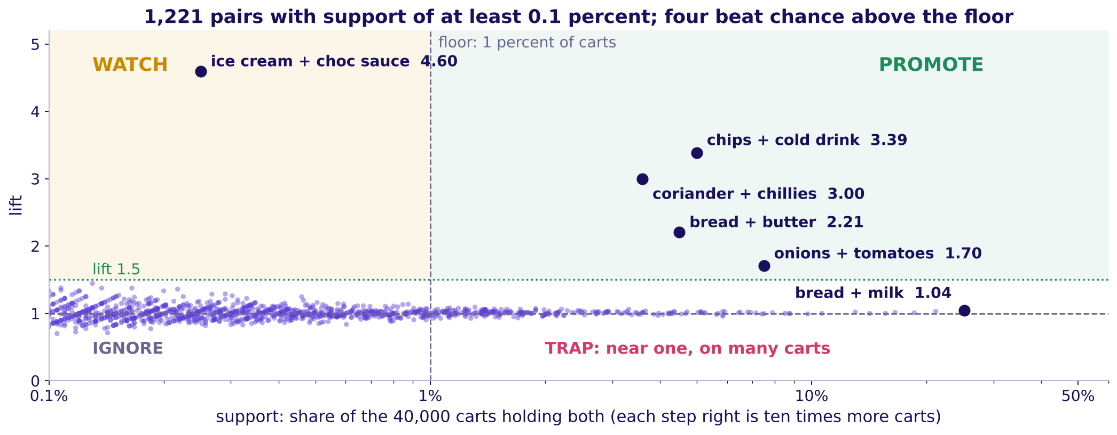
Indian Institute of Technology Gandhinagar
WEEK 4 · WEDNESDAY · MARKET BASKET, LIFT AND CROSS-SELL
ADMINISTERED THROUGH THE COMPETENCY ADVANCEMENT ACADEMY
Answer: b, the strongest lift above the floor
Where does every pair sit, and which pairs fill the strip?
Every pair with support of at least 0.1 percent: lift against support, with the 1 percent floor
Above a floor of 1 percent of carts (400 carts), 246 pairs qualify; four reach lift 1.5: chips and cold drink 3.39, coriander and green chillies 3.00, bread and butter 2.21, onions and tomatoes 1.70. Each fills a slot beside its own item, and elsewhere the strip falls back to the curated list it ran before 7 September. No partner of milk can pass 1 / 0.71 = 1.41.
What is a combo worth?
What is a slot worth?
S63 · 10 / 21
Notes:
LIVE, 3 minutes. The fifth pair above the floor reads 1.09, near one. Run notebook 10's first
cells, which rank the pairs above the floor and list the strong ones below it, then hand out the pair cards: each group places its nine cards on chapter 6's
four regions and defends one placement in a sentence (the run sheet has the placements). Promote is
above the floor and over the bar; watch, over the bar below the floor; trap, near one above the
floor, where milk's pairs sit; ignore, near one below it. Each step right on the picture is ten
times more carts. The floor is a decision: 0.5 percent admits more pairs on thinner ground, 2
percent fewer. Explorer: scene W5, the floor slider counts the pairs that survive. Transition: the
thin pair.

Slide 11
Indian Institute of Technology Gandhinagar
WEEK 4 · WEDNESDAY · MARKET BASKET, LIFT AND CROSS-SELL
ADMINISTERED THROUGH THE COMPETENCY ADVANCEMENT ACADEMY
The watch list holds lift 4.60 on 100 carts
What does chapter 6's rule do with a strong pair that almost nobody buys?
Ice cream and chocolate sauce read lift 4.60 on 100 carts, the strongest pair below the 1 percent floor with enough carts to trial. The pair is real, 100 carts where chance gives 22, but the strip suggests it only beside ice cream, which is in 4 percent of carts: about 2,400 of the strip's 60,000 views a day, if views follow carts, and 100 carts cannot say how shoppers will click it there. It goes on the watch list: in two zones, a random half of shoppers see it beside ice cream, and it takes the slot only if their ice-cream carts buy sauce more often than the other half's, by a gap set before the trial, with margin per shopper as the guardrail, a number that must not fall while the trial runs.
What is a combo worth?
What is a slot worth?
S64 · 11 / 21
Notes:
LIVE, 2 minutes. Chapter 6's gulab jamun and curd at city scale: a strong lift on thin support
earns a trial, never a slot. Notebook 10 searches the band between 0.2 percent (80 carts) and the
floor, since thousands of pairs on a handful of carts read wild lifts by luck, as chapter 6's month
showed. How long a trial must run to trust its answer is a sample-size
question, parked by name for the faculty session (tentative). Transition: what a slot is worth.

Slide 12

Indian Institute of Technology Gandhinagar
WEEK 4 · WEDNESDAY · MARKET BASKET, LIFT AND CROSS-SELL
ADMINISTERED THROUGH THE COMPETENCY ADVANCEMENT ACADEMY
What does taking milk out recover in a month?
Milk holds half the slot impressions at 1.2 percent. Given to suggestions that click at 6.4, how much does a month recover?
A
B
C
D
About Rs 50,000
About Rs 2 lakh
About Rs 6 lakh
About Rs 50 lakh
A rounding error on the city's month.
One slot's gap for half a month.
The gap on milk's share of all three slots.
Sales from every add the strip makes.
The inputs: 60,000 views a slot a day, 0.5 adds per click, Rs 9 of margin an add, 30 days.
What is a combo worth?
What is a slot worth?
S65 · 12 / 21
Notes:
LIVE, 1 minute. Guess first, then build it; the split is usually b against c. Transition: the
cascade.

Slide 13
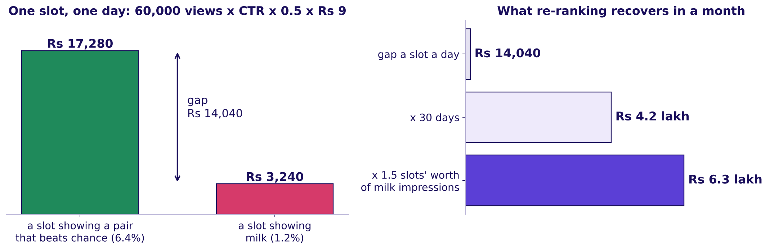
Indian Institute of Technology Gandhinagar
WEEK 4 · WEDNESDAY · MARKET BASKET, LIFT AND CROSS-SELL
ADMINISTERED THROUGH THE COMPETENCY ADVANCEMENT ACADEMY
Answer: c, about Rs 6.3 lakh a month, gross
How do chapter 9's rupees price a slot, and where does the month's money come from?
One slot a day at 6.4 and at 1.2 percent, and the month recovered by moving milk's impressions
A slot's day is 60,000 views (strip_log) x click-through x 0.5 adds per click (strip_log, range 0.4 to 0.6) x Rs 9 margin an add (the average cart_items line, range Rs 7 to Rs 11). Milk holds 1.5 slots' worth: Rs 4.2 lakh x 1.5 = Rs 6.3 lakh a month, Rs 3.9 lakh to Rs 9.3 lakh across the ranges, before the adds that would have come anyway. The 6.4 percent is what any suggestion but milk drew: in slot 1, cold drink beside chips (lift 3.39) drew 8.2 percent and bread beside eggs (0.99) 8.4, so the money comes from taking milk out.
What is a combo worth?
What is a slot worth?
S66 · 13 / 21
Notes:
LIVE, 2 minutes. The kirana's card at city scale: margin on the adds a slot makes, never its sales.
Build it left to right on the board, each factor said with its source and its range, as the
kirana's 4 percent was. Margin is what Instamart keeps from a sale after the item's cost: bread
sells for Rs 45 and keeps Rs 6.70. Every add is priced at the basket's average Rs 9, milk's too.
Two corrections pull opposite ways and both land inside the range: milk earns only Rs 2 a pouch,
which raises the gain, and the strip's own adds earned about Rs 7, which lowers it; with both,
about Rs 5.7 lakh. Whether a lift-ranked pair clicks better than any other suggestion is not in
this log: a test with a count-ranked arm, milk left out, against a lift-ranked arm measures it.
Back to S64's thin pair, priced at its own margins, Rs 37.40 for sauce against Rs 2 for milk: on
about 2,400 views a day in place of milk, 2,400 x 30 x (0.064 x 0.5 x Rs 37.40 less 0.012 x 0.5 x
Rs 2), it earns about Rs 85,000 a month, which is why it earns a test and never a blind slot.
Explorer: scene W4, the strip simulator, rank by count against rank by lift. Transition: the
number people get wrong.

Slide 14
Indian Institute of Technology Gandhinagar
WEEK 4 · WEDNESDAY · MARKET BASKET, LIFT AND CROSS-SELL
ADMINISTERED THROUGH THE COMPETENCY ADVANCEMENT ACADEMY
The trap: about Rs 80,200 of sales is not the gain
Which number would overstate the slot four and a half times over?
The plausible wrong answer books sales, the kirana's Rs 5,040 at city scale: a slot at 6.4 percent makes 1,920 adds a day, each selling for Rs 41.77 on average, so about Rs 80,200 a day of "strip revenue". The growth lead keeps the margin, Rs 17,280. If the strip ever adds a bundle discount, the discount is margin handed back, on adds that might have happened anyway, as on the kirana's 150 bills that held both before the card. Swiggy's shareholder letter for April to June 2025 describes Maxxsaver, a discount unlocked once a basket passes a set size, as margin returned to the user: the cost line a rupee case must carry (checked 12 October 2026).
What is a combo worth?
What is a slot worth?
S67 · 14 / 21
Notes:
LIVE, 1 minute. Ask: "which line of the cascade would a bundle discount change?" The margin per
add falls by the discount. The doubts on D68 are read inside S70's group work, and the heavy tenth
on D69 is self-study. Transition: the doubts, then the brief.

Slide 15
Indian Institute of Technology Gandhinagar
WEEK 4 · WEDNESDAY · MARKET BASKET, LIFT AND CROSS-SELL
ADMINISTERED THROUGH THE COMPETENCY ADVANCEMENT ACADEMY
Six doubts the counts cannot settle alone
DEPTH
What must the growth lead say aloud, and what check settles each doubt?
Doubt | The check | What it showed
Together is no proof of cause | A holdout: a random share of shoppers who see no strip, compared with the rest | This week's Monday faculty session on A/B testing (tentative)
Heavy buyers, each placing many carts | Count each customer once | Chips and cold drink 3.39 falls to 2.56; milk's pair stays 1.04
Curd stock-out | Set aside two zones in week three | Curd's share 26.0 rises to 27.8 percent; its lift with milk stays 1.01
Time of day | Each time band alone | Morning carts hold milk 80 percent of the time; bread with milk reads 1.03 to 1.05 in every band
Position in the strip | Click-through by slot | Among suggestions other than milk, slot 1 draws 8.2 percent and slot 3 5.4; milk is low in all three
The strip feeds its own counts | The holdout's shoppers, who never see the strip | Not in this data; the holdout in the first row settles it
What is a combo worth?
What is a slot worth?
D68 · 15 / 21
Notes:
SELF-STUDY, 0 minutes live: groups read it inside S70's work. Each doubt has its number in notebook 10; the slot row is D54's
picture and notebook 10's slot split. A check that comes back clean is said in one line, as the
time-of-day check does. One more doubt sits under S66: whether a lift-ranked pair clicks better
than any other suggestion, which this log cannot say and a count-against-lift test measures. In Hadapsar and Viman Nagar from 15 to 21
September, curd is in 12 of 2,583 carts; a stock-out cuts the count, never the pull.

Slide 16
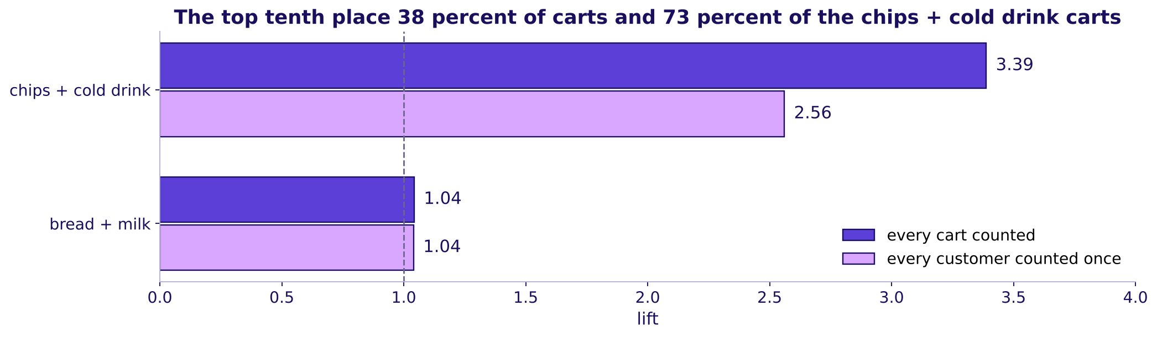
Indian Institute of Technology Gandhinagar
WEEK 4 · WEDNESDAY · MARKET BASKET, LIFT AND CROSS-SELL
ADMINISTERED THROUGH THE COMPETENCY ADVANCEMENT ACADEMY
Counted once per customer, the party pair shrinks
DEPTH
How much of chips and cold drink comes from a few heavy shoppers?
Lift per cart against lift with every customer counted once, for chips and cold drink and for bread and milk
The top tenth of customers place 38 percent of the carts and 73 percent of the carts holding both chips and a cold drink. Counting every customer once gives each cart a weight of one over its customer's number of carts, so a shopper with 4 carts counts each as 0.25; lift is then the weighted share of carts holding both over the weighted shares holding each, multiplied. Counted that way, the pair's lift falls from 3.39 to 2.56 and still beats chance; bread and milk stays at 1.04. The pair keeps its slot, and the growth lead says the smaller number.
What is a combo worth?
What is a slot worth?
D69 · 16 / 21
Notes:
SELF-STUDY, 0 minutes live. "Counted once" means each cart weighs one over its customer's number of
carts, so a shopper with fourteen carts counts as much as a shopper with one. Amazon's history
(chapter 8) met the same heavy-buyer problem.

Slide 17



Indian Institute of Technology Gandhinagar
WEEK 4 · WEDNESDAY · MARKET BASKET, LIFT AND CROSS-SELL
ADMINISTERED THROUGH THE COMPETENCY ADVANCEMENT ACADEMY
Ship one strip, priced and defended
What does each group hand in?
STEP 1
STEP 2
STEP 3
STEP 4
Rank three pairs
Price the strip
Name two doubts
Answer the category manager
From the pairs table: support at least 1 percent and lift 1.5 or more, each with its two numbers.
A slot a day and the month recovered, each assumption with its range.
Each with the check and the number it gave.
Two sentences: the number first, then what you concede.
The one-page strip carries four fields, one line each: the three pairs with support and lift, the price with its low and high ends, the two doubts with their checks, and the two sentences. A strip that names a pair without its support, or a rupee figure without its range, goes back. The strip set in exercises/unguided asks the same steps as items; a group posts its letters once its page is done.
What is a combo worth?
What is a slot worth?
S70 · 17 / 21
Notes:
LIVE, 2 minutes to brief, then 10 minutes of group work, unguided, level L5, in groups of about
four on notebook 10. The TA moves between tables. A group that picks a pair below the floor is
asked "how many carts would the slot touch?". A group that prices sales instead of margin is asked
"which number does the growth lead keep?". Groups read D68 for step 3 inside the ten minutes.
Checkpoint: every group hands in one strip with a rupee range. The strip set's solutions file is
released at the close. Transition: the objection each group must
answer.

Slide 18




Indian Institute of Technology Gandhinagar
WEEK 4 · WEDNESDAY · MARKET BASKET, LIFT AND CROSS-SELL
ADMINISTERED THROUGH THE COMPETENCY ADVANCEMENT ACADEMY
"Milk is our top seller; put it in every slot"
Which part of the category manager's objection is right, and what answers the rest?
RESTATE
ANSWER
CONCEDE
WHAT WOULD CHANGE IT
Milk is in most carts
The slot moves nothing
Milk belongs in the cart
If milk earned its slot
It is in 71 percent of carts and brings shoppers back daily.
Milk slots click at 1.2 percent against 6.4, and no item's lift with milk can pass 1.41.
Which is why it needs no reminder; keep it on the home screen and in search.
A test with shoppers randomised, in which a milk slot earned as much margin per shopper as the suggestion it replaced, would put milk back.
What is a combo worth?
What is a slot worth?
S71 · 18 / 21
Notes:
LIVE, 3 minutes. Tuesday's four moves, used on today's numbers: restate until the owner agrees,
answer from the evidence, concede what is true, say what would change your mind. Two groups read
their answers aloud; the room names the move each sentence makes. Transition: the interview room.

Slide 19


Indian Institute of Technology Gandhinagar
WEEK 4 · WEDNESDAY · MARKET BASKET, LIFT AND CROSS-SELL
ADMINISTERED THROUGH THE COMPETENCY ADVANCEMENT ACADEMY
Lift divides popularity out; confidence does not
"Support, confidence, lift: which one cannot be fooled by popularity, and why?"
WEAK ANSWER
HIRE-GRADE ANSWER
WHAT THE INTERVIEWER LISTENS FOR
Confidence
Lift, because it divides by the base rate
The base rate and its window
"Confidence, because it is the probability of B given A, so the highest-confidence pair goes in the strip." It ranks milk first.
Three questions kept apart, the denominator and window said aloud, a floor, a decision.
"Bread to milk reads confidence 0.74, but milk is in 71 percent of carts anyway, so lift is 1.04. Chips and cold drink read 0.42 and lift 3.39. I rank by lift above a floor of 1 percent of September's carts, 400 carts, and slot a pair only at 1.5 or more."
What is a combo worth?
What is a slot worth?
S72 · 19 / 21
Notes:
LIVE, 3 minutes, level L6, the interview room's [S] answer. Pairs read the two answers side by
side. The weak answer is not wrong about confidence's meaning; it is wrong about what to do with
it. The full transcript, its three follow-ups and the AI-company variant, an LLM shopping assistant
scored against a popularity baseline, are read in pairs in the lab from the extras folder.
Transition: the handoff.

Slide 20
Indian Institute of Technology Gandhinagar
WEEK 4 · WEDNESDAY · MARKET BASKET, LIFT AND CROSS-SELL
ADMINISTERED THROUGH THE COMPETENCY ADVANCEMENT ACADEMY
Handoff: lift read as probability, next
What does the IITGN faculty session (tentative) pick up from today?
You counted lift on twelve carts and on forty thousand. The next 120 minutes show the same three numbers as probabilities: a lift near one is independence made visible, which is what milk showed you, and the support floor you set is what lets an algorithm skip counting every combination.
Independent means that knowing one item is in the cart tells you nothing about the other, and a rule is a sentence such as "bread, so milk". The IITGN faculty session is tentative until IIT Gandhinagar confirms it.
What is a combo worth?
What is a slot worth?
S73 · 20 / 21
Notes:
LIVE, 8 minutes: 1 for the line, read as it stands, and 7 for the Kahoot pack from the kahoot
folder, ungraded, eight items: the three counts and a lift from three counts; a popular partner and
the strip's blended click-through; a strong thin pair, what a promotion is worth and one cart's
pairs; Tuesday's four moves. Re-teach in one line any item most of the room misses. Park any
question about how long a watch-list trial must run for the faculty session (tentative).
Transition: the close.

Slide 21
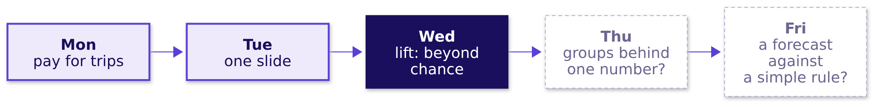
Indian Institute of Technology Gandhinagar
WEEK 4 · WEDNESDAY · MARKET BASKET, LIFT AND CROSS-SELL
ADMINISTERED THROUGH THE COMPETENCY ADVANCEMENT ACADEMY
The sentence for Friday, and Thursday's question
What does the room say on Friday, and what comes next?
The sentence. "The click-through fell because the strip gave half its slots to milk, which shoppers buy anyway. Taking milk out, which ranking by lift above a 1 percent floor and a 1.5 bar does by arithmetic, recovers about Rs 6.3 lakh a month before the adds that would have come anyway; a test against a count ranking without milk shows whether lift earns more."
Tomorrow. Zomato Gold in Chennai: a retention number that stays flat while every group of members shrinks. Who is leaving, and at which step?
What is a combo worth?
What is a slot worth?
S74 · 21 / 21
Notes:
LIVE, 2 minutes. Ask two learners to say the sentence without notes. The lab after class runs the
same method on Kalpa Retail's baskets in notebook 11. Tomorrow's pre-read ships tonight.

