Slide 1


Indian Institute of Technology Gandhinagar
PG DIPLOMA IN AI-ML AND AGENTIC AI ENGINEERING · COHORT 2
ADMINISTERED THROUGH THE COMPETENCY ADVANCEMENT ACADEMY
06
Which line would have caught it?
Which line of a complete definition does each of five facts in the SEC's Wells Fargo order breach, before the room writes its own definitions again?
Which line would have caught it?
Does each number survive its owner?
Which numbers lead, and which lag?
What do you say to the teams who lose?
Week 4, Day 1. The metric clinic: which line would have caught it?
1 / 14
Notes:
LIVE, 35 minutes: the five facts (8), the match in groups (15), the answers argued (12). This deck runs
only if the tentative IITGN block W4-1 does not; it teaches nothing about testing, which stays with
the block whenever it runs. Fallback note: trainer/C2_W04_D01_fallback_note_TRAINER.md.
Transition: the five facts.

Slide 2






Indian Institute of Technology Gandhinagar
WEEK 4 · DAY 1 · THE METRIC CLINIC, IF THE TENTATIVE FACULTY BLOCK SLIPS
ADMINISTERED THROUGH THE COMPETENCY ADVANCEMENT ACADEMY
Five facts from the SEC's Wells Fargo order
What did the order find about how the cross-sell number was built and hit?
FACT 1
FACT 2
FACT 3
FACT 4
FACT 5
No usage condition
Four years unused
A silent addition
Simulated funding
Surveys dodged
Accounts and products per household counted whether or not anyone used them
A debit card, the largest product, could sit unused in the count for up to four years
In 2013 remittance accounts were added without telling investors; 0.04 of that year's 0.11 rise
Staff moved customers' money into new accounts to meet the funding rule for sales credit
Staff changed contact details so satisfaction surveys would not reach customers
Source: the SEC order, Release 34-88257, February 2020, checked 12 October 2026.
Which line would have caught it?
Does each number survive its owner?
Which numbers lead, and which lag?
What do you say to the teams who lose?
S1 · 2 / 14
Notes:
LIVE, 8 minutes. Read each fact; each group takes one fact first and reads it aloud. Do not add facts
that are not on the card: firing counts and the "3.5 million accounts" figure are not verified in
the week's sources. Source:
https://www.sec.gov/files/litigation/admin/2020/34-88257.pdf (checked 12 October 2026)
Transition: the match.

Slide 3
Indian Institute of Technology Gandhinagar
WEEK 4 · DAY 1 · THE METRIC CLINIC, IF THE TENTATIVE FACULTY BLOCK SLIPS
ADMINISTERED THROUGH THE COMPETENCY ADVANCEMENT ACADEMY
Which line would have caught each fact?
Match each of the five facts to the line of a complete definition that would have stopped it; one line is left over.
Fact
1 | No usage condition
2 | Four years unused
3 | A silent addition in 2013
4 | Simulated funding
5 | Surveys dodged
a) Numerator: count only accounts the customer used
b) Denominator: households, with the count printed beside the ratio
c) Window: an account counts only if used inside the period
d) Exclusions, dated: every change to what is counted is dated on the definition
e) What it does not reward: money moved in and out to meet a rule
f) A guardrail read from data the measured staff cannot touch
Which line would have caught it?
Does each number survive its owner?
Which numbers lead, and which lag?
What do you say to the teams who lose?
S2 · 3 / 14
Notes:
LIVE, 15 minutes. Groups answer as a string of five letters in fact order. One line is spare, so
elimination alone does not finish it.
Transition: the answers.

Slide 4
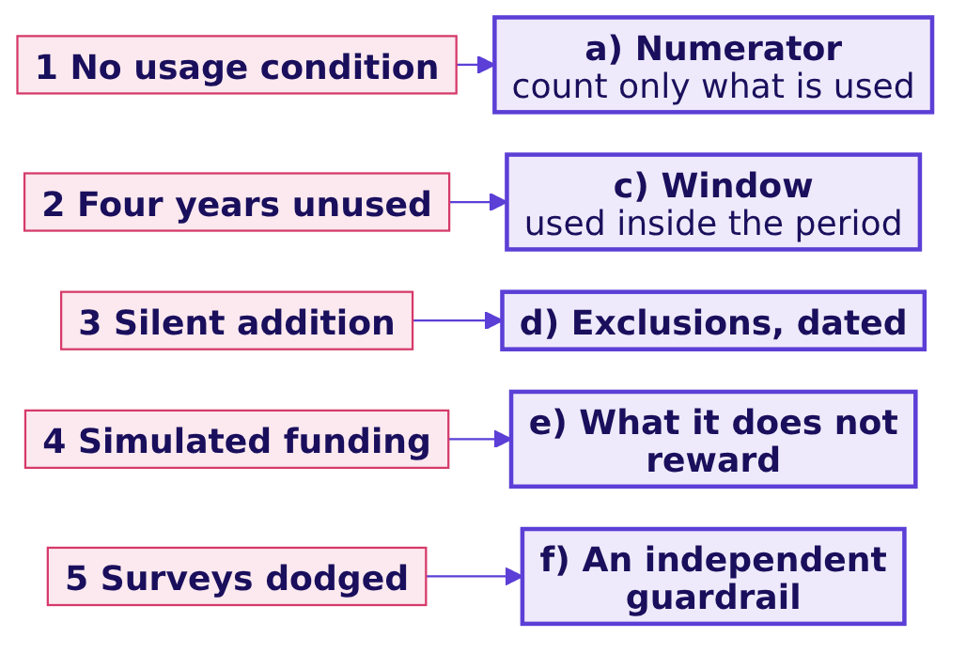
Indian Institute of Technology Gandhinagar
WEEK 4 · DAY 1 · THE METRIC CLINIC, IF THE TENTATIVE FACULTY BLOCK SLIPS
ADMINISTERED THROUGH THE COMPETENCY ADVANCEMENT ACADEMY
Answer: a c d e f; the denominator is spare
Why does each fact belong to its line, and why is the denominator left over?
Fact | The line that catches it | Why
1 No usage condition | a) Numerator with a usage condition | The count itself must require the thing it stands for
2 Four years unused | c) Window | Use inside the period, or it leaves the count
3 Silent addition | d) Exclusions, dated | A change to what is counted carries a date and a note
4 Simulated funding | e) What it does not reward | Names the behaviour the number refuses to pay for
5 Surveys dodged | f) Independent guardrail | A guardrail the measured can redirect guards nothing
The denominator (b) was households throughout; the gaming sat in what was counted, when, and who could reach the check.
Which line would have caught it?
Does each number survive its owner?
Which numbers lead, and which lag?
What do you say to the teams who lose?
S3 · 4 / 14
Notes:
LIVE, 12 minutes. Take the most-argued fact first. Then the Uber parallel, one line each: an hour
counted with no trip (fact 1), an online hour that starts when the driver chooses (fact 2's window,
and VA's desired date from the morning), a definition change in Uber's own count (none in the case;
say so), a top-up for idling (fact 4), a check the drivers cannot touch (the rider's wait, fact 5).
Transition: the city's three numbers, written out in full.

Slide 5
Indian Institute of Technology Gandhinagar
PG DIPLOMA IN AI-ML AND AGENTIC AI ENGINEERING · COHORT 2
ADMINISTERED THROUGH THE COMPETENCY ADVANCEMENT ACADEMY
07
Does each number survive its owner?
What happens when each of three proposed numbers is written as a complete definition and its owner attacks it?
Which line would have caught it?
Does each number survive its owner?
Which numbers lead, and which lag?
What do you say to the teams who lose?
Week 4, Day 1. The metric clinic: which line would have caught it?
5 / 14
Notes:
LIVE, 40 minutes: set up (5), groups write (20), owners attack (15). Nine groups in three sets of
three, each set on one number.
Transition: the three numbers and their owners.

Slide 6



Indian Institute of Technology Gandhinagar
WEEK 4 · DAY 1 · THE METRIC CLINIC, IF THE TENTATIVE FACULTY BLOCK SLIPS
ADMINISTERED THROUGH THE COMPETENCY ADVANCEMENT ACADEMY
Three numbers, each with an owner who wants it
Which number does each owner propose, and what would it reward?
DRIVER-OPERATIONS LEAD
CITY HEAD
FINANCE PARTNER
Peak online hours
Completed peak trips
Acceptance share
Rewards being online, whatever happens in the hour
Rewards trips, including the short ones a driver cherry-picks
Rewards saying yes, including to trips later cancelled
Each set writes its number as a complete definition of seven lines: numerator, denominator, window, exclusions, what it does not reward, guardrails, and the gaming note.
Which line would have caught it?
Does each number survive its owner?
Which numbers lead, and which lag?
What do you say to the teams who lose?
S4 · 6 / 14
Notes:
LIVE, 5 minutes to set. The template is in exercises/guided/C2_W04_D01_definition_STUDENT.md. Twenty
minutes to write.
Transition: the attack each owner will mount.

Slide 7
Indian Institute of Technology Gandhinagar
WEEK 4 · DAY 1 · THE METRIC CLINIC, IF THE TENTATIVE FACULTY BLOCK SLIPS
ADMINISTERED THROUGH THE COMPETENCY ADVANCEMENT ACADEMY
Each owner's attack, and the line that holds
What does each owner say against the definition written for their number, and which line answers it?
Owner | The attack | The part that is true | The line that answers it
Driver operations | "Hours are what we control; trips depend on riders" | Supply is driver operations' job | Guardrail: trips per online hour beside the hours
City head | "Trips are the outcome; why guard them?" | Trips are what the city wants | Guardrail: accepted share, which catches cherry-picking
Finance partner | "Acceptance is the cheapest number to check" | It moves first, in the launch week | Gaming note: an accepted trip then cancelled; cancels beside it
On the case data the three numbers moved 24 percent up (hours), 3 percent up (trips) and 13 points down (acceptance): three owners, three stories about the same six weeks.
Which line would have caught it?
Does each number survive its owner?
Which numbers lead, and which lag?
What do you say to the teams who lose?
S5 · 7 / 14
Notes:
LIVE, 15 minutes. Each owner attacks the set that wrote their number; the set answers with a line.
Score as in round 3: answered, conceded, or lost.
Transition: which numbers move first.

Slide 8
Indian Institute of Technology Gandhinagar
PG DIPLOMA IN AI-ML AND AGENTIC AI ENGINEERING · COHORT 2
ADMINISTERED THROUGH THE COMPETENCY ADVANCEMENT ACADEMY
08
Which numbers lead, and which lag?
Which of eight city numbers move before the north star and which confirm it later, and which guardrail does each north star need?
Which line would have caught it?
Does each number survive its owner?
Which numbers lead, and which lag?
What do you say to the teams who lose?
Week 4, Day 1. The metric clinic: which line would have caught it?
8 / 14
Notes:
LIVE, 30 minutes: the eight numbers (12), defended (6), the three north stars and their guardrails
(12). Cut this section first if time runs short.
Transition: the eight numbers.

Slide 9
Indian Institute of Technology Gandhinagar
WEEK 4 · DAY 1 · THE METRIC CLINIC, IF THE TENTATIVE FACULTY BLOCK SLIPS
ADMINISTERED THROUGH THE COMPETENCY ADVANCEMENT ACADEMY
Which of eight numbers lead, and which lag?
For each number, does it move before completed peak trips per driver, or confirm it later?
# | City number
1 | Enrolled drivers online in the first peak hour
2 | Rider requests per online hour, by zone
3 | Share of offers accepted this week
4 | New driver sign-ups this week
5 | Top-up paid for the month
6 | Rider rating at month end
7 | Drivers who left the platform next quarter
8 | Gross bookings for the quarter
a) 1, 2, 3 and 4 lead; 5, 6, 7 and 8 lag
b) 1, 3, 5 and 7 lead; 2, 4, 6 and 8 lag
c) 1 and 2 lead; the other six lag
d) 3, 5 and 8 lead; the other five lag
Which line would have caught it?
Does each number survive its owner?
Which numbers lead, and which lag?
What do you say to the teams who lose?
S6 · 9 / 14
Notes:
LIVE, 8 minutes. Letters first, then each group defends two of its calls aloud.
Transition: the answer.

Slide 10
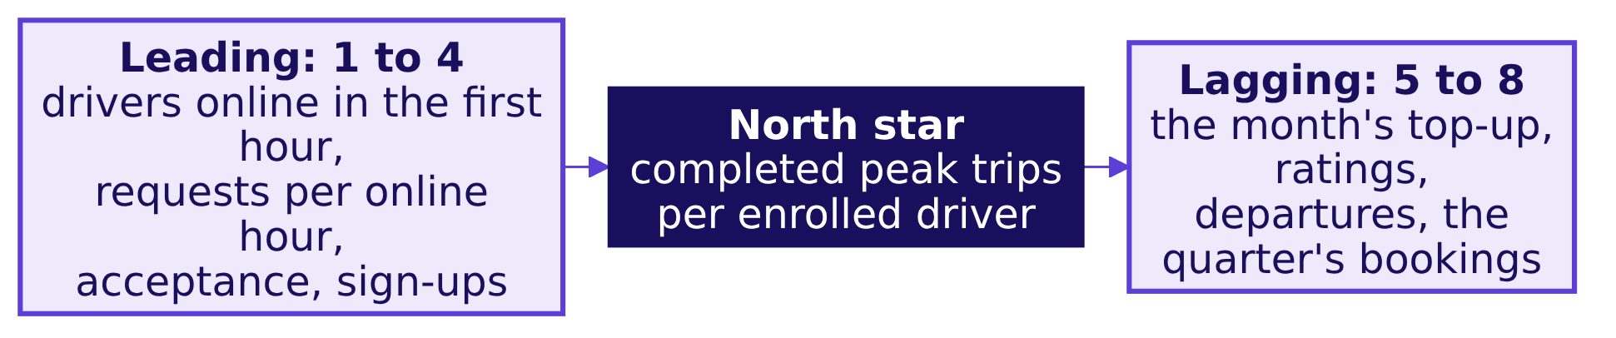
Indian Institute of Technology Gandhinagar
WEEK 4 · DAY 1 · THE METRIC CLINIC, IF THE TENTATIVE FACULTY BLOCK SLIPS
ADMINISTERED THROUGH THE COMPETENCY ADVANCEMENT ACADEMY
Answer: a; inputs lead, bills and ratings lag
Why does each number sit where it does?
Answer: a. The four inputs move before trips per driver do, and the city team can act on them this week; the four confirmations arrive after the trips have happened. On the case data acceptance settled in the launch week while bookings per online hour took three weeks.
Which line would have caught it?
Does each number survive its owner?
Which numbers lead, and which lag?
What do you say to the teams who lose?
S7 · 10 / 14
Notes:
LIVE, 4 minutes. A dashboard of only lagging numbers lets a drift run for weeks before anyone sees
it; a dashboard of only leading numbers never says whether the outcome came.
Transition: three north stars and the guardrail each needs.

Slide 11
Indian Institute of Technology Gandhinagar
WEEK 4 · DAY 1 · THE METRIC CLINIC, IF THE TENTATIVE FACULTY BLOCK SLIPS
ADMINISTERED THROUGH THE COMPETENCY ADVANCEMENT ACADEMY
Three north stars, and the guardrail each needs
How could each north star be hit while riders were served worse, and which guardrail catches it?
North star | How it could be hit badly | The guardrail
Completed peak trips per enrolled driver per week | Drivers accept short trips and decline the rest | Share of offers accepted, at or above a floor
Peak online hours per enrolled driver | Drivers sit online in zones with no riders | Share of online hours with no completed trip (0.22 to 0.38 on the case)
Enrolled drivers | Drivers sign up and never drive | Count only drivers online at least one peak hour that week
Which line would have caught it?
Does each number survive its owner?
Which numbers lead, and which lag?
What do you say to the teams who lose?
S8 · 11 / 14
Notes:
LIVE, 12 minutes. Each group writes one more guardrail for a north star of its choice and names the
gaming it catches. A guardrail that is another growth count gets the question: what would it catch?
Transition: the dispute, as an interviewer asks it.

Slide 12
Indian Institute of Technology Gandhinagar
PG DIPLOMA IN AI-ML AND AGENTIC AI ENGINEERING · COHORT 2
ADMINISTERED THROUGH THE COMPETENCY ADVANCEMENT ACADEMY
09
What do you say to the teams who lose?
How does a candidate get three teams who each want their own target to one number, and what do they say to the two who lose?
Which line would have caught it?
Does each number survive its owner?
Which numbers lead, and which lag?
What do you say to the teams who lose?
Week 4, Day 1. The metric clinic: which line would have caught it?
12 / 14
Notes:
LIVE, 15 minutes: the second transcript read in pairs (10), scored (5). The transcript is the [D]
section of extras/C2_W04_D01_transcript_STUDENT.md.
Transition: the two answers.

Slide 13
Indian Institute of Technology Gandhinagar
WEEK 4 · DAY 1 · THE METRIC CLINIC, IF THE TENTATIVE FACULTY BLOCK SLIPS
ADMINISTERED THROUGH THE COMPETENCY ADVANCEMENT ACADEMY
Three teams, one number: two answers compared
Where does a weak answer to the dispute go wrong, and what does a hire-grade answer do?
Beat | Weak answer | Hire-grade answer
Clarify | "Which team is right?" | "What is the scheme for, and what does each team need to see to do its job?"
The call | Gives each team its own target | One north star tied to the scheme's goal: completed peak trips per enrolled driver online at peak
The two who lose | Promises to revisit | Shows where their number now lives: hours as an input beside trips per hour, top-up per trip as a guardrail
What would change it | Nothing | "If waits rose while the north star held, I would revisit the floor"
Which line would have caught it?
Does each number survive its owner?
Which numbers lead, and which lag?
What do you say to the teams who lose?
S9 · 13 / 14
Notes:
LIVE, 8 minutes. Score both on the scorecard (trainer/C2_W04_D01_interview_scorecards_TRAINER.md).
Transition: the clinic's close.

Slide 14
Indian Institute of Technology Gandhinagar
WEEK 4 · DAY 1 · THE METRIC CLINIC, IF THE TENTATIVE FACULTY BLOCK SLIPS
ADMINISTERED THROUGH THE COMPETENCY ADVANCEMENT ACADEMY
Close: a definition is a set of lines that hold
What has the clinic added to the morning's definition?
The crux. Every way of gaming a number gets caught by a line written down before anyone is paid: the count, its window, what it does not reward, and a check the measured cannot touch.
Which line would have caught it?
Does each number survive its owner?
Which numbers lead, and which lag?
What do you say to the teams who lose?
S10 · 14 / 14
Notes:
LIVE, 2 minutes. The test of the redesign stays with the tentative faculty block whenever it runs.
Transition: the TA lab.

