Slide 1
SECTION A. The ask
Week 0, Day 4. The warden's mess: the problem before the solution
1 / 15

Slide 2
S1
"I want an app that predicts how many will eat"
The warden of a student hostel:
"Our mess throws away about a fifth of what it cooks. I want an app that predicts how many students will eat."
The mess manager adds:
"Students skip dinner without telling anyone, and the vendor bills us for what we order, eaten or not."
You are the engineer in the room. For the first twenty minutes you may ask anything, and you may propose nothing.
Week 0, Day 4. The warden's mess: the problem before the solution
2 / 15

Slide 3
SECTION B. Twenty minutes of questions
Week 0, Day 4. The warden's mess: the problem before the solution
3 / 15

Slide 4
S2
Ask first: the ask arrives with its answer attached
The warden has already chosen a solution. Your first job is to find the problem it was chosen for, and whether it is the right one.
Every answer you get in the next twenty minutes comes only from a question someone asked.
Week 0, Day 4. The warden's mess: the problem before the solution
4 / 15

Slide 5
SECTION C. The four questions
Week 0, Day 4. The warden's mess: the problem before the solution
5 / 15

Slide 6
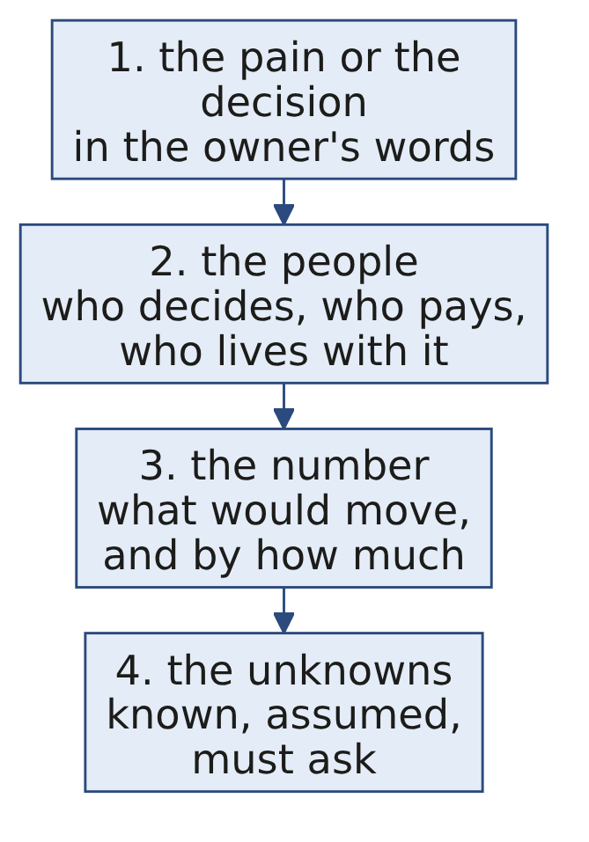
S3
Four questions come before any proposal
Question | For the warden's mess
The pain or the decision | Money spent on food nobody eats
The people | The warden, the mess manager, the vendor, the students, the mess committee
The number | Plates thrown away each week, and the bill
The unknowns | What the records show, how early the vendor needs a count, who must agree to a new rule
Week 0, Day 4. The warden's mess: the problem before the solution
6 / 15

Slide 7
D4
Known, assumed or must ask?
DEPTH
Question. Sort the eight statements. Known means someone who would know has said it; assumed means nobody has checked it; must ask means only the owner can fill the gap.
# | Statement
1 | The mess cooks for all 240 students every night.
2 | About a fifth of the food is thrown away.
3 | Students would use an app to say they are skipping dinner.
4 | The vendor bills for every plate ordered, eaten or not.
5 | Weekends waste the most.
6 | Who has to agree before students are asked to do anything new?
7 | How early does the vendor need the next day's count?
8 | Students skip dinner without telling anyone.
Week 0, Day 4. The warden's mess: the problem before the solution
7 / 15

Slide 8
D5
Answer: three known, three assumed, two must ask
DEPTH
Known | Assumed | Must ask
1, the mess manager cooks for all 240 | 2, the warden's estimate until the register is read | 6, who must agree
4, the mess manager knows the bill | 3, nobody has asked a student | 7, the vendor's deadline
8, the mess manager sees it nightly | 5, a guess until the register is read
An assumption becomes a fact the moment someone checks it. The mess keeps a register of plates served each night, so statements 2 and 5 can be checked this week.
Week 0, Day 4. The warden's mess: the problem before the solution
8 / 15

Slide 9
SECTION D. Stated and real
Week 0, Day 4. The warden's mess: the problem before the solution
9 / 15

Slide 10
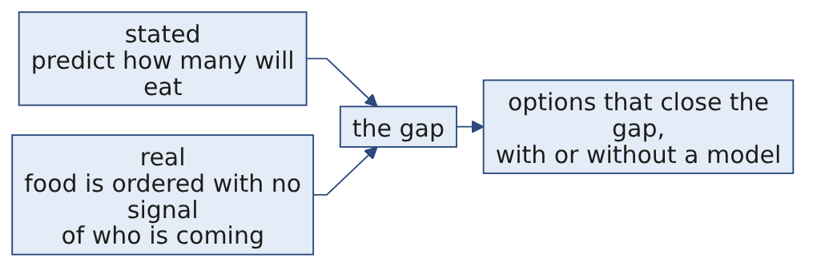
S6
The stated problem and the real one
 | In the warden's words | Underneath
The ask | "An app that predicts how many students will eat" | A way to order closer to what is eaten
The cause | "Students skip dinner without telling anyone" | Nobody has a way to tell the mess in time
The cost | "The vendor bills us for what we order" | Every uneaten plate is paid for
Week 0, Day 4. The warden's mess: the problem before the solution
10 / 15

Slide 11
S7
The cheapest fix may need no model
Option | What it takes | Model?
A sign-out each morning on the mess group | One message a day from each student who will skip | No
Cook each weekday's recent average, plus a small margin | The mess register and a calculator | No
An app that predicts attendance | Data, a model, an app, and someone to keep it running | Yes
The first two could start next week. Choosing between the three is the weekend project's work; today's work is being sure the problem underneath is the right one.
Week 0, Day 4. The warden's mess: the problem before the solution
11 / 15

Slide 12
D8
Write it for the warden's ask
DEPTH
Question. Write the stated problem, a candidate real problem, and five questions ranked by importance, each with the decision its answer would change.
Week 0, Day 4. The warden's mess: the problem before the solution
12 / 15

Slide 13
D9
Answer: one strong version
DEPTH
Stated: predict how many students will eat dinner.
Real, as a candidate: the mess orders food for all 240 students because it has no signal of who is coming, and the vendor bills for every plate.
Rank | Question | The decision its answer changes
1 | How many plates are thrown away, and on which nights? | Whether the fix is needed every night or only some
2 | How early does the vendor need the count, and can that move? | How late a signal can arrive and still help
3 | Who has to agree before students are asked to do something new? | Whether a sign-out rule is possible at all
4 | Which number would tell you it is fixed, by how much, and by when? | What to measure, and when to stop
5 | How do students tell anyone today that they will skip? | Whether to build on a habit that already exists
Week 0, Day 4. The warden's mess: the problem before the solution
13 / 15

Slide 14
SECTION E. Your card
Week 0, Day 4. The warden's mess: the problem before the solution
14 / 15

Slide 15
S10
The problem card, due Saturday
One page, handed in on Saturday: a real problem from a field you know, the four questions answered for it, the stated problem and a candidate real problem written apart, and the three questions you would ask first.
Week 0, Day 4. The warden's mess: the problem before the solution
15 / 15

