Slide 1
SECTION A. Two asks, and a condition
Week 2, Day 3. Top members, falling spend, and the running total against plan
1 / 30

Slide 2
S1
Marketing is working with you now, not around you
"Retail-Plus frequency is the problem, so we want to protect our best members before they
drift. Give us the top fifty customers by Q2 revenue in each segment, and flag anyone whose
monthly spend has fallen for two months running."
They have read your note. The ask follows from your own finding.
Week 2, Day 3. Top members, falling spend, and the running total against plan
2 / 30

Slide 3
S2
And Meera wants the third thing
"Meera wants to see revenue accumulate week by week against the plan line, so we know by
mid-quarter whether we are on track."
Three asks. Two of them are impossible with what you know so far.
Week 2, Day 3. Top members, falling spend, and the running total against plan
3 / 30

Slide 4
S3
The head of Retail-Plus adds a condition
"Ties matter. If two members spent the same, I want them ranked the same, and I want to know how
many made the top fifty, not forty-nine because of a tie."
That sentence decides a function name. Hold on to it.
Week 2, Day 3. Top members, falling spend, and the running total against plan
4 / 30

Slide 5
SECTION B. What GROUP BY cannot do
Week 2, Day 3. Top members, falling spend, and the running total against plan
5 / 30

Slide 6
S4
Try the top fifty per segment with what you have
SELECT c.segment, o.customer_id, sum(o.amount) AS revenue
FROM orders o JOIN customers c USING (customer_id)
WHERE o.quarter = 'Q2'
GROUP BY c.segment, o.customer_id
ORDER BY c.segment, revenue DESC;
This is correct and it is not the answer. It gives every customer, not the top fifty in each
segment.
Week 2, Day 3. Top members, falling spend, and the running total against plan
6 / 30

Slide 7
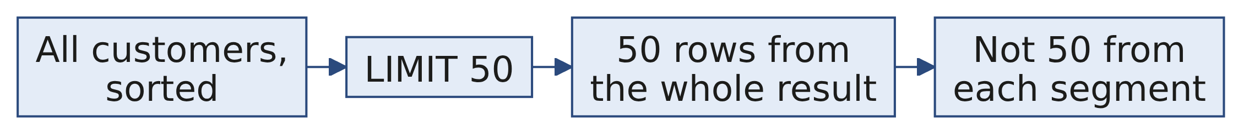
S5
Adding LIMIT does not fix it
LIMIT 50 takes fifty rows from the whole result, not fifty from each segment.
There is no clause you have met that says "the best fifty within each group". That is the gap.
Week 2, Day 3. Top members, falling spend, and the running total against plan
7 / 30

Slide 8
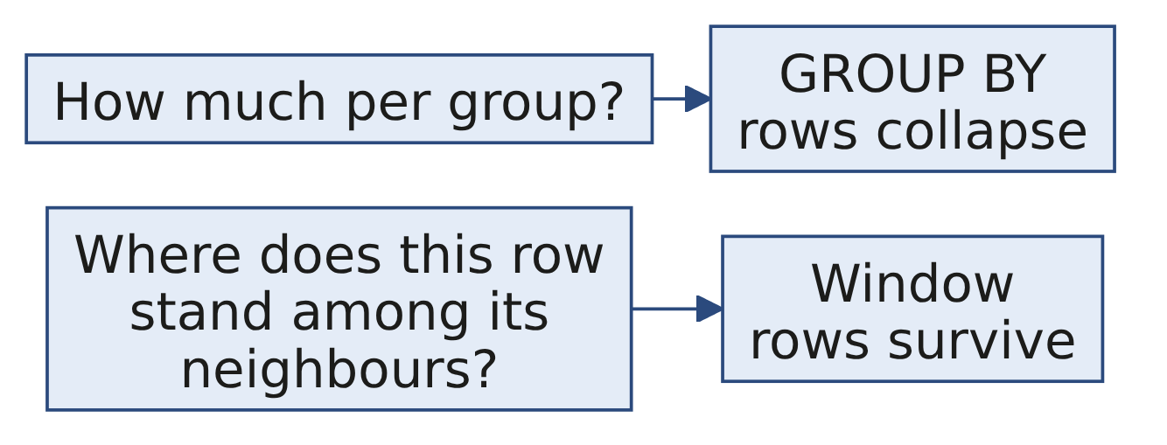
S6
The two shapes of question
Week 2, Day 3. Top members, falling spend, and the running total against plan
8 / 30

Slide 9
S7
A window keeps every row and adds a column
SELECT customer_id, revenue,
rank() OVER (ORDER BY revenue DESC) AS position
FROM q2_spend;
Nothing collapsed. Each row gained a fact about where it sits.
Week 2, Day 3. Top members, falling spend, and the running total against plan
9 / 30

Slide 10
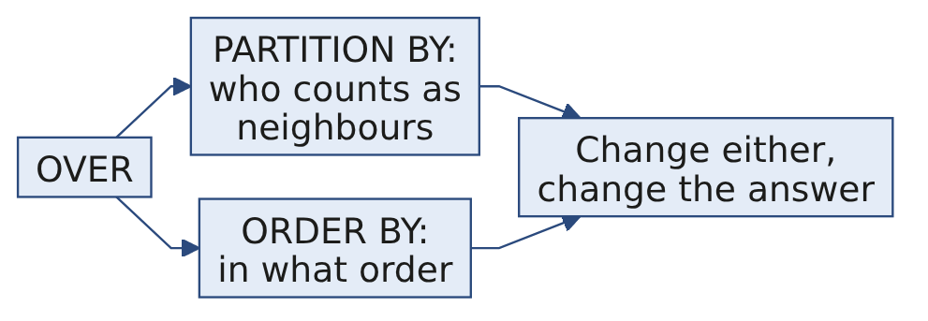
D1
OVER is the whole idea, and it has two dials
DEPTH
PARTITION BY says which rows count as neighbours. ORDER BY inside the window says in what
order they are considered.
Change either and the answer changes. They are not decoration on a function name; they are the
definition of the question.
Week 2, Day 3. Top members, falling spend, and the running total against plan
10 / 30

Slide 11
SECTION C. Ranking, and the tie
Week 2, Day 3. Top members, falling spend, and the running total against plan
11 / 30

Slide 12
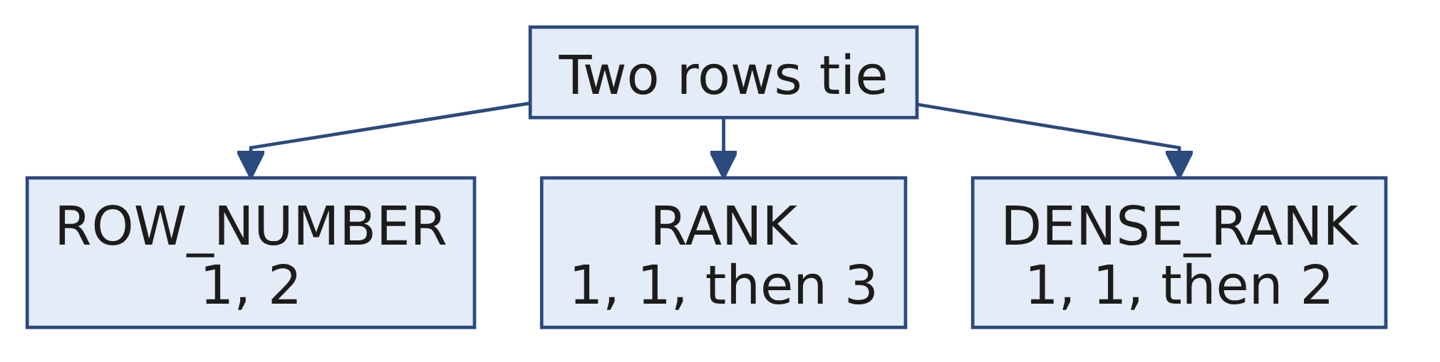
S8
Three ranking functions, one tie
Week 2, Day 3. Top members, falling spend, and the running total against plan
12 / 30

Slide 13
S9
What each one does, in words
Function | On a tie | After the tie
ROW_NUMBER | Breaks it arbitrarily | Continues, 1 2 3
RANK | Gives both the same | Skips, 1 1 3
DENSE_RANK | Gives both the same | Does not skip, 1 1 2
ROW_NUMBER is the only one that is not repeatable: run it twice on a tie and it can swap them.
Week 2, Day 3. Top members, falling spend, and the running total against plan
13 / 30

Slide 14
S10
Our data has a tie at exactly the wrong place
Two Retail-Plus members have identical Q2 revenue, and they sit at positions fifty and fifty-one.
Not a coincidence engineered for a slide. It is what happens when fifty is a round number somebody
picked.
Week 2, Day 3. Top members, falling spend, and the running total against plan
14 / 30

Slide 15
S11
So how many rows does the top fifty ship?
Depends entirely on the function.
Week 2, Day 3. Top members, falling spend, and the running total against plan
15 / 30

Slide 16
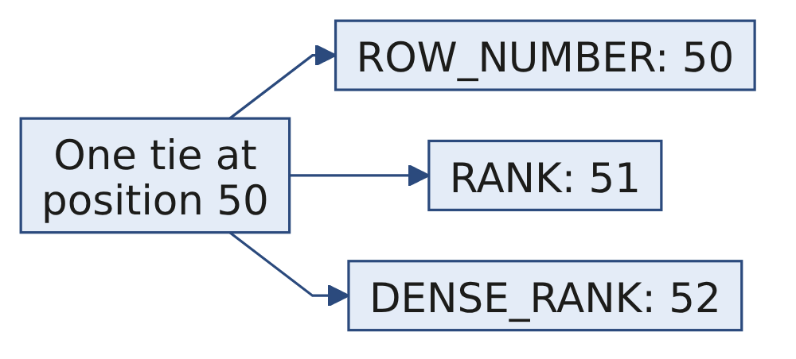
S12
Answer: fifty, fifty-one or fifty-two
Filter | Rows shipped
ROW_NUMBER <= 50 | 50
RANK <= 50 | 51
DENSE_RANK <= 50 | 52
Three defensible answers to one question. Only one matches what the head of Retail-Plus asked for.
Week 2, Day 3. Top members, falling spend, and the running total against plan
16 / 30

Slide 17
D2
He told you the answer before you asked
DEPTH
"If two members spent the same, I want them ranked the same, and I want to know how many made
the top fifty, not forty-nine because of a tie."
Ranked the same rules out ROW_NUMBER. Not forty-nine rules out cutting the tie. RANK at 50
ships fifty-one names, and the extra name is the point rather than a rounding error.
Write that sentence in the query as a comment. The next person will not have heard him say it.
Week 2, Day 3. Top members, falling spend, and the running total against plan
17 / 30

Slide 18
S13
Top-N within a group needs PARTITION BY
SELECT * FROM (
SELECT c.segment, o.customer_id, sum(o.amount) AS revenue,
rank() OVER (PARTITION BY c.segment ORDER BY sum(o.amount) DESC) AS pos
FROM orders o JOIN customers c USING (customer_id)
WHERE o.quarter = 'Q2'
GROUP BY c.segment, o.customer_id
) t WHERE pos <= 50;
PARTITION BY restarts the numbering for each segment.
Week 2, Day 3. Top members, falling spend, and the running total against plan
18 / 30

Slide 19
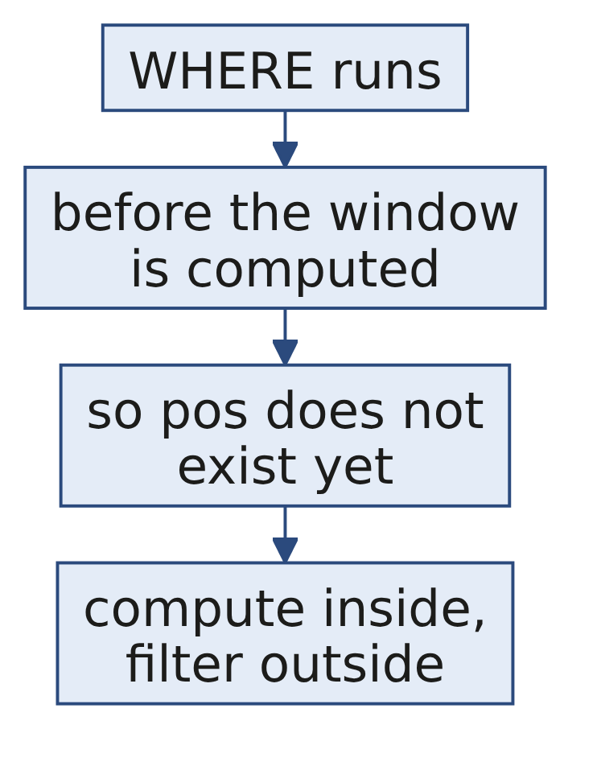
S14
Notice the query had to be wrapped
ERROR: window functions are not allowed in WHERE
WHERE runs before the window is computed, which is Monday's execution order again. The fix is to
compute the window in an inner query or a CTE, then filter outside it.
Week 2, Day 3. Top members, falling spend, and the running total against plan
19 / 30

Slide 20
SECTION D. Looking sideways
Week 2, Day 3. Top members, falling spend, and the running total against plan
20 / 30

Slide 21
S15
LAG reads the previous row
SELECT customer_id, month, spend,
lag(spend) OVER (PARTITION BY customer_id ORDER BY month) AS prev
FROM monthly;
For each row, the value from the row before it, within the same customer, in month order.
Week 2, Day 3. Top members, falling spend, and the running total against plan
21 / 30

Slide 22
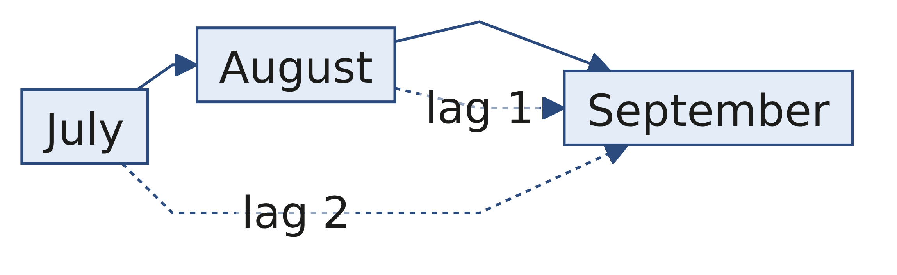
S16
"Fallen for two months running" is two LAGs
Keep the row where July is above August and August is above September. Three members qualify.
Week 2, Day 3. Top members, falling spend, and the running total against plan
22 / 30

Slide 23
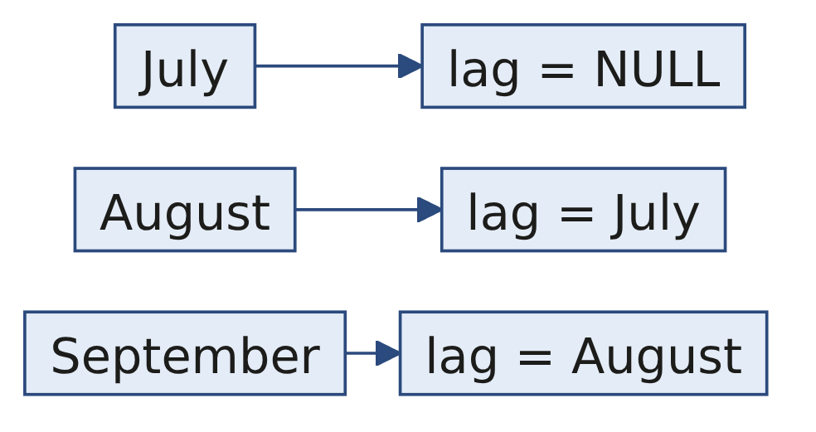
S17
The first month of every customer returns NULL
There is no previous row, so lag has nothing to give. That is correct behaviour and it will
quietly drop customers from your flag if you compare without thinking about it.
Decide out loud whether a customer with one month of data is falling. The honest answer is that
you cannot tell.
Week 2, Day 3. Top members, falling spend, and the running total against plan
23 / 30

Slide 24
D3
What you would say to the member who was on holiday
DEPTH
Marketing will act on this list, and somebody on it will object that they were away in August.
They are right, and the flag is still correct. A flag is a shortlist for a conversation rather
than a verdict, and the sentence that makes it usable is "three months of falling spend, worth a
call, not worth an assumption".
Week 2, Day 3. Top members, falling spend, and the running total against plan
24 / 30

Slide 25
S18
A running total accumulates without collapsing
SELECT week_start, revenue,
sum(revenue) OVER (ORDER BY week_start) AS cumulative
FROM weekly;
Every week keeps its own row and gains the total so far.
Week 2, Day 3. Top members, falling spend, and the running total against plan
25 / 30

Slide 26
S19
A running total is only deterministic if its order is
If two rows share a week_start, their relative order is undefined, so the cumulative column can
differ between runs.
Add a tiebreaker to the window's ORDER BY. A number that changes between runs is worse than a
number that is wrong, because nobody can reproduce the argument about it.
Week 2, Day 3. Top members, falling spend, and the running total against plan
26 / 30

Slide 27
SECTION E. What you hand over
Week 2, Day 3. Top members, falling spend, and the running total against plan
27 / 30

Slide 28
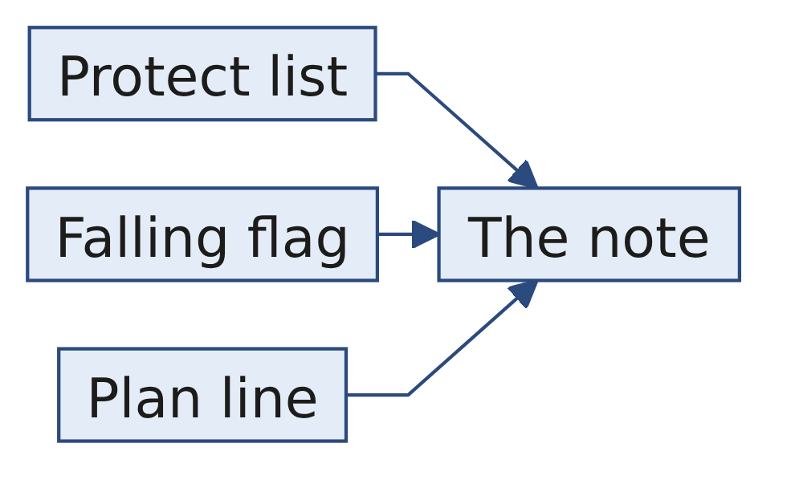
S20
Three deliverables, one note
Piece | What it carries
The protect list | Top fifty per segment, RANK, fifty-one Retail-Plus names
The falling flag | Three members, with their three monthly figures
The plan line | Weekly revenue and cumulative, against plan
The note | Which tie rule you chose, and the sentence that decided it
Week 2, Day 3. Top members, falling spend, and the running total against plan
28 / 30

Slide 29
S21
What today equipped you to answer
[S] RANK, DENSE_RANK and ROW_NUMBER on a tie.
[S] Top-3 per group: GROUP BY or a window, and why?
[F] How would you find customers whose spend fell two months in a row?
[F] Why can a window function not sit inside WHERE, and what do you do instead?
[D] The business says 'ties rank the same'; which function, and how many rows might the top-N
report ship?
Week 2, Day 3. Top members, falling spend, and the running total against plan
29 / 30

Slide 30
S22
Tomorrow
The growth team wants one table, one row per customer, refreshed every Monday. In pandas, because
Marketing's analysts live in Python.
Week 2, Day 3. Top members, falling spend, and the running total against plan
30 / 30

