Slide 1


Indian Institute of Technology Gandhinagar
ADMINISTERED THROUGH THE COMPETENCY ADVANCEMENT ACADEMY
WEEK 1 · WEDNESDAY · HALF TWO
The reconciliation Anand can audit
“Send the reconciliation and the log before the day closes. My analyst checks it tonight.”
Anand Iyer, finance controller, Kalpa Retail
01
The log the analyst audits
02
The escalated case
03
The room's wrong answers
04
The second case, in pairs
05
The interview drill
Week 1, Day 3. The reconciliation Anand can audit
1 / 31
Notes:
LIVE, one minute. Chapter 6 first, then the full pass alone, the debrief of the room's wrong
answers, the auditor in pairs, the interview drill and the close.

Slide 2
Indian Institute of Technology Gandhinagar
PG DIPLOMA IN AI-ML AND AGENTIC AI ENGINEERING · COHORT 2
ADMINISTERED THROUGH THE COMPETENCY ADVANCEMENT ACADEMY
01
The log the analyst audits
A log is finished when a stranger can replay it.
The log the analyst audits
The escalated case
The room's wrong answers
The second case, in pairs
The interview drill
The close
Week 1 Day 3: which Q1 figure is right
2 / 31
Notes:
LIVE. Thirty minutes. Notebook C2_W01_D03_06_audit_logs is the demonstration. Say it is chapter 6:
the numeral on screen reads 01 because it opens this deck.

Slide 3


Indian Institute of Technology Gandhinagar
WEEK 1 · DAY 3 · KALPA GLOBAL CAPABILITY CENTRE
ADMINISTERED THROUGH THE COMPETENCY ADVANCEMENT ACADEMY
The need: control totals and a reason per row
The analyst checks tonight; an auditor may ask next quarter.
rows and rupees
the analyst
a week
THE METRIC
WHO ASKS
A LOG SHE CANNOT FOLLOW
control totals, export to books
for Anand
of questions, and her trust
THE CLIENT ASKS
"Can my analyst follow every decision you made, and rebuild your file from it?"
The log the analyst audits
The escalated case
The room's wrong answers
The second case, in pairs
The interview drill
The close
S1 · 3 / 31
Notes:
LIVE, 3 minutes. A log that ties in rows and misses in rupees costs the team her trust in
everything else it sends.

Slide 4

Indian Institute of Technology Gandhinagar
WEEK 1 · DAY 3 · KALPA GLOBAL CAPABILITY CENTRE
ADMINISTERED THROUGH THE COMPETENCY ADVANCEMENT ACADEMY
Patisserie Valerie's auditor missed the red flags
A UK cafe chain's accounting hole reached £94m; the auditor was fined.
£94m
£4m
3 years
THE HOLE
FRC FINE
OF AUDITS
administrators, March 2019
reduced to £2.34m
sanctioned in September 2021
WHAT BREAKS
An auditor who cannot trace a number to its rows signs off on it anyway, and pays for it later.
The log the analyst audits
The escalated case
The room's wrong answers
The second case, in pairs
The interview drill
The close
S2 · 4 / 31
Notes:
LIVE, 2 minutes. Sources checked 30 Sep 2026: BBC News, 15 March 2019; FRC, 27 September 2021. The
criminal case against individuals is unresolved, so name no person and say nobody was convicted.

Slide 5

Indian Institute of Technology Gandhinagar
WEEK 1 · DAY 3 · KALPA GLOBAL CAPABILITY CENTRE
ADMINISTERED THROUGH THE COMPETENCY ADVANCEMENT ACADEMY
Four hand-overs, sized for the analyst
Lines to read at an illustrative 30 seconds a line.
Option | Lines | Ties rows | Ties rupees | Replayable
a) The clean file alone | 387 | no | no | no
b) The file and a count | 1 | yes | no | no
c) Logs and control totals | 23 | yes | yes | yes
d) A full diff | 201 | yes | no | no
KAVYA'S REVIEW
c. What would switch it: an external auditor who must re-derive every row, and then d goes beside c.
The log the analyst audits
The escalated case
The room's wrong answers
The second case, in pairs
The interview drill
The close
S3 · 5 / 31
Notes:
LIVE, 5 minutes. 23 lines: 15 set-aside rows, 1 flag, 5 decisions, 2 control totals, and an empty
rejects log. Options a and d cost over an hour and still say nothing about why.

Slide 6
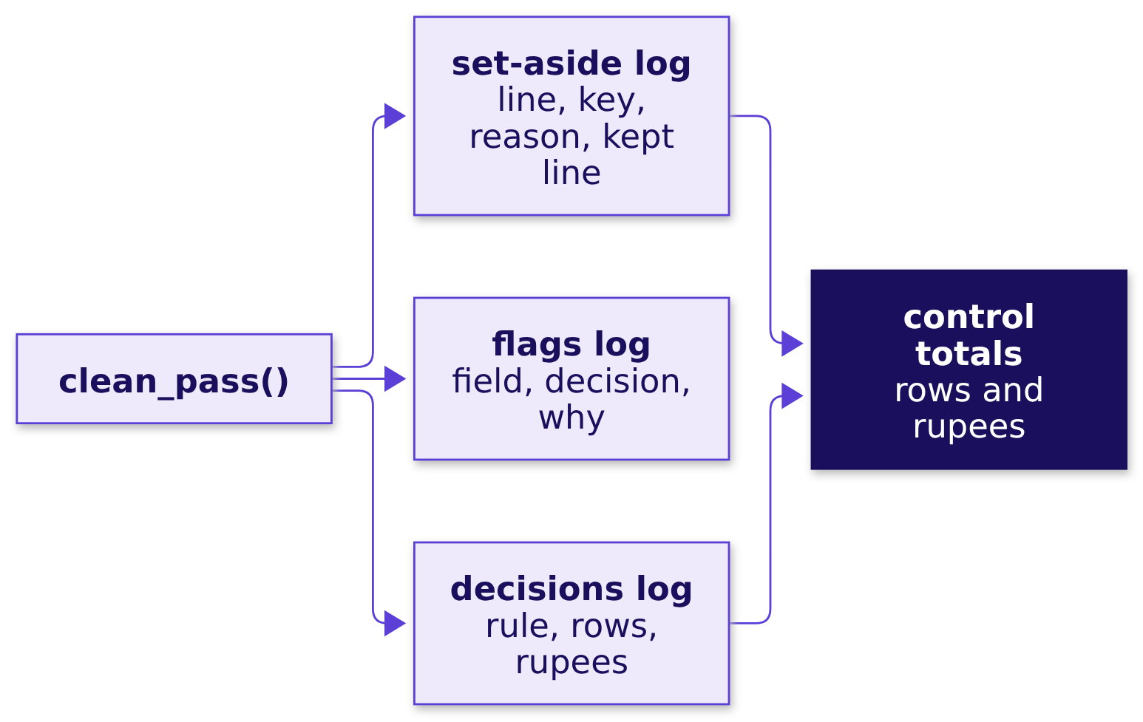
Indian Institute of Technology Gandhinagar
WEEK 1 · DAY 3 · KALPA GLOBAL CAPABILITY CENTRE
ADMINISTERED THROUGH THE COMPETENCY ADVANCEMENT ACADEMY
What the logs carry
Three logs and two totals, written as the pass runs.
The log the analyst audits
The escalated case
The room's wrong answers
The second case, in pairs
The interview drill
The close
S4 · 6 / 31
Notes:
LIVE, 3 minutes. The decisions log has five lines; only the identity rule moves Q1 rupees, all
Rs 19,98,210, and every other decision still gets its line.

Slide 7
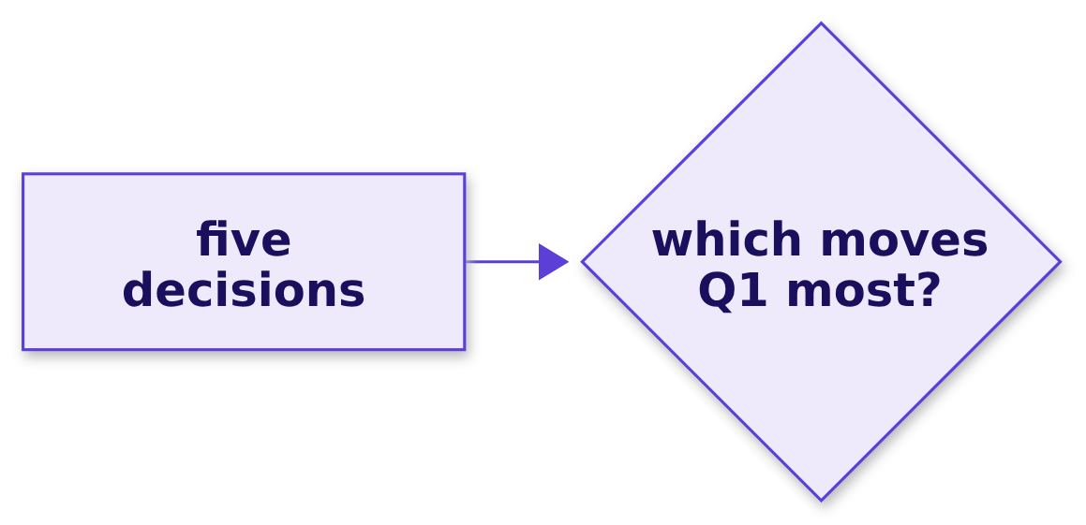
Indian Institute of Technology Gandhinagar
WEEK 1 · DAY 3 · KALPA GLOBAL CAPABILITY CENTRE
ADMINISTERED THROUGH THE COMPETENCY ADVANCEMENT ACADEMY
Question: which decision moves the most rupees?
Five decisions in the log, one line each.
Question. As a letter? a) the identity rule; b) the missing status; c) the bulk order; d) the missing discount.
The log the analyst audits
The escalated case
The room's wrong answers
The second case, in pairs
The interview drill
The close
S5 · 7 / 31
Notes:
LIVE, 2 minutes. Letters in chat.

Slide 8
Indian Institute of Technology Gandhinagar
WEEK 1 · DAY 3 · KALPA GLOBAL CAPABILITY CENTRE
ADMINISTERED THROUGH THE COMPETENCY ADVANCEMENT ACADEMY
Answer: the identity rule moves all of it
Four decisions move no Q1 rupees, and each still gets a line.
-Rs 19,98,210
Rs 0
THE IDENTITY RULE
THE OTHER FOUR
15 rows
57 rows flagged or kept
What changed. The answer is a. The logs are written with csv.DictWriter and json.dump, then read back and compared, because a log that lives only in a notebook reaches nobody.
The log the analyst audits
The escalated case
The room's wrong answers
The second case, in pairs
The interview drill
The close
S6 · 8 / 31
Notes:
LIVE, 3 minutes. In the notebook, read_orders() would overwrite the log's own line column, so the
log is read back with a plain DictReader. Point that out if a learner trips on it.

Slide 9
Indian Institute of Technology Gandhinagar
WEEK 1 · DAY 3 · KALPA GLOBAL CAPABILITY CENTRE
ADMINISTERED THROUGH THE COMPETENCY ADVANCEMENT ACADEMY
The plausible wrong answer: a perfect-looking log
A colleague removed repeated ids first, keeping the first copy, then converted.
201 = 185 + 16
Rs 20,00,000
Rs 1,89,98,210
ROWS RECONCILE
Q1 SET ASIDE
Q1 CLEAN
in equals kept plus logged
Anand's gap, to the lakh
1.90 crore when rounded
The log the analyst audits
The escalated case
The room's wrong answers
The second case, in pairs
The interview drill
The close
S7 · 9 / 31
Notes:
LIVE, 3 minutes, notebook 06, section 3. Ask whether the room would send this. Round Rs 20 lakh
set aside feels like proof.

Slide 10
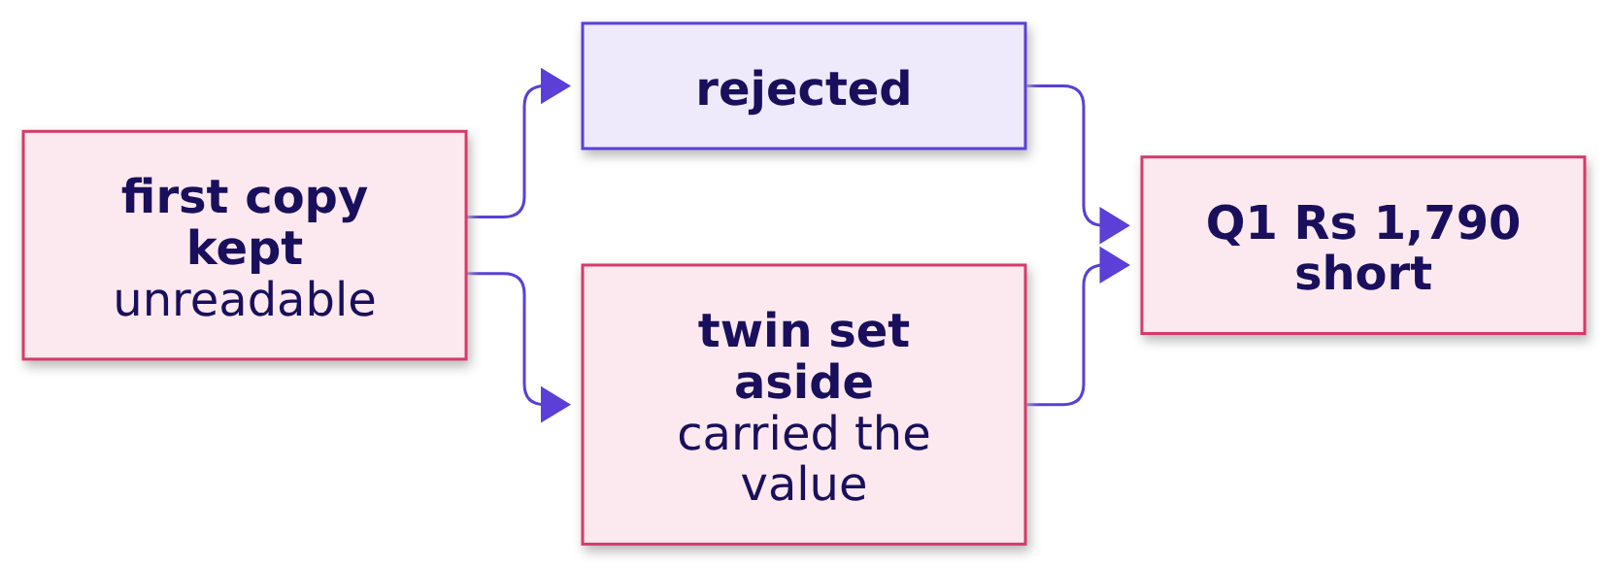
Indian Institute of Technology Gandhinagar
WEEK 1 · DAY 3 · KALPA GLOBAL CAPABILITY CENTRE
ADMINISTERED THROUGH THE COMPETENCY ADVANCEMENT ACADEMY
Why it is wrong: rows tie, rupees do not
Rs 1,790 short of the books: the valued copy set aside, the unreadable one rejected.
The check. The books against the clean Q1, and a rejected order whose twin sits in the set-aside log with a value.
The log the analyst audits
The escalated case
The room's wrong answers
The second case, in pairs
The interview drill
The close
S8 · 10 / 31
Notes:
LIVE, 3 minutes. A row reconciliation proves nothing vanished; it cannot prove the right rows
stayed. The colleague's bridge closes on its own file and misses the books.

Slide 11
Indian Institute of Technology Gandhinagar
WEEK 1 · DAY 3 · KALPA GLOBAL CAPABILITY CENTRE
ADMINISTERED THROUGH THE COMPETENCY ADVANCEMENT ACADEMY
The fix, and the auditor's 14
Convert inside the identity rule; then every Q1 row set aside has a kept twin.
114 = 100 + 14
14 of 14
Rs 0
Q1 ROWS
WITH A KEPT TWIN
AGAINST THE BOOKS
in, kept, set aside
same order_id
Q1 clean
What changed. The Rs 1,790 order is back, the rejects log is empty, and "set aside with a reason" replaces "dropped".
The log the analyst audits
The escalated case
The room's wrong answers
The second case, in pairs
The interview drill
The close
S9 · 11 / 31
Notes:
LIVE, 3 minutes. The second case after the break walks this in pairs.

Slide 12
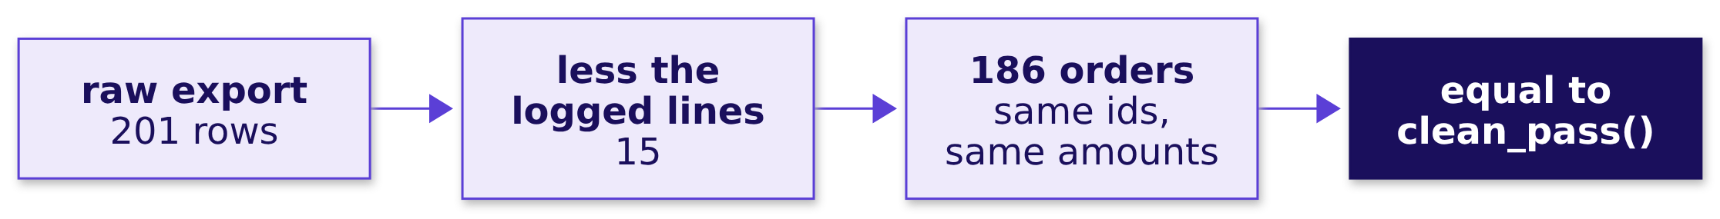
Indian Institute of Technology Gandhinagar
WEEK 1 · DAY 3 · KALPA GLOBAL CAPABILITY CENTRE
ADMINISTERED THROUGH THE COMPETENCY ADVANCEMENT ACADEMY
A second route: replay the log
The raw export less the logged lines rebuilds the clean file exactly.
When to switch. Control totals are the quick test; the replay is for an auditor who trusts nothing, and it runs before any log leaves the team.
The log the analyst audits
The escalated case
The room's wrong answers
The second case, in pairs
The interview drill
The close
S10 · 12 / 31
Notes:
LIVE, 3 minutes. Notebook 06 asserts the replay equals the clean file.

Slide 13



Indian Institute of Technology Gandhinagar
WEEK 1 · DAY 3 · KALPA GLOBAL CAPABILITY CENTRE
ADMINISTERED THROUGH THE COMPETENCY ADVANCEMENT ACADEMY
Kavya's review of chapter 6
Rows and rupees both tie, a reason on every line, the twin named for every copy.
KAVYA'S REVIEW
A log is finished when a stranger can replay it.
IN THE INTERVIEW
[D] An auditor asks why you dropped 14 rows; walk them through it.
CHAPTER 6
THE ESCALATED CASE
Established
Next
Logs that tie in rows and rupees and replay to the clean file.
The whole pass, alone.
The log the analyst audits
The escalated case
The room's wrong answers
The second case, in pairs
The interview drill
The close
S11 · 13 / 31
Notes:
LIVE, 2 minutes. One breath: set aside, not dropped; the rule, the twin, the rupees by segment,
both totals tie and the log replays.

Slide 14
Indian Institute of Technology Gandhinagar
PG DIPLOMA IN AI-ML AND AGENTIC AI ENGINEERING · COHORT 2
ADMINISTERED THROUGH THE COMPETENCY ADVANCEMENT ACADEMY
02
The escalated case
The full pass, alone: every chapter, on the same file, with nobody driving.
The log the analyst audits
The escalated case
The room's wrong answers
The second case, in pairs
The interview drill
The close
Week 1 Day 3: which Q1 figure is right
14 / 31
Notes:
LIVE. Fifty minutes unguided. The notebook is ex1_escalated_case, a TODO twin with eight lettered
choices; the brief is in exercises/unguided.

Slide 15
Indian Institute of Technology Gandhinagar
WEEK 1 · DAY 3 · KALPA GLOBAL CAPABILITY CENTRE
ADMINISTERED THROUGH THE COMPETENCY ADVANCEMENT ACADEMY
Anand's deadline, and what goes with it
Five parts, one file, and a log that has to stand up tonight.
PART 1
PART 2
PART 3
PART 4
PART 5
Read and profile
Convert with a log
The identity rule
Two decisions
Reconcile and recompute
Rows, distinct orders, and the three counts for every field.
Every amount that fails, set aside with its line and reason.
One row per order, and the copy that validates stays.
The missing status and the largest order, each with a reason.
Rows and rupees to the books, the bridge, Tuesday, the note.
THE CLIENT ASKS
"Which figure is right, the proof in rows and in rupees, and every decision in a log my analyst can follow."
The log the analyst audits
The escalated case
The room's wrong answers
The second case, in pairs
The interview drill
The close
S12 · 15 / 31
Notes:
LIVE, 3 minutes. Eight notebook letters, ten brief letters, then the note in under 120 words.
Watch for rows totalled before profiling, a first-copy dedupe, and a bridge that closes to 1.9
only after rounding.

Slide 16
Indian Institute of Technology Gandhinagar
WEEK 1 · DAY 3 · KALPA GLOBAL CAPABILITY CENTRE
ADMINISTERED THROUGH THE COMPETENCY ADVANCEMENT ACADEMY
The checks you post with your letters
Every check in the notebook passes before the letters go into chat.
186 + 15
Rs 1,90,00,000
Rs 1,87,00,000
-35.0%
ROWS
Q1 CLEAN
Q2 CLEAN
RETAIL-PLUS
kept and set aside, of 201
the books, to the rupee
every real order kept
orders per customer, clean
The log the analyst audits
The escalated case
The room's wrong answers
The second case, in pairs
The interview drill
The close
S13 · 16 / 31
Notes:
SELF-STUDY, reference while working. A Q1 of Rs 1,89,98,210 kept the wrong copy; a Q2 of
Rs 1,57,54,540 removed the bulk order. Both are debriefed next.

Slide 17
Indian Institute of Technology Gandhinagar
PG DIPLOMA IN AI-ML AND AGENTIC AI ENGINEERING · COHORT 2
ADMINISTERED THROUGH THE COMPETENCY ADVANCEMENT ACADEMY
03
The room's wrong answers
Fifteen minutes on the numbers the room produced, each traced to the step that made it.
The log the analyst audits
The escalated case
The room's wrong answers
The second case, in pairs
The interview drill
The close
Week 1 Day 3: which Q1 figure is right
17 / 31
Notes:
LIVE. Put the most common wrong number on the screen first. Name no learner; name the step.

Slide 18
Indian Institute of Technology Gandhinagar
WEEK 1 · DAY 3 · KALPA GLOBAL CAPABILITY CENTRE
ADMINISTERED THROUGH THE COMPETENCY ADVANCEMENT ACADEMY
Six wrong numbers, six steps
Every wrong figure the room produces comes from one of the day's traps.
The number on the screen | The step that made it | The check
Largest Q2 order Rs 970 | Sorting amounts as text | Below every Business order
0 duplicates | The line in the whole-record key | 201 rows, 186 ids
188 orders, Q2 Rs 1,87,03,710 | Record less line; Q1 tied, so stop | Rows against ids
201 of 201 convert | Failures coerced to zero | An order worth Rs 0
Q2 Rs 1,57,54,540, -17.1% | The bulk order fenced out | A real Business account
201 = 185 + 16, Q1 Rs 1,89,98,210 | Keep first, then convert | Rs 1,790 short of the books
The log the analyst audits
The escalated case
The room's wrong answers
The second case, in pairs
The interview drill
The close
S14 · 18 / 31
Notes:
LIVE, 10 minutes. For each, ask a pair that produced it which line of code made it. Each wrong
number was plausible and one check away.

Slide 19
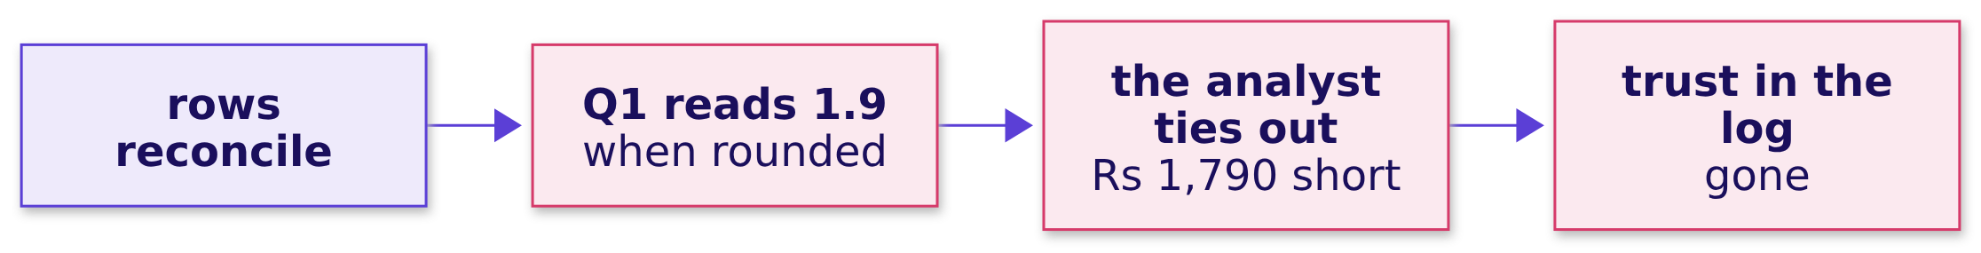
Indian Institute of Technology Gandhinagar
WEEK 1 · DAY 3 · KALPA GLOBAL CAPABILITY CENTRE
ADMINISTERED THROUGH THE COMPETENCY ADVANCEMENT ACADEMY
The one most rooms miss
Rounding is where reconciliations go to hide.
KAVYA'S REVIEW
Compare to the rupee, then round for the note.
The log the analyst audits
The escalated case
The room's wrong answers
The second case, in pairs
The interview drill
The close
S15 · 19 / 31
Notes:
LIVE, 5 minutes. If nobody produced it, show it from chapter 6. Then the 10-minute break.

Slide 20
Indian Institute of Technology Gandhinagar
PG DIPLOMA IN AI-ML AND AGENTIC AI ENGINEERING · COHORT 2
ADMINISTERED THROUGH THE COMPETENCY ADVANCEMENT ACADEMY
04
The second case, in pairs
The auditor asks why 14 rows were dropped, and the answer comes from the log.
The log the analyst audits
The escalated case
The room's wrong answers
The second case, in pairs
The interview drill
The close
Week 1 Day 3: which Q1 figure is right
20 / 31
Notes:
LIVE. Forty minutes in pairs: one drives ex2_auditor, the other plays the auditor and asks the next
question only when the check passes. Swap halfway.

Slide 21
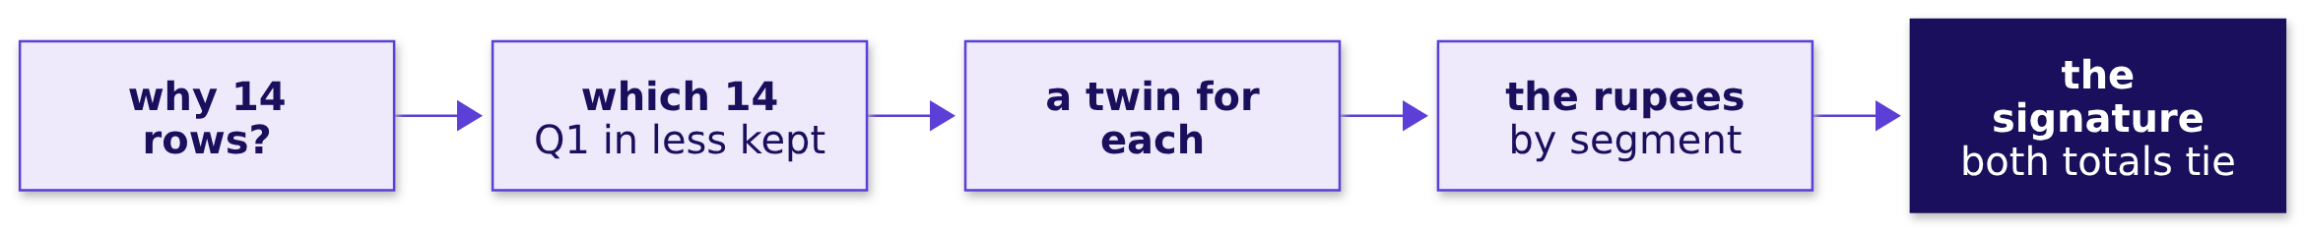
Indian Institute of Technology Gandhinagar
WEEK 1 · DAY 3 · KALPA GLOBAL CAPABILITY CENTRE
ADMINISTERED THROUGH THE COMPETENCY ADVANCEMENT ACADEMY
The auditor's question
"Your log says 14 Q1 rows were dropped. Why those 14, and how do I know nothing else went?"
The log the analyst audits
The escalated case
The room's wrong answers
The second case, in pairs
The interview drill
The close
S16 · 21 / 31
Notes:
LIVE, 3 minutes. "Dropped" is the word to correct.

Slide 22
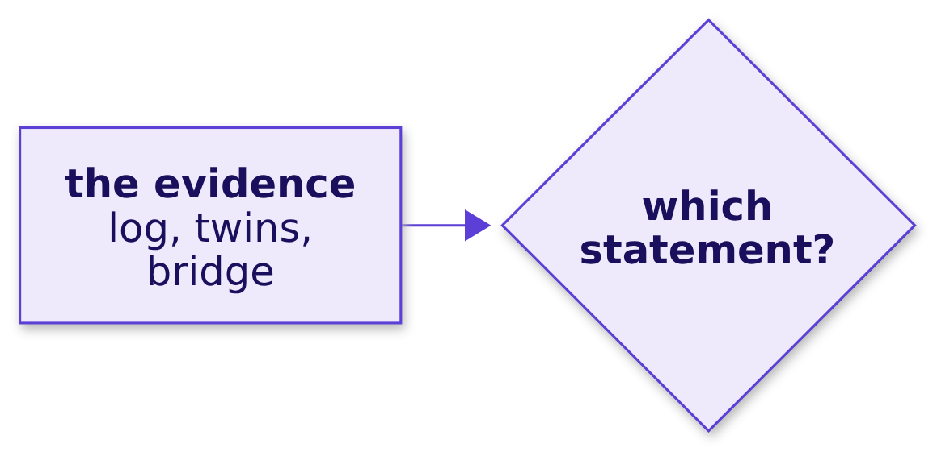
Indian Institute of Technology Gandhinagar
WEEK 1 · DAY 3 · KALPA GLOBAL CAPABILITY CENTRE
ADMINISTERED THROUGH THE COMPETENCY ADVANCEMENT ACADEMY
Question: which statement does the auditor sign?
Four statements, one supported by the evidence.
Question. As a letter? a) 14 Q1 rows were deleted as errors; b) the dashboard was right and the books are short; c) 14 Q1 rows are second copies set aside by the order_id rule, and rows and rupees reconcile; d) the 14 rows were outliers.
The log the analyst audits
The escalated case
The room's wrong answers
The second case, in pairs
The interview drill
The close
S17 · 22 / 31
Notes:
LIVE, 2 minutes, after pairs finish question 5.

Slide 23
Indian Institute of Technology Gandhinagar
WEEK 1 · DAY 3 · KALPA GLOBAL CAPABILITY CENTRE
ADMINISTERED THROUGH THE COMPETENCY ADVANCEMENT ACADEMY
Answer: copies set aside, both totals tie
The statement names the rule, the evidence and both reconciliations.
114 = 100 + 14
14 of 14
Rs 19,98,210
Q1 ROWS
WITH A KEPT TWIN
SET-ASIDE RUPEES
in, kept, set aside
same order_id
98% in two corporate rows
KAVYA'S REVIEW
"Dropped" is the auditor's word; "set aside with a reason" is yours.
The log the analyst audits
The escalated case
The room's wrong answers
The second case, in pairs
The interview drill
The close
S18 · 23 / 31
Notes:
LIVE, 3 minutes. The answer is c.

Slide 24
Indian Institute of Technology Gandhinagar
PG DIPLOMA IN AI-ML AND AGENTIC AI ENGINEERING · COHORT 2
ADMINISTERED THROUGH THE COMPETENCY ADVANCEMENT ACADEMY
05
The interview drill
Twelve questions aloud, the design question among them, each in under ninety seconds.
The log the analyst audits
The escalated case
The room's wrong answers
The second case, in pairs
The interview drill
The close
Week 1 Day 3: which Q1 figure is right
24 / 31
Notes:
LIVE. Twenty minutes. Pairs: one asks, one answers, the asker times it and names the one number
the answer should have used. Swap every three questions.

Slide 25
Indian Institute of Technology Gandhinagar
WEEK 1 · DAY 3 · KALPA GLOBAL CAPABILITY CENTRE
ADMINISTERED THROUGH THE COMPETENCY ADVANCEMENT ACADEMY
The row's five, asked everywhere
The questions analytics screens ask of anyone who has cleaned a file.
Tag | Question
[S] | How do you handle missing data?
[S] | Finance and your dashboard disagree; what do you do?
[F] | How do you find duplicates, and what makes two records the same?
[F] | Everything read from a CSV is a string; what breaks and where do you convert?
[D] | An auditor asks why you dropped 14 rows; walk them through it.
The log the analyst audits
The escalated case
The room's wrong answers
The second case, in pairs
The interview drill
The close
S19 · 25 / 31
Notes:
LIVE, 10 minutes. The shape of every answer: the rule, today's number, the check. Full answers in
the study notes and the notebooks' In the interview sections.

Slide 26
Indian Institute of Technology Gandhinagar
WEEK 1 · DAY 3 · KALPA GLOBAL CAPABILITY CENTRE
ADMINISTERED THROUGH THE COMPETENCY ADVANCEMENT ACADEMY
Seven follow-ups, the design questions among them
Each is a chapter's trap or its options, asked as a case.
Tag | Question
[F] | A dedupe returns zero. Do you believe it?
[F] | Your row counts reconcile. Are you done?
[S] | The largest order is 1.66 times the next. Remove it?
[D] | Order id, whole record or fuzzy, for customers from two apps?
[D] | Coerce, reject or repair a malformed amount, and what would switch you?
[D] | Bridge or rebuild from a second source to prove a figure?
[SV] | Walk me through cleaning a file you have never seen.
The log the analyst audits
The escalated case
The room's wrong answers
The second case, in pairs
The interview drill
The close
S20 · 26 / 31
Notes:
LIVE, 10 minutes. The design questions want a choice, a sizing and the fact that would change it.

Slide 27
Indian Institute of Technology Gandhinagar
PG DIPLOMA IN AI-ML AND AGENTIC AI ENGINEERING · COHORT 2
ADMINISTERED THROUGH THE COMPETENCY ADVANCEMENT ACADEMY
06
The close
The sentence to Anand, the lines worth keeping, and tomorrow's question.
The log the analyst audits
The escalated case
The room's wrong answers
The second case, in pairs
The interview drill
The close
Week 1 Day 3: which Q1 figure is right
27 / 31
Notes:
LIVE. Fifteen minutes: the Kahoot, then this chapter.

Slide 28
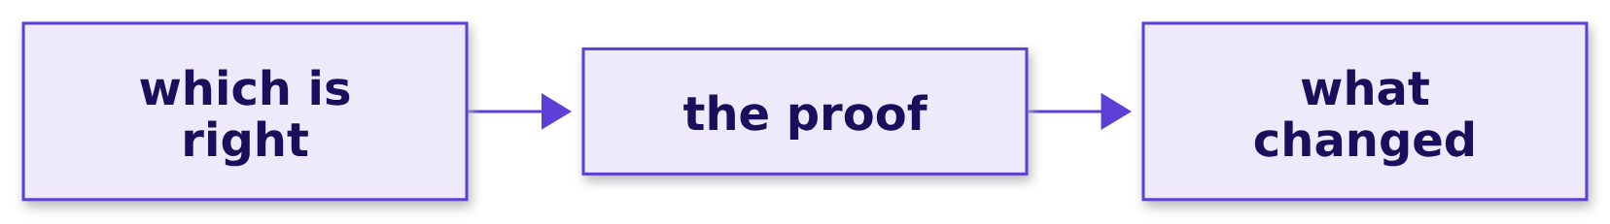
Indian Institute of Technology Gandhinagar
WEEK 1 · DAY 3 · KALPA GLOBAL CAPABILITY CENTRE
ADMINISTERED THROUGH THE COMPETENCY ADVANCEMENT ACADEMY
The sentence to Anand
Which figure is right, the proof, and what changed downstream.
"Your 1.9 crore is right: the export counted fifteen rows twice, and the bridge from 2.1 closes to your books in rows and in rupees. On clean data the drop is 1.6 percent and the Retail-Plus fall is 35 percent, smaller than we reported."
The GCC data and AI team
The log the analyst audits
The escalated case
The room's wrong answers
The second case, in pairs
The interview drill
The close
S21 · 28 / 31
Notes:
LIVE, 2 minutes. Read it aloud once.

Slide 29
Indian Institute of Technology Gandhinagar
WEEK 1 · DAY 3 · KALPA GLOBAL CAPABILITY CENTRE
ADMINISTERED THROUGH THE COMPETENCY ADVANCEMENT ACADEMY
The six lines worth keeping
The cheat sheet prints these word for word.
 | The line
1 | Profile before you total: present, convertible, distinct, for every field.
2 | Say what makes two rows one order before you count duplicates.
3 | Keep the copy that validates, and log every row you set aside.
4 | A failure is logged, never turned into a number; large is not wrong.
5 | Reconcile twice, in rows and in rupees, to the books.
6 | Recompute what you reported, and say what changed, the smaller number first.
The log the analyst audits
The escalated case
The room's wrong answers
The second case, in pairs
The interview drill
The close
S22 · 29 / 31
Notes:
LIVE, 3 minutes. One line per chapter. Tonight's take-home tests every line on an export nobody
in the room has seen.

Slide 30
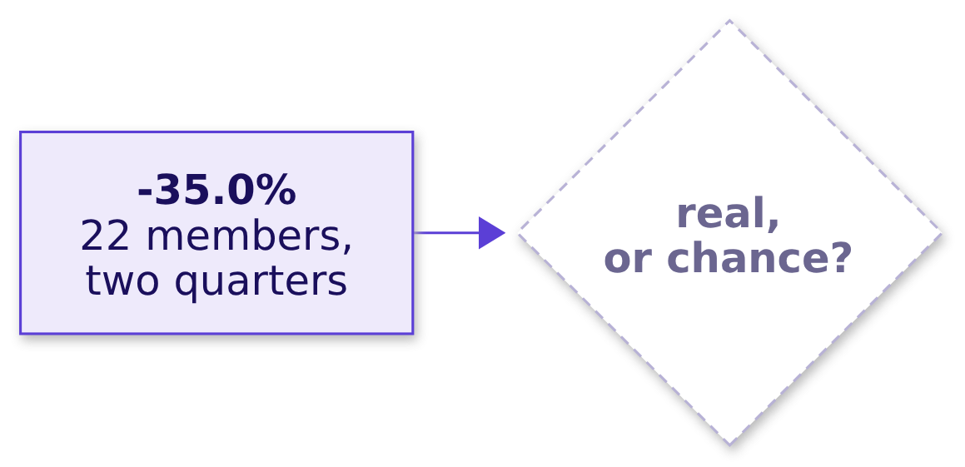
Indian Institute of Technology Gandhinagar
WEEK 1 · DAY 3 · KALPA GLOBAL CAPABILITY CENTRE
ADMINISTERED THROUGH THE COMPETENCY ADVANCEMENT ACADEMY
Tomorrow's question, left open
The Retail-Plus fall survived cleaning. Is it real, or the wobble every quarter shows?
THE CLIENT ASKS
"Retail-Plus is down, smaller than first reported. Real, or the wobble we see every quarter?" Meera Raghavan, CEO, Kalpa Retail
The log the analyst audits
The escalated case
The room's wrong answers
The second case, in pairs
The interview drill
The close
S23 · 30 / 31
Notes:
LIVE, 2 minutes. Do not answer it. Thursday builds the chance reference with a shuffle.

Slide 31
Indian Institute of Technology Gandhinagar
WEEK 1 · DAY 3 · KALPA GLOBAL CAPABILITY CENTRE
ADMINISTERED THROUGH THE COMPETENCY ADVANCEMENT ACADEMY
Depth: the reconciliation in other trades
DEPTH
The same two checks run wherever money moves between systems.
Where | Rows | Money
Bank statement against the ledger | Transactions matched | Balance to the paisa
Payment gateway against orders | Settlements per order | Collected against booked
Warehouse load against the source | Row counts per table | Control totals per column
The log the analyst audits
The escalated case
The room's wrong answers
The second case, in pairs
The interview drill
The close
D24 · 31 / 31
Notes:
SELF-STUDY, 3 minutes. Week 2 Tuesday meets the gateway case, where one order carries two payment
rows and the rupees double.

