Slide 1


Indian Institute of Technology Gandhinagar
ADMINISTERED THROUGH THE COMPETENCY ADVANCEMENT ACADEMY
WEEK 2 · TUESDAY · MORNING
Booked against collected, without lying
“Booked revenue is not collected revenue. Show me, order by order, what we actually collected against what we booked in Q2.”
Anand Iyer, finance controller, Kalpa Retail, replying to the team's Monday suite
01
The ask
02
What a join does to the rows
03
Prove the join before the number
04
Which orders, and which payments
Week 2, Day 2. Booked against collected, without lying
1 / 44
Notes:
LIVE, one minute. Read Anand's line aloud and leave it on screen while the room settles.
Yesterday the room rebuilt Week 1's tree as queries, one table at a time. Today the second table
arrives, and with it the first number in this programme that can be wrong while every row is right.
The arc of the morning: the ask and the thinking, then three rounds of fifty minutes. The escalated
case runs after lunch.

Slide 2
Indian Institute of Technology Gandhinagar
PG DIPLOMA IN AI-ML AND AGENTIC AI ENGINEERING · COHORT 2
ADMINISTERED THROUGH THE COMPETENCY ADVANCEMENT ACADEMY
01
The ask
A finance controller wants cash against bookings, and the payments feed has a habit.
The ask
What a join does to the rows
Prove the join before the number
Which orders, and which payments
Week 2, Day 2. Booked against collected, without lying
2 / 44
Notes:
LIVE. This chapter runs 20 minutes. No query runs in it. Its job is to turn Anand's message into
questions about rows, and to draw the one picture the whole day rests on.

Slide 3


Indian Institute of Technology Gandhinagar
WEEK 2 · DAY 2 · KALPA GLOBAL CAPABILITY CENTRE
ADMINISTERED THROUGH THE COMPETENCY ADVANCEMENT ACADEMY
Anand's reply to Monday's suite
Monday's numbers were bookings; Finance runs on cash.
THE CLIENT ASKS
"Booked revenue is not collected revenue. Some orders are paid in two instalments, some are refunded, some were never paid at all. Show me, order by order, what we actually collected against what we booked in Q2. If there is a gap, I want to know which orders and which channel."
Rs 9.84 cr
462
?
BOOKED IN Q2
Q2 ORDERS
COLLECTED IN Q2
Monday's number, from orders alone
one row each in the orders table
today's question
The ask
What a join does to the rows
Prove the join before the number
Which orders, and which payments
S1 · 3 / 44
Notes:
LIVE, 3 minutes. The booked figure is Monday's own number, so the room can check it without
running anything. Ask: what would make collected smaller than booked? Collect answers: unpaid
orders, refunds, partial payments. Then ask: what could make it larger? Let the room sit with that
one; the platform lead answers it on the next slide.

Slide 4
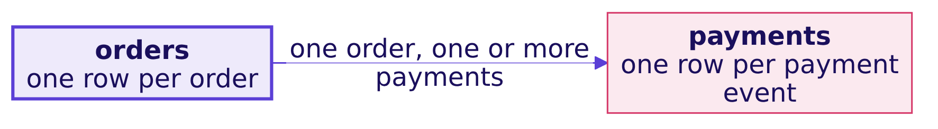
Indian Institute of Technology Gandhinagar
WEEK 2 · DAY 2 · KALPA GLOBAL CAPABILITY CENTRE
ADMINISTERED THROUGH THE COMPETENCY ADVANCEMENT ACADEMY
What the platform lead added
A new table, a new grain, and a remark made in passing.
"The payments feed sometimes double-posts when the gateway retries."
The data platform lead, Kalpa Retail
Table | One row per | Rows | What it carries
orders | Order | 1,000 | The amount booked, the channel, the quarter and the status
payments | Payment event | 1,428 | The order it pays, the date, the amount, the method and the instalment number
Your role. You sign off the collected number, and Anand will ask how you know it is not double-counted before he uses it.
The ask
What a join does to the rows
Prove the join before the number
Which orders, and which payments
S2 · 4 / 44
Notes:
LIVE, 3 minutes. The grain column is the slide. Orders has one row per order; payments has one
row per payment event, which is a different grain. Any time two tables have different grains, a
join between them can change the number of rows. Do not say fan-out yet; the room finds it in
round 1. Point at the remark: a retry is a second payment row for the same payment.

Slide 5
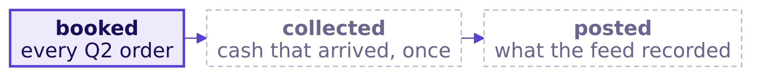
Indian Institute of Technology Gandhinagar
WEEK 2 · DAY 2 · KALPA GLOBAL CAPABILITY CENTRE
ADMINISTERED THROUGH THE COMPETENCY ADVANCEMENT ACADEMY
Question: which number is "collected"?
Three honest totals sit in the payments feed, and Anand wants one.
Question. Anand asks for collected revenue. Which total does he mean? a) the sum of every payment row the feed posted; b) the cash that arrived, with each payment counted once; c) the booked amount of every order that has at least one payment; d) booked less refunds.
The ask
What a join does to the rows
Prove the join before the number
Which orders, and which payments
S3 · 5 / 44
Notes:
LIVE, 3 minutes. One minute in pairs, then a show of letters. Expect a split between a and c.
Do not resolve it here.

Slide 6

Indian Institute of Technology Gandhinagar
WEEK 2 · DAY 2 · KALPA GLOBAL CAPABILITY CENTRE
ADMINISTERED THROUGH THE COMPETENCY ADVANCEMENT ACADEMY
Answer: cash that arrived, counted once
The feed's own total and the value of paid orders are both easy to compute and both wrong.
Reading | Why it is tempting | What it gets wrong
a) Every posted row | It is one SUM over one table | A retried payment is counted twice
b) Cash counted once | It is what reached Kalpa's bank | Nothing; this is Anand's number
c) Booked value of paid orders | It feels like "the orders we were paid for" | A part-paid order counts in full
d) Booked less refunds | Refunds are in Anand's message | It never looks at payments at all
KAVYA'S REVIEW
Write the definition above the number: "Collected, Q2 orders, each payment counted once." Then every query you write has to earn that sentence.
The ask
What a join does to the rows
Prove the join before the number
Which orders, and which payments
S4 · 6 / 44
Notes:
LIVE, 2 minutes. The answer is b. Refunds are real and belong to the take-home; the twelve
refund rows in the warehouse all sit on Q1 orders, so Q2's report can say so in one line.
Say that option c returns in round 1 as the first wrong number of the day.

Slide 7
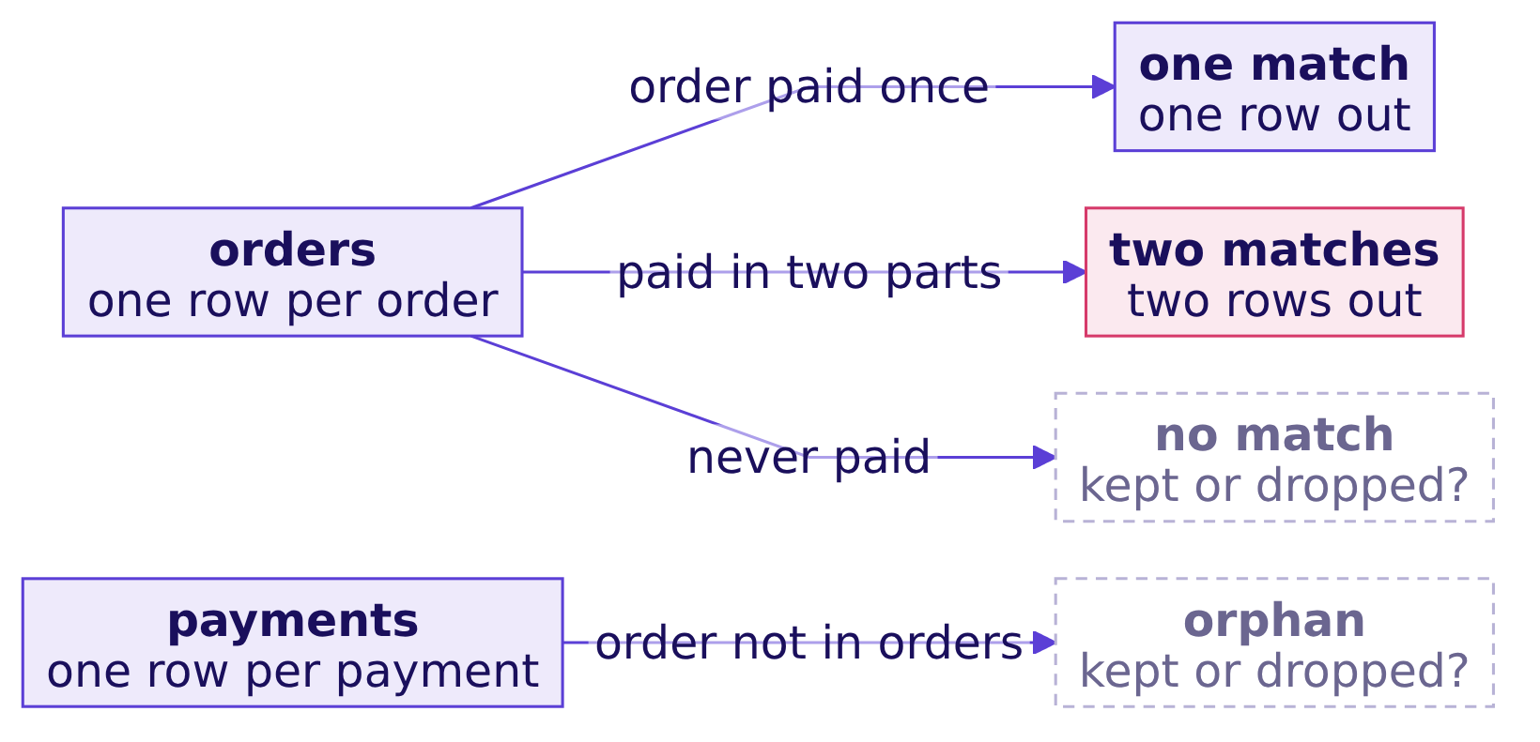
Indian Institute of Technology Gandhinagar
WEEK 2 · DAY 2 · KALPA GLOBAL CAPABILITY CENTRE
ADMINISTERED THROUGH THE COMPETENCY ADVANCEMENT ACADEMY
Every join asks about the rows that miss
Before any tool opens: what happens to an order with no payment, and a payment with no order?
The join type is the answer to the two open questions, and the grain of the right-hand table decides whether an order comes out once or twice.
The ask
What a join does to the rows
Prove the join before the number
Which orders, and which payments
S5 · 7 / 44
Notes:
LIVE, 5 minutes. Draw this on the board with the room, left to right, before anything else. Ask
of each arrow: how many rows does this order produce after the join? One, two, and "it depends on
the join". This drawing stays on the board all day; every trap of the day is one of its arrows.

Slide 8

Indian Institute of Technology Gandhinagar
WEEK 2 · DAY 2 · KALPA GLOBAL CAPABILITY CENTRE
ADMINISTERED THROUGH THE COMPETENCY ADVANCEMENT ACADEMY
The habit the whole day rests on
A join is finished when its row count is explained, and not a moment before.
STEP 1
STEP 2
STEP 3
STEP 4
STEP 5
Rows in
Predict
Rows out
Explain
Then the number
Count each table at its own grain before the join.
Say how many rows the join should return, and why.
Count what the join returned.
Name every row of difference: repeated keys, unmatched rows, filters.
Only now read the total, with the reconciliation written above it.
IN THE INTERVIEW
[D] Design the validation you run before a joined number reaches Finance, and say what you do when it fails at the end of reporting day.
The ask
What a join does to the rows
Prove the join before the number
Which orders, and which payments
S6 · 8 / 44
Notes:
LIVE, 4 minutes. This is Week 1 Wednesday's reconciliation, one tool later: input equals clean
plus rejected became rows in equals rows out plus what the join did. The model answer to the
interview question is these five steps plus a fallback: ship the booked figure with the
reconciliation's open line stated, never an unreconciled collected figure. The answer is in the
day sheet.
Transition: round 1 starts on two tables small enough to trace by hand.

Slide 9
Indian Institute of Technology Gandhinagar
PG DIPLOMA IN AI-ML AND AGENTIC AI ENGINEERING · COHORT 2
ADMINISTERED THROUGH THE COMPETENCY ADVANCEMENT ACADEMY
02
What a join does to the rows
Two tiny tables traced by hand, then the warehouse's first join and the number it doubles.
The ask
What a join does to the rows
Prove the join before the number
Which orders, and which payments
Week 2, Day 2. Booked against collected, without lying
9 / 44
Notes:
LIVE. Round 1 runs 50 minutes: the question and its picture (8), the tiny tables traced (12), the
warehouse join and its trap (15), the room's harder variant (10), Kavya's review (5).
Notebook 1 and sql/C2_W02_D02_01 and 02 run beside it.

Slide 10
Indian Institute of Technology Gandhinagar
WEEK 2 · DAY 2 · KALPA GLOBAL CAPABILITY CENTRE
ADMINISTERED THROUGH THE COMPETENCY ADVANCEMENT ACADEMY
Five invented orders, small enough to trace
The left-hand table: one row per order, and the payment story of each.
order_id | channel | amount | Its payment story
T-1 | app | 1,000 | Paid once, in full
T-2 | web | 2,000 | Paid in two instalments
T-3 | store | 1,500 | Paid once, and the gateway posted it twice
T-4 | app | 800 | Never paid
T-5 | store | 500 | Paid once, in full
The ask
What a join does to the rows
Prove the join before the number
Which orders, and which payments
S7 · 10 / 44
Notes:
LIVE, 2 minutes. These numbers are invented to show the mechanism, and the slide says so. Copy the
table onto the board. The story column is what the room should be able to say after tracing.

Slide 11
Indian Institute of Technology Gandhinagar
WEEK 2 · DAY 2 · KALPA GLOBAL CAPABILITY CENTRE
ADMINISTERED THROUGH THE COMPETENCY ADVANCEMENT ACADEMY
Seven invented payments, one of them an orphan
The right-hand table: one row per payment event, a different grain from orders.
payment_id | order_id | paid_date | amount | instalment_no
P-1 | T-1 | 3 Jul | 1,000 | 1
P-2 | T-2 | 5 Jul | 1,200 | 1
P-3 | T-2 | 5 Aug | 800 | 2
P-4 | T-3 | 9 Jul | 1,500 | 1
P-5 | T-3 | 9 Jul | 1,500 | 1
P-6 | T-5 | 12 Jul | 500 | 1
P-7 | T-9 | 14 Jul | 600 | 1
The ask
What a join does to the rows
Prove the join before the number
Which orders, and which payments
S8 · 11 / 44
Notes:
LIVE, 2 minutes. Copy this beside the orders on the board. Ask the room to find, in words, the
order with two parts, the payment posted twice, the order never paid and the payment whose order
is not in the orders table. The same four stories are in the warehouse; the room will find them
there without being told how many.

Slide 12
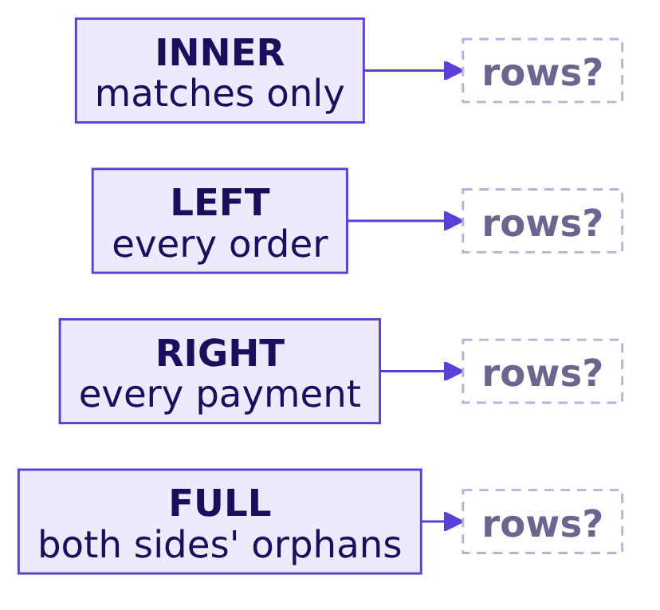
Indian Institute of Technology Gandhinagar
WEEK 2 · DAY 2 · KALPA GLOBAL CAPABILITY CENTRE
ADMINISTERED THROUGH THE COMPETENCY ADVANCEMENT ACADEMY
Question: four joins, four row counts
Write your four numbers before anyone runs anything.
Question. Joining tiny_orders to tiny_payments on order_id, how many rows does each join return? a) 5, 5, 7, 7; b) 6, 7, 7, 8; c) 5, 6, 7, 8; d) 6, 6, 7, 7.
The ask
What a join does to the rows
Prove the join before the number
Which orders, and which payments
S9 · 12 / 44
Notes:
LIVE, 4 minutes. Two minutes alone, writing four numbers on paper, then a show of letters. The
most common wrong answer is a, from people who think a join keeps one row per order. Do not
correct anyone yet.

Slide 13

Indian Institute of Technology Gandhinagar
WEEK 2 · DAY 2 · KALPA GLOBAL CAPABILITY CENTRE
ADMINISTERED THROUGH THE COMPETENCY ADVANCEMENT ACADEMY
Answer: 6, 7, 7 and 8, traced row by row
T-2 and T-3 come out twice, T-4 appears only with LEFT, and P-7 only with RIGHT.
Join | Rows | Where the rows come from
INNER | 6 | T-1 once, T-2 twice, T-3 twice, T-5 once
LEFT | 7 | The six, plus T-4 with NULLs on the payments side
RIGHT | 7 | The six, plus P-7 with NULLs on the orders side
FULL | 8 | The six, plus T-4, plus P-7
THE RULE
An order comes out once per matching payment row, so a key that repeats on the right multiplies the left before any number is summed.
The ask
What a join does to the rows
Prove the join before the number
Which orders, and which payments
S10 · 13 / 44
Notes:
LIVE, 5 minutes. The answer is b. Trace the INNER join on the board, drawing a line from each
order to each of its payments: the lines are the rows. Then add T-4 for LEFT and P-7 for RIGHT.
Run sql/C2_W02_D02_01, step 6, to confirm the four counts. Keep the lines on the board.

Slide 14


Indian Institute of Technology Gandhinagar
WEEK 2 · DAY 2 · KALPA GLOBAL CAPABILITY CENTRE
ADMINISTERED THROUGH THE COMPETENCY ADVANCEMENT ACADEMY
INNER and LEFT answer different questions
Choose a join by the question you are asking about the rows that do not match.
INNER JOIN
LEFT JOIN
RIGHT AND FULL
Only the matches
Every order, matched or not
The other side's orphans
Answers "what do the paid orders look like?" An unpaid order disappears without a trace.
Answers "what happened to each order we booked?" An unpaid order stays, with NULL where its payment would be.
RIGHT keeps every payment; FULL keeps both sides. Named today and used later, when two feeds are reconciled.
IN THE INTERVIEW
[S] INNER against LEFT join: what does each drop or keep?
The ask
What a join does to the rows
Prove the join before the number
Which orders, and which payments
S11 · 14 / 44
Notes:
LIVE, 3 minutes. The model answer: INNER keeps rows that match on both sides and drops the rest
from both; LEFT keeps every row of the left table and fills the right side with NULL where nothing
matched; both repeat a left row once per matching right row. The last clause is the one most
candidates forget. FULL OUTER is named and parked, as the row says.

Slide 15
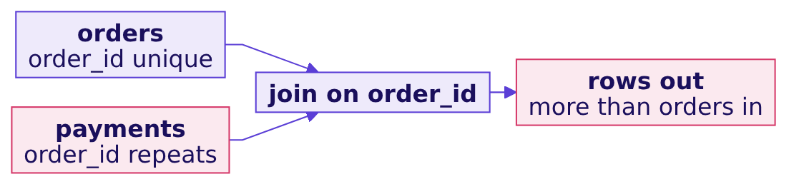
Indian Institute of Technology Gandhinagar
WEEK 2 · DAY 2 · KALPA GLOBAL CAPABILITY CENTRE
ADMINISTERED THROUGH THE COMPETENCY ADVANCEMENT ACADEMY
The warehouse's grain, checked first
Before the warehouse join, count each table and ask whether order_id repeats in payments.
SELECT order_id, count(*) AS payment_rows
FROM payments
GROUP BY order_id
HAVING count(*) > 1;
462
1,428
450
Q2 ORDERS
PAYMENT ROWS
ORDERS WITH TWO PAYMENT ROWS
one row each, Rs 9.84 crore booked
across both quarters
both quarters, sql 02, step 2
The ask
What a join does to the rows
Prove the join before the number
Which orders, and which payments
S12 · 15 / 44
Notes:
LIVE, 3 minutes. Run steps 1 and 2 of sql/C2_W02_D02_02. The room sees that order_id repeats in
payments, so the join will multiply. Ask what the second rows are. Some are second instalments on
large invoices; the platform lead's remark says some might be retries. Which is which is round 3's
question, and nobody should answer it yet.

Slide 16
Indian Institute of Technology Gandhinagar
WEEK 2 · DAY 2 · KALPA GLOBAL CAPABILITY CENTRE
ADMINISTERED THROUGH THE COMPETENCY ADVANCEMENT ACADEMY
Question: what did Kalpa collect in Q2?
A hurried analyst writes the value of the orders that were paid.
SELECT sum(o.amount) AS collected_as_reported
FROM orders o
JOIN payments p ON p.order_id = o.order_id
WHERE o.quarter = 'Q2';
Question. Booked in Q2 is Rs 9,84,00,000. What does this query return? a) a little under Rs 9.84 crore, since some orders are unpaid; b) exactly Rs 9.84 crore; c) about Rs 19.3 crore; d) about Rs 4.9 crore.
The ask
What a join does to the rows
Prove the join before the number
Which orders, and which payments
S13 · 16 / 44
Notes:
LIVE, 3 minutes. Pairs predict, then show letters. Most rooms say a, because the query "only
keeps paid orders". The ones who say c have understood S9. Run it after the letters are up.

Slide 17
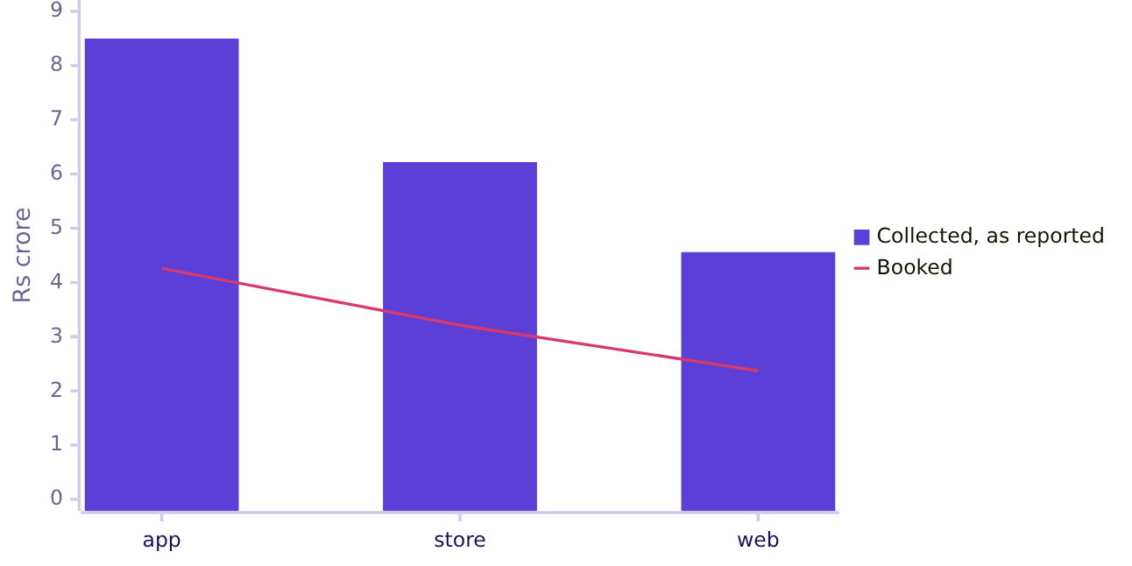
Indian Institute of Technology Gandhinagar
WEEK 2 · DAY 2 · KALPA GLOBAL CAPABILITY CENTRE
ADMINISTERED THROUGH THE COMPETENCY ADVANCEMENT ACADEMY
Answer: the plausible wrong answer, Rs 19.29 crore
The bars are collected as reported by channel; the line is booked, and every bar sits near twice it.
Rs 19,29,04,410
Rs 9,84,00,000
1.96 x
COLLECTED, AS REPORTED
BOOKED
COLLECTED OVER BOOKED
the hurried query
Monday's number
the fan-out
The ask
What a join does to the rows
Prove the join before the number
Which orders, and which payments
S14 · 17 / 44
Notes:
LIVE, 4 minutes. The answer is c. The bars are the hurried collected by channel; the line is
booked, from Monday. Let the room find the doubling before anyone says fan-out: ask why an order would be
summed twice. Someone will point at S10's lines. Then, and only then, name it: a fan-out.

Slide 18
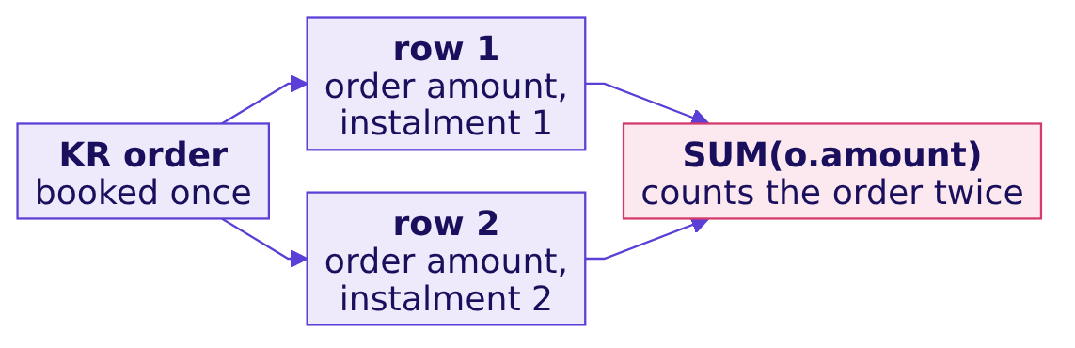
Indian Institute of Technology Gandhinagar
WEEK 2 · DAY 2 · KALPA GLOBAL CAPABILITY CENTRE
ADMINISTERED THROUGH THE COMPETENCY ADVANCEMENT ACADEMY
Why it is wrong, and the check that catches it
The order amount rides along on every payment row, so a two-part order is summed twice.
What it would have misled. "Collections are running ahead of bookings" stands the collections team down in the one quarter Anand is asking about.
Check | Rows in | Rows out | Verdict
Orders LEFT JOIN payments, Q2 | 462 orders | 678 rows | The join multiplied 216 rows
Collected against booked | Rs 9.84 crore | Rs 19.29 crore | Collected cannot exceed booked by 96 percent
The ask
What a join does to the rows
Prove the join before the number
Which orders, and which payments
S15 · 18 / 44
Notes:
LIVE, 4 minutes. Two checks, and either one catches it: rows out against rows in, and collected
against booked. Run step 4 of sql/C2_W02_D02_02. Say the sentence: a SUM after a join sums at
the grain of the join, which is the payment, whatever column it names.

Slide 19
Indian Institute of Technology Gandhinagar
WEEK 2 · DAY 2 · KALPA GLOBAL CAPABILITY CENTRE
ADMINISTERED THROUGH THE COMPETENCY ADVANCEMENT ACADEMY
The fix: bring payments to the order's grain
Aggregate the many side to one row per order, then join, and the count closes.
462
Rs 9,84,00,000
ROWS OUT
BOOKED AFTER THE JOIN
equals the 462 orders in
equals Monday's booked
WITH paid_per_order AS (
SELECT order_id, sum(amount) AS paid, count(*) AS payment_rows
FROM payments
GROUP BY order_id
)
SELECT count(*) AS rows_out, sum(o.amount) AS booked,
sum(coalesce(pp.paid, 0)) AS paid_as_posted
FROM orders o
LEFT JOIN paid_per_order pp ON pp.order_id = o.order_id
WHERE o.quarter = 'Q2';
The ask
What a join does to the rows
Prove the join before the number
Which orders, and which payments
S16 · 19 / 44
Notes:
LIVE, 4 minutes. What changed: 216 repeated rows went away, the order-side sum went from Rs 19.29 crore
back to Rs 9.84 crore, and the order amount is summed once per order. Steps 6 and 7 of sql 02 run
this and the one-line check. Do not read the paid column aloud yet; round 2 reconciles it.

Slide 20
Indian Institute of Technology Gandhinagar
WEEK 2 · DAY 2 · KALPA GLOBAL CAPABILITY CENTRE
ADMINISTERED THROUGH THE COMPETENCY ADVANCEMENT ACADEMY
Question: the both-columns report by channel
The room's harder variant: booked and collected side by side, from one join.
SELECT o.channel, sum(o.amount) AS booked, sum(p.amount) AS collected
FROM orders o
LEFT JOIN payments p ON p.order_id = o.order_id
WHERE o.quarter = 'Q2'
GROUP BY o.channel;
Question. The collected column now sums payment amounts, so it looks safe. What does the report say? a) collected close to booked on every channel; b) booked near Rs 19.5 crore and about half of it collected; c) collected near Rs 19.3 crore again; d) the query fails because of the NULLs.
The ask
What a join does to the rows
Prove the join before the number
Which orders, and which payments
S17 · 20 / 44
Notes:
SELF-STUDY for the fast half, LIVE for the room in the 10-minute variant slot. Pairs run step 5 of
sql 02 and answer before looking. Walk the room, and ask each pair which column is wrong and why.

Slide 21
Indian Institute of Technology Gandhinagar
WEEK 2 · DAY 2 · KALPA GLOBAL CAPABILITY CENTRE
ADMINISTERED THROUGH THE COMPETENCY ADVANCEMENT ACADEMY
Answer: half of Q2 "uncollected", which is false
The same fan-out, now on the booked side, invents a collections crisis.
Channel | Booked, as reported | Collected, as reported | Share collected
app | Rs 8,50,44,740 | Rs 4,25,89,770 | 50.1 percent
store | Rs 6,32,06,360 | Rs 3,11,96,760 | 49.4 percent
web | Rs 4,64,08,240 | Rs 2,28,79,290 | 49.3 percent
The ask
What a join does to the rows
Prove the join before the number
Which orders, and which payments
S18 · 21 / 44
Notes:
LIVE, 4 minutes. The answer is b. The same mechanism misleads in the opposite direction: S14 stood
collections down, this one would send a team after Rs 9.8 crore that was never owed. A fan-out has
no direction of its own; it inflates whichever side repeats. The fix is S16's, on the booked side.

Slide 22



Indian Institute of Technology Gandhinagar
WEEK 2 · DAY 2 · KALPA GLOBAL CAPABILITY CENTRE
ADMINISTERED THROUGH THE COMPETENCY ADVANCEMENT ACADEMY
Kavya's review of round 1
A join is a multiplication until you prove it is not.
KAVYA'S REVIEW
A join is a multiplication until you prove it is not. Tell me the grain of each table before you tell me a total.
IN THE INTERVIEW
[S] Your join grew the row count; name the cause and the check. [F] Revenue doubled after a join and every row looks fine; where do you look?
THE CAUSE
THE CHECK
THE FIX
A key that repeats
Rows in, rows out
Match the grain
The right-hand table has more than one row per key, so each left row comes out once per match.
Count before and after; any growth is explained by the repeated keys, or the join is wrong.
Aggregate the many side to the key's grain in a CTE, then join.
The ask
What a join does to the rows
Prove the join before the number
Which orders, and which payments
S19 · 22 / 44
Notes:
LIVE, 5 minutes. Two learners answer the interview questions aloud in under thirty seconds each.
The model answers: the cause is duplicate keys on the right, usually a one-to-many relationship
read as one-to-one; the check is the count before and after and a GROUP BY key HAVING count(*) > 1
on the right table; for a doubled revenue, look at the grain of the join, not at the rows, because
each row is individually correct. Transition: the join is now at the right grain; round 2 asks
whether it kept every order.

Slide 23
Indian Institute of Technology Gandhinagar
PG DIPLOMA IN AI-ML AND AGENTIC AI ENGINEERING · COHORT 2
ADMINISTERED THROUGH THE COMPETENCY ADVANCEMENT ACADEMY
03
Prove the join before the number
Rows in, rows out, the difference named, then the bridge from booked to collected.
The ask
What a join does to the rows
Prove the join before the number
Which orders, and which payments
Week 2, Day 2. Booked against collected, without lying
23 / 44
Notes:
LIVE. Round 2 runs 50 minutes: the question (6), the reconciliation template (8), the INNER trap on
the tiny tables (14), the bridge (10), the room's variant on Q2 (8), Kavya's review (4).
Notebook 2 and sql/C2_W02_D02_03 run beside it.

Slide 24
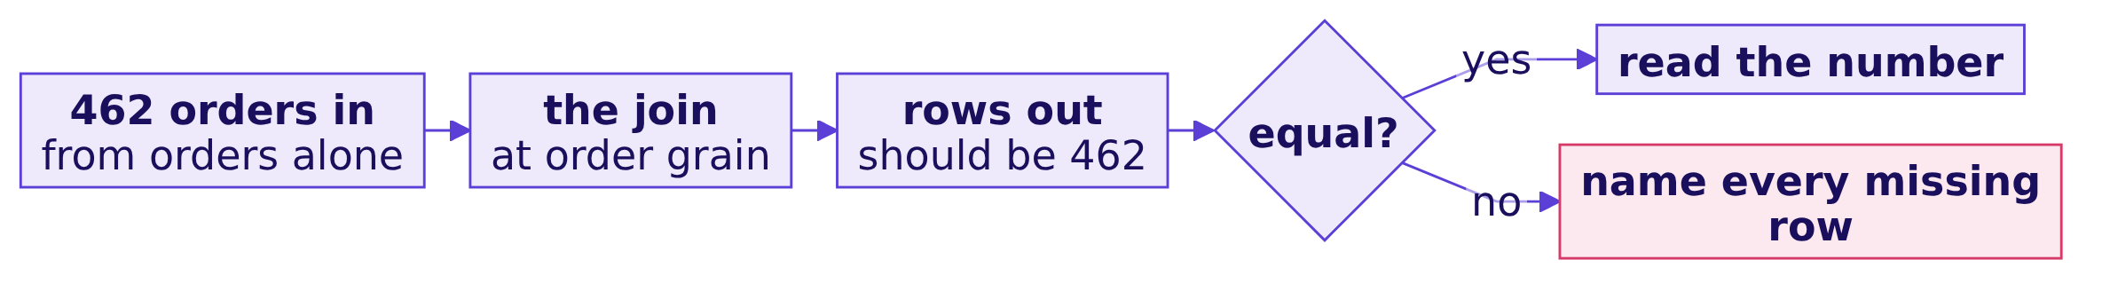
Indian Institute of Technology Gandhinagar
WEEK 2 · DAY 2 · KALPA GLOBAL CAPABILITY CENTRE
ADMINISTERED THROUGH THE COMPETENCY ADVANCEMENT ACADEMY
Every Q2 order has to survive the join
Anand asked order by order, so an order that vanishes is an order he never sees.
THE CLIENT ASKS
"If there is a gap, I want to know which orders." An order missing from the report cannot be on anyone's list.
The ask
What a join does to the rows
Prove the join before the number
Which orders, and which payments
S20 · 24 / 44
Notes:
LIVE, 4 minutes. After round 1 the join is at order grain, so rows out can only fall short of rows
in, never exceed it. Ask: which join types can make rows out smaller than rows in? INNER, and any
filter. That is the whole of round 2 and half of round 3.

Slide 25
Indian Institute of Technology Gandhinagar
WEEK 2 · DAY 2 · KALPA GLOBAL CAPABILITY CENTRE
ADMINISTERED THROUGH THE COMPETENCY ADVANCEMENT ACADEMY
The reconciliation, written above the number
Four lines of comment that make a joined total auditable by Anand's analyst.
-- Rows in: 462 Q2 orders, Rs 9,84,00,000 booked (orders alone).
-- Rows out: ___ rows after the join at order grain.
-- Booked: the sum over rows out equals the booked above.
-- The gap: booked minus collected equals the unpaid orders' booked value.
Line | What it proves | What breaks it
Rows in and out | No order was dropped or repeated | An INNER join, a filter, a repeated key
Booked after the join | The join added and lost nothing | A fan-out on the order side
The gap | Every rupee of gap belongs to a named order | A retry inside collected, an unpaid order dropped
The ask
What a join does to the rows
Prove the join before the number
Which orders, and which payments
S21 · 25 / 44
Notes:
LIVE, 4 minutes. The blank is deliberate: it is filled from the data, never from the slide.
This comment block is the deliverable the row asks for in the escalated case. Anand's analyst
reads it before reading the number.

Slide 26
Indian Institute of Technology Gandhinagar
WEEK 2 · DAY 2 · KALPA GLOBAL CAPABILITY CENTRE
ADMINISTERED THROUGH THE COMPETENCY ADVANCEMENT ACADEMY
Question: the INNER report on the tiny tables
Payments at order grain this time, joined with an INNER join, as most first drafts are.
WITH paid_per_order AS (
SELECT order_id, sum(amount) AS paid FROM tiny_payments GROUP BY order_id
)
SELECT count(*) AS orders, sum(o.amount) AS booked, sum(pp.paid) AS collected
FROM tiny_orders o
JOIN paid_per_order pp ON pp.order_id = o.order_id;
Question. Booked across the five invented orders is 5,800. What gap does this report show? a) 800; b) 0; c) minus 1,500; d) 700.
The ask
What a join does to the rows
Prove the join before the number
Which orders, and which payments
S22 · 26 / 44
Notes:
LIVE, 3 minutes. Pairs trace it on the board from the tables on S7 and S8 before anyone runs part A of
sql/C2_W02_D02_03. The ones who say a have forgotten that INNER drops T-4.

Slide 27
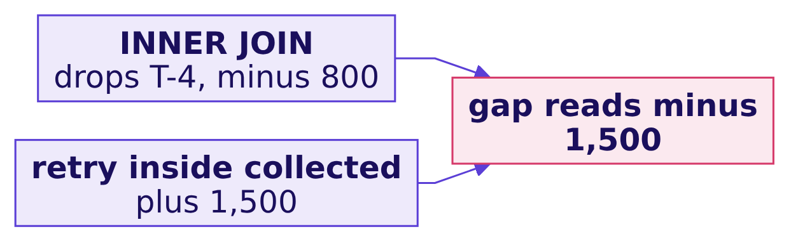
Indian Institute of Technology Gandhinagar
WEEK 2 · DAY 2 · KALPA GLOBAL CAPABILITY CENTRE
ADMINISTERED THROUGH THE COMPETENCY ADVANCEMENT ACADEMY
Answer: a gap of minus 1,500 on four orders
The report says Kalpa collected everything and a little more, which is the plausible wrong answer.
4
5,000
6,500
minus 1,500
ORDERS IN THE REPORT
BOOKED, AS REPORTED
COLLECTED, AS REPORTED
GAP, AS REPORTED
out of 5 in the table
T-4's 800 is gone
T-3's retry is inside
"fully collected, with a surplus"
What it would have misled. "There is no gap, Anand" means nobody chases the unpaid order, and nobody asks why the feed shows more cash than was booked.
The ask
What a join does to the rows
Prove the join before the number
Which orders, and which payments
S23 · 27 / 44
Notes:
LIVE, 4 minutes. The answer is c. Two errors cancel into a comfortable number: the INNER join
hides the unpaid order, and the retry inflates collected. These numbers are invented; the trainer
runs the same query on Q2 live, and the room writes down what it sees without reading it aloud.

Slide 28
Indian Institute of Technology Gandhinagar
WEEK 2 · DAY 2 · KALPA GLOBAL CAPABILITY CENTRE
ADMINISTERED THROUGH THE COMPETENCY ADVANCEMENT ACADEMY
Why it is wrong, and the check that catches it
An INNER join answers "what do the paid orders look like", and Anand asked about every order.
Check | Expected | The INNER report | Verdict
Orders in the report | 5, from tiny_orders | 4 | One order was dropped
Booked after the join | 5,800 | 5,000 | The dropped order was booked
Collected against booked | At most booked | Above booked | Something was counted twice
THE RULE
When the question is about every order, the orders table sits on the left of a LEFT JOIN, and a missing payment becomes a zero with COALESCE.
The ask
What a join does to the rows
Prove the join before the number
Which orders, and which payments
S24 · 28 / 44
Notes:
LIVE, 4 minutes. The first check needs no rupee at all, which is why it is the habit: count the
orders in the report against the orders in the table. Ask the room which check would catch this
on Kalpa's Q2 in one query. Answer: count(*) against 462.

Slide 29
Indian Institute of Technology Gandhinagar
WEEK 2 · DAY 2 · KALPA GLOBAL CAPABILITY CENTRE
ADMINISTERED THROUGH THE COMPETENCY ADVANCEMENT ACADEMY
The LEFT fix, and a gap that is still wrong
LEFT JOIN keeps T-4, the count closes, and the gap reads minus 700.
5
5,800
6,500
minus 700
ORDERS IN THE REPORT
BOOKED
COLLECTED AS POSTED
GAP
rows in equals rows out
equals the table
the retry is still inside
800 unpaid, less the 1,500 retry
The count now closes and the gap is still wrong, because the gap mixes two different things: an order nobody paid, and a payment posted twice.
The ask
What a join does to the rows
Prove the join before the number
Which orders, and which payments
S25 · 29 / 44
Notes:
LIVE, 3 minutes. What changed: one order and 800 of booked came back. What did not: the retry.
This is the argument for a bridge, on the next slide: separate the moves so each has a name.

Slide 30
Indian Institute of Technology Gandhinagar
WEEK 2 · DAY 2 · KALPA GLOBAL CAPABILITY CENTRE
ADMINISTERED THROUGH THE COMPETENCY ADVANCEMENT ACADEMY
The bridge from booked to what the feed posted
Each move between two totals gets its own bar, its own name and its own list of orders.
Move | Tiny tables, invented | The list behind it
Booked | 5,800 | Every order
Less never paid | minus 800 | The unpaid list: T-4
Collected | 5,000 | Anand's number
Plus posted twice | plus 1,500 | The double-paid list: T-3's retry
Posted in the feed | 6,500 | Every payment row matched to an order
The ask
What a join does to the rows
Prove the join before the number
Which orders, and which payments
S26 · 30 / 44
Notes:
LIVE, 5 minutes. The notebook draws this as a bridge chart with kit.bridge, and the companion page
redraws it as the room changes one assumption at a time. Say what a bridge buys: each bar is a
question for Anand, and each bar has a list of orders behind it. The bridge closes when booked plus
every move equals what the feed posted.

Slide 31
Indian Institute of Technology Gandhinagar
WEEK 2 · DAY 2 · KALPA GLOBAL CAPABILITY CENTRE
ADMINISTERED THROUGH THE COMPETENCY ADVANCEMENT ACADEMY
Your turn: reconcile Q2 on the warehouse
The room runs part B of sql 03 and writes the reconciliation before reading any rupee.
B1
B2
B3
B4
Rows in
Rows out
The bridge
It closes
Q2 orders and booked from orders alone.
The order-grain LEFT join; compare the count and the booked.
Booked, less never paid, collected, plus posted twice, posted.
Posted must equal the feed's own total against Q2 orders.
Write what you find in the four comment lines of the reconciliation, with your own numbers, before you say any of them aloud.
The ask
What a join does to the rows
Prove the join before the number
Which orders, and which payments
S27 · 31 / 44
Notes:
LIVE, 8 minutes. The room runs it; the trainer walks the room and does not read results aloud.
Anyone who finishes early runs the INNER version on Q2 and compares its order count with B1.
The day sheet carries the numbers. The discovery is theirs.

Slide 32



Indian Institute of Technology Gandhinagar
WEEK 2 · DAY 2 · KALPA GLOBAL CAPABILITY CENTRE
ADMINISTERED THROUGH THE COMPETENCY ADVANCEMENT ACADEMY
Kavya's review of round 2
Rows in, rows out, and the difference explained, written above the number.
KAVYA'S REVIEW
Rows in, rows out, and the difference explained, written above the number. If the count does not close, the number does not leave the team.
IN THE INTERVIEW
[S] When is an INNER join the honest choice? [F] How do you reconcile a total after a join back to its source table?
INNER IS HONEST
RECONCILE
THEN
When the question is about matches
Back to the source
A bridge for the gap
"What do paid orders look like?" or "which campaigns converted" ask only about rows that matched.
Sum the joined column at the source's grain and compare it with the source table's own total.
Name each move between the two totals and list the rows behind it.
The ask
What a join does to the rows
Prove the join before the number
Which orders, and which payments
S28 · 32 / 44
Notes:
LIVE, 4 minutes. Two learners answer aloud. Model answers: INNER is honest when unmatched rows are
out of scope by definition, and the report says so; reconcile by recomputing the total from the
source table alone and explaining every rupee of difference as a bridge. Break for 10 minutes.

Slide 33
Indian Institute of Technology Gandhinagar
PG DIPLOMA IN AI-ML AND AGENTIC AI ENGINEERING · COHORT 2
ADMINISTERED THROUGH THE COMPETENCY ADVANCEMENT ACADEMY
04
Which orders, and which payments
The unpaid list, the double-paid list, and two ways a correct-looking query loses the answer.
The ask
What a join does to the rows
Prove the join before the number
Which orders, and which payments
Week 2, Day 2. Booked against collected, without lying
33 / 44
Notes:
LIVE. Round 3 runs 50 minutes: the question (5), the WHERE trap on the tiny tables (12), the
anti-join (8), the HAVING trap on the warehouse (13), the room's variant (8), Kavya's review (4).
Notebook 3 and sql/C2_W02_D02_04 run beside it.

Slide 34
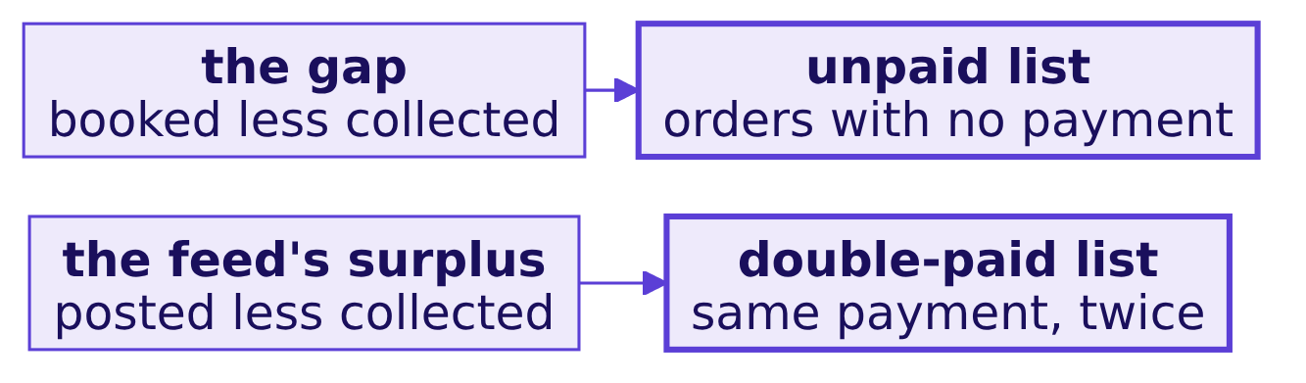
Indian Institute of Technology Gandhinagar
WEEK 2 · DAY 2 · KALPA GLOBAL CAPABILITY CENTRE
ADMINISTERED THROUGH THE COMPETENCY ADVANCEMENT ACADEMY
Anand wants names, and a quarter's cash
Two lists, and a filter that sounds harmless: payments received inside Q2.
THE CLIENT ASKS
"Which orders, and which channel." The first list is every Q2 order with no payment. The second is every payment the gateway posted twice.
The ask
What a join does to the rows
Prove the join before the number
Which orders, and which payments
S29 · 34 / 44
Notes:
LIVE, 5 minutes. Tie each list to a bar of S26's bridge. A list whose total does not equal its
bar is the wrong list, which is the check for the rest of the round.

Slide 35
Indian Institute of Technology Gandhinagar
WEEK 2 · DAY 2 · KALPA GLOBAL CAPABILITY CENTRE
ADMINISTERED THROUGH THE COMPETENCY ADVANCEMENT ACADEMY
Question: LEFT JOIN, with the quarter in WHERE
The analyst learnt round 2's lesson, wrote LEFT, and added "cash received in Q2".
SELECT o.order_id, p.payment_id, p.paid_date
FROM tiny_orders o
LEFT JOIN tiny_payments p ON p.order_id = o.order_id
WHERE p.paid_date BETWEEN '2026-07-01' AND '2026-09-30';
Question. On the invented tiny tables, how many rows come back, and is T-4 among them? a) 7 rows, T-4 with NULLs; b) 6 rows, T-4 gone; c) 5 rows, one per order; d) 8 rows, P-7 included.
The ask
What a join does to the rows
Prove the join before the number
Which orders, and which payments
S30 · 35 / 44
Notes:
LIVE, 3 minutes. Pairs trace T-4's row: after the join it has NULL paid_date. Ask what
NULL BETWEEN two dates evaluates to. Most of the room has not met three-valued logic by name.

Slide 36
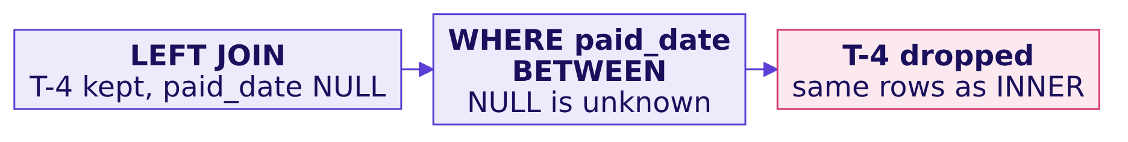
Indian Institute of Technology Gandhinagar
WEEK 2 · DAY 2 · KALPA GLOBAL CAPABILITY CENTRE
ADMINISTERED THROUGH THE COMPETENCY ADVANCEMENT ACADEMY
Answer: 6 rows, and the LEFT JOIN became INNER
A WHERE on the right-hand table throws away every row the LEFT JOIN kept for you.
6
T-4
0
ROWS OUT
GONE
UNPAID ORDERS LISTED
exactly the INNER join's count
its NULL date fails the WHERE
the list Anand asked for is empty
What it would have misled. "Every Q2 order was paid within the quarter" is the sentence this query supports, and it is false. Checked on PostgreSQL 16.13 on 29 September 2026: the same WHERE on Kalpa's payments drops every unpaid Q2 order.
The ask
What a join does to the rows
Prove the join before the number
Which orders, and which payments
S31 · 36 / 44
Notes:
LIVE, 4 minutes. The answer is b. NULL compared with anything is unknown, and WHERE keeps only
rows that are true. The trainer runs the same query on Q2 live; the room counts rows against 462
and sees the shortfall without the trainer naming it.

Slide 37
Indian Institute of Technology Gandhinagar
WEEK 2 · DAY 2 · KALPA GLOBAL CAPABILITY CENTRE
ADMINISTERED THROUGH THE COMPETENCY ADVANCEMENT ACADEMY
The fix: the payments condition goes in ON
ON decides what matches; WHERE decides what survives, after the join.
SELECT o.order_id, p.payment_id, p.paid_date
FROM tiny_orders o
LEFT JOIN tiny_payments p
ON p.order_id = o.order_id
AND p.paid_date BETWEEN '2026-07-01' AND '2026-09-30';
Where the condition sits | Rows on the tiny tables | T-4
WHERE p.paid_date BETWEEN ... | 6 | Dropped
ON ... AND p.paid_date BETWEEN ... | 7 | Kept, with NULL payment
IN THE INTERVIEW
[F] A filter on the right-hand table of a LEFT JOIN: WHERE or ON, and what changes?
The ask
What a join does to the rows
Prove the join before the number
Which orders, and which payments
S32 · 37 / 44
Notes:
LIVE, 3 minutes. What changed: one row, and the whole unpaid list. The model answer: in ON, the
filter decides which right rows match and every left row survives; in WHERE, it runs after the
join and removes the NULL rows, so the LEFT JOIN behaves as INNER. The PostgreSQL 16 manual's
table-expressions page says the same; the link is in the notes.

Slide 38
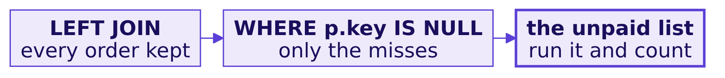
Indian Institute of Technology Gandhinagar
WEEK 2 · DAY 2 · KALPA GLOBAL CAPABILITY CENTRE
ADMINISTERED THROUGH THE COMPETENCY ADVANCEMENT ACADEMY
The anti-join: the one WHERE that belongs there
IS NULL on the right table's key keeps exactly the orders nothing matched.
SELECT o.order_id, o.channel, o.amount
FROM orders o
LEFT JOIN payments p ON p.order_id = o.order_id
WHERE o.quarter = 'Q2'
AND p.payment_id IS NULL;
IN THE INTERVIEW
[F] How do you find orders with no payment?
The ask
What a join does to the rows
Prove the join before the number
Which orders, and which payments
S33 · 38 / 44
Notes:
LIVE, 4 minutes. On the tiny tables it returns T-4. On Q2 the room runs step B1 of sql 04 and
reads the count first. NOT EXISTS gives the same list and reads as Anand's sentence; both are fine,
and the day sheet has the numbers. The model answer: a LEFT JOIN with IS NULL on the right key, or
NOT EXISTS, and a check that the list's booked total equals the gap.

Slide 39
Indian Institute of Technology Gandhinagar
WEEK 2 · DAY 2 · KALPA GLOBAL CAPABILITY CENTRE
ADMINISTERED THROUGH THE COMPETENCY ADVANCEMENT ACADEMY
Question: the double-paid list on Q2
The analyst reaches for HAVING, which Monday taught.
SELECT o.order_id, count(*) AS payment_rows
FROM orders o
JOIN payments p ON p.order_id = o.order_id
WHERE o.quarter = 'Q2'
GROUP BY o.order_id
HAVING count(*) > 1;
Question. Anand will call every customer on this list about a refund. What does it return? a) a short list of small card payments; b) 216 orders, about Rs 9.6 crore of bookings; c) no rows, since payments have unique ids; d) every Q2 order.
The ask
What a join does to the rows
Prove the join before the number
Which orders, and which payments
S34 · 39 / 44
Notes:
LIVE, 3 minutes. Pairs predict. S12 already showed 216 orders with two payment rows, so the sharp
ones answer b from memory. Ask them what kind of orders those are.

Slide 40
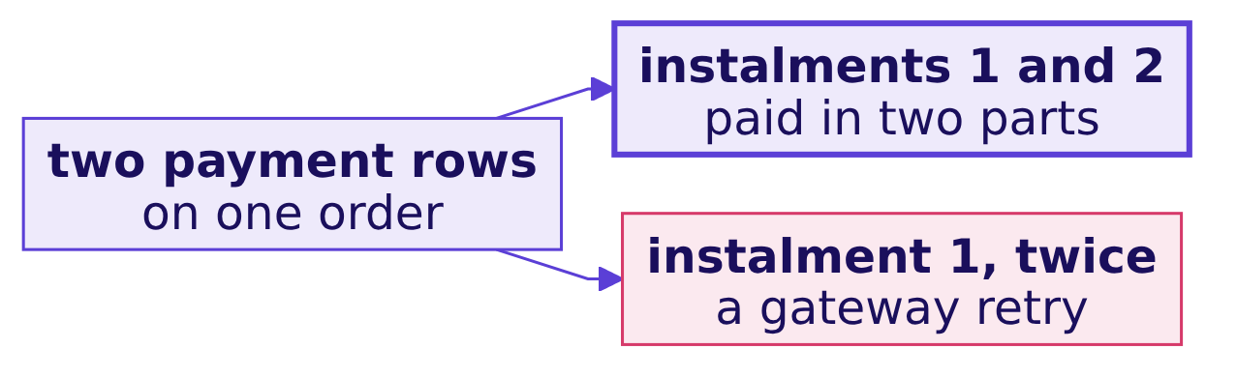
Indian Institute of Technology Gandhinagar
WEEK 2 · DAY 2 · KALPA GLOBAL CAPABILITY CENTRE
ADMINISTERED THROUGH THE COMPETENCY ADVANCEMENT ACADEMY
Answer: 216 orders flagged, Rs 9,62,59,340 booked
Most of the list is large invoices paid in two instalments, which are not double payments at all.
216
Rs 9,62,59,340
2
Q2 ORDERS FLAGGED
BOOKED ON THE LIST
INSTALMENT NUMBERS
more than one payment row each
98 percent of Q2
on most flagged orders
What it would have misled. A refund review of Rs 9.6 crore of legitimate second instalments, and a call to every corporate buyer who paid on time.
The ask
What a join does to the rows
Prove the join before the number
Which orders, and which payments
S35 · 40 / 44
Notes:
LIVE, 4 minutes. The answer is b. Two payment rows can be two instalments or one payment posted
twice; the count cannot tell them apart. Ask what column could: instalment_no.

Slide 41
Indian Institute of Technology Gandhinagar
WEEK 2 · DAY 2 · KALPA GLOBAL CAPABILITY CENTRE
ADMINISTERED THROUGH THE COMPETENCY ADVANCEMENT ACADEMY
Why it is wrong, and the grain that fixes it
A retry is the same instalment posted twice, so the double-paid grain is order and instalment.
Pattern of payment rows | What it is | On which list
Instalment 1 only | Paid once, in full | Neither
Instalments 1 and 2 | Paid in two parts | Neither
Instalment 1, twice | A gateway retry | The double-paid list
SELECT p.order_id, p.instalment_no, count(*) AS times_posted,
max(p.amount) * (count(*) - 1) AS posted_twice
FROM payments p
JOIN orders o ON o.order_id = p.order_id
WHERE o.quarter = 'Q2'
GROUP BY p.order_id, p.instalment_no
HAVING count(*) > 1;
IN THE INTERVIEW
[F] HAVING COUNT(*) > 1 on payments by order: what does it find, and what does it wrongly include?
The ask
What a join does to the rows
Prove the join before the number
Which orders, and which payments
S36 · 41 / 44
Notes:
LIVE, 4 minutes. The room runs step B3 and B4 of sql 04 and counts its own list; step B4 prints
the patterns. Do not read the count aloud. The check: the list's surplus must equal the bridge's
"posted twice" bar from S27.

Slide 42
Indian Institute of Technology Gandhinagar
WEEK 2 · DAY 2 · KALPA GLOBAL CAPABILITY CENTRE
ADMINISTERED THROUGH THE COMPETENCY ADVANCEMENT ACADEMY
Your turn: both lists, and every payment row
The room builds both lists on Q2 and accounts for all 1,428 payment rows.
Step | Query | The check it must pass
The unpaid list | sql 04, B1 and B2 | Its booked total equals booked less collected
The double-paid list | sql 04, B3 | Its surplus equals posted less collected
Every payment row | sql 04, B5 | Q1 rows plus Q2 rows plus unmatched rows equals 1,428
The last line. A payment that matches no order is a third finding, and it goes back to the platform lead with its ids.
The ask
What a join does to the rows
Prove the join before the number
Which orders, and which payments
S37 · 42 / 44
Notes:
LIVE, 8 minutes. The room runs it. Anyone who finds the unmatched payments has found what the FULL
OUTER join would show; name that and park it. The escalated case after lunch packages all of it
by channel for Anand.

Slide 43



Indian Institute of Technology Gandhinagar
WEEK 2 · DAY 2 · KALPA GLOBAL CAPABILITY CENTRE
ADMINISTERED THROUGH THE COMPETENCY ADVANCEMENT ACADEMY
Kavya's review of round 3
Two payment rows are not a double payment.
KAVYA'S REVIEW
Two payment rows are not a double payment. Show me what makes a retry a retry before you call anyone about a refund.
IN THE INTERVIEW
[D] Anand says the gap is too small to matter; how do you decide whether to chase it?
THE UNPAID LIST
THE DOUBLE-PAID LIST
THE FILTER
An anti-join
The right grain
ON, never WHERE
LEFT JOIN with IS NULL on the right key, or NOT EXISTS; its total equals the gap.
Group by order and instalment; its surplus equals posted less collected.
A condition on the right-hand table goes in the ON clause of a LEFT JOIN.
The ask
What a join does to the rows
Prove the join before the number
Which orders, and which payments
S38 · 43 / 44
Notes:
LIVE, 4 minutes. The [D] answer: size it by channel and by order, since a small total can hide one
large invoice; check its age, since an unpaid order from July is overdue while one from yesterday
is not; and state the cost of chasing against the cash at stake. The answer is in the day sheet.
Transition: after lunch, the escalated case puts the three rounds into one report by channel.

Slide 44
Indian Institute of Technology Gandhinagar
WEEK 2 · DAY 2 · KALPA GLOBAL CAPABILITY CENTRE
ADMINISTERED THROUGH THE COMPETENCY ADVANCEMENT ACADEMY
What the morning leaves on your desk
Five moves, each one used again in the afternoon's case.
You can now | The evidence from this morning
Trace a join by hand before running it | Six, seven, seven and eight rows on the tiny tables
Spot a fan-out and fix the grain | Rs 19.29 crore back to Rs 9.84 crore at order grain
Write the reconciliation above the number | Rows in, rows out, booked, and the gap
Keep a LEFT JOIN a LEFT JOIN | The paid_date condition moved into ON
Tell a retry from an instalment | The double-paid grain is order and instalment
The ask
What a join does to the rows
Prove the join before the number
Which orders, and which payments
S39 · 44 / 44
Notes:
LIVE, 2 minutes. Ask the room which row felt weakest by a show of hands, and note it for the
escalated case: that is where the room will stall after lunch.

