Slide 1


Indian Institute of Technology Gandhinagar
ADMINISTERED THROUGH THE COMPETENCY ADVANCEMENT ACADEMY
WEEK 4 · WEDNESDAY · ILLUSTRATIVE CASE
Instamart Pune: strip click-through fell from 6.1 to 3.8 percent
“Rank the pairs the strip should show, explain why its click-through fell, and put a rupee value on a slot, by Friday.”
The ask on the ticket, to the category manager and the growth lead. Illustrative case: the company is real, the situation and the data are synthetic, built for this class.
01
What does together mean?
02
What do 40,000 carts say?
03
What fills the strip?
Week 4, Day 3. Instamart Pune: strip click-through fell from 6.1 to 3.8 percent
1 / 41
Notes:
On screen as the room sits down. Read the title and the ask aloud, then the label line: the company
is real, the situation and the data are synthetic. Today has three chapters: count by hand, count
everything, then decide and price. Transition: the ticket, line by line.

Slide 2

Indian Institute of Technology Gandhinagar
WEEK 4 · DAY 3 · KALPA GLOBAL CAPABILITY CENTRE
ADMINISTERED THROUGH THE COMPETENCY ADVANCEMENT ACADEMY
Strip click-through fell from 6.1 to 3.8 percent
What has the analyst been handed, and what is due Friday?
On the ticket | What it says
Company, city, surface | Swiggy Instamart, Pune: the cart page's strip of three suggested items
The change | Monday 7 September 2026: a curated list became the items most often found in the same cart; toned milk is in 71 percent of carts, so it now sits beside nearly everything
The metric | Strip click-through (clicks over impressions): 6.1 percent from 17 August to 6 September, 3.8 percent from 7 to 27 September
The data | carts (cart_id, customer_id, placed_date, zone, time_band, cart_value_rs): 40,000 carts, 1 to 28 September, eight zones; cart_items (cart_id, item, quantity, price_rs, margin_rs); strip_log (date, slot, anchor_item, suggested_item, impressions, clicks, adds)
The ask, due Friday | Rank the pairs the strip should show, explain the fall, put a rupee value on a slot
Caveats | Curd ran out in two zones in week three; the top tenth of customers place 38 percent of carts; the strip causes some of the co-occurrence it counts; a cart is one order, a customer places many
Illustrative case: the company is real, the situation and the data are synthetic, built for this class.
What does together mean?
What do 40,000 carts say?
What fills the strip?
S1 · 2 / 41
Notes:
LIVE, 5 minutes. Read the table top to bottom. Define two words as they appear: an impression is
one time a slot was shown, and click-through is clicks divided by impressions. Point at the three
tables and their columns; every number today comes from them. Ask the room for one reason "in
most carts" might be the wrong reason to show an item, and write the answers on the board
without judging them. Transition: where today sits in the week.

Slide 3
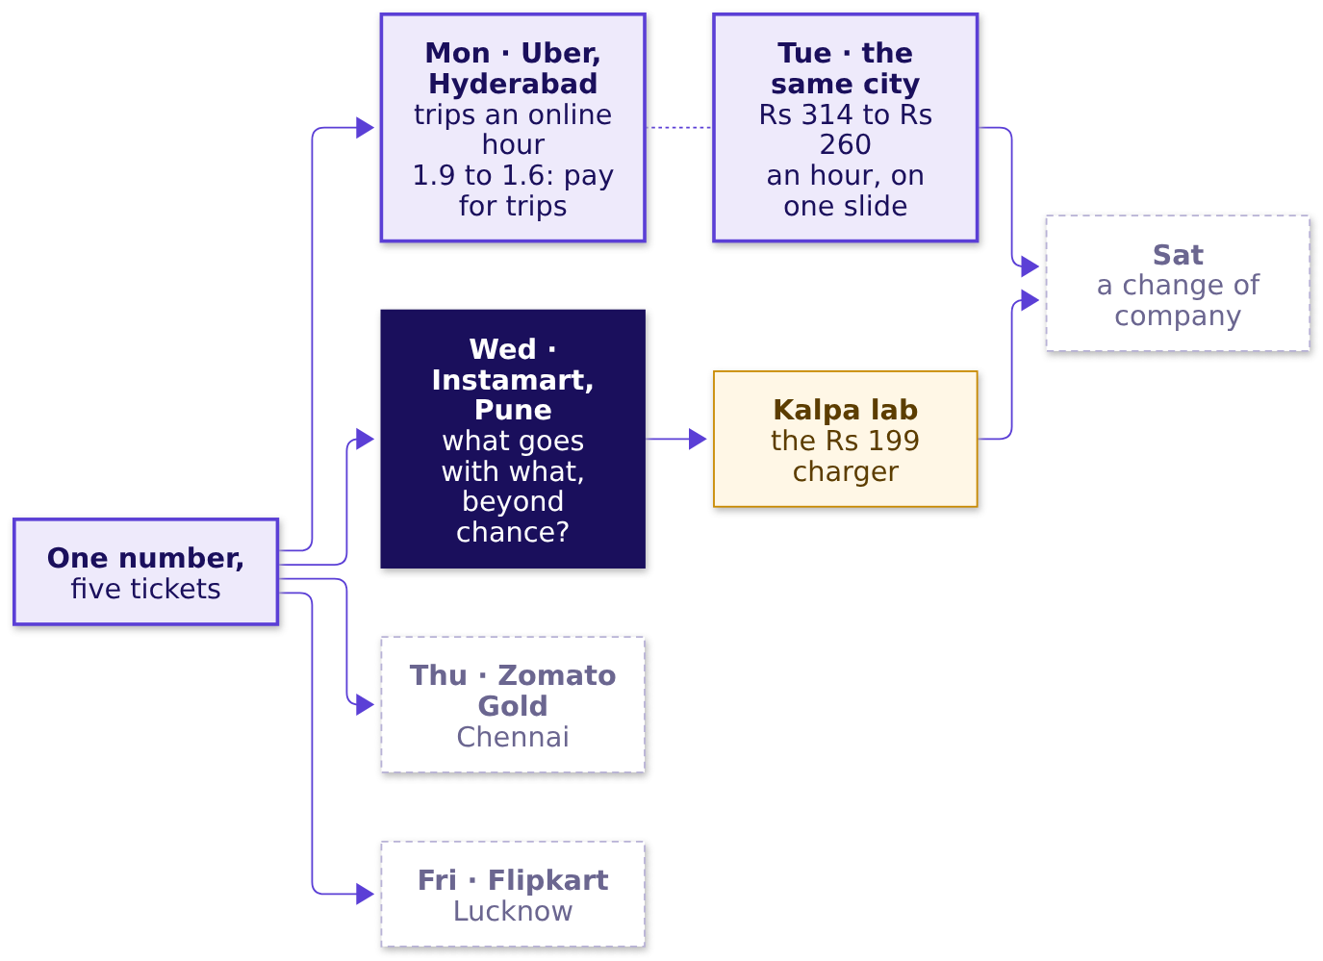
Indian Institute of Technology Gandhinagar
WEEK 4 · DAY 3 · KALPA GLOBAL CAPABILITY CENTRE
ADMINISTERED THROUGH THE COMPETENCY ADVANCEMENT ACADEMY
Wednesday asks what goes with what, beyond chance
Where does today sit among the week's five tickets?
What does together mean?
What do 40,000 carts say?
What fills the strip?
S2 · 3 / 41
Notes:
LIVE, 2 minutes. Monday and Tuesday carry the numbers the room produced on them. Today's node is
lit; Thursday, Friday and Saturday stay dashed. The Kalpa node is the lab after class, where the
same method meets Kalpa Retail's baskets. Explorer: the home screen, Wednesday lit.
Transition: where today ends.

Slide 4



Indian Institute of Technology Gandhinagar
WEEK 4 · DAY 3 · KALPA GLOBAL CAPABILITY CENTRE
ADMINISTERED THROUGH THE COMPETENCY ADVANCEMENT ACADEMY
Where today ends: three pairs, one floor, Rs 6.3 lakh
What will the growth lead carry out of the room?
PROMOTE
WATCH
PRICE
Three pairs above a 1 percent floor
One strong, thin pair
A slot, in rupees
Ice cream and chocolate sauce: lift 4.60 on 100 carts, tested before it is promoted.
Rs 17,280 a day with a pair that beats chance, Rs 3,240 with milk; re-ranking recovers Rs 6.3 lakh a month.
Chips and cold drink 3.39, coriander and green chillies 3.00, bread and butter 2.21. Milk takes no slot.
What does together mean?
What do 40,000 carts say?
What fills the strip?
S3 · 4 / 41
Notes:
LIVE, 2 minutes. Show the finished answer once, then earn it. Leave the cause of the fall open:
chapter 2 finds it. Say that every number on the three cards is computed in the room before
lunch. Transition: chapter 1, counting by hand.

Slide 5
Indian Institute of Technology Gandhinagar
PG DIPLOMA IN AI-ML AND AGENTIC AI ENGINEERING · COHORT 2
ADMINISTERED THROUGH THE COMPETENCY ADVANCEMENT ACADEMY
01
What does together mean?
Which items go together on twelve real carts, counted three ways by hand before any code opens?
What does together mean?
What do 40,000 carts say?
What fills the strip?
Week 4, Day 3. Instamart Pune: strip click-through fell from 6.1 to 3.8 percent
5 / 41
Notes:
LIVE, 1 minute. Chapter 1 of 3, level L1. Receipts on the table: the tea stall first, then the
twelve cart cards per group. No laptop opens in this chapter. Transition: the questions.

Slide 6
Indian Institute of Technology Gandhinagar
WEEK 4 · DAY 3 · KALPA GLOBAL CAPABILITY CENTRE
ADMINISTERED THROUGH THE COMPETENCY ADVANCEMENT ACADEMY
Three counts and one limit, climbed by hand
Who needs the answer, and which questions lead to it?
Who needs the answer. The category manager, who picks what the strip may suggest: a strip filled on the wrong count wastes the three spaces under every cart.
HOW OFTEN?
HOW RELIABLY?
AGAINST CHANCE?
HOW FAR?
Support
Confidence
Lift
What twelve cannot say
Carts holding both items, over all carts.
Of the carts holding A, the share that also hold B.
Carts seen holding both, over the carts chance alone would give.
Whether a pull on four carts is real or luck.
What does together mean?
What do 40,000 carts say?
What fills the strip?
S4 · 6 / 41
Notes:
LIVE, 2 minutes. Read the four questions. Each gets a number before the next is asked. Write the
three words support, confidence, lift on the board only after the room has counted each one.
Transition: ten tea-stall orders.

Slide 7

Indian Institute of Technology Gandhinagar
WEEK 4 · DAY 3 · KALPA GLOBAL CAPABILITY CENTRE
ADMINISTERED THROUGH THE COMPETENCY ADVANCEMENT ACADEMY
Which tea-stall sentence is wrong?
Ten invented orders: chai on 6, biscuit on 4, both on 3. Which reading fails?
A
B
C
D
Support is 0.30
Confidence is 0.50
Lift is 1.25 both ways
Chai lifts biscuit sales 25%
Orders holding both, over all ten: 3 of 10.
Of the 6 chai orders, the share with biscuit: 3 of 6.
Seen together 3; chance gives 2.4; the ratio reads the same from biscuit.
Chai makes a customer buy a quarter more biscuits.
What does together mean?
What do 40,000 carts say?
What fills the strip?
S5 · 7 / 41
Notes:
LIVE, 4 minutes. Groups vote by holding up a letter. Then two minutes for neighbours to argue, and
vote again. The split is usually between c and d. Do not explain lift yet; the next slide does.
Transition: the dots.

Slide 8
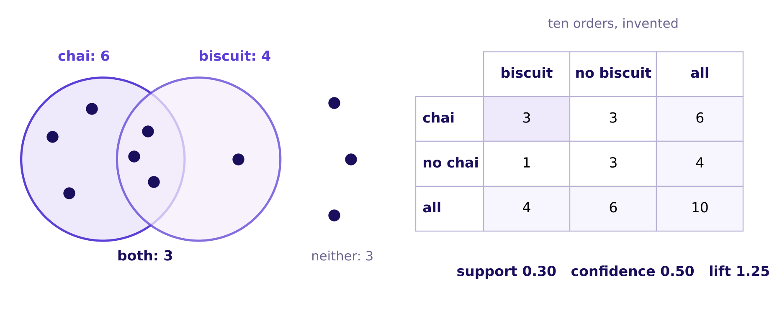
Indian Institute of Technology Gandhinagar
WEEK 4 · DAY 3 · KALPA GLOBAL CAPABILITY CENTRE
ADMINISTERED THROUGH THE COMPETENCY ADVANCEMENT ACADEMY
Answer: d, since lift counts and never names a cause
What does a lift of 1.25 say, read off the dots?
The ten invented tea-stall orders as dots in two circles, beside the 2 by 2 table of counts
If chai and biscuit ignored each other, 60 percent of the 4 biscuit orders, 2.4 orders, would hold chai. Three do. Lift is 3 / 2.4 = 1.25, and from biscuit's side it is 0.75 / 0.60, the same 1.25. The pair turns up a quarter more often than chance would put it there; ten receipts cannot say why.
What does together mean?
What do 40,000 carts say?
What fills the strip?
S6 · 8 / 41
Notes:
LIVE, 7 minutes. Count each cell of the 2 by 2 aloud from the dots (StatQuest). Support: the
shaded cell over all ten. Confidence: shrink the world to the chai row, 3 of 6. Expected: the
chai share times the biscuit share times ten, 0.6 x 0.4 x 10. Lift: seen over expected. Then the
reverse direction. Ask: "what would make the 1.25 a cause?" Only a test that changes chai and
watches biscuit, which Monday's faculty session on A/B testing (tentative) took up. Transition: a carry bag.

Slide 9
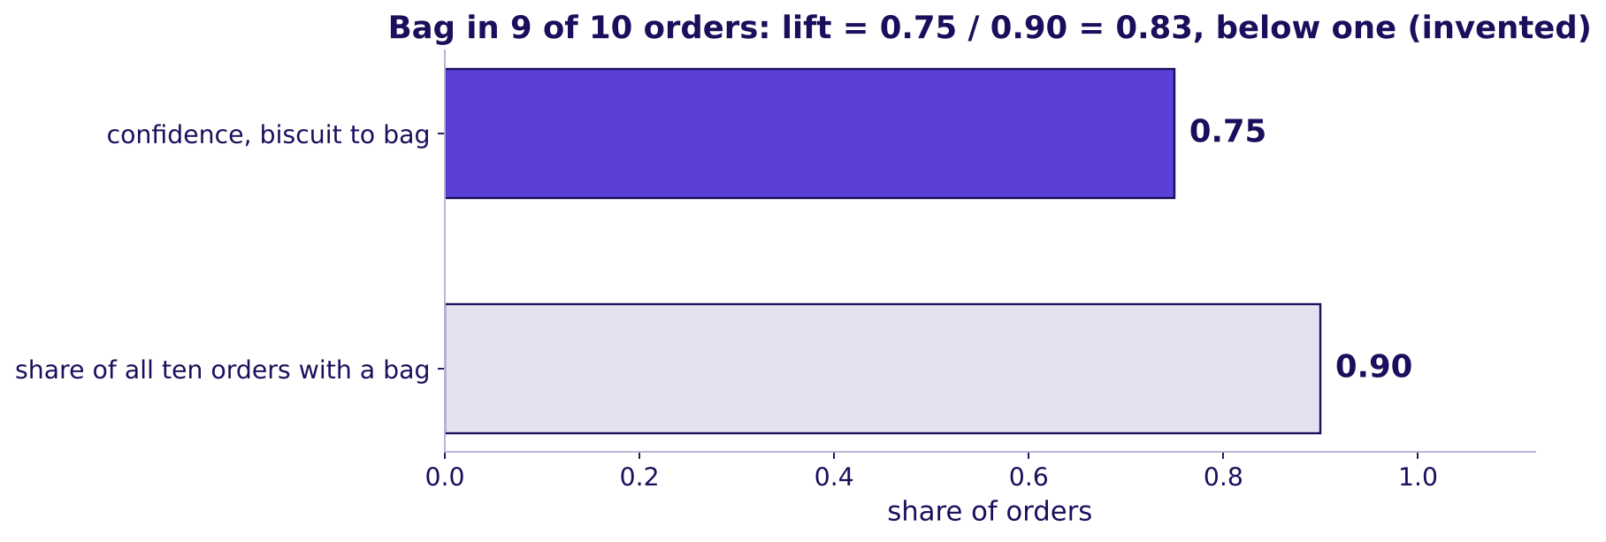
Indian Institute of Technology Gandhinagar
WEEK 4 · DAY 3 · KALPA GLOBAL CAPABILITY CENTRE
ADMINISTERED THROUGH THE COMPETENCY ADVANCEMENT ACADEMY
The carry bag: confidence 0.75, lift 0.83
How can a partner look reliable and still sit below chance?
Confidence from biscuit to carry bag beside the bag's share of all orders, invented counts
Add a carry bag, invented, in 9 of the 10 orders and in 3 of the 4 biscuit orders. Confidence from biscuit to bag is 0.75, which sounds like a bundle. The bag is in 0.90 of all orders, so lift is 0.75 / 0.90 = 0.83: biscuit orders hold a bag a little less often than orders in general. The item in every bag earns high confidence toward everything.
What does together mean?
What do 40,000 carts say?
What fills the strip?
S7 · 9 / 41
Notes:
LIVE, 6 minutes. This is the day's trap in miniature, on numbers small enough to hold in the head.
Ask a learner to say in one sentence why the bag looks like everyone's best partner. The answer to
listen for: because it is in nearly every order. Transition: twelve real carts.

Slide 10
Indian Institute of Technology Gandhinagar
WEEK 4 · DAY 3 · KALPA GLOBAL CAPABILITY CENTRE
ADMINISTERED THROUGH THE COMPETENCY ADVANCEMENT ACADEMY
Twelve real carts: milk in 8, bread in 4
What do twelve of the 40,000 carts hold, card by card?
Cart | Items held
C000098 | toned milk, bread, eggs, bananas, coriander, onions, potatoes
C003216 | toned milk, bread, eggs, curd, bananas
C006334 | toned milk, bread, curd, paneer, onions
C009452 | toned milk, bread, eggs, tomatoes
C012570 | toned milk, eggs, chips, cold drink, onions
C015688 | toned milk, chips, cold drink, coriander
C018806 | toned milk, bananas, onions, potatoes
C022633 | toned milk, paneer, coriander, tomatoes
C026803 | chips, coriander, onions, potatoes
C030743 | cold drink, curd, bananas, tomatoes
C033861 | eggs, ice cream, chocolate sauce
C036979 | curd, onions
What does together mean?
What do 40,000 carts say?
What fills the strip?
S8 · 10 / 41
Notes:
LIVE, 10 minutes. Each group holds these twelve as printed cards. Say: "sort the pack by whether it
has bread, then count how many of those have milk; now count how many have milk at all." Counts
are called out and written on the board before any formula is named. When a group stops at a
confidence and calls it the answer, ask: "how many carts hold milk whether or not they hold
bread?" Transition: predict before the reveal.

Slide 11

Indian Institute of Technology Gandhinagar
WEEK 4 · DAY 3 · KALPA GLOBAL CAPABILITY CENTRE
ADMINISTERED THROUGH THE COMPETENCY ADVANCEMENT ACADEMY
How reliably does bread bring milk on twelve carts?
Bread is in 4 carts and milk in 8. What is the confidence from bread to milk?
A
B
C
D
0.33
0.50
0.75
1.00
Bread's own share of the twelve carts.
The share of milk carts that hold bread.
Three of the four bread carts hold milk.
Every bread cart holds milk.
What does together mean?
What do 40,000 carts say?
What fills the strip?
S9 · 11 / 41
Notes:
LIVE, 3 minutes. Groups commit in writing. Option b is the reverse direction, milk to bread, which
reads 4 of 8. Transition: the count.

Slide 12
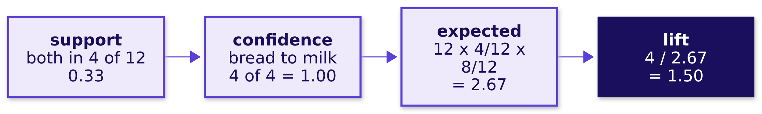
Indian Institute of Technology Gandhinagar
WEEK 4 · DAY 3 · KALPA GLOBAL CAPABILITY CENTRE
ADMINISTERED THROUGH THE COMPETENCY ADVANCEMENT ACADEMY
Answer: d, confidence 1.00 and lift 1.50
How do the three counts read for bread and milk?
All four bread carts hold milk, so confidence is 1.00. Milk is in 8 of 12 carts anyway, so chance alone puts it in 2.67 of the four bread carts. Lift is 4 / 2.67 = 1.50: on these twelve carts, bread brings milk half again as often as chance would.
What does together mean?
What do 40,000 carts say?
What fills the strip?
S10 · 12 / 41
Notes:
LIVE, 7 minutes. Walk the four boxes left to right, writing each number on the board. Read the
reverse confidence too: milk to bread is 4 of 8, 0.50. Lift is the same from both sides.
Transition: what confidence threw away.

Slide 13
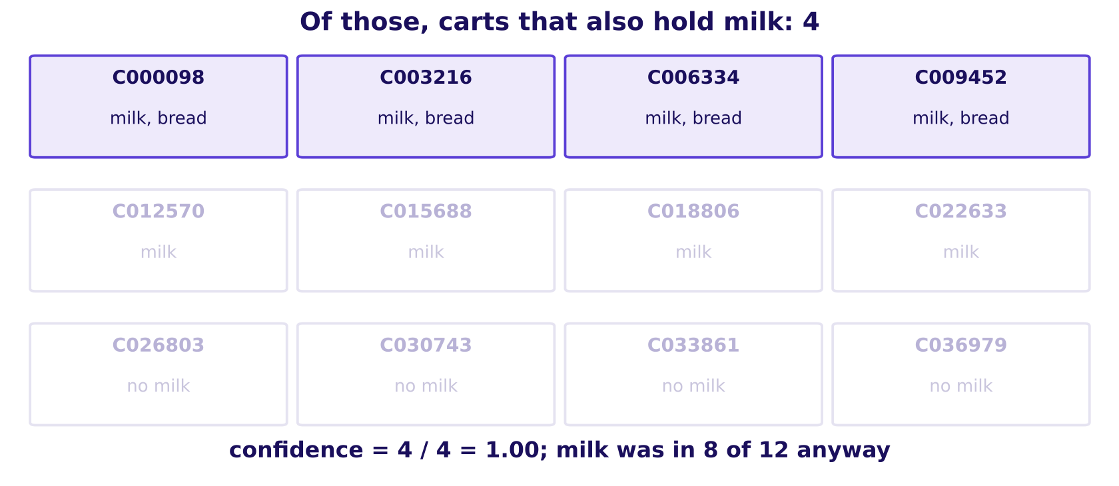
Indian Institute of Technology Gandhinagar
WEEK 4 · DAY 3 · KALPA GLOBAL CAPABILITY CENTRE
ADMINISTERED THROUGH THE COMPETENCY ADVANCEMENT ACADEMY
The trap: 1.00 reads like a bundle
What does confidence throw away that lift keeps?
The twelve carts, then only the four bread carts, then the four that also hold milk
The plausible wrong answer: "confidence 1.00, so show milk beside bread." Confidence looked only inside the four bread carts. The check: milk is in 8 of 12 carts anyway. The fix: read lift, 1.50, on too few carts to trust.
What does together mean?
What do 40,000 carts say?
What fills the strip?
S11 · 13 / 41
Notes:
LIVE, 6 minutes. The GIF beside this still dims the carts in two steps (whiteboards folder). Say
the sentence that stays: confidence shrinks the world to the carts with A; lift compares that world
with all the carts. Explorer: scene W2, two buttons that grey the carts without A, then without B.
Transition: the other pairs on the cards.

Slide 14
Indian Institute of Technology Gandhinagar
WEEK 4 · DAY 3 · KALPA GLOBAL CAPABILITY CENTRE
ADMINISTERED THROUGH THE COMPETENCY ADVANCEMENT ACADEMY
Chips and cold drink beat chance; one cart cannot
What do the other two pairs on the cards read?
Pair | Carts with A | Carts with B | Both | Expected by chance | Lift
chips, cold drink | 3 | 3 | 2 | 12 x 3/12 x 3/12 = 0.75 | 2.67
ice cream, chocolate sauce | 1 | 1 | 1 | 12 x 1/12 x 1/12 = 0.08 | 12
Chips and cold drink share 2 carts where chance gives 0.75: lift 2.67, a pull between two items that are each in only 3 carts. Ice cream and chocolate sauce share a single cart, and one cart makes a lift of 12, a number with nothing under it.
What does together mean?
What do 40,000 carts say?
What fills the strip?
S12 · 14 / 41
Notes:
LIVE, 9 minutes. Groups compute the chips row first, then the ice cream row. Ask: "would you give a
slot to the lift of 12?" Hold the answer for chapter 3's floor. Transition: what the chapter
counted.

Slide 15
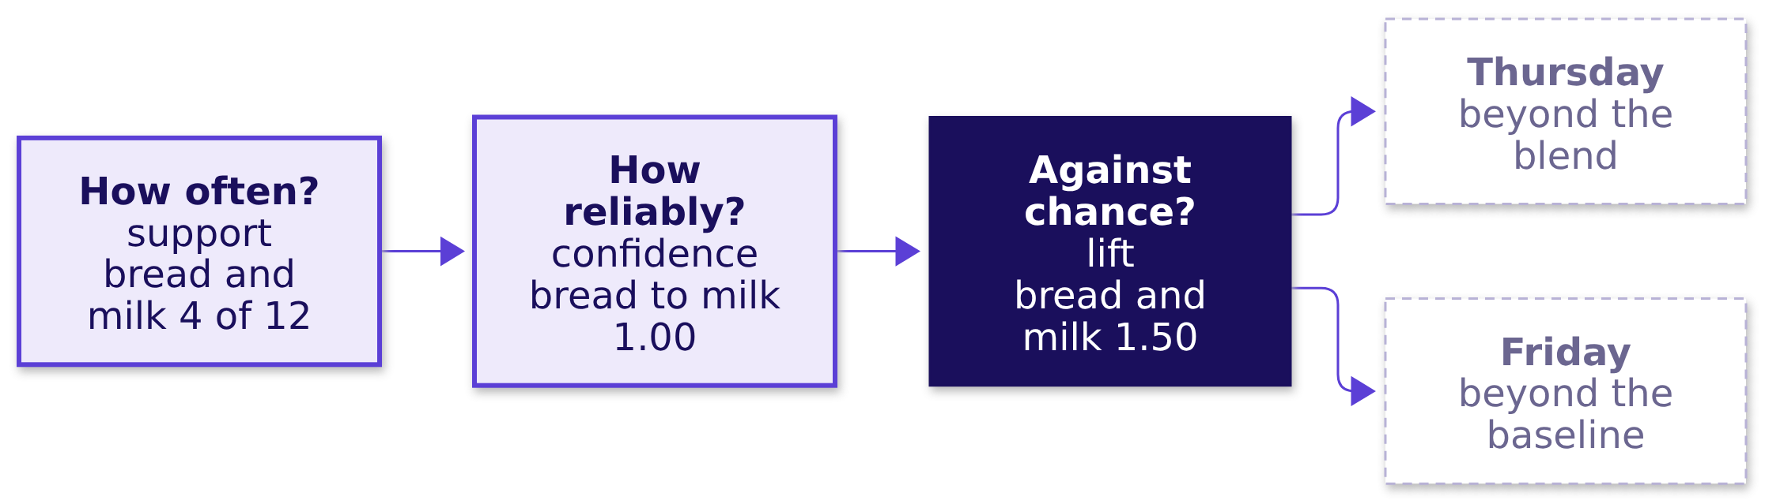
Indian Institute of Technology Gandhinagar
WEEK 4 · DAY 3 · KALPA GLOBAL CAPABILITY CENTRE
ADMINISTERED THROUGH THE COMPETENCY ADVANCEMENT ACADEMY
Three counts, one trap, and what twelve cannot say
What did the twelve carts answer, and where does lift lead this week?
Lift joins the week's map as "beyond chance": Thursday asks the same of a cohort against the blend, Friday of a forecast against the baseline. Twelve carts cannot say whether 1.50 is a real pull or four lucky carts.
What does together mean?
What do 40,000 carts say?
What fills the strip?
S13 · 15 / 41
Notes:
LIVE, 5 minutes. Ask a learner to say all three counts in one breath: how often, how reliably,
against chance. Then the limit. Transition: chapter 2, every cart.

Slide 16
Indian Institute of Technology Gandhinagar
PG DIPLOMA IN AI-ML AND AGENTIC AI ENGINEERING · COHORT 2
ADMINISTERED THROUGH THE COMPETENCY ADVANCEMENT ACADEMY
02
What do 40,000 carts say?
What do support, confidence and lift say across every cart, and why did the click-through fall?
What does together mean?
What do 40,000 carts say?
What fills the strip?
Week 4, Day 3. Instamart Pune: strip click-through fell from 6.1 to 3.8 percent
16 / 41
Notes:
LIVE, 1 minute. Chapter 2 of 3, levels L2 and L3. Notebook 02 opens now: one plain line above every
cell, run top to bottom with the room. Transition: the questions.

Slide 17
Indian Institute of Technology Gandhinagar
WEEK 4 · DAY 3 · KALPA GLOBAL CAPABILITY CENTRE
ADMINISTERED THROUGH THE COMPETENCY ADVANCEMENT ACADEMY
Four questions from counts to the fall
Who needs the answer, and which questions lead to it?
Who needs the answer. The growth lead, who explains the fall on Friday, against a category manager who defends milk because it is the top seller.
QUESTION 1
QUESTION 2
QUESTION 3
QUESTION 4
How often is each item in a cart?
Which pairs sit together most often?
What does lift say about milk?
Why did the click-through fall?
Each item's share of the 40,000 carts.
And is that count the ranking the strip should use?
For every item in at least 2 percent of carts.
Split by what each slot suggested.
What does together mean?
What do 40,000 carts say?
What fills the strip?
S14 · 17 / 41
Notes:
LIVE, 2 minutes. Read the four questions; each ends on a number from notebook 02.
Transition: the first prediction.

Slide 18

Indian Institute of Technology Gandhinagar
WEEK 4 · DAY 3 · KALPA GLOBAL CAPABILITY CENTRE
ADMINISTERED THROUGH THE COMPETENCY ADVANCEMENT ACADEMY
Which pair sits together most often?
Rank all 40,000 carts' pairs by count. Which pair comes first?
A
B
C
D
Chips and cold drink
Bread and toned milk
Ice cream and chocolate sauce
Onions and tomatoes
The pair that beat chance on the cards.
Two daily staples.
The cooking pair.
The lift of 12 on one card.
What does together mean?
What do 40,000 carts say?
What fills the strip?
S15 · 18 / 41
Notes:
LIVE, 3 minutes. Vote, argue in pairs, vote again. Write the split on the board. Transition: the
count.

Slide 19
Indian Institute of Technology Gandhinagar
WEEK 4 · DAY 3 · KALPA GLOBAL CAPABILITY CENTRE
ADMINISTERED THROUGH THE COMPETENCY ADVANCEMENT ACADEMY
Answer: b, bread and milk, in 10,064 carts
What does a ranking by count put on top?
Pair | Carts holding both
bread, toned milk | 10,064
eggs, toned milk | 8,468
curd, toned milk | 7,436
bananas, toned milk | 6,624
onions, toned milk | 6,248
tomatoes, toned milk | 5,680
Every one of the six most frequent pairs holds milk. The plausible wrong answer is "the pairs table is the ranking": ranked by count, milk is the top partner of almost every item, which is exactly what the strip has shown since 7 September. A count rewards the popular item, whatever it is paired with.
What does together mean?
What do 40,000 carts say?
What fills the strip?
S16 · 19 / 41
Notes:
LIVE, 5 minutes. Say the trap aloud: the team built the strip on this table. The check is to ask
how often milk would sit beside bread if the two ignored each other, which is lift's question.
Transition: the five lines that counted this.

Slide 20
Indian Institute of Technology Gandhinagar
WEEK 4 · DAY 3 · KALPA GLOBAL CAPABILITY CENTRE
ADMINISTERED THROUGH THE COMPETENCY ADVANCEMENT ACADEMY
Every pair counted in five lines of pandas
How does the code count 40,000 carts of pairs?
baskets = items.groupby("cart_id").item.apply(set) # one set of items per cart
pair_count = Counter(p for b in baskets # every two items in a cart
for p in combinations(sorted(b), 2)) # sorted, so (a, b) is one key
single = Counter(x for b in baskets for x in b) # carts holding each item
lift = pair_count[("bread", "toned milk")] * n / (single["bread"] * single["toned milk"])
A cart becomes a set of items; every pair inside it adds one to its tally; lift is carts with both, times all carts, over the two items' own counts. The same three counts as the cards, with n = 40,000.
What does together mean?
What do 40,000 carts say?
What fills the strip?
S17 · 20 / 41
Notes:
LIVE, 5 minutes. Code along in notebook 02 (Krish Naik): say what each line is for before running
it. Sorting the pair keeps bread with milk and milk with bread as one key. Interview note: "why
sorted?" is a common follow-up. Transition: bread and milk on every cart.

Slide 21
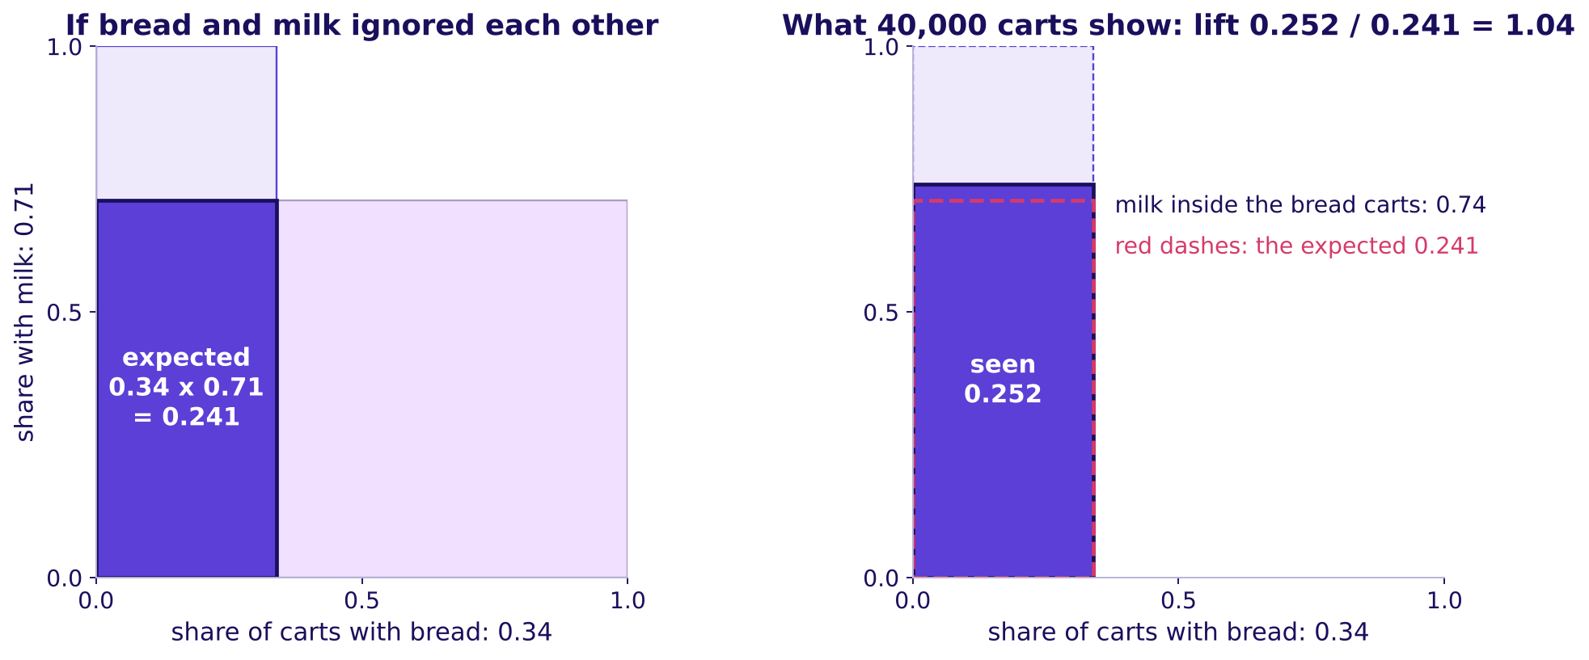
Indian Institute of Technology Gandhinagar
WEEK 4 · DAY 3 · KALPA GLOBAL CAPABILITY CENTRE
ADMINISTERED THROUGH THE COMPETENCY ADVANCEMENT ACADEMY
Twelve carts said lift 1.50; 40,000 carts say 1.04
What does lift say about bread and milk on all the carts?
Bread's share times milk's share as the overlap chance would give, beside the overlap seen in 40,000 carts
On twelve carts lift read 1.50 because all four bread carts happened to hold milk. On 40,000 carts bread to milk reads confidence 0.74 and lift 1.04: milk sits beside bread about as often as it sits in any cart. Chance gives 0.34 x 0.71 = 0.241 of carts holding both; 0.252 do.
What does together mean?
What do 40,000 carts say?
What fills the strip?
S18 · 21 / 41
Notes:
LIVE, 6 minutes. Read the picture as two areas (3Blue1Brown): bread's band times milk's band is
the overlap chance gives; the overlap seen is barely bigger, and lift is the ratio of the two
areas. Say the lesson in one line: a few carts can make a pull look strong, and the full count
shows it near one. Explorer: scene W1, sliders for the two shares and the overlap.
Transition: is bread special, or is every item like this?

Slide 22




Indian Institute of Technology Gandhinagar
WEEK 4 · DAY 3 · KALPA GLOBAL CAPABILITY CENTRE
ADMINISTERED THROUGH THE COMPETENCY ADVANCEMENT ACADEMY
What is a popular item's lift with milk?
For the 50 items in at least 2 percent of carts, what does lift with milk look like?
A
B
C
D
It rises with popularity
Near one for all of them
It falls with popularity
It scatters
The more common the item, the higher its lift.
Every item sits close to chance with milk.
Common items pair less with milk than rare ones.
Each item goes its own way.
What does together mean?
What do 40,000 carts say?
What fills the strip?
S19 · 22 / 41
Notes:
LIVE, 2 minutes. A quick vote. Transition: the chart.

Slide 23
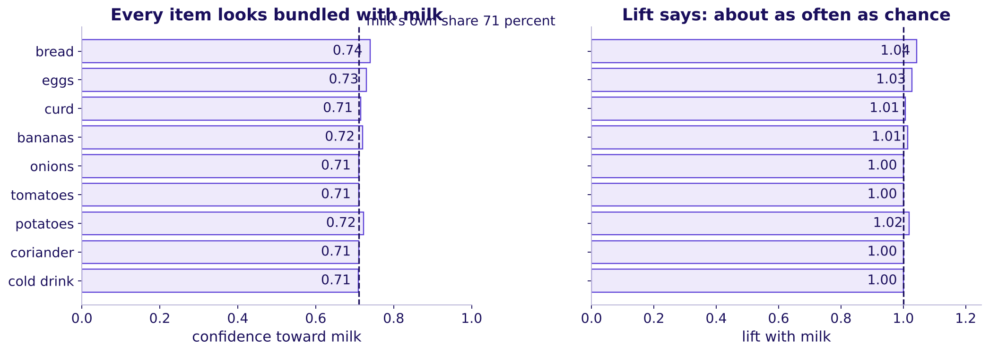
Indian Institute of Technology Gandhinagar
WEEK 4 · DAY 3 · KALPA GLOBAL CAPABILITY CENTRE
ADMINISTERED THROUGH THE COMPETENCY ADVANCEMENT ACADEMY
Answer: b, near one for every common item
Why does every item look bundled with milk, and what does lift say?
Confidence toward milk and lift with milk for the twelve most common items
For all 50 items in at least 2 percent of carts, confidence toward milk runs 0.70 to 0.74, near milk's own 0.71, and lift runs 0.99 to 1.04. Lift divides milk's popularity out.
What does together mean?
What do 40,000 carts say?
What fills the strip?
S20 · 23 / 41
Notes:
LIVE, 5 minutes. The left panel is what the new strip ranked by; the right panel is what it should
have read. Feynman line for the room to repeat: "the item in every bag is the worst bundle
partner, because it was going in the bag anyway". Explorer: scene W3, the milk share slider.
Transition: a company that met this trap.

Slide 24
Indian Institute of Technology Gandhinagar
WEEK 4 · DAY 3 · KALPA GLOBAL CAPABILITY CENTRE
ADMINISTERED THROUGH THE COMPETENCY ADVANCEMENT ACADEMY
Amazon met the same popular-partner trap
Where has a real recommender met the item that sits beside everything?
Amazon. Its recommender team wrote that counting how often buyers of A also bought B would have made a bestseller such as Harry Potter the top recommendation beside everything. The fix compared what was seen with what chance would predict, which is lift in spirit. Years later the team measured the base rate per purchase, because heavy buyers inflate every count (Amazon Science, checked 12 October 2026).
The cost of the trap is a recommendation slot spent on an item the shopper was buying anyway.
What does together mean?
What do 40,000 carts say?
What fills the strip?
S21 · 24 / 41
Notes:
LIVE, 3 minutes. Name the decision and the cost: a slot shown to everyone that moves nothing. The
heavy-buyer point returns in chapter 3 as the top tenth of customers. Transition: the four pairs
side by side.

Slide 25
Indian Institute of Technology Gandhinagar
WEEK 4 · DAY 3 · KALPA GLOBAL CAPABILITY CENTRE
ADMINISTERED THROUGH THE COMPETENCY ADVANCEMENT ACADEMY
Four pairs, three numbers each, one second route
What do support, confidence both ways and lift read for four pairs?
Pair | Support | Confidence A to B | Confidence B to A | Lift
bread, toned milk | 25.2% | 0.74 | 0.35 | 1.04
eggs, toned milk | 21.2% | 0.73 | 0.30 | 1.03
chips, cold drink | 5.0% | 0.42 | 0.41 | 3.39
ice cream, chocolate sauce | 0.25% | 0.06 | 0.18 | 4.60
The second route: lift is also confidence over the partner's share. Bread to milk 0.74 / 0.71 = 1.04, and milk to bread 0.35 / 0.34 = 1.04. Both routes agree and lift reads the same from either side.
What does together mean?
What do 40,000 carts say?
What fills the strip?
S22 · 25 / 41
Notes:
LIVE, 4 minutes. Point at the chips row: confidence 0.42 looks weak beside 0.74, yet its lift is
3.39. Confidence and lift can rank pairs in opposite orders. Notebook 02 asserts the second route
for three pairs. Transition: why did the click-through fall?

Slide 26




Indian Institute of Technology Gandhinagar
WEEK 4 · DAY 3 · KALPA GLOBAL CAPABILITY CENTRE
ADMINISTERED THROUGH THE COMPETENCY ADVANCEMENT ACADEMY
Why did the strip's click-through fall?
It fell from 6.1 to 3.8 percent after 7 September. Which explanation will the log support?
A
B
C
D
Shoppers changed habits
Fewer cart-page views
Milk fills the slots
The strip moved down
After the monsoon, carts shifted away from the old pairs.
Fewer people opened the cart page in September.
Milk now takes the slots and few shoppers click it.
The strip sits lower on the page than before.
What does together mean?
What do 40,000 carts say?
What fills the strip?
S23 · 26 / 41
Notes:
LIVE, 2 minutes. Vote. A view count says nothing about a rate, which rules out b for anyone who
thinks it through; let the room find that. Transition: the split.

Slide 27
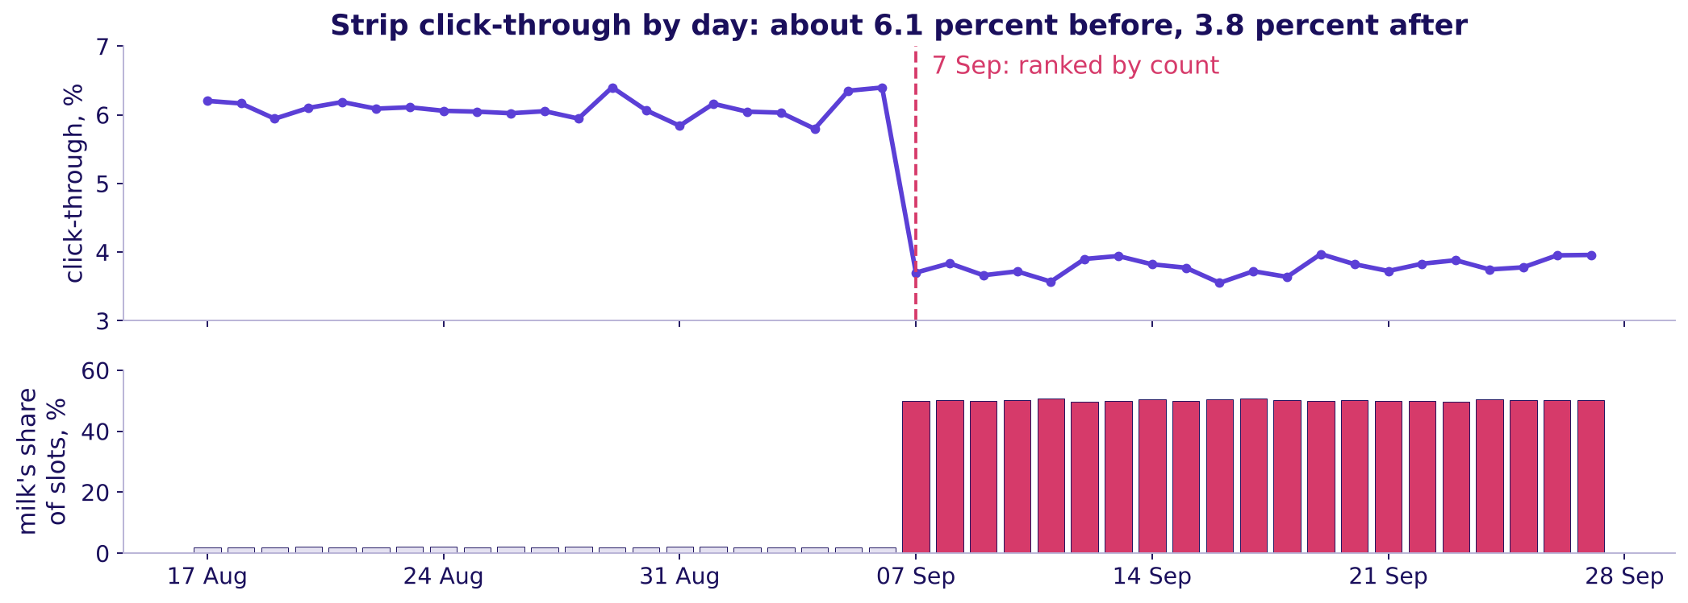
Indian Institute of Technology Gandhinagar
WEEK 4 · DAY 3 · KALPA GLOBAL CAPABILITY CENTRE
ADMINISTERED THROUGH THE COMPETENCY ADVANCEMENT ACADEMY
Answer: c, milk took half the slots at 1.2 percent
Where in the log does the fall sit?
Daily strip click-through from 17 August to 27 September, and milk's share of slot impressions
Milk took half the slot impressions at 1.2 percent; everything else clicked at 6.4, up from 6.2. Half of 1.2 plus half of 6.4 is 3.8. The plausible wrong answer, "shoppers changed after the monsoon", fails the split by suggested item.
What does together mean?
What do 40,000 carts say?
What fills the strip?
S24 · 27 / 41
Notes:
LIVE, 6 minutes. This is notebook 02's your-turn cell: each learner splits the after rows by
whether the slot suggested milk before the answer is shown. Read the daily line first: it moves a
few tenths of a point every day and steps down on 7 September. The strip shows packs, so one view
can show milk in two slots. Transition: which slot milk took.

Slide 28
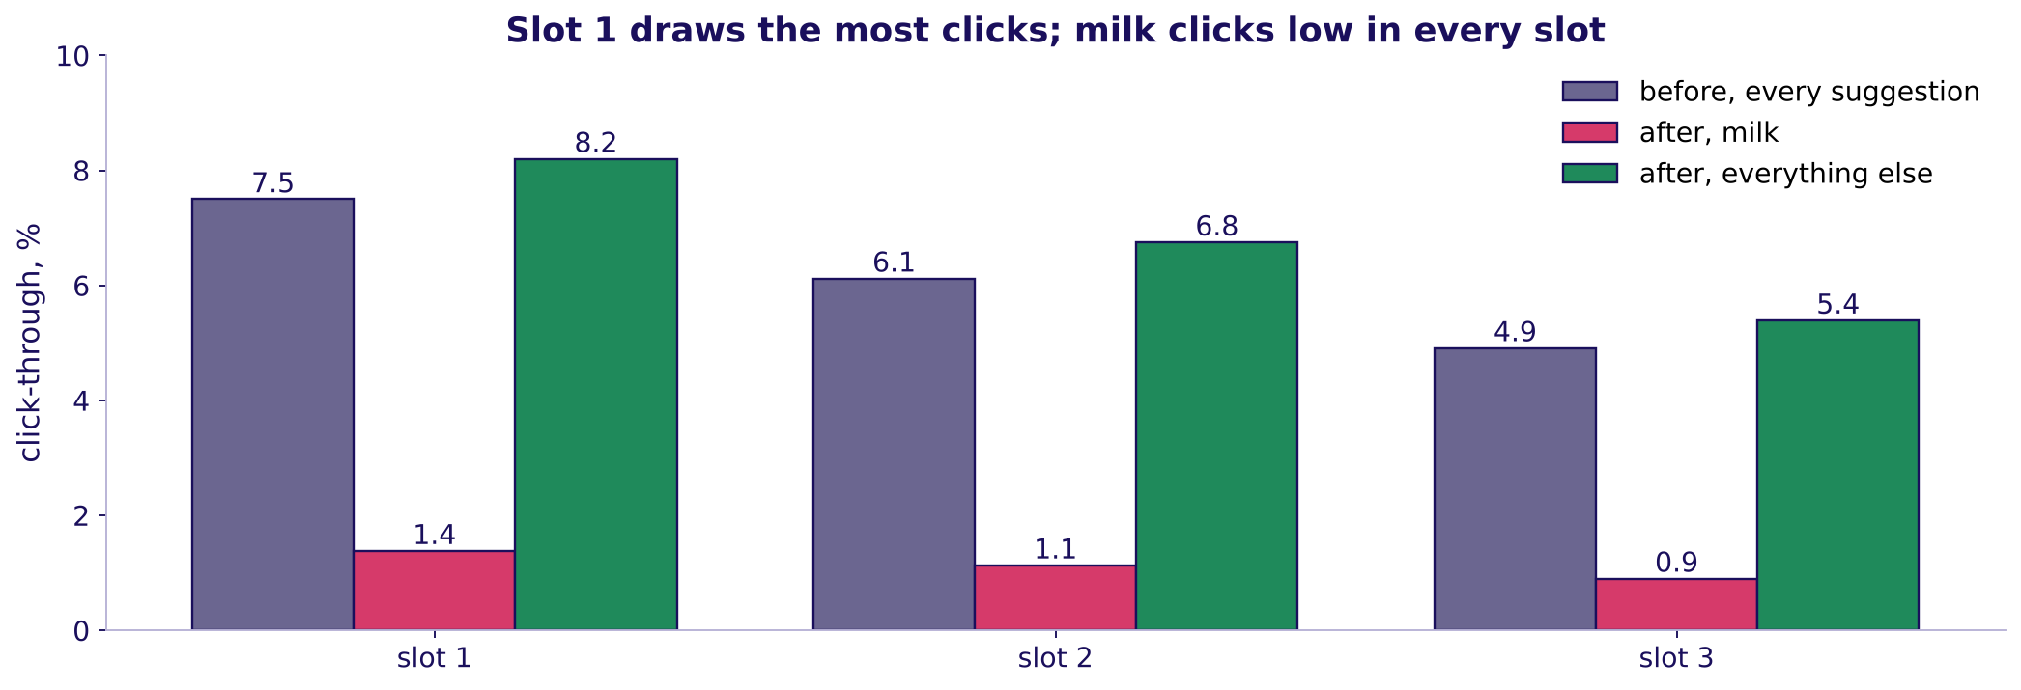
Indian Institute of Technology Gandhinagar
WEEK 4 · DAY 3 · KALPA GLOBAL CAPABILITY CENTRE
ADMINISTERED THROUGH THE COMPETENCY ADVANCEMENT ACADEMY
Slot 1 draws the most clicks, and milk took it
Does the position of a slot change its click-through?
Click-through by slot position: before the change, milk after, everything else after
After the change, slot 1 draws 8.2 percent for a suggestion other than milk and slot 3 draws 5.4. Milk clicks at 1.4, 1.1 and 0.9 percent and holds 70 percent of slot 1. The best slot went to the item nobody needed reminding of.
What does together mean?
What do 40,000 carts say?
What fills the strip?
S25 · 28 / 41
Notes:
LIVE, 3 minutes. This is the strip's own pull: whatever slot 1 shows draws clicks. It returns in
chapter 3 as a caveat. Transition: the chapter's answer.

Slide 29
Indian Institute of Technology Gandhinagar
WEEK 4 · DAY 3 · KALPA GLOBAL CAPABILITY CENTRE
ADMINISTERED THROUGH THE COMPETENCY ADVANCEMENT ACADEMY
Lift is the count popularity cannot fool
What did 40,000 carts answer?
HOW OFTEN?
MOST OFTEN TOGETHER?
WHAT LIFT SAYS
WHY THE FALL
Milk in 71 percent of carts
Pairs with milk
Near one with milk
Milk's half of the slots
Bread 34, eggs 29, curd 26 percent.
Bread and milk lead with 10,064 carts, so a count fills the strip with milk.
Bread 1.04, eggs 1.03; chips and cold drink 3.39.
1.2 percent on milk, 6.4 on the rest, 3.8 blended.
What does together mean?
What do 40,000 carts say?
What fills the strip?
S26 · 29 / 41
Notes:
LIVE, 3 minutes. Read the four lines, then break for 10 minutes. On the board before the break: the
week map with "lift: beyond chance" added under Wednesday. Transition after the break: chapter 3,
what fills the strip.

Slide 30
Indian Institute of Technology Gandhinagar
PG DIPLOMA IN AI-ML AND AGENTIC AI ENGINEERING · COHORT 2
ADMINISTERED THROUGH THE COMPETENCY ADVANCEMENT ACADEMY
03
What fills the strip?
Which pairs should fill the strip, what is a slot worth in rupees, and what can the counts not tell us?
What does together mean?
What do 40,000 carts say?
What fills the strip?
Week 4, Day 3. Instamart Pune: strip click-through fell from 6.1 to 3.8 percent
30 / 41
Notes:
LIVE, 1 minute. Chapter 3 of 3, levels L4 and L5; part one now, part two unguided after lunch.
Notebook 03. Transition: the questions.

Slide 31
Indian Institute of Technology Gandhinagar
WEEK 4 · DAY 3 · KALPA GLOBAL CAPABILITY CENTRE
ADMINISTERED THROUGH THE COMPETENCY ADVANCEMENT ACADEMY
Four questions from a ranking to rupees
Who needs the answer, and which questions lead to it?
Who needs the answer. The growth lead, who takes a ranked list and a rupee figure to Friday's review, where the category manager will argue that milk anchors the cart.
QUESTION 1
QUESTION 2
QUESTION 3
QUESTION 4
Which pairs beat chance by enough, on enough carts?
What should the watch list do with a strong thin pair?
What is a slot worth in rupees?
What can the counts not tell us?
Lift above a support floor.
Ice cream and chocolate sauce.
Views, click-through, adds, margin.
Six doubts and the check for each.
What does together mean?
What do 40,000 carts say?
What fills the strip?
S27 · 31 / 41
Notes:
LIVE, 2 minutes. Read the four questions. Transition: the problem first.

Slide 32
Indian Institute of Technology Gandhinagar
WEEK 4 · DAY 3 · KALPA GLOBAL CAPABILITY CENTRE
ADMINISTERED THROUGH THE COMPETENCY ADVANCEMENT ACADEMY
Which of these four pairs would you promote?
Each pair shows its support and its lift. Which takes the strip's first slot?
A
B
C
D
Bread and toned milk
Chips and cold drink
Ice cream and chocolate sauce
Onions and tomatoes
Support 25.2 percent, lift 1.04.
Support 5.0 percent, lift 3.39.
Support 7.5 percent, lift 1.70.
Support 0.25 percent, lift 4.60.
What does together mean?
What do 40,000 carts say?
What fills the strip?
S28 · 32 / 41
Notes:
LIVE, 4 minutes. Vote, argue, vote again (Brilliant: the problem before the explanation). The split
is usually b against c. Transition: every pair on one picture.

Slide 33
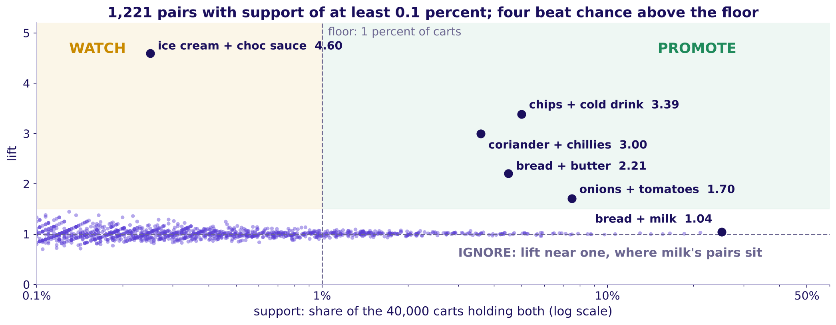
Indian Institute of Technology Gandhinagar
WEEK 4 · DAY 3 · KALPA GLOBAL CAPABILITY CENTRE
ADMINISTERED THROUGH THE COMPETENCY ADVANCEMENT ACADEMY
Answer: b, the strongest lift above the floor
Where does every pair sit, and which four ways of ranking compete?
Every pair with support of at least 0.1 percent: lift against support, with the 1 percent floor
Above a floor of 1 percent of carts (400 carts), 246 pairs qualify and four beat chance clearly: chips and cold drink 3.39, coriander and green chillies 3.00, bread and butter 2.21, onions and tomatoes 1.70. The fifth reads 1.09.
What does together mean?
What do 40,000 carts say?
What fills the strip?
S29 · 33 / 41
Notes:
LIVE, 8 minutes. Walk the regions: promote above the floor and well above one; watch, high lift
below the floor; ignore, near one, where milk's pairs sit. The floor is a decision: 0.5 percent
admits more pairs on thinner ground, 2 percent fewer. Explorer: scene W5, the floor slider counts
the pairs that survive. Transition: the thin pair.

Slide 34
Indian Institute of Technology Gandhinagar
WEEK 4 · DAY 3 · KALPA GLOBAL CAPABILITY CENTRE
ADMINISTERED THROUGH THE COMPETENCY ADVANCEMENT ACADEMY
The watch list holds lift 4.60 on 100 carts
What should a team do with a strong pair that almost nobody buys?
Ice cream and chocolate sauce read lift 4.60, the strongest pair between 0.2 and 1 percent support, on 100 carts in four weeks of this sample. A slot is shown on every cart page, so a pair that thin cannot repay it. It goes on a watch list: tried in two zones for two weeks and promoted only if its click-through beats the slot's own record. Acting on lift alone is the trap a floor exists to stop.
What does together mean?
What do 40,000 carts say?
What fills the strip?
S30 · 34 / 41
Notes:
LIVE, 4 minutes. How long a trial must run to trust its answer is a sample-size question, parked by
name for the faculty session (tentative). Transition: what a slot is worth.

Slide 35

Indian Institute of Technology Gandhinagar
WEEK 4 · DAY 3 · KALPA GLOBAL CAPABILITY CENTRE
ADMINISTERED THROUGH THE COMPETENCY ADVANCEMENT ACADEMY
What does re-ranking recover in a month?
Milk holds half the slot impressions at 1.2 percent. Moving them to pairs that click at 6.4 recovers how much?
A
B
C
D
About Rs 50,000
About Rs 2 lakh
About Rs 6 lakh
About Rs 50 lakh
A rounding error on the city's month.
One slot's gap for half a month.
The gap on milk's share of all three slots.
Sales from every add the strip makes.
What does together mean?
What do 40,000 carts say?
What fills the strip?
S31 · 35 / 41
Notes:
LIVE, 3 minutes. Guess first, then build it. Transition: the cascade.

Slide 36
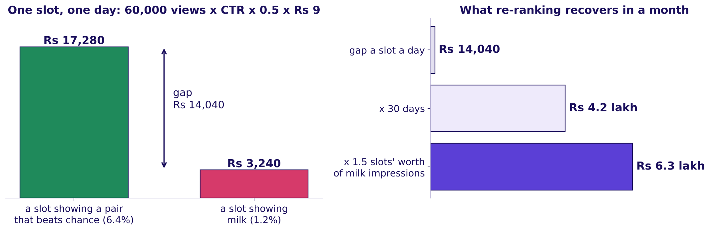
Indian Institute of Technology Gandhinagar
WEEK 4 · DAY 3 · KALPA GLOBAL CAPABILITY CENTRE
ADMINISTERED THROUGH THE COMPETENCY ADVANCEMENT ACADEMY
Answer: c, about Rs 6.3 lakh a month
How do four numbers build a slot's value, and what does a month recover?
One slot a day at 6.4 and at 1.2 percent, and the month recovered by moving milk's impressions
60,000 views a day (strip_log) x click-through x 0.5 adds per click (range 0.4 to 0.6) x Rs 9 margin an add (range Rs 7 to 11). Milk's half of three slots is 1.5 slots' worth: Rs 4.2 lakh x 1.5 = Rs 6.3 lakh a month, from Rs 3.9 lakh to Rs 9.3 lakh across the ranges.
What does together mean?
What do 40,000 carts say?
What fills the strip?
S32 · 36 / 41
Notes:
LIVE, 7 minutes. Build it left to right on the board. Each factor is said with its source and its
range. Ask what the Rs 3,240 hides: milk earns Rs 2 a pouch, so a milk slot earns even less than
the Rs 9 assumption gives it. Explorer: scene W4, the strip simulator, rank by count against rank
by lift. Transition: the number people get wrong.

Slide 37
Indian Institute of Technology Gandhinagar
WEEK 4 · DAY 3 · KALPA GLOBAL CAPABILITY CENTRE
ADMINISTERED THROUGH THE COMPETENCY ADVANCEMENT ACADEMY
The trap: Rs 80,197 of sales is not the gain
Which number would overstate the slot four times over?
The plausible wrong answer books sales: a slot at 6.4 percent makes 1,920 adds a day, each selling for about Rs 42, so Rs 80,197 a day of "strip revenue". The growth lead keeps the margin, Rs 17,280. If the strip ever adds a bundle discount, the discount is margin handed back for adds that might have happened anyway. Swiggy's own letter describes its Maxxsaver discount as margin returned to the user, the cost line a rupee case must carry (W4, checked 12 October 2026).
What does together mean?
What do 40,000 carts say?
What fills the strip?
S33 · 37 / 41
Notes:
LIVE, 5 minutes. Ask: "which line of the cascade would a bundle discount change?" The margin per
add falls by the discount. Transition: what the counts cannot tell us.

Slide 38
Indian Institute of Technology Gandhinagar
WEEK 4 · DAY 3 · KALPA GLOBAL CAPABILITY CENTRE
ADMINISTERED THROUGH THE COMPETENCY ADVANCEMENT ACADEMY
Six doubts the counts cannot settle alone
What must the growth lead say aloud, and what check settles each doubt?
Doubt | The check | What it showed
Together is no proof of cause | A holdout that changes the strip | Monday's faculty session on A/B testing (tentative)
Heavy buyers | Count each customer once | Chips and cold drink 3.39 falls to 2.56; milk's pair stays 1.04
Curd stock-out | Set aside two zones in week three | Curd's share 26.0 rises to 27.8 percent; its lift with milk stays 1.01
Time of day | Morning carts only | Morning carts hold milk 80 percent of the time; bread with milk still about 1.04
The strip's own pull | Click-through by slot | Slot 1 draws 8.2 percent, slot 3 5.4; milk is low in all three
Per cart against per customer | The heavy-buyer check | Answered above
What does together mean?
What do 40,000 carts say?
What fills the strip?
S34 · 38 / 41
Notes:
LIVE, 6 minutes. One doubt at a time, each with its number from notebook 03. A check that comes
back clean is said in one line, as the time-of-day check does. Transition: the heavy tenth.

Slide 39
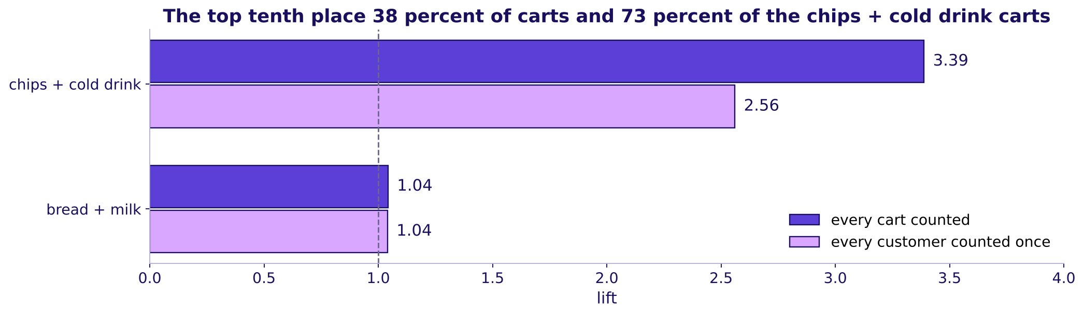
Indian Institute of Technology Gandhinagar
WEEK 4 · DAY 3 · KALPA GLOBAL CAPABILITY CENTRE
ADMINISTERED THROUGH THE COMPETENCY ADVANCEMENT ACADEMY
Counted once per customer, the party pair shrinks
How much of chips and cold drink comes from a few heavy shoppers?
Lift per cart against lift with every customer counted once, for chips and cold drink and for bread and milk
The top tenth of customers place 38 percent of the carts and 73 percent of the carts holding both chips and a cold drink. Counted with every customer once, the pair's lift falls from 3.39 to 2.56 and still beats chance; bread and milk stays at 1.04. The pair keeps its slot, and the growth lead says the smaller number.
What does together mean?
What do 40,000 carts say?
What fills the strip?
S35 · 39 / 41
Notes:
LIVE, 4 minutes. "Counted once" means each cart weighs one over its customer's number of carts, so
a shopper with fourteen carts counts as much as a shopper with one. Transition: the stock-out.

Slide 40
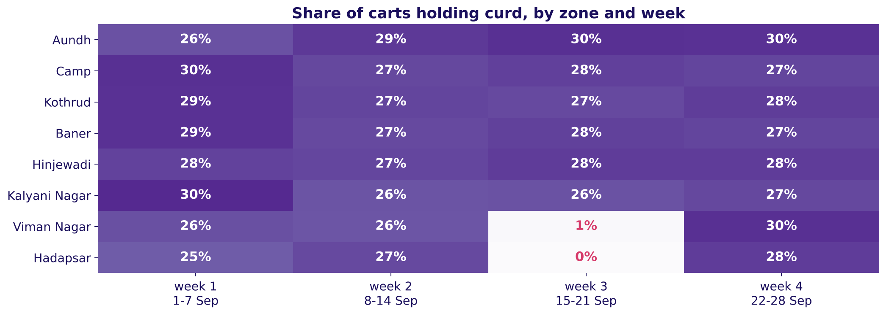
Indian Institute of Technology Gandhinagar
WEEK 4 · DAY 3 · KALPA GLOBAL CAPABILITY CENTRE
ADMINISTERED THROUGH THE COMPETENCY ADVANCEMENT ACADEMY
Curd ran out in two zones in week three
What does a stock-out do to support, and what does it leave alone?
Share of carts holding curd, by zone and week: Hadapsar and Viman Nagar near zero from 15 to 21 September
In Hadapsar and Viman Nagar from 15 to 21 September, curd is in 12 of 2,583 carts. Set those aside and curd's share rises from 26.0 to 27.8 percent; its lift with milk stays 1.01. A stock-out cuts the count, never the pull.
What does together mean?
What do 40,000 carts say?
What fills the strip?
S36 · 40 / 41
Notes:
LIVE, 4 minutes. A caveat is a labelled line and a recomputation, never a disclaimer. Transition:
the morning's answer.

Slide 41
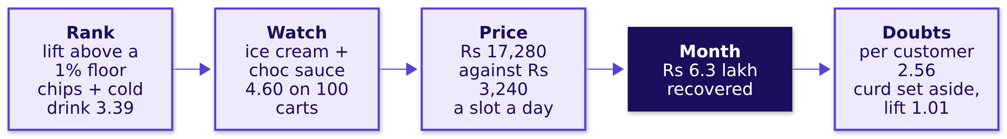
Indian Institute of Technology Gandhinagar
WEEK 4 · DAY 3 · KALPA GLOBAL CAPABILITY CENTRE
ADMINISTERED THROUGH THE COMPETENCY ADVANCEMENT ACADEMY
The morning's answer, ready for the afternoon
What does the growth lead now hold?
After lunch each group re-ranks the strip, prices its three slots and answers the category manager, who will say that milk anchors the cart.
What does together mean?
What do 40,000 carts say?
What fills the strip?
S37 · 41 / 41
Notes:
LIVE, 2 minutes. Read the chain left to right. The afternoon's first 35 minutes run unguided on
notebook 03. Transition: lunch.

