Slide 1


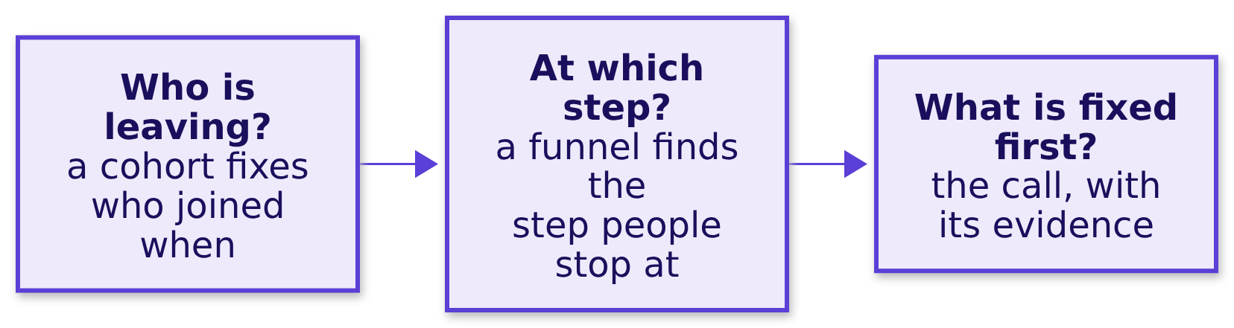
Indian Institute of Technology Gandhinagar
WEEK 4 · DAY 4 · COHORT AND FUNNEL
ADMINISTERED THROUGH THE COMPETENCY ADVANCEMENT ACADEMY
Thursday's topic: cohort and funnel
Who is leaving, and at which step do we lose them?
Thursday's topic, as the curriculum words it. Cohort and funnel: why Retail-Plus frequency fell, and where the loss actually happens.
The day climbs these three questions twice: first on a gym and a college, invented so every number can be counted by hand, then on Zomato Gold in Chennai, an illustrative case, and in the lab on Kalpa Retail's Retail-Plus tier.
Who joined when?
Where is the floor?
What is a blend made of?
Which step owns a loss?
Who entered when?
What is the 38 made of?
Which stage owns the loss?
S1 · 1 / 73
Notes:
LIVE, 1 minute. Read the topic as the curriculum words it, then the three questions. Say once,
in plain words, the shape of the day: five topics first on examples small enough to count by hand,
then the same topics on a real company's synthetic data, then Kalpa in the lab.
Transition: where Thursday sits in the week.

Slide 2
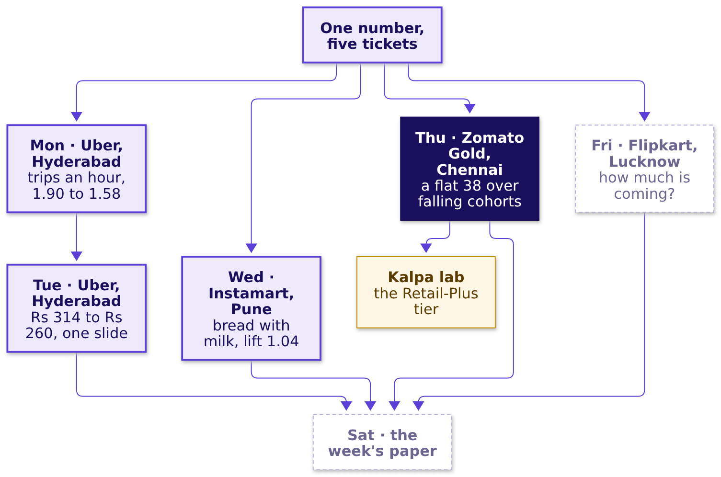
Indian Institute of Technology Gandhinagar
WEEK 4 · DAY 4 · COHORT AND FUNNEL
ADMINISTERED THROUGH THE COMPETENCY ADVANCEMENT ACADEMY
The week map, Thursday lit
Where does today sit, and what did the days before it find?
Who joined when?
Where is the floor?
What is a blend made of?
Which step owns a loss?
Who entered when?
What is the 38 made of?
Which stage owns the loss?
S2 · 2 / 73
Notes:
LIVE, 1 minute. Monday asked whether the number paid for measures what is wanted, Tuesday put
one denominator on one slide, Wednesday judged a pair against chance. Thursday judges a cohort
against the blend. Friday stays dashed. The explorer's home screen draws the same map (day
control: Thu).
Transition: the day's five topics.

Slide 3
Indian Institute of Technology Gandhinagar
WEEK 4 · DAY 4 · COHORT AND FUNNEL
ADMINISTERED THROUGH THE COMPETENCY ADVANCEMENT ACADEMY
Five topics, each with its chapter and notebook
Which topics does Thursday teach, in which chapter, for how long, and with which notebook?
# | The topic, as the curriculum words it | Taught in | Minutes | Notebook | Applied in
1 | Cohort construction | SECTION 1 | 25 | 01 cohort construction | SECTIONs 5 and 6
2 | Funnel stages, drop-off, denominators | SECTION 4 | 25 | 04 funnel denominators | SECTION 7
3 | Retention curves: shape and floor | SECTION 2 | 15 | 02 retention curves | SECTION 6
4 | Blended numbers against cohort truth | SECTION 3 | 20 | 03 blended vs cohort truth | SECTION 6
5 | The fix-first decision and its evidence | SECTION 8, after lunch | 10 | 08 fix first evidence | SECTION 9 and the lab
The chapters run 1, 3, 4, 2, 5: topics 1, 3 and 4 share one invented gym and one table read three ways, topic 2 brings an invented college, and topic 5 opens the afternoon right before the call that uses it.
Who joined when?
Where is the floor?
What is a blend made of?
Which step owns a loss?
Who entered when?
What is the 38 made of?
Which stage owns the loss?
S3 · 3 / 73
Notes:
LIVE, 3 minutes. Read the five topics in the curriculum's words, top to bottom, then the order
they are taught in and why: the three retention topics build one table once and read it three
ways, the funnel is a second picture and a second example, and the decision is a pattern, so it
sits right before the Zomato Gold call that applies it. A trainer matching the row to the deck
reads this table: every topic has its chapter, its minutes and its notebook.
Transition: how the five connect.

Slide 4
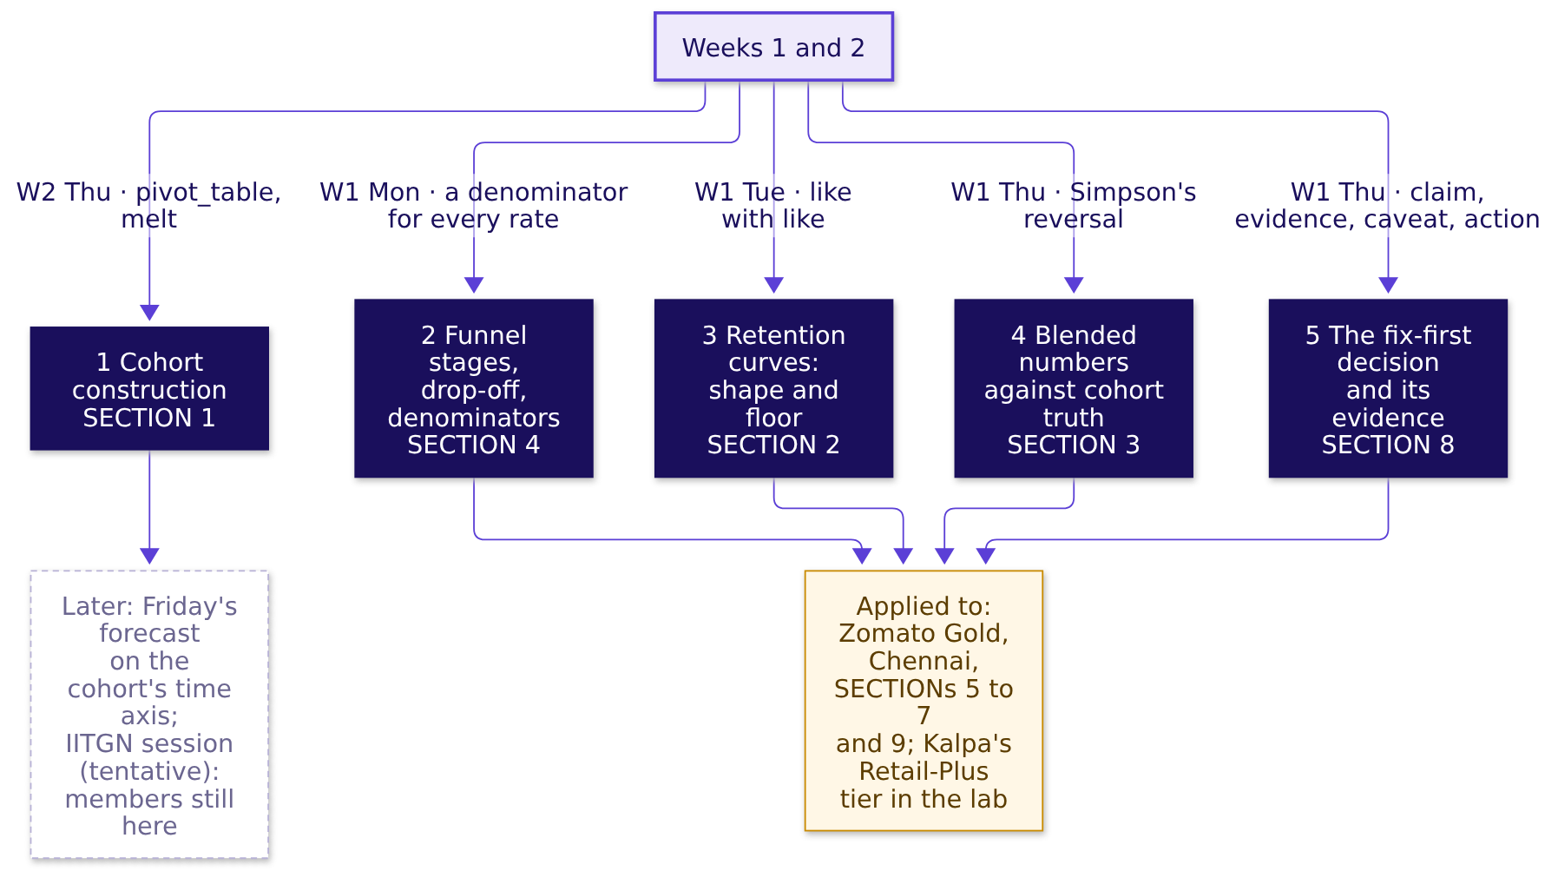
Indian Institute of Technology Gandhinagar
WEEK 4 · DAY 4 · COHORT AND FUNNEL
ADMINISTERED THROUGH THE COMPETENCY ADVANCEMENT ACADEMY
How the five topics connect, and where they go
What does each topic rest on from earlier weeks, what does it feed, and where is it used?
Who joined when?
Where is the floor?
What is a blend made of?
Which step owns a loss?
Who entered when?
What is the 38 made of?
Which stage owns the loss?
S4 · 4 / 73
Notes:
LIVE, 3 minutes. Walk the map in words a newcomer can repeat: a cohort fixes who joined when (1),
so one cohort's share month by month is a curve whose shape and floor can be read (3); one number
over all cohorts is a weighted blend, which a growing young cohort can hold flat while every
cohort falls (4); a funnel is the other picture, a chain of steps where each rate divides by the
step before in one unit (2); the fix-first call takes the cohort and the step and carries its
evidence (5). Weeks 1 and 2 gave the pieces: the denominator habit, the segment reversal,
pivot_table. Each chapter's last slide lights its own node on a map like this one.
Transition: the case these topics are used on.

Slide 5
Indian Institute of Technology Gandhinagar
WEEK 4 · DAY 4 · COHORT AND FUNNEL
ADMINISTERED THROUGH THE COMPETENCY ADVANCEMENT ACADEMY
The ticket: a flat 38 and a release on Android
Where will the five topics be used, and what is due Friday?
Measure | Value
Month-two retention on the dashboard, June to September 2026 | 38 percent each month
Month one (the first full month after joining), by signup month, January to August | 58, 56, 55, 53, 52, 50, 49, 31 percent
The August cohort, grown by a sale week | 13,000 members, 2.6 times the 5,000 a month of January to July
Members on Android, add-to-cart to order, before and after 14 September | 58 to 44 percent
Members on iOS; non-members on Android | 57 to 56 percent; 52 to 51 percent
Search to menu view and menu view to add-to-cart, per session, September | 118 percent; 34 percent
Gold is the app's paid membership, with free delivery. Month-two retention is the dashboard's name for the share of members two or more months past their signup month who ordered in the month. Data. members (53,089 who joined January to September), member_months (orders per member per month, from the order records), events (one row for each stage an app session reached, a session being one visit to the app; August and September; with the platform and the checkout version, v1 or the new v2; Gold members and 4,000 non-members). The ask, due Friday. Cohort problem or everyone problem; which funnel stage owns the loss; what to fix first, with the evidence. Known caveats. The home carousel opens a menu without a search; sessions and members are different units; the August cohort was bought on a discount; the release renamed one Android event, which the app team has mapped.
Illustrative case. The company is real; the situation and the data are synthetic, built for this class.
Who joined when?
Where is the floor?
What is a blend made of?
Which step owns a loss?
Who entered when?
What is the 38 made of?
Which stage owns the loss?
S5 · 5 / 73
Notes:
Source for Gold's free delivery: Zomato's shareholder letter of 19 May 2023,
https://www.bseindia.com/xml-data/corpfiling/AttachHis/42b3bf3b-1edb-4da7-849a-87ca9da27ff8.pdf (checked 12 October 2026)
LIVE, 2 minutes. This slide is the destination, shown before the topics are taught. Say the label
line aloud first: the company is real, the situation and the data are synthetic. Read the ask,
then point at two numbers only: the flat 38 and the 58 to 44 on Android. Say that each of the five
topics will be needed to read this ticket, and that the full read opens the case in SECTION 5,
after the topics.
Transition: the first topic, cohort construction, on a gym.

Slide 6

Indian Institute of Technology Gandhinagar
PG DIPLOMA IN AI-ML AND AGENTIC AI ENGINEERING · COHORT 2
ADMINISTERED THROUGH THE COMPETENCY ADVANCEMENT ACADEMY
01
Cohort construction
Who joined when?
Group people by the month they joined, count each group at each age since joining, and compare groups at the same age, on one gym branch's thirty joiners counted by hand.
Who joined when?
Where is the floor?
What is a blend made of?
Which step owns a loss?
Who entered when?
What is the 38 made of?
Which stage owns the loss?
Week 4, Day 4. Cohort and funnel: who is leaving, and at which step?
6 / 73
Notes:
LIVE, 25 minutes. Laptops closed until the code glimpse; notebook 01 afterwards or in the lab.
Hand out: drill c1 with the rules slide; it runs on paper after S11, 4 minutes. If late: S12 in
one sentence, and drill c1 moves to the lab.
Styles: Veritasium (the owner's reading, then predict and vote), StatQuest (the count aloud,
one row at a time), 3Blue1Brown (the triangle, the formula named last), Krish Naik (one
pivot_table, line by line), ByteByteGo (the map node). The gym is invented; say so once.
Transition: the chapter's questions.

Slide 7
Indian Institute of Technology Gandhinagar
WEEK 4 · DAY 4 · COHORT AND FUNNEL
ADMINISTERED THROUGH THE COMPETENCY ADVANCEMENT ACADEMY
Cohort construction: four questions, one gym
Who needs the answer, and which smaller questions lead to it?
Who needs the answer. The owner of a neighbourhood gym (invented), who wants to know which month's joiners keep coming, so that a retention offer reaches the batch that needs it; read by calendar month, the offer goes to the wrong batch. A cohort is a batch, as a coaching centre runs a June batch and a July batch: everyone who joined in the same month.
The questions on the way. Four, and each is answered with a count before the next is asked.
1
2
3
4
Which batch looks best in April?
What does each batch keep at each age?
Why is the table a triangle?
How does code count the same table?
The owner's reading, one calendar month
Thirty joiners counted by hand
Rows by joining month, columns by age
One pivot_table, month zero left out
Who joined when?
Where is the floor?
What is a blend made of?
Which step owns a loss?
Who entered when?
What is the 38 made of?
Which stage owns the loss?
S6 · 7 / 73
Notes:
LIVE, 2 minutes. Read the four questions; each is answered with a count before the next is asked.
The coaching-batch line is the only place the batches appear: a learner who has sat in a coaching
class already knows what a cohort is.
Transition: the owner's reading.

Slide 8
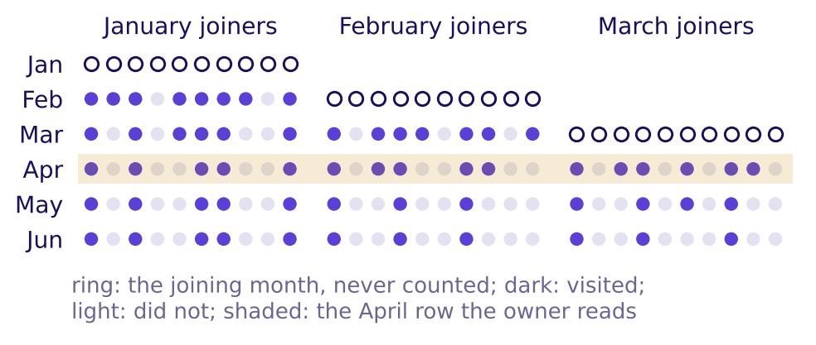
Indian Institute of Technology Gandhinagar
WEEK 4 · DAY 4 · COHORT AND FUNNEL
ADMINISTERED THROUGH THE COMPETENCY ADVANCEMENT ACADEMY
Predict: which batch keeps most in month one?
In April the owner reads 5, 5 and 6 of 10 January, February and March joiners and calls March best. Counted by months since joining, which batch keeps the most in its own month one?
a) March, as the owner reads it
b) February
c) January
d) All three keep the same share
The gym branch's thirty joiners, January to June 2026, one row each (invented)
Who joined when?
Where is the floor?
What is a blend made of?
Which step owns a loss?
Who entered when?
What is the 38 made of?
Which stage owns the loss?
S7 · 8 / 73
Notes:
LIVE, 3 minutes. Month one is the first full month after joining; the joining month is month
zero, ringed on the picture. Vote first, in writing, then pairs argue for one minute and vote
again (peer instruction). Expect a from tables that trust the shaded April column.
Transition: the count, by hand.

Slide 9
Indian Institute of Technology Gandhinagar
WEEK 4 · DAY 4 · COHORT AND FUNNEL
ADMINISTERED THROUGH THE COMPETENCY ADVANCEMENT ACADEMY
Answer: January keeps 8 of 10, March 6 of 10
What does each batch keep at each age, counted by hand?
Joined, 10 each (invented) | Age 1 | Age 2 | Age 3 | Age 4 | Age 5
January | 8 | 6 | 5 | 5 | 5
February | 7 | 5 | 3 | 3
March | 6 | 4 | 3
The answer is c. Age is the month minus the joining month, and the joining month is age zero, never counted, so a January joiner's age one is February. At age one the batches keep 8, 7 and 6 of 10: March, best in April, is the weakest at the same age. April's column mixed January at age three, February at age two and March at age one, so its 16 of 30 names no batch.
Who joined when?
Where is the floor?
What is a blend made of?
Which step owns a loss?
Who entered when?
What is the 38 made of?
Which stage owns the loss?
S8 · 9 / 73
Notes:
LIVE, 5 minutes. Count January's row aloud from the register: down the February column for the
ten January joiners (8), then March (6), then April, May and June (5 each). Then February's row
from March on, then March's from April on. Build the table on the board as it is counted. Say the
word cohort only now: a cohort is everyone who joined in the same month, and the table has one
row per cohort and one column per age.
Transition: the table as a picture.

Slide 10
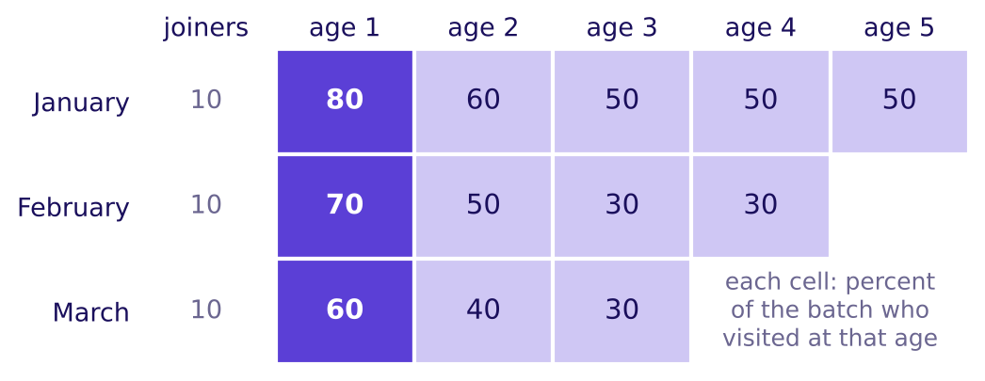
Indian Institute of Technology Gandhinagar
WEEK 4 · DAY 4 · COHORT AND FUNNEL
ADMINISTERED THROUGH THE COMPETENCY ADVANCEMENT ACADEMY
The cohort table is a triangle
Why does each row stop where it does, and what does one cell mean?
The gym's cohort table: percent of each batch who visited, by age (invented)
Each row is a cohort, everyone who joined in one month, and each column is an age. By June, March's joiners have lived only three ages, so their row is short, and a newer cohort's row is always shorter: that is why a cohort table is a triangle. Named last, the formula: retention of cohort c at age k = members of c who visited at age k ÷ the members of c. January at age two: 6 ÷ 10 = 60 percent.
Who joined when?
Where is the floor?
What is a blend made of?
Which step owns a loss?
Who entered when?
What is the 38 made of?
Which stage owns the loss?
S9 · 10 / 73
Notes:
LIVE, 3 minutes. Point at one cell and say its sentence: of the ten who joined in January, six
visited in their second month after joining. Point at the empty corner: those months have not
happened yet for the later batches. Then the formula, last, as the shorthand for the sentence.
Transition: the same table in code.

Slide 11
Indian Institute of Technology Gandhinagar
WEEK 4 · DAY 4 · COHORT AND FUNNEL
ADMINISTERED THROUGH THE COMPETENCY ADVANCEMENT ACADEMY
One pivot_table builds the same triangle
How does pandas count the triangle from the register?
PLACE = {"jan": 0, "feb": 1, "mar": 2, "apr": 3, "may": 4, "jun": 5}
long = roster.melt(id_vars=["member_id", "joined"], var_name="month",
value_name="visited").dropna() # one row per member per month
long["age"] = long["month"].map(PLACE) - long["joined"].map(PLACE) # joining month = age 0
tri = long[long["age"] >= 1].pivot_table(index="joined", columns="age",
values="visited", aggfunc="mean")
This is Week 2 Thursday's pivot_table with one new line: age >= 1 keeps month zero out of the table. Each cell is the mean of ones and zeros, which is the share who visited, so the code prints 0.8, 0.6, 0.5, 0.5, 0.5 for January, the row counted by hand.
Who joined when?
Where is the floor?
What is a blend made of?
Which step owns a loss?
Who entered when?
What is the 38 made of?
Which stage owns the loss?
S10 · 11 / 73
Notes:
LIVE, 3 minutes. Read the code a line at a time: melt makes one row per member per month (the
shape called panel data), the age line subtracts two places in the year, the filter drops month
zero, and pivot_table puts cohorts on the rows and ages on the columns. Ask what the table would
show without the filter: a column of 100 percent at age zero, since everyone visits the month
they join. Notebook 01 runs the cell and checks the code against the hand count.
Transition: the rules.

Slide 12

Indian Institute of Technology Gandhinagar
WEEK 4 · DAY 4 · COHORT AND FUNNEL
ADMINISTERED THROUGH THE COMPETENCY ADVANCEMENT ACADEMY
Four rules for building a cohort table
What does an analyst do every time a retention table is built, and what does an interviewer listen for?
01
A cohort is everyone who joined in the same month, and a member keeps her cohort for good.
02
The joining month is age zero and is never counted; age one is the first full month after it.
03
Every cell divides by the whole cohort, never by the members who visited the month before.
04
Cohorts are compared at the same age, since one calendar month mixes ages and names no cohort.
IN THE INTERVIEW
[S] "Retention dropped; walk me through your investigation." A strong first move: "I'd confirm what the number counts and that the count is right, then fix each member's joining month and compare cohorts at the same age before I read any blended number." The tag says how often it is asked: [S] a staple everywhere, [F] frequent in GCC (global capability centre) and product screens, [D] a question that sets a candidate apart.
Who joined when?
Where is the floor?
What is a blend made of?
Which step owns a loss?
Who entered when?
What is the 38 made of?
Which stage owns the loss?
S11 · 12 / 73
Notes:
LIVE, 3 minutes. Read the four rules; learners photograph this slide. One learner says the
interview line aloud in under twenty seconds. Then drill c1 on paper, 4 minutes: three items on
the gym, letters posted before S12.
Transition: where this topic goes next.

Slide 13
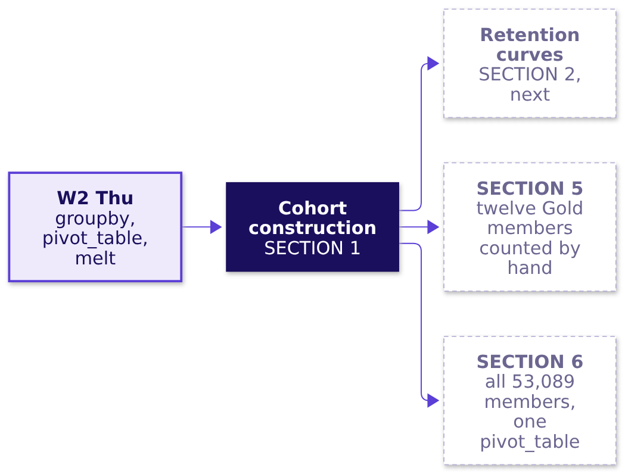
Indian Institute of Technology Gandhinagar
WEEK 4 · DAY 4 · COHORT AND FUNNEL
ADMINISTERED THROUGH THE COMPETENCY ADVANCEMENT ACADEMY
Cohort construction feeds three later chapters
Where does this topic come from, and which chapters use it next?
Where it shows up. Swiggy Instamart publishes its cohorts as this same triangle, each cohort's spend set against one cohort's spend in its first quarter, and the table states no denominator (Swiggy's Q2 FY26 shareholder letter, checked 12 October 2026). Before trusting any cohort chart, ask per what.
Who joined when?
Where is the floor?
What is a blend made of?
Which step owns a loss?
Who entered when?
What is the 38 made of?
Which stage owns the loss?
S12 · 13 / 73
Notes:
Source:
https://www.swiggy.com/corporate/wp-content/uploads/2025/10/Q2-FY2026-Shareholder-letter.pdf (checked 12 October 2026)
LIVE, 2 minutes. Light the node on the concept map. Swiggy's table is the same shape as the gym's,
with spend in place of visits: per user who joined, or per user who stayed? The denominator
decides what the chart says.
Transition: the next topic, the rows read as curves.

Slide 14
Indian Institute of Technology Gandhinagar
PG DIPLOMA IN AI-ML AND AGENTIC AI ENGINEERING · COHORT 2
ADMINISTERED THROUGH THE COMPETENCY ADVANCEMENT ACADEMY
02
Retention curves: shape and floor
Where is the floor?
Read one cohort's row as a curve: how fast it falls in its first months, and the level it stops falling at, on the same gym's three batches.
Who joined when?
Where is the floor?
What is a blend made of?
Which step owns a loss?
Who entered when?
What is the 38 made of?
Which stage owns the loss?
Week 4, Day 4. Cohort and funnel: who is leaving, and at which step?
14 / 73
Notes:
LIVE, 15 minutes. Laptops closed; notebook 02 afterwards. Hand out: drill c2, on paper after S18,
3 minutes. If late: S16's table in one sentence, and drill c2 moves to the lab. Styles: Veritasium (predict January's
age five), 3Blue1Brown (the three curves, then the words shape and floor), StatQuest (churn on
ten members), the case method (Blinkit's own retention figure).
Transition: the chapter's questions.

Slide 15
Indian Institute of Technology Gandhinagar
WEEK 4 · DAY 4 · COHORT AND FUNNEL
ADMINISTERED THROUGH THE COMPETENCY ADVANCEMENT ACADEMY
Retention curves: four questions, one gym
Who needs the answer, and which smaller questions lead to it?
Who needs the answer. The gym's owner, who staffs the floor for the regulars: the level a batch stops falling at says how many joiners became regulars, and a level read too early staffs for members who are about to leave.
The questions on the way. Four, each read off the gym's three batches.
1
2
3
4
How fast does a batch fall?
Where does it stop falling?
When can a floor be called?
Which batch is strongest, fairly?
The curve's shape in its first ages
The floor, and churn beside it
Two ages that read the same
The same age for all three
Who joined when?
Where is the floor?
What is a blend made of?
Which step owns a loss?
Who entered when?
What is the 38 made of?
Which stage owns the loss?
S13 · 15 / 73
Notes:
LIVE, 1 minute. The table from SECTION 1 is unchanged; this chapter reads its rows.
Transition: the prediction.

Slide 16
Indian Institute of Technology Gandhinagar
WEEK 4 · DAY 4 · COHORT AND FUNNEL
ADMINISTERED THROUGH THE COMPETENCY ADVANCEMENT ACADEMY
Predict: what does January read at age five?
January's ten joiners read 80, 60 and then 50 percent at ages one to three. What do they read at age five?
a) About 25 percent, the fall carrying on
b) 50 percent
c) Under 10 percent
d) Back up to 80 percent
Who joined when?
Where is the floor?
What is a blend made of?
Which step owns a loss?
Who entered when?
What is the 38 made of?
Which stage owns the loss?
S14 · 16 / 73
Notes:
LIVE, 2 minutes. Vote. Most of the room extends the line: a and c. A learner who says b, ask why;
the reason should be that the members still coming by age three are the ones who stay.
Transition: the three curves.

Slide 17
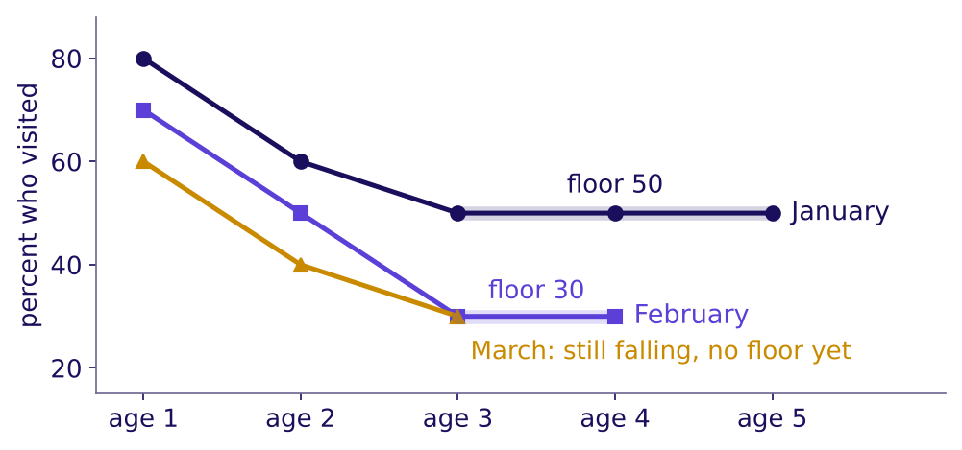
Indian Institute of Technology Gandhinagar
WEEK 4 · DAY 4 · COHORT AND FUNNEL
ADMINISTERED THROUGH THE COMPETENCY ADVANCEMENT ACADEMY
Answer: January holds at 50 from age three
What do the three batches' curves look like, and where does each stop falling?
The gym's three batches as curves, with their floors (invented)
The answer is b: 80, 60, 50, 50, 50. A curve's shape is how fast it falls in its first ages: January fell 20 points from age one to age two, then 10, then none. Its floor is the level where it stops falling: January's is 50, the five of ten who made visiting a habit, and February's is 30. March reads 60, 40, 30 and is still falling, so its floor is not known yet.
Who joined when?
Where is the floor?
What is a blend made of?
Which step owns a loss?
Who entered when?
What is the 38 made of?
Which stage owns the loss?
S15 · 17 / 73
Notes:
LIVE, 2 minutes. Trace January with a finger: steep, then flat. A point is the gap between two
percentages, so 80 to 60 is a fall of 20 points. Then February's floor and March's open end.
Transition: churn, the same row counted as losses.

Slide 18
Indian Institute of Technology Gandhinagar
WEEK 4 · DAY 4 · COHORT AND FUNNEL
ADMINISTERED THROUGH THE COMPETENCY ADVANCEMENT ACADEMY
Churn is the share lost, counted two ways
What share of January's joiners has stopped by each age, and what share of last month's visitors stopped?
January's ten joiners (invented) | Age 1 | Age 2 | Age 3 | Age 4 | Age 5
Still visiting, percent of 10 | 80 | 60 | 50 | 50 | 50
Churned so far, percent of 10 | 20 | 40 | 50 | 50 | 50
Stopped since the month before, percent | 20 | 25 | 16.7 | 0 | 0
Named last. In this branch nobody who stopped came back, which is what lets both counts work. Churn so far is 100 less the retention. Month-to-month churn divides those who stopped by those still visiting the month before: 2 of 8 at age two, 25 percent. Where members do come back, a team first picks when a member counts as gone, for example 60 days with no visit, and labels that a choice. A chart that prints a churn number says which of the two it is.
Who joined when?
Where is the floor?
What is a blend made of?
Which step owns a loss?
Who entered when?
What is the 38 made of?
Which stage owns the loss?
S16 · 18 / 73
Notes:
LIVE, 2 minutes. In this branch no member came back after stopping, so the members visiting at
each age are the ones who were still visiting the age before, which is what lets the third row
divide by last month's visitors. Ask which row the owner should print on a wall chart; either,
with its name.
Transition: when can a floor be called?

Slide 19

Indian Institute of Technology Gandhinagar
WEEK 4 · DAY 4 · COHORT AND FUNNEL
ADMINISTERED THROUGH THE COMPETENCY ADVANCEMENT ACADEMY
A floor needs two ages that agree
February read 50 at age two; why was that not its floor, and how does code test for one?
WHAT BREAKS
After February's age two, 5 of 10, the owner staffed for a floor of five regulars. Ages three and four read 3 of 10, so the plan counted two regulars too many.
The rule we use, this programme's own. Call a floor only when two ages in a row read within a point of each other; until then the curve is still falling. A batch of ten moves in steps of ten points, so on the gym that means two equal ages.
def floor_of(row, within=0.01): # row: shares at ages 1, 2, 3, ...
pairs = zip(row, row[1:])
near = (b for a, b in pairs if abs(a - b) <= within)
return next(near, None) # None: still falling
# floor_of([0.8, 0.6, 0.5, 0.5, 0.5]) gives 0.5; floor_of([0.6, 0.4, 0.3]) gives None
Who joined when?
Where is the floor?
What is a blend made of?
Which step owns a loss?
Who entered when?
What is the 38 made of?
Which stage owns the loss?
S17 · 19 / 73
Notes:
LIVE, 3 minutes. The two-ages rule, within a point, is this programme's rule of thumb, so say it
as ours; exact equality never fires on a large cohort's shares, which is why the code allows a
point. A floor
read from one age is the plausible wrong answer: it looks settled after a big drop. March's row
returns None: a young cohort has not lived enough ages to show a floor, which is the plain-words
version of what the IITGN block (tentative) calls censoring.
Transition: the rules.

Slide 20
Indian Institute of Technology Gandhinagar
WEEK 4 · DAY 4 · COHORT AND FUNNEL
ADMINISTERED THROUGH THE COMPETENCY ADVANCEMENT ACADEMY
Four rules for reading a retention curve
What does an analyst read off every retention curve, and what does an interviewer listen for?
01
A retention curve is one cohort's row of the table, drawn by age.
02
The shape says how fast a cohort leaves; the floor says how many stay where members who stop never return, and otherwise the share active in a typical month.
03
Cohorts are ranked at the same age, never by the latest calendar month.
04
A young cohort has no floor yet, since it has not lived the ages that would show one.
IN THE INTERVIEW
[F] "How would you use cohort analysis to find a retention issue?" Read each cohort's shape and floor, rank cohorts at the same age, and look for the cohort whose curve starts lower or never flattens.
Blinkit, Eternal's quick-commerce app: in the fourth quarter after joining, 46 percent of a cohort's customers still ordered, on average, and the cohort's order value was 150 percent of its first quarter's (Eternal's Q1 FY27 letter of 22 July 2026, checked 12 October 2026). The customers who stay carry the business: fewer of them, each spending more.
Who joined when?
Where is the floor?
What is a blend made of?
Which step owns a loss?
Who entered when?
What is the 38 made of?
Which stage owns the loss?
S18 · 20 / 73
Notes:
Sources:
https://www.eternal.com/blog/q1fy27/ (checked 12 October 2026), which links the letter itself:
https://drive.google.com/file/d/1jb9KWd4Ap4RTKHFHxzEOO7jgQqVZEGcd/view (checked 12 October 2026)
LIVE, 1 minute. Read the rules. Blinkit's two numbers measure different things: 46 is a share of
the cohort's customers and 150 compares the cohort's order value with its first quarter's. Then
drill c2 on paper, 3 minutes, letters posted before S19.
Transition: where this topic goes next.

Slide 21
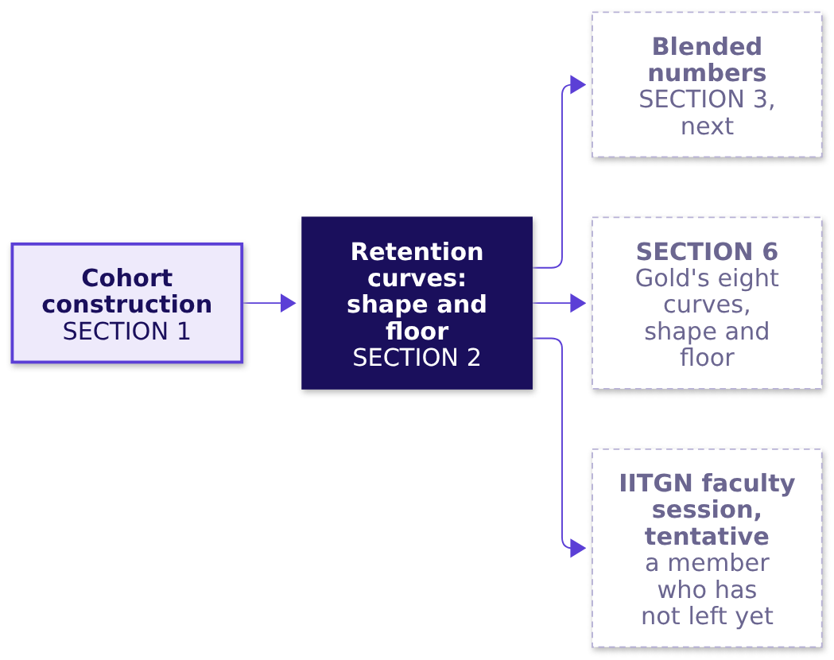
Indian Institute of Technology Gandhinagar
WEEK 4 · DAY 4 · COHORT AND FUNNEL
ADMINISTERED THROUGH THE COMPETENCY ADVANCEMENT ACADEMY
The floor feeds the blend and the case
Where does this topic come from, and which chapters use it next?
Rank at the same age, read the floor only once two ages agree within a point (our rule), and leave a young cohort's floor open.
Who joined when?
Where is the floor?
What is a blend made of?
Which step owns a loss?
Who entered when?
What is the 38 made of?
Which stage owns the loss?
S19 · 21 / 73
Notes:
LIVE, 1 minute. Light the node. The IITGN faculty session this afternoon is tentative; name it
only as the place where a member who has not left yet gets a name.
Transition: the next topic, one number over every cohort.

Slide 22
Indian Institute of Technology Gandhinagar
PG DIPLOMA IN AI-ML AND AGENTIC AI ENGINEERING · COHORT 2
ADMINISTERED THROUGH THE COMPETENCY ADVANCEMENT ACADEMY
03
Blended numbers against cohort truth
What is a blend made of?
Rebuild one number over all members as an average weighted by cohort size, and see how a large new cohort holds it flat while the older members fall, on the whole gym's dashboard.
Who joined when?
Where is the floor?
What is a blend made of?
Which step owns a loss?
Who entered when?
What is the 38 made of?
Which stage owns the loss?
Week 4, Day 4. Cohort and funnel: who is leaving, and at which step?
22 / 73
Notes:
LIVE, 20 minutes. Laptops closed until the code; notebook 03 afterwards. Hand out: drill c3, on
paper after S25, 3 minutes. If late: S26's origin in one sentence, and drill c3 moves to the lab.
Styles: Veritasium (the
room predicts what a big new cohort does to the dashboard), 3Blue1Brown (the stacked bars, the
formula named last), StatQuest (the weighted average on two numbers), ByteByteGo (the Week 1
Thursday link). Explorer scene Th2 lets a learner slide the new cohort's size; it draws the
same 100 and 400 as a coaching centre's batches A and B.
Transition: the chapter's questions.

Slide 23
Indian Institute of Technology Gandhinagar
WEEK 4 · DAY 4 · COHORT AND FUNNEL
ADMINISTERED THROUGH THE COMPETENCY ADVANCEMENT ACADEMY
Blended numbers: four questions, one dashboard
Who needs the answer, and which smaller questions lead to it?
Who needs the answer. The gym's owner, who reads one dashboard number each month, the share of members who visited; a flat number read as "nothing changed" leaves a falling cohort with no action.
The questions on the way. Four, from the dashboard's one number down to the cohorts under it.
1
2
3
4
What does February's dashboard read?
What are the cohorts doing under it?
What is the dashboard's number made of?
Which quick average is wrong?
100 older members and 400 January joiners
Each cohort's own rate
An average weighted by size
The plain mean of the rates
Who joined when?
Where is the floor?
What is a blend made of?
Which step owns a loss?
Who entered when?
What is the 38 made of?
Which stage owns the loss?
S20 · 23 / 73
Notes:
LIVE, 1 minute. The dashboard is the whole gym's, all branches; the branch's thirty joiners from
SECTION 1 are part of the January, February and March joiners.
Transition: the prediction.

Slide 24
Indian Institute of Technology Gandhinagar
WEEK 4 · DAY 4 · COHORT AND FUNNEL
ADMINISTERED THROUGH THE COMPETENCY ADVANCEMENT ACADEMY
Predict: what does February's dashboard read?
The dashboard counts a member from the month after she joins. January read 50 of 100 older members, 50 percent. In February the older members fall to 40 of 100, and the 400 January joiners, in their month one, visit at 52.5 percent. What does February read?
The gym's dashboard (invented) | January | February
Older members, joined before 2026 | 50 of 100 | 40 of 100
January joiners | their joining month, not counted | 210 of 400
a) It falls, because the older members fell
b) It rises, because 400 members joined
c) It holds at 50 percent
d) It cannot be read without more months
Who joined when?
Where is the floor?
What is a blend made of?
Which step owns a loss?
Who entered when?
What is the 38 made of?
Which stage owns the loss?
S21 · 24 / 73
Notes:
LIVE, 3 minutes. Vote, argue, vote again. Most of the room says a: when a group falls, the average
falls with it. Hold the reveal until every table has committed.
Transition: the reveal.

Slide 25
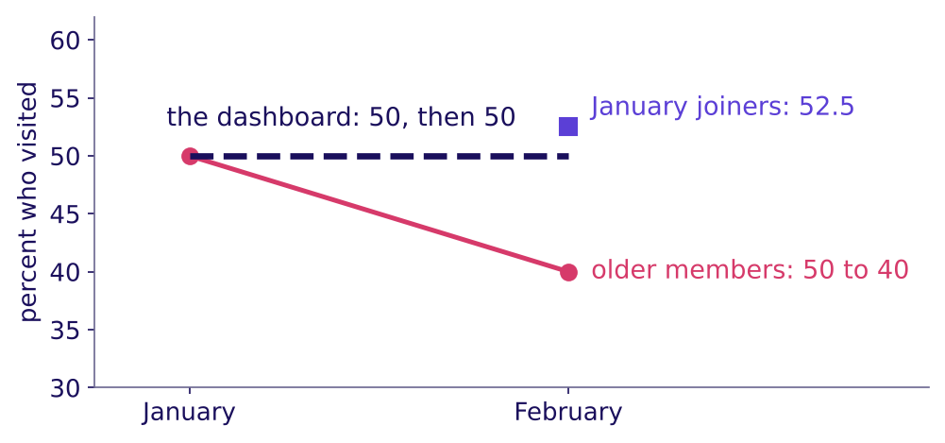
Indian Institute of Technology Gandhinagar
WEEK 4 · DAY 4 · COHORT AND FUNNEL
ADMINISTERED THROUGH THE COMPETENCY ADVANCEMENT ACADEMY
Answer: 250 of 500, 50 percent, unmoved
How can the dashboard stand still while the older members fall ten points?
The gym's dashboard holds at 50 while the older members fall (invented)
The answer is c. February counts 40 older members plus 210 January joiners who visited: 250 of 500, 50 percent, the same as January's 50 of 100. The older members fell ten points, from 50 to 40 percent, and the one number over everyone did not move, because 400 joiners at their high early rate now carry four votes in five.
Who joined when?
Where is the floor?
What is a blend made of?
Which step owns a loss?
Who entered when?
What is the 38 made of?
Which stage owns the loss?
S22 · 25 / 73
Notes:
LIVE, 3 minutes. Point at the dashed line, then the falling line under it. Next month the
January joiners age too, and unless another large batch joins, the dashboard starts to fall.
Transition: what the 50 is made of.

Slide 26
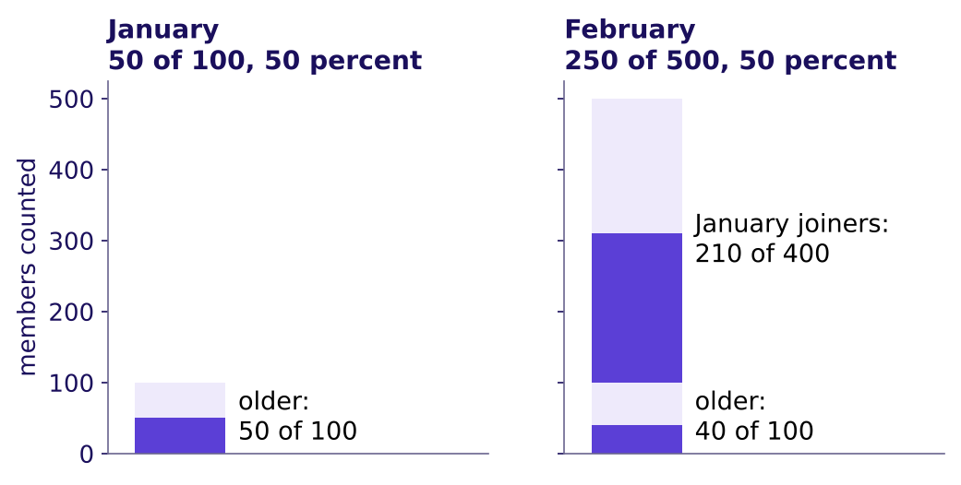
Indian Institute of Technology Gandhinagar
WEEK 4 · DAY 4 · COHORT AND FUNNEL
ADMINISTERED THROUGH THE COMPETENCY ADVANCEMENT ACADEMY
A blend is an average weighted by size
What is February's 50 made of, cohort by cohort?
January and February's counts, stacked by cohort (invented)
Named last, the formula: blend = sum of (cohort size × cohort rate) ÷ sum of cohort sizes = (100 × 0.40 + 400 × 0.525) ÷ 500 = (40 + 210) ÷ 500 = 50 percent. Rebuilt from its cohorts, the blend lands on the direct count, 250 of 500; a rebuild that misses the count has left a cohort out or counted one twice.
Who joined when?
Where is the floor?
What is a blend made of?
Which step owns a loss?
Who entered when?
What is the 38 made of?
Which stage owns the loss?
S23 · 26 / 73
Notes:
LIVE, 3 minutes. Read the two stacks, then the formula last, as the shorthand for what the bars
already showed. The weighted average and the direct count are the same number by arithmetic, so
the rebuild is a check on the cohorts, not on the formula.
Transition: the quick average that gets it wrong.

Slide 27
Indian Institute of Technology Gandhinagar
WEEK 4 · DAY 4 · COHORT AND FUNNEL
ADMINISTERED THROUGH THE COMPETENCY ADVANCEMENT ACADEMY
The plain mean of the rates is the wrong number
Why is 46.25 percent wrong, and how does code catch it?
WHAT BREAKS
Averaging the two rates, (40 + 52.5) ÷ 2 = 46.25 percent, gives 100 older members the same vote as 400 joiners. It is neither the count, 50 percent, nor the older members' own 40, and a report of "46.25 percent, down 3.75 points" describes no group in the gym.
feb = dash[(dash["example"] == "gym") & (dash["month"] == "2026-02")]
rate = feb["visited"] / feb["members"]
direct = feb["visited"].sum() / feb["members"].sum() # 250 / 500 = 0.50
weighted = (feb["members"] * rate).sum() / feb["members"].sum() # equals direct
plain = rate.mean() # 0.4625, one vote each
Who joined when?
Where is the floor?
What is a blend made of?
Which step owns a loss?
Who entered when?
What is the 38 made of?
Which stage owns the loss?
S24 · 27 / 73
Notes:
LIVE, 3 minutes. The check that catches it: the weighted average must equal the direct count, and
the plain mean does not. The plain mean matches the blend only when the cohorts are the same size
or read the same rate. Notebook 03 asserts both lines.
Transition: the rules.

Slide 28
Indian Institute of Technology Gandhinagar
WEEK 4 · DAY 4 · COHORT AND FUNNEL
ADMINISTERED THROUGH THE COMPETENCY ADVANCEMENT ACADEMY
Four rules for a blended number
What does an analyst do before believing one number over many cohorts?
01
A number over several cohorts is their average weighted by cohort size.
02
It moves when the mix of young and old cohorts moves, as well as when behaviour does.
03
Rebuild it from its cohorts, and check the rebuild equals the direct count, before believing it.
04
A plain mean of cohort rates gives each cohort one vote, so it matches the blend only when the cohorts are the same size or read the same rate.
IN THE INTERVIEW
[F] "Blended retention is flat while every cohort declines; how?" A mix shift: a growing young cohort at its high early rate carries more weight each month, so the average holds while each cohort falls; read the cohorts at the same age.
Swiggy: users who ordered at least once a month rose 27.4 percent in a year while orders per user fell from 4.13 to 3.87, about 6.3 percent (Swiggy's Q1 FY27 letter, checked 12 October 2026; the 6.3 is our arithmetic). One blended number cannot say whether existing users ordered less or new users ordered little.
Who joined when?
Where is the floor?
What is a blend made of?
Which step owns a loss?
Who entered when?
What is the 38 made of?
Which stage owns the loss?
S25 · 28 / 73
Notes:
Source:
https://nsearchives.nseindia.com/corporate/SWIGGY_30072026154100_Covering_Letter_Letter_to_Shareholders_-_signed.pdf (checked 12 October 2026)
LIVE, 2 minutes. Read the rules, then Swiggy's two numbers: more users, fewer orders each, and a
blend that cannot say which group moved. Then drill c3 on paper, 3 minutes, letters posted before
S26.
Transition: where this topic comes from.

Slide 29
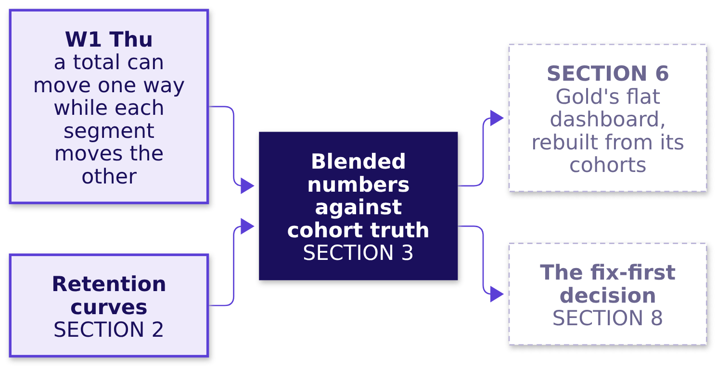
Indian Institute of Technology Gandhinagar
WEEK 4 · DAY 4 · COHORT AND FUNNEL
ADMINISTERED THROUGH THE COMPETENCY ADVANCEMENT ACADEMY
The blend uses Week 1 Thursday's arithmetic
Where does this topic come from, and which chapters use it next?
A total that runs against its parts is called Simpson's paradox, after E. H. Simpson's 1951 paper in the Journal of the Royal Statistical Society. A flat blend over falling cohorts uses the same arithmetic, a weighted average whose weights moved; nothing reverses here, so it is called a mix effect.
Who joined when?
Where is the floor?
What is a blend made of?
Which step owns a loss?
Who entered when?
What is the 38 made of?
Which stage owns the loss?
S26 · 29 / 73
Notes:
Source: the paper's Crossref record, https://doi.org/10.1111/j.2517-6161.1951.tb00088.x (checked 13 October 2026).
LIVE, 2 minutes. Say the Week 1 Thursday link in one sentence and let the room name the reversal
it met then; do not restate that week's numbers. Light the node.
Transition: the next topic, the funnel, on a college.

Slide 30
Indian Institute of Technology Gandhinagar
PG DIPLOMA IN AI-ML AND AGENTIC AI ENGINEERING · COHORT 2
ADMINISTERED THROUGH THE COMPETENCY ADVANCEMENT ACADEMY
04
Funnel stages, drop-off, denominators
Which step owns a loss?
Divide each step by the step before in one named unit, find the step that moved against its own past, and tell a real loss from a step people can skip, on one college's admissions.
Who joined when?
Where is the floor?
What is a blend made of?
Which step owns a loss?
Who entered when?
What is the 38 made of?
Which stage owns the loss?
Week 4, Day 4. Cohort and funnel: who is leaving, and at which step?
30 / 73
Notes:
LIVE, 25 minutes. Laptops closed until the code; notebook 04 afterwards. Hand out: drill c4, on
paper after S33, 4 minutes. If late: S32's code read and not run, and drill c4 moves to the lab.
Styles: Brilliant (the
two cycles shown before any rate is named), Veritasium (predict the losing step), StatQuest (each
step over the step before, by hand), the case method (a sister programme's 107 percent).
Transition: the chapter's questions.

Slide 31
Indian Institute of Technology Gandhinagar
WEEK 4 · DAY 4 · COHORT AND FUNNEL
ADMINISTERED THROUGH THE COMPETENCY ADVANCEMENT ACADEMY
The funnel: four questions, one college
Who needs the answer, and which smaller questions lead to it?
Who needs the answer. The dean of a college (invented), who has one admissions team for one fix this year: a step blamed because it is low sends the team to a step that works. A funnel is a chain of steps people pass through, fewer at each, as every learner here passed through one to be admitted: applied, sat a test, shortlisted, accepted an offer, joined.
The questions on the way. Four, each answered on the college's own counts.
1
2
3
4
Which step owns this cycle's loss?
What does each step read?
Why does one step pass 100 percent?
Per application or per applicant?
Step rate, drop-off, overall
Two cycles side by side
A step people can skip
The unit, named
Who joined when?
Where is the floor?
What is a blend made of?
Which step owns a loss?
Who entered when?
What is the 38 made of?
Which stage owns the loss?
S27 · 31 / 73
Notes:
LIVE, 1 minute. Every learner has been through an admissions funnel; ask nobody to share theirs.
Transition: the two cycles.

Slide 32
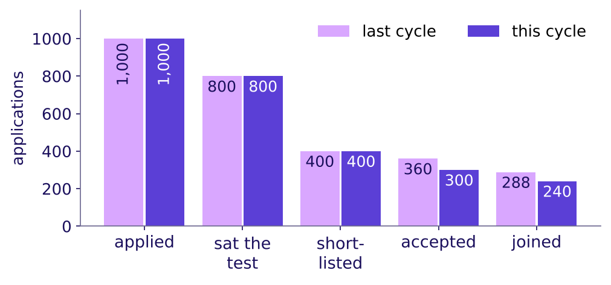
Indian Institute of Technology Gandhinagar
WEEK 4 · DAY 4 · COHORT AND FUNNEL
ADMINISTERED THROUGH THE COMPETENCY ADVANCEMENT ACADEMY
Predict: which step owns this cycle's loss?
Last cycle against this one, at an invented college: which step owns the loss?
a) Shortlisting, the lowest step at 50 percent
b) Offer acceptance, at 75 percent this cycle
c) Joining, at 80 percent
d) The test, which 200 applications never sit
Applications at each stage, last cycle and this cycle (invented)
Who joined when?
Where is the floor?
What is a blend made of?
Which step owns a loss?
Who entered when?
What is the 38 made of?
Which stage owns the loss?
S28 · 32 / 73
Notes:
LIVE, 3 minutes. Brilliant's move: the numbers before the explanation. Vote, argue, vote. Expect
a from most of the room: the lowest step looks like the loss.
Transition: the step that moved.

Slide 33
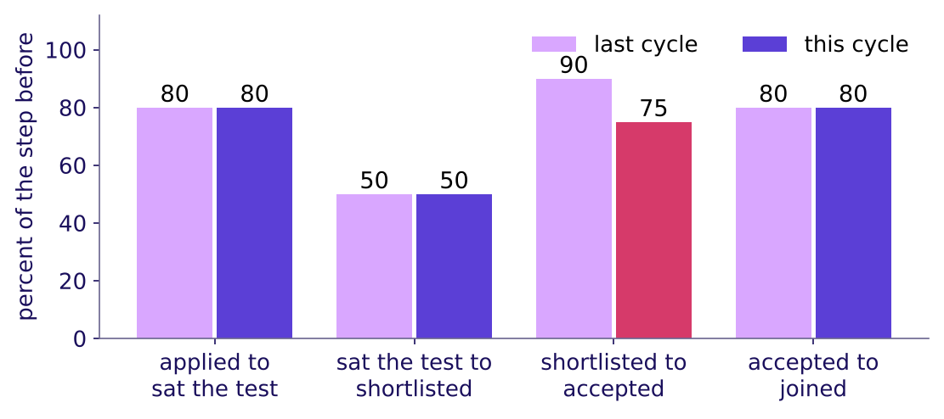
Indian Institute of Technology Gandhinagar
WEEK 4 · DAY 4 · COHORT AND FUNNEL
ADMINISTERED THROUGH THE COMPETENCY ADVANCEMENT ACADEMY
Answer: offer acceptance, the step that moved
Which step changed against its own past, and which only looks low?
Each step's rate, last cycle and this cycle (invented)
The answer is b. Offer acceptance fell from 90 to 75 percent of those shortlisted, and every other step read the same in both cycles. Shortlisting reads 50 percent because the college selects half by design, and it did not move: when the overall falls, the step that moved against its own past owns the fall, and a low, steady step is how the process runs.
Who joined when?
Where is the floor?
What is a blend made of?
Which step owns a loss?
Who entered when?
What is the 38 made of?
Which stage owns the loss?
S29 · 33 / 73
Notes:
LIVE, 3 minutes. Point at the one pair of bars that differs. Then at shortlisting: low, and the
same both cycles. A committee sent to redesign shortlisting would work on a step that works.
Transition: each step by hand.

Slide 34
Indian Institute of Technology Gandhinagar
WEEK 4 · DAY 4 · COHORT AND FUNNEL
ADMINISTERED THROUGH THE COMPETENCY ADVANCEMENT ACADEMY
Step rate, drop-off and overall, by hand
What does each step read this cycle, and how do the steps make the overall?
This cycle (invented) | Applied | Sat the test | Shortlisted | Accepted | Joined
Applications | 1,000 | 800 | 400 | 300 | 240
Step rate, percent of the step before |  | 80 | 50 | 75 | 80
Drop-off, percent |  | 20 | 50 | 25 | 20
Named last. Step rate = those who reached a step ÷ those who reached the step before, in one unit. Drop-off = 100 less the step rate. Overall conversion = the last step ÷ the first: 240 ÷ 1,000 = 24 percent this cycle against 28.8 last cycle, and the step rates multiply to it, 0.80 × 0.50 × 0.75 × 0.80 = 0.24.
Who joined when?
Where is the floor?
What is a blend made of?
Which step owns a loss?
Who entered when?
What is the 38 made of?
Which stage owns the loss?
S30 · 34 / 73
Notes:
LIVE, 4 minutes. Divide aloud, step by step: 800 of 1,000, 400 of 800, 300 of 400, 240 of 300.
Then the overall, then the product. The definitions are the ones analytics tools print as step
conversion, funnel conversion from the first step, and drop-off.
Transition: a step that reads above 100 percent.

Slide 35
Indian Institute of Technology Gandhinagar
WEEK 4 · DAY 4 · COHORT AND FUNNEL
ADMINISTERED THROUGH THE COMPETENCY ADVANCEMENT ACADEMY
A step above 100 percent is one people skip
Why does the sister programme's test to shortlist read 107 percent, and what does it really read?
The sister programme, this cycle (invented) | Applications
Applied | 1,000
Sat the optional test | 300
Shortlisted | 320: 230 who sat the test, 90 on school results alone
WHAT BREAKS
"Test to shortlist reads 107 percent, our best step": 320 ÷ 300 puts 90 students who never sat the test over the test-takers. A rate above 100 says the numerator holds people the denominator never had: here, students who skipped the test; elsewhere, a double count, two units or two time windows. The 107 is an artefact, a number made by the way the count is taken. The fix. Count the shortlist among those who sat the test: 230 ÷ 300 = 77 percent.
Who joined when?
Where is the floor?
What is a blend made of?
Which step owns a loss?
Who entered when?
What is the 38 made of?
Which stage owns the loss?
S31 · 35 / 73
Notes:
LIVE, 4 minutes. The test team's question is "how often does sitting our test lead to a
shortlist?", and only 77 answers it. Shortlisted over applications, 32 percent, and test-takers
over applications, 30 percent, are true numbers that answer other questions.
Transition: the unit.

Slide 36
Indian Institute of Technology Gandhinagar
WEEK 4 · DAY 4 · COHORT AND FUNNEL
ADMINISTERED THROUGH THE COMPETENCY ADVANCEMENT ACADEMY
The unit: per application or per applicant
What does the same funnel read counted in people, and how does code read every step?
This cycle's 1,000 applications came from 900 applicants, since some applied in two rounds. The same 240 joiners are 24 percent of applications and 26.7 percent of applicants. Each applicant joins at most once, so the overall reads higher per person; a middle step can move either way, so its direction is read from the data, and a chart names its unit.
STAGES = ["applied", "sat_test", "shortlisted", "accepted", "joined"]
this = adm.query("programme == 'main' and cycle == 2026 and group == 'all'")
for unit, c in this.groupby("unit"):
c = c.set_index("stage")["count"].reindex(STAGES)
print(unit, (c / c.shift()).round(3).tolist()[1:], round(c.iloc[-1] / c.iloc[0], 3))
Who joined when?
Where is the floor?
What is a blend made of?
Which step owns a loss?
Who entered when?
What is the 38 made of?
Which stage owns the loss?
S32 · 36 / 73
Notes:
LIVE, 3 minutes. The loop prints each unit's step rates (each count over the one before, which is
what shift does) and its overall. In this college's data every step reads at least as high per
applicant; that is this data's pattern, and only the overall is sure to, since each applicant joins
once. Notebook 04 draws both.
Transition: the rules.

Slide 37
Indian Institute of Technology Gandhinagar
WEEK 4 · DAY 4 · COHORT AND FUNNEL
ADMINISTERED THROUGH THE COMPETENCY ADVANCEMENT ACADEMY
Four rules for reading a funnel
What does an analyst check at every step, and what does an interviewer listen for?
01
Each step divides by the step before, in one named unit, and drop-off is 100 less that rate.
02
The overall rate divides the last step by the first, and where each stage is a subset of the one before, the step rates multiply to it.
03
When the overall falls, the step that moved against its own past owns the fall; a low, steady step is how the process runs, and where to invest is a separate question.
04
A rate above 100 percent means the numerator holds people the denominator never had: a skipped step, a double count, or mixed units or windows; count only those who passed the step before.
IN THE INTERVIEW
[S] "Checkout conversion fell this month; how do you find where?" Check the count first, then read each step over the step before in one named unit against its own past, split by platform, group and date, and name the step that moved beside a step that held.
Who joined when?
Where is the floor?
What is a blend made of?
Which step owns a loss?
Who entered when?
What is the 38 made of?
Which stage owns the loss?
S33 · 37 / 73
Notes:
LIVE, 2 minutes. Read the rules; the last two are the traps the case meets on its event log. Then
drill c4 on paper, 4 minutes, letters posted before S34.
Transition: where this topic goes next.

Slide 38
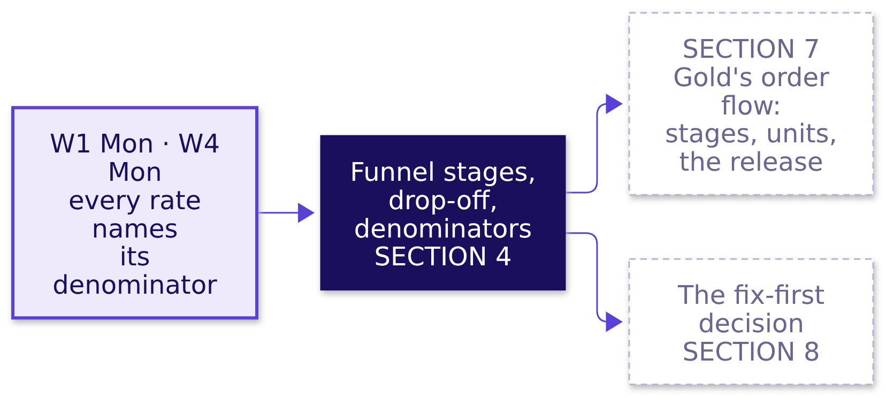
Indian Institute of Technology Gandhinagar
WEEK 4 · DAY 4 · COHORT AND FUNNEL
ADMINISTERED THROUGH THE COMPETENCY ADVANCEMENT ACADEMY
The funnel feeds the case's order flow
Where does this topic come from, and which chapters use it next?
Four of the five topics are now on the map; SECTIONs 5 to 7 apply them to Zomato Gold in Chennai, and the fifth opens the afternoon.
Who joined when?
Where is the floor?
What is a blend made of?
Which step owns a loss?
Who entered when?
What is the 38 made of?
Which stage owns the loss?
S34 · 38 / 73
Notes:
LIVE, 1 minute. Light the node. Break follows: 10 minutes, the seam between the topics and the
case. If the room needs the break earlier, it falls after SECTION 3.
Transition: after the break, the case opens on the ticket read in full.

Slide 39
Indian Institute of Technology Gandhinagar
PG DIPLOMA IN AI-ML AND AGENTIC AI ENGINEERING · COHORT 2
ADMINISTERED THROUGH THE COMPETENCY ADVANCEMENT ACADEMY
05
Cohort construction on twelve Gold members
Who entered when?
The ticket read in full, the causes listed before any data, and twelve members of the case counted by hand by age, as SECTION 1 counted the gym.
Who joined when?
Where is the floor?
What is a blend made of?
Which step owns a loss?
Who entered when?
What is the 38 made of?
Which stage owns the loss?
Week 4, Day 4. Cohort and funnel: who is leaving, and at which step?
39 / 73
Notes:
LIVE, 15 minutes. Laptops closed; the twelve-row card is on every table. Hand out: the hypothesis
board template at S38, the card and the guided set at S39. If late: S37 is read without discussion. Styles: the case method
(the hypothesis board), StatQuest (the twelve counted aloud), Veritasium (two predictions).
Notebook 05 reproduces every count.
Transition: the chapter's questions.

Slide 40
Indian Institute of Technology Gandhinagar
WEEK 4 · DAY 4 · COHORT AND FUNNEL
ADMINISTERED THROUGH THE COMPETENCY ADVANCEMENT ACADEMY
Twelve members: the board, then the card
Who needs the answer, and which smaller questions lead to it?
Who needs the answer. The membership lead, who must say on Friday whether Gold has a cohort problem or an everyone problem. A wrong call sends the fix to the wrong team.
Applies: Cohort construction (SECTION 1).
1
2
3
4
Which topic does each ticket line need?
Which causes could explain it?
What does each group keep, month by month?
What does the dashboard count?
The ticket read in full
Five causes, each with its test
Twelve members of the case data, by age
The same twelve, the dashboard's way
Who joined when?
Where is the floor?
What is a blend made of?
Which step owns a loss?
Who entered when?
What is the 38 made of?
Which stage owns the loss?
S35 · 40 / 73
Notes:
LIVE, 1 minute. Read the four questions; each is answered before the next is asked.
Transition: the ticket, read in full.

Slide 41
Indian Institute of Technology Gandhinagar
WEEK 4 · DAY 4 · COHORT AND FUNNEL
ADMINISTERED THROUGH THE COMPETENCY ADVANCEMENT ACADEMY
The ticket read in full: each line and its topic
Which of the five topics does each line of the ticket need, and where is it answered?
The ticket says | The topic that reads it | Answered in
Month-two retention flat at 38 percent, June to September | Blended numbers against cohort truth | SECTION 6
Month one 58, 56, 55, 53, 52, 50, 49, then 31 percent | Cohort construction; retention curves: shape and floor | SECTIONs 5 and 6
Members' add-to-cart to order on Android, 58 to 44 percent after 14 September | Funnel stages, drop-off, denominators | SECTION 7
Search to menu view 118 percent; menu view to add-to-cart 34 percent, per session | Funnel stages, drop-off, denominators | SECTION 7
The ask: cohort or everyone, which stage, what first | The fix-first decision and its evidence | SECTIONs 8 and 9
Who joined when?
Where is the floor?
What is a blend made of?
Which step owns a loss?
Who entered when?
What is the 38 made of?
Which stage owns the loss?
S36 · 41 / 73
Notes:
LIVE, 2 minutes. Go back to the ticket's table (the slide after the concept map) if the room
wants it; this slide is the same ticket read line by line against the topics. Every line now has
a topic the room has met, except the last, which opens the afternoon.
Transition: where today ends.

Slide 42
Indian Institute of Technology Gandhinagar
WEEK 4 · DAY 4 · COHORT AND FUNNEL
ADMINISTERED THROUGH THE COMPETENCY ADVANCEMENT ACADEMY
Where today ends: one sentence with blanks
What sentence will the membership lead carry out of the room?
"It is ______: a cohort problem, an everyone problem, or both. Retention: the dashboard starts counting at month ______, so it never sees ______, and it has not yet counted ______. Orders: members of every signup month on ______ lose orders at one step, ______, from ______. Fix ______ first; before buying another sale, work out ______."
The words. Month-two retention is the dashboard's name for the share of members two or more months past their signup month who ordered in the month; a member with no order in a month is not retained that month, and she is still a member. A cohort problem sits in some signup months; an everyone problem hits members of every signup month at once.
Each blank is filled in order: by hand on twelve members, on all 53,089, then on 1,386,235 app events, and SECTION 9 writes the sentence whole.
Who joined when?
Where is the floor?
What is a blend made of?
Which step owns a loss?
Who entered when?
What is the 38 made of?
Which stage owns the loss?
S37 · 42 / 73
Notes:
LIVE, 1 minute. Read it once with its blanks and move on; nothing to write yet. The room fills
each blank as the morning earns it; the filled sentence is in the case file.
Transition: the hypothesis board, before any data opens.

Slide 43
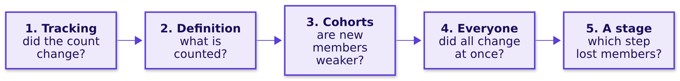
Indian Institute of Technology Gandhinagar
WEEK 4 · DAY 4 · COHORT AND FUNNEL
ADMINISTERED THROUGH THE COMPETENCY ADVANCEMENT ACADEMY
Five causes on the board, each with its test
Before any chart, which causes could explain the ticket, and what would test each?
Cause | The test that settles it
1. Tracking | The orders counted a second way, in the order records, against the app's event log
2. Definition | The dashboard's written rule: who is counted, from which month
3. Cohorts | The cohort table, each signup month read at the same age
4. Everyone | One calendar month read across every cohort: did all of them move at once, on one platform?
5. A stage | Each step over the step before, by unit, platform and date
Who joined when?
Where is the floor?
What is a blend made of?
Which step owns a loss?
Who entered when?
What is the 38 made of?
Which stage owns the loss?
S38 · 43 / 73
Notes:
LIVE, 3 minutes. The groups write their own ordered list first, with the test each cause needs,
on the hypothesis board template; then show this ladder. It runs in the order a careful analyst
checks: the count, the rule, the cohorts, everyone, then the stage. Rows 3 and 4 read the same table
two ways: cohorts compared at the same age for strength, one calendar month read across them for a
shock that hit everyone. Each chapter's reveal strikes or confirms a line; keep the board up all
morning.
Transition: the card.

Slide 44
Indian Institute of Technology Gandhinagar
WEEK 4 · DAY 4 · COHORT AND FUNNEL
ADMINISTERED THROUGH THE COMPETENCY ADVANCEMENT ACADEMY
The card: twelve members, four months
Which of the twelve ordered in each month after joining?
Member | Joined | Channel | Jun | Jul | Aug | Sep
ZG20844 | May | organic | 1 | 1 | 1 | 1
ZG21052 | May | organic | 1 | 1 | 0 | 0
ZG22010 | May | organic | 1 | 0 | 0 | 0
ZG22634 | May | organic | 0 | 0 | 0 | 0
ZG25312 | Jun | organic | joined | 1 | 1 | 1
ZG27475 | Jun | organic | joined | 1 | 0 | 0
ZG28603 | Jun | organic | joined | 0 | 0 | 0
ZG39559, ZG40539, ZG41000, ZG41529, ZG42328 | Aug | sale |  |  | joined | 0 each
A 1 means she placed at least one order that month. Month one is the first full calendar month after joining, so May's is June and August's is September; the joining month is month zero and is never counted, as Cohort construction (SECTION 1) set out on the gym.
Who joined when?
Where is the floor?
What is a blend made of?
Which step owns a loss?
Who entered when?
What is the 38 made of?
Which stage owns the loss?
S39 · 44 / 73
Notes:
LIVE, 1 minute. Hand out the card if it is not on the tables, with the guided set
(exercises/guided, one row), whose two items are the rewrite below. Read one row aloud: ZG21052 joined
in May, ordered in June and July, then stopped. The last line holds the five sale-week members,
named one by one, none of whom ordered in September. Ask each table to rewrite the card by months
since joining, as they rewrote the gym's register, before the next slide.
Transition: the prediction.

Slide 45
Indian Institute of Technology Gandhinagar
WEEK 4 · DAY 4 · COHORT AND FUNNEL
ADMINISTERED THROUGH THE COMPETENCY ADVANCEMENT ACADEMY
Predict: which group keeps the most in month one?
Counted by months since joining, which group keeps the largest share in its own month one?
a) The four May members
b) The three June members
c) The five August sale-week members
d) All three keep the same share
Who joined when?
Where is the floor?
What is a blend made of?
Which step owns a loss?
Who entered when?
What is the 38 made of?
Which stage owns the loss?
S40 · 45 / 73
Notes:
LIVE, 1 minute. Vote. Expect some c from tables that read September's column, where August's
month one sits beside May's month four: the gym's April reading again.
Transition: the count.

Slide 46
Indian Institute of Technology Gandhinagar
WEEK 4 · DAY 4 · COHORT AND FUNNEL
ADMINISTERED THROUGH THE COMPETENCY ADVANCEMENT ACADEMY
Answer: May 3 of 4, June 2 of 3, sale 0 of 5
What does each group keep at each age, and what does that show?
Joined | Month one | Month two | Month three | Month four
May (4) | 3 of 4 | 2 of 4 | 1 of 4 | 1 of 4
June (3) | 2 of 3 | 1 of 3 | 1 of 3
August sale week (5) | 0 of 5
The answer is a. Each group falls as it ages, and each later group starts lower: 75, 67 and then 0 percent in month one. Only read by age, as Cohort construction (SECTION 1) read the gym, can the three groups be compared at all. The twelve were picked to show the pattern on one card: on all 53,089, May's month one is 52 percent and June's 50.
Who joined when?
Where is the floor?
What is a blend made of?
Which step owns a loss?
Who entered when?
What is the 38 made of?
Which stage owns the loss?
S41 · 46 / 73
Notes:
LIVE, 2 minutes. Count May's row aloud: three ordered in month one, two in month two, one in three
and four. Then June's, then August's. In September the sale member's month one sits beside May's
month four, which is why the age column, not the calendar column, is the fair comparison.
Transition: what the dashboard does with the same card.

Slide 47
Indian Institute of Technology Gandhinagar
WEEK 4 · DAY 4 · COHORT AND FUNNEL
ADMINISTERED THROUGH THE COMPETENCY ADVANCEMENT ACADEMY
Predict: what does the dashboard's way read?
The dashboard counts a member from her second month after joining. On the card, what does it read in August and September?
a) A fall from August to September, because the sale-week members ordered so little
b) 2 of 7 in both months, with the five sale-week members outside the count
c) A rise, because new members joined
d) 2 of 12 in both months
Who joined when?
Where is the floor?
What is a blend made of?
Which step owns a loss?
Who entered when?
What is the 38 made of?
Which stage owns the loss?
S42 · 47 / 73
Notes:
LIVE, 1 minute. Remind the rule: in a reporting month, count every member two or more months past
her joining month, and ask what share ordered. Vote, argue, vote again.
Transition: the count, both ways.

Slide 48
Indian Institute of Technology Gandhinagar
WEEK 4 · DAY 4 · COHORT AND FUNNEL
ADMINISTERED THROUGH THE COMPETENCY ADVANCEMENT ACADEMY
Answer: 2 of 7 in August, 2 of 7 in September
What does the card say counted the dashboard's way, and counted for everyone?
Reporting month | July | August | September
The dashboard's way: members two or more months past joining | 2 of 4 | 2 of 7 | 2 of 7
Everyone who joined before the month | 4 of 7 | 2 of 7 | 2 of 12
The answer is b. The dashboard's way did not move from August to September, though five members joined in the sale week and none of them ordered: they are outside its count until October. Counted for everyone, September reads 2 of 12.
Who joined when?
Where is the floor?
What is a blend made of?
Which step owns a loss?
Who entered when?
What is the 38 made of?
Which stage owns the loss?
S43 · 48 / 73
Notes:
LIVE, 2 minutes. Ring the two 2-of-7 cells. Then the August column of the sale-week members: they
joined in August, so August is their month zero, and September is their month one, which the
dashboard skips. SECTION 6 finds the same two readings on all 53,089 members.
Transition: what the card showed.

Slide 49
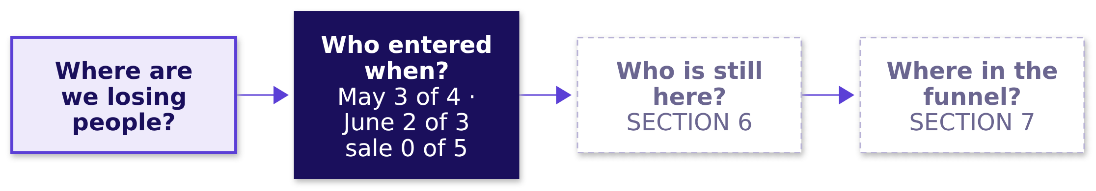

Indian Institute of Technology Gandhinagar
WEEK 4 · DAY 4 · COHORT AND FUNNEL
ADMINISTERED THROUGH THE COMPETENCY ADVANCEMENT ACADEMY
What the card showed: fix the entry month
What has the card answered, and what is still open?
THE RULE
Before reading any retention number, ask which members it counts and from which month.
IN THE INTERVIEW
[F], frequent in GCC (global capability centre) and product-company screens: blended retention is flat while every cohort declines; how? The mix, each cohort's share of the count, changes under the average.
Who joined when?
Where is the floor?
What is a blend made of?
Which step owns a loss?
Who entered when?
What is the 38 made of?
Which stage owns the loss?
S44 · 49 / 73
Notes:
LIVE, 1 minute. Read the board's first region; Q2 and Q3 stay dashed. Strike or confirm on the
hypothesis board: "a cohort problem" is now likely; the test was the card.
Transition: SECTION 6 and the full data.

Slide 50
Indian Institute of Technology Gandhinagar
PG DIPLOMA IN AI-ML AND AGENTIC AI ENGINEERING · COHORT 2
ADMINISTERED THROUGH THE COMPETENCY ADVANCEMENT ACADEMY
06
Retention curves and blended numbers on 53,089 members
What is the 38 made of?
Every cohort's curve on the full data, the dashboard's flat 38 rebuilt from its cohorts, and the cohort the count leaves out, as SECTIONs 2 and 3 read the gym.
Who joined when?
Where is the floor?
What is a blend made of?
Which step owns a loss?
Who entered when?
What is the 38 made of?
Which stage owns the loss?
Week 4, Day 4. Cohort and funnel: who is leaving, and at which step?
50 / 73
Notes:
LIVE, 30 minutes. Laptops open; notebook 06. Hand out: reveal 1 at S47, reveal 2 at S53. If late:
D1 stays self-study. Styles: Krish Naik (one pivot_table, line by line),
Veritasium (three predictions), 3Blue1Brown (the triangle, the stacked count), StatQuest (the
weighted average on seven numbers). Explorer scene Th1.
Transition: the chapter's questions.

Slide 51
Indian Institute of Technology Gandhinagar
WEEK 4 · DAY 4 · COHORT AND FUNNEL
ADMINISTERED THROUGH THE COMPETENCY ADVANCEMENT ACADEMY
From twelve members to 53,089
Who needs the answer, and which smaller questions lead to it?
Who needs the answer. The membership lead, about to report "nothing changed" because the number is flat. If the flat number hides falling cohorts and a weak August cohort, the fix waits a month too long.
Applies: Cohort construction (SECTION 1); Retention curves: shape and floor (SECTION 2); Blended numbers against cohort truth (SECTION 3).
1
2
3
4
What does each cohort keep, month by month?
What does the dashboard print, and why does it hold?
What is September's 38 made of?
What is outside the count?
The August cohort
One pivot_table on member_months
June to September
The weighted average, cohort by cohort
Who joined when?
Where is the floor?
What is a blend made of?
Which step owns a loss?
Who entered when?
What is the 38 made of?
Which stage owns the loss?
S45 · 51 / 73
Notes:
LIVE, 1 minute. Read the four questions. Say what SECTION 5 found, with its numbers, so the room
carries it in: each group fell with age, the sale-week members kept 0 of 5, and the dashboard's
way read 2 of 7 two months running.
Transition: the code that builds the table.

Slide 52
Indian Institute of Technology Gandhinagar
WEEK 4 · DAY 4 · COHORT AND FUNNEL
ADMINISTERED THROUGH THE COMPETENCY ADVANCEMENT ACADEMY
Predict: which way does each cohort's row run?
Once age is computed, one pivot_table builds the table, as SECTION 1 built the gym's. After month one, which way does each row run?
# mm: member_months joined to members for cohort_month; active = orders > 0
# year x 12 + month is a running count, so 2026-09 minus 2026-07 is 2
month_n = mm["month"].str[:4].astype(int) * 12 + mm["month"].str[5:].astype(int)
cohort_n = mm["cohort_month"].str[:4].astype(int) * 12 + mm["cohort_month"].str[5:].astype(int)
mm["age"] = month_n - cohort_n # month zero is the joining month
# active is True or False, so a cell's mean is a share
tri = mm[mm["age"] >= 1].pivot_table(index="cohort_month", columns="age",
values="active", aggfunc="mean")
a) Up, as members settle into a habit
b) Flat, which is why the dashboard is flat
c) Down: a big step after month one, then a slow slide
d) Up, then down
Who joined when?
Where is the floor?
What is a blend made of?
Which step owns a loss?
Who entered when?
What is the 38 made of?
Which stage owns the loss?
S46 · 52 / 73
Notes:
LIVE, 3 minutes. Read the code a line at a time: each year-month as one count of months, age as
the gap between the two, then one pivot_table with cohorts on the rows and ages on the columns;
active (at least one order) was set when the table loaded, and each cell is a mean of True and
False, so it is a share. Vote before the cell runs.
Transition: the table.

Slide 53
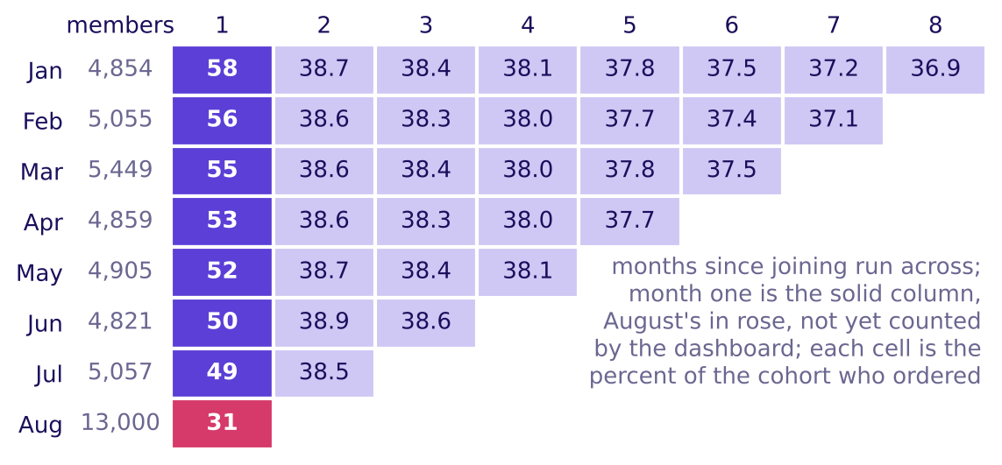
Indian Institute of Technology Gandhinagar
WEEK 4 · DAY 4 · COHORT AND FUNNEL
ADMINISTERED THROUGH THE COMPETENCY ADVANCEMENT ACADEMY
Answer: every row falls, and each starts lower
What does the full table show, cohort by cohort?
Every cohort falls with age, and each new cohort starts lower
The answer is c. Each cohort drops from its month one to about 38.5 percent in month two, then slides about 0.3 points a month. Read as in SECTION 2, that is a cliff after month one; ages two and three agree within a point, so by our rule each row old enough to show it reaches its floor at month two, and the floor then erodes slowly. What changes from cohort to cohort is month one: 58 percent for January down to 49 for July, and 31 for the 13,000-member August cohort. The dashboard starts at month two, so it never sees the weaker start.
Who joined when?
Where is the floor?
What is a blend made of?
Which step owns a loss?
Who entered when?
What is the 38 made of?
Which stage owns the loss?
S47 · 53 / 73
Notes:
LIVE, 4 minutes. Walk one row (January: 58, then 38.7 and down to 36.9 by month eight) and one
column (month one: 58 down to 49, then 31). By our rule, two ages within a point, January to
June each reach a floor at month two, which erodes about 0.3 points a month; July has not lived
month three. Members come back after a month with no order, so the floor is the share ordering in
a typical month, and the 38 who order are not always the same 38. If the room wants the motion, open
whiteboards/C2_W04_D04_cohort_fill_STUDENT.gif, which fills the triangle one month at a time with
the dashboard drawn beside it, or explorer scene Th1, which adds a "next month" button.
Transition: why the dashboard holds over the same months.

Slide 54
Indian Institute of Technology Gandhinagar
WEEK 4 · DAY 4 · COHORT AND FUNNEL
ADMINISTERED THROUGH THE COMPETENCY ADVANCEMENT ACADEMY
Predict: why does the dashboard hold near 38?
Every cohort's row falls, yet month-two retention printed 38 percent from June to September. Which reason holds?
a) Members who stopped ordering came back the next month, so the share held
b) After month two, rows slide 0.3 a month and each new cohort enters near 38.5
c) The dashboard averages the seven cohorts' rates without weighting by size
d) The 13,000-member August cohort, counted from September, holds the share up
Who joined when?
Where is the floor?
What is a blend made of?
Which step owns a loss?
Who entered when?
What is the 38 made of?
Which stage owns the loss?
S48 · 54 / 73
Notes:
LIVE, 2 minutes. Vote. The d voters are thinking about the August cohort, which the dashboard has
not counted yet; ask them to hold that thought for four slides. The a voters hold a true fact,
since members do come back, and the rows already count every returner.
Transition: the direct count.

Slide 55
Indian Institute of Technology Gandhinagar
WEEK 4 · DAY 4 · COHORT AND FUNNEL
ADMINISTERED THROUGH THE COMPETENCY ADVANCEMENT ACADEMY
Answer: a slow slide, refilled each month
What does the dashboard print, counted directly, and what holds it near 38?
38.2
38.0
37.9
37.8
JUNE
JULY
AUGUST
SEPTEMBER
7,722 of 20,217 members
9,558 of 25,122
11,359 of 29,943
13,218 of 35,000
The answer is b. After month two each row slides only about 0.3 points a month, and each month a new cohort enters the count near 38.5, which props September by about half a point: held to June's four cohorts, it reads 37.3. The weak starts sit in month one, which the dashboard never counts, since it counts every member aged two or more.
Who joined when?
Where is the floor?
What is a blend made of?
Which step owns a loss?
Who entered when?
What is the 38 made of?
Which stage owns the loss?
S49 · 55 / 73
Notes:
LIVE, 3 minutes. Read the four counts. Point at the denominators growing by about 5,000 a month:
one new cohort a month enters the count. The prop is real and small; the number looks flat mostly
because the slide is slow and the count starts at month two. Then say what the room is about to
be tempted to say.
Transition: the plausible wrong answer.

Slide 56
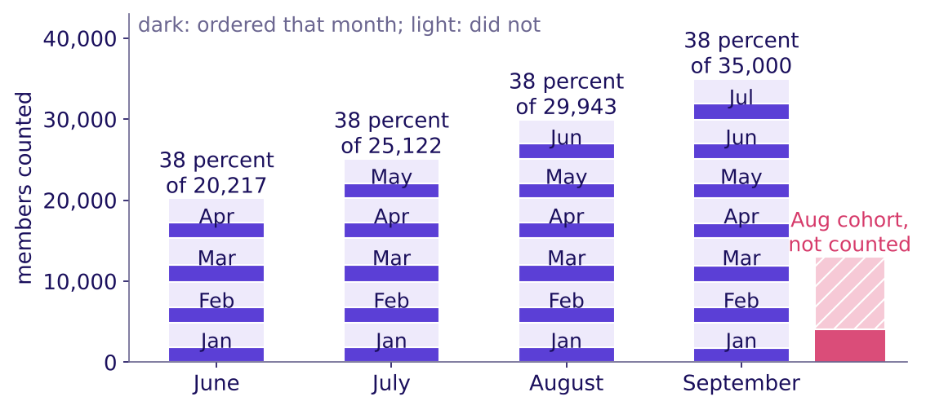
Indian Institute of Technology Gandhinagar
WEEK 4 · DAY 4 · COHORT AND FUNNEL
ADMINISTERED THROUGH THE COMPETENCY ADVANCEMENT ACADEMY
The wrong call: "38 and flat, nothing changed"
What would a hurried analyst conclude from four flat months, and what would it cost?
WHAT BREAKS
Why it is wrong. The 38 is a blend weighted by cohort size, as Blended numbers against cohort truth (SECTION 3) showed on the gym, and it counts a member only from her second month: each month a new cohort enters at the top while every older one shrinks, and the hatched August cohort is outside the count.
"Month-two retention is 38 percent and flat, so nothing changed": the August cohort gets no action, and October's drop arrives as a surprise.
Each month's 38 percent: a new cohort enters, every older one falls
Who joined when?
Where is the floor?
What is a blend made of?
Which step owns a loss?
Who entered when?
What is the 38 made of?
Which stage owns the loss?
S50 · 56 / 73
Notes:
LIVE, 3 minutes. Read the wrong sentence exactly as a hurried analyst would say it. Ask for the
decision it would drive. Point at September's stack: seven cohorts, January at the bottom, July at
the top, then the hatched bar beside it: 13,000 members the dashboard does not count yet. The
check, taking the number apart, runs in the notebook's empty your-turn cell before the next slide.
Transition: the second route.

Slide 57
Indian Institute of Technology Gandhinagar
WEEK 4 · DAY 4 · COHORT AND FUNNEL
ADMINISTERED THROUGH THE COMPETENCY ADVANCEMENT ACADEMY
Second route: 13,218 of 35,000, both ways
Does September's 38, rebuilt as a weighted average of its cohorts, equal the direct count?
Cohort | Members | Ordered in September
January | 4,854 | 36.9 percent
February | 5,055 | 37.1 percent
March | 5,449 | 37.5 percent
April | 4,859 | 37.7 percent
May | 4,905 | 38.1 percent
June | 4,821 | 38.6 percent
July | 5,057 | 38.5 percent
Sum of (members × rate) over the seven cohorts = 13,218 orderers; 13,218 / 35,000 = 37.8 percent, the same to the last digit as the direct count. The rates rise with youth, from January's 36.9 to June's 38.6 and July's 38.5, so the younger cohorts prop the average, by about half a point in September.
Who joined when?
Where is the floor?
What is a blend made of?
Which step owns a loss?
Who entered when?
What is the 38 made of?
Which stage owns the loss?
S51 · 57 / 73
Notes:
LIVE, 5 minutes. Have one table read its weighted average aloud; it must match 37.8. Unweighted,
the seven rates also average 37.8, because the seven cohorts are about the same size. Add the
13,000-member August cohort and the unweighted mean (36.9) drifts a point from the true 35.9: the
gym's plain mean of rates again, which is why weights matter when sizes differ.
Transition: what the count leaves out.

Slide 58
Indian Institute of Technology Gandhinagar
WEEK 4 · DAY 4 · COHORT AND FUNNEL
ADMINISTERED THROUGH THE COMPETENCY ADVANCEMENT ACADEMY
Predict: counting everyone, what is September?
In September, 13,000 August members are in their month one and outside the dashboard. Counting everyone who joined before September, what does September read?
a) Still 38 percent
b) About 36 percent
c) About 31 percent, August's rate
d) About 49 percent, the July cohort's month-one rate
Who joined when?
Where is the floor?
What is a blend made of?
Which step owns a loss?
Who entered when?
What is the 38 made of?
Which stage owns the loss?
S52 · 58 / 73
Notes:
LIVE, 2 minutes. Vote. Remind the August cohort's month one is 31 percent, below the 38.
Transition: the reveal.

Slide 59
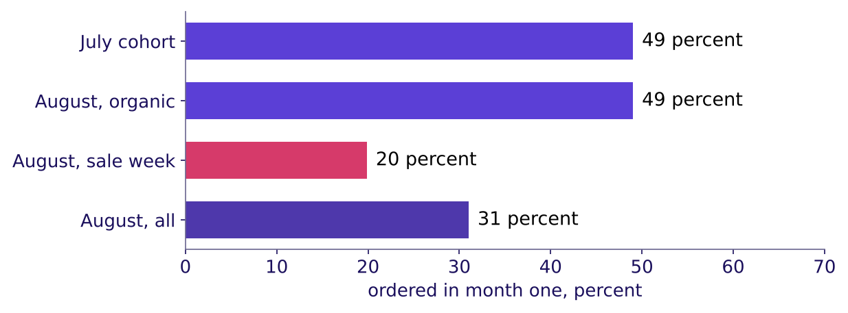
Indian Institute of Technology Gandhinagar
WEEK 4 · DAY 4 · COHORT AND FUNNEL
ADMINISTERED THROUGH THE COMPETENCY ADVANCEMENT ACADEMY
Answer: 36 percent, and the sale week is the gap
What does September read with the August cohort counted, and which of its members sit low?
The sale-week members, not August, sit low
The answer is b: 17,248 of 48,000, 35.9 percent; the 5,089 who joined in September are in their month zero and in neither count. Counted this way, everyone who joined before the month, the four months read 40.9, 40.0, 39.5 and 35.9: the drop the dashboard hides. Split by how they joined, the 4,973 organic August members kept 49 percent in month one, July's rate; the 8,027 sale-week members kept 20. In October the August cohort enters the dashboard, which, on the assumption the next slide sets out, drops to about 33 percent.
Who joined when?
Where is the floor?
What is a blend made of?
Which step owns a loss?
Who entered when?
What is the 38 made of?
Which stage owns the loss?
S53 · 59 / 73
Notes:
LIVE, 5 minutes. Hand out reveal 2 now. Two readings of the same month differ only by who is counted. Then the split:
the problem is the sale week, not the month. The October estimate rests on an assumption, set out
on the self-study slide that follows; name it as one. Strike on the hypothesis board: a cohort
problem, confirmed; the cohort is the sale week's.
Transition: the chapter's close.

Slide 60
Indian Institute of Technology Gandhinagar
WEEK 4 · DAY 4 · COHORT AND FUNNEL
ADMINISTERED THROUGH THE COMPETENCY ADVANCEMENT ACADEMY
October's dashboard: about 33 percent, worked
DEPTH
Why does the dashboard drop to about 33 in October, and what does that estimate assume?
Step | The working
The assumption | The August cohort loses the same 10.5 points from month one to month two that July's lost (49 to 38.5)
August at month two | 31 less 10.5 is about 20.5 percent
The older cohorts | Each slides one month further, about 0.3 points
October, counted the dashboard's way | About 33 percent, against the 38 printed since June
The range | 32 to 34 percent for an August month two anywhere from 17 to 24 percent
The drop comes from who enters the count; no member has to change what she does in October for it to happen. The assumption is the weak point: the sale-week members may not lose the same 10.5 points as July's organic members, which is why the range is printed.
Who joined when?
Where is the floor?
What is a blend made of?
Which step owns a loss?
Who entered when?
What is the 38 made of?
Which stage owns the loss?
D1 · 60 / 73
Notes:
SELF-STUDY, notebook 06's October cell computes the same three numbers. Read it as an estimate with
its assumption named, never as a forecast.
Transition: the chapter's close.

Slide 61
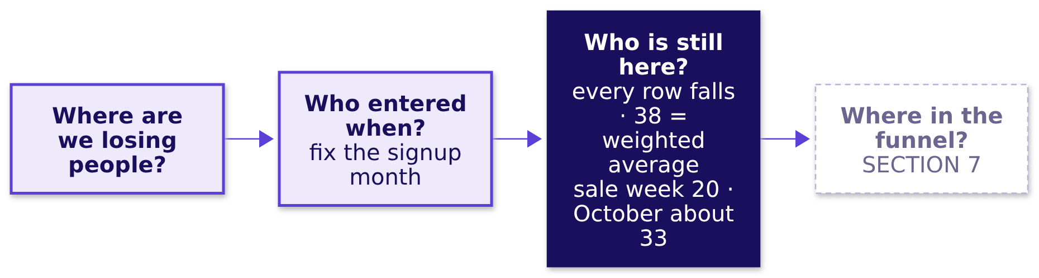
Indian Institute of Technology Gandhinagar
WEEK 4 · DAY 4 · COHORT AND FUNNEL
ADMINISTERED THROUGH THE COMPETENCY ADVANCEMENT ACADEMY
Gold's 38 is a weighted average of falling cohorts
What has the full table answered, and what is still open?
THE RULE
A flat retention number is a size-weighted average of cohorts at different ages; rebuild it from its cohorts, check the rebuild matches, and read what the count leaves out.
IN THE INTERVIEW
[F] How would you use cohort analysis to find a retention issue? Fix the entry month, build the table, read rows for decay and columns for each cohort's start, then rebuild the blend from it.
Who joined when?
Where is the floor?
What is a blend made of?
Which step owns a loss?
Who entered when?
What is the 38 made of?
Which stage owns the loss?
S54 · 61 / 73
Notes:
LIVE, 2 minutes. The cohort axis, months since joining, is the time axis Friday's forecast runs on.
Transition: SECTION 7, the order flow.

Slide 62
Indian Institute of Technology Gandhinagar
PG DIPLOMA IN AI-ML AND AGENTIC AI ENGINEERING · COHORT 2
ADMINISTERED THROUGH THE COMPETENCY ADVANCEMENT ACADEMY
07
Funnel stages, drop-off, denominators on the event log
Which stage owns the loss?
Gold's order flow read step over step in a named unit, the step that passes 100 percent, and the fall split by membership, platform and date, as SECTION 4 read the college.
Who joined when?
Where is the floor?
What is a blend made of?
Which step owns a loss?
Who entered when?
What is the 38 made of?
Which stage owns the loss?
Week 4, Day 4. Cohort and funnel: who is leaving, and at which step?
62 / 73
Notes:
LIVE, 30 minutes. Notebook 07. Hand out: reveal 3 at S62. If late: S62's weekly picture described,
and S64's four self-study rows left to the notes. Styles: Brilliant (the five rates before any explanation),
Veritasium (three predictions), the case method (the app team's partly right chart), Krish Naik
(the release split built line by line). Explorer scene Th3.
Transition: the chapter's questions.

Slide 63
Indian Institute of Technology Gandhinagar
WEEK 4 · DAY 4 · COHORT AND FUNNEL
ADMINISTERED THROUGH THE COMPETENCY ADVANCEMENT ACADEMY
The funnel, its units and the release
Who needs the answer, and which smaller questions lead to it?
Who needs the answer. The membership lead and the app team's lead, who will say the stage the room blames is fine. Blaming the wrong step sends engineers to fix one that works.
Applies: Funnel stages, drop-off, denominators (SECTION 4).
1
2
3
4
5
Which step owns the loss?
Why does one step pass 100 percent?
Per session or per member?
When did the Android rate break, and where?
What can the data not show?
Five rates, before any split
A step members can skip
Two units, two questions
Seven doubts, each with its check
Platform, membership, date, then the size
Who joined when?
Where is the floor?
What is a blend made of?
Which step owns a loss?
Who entered when?
What is the 38 made of?
Which stage owns the loss?
S55 · 63 / 73
Notes:
LIVE, 1 minute. Say what SECTION 6 found, with its numbers: 38 is a weighted average of falling
cohorts, and the sale-week members kept 20 percent in month one.
Transition: the five rates.

Slide 64
Indian Institute of Technology Gandhinagar
WEEK 4 · DAY 4 · COHORT AND FUNNEL
ADMINISTERED THROUGH THE COMPETENCY ADVANCEMENT ACADEMY
Question: which step owns the loss?
September, Gold members, per session: open to search 68, search to menu view 118, menu view to cart 34, cart to checkout 80, checkout to order 64 percent. Which step owns the loss?
a) Search to menu view, the one step above 100 percent
b) Menu view to add-to-cart, the lowest rate on the page
c) Open to search, the first step of every session
d) None yet: each must be split and set against its past
Who joined when?
Where is the floor?
What is a blend made of?
Which step owns a loss?
Who entered when?
What is the 38 made of?
Which stage owns the loss?
S56 · 64 / 73
Notes:
LIVE, 3 minutes. Brilliant's move: the numbers first. Vote, argue, vote. Expect b from part of
the room even after the college; the lowest rate still looks like the loss.
Transition: the answer.

Slide 65
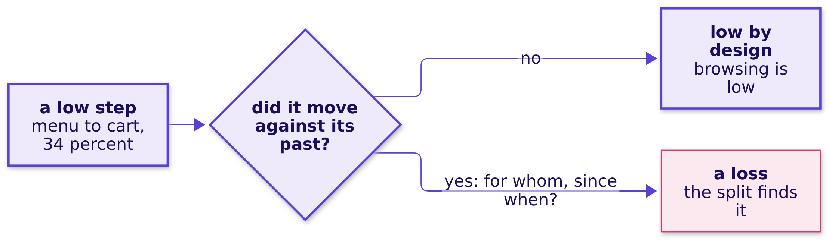
Indian Institute of Technology Gandhinagar
WEEK 4 · DAY 4 · COHORT AND FUNNEL
ADMINISTERED THROUGH THE COMPETENCY ADVANCEMENT ACADEMY
Answer: no step owns it until it is split
Which step owns the loss before any split by who, where and when?
The answer is d. When the overall falls, the step that moved against its own past owns the fall, as Funnel stages, drop-off, denominators (SECTION 4) found on the college, where shortlisting read 50 percent in both cycles. Menu view to add-to-cart, at 34 percent, is the lowest step and may be low by design; search to menu view, at 118, is a step members can skip. The loss shows only once a step is split by membership, platform and date.
Who joined when?
Where is the floor?
What is a blend made of?
Which step owns a loss?
Who entered when?
What is the 38 made of?
Which stage owns the loss?
S57 · 65 / 73
Notes:
LIVE, 2 minutes. One line of recall, then straight to the data: the next slide takes the 118 apart.
Transition: the step above 100 percent.

Slide 66
Indian Institute of Technology Gandhinagar
WEEK 4 · DAY 4 · COHORT AND FUNNEL
ADMINISTERED THROUGH THE COMPETENCY ADVANCEMENT ACADEMY
118 percent: the carousel skips search
Why does search to menu view read 118 percent, and what does it really read?
September, member sessions | Count
Sessions with a search | 131,974
Sessions with a menu view | 155,729
Sessions with a menu view and no search: the home carousel | 38,932
Sessions with a search and a menu view | 116,797, which is 89 percent of 131,974
WHAT BREAKS
"Search to menu view is 118 percent, our best step." The home carousel opens a restaurant's menu without a search, so the ratio divides two counts of different sessions: search is a step members can skip, as the sister programme's optional test was in SECTION 4, and the 118 is an artefact, a number made by the way the count is taken. The fix. Count menu views only among sessions that searched: 89 percent.
Who joined when?
Where is the floor?
What is a blend made of?
Which step owns a loss?
Who entered when?
What is the 38 made of?
Which stage owns the loss?
S58 · 66 / 73
Notes:
LIVE, 5 minutes. The artefact: a rate above 100 percent says the numerator holds people who never
passed the denominator's step. Explorer scene Th3 toggles the carousel entries in and out. Strike
on the hypothesis board: the funnel's first steps are not the loss.
Transition: the second unit.

Slide 67
Indian Institute of Technology Gandhinagar
WEEK 4 · DAY 4 · COHORT AND FUNNEL
ADMINISTERED THROUGH THE COMPETENCY ADVANCEMENT ACADEMY
Predict: per member, what does menu to cart read?
Menu view to add-to-cart reads 34 percent per session. Counted per member, what does it read?
a) The same, 34 percent
b) Lower, because members browse many times
c) Higher, because a member who browses five times and buys once counts once
d) Above 100 percent
Who joined when?
Where is the floor?
What is a blend made of?
Which step owns a loss?
Who entered when?
What is the 38 made of?
Which stage owns the loss?
S59 · 67 / 73
Notes:
LIVE, 2 minutes. Vote. Ask one table to explain its letter in a sentence; the college's applicants
are the clue.
Transition: the two units side by side.

Slide 68
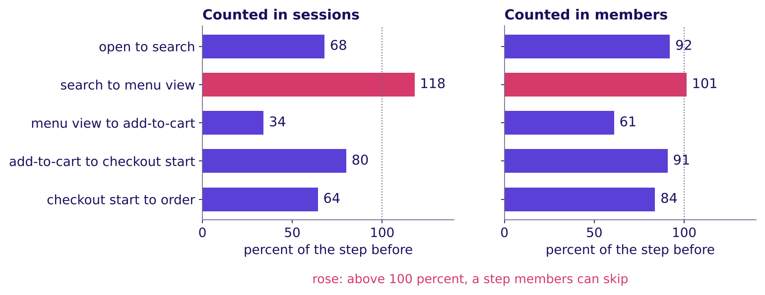
Indian Institute of Technology Gandhinagar
WEEK 4 · DAY 4 · COHORT AND FUNNEL
ADMINISTERED THROUGH THE COMPETENCY ADVANCEMENT ACADEMY
Answer: 61 per member, 34 per session
What does each unit answer, and which does the chart name?
September, Gold members: one funnel, two units
The answer is c. Per session asks how often a menu visit becomes a cart; per member asks how many members who browsed ever added to a cart that month. Neither is wrong, and a chart that does not name its unit invites the wrong one. Here every step except search to menu view reads higher per member, 118 to 101, since a member who fails in one session can succeed in another; a member who orders in many sessions can pull a per-member rate lower, so the direction is read from the data. This chart pools every platform and all of September, so neither panel shows the ticket's loss: the split by platform and date does.
Who joined when?
Where is the floor?
What is a blend made of?
Which step owns a loss?
Who entered when?
What is the 38 made of?
Which stage owns the loss?
S60 · 68 / 73
Notes:
LIVE, 3 minutes. Point at the same step in both panels: 34 and 61. Then at the 101: members skip
search in either unit, which is what makes the step pass 100.
Transition: the release.

Slide 69
Indian Institute of Technology Gandhinagar
WEEK 4 · DAY 4 · COHORT AND FUNNEL
ADMINISTERED THROUGH THE COMPETENCY ADVANCEMENT ACADEMY
Predict: when did members' Android rate break?
Members' add-to-cart to order on Android read 58 percent from 1 August to 13 September and 44 from 14 to 30 September. Week by week, what does the line look like?
a) A slow slide across August and September
b) Flat near 58 for seven weeks, then a break in the release week
c) A fall that started a week before the release
d) A dip in the release week that recovered by the month's end
Who joined when?
Where is the floor?
What is a blend made of?
Which step owns a loss?
Who entered when?
What is the 38 made of?
Which stage owns the loss?
S61 · 69 / 73
Notes:
LIVE, 2 minutes. Vote. The ticket gave the before and the after; the shape between them says
whether the release is the moment. The app team's lead will say the checkout works.
Transition: the split by membership, platform and date.

Slide 70
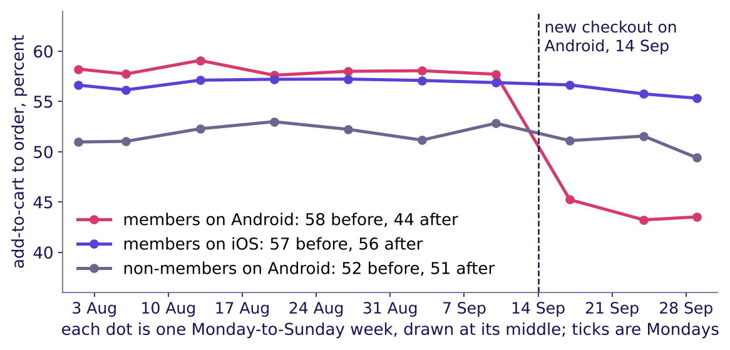
Indian Institute of Technology Gandhinagar
WEEK 4 · DAY 4 · COHORT AND FUNNEL
ADMINISTERED THROUGH THE COMPETENCY ADVANCEMENT ACADEMY
Answer: flat, then a break in the release week
How does add-to-cart to order move by membership, platform and week?
Only members on Android fall, and only from the release week
The answer is b. Members on Android: 58 to 44 percent, about 58 in each of the seven weeks before the release, then 45, 43 and 44. Members on iOS: 57 to 56. Non-members on Android: 52 to 51. Moving the cut a week either way keeps the fall, 58 to 47 with the cut on 7 September and 56 to 43 on 21 September, so the fall does not depend on where the line is drawn.
Who joined when?
Where is the floor?
What is a blend made of?
Which step owns a loss?
Who entered when?
What is the 38 made of?
Which stage owns the loss?
S62 · 70 / 73
Notes:
LIVE, 4 minutes. Read the three lines. The moved cut dates the fall; it does not test tracking,
since the rename shipped with the release and a logging fault would also start on 14 September.
The tracking test is on the doubts slide: the orders counted in member_months against the event
log. Every Android session from 14 September ran checkout v2, so the date and the version are one
split here.
Transition: which step inside the checkout.

Slide 71
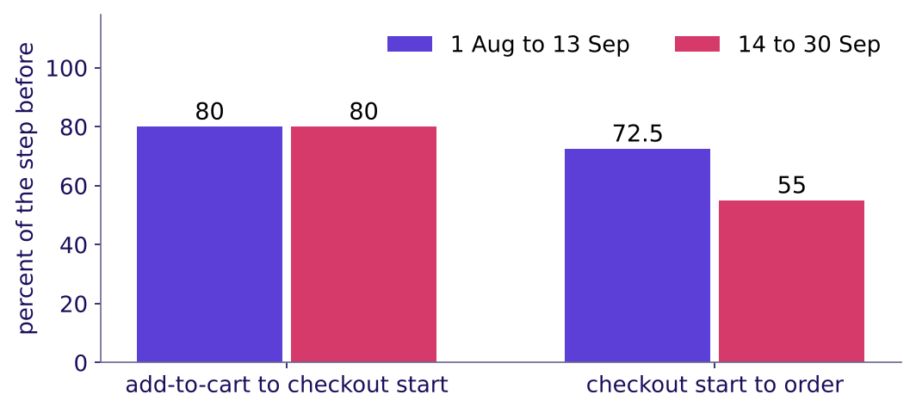
Indian Institute of Technology Gandhinagar
WEEK 4 · DAY 4 · COHORT AND FUNNEL
ADMINISTERED THROUGH THE COMPETENCY ADVANCEMENT ACADEMY
The step that broke: checkout start to order
Which of the two steps inside the checkout changed, and is the app team's chart wrong?
Android members: the step that changed is checkout to order
Android members still start checkout from 80 percent of carts, before and after. Completing the order once checkout has started fell from 72.5 to 55 percent, and the two steps multiply to the ticket's numbers: 0.80 × 72.5 = 58, 0.80 × 55 = 44. On this same step, iOS members went from 71 to 70 and non-members on Android from 65 to 64. The app team's chart, carts that start checkout, reads 80 percent flat: true, and it measures the step that did not break.
Who joined when?
Where is the floor?
What is a blend made of?
Which step owns a loss?
Who entered when?
What is the 38 made of?
Which stage owns the loss?
S63 · 71 / 73
Notes:
LIVE, 5 minutes. The case method: the app team is partly right, so find the part. Concede that
checkout starts held; bring the split that shows completion fell, for members, on Android, from
the release. Only members on Android fell, so the place to look is something in the new flow that
members see. The 55 rests on 18,273 checkout starts, so chance moves it by under a point if sessions were
independent; sessions cluster within members, so the honest margin is somewhat wider and still far
smaller than the fall from 72.5 to 55. The non-members' comparator rests on 1,600, so "held" there means
within about 2.5 points. The
afternoon's role card replays this dispute.
Transition: the checks before the call.

Slide 72
Indian Institute of Technology Gandhinagar
WEEK 4 · DAY 4 · COHORT AND FUNNEL
ADMINISTERED THROUGH THE COMPETENCY ADVANCEMENT ACADEMY
Seven checks before the call
What could still make the call wrong, and which check settles each?
Caveat | The check | What it found
Selection: the sale-week members were bought on a discount | The August cohort's organic members beside July's cohort | 49 against 49 percent; the sale-week members alone sit at 20
Censoring: the newest cohorts have few months on record | Compare cohorts only at ages all have reached; an empty cell is a month not yet lived | Named here; the IITGN faculty session W4-3 (tentative) takes it up
Seasonality: exam months in a student-heavy zone (hypothetical) | September split by zone (notebook 06) | No zone more than 0.9 points from the city
Tracking: the release renamed an Android event | Orders in member_months, which event names do not touch, against the event log | The same 27,212 member orders in September: none went missing
Mix inside the split: the August cohort aged across 14 September | Members who joined before August, on the same step | Android 70.3 to 53.6; iOS 68.6 to 69.3
Sessions against members | The unit named on every chart | 34 per session, 61 per member, both true
Joiners' orders rising after they join | Zomato Gold's frequency rose about 60 percent after joining | Members join when they expect to order more; the release split has a comparison, this has none
Zomato's 60 percent comes from its shareholder letter of 19 May 2023 (checked 12 October 2026); it describes members, and says nothing about what Gold caused.
Who joined when?
Where is the floor?
What is a blend made of?
Which step owns a loss?
Who entered when?
What is the 38 made of?
Which stage owns the loss?
S64 · 72 / 73
Notes:
Source:
https://www.bseindia.com/xml-data/corpfiling/AttachHis/42b3bf3b-1edb-4da7-849a-87ca9da27ff8.pdf (checked 12 October 2026)
LIVE, 2 minutes. Read three rows aloud: tracking, the mix inside the split, and sessions against
members; the other four are for self-study and the notebook. Strike the last lines of the
hypothesis board: tracking is ruled out, the definition explained, a cohort problem confirmed,
and an everyone-on-Android problem in one step. Name censoring for the faculty block (tentative)
and park any "are these curves different by chance" question there.
Transition: the chapter's close.

Slide 73
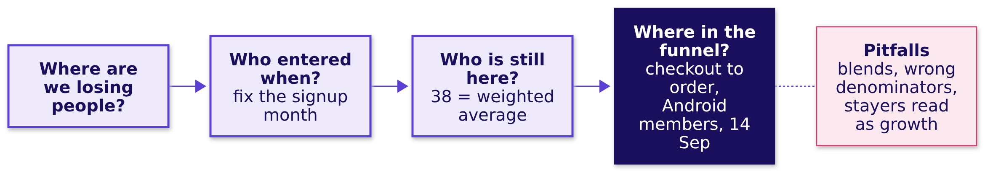
Indian Institute of Technology Gandhinagar
WEEK 4 · DAY 4 · COHORT AND FUNNEL
ADMINISTERED THROUGH THE COMPETENCY ADVANCEMENT ACADEMY
One step, one platform, one date
Which stage owns the loss, for whom, since when, and how big is it?
The size. 0.14 × 22,841 carts is about 3,198 orders in 17 days, 1,317 a week if none came back; counted in orders placed, 1,133 to 1,266 a week, about a quarter of the 5,064 orders a week Android members placed before the release. At Rs 300 to Rs 500 an order (an assumption), Rs 3.4 to 6.6 lakh of order value a week.
THE RULE
Name the unit, split by who, where and when, and find the step that changed before blaming the step that is low.
Who joined when?
Where is the floor?
What is a blend made of?
Which step owns a loss?
Who entered when?
What is the 38 made of?
Which stage owns the loss?
S65 · 73 / 73
Notes:
Source:
https://www.amplitude.com/blog/7-percent-retention-rule (checked 13 October 2026)
A "good" retention number needs its definition: Amplitude, a product-analytics vendor, says 7
percent of a cohort back on day seven puts a product in the top 25 percent for activation among the
more than 2,600 companies it studied, and its blog gives no method. Say so if the room asks for a
benchmark. The size's working: Android members placed 5,064 orders a week before the release and
4,138 after, down 18 percent, while iOS members' orders rose 7 percent and non-members' on Android
4 percent; held to either comparator's change, the loss is 1,266 or 1,133 orders a week.
LIVE, 1 minute. Say the morning's sentence: the dashboard was flat because of who it counts;
every cohort fell; one step, on one platform, after one date, drove the order loss. Board complete.
The afternoon opens on the fifth topic, then makes the call and reads the interview.
Transition: lunch.

