Slide 1


Indian Institute of Technology Gandhinagar
ADMINISTERED THROUGH THE COMPETENCY ADVANCEMENT ACADEMY
WEEK 2 · MONDAY · HALF ONE
The Monday numbers, from the warehouse
“I want these numbers every Monday, for every segment and channel, computed from the warehouse itself. No notebooks, no exports, nothing a person can mistype.”
Anand Iyer, CFO, Kalpa Retail, to the data and AI team at Kalpa's Global Capability Centre
01
The ask
02
Round 1, is it the book
03
Round 2, per segment
04
Round 3, named steps
Week 2, Day 1. The Monday numbers, from the warehouse
1 / 46
Notes:
LIVE, one minute. Read Anand's words aloud and leave them up while the room settles. Last week
ended with Meera accepting "real, modest, fix frequency". This week the numbers move from files to
the warehouse, and every day is a harder version of Anand's request: today the tree as queries,
Tuesday booked against collected, Wednesday the top members and the running total, Thursday one
row per customer in pandas, Friday the leadership deck in Excel. Say the arc once and move on.

Slide 2
Indian Institute of Technology Gandhinagar
PG DIPLOMA IN AI-ML AND AGENTIC AI ENGINEERING · COHORT 2
ADMINISTERED THROUGH THE COMPETENCY ADVANCEMENT ACADEMY
01
The ask
The CFO wants last week's tree every Monday, from the warehouse, and an analyst who audits every line.
The ask
Round 1, is it the book
Round 2, per segment
Round 3, named steps
Week 2 Day 1: the Monday numbers, from the warehouse
2 / 46
Notes:
LIVE. Twenty minutes: the ask, what it rules out, and the thinking drawn on the board before any
tool opens. No SQL is typed in this chapter.

Slide 3

Indian Institute of Technology Gandhinagar
WEEK 2 · DAY 1 · KALPA GLOBAL CAPABILITY CENTRE
ADMINISTERED THROUGH THE COMPETENCY ADVANCEMENT ACADEMY
Monday at the GCC: the ask moves to the warehouse
Last week's note carried the growth review; this week the numbers have to run themselves.
1.6%
every Monday
6
0
THE FALL, Q1 TO Q2
HOW OFTEN
QUERIES
EXPORTS
Week 1's reconciled number
for every segment and channel
the Monday suite the analyst audits
query it, do not export it
The ask
Round 1, is it the book
Round 2, per segment
Round 3, named steps
S1 · 3 / 46
Notes:
LIVE, 3 minutes. The stats row is the brief. Anand is the CFO of Kalpa Retail; his analyst will
read every query line by line without the team beside him. The data platform lead has given read
access to Postgres and one rule: query it, do not export it. Ask: which of these four numbers
changes how you work most? The zero exports, because every Week 1 step ran on a file.

Slide 4

Indian Institute of Technology Gandhinagar
WEEK 2 · DAY 1 · KALPA GLOBAL CAPABILITY CENTRE
ADMINISTERED THROUGH THE COMPETENCY ADVANCEMENT ACADEMY
What Anand wrote, and what the platform lead added
Four questions in two messages, and each has a day this week.
THE CLIENT ASKS
"I want these numbers every Monday, for every segment and channel, computed from the warehouse itself. No notebooks, no exports, nothing a person can mistype."
"The warehouse holds the orders and customers you cleaned last week, one thousand orders for the two quarters, already de-duplicated. Query it; do not export it."
The data platform lead, Kalpa Retail
What they asked | What it becomes for the team | Answered
Last week's tree as queries | The leaves per segment and quarter in SQL | Today
Readable enough to audit | Named steps, comments, an order on every list | Today
Which Python steps become one line | COUNT, SUM, GROUP BY, WHERE, a CTE | Today
Where SQL stops | Charts, tests and exploration stay in Python | Thursday
The ask
Round 1, is it the book
Round 2, per segment
Round 3, named steps
S2 · 4 / 46
Notes:
LIVE, 3 minutes. Read both messages aloud. Separate the four questions and say when each gets
answered. The platform lead's "one thousand orders" is a claim the room checks in round 1; do not
comment on it now.

Slide 5
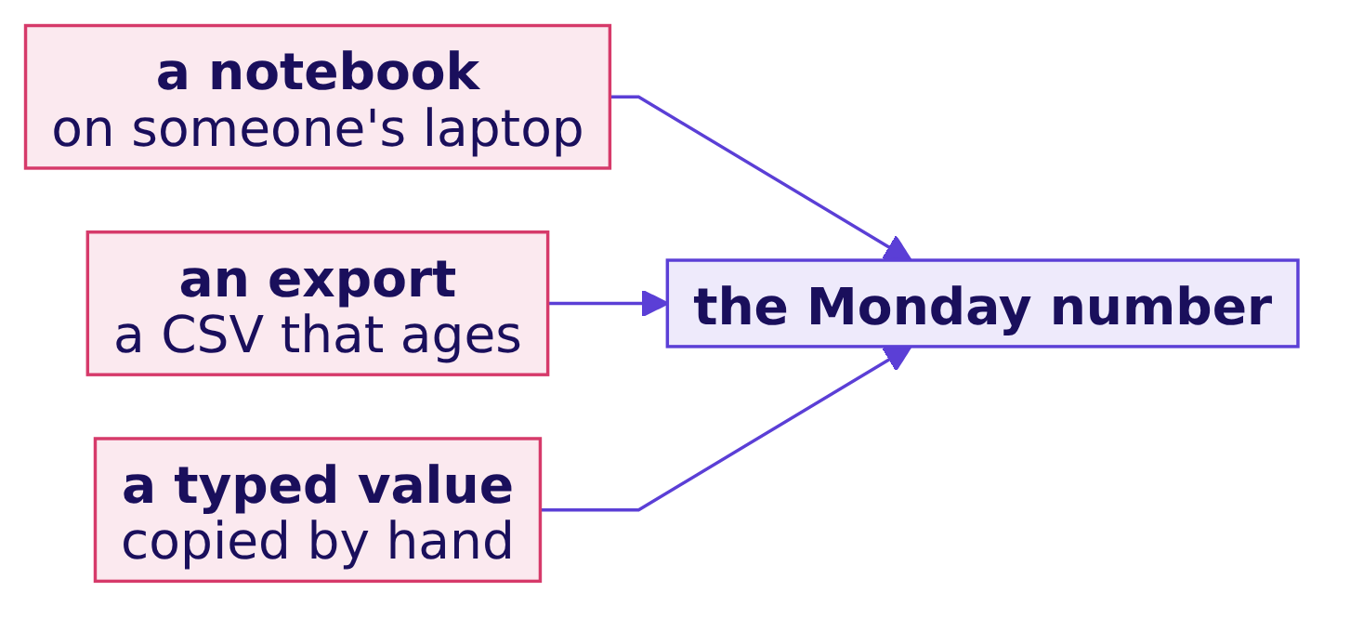
Indian Institute of Technology Gandhinagar
WEEK 2 · DAY 1 · KALPA GLOBAL CAPABILITY CENTRE
ADMINISTERED THROUGH THE COMPETENCY ADVANCEMENT ACADEMY
Question: what does "from the warehouse" rule out?
Anand listed three things he never wants to see again.
Question. Which of these does Anand's rule still allow? a) Exploring in a notebook, while the reported number comes from a saved query; b) exporting once a quarter to a shared drive; c) pasting the query's output into the sheet by hand; d) none of them, all analysis moves to SQL.
The ask
Round 1, is it the book
Round 2, per segment
Round 3, named steps
S3 · 5 / 46
Notes:
LIVE, 3 minutes. One minute in pairs, then letters. Expect d from the cautious and b from the
practical.

Slide 6

Indian Institute of Technology Gandhinagar
WEEK 2 · DAY 1 · KALPA GLOBAL CAPABILITY CENTRE
ADMINISTERED THROUGH THE COMPETENCY ADVANCEMENT ACADEMY
Answer: explore anywhere, report from the query
The rule covers the number on the sheet; exploration still belongs in a notebook.
Option | Verdict | Why
a) Explore in a notebook, report from a saved query | Allowed | The reported number is rerun against the book every Monday
b) Export once a quarter | Ruled out | The export is stale the day it lands
c) Paste output by hand | Ruled out | A typed value leaves no trace
d) All analysis in SQL | Too far | Charts, tests and exploration are Python's job
KAVYA'S REVIEW
The query is what we hand over; the notebook is where we think. Keep them apart and say which is which.
The ask
Round 1, is it the book
Round 2, per segment
Round 3, named steps
S4 · 6 / 46
Notes:
LIVE, 2 minutes. The answer is a. Option d sounds disciplined and would throw away every chart the
week needs. This slide is the interview answer to "why compute a KPI in the warehouse", which
returns at the end of round 1.

Slide 7
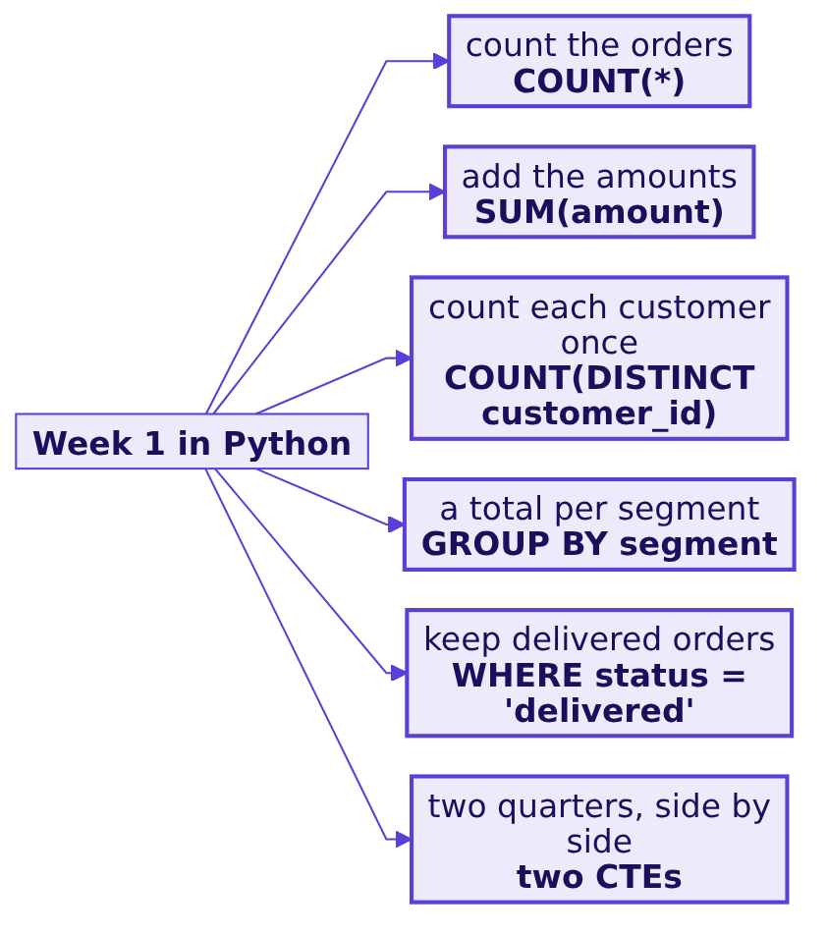
Indian Institute of Technology Gandhinagar
WEEK 2 · DAY 1 · KALPA GLOBAL CAPABILITY CENTRE
ADMINISTERED THROUGH THE COMPETENCY ADVANCEMENT ACADEMY
Every Week 1 step has a SQL counterpart
Counting is COUNT, summing is SUM, per segment is GROUP BY, a filter is WHERE.
The room knows every right answer from Week 1, so today's attention goes to the language.
The ask
Round 1, is it the book
Round 2, per segment
Round 3, named steps
S5 · 7 / 46
Notes:
LIVE, 3 minutes. Draw this on the board: last week's move on the left, its SQL on the right. The
contrast to say aloud: Tuesday's thirty-line profiler becomes three lines of SQL. Leave the board
drawing up all morning; each round ticks one row.

Slide 8
Indian Institute of Technology Gandhinagar
WEEK 2 · DAY 1 · KALPA GLOBAL CAPABILITY CENTRE
ADMINISTERED THROUGH THE COMPETENCY ADVANCEMENT ACADEMY
A query describes a result and runs in fixed order
The database reads a query in a different order from the one it is written in.
Written order: SELECT, FROM, WHERE, GROUP BY, HAVING, ORDER BY, LIMIT. Run order: the arrows.
The ask
Round 1, is it the book
Round 2, per segment
Round 3, named steps
S6 · 8 / 46
Notes:
LIVE, 3 minutes. Draw the seven boxes on the board and keep them there all day. Say: you write
what you want; the database decides how. The run order explains most errors a beginner meets, and
the analyst reads a query in this order whatever order it is written in. Do not teach each clause
now; each round lights one part.

Slide 9
Indian Institute of Technology Gandhinagar
WEEK 2 · DAY 1 · KALPA GLOBAL CAPABILITY CENTRE
ADMINISTERED THROUGH THE COMPETENCY ADVANCEMENT ACADEMY
One case, five rungs, each a harder question
The day climbs from one number to the suite the analyst reruns every Monday.
RUNG 1
RUNG 2
RUNG 3
RUNG 4
RUNG 5
Is it the book?
Per segment, per quarter
Two quarters as named steps
The Monday suite
By channel
The leaves re-answered in SQL and checked against Week 1.
Six queries the analyst audits line by line.
The same tree for every channel, in the practice lab.
Eight rows of the same leaves, with honest division.
Which branch moved, and an average that skips no one.
The ask
Round 1, is it the book
Round 2, per segment
Round 3, named steps
S7 · 9 / 46
Notes:
LIVE, 3 minutes. Walk the rungs. The morning is rungs 1 to 3, the first hour of the afternoon is
rung 4, and the practice lab is rung 5. The IITGN block that closes the day is tentative; say it
once with that word and do not describe its content.
Transition: rung 1 opens with a connection.

Slide 10
Indian Institute of Technology Gandhinagar
PG DIPLOMA IN AI-ML AND AGENTIC AI ENGINEERING · COHORT 2
ADMINISTERED THROUGH THE COMPETENCY ADVANCEMENT ACADEMY
02
Round 1, is it the book
Before one number goes on Anand's sheet, the warehouse has to agree with what we already defended.
The ask
Round 1, is it the book
Round 2, per segment
Round 3, named steps
Week 2 Day 1: the Monday numbers, from the warehouse
10 / 46
Notes:
LIVE. Fifty minutes: the question and its picture (5), first contact and the leaves (15), the
customer trap (10), the sample trap and the harder variant (15), Kavya's review (5).
Notebook: notebooks/C2_W02_D01_01_warehouse_STUDENT.ipynb. SQL: sql/C2_W02_D01_01_first_queries_STUDENT.sql.

Slide 11
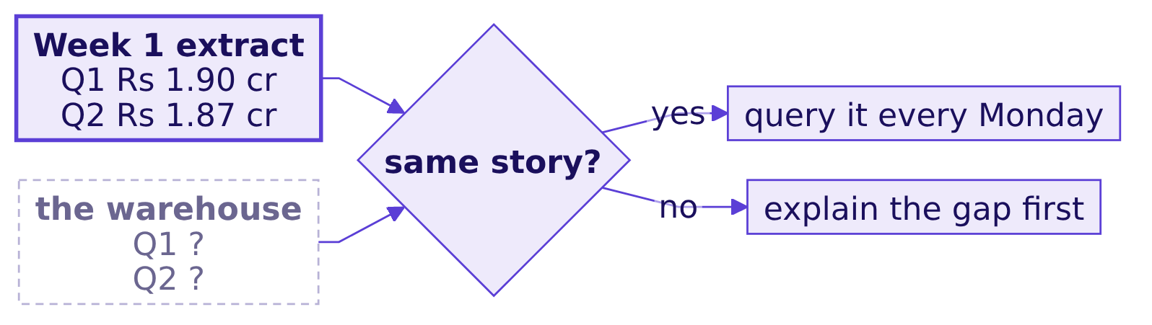
Indian Institute of Technology Gandhinagar
WEEK 2 · DAY 1 · KALPA GLOBAL CAPABILITY CENTRE
ADMINISTERED THROUGH THE COMPETENCY ADVANCEMENT ACADEMY
The question: the warehouse against Week 1
A new source that disagrees with the old one is the first thing to explain.
THE CLIENT ASKS
"Before your numbers go in my book, show me they match the ones you gave Meera."
The ask
Round 1, is it the book
Round 2, per segment
Round 3, named steps
S8 · 11 / 46
Notes:
LIVE, 2 minutes. Draw it. Ask what "the same story" should mean: the same totals, or the same fall?
Leave the question open; the demonstration answers it.

Slide 12
Indian Institute of Technology Gandhinagar
WEEK 2 · DAY 1 · KALPA GLOBAL CAPABILITY CENTRE
ADMINISTERED THROUGH THE COMPETENCY ADVANCEMENT ACADEMY
First contact: a live connection, a .sql file
Connect from VS Code, open a .sql file, run one block, read the result grid.
STEP 1
STEP 2
STEP 3
STEP 4
Connect
Open the file
Run one block
Read the schema
The Postgres extension in VS Code, the Codespace's warehouse, database kalpa.
sql/C2_W02_D01_01_first_queries_STUDENT.sql, one block per question.
Cursor inside the block, run it, read the grid under the editor.
Seven tables; orders and customers carry today's tree.
The walkthrough is whiteboards/C2_W02_D01_execution_order_STUDENT.md, part one.
The ask
Round 1, is it the book
Round 2, per segment
Round 3, named steps
S9 · 12 / 46
Notes:
LIVE, 8 minutes, the only tool-setup time today. Everyone runs r1_tables. Anyone whose connection
fails pairs with a neighbour now and the support TA fixes it at the break; do not stop the room.
The notebooks run the same blocks, so a learner can follow in either.

Slide 13
Indian Institute of Technology Gandhinagar
WEEK 2 · DAY 1 · KALPA GLOBAL CAPABILITY CENTRE
ADMINISTERED THROUGH THE COMPETENCY ADVANCEMENT ACADEMY
SELECT, FROM, WHERE: one quarter's book
Three clauses answer the first leaf: how much did Q1 book?
-- The question: how many orders did Q1 book, and for how much? Booked means every status.
SELECT count(*) AS orders, sum(amount) AS revenue
FROM orders
WHERE quarter = 'Q1';
Clause | What it does here
FROM orders | Every order row in the book
WHERE quarter = 'Q1' | Keeps the Q1 rows
SELECT count(*), sum(amount) | Counts and adds what survived
The ask
Round 1, is it the book
Round 2, per segment
Round 3, named steps
S10 · 13 / 46
Notes:
LIVE, 4 minutes. Type it with the room. Point at the comment line: the analyst reads it first,
so it states the question and the definition. Then run the Q2 block beside it.

Slide 14
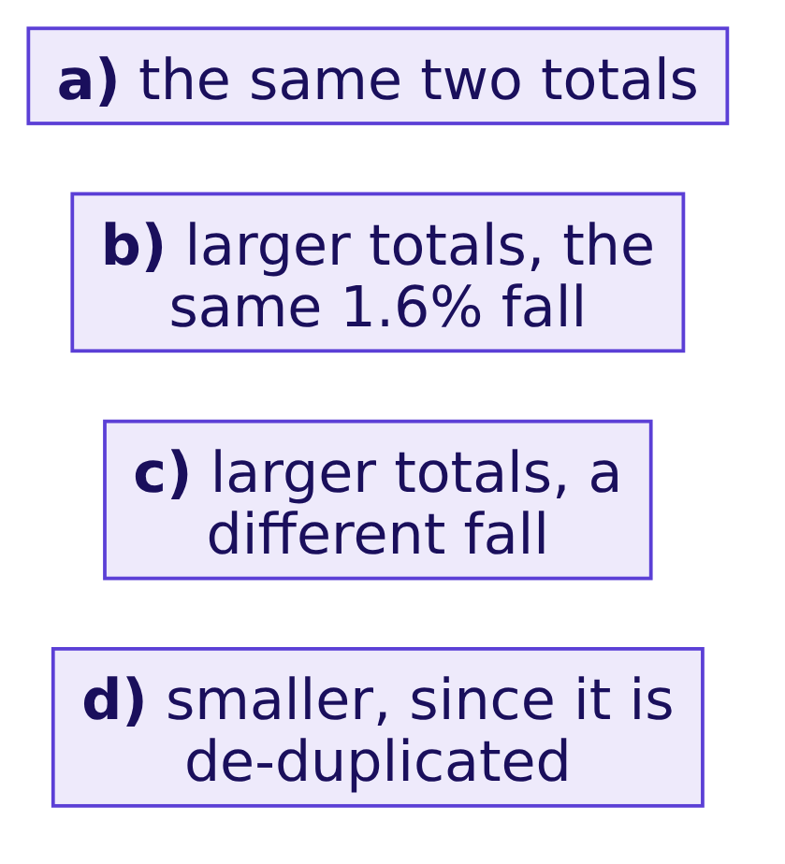
Indian Institute of Technology Gandhinagar
WEEK 2 · DAY 1 · KALPA GLOBAL CAPABILITY CENTRE
ADMINISTERED THROUGH THE COMPETENCY ADVANCEMENT ACADEMY
Question: what does the warehouse say for Q1?
Week 1 reconciled Q1 to Rs 1,90,00,000 and Q2 to Rs 1,87,00,000.
Question. Before you run the Q1 and Q2 blocks, which of these do you expect? Answer as a letter.
The ask
Round 1, is it the book
Round 2, per segment
Round 3, named steps
S11 · 14 / 46
Notes:
LIVE, 2 minutes. Letters first, then run both blocks.

Slide 15
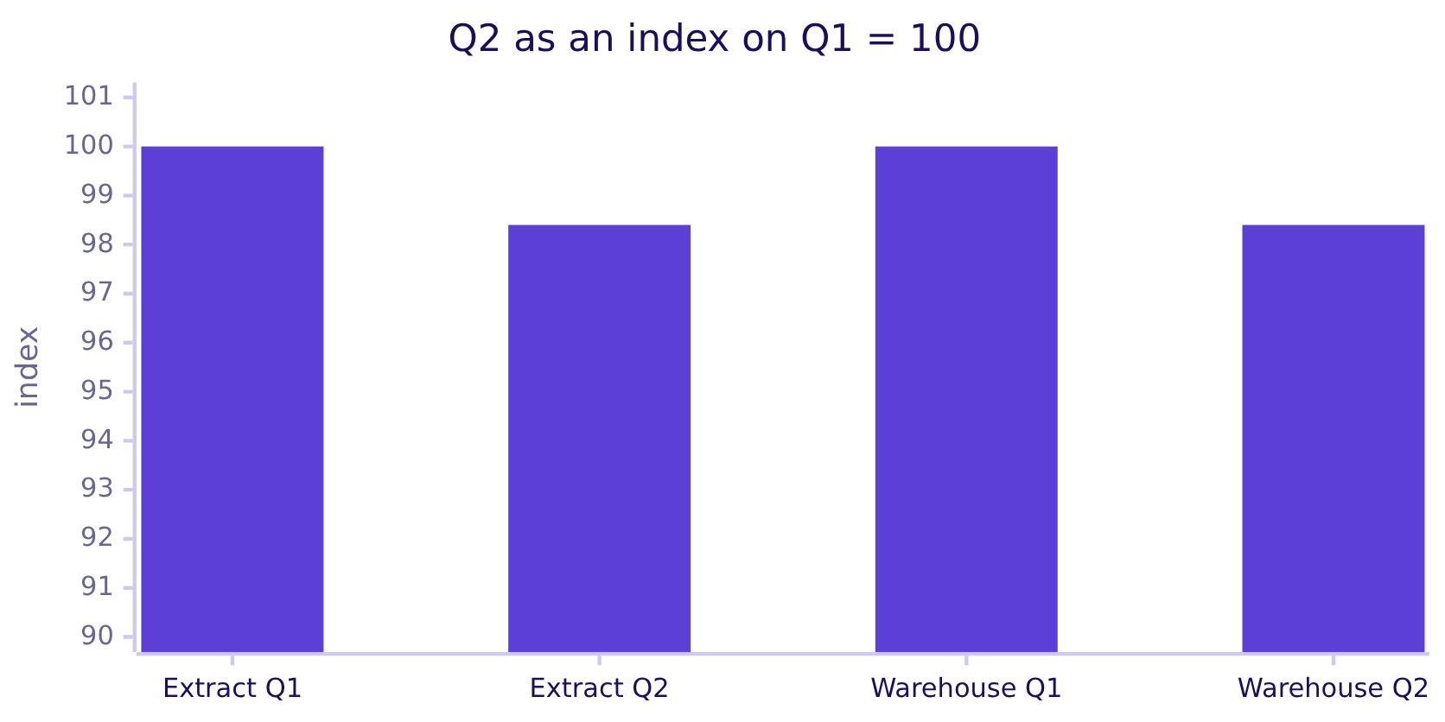
Indian Institute of Technology Gandhinagar
WEEK 2 · DAY 1 · KALPA GLOBAL CAPABILITY CENTRE
ADMINISTERED THROUGH THE COMPETENCY ADVANCEMENT ACADEMY
Answer: five times the totals, the same fall
The book is the whole two quarters; last week's files were an extract.
Extract: Rs 1.90 crore to Rs 1.87 crore. Warehouse: Rs 10.00 crore to Rs 9.84 crore. Both fall 1.6 percent.
The ask
Round 1, is it the book
Round 2, per segment
Round 3, named steps
S12 · 15 / 46
Notes:
LIVE, 4 minutes. The answer is b. The extract held 186 cleaned orders; the warehouse holds 1,000.
The rate carries over and the total does not, and that is the check whenever a source changes.
Retail-Plus orders fall 34.9 percent in the book against 35.0 in the extract (r1_plus_orders).
Kavya's point: the warehouse is now the source, because it agrees on the rate.

Slide 16
Indian Institute of Technology Gandhinagar
WEEK 2 · DAY 1 · KALPA GLOBAL CAPABILITY CENTRE
ADMINISTERED THROUGH THE COMPETENCY ADVANCEMENT ACADEMY
The plausible wrong answer: 1,000 customers
The next leaf, asked the quickest way.
SELECT count(*) AS customers FROM orders;
1,000
1,000
1.00
CUSTOMERS
ORDERS
ORDERS PER CUSTOMER
the column's own label
Q1 plus Q2
so nobody ever came back
On Anand's sheet this says every customer bought once: the frequency branch, the one Meera was told to fix, reads as if there were nothing to fix.
The ask
Round 1, is it the book
Round 2, per segment
Round 3, named steps
S13 · 16 / 46
Notes:
LIVE, 3 minutes. Run it and read the result as the hurried analyst would, straight-faced. Ask
whether anyone would sign it. Most hesitate at 1.00 because Week 1 said members come back.

Slide 17
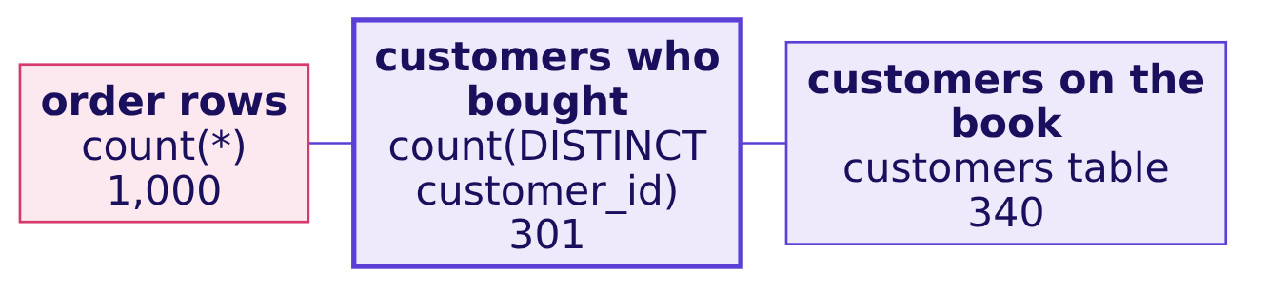
Indian Institute of Technology Gandhinagar
WEEK 2 · DAY 1 · KALPA GLOBAL CAPABILITY CENTRE
ADMINISTERED THROUGH THE COMPETENCY ADVANCEMENT ACADEMY
Why it is wrong: count(*) counts rows
A label is a promise the query does not keep; the database prints whatever name you give it.
The check. Count the same table three ways, each named for what it counts (block r1_customers_three). The three numbers differ, so at most one of them is "customers".
The ask
Round 1, is it the book
Round 2, per segment
Round 3, named steps
S14 · 17 / 46
Notes:
LIVE, 3 minutes. Run r1_customers_three. Ask which of 301 and 340 belongs on Anand's sheet: 301
for orders per customer, because a customer who bought nothing places no orders; 340 answers how
many members Kalpa holds. The suite states which one it uses.

Slide 18
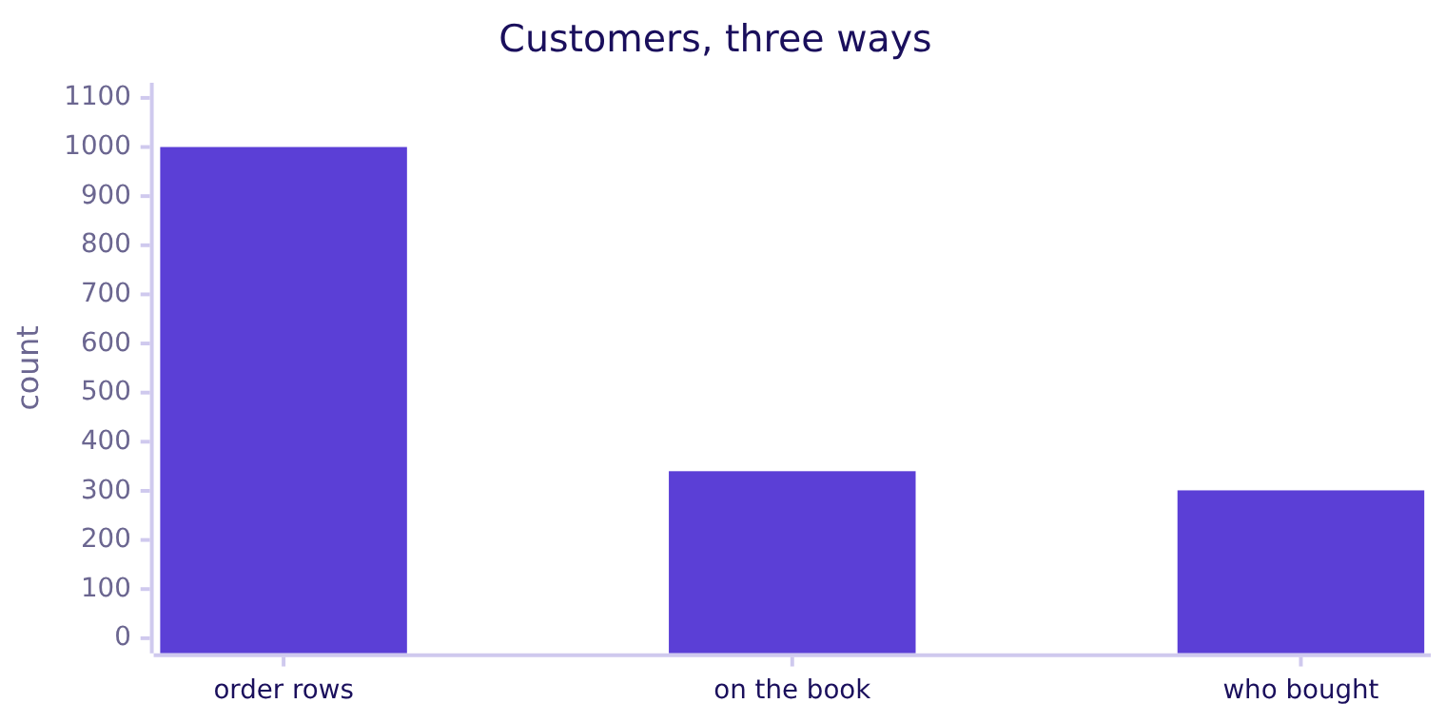
Indian Institute of Technology Gandhinagar
WEEK 2 · DAY 1 · KALPA GLOBAL CAPABILITY CENTRE
ADMINISTERED THROUGH THE COMPETENCY ADVANCEMENT ACADEMY
The fix: 301 customers, 3.32 orders each
count(DISTINCT customer_id) counts each person once, and the frequency branch is back.
What changed. 699 customers who do not exist leave the sheet, and orders per customer moves from 1.00 to 3.32 over the two quarters.
The ask
Round 1, is it the book
Round 2, per segment
Round 3, named steps
S15 · 18 / 46
Notes:
LIVE, 2 minutes. Say the fix in one line and the change in people. Week 1 met the same trap with
30 rows and 23 customers; the room should recognise it.

Slide 19
Indian Institute of Technology Gandhinagar
WEEK 2 · DAY 1 · KALPA GLOBAL CAPABILITY CENTRE
ADMINISTERED THROUGH THE COMPETENCY ADVANCEMENT ACADEMY
Question: which five does LIMIT 5 return?
The analyst will trace five delivered Q2 app orders against the ERP, and rerun your query to get the same five.
SELECT order_id, amount
FROM orders
WHERE quarter = 'Q2' AND channel = 'app' AND status = 'delivered'
LIMIT 5;
Question. Without ORDER BY, which five rows come back? a) The five smallest order ids; b) the five most recent; c) whichever five the database reaches first, which can change between runs; d) five at random every time.
The ask
Round 1, is it the book
Round 2, per segment
Round 3, named steps
S16 · 19 / 46
Notes:
LIVE, 2 minutes. Letters, then run r1_sample_hurried. Everyone in the room gets the same five
today, which is exactly why the trap survives: it looks stable.

Slide 20

Indian Institute of Technology Gandhinagar
WEEK 2 · DAY 1 · KALPA GLOBAL CAPABILITY CENTRE
ADMINISTERED THROUGH THE COMPETENCY ADVANCEMENT ACADEMY
Answer: whichever five it reaches first
A reload rewrites two rows with identical values, and the same query returns a different five.
Run | The five orders | Their total
Yours, Monday | KR-00542, 544, 545, 546, 547 | Rs 3,900
The analyst's, after the reload | KR-00545, 546, 547, 549, 553 | Rs 4,590
The ask
Round 1, is it the book
Round 2, per segment
Round 3, named steps
S17 · 20 / 46
Notes:
LIVE, 4 minutes. The answer is c. Run r1_sample_after_reload: it updates two rows to the values
they already hold inside a transaction, reruns, and rolls back. No number in the book changed; the
audit still reports a Rs 690 disagreement. A table has no order.

Slide 21

Indian Institute of Technology Gandhinagar
WEEK 2 · DAY 1 · KALPA GLOBAL CAPABILITY CENTRE
ADMINISTERED THROUGH THE COMPETENCY ADVANCEMENT ACADEMY
The fix: order by a unique key, then limit
The same five rows before and after the reload, so the analyst audits what you audited.
SELECT order_id, amount
FROM orders
WHERE quarter = 'Q2' AND channel = 'app' AND status = 'delivered'
ORDER BY order_id
LIMIT 5;
THE RULE
Every list on Anand's sheet carries an ORDER BY on a column, or a set of columns, that no two rows share. Ordering by amount alone still lets two equal amounts swap.
The ask
Round 1, is it the book
Round 2, per segment
Round 3, named steps
S18 · 21 / 46
Notes:
LIVE, 2 minutes. Run r1_sample_fixed. The notebook reruns it inside the reload and checks it is
identical. Wednesday returns to ties when the head of Retail-Plus wants a top fifty.

Slide 22
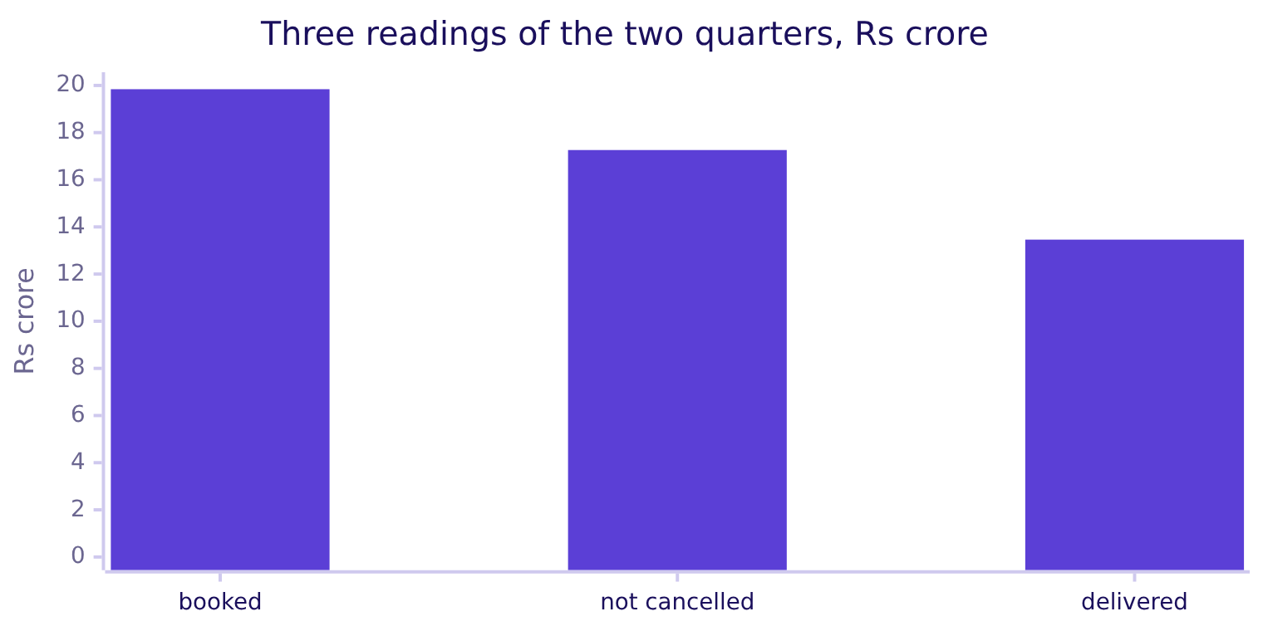
Indian Institute of Technology Gandhinagar
WEEK 2 · DAY 1 · KALPA GLOBAL CAPABILITY CENTRE
ADMINISTERED THROUGH THE COMPETENCY ADVANCEMENT ACADEMY
Your turn: the three readings of sales
Week 1's readings, re-answered with one WHERE each.
The harder variant. Write the not-cancelled and delivered readings for each quarter, and say which one Anand's sheet uses and where the comment says so. Block r1_readings has the answer for both quarters together.
The ask
Round 1, is it the book
Round 2, per segment
Round 3, named steps
S19 · 22 / 46
Notes:
LIVE, 10 minutes of the room's own typing. The bars are r1_readings' three totals. The suite uses booked revenue, the definition Week 1 reconciled; the comment line
says so. Fast finishers compute the median order with percentile_cont (block r1_typical): the
mean is about 80 times the median, the Week 1 shape at warehouse scale.

Slide 23
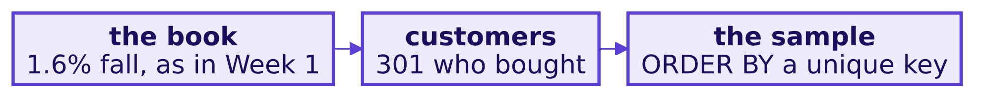

Indian Institute of Technology Gandhinagar
WEEK 2 · DAY 1 · KALPA GLOBAL CAPABILITY CENTRE
ADMINISTERED THROUGH THE COMPETENCY ADVANCEMENT ACADEMY
Round 1: the warehouse is the book
It agrees with Week 1 on the rate, so it is the source from Monday on.
KAVYA'S REVIEW
Every count says what it counts, and every list says how it is ordered. The comment above the query names both, because it is the first line the analyst reads.
IN THE INTERVIEW
[F] What does LIMIT without ORDER BY return? [F] Why would you compute a KPI in the warehouse rather than in a notebook?
The ask
Round 1, is it the book
Round 2, per segment
Round 3, named steps
S20 · 23 / 46
Notes:
LIVE, 5 minutes. Ask the two questions aloud and take one answer each; the model answers are in
the notebook's "In the interview" section and in the day sheet. Tick the first row of the board.

Slide 24
Indian Institute of Technology Gandhinagar
PG DIPLOMA IN AI-ML AND AGENTIC AI ENGINEERING · COHORT 2
ADMINISTERED THROUGH THE COMPETENCY ADVANCEMENT ACADEMY
03
Round 2, per segment
Eight rows of the same leaves, one clause, and a ratio the database rounds without saying so.
The ask
Round 1, is it the book
Round 2, per segment
Round 3, named steps
Week 2 Day 1: the Monday numbers, from the warehouse
24 / 46
Notes:
LIVE. Fifty minutes: GROUP BY and the run order (15), the GROUP BY error (2), the integer-division
trap (13), HAVING and the harder variant (15), Kavya's review (5).
Notebook: notebooks/C2_W02_D01_02_segments_STUDENT.ipynb. SQL: sql/C2_W02_D01_02_segments_STUDENT.sql.

Slide 25
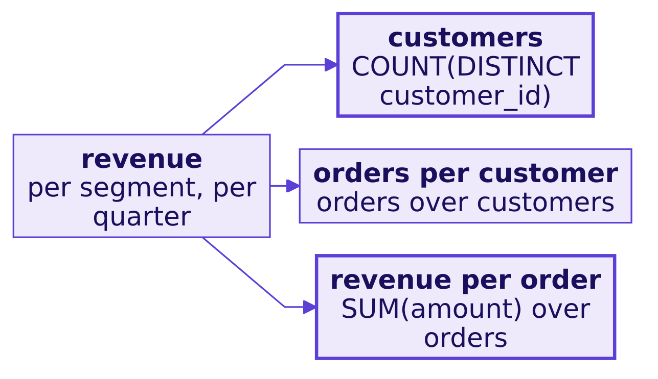
Indian Institute of Technology Gandhinagar
WEEK 2 · DAY 1 · KALPA GLOBAL CAPABILITY CENTRE
ADMINISTERED THROUGH THE COMPETENCY ADVANCEMENT ACADEMY
The question: every leaf, every segment, both quarters
Anand's sheet is the tree repeated for four segments and two quarters.
THE CLIENT ASKS
"Every segment. I do not want a total that hides which one moved."
The ask
Round 1, is it the book
Round 2, per segment
Round 3, named steps
S21 · 25 / 46
Notes:
LIVE, 2 minutes. The segment lives on the customer, so each order borrows it with one lookup line,
JOIN customers USING (customer_id). Each order has exactly one customer, so the row count stays
1,000; say that joins are tomorrow's day and move on.

Slide 26
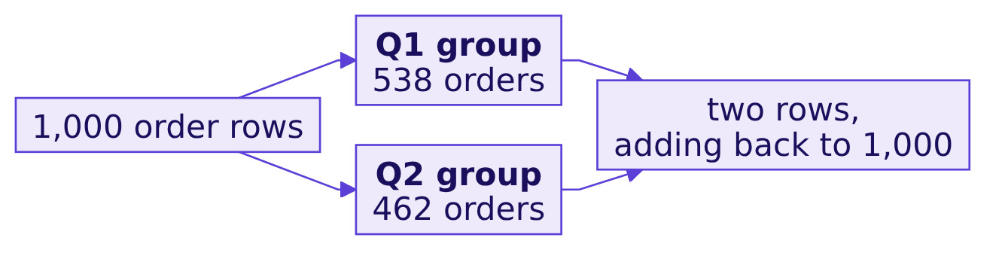
Indian Institute of Technology Gandhinagar
WEEK 2 · DAY 1 · KALPA GLOBAL CAPABILITY CENTRE
ADMINISTERED THROUGH THE COMPETENCY ADVANCEMENT ACADEMY
GROUP BY: one row per group
The thousand rows collapse into one row per quarter, and each aggregate runs inside its group.
SELECT quarter, count(*) AS orders, sum(amount) AS revenue
FROM orders
GROUP BY quarter
ORDER BY quarter;
The ask
Round 1, is it the book
Round 2, per segment
Round 3, named steps
S22 · 26 / 46
Notes:
LIVE, 5 minutes. Predict the row count first: 2. Then the first check on any grouped result: the
groups add back to the table. A grouped result that does not add back has lost or doubled rows.

Slide 27
Indian Institute of Technology Gandhinagar
WEEK 2 · DAY 1 · KALPA GLOBAL CAPABILITY CENTRE
ADMINISTERED THROUGH THE COMPETENCY ADVANCEMENT ACADEMY
The error worth two minutes
A column that is neither grouped nor aggregated has four values per group, so the database refuses.
SELECT c.segment, o.quarter, count(*) AS orders
FROM orders o JOIN customers c USING (customer_id)
GROUP BY o.quarter;
-- ERROR: column "c.segment" must appear in the GROUP BY clause
-- or be used in an aggregate function
Two fixes. Add c.segment to GROUP BY, which is Anand's question, or wrap it in an aggregate, which answers another one.
The ask
Round 1, is it the book
Round 2, per segment
Round 3, named steps
S23 · 27 / 46
Notes:
LIVE, 2 minutes and no more. Let it fail on the room's screens, read the last line aloud, fix it by
adding the column. This is a syntax error, never a trap: nobody would ship it, because it prints no
number.

Slide 28
Indian Institute of Technology Gandhinagar
WEEK 2 · DAY 1 · KALPA GLOBAL CAPABILITY CENTRE
ADMINISTERED THROUGH THE COMPETENCY ADVANCEMENT ACADEMY
Question: what does 140 / 76 return?
Retail-Plus in Q2: 140 orders from 76 customers. The hurried query divides count by count.
SELECT c.segment, o.quarter,
count(*) / count(DISTINCT o.customer_id) AS orders_per_customer
FROM orders o JOIN customers c USING (customer_id)
GROUP BY c.segment, o.quarter;
Question. What does Postgres print for Retail-Plus in Q2? a) 1.84; b) 1; c) 2; d) an error.
The ask
Round 1, is it the book
Round 2, per segment
Round 3, named steps
S24 · 28 / 46
Notes:
LIVE, 2 minutes. Letters, then run r2_frequency_hurried.

Slide 29
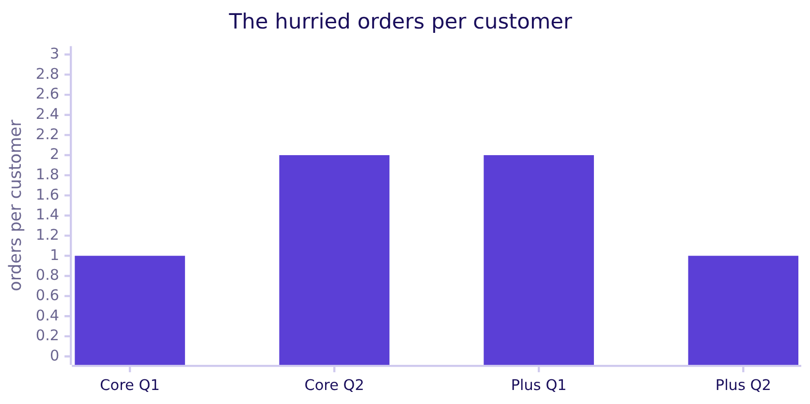
Indian Institute of Technology Gandhinagar
WEEK 2 · DAY 1 · KALPA GLOBAL CAPABILITY CENTRE
ADMINISTERED THROUGH THE COMPETENCY ADVANCEMENT ACADEMY
Answer: 1, and the sheet says frequency halved
The plausible wrong answer: Retail-Plus drops from 2 to 1 and Retail-Core doubles from 1 to 2.
Read aloud to the head of Retail-Plus, it says her members now order once a quarter, and it says the loyalty budget should follow Retail-Core, whose members suddenly order twice as often.
The ask
Round 1, is it the book
Round 2, per segment
Round 3, named steps
S25 · 29 / 46
Notes:
LIVE, 3 minutes. The answer is b. Present it straight, as the sheet would. Ask what the head of
Retail-Plus would do with it. Then ask whether anyone believes Retail-Core doubled in one quarter.

Slide 30
Indian Institute of Technology Gandhinagar
WEEK 2 · DAY 1 · KALPA GLOBAL CAPABILITY CENTRE
ADMINISTERED THROUGH THE COMPETENCY ADVANCEMENT ACADEMY
Why it is wrong: integers divide as integers
Both counts are integers, so Postgres drops the fraction; nothing on the grid warns you.
Segment, quarter | Orders | Customers | Hurried ratio | Orders it implies
Retail-Plus, Q1 | 215 | 91 | 2 | 182
Retail-Plus, Q2 | 140 | 76 | 1 | 76
Retail-Core, Q1 | 199 | 102 | 1 | 102
Retail-Core, Q2 | 193 | 96 | 2 | 192
The check. Multiply the ratio back by the customers. A right ratio gives the orders; this one misses in all eight rows (block r2_frequency_check).
The ask
Round 1, is it the book
Round 2, per segment
Round 3, named steps
S26 · 30 / 46
Notes:
LIVE, 4 minutes. Point at Retail-Plus Q2: the ratio accounts for 76 of 140 orders. The check is a
calculator habit the analyst will use on every ratio on the sheet.

Slide 31
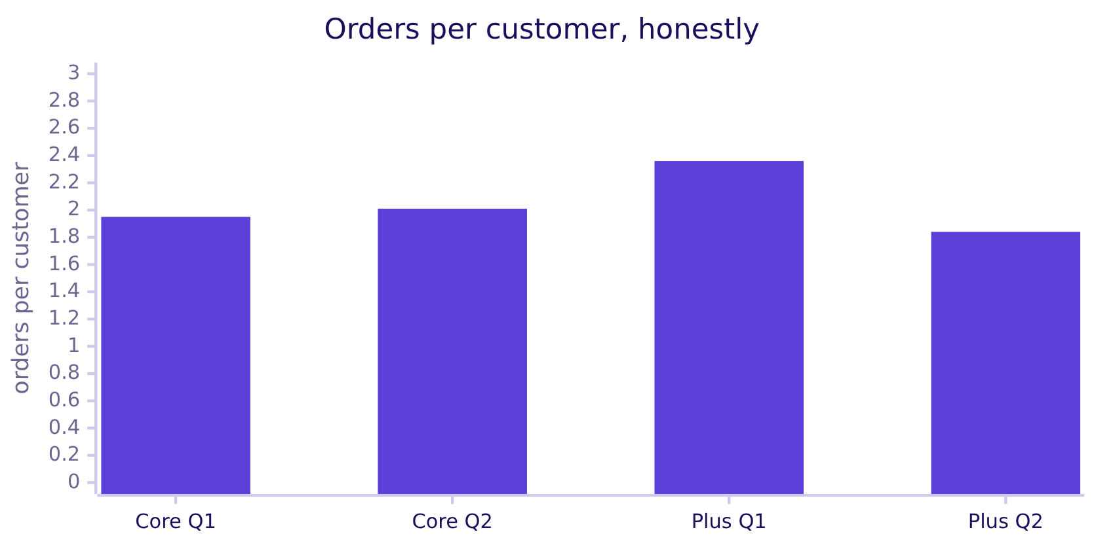
Indian Institute of Technology Gandhinagar
WEEK 2 · DAY 1 · KALPA GLOBAL CAPABILITY CENTRE
ADMINISTERED THROUGH THE COMPETENCY ADVANCEMENT ACADEMY
The fix: numeric division, and the decision flips back
One cast keeps the fraction; round on purpose for the reader.
round(count(*)::numeric / count(DISTINCT o.customer_id), 2): Retail-Plus falls 22 percent, 2.36 to 1.84, and Retail-Core rises 3 percent. Retail-Plus is still the segment to fix, and no budget moves to Core.
The ask
Round 1, is it the book
Round 2, per segment
Round 3, named steps
S27 · 31 / 46
Notes:
LIVE, 4 minutes. Run r2_frequency_fixed. Say what changed in business terms: halved becomes a
fifth, doubled becomes flat.

Slide 32

Indian Institute of Technology Gandhinagar
WEEK 2 · DAY 1 · KALPA GLOBAL CAPABILITY CENTRE
ADMINISTERED THROUGH THE COMPETENCY ADVANCEMENT ACADEMY
WHERE keeps rows, HAVING keeps groups
A filter on a count runs after GROUP BY, because before it no count exists.
The question it answers. Which segment-quarters hold fewer than 30 orders, too thin to read a rate from? One: Student in Q1, with 27.
The ask
Round 1, is it the book
Round 2, per segment
Round 3, named steps
S28 · 32 / 46
Notes:
LIVE, 5 minutes. Week 1 Thursday warned against a rate on twelve orders; the suite flags thin
cells rather than hiding them. WHERE count(*) < 30 fails because WHERE runs before groups exist;
let one learner try it, read the last line, move on.

Slide 33
Indian Institute of Technology Gandhinagar
WEEK 2 · DAY 1 · KALPA GLOBAL CAPABILITY CENTRE
ADMINISTERED THROUGH THE COMPETENCY ADVANCEMENT ACADEMY
Your turn: the same tree on delivered orders
The status filter tests rows, so it is a WHERE, and it runs before the groups form.
Segment | Q1 delivered orders per customer | Q2
Business | 1.90 | 2.08
Retail-Core | 1.57 | 1.74
Retail-Plus | 1.87 | 1.56
Student | 1.58 | 1.65
The harder variant. Write it before you look at block r2_delivered_by_segment, and check the groups add back to 653 delivered orders.
The ask
Round 1, is it the book
Round 2, per segment
Round 3, named steps
S29 · 33 / 46
Notes:
LIVE, 10 minutes of the room's own typing. The table is the answer; reveal it after. Retail-Plus
still falls on delivered orders, so the finding does not depend on the reading of sales.

Slide 34
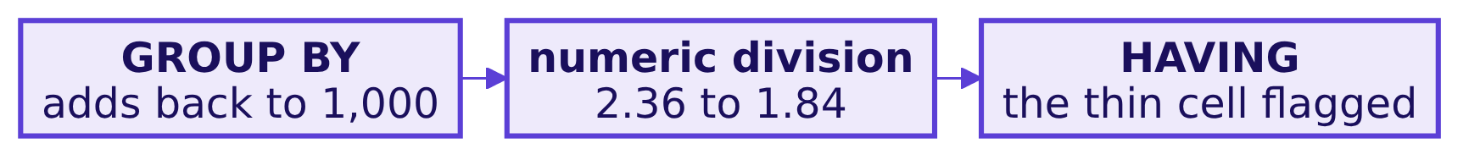
Indian Institute of Technology Gandhinagar
WEEK 2 · DAY 1 · KALPA GLOBAL CAPABILITY CENTRE
ADMINISTERED THROUGH THE COMPETENCY ADVANCEMENT ACADEMY
Round 2: honest ratios, per segment
Every ratio sits beside the two counts it divides.
KAVYA'S REVIEW
Show me the orders and customers beside every orders-per-customer figure, so I can divide them myself. Say which orders count, booked or delivered.
IN THE INTERVIEW
[S] WHERE against HAVING, one sentence each. [S] Explain the logical order in which a SQL query executes.
The ask
Round 1, is it the book
Round 2, per segment
Round 3, named steps
S30 · 34 / 46
Notes:
LIVE, 5 minutes. Ask both questions aloud, one learner each, under thirty seconds. Then the break
of 10 minutes.

Slide 35
Indian Institute of Technology Gandhinagar
PG DIPLOMA IN AI-ML AND AGENTIC AI ENGINEERING · COHORT 2
ADMINISTERED THROUGH THE COMPETENCY ADVANCEMENT ACADEMY
04
Round 3, named steps
Which branch moved, read top to bottom, and an average that skips no one.
The ask
Round 1, is it the book
Round 2, per segment
Round 3, named steps
Week 2 Day 1: the Monday numbers, from the warehouse
35 / 46
Notes:
LIVE. Fifty minutes: the subquery (5), two CTEs and the bridge (15), the AVG trap (15), the
harder variant (10), Kavya's review (5). Cut first: the subquery slide, straight to CTEs.
Notebook: notebooks/C2_W02_D01_03_quarters_STUDENT.ipynb. SQL: sql/C2_W02_D01_03_quarters_STUDENT.sql.

Slide 36
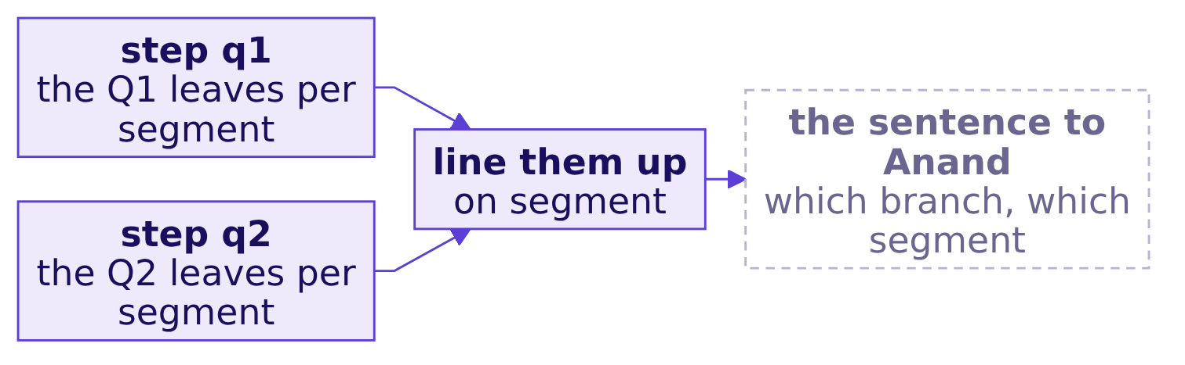
Indian Institute of Technology Gandhinagar
WEEK 2 · DAY 1 · KALPA GLOBAL CAPABILITY CENTRE
ADMINISTERED THROUGH THE COMPETENCY ADVANCEMENT ACADEMY
The question: which branch moved, and where
Week 1's question, asked of the book: the two quarters on one row per segment.
THE CLIENT ASKS
"Which part of the tree moved, and in which segment? The analyst has to be able to read it top to bottom."
The ask
Round 1, is it the book
Round 2, per segment
Round 3, named steps
S31 · 36 / 46
Notes:
LIVE, 2 minutes. Draw the three boxes before any SQL. Each box becomes one WITH block.

Slide 37
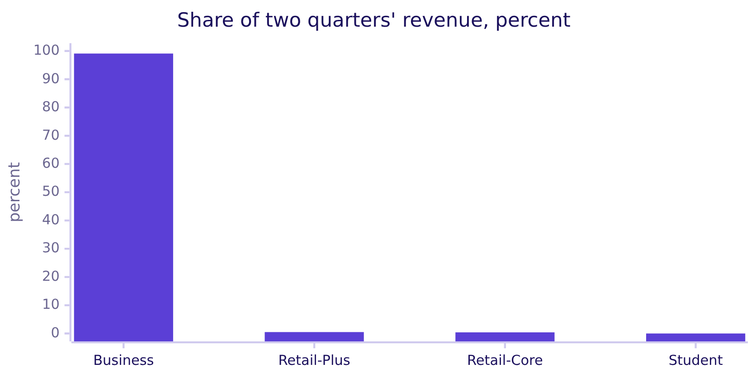
Indian Institute of Technology Gandhinagar
WEEK 2 · DAY 1 · KALPA GLOBAL CAPABILITY CENTRE
ADMINISTERED THROUGH THE COMPETENCY ADVANCEMENT ACADEMY
A query inside a query: each segment's share
The share needs the total as its denominator, and the total is a query of its own.
round(100 * sum(o.amount) / (SELECT sum(amount) FROM orders), 1). Business carries 99 percent of the rupees and the consumer segments carry the customers, which is why the tree is read per segment.
The ask
Round 1, is it the book
Round 2, per segment
Round 3, named steps
S32 · 37 / 46
Notes:
LIVE, 4 minutes. Cut first if the morning runs late. The subquery works and hides its step inside
a line; the next slide names the steps instead.

Slide 38
Indian Institute of Technology Gandhinagar
WEEK 2 · DAY 1 · KALPA GLOBAL CAPABILITY CENTRE
ADMINISTERED THROUGH THE COMPETENCY ADVANCEMENT ACADEMY
Two CTEs: each step named, the last one reads
WITH q1 AS, q2 AS, then one SELECT that lines them up on segment.
WITH q1 AS (
SELECT c.segment, count(DISTINCT o.customer_id) AS customers,
count(*) AS orders, sum(o.amount) AS revenue
FROM orders o JOIN customers c USING (customer_id)
WHERE o.quarter = 'Q1'
GROUP BY c.segment
),
q2 AS ( ... the same, WHERE o.quarter = 'Q2' ... )
SELECT segment, q1.customers, q2.customers,
round(q1.orders::numeric / q1.customers, 2) AS q1_frequency,
round(q2.orders::numeric / q2.customers, 2) AS q2_frequency
FROM q1 JOIN q2 USING (segment)
ORDER BY segment;
The ask
Round 1, is it the book
Round 2, per segment
Round 3, named steps
S33 · 38 / 46
Notes:
LIVE, 6 minutes. Build it with the room from block r3_two_quarters. Ask what the last SELECT can
see: both steps and every table. A later step reads every earlier one.

Slide 39
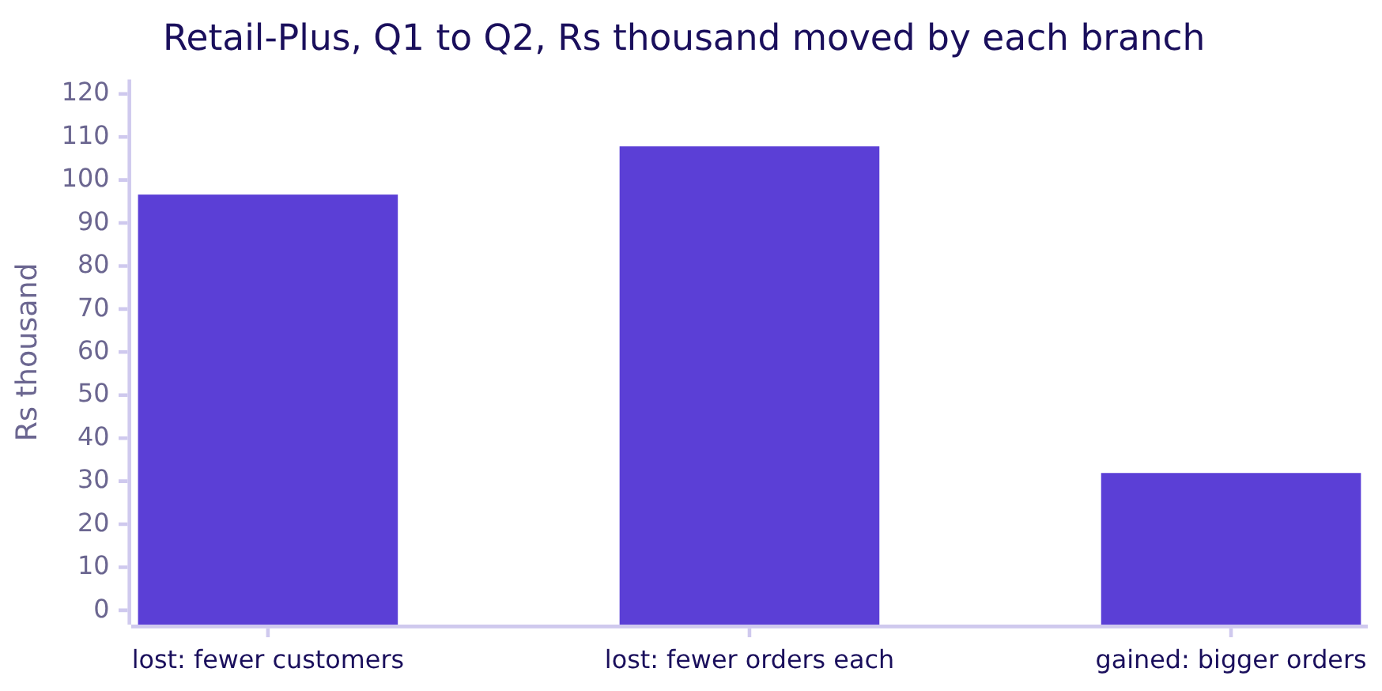
Indian Institute of Technology Gandhinagar
WEEK 2 · DAY 1 · KALPA GLOBAL CAPABILITY CENTRE
ADMINISTERED THROUGH THE COMPETENCY ADVANCEMENT ACADEMY
Retail-Plus: frequency is the biggest branch
The Rs 1.72 lakh fall, split one branch at a time.
Customers 91 to 76, orders per customer 2.36 to 1.84, revenue per order Rs 2,725 to Rs 2,953.
The ask
Round 1, is it the book
Round 2, per segment
Round 3, named steps
S34 · 39 / 46
Notes:
LIVE, 5 minutes. The split is sequential: customers first, then frequency, then order value, and
the order of steps changes it slightly; say so. Frequency costs Rs 1.08 lakh, the Week 1 lever at
warehouse scale. The book also shows fewer members buying at all, which an extract of 22 members
could not show. The other three segments move under 2 percent, except Student, which grew.

Slide 40
Indian Institute of Technology Gandhinagar
WEEK 2 · DAY 1 · KALPA GLOBAL CAPABILITY CENTRE
ADMINISTERED THROUGH THE COMPETENCY ADVANCEMENT ACADEMY
Question: how did spend per member move?
The head of Retail-Plus asks; the hurried analyst builds one row per member and averages it.
WITH member AS (
SELECT o.customer_id,
sum(CASE WHEN o.quarter = 'Q1' THEN o.amount END) AS q1_spend,
sum(CASE WHEN o.quarter = 'Q2' THEN o.amount END) AS q2_spend
FROM orders o JOIN customers c USING (customer_id)
WHERE c.segment = 'Retail-Plus'
GROUP BY o.customer_id
)
SELECT round(avg(q1_spend)), round(avg(q2_spend)) FROM member;
Question. A member who ordered in Q1 and not in Q2 carries which Q2 spend? a) Rs 0; b) NULL, no value at all; c) their Q1 spend; d) an error.
The ask
Round 1, is it the book
Round 2, per segment
Round 3, named steps
S35 · 40 / 46
Notes:
LIVE, 2 minutes. Letters, then run r3_member_spend_hurried.

Slide 41
Indian Institute of Technology Gandhinagar
WEEK 2 · DAY 1 · KALPA GLOBAL CAPABILITY CENTRE
ADMINISTERED THROUGH THE COMPETENCY ADVANCEMENT ACADEMY
Answer: NULL, and the average reads a 15.5% fall
The plausible wrong answer, as it would reach the head of Retail-Plus.
Rs 6,437
Rs 5,439
15.5%
Q1 SPEND PER MEMBER
Q2 SPEND PER MEMBER
THE FALL
the hurried average
the hurried average
a soft quarter
She plans a light touch: a reminder email to members, no retention budget.
The ask
Round 1, is it the book
Round 2, per segment
Round 3, named steps
S36 · 41 / 46
Notes:
LIVE, 3 minutes. The answer is b: a CASE with no ELSE returns NULL, and a sum of nothing but NULLs
is NULL. Present the 15.5 percent straight. Ask what a light touch would cost if the real fall
were twice that.

Slide 42
Indian Institute of Technology Gandhinagar
WEEK 2 · DAY 1 · KALPA GLOBAL CAPABILITY CENTRE
ADMINISTERED THROUGH THE COMPETENCY ADVANCEMENT ACADEMY
Why it is wrong: AVG skips NULLs, silently
The average divides by the members who bought, and drops the ones who stopped.
Invented values, not Kalpa data | Result
spend: 100, NULL, 200 | three rows
avg(spend) | 150
count(*) | 3
count(spend) | 2
sum(spend) / count(*) | 100
The members the head most needs to hear about have left the denominator without a word.
The ask
Round 1, is it the book
Round 2, per segment
Round 3, named steps
S37 · 42 / 46
Notes:
LIVE, 4 minutes. Show the mechanism on the invented table first (block r3_invented_null), and say
aloud that the three values are invented. Then the next slide finds it in the book.

Slide 43
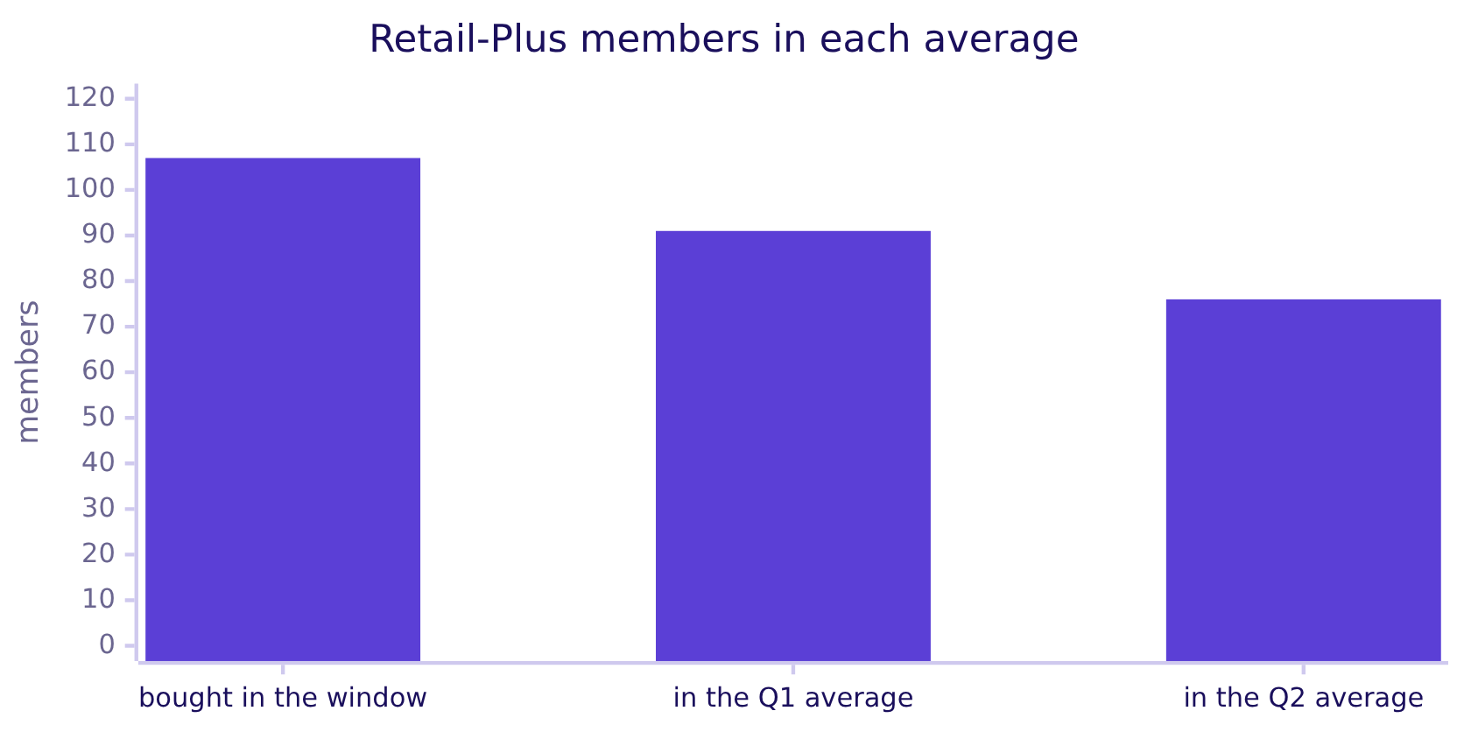
Indian Institute of Technology Gandhinagar
WEEK 2 · DAY 1 · KALPA GLOBAL CAPABILITY CENTRE
ADMINISTERED THROUGH THE COMPETENCY ADVANCEMENT ACADEMY
The check: count who is in each average
The two averages divide by different people.
31 members bought in Q1 and nothing in Q2. The hurried Q2 average never saw them (block r3_member_spend_check).
The ask
Round 1, is it the book
Round 2, per segment
Round 3, named steps
S38 · 43 / 46
Notes:
LIVE, 3 minutes. count(*) against count(q2_spend). This is the habit: every average gets its
count beside it.

Slide 44
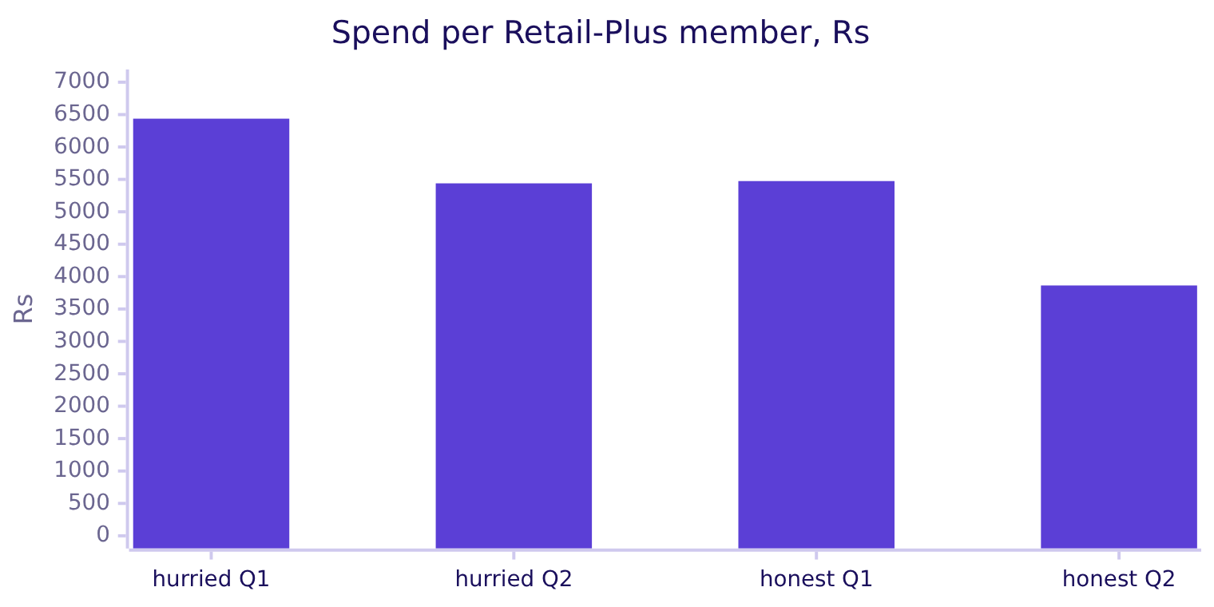
Indian Institute of Technology Gandhinagar
WEEK 2 · DAY 1 · KALPA GLOBAL CAPABILITY CENTRE
ADMINISTERED THROUGH THE COMPETENCY ADVANCEMENT ACADEMY
The fix: say Rs 0 on purpose, and the fall doubles
coalesce(sum(...), 0) counts a member who bought nothing as spending nothing.
What changed. The fall is 29.4 percent, from Rs 5,474 to Rs 3,863, nearly twice the hurried 15.5. The light touch becomes a retention problem.
The ask
Round 1, is it the book
Round 2, per segment
Round 3, named steps
S39 · 44 / 46
Notes:
LIVE, 3 minutes. The honest change equals the segment's revenue change, 29.4 percent, as it must
when the members are the same 107 people. That equality is the analyst's proof the denominator is
right.

Slide 45
Indian Institute of Technology Gandhinagar
WEEK 2 · DAY 1 · KALPA GLOBAL CAPABILITY CENTRE
ADMINISTERED THROUGH THE COMPETENCY ADVANCEMENT ACADEMY
Your turn: the honest average for every segment
One more column in the member step, one GROUP BY at the end.
Segment | Members | Q1 spend each | Q2 spend each | Change
Retail-Core | 131 | Rs 2,848 | Rs 2,796 | 1.8% down
Retail-Plus | 107 | Rs 5,474 | Rs 3,863 | 29.4% down
Student | 24 | Rs 1,113 | Rs 1,490 | 33.9% up
Business | 39 | Rs 25,38,832 | Rs 25,02,169 | 1.4% down
The harder variant. Write it, then check each segment's change against its revenue change from S33's query.
The ask
Round 1, is it the book
Round 2, per segment
Round 3, named steps
S40 · 45 / 46
Notes:
LIVE, 10 minutes of the room's own typing. Reveal the table after. Block r3_member_spend_by_segment.

Slide 46
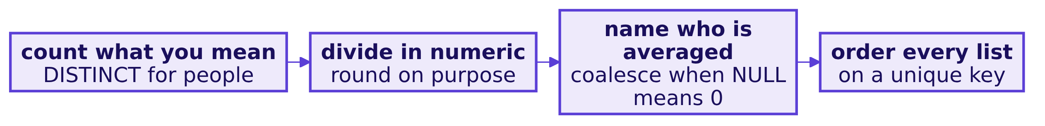
Indian Institute of Technology Gandhinagar
WEEK 2 · DAY 1 · KALPA GLOBAL CAPABILITY CENTRE
ADMINISTERED THROUGH THE COMPETENCY ADVANCEMENT ACADEMY
Round 3, and the crux of the morning
Named steps, honest denominators, and a sentence the analyst can check.
KAVYA'S REVIEW
When a number comes out of an average, say who is in it. That is the difference between a 15 percent wobble and a 29 percent problem.
IN THE INTERVIEW
[D] A stakeholder's analyst must audit your query; what changes in how you write it, and what would you refuse to compute in a notebook?
The ask
Round 1, is it the book
Round 2, per segment
Round 3, named steps
S41 · 46 / 46
Notes:
LIVE, 5 minutes. Read the four crux lines aloud; they return word for word on the cheat sheet and
the afternoon's close. Ask the [D] question and take one answer. Transition: the afternoon
assembles all of it into the suite.

