Slide 1
So you think ADMM is fast, huh? Try the GPU-ified interior-point method
Frank DeGuire III¹, Emanuel Herberthson¹
¹Electrical Engineering Department, Stanford University
Electrical Engineering
Abstract
Example Section 1
Example Section 2
Example Section 3
Example Section 4

Slide 2
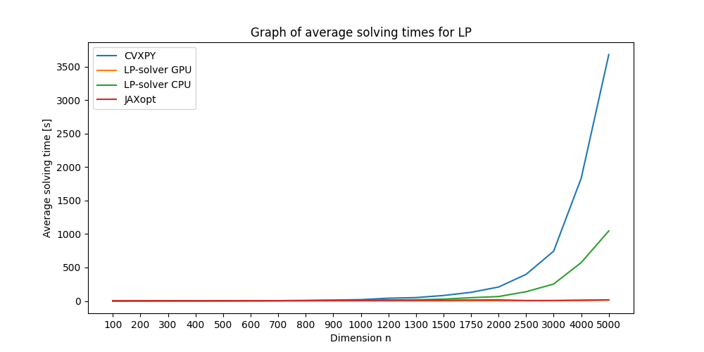
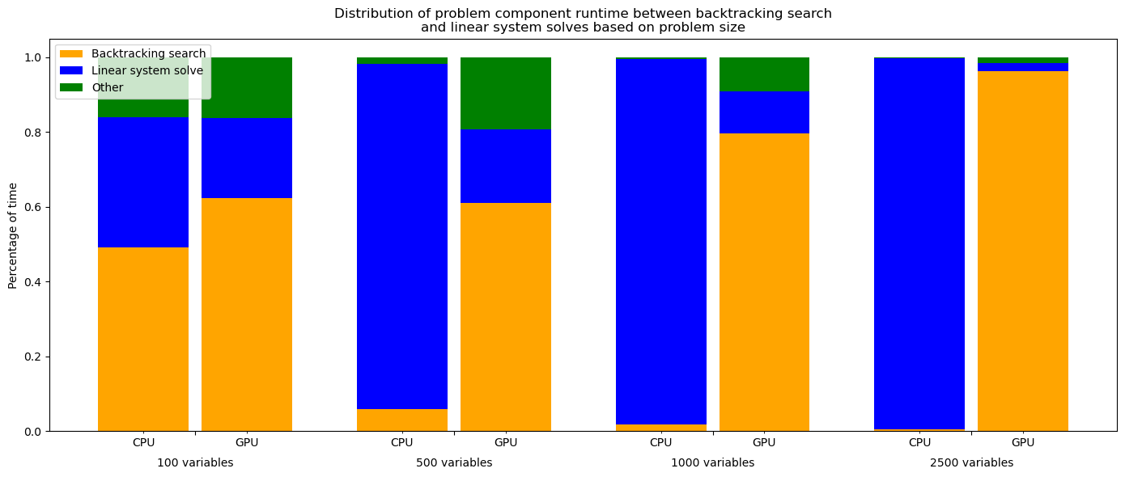


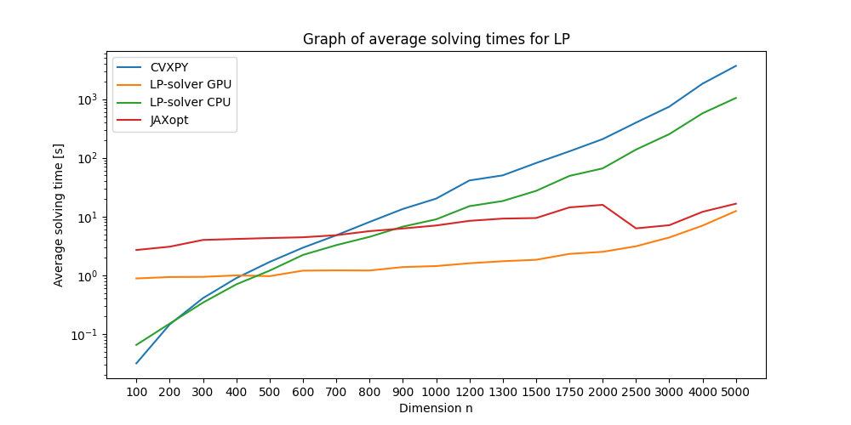


So you think ADMM is fast, huh? Try the GPU-ified interior-point method
Frank DeGuire III,¹ Emanuel Herberthson,¹
¹Electrical Engineering, Stanford University
Electrical Engineering
Abstract
Testing
Results MIPLIB Data
With GPUs becoming increasingly more powerful, this presents an opportunity to speed up algorithms which rely heavily on matrix operations. Leveraging this fact, this project implements a GPU accelerated LP-, QP- and SOCP-solver based on using the interior point algorithm. As a bonus, a Lasso-solver was implemented using ADMM.
Two types of testing were conducted, one type was relaxed integer problems from MIPLIB and the other was randomly generated data from Numpy. MIPLIB was in general very sparse and generated data was dense.
In the case of a sparse problem, the LP-solver stands no chance against CVXPY which utilized the scipy.linalg.sparse library.
Results Generated Data
Solver | CVXPY | LP-solver using GPU | LP-solver using CPU
505 variables | 0.0283 s | 2.52 s | 3.63 s
2728 variables | 0.128 s | 5.41 s | N/A
In the case of LP-problems, a big difference can be seen in time compared to CVXPY while the time consumtion is on the same order as JAX. Similar results were seen for QP, SOCP and Lasso.
Solver Profiling
Phases I and II
Phase I found a strictly feasible point through solving, using interior point,
Phase II then solved the problem by solving, for increasing values of t,
Conclusions and Future Work
Implementing sparse handling would greatly improve performance in real life
Writing a more optimized backtracking search would benefit the GPU-version a lot.
There were some numerical instabilities when having too many constraints. Future work should address this.
The extentions to QP and SOCP were straight forward as only the gradient, hessian and objective needed to be altered slightly.
Link to GitHub: https://github.com/fdeguire03/InteriorPoint-GPU

