Slide 1
So you think ADMM is fast, huh? Try the GPU-ified interior-point method
Frank DeGuire III¹, Emanuel Herberthson¹
¹Electrical Engineering Department, Stanford University
Electrical Engineering
Abstract
Example Section 1
Example Section 2
Example Section 3
Example Section 4

Slide 2
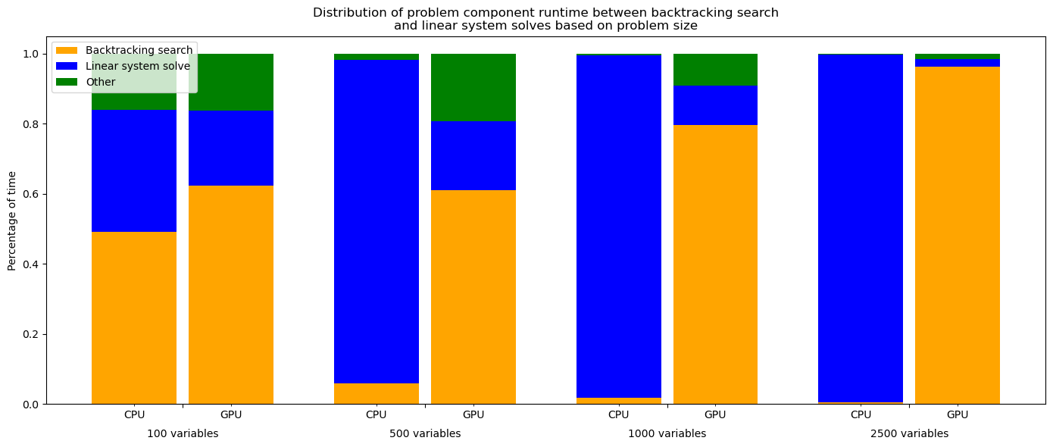
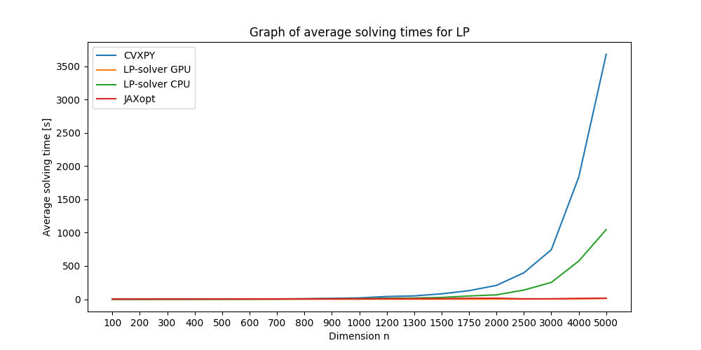
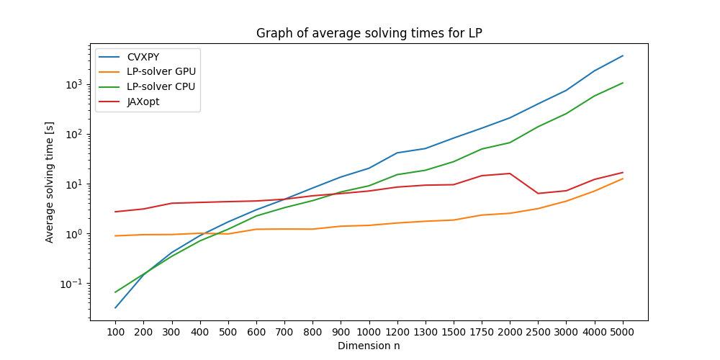
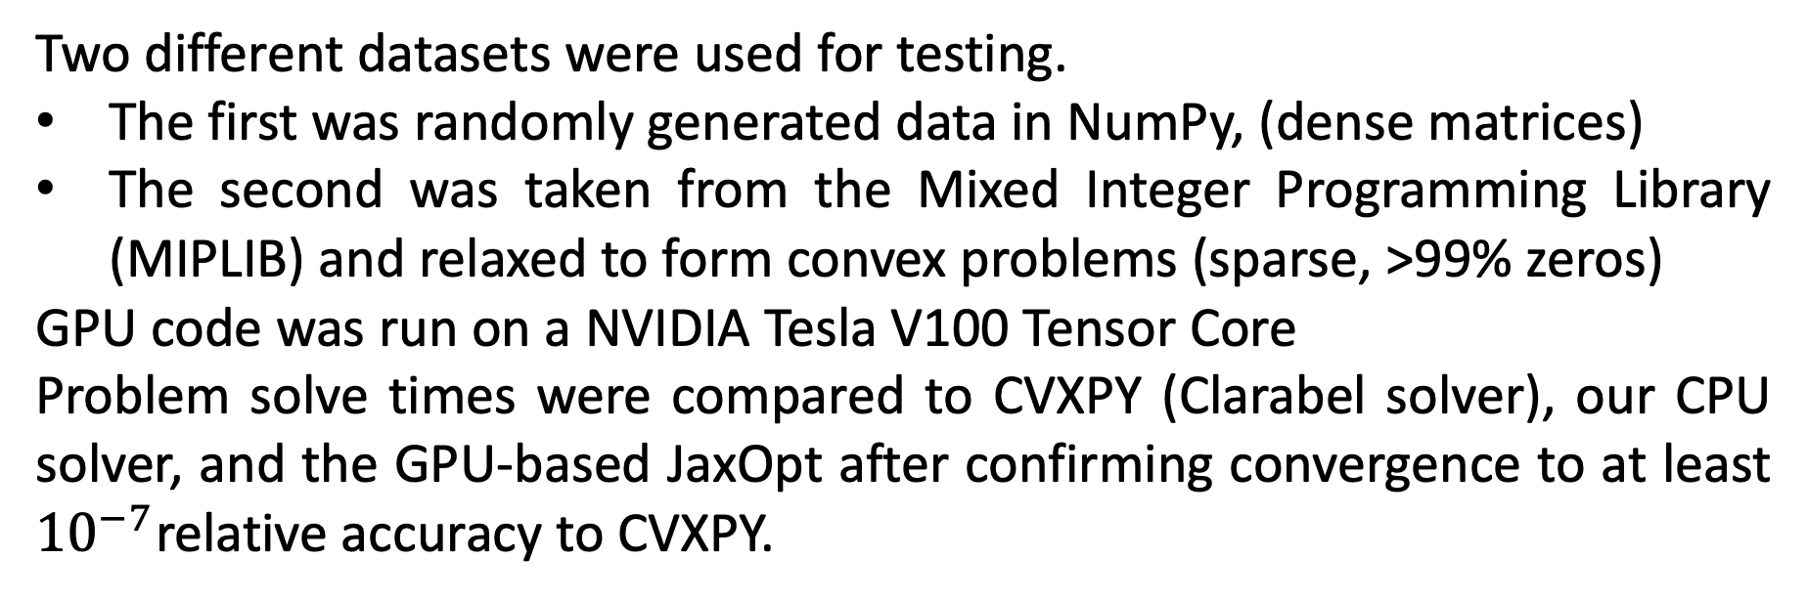
So you think ADMM is fast, huh? Try the GPU-ified interior-point method
Frank DeGuire III,¹ Emanuel Herberthson,¹
¹Electrical Engineering, Stanford University
Electrical Engineering
Abstract
Testing
Results MIPLIB Data
The rise of widespread GPU technology presents an enormous opportunity to accelerate convex algorithms that rely on matrix operations. This project implements a GPU-accelerated LP-, QP- and SOCP-solver using the interior point algorithm. In addition to these robust solvers, a specialized LASSO-solver using ADMM was also implemented to showcase the benefit of distributed optimization on GPU hardware.
Two different datasets were used for testing.
The first was randomly generated data in NumPy, (dense matrices)
The second was taken from the Mixed Integer Programming Library (MIPLIB) and relaxed to form convex problems (sparse, >99% zeros)
GPU code was run on a NVIDIA Tesla V100 Tensor Core
Problem solve times were compared to CVXPY (Clarabel solver), our CPU solver, and the GPU-based JaxOpt after confirming convergence to at least ${10}^{−7}$relative accuracy to CVXPY.
On sparse problems, CVXPY continues to outperform our GPU implementation, even on large problems. The CVXPY backend implements sparse matrix packages to accelerate solve time.
Problem size | CVXPY | LP-solver using GPU | LP-solver using CPU
505 variables | 0.0283 s | 2.52 s | 3.63 s
2728 variables | 0.128 s | 5.41 s | N/A (Not solved in an hour)
Random data results
Solver Profiling
Existing GPU solvers
Timing results for LP tests shown below
After problem size surpassed approximately 500 variables, the GPU solver greatly outperforms CPU solvers. At 5,000 variables, CVXPY takes over an hour, while our solver solves the problem in less than 10 seconds!
The CPU solve time was dominated by linear system solves, while the GPU solve time was dominated by comparisons inside of the backtracking search
Currently, only a few GPU widespread GPU solvers exist, almost all of which are based on the alternating direction of multipliers method (ADMM).
This project implements an interior point method, which was compared to the existing JaxOpt solver.
Implementation
Our LP solver implemented the barrier method, leveraging Newton’s method to solve a modified objective during each centering step:
Conclusions and Future Work
Implementing sparse matrix handling would greatly improve performance
Writing a more optimized backtracking search would benefit the GPU-version
There were some numerical instabilities when having too many constraints. Future work should address this.
All linear systems in Newton’s method were solved using block elimination and Cholesky factorization.
The extensions to QPs and SOCPs implemented the same methods by modifying only the objective function and its gradient / Hessian.
Acknowledgements
Some of the computing for this project was performed on the Sherlock cluster. We would like to thank Stanford University and the Stanford Research Computing for providing computational resources and support that contributed to these research results.
We would also like to thank Dr. Mert Pilanci, Aaron Mishkin, and Indu Subramaniam for their teaching and support on the topics implemented in this final project.
All code was written in Python, with parallel CPU and GPU implementations written using the NumPy and CuPy packages, respectively.

