Slide 1
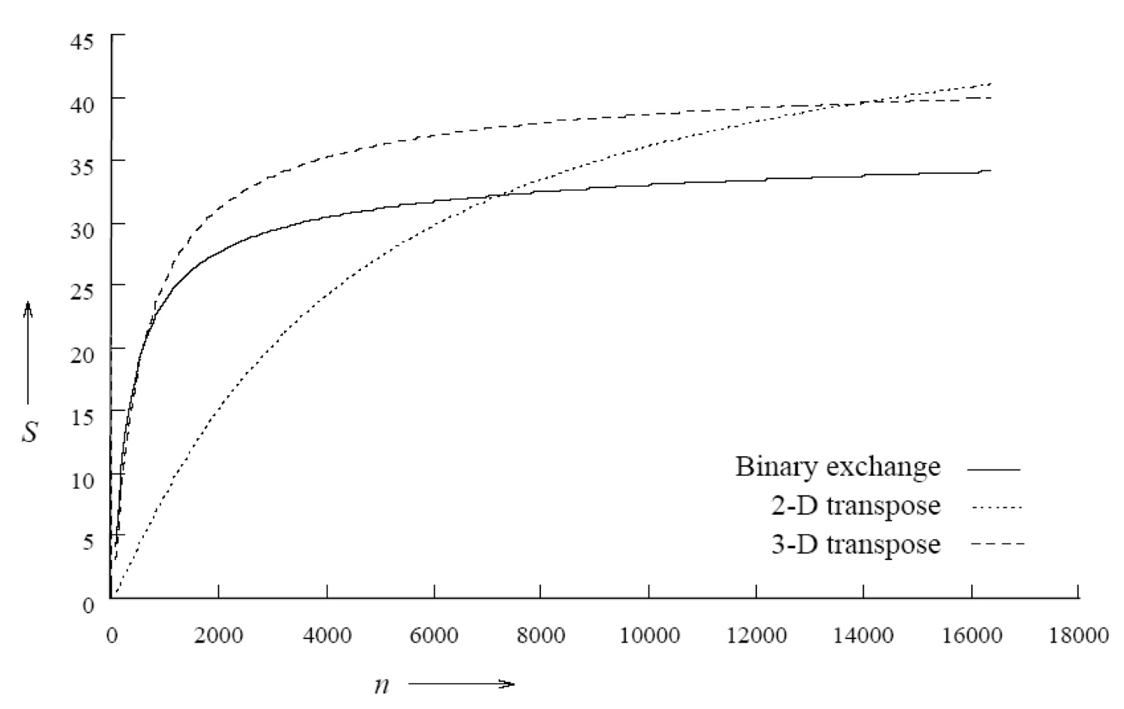
Frédéric Desprez
Performance
Evaluation
INRIA

Slide 2
Some references
Parallel Programming – For Multicore and Cluster System, T. Rauber, G. Rünger
Introduction to parallel Computing, 2nd Edition, A. Grama, A. Gupta, G. Karypis, V. Kumar, Addison Wesley

Slide 3
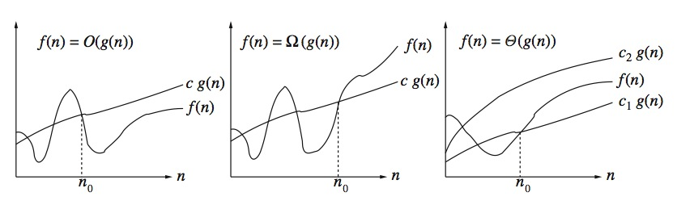
Orders of magnitude
The order of magnitude of a monotonically increasing function f = f (x) can be expressed in different ways
The most well known
    The O(x) notation which gives an upper bound on the order of the function (i.e. its rate of variation or growth);
      There exists a positive constant c and n₀ integer such that for any n >= n₀ : 0 <= f(n) <= c g(n)
      We then guarantee that f(n) increases, at most, as fast as O(n) from n > n₀.
      Upper bound of complexity
    The Ω(n) notation which gives a lower bound on the order of the function;
      There exists a positive constant c and n₀ integer such that for any n >= n₀: 0 <= c g(n) <= f(n)
      We then guarantee that f(n) increases, at least, as fast as Ω(n) from n > n₀.
      Lower bound of complexity
    The Θ(n) which is a combination of the first two and which can therefore give a more precise idea of ​​the order of magnitude of the function;
      There are positive constants c₁ and c₂ and n₀ integer, such that for any n >= n₀ : 0 <= c₁ g(n) <= f(n) <= c₂ g(n)
      We then guarantee that f(n) grows as fast as Θ(n) from n > n₀.
      Equivalence in complexity
Notes:
O, Omega, Delta

Slide 4
Measuring time
Before parallelizing a program, one must be able to know which part of a program takes the most time in computation
Three types of time to consider
    Wall time
      The time spent executing a program: the time spent between the beginning of the execution and the end
    User time
      The time really used by the program
      It can be much lower than the wall time if the program has to wait a lot, for example for system calls or data exchanges
      This lost time can give indications for optimizations
    System time
      Time not used by the program itself but by the operating system (memory allocation, process management, disk access, ...)
      We try to keep it minimal

Slide 5
Measuring time, contd.
Unix time command: time ./executable
    Output example
      real 3m13.535s
      user 3m11.298s
      sys 0m1.915s
    Measures the total time of the program
  For performance analysis, it is necessary to know the execution time of certain parts of the program
    Methods dependent on programming languages or operating systems
    MPI: MPI_Wtime(), OpenMP: omp_get_wtime()
      Give the wall time between two function calls
  Application profiling
    If proper compilation, use gprof (gprof executable > prof.txt)
    List of all functions with their execution time, their total time percentage, number of calls
    Call tree
  Software timers
    PAPI

Slide 6
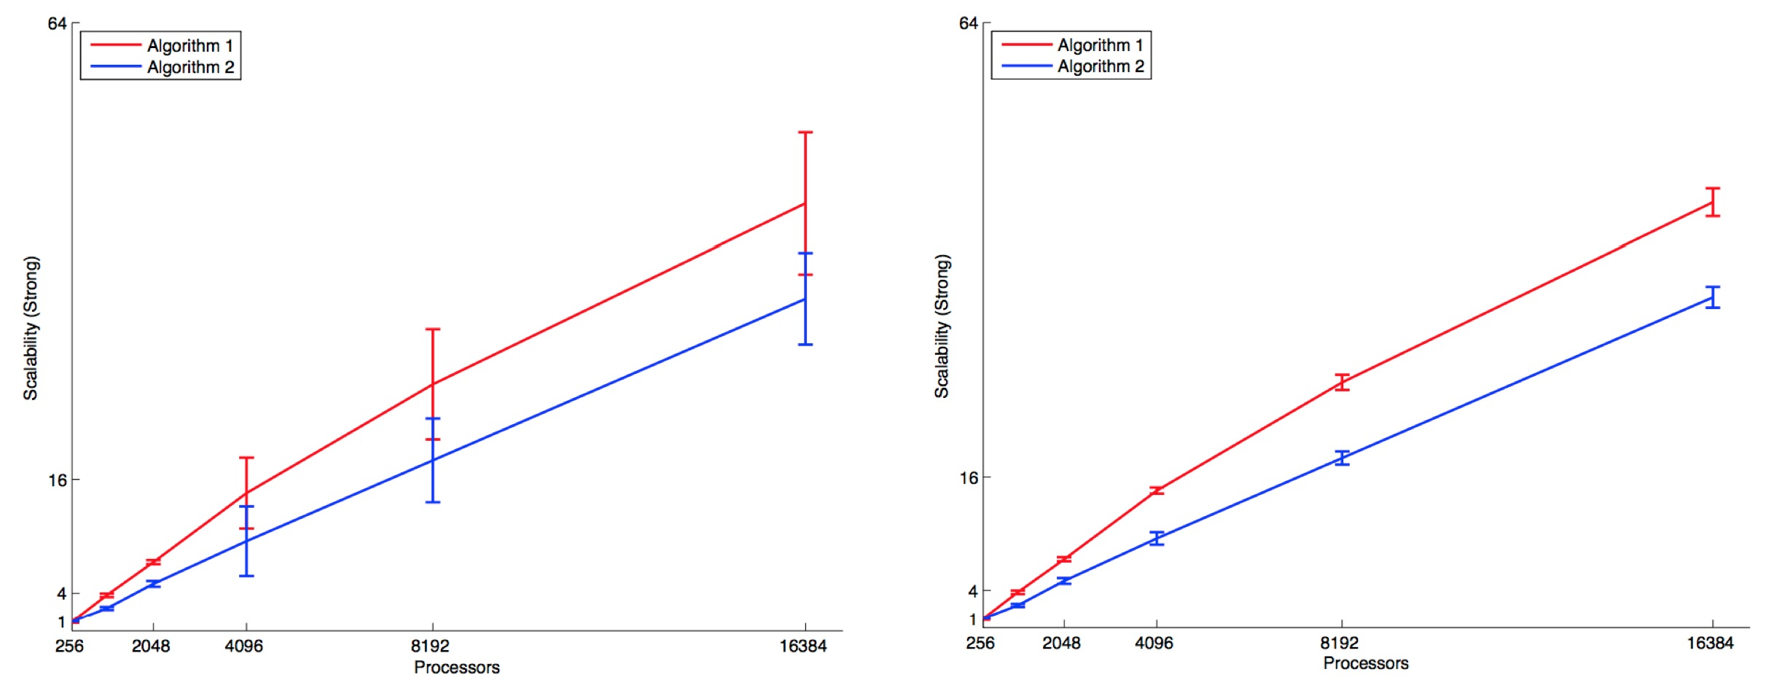
Good Measurement Practices
Choice of number of processors
    Depending on available resources
    Beware of physical topology
  Pay attention to the resolution of the clock
  Repeat experiments to understand variability
    Shared resources (processors, network)
    Placing jobs / threads on potentially different processors / cores
  Confidence Interval

Slide 7
Need for analytical models of parallel programs
A sequential program can be evaluated according to its given execution time according to the size of its input data
A parallel program has its time that depends on other elements
    Number of processors used
    Their relative speed
    The speed of communication between them
    A parallel program can not be evaluated independently of these elements
  Some intuitive measures
    The wall time obtained to solve a given problem on a given parallel platform
    What is the gain obtained in speed with respect to the sequential time: the acceleration (or speedup)

Slide 8
Execution time
Sequential execution time (T_{s})
    It is the time spent between the beginning and the end of an execution on a sequential node
  The parallel time (T_{p})
      This is the time between the start of parallel execution and the time the last processor finishes
  Warning!
    To compare, use the same processors!
    Take the data transfers into account if necessary

Slide 9
Factors Affecting Performance
The algorithm should be able to be parallelized!
The volume of data to which it applies must be sufficiently large in relation to the number of processors used
Additional overhead due to synchronization and memory access conflicts can reduce performance
Load balancing between processors
The use of parallel algorithms can increase the complexity of parallel algorithms compared to sequential algorithms
The distribution of data between multiple memory units can reduce memory contention and improve the locality of the data, which can lead to performance gains

Slide 10
Overhead sources
Interactions between processes
    A non-trivial parallel algorithm will require interactions between processes during execution (synchronization, intermediate data exchange)
    Communications are generally the most important sources of performance loss
  Waiting time
    Because of many reasons like
      A load imbalance,
      synchronizations,
      the presence of sequential parts.

Slide 11
Overhead sources
The fastest sequential algorithms for a given problem may prove to be difficult / impossible to parallelize
    Using a parallel algorithm based on a sequential algorithm that is simpler to parallelize (with a high degree of concurrency)
    Example: matrix product using Strassen or Winograd algorithms vs 3 loops
  Difference between the number of operations between the best sequential algorithm and the parallel algorithm
    Overhead in number of operations
    But a parallel algorithm based on the best sequential algorithm can still perform more calculations than the sequential algorithm
    Example: Fast Fourier Transform (FFT)
      In the sequential version, the results of some computations can be reused
      In the parallel version, generated by different processors (thus performed several times by different processors)

Slide 12
Extra cost
The extra costs induced by a parallel algorithm are encapsulated in a unique expression called an extra cost function
The total overhead or overhead cost of a parallel system (T_{o}) is defined as the total time taken by all processors over the time required for the fastest sequential algorithm on a single processor
Thus
    Total time to solve a problem summed up on all processors: pT_{p}
    T_{s} units of this time to do useful work
    What's left is extra cost
    The extra cost function is given by: T_{o} = pT_{p} - T_{s}

Slide 13
Acceleration (speedup)
What performance gain can be achieved by parallelizing an application compared to its sequential implementation?
The speedup is a measure that captures the relative benefit of solving a problem in parallel
The speedup S is the ratio of time to solve a problem on a single processor over time to solve a problem on a parallel p processors machine
It generally ranges between 0 and p, where p is the number of processors
    Same type of processors between parallel and sequential execution
    One should (normally) take the best sequential algorithm to solve the same problem
      Sometimes it is not known or its implementation makes it ineffective
      Then take the best implementable algorithm

Slide 14
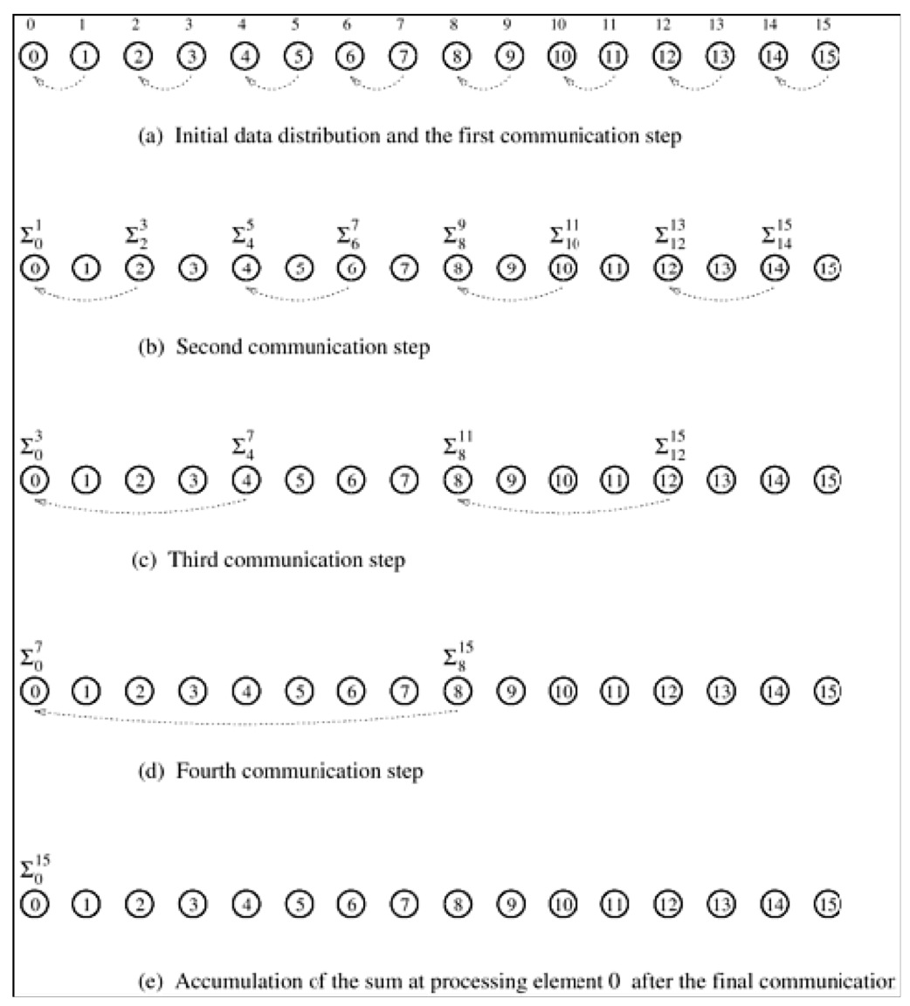
Example: adding n numbers over n processors
If n = 2^{k}, perform the operation in log n = k steps
n = 16
Tp = Θ(log n)
Ts = Θ (n)
S = Θ (n/log n)

Slide 15
Example: integer sort
Bubble sort parallelization
We find
    A sequential version for 105 entries: 150 s
    Quick sort: 30 s
    A parallel version (odd-even sort over 4 processors): 40 s
  By taking the same two versions, we get a speedup of
    150/40 = 3.75
  But with the best algorithm, we get
    30/40 = 0.75

Slide 16
Theoretically S<p
If the best sequential algorithm takes T_{s} units of time to solve a given problem on a single processor, then an speedup of p can be obtained for p processors if none of the processors takes more than T_{s}/p
Suppose that S>p
    Possible only if each processor spends less than T_{s}/p units of time to solve the problem
    A single processor could emulate p processors and solve the problem in less than T_{s} units of time
    Contradiction because the acceleration S is calculated with respect to the best sequential algorithm

Slide 17
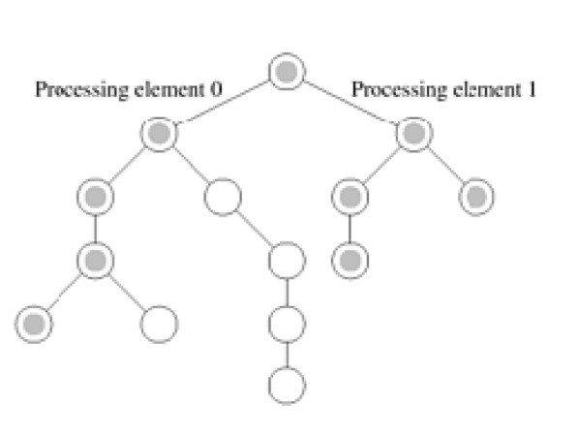
Superlinear speedup
There are sometimes accelerations greater than p
This happens when
    The work done by a sequential algorithm is superior to that of its parallel version
    Exemple: search, algorithms in trees
    If the data enters the caches for the parallel version
      The performance of larger memory sizes is less important

Slide 18
Efficiency
Efficiency measures the fraction of time for which a processor is used in a useful way
E = S/p
    An efficient system has an efficiency equal to 1
    In practice 0 ≤ E ≤ 1

Slide 19
Cost
The cost is equal to the parallel time multiplied by the number of processors used : pT_{p}
It reflects the time spent by each processor to solve the problem
A parallel system is cost optimal if
    O(solve a problem in parallel) = O(to solve it sequentially)
  As E = T_{s}/pT_{p}, for cost optimal systems E = O(1)

Slide 20
Cost optimality and n numbers sum
Is the parallel version on n nodes cost optimal?
T_{p} = log n for p = n
Cost of this parallel version = p T_{p} = Θ (n log n)
Sequential time = Θ (n)
The algorithm is not cost optimal
    E = Θ (n / (n log n)) = Θ (1 / log n)

Slide 21
Impact of non cost-optimality
Using n processors to sort a vector in (log n)²
    Bitonic sort [Batcher, 1968]
  Sequential sort using comparisons: n log n
  Speedup = n log n / (log n)² = n / log n
  Cost = p T_{p} of this algorithm is n (log n)²
    Not cost optimal of a factor of log n
  If p < n
    Assign n tasks with p processors: T_{p} = n (log n)² / p
    Speedup = n log n / (n (log n)² / p) = p / log n
    Speedup decreases when size increases for a given p
    High cost associated with lack of optimality in cost
      Beware of cost optimality!

Slide 22
Effect of granularity on performance
Reduce the size of the parallel platform
    Use fewer processors than available
    Usually improves the efficiency of a parallel system
      Consider each processor as a virtual processor
      Map virtual processors to the reduced subsystem of processors
  Impact
    If the number of processors decreases by a factor of n / p
    The compute volume for each processor increases by one factor of n / p
    The communication costs depend on what the virtual processors do

Slide 23
Improving granularity: the example of the sum
Adding n numbers on p processors
    p < n
    n and p are power of 2
  Using an algorithm for n virtual processors
    Assign to each physical processor n / p virtual processors

Slide 24
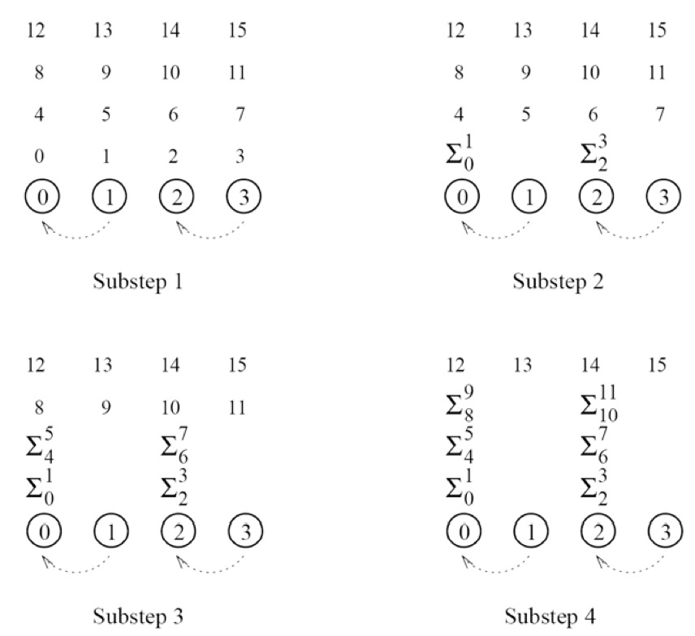
Improving granularity: the example of the sum, contd.

Slide 25
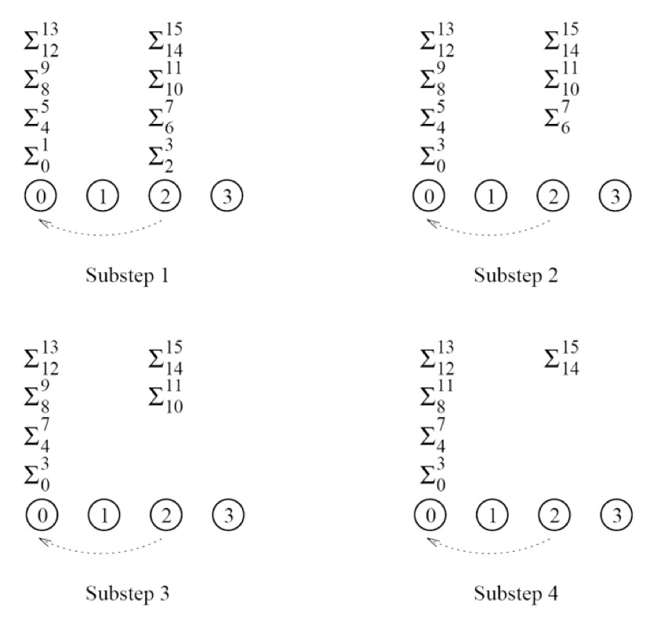
Improving granularity: the example of the sum, contd.

Slide 26
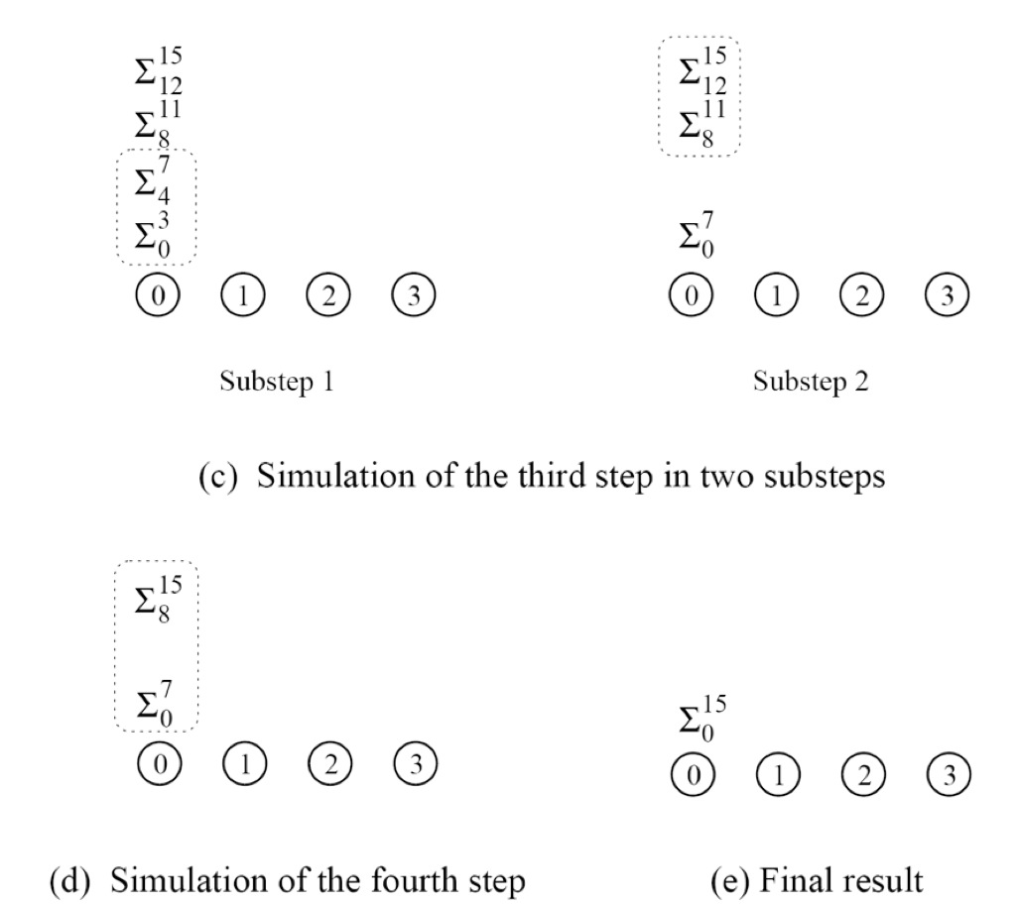
Improving granularity: the example of the sum, contd.

Slide 27
Improving granularity: the example of the sum, contd.
Execution cost
    log p of the log n steps of the original algorithm
      simulated in (n / p) log p steps on the p processors
    The last log n - log p steps: no communications
  Total parallel execution time =
  T_{p} = Θ ( (n / p) log p)
  Total cost
  p T_{p} = Θ (n log p)
    Asymptotically > Θ (n) to add n numbers sequentially
    The parallel system is therefore not cost optimal

Slide 28
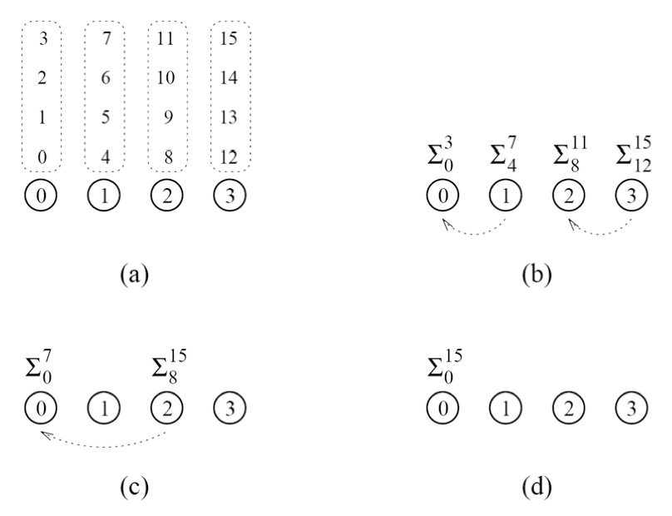
Adding numbers in a cost-optimal fashion
Local sum: Θ (n / p)
Partial sum: Θ (log p)
Tp = Θ (n / p + log p)
Cost = Θ (n + p log p)
As long as n = Ω ( p log p) , the cost is equal to Θ (n)

Slide 29
Scalability of parallel systems
Extrapolate performance
    How to move from a small problem on a small system
    to a big problem on a larger configuration
  Examples: 3 algorithms to compute a n-point FFT on 64 processors
  Choosing this algorithm
  depending of
  configurations

Slide 30
Scalable parallel systems
Total overhead function T_{o}(T_{s}, p)
    Best sequential time T_{s}
    Number of processors p
  Efficiency
    E = T_{s} / pT_{p} = T_{s} / ( T_{o} + T_{s}) = 1 / (1 + T_{o} / T_{s})
  Often, we have T_{o}(T_{s}, p) / T_{s} < 1
    T_{o} grows in a sub-linear manner with respect to T_{s}
    In this case, the efficiency increases if the size of the problem increases and if the number of processors is constant
  For such systems, it is possible to keep a constant efficiency by
    Increasing the size of the problem
    Increasing the number of processors proportionally
  Such systems are scalable
T_{o} = pT_{p} – T_{s}

Slide 31
Scalability of parallel programs
In scientific papers we read observations such as
    "We implemented an algorithm on the parallel machine X which obtained an acceleration of 10.8 out of 12 processors with a problem size equal to 100.”
  A dot on a curve!
    What happens if we have 100, 1000 processors?
    What happens if we have data of size 10, 1000?

Slide 32
Scalability of parallel programs, contd.
Three theoretical performance models
    T = N + N² / P
      This algorithm splits N² computations but also replicates N other computations
      No other sources of additional cost
    T = (N + N²⁾ / P + 100
      This algorithm splits all the computations and adds an additional cost of 100
    T = (N + N²⁾ / P + 0.6 P²
      This algorithm splits all the computations and adds an additional cost of 0.6 P²
  All these algorithms have an acceleration of 10.8 on 12 processors for N = 100 !

Slide 33
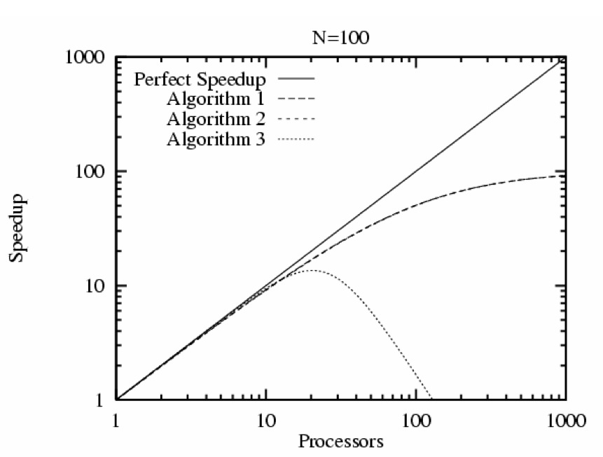
Scalability of parallel programs, contd.
If we increase the number of processors for N = 100

Slide 34
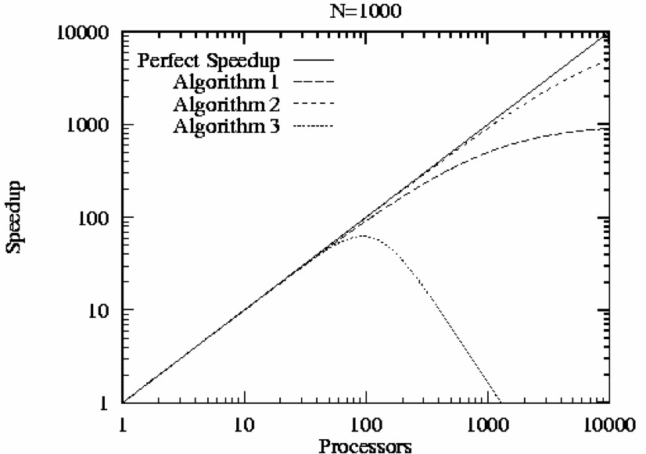
Scalability of parallel programs, contd.
If we increase the number of processors for N = 1000

Slide 35
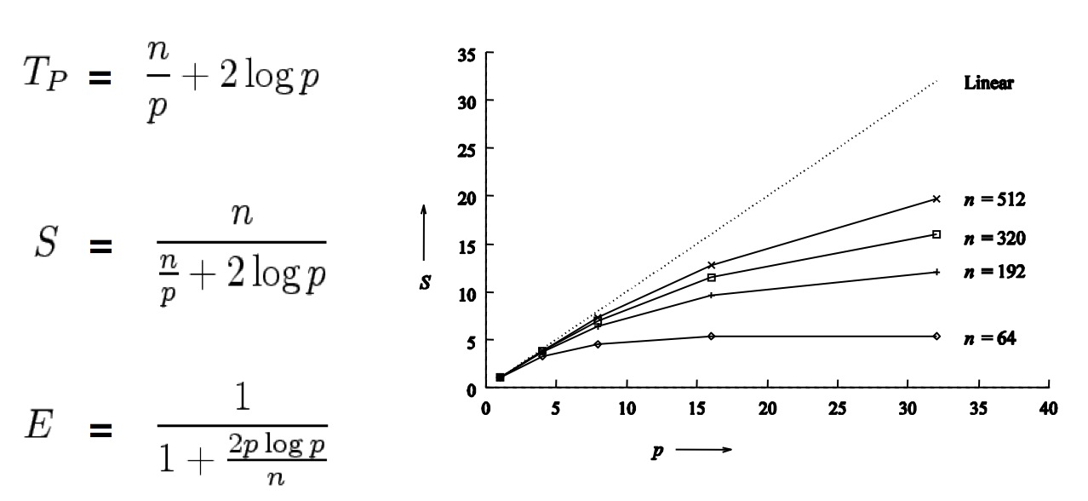
Scalability of parallel programs, contd.
Adding n numbers on p processors
Supposition: addition = communication = 1 time unit
Acceleration tends to saturate and efficiency decreases

Slide 36
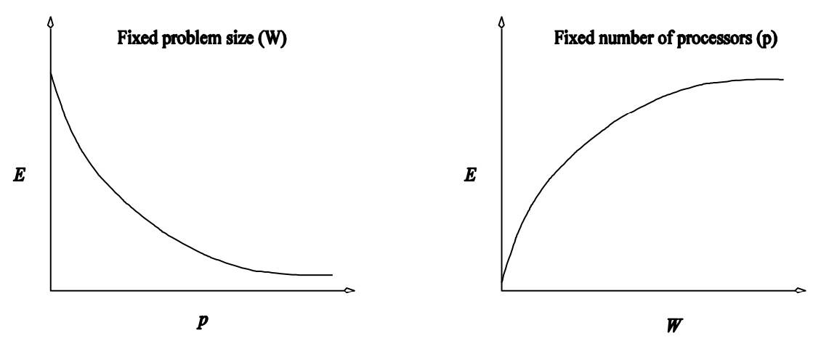
Scalability of parallel programs, contd.
Scalability and cost optimality are related
    In cost-optimal parallel systems, the efficiency = Θ (1)
    Any parallel system can be made cost optimal
    Great care must be taken to choose
      The size of the computations
      The number of processors used
  Scalability and efficiency
Fixed problem size
# Procs increases
All parallel systems
Problem size's increases
Fixed number of processors
Some parallel systems

Slide 37
Isoefficiency
Rate at which the size of the problem must grow for each processor added to maintain a fixed efficiency
Determines system scalability
    The lower the rate the better
  To formalize this rate, define
    Problem size W = asymptotic number of operations of the best sequential algorithm to solve the problem

Slide 38
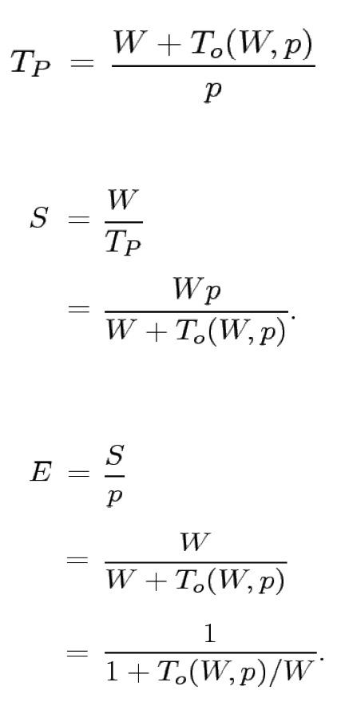
Scalability metrics as a function of W
Parallel execution time
Speedup
Efficiency

Slide 39
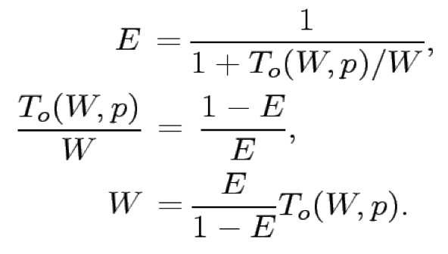
Isoefficiency for scalable parallel systems
To maintain efficiency at a set value (between 0 and 1)
Maintain the rate T_{o}(W, p) / W with a constant value
  For a desired efficiency value E
  Let K = E / (1 – E) be a constant connected to a desired efficiency
As T₀ is a function of W and p, we have
  W = K T_{o} (W, p)

Slide 40
Isoefficiency function
Rate of increase of W with respect to p to maintain a constant efficiency
    Function of problem size W as a function of p
    Can be obtained by algebraic manipulation
  Determines the ease with which a parallel system
    Can maintain constant efficiency
    Can attain increasing speedups in relation to the number of processors increasing

Slide 41
Asymptotic isoefficiency: example 1
Adding n numbers on p processors
The overhead T₀ is approximately equal to 2p log p
    log p levels in the tree
    Communication and addition at each step
  For isoefficiency, we want to have W = K T₀(W, p)
  By replacing T₀ by 2p log p, we obtain W = K 2p log p
  This gives an asymptotic isoeficiency equal to Θ(p log p)
  We want to obtain the same efficiency on p’ processors as on p
      When the number of processors changes from p to p’
      The size of the problem n must increase by (p’ log p’)(p log p)

Slide 42
Asymptotic isoefficiency: example 2
Gaussian elimination for a matrix of size n on p processors
  Execution time = O(n³/p + n² + n log p)
  Total parallel cost = O(n³ + pn² + pn log p)
Overhead T_{o} = O(pn² + pn log p)
    Pivot computation + backward substitution
  For the isoefficiency, we want to get W = K T_{o}(W, p)
  Expressing the overhead as a function of W = n³ gives
    T_{o} = O(pW^{2/3} + pW^{1/3} log p)
  Asymptotic isoefficiency W = K(pW^{2/3} + pW^{1/3} log p)
  We want to have the same efficiency with p’ procs than with p procs
    Using the 1st term W = KpW^{2/3} → W = K³ p³
    Using the second term W = KpW^{1/3} log p → W = K^{3/2} (p log p)^{3/2}
    The first term dominates: the work must increase with (p’)³ / p³
      The problem size should increase with p’ / p

Slide 43
Asymptotic isoefficiency: example 3
A more complex example:
T_{o} = p^{3/2} + p^{3/4} W^{3/4}
By using the 1st term of T_{o}:
W = K p^{3/2}
By using the 2nd term of T_{o}:
W = K p^{3/2} W^{3/4}
W^{1/4} = K p^{3/4}
W = K⁴ p³
The largest of these asymptotic rates determines the isoefficiency
The asymptotic isofficiency is therefore equal to Θ(p³)

Slide 44
Cost optimality and isoefficiency
A parallel system is cost optimal iff
pT_{p} = Θ(W)
Thus we have
    W + T_{o}(W, p) = Θ(W)
    T_{o}(W, p) = O(W)
    W = Ω(T_{o}(W, p))
  If we have an isoefficiency function f(p)
    W = Ω(T_{o}(W, p)) must be satisfied to ensure a cost optimality of a parallel system when its size increases

Slide 45
Lower bound for isoefficiency
For a problem consisting of W work units
    No more than W processors can be used optimally in cost
  To maintain a fixed efficiency
    The problem size can increase at the speed of Θ(p)
    Ω(p) is the asymptotic lower bound of the isoefficiency function
Introduction to parallel Computing, 2nd Edition, A. Grama, A. Gupta, G. Karypis, V. Kumar, Addison Wesley

Slide 46
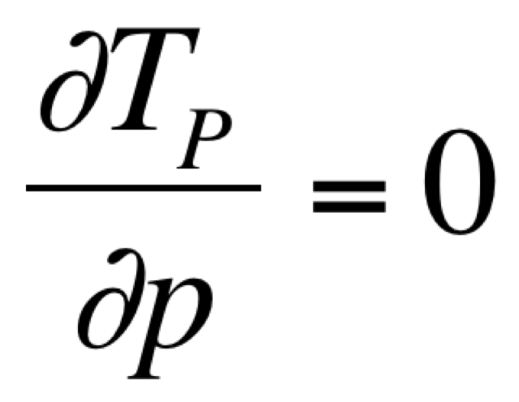
Minimum execution time
Find the minimum time (T_{P}^{min}) to find a solution to a problem with a computing volume W
    Derive the expression of the parallel time (T_{P}) with respect to the number of processors and equal it to 0
  If
    p₀ is the value of p determined by this equation
    T_{P}(p₀) is the minimum value of the parallel time

Slide 47
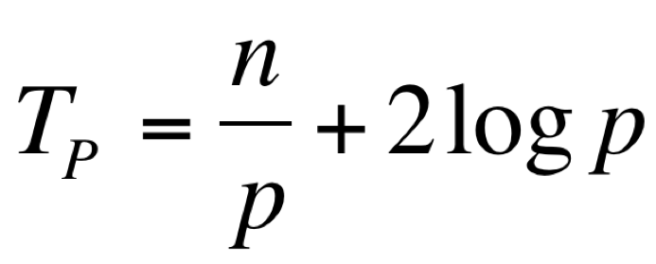
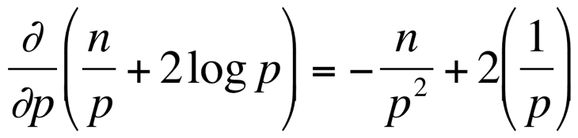
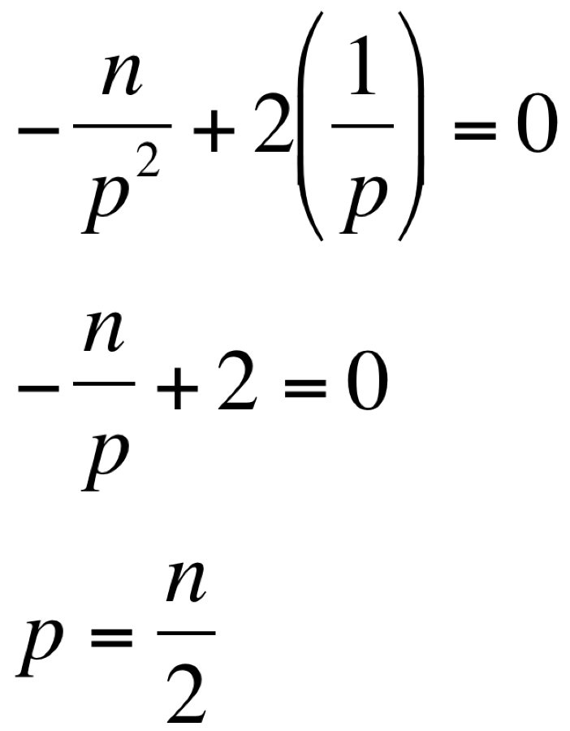
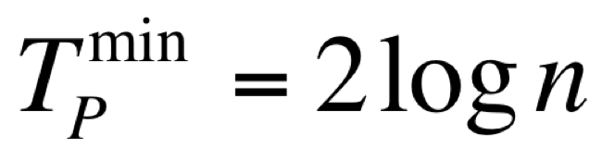
Minimum execution time: example
Minimum time for the n numbers sum
Parallel execution time
Computing the derivative
with respect to p
Equating the derivative to 0, solve for p
The corresponding time is equal to

