Slide 1

Conception of parallel algorithms

Slide 2
Some references
Parallel Programming – For Multicore and Cluster System, T. Rauber, G. Rünger
Decomposing the Potentially Parallel A one day course, Elspeth Minty, Robert Davey, Alan Simpson, David Henty, Edinburgh Parallel Computing Centre The University of Edinburgh

Slide 3
Algorithm Parallelization
The target architecture and the programing model have an influence over the way of designing (and writing) a parallel algorithm
The parallel algorithm should be designed depending of the characteristics of the sequential algorithm
    Type of data manipulated (tables, graphs, data structures, …)
    Data accesses (regular, random, …)
    Granularity
    Dependences (control, data)
    …
  Goals
    To obtain the same results as the sequential program!
    Gain some time
    Reduce the storage consumption (memory, disk)

Slide 4
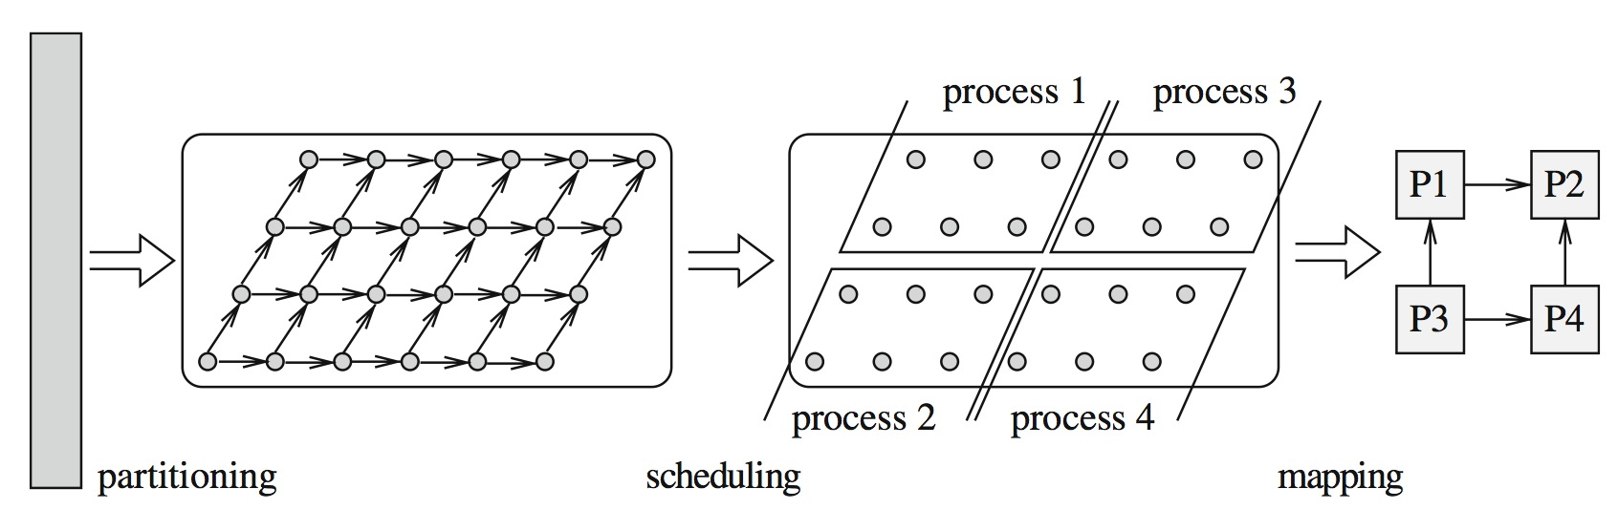
Parallelization Steps

Slide 5
Computation decomposition
The computations of a sequential program are decomposed into tasks (with dependencies between them)
Each task is the smallest unit of parallelism
Various levels of execution
    Instruction parallelism
    Data parallelism
    Functional parallelism
  The decomposition can be static (before execution) or dynamic (at runtime)
  At any time of execution, the number of "executable" tasks gives a higher bound of the degree of parallelism of the program
  The decomposition into tasks consists in generating enough parallelism to have a maximum occupancy of the cores / processors / machines

Slide 6
Computation decomposition, contd.
Pay attention to granularity !
    The execution time of a task must be large in relation to the time it takes to schedule it, place it, start it, acquire its data, return the computed data
    Large coarse grain tasks with numerous computations
      Fine-grained tasks with few computations
    Compromise to find according to the performances (computation, access to the data, overhead of the system, communications, disk access, ...)

Slide 7
Assignment to processes or threads
A process or thread represents a flow of control executed by a processor or a core
    Performs tasks one after the other
    Not necessarily the same number as the number of processors (or cores)
  Assign tasks to ensure proper balancing (i.e. all processors or cores must have the same volume of computation to run)
    Attention should be paid to memory access (for shared memories) and message exchanges (for distributed memories)
    Re-use of data if possible
    Also called scheduling
      If executed during the initialization phase of the program: static scheduling
      If executed during program execution: dynamic scheduling
    Main goal: equal use of processors while maintaining a smallest amount of communication between processors

Slide 8
Placing processes on processors
Generally placing each process (or thread) on separate processors (or core)
If more processes than processors then placing more processes on processors
    Performed by the system and / or program directives
    Goal: Balance and reduce communications
  Scheduling algorithm
    A method for efficiently executing a set of tasks for a determined duration on a set of specified execution units
    Satisfying dependencies between tasks (precedence constraints)
    Capacity constraints (because number of execution units limited)
    Sequential or Parallel Tasks
    Goal
      Set the start time and the target execution unit for each task
      Minimize the execution time (makespan) = time between start of the 1st task and the end of the last task

Slide 9
Parallelism levels
Computations executed by a program provide opportunities for parallel execution at different levels
    Instruction
    Loop
    Functions
  Different levels of granularity (fine, medium, wide)
    Possibility of grouping the different elements to increase the granularity
    Different algorithms according to the different granularities

Slide 10
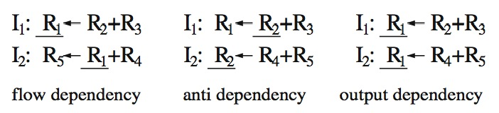
Parallelism at the instruction level
The instructions of a program can run in parallel if they are independent
There are several types of dependencies
    Flow dependencies (ou true dependencies): there is a flow dependency between I₁ and I₂ if I₁ computes a result value in a register or a variable used by I₂ as an operand
    Anti-dependency: there is an anti-dependency between I₁ and I₂ if I₁ uses a register or an operand variable that is used by I₂ to store a result
    Output dependency: there is an output dependency between I₁ and I₂ if I₁ and I₂ use the same register or the same variable to store a result of a calculation

Slide 11
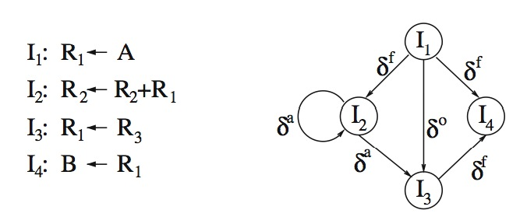
Dependence Graph

Slide 12
Using instruction parallelism
Used by superscalar processors
    Dynamic scheduling of hardware-level instructions with extraction of independent instructions automatically
    Then assigned to independent units
  On VLIW, static scheduling performed by the compiler with arrangement of instructions in long instructions with assignment to the units
  As an input a sequential program with no explicit parallelism

Slide 13
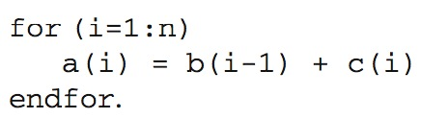

Data parallelism
Same operation performed on different elements of a larger data structure (array for example)
    If these operations are independent then they can be carried out in parallel
    The elements of the data structure are distributed in a balanced manner on the processors
    Each processor executes the operation on the elements assigned to it
  Extension of programming languages (data-parallel languages)
    A single flow of control
    Special constructions to express data-parallel operations on arrays (SIMD model)
    C*, data-parallel C, PC++, DINO, High Performance Fortran, Vienna Fortran
    Owner computes rule

Slide 14
Loop parallelism
Many algorithms traverse a large data structure (data array, matrix, image, ...)
Expressed by a loop in the imperative languages
If there are no dependencies between the different iterations of a loop, we will have a parallel loop
Several kinds of parallel loops
    FORALL
    DOPAR
  Possibility of having
    Multiple instructions in a loop
    Nested loops
  Loop transformations of to find parallelism

Slide 15
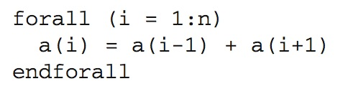

FORALL loop
With one or more assignments to array elements
If only one assignment, then equivalent to an array assignment
    The computations given in the right part of the assignment are executed in any order
    Then the results are affected in the array elements (in any order)
If more than one assignment
    They are executed one after the other as array assignments
    An assignment ends before the next one starts

Slide 16
DOPAR loop
Can contain
    one or more assignments to tables
    other instructions or other loops
  Executed by multiple processors in parallel (in any order)
  The instructions for each iteration are executed sequentially in the order of the program, using the values of the variables in the initial state (before execution of the DOPAR loop)
  The updates of the variables of an iteration are not visible for the other iterations
  Once all iterations have been executed, the iterations updates are combined and a new global state is computed

Slide 17
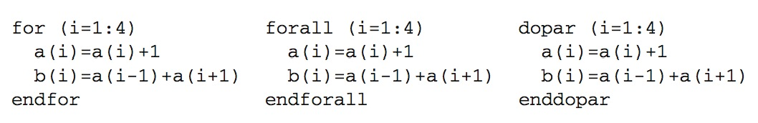
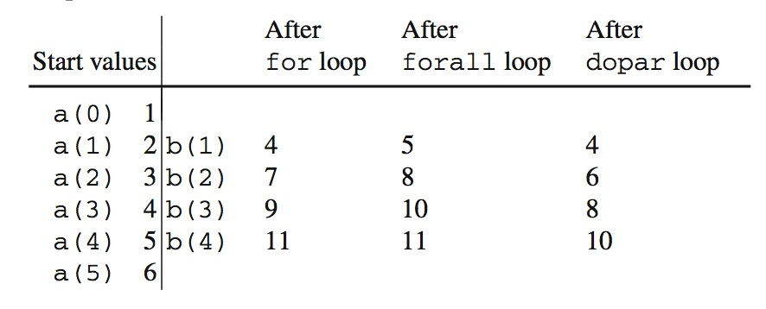
Execution Comparison
Notes:
In the sequential for loop, the computation of b(i) uses the value of a(i-1) that has been computed in the preceding iteration and the value of a(i+1) valid before the loop.
The two statements in the forall loop are treated as separate array assignments. Thus, the computation of b(i) uses for both a(i-1) and a(i+1) the new value computed by the first statement.
In the dopar loop, updates in one iteration are not visible to the other iterations. Since the computation of b(i) does not use the value of a(i) that is computed in the same iteration, the old values are used for a(i-1) and a(i+1).

Slide 18
Functional parallelism
Many parallel programs have independent parts that can be executed in parallel
    Simple Instructions, blocks, loops, or function calls
  One can see the parallelism of tasks by considering the different parts of a program as tasks
    Functional parallelism or task parallelism
  To use task parallelism, tasks and their dependencies are represented as a graph where the nodes are tasks and the vertexes dependencies between tasks
    Sequential tasks or parallel tasks (mixed parallelism)
  To schedule tasks, you must assign a start date to each task that satisfies dependencies (a task can not be started until all tasks on which it depends have been completed)
    Minimize overall execution time (makespan)
    Static and dynamic algorithms

Slide 19
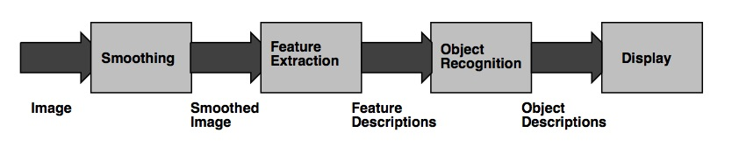
Functional parallelism
Limitations
Start-up costs
    At the beginning (and at the end of the pipeline) few active tasks
  Load Balancing
    If tasks have higher costs, it is difficult to balance the work between processors (think of re-splitting if possible)
  Scalability
    Limitation on the number of processors that can be used

Slide 20
Functional parallelism
Static Scheduling Algorithm
    Determines assignment of tasks deterministically at the start of the program or at compilation
    Based on an estimate of the execution time of tasks (measures or models)
Dynamic Scheduling Algorithm
    Determines the assignment of tasks at runtime
    Allows to adapt placement according to conditions
    Using a task pool that contains tasks that are ready to run
      At each task execution, all tasks that depend on them (and whose dependencies are satisfied) are found in the pool
      Often used in shared memory machines (pool in main memory)
  Languages that allow functional parallelism
    TwoL, PCN, P3L, Kaapi, OpenMP
  Used in multi-threaded systems, workflows systems

Slide 21
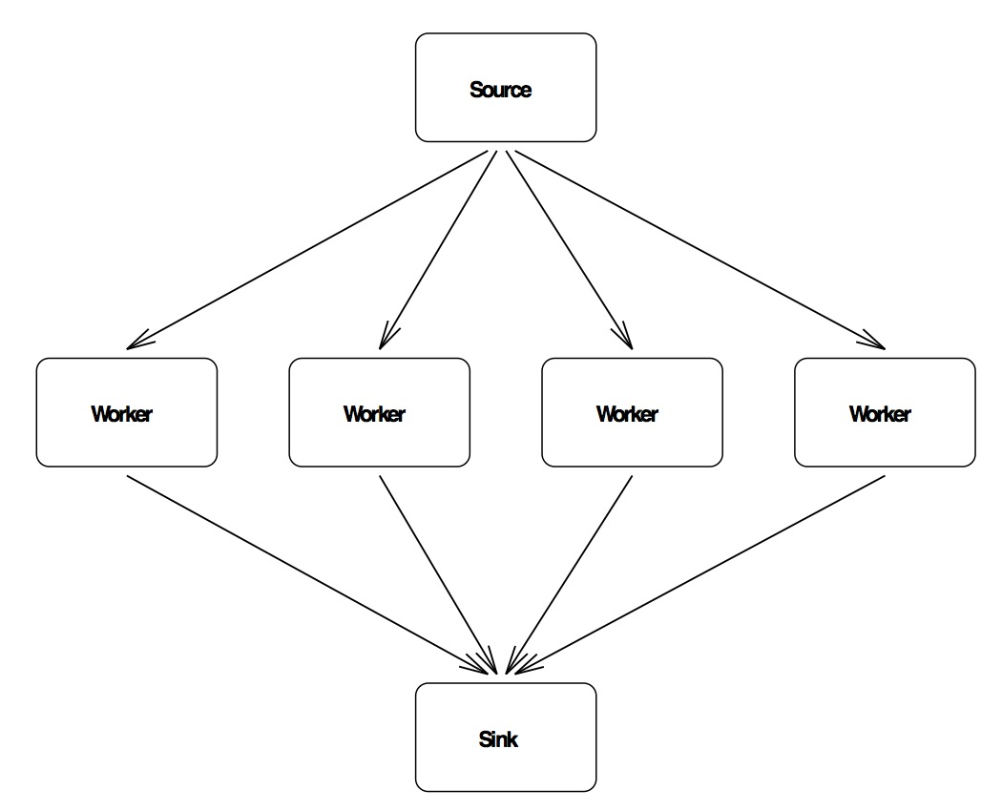
Task farming
Source
    Divides initial tasks among workers and ensures balancing
  Worker
    Receives the task from the source, performs the job and passes the result
  Sink
    Receives completed tasks from workers and collects partial results

Slide 22
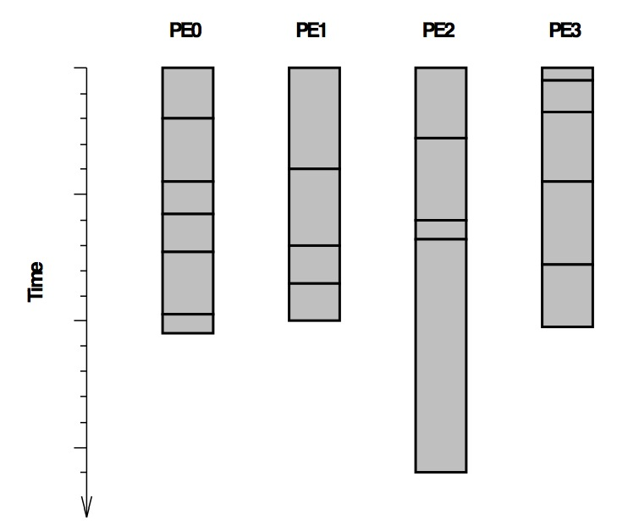
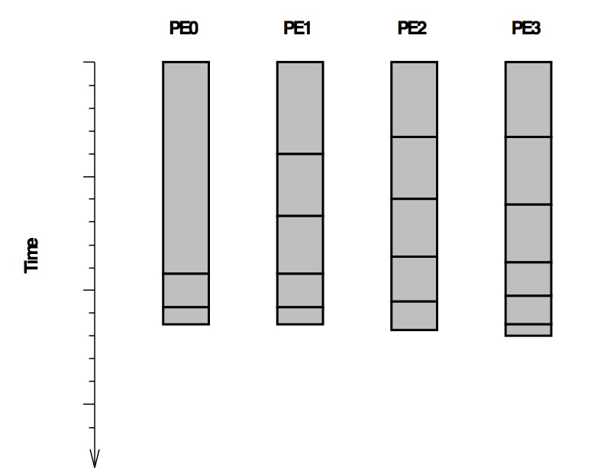
Task farming, contd.
Limitations of the task farming model
    Large number of communications
    Limited to certain types of applications
    Scheduling management if no knowledge of task execution times

Slide 23
Conclusion
Not one single solution but several solutions
Combination of models
    Task parallelism and data parallelism (mixed parallelism)
  Implicit or explicit parallelism
  Automatic or semi-automatic discovery of parallelism
  Scheduling and task load-balancing algorithms
  Importance of execution models!

