Slide 1
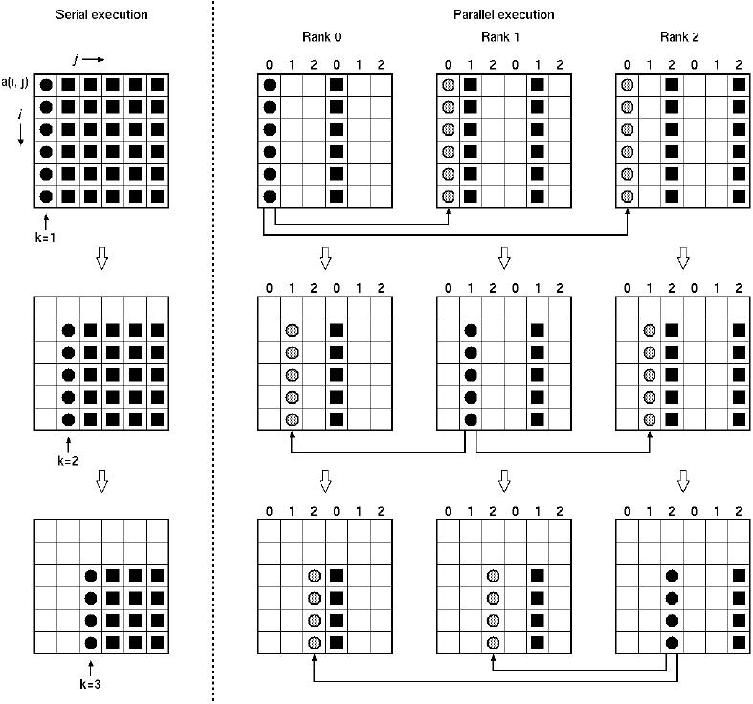
Collective
Communications

Slide 2
Some references
Parallel Algorithms, H. Casanova, A. Legrand, Y. Robert
    Parallel Programming – For Multicore and Cluster System, T. Rauber, G. Rünger

Slide 3
MIMD: Multiple Instructions stream, multiple data stream
Multi-Processor Machines
Each processor runs its own code asynchronously and independently
Two sub-classes
Shared memory Distributed memory
A mix between SIMD and MIMD: SPMD (Single Program, Multiple Data)

Slide 4
Collectives communications
Interactions between parts of a parallel program mapped in a set of processors happen following well defined schemes between groups of processors/cores
    Not only point-to-point communications
To write parallel algorithms, we need collectives operations
    Broadcast, scatter, gather, all-to-all, ...
    Used in most parallel applications
  MPI provides many of them
    They should be designed to use efficiently hardware resources (processors, network, memory interfaces, bus, …)
  Optimizing these operations can
    Improve global performance of programs
    Reduce the development cost of applications
    Improve parallel software quality
If possible, take the hardware architecture into account
So why should we take a look at the way they are designed ?

Slide 5
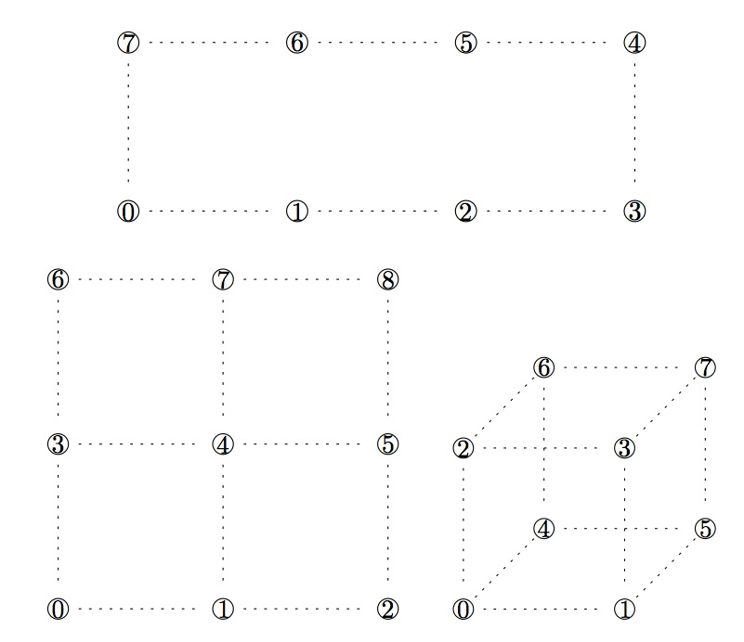
Topologies

Slide 6
Communication costs
Global communications are usually written using point-to-point communications
Difficulty to find accurate models
    MPI implementations have different optimisations depending of the message sizes
    Smart optimizations taking into account special hardware/software features
Here we use a simplified model
    Time = L + m/B (without contentions)
    L: startup (or latency) time
    B: bandwidth (b = 1/B)
    m: message size
Store-and-forward
  If we suppose that a message of length m is sent from de P₀ to P_{q}, then the communication cost is
  T_{c}(m) = q(L + m b)

Slide 7
Suppositions about communications
Several options
    Send() and Recv() are both blocking
      Called “rendez-vous” mode
    Recv() is blocking, but Send() is not
      Pretty standard
      MPI supports it
    Recv() and Send() are both non-blocking
      Pretty standard too
      MPI supports it as well

Slide 8
Supposition about concurrency
An important question: can the processor perform several operations at the same time?
Generally we suppose that the processor is able to send, receive, and compute at the same time
    MPI_IRecv()
    MPI_ISend()
    Compute something
We need these three operations to be independent
    We can not send the result of a computation before it is computed
    We can not send what we receive (forwarding) unless we pipeline the communication
When we write parallel algorithms (in pseudo-code), we write concurrent activities with the || sign

Slide 9
Virtual topology versus physical topology
We have chosen that our virtual topology is a ring
    We suppose that the topology is a ring too
  Maybe an other virtual topology is more adapted to the physical one we have for our cluster
  The ring of processes allows to have simple algorithms
  With quite good performances
  Good candidate for our first approach of parallel algorithmics

Slide 10

Some global operations
  One-to-all broadcast and reduction
  All-to-all broadcast and reduction
  All-Reduce operation and prefix sum
  Scatter and Gather
  Personnalized all-to-all communication
  Circular shift

Slide 11
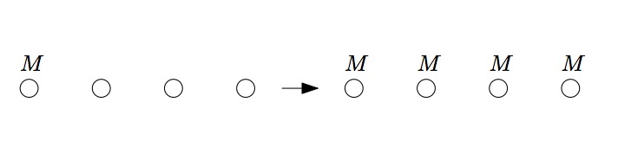
Broadcast (one-to-all communication)
Input
    Message M is stored on root processor
  Output
    Message M is stored locally on every processors

Slide 12
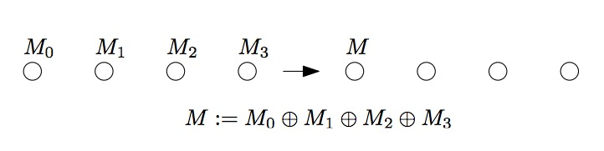
Reduction (all-to-one reduction)
Input
    The p messages M_{k} for k = 0, 1, …, p-1
    Message M_{k} is stored locally on processor k
    An associative operation (+, x, max, min)
  Output
    The “sum” is stored on root processor

Slide 13
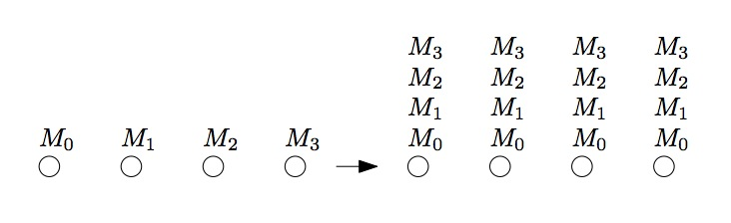
All-to-all broadcast
Input
    The p messages M_{k} for k = 0, 1, …, p-1
    Message M_{k} is stored locally processor k
  Output
    The p messages M_{k} for k = 0, 1, …, p-1 are stored locally on every processors

Slide 14
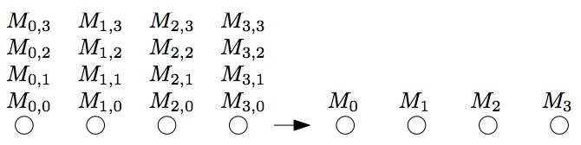

All-to-all reduction
Input
    The p² messages M_{r,k} for r, k = 0, 1, …, p-1
    Message M_{r,k} is stored locally on processor r
    An associative operation (+, x, max, min)
  Output
    The “sum” is stored on the root processor

Slide 15
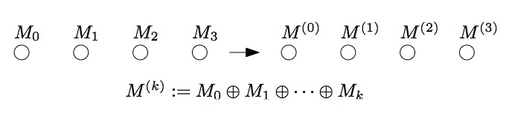

Prefix sum
Input
    The p messages M_{k} for k = 0, 1, …, p-1
    Message M_{k} is stored locally on processor k
    An associative operation (+, x, max, min)
  Output
    The “sum” is stored locally on processor k for all k

Slide 16
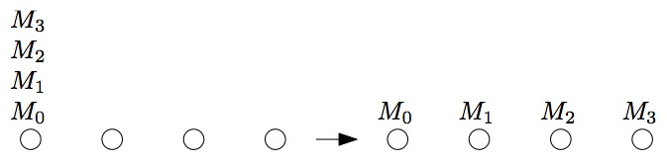
Scatter
Input
    The p messages M_{k} for k = 0, 1, …, p-1 are stored locally on root processor
  Output
    Message M_{k} is stored locally processor k for all k

Slide 17
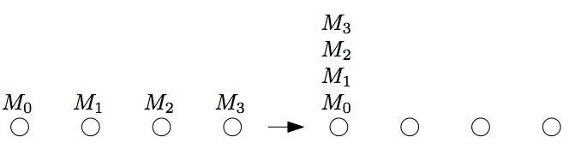
Gather
Input
    The p messages M_{k} for k = 0, 1, …, p-1
    Message M_{k} is stored locally on processor k
  Output
    The p messages M_{k} are stored locally on root processor

Slide 18
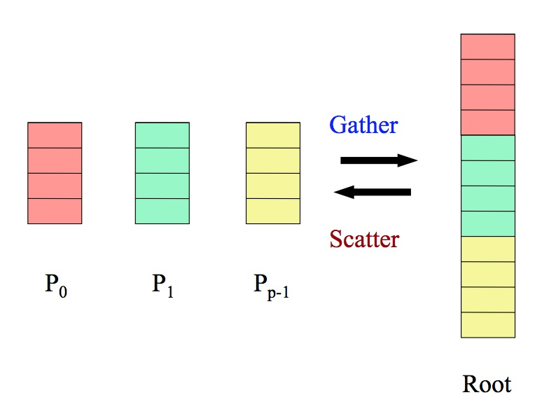
Scatter/Gather

Slide 19
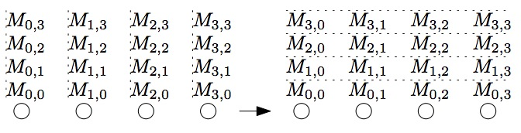
Personnalized All-to-all (transposition)
Input
    The p² messages M_{r,k} for r, k = 0, 1, …, p-1
    Message M_{r,k} is stored locally on processor r
  Output
    The p messages M_{r,k} are stored locally processor k for all k

Slide 20
Circular shift
M₀
M₁
M₂
M₃
M₃
M₀
M₁
M₂
Input
    The p messages M_{k} for k = 0, 1, …, p-1 are stored locally on each processor
  Output
    Message M_{(k-1)%p} is stored locally on k for each k

Slide 21
Algorithms on a ring of processors

Slide 22
Ring of processors
P_{p-1}
P₀
Each process is identified by his rank
    MY_NUM()
We have a way of finding the total number of processes
    NUM_PROCS()
Each process can send message to each successor
    SEND(addr, L)
And receive a message to its predecessor
    RECV(addr, L)
P₁
P₃
P₂

Slide 23
Broadcast
We want to write a program in which P_{k} sends the same message of length m to all other processors
    Broadcast (k, addr, m)
On a ring, the naive algorithm consists in sending message to the neighbor processor and so on an so forth, with no parallel communication
It should not be written like this if the physical topology is not a ring
    MPI uses some kind of tree

Slide 24
Broadcast
Broadcast(k,addr,m)
q = MY_NUM()
p = NUM_PROCS()
if (q == k)
SEND(addr,m)
else
if (q == k-1 mod p)
RECV(addr,m)
else
RECV(addr,m)
SEND(addr,m)
endif
endif
Assumes a blocking receive
Send can be non-blocking
The broadcast time is the following
(p-1)(L+m b)

Slide 25
Optimized broadcast
How to improve performance?
We can split the message in smaller packets
  r packets where m can be divided by r
The root process sends r messages
The model of the broadcast can be computed like this
  Consider the last process to obtain the last packet of the message
  We need p-1 steps for the first packet to reach its destination, thus
  (p-1)(L + m b / r)
  The the next r-1 packets arrive one after an other
  (r-1)(L + m b / r)
  Thus a total of
  (p + r - 2) (L + mb / r)

Slide 26
Optimized broadcast, contd.
The next question is, what is the value r that that minimizes
(p + r- 2) (M + m b / r) ?
We can see the previous expression as
(c+ar)(d+b/r), with four constant values a, b, c, d
The non-constant part of the expression is thus
ad.r + cb/r, that should be minimized
This value is minimized for
sqrt(cb / ad)
thus we have
r_{opt} = sqrt(m(p-2) b / L)
With the optimal time
(sqrt((p-2) L) + sqrt(m b))²
that tends towards mb when m is large (independent of p !)
Notes:
D (adr + cb/r) = ad – cb/r2
D = 0 => r2 = cb/ad => r = sqrt (cb/ad)

Slide 27
Classical network principle
We have seen that if we cut a (large) message into a large number of (small) messages, then we can send the message through several jumps (in our case p-1) virtually as fast as sending it to just one jump
This is the fundamental principle of IP networks
  Messages are divided into several IP frames
  They are sent on several routers
  But the execution time is limited by the slowest router time

Slide 28
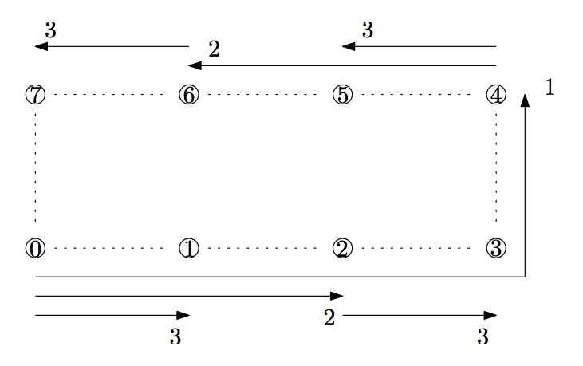
Other solution: Recursive Doubling
Double the number of active processes at each step

Slide 29
Scatter
Process k sends a different message to all other processes (including it)
    P_{k} stores messages for P_{q} at address addr[q], including a message to addr[k]
At the end of the execution, each processor has the message it received in msg
The principle of the algorithm is just pipelining the communications starting with the message intended for P_{k-1}, the most distant process

Slide 30
Scatter
Scatter(k,msg,addr,m)
q = MY_NUM()
p = NUM_PROCS()
if (q == k)
for i = 0 to p-2
SEND(addr[k+p-1-i mod p],m)
msg ← addr[k]
else
RECV(tempR,L)
for i = 1 to k-1-q mod p
tempS ↔ tempR
SEND(tempS,m) || RECV(tempR,m)
msg ← tempR
Same execution time than broadcast
(p-1)(L + m b)
Exchange of Send Buffer and Receive Buffer (Pointer)
Send and receive in parallel, with a non-blocking send

Slide 31
Scatter
0
1
k = 2, p = 4
3
Scatter(k,msg,addr,m)
q = MY_NUM()
p = NUM_PROCS()
if (q == k)
for i = 0 to p-2
SEND(addr[k+p-1-i mod p],m)
msg ← addr[k]
else
RECV(tempR,L)
for i = 1 to k-1-q mod p
tempS ↔ tempR
SEND(tempS,m) || RECV(tempR,m)
msg ← tempR
2
Proc q=2
send addr[2+4-1-0 % 4 = 1]
send addr[2+4-1-1 % 4 = 0]
send addr[2+4-1-2 % 4 = 3]
msg = addr[2]
Proc q=3
recv (addr[1])
// loop 2-1-3 % 4 = 2 times
send (addr[1]) || recv (addr[0])
send (addr[0]) || recv (addr[3])
msg = addr[3]
Proc q=0
recv (addr[1])
// loop 2-1-2 % 4 = 1 time
send (addr[1]) || recv (addr[0])
msg = addr[0]
Proc q=1
// loop 2-1-1 % 4 = 0 time
recv (addr[1])
msg = addr[1]

Slide 32
All-to-all
Same execution time than scatter
(p-1)(L + m b)
All2All(my_addr, addr, m)
q = MY_NUM()
p = NUM_PROCS()
addr[q] ← my_addr
for i = 1 to p-1
SEND(addr[q-i+1 mod p],m) || RECV(addr[q-i mod p],m)
1
1
0
0
2
2

Slide 33
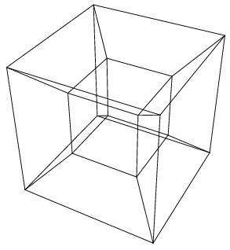
Algorithms ON Hypercube

Slide 34
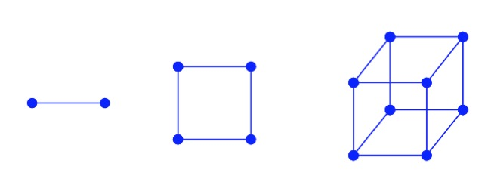
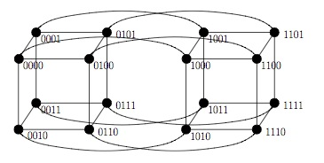
Reminder on hypercubes
d dimensional graph
2^{d} nodes with d neighbor each
A 0-cube is a simple node simple, a 1-cube a row of processors, a 2-cube a mesh, etc
Log(p) dimensions if p processors
Diameter d

Slide 35
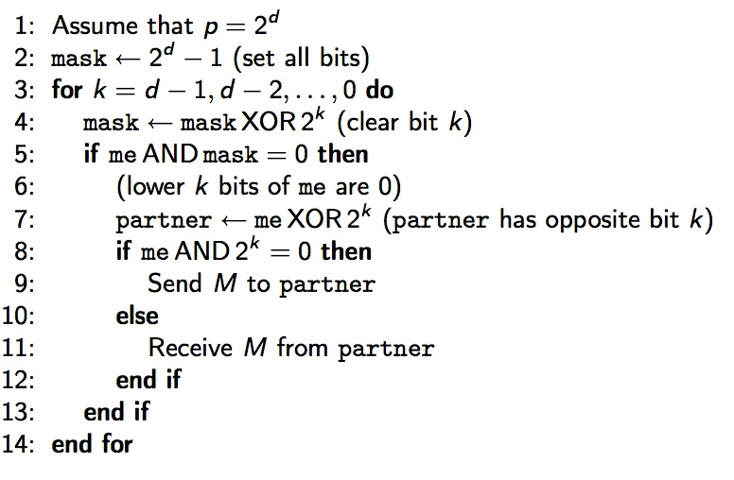
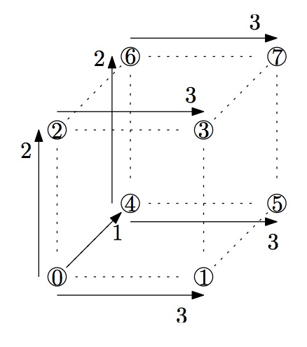
Broadcast in hypercubes
Same algorithm as the ring one but generalized to d dimensions
If the root process is not 0
rename processes me = me XOR root

Slide 36
Broadcast cost
Number of steps: d = log₂ (p)
Cost per step: L + m/B
Total cost: (L + m/B) log₂ (p)
The broadcast cost with p² processors is only the double of the broadcast cost with p processors
    log₂ (p²)= 2 log₂ (p)

Slide 37
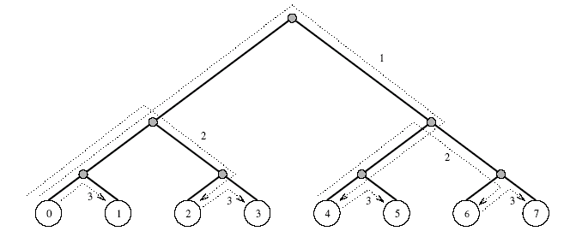
Broadcast in a binary tree

Slide 38
Reduction (all-to-one)
Same algorithm as broadcast but reversing the communication order and directions
Same execution time (adding the reduction cost)
Combining the incoming message with the local data with the operation

Slide 39
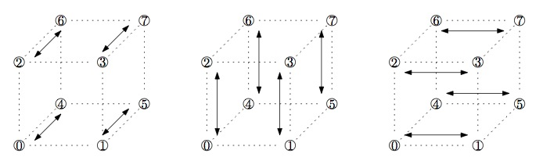
All-to-all broadcast in a hypercube
Using the ring algorithm
      For each dimension d of the hypercube, apply in sequence the algorithm on a ring on the 2^{d-1} links of the current dimension in parallel

Slide 40
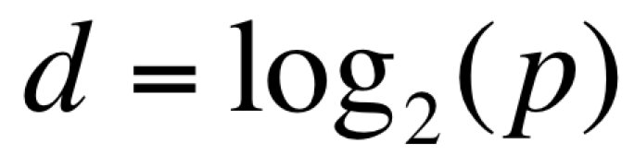
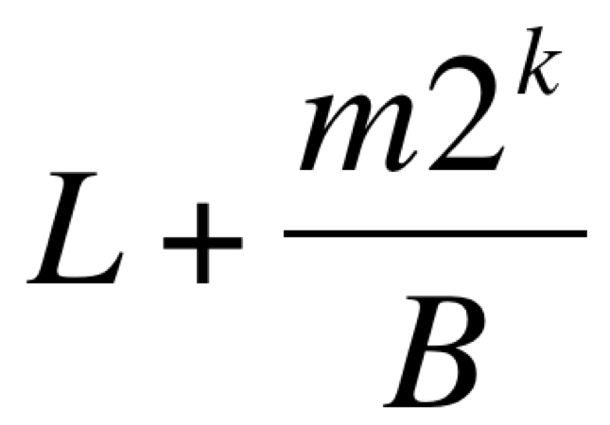
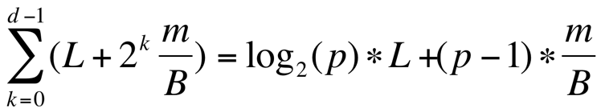
All-to-all broadcast in a hypercube
Cost
    Number of steps:
    Cost for step k = 0, 1, …, d-1:
    Total cost:

Slide 41
Algorithms on a grid of processors

Slide 42
Bi-dimensional grid of processors
Let p = q² processors
They can be seen as being arranged in the form of a square grid
    One can also have a rectangular grid
Each processor is identified by two indexes
    i: its row
    j: its column
P_{0,0}
P_{0,1}
P_{0,2}
P_{1,0}
P_{1,1}
P_{1,2}
P_{2,0}
P_{2,1}
P_{2,2}

Slide 43
Bi-dimensional torus (2D torus)
We have links which connect each side of the grid
Each processor belongs to two different rings
    Possibility to use algorithms designed for ring topologies
Mono-directional or bi-directional links
    Depends on what we need for our
    algorithm and/or physical resources
P_{0,0}
P_{0,1}
P_{0,2}
P_{1,0}
P_{1,1}
P_{1,2}
P_{2,0}
P_{2,1}
P_{2,2}

Slide 44
Overlaps
In our performance analyzes, it is often assumed that a processor can perform three activities in parallel
    Computation
    Send
    Receive
It is also necessary to know whether the links are bi-directional or not
  Two models
    Half-duplex: two messages on the same link going in opposite directions share the link bandwidth
    Full-duplex: it's like having two links between each processor
  To be checked (and to measure and verify sometimes) with the target platform

Slide 45
Multiple concurrent communications?
We now have four (logical) links on each processor
You need to know how many concurrent calls can be made at the same time
    There can be 4 sends and 4 receives in the model with bi-directional links
    Assuming that the 4 sends and the 4 receives can take place in parallel, one has a multi-port model
    If we assume 1 send and 1 receive in parallel, we have a 1-port model
    Other possible variations
      k-port (bounded multi-port), inputs/outputs

Slide 46
Next
We have several options
    Grid or torus
    Mono- ou bi-directional links
    1-port or multi-port (or k-port)
    Half- or full-duplex
We will generally assume a bi-directional and full-duplex torus
We will examine the 1-port and multi-port assumptions
"Easy" to modify a performance analysis to stick with the physical resources of the target machines studied

Slide 47
Is the grid topology realistic?
Some parallel machines are(were) built with physical networks in the form of grids (2D or 3D)
    Examples: Intel Paragon, IBM’s Blue Gene/L
If the platform uses a switch with all-to-all communications, then the grid is assumed to be valid
  On the other hand, the assumptions of full-duplex or multi-port are not necessarily valid
We will see that even if the physical platform is a unique shared medium (such as a non-switched Ethernet network), it is sometimes better to think of it as a grid when developing algorithms!

Slide 48
Communications in a grid
A process can call two functions to know its position in the grid:
    My_Proc_Row() and My_Proc_Col()
A process can know how many total processes are in the topology with:
Num_Procs()
    Assume that we have a square grid
  There are two point-to-point communications functions:
    Send(dest, addr, L)
    Recv(src, addr, L)
Broadcast functions can be created in rows and columns
    BroadcastRow(i, j, srcaddr, dstaddr, L)
    BroadcastCol(i, j, srcaddr, dstaddr, L)
It is assumed that a call to such a function in a row or column that is not right returns immediately

Slide 49
Row and column broadcast
If we have a torus
    If one has mono-directional links, one can re-use the broadcast function developed for the rings of processors
    Pipelined or not
    If you have bi-directional links and a multi-port model, you can improve performance by sending data on both sides of the ring
    Asymptotic performances are not changed
If you have a grid
    If the links are bi-directional, then we can send the messages on both sides from the source processor concurrently or not, depending on whether we have a 1-port or multi-port model
    If the links are mono-directional, one can simply not implement the broadcast

Slide 50
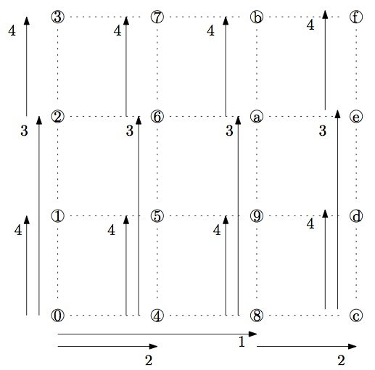
Broadcast in a grid
Use the ring broadcast algorithm on the row where the root is located
Use the ring broadcast algorithm on all columns in //

Slide 51
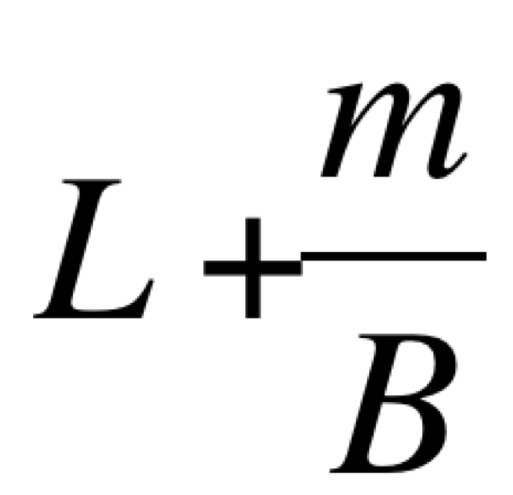
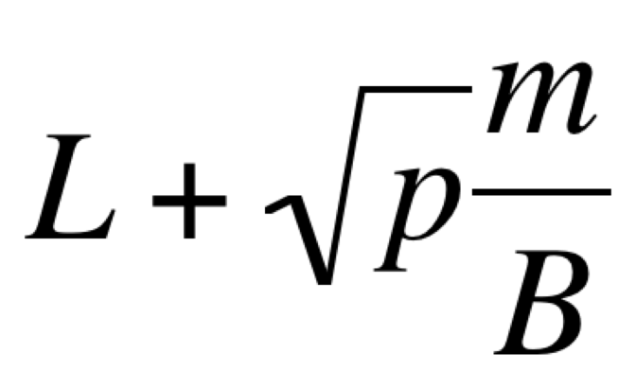
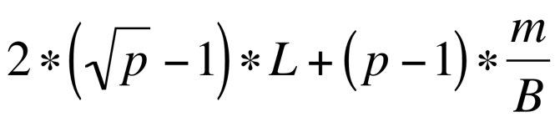
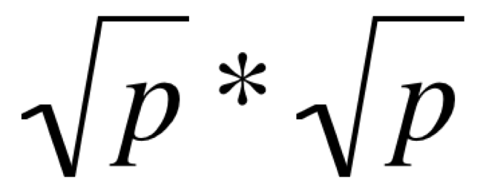
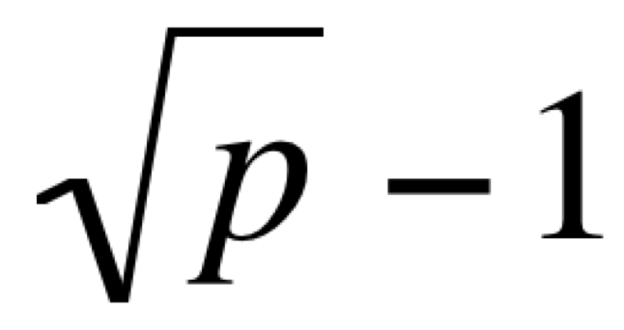
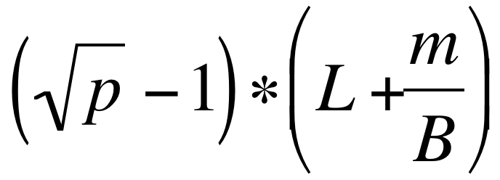
All-to-all in a grid of processors
Use the ring broadcast algorithm on each row in //
  Cost (we suppose that we have a grid of processors)
      Number of steps:
      Time per step:
      Total time:
  Use the ring broadcast algorithm on each column in //
    Cost
      Number of steps:
      Time per step:
      Total time:
  Total time:

Slide 52
Bi-dimensional matrix distribution
Let a_{i,j} be a element of the matrix
We denote by A_{i,j} (or A_{ij}) the block of matrix A assigned to P_{i,j}
P_{0,0}
P_{0,1}
P_{0,2}
P_{0,3}
P_{1,0}
P_{1,1}
P_{1,2}
P_{1,3}
P_{2,0}
P_{2,1}
P_{2,2}
P_{2,3}
P_{3,0}
P_{3,1}
P_{3,2}
P_{3,3}
C₀₀ | C₀₁ | C₀₂ | C₀₃
C₁₀ | C₁₁ | C₁₂ | C₁₃
C₂₀ | C₂₁ | C₂₂ | C₂₃
C₃₀ | C₃₁ | C₃₂ | C₃₃
A₀₀ | A₀₁ | A₀₂ | A₀₃
A₁₀ | A₁₁ | A₁₂ | A₁₃
A₂₀ | A₂₁ | A₂₂ | A₂₃
A₃₀ | A₃₁ | A₃₂ | A₃₃
B₀₀ | B₀₁ | B₀₂ | B₀₃
B₁₀ | B₁₁ | B₁₂ | B₁₃
B₂₀ | B₂₁ | B₂₂ | B₂₃
B₃₀ | B₃₁ | B₃₂ | B₃₃

Slide 53
Cannon matrix product algorithm
Old algorithm
    Designed for systolic architectures (SIMD)
    Adapted to a 2D grid
The algorithm starts with a redistribution of matrices A and B
    Called “preskewing”
Then matrices are multiplied together
At the end, the matrices are re-distributed to find their initial distribution
    Called “postskewing”

Slide 54
Cannon Preskewing
Matrix A
Each block of matrix A is shifted to the left until the process of the first process column contains a block of the diagonal of the matrix
A₀₀ | A₀₁ | A₀₂ | A₀₃
A₁₀ | A₁₁ | A₁₂ | A₁₃
A₂₀ | A₂₁ | A₂₂ | A₂₃
A₃₀ | A₃₁ | A₃₂ | A₃₃
A₀₀ | A₀₁ | A₀₂ | A₀₃
A₁₁ | A₁₂ | A₁₃ | A₁₀
A₂₂ | A₂₃ | A₂₀ | A₂₁
A₃₃ | A₃₀ | A₃₁ | A₃₂

Slide 55
Cannon Preskewing, contd.
Matrix B
Each block of matrix B is shifted upward until process of the first process line contains a block of the diagonal of the matrix
B₀₀ | B₀₁ | B₀₂ | B₀₃
B₁₀ | B₁₁ | B₁₂ | B₁₃
B₂₀ | B₂₁ | B₂₂ | B₂₃
B₃₀ | B₃₁ | B₃₂ | B₃₃
B₀₀ | B₁₁ | B₂₂ | B₃₃
B₁₀ | B₂₁ | B₃₂ | B₀₃
B₂₀ | B₃₁ | B₀₂ | B₁₃
B₃₀ | B₀₁ | B₁₂ | B₂₃

Slide 56
Cannon algorithm
The algorithm runs in q steps
At each step, each processor executes a multiplication of its block of A and its block of B and adds it to its block of C
Then the blocks of A are shifted to the left and the blocks of B are shifted upwards
C blocks do not move
Participate to the preskewing of A
Participate to the preskewing of B
For k = 1 to q
Local C = C + A*B
Horizontal shift of A
Vertical shift of B
Participate to the postskewing of A
Participate to the postskewing of B

Slide 57
Steps of the Cannon algorithm
C₀₀ | C₀₁ | C₀₂ | C₀₃
C₁₀ | C₁₁ | C₁₂ | C₁₃
C₂₀ | C₂₁ | C₂₂ | C₂₃
C₃₀ | C₃₁ | C₃₂ | C₃₃
A₀₀ | A₀₁ | A₀₂ | A₀₃
A₁₁ | A₁₂ | A₁₃ | A₁₀
A₂₂ | A₂₃ | A₂₀ | A₂₁
A₃₃ | A₃₀ | A₃₁ | A₃₂
B₀₀ | B₁₁ | B₂₂ | B₃₃
B₁₀ | B₂₁ | B₃₂ | B₀₃
B₂₀ | B₃₁ | B₀₂ | B₁₃
B₃₀ | B₀₁ | B₁₂ | B₂₃
Local
computation
on processor
(0,0)
C₀₀ | C₀₁ | C₀₂ | C₀₃
C₁₀ | C₁₁ | C₁₂ | C₁₃
C₂₀ | C₂₁ | C₂₂ | C₂₃
C₃₀ | C₃₁ | C₃₂ | C₃₃
A₀₁ | A₀₂ | A₀₃ | A₀₀
A₁₂ | A₁₃ | A₁₀ | A₁₁
A₂₃ | A₂₀ | A₂₁ | A₂₂
A₃₀ | A₃₁ | A₃₂ | A₃₃
B₁₀ | B₂₁ | B₃₂ | B₀₃
B₂₀ | B₃₁ | B₀₂ | B₁₃
B₃₀ | B₀₁ | B₁₂ | B₂₃
B₀₀ | B₁₁ | B₂₂ | B₃₃
Shifts
C₀₀ | C₀₁ | C₀₂ | C₀₃
C₁₀ | C₁₁ | C₁₂ | C₁₃
C₂₀ | C₂₁ | C₂₂ | C₂₃
C₃₀ | C₃₁ | C₃₂ | C₃₃
A₀₁ | A₀₂ | A₀₃ | A₀₀
A₁₂ | A₁₃ | A₁₀ | A₁₁
A₂₃ | A₂₀ | A₂₁ | A₂₂
A₃₀ | A₃₁ | A₃₂ | A₃₃
B₁₀ | B₂₁ | B₃₂ | B₀₃
B₂₀ | B₃₁ | B₀₂ | B₁₃
B₃₀ | B₀₁ | B₁₂ | B₂₃
B₀₀ | B₁₁ | B₂₂ | B₃₃
Local
computation
on processor
(0,0)

Slide 58
Fox algorithm
This algorithm was originally developed to run on a hypercube topology
    But in fact it uses a grid, mapped on a hypercube
It does not require any pre / post-skewing
It is based on horizontal broadcast of the diagonals of matrix A and vertical shifts of matrix B
Sometimes also called the broadcast-multiply-roll algorithm

Slide 59
Steps of the Fox algorithm
C₀₀ | C₀₁ | C₀₂ | C₀₃
C₁₀ | C₁₁ | C₁₂ | C₁₃
C₂₀ | C₂₁ | C₂₂ | C₂₃
C₃₀ | C₃₁ | C₃₂ | C₃₃
A₀₀ | A₀₁ | A₀₂ | A₀₃
A₁₀ | A₁₁ | A₁₂ | A₁₃
A₂₀ | A₂₁ | A₂₂ | A₂₃
A₃₀ | A₃₁ | A₃₂ | A₃₃
B₀₀ | B₀₁ | B₀₂ | B₀₃
B₁₀ | B₁₁ | B₁₂ | B₁₃
B₂₀ | B₂₁ | B₂₂ | B₂₃
B₃₀ | B₃₁ | B₃₂ | B₃₃
Initial
state
C₀₀ | C₀₁ | C₀₂ | C₀₃
C₁₀ | C₁₁ | C₁₂ | C₁₃
C₂₀ | C₂₁ | C₂₂ | C₂₃
C₃₀ | C₃₁ | C₃₂ | C₃₃
A₀₀ | A₀₀ | A₀₀ | A₀₀
A₁₁ | A₁₁ | A₁₁ | A₁₁
A₂₂ | A₂₂ | A₂₂ | A₂₂
A₃₃ | A₃₃ | A₃₃ | A₃₃
B₀₀ | B₀₁ | B₀₂ | B₀₃
B₁₀ | B₁₁ | B₁₂ | B₁₃
B₂₀ | B₂₁ | B₂₂ | B₂₃
B₃₀ | B₃₁ | B₃₂ | B₃₃
Broadcast of the 1st diagonal of A (stored in a separate buffer)
C₀₀ | C₀₁ | C₀₂ | C₀₃
C₁₀ | C₁₁ | C₁₂ | C₁₃
C₂₀ | C₂₁ | C₂₂ | C₂₃
C₃₀ | C₃₁ | C₃₂ | C₃₃
A₀₀ | A₀₀ | A₀₀ | A₀₀
A₁₁ | A₁₁ | A₁₁ | A₁₁
A₂₂ | A₂₂ | A₂₂ | A₂₂
A₃₃ | A₃₃ | A₃₃ | A₃₃
B₀₀ | B₀₁ | B₀₂ | B₀₃
B₁₀ | B₁₁ | B₁₂ | B₁₃
B₂₀ | B₂₁ | B₂₂ | B₂₃
B₃₀ | B₃₁ | B₃₂ | B₃₃
Local
computations

Slide 60
Steps of the Fox algorithm, contd.
C₀₀ | C₀₁ | C₀₂ | C₀₃
C₁₀ | C₁₁ | C₁₂ | C₁₃
C₂₀ | C₂₁ | C₂₂ | C₂₃
C₃₀ | C₃₁ | C₃₂ | C₃₃
A₀₀ | A₀₁ | A₀₂ | A₀₃
A₁₀ | A₁₁ | A₁₂ | A₁₃
A₂₀ | A₂₁ | A₂₂ | A₂₃
A₃₀ | A₃₁ | A₃₂ | A₃₃
B₁₀ | B₁₁ | B₁₂ | B₁₃
B₂₀ | B₂₁ | B₂₂ | B₂₃
B₃₀ | B₃₁ | B₃₂ | B₃₃
B₀₀ | B₀₁ | B₀₂ | B₀₃
Shift of B
C₀₀ | C₀₁ | C₀₂ | C₀₃
C₁₀ | C₁₁ | C₁₂ | C₁₃
C₂₀ | C₂₁ | C₂₂ | C₂₃
C₃₀ | C₃₁ | C₃₂ | C₃₃
A₀₁ | A₀₁ | A₀₁ | A₀₁
A₁₂ | A₁₂ | A₁₂ | A₁₂
A₂₃ | A₂₃ | A₂₃ | A₂₃
A₃₀ | A₃₀ | A₃₀ | A₃₀
B₁₀ | B₁₁ | B₁₂ | B₁₃
B₂₀ | B₂₁ | B₂₂ | B₂₃
B₃₀ | B₃₁ | B₃₂ | B₃₃
B₀₀ | B₀₁ | B₀₂ | B₀₃
Broadcast of the 2nd diagonal of A (stored in a separate
buffer)
C₀₀ | C₀₁ | C₀₂ | C₀₃
C₁₀ | C₁₁ | C₁₂ | C₁₃
C₂₀ | C₂₁ | C₂₂ | C₂₃
C₃₀ | C₃₁ | C₃₂ | C₃₃
A₀₁ | A₀₁ | A₀₁ | A₀₁
A₁₂ | A₁₂ | A₁₂ | A₁₂
A₂₃ | A₂₃ | A₂₃ | A₂₃
A₃₀ | A₃₀ | A₃₀ | A₃₀
B₁₀ | B₁₁ | B₁₂ | B₁₃
B₂₀ | B₂₁ | B₂₂ | B₂₃
B₃₀ | B₃₁ | B₃₂ | B₃₃
B₀₀ | B₀₁ | B₀₂ | B₀₃
Local
computations

Slide 61
Fox algorithm
// No initial move
for k = 1 to q in parallel
Broadcast of the k-th diagonal of A
Local computation C = C + A*B
Vertical shift of B
// No final move
We need an additional array to store the diagonal blocks that are received on processes
This is the array used for multiplication A * B

Slide 62
Notes:
Fini en avance (30’) (rajouter dernière partie Henri)

