Slide 1
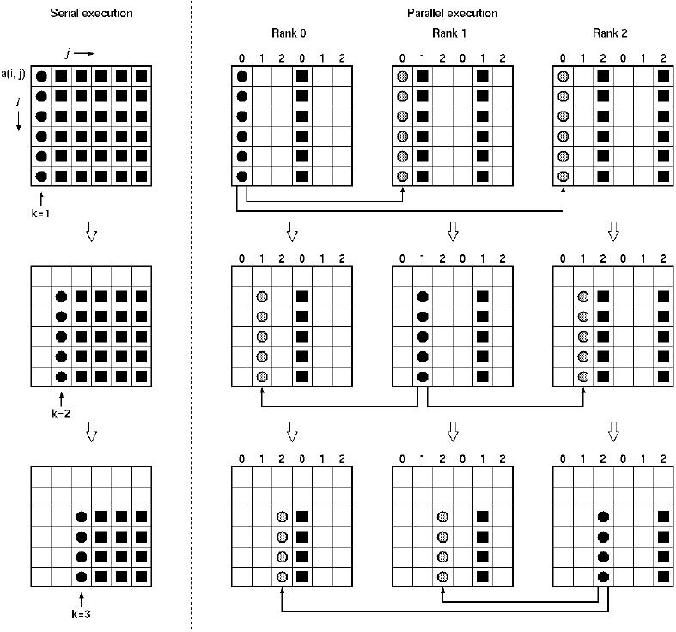
Parallel Linear Algebra

Slide 2
Some references
J. Demmel, K. Yelick, Berkeley
H. Casanova, University of Manoa, Hawaï
Parallel Algorithms, H. Casanova, A. Legrand, Y. Robert
    Parallel Programming – For Multicore and Cluster System, T. Rauber, G. Rünger

Slide 3
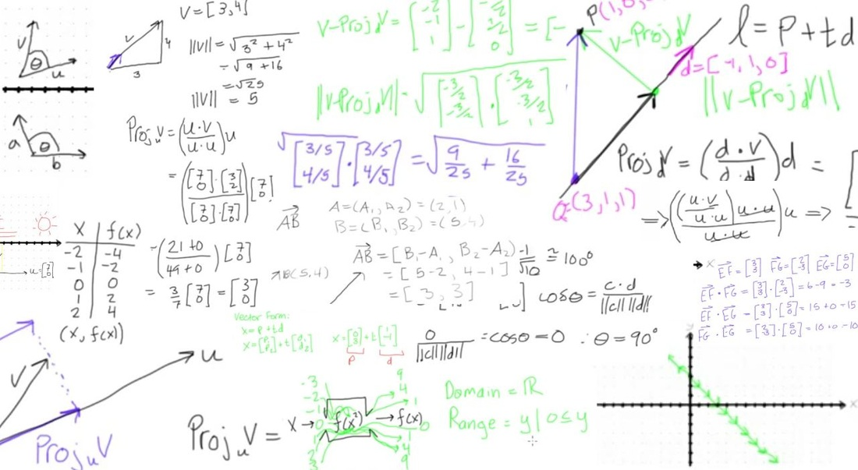
Linear Algebra

Slide 4
What is dense linear algebra?
Not only matrix product!
    Linear systems: Ax=b
    Least Squares: Choose x to minimize ||Ax-b||²
    eigenvalues and eigenvectors of symmetric matrices
        Standard (Ax = λx), generalized (Ax=λBx)
    Eigenvalues and eigenvectors of non-symmetric matrices
    Singular vectors and singular Values (SVD)
        Standard, generalized
Several types of matrices structures
    real, complex; symmetric, Hermitian, positive definite
    dense, triangular, band, …
Detail level
    Simple driver
    Driver with error bounds, more precision, other options
    Low level routines (“apply a given orthogonal transformation”, matrix product, …)

Slide 5
A quick history of dense linear algebra libraries
  Libraries like EISPACK (for eigenvalues problems)
  Then the BLAS (1) came up (1973-1977)
  Standard library with 15 operations (mainly) on vectors
    “AXPY” ( y = α·x + y ), dot product, scale (x = α·x ), …
    Up to 4 versions for each (S/D/C/Z), 46 routines, 3300 LOC
  Goals
    Common pattern to simplify programming, readability, documentation
    Robustness, thanks to a clean coding (avoid over/underflow)
    Portability + efficiency thanks to specific implementations
  Why BLAS 1 ? These routines compute O(n¹) operations over O(n¹) data elements
  Used in libraries such as LINPACK (for linear systems)

Slide 6
A quick history of dense linear algebra libraries, contd.
But BLAS-1 were not sufficient
    Ex: AXPY operation ( y = α·x + y ): 2n flops for 3n reads/writes
    Computational intensity = (2n)/(3n) = 2/3
    Too small to reach performance close to peak performance (reads/writes dominate)
    Tough to vectorize (“SIMD’ize”) over supercomputers of the 1980’s
The BLAS-2 were invented (1984-1986)
    Standard library with 25 operations (mainly) on matrix/vector pairs
    “GEMV”: y = α·A·x + β·x, “GER”: A = A + α·x·yT, x = T-1·x
    Up to 4 versions for each (S/D/C/Z), 66 routines, 18K LOC
  Why BLAS 2 ? They perform O(n²) operations over O(n²) data elements
  Computational intensity is ~(2n²)/(n²) = 2
    Fine for vector machines, not for machines with caches

Slide 7
A quick history of dense linear algebra libraries, contd.
Next step: BLAS-3 (1987-1988)
    Standard library with 9 operations (mainly) on matrix/matrix pairs
    “GEMM”: C = α·A·B + β·C, C = α·A·AT + β·C, B = T-1·B
    Up to 4 version of each (S/D/C/Z), 30 routines, 10K LOC
  Why BLAS 3 ? They perform O(n³) operations over O(n²) data elements
  This leads to a computational intensity equal to (2n³)/(4n²) = n/2 !
    Good to machines with caches, other memory hierarchies
Code volume of BLAS1/2/3 (available on www.netlib.org/blas)
  Source: 142 routines, 31K LOC, Testing: 28K LOC
    Reference implementation (non optimized)
    Ex: 3 nested loops for the GEMM routine
  Much code optimized elsewhere
    Motivates the "automatic tuning" of BLAS
  Part of standard mathematical libraries (AMD AMCL, Intel MKL)

Slide 8
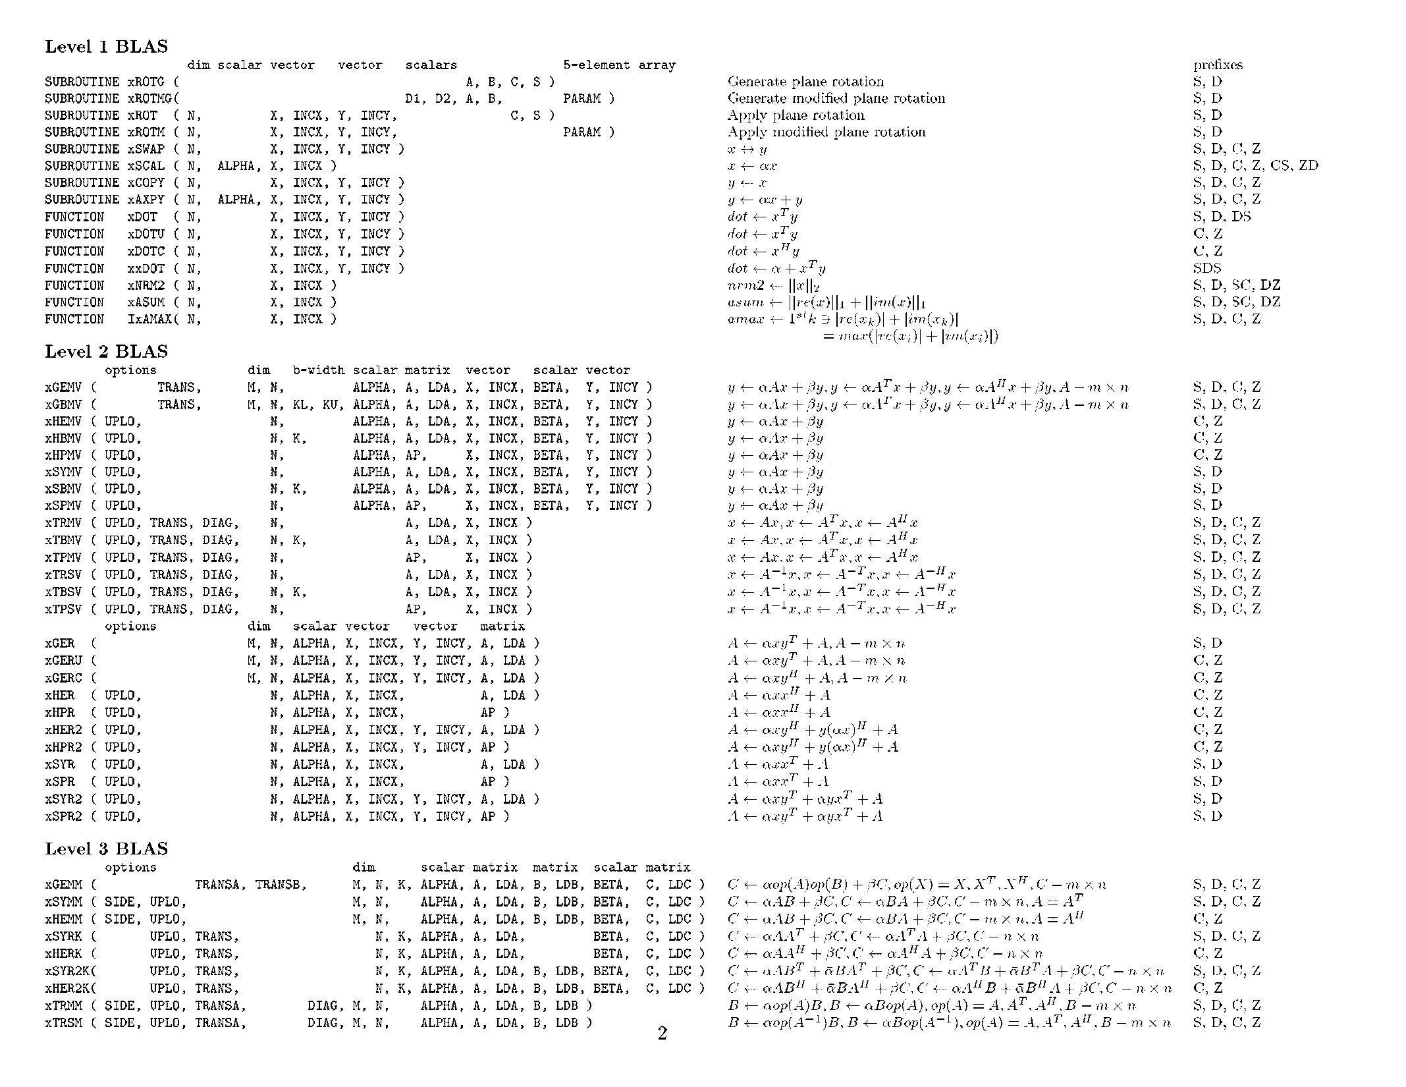

Slide 9
A quick history of dense linear algebra libraries, contd.
LAPACK – “Linear Algebra PACKage” – uses BLAS-3 (1989 – today)
  LAPACK content (summary)
    Algorithms we can transform in (almost) 100% BLAS 3
      Linear systems: solve Ax = b for x
      Least Squares: choose x to minimize ||Ax-b||²
    Algorithms that are ≈ 50% BLAS 3
      Eigenvalue problems: Find l and x where Ax = l x
      Singular Value Decomposition, SVD
    Generalized problems (Ax = l Bx)
    Error bounds on all routines
    Many variants according to the structure of A (band, A = A^{T}, …)
  How much code? (Release 3.7.0, 2016) (www.netlib.org/lapack)
    Source: 1586 routines, 500K LOC,
    Testing: 363K LOC
Notes:
How much code from release 3.2.1,
LOC from SRC, TESTING/{EIG,LIN,MATGEN} only

Slide 10
A quick history of dense linear algebra libraries, contd.
Is LAPACK parallel?
    Only if the BLAS are parallel (possible in shared memory)
ScaLAPACK – “Scalable LAPACK” (1995 – 2005)
    For distributed memory - uses MPI
    More complex data structures / algorithms than LAPACK
    Only a (small) subset of LAPACK features are available
    Available at www.netlib.org/scalapack
  Plasma (2005-today)
    Parallel Linear Algebra Software for Multicore Architectures
    Multicore friendly
    Using a scheduler for DAGs
    Reduction of granularity of calculations
    Decrease in the number of dependencies

Slide 11
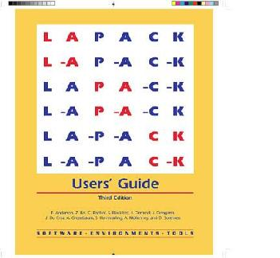
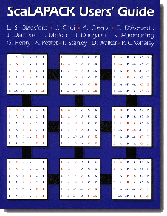
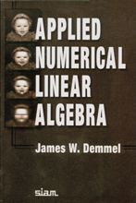


Books about linear algebra libraries
www.netlib.org/lapack
www.netlib.org/scalapack
gams.nist.gov
www.netlib.org/templates
www.cs.utk.edu/~dongarra/etemplates

Slide 12
Why should we avoid communications?
Algorithms have two costs
    Arithmetic (flops)
    Communications: moving data between
      Memory hierarchy levels (sequential case)
      Processors through a network or through a shared memory (parallel case)
CPU
Cache
CPU
DRAM
CPU
DRAM
DRAM
CPU
DRAM
CPU
DRAM

Slide 13
Why should we avoid communications
The exécution of an algorithm is the sum of three terms
    # flops * time_per_flop
    # words moved / bandwidth
    # messages * latency
communication
Time_per_flop << 1/ bandwitdth << latency
  Differences increase exponentially with the time
Annual improvements
Time_per_flop |  | Bandwidth | Latency
 | Network | 26% | 15%
 | DRAM | 23% | 5%
59%
Goal: design algorithms that avoid communications
  Between all the levels of memory hierarchies
    L1 L2 DRAM network, etc
  Not only hiding communications (overlap with arithmetic operations) (acceleration ≤ 2x )
  Any acceleration possible

Slide 14

First Algorithms on a ring of processors

Slide 15
Matrix-Vector product
y = A x
Let N be the size of the matrix
Int A[N][N];
int x[N];
for i = 0 to n-1 {
y[i] = 0;
for j = 0 to n-1
y[i] = y[i] + A[i,j] * x[j];
}
x[N]
y[N]
How to parallelize this operation ?
A[N][N]

Slide 16
Matrix-Vector product, contd.
Parallelism
  Computations on vector elements are independent
  Each computation needs one line of A and vector x
In shared memory
#pragma omp parallel for private(i,j)
for i = 0 to n-1 {
y[i] = 0;
for j = 0 to n-1
y[i] = y[i] + A[i,j] * x[j];
}
x[N]
y[N]
A[N][N]

Slide 17
Matrix-Vector product, contd.
In distributed memory, one possibility consists in giving each process a copy of matrix A (needed rows) and vector x
Each process declares a vector y of size N/n
    We suppose that n divides N
Then, the code can be
    load(a); load(x)
    n = NUM_PROCS();
    r = MY_RANK();
    for (i=r*N/n; i<(r+1)*N/n; i++) {
    for (j=0;j<N;j++)
    y[i-r*N/n] = a[i][j] * x[j];
    }
It is “embarrassingly parallel”. What’s about the result?

Slide 18
What’s about the result of the computation?
After completion of the computation, each process owns one part of the result
One might want to store the result in a file.
    Needs a synchronization such as to have the I/O performed in order
With the following code
if (r != 0)
recv(&token,1);
open(file, “append”);
for (j=0; j<N/n ; j++)
write(file, y[j]);
send(&token,1);
close(file)
barrier(); // optional
One can also use a gather to get the whole vector on process 0
    Vector y can stay in the memory of one node

Slide 19
What happens if the matrix is too large?
The matrix may not fit in memory
  This is one of the motivations for using a distributed version of this operation!
In this case, each processor can only store part of the matrix A
For the matrix-vector product, each processor can only store N/n rows of the matrix
    Conceptually A[N][N]
    But the program declares A[N/n][N]
This raises the problem of global indexes and local indexes

Slide 20
Global and local indexes
When a table is split between processes
    Global indexes (I, J) that reference an element of the matrix
    Local indexes (i, j) that reference an element of the local array that stores a part of the array
  It is necessary to have a translation between the global and local indices
    The algorithm must be thought in terms of global indexes
    And implement it in terms of local indexes
P0
P1
Global: A[5][3]
Local: a[1][3] on process P1
a[i,j] = A[(N/n)*rank + i][j]
P2
N / n
N

Slide 21
Global indexes computation
Parallel codes implement translation functions
    GlobalToLocal()
    LocalToGlobal()
  Make a habit of implementing such functions
    Easy for ring algorithms with block distributions
    More complicated for other topologies and other data distributions

Slide 22
Array distributions
We have the following distributions
    2-D array A distributed
    1-D array y distributed
    1-D array x duplicated
Having distributed arrays allows to partition work between processes
    But this makes the code more complex because of translations of global and local indices
    This may require synchronization to load / save the elements of an array in a file

Slide 23
Distribute every vector ?
Up to now we have the vector x duplicated
Generally, one tries to have all the tables involved in a same computation distributed in the same way
    This simplifies the reading of the code without constantly keeping in mind what is distributed and what is not
      For example, the local indices for the array are different from the global indices, but the local indices in array x are the same as the global indices. This leads to bugs!
We would like each process to have
    N/n rows of the matrix A in an array A[N/n][N]
    N/n pieces of vector x in an array x[N/n]
    N/n pieces of vector y in an array y[N/n]

Slide 24
Principle of the algorithm
P₀
A₀₀ A₀₁ A₀₂ A₀₃ A₀₄ A₀₅ A₀₆ A₀₇
A₁₀ A₁₁ A₁₂ A₁₃ A₁₄ A₁₅ A₁₆ A₁₇
x₀
x₁
P₁
A₂₀ A₂₁ A₂₂ A₂₃ A₂₄ A₂₅ A₂₆ A₂₇
A₃₀ A₃₁ A₃₂ A₃₃ A₃₄ A₃₅ A₃₆ A₃₇
x₂
x₃
Initial data distribution for:
N = 8
n = 4
N/n = 2
P₂
A₄₀ A₄₁ A₄₂ A₄₃ A₄₄ A₄₅ A₄₆ A₄₇
A₅₀ A₅₁ A₅₂ A₅₃ A₅₄ A₅₅ A₅₆ A₅₇
x₄
x₅
P₃
A₆₀ A₆₁ A₆₂ A₆₃ A₆₄ A₆₅ A₆₆ A₆₇
A₇₀ A₇₁ A₇₂ A₇₃ A₇₄ A₇₅ A₇₆ A₇₇
x₆
x₇

Slide 25
Principle of the algorithm, contd.
P₀
A₀₀ A₀₁      
A₁₀ A₁₁      
x₀
x₁
P₁
●  A₂₂ A₂₃    
●  A₃₂ A₃₃    
x₂
x₃
P₂
●    A₄₄ A₄₅  
●    A₅₄ A₅₅  
x₄
x₅
P₃
●      A₆₆ A₆₇
●      A₇₆ A₇₇
x₆
x₇
Step 0

Slide 26
Principle of the algorithm, contd.
P₀
●      A₀₆ A₀₇
●      A₁₆ A₁₇
x₆
x₇
P₁
A₂₀ A₂₁      
A₃₀ A₃₁      
x₀
x₁
P₂
●  A₄₂ A₄₃    
●  A₅₂ A₅₃    
x₂
x₃
P₃
●    A₆₄ A₆₅  
●    A₇₄ A₇₅  
x₄
x₅
Step 1

Slide 27
Principle of the algorithm, contd.
P₀
●    A₀₄ A₀₅  
●    A₁₄ A₁₅  
x₄
x₅
P₁
●      A₂₆ A₂₇
●      A₃₆ A₃₇
x₆
x₇
P₂
A₄₀ A₄₁      
A₅₀ A₅₁      
x₀
x₁
P₃
●  A₆₂ A₆₃    
●  A₇₂ A₇₃    
x₂
x₃
Step 2

Slide 28
Principle of the algorithm, contd.
P₀
●  A₀₂ A₀₃    
●  A₁₂ A₁₃    
x₂
x₃
P₁
●    A₂₄ A₂₅  
●    A₃₄ A₃₅  
x₄
x₅
P₂
●      A₄₆ A₄₇
●      A₅₆ A₅₇
x₆
x₇
P₃
A₆₀ A₆₁      
A₇₀ A₇₁      
x₀
x₁
Step 3

Slide 29
Principle of the algorithm, contd.
P₀
A₀₀ A₀₁      
A₁₀ A₁₁      
x₀
x₁
The final exchange of the vector x is not necessary for the calculation
It makes it possible to find the vector x distributed as at the start of the algorithm
P₁
●  A₂₂ A₂₃    
●  A₃₂ A₃₃    
x₂
x₃
P₂
●    A₄₄ A₄₅  
●    A₅₄ A₅₅  
x₄
x₅
P₃
●      A₆₆ A₆₇
●      A₇₆ A₇₇
x₆
x₇
Final step

Slide 30
Algorithm
Uses two buffers
  tempS to send and tempR to receive
float A[N/p][N], x[N/p], y[N/p];
r ← N/p
tempS ← x /* My part of the vector (N/n elements) */
for (step=0; step<p; step++) { /* p steps */
SEND(tempS,r)
RECV(tempR,r)
for (i=0; i<N/p; i++)
for (j=0; j <N/p; j++)
y[i] ← y[i] + a[i,(rank - step mod p) * N/p + j] * tempS[j]
tempS ↔ tempR
}
In the example, the process of rank 2 in step 3 will work with a 2x2 block of the matrix that starts at column
((2 - 3) mod 4)*8/4 = 3 * 8 / 4 = 6;

Slide 31
Some general principles
Large data must be distributed on processes (which run on different processors in a cluster)
    Requires arithmetic operations to compute indexes
    We write functions local_to_global () and global_to_local ()
  Data must be loaded / written before / after calculations
    Requires synchronization between processes
  Trying to have distributed data structures in the same way to avoid confusion between local and global indexes
  In the last algorithm, all the indexes are local
Code is more complex than an OpenMP implementation but more freedom in optimizations

Slide 32
Performance analysis
They are p identical steps
At each step, each process performs three activities
    Compute, send and receive
  Compute
  r²w (w: time to perform a += * operation)
  Receive
    L + r b
  Send
    L + r b
  Thus a total
    T(p) = p (r²w + 2L + 2rb)

Slide 33
Asymptotic performance
T(p) = p(r²w + 2L + 2mb)
  Speedup(p) = T_{s}/T_{p} = n²w / p (r²w + 2L + 2mb)
  = n²w / (n²w/p + 2pL + 2pmb)
  Efficiency(p) = T_{s}/pT_{p} = n²w / (n²w+ 2p²L + 2p²mb)
  For p fixed, when n is big, then Efficiency(p) ~ 1
Conclusion
The algorithm is asymptotically optimal

Slide 34
Performance analysis, contd.
Remark that a naïve algorithm that will broadcast the whole vector to all the processes to allow them to compute in a independent way will execute in the following time
T(p) = (p-1)(L + nb) + pr² w
  It could use a pipelined broadcast with
    The same asymptotic performance
    More simple
    Only waste a small fraction of memory (the vector)
    Less “elegant”
We have to evaluate the different solutions to find out which the most performant one given the size of the target matrices, the parameters of the target platform, …
Notes:
Pause 02/04/13

Slide 35
Back to the algorithm
float A[N/p][N], x[N/p], y[N/p];
r ← N/p
tempS ← x /* My part of the vector (N/n elements) */
for (step=0; step<p; step++) { /* p steps */
SEND(tempS,r)
RECV(tempR,r)
for (i=0; i<N/p; i++)
for (j=0; j <N/p; j++)
y[i] ← y[i] + a[i,(rank - step mod p) * N/p + j] * tempS[j]
tempS ↔ tempR
}
In this code, at each iteration, SENDs, RECVs and the computation can be performed in parallel
We can overlap communications and computations using non-clocking SEND and RECV
  In MPI: MPI_ISend() et MPI_IRecv()

Slide 36
Algorithm with overlaps
float A[N/p][N], x[N/p], y[N/p];
tempS ← x /* My part of the vector (N/n elements) */
r ← N/p
for (step=0; step<p; step++) { /* p steps */
SEND(tempS,r) || RECV(tempR,r) ||
for (i=0; i<N/p; i++) {
for (j=0; j <N/p; j++) {
y[i] ← y[i]+a[i,(rank-step mod p)*N/p+j]*tempS[j]
}
}
tempS ↔ tempR
}

Slide 37
Best performance
There are p identical steps
At each step, each processor performs the three activities (compute, send, receive) in parallel
    Compute: r²w
    Receive: L + rb
    Send: L + rb
  Thus a total time of
    T(p) = p max(r²w , L + rb)
  Same asymptotic performance like before but better performance for small values of n

Slide 38
Hybrid parallelism
Multicore architectures are standard now
How to exploit multiple cores
Option 1: Execute several process per node
    Can lead to additional overheads and more communications
    In fact, we will have network communications between processes inside a node!
    MPI will not know that the processes are allocated to the same node
  Option 2: Execute a single multithreaded process per node
    Less overhead, fast communications inside a node
    Made by combining MPI with OpenMP
    Write an MPI program
    Add OpenMP pragmas around loops

Slide 39
Hybrid parallelism
float A[N/n][N], x[N/n], y[N/n];
tempS ← x /* My part of the vector (N/n elements) */
for (step=0; step<p; step++) { /* n steps */
SEND(tempS,r)
|| RECV(tempR,r)
|| #pragma omp parallel for private(i,j)
for (i=0; i<N/p; i++)
for (j=0; j <N/p; j++)
y[i] ← y[i] + a[i,(rank - step mod p)*N/p+j]*
tempS[j]
tempS ↔ tempR
}
We call this hybrid parallelism
Communication through the network between nodes
Communication through shared memory within nodes

Slide 40
Matrix multiplication on a ring
We can perform the matrix product with an algorithm close to the matrix-vector product
    A matrix product is just the computation of n² scalar products (not only n)
We have three matrices A, B, and C
We want to compute C = A*B
The matrices are distributed so that each processor contains a block of rows of each matrix
  Easy to do if matrices are stored in C because all matrix elements will be stored contiguously in memory
Notes:
Pause
See Section 4.2

Slide 41
Data distribution
r
B
n
A
C

Slide 42
First step
p=4
r
B_{1,0}
B_{1,1}
B_{1,2}
B_{1,3}
Processor P₁
n
A_{1,0}
A_{1,1}
A_{1,2}
A_{1,3}
+=
A_{1,1}xB_{1,0}
+=
A_{1,1}xB_{1,1}
+=
A_{1,1}xB_{1,2}
+=
A_{1,1}xB_{1,3}

Slide 43
Rotation of blocks of rows of B
p=4
Processor P_{q}
r
n
A_{q,0}
A_{q,1}
A_{q,2}
A_{q,3}

Slide 44
Second step
p=4
r
B_{0,0}
B_{0,1}
B_{0,2}
B_{0,3}
Processor P₁
n
A_{1,0}
A_{1,1}
A_{1,2}
A_{1,3}
+=
A_{1,0}xB_{0,0}
+=
A_{1,0}xB_{0,1}
+=
A_{1,0}xB_{0,2}
+=
A_{1,0}xB_{0,3}

Slide 45
Algorithm
A the end of the computation, each block C_{i,j} has a correct value:
A_{i,0} B_{0,j} + A_{i,1} B_{1,j} + ...
Basically, it is the same algorithm as the matrix-vector product, replacing the partial scalar products with sub-matrix products (complex with loops and indices)
    float A[N/p][N], B[N/p][N], C[N/p][N];
    r ← N/p
    tempS ← B
    q ← MY_RANK()
    for (step=0; step<p; step++) { /* p steps */
    SEND(tempS,r*N) || RECV(tempR,r*N)
    || for (l=0; l<p; l++)
    for (i=0; i<N/p; i++)
    for (j=0; j<N/p; j++)
    for (k=0; k<N/p; k++)
    C[i,l*r+j] ← C[i,l*r+j] + A[i,r((q - step)%p)+k] * tempS[k,l*r+j]
    tempS ↔ tempR
    }

Slide 46
Algorithm
float A[N/p][N], B[N/p][N], C[N/p][N];
r ← N/p
tempS ← B
q ← MY_RANK()
for (step=0; step<p; step++) { /* p steps */
SEND(tempS,r*N) || RECV(tempR,r*N)
|| for (l=0; l<p; l++)
for (i=0; i<N/p; i++)
for (j=0; j<N/p; j++)
for (k=0; k<N/p; k++)
C[i,l*r+j] ← C[i,l*r+j] + A[i,r((q - step)%p)+k] * tempS[k,l*r+j]
tempS ↔ tempR
}
Step 0
l=0
i=0
j=0

Slide 47
Algorithm
float A[N/p][N], B[N/p][N], C[N/p][N];
r ← N/p
tempS ← B
q ← MY_RANK()
for (step=0; step<p; step++) { /* p steps */
SEND(tempS,r*N) || RECV(tempR,r*N)
|| for (l=0; l<p; l++)
for (i=0; i<N/p; i++)
for (j=0; j<N/p; j++)
for (k=0; k<N/p; k++)
C[i,l*r+j] ← C[i,l*r+j] + A[i,r((q - step)%p)+k] * tempS[k,l*r+j]
tempS ↔ tempR
}
Step 0
l=0
i=0
j=*

Slide 48
Algorithm
float A[N/p][N], B[N/p][N], C[N/p][N];
r ← N/p
tempS ← B
q ← MY_RANK()
for (step=0; step<p; step++) { /* p steps */
SEND(tempS,r*N) || RECV(tempR,r*N)
|| for (l=0; l<p; l++)
for (i=0; i<N/p; i++)
for (j=0; j<N/p; j++)
for (k=0; k<N/p; k++)
C[i,l*r+j] ← C[i,l*r+j] + A[i,r((q - step)%p)+k] * tempS[k,l*r+j]
tempS ↔ tempR
}
Step 0
l=0
i=*
j=*

Slide 49
Algorithm
float A[N/p][N], B[N/p][N], C[N/p][N];
r ← N/p
tempS ← B
q ← MY_RANK()
for (step=0; step<p; step++) { /* p steps */
SEND(tempS,r*N) || RECV(tempR,r*N)
|| for (l=0; l<p; l++)
for (i=0; i<N/p; i++)
for (j=0; j<N/p; j++)
for (k=0; k<N/p; k++)
C[i,l*r+j] ← C[i,l*r+j] + A[i,r((q - step)%p)+k] * tempS[k,l*r+j]
tempS ↔ tempR
}
Step 0
l=1
i=*
j=*

Slide 50
Algorithm
float A[N/p][N], B[N/p][N], C[N/p][N];
r ← N/p
tempS ← B
q ← MY_RANK()
for (step=0; step<p; step++) { /* p steps */
SEND(tempS,r*N) || RECV(tempR,r*N)
|| for (l=0; l<p; l++)
for (i=0; i<N/p; i++)
for (j=0; j<N/p; j++)
for (k=0; k<N/p; k++)
C[i,l*r+j] ← C[i,l*r+j] + A[i,r((q - step)%p)+k] * tempS[k,l*r+j]
tempS ↔ tempR
}
Step 0
l=*
i=*
j=*

Slide 51
Algorithm
float A[N/p][N], B[N/p][N], C[N/p][N];
r ← N/p
tempS ← B
q ← MY_RANK()
for (step=0; step<p; step++) { /* p steps */
SEND(tempS,r*N) || RECV(tempR,r*N)
|| for (l=0; l<p; l++)
for (i=0; i<N/p; i++)
for (j=0; j<N/p; j++)
for (k=0; k<N/p; k++)
C[i,l*r+j] ← C[i,l*r+j] + A[i,r((q - step)%p)+k] * tempS[k,l*r+j]
tempS ↔ tempR
}
Step 1
l=*
i=*
j=*

Slide 52
Algorithm
float A[N/p][N], B[N/p][N], C[N/p][N];
r ← N/p
tempS ← B
q ← MY_RANK()
for (step=0; step<p; step++) { /* p steps */
SEND(tempS,r*N) || RECV(tempR,r*N)
|| for (l=0; l<p; l++)
for (i=0; i<N/p; i++)
for (j=0; j<N/p; j++)
for (k=0; k<N/p; k++)
C[i,l*r+j] ← C[i,l*r+j] + A[i,r((q - step)%p)+k] * tempS[k,l*r+j]
tempS ↔ tempR
}
Step 2
l=*
i=*
j=*

Slide 53
Algorithm
float A[N/p][N], B[N/p][N], C[N/p][N];
r ← N/p
tempS ← B
q ← MY_RANK()
for (step=0; step<p; step++) { /* p steps */
SEND(tempS,r*N) || RECV(tempR,r*N)
|| for (l=0; l<p; l++)
for (i=0; i<N/p; i++)
for (j=0; j<N/p; j++)
for (k=0; k<N/p; k++)
C[i,l*r+j] ← C[i,l*r+j] + A[i,r((q - step)%p)+k] * tempS[k,l*r+j]
tempS ↔ tempR
}
Step 3
l=*
i=*
j=*

Slide 54
Algorithms on a grid

Slide 55
Bi-dimensional grid of processors
Let p = q² processors
They can be seen as being arranged in the form of a square grid
    One can also have a rectangular grid
Each processor is identified by two indexes
    i: its row
    j: its column
P_{0,0}
P_{0,1}
P_{0,2}
P_{1,0}
P_{1,1}
P_{1,2}
P_{2,0}
P_{2,1}
P_{2,2}

Slide 56
Bi-dimensional torus (2D torus)
We have links which connect each side of the grid
Each processor belongs to two different rings
    Possibility to use algorithms designed for ring topologies
Mono-directional or bi-directional links
    Depends on what we need for our
    algorithm and/or physical resources
P_{0,0}
P_{0,1}
P_{0,2}
P_{1,0}
P_{1,1}
P_{1,2}
P_{2,0}
P_{2,1}
P_{2,2}

Slide 57
Matrix product on a grid
Algorithm very studied!
    Operations used in many applications and other calculation kernels
    Implements several communication and computation problems in grids and torus topologies

Slide 58
Bi-dimensional matrix distribution
Let a_{i,j} be a element of the matrix
We denote by A_{i,j} (or A_{ij}) the block of matrix A assigned to P_{i,j}
P_{0,0}
P_{0,1}
P_{0,2}
P_{0,3}
P_{1,0}
P_{1,1}
P_{1,2}
P_{1,3}
P_{2,0}
P_{2,1}
P_{2,2}
P_{2,3}
P_{3,0}
P_{3,1}
P_{3,2}
P_{3,3}
C₀₀ | C₀₁ | C₀₂ | C₀₃
C₁₀ | C₁₁ | C₁₂ | C₁₃
C₂₀ | C₂₁ | C₂₂ | C₂₃
C₃₀ | C₃₁ | C₃₂ | C₃₃
A₀₀ | A₀₁ | A₀₂ | A₀₃
A₁₀ | A₁₁ | A₁₂ | A₁₃
A₂₀ | A₂₁ | A₂₂ | A₂₃
A₃₀ | A₃₁ | A₃₂ | A₃₃
B₀₀ | B₀₁ | B₀₂ | B₀₃
B₁₀ | B₁₁ | B₁₂ | B₁₃
B₂₀ | B₂₁ | B₂₂ | B₂₃
B₃₀ | B₃₁ | B₃₂ | B₃₃

Slide 59
How are the matrices distributed ?
Develop a general routine used for other functions
Two options
Centralized version
    When a function is called (eg: matrix product)
      Input data is available on a single "master" machine (file?)
      Input data must be distributed over other processes
      The output data must be retrieved and returned to the master machine (file)
    Easier for the user
    Allows the library to make data distribution decisions seamlessly to the user
    Costly if you carry out sequences of operations!
Notes:
(Sec. 4.7)

Slide 60
How are the matrices distributed ? Contd.
Distributed
    At the call of a function
    It is assumed that the data is already distributed
    Leaves data in already distributed outputs
    Can lead to having to redistribute data between calls for distributions match, which is more complicated for the user and sometimes more expensive
    For example, it may be desired to change the block size between calls, or to switch from a cyclic distribution to a non-cyclic distribution
Most software and libraries adopt the distributed approach
    More work for the user
    More flexibility and control
In the following, it is always assumed that the data are already distributed

Slide 61
Four parallel matrix product algorithms
    Scalar products (Outer-Product)
    Cannon
    Fox
    Snyder

Slide 62
Algorithm using scalar products
Matrix product algorithm
  for i=0 to n-1
  for j=0 to n-1
  for k=0 to n-1
  c_{i,j} += a_{i,k} * b_{k,j}
  Loops can be reversed !
  for k=0 to n-1
  for i=0 to n-1
  for j=0 to n-1
  c_{i,j} += a_{i,k} * b_{k,j}
  Sequence of scalar products !

Slide 63
Algorithm using scalar products, contd.
  for k=0 to n-1
  for i=0 to n-1
  for j=0 to n-1
  c_{i,j} += a_{i,k} * b_{k,j}
B
B
K=0
K=1
A
C += x
A
C += x

Slide 64
Algorithm using scalar products, contd.
Thanks to the loop exchange, we can design a very simple parallel algorithm working on a grid of processors
First step: see the algorithm in terms of blocks assigned to processors
(qxq grid)
  for k=0 to q-1
  for i=0 to q-1
  for j=0 to q-1
  C_{i,j} += A_{i,k} * B_{k,j}
C₀₀ | C₀₁ | C₀₂ | C₀₃
C₁₀ | C₁₁ | C₁₂ | C₁₃
C₂₀ | C₂₁ | C₂₂ | C₂₃
C₃₀ | C₃₁ | C₃₂ | C₃₃
A₀₀ | A₀₁ | A₀₂ | A₀₃
A₁₀ | A₁₁ | A₁₂ | A₁₃
A₂₀ | A₂₁ | A₂₂ | A₂₃
A₃₀ | A₃₁ | A₃₂ | A₃₃
B₀₀ | B₀₁ | B₀₂ | B₀₃
B₁₀ | B₁₁ | B₁₂ | B₁₃
B₂₀ | B₂₁ | B₂₂ | B₂₃
B₃₀ | B₃₁ | B₃₂ | B₃₃

Slide 65
Algorithm using scalar products, contd.
At step k, process P_{i,j} needs A_{i,k} and B_{k,j}
    If k = j, then the process already holds the needed block of A
      Otherwise it needs to ask it to P_{i,k}
    If k = i, then the process already holds the needed block of B
      Otherwise, it needs to ask it to P_{k,j}
  for k=0 to q-1
  for i=0 to q-1
  for j=0 to q-1
  C_{i,j} += A_{i,k} * B_{k,j}
C₀₀ | C₀₁ | C₀₂ | C₀₃
C₁₀ | C₁₁ | C₁₂ | C₁₃
C₂₀ | C₂₁ | C₂₂ | C₂₃
C₃₀ | C₃₁ | C₃₂ | C₃₃
A₀₀ | A₀₁ | A₀₂ | A₀₃
A₁₀ | A₁₁ | A₁₂ | A₁₃
A₂₀ | A₂₁ | A₂₂ | A₂₃
A₃₀ | A₃₁ | A₃₂ | A₃₃
B₀₀ | B₀₁ | B₀₂ | B₀₃
B₁₀ | B₁₁ | B₁₂ | B₁₃
B₂₀ | B₂₁ | B₂₂ | B₂₃
B₃₀ | B₃₁ | B₃₂ | B₃₃

Slide 66
Algorithm using scalar products, contd.
How the algorithm works
At step k
    Process P_{i,k} broadcasts its block of matrix A to all the processes of line i
      True for every i
    Process P_{k,j} broadcasts its block of matrix B to all the processes of column j
      True for every j
There are q-1 steps

Slide 67
Algorithm using scalar products, contd.
Step k=1 of the algorithm
P₀₀ | A₀₁ | P₀₂ | P₀₃
P₁₀ | A₁₁ | P₁₂ | P₁₃
P₂₀ | A₂₁ | P₂₂ | P₂₃
P₃₀ | A₃₁ | P₃₂ | P₃₃
P₀₀ | P₀₁ | P₀₂ | P₀₃
B₁₀ | B₁₁ | B₁₂ | B₁₃
P₂₀ | P₂₁ | P₂₂ | P₂₃
P₃₀ | P₃₁ | P₃₂ | P₃₃

Slide 68
Algorithm using scalar products, contd.
// m = n/q
var A, B, C: array[0..m-1, 0..m-1] of real
var bufferA, bufferB: array[0..m-1, 0..m-1] of real
var myrow, mycol
myrow = My_Proc_Row()
mycol = My_Proc_Col()
for k = 0 to q-1
for i = 0 to m-1
BroadcastRow(i,k,A,bufferA,m*m) // Broadcast of A over rows
for j=0 to m-1
BroadcastCol(k,j,B,bufferB,m*m) // Broadcast of B over columns
// Matrix product over blocks
if (myrow == k) and (mycol == k) MatrixMultiplyAdd(C,A,B,m)
else if (myrow == k) MatrixMultiplyAdd(C,bufferA,B,m)
else if (mycol == k) MatrixMultiplyAdd(C, A, bufferB, m)
else MatrixMultiplyAdd(C, bufferA, bufferB, m)

Slide 69
Performance analysis
1-port model
    Matrix product at step k can be executed at the same time as broadcast of step k+1
    The two broadcasts execute in sequence
T(m,q) = 2 T_{bcast} + (q-1) max (2T_{bcast}, m³w) + m³w
      w: elementary += * operation
      T_{bcast}: execution time of a broadcast
Multi-port model
  Broadcasts can be executed in parallel
T(m,q) = T_{bcast} + (q-1) max ( T_{bcast}, m³w) + m³w
  Execution time for the pipelined broadcast
Tbcast = (sqrt((q-2)L) + sqrt(m² b))²
When n grows: T(m,q) ~ q m³ = n³ / q²
Asymptotic efficiency is 1!
Notes:
q2 = p

Slide 70
And then
On a ring platform, we have already presented an asymptotically optimal algorithm
Why bother to have another algorithm (a little more complicated) also asymptotically optimal?
When n is big, it is not a problem
But in reality, communication costs can not be neglected
    When n has a "moderate" size,
    When the ratio w / b is small
    Grid topology is beneficial in reducing communications costs!

Slide 71
Ring versus grid
The ring algorithm gave a communication complexity of
n² b
    At each step, the algorithm sends n²/p elements to neighboring processes and there are p steps
For the algorithm on a grid
    Each step requires two diffusions of n²/p elements
      We assume a 1-port model so as not to give too much advantage to the grid
    With a pipelined diffusion, this operation can be carried out at the same time as sending n²/p elements of matrices between the neighbors in each ring (unless n is really small)
    At each step, the algorithm performs twice as much communication as the ring but with sqrt (p) fewer steps
Conclusion
    The algorithm on a grid has sqrt (p) less time in communications than the algorithm on a ring

Slide 72
Ring versus grid, contd.
Why is the algorithm on the grid better?
Reason: More communication links can be used in parallel
    Point-to-point communications replaced by broadcasts
    More communication links used at each stage
On the other hand, if the underlying network is not really a grid, then less advantage
But the 2D distribution is always better than the 1D distribution, whatever the underlying platform

Slide 73
Ring versus grid, contd.
On a ring
  The algorithm communicates p blocks of matrices contain n²/p elements, p times
  Total number of elements communicated: pn²
On a grid
    At each step, 2sqrt (p) blocks of n²/p elements are sent, each to sqrt(p)-1 process, sqrt(p) times
    Total number of elements communicated: 2sqrt(p)n²
Conclusion
    The algorithm with a grid sends less data than on a ring
    The use of a 2D distribution is better than a 1D distribution, even if the underlying platform is a basic network
    A non-switched Ethernet network for example which is a network with a link that is closer to a ring (p communication links) than a grid (p² communication links)

Slide 74
Ring versus grid, conclusion
Writing algorithms on a grid is a bit more complicated
But generally gain more in terms of performance
Notes:
Arrêt 8/4/14

Slide 75
Cannon matrix product algorithm
Old algorithm
    Designed for systolic architectures (SIMD)
    Adapted to a 2D grid
The algorithm starts with a redistribution of matrices A and B
    Called “preskewing”
Then matrices are multiplied together
At the end, the matrices are re-distributed to find their initial distribution
    Called “postskewing”

Slide 76
Cannon Preskewing
Matrix A
Each block of matrix A is shifted to the left until the process of the first process column contains a block of the diagonal of the matrix
A₀₀ | A₀₁ | A₀₂ | A₀₃
A₁₀ | A₁₁ | A₁₂ | A₁₃
A₂₀ | A₂₁ | A₂₂ | A₂₃
A₃₀ | A₃₁ | A₃₂ | A₃₃
A₀₀ | A₀₁ | A₀₂ | A₀₃
A₁₁ | A₁₂ | A₁₃ | A₁₀
A₂₂ | A₂₃ | A₂₀ | A₂₁
A₃₃ | A₃₀ | A₃₁ | A₃₂

Slide 77
Cannon Preskewing, contd.
Matrix B
Each block of matrix B is shifted upward until process of the first process line contains a block of the diagonal of the matrix
B₀₀ | B₀₁ | B₀₂ | B₀₃
B₁₀ | B₁₁ | B₁₂ | B₁₃
B₂₀ | B₂₁ | B₂₂ | B₂₃
B₃₀ | B₃₁ | B₃₂ | B₃₃
B₀₀ | B₁₁ | B₂₂ | B₃₃
B₁₀ | B₂₁ | B₃₂ | B₀₃
B₂₀ | B₃₁ | B₀₂ | B₁₃
B₃₀ | B₀₁ | B₁₂ | B₂₃

Slide 78
Cannon algorithm
The algorithm runs in q steps
At each step, each processor executes a multiplication of its block of A and its block of B and adds it to its block of C
Then the blocks of A are shifted to the left and the blocks of B are shifted upwards
C blocks do not move
Participate to the preskewing of A
Participate to the preskewing of B
For k = 1 to q
Local C = C + A*B
Horizontal shift of A
Vertical shift of B
Participate to the postskewing of A
Participate to the postskewing of B

Slide 79
Steps of the Cannon algorithm
C₀₀ | C₀₁ | C₀₂ | C₀₃
C₁₀ | C₁₁ | C₁₂ | C₁₃
C₂₀ | C₂₁ | C₂₂ | C₂₃
C₃₀ | C₃₁ | C₃₂ | C₃₃
A₀₀ | A₀₁ | A₀₂ | A₀₃
A₁₁ | A₁₂ | A₁₃ | A₁₀
A₂₂ | A₂₃ | A₂₀ | A₂₁
A₃₃ | A₃₀ | A₃₁ | A₃₂
B₀₀ | B₁₁ | B₂₂ | B₃₃
B₁₀ | B₂₁ | B₃₂ | B₀₃
B₂₀ | B₃₁ | B₀₂ | B₁₃
B₃₀ | B₀₁ | B₁₂ | B₂₃
Local
computation
on processor
(0,0)
C₀₀ | C₀₁ | C₀₂ | C₀₃
C₁₀ | C₁₁ | C₁₂ | C₁₃
C₂₀ | C₂₁ | C₂₂ | C₂₃
C₃₀ | C₃₁ | C₃₂ | C₃₃
A₀₁ | A₀₂ | A₀₃ | A₀₀
A₁₂ | A₁₃ | A₁₀ | A₁₁
A₂₃ | A₂₀ | A₂₁ | A₂₂
A₃₀ | A₃₁ | A₃₂ | A₃₃
B₁₀ | B₂₁ | B₃₂ | B₀₃
B₂₀ | B₃₁ | B₀₂ | B₁₃
B₃₀ | B₀₁ | B₁₂ | B₂₃
B₀₀ | B₁₁ | B₂₂ | B₃₃
Shifts
C₀₀ | C₀₁ | C₀₂ | C₀₃
C₁₀ | C₁₁ | C₁₂ | C₁₃
C₂₀ | C₂₁ | C₂₂ | C₂₃
C₃₀ | C₃₁ | C₃₂ | C₃₃
A₀₁ | A₀₂ | A₀₃ | A₀₀
A₁₂ | A₁₃ | A₁₀ | A₁₁
A₂₃ | A₂₀ | A₂₁ | A₂₂
A₃₀ | A₃₁ | A₃₂ | A₃₃
B₁₀ | B₂₁ | B₃₂ | B₀₃
B₂₀ | B₃₁ | B₀₂ | B₁₃
B₃₀ | B₀₁ | B₁₂ | B₂₃
B₀₀ | B₁₁ | B₂₂ | B₃₃
Local
computation
on processor
(0,0)

Slide 80
Performance analysis
Performance analysis with the 4-port model
    1-port model is usually simpler
Symbols
    n: matrix size
    qxq: process grid size
    m = n / q
    L: communication start size
    b: time to communicate one element of a matrix
    w: basic arithmetic operation cost (+= . * .)
T(m,q) = T_{preskew} + T_{compute} + T_{postskew}

Slide 81
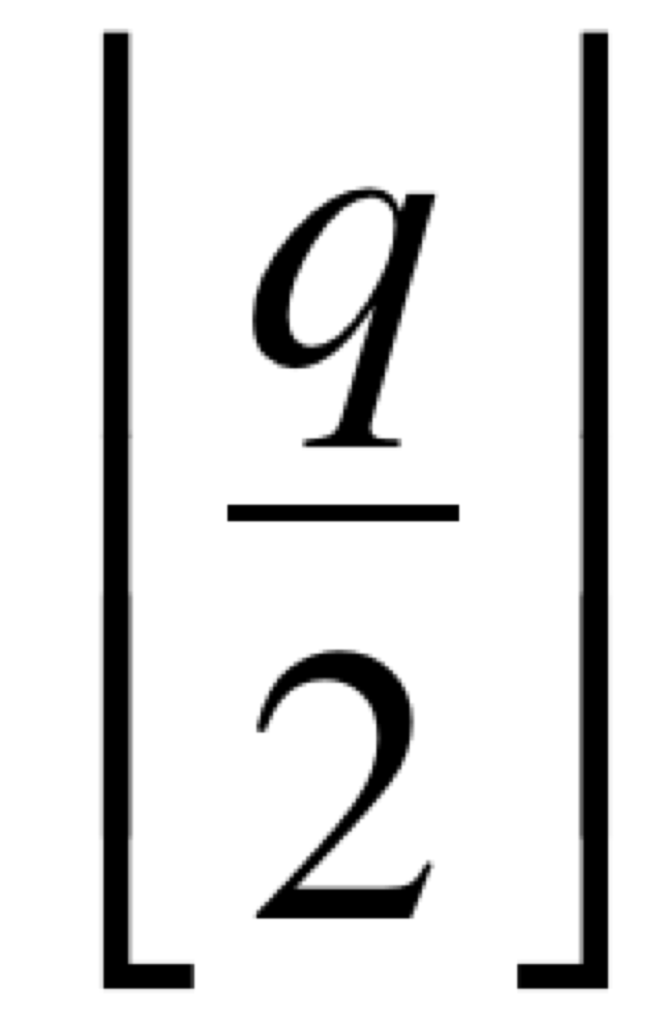
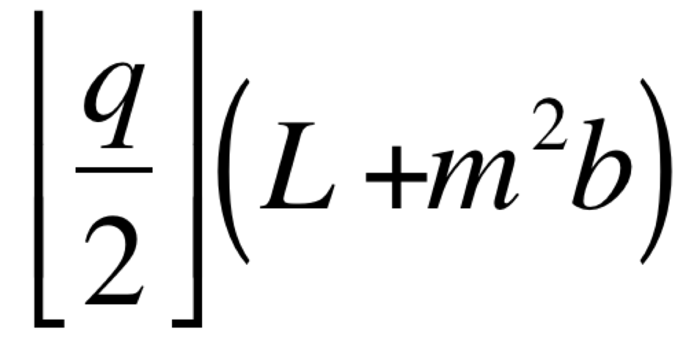
Pre/Post-skewing execution time
Horizontal shift
    Each row has to be shifted so as the diagonal of the matrix ends up on the first column of processes
On a uni-directional ring
    The last line has to be shifted (q-1) times
    All the rows can be shifted in parallel
    Total time: (q-1)(L + m²b)
On a bi-directional ring
    A row can be shifted on the right or on the left depending of the distance
    A row is shifted at most times
    All the rows can be shifted in parallel
    Total time:
With the 4-port model, preskewing of A and B can occur in parallel (horizontal and vertical shifts do not interfer)
Tpreskew = Tpostskew =

Slide 82
Execution time for each step
At each step, each process executes one matrix multiplication mxm
    Computation time: m³w
At each step, each process sends/receives a block of size mxm in its row of processes and in its column of processes
    All communications can occur simultaneously in the 4-port model
    Time: L+ m²b
Then, the total time for the q steps is given by
T_{total} = q max (L + m²b, m³w)

Slide 83
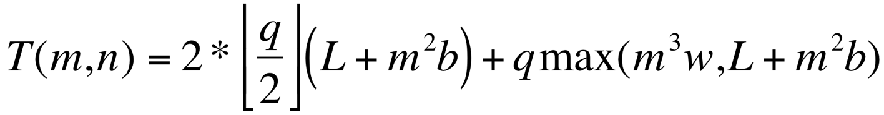
Performance model for the Cannon algorithm
This performance model can be easily adapted to other models
    If we suppose that we have mono-directional links, the becomes
    (q-1)
    If we suppose that we have a 1-port model, there is a factor 2 to add in front of communication terms
    If we suppose that there are no communication/computation overlap, then the maximum becomes a sum

Slide 84
Fox algorithm
This algorithm was originally developed to run on a hypercube topology
    But in fact it uses a grid, mapped on a hypercube
It does not require any pre / post-skewing
It is based on horizontal broadcast of the diagonals of matrix A and vertical shifts of matrix B
Sometimes also called the broadcast-multiply-roll algorithm

Slide 85
Steps of the Fox algorithm
C₀₀ | C₀₁ | C₀₂ | C₀₃
C₁₀ | C₁₁ | C₁₂ | C₁₃
C₂₀ | C₂₁ | C₂₂ | C₂₃
C₃₀ | C₃₁ | C₃₂ | C₃₃
A₀₀ | A₀₁ | A₀₂ | A₀₃
A₁₀ | A₁₁ | A₁₂ | A₁₃
A₂₀ | A₂₁ | A₂₂ | A₂₃
A₃₀ | A₃₁ | A₃₂ | A₃₃
B₀₀ | B₀₁ | B₀₂ | B₀₃
B₁₀ | B₁₁ | B₁₂ | B₁₃
B₂₀ | B₂₁ | B₂₂ | B₂₃
B₃₀ | B₃₁ | B₃₂ | B₃₃
Initial
state
C₀₀ | C₀₁ | C₀₂ | C₀₃
C₁₀ | C₁₁ | C₁₂ | C₁₃
C₂₀ | C₂₁ | C₂₂ | C₂₃
C₃₀ | C₃₁ | C₃₂ | C₃₃
A₀₀ | A₀₀ | A₀₀ | A₀₀
A₁₁ | A₁₁ | A₁₁ | A₁₁
A₂₂ | A₂₂ | A₂₂ | A₂₂
A₃₃ | A₃₃ | A₃₃ | A₃₃
B₀₀ | B₀₁ | B₀₂ | B₀₃
B₁₀ | B₁₁ | B₁₂ | B₁₃
B₂₀ | B₂₁ | B₂₂ | B₂₃
B₃₀ | B₃₁ | B₃₂ | B₃₃
Broadcast of the 1st diagonal of A (stored in a separate buffer)
C₀₀ | C₀₁ | C₀₂ | C₀₃
C₁₀ | C₁₁ | C₁₂ | C₁₃
C₂₀ | C₂₁ | C₂₂ | C₂₃
C₃₀ | C₃₁ | C₃₂ | C₃₃
A₀₀ | A₀₀ | A₀₀ | A₀₀
A₁₁ | A₁₁ | A₁₁ | A₁₁
A₂₂ | A₂₂ | A₂₂ | A₂₂
A₃₃ | A₃₃ | A₃₃ | A₃₃
B₀₀ | B₀₁ | B₀₂ | B₀₃
B₁₀ | B₁₁ | B₁₂ | B₁₃
B₂₀ | B₂₁ | B₂₂ | B₂₃
B₃₀ | B₃₁ | B₃₂ | B₃₃
Local
computations

Slide 86
Steps of the Fox algorithm, contd.
C₀₀ | C₀₁ | C₀₂ | C₀₃
C₁₀ | C₁₁ | C₁₂ | C₁₃
C₂₀ | C₂₁ | C₂₂ | C₂₃
C₃₀ | C₃₁ | C₃₂ | C₃₃
A₀₀ | A₀₁ | A₀₂ | A₀₃
A₁₀ | A₁₁ | A₁₂ | A₁₃
A₂₀ | A₂₁ | A₂₂ | A₂₃
A₃₀ | A₃₁ | A₃₂ | A₃₃
B₁₀ | B₁₁ | B₁₂ | B₁₃
B₂₀ | B₂₁ | B₂₂ | B₂₃
B₃₀ | B₃₁ | B₃₂ | B₃₃
B₀₀ | B₀₁ | B₀₂ | B₀₃
Shift of B
C₀₀ | C₀₁ | C₀₂ | C₀₃
C₁₀ | C₁₁ | C₁₂ | C₁₃
C₂₀ | C₂₁ | C₂₂ | C₂₃
C₃₀ | C₃₁ | C₃₂ | C₃₃
A₀₁ | A₀₁ | A₀₁ | A₀₁
A₁₂ | A₁₂ | A₁₂ | A₁₂
A₂₃ | A₂₃ | A₂₃ | A₂₃
A₃₀ | A₃₀ | A₃₀ | A₃₀
B₁₀ | B₁₁ | B₁₂ | B₁₃
B₂₀ | B₂₁ | B₂₂ | B₂₃
B₃₀ | B₃₁ | B₃₂ | B₃₃
B₀₀ | B₀₁ | B₀₂ | B₀₃
Broadcast of the 2nd diagonal of A (stored in a separate
buffer)
C₀₀ | C₀₁ | C₀₂ | C₀₃
C₁₀ | C₁₁ | C₁₂ | C₁₃
C₂₀ | C₂₁ | C₂₂ | C₂₃
C₃₀ | C₃₁ | C₃₂ | C₃₃
A₀₁ | A₀₁ | A₀₁ | A₀₁
A₁₂ | A₁₂ | A₁₂ | A₁₂
A₂₃ | A₂₃ | A₂₃ | A₂₃
A₃₀ | A₃₀ | A₃₀ | A₃₀
B₁₀ | B₁₁ | B₁₂ | B₁₃
B₂₀ | B₂₁ | B₂₂ | B₂₃
B₃₀ | B₃₁ | B₃₂ | B₃₃
B₀₀ | B₀₁ | B₀₂ | B₀₃
Local
computations

Slide 87
Fox algorithm
// No initial move
for k = 1 to q in parallel
Broadcast of the k^{th} diagonal of A
Local computation C = C + A*B
Vertical shift of B
// No final move
We need an additional array to store the diagonal blocks that are received on processes
This is the array used for multiplication A * B

Slide 88
Snyder algorithm (1992)
A bit more complicated that Fox et Cannon’s algorithms
Start by transposing matrix B
Uses reductions (sums) over rows of matrix C
And shifts for matrix B

Slide 89
Steps of the Snyder’s algorithm
C₀₀ | C₀₁ | C₀₂ | C₀₃
C₁₀ | C₁₁ | C₁₂ | C₁₃
C₂₀ | C₂₁ | C₂₂ | C₂₃
C₃₀ | C₃₁ | C₃₂ | C₃₃
A₀₀ | A₀₁ | A₀₂ | A₀₃
A₁₀ | A₁₁ | A₁₂ | A₁₃
A₂₀ | A₂₁ | A₂₂ | A₂₃
A₃₀ | A₃₁ | A₃₂ | A₃₃
B₀₀ | B₀₁ | B₀₂ | B₀₃
B₁₀ | B₁₁ | B₁₂ | B₁₃
B₂₀ | B₂₁ | B₂₂ | B₂₃
B₃₀ | B₃₁ | B₃₂ | B₃₃
Initial
state
C₀₀ | C₀₁ | C₀₂ | C₀₃
C₁₀ | C₁₁ | C₁₂ | C₁₃
C₂₀ | C₂₁ | C₂₂ | C₂₃
C₃₀ | C₃₁ | C₃₂ | C₃₃
A₀₀ | A₀₁ | A₀₂ | A₀₃
A₁₀ | A₁₁ | A₁₂ | A₁₃
A₂₀ | A₂₁ | A₂₂ | A₂₃
A₃₀ | A₃₁ | A₃₂ | A₃₃
B₀₀ | B₁₀ | B₂₀ | B₃₀
B₀₁ | B₁₁ | B₂₁ | B₃₁
B₀₂ | B₁₂ | B₂₂ | B₃₂
B₀₃ | B₁₃ | B₂₃ | B₃₃
Transpose
B
C₀₀ | C₀₁ | C₀₂ | C₀₃
C₁₀ | C₁₁ | C₁₂ | C₁₃
C₂₀ | C₂₁ | C₂₂ | C₂₃
C₃₀ | C₃₁ | C₃₂ | C₃₃
A₀₀ | A₀₁ | A₀₂ | A₀₃
A₁₀ | A₁₁ | A₁₂ | A₁₃
A₂₀ | A₂₁ | A₂₂ | A₂₃
A₃₀ | A₃₁ | A₃₂ | A₃₃
B₀₀ | B₁₀ | B₂₀ | B₃₀
B₀₁ | B₁₁ | B₂₁ | B₃₁
B₀₂ | B₁₂ | B₂₂ | B₃₂
B₀₃ | B₁₃ | B₂₃ | B₃₃
Local
computations

Slide 90
Steps of the Snyder’s algorithm, contd.
C₀₀ | C₀₁ | C₀₂ | C₀₃
C₁₀ | C₁₁ | C₁₂ | C₁₃
C₂₀ | C₂₁ | C₂₂ | C₂₃
C₃₀ | C₃₁ | C₃₂ | C₃₃
A₀₀ | A₀₁ | A₀₂ | A₀₃
A₁₀ | A₁₁ | A₁₂ | A₁₃
A₂₀ | A₂₁ | A₂₂ | A₂₃
A₃₀ | A₃₁ | A₃₂ | A₃₃
B₀₁ | B₁₁ | B₂₁ | B₃₁
B₀₂ | B₁₂ | B₂₂ | B₃₂
B₀₃ | B₁₃ | B₂₃ | B₃₂
B₀₀ | B₁₀ | B₂₀ | B₃₀
Shift of B
C₀₀ | C₀₁ | C₀₂ | C₀₃
C₁₀ | C₁₁ | C₁₂ | C₁₃
C₂₀ | C₂₁ | C₂₂ | C₂₃
C₃₀ | C₃₁ | C₃₂ | C₃₃
A₀₀ | A₀₁ | A₀₂ | A₀₃
A₁₀ | A₁₁ | A₁₂ | A₁₃
A₂₀ | A₂₁ | A₂₂ | A₂₃
A₃₀ | A₃₁ | A₃₂ | A₃₃
B₀₁ | B₁₁ | B₂₁ | B₃₁
B₀₂ | B₁₂ | B₂₂ | B₃₂
B₀₃ | B₁₃ | B₂₃ | B₃₂
B₀₀ | B₁₀ | B₂₀ | B₃₀
Global sum
over rows
of C
C₀₀ | C₀₁ | C₀₂ | C₀₃
C₁₀ | C₁₁ | C₁₂ | C₁₃
C₂₀ | C₂₁ | C₂₂ | C₂₃
C₃₀ | C₃₁ | C₃₂ | C₃₃
A₀₀ | A₀₁ | A₀₂ | A₀₃
A₁₀ | A₁₁ | A₁₂ | A₁₃
A₂₀ | A₂₁ | A₂₂ | A₂₃
A₃₀ | A₃₁ | A₃₂ | A₃₃
B₀₁ | B₁₁ | B₂₁ | B₃₁
B₀₂ | B₁₂ | B₂₂ | B₃₂
B₀₃ | B₁₃ | B₂₃ | B₃₂
B₀₀ | B₁₀ | B₂₀ | B₃₀
Local
computations

Slide 91
Steps of the Snyder’s algorithm, contd.
C₀₀ | C₀₁ | C₀₂ | C₀₃
C₁₀ | C₁₁ | C₁₂ | C₁₃
C₂₀ | C₂₁ | C₂₂ | C₂₃
C₃₀ | C₃₁ | C₃₂ | C₃₃
A₀₀ | A₀₁ | A₀₂ | A₀₃
A₁₀ | A₁₁ | A₁₂ | A₁₃
A₂₀ | A₂₁ | A₂₂ | A₂₃
A₃₀ | A₃₁ | A₃₂ | A₃₃
B₀₂ | B₁₂ | B₂₂ | B₃₂
B₀₃ | B₁₃ | B₂₃ | B₃₃
B₀₀ | B₁₀ | B₂₀ | B₃₀
B₀₁ | B₁₁ | B₂₁ | B₃₁
Shift of B
C₀₀ | C₀₁ | C₀₂ | C₀₃
C₁₀ | C₁₁ | C₁₂ | C₁₃
C₂₀ | C₂₁ | C₂₂ | C₂₃
C₃₀ | C₃₁ | C₃₂ | C₃₃
A₀₀ | A₀₁ | A₀₂ | A₀₃
A₁₀ | A₁₁ | A₁₂ | A₁₃
A₂₀ | A₂₁ | A₂₂ | A₂₃
A₃₀ | A₃₁ | A₃₂ | A₃₃
B₀₂ | B₁₂ | B₂₂ | B₃₂
B₀₃ | B₁₃ | B₂₃ | B₃₃
B₀₀ | B₁₀ | B₂₀ | B₃₀
B₀₁ | B₁₁ | B₂₁ | B₃₁
Global sum
over rows
of C
C₀₀ | C₀₁ | C₀₂ | C₀₃
C₁₀ | C₁₁ | C₁₂ | C₁₃
C₂₀ | C₂₁ | C₂₂ | C₂₃
C₃₀ | C₃₁ | C₃₂ | C₃₃
A₀₀ | A₀₁ | A₀₂ | A₀₃
A₁₀ | A₁₁ | A₁₂ | A₁₃
A₂₀ | A₂₁ | A₂₂ | A₂₃
A₃₀ | A₃₁ | A₃₂ | A₃₃
B₀₂ | B₁₂ | B₂₂ | B₃₂
B₀₃ | B₁₃ | B₂₃ | B₃₃
B₀₀ | B₁₀ | B₂₀ | B₃₀
B₀₁ | B₁₁ | B₂₁ | B₃₁
Local
computations

Slide 92
Snyder’s algorithm
var A,B,C: array[0..m-1][0..m-1] of real
var bufferC: array[0..m-1][0..m-1] of real
Transpose B
MatrixMultiplyAdd(bufferC, A, B, m)
Vertical shift of B
For k = 1 to q-1
Global sum of bufferC over rows of proc in C_{i,(i+k-1)%q}
MatrixMultiplyAdd(bufferC, A, B, m)
Vertical shift of B
Global sum of bufferC over rows of proc in C_{i,(i+k-1)%q}
Transpose B

Slide 93
Some storage strategies for dense matrices
0 | 1 | 2 | 3
0 | 1 | 2 | 3 | 0 | 1 | 2 | 3 | 0 | 1 | 2 | 3 | 0 | 1 | 2 | 3
1) 1D Block columns
2) Columns 1D cyclic
0 | 1 | 2 | 3 | 0 | 1 | 2 | 3
b
3) Block columns 1D cyclic
4) Row versions of previous storage strategies
0 | 1
2 | 3
0 | 1 | 0 | 1 | 0 | 1 | 0 | 1
2 | 3 | 2 | 3 | 2 | 3 | 2 | 3
0 | 1 | 0 | 1 | 0 | 1 | 0 | 1
2 | 3 | 2 | 3 | 2 | 3 | 2 | 3
0 | 1 | 0 | 1 | 0 | 1 | 0 | 1
2 | 3 | 2 | 3 | 2 | 3 | 2 | 3
0 | 1 | 0 | 1 | 0 | 1 | 0 | 1
2 | 3 | 2 | 3 | 2 | 3 | 2 | 3
Generalization of the other
ones
6) Block 2D rows and columns cyclic
5) Block 2D rows and columns

Slide 94
Which data storage?
We have seen
    Block distributions
    1D distributions
    2D distributions
    Cyclic distributions
What is the best choice?
2D block cyclic distribution is the Swiss army knife of the dense matrix distribution!

Slide 95
2-D block-cyclic distribution
Goal:
    Trying to get at the same time the advantages of 1D horizontal and vertical block-cyclic distributions
    Works whatever the progresses of the computations are
      Left-to-right, top-to-bottom, wave, …
Consider the number of processes p = r * c
    Arranged like a r * c matrix
Consider a 2D matrix of size NxN
Consider a block size b (that divides N)

Slide 96
2-D block-cyclic distribution
P0
P1
P2
P3
P4
P5
N
b
b

Slide 97
2-D block-cyclic distribution, contd.
P0
P1
P2
P0
P1
P2
P3
P4
P5
P3
P4
P5
N
b
b

Slide 98
2-D block-cyclic distribution, contd.
P0
P1
P2
P3
P4
P5
P0
P1
P2
P0
P1
P2
P0
P1
Slight disequilibrium
    Can be neglected with a large number of blocks
Indexed computations have to be implemented in other functions
+ functions that give the neighbors from a given position in the grid
P3
P4
P5
P3
P4
P5
P3
P4
P0
P1
P2
P0
P1
P2
P0
P1
N
P3
P4
P5
P3
P4
P5
P3
P4
P0
P1
P2
P0
P1
P2
P0
P1
P3
P4
P5
P3
P4
P5
P3
P4
P0
P1
P2
P0
P1
P2
P0
P1
b
b
Notes:
Fin 02/04/13

Slide 99
Notes:
Fini en avance (14’) (rajouter dernière partie Henri)

