Slide 1
Trace Capture and Persistence
LLM → trace, MCP → trace, up to the store — Technical Design v1.0 Florian Dittgen · Trelleborg IT Services

Slide 2
Scope of this design
In scope | Out of scope
MCP → trace: every tool call produces one structural record, automatically | reading traces back — by the model or by any tool
LLM → trace: the model records an investigation in three phases through one write-only tool | classification of mappings (known / candidate / unknown)
Correlation written at trace time — an investigation_id stamped on every record | DQ-rule derivation, semantic-layer writes, dashboards, exports
Privacy enforcement at one choke point before anything leaves the process | anything the analysis project does with the persisted records
Transport and persistence: non-blocking writer → sinks → ingest → Cosmos DB

Slide 3
The two streams
 | Stream 1 — mcp | Stream 2 — claude
Trigger | every tool call, after the handler resolves | the model calls trace_investigation
Producer | withTrace() on the registration path | the tool handler
Content | tool, allow-listed args, result kind, entities, structural observations | phase, goal, per-entity role, expectations, conclusion
Visible to the model | no — no tool, no read path | one write-only tool
Correlation | investigation_id from the parameter or the process default | investigation_id minted by open, required on annotate / close

Slide 4
What one investigation writes
trace_investigation { open, purpose, title, asked_by_role } → claude record; returns investigation_id (locally: becomes the process default).
d365_lookup_table { table_name, investigation_id } → the tool runs unchanged; one mcp record, stamped.
… further lookups → one stamped mcp record each.
trace_investigation { annotate, id, entities[role], expectations[] } → claude record.
trace_investigation { close, id, conclusion, outcome } → claude record; default cleared.
Every record: sanitize() → TraceWriter → sink → ingest → Cosmos. Nothing reads anything back.

Slide 5
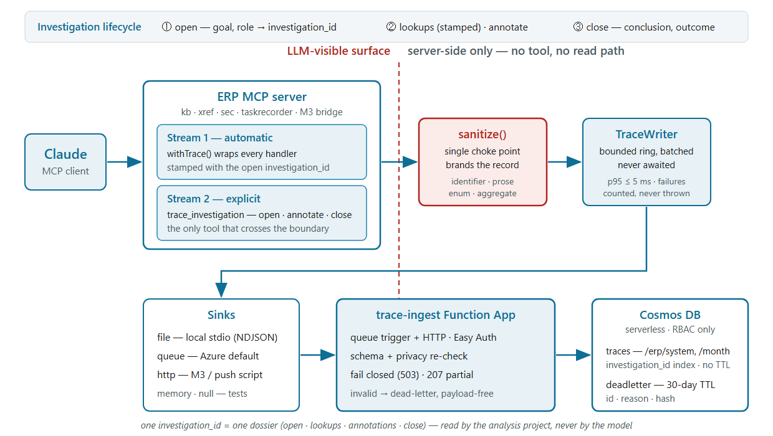
Architecture

Slide 6
Correlation — written, not reconstructed
Carrier | Where | Strength
investigation_id parameter, injected centrally into every data tool’s schema, stripped before the handler runs | all servers | strong, explicit
Process default set by open, cleared by close, 8 h TTL | stdio — one Claude Code session = one process | strong, implicit
session_key — hour bucket by default, not person-derived | records with no investigation id | weak — fallback only
Why | Azure servers are stateless per request | the records carry the link, not a session

Slide 7
The record — one envelope, two bodies
Envelope (both): id · contract version · stream · timestamp · ERP system / version / build / installation · MCP service / version / snapshot date · investigation_id · session key · sequence.
mcp body: tool + allow-listed args · result kind · entities (kind, name, owner, type, origin, model) · observations (type, mandatory, relation, index, enum values, null ratio, row-count bucket).
claude body by phase: open — purpose, goal, asked-by role · annotate — entities with source | target | related | excluded, expectations · close — conclusion, outcome, expectations.
No confidence, status or verdict field exists in either stream.
Identifier grammar starts with a letter — no RecId or account number can pass as one.

Slide 8
Privacy — one choke point
sanitize() is the only producer of a branded record; the writer refuses anything unbranded; the ingest re-checks.
Field policies from the schema: identifier (Stream 1 drops, Stream 2 rejects) · prose (denylist + cap; any hit rejects the call) · enum · aggregate.
Denylist: e-mail, IBAN, VAT, phone plus digit runs ≥ 7, URLs with queries, keys named sample | value | data | record | row.
Default-deny on tool arguments. Raw SQL, Task Recorder and user-scoped security tools record structure only.
Rejections name the field, never quote the text. Dead-letter stores id, reason, hash — never the payload.

Slide 9
Transport — never on the hot path
enqueue() synchronous, O(1), bounded ring of 500, drop-oldest, one warning per minute.
Flush scheduled and batched (≤ 100 records); sink timeout 3 s; one retry on network / 5xx / 429; none on 4xx.
Never awaited on the response path — the tool result object is returned unchanged; p95 ≤ 5 ms added per call.
Sinks: file (stdio, NDJSON) · queue (Azure default, Storage Queue, managed identity) · http (M3 bridge, push script) · memory / null (tests).
MCP_TRACE=off → no wrapper, no tool, no parameter — tools/list byte-identical. Loss on scale-in is counted, not hidden.

Slide 10
Persistence — ingest and Cosmos DB
Ingest Function App: queue trigger + HTTP, Easy Auth with an application allow-list, fail-closed 503, 413 before parsing, 207 on mixed batches; schema and privacy re-checked.
Cosmos DB serverless, RBAC only — no keys anywhere (asserted in Bicep tests).
traces: hierarchical partition key /erp/system + /month; no TTL; indexed on investigation_id, entity names and kinds, tools, phase.
Free text (conclusion, observations, args, note) excluded from the index.
deadletter: 30-day TTL, payload-free.
≈ 2–10k records/day ≈ well under €1/day; €10/month cost alert.

Slide 11
Integration in this repo
One seam: withRegistrationPolicy in tool-sets.js — inject the investigation_id parameter, then wrap with withTrace. Zero per-tool edits; a static scan forbids the parameter in tool files.
trace_investigation is the last set of every server and joins CORE_TOOLS; effectiveProfile ignores it when deciding “zero tools”.
New: trace-extractors.js (per-tool structural extraction, default-deny args) and trace-identity.js (ERP version/build from model_versions).
Entry points: MCP_TRACE=on; stdio → file sink; Azure → queue sink.
src/trace/ imports nothing from src/azure/; the ingest app takes a hash-checked copy of the contract.

Slide 12
Work items — 14, each with OK and KO tests
# | Item | # | Item
01 | Contract, schema v1, Zod mirror, isolation scan | 08 | trace_investigation — three phases
02 | Privacy sanitizer | 09 | D365FO identity adapter
03 | Ids, session key, investigation registry | 10 | Registration policy, profile, budget, scans
04 | TraceWriter + memory/file/null sinks | 11 | Ingest service — core, HTTP, queue
05 | Queue and HTTP sinks | 12 | Bicep — Cosmos, Function App, roles (not executed)
06 | D365FO extractors | 13 | Local push tooling, docs, plugin refs
07 | withTrace + central parameter injection | 14 | Conformance kit for the next emitter

Slide 13
Open decisions for the checkpoint
Session-key mode: keep hour — the investigation id carries correlation; principal-hash stays a governance opt-in.
Loss on scale-in: accept best-effort (counted) vs. 20–50 ms to await the queue send.
tools/list growth: +1 tool and the injected parameter ≈ +4 %; if any server exceeds +5 %, inject on CORE_TOOLS only.
Parameter discipline on Azure: the strong link needs the model to pass the id; locally the process default removes the need.
Digit-run ≥ 7 also redacts long legitimate identifiers inside prose.
Bicep last, reviewed, run by the operator — az stays human-gated.

