Slide 1
Cross-ERP Trace Module
Objectives, concept and architecture — Technical Design v1.1 Florian Dittgen · Trelleborg IT Services

Slide 2
Why this module exists
Every legacy-ERP → D365FO migration has two steps: understand the mapping, then execute it (DMF / Connectivity Studio).
Step 2 has tools. Step 1 is manual: someone investigates a table, forms a belief, and the belief lives in their head or a one-off spreadsheet — redone for every question, every site, every consultant.
Meanwhile the same people need dashboards and reports from that legacy ERP today.
The trace module makes both the same activity: every investigation Claude runs for a key user leaves a dossier — what was asked, what was looked at, what was concluded, what correct looks like.

Slide 3
The four objectives (Ziele) — one mechanism serves all four
 | Objective | Produced | Consumer
O1 | Migration knowledge | source table/field → functional entity → D365FO technical entity, as evidence | analysis project → DMF / Connectivity Studio mapping
O2 | Data-quality reports, generated | expectations: type, range, format, relation, mandatory, uniqueness, anti-pattern | DQ rules → generated SQL → nightly run → dashboard
O3 | Better tools for key users now | dashboards, reports, small apps — each investigation starts from the last | key users of the legacy ERP
O4 | Consultants understand the legacy ERP | accumulated dossiers incl. what was excluded | D365FO functional & technical consultants
Mechanism | two trace streams bracketed by an investigation lifecycle | open → stamped lookups + annotate → close | all four

Slide 4
How O1 is achieved — migration knowledge
Stream 1 records what every MCP response contained: entities, fields, types, origins — stamped with the investigation id.
annotate records Claude’s judgement for this goal: each returned entity is source | target | related | excluded, tied to an ERP-neutral vocabulary id (sales_order, inventory_balance…).
The same vocabulary id is already mapped to D365FO AOT entities in the semantic layer → the chain source → concept → target closes by construction.
The analysis project (separate) classifies each source object as known / candidate / unknown across the corpus. The trace never carries that verdict.

Slide 5
How O2 is achieved — DQ reports, not hand-written
Step | Owner | State
1. Expectation captured in an annotate / close trace | this module | new
2. Analysis drafts declarative DQ rules from expectations | analysis project | separate
3. Rule stored in sem_dq_rules | semantic layer (W7) | exists
4. gen-dq-sql renders SQL (T-SQL / SQLite dialects) | semantic layer | exists
5. Script runs where the data lives, no AI in the loop — the MCP knows the rule, the script finds the rows | scheduled job | pattern exists
6. Aggregates return; deterministic dashboard shows them | semantic layer | exists

Slide 6
The win-win for functional key users
The key user gives | The key user gets | The organisation gets
The goal of each investigation, one sentence | A report built against the right tables, faster | Which business questions touch which legacy tables
source / related / excluded per returned table | Fewer wrong turns next time — excluded stays excluded | The functional mapping of the legacy ERP, from the people who know it
What correct looks like for the fields they rely on | DQ findings on their own KPIs, fixed before a report breaks | Target-readiness rules for the migration, from real usage
A conclusion | Reusable — the next consultant reads it instead of asking | Institutional memory that survives staff changes
Never given | a business record, a person’s identity, free text about a party — the choke point rejects it | —

Slide 7
Worked example — the rétention pilot
open — dashboard: “Projected pallet stock per retention zone vs. capacity”, role key_user.
Claude looks up MITBAL, MITLOC, MPLINE, MITMAS — each response traced automatically with the investigation id: fields, types, null ratio of the pallet-factor field.
annotate — MITBAL is source for inventory_balance; pallet factor mandatory, anti-pattern “0 means unknown”; the site’s rétention flag is a customization field → source for storage_zone.
close — projection = on-hand + open PO − planned consumption, in pallets; answered.
Later, outside this module: the anti-pattern becomes a DQ rule → SQL → nightly run → “items on rétention without a valid pallet factor” on the dashboard — the DQ sensor, and master data D365 WHM needs later.

Slide 8
The investigation lifecycle — one tool, three phases
Phase | Claude supplies | What it produces
open | purpose, goal, asked-by role, expected functional entities | investigation_id — stamped on every lookup that follows
(lookups) | normal MCP calls | Stream 1 records, automatically linked
annotate | role per returned entity, note, expectations | Claude’s link between MCP facts and the goal
close | conclusion, outcome (answered / partial / abandoned), expectations | the dossier is complete
Principle | trace_investigation is the only tool that crosses the boundary | correlation is written at trace time, not reconstructed

Slide 9
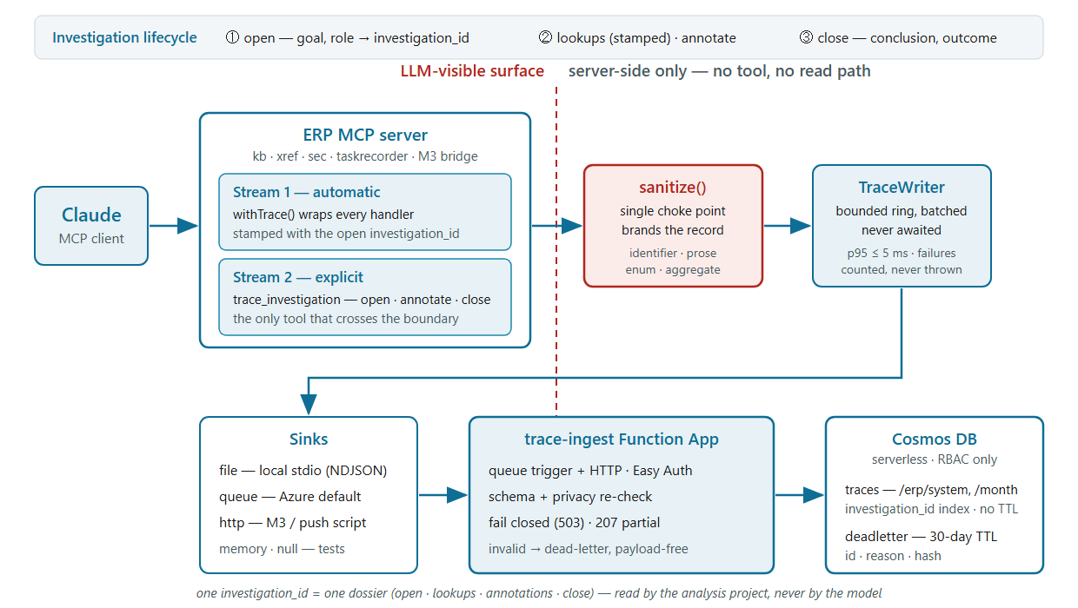
Architecture

Slide 10
Two streams, one envelope
 | Stream 1 — mcp | Stream 2 — claude
Written by | every tool call, automatically | Claude, three phases per investigation
Content | entities, fields, types, origins, aggregate DQ facts | goal, judgements, conclusion, expectations
Model sees it? | never — no tool, no read path | one write-only tool
Shared envelope | ERP system / version / build · MCP service / version / snapshot · investigation_id | identical, by contract

Slide 11
Principles 1–3
Evidence, not conclusions. The semantic layer (W7) already holds curated mappings with confidence and DQ rules; the trace is the raw evidence feeding it. Shared: vocabulary ids and the privacy denylist — nothing else.
Classification is post-hoc. No confidence, status or verdict in a trace. role is Claude’s assertion for this goal, not a corpus-level class.
One write-only LLM boundary. Exactly one tool crosses; no read, query, list or delete on traces — enforced by static scan, not convention.

Slide 12
Principles 4–7
Privacy is a choke point. sanitize() brands every record; the writer refuses anything unbranded. Denylist: e-mail, IBAN, VAT, phone, digit runs ≥ 7, URLs with queries, keys named sample | value | data | record | row. Default-deny on tool arguments; raw SQL, Task Recorder and user-scoped security tools record structure only.
Never on the hot path. Synchronous O(1) enqueue, scheduled batched flush, never awaited; p95 ≤ 5 ms; failures counted, never thrown; MCP_TRACE=off is byte-identical.
Loose coupling is the contract. A JSON Schema, not a library — a Python M3 bridge participates with the schema and an endpoint; a conformance kit lets it self-test.
D365FO AOT is the reference model. Other ERPs are mapped toward it, never assumed to resemble it.

Slide 13
Where it lands
Cosmos DB, serverless, single region, RBAC only — no keys anywhere.
traces: hierarchical partition key /erp/system + /month; indexed on investigation_id, entity names, tools; no TTL — institutional memory is the point.
deadletter: 30-day TTL, payload-free (id, reason, hash).
Free text explicitly excluded from the index.
Ingest is a second Function App: queue trigger + HTTP, same Bicep / Deploy / Easy Auth pattern, fail-closed 503.
≈ 2–10k records/day, well under €1/day; €10/month cost alert.

Slide 14
What the code review corrected
Finding | Consequence
The semantic layer already does functional↔technical mapping | Trace module repositioned as evidence, not a second store
Azure servers are stateless per request — no session id | Correlation is written: open first, stamp every lookup
v1.0 logged once at the end, recalling calls | Replaced by the three-phase lifecycle
A write-annotation constant already exists | Reuse the pattern; widen the static scan deliberately
Deploy is a root-zip of the repo | No npm workspaces; contract copied with a hash check

Slide 15
How it will be built
15 work items, each with OK and KO tests — the KO half proves the privacy, boundary and non-blocking promises.
The investigation_id parameter is injected centrally on the registration path and stripped before any handler runs — zero per-tool edits, a scan forbids it in tool files.
Order: contract → sanitizer → ids/registry → writer → extractors → wrapper → tool → identity → policy/budget → sinks → ingest → tooling → docs → conformance → Bicep last.
One commit per work item; npm test + npm run typecheck green at each. az provisioning stays human-gated.

Slide 16
Open decisions for the checkpoint
Session-key mode: keep hour (not person-derived) — the investigation id now carries correlation, so the pressure for principal-hash is gone.
Loss semantics: best-effort on scale-in vs. 20–50 ms to await the queue send.
Budget: +1 tool and the injected parameter ≈ +4 % on tools/list; if a server exceeds +5 %, inject on CORE_TOOLS only.
Parameter discipline on Azure: the strong link needs Claude to pass the id; locally the process default removes the need.
Placement: in-repo folders now; own repo when the M3 bridge lands.

