Slide 1

APIs
Project 1 (Team 4)

Slide 2
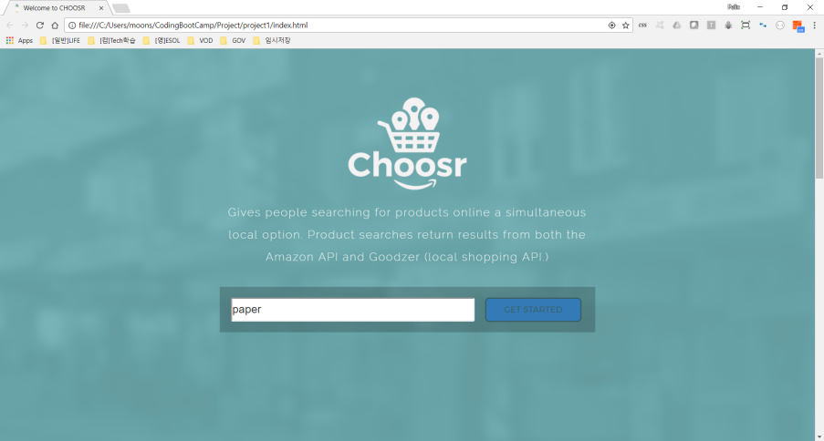
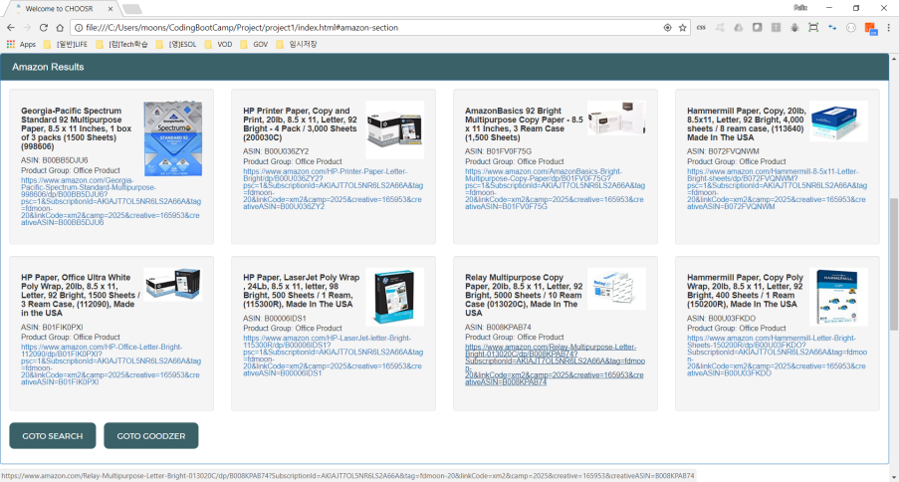
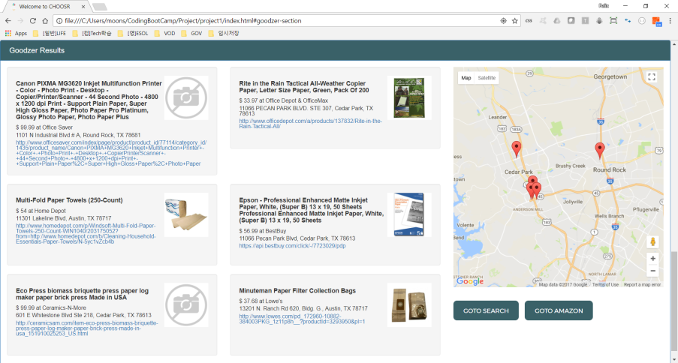
APIs used in this project
Amazon’s Product Advertising API
Geolocation API
Goodzer API
Google Map API

Slide 3
amazon.js (Amazon’s Product Advertising API)
When to type keyword and click “Submit” button,
Send ajax query to search items [Operation=ItemSearch]
Save received items to Firebase ("/AmazonSearchItems")
{
asin: asin, // ASIN code
title: title, // Item name
group: productGrp, // Item Category
url: pageUrl // Item URL
}
Read items from Firebase ("/AmazonSearchItems")
and display at $("#display-amazon")
and send ajax query to get image for each item [Operation=ItemLookup]
Save received image to Firebase ("/AmazonSearchItemImages")
{
asin: asin, // ASIN code
url: imageUrl // Image URL
}
Read items from Firebase ("/AmazonSearchItemImages")
and display at $("#“ + ASIN code)

Slide 4
goodzer.js (Geolocation API, Goodzer API and Google Map API)
Get current location and initialize Google map
When to type keyword and click “Submit” button,
Send ajax query to search items based on current location
Save received items to Firebase ("/GoodzerSearchItems")
{
id: resp.stores[i].products[0].id, // Product ID
product: resp.stores[i].products[0], // Product details
store: resp.stores[i].name, // Store name
website: resp.stores[i].website, // Store website
location: resp.stores[i].locations[0] // Store location
}
Read items from Firebase ("/GoodzerSearchItems")
and display at $("#display-goodzer")
and make markers in Google map

