Slide 1
Backtracking – Maximal Clique
Backtrack_Clique(X, l)
{ if (l == 0)
C_{l} = V;
else
C_{l} = C_{l-1} ∩ Ax_{l-1} ∩ Bx_{l-1};
for each x in C_{l} {
x_{l} = x;
N_{l+1} = Ax_{l} ∩ N_{l};
if(N_{l+1} != {})
Backtrack_Clique(X, l+1);
else
print(x₀, …, x_{l});
}
}
COSC 4P03 Week 6

Slide 2
Maximal Clique Example
v | A_{v} | B_{v}
0 | 1,3,6 | 1,…,6
1 | 0,2,4,5 | 2,…,6
2 | 1,3,4,5, | 3,…,6
3 | 0,2,6 | 4,5,6
4 | 1,2 | 5,6
5 | 1,2 | 6
6 | 0,3 | -
0
6
1
5
4
2
3
COSC 4P03 Week 6

Slide 3
Generic Backtrack Search
backtrack(X, c, n)
{
compute candidates for level c;
for each candidate x
{
if(x₁, …, x_{c-1}, x) is acceptable // point 1
{
x_{c} = x;
if(c < n)
backtrack(X, c+1, n); // point 2
else
process solution; // point 3
}
}
}
COSC 4P03 Week 6

Slide 4
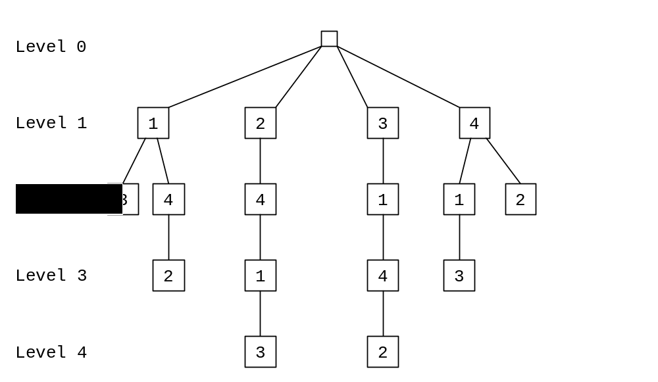
4-Queens Search Tree
COSC 4P03 Week 6

Slide 5
Backtrack Estimation
Backtrack_estimate({x₁,…,x_{c-1}}, c, n)
{
compute candidates for level c;
for each candidate x {
if(x₁, …, x_{c-1}, x) is acceptable {
record(x);
d[c]++;
}
}
estimate[c] = scale * d[c];
scale = scale * d[c];
x_{c} = random acceptable candidate;
if(c < n)
backtrack_estimate({x₁,…,x_{c}}, c+1, n);
else
process solution;
}
COSC 4P03 Week 6

