Slide 1
Self driving in DuckieTown environment
Önvezető autózás DuckieTown környezetben
Ódor Dávid
Weyde Szabolcs Frey Dominik
(DSD team)

Slide 2

Introduction
Increasing demand for autonomous driving
An extremely expensive process in a real-world environment
Using simulator to decrease costs and risks of development
Using DuckieTown Environment, a platform designed for education and research purposes
Notes:
The development and research of vehicles supporting full or partial self-driving now cover a very significant part of both industrial and academic projects. This task mainly involves the design, training and testing of algorithms and models based on machine learning. Training and testing such models is an extremely expensive process in a real-world environment. This is because huge annotated datasets are required for training, and testing is not safe in real traffic situations. As a result, the idea arises to train rudimentary models on generated data sets and test them in simulation environment. DuckieTown is a platform for educational and research purposes, where we can test and compete our models in an environment developed for this purpose, on maps that can be configured as desired.

Slide 3

Our Approach
An imitation learning and behavior cloning based approach
Generate a reasonable amount of data
Observe the angular and linear velocity values for each frame
Learn the angular and linear combinations
Convert into PWN values
CNN-LSTM approach
Notes:
Our idea is to generate a reasonable amount of data while driving the duckiebot in the duckie simulator. The data consists of observations as snapshots of the scene, angular and linear speed values. Our models learn the angular and linear combinations for a given observation and that later in the process can be converted into PWM values. We were experimenting on two model architectures. One that is a pure volatile convolutional network and another with convolution combined with LSTM We will see that the LSTM network performs better as it relies also on previous observations.

Slide 4
Data generation
Generating data using DuckieTown Simulator
Generating our own map
Using xbox ONE controller to drive the vehicle while capturing data: snapshot images of the observed environment, corresponding angular and linear velocity (1.1 GB)
Visualizing the data
Splitting the dataset into train, test and validation datasets
Notes:
To collect a proper amount of data for training our model we are using the Duckie Town Simulator available at Gym Duckie Town.
We are generating data while driving the vehicle in the simulator, capturing images assigned with the appropriate action (linear and angular velocity). We used a map generator available at the map-utils repository to generate our own map.
We used an xbox ONE controller for driving the car in the simulator.
For visualizing our data we used a tool so we can see the recorded frames and the corresponding angular and linear velocity.
We split the generated dataset using sklearn.model selection modules train test split() method. The validation split percent is 0.2-0.8 while for testing, we generated a completely new dateset on a different map to also check the robustness of the system.

Slide 5
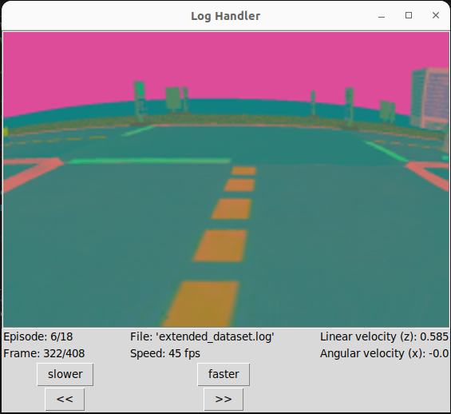
Data generation
Visualizing the data with a customized tool
Domain randomization is visible
Notes:
We used domain randomization during the data generation phrase.

Slide 6
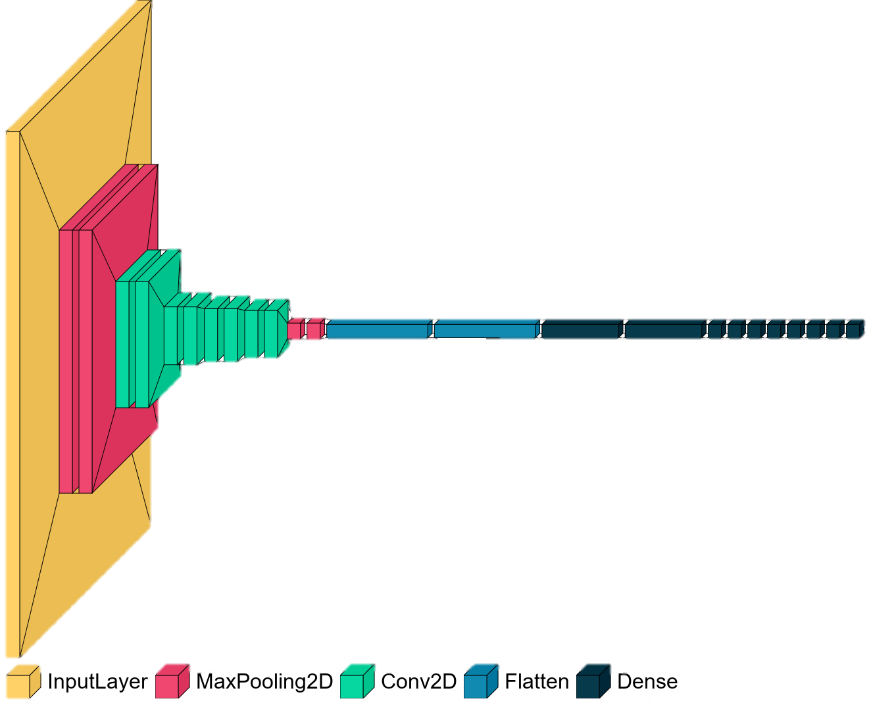
Model Architecture
CNN
Using 2D convolution
Sepaarated the linear and the angular value
Learn the angular and linear combinations

Slide 7
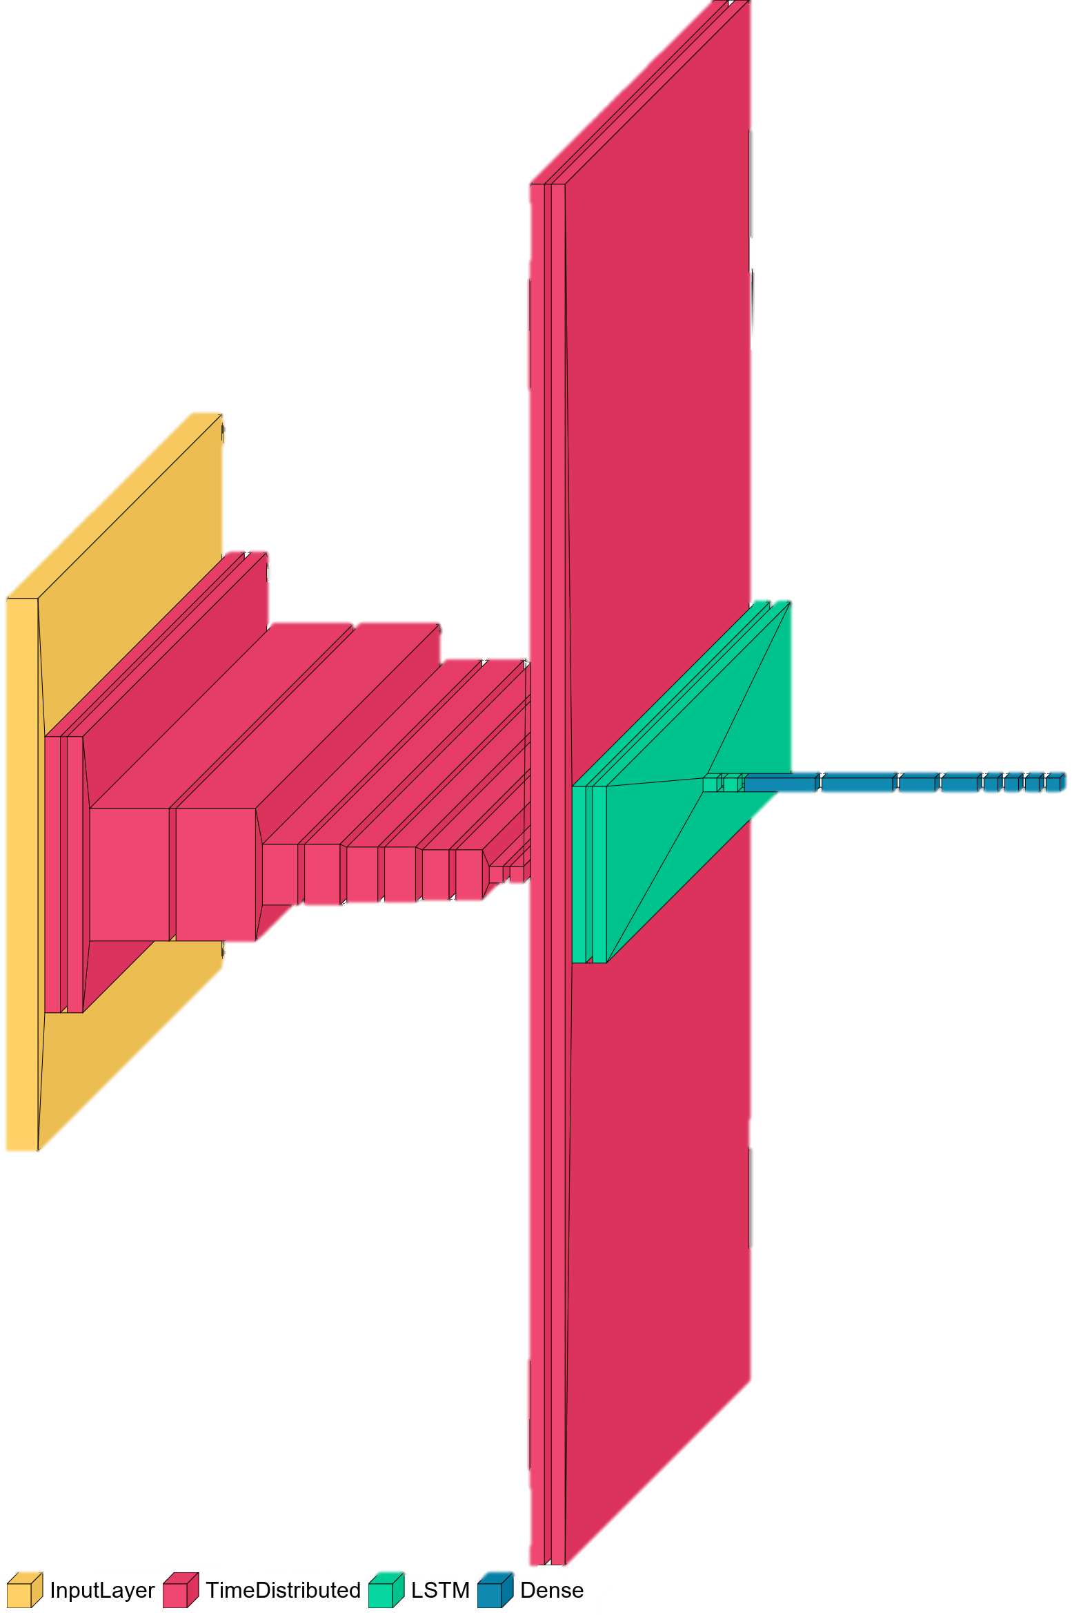
Model Architecture
Hybrid
Using Convolution and LSTM
Separated the linear and the angular value
Learn the angular and linear combinations
Improved results on the test dataset
Visualized by visualkeras

Slide 8
Hyper-parameter optimalization
Using automation to optimize hyperparameters
Keras Tuner
Define the search space (unique hyper-parameter names, how many units in each layer, which activation functions to use)
Start the search (Random Search, hypermodel, max trials)
Print the results
Notes:
The program we used is Keras Tuner.
We defined the search space in the model. Each of the hyper-parameters are uniquely identified by their names. The hyper-parameters we tried to optimize are units and activation functions (relu, tanh) in each layer.
Then we started the search. We used the Random Search tuning algorithm with parameters for example hypermodel which is the model with hyper-paramters, and max trials which are the total number of trials to run during the search.
After that, we printed the results of the search.

Slide 9
Evaluation
Evaluation on a disjoint test dataset
Model | Loss | Linear loss | Anglar loss
Convolutional | 7.6462 | 0.1085 | 0.7429
LSTM | 4.5859 | 0.0776 | 0.4431

Slide 10
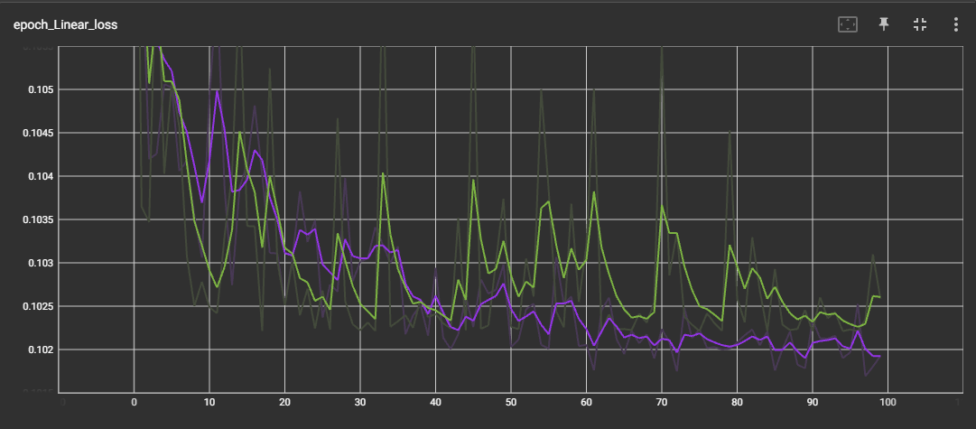
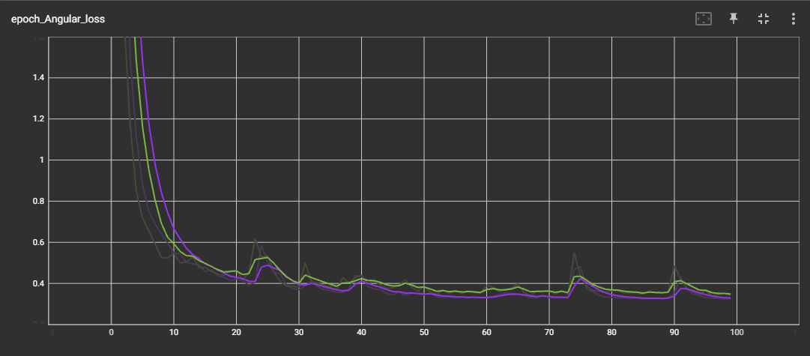
Evaluation
Training evaluation with Tensorboard for the LSTM approach
Notes:
Only the LSTM model

Slide 11
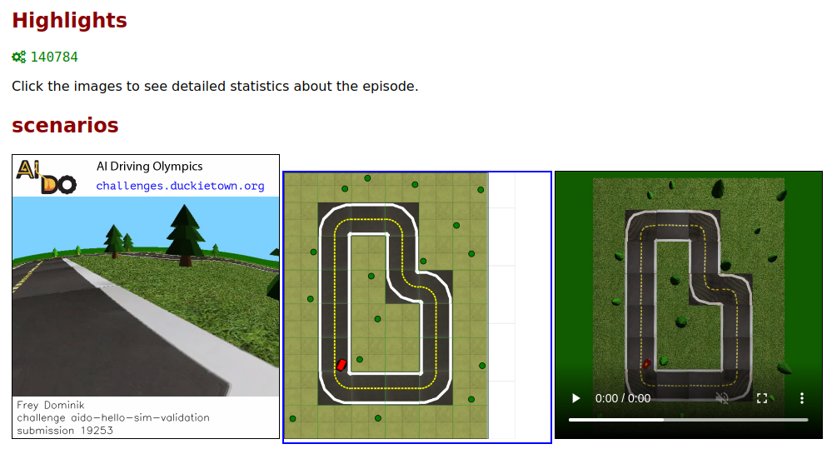
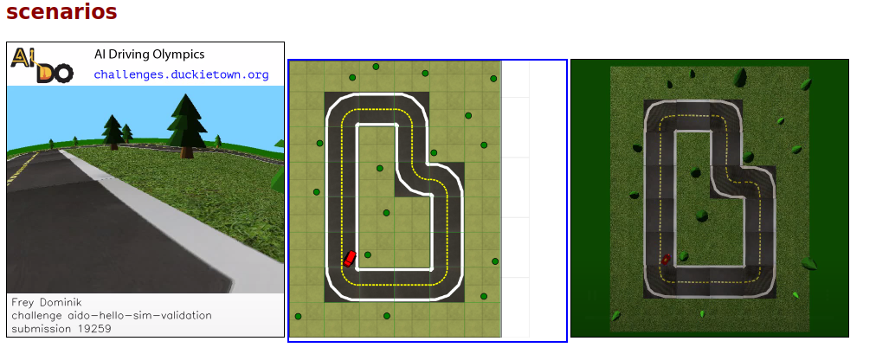
Evaluation
Testing the two models in simulation with DuckieTown Challenges
Notes:
The result are not satisfactory

Slide 12
Conclusion and future work
We gathered relatively large datasets by driving the ego car in simulation
We designed two models:
Convolutional and dense layers combined with MaxPooling
Additional LSTM layers
After evaluating, the result weren’t satisfactory
In the future we want to try out reinforcement learning algorithms hoping to see better results
Notes:
Throughout our work we gathered relatively large training, validation and test datasets by driving the ego car in simulation and applying pure pursuit . Then we designed two models, one that contains only convolutional and dense layers combined with MaxPooling and one that has additional LSTM layers. We trained the models, applied hyper parameter optimization and evaluated the results both on the validation and the test datasets. Lastly we updated our solutions to https://challenges. duckietown.org to get feedback. We expected better result, but it is an open task in the future to improve the model and the dataset. We also want to try out reinforcement learning algorithms to see the difference.

