Slide 1

Treatment Evaluation Statistical Tools for Research Experiments (TEST)
Asdhgfajshgdaslkd haslkhjalkdshfjalkhfjadslkfhjdalkfshjkfdshj
sagdasgashhh

Slide 2
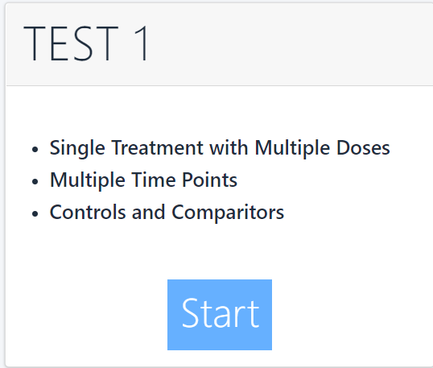
Treatment Evaluation Statistical Tools for Research Experiments (TEST)

