Slide 1
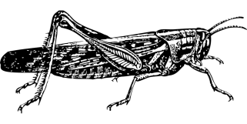
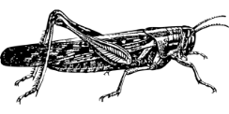
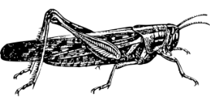
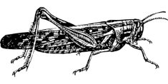
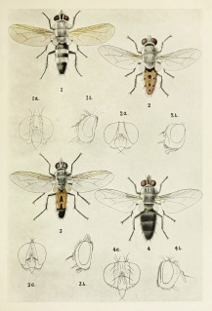
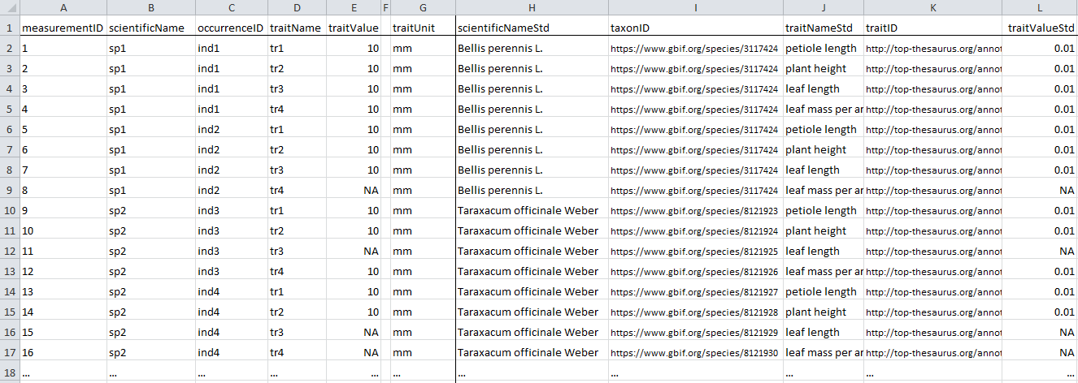
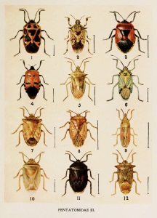
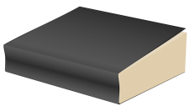
a) Measured quantitative data:
b) Aggregate quantitative data:
Entity: an individual x of taxon z
Entity: taxon x
Quality: average adult femur length
is 12.2 ± 2.3 mm
Quality: femur length equals 14.1 mm
d) Quantitative literature data:
c) Qualitative literature or database data:
Entity: genus x
Entity: males of taxon x
Quality: herbivore
Quality: min. body length of 8 mm

Slide 2
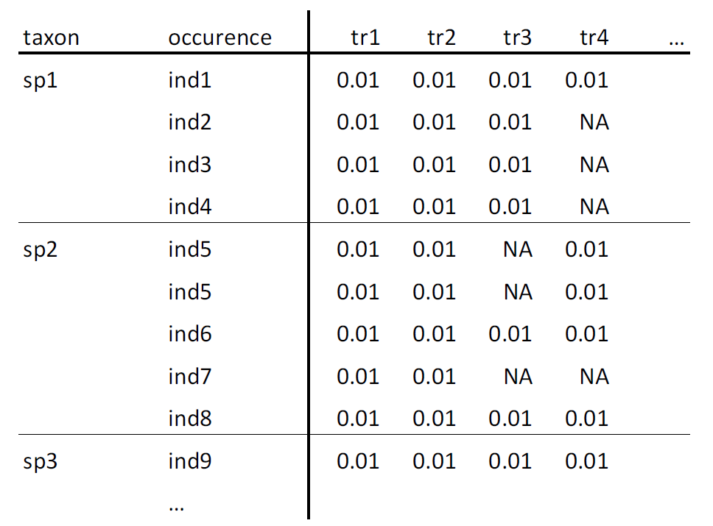
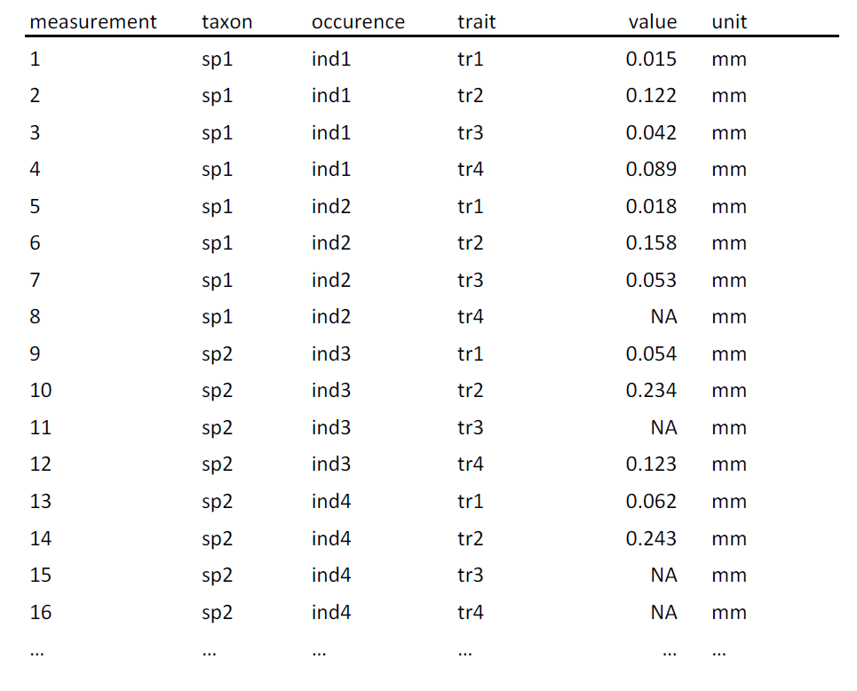
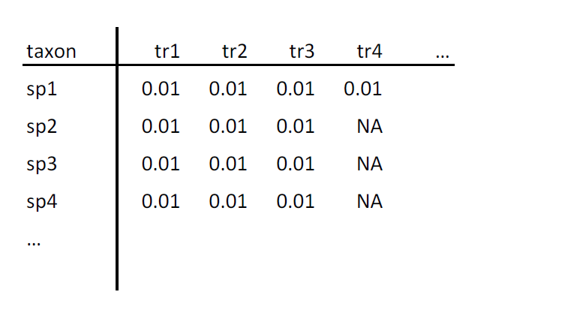
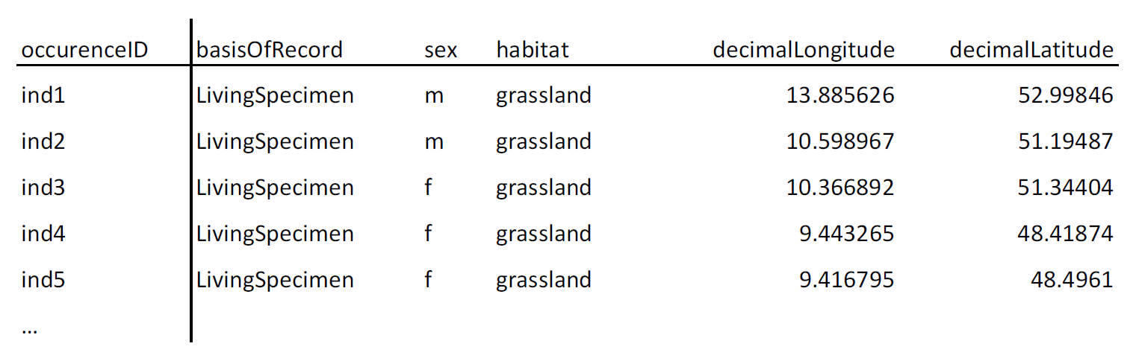
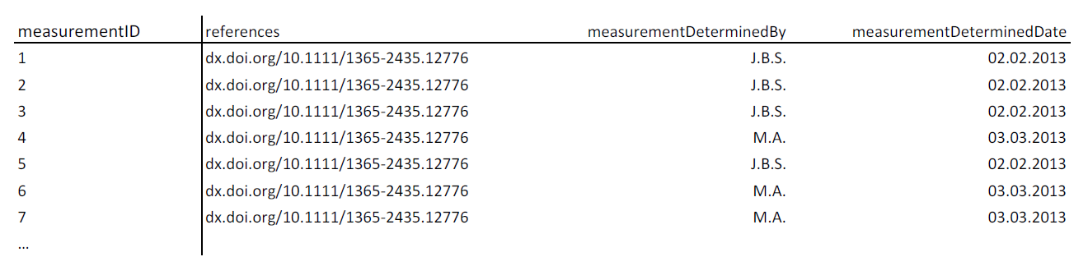
a) species x trait matrix
b) occurrence wide-table
c) measurement long-table
taxon identifier
occurrence identifier
measurement identifier
occurrence identifier
trait identifier
taxon identifier
trait identifier
taxon identifier
trait identifier
values
values
values
d) occurrence level information
e) measurement-level information
occurrence identifier
measurement identifier

Slide 3
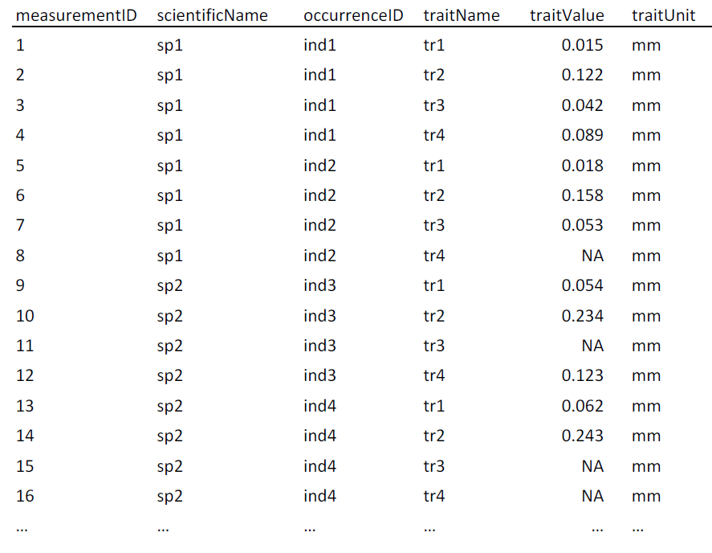
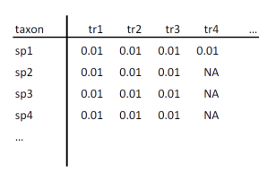

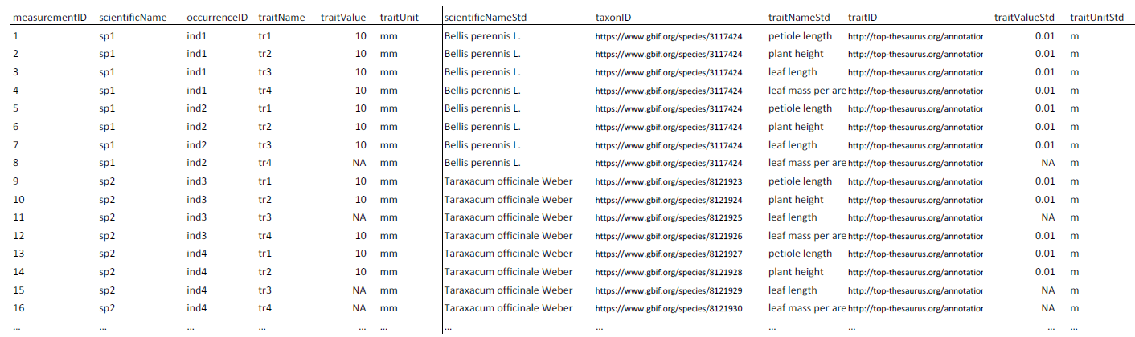
user raw data
(matrix or table)
standard columns measurement table
as.traitdata()
standardize.traits()
features:
harmonize trait names
unit conversion
map traitID
features:
map column names
add measurementID and occurenceID
add units
or
standardize.taxonomy()
features:
resolve user names to accepted names
fuzzy matching (spell checking)
resolve synonyms
map taxonID
standardize()
compliant trait-dataset with mapped taxon names and traits

