Slide 1
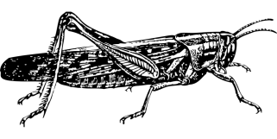
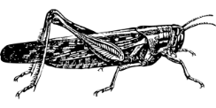
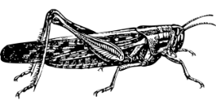
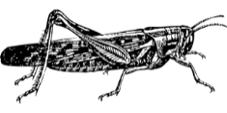
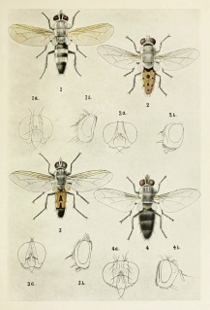
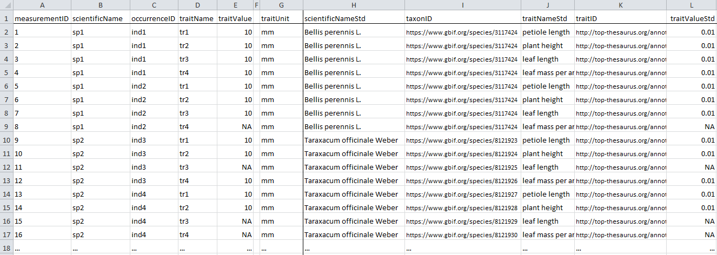
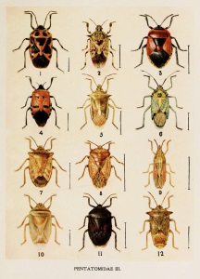
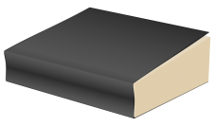
a) Measured quantitative data:
b) Aggregate quantitative data:
Entity: an individual x of taxon z
Entity: taxon x
Quality: average adult femur length
is 12.2 ± 2.3 mm
Quality: femur length equals 14.1 mm
d) Quantitative literature data:
c) Qualitative literature or database data:
Entity: genus x
Entity: males of taxon x
Quality: herbivore
Quality: min. body length of 8 mm

Slide 2
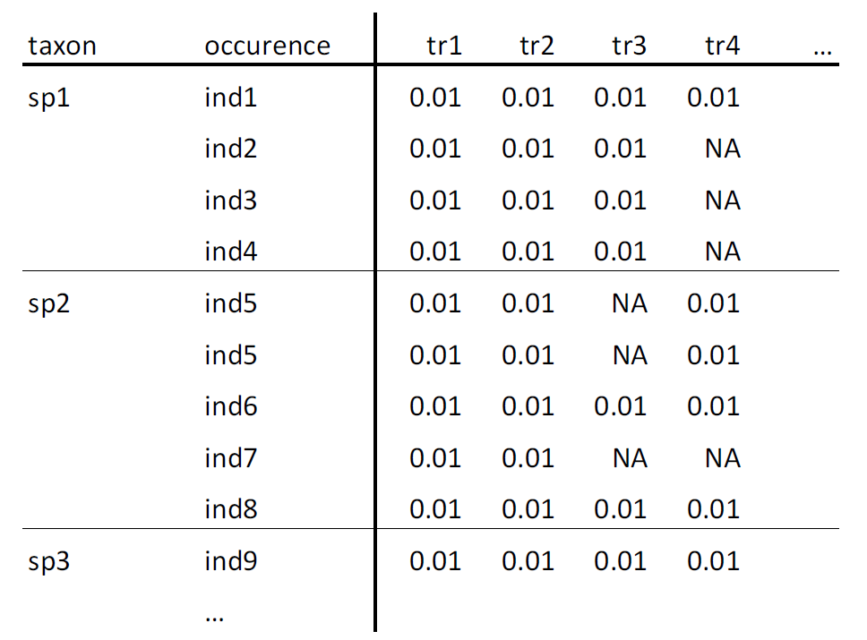
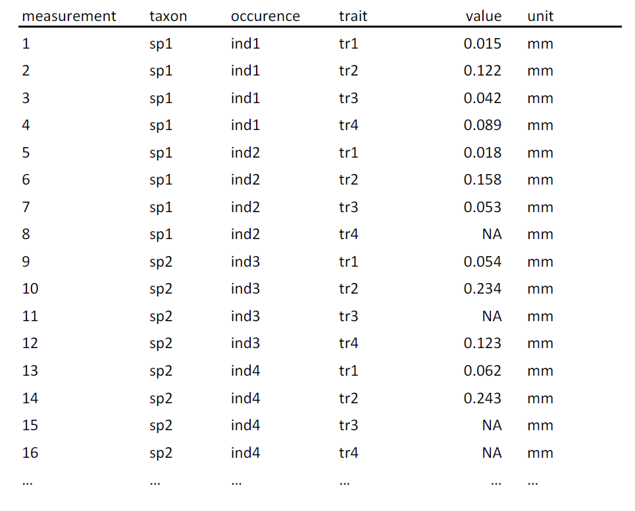
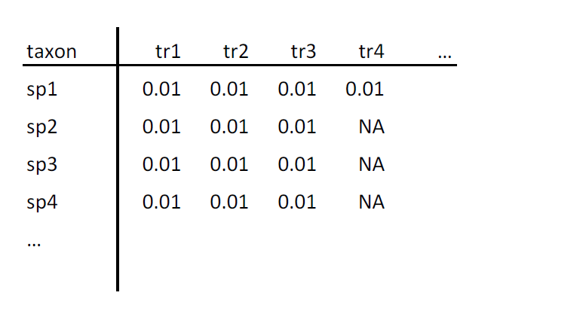
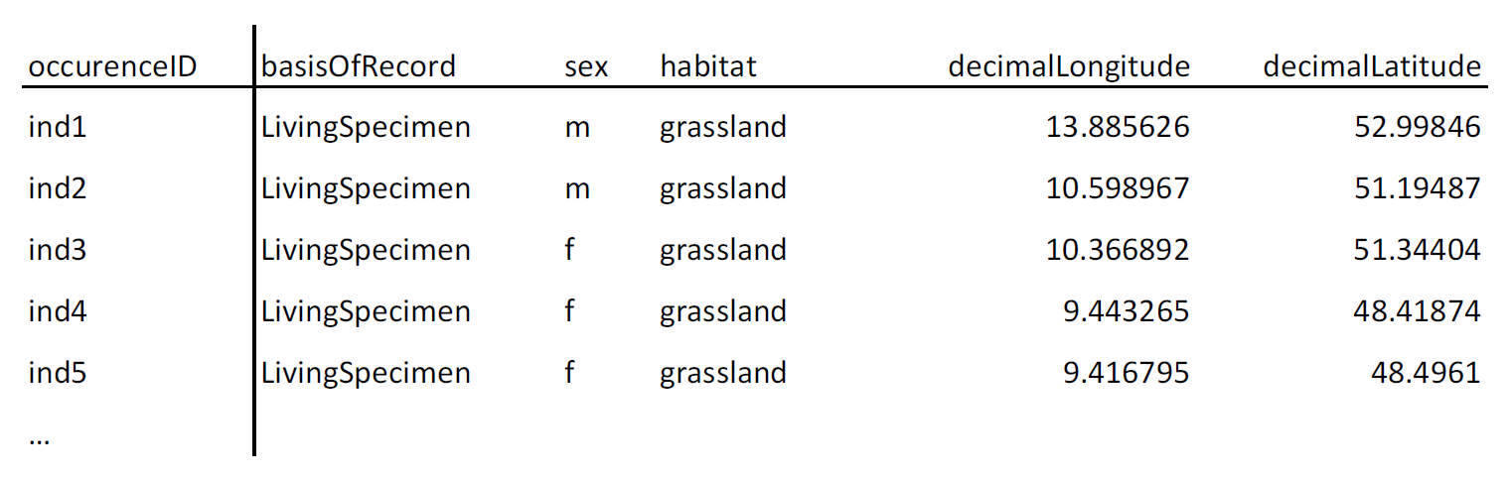
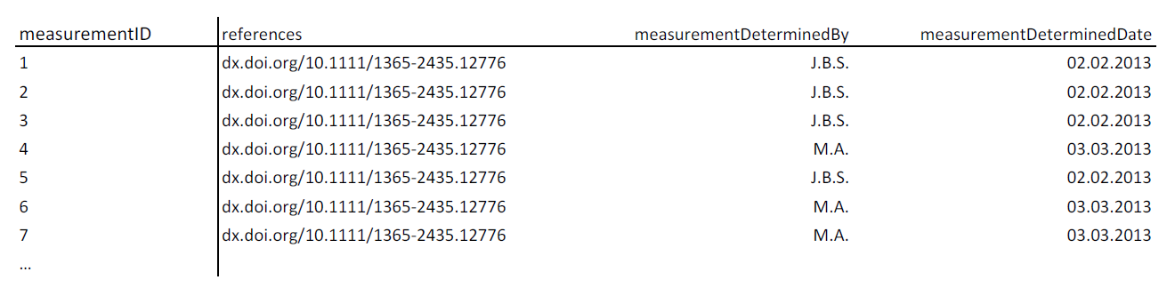
a) species x trait matrix
b) occurrence wide-table
c) measurement long-table
taxon identifier
occurrence identifier
measurement identifier
occurrence identifier
trait identifier
taxon identifier
trait identifier
taxon identifier
trait identifier
values
values
values
d) occurrence level information
e) measurement-level information
occurrence identifier
measurement identifier

Slide 3
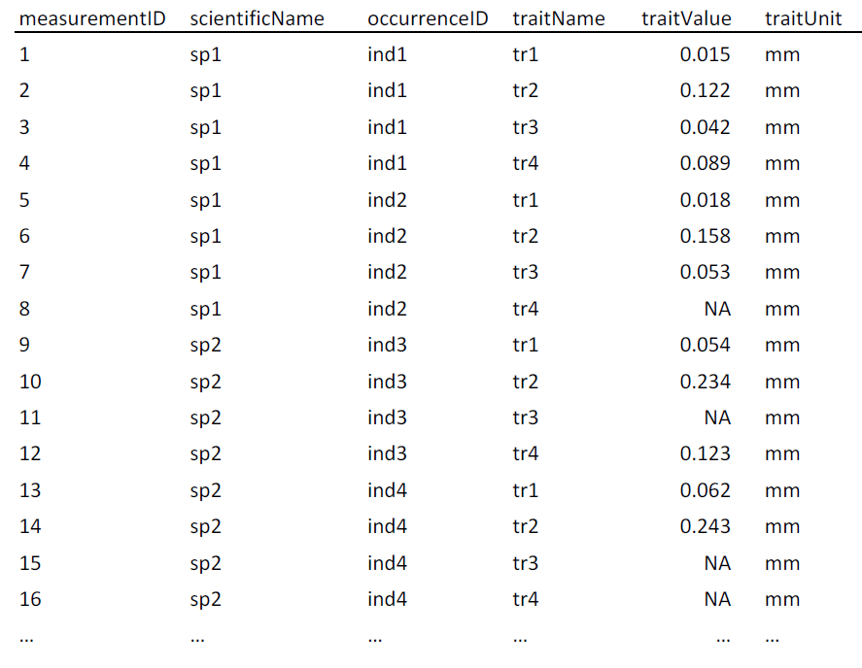
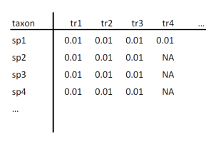

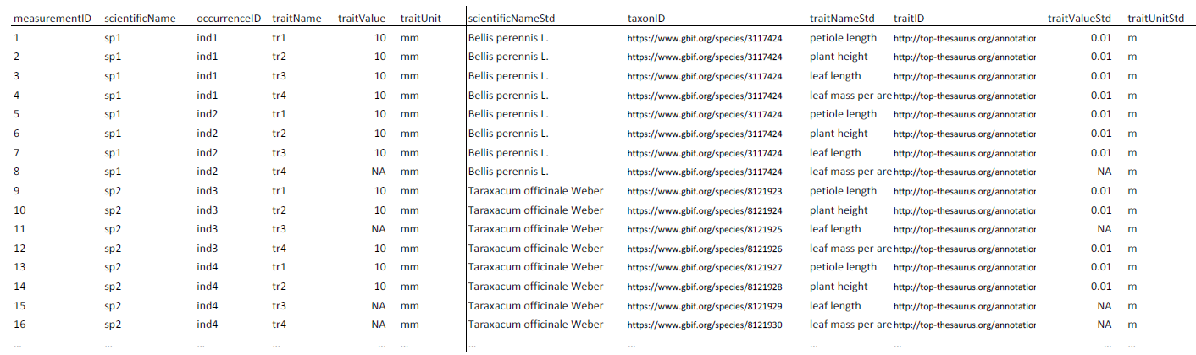
user raw data
(matrix or table)
standard columns measurement table
as.traitdata()
standardize.traits()
features:
harmonize trait names
unit conversion
map traitID
features:
map column names
add measurementID and occurenceID
add units
or
standardize.taxonomy()
features:
resolve user names to accepted names
fuzzy matching (spell checking)
resolve synonyms
map taxonID
standardize()
compliant trait-dataset with mapped taxon names and traits

Slide 4
Species x traits matrix (several trait measures per species)
my_sp_name | body_length_cm | antenna_length_cm | …
Agonum_ericeti | 0.587 | 0.374
Agonum_gracilis | 0.480 | 0.322
… | … | …
Core observation table (one row per measurement)
scientificName | traitName | traitValue | traitUnit
Agonum_ericeti | body_length_cm | 0.587 | cm
Agonum_ericeti | antenna_length_cm | 0.374 | cm
Agonum_gracilis | body_length_cm | 0.480 | cm
… | … | … | …
Standardized names and URIs
(added as columns to core table)
+
scientificNameStd | traitNameStd | traitValueStd | traitUnitStd | taxonRank | order | taxonID | traitID | measurementID | occurrenceID
Agonum ericeti | body_length | 5.87 | mm | species | Coleoptera | http://www.gbif.org/species/5755044 | http://t-sita.cesab.org/ BETSI_vizInfo.jsp?trait=Body_length | 1 | 001
Agonum ericeti | antenna_length | 3.74 | mm | species | Coleoptera | http://www.gbif.org/species/5755044 | http://t-sita.cesab.org/ BETSI_vizInfo.jsp?trait=Antenna_length | 2 | 001
Agonum gracile | body_length | 4.80 | mm | species | Coleoptera | http://www.gbif.org/species/5755080 | http://t-sita.cesab.org/ BETSI_vizInfo.jsp?trait=Body_length | 3 | 002
… | … | … | … | … | … | ..
+
Extensions (added as columns, mapped to identifiers)
Measurement
or Fact
measurementID | basisOfRecord | measurementMethod | measurementResolution | references | …
1 | PreservedSpecimen | Digital caliper | 0.1 mm | NA
2 | LiteratureData | NA | genus | https://doi.org/ 10.1038/sdata.2015.13
… | … | … | …
Occurrence
occurrenceID | sex | lifeStage | samplingProtocol | eventDate | country | habitat | …
001 | f | adult | Pitfall trap | 2008-06-12 | DE | forest
002 | m | adult | Pitfall trap | 2008-06-12 | DE | forest
… | … | … | … | … | … | …
Biodiversity
Exploratories
occurrenceID | OriginExploratories | ExploratoriesPlotID | Exploratory | ExploType | …
001 | TRUE | AEW2 | ALB | F
002 | TRUE | HEW12 | HAI | F
… | … | … | … | …

