Slide 1
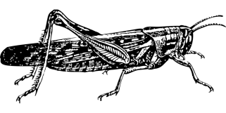
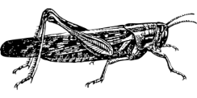
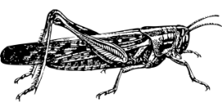
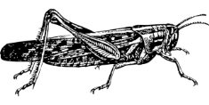
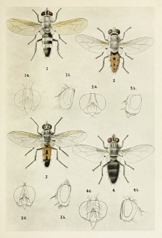
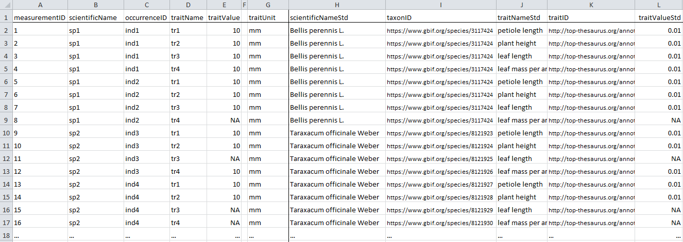
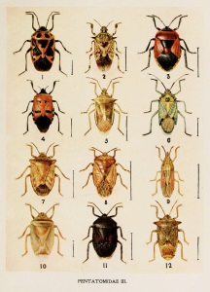
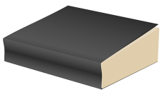
a) Measured quantitative data:
b) Aggregate quantitative data:
Entity: an individual x of taxon z
Entity: taxon x
Quality: average adult femur length
is 12.2 ± 2.3 mm
Quality: femur length equals 14.1 mm
d) Quantitative literature data:
c) Qualitative literature or database data:
Entity: genus x
Entity: males of taxon x
Quality: herbivore
Quality: min. body length of 8 mm

Slide 2
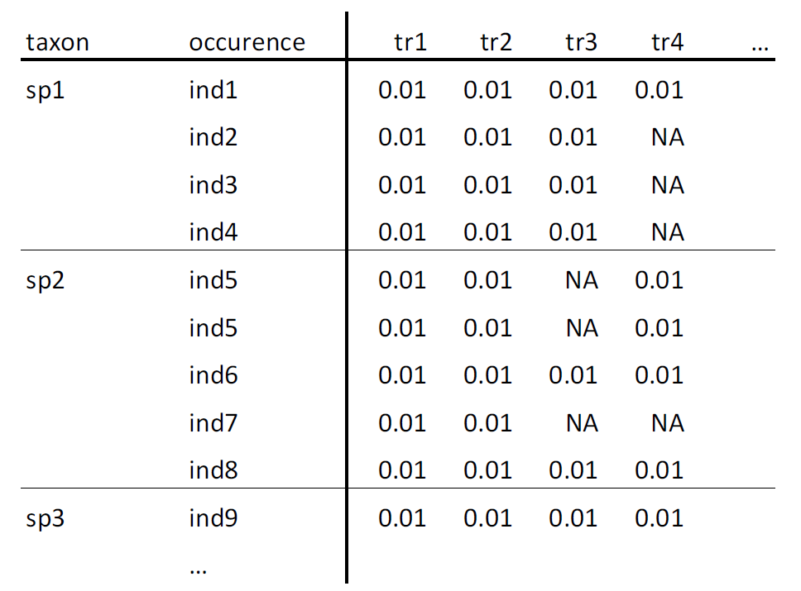
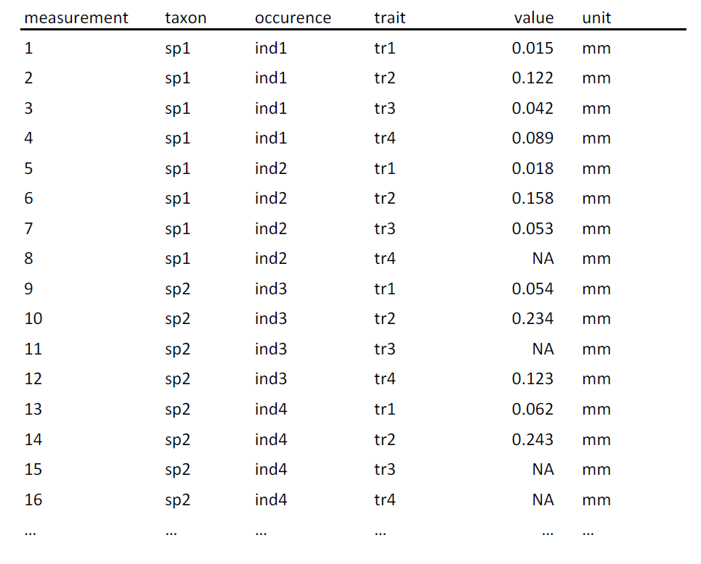
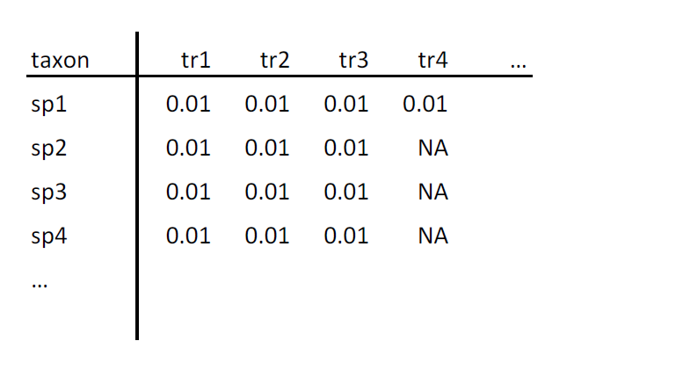
a) species x trait matrix
b) occurrence table
c) measurement longtable
measurement identifier
occurence identifier
taxon identifier
occurence identifier
trait identifier
taxon identifier
trait identifier
taxon identifier
trait identifier
values
values
values
values
values
values

Slide 3
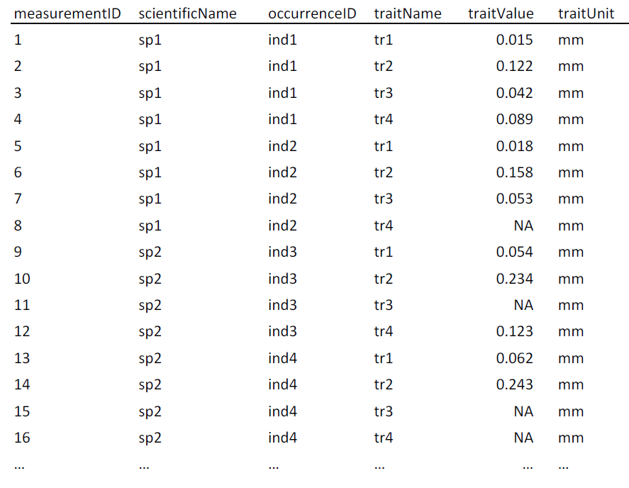
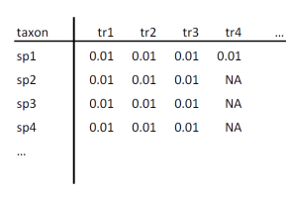

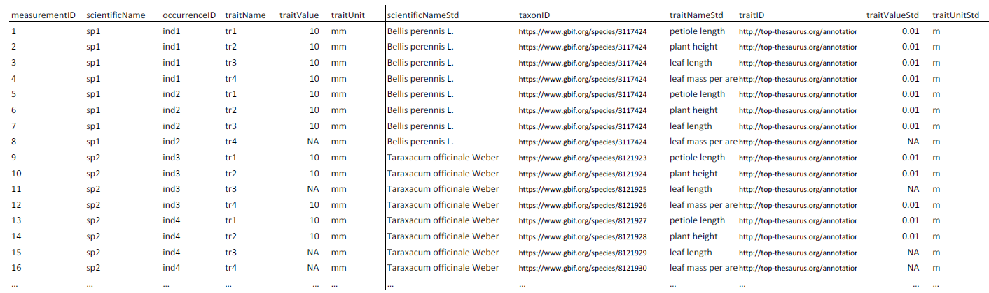
user raw data
(matrix or table)
standard columns measurement table
as.traitdata()
standardize.traits()
features:
harmonize trait names
unit conversion
map traitID
features:
map column names
add measurementID and occurenceID
add units
or
standardize.taxonomy()
features:
resolve user names to accepted names
fuzzy matching (spell checking)
resolve synonyms
map taxonID
standardize()
compliant trait-dataset with mapped taxon names and traits

